Slide 1
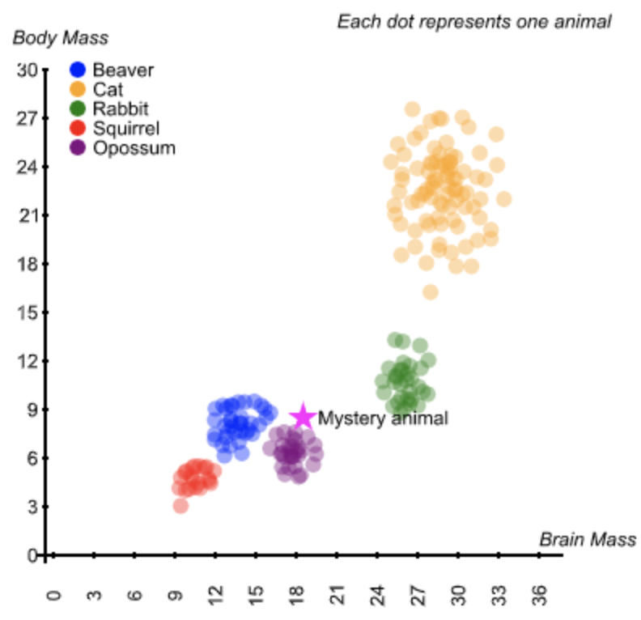
Visualizing Data to Make Predictions
What label should we assign the mystery point?

Slide 2

Demystifying AI
Nearest Neighbor
Instructor: Pat Virtue

Slide 3
Visualizing Data to Make Predictions
What label should we assign the mystery point?

Slide 4
Input and Output?
What is the input and the output for this task?
Agent
Input
?
Predicted
Output

Slide 5

Agent Uses Data to Make Decisions
Agent
Input
?
Predicted
Output

Slide 6
Using Distance as a Measure of Similarity
Assumption: closer points are more likely to be in the same category

Slide 7
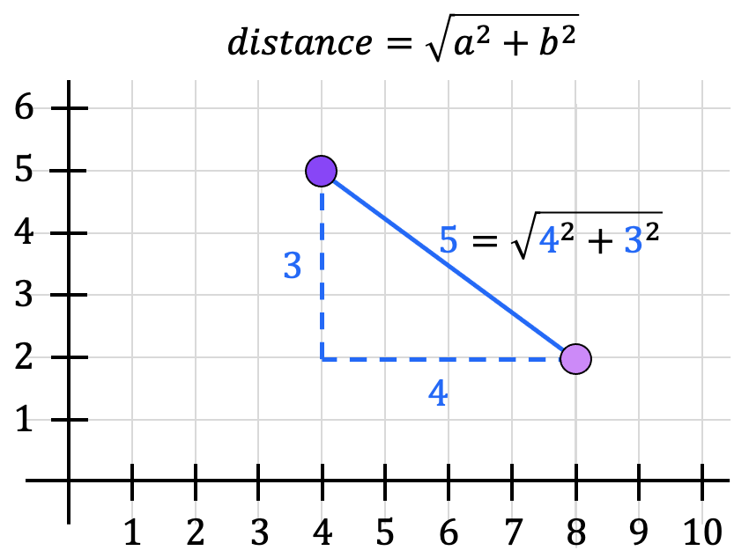
Distance

Slide 8
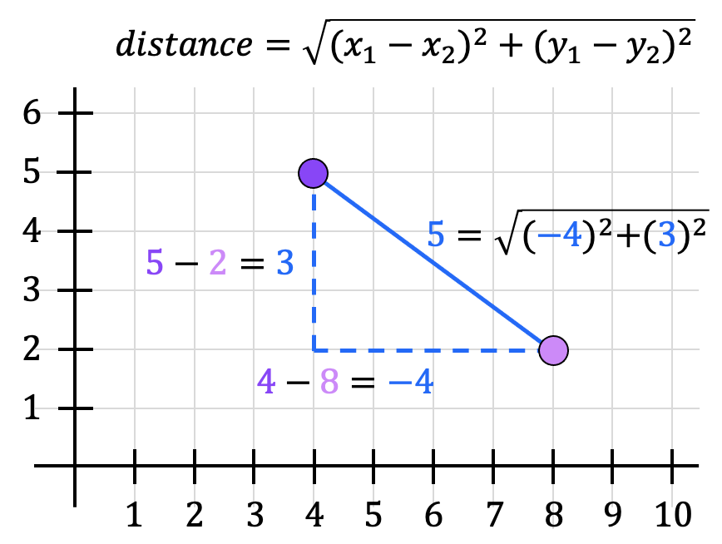
Distance

Slide 9
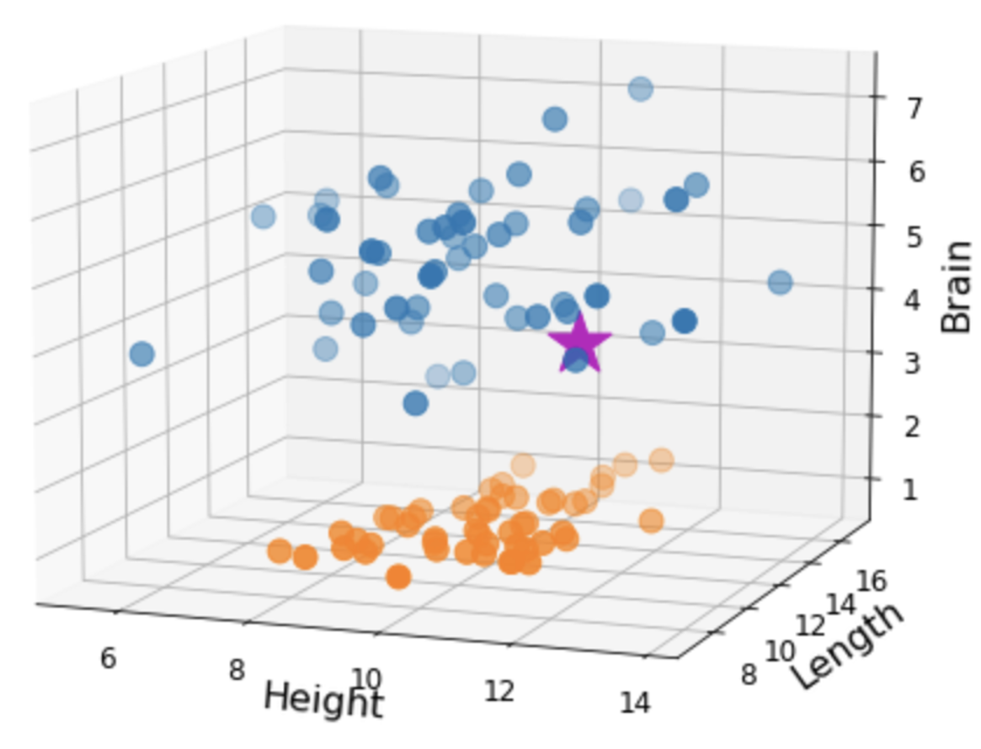
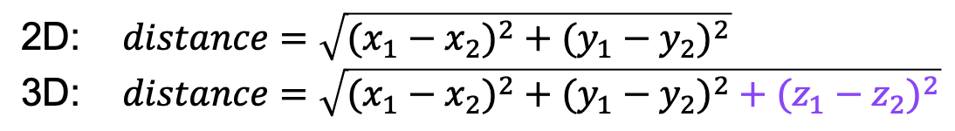
Distance

Slide 10
Distance

Slide 11
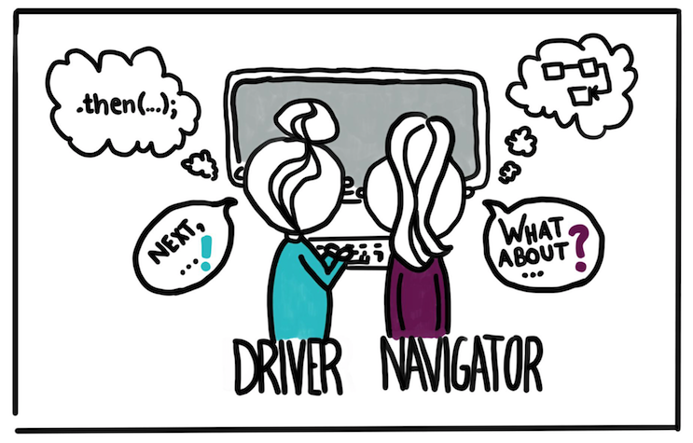
Pair Programming
https://devopedia.org/pair-programming

Slide 12
Exercise 1: Distance
Shared Drive Folder/Lec5_NearestNeighbor
https://drive.google.com/drive/folders/11aAngUK5sifAnK4izULqPC-Y0QnDfbqG

Slide 13
Nearest Neighbor Algorithm

Slide 14
Exercise 2: Nearest Neighbor
Shared Drive Folder/Lec5_NearestNeighbor
https://drive.google.com/drive/folders/11aAngUK5sifAnK4izULqPC-Y0QnDfbqG

Slide 15
Input and Output?
What is the input and the output for this task?
Agent
Input
?
Predicted
Output

Slide 16
Performance Measure
Classification error rate

Slide 17
Exercise 3: Error rate
Shared Drive Folder/Lec5_NearestNeighbor
https://drive.google.com/drive/folders/11aAngUK5sifAnK4izULqPC-Y0QnDfbqG

