Slide 1


Demystifying AI
Human Compatible AI
Instructor: Pat Virtue

Slide 2
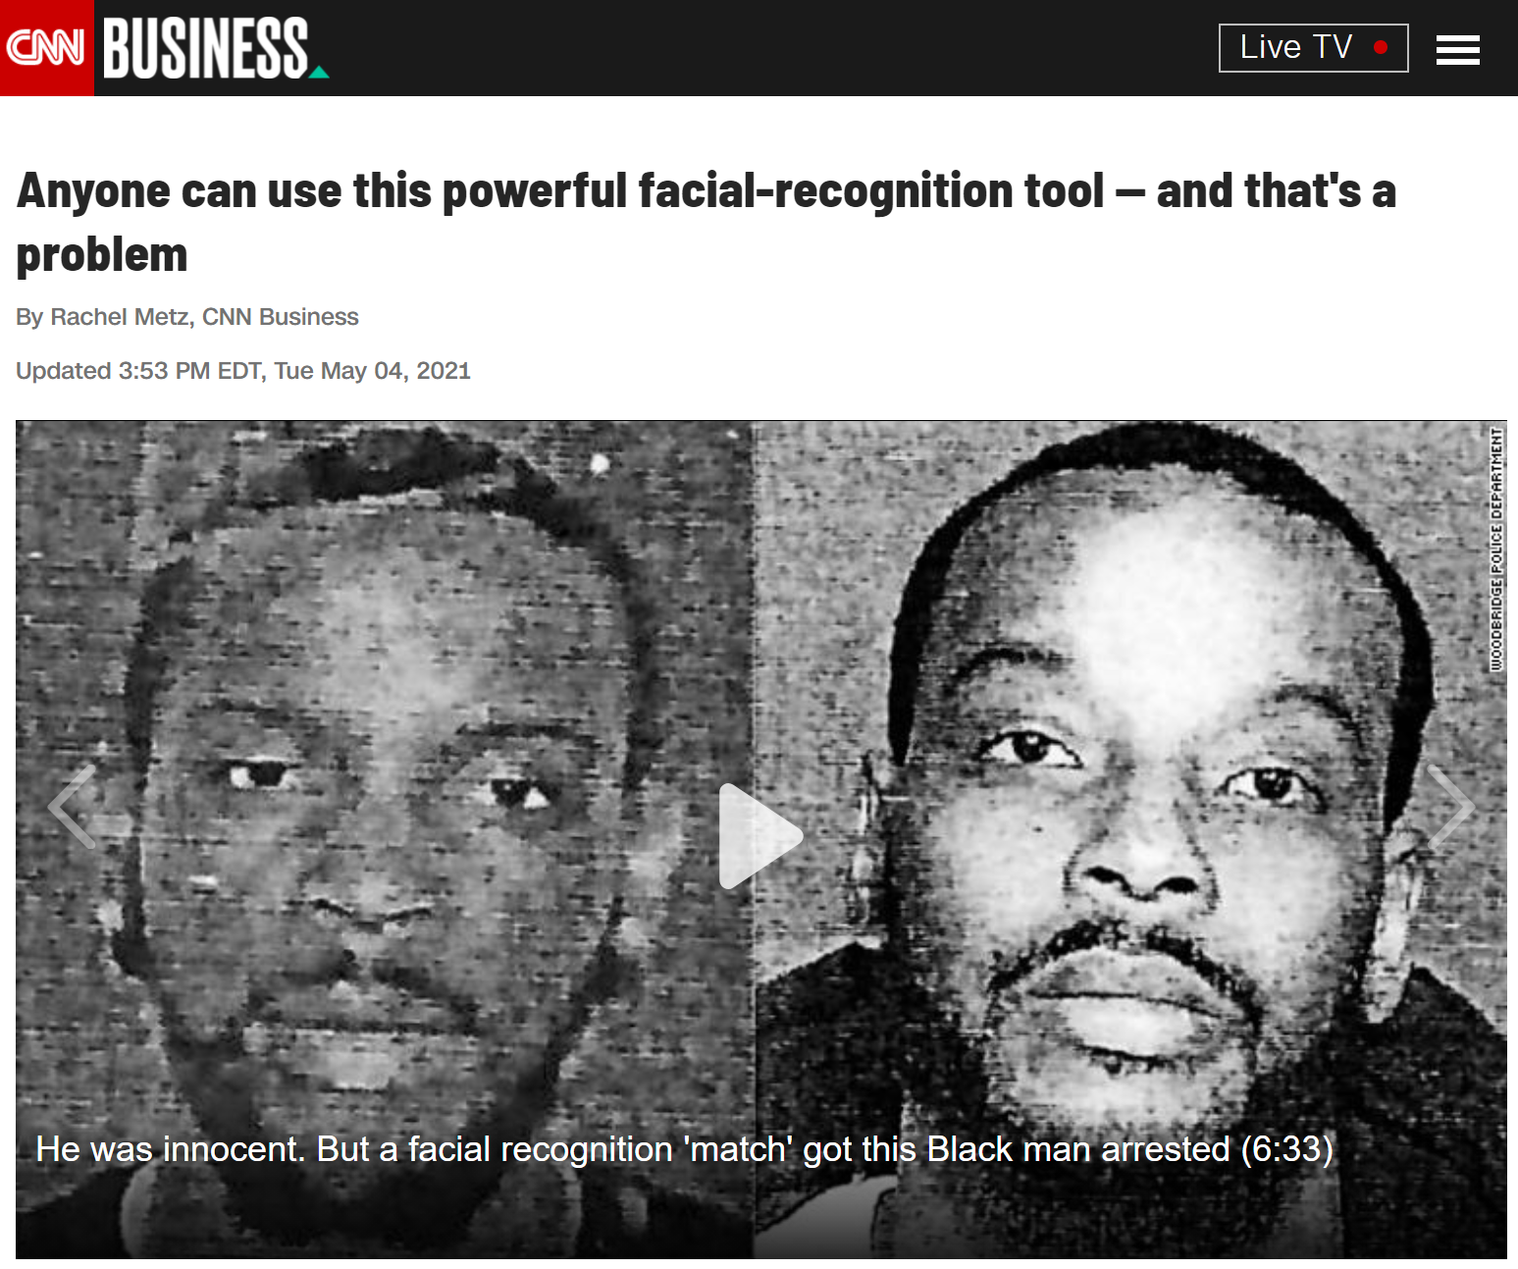
AI in the News
https://amp.cnn.com/cnn/2021/05/04/tech/pimeyes-facial-recognition/index.html

Slide 3

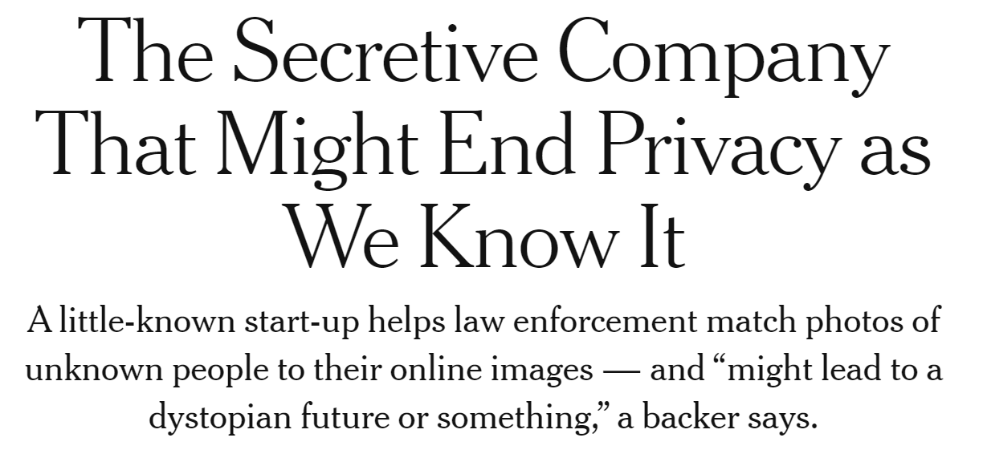

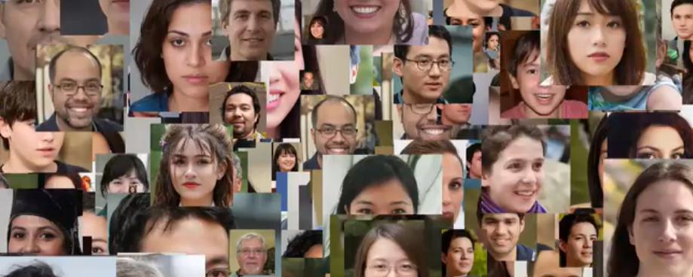
AI in the News
https://www.nytimes.com/2020/01/18/technology/clearview-privacy-facial-recognition.html

Slide 4
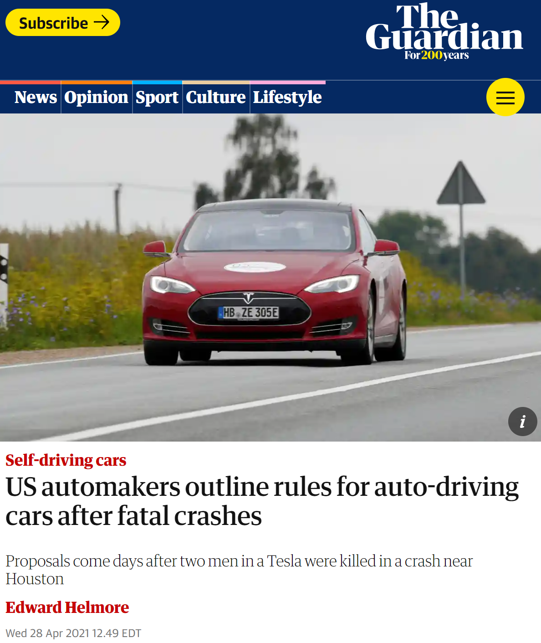
AI in the News
https://amp.theguardian.com/business/2021/apr/28/us-automakers-rules-auto-driving-cars-fatal-crashes

Slide 5
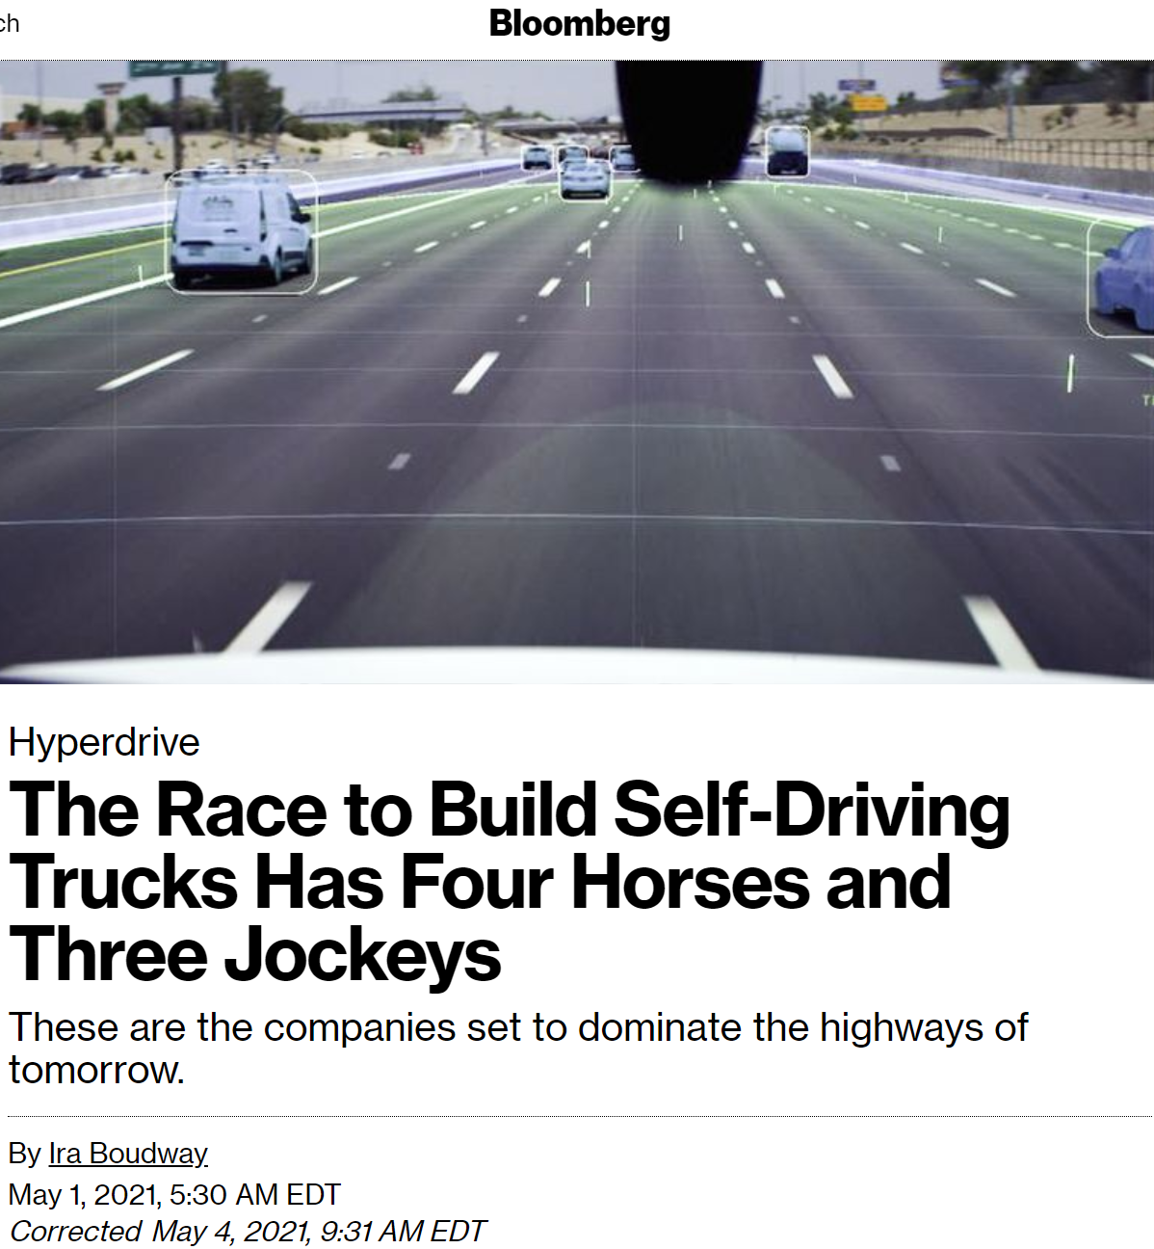
AI in the News
https://www.bloomberg.com/news/articles/2021-05-01/waymo-tusimple-aurora-inside-the-race-to-build-self-driving-trucks

Slide 6
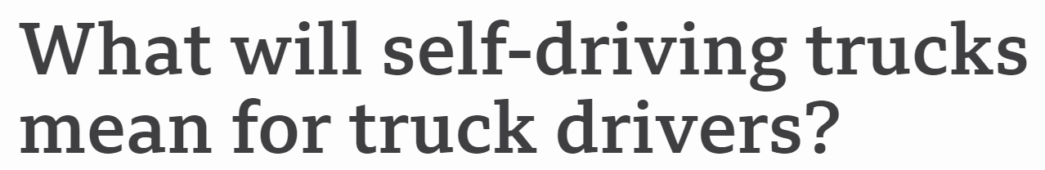



AI in the News
https://www.bbc.com/news/business-56332388.amp

Slide 7
Poll 1
Is it ok if autonomous vehicles completely replace human drivers?

Slide 8
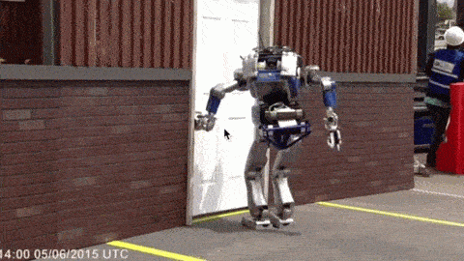
Should We Worry about Today’s A.I.?

Slide 9
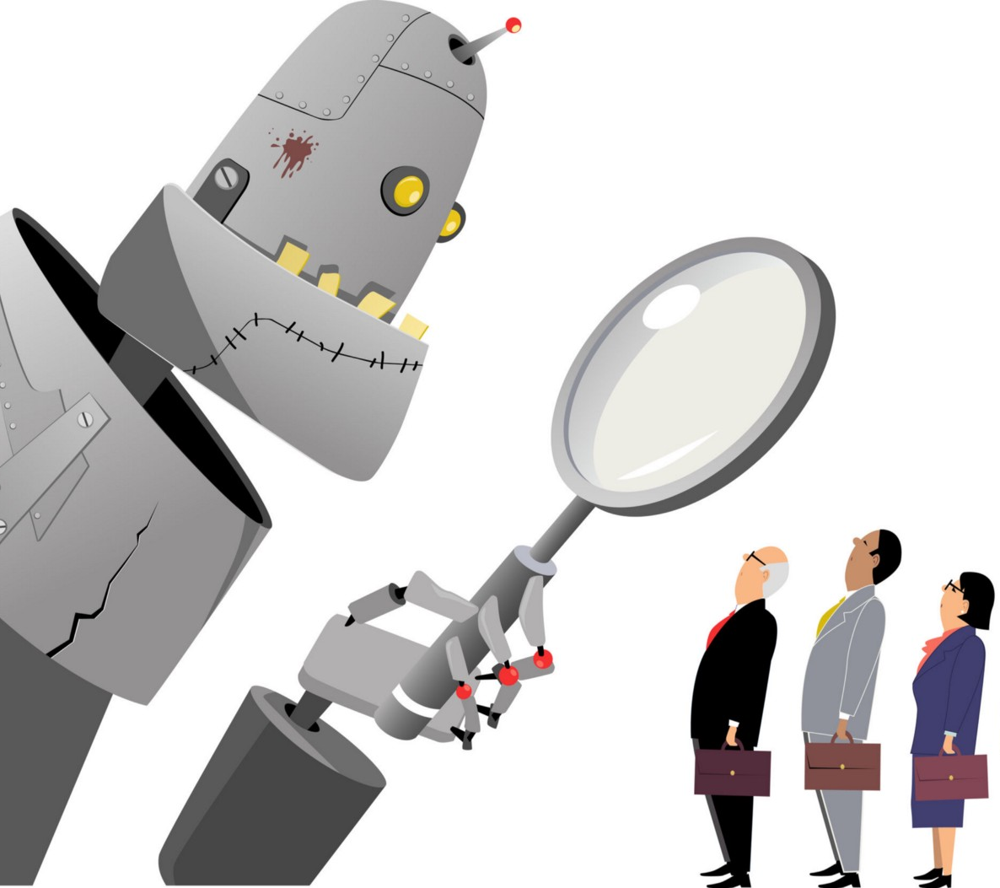

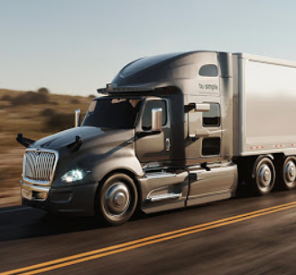
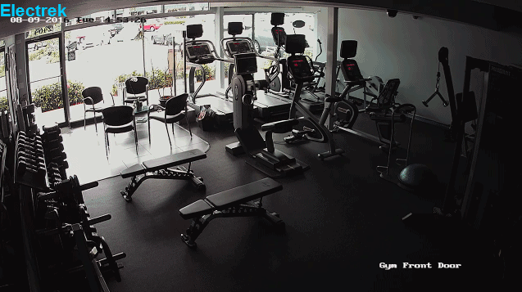
Should We Worry about Today’s A.I.?
Bias/Fairness
Privacy
Jobs
Weapons/Safety
Liability
Notes:
Images:
https://medium.com/@turalt/ai-isnt-biased-we-are-b74ec94d1698
http://futureoflife.org/2016/09/20/podcast-what-is-nuclear-risk/
https://electrek.co/2016/09/25/tesla-model-s-crashes-into-gym-driver-claims-autonomous-acceleration-tesla-says-drivers-fault/
http://ot.to/

Slide 10
Bias/Fairness
How are AI systems motivated? How does this motivation cause bias?
How could we measure bias (including cultural bias) in an AI system?
What are some ways that bias in AI programming can impact the world?
Domains to think about:
Self-driving cars
Hiring and judicial decision making
Traffic control
Face recognition

Slide 11
Weapons/Safety
Should AI be used as a weapon or in warfare?
Where would you draw the line for how it could be used and how not?
Would you let a fully autonomous robot perform surgery on a family member?
Can you think of some rules or laws that may help prevent unsafe AI?
Domains to think about:
Social media bots and information warfare
Drones and autonomous weapons machines
Healthcare

Slide 12
Privacy
What are some tradeoffs we make when giving AI our private information?
Do you have a limit for the type or amount of data you are willing to provide?
How can we make the data usage of AI systems more explicit?
Are there ways that we can still enjoy the benefits of AI systems without giving up our private information?
Domains to think about:
Social media
Search (Google, Amazon, Yelp, …)
Healthcare
Insurance

Slide 13
Liability
How do we determine what went wrong (or right) in deployed AI systems?
Which techniques that we learned about have explainable results?
Who is responsible for “mistakes” that AI systems make?
What if someone or another AI misuses AI technology? Who is responsible?
Once autonomous vehicles are readily available, should it be illegal for humans to drive?
Domains to think about:
Self-driving cars
Healthcare decision-making
Land and Air traffic control

Slide 14
Jobs
What types of jobs should AI do instead of people?
Is it ok if autonomous vehicles completely replace human drivers?
What will people do if their jobs are taken?
How can AI systems improve or change people’s jobs even if it doesn’t take the jobs?
Domains to think about:
Driving and Logistics
Healthcare decision-making
Entertainment

Slide 15
Should We Worry about Today’s A.I.?
Bias/Fairness
Privacy
Jobs
Weapons/Safety
Liability
Notes:
Images:
https://medium.com/@turalt/ai-isnt-biased-we-are-b74ec94d1698
http://futureoflife.org/2016/09/20/podcast-what-is-nuclear-risk/
https://electrek.co/2016/09/25/tesla-model-s-crashes-into-gym-driver-claims-autonomous-acceleration-tesla-says-drivers-fault/
http://ot.to/

Slide 16
Additional Resources and Ideas

Slide 17

AI Bias/Fairness
Alexandra Chouldechova
CMU, Statistics and Public Policy
http://www.contrib.andrew.cmu.edu/~achoulde/
https://facctconference.org/

Slide 18
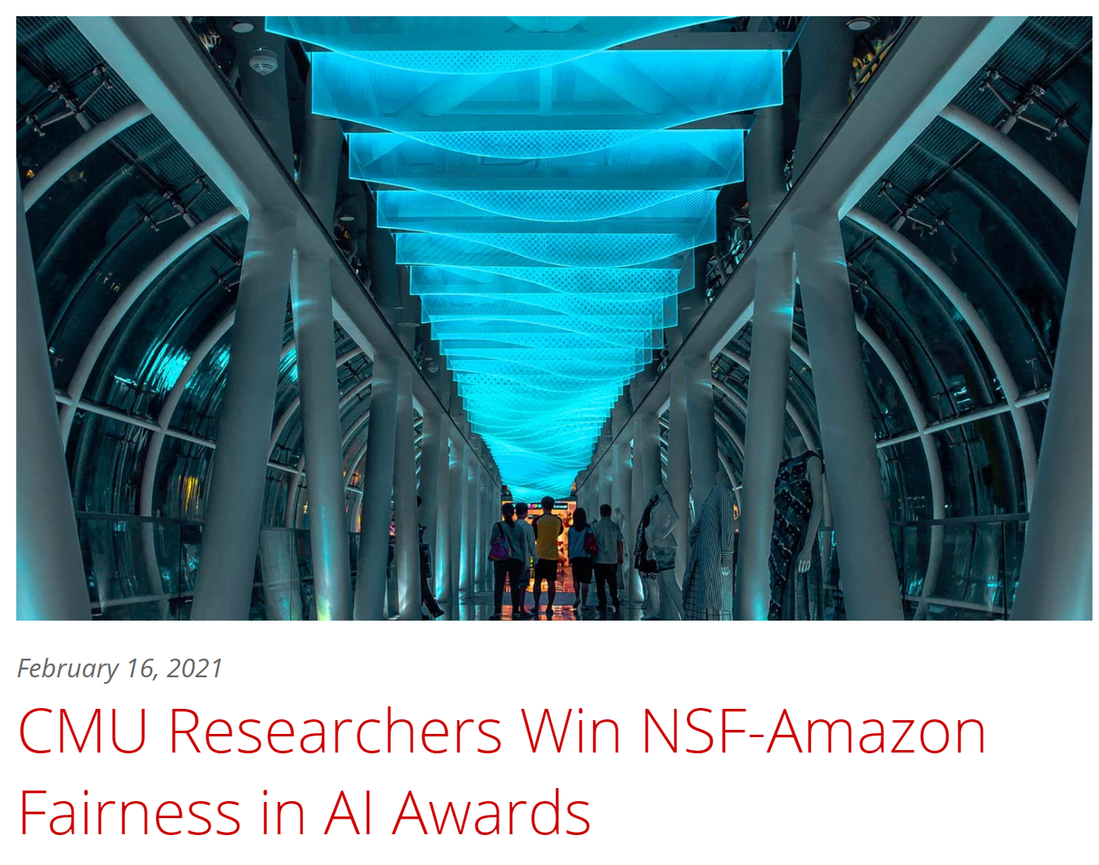
AI Bias/Fairness
Hoda Heidari
MLD
Jason Hong
HCII
Graham Neubig
LTI
https://www.ml.cmu.edu/news/news-archive/2021-2025/2021/february/carnegie-mellon-researchers-win-nsf-amazon-fairness-in-ai-awards.html

Slide 19
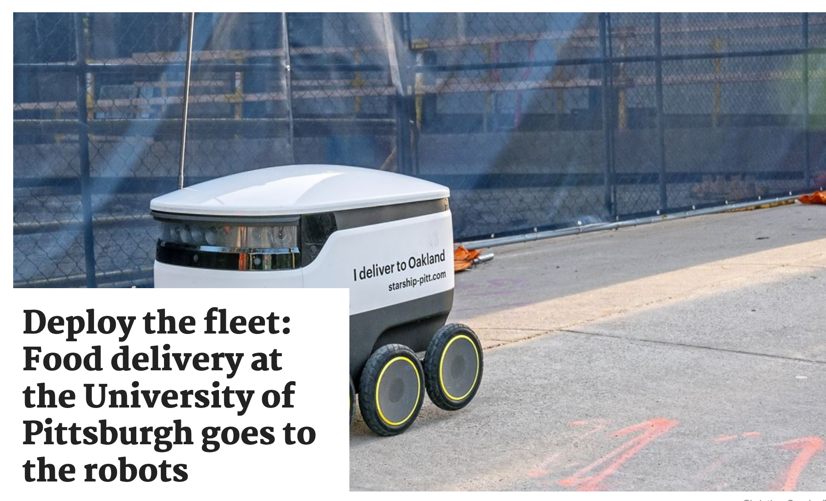
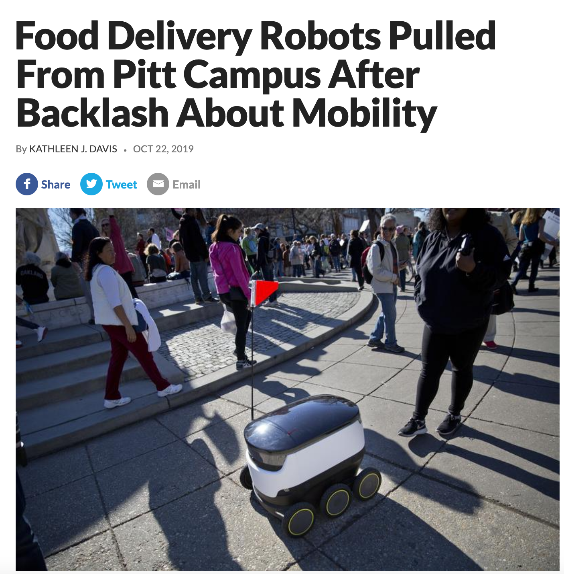
AI Bias/Fairness
Question: What technique could have been used to learn from the mistake?

Slide 20
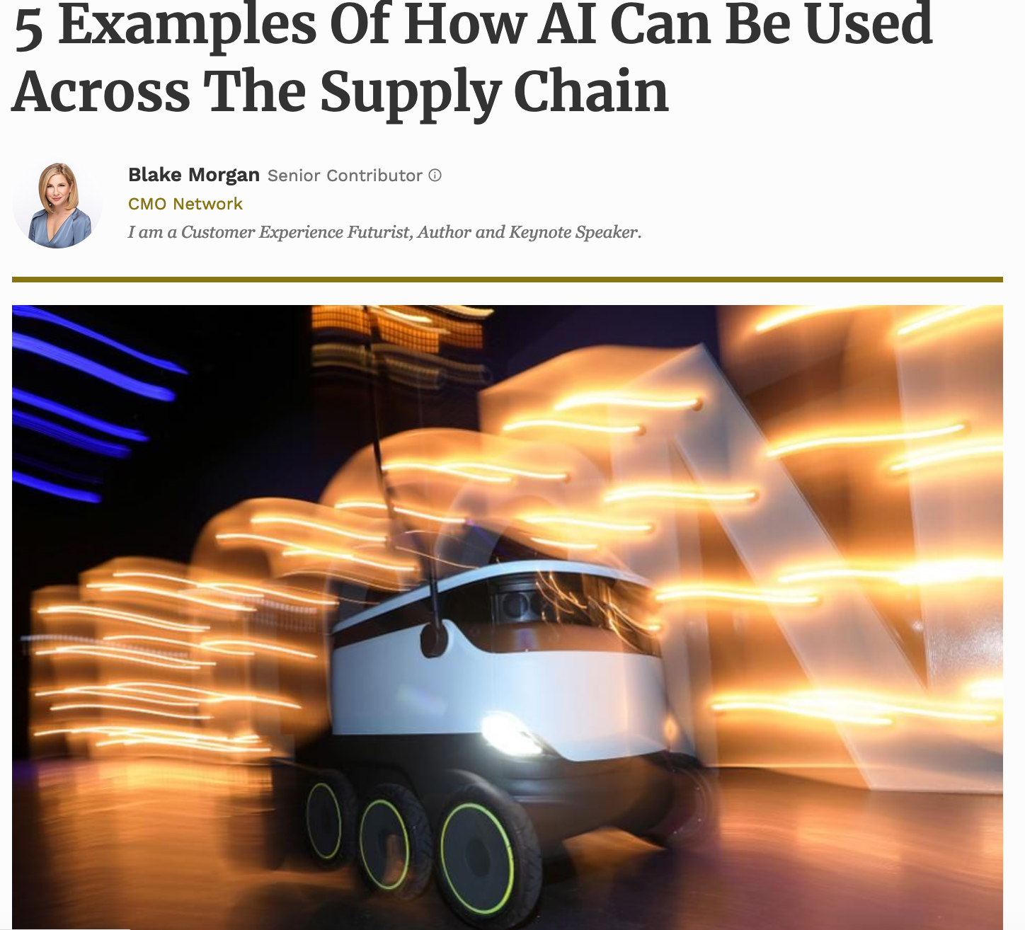
AI Bias/Fairness
Search/Navigation:
Create efficient routes for the fleet of trucks
Use of robots to deliver medicine, groceries etc
CSPs:
Deciding which stores get preference for deliveries
Deciding what products go to what stores
Forbes

Slide 21
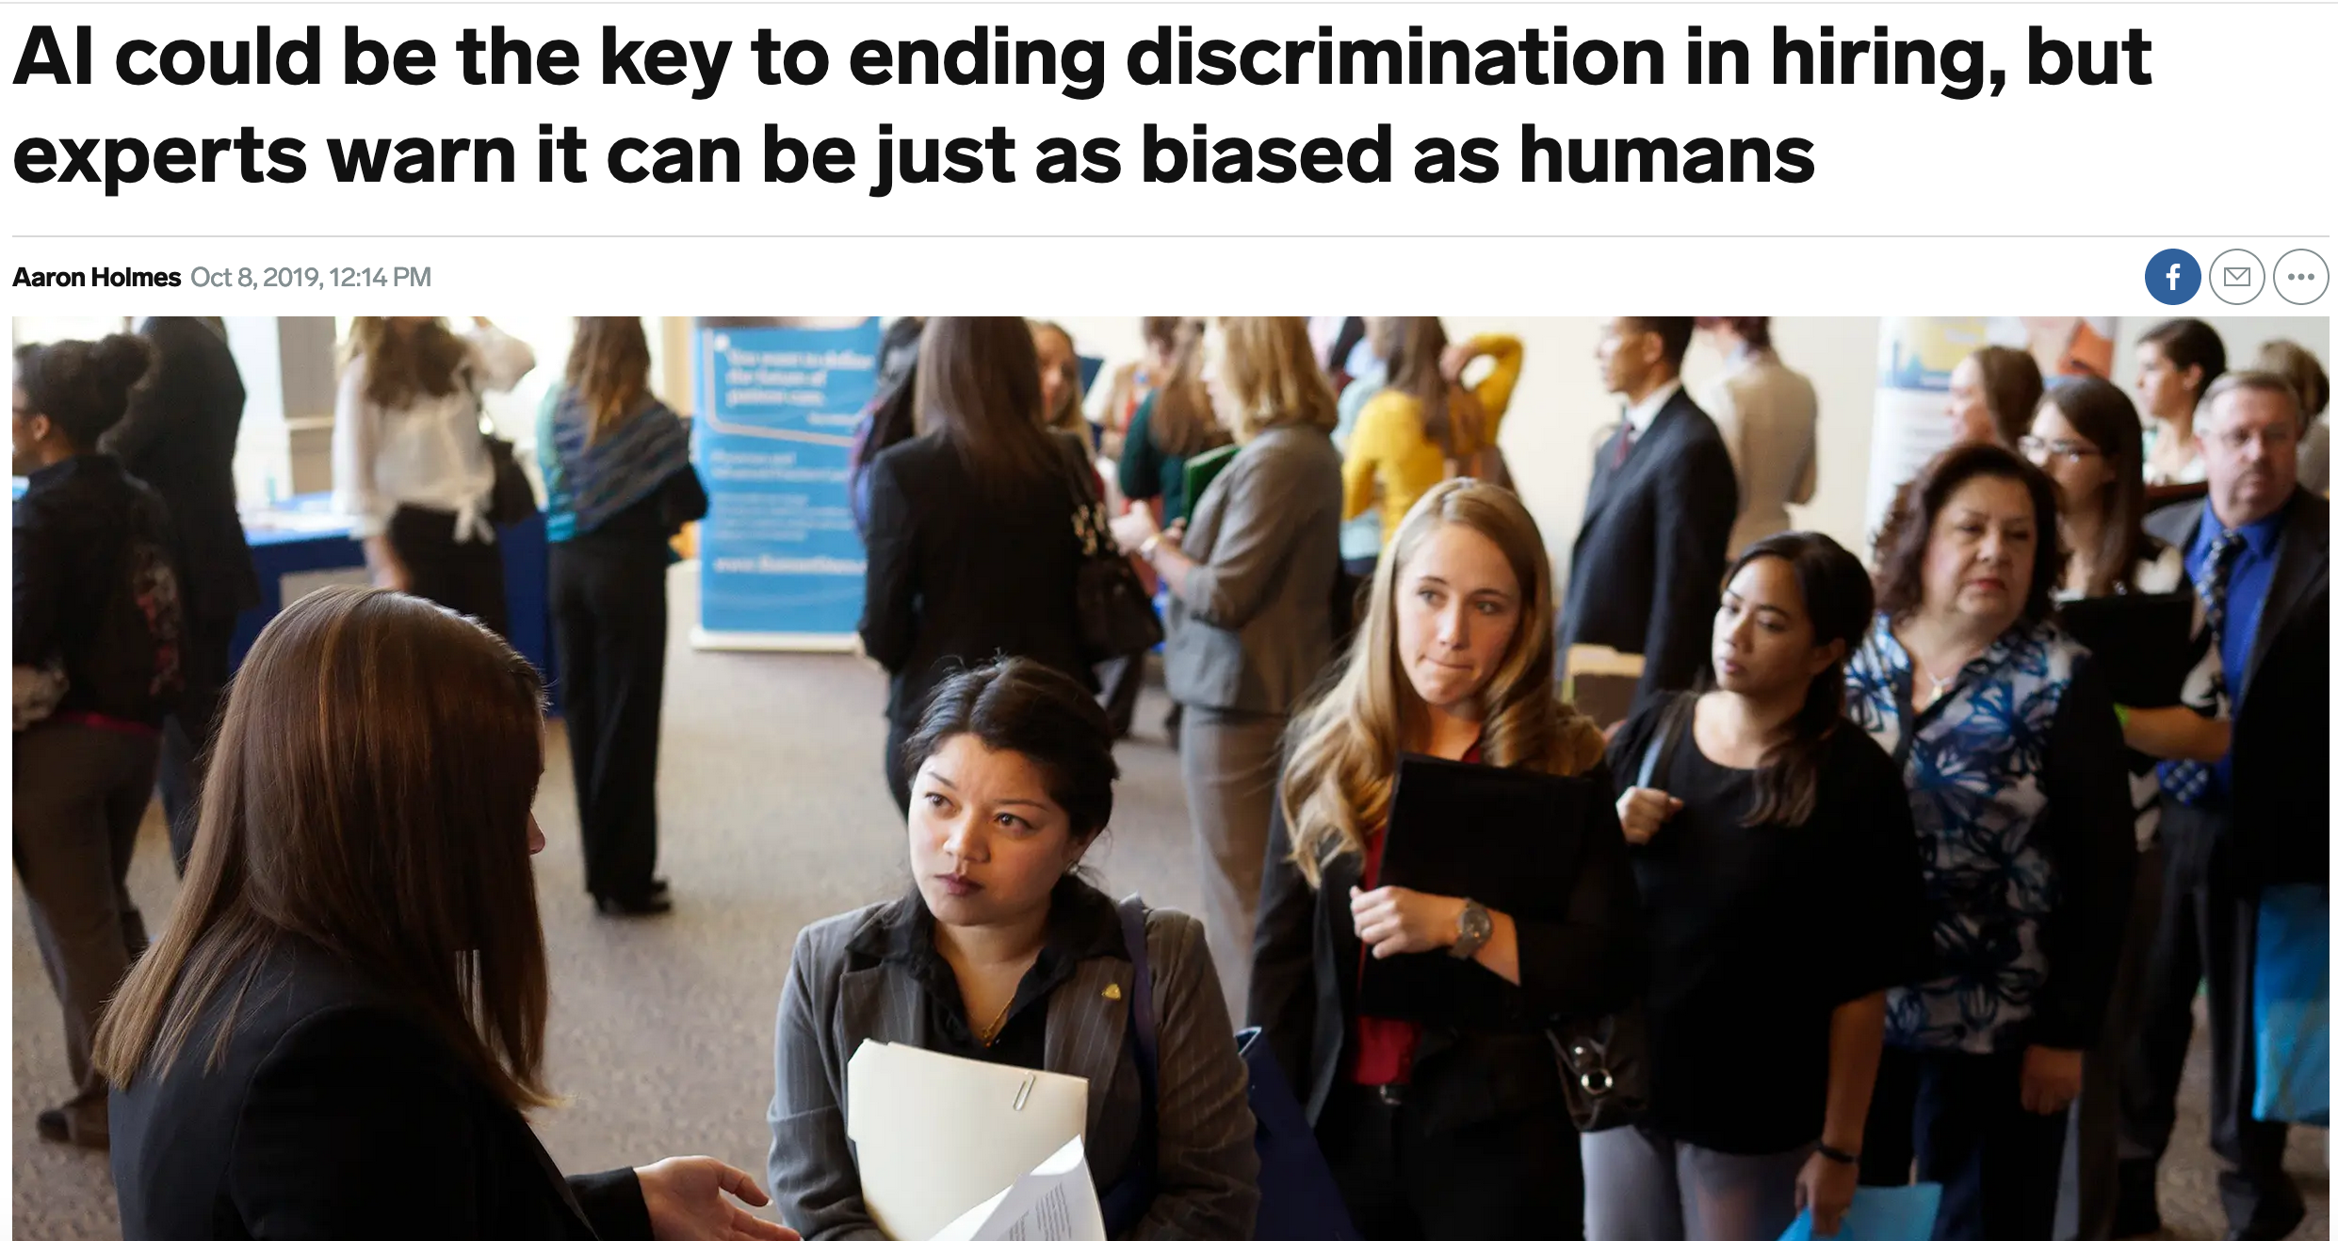
AI Bias/Fairness

Slide 22
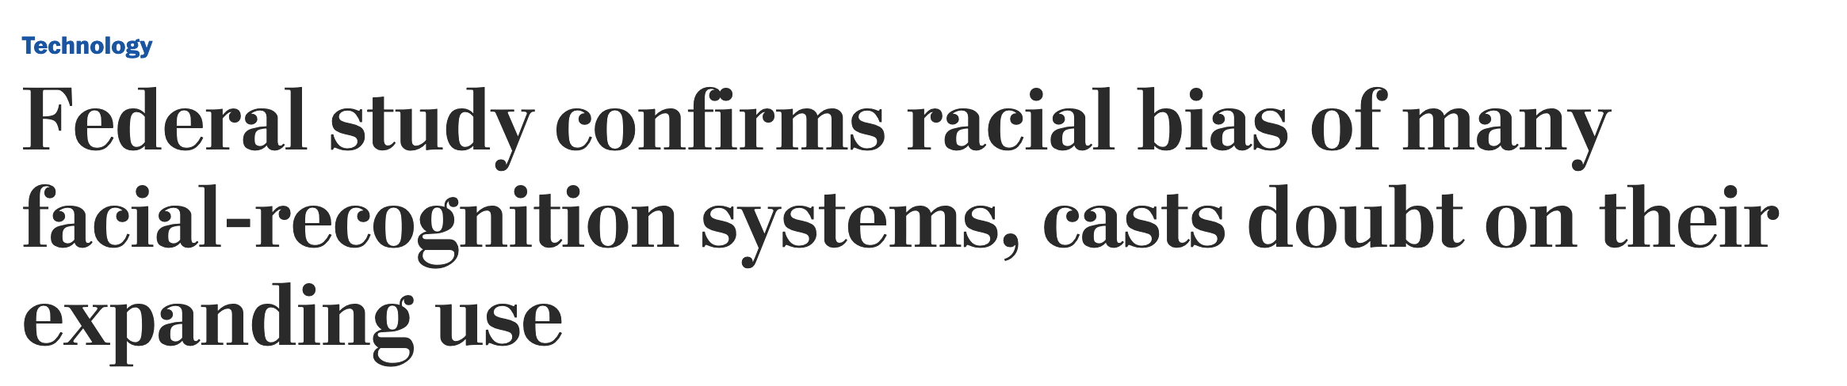
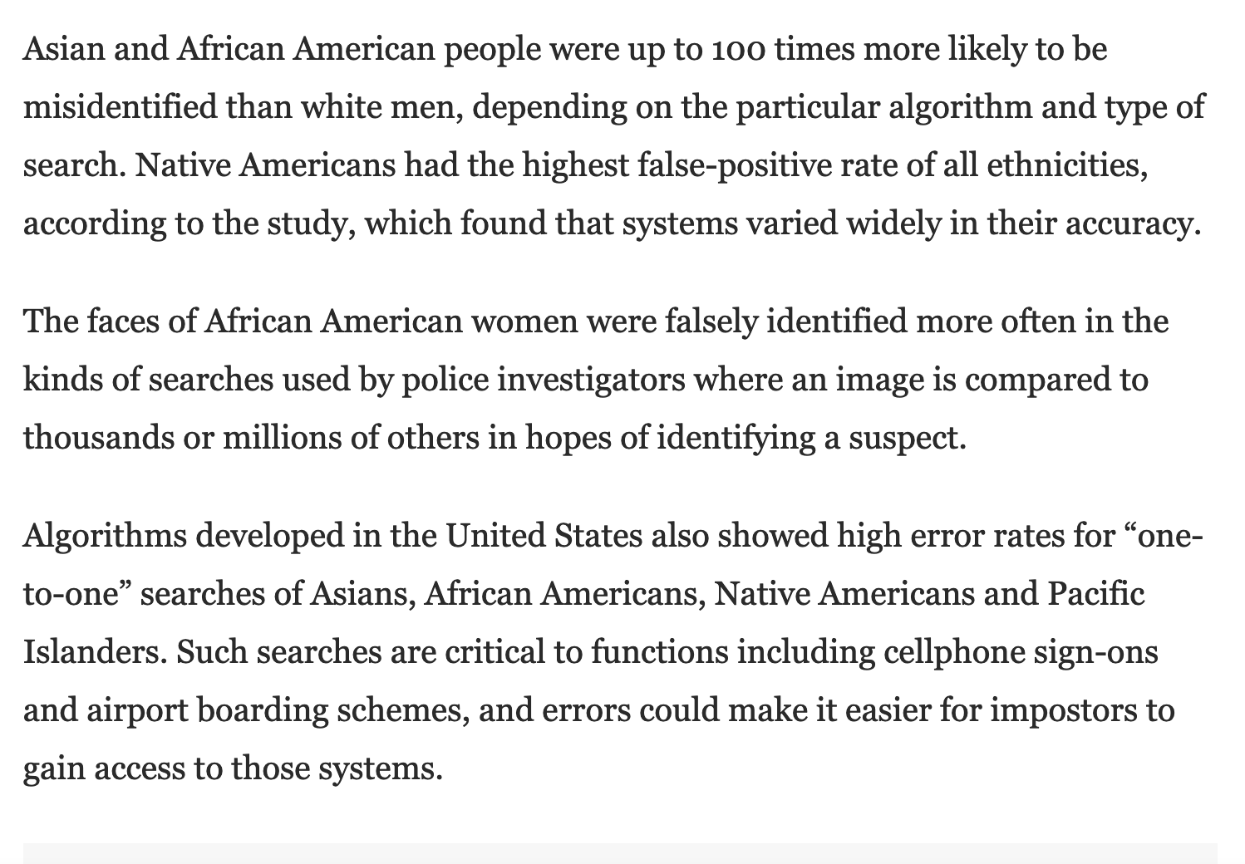
https://www.washingtonpost.com/technology/2019/12/19/federal-study-confirms-racial-bias-many-facial-recognition-systems-casts-doubt-their-expanding-use/

Slide 23
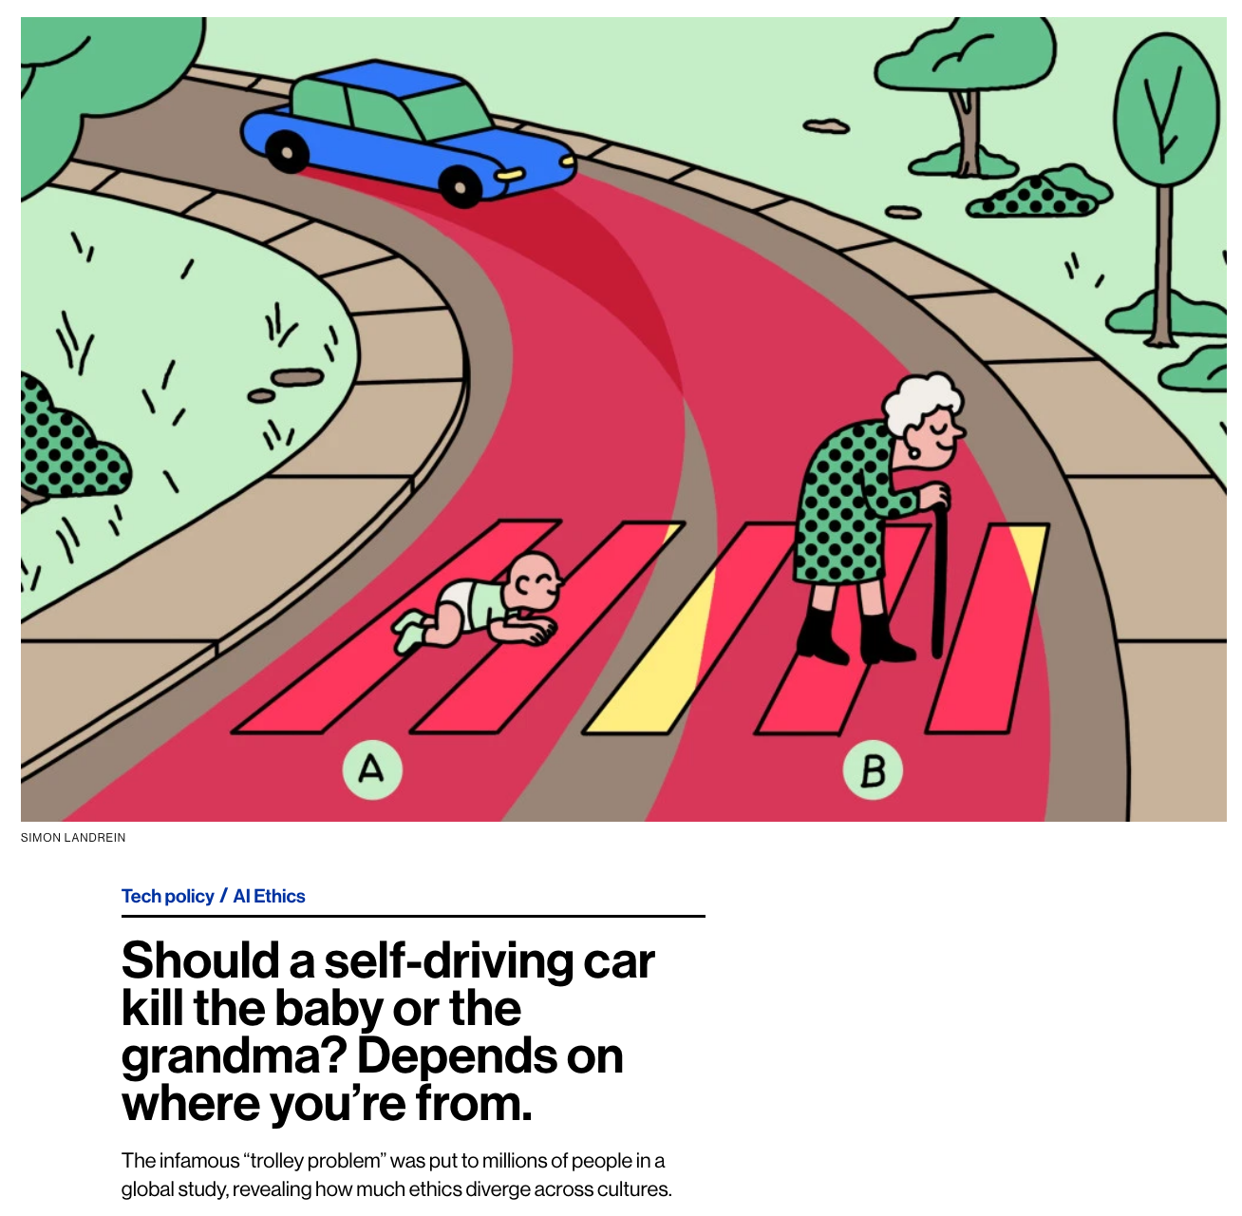
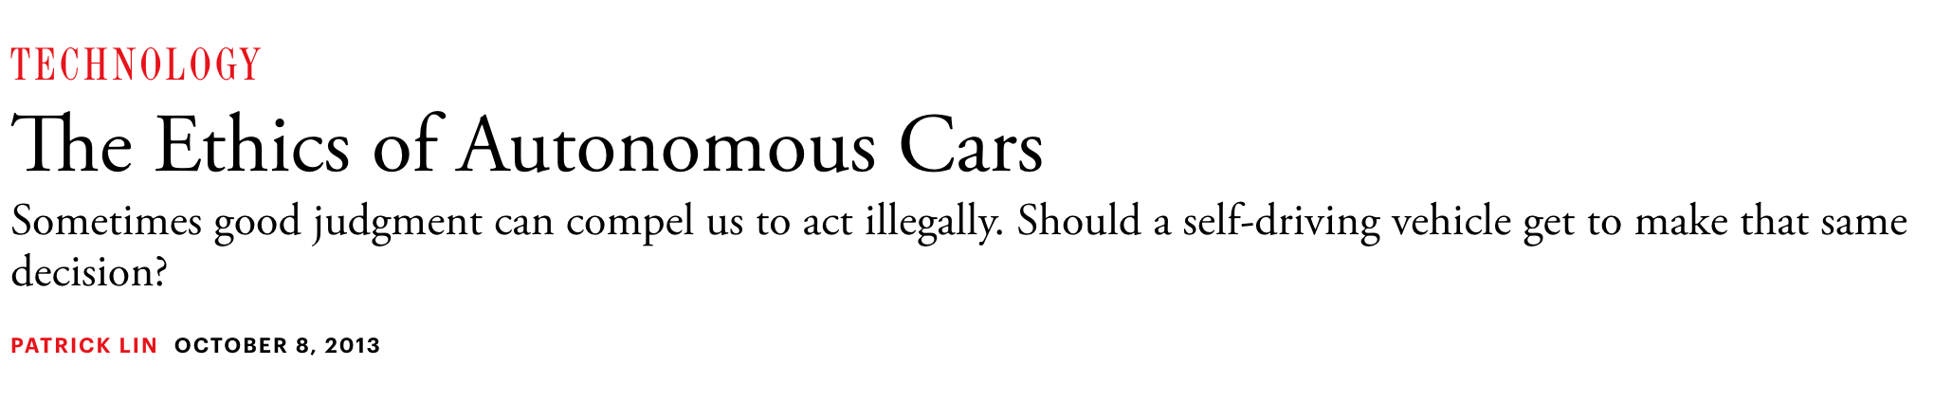
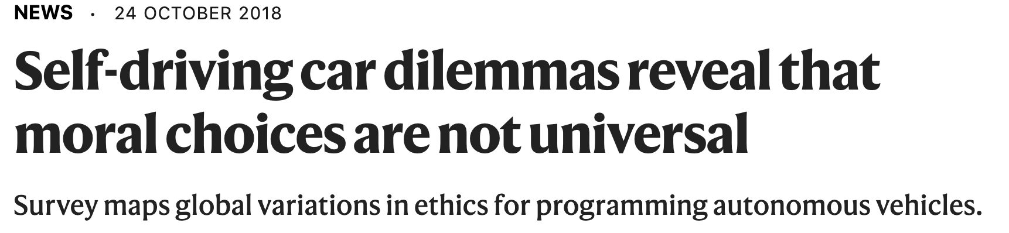
https://www.moralmachine.net/
https://www.technologyreview.com/2018/10/24/139313/a-global-ethics-study-aims-to-help-ai-solve-the-self-driving-trolley-problem/
https://www.theatlantic.com/technology/archive/2013/10/the-ethics-of-autonomous-cars/280360/

Slide 24
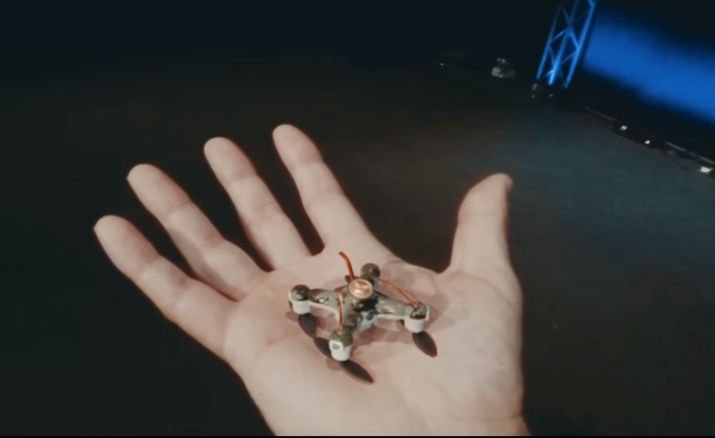
AI Weapons/Safety
https://www.youtube.com/watch?v=9CO6M2HsoIA

Slide 25
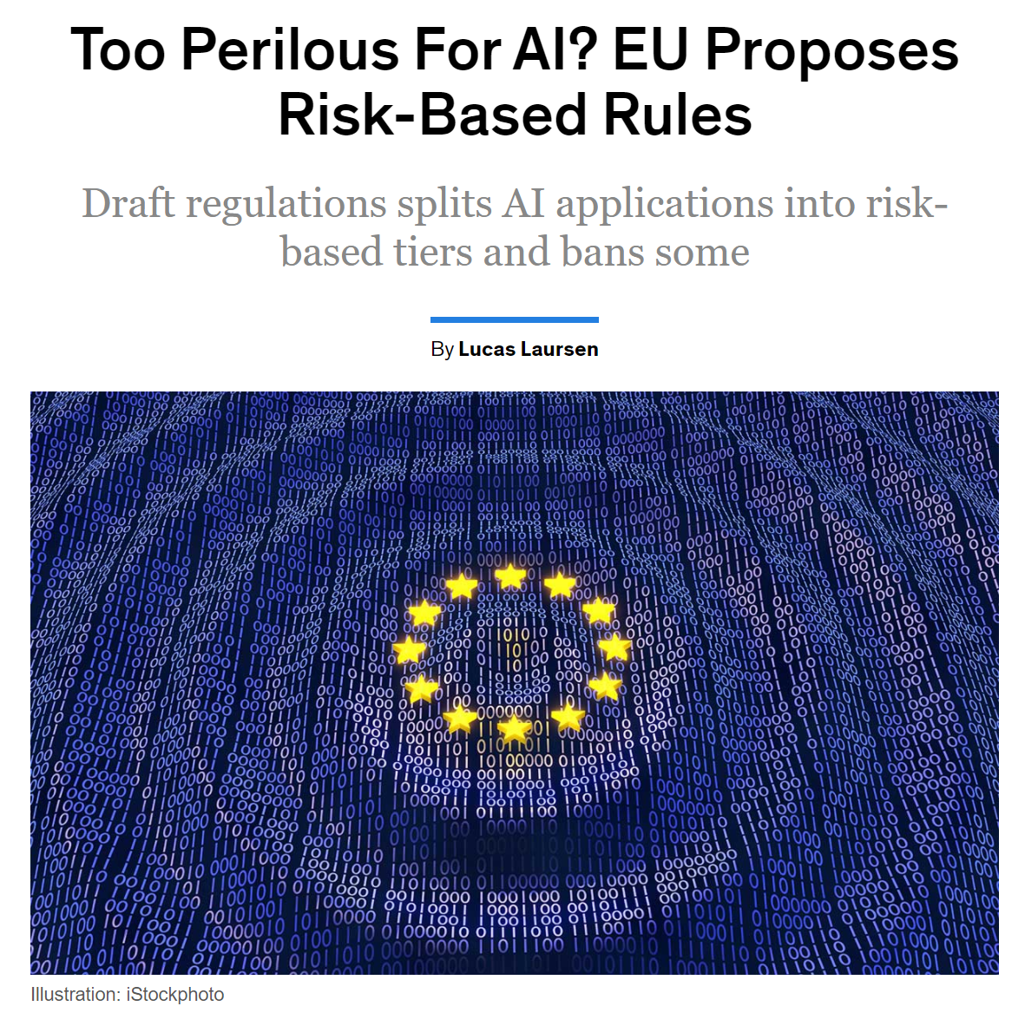
AI Weapons/Safety
https://spectrum.ieee.org/tech-talk/artificial-intelligence/embedded-ai/euairules

Slide 26
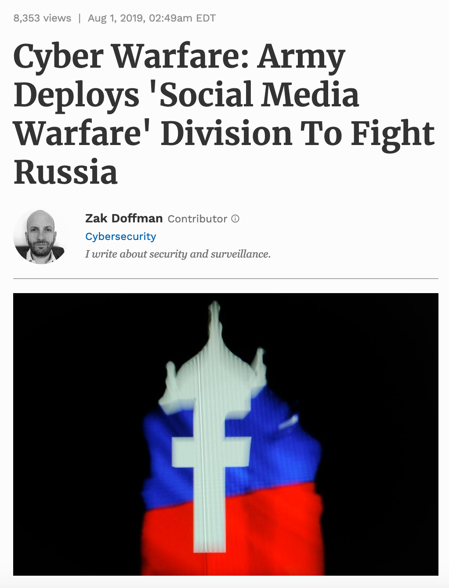
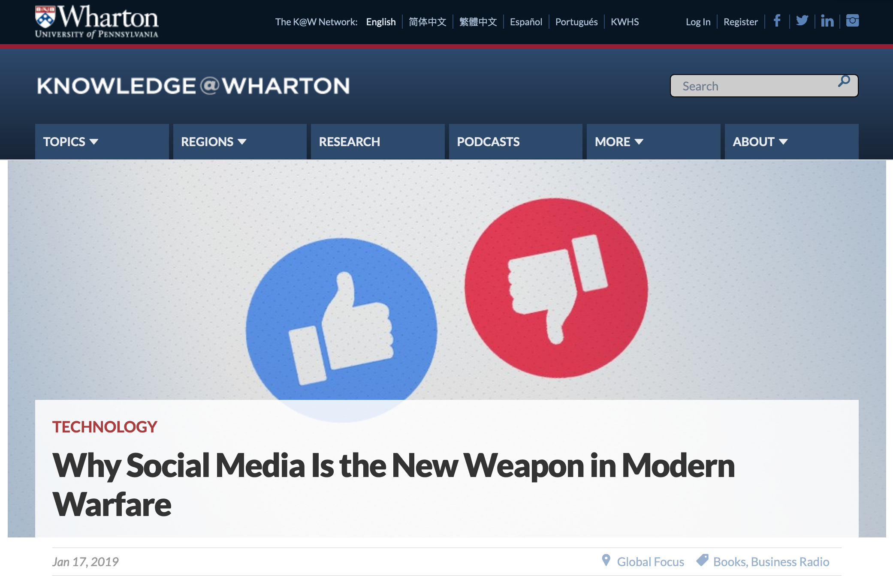
AI Weapons/Safety

Slide 27
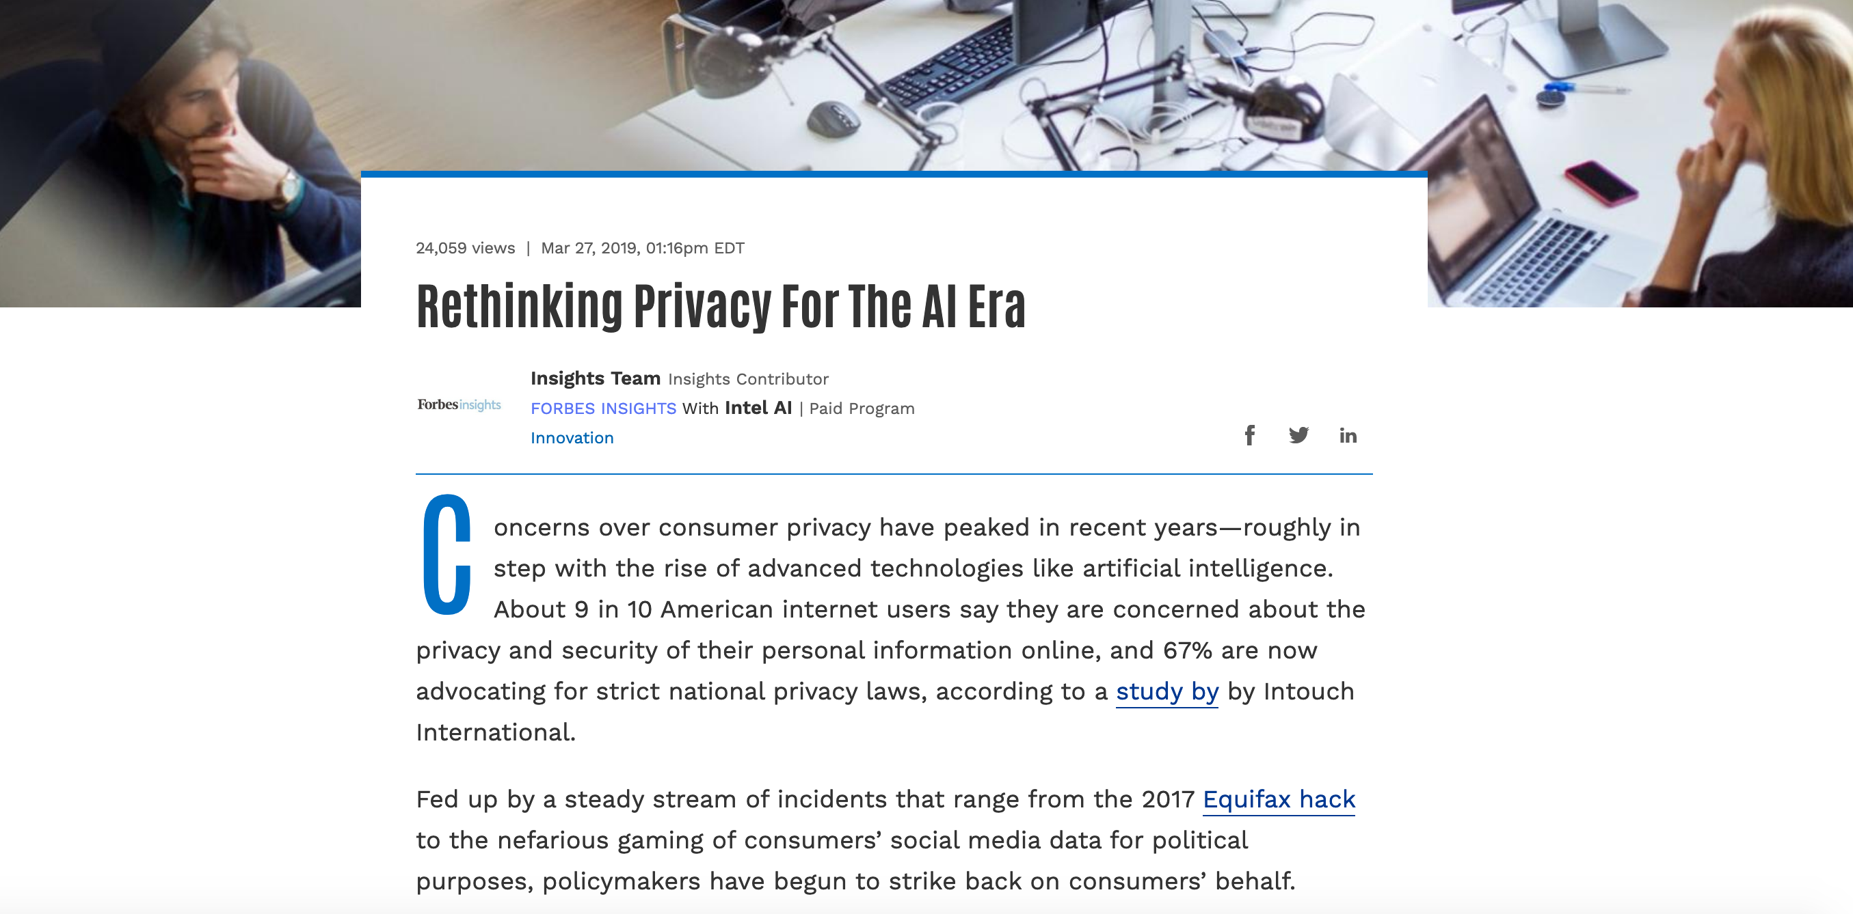
AI Privacy
https://www.forbes.com/sites/insights-intelai/2019/03/27/rethinking-privacy-for-the-ai-era

Slide 28
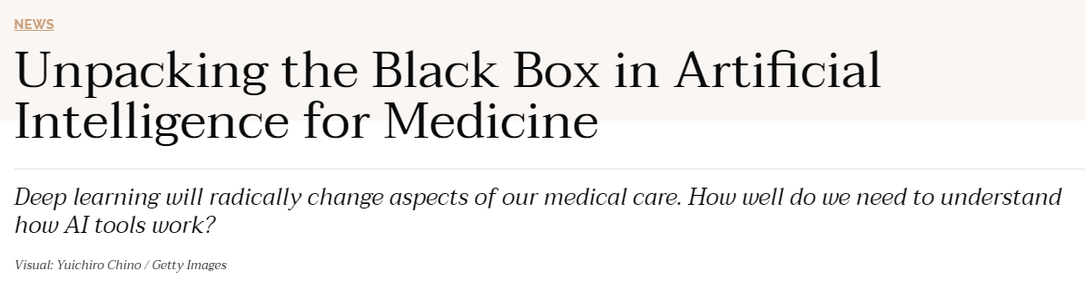
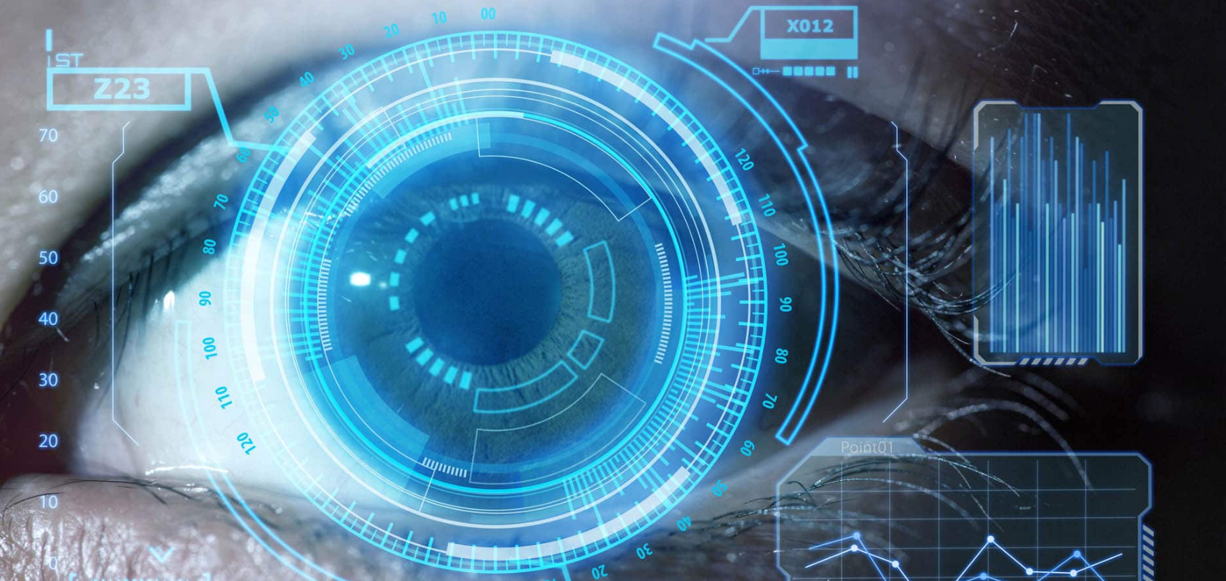
AI Liability
https://undark.org/2019/12/04/black-box-artificial-intelligence/

Slide 29
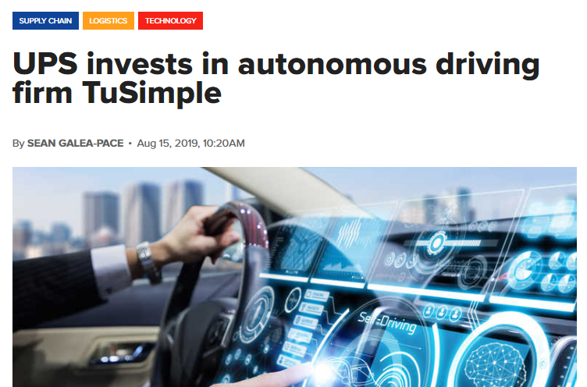
AI Jobs
https://www.supplychaindigital.com/technology/ups-invests-autonomous-driving-firm-tusimple

Slide 30
AI Jobs
Is it ok if autonomous vehicles completely replace human drivers?
https://www.brookings.edu/research/what-jobs-are-affected-by-ai-better-paid-better-educated-workers-face-the-most-exposure/
https://www.vox.com/platform/amp/policy-and-politics/2019/12/3/20965464/2020-presidential-candidates-jobs-automation-ai
https://www.irishtimes.com/business/technology/short-window-to-stop-ai-taking-control-of-society-warns-ex-google-employee-1.4104535

Slide 31
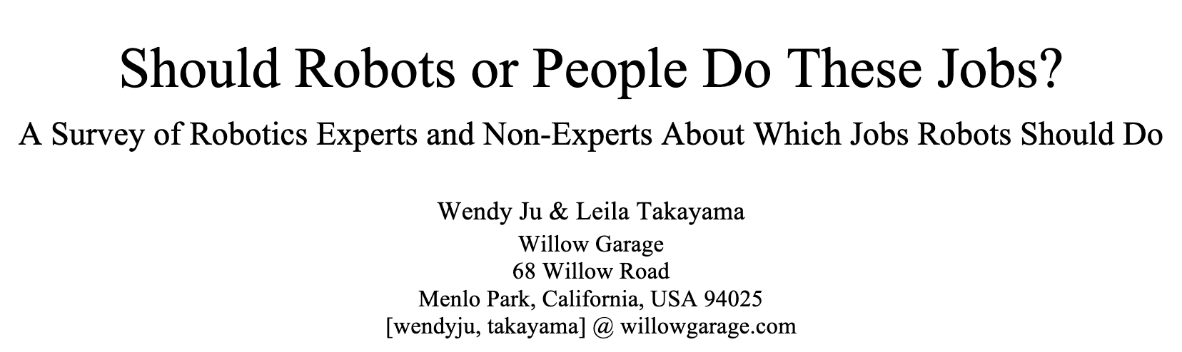
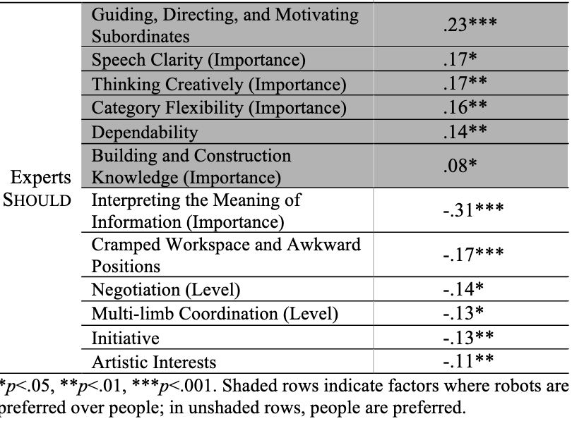
AI Jobs
http://www.wendyju.com/publications/ju_iros11.pdf

Slide 32
What about the Future?

Slide 33
Should we worry about future A.I.?
Singularity
Weak AI
Strong AI
Narrow AI
Limited number of applications
Artificial General Intelligence (AGI)
Recursive self-improvement
Beyond human control

Slide 34
Should we worry about future A.I.?
Question: What motivation could cause problems?

Slide 35
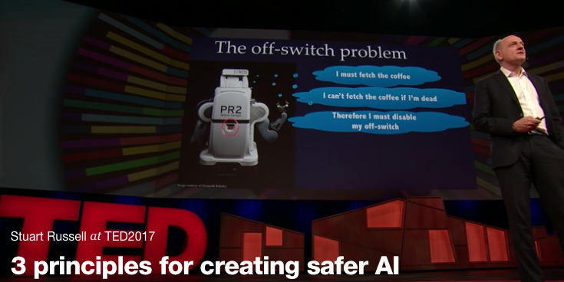
Should we worry about future A.I.?
Stuart Russell, UC Berkeley Center for Human-Compatible AI
https://www.ted.com/talks/stuart_russell_how_ai_might_make_us_better_people

Slide 36
Three simple ideas
1. The robot’s only objective is to maximize the realization of human values
2. The robot is initially uncertain about what those values are
3. The best source of information about human values is human behavior
Slides: Stuart Russell, IJCAI 2017

Slide 37
AIMA 1,2,3: objective given to machine
Human objective
Human behaviour
Machine behaviour
Slides: Stuart Russell, IJCAI 2017

Slide 38
AIMA 4: objective is a latent variable
Human objective
Human behaviour
Machine behaviour
Slides: Stuart Russell, IJCAI 2017

Slide 39
The off-switch problem
A robot, given an objective, has an incentive to disable its own off-switch
  (You can’t fetch the coffee if you’re dead)
How can we prevent this?
Answer: robot must allow for uncertainty about the true human objective
  The human will only switch off the robot if that leads to better outcomes for the true human objective
  Theorem: it’s in the robot’s interest to allow it
  Theorem: Such a robot is provably beneficial
Slides: Stuart Russell, IJCAI 2017, with work by Dylan Hadfield-Menell

Slide 40
Off-switch model
R
a
s
w(a)
U = U_{a}
H
U = 0
¬ s
s
R
U = 0
a
U = U_{a}
w(a) preferred to a or s
Slides: Stuart Russell, IJCAI 2017, with work by Dylan Hadfield-Menell

Slide 41
Should we worry about future A.I.?
Singularity
Weak AI
Strong AI
Narrow AI
Limited number of applications
Artificial General Intelligence (AGI)
Recursive self-improvement
Beyond human control

Slide 42
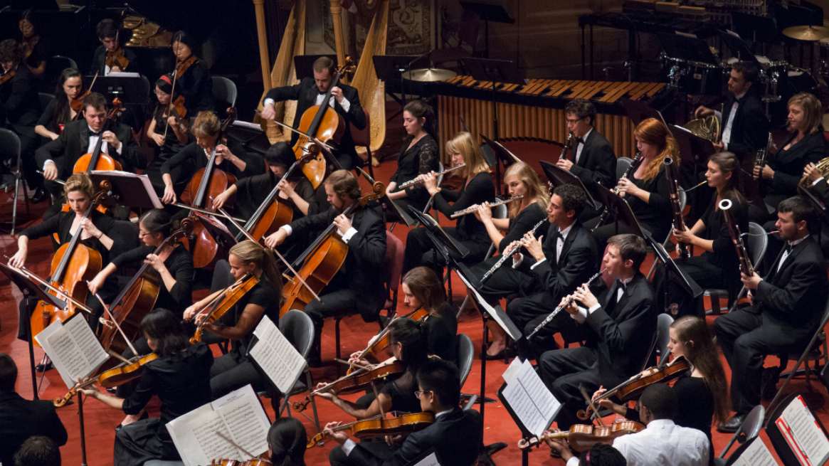
Thanks Team!!

