Slide 1

Demystifying AI
Search
Instructor: Pat Virtue

Slide 2
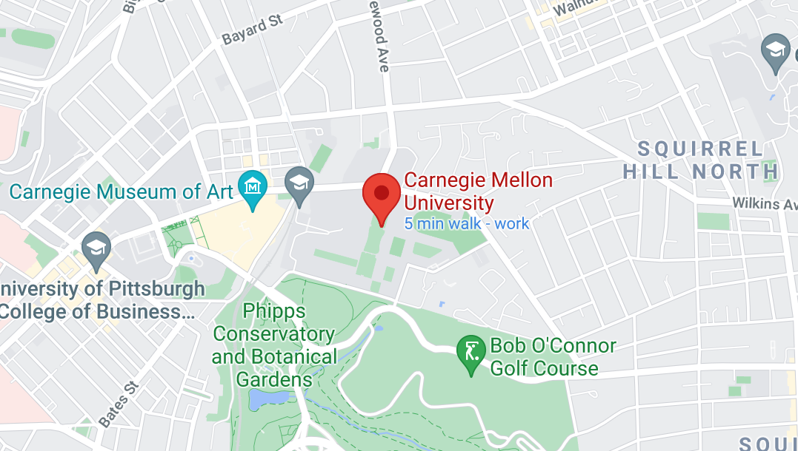
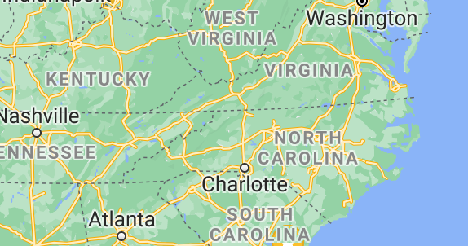
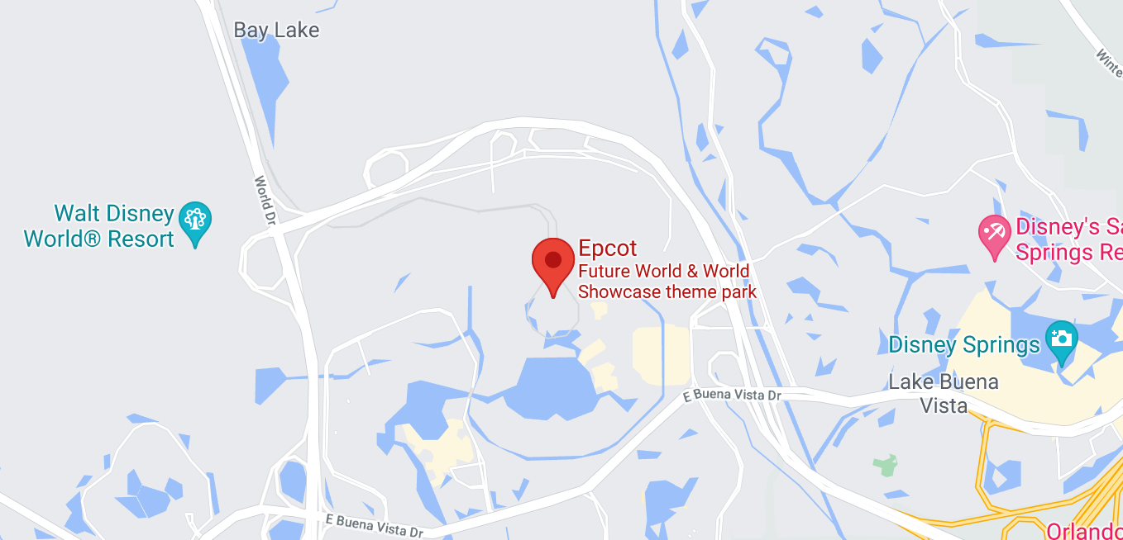
Map Directions
Input: start, end, map
Output: sequence of actions
[Demo: dfs/bfs maze water (L2D6)]

Slide 3
Reminder: Lecture 1
Candy Grab game!
Shared Drive Folder/Lec1

Slide 4
CandyGrab Agent
class Agent
function getAction(state)
return action

Slide 5


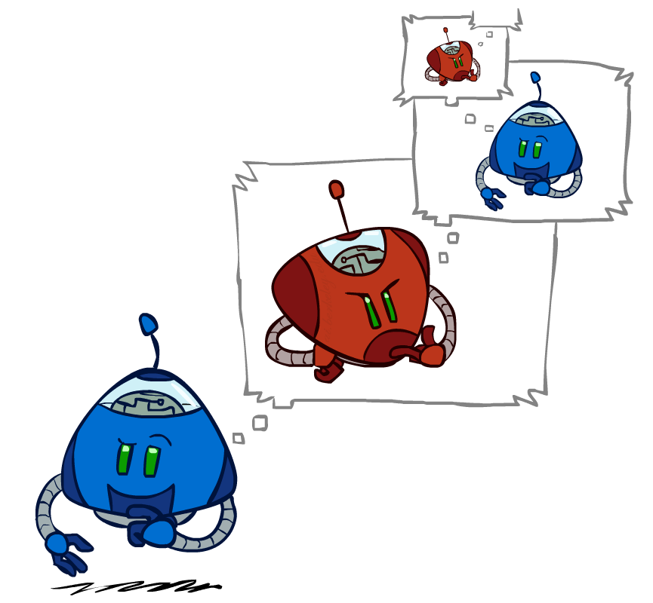
Search Agent
Search / Recursion
11
10
9
9
8
8
7
8
7
…
…
2
1
0
+1
+1
-1
Image credit: ai.berkeley.edu

Slide 6
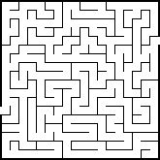
Solving a Maze

Slide 7
Search Applications
Path planning
Image credit: ai.berkeley.edu, google.com/maps

Slide 8

Search Applications
Path planning
Image credit: CMU, Manuela Veloso

Slide 9
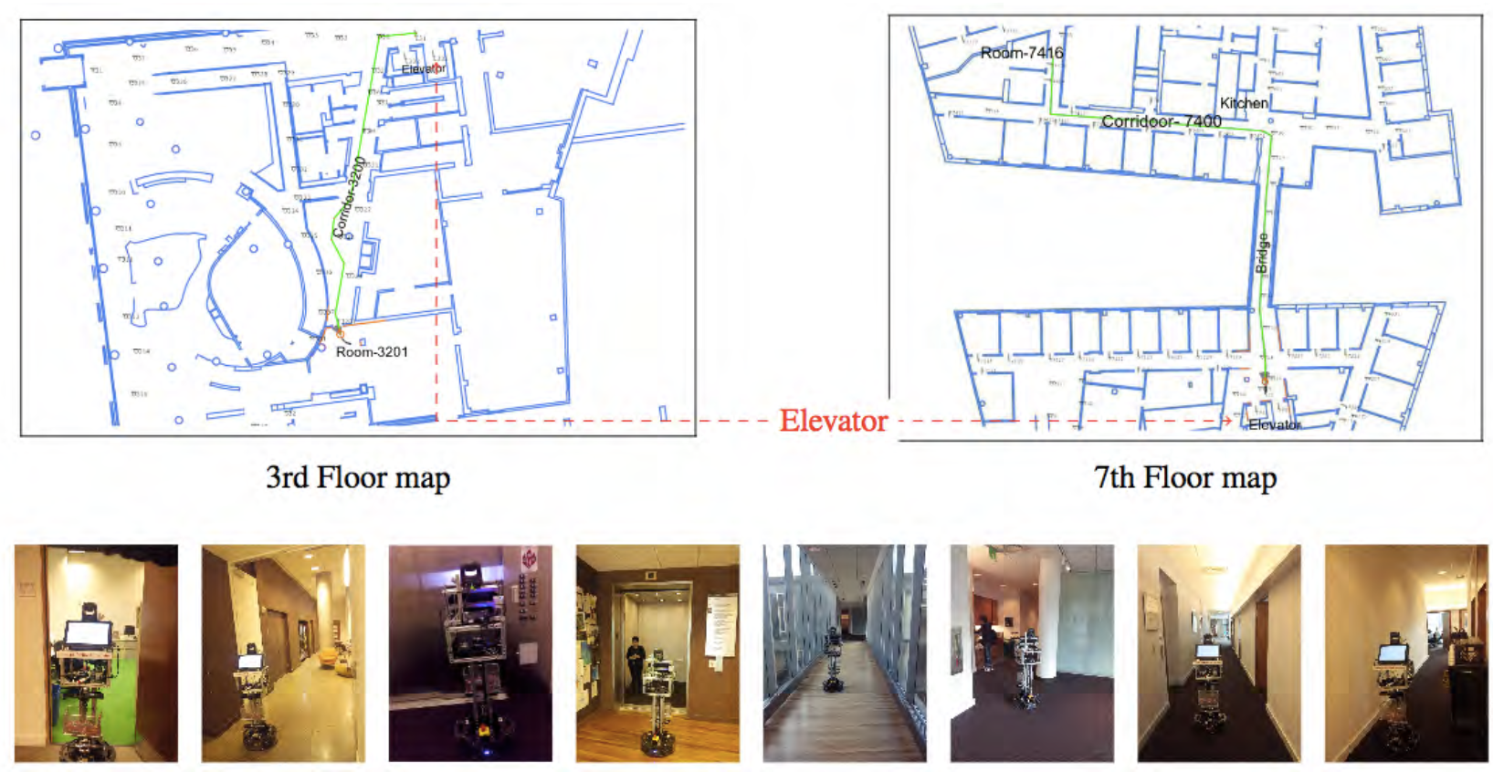
Search Applications
Path planning
Image credit: CMU, Manuela Veloso

Slide 10
Search Applications
Path planning
Image credit: ai.berkeley.edu

Slide 11
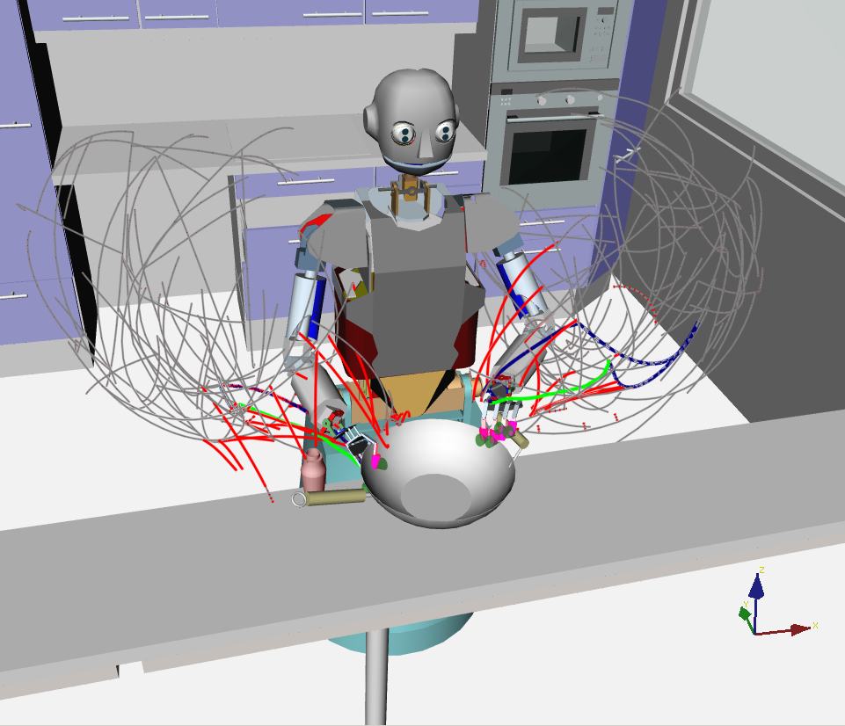
Search Applications
Path planning
https://h2t.anthropomatik.kit.edu/english/376.php

Slide 12
Candy Grab Agents
Candy Grab game!
Original: Shared Drive Folder/Lec1
Exercise: Shared Drive Folder/Individual/*/Lec_24_25_Search
Agent Experiments
Search trees - Printing the game tree
Search trees - Searching
Search trees - Search agent

Slide 13
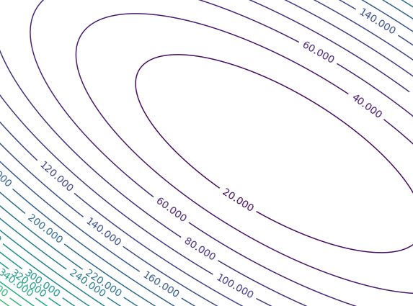

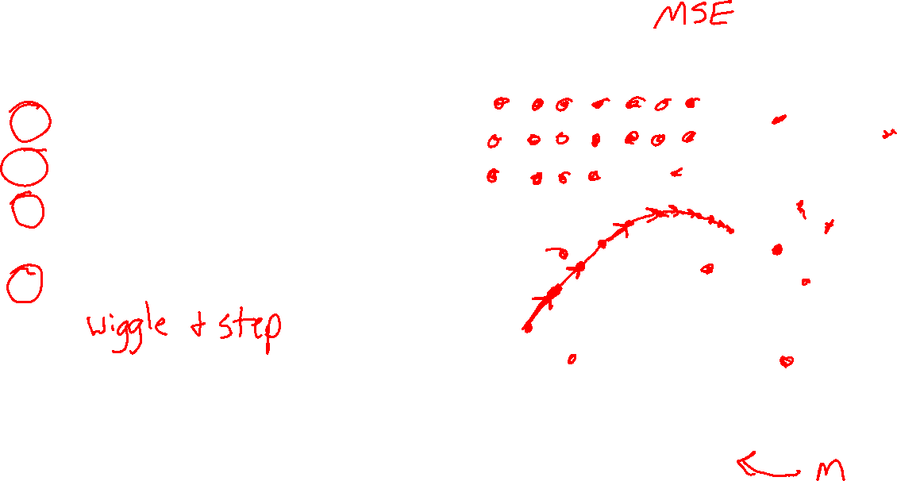


Search Applications
Methods for optimizing the objective
Grid search
Random search
(Solve for the minimum of this parabaloid)
Gradient descent
$$J(w,b)$$
$$b$$
$$w$$

Slide 14
Search Applications
Methods for optimizing the objective
Image credit: ai.berkeley.edu

Slide 15
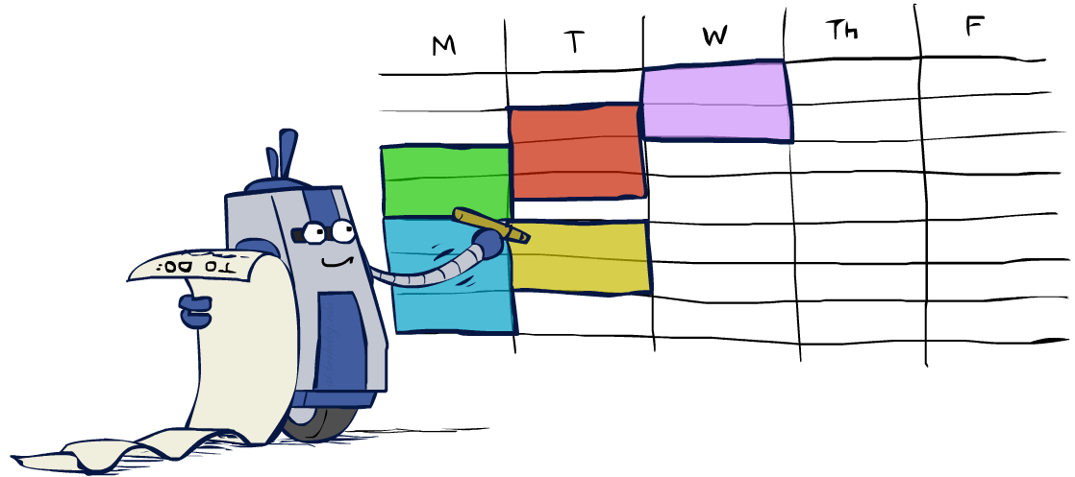
Search Applications
Sudoku
Constraint satisfaction problems
1
2
1
3
4
Image credit: ai.berkeley.edu

Slide 16
Search Applications
Constraint satisfaction problems
Variables:
Values:
Constraints:
Image credit: ai.berkeley.edu

Slide 17
Search Applications
Sudoku
Constraint satisfaction problems
Variables:
Values:
Constraints:
1
2
1
3
4
Image credit: ai.berkeley.edu

Slide 18
Search Applications
Constraint satisfaction problems
Variables:
Values:
Constraints:
Image credit: ai.berkeley.edu

Slide 19
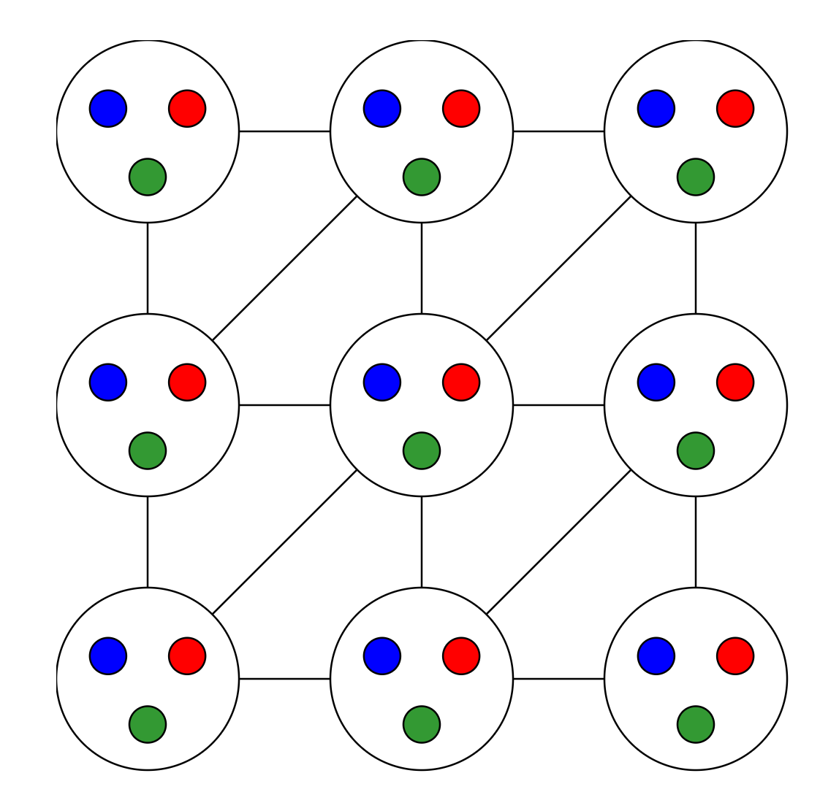
Search Applications
Constraint satisfaction problems
Search and filtering
https://www.cs.cmu.edu/~15281-s20/demos/csp_backtracking/
Demo credit: ai.berkeley.edu

Slide 20
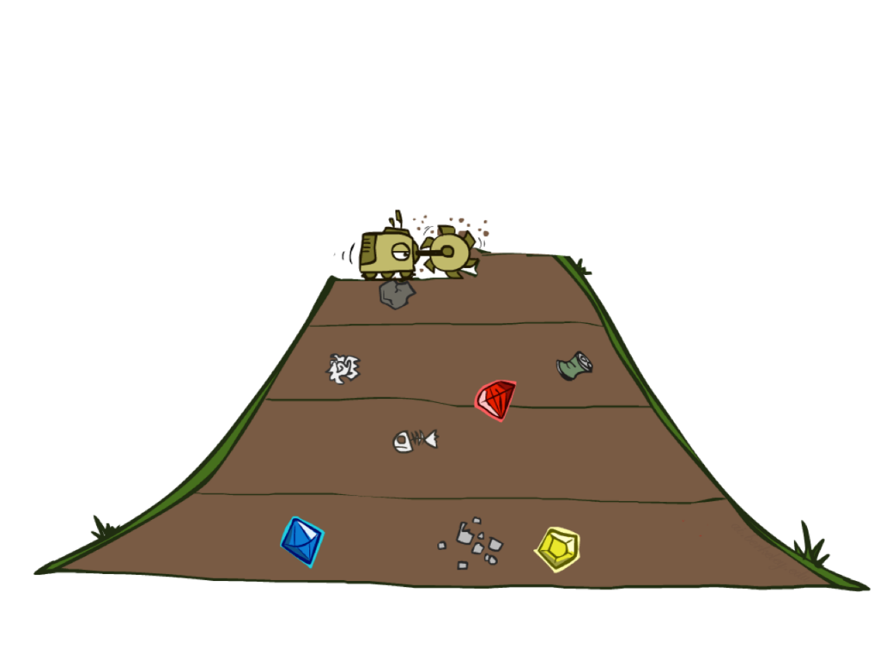
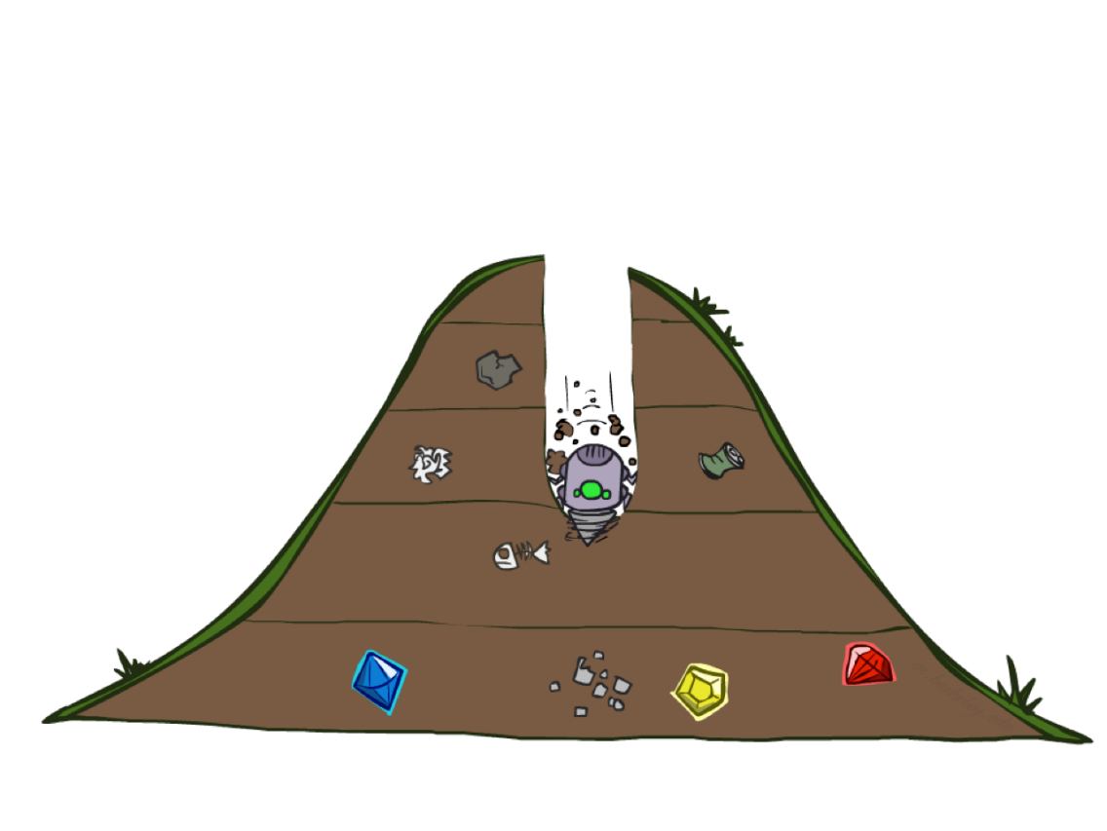
BFS vs DFS
Slide credit: ai.berkeley.edu

Slide 21
Question
Is the following demo using BFS or DFS
Slide credit: ai.berkeley.edu
[Demo: dfs/bfs maze water (L2D6)]

Slide 22
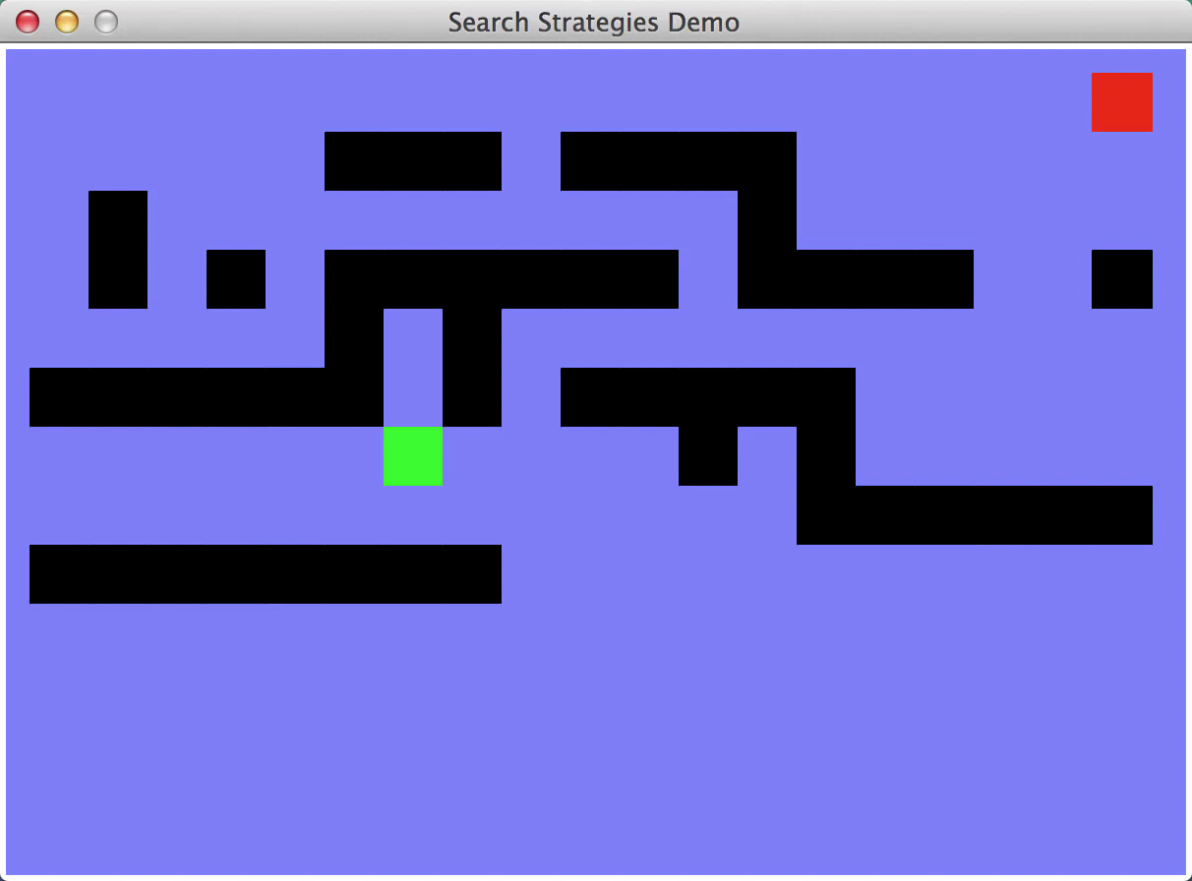
Video of Demo Maze Water DFS/BFS (part 1)
Slide credit: ai.berkeley.edu

Slide 23

Video of Demo Maze Water DFS/BFS (part 2)
Slide credit: ai.berkeley.edu

Slide 24
Search Applications
Constraint satisfaction problems

Slide 25
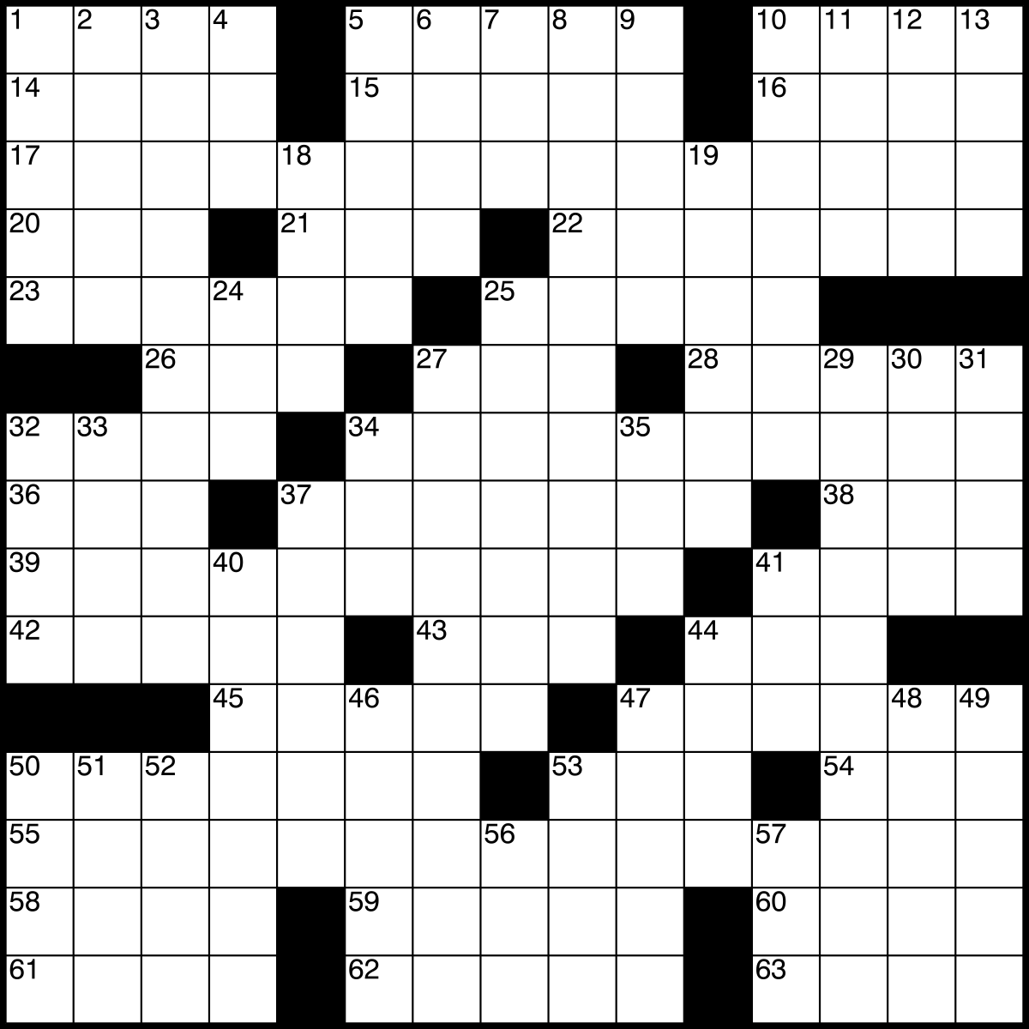
Design Challenge: Crossword Puzzle Agent

Slide 26


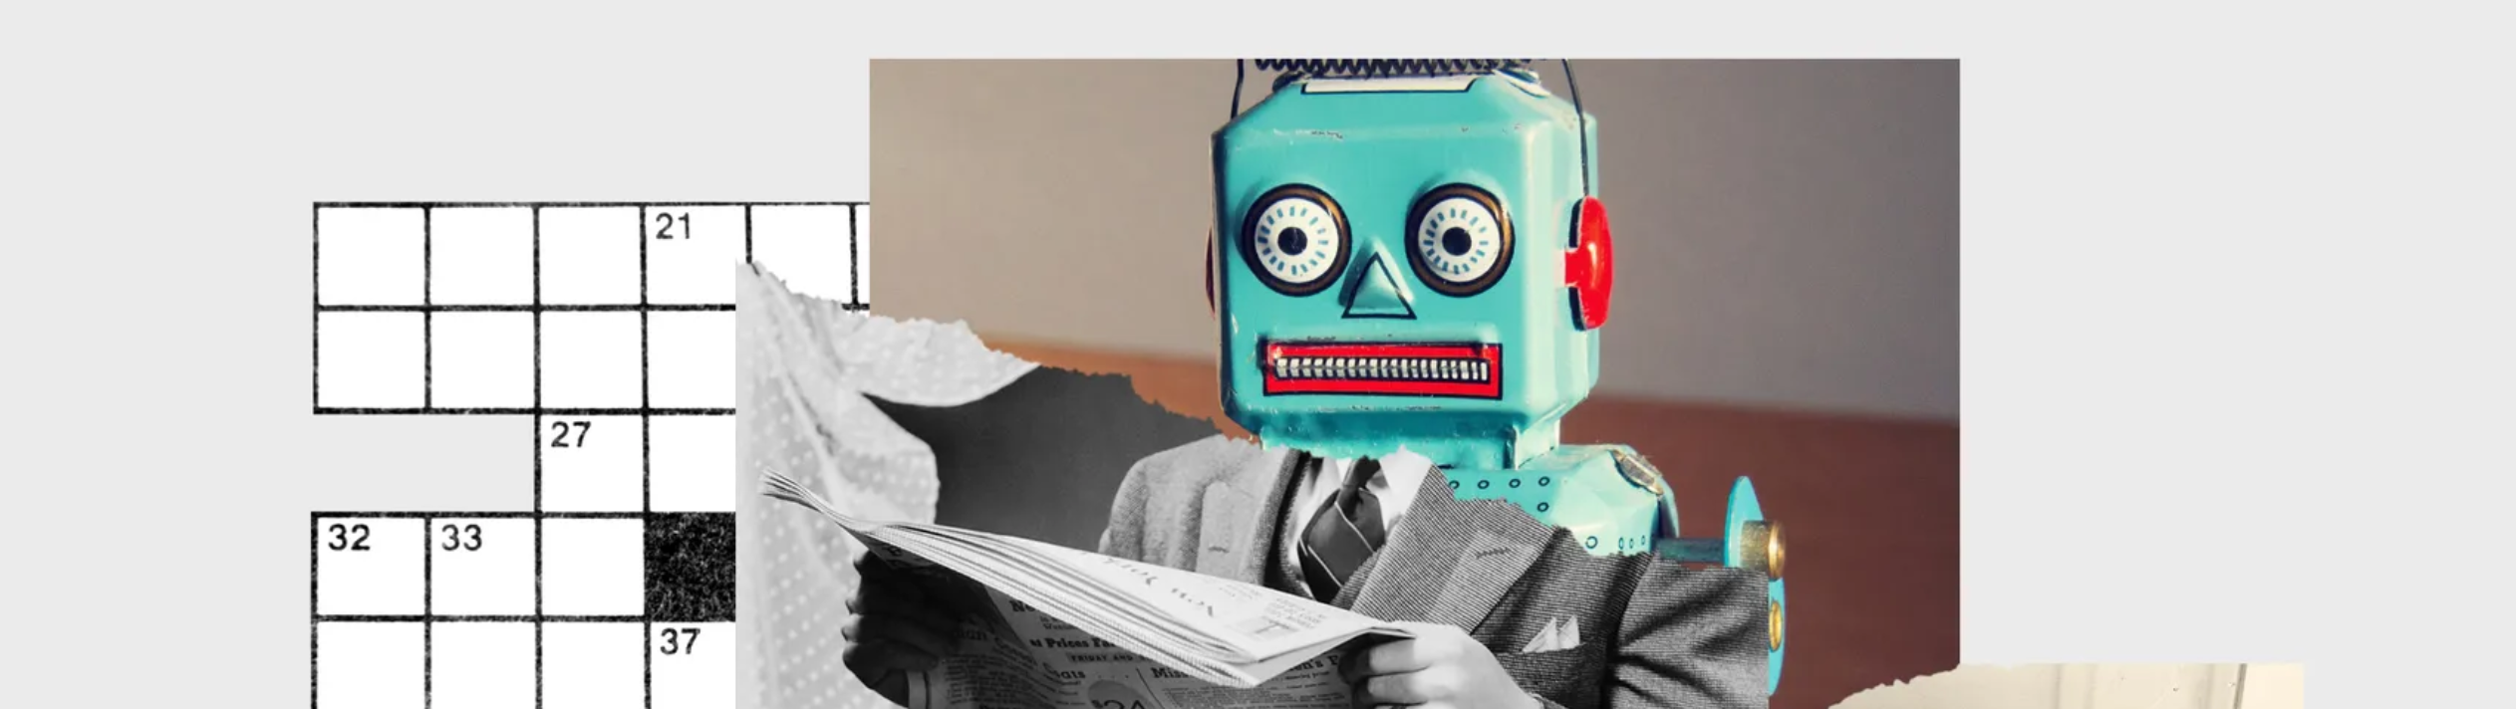
Design Challenge: Crossword Puzzle Agent
News: https://www.wired.com/story/crossword-ai-humans-way-with-words/amp
UC Berkeley NLP: http://nlp.cs.berkeley.edu/projects/crosswords

Slide 27
Search Features

Slide 28
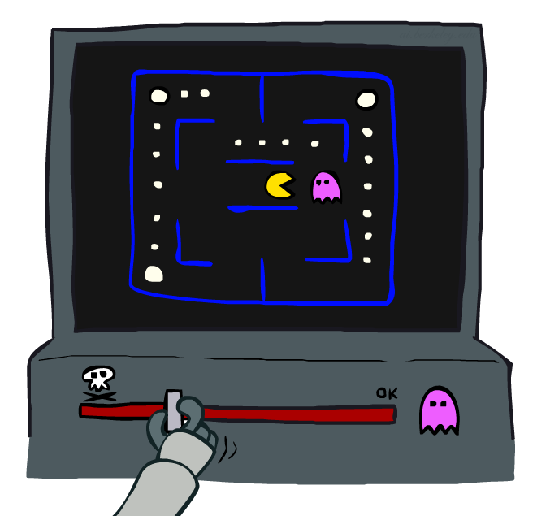
Approximate Q-Learning
Notes:
:34 in, :40 to go

Slide 29
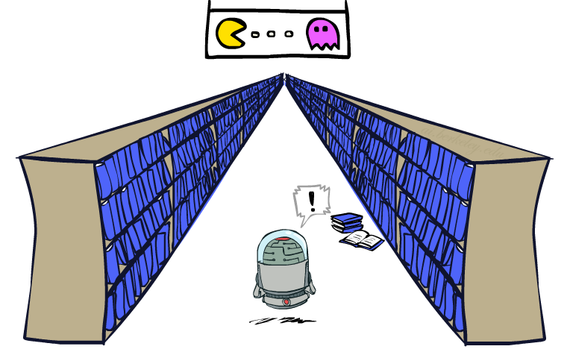

Generalizing Across States
In realistic situations, we cannot possibly learn about every single state!
  Too many states to visit them all in training
  Too many states to hold the in memory
Slide credit: ai.berkeley.edu
[demo – RL pacman]

Slide 30
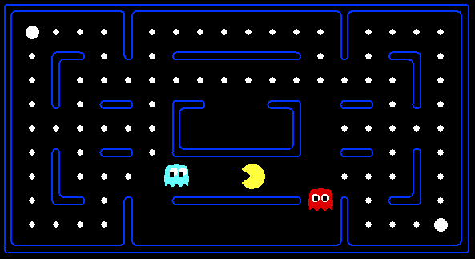



Example: Pacman
Let’s say we discover through experience that this state is bad:
In naïve q-learning, we know nothing about this state:
Or even this one!
[Demo: Q-learning – pacman – tiny – watch all (L11D5)]
[Demo: Q-learning – pacman – tiny – silent train (L11D6)]
[Demo: Q-learning – pacman – tricky – watch all (L11D7)]
Slide credit: ai.berkeley.edu

Slide 31
Feature-Based Representations
Solution: describe a state using a vector of features (properties)
  Features are functions from states to real numbers (often 0/1) that capture important properties of the state
  Example features:
    Distance to closest ghost
    Distance to closest dot
    Number of ghosts
    1 / (dist to dot)²
    Is Pacman in a tunnel? (0/1)
    …… etc.
    Is it the exact state on this slide?
Slide credit: ai.berkeley.edu

Slide 32
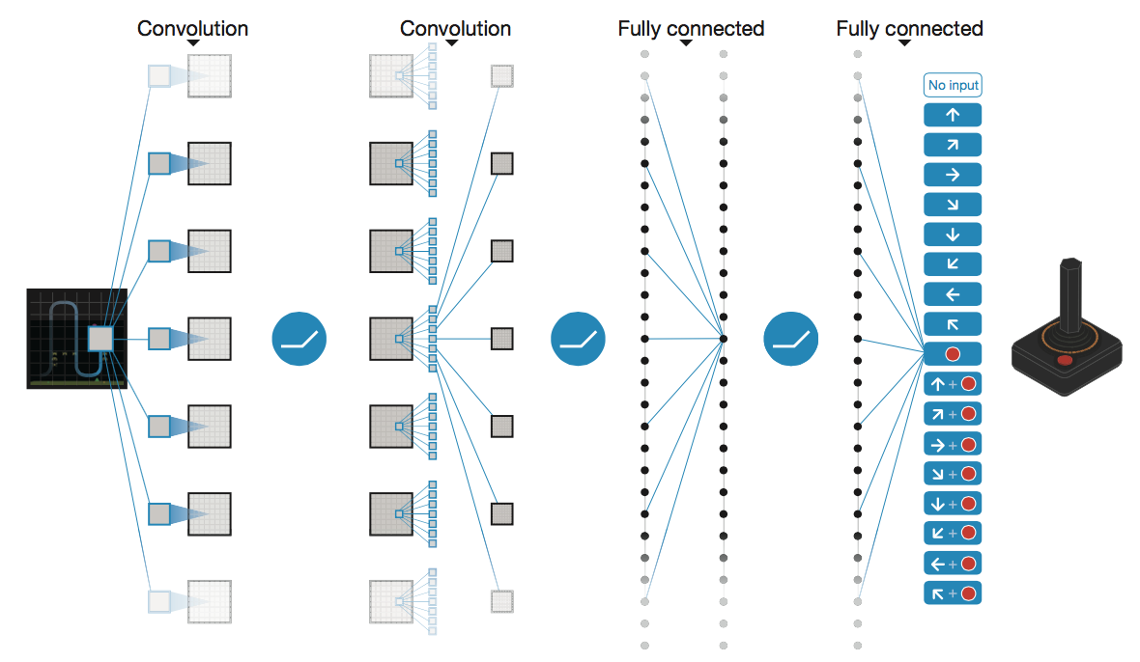
Search with Neural Networks (and RL)
Deep Mind, 2015
Used neural network to learn state features:
  Input is last 4 images (84x84 pixel values) plus score
49 Atari games, incl. Breakout, Space Invaders, Seaquest, Enduro
Image: Deep Mind

Slide 33
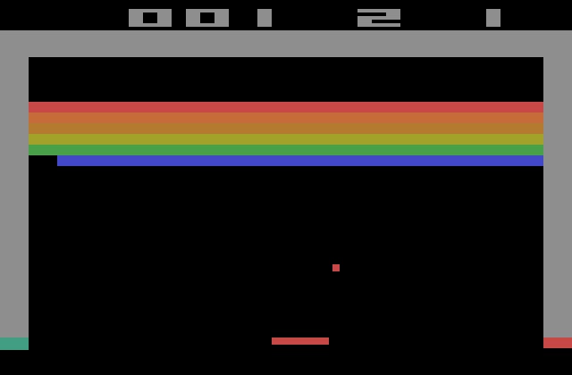
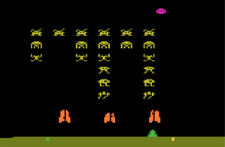
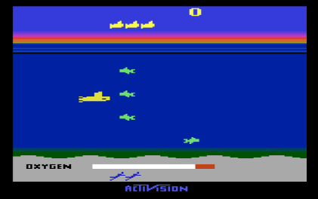
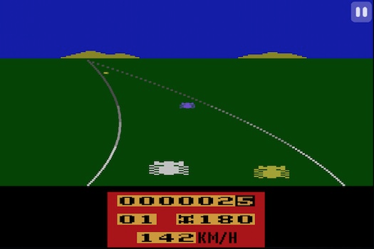
Images: Open AI, Atari

