Slide 1

15-181 Demystifying AI Overview & Intelligence
Instructor: Pat Virtue

Slide 2
Warm-up as we get started
Candy Grab game!
Shared Drive Folder/Lec1
https://drive.google.com/drive/folders/1JXonj8iPWRXngauDaR6vRUYbjm79aYo_?usp=sharing

Slide 3
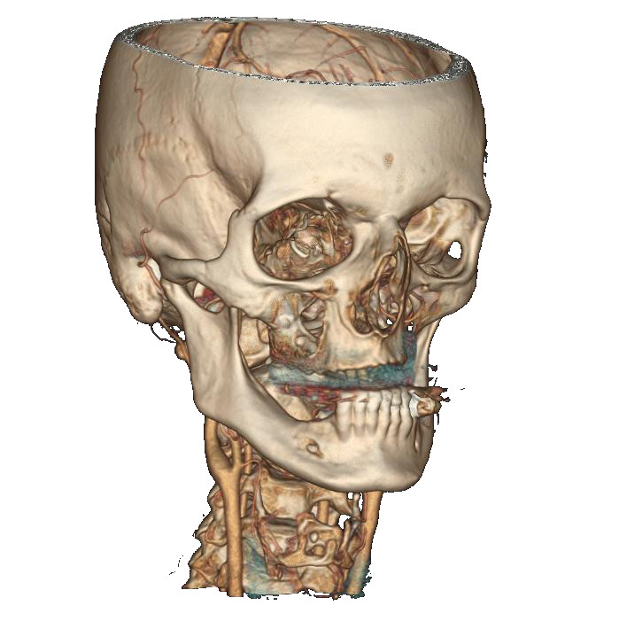
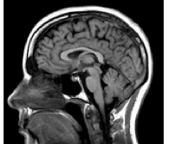
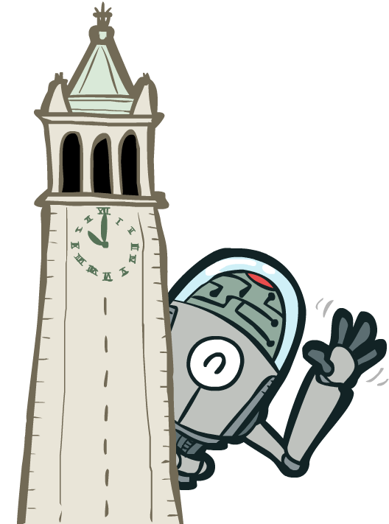



Instructor Pat Virtue CS and ML Departments Teaching Professor

Slide 4
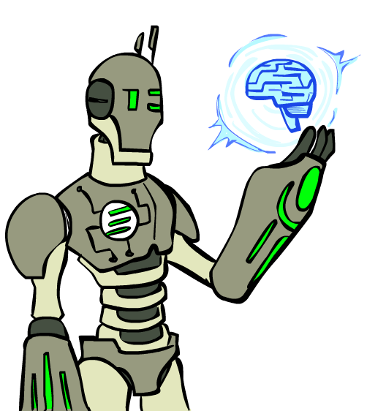

Plan
Course Info (part 1)
Candy Grab
Discussion on Intelligence
AI focus in this course
Weak AI
“Scholarly” AI
Agents that act rationally
Course Info (part 2)
Images: ai.berkeley.edu

Slide 5
Demystifying AI
Pilot Course!
Explaining AI
What it is
What it can do
How to use it
How it works
What can go wrong
Prereqs
15-110
(High school algebra)

Slide 6
Quick Logistics
Slides will be available
Asking questions in main room
Use the hand-raise icon
Prof. can’t really see the chat
Asking questions in breakout room
Press request help button
Pop back into main room

Slide 7
Quick Logistics
Breakout rooms
Cameras on
Unmuted
Introduce yourself if you haven’t met
At least just a quick, “Hi, I’m Pat”
One person share screen

Slide 8
Warm-up as we get started
Candy Grab game!
Shared Drive Folder/Lec1
https://drive.google.com/drive/folders/1JXonj8iPWRXngauDaR6vRUYbjm79aYo_?usp=sharing

Slide 9
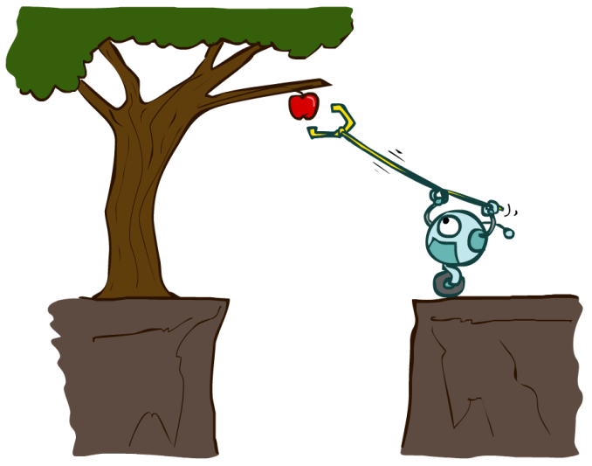

Designing Agents
An agent is an entity that perceives and acts.
Actions can have an effect on the environment.
The specific sensors and actuators affect what the agent is capable of perceiving and what actions it is capable of taking
Sensors
Agent
Percepts
Environment
?
Actuators
Actions
Slide credit: ai.berkeley.edu

Slide 10
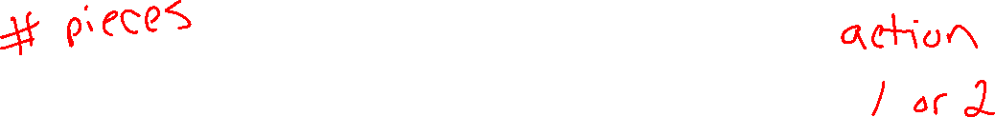
Agent Model: Simple Input/Output Version
Agent
Input
?
Predicted
Output

Slide 11

Nim Agent
class Agent
function getAction(state)
return action

Slide 12
Nim Agent
Agent 001 – Always choose 1
function getAction( numPiecesAvailable )
return 1

Slide 13
Nim Agent
Agent 002 – Always choose 2
function getAction( numPiecesAvailable )
return 2

Slide 14

Nim Agent
Agent 004 – Choose the opposite of opponent
function getAction( numPiecesAvailable )
return ?

Slide 15
Nim Agent
Agent 007 – Whatever you think is best
function getAction( numPiecesAvailable )
return ?

Slide 16
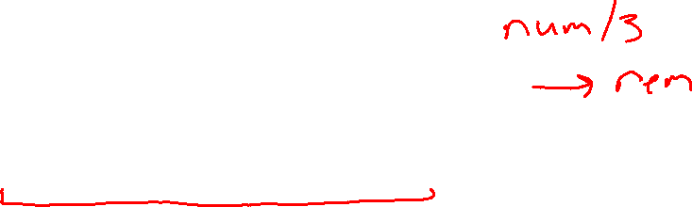
Nim Agent
Agent 007 – Whatever you think is best
function getAction( numPiecesAvailable )
remainder = numPiecesAvailable % 3
if remainder == 2
return 2
else
return 1

Slide 17
Games – Three “Intelligent” Agents
Poll 1
Which agent code is the most “intelligent”?

Slide 18
Games – Three “Intelligent” Agents
A: Search / Recursion

Slide 19

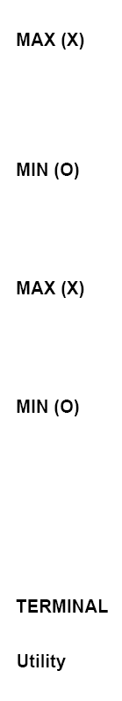

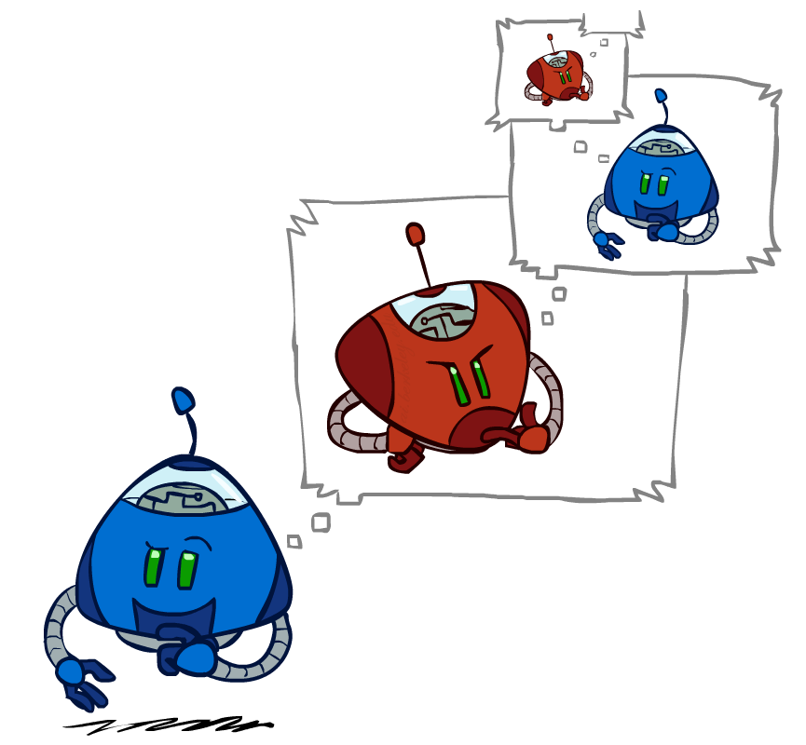
Games – Three “Intelligent” Agents
A: Search / Recursion
11
10
9
9
8
8
7
8
7
…
…
2
1
0
+1
+1
-1
Image credit: ai.berkeley.edu

Slide 20
Games – Three “Intelligent” Agents
B: Encode the pattern
10’s value:Win
9’s value:Lose
8’s value:Win
7’s value:Win
6’s value:Lose
5’s value:Win
4’s value:Win
3’s value:Lose
2’s value:Win
1’s value:Win
0’s value:Lose
function getAction( numPiecesAvailable )
if numPiecesAvailable % 3 == 2
return 2
else
return 1

Slide 21

Games – Three “Intelligent” Agents
C: Record statistics of winning positions
Pieces Available | Take 1 | Take 2
2
3
4
5
6
7
Pieces Available | Take 1 | Take 2
2 |  | 100%
3
4 | 100%
5
6
7 |  | 100%
Pieces Available | Take 1 | Take 2
2 |  | 100%
3 | 0%
4 | 100%
5
6
7 |  | 50%
Pieces Available | Take 1 | Take 2
2 | 0% | 100%
3 | 2% | 0%
4 | 75% | 2%
5 | 4% | 68%
6 | 5% | 6%
7 | 60% | 5%

Slide 22
Poll 1
Games – Three “Intelligent” Agents
Which agent code is the most “intelligent”?
Search / Recursion
Encode multiple of 3 pattern
Keep stats on winning positions
Which agent code is the most “intelligent”?

Slide 23
Games – Three “Intelligent” Agents
C: Record statistics of winning positions
Pieces Available | Take 1 | Take 2
2
3
4
5
6
7
Pieces Available | Take 1 | Take 2
2 |  | 100%
3
4 | 100%
5
6
7 |  | 100%
Pieces Available | Take 1 | Take 2
2 |  | 100%
3 | 0%
4 | 100%
5
6
7 |  | 50%
Pieces Available | Take 1 | Take 2
2 | 0% | 100%
3 | 2% | 0%
4 | 75% | 2%
5 | 4% | 68%
6 | 5% | 6%
7 | 60% | 5%

Slide 24
Plan
Course Info (part 1)
Candy Grab
Discussion on Intelligence
AI focus in this course
Weak AI
“Scholarly” AI
Agents that act rationally
Course Info (part 2)
Images: ai.berkeley.edu

Slide 25
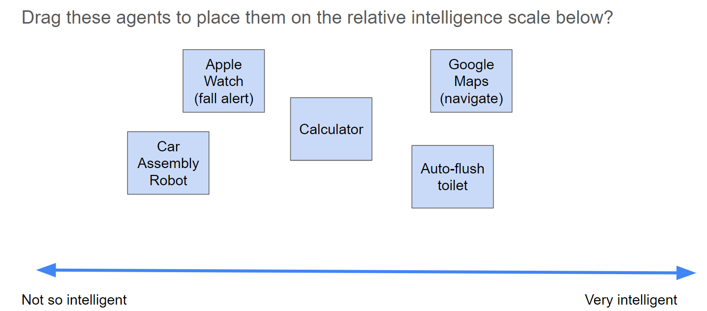
How intelligent are these agents?
Shared Drive Folder/Lec1
https://drive.google.com/drive/folders/1JXonj8iPWRXngauDaR6vRUYbjm79aYo_?usp=sharing

Slide 26
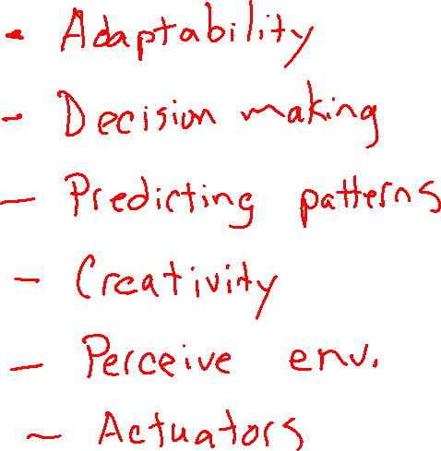
Attributes of Intelligence

Slide 27
Intelligence and Uncertainty
Another way to think about intelligence is to consider how much uncertainty is involved
Uncertainty comes into play whenever it is not feasible to determine exact information
Uncertainty requires decisions to be made

Slide 28
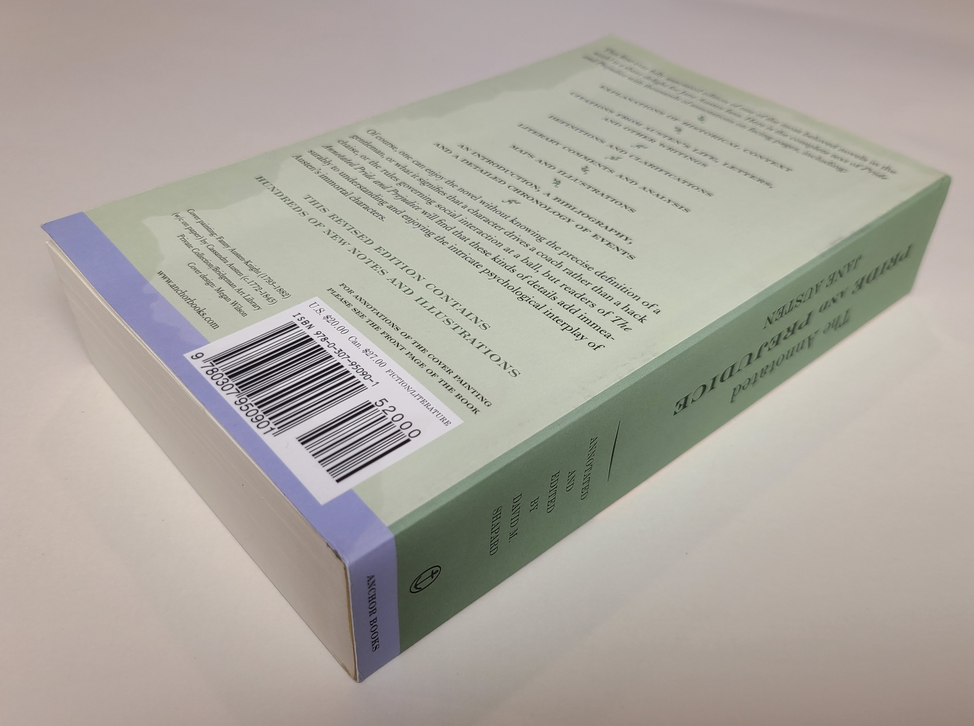
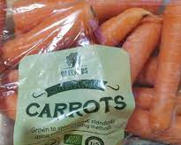

Intelligence and Uncertainty
ISBN 978-0-307-95090-1
Consider the uncertainty present in the following
Typing a product ID number into a website (book ISBN number into amazon.com)
Barcode reader scanning a book in a well-lit library
Barcode reader scanning a bag of carrots in a grocery store

Slide 29

Intelligence and Uncertainty
Uncertainty can have lots of sources, including anything we attribute to random chance
Hidden information
Cards in another player’s hand
Noise
Sensor noise
Way to complicated to model
Leaves blowing in the wind
Infinite number of possible configurations
More possibilities than any computer can compute in a reasonable time
Tic-tac-toe → Checkers → Chess

Slide 30
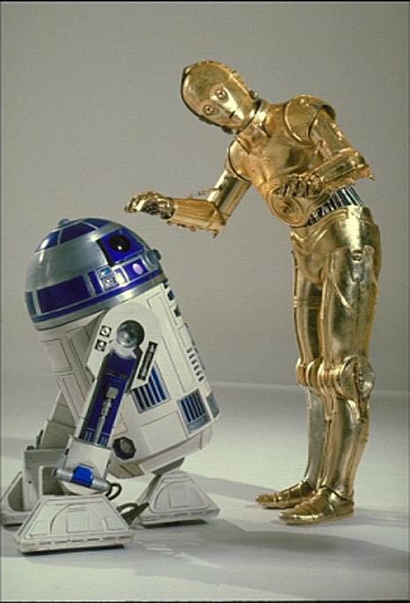
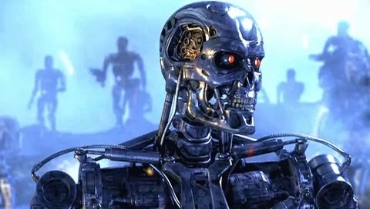
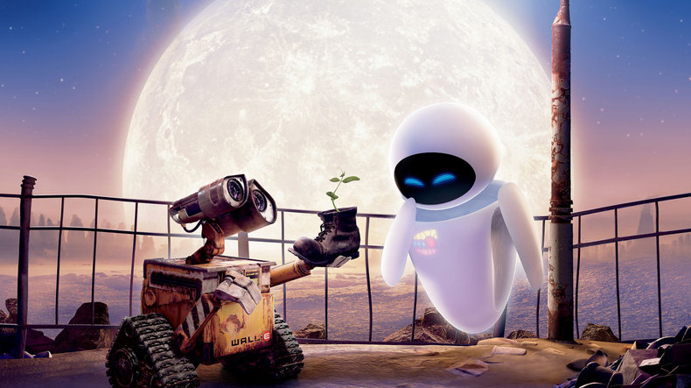
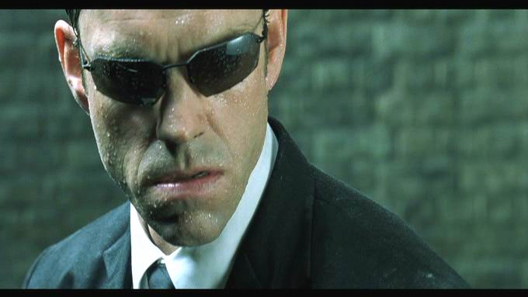
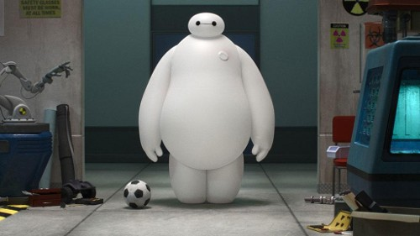

Sci-Fi AI?
Slide credit: ai.berkeley.edu
Notes:
Who are these? C3PO, what does he do? Essentially google translate, (but with anxiety!)
Little guy? R2D2 – what does he do, yeah, not so sure
Things got darker: machines come back from the future – to kill us!
90’s : software is scary
Basic fear about what technology might do ?
What if we can’t even tell technology apart from ourselves?
OR maybe it’ll look really different and snarky
Some exceptions like wall-E, positive view of technology (but maybe not of us humans!)
But mostly a worry
[not very worried myself, at least at present]

Slide 31
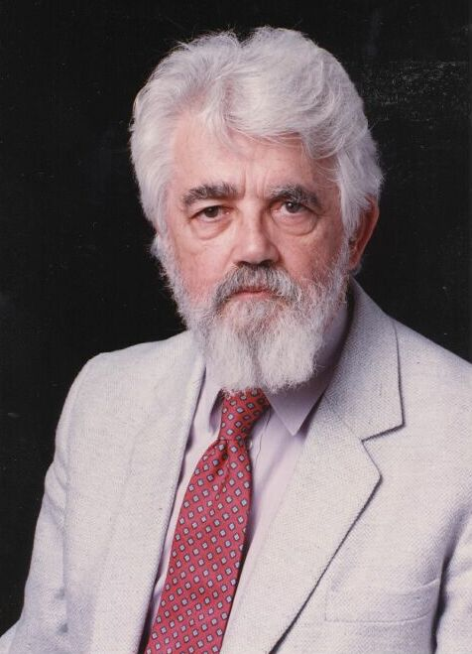
AI Definition by John McCarthy
What is artificial intelligence
It is the science and engineering of making intelligent machines, especially intelligent computer programs
What is intelligence
Intelligence is the computational part of the ability to achieve goals in the world
http://www-formal.stanford.edu/jmc/whatisai/whatisai.html

Slide 32
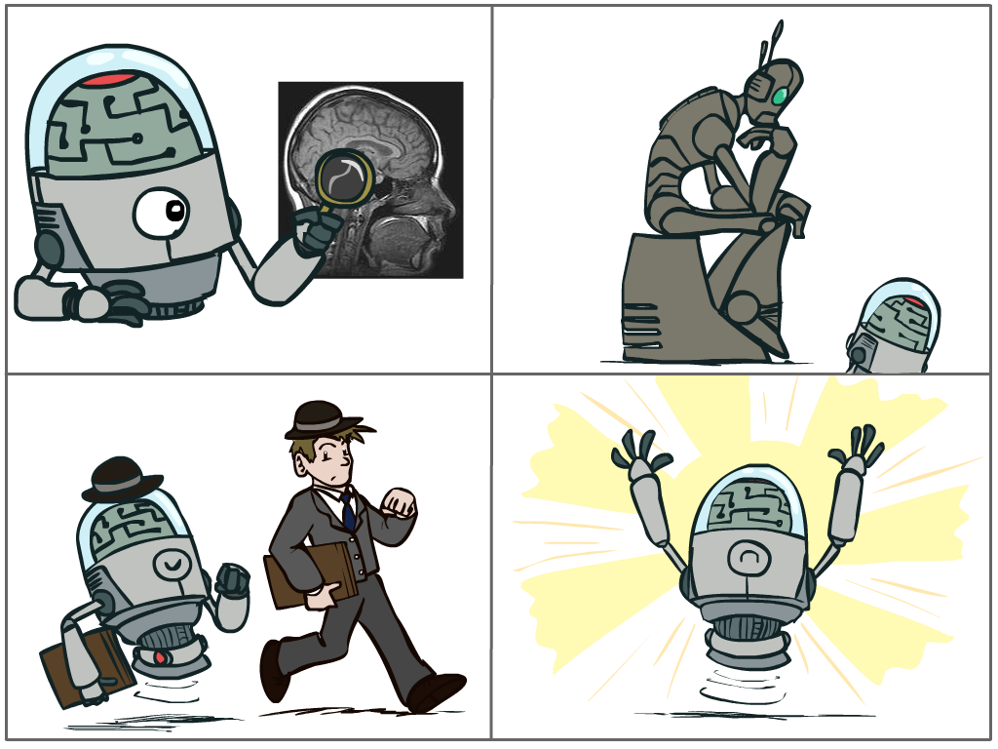
What is AI?
The science of making machines that:
Think like people
Think rationally
Act like people
Act rationally
Slide credit: ai.berkeley.edu
Notes:
Top left: Think like people --- cognitive science, neuroscience
Bottom left: act like people --- actually very early definition, dating back to Alan Turing --- Turing test; problem to do really well you start focusing on things like don’t answer too quickly what the square root of 1412 is, don’t spell too well, and make sure you have a favorite movie etc. So it wasn’t really leading us to build intelligence
Think rationally – long tradition dating back to Aristotle --- but not a winner, because difficult to encode how to think, and in the end it’s not about how you think, it’s about how you end up acting

Slide 33
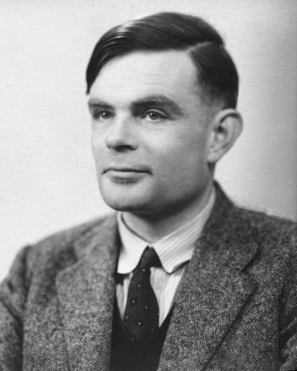
Turing Test
In 1950, Turing defined a test of whether a machine could “think”
“A human judge engages in a natural language conversation with one human and one machine, each of which tries to appear human. If judge can’t tell, machine passes the Turing test”
en.wikipedia.org/wiki/Turing_test
Slide credit: ai.berkeley.edu
Notes:
Top left: Think like people --- cognitive science, neuroscience
Bottom left: act like people --- actually very early definition, dating back to Alan Turing --- Turing test; problem to do really well you start focusing on things like don’t answer too quickly what the square root of 1412 is, don’t spell too well, and make sure you have a favorite movie etc. So it wasn’t really leading us to build intelligence
Think rationally – long tradition dating back to Aristotle --- but not a winner, because difficult to encode how to think, and in the end it’s not about how you think, it’s about how you end up acting

Slide 34

What is AI?
The science of making machines that:
Think like people
Think rationally
Act like people
Act rationally
Slide credit: ai.berkeley.edu
Notes:
Top left: Think like people --- cognitive science, neuroscience
Bottom left: act like people --- actually very early definition, dating back to Alan Turing --- Turing test; problem to do really well you start focusing on things like don’t answer too quickly what the square root of 1412 is, don’t spell too well, and make sure you have a favorite movie etc. So it wasn’t really leading us to build intelligence
Think rationally – long tradition dating back to Aristotle --- but not a winner, because difficult to encode how to think, and in the end it’s not about how you think, it’s about how you end up acting

Slide 35
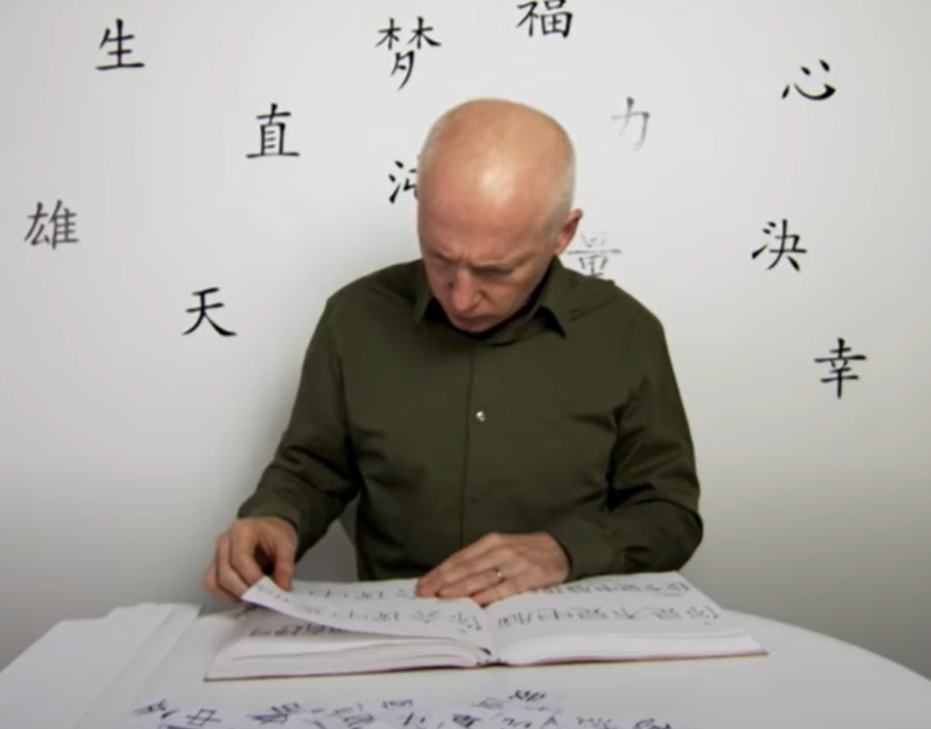
What is Intelligence?
Chinese room experiment
John Searle
https://www.youtube.com/watch?v=D0MD4sRHj1M

Slide 36
Weak AI vs AGI
Singularity
Weak AI
Strong AI
Narrow AI
Limited number of applications
Artificial General Intelligence (AGI)
Recursive self-improvement
Beyond human control

Slide 37
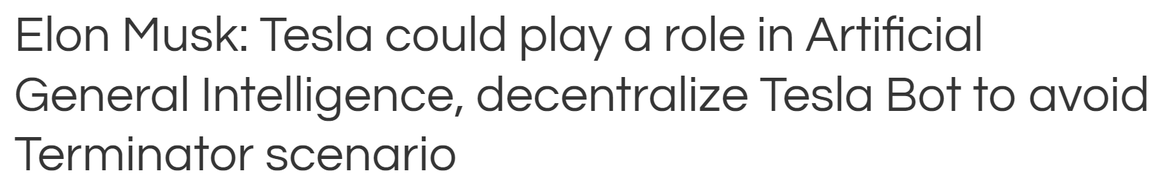
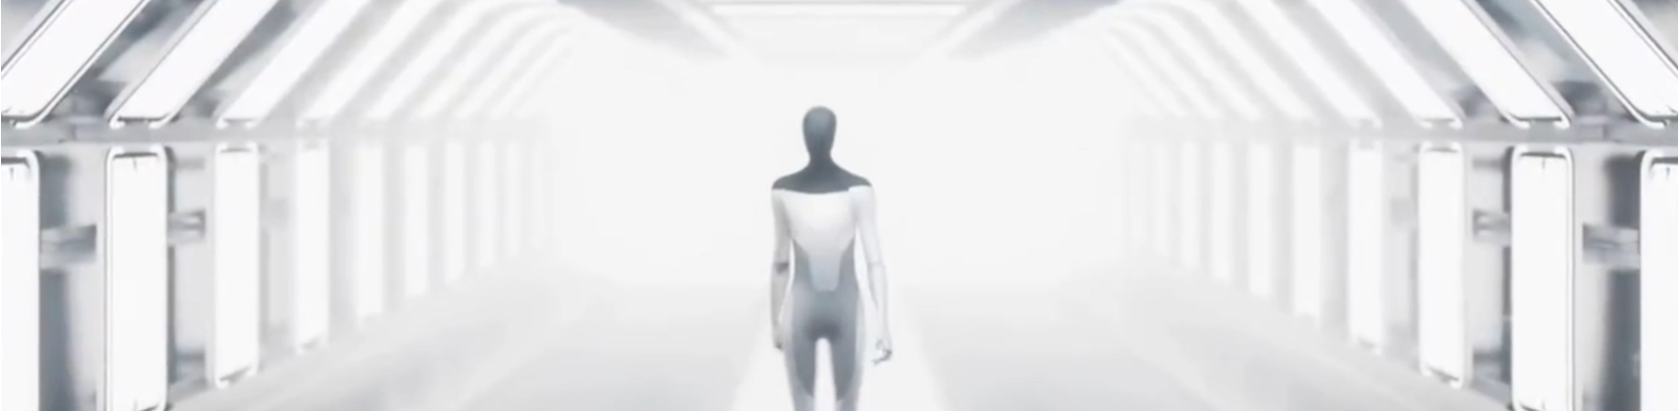
AI in the News
https://electrek.co/2022/01/19/elon-musk-tesla-artificial-general-intelligence-decentralize-tesla-bot-avoid-terminator-scenario/amp/
https://twitter.com/elonmusk/status/1483728729545363457

Slide 38
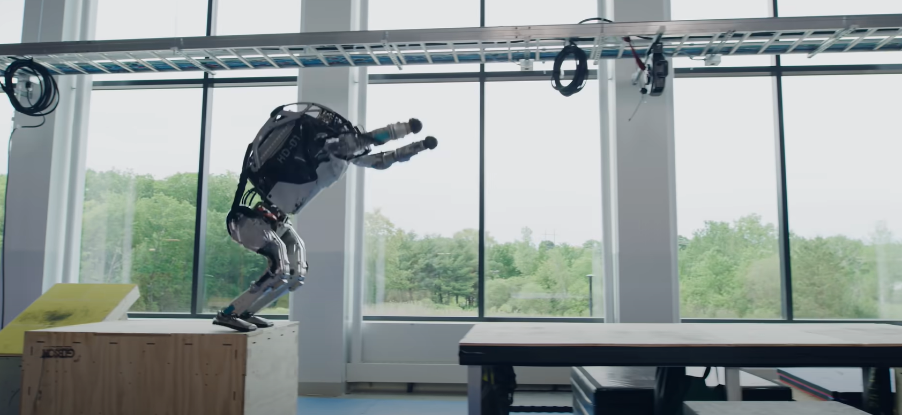
“Athletic” vs “Scholarly” AI
Boston Dynamics Founder and Chairman Marc Raibert
https://venturebeat.com/2019/11/12/boston-dynamics-ceo-on-the-companys-top-3-robots-ai-and-viral-videos/
https://www.youtube.com/watch?v=tF4DML7FIWk

Slide 39
“Athletic” vs “Scholarly” AI
Boston Dynamics Founder and Chairman Marc Raibert
“Athletic AI”
[Being] smart about controlling our bodies,
managing the energy use of our bodies,
receiving the world that’s right around us
and maneuvering in real time with respect to either obstacles or competitors
“Scholarly AI”
Make plans and then you execute on the plans. That’s the bulk of AI now — working at a high level where you’ve abstracted the world. You’re not interacting in real time with the physical world, you’ve abstracted the world
https://venturebeat.com/2019/11/12/boston-dynamics-ceo-on-the-companys-top-3-robots-ai-and-viral-videos/

Slide 40
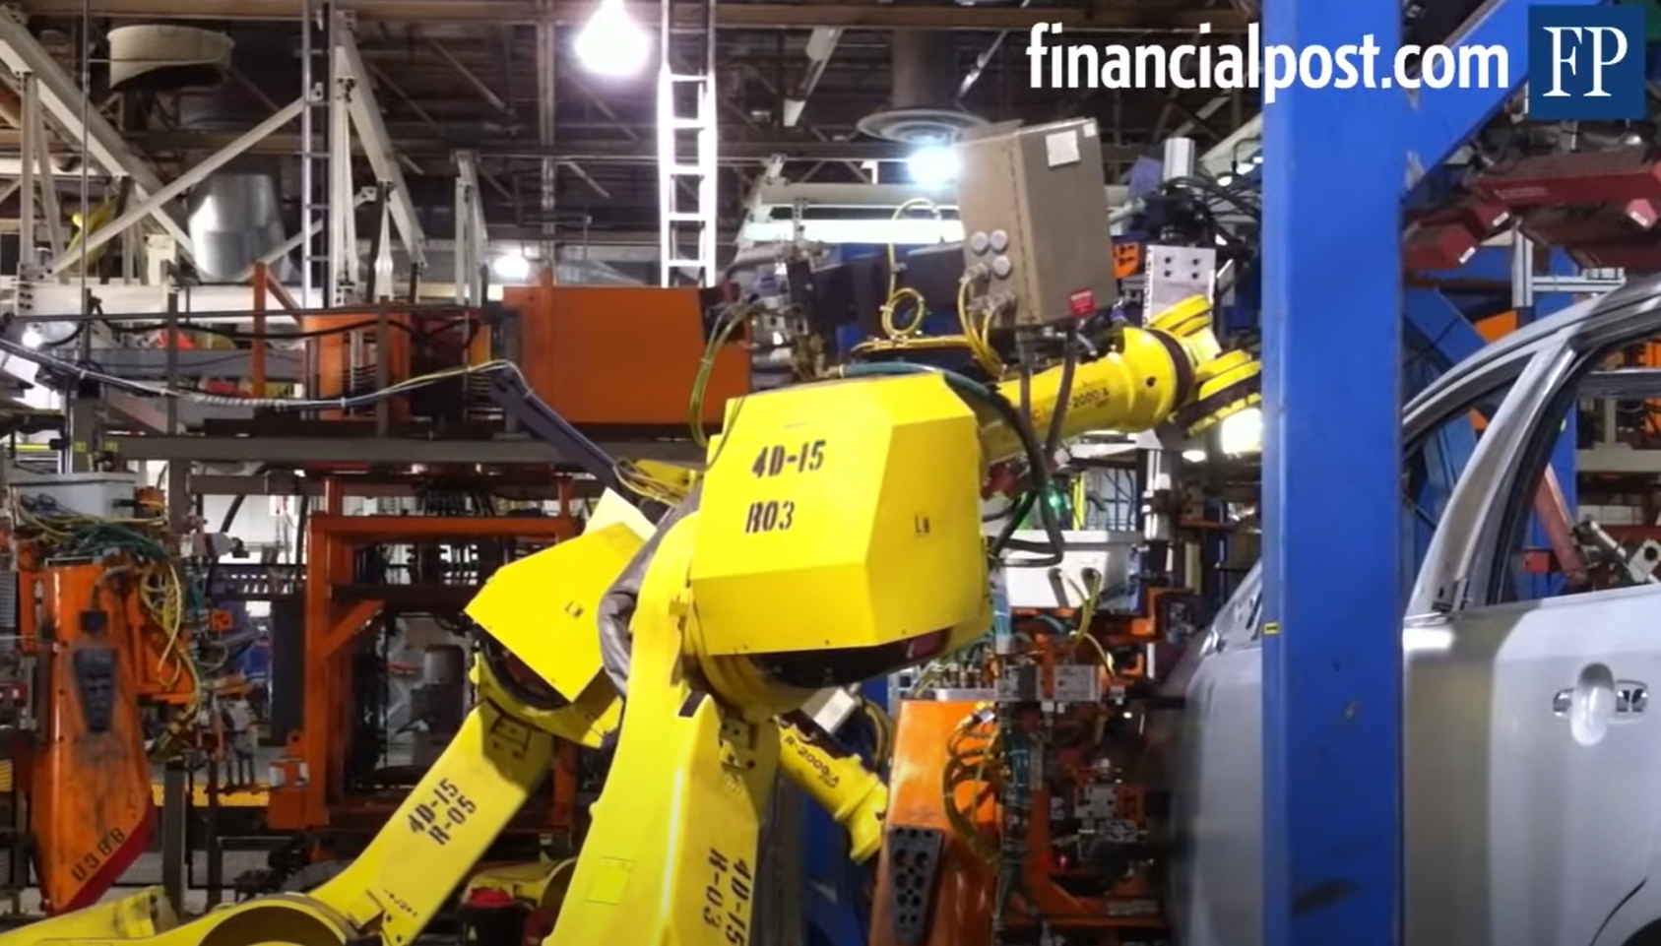
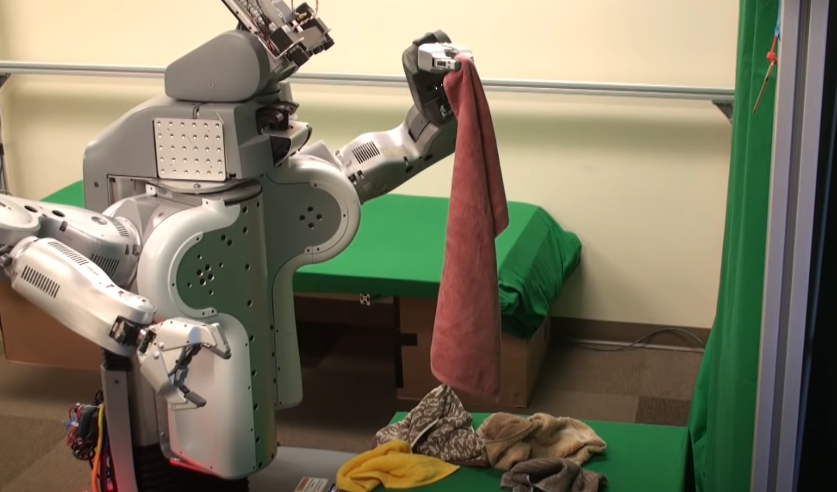
Intelligence and Uncertainty
Uncertainty in “athletic AI”
Robot that assemble cars in factory
Robot that fold clothes
https://www.youtube.com/watch?v=pxLpsSkEtuY
https://www.youtube.com/watch?v=gy5g33S0Gzo

Slide 41
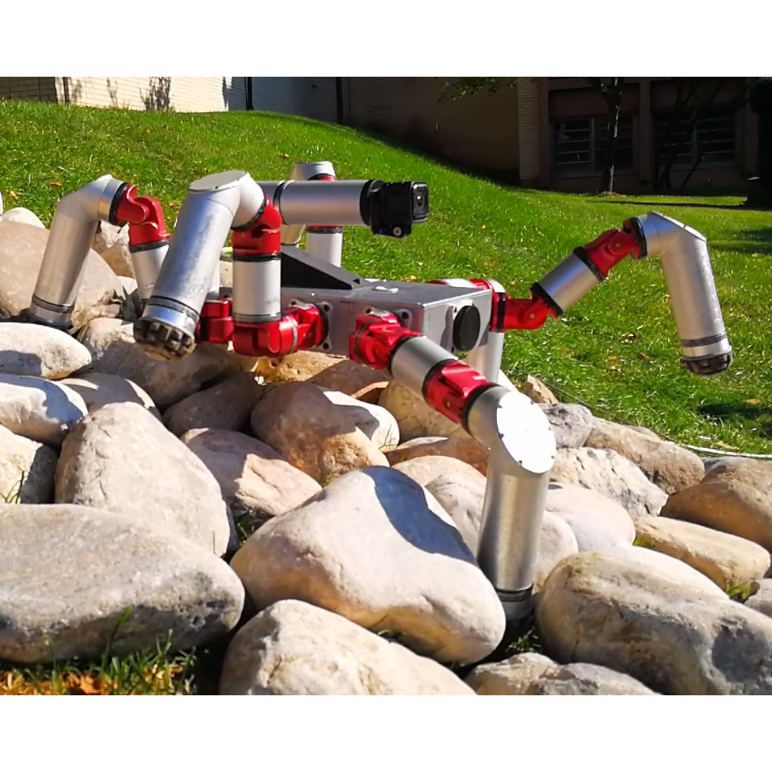
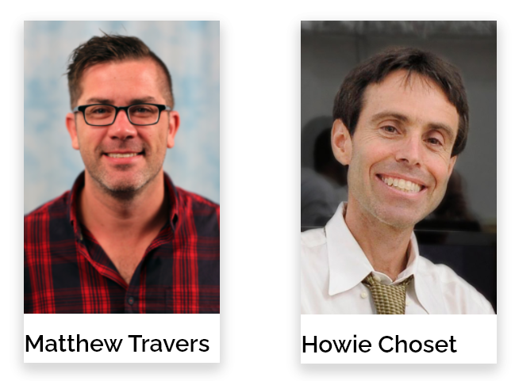
CMU Spotlight
CMU Biorobotics Laboratory
http://biorobotics.ri.cmu.edu/

Slide 42
Intelligence
In this course we’ll focus on
Rational agents
Agents that choose actions that maximize their expected performance measure
Weak AI (rather than AGI)
“Scholarly” AI (rather than “athletic” AI)

Slide 43
Plan
Course Info (part 1)
Candy Grab
Discussion on Intelligence
AI focus in this course
Weak AI
“Scholarly” AI
Agents that act rationally
Course Info (part 2)
Images: ai.berkeley.edu

Slide 44




Course Information
Website: https://www.cs.cmu.edu/~15181
Canvas: canvas.cmu.edu
Gradescope: gradescope.com
Communication:
piazza.com
E-mail (only if piazza doesn’t work):
pvirtue@andrew.cmu.edu

Slide 45
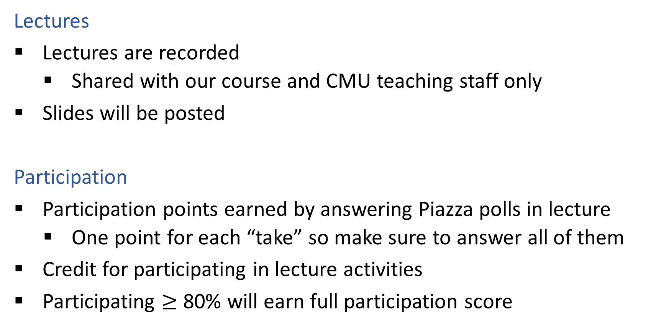
Course Information
Lectures
Lectures are recorded
Shared with our course and CMU teaching staff only
Slides will be posted
Participation
Participation points earned by answering Piazza polls in lecture
One point for each “take” so make sure to answer all of them
Credit for participating in lecture activities
Participating $≥$ 80% will earn full participation score

Slide 46
Course Information
Assignments
Online homeworks
Quick exercises to help practice topics
Online in Gradescope
Projects
Hand-on experience with AI
Python
Data
Report

Slide 47
Course Information
Quizzes
Quizzes will in lecture, announced two days ahead of time
Final exam
Schedule TBD

Slide 48
Course Information
Office Hours
OH calendar on course website
OH-by-appointment requests are certainly welcome
Mental Health
Don’t struggle alone
Find at least one person and let them know how you’re feeling
Friend, family, roommate, advisor
https://www.cmu.edu/student-affairs/resources/index.html#liaisons
CMU CaPS https://www.cmu.edu/counseling/
And, of course, you can always talk to me

