Slide 1

Demystifying AI
Feature Learning
Instructor: Pat Virtue

Slide 2
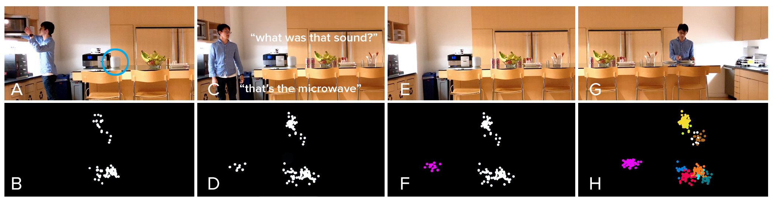
Listen Learner
Chris Harrison, CMU
https://chrisharrison.net/index.php/Research/ListenLearner

Slide 3
Games to warm up
https://www.sporcle.com/games/MrChewypoo/minimalist_disney
https://www.sporcle.com/games/Stanford0008/minimalist-cartoons-slideshow
https://www.sporcle.com/games/MrChewypoo/minimalist

Slide 4


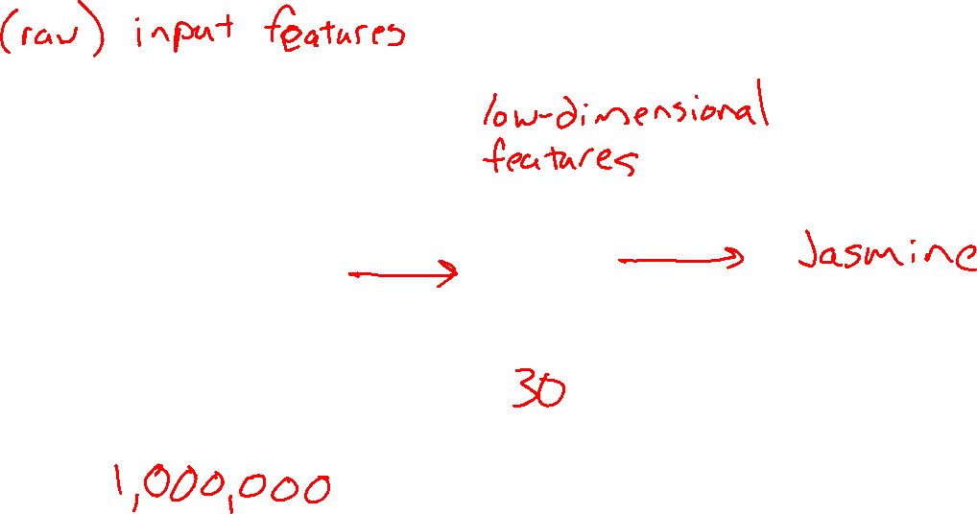
Dimensionality Reduction

Slide 5
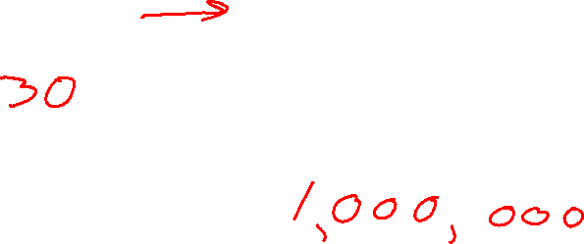
Dimensionality Reduction

Slide 6

Dimensionality Reduction

Slide 7
Dimensionality Reduction
https://cs.stanford.edu/people/karpathy/convnetjs/demo/autoencoder.html

Slide 8




Exercise: Human-defined Feature Space
Step1: Write a bunch of digits 0-9 on post-it notes

Slide 9
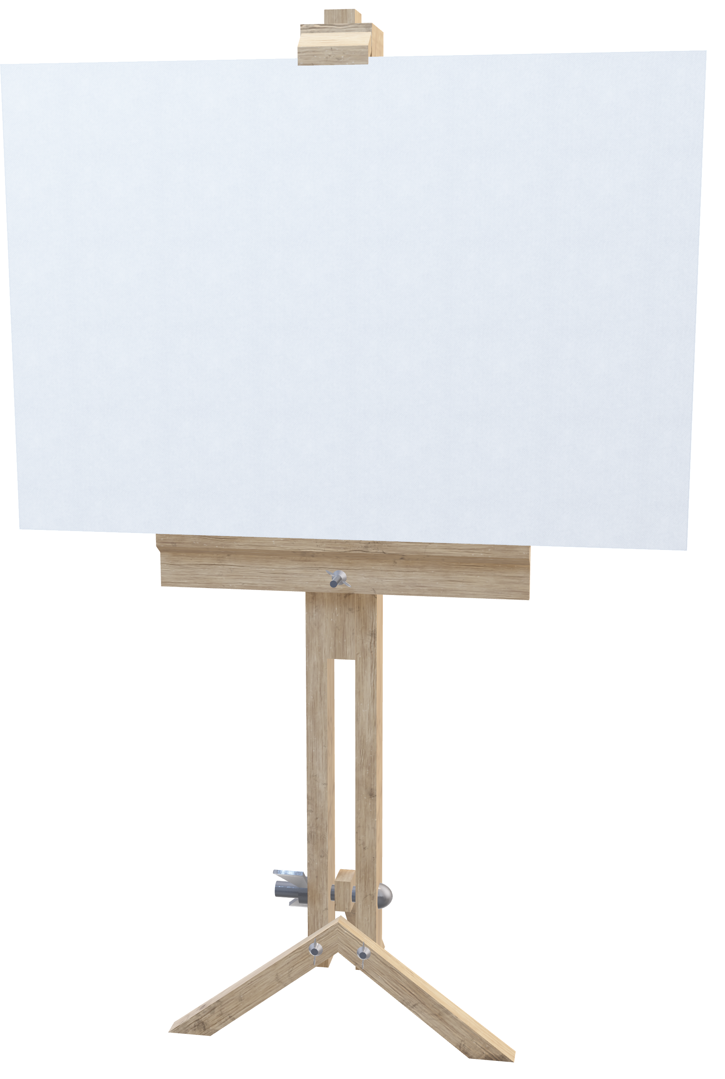
Exercise: Human-defined Feature Space
Step2: In groups, students try to organize digits on a 2-D coordinate plot
Optional: label the extreme ends of both coordinate axes

Slide 10
Exercise: Human-defined Feature Space
Step2: In groups, try to organize digits on a 2-D coordinate plot
Optional: label the extreme ends of both coordinate axes

Slide 11
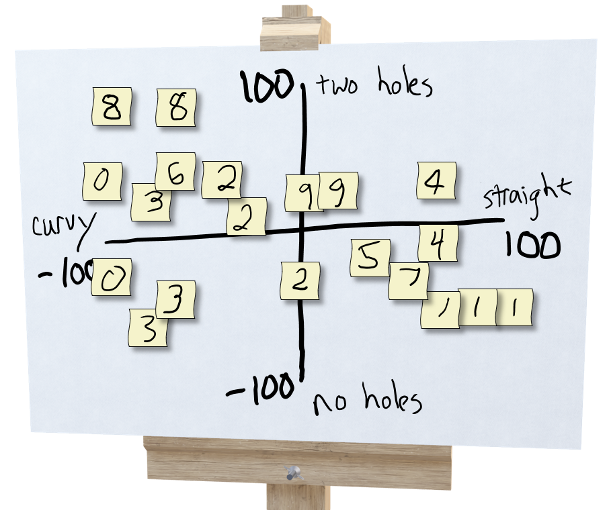
Exercise: Human-defined Feature Space
Step 3: Prediction!
Select three students: A,B,C
Student A draws a new digit and hands it to student B
Student B thinks about where to plot it and comes up with a 2-D coordinate, (x, y)
Student C looks at the coordinate and the plot (but not the drawing from A) and predicts the digit, 0-9

Slide 12
Exercise: Human-defined Feature Space
Step 4: Creation!
Select three students: A,B,C
Student A draws a new digit and hands it to student B
Student B thinks about where to plot it and comes up with a 2-D coordinate, (x, y)
Student C looks at the coordinate and the plot (but not the drawing from A) and draws a new digit

Slide 13
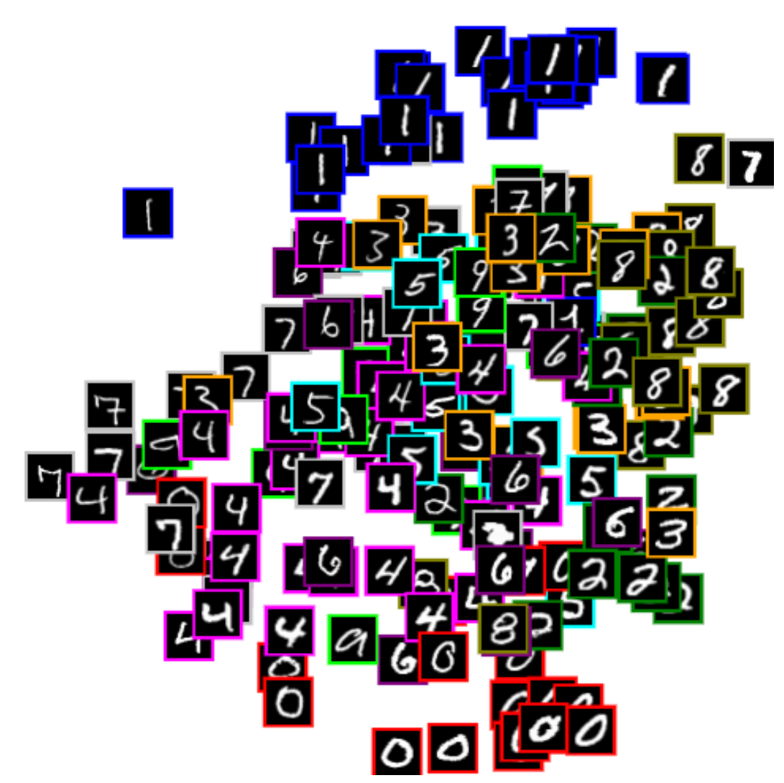





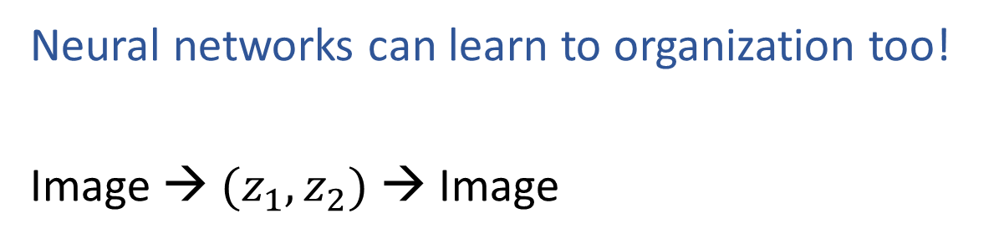


Learning to Organize Data
Neural networks can learn to organization too!
Image → $(z_{1},z_{2})$ → Image
$$z_{2}$$
Net
Net
$(z_{1},z_{2})$
Net
Net
$$(z_{1},z_{2})$$
$$z_{1}$$
https://cs.stanford.edu/people/karpathy/convnetjs/demo/autoencoder.html

Slide 14
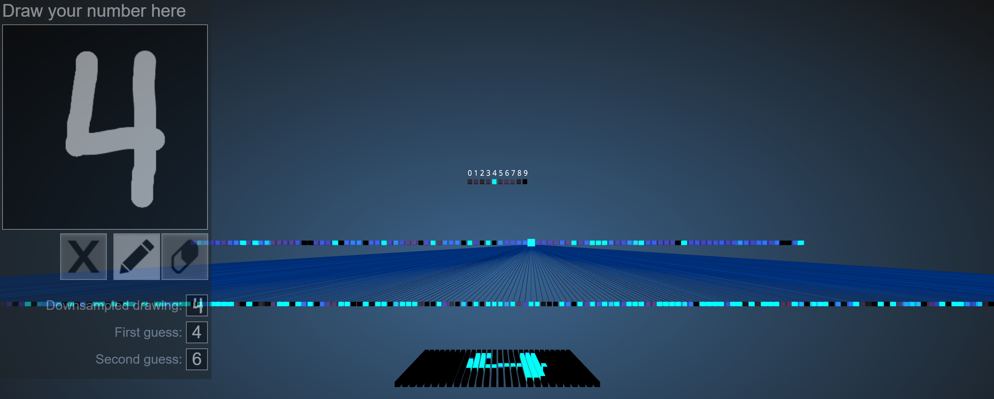

Reminder: Image Classification
Demo of (Fully-connected) neural network to classify images of hand-written digits
https://www.cs.ryerson.ca/~aharley/vis/fc/

Slide 15
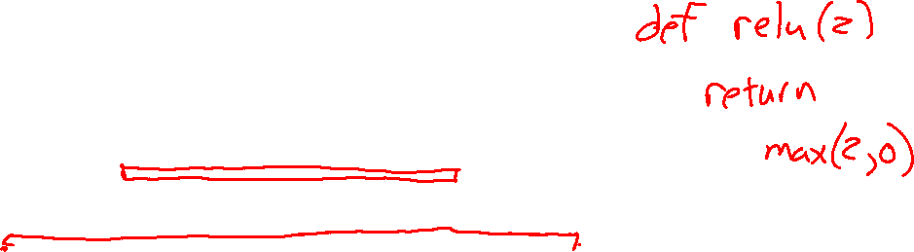
Reminder: Image Classification
Demo of (Fully-connected) neural network to classify images of hand-written digits
https://www.cs.ryerson.ca/~aharley/vis/fc/
Digit network
Output layer
10 neurons
Hidden layer 2
100 neurons
Hidden layer 1
300 neurons
Input
784 pixels

Slide 16
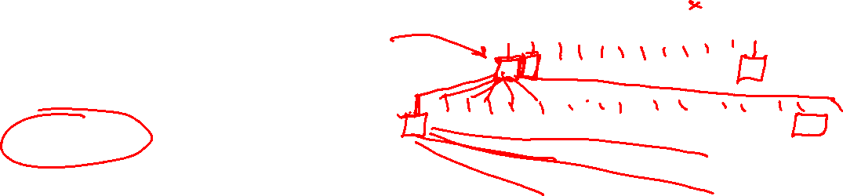
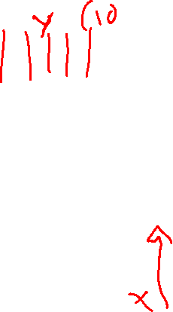
Poll 1
When we pass a single image through this network how many times does ReLU(z) get called (assume ReLU(z) can only take a single number not many)?
1
10
100
300
400
30,000
https://www.cs.ryerson.ca/~aharley/vis/fc/
Digit network
Output layer
10 neurons
Hidden layer 2
100 neurons
Hidden layer 1
300 neurons
Input
784 pixels

Slide 17

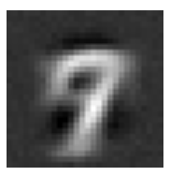
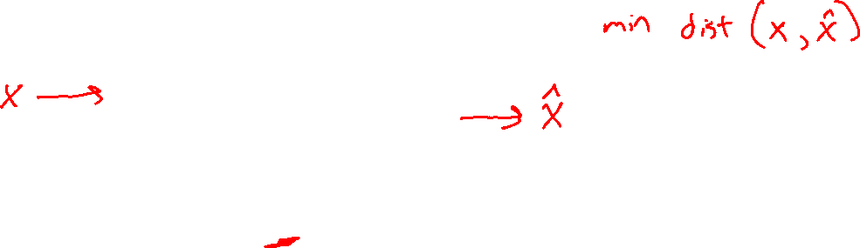
Digit Autoencoder
https://cs.stanford.edu/people/karpathy/convnetjs/demo/autoencoder.html
Layer 1
Layer 2
Layer 4
Layer 5
Layer 6
Input
28x28 = 784 pixels
Layer 3
50 neurons
50 neurons
784 neurons
50 neurons
50 neurons
2 neurons
Autoencoder network

Slide 18
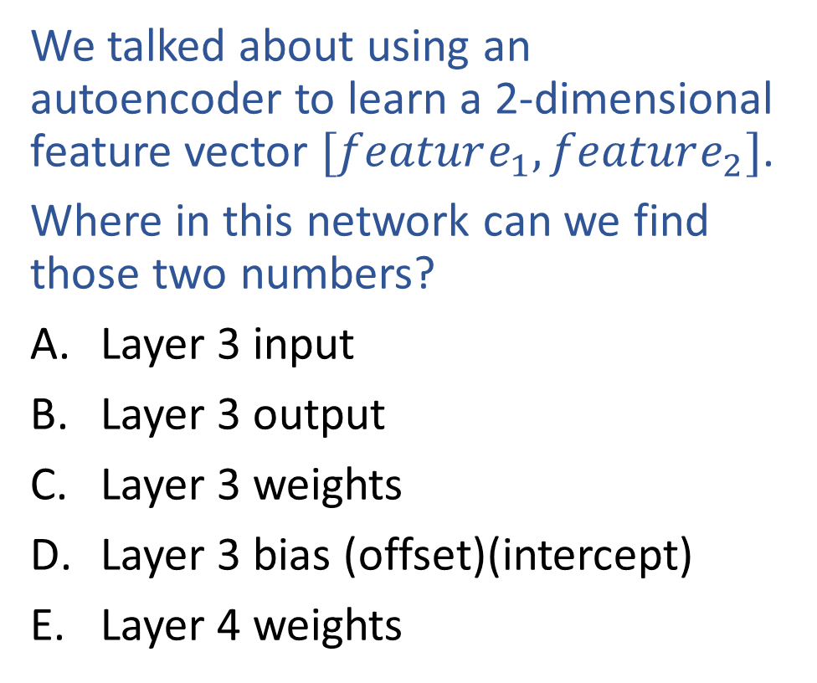

Poll 2
We talked about using an autoencoder to learn a 2-dimensional feature vector $[feature_{1}, feature_{2}]$.
Where in this network can we find those two numbers?
Layer 3 input
Layer 3 output
Layer 3 weights
Layer 3 bias (offset)(intercept)
Layer 4 weights
Layer 1
Layer 2
Layer 4
Layer 5
Layer 6
Layer 3
50 neurons
50 neurons
784 neurons
50 neurons
50 neurons
2 neurons
Autoencoder network

Slide 19
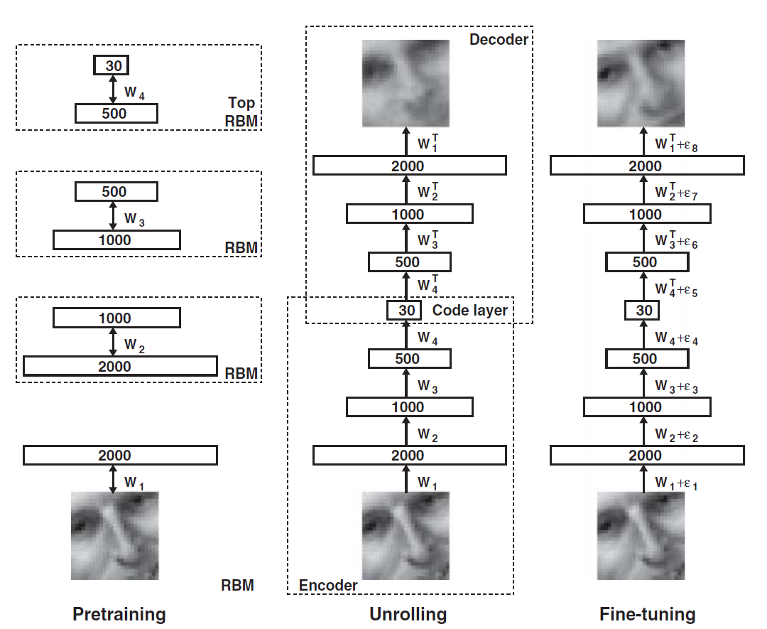
Dimensionality Reduction with Deep Learning
Hinton, Geoffrey E., and Ruslan R. Salakhutdinov.
"Reducing the dimensionality of data with neural networks.”
Science 313.5786 (2006): 504-507.

Slide 20
Listen Learner
https://chrisharrison.net/index.php/Research/ListenLearner

Slide 21
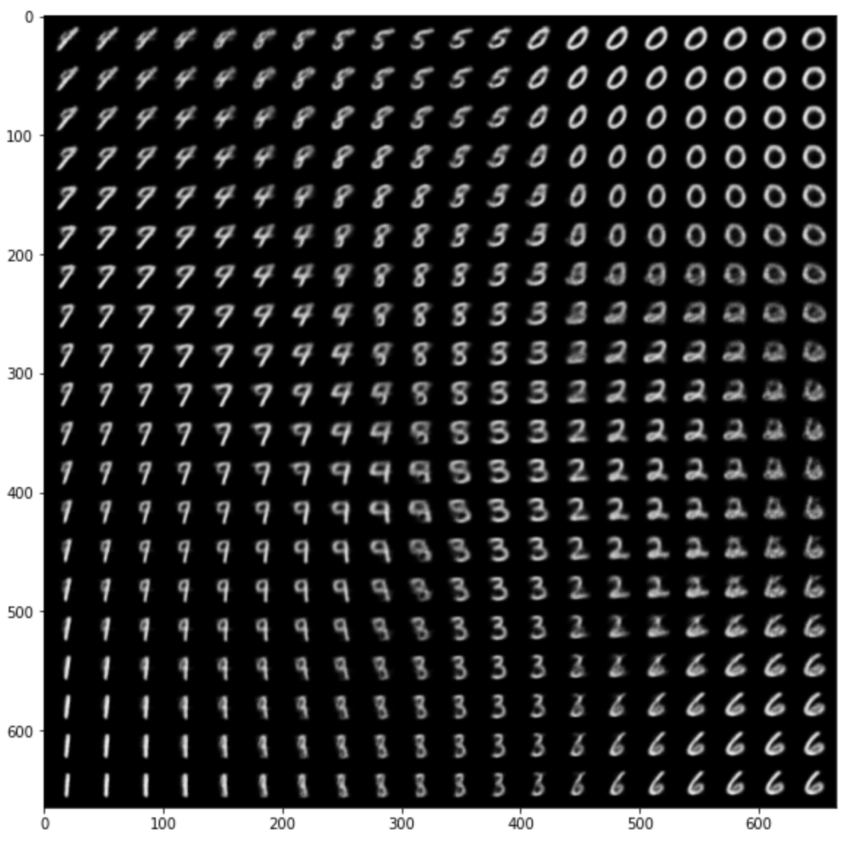
Autoencoder Demo
Zhuoyue Lyu, Safinah Ali, and Cynthia Breazeal. EAAI 2022.
https://colab.research.google.com/gist/ZhuoyueLyu/5046225a9ae3675cf633c1df5f63be06/digits-interpolation-notebook-eaai.ipynb

Slide 22
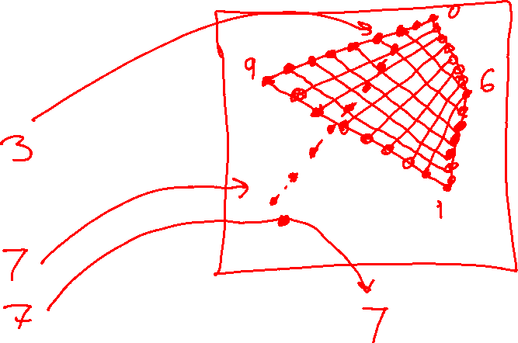

Autoencoder Demo
Feature space interpolation

Slide 23
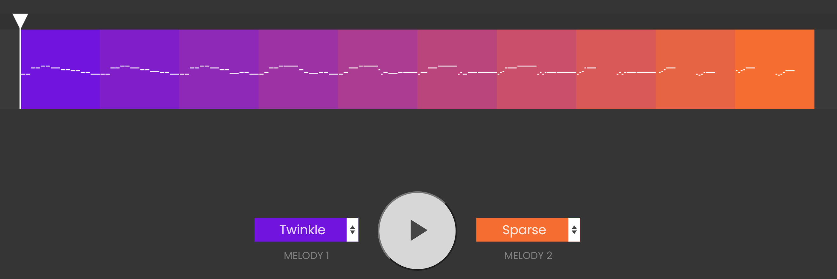
Exploring Feature Space
https://experiments.withgoogle.com/ai/melody-mixer/view/

Slide 24

Exploring Feature Space
https://experiments.withgoogle.com/ai/beat-blender/view/

