Slide 1

Demystifying AI Neural Network Structure
Instructor: Pat Virtue

Slide 2
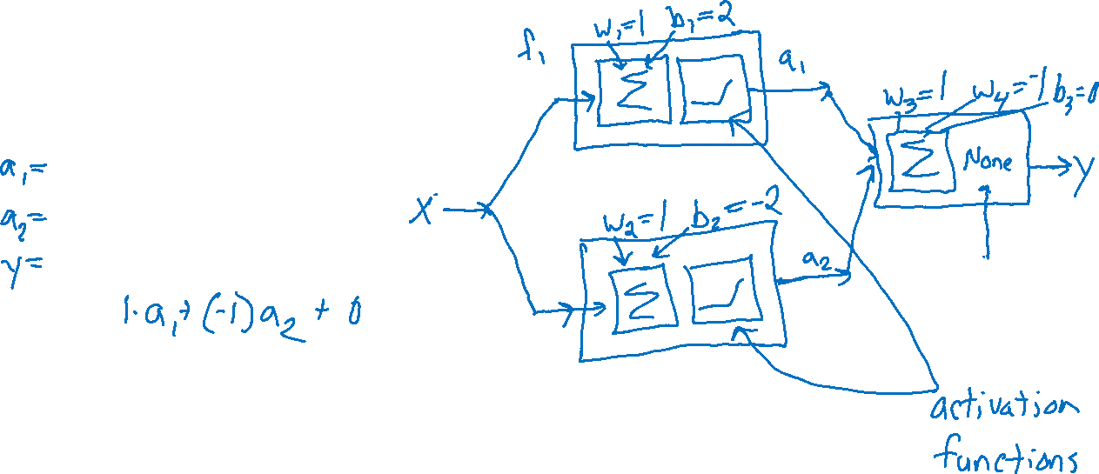
Three-neuron network
Connecting functions
Plot the function f₃(x) vs x
f₁(x) = max(0, 1x + 2)
f₂(x) = max(0, 1x - 2)
f₃(x) = f₁(x) - f₂(x)

Slide 3




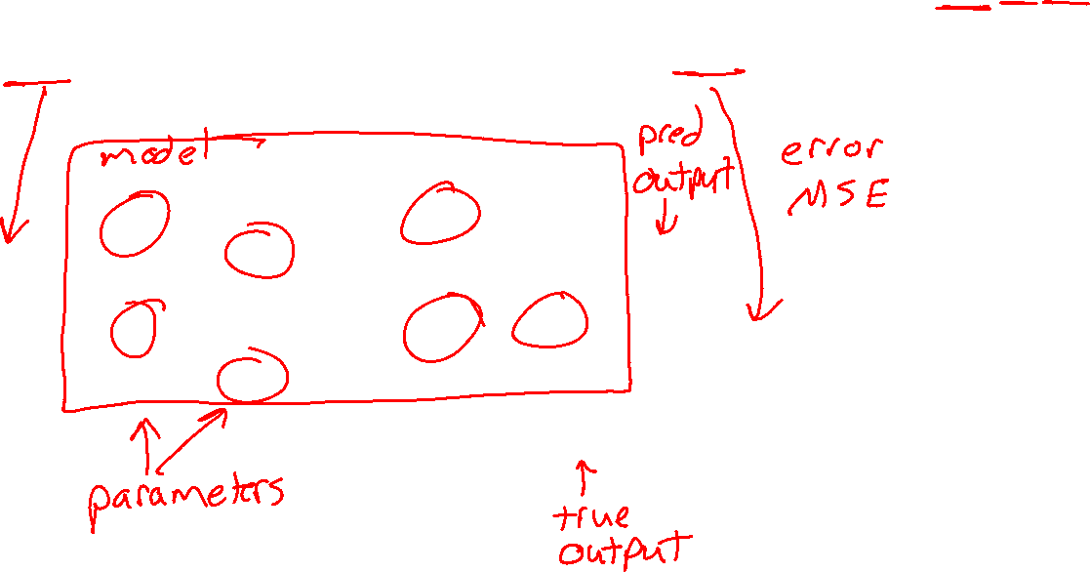














Neural Network Architecture
Our weight naming convention:
$$wlayer input output$$
Input, Neurons, Layers, Activation Functions, Loss
$$z11$$
$$w111$$
$$∑$$
$$g$$
$$w211$$
$$b11$$
$$ypred$$
$$x1$$
$$∑$$
$$g$$
$$w112$$
$$z12$$
$$b21$$
$$∑$$
$$g$$
$$w221$$
$$b12$$
$$Loss$$
$$ymeas$$

Slide 4
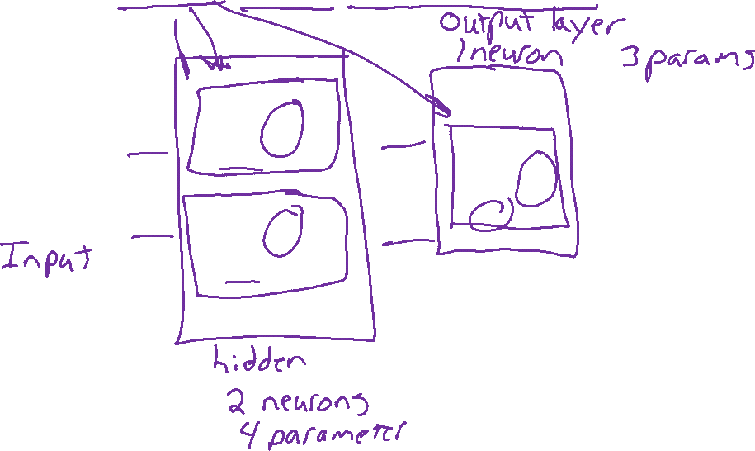
Neural Network Architecture
Our weight naming convention:
$$wlayer input output$$
Input, Neurons, Layers, Activation Functions, Loss
$$z11$$
$$w111$$
$$∑$$
$$g$$
$$w211$$
$$b11$$
$$ypred$$
$$x1$$
$$∑$$
$$g$$
$$w112$$
$$z12$$
$$b21$$
$$∑$$
$$g$$
$$w221$$
$$b12$$
$$Loss$$
$$ymeas$$

Slide 5
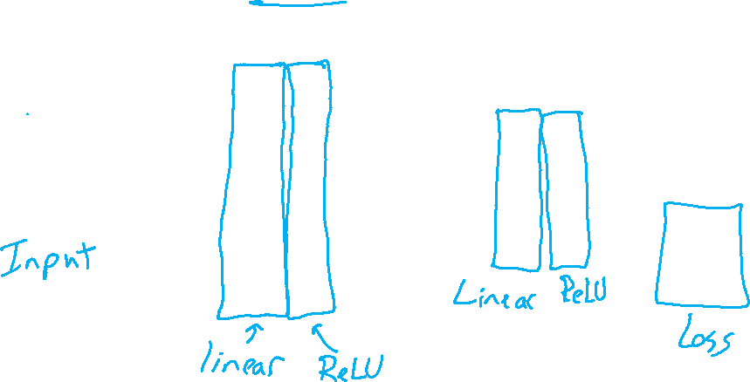
Neural Network Architecture
Our weight naming convention:
$$wlayer input output$$
Input, Neurons, Layers, Activation Functions, Loss
$$z11$$
$$w111$$
$$∑$$
$$g$$
$$w211$$
$$b11$$
$$ypred$$
$$x1$$
$$∑$$
$$g$$
$$w112$$
$$z12$$
$$b21$$
$$∑$$
$$g$$
$$w221$$
$$b12$$
$$Loss$$
$$ymeas$$

Slide 6








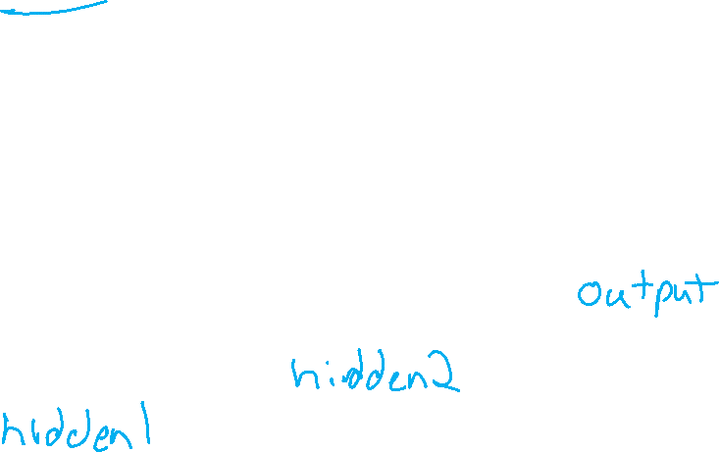






























Neural Network Architecture
Our weight naming convention:
$$wlayer input output$$
Input, Neurons, Layers, Activation Functions, Loss
$$w111$$
$$z21$$
$$x1$$
$$∑$$
$$g$$
$$w211$$
$$w112$$
$$w113$$
$$b11$$
$$w212$$
$$z31$$
$$∑$$
$$g$$
$$w311$$
$$w121$$
$$w221$$
$$z22$$
$$b21$$
$$ypred$$
$$x2$$
$$∑$$
$$g$$
$$∑$$
$$g$$
$$w123$$
$$b12$$
$$w222$$
$$b31$$
$$z32$$
$$w321$$
$$w131$$
$$w231$$
$$∑$$
$$g$$
$$b22$$
$$Loss$$
$$w132$$
$$z23$$
$$x3$$
$$∑$$
$$g$$
$$w232$$
w₁₃₃
$$b13$$
$$ymeas$$

Slide 7
Neural Network Architecture
Our weight naming convention:
$$wlayer input output$$
Input, Neurons, Layers, Activation Functions, Loss
$$w111$$
$$z21$$
$$x1$$
$$∑$$
$$g$$
$$w211$$
$$w112$$
$$w113$$
$$b11$$
$$w212$$
$$z31$$
$$∑$$
$$g$$
$$w311$$
$$w121$$
$$w221$$
$$z22$$
$$b21$$
$$ypred$$
$$x2$$
$$∑$$
$$g$$
$$∑$$
$$g$$
$$w123$$
$$b12$$
$$w222$$
$$b31$$
$$z32$$
$$w321$$
$$w131$$
$$w231$$
$$∑$$
$$g$$
$$b22$$
$$Loss$$
$$w132$$
$$z23$$
$$x3$$
$$∑$$
$$g$$
$$w232$$
w₁₃₃
$$b13$$
$$ymeas$$

Slide 8



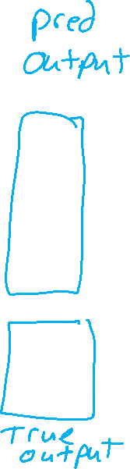












Neural Network Architecture
Our weight naming convention:
$$wlayer input output$$
Input, Neurons, Layers, Activation Functions, Loss
$$w111$$
$$z21$$
$$x1$$
$$∑$$
$$g$$
$$w211$$
$$w112$$
$$w113$$
$$b11$$
$$w212$$
$$z31$$
$$w311$$
$$y_{1,pred}$$
$$∑$$
$$g$$
$$∑$$
$$g$$
$$w121$$
$$w221$$
$$w312$$
$$z22$$
$$b21$$
$$b31$$
$$x2$$
$$∑$$
$$g$$
$$w123$$
$$b12$$
$$w222$$
$$w321$$
$$z32$$
$$y_{2,pred}$$
$$w131$$
$$w231$$
$$∑$$
$$g$$
$$∑$$
$$g$$
$$w311$$
$$w132$$
$$z23$$
$$b22$$
$$b32$$
$$x3$$
$$∑$$
$$g$$
$$w232$$
$$Loss$$
w₁₃₃
$$b13$$
$$y_{1,meas}$$
$$y_{2,meas}$$

Slide 9
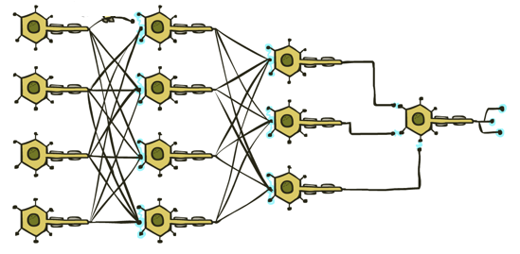


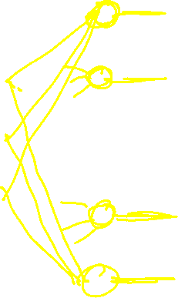
Neural Networks
Many layers of neurons, millions of parameters
Output
Signal
Input Signal
DOG
CAT
TREE
CAR
SKY

Slide 10
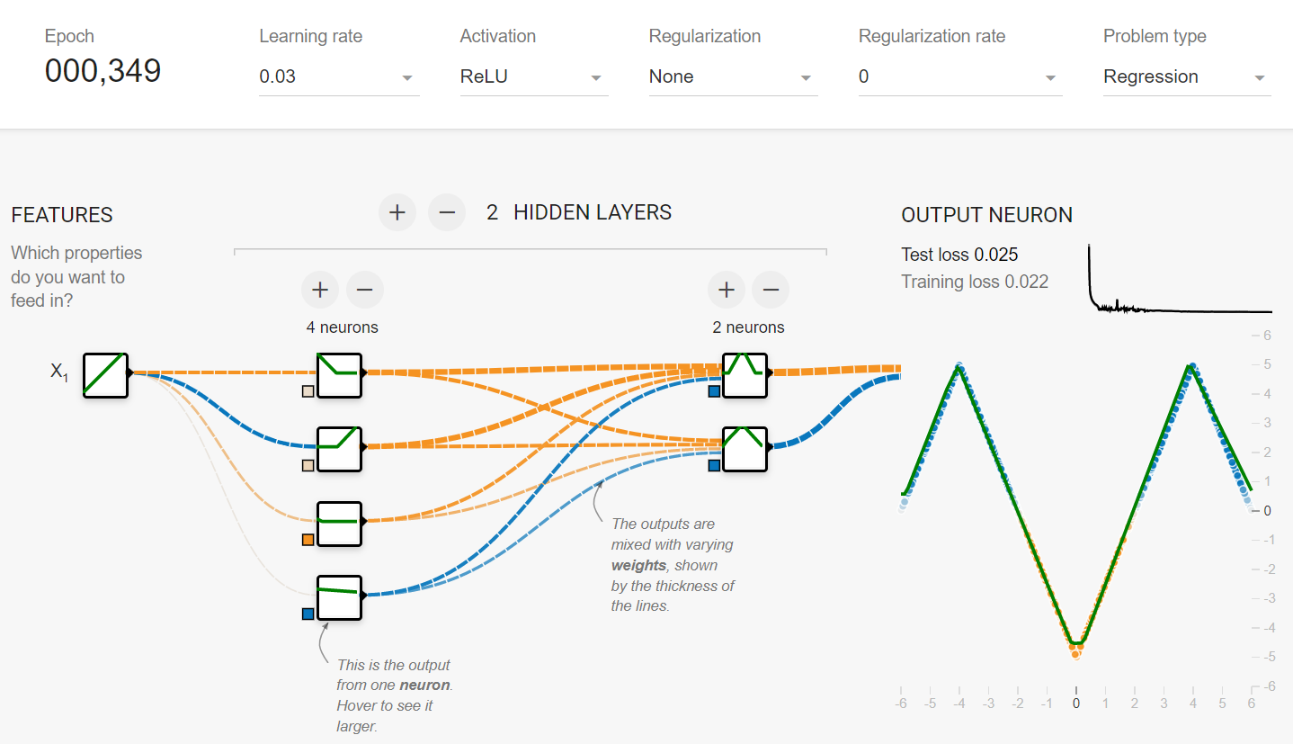
Simple Network
What do the colors of the lines represent?
Weight
Value from previous neuron
https://playground.tensorflow.org/
https://www.cs.cmu.edu/~15181/tfp

Slide 11
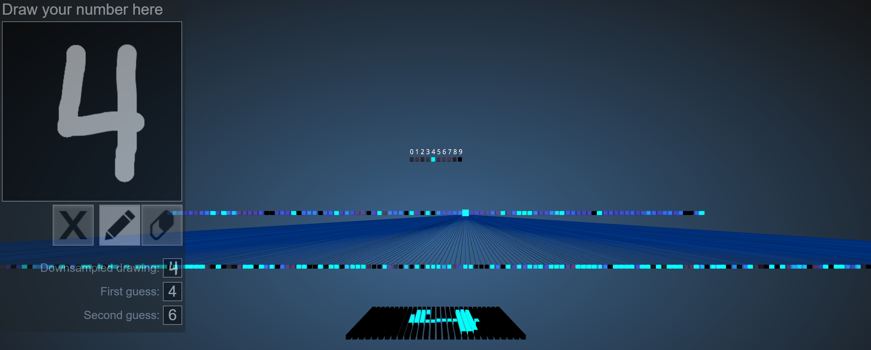
Image Classification
Demo of (Fully-connected) neural network to classify images of hand-written digits
https://www.cs.ryerson.ca/~aharley/vis/fc/

Slide 12
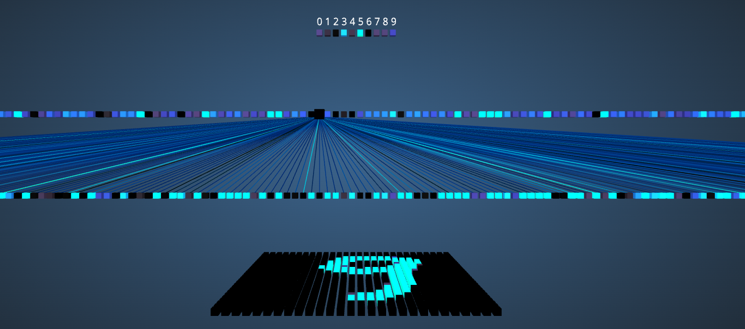

Poll 2
What do the colors of the lines represent?
Weight
Value from previous neuron
https://www.cs.ryerson.ca/~aharley/vis/fc/

Slide 13
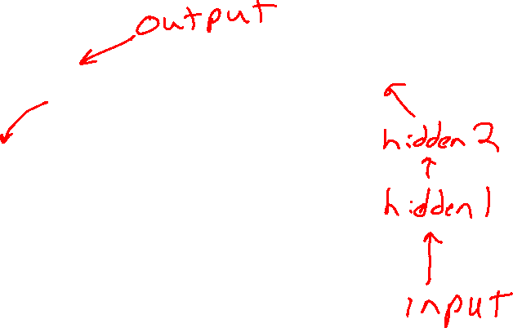
Poll 3
What do the colors of the neuron squares represent?
Weight
Output value of the neuron
Input value of the neuron
https://www.cs.ryerson.ca/~aharley/vis/fc/

Slide 14
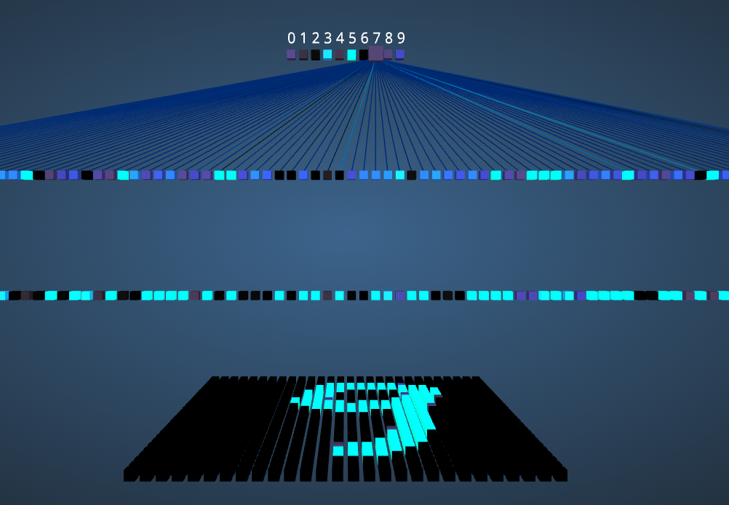
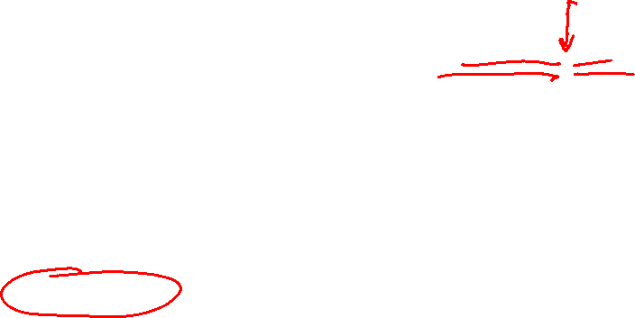
Poll 4
How many parameters does one neuron in the output hidden layer have?
1
2
10
11
100
101
https://www.cs.ryerson.ca/~aharley/vis/fc/

Slide 15
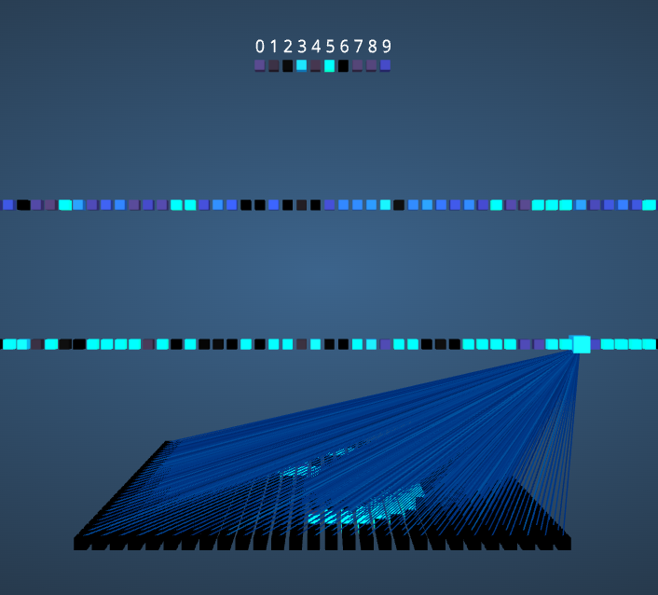
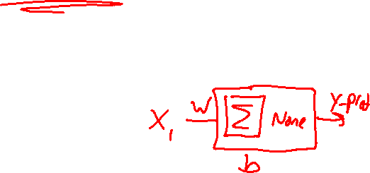
Poll 5
How many parameters does one neuron in the first hidden layer have?
1
2
300
301
784
785
https://www.cs.ryerson.ca/~aharley/vis/fc/

