Slide 1

Demystifying AI
Neural Network Optimization
Instructor: Pat Virtue

Slide 2
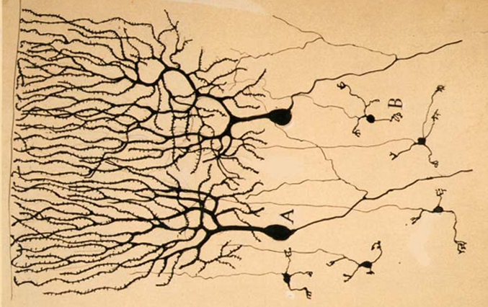

Neural Networks
Inspired by actual human brain
Output
Signal
Input Signal
DOG
CAT
TREE
CAR
SKY
Image: https://en.wikipedia.org/wiki/Neuron

Slide 3
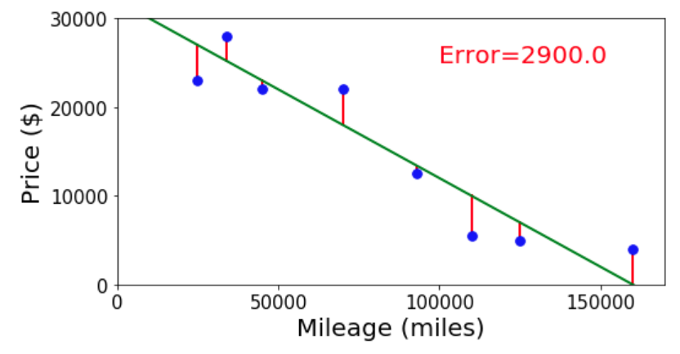

Neural Networks
Simple single neuron example:
Selling my car

Slide 4
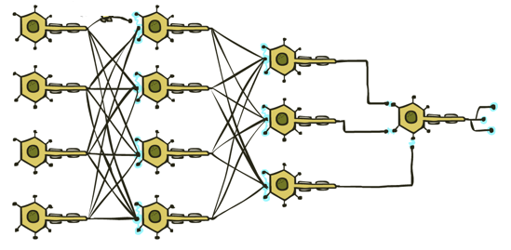

Neural Networks
Many layers of neurons, millions of parameters
Output
Signal
Input Signal
DOG
CAT
TREE
CAR
SKY

Slide 5
Neural Networks
Many layers of neurons, millions of parameters
Output
Signal
Input Signal
DOG
CAT
TREE
CAR
SKY

Slide 6

Neural Networks
Many layers of neurons, millions of parameters
Output
Signal
Input Signal
LEFT
RIGHT
UP
DOWN
BUTTON

Slide 7
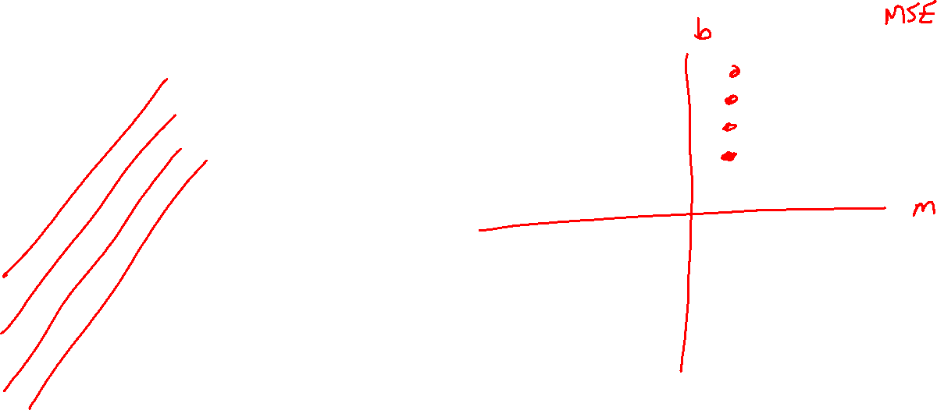
Reminder: Training: Finding the Best Parameters
Searching for parameters that minimize mean squared error
y
x

Slide 8
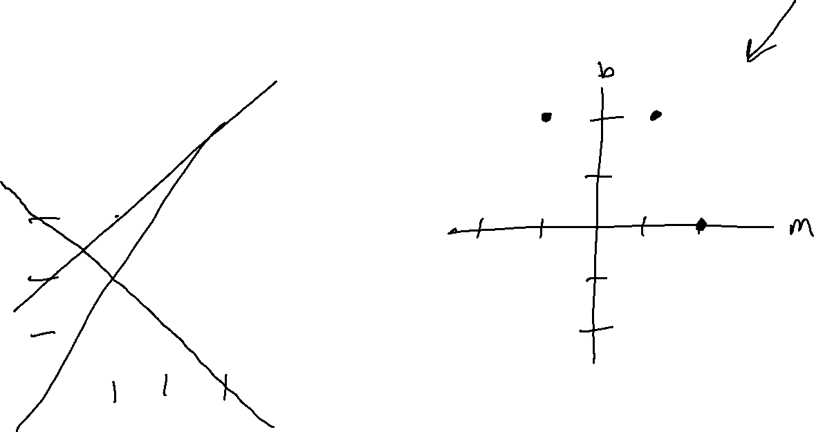
Reminder: Training: Finding the Best Parameters
Searching for parameters that minimize mean squared error
y
x

Slide 9
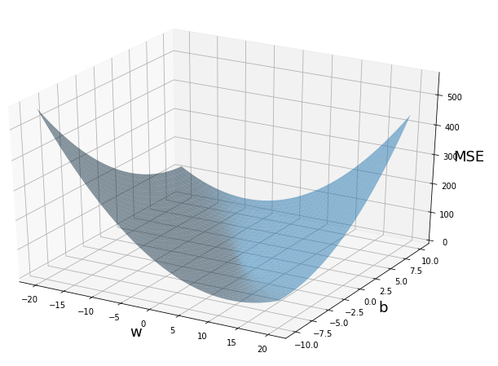
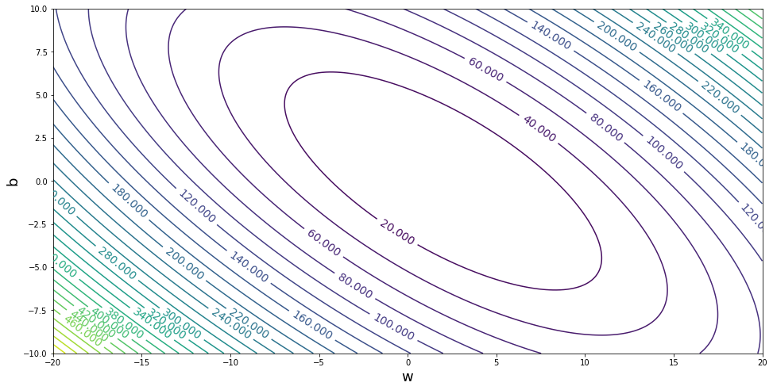



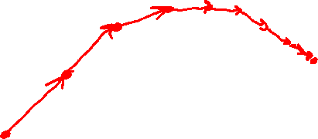

Reminder: Linear Regression
Gradient descent
$$b$$
$$m$$
$$b$$
$$m$$

Slide 10

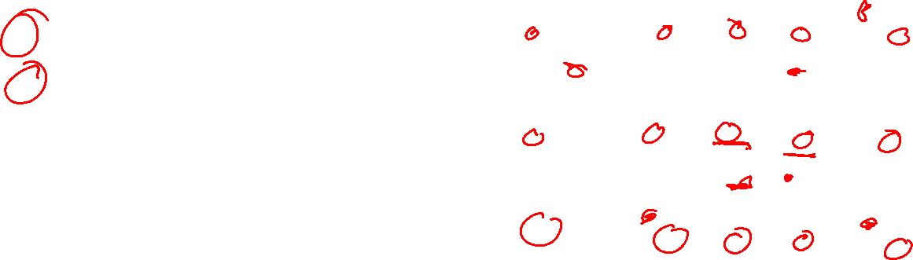

Reminder: Linear Regression
Methods for optimizing the objective
Grid search
Random search
(Solve for the minimum of this paraboloid)
Gradient descent
Performance measure:
Mean Squared Error
$$b$$
$$m$$

Slide 11
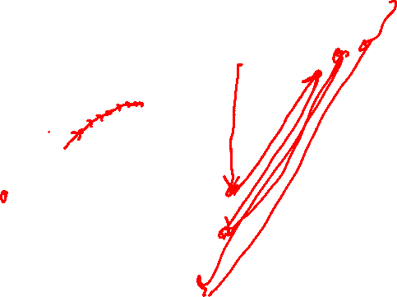
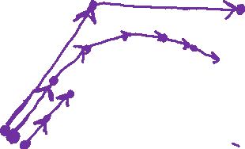

Reminder: Linear Regression
Methods for optimizing the objective
Grid search
Random search
(Solve for the minimum of this paraboloid)
Gradient descent
    Low learning rate
    Med learning rate
    High learning rate
Performance measure:
Mean Squared Error
$$b$$
$$m$$

Slide 12
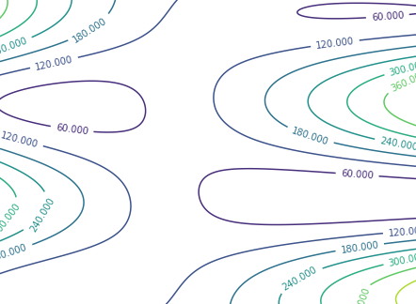
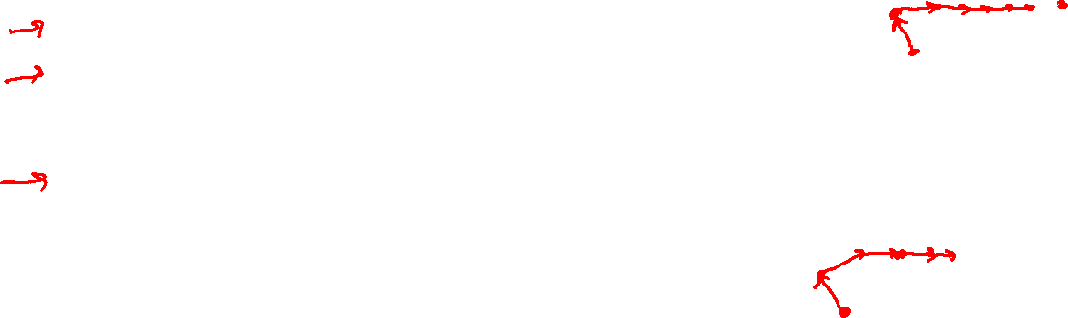

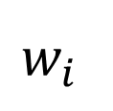

Neural Network Optimization
Methods for minimizing the mean squared error for a neural network
Grid search
Random search
☹ Can’t solve for the minimum
Gradient descent
    Can get stuck
    Different starting points can lead to different results
$$MSE$$
$$w_{j}$$
$$w_{i}$$

Slide 13
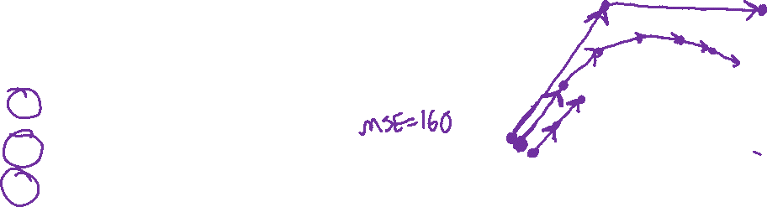

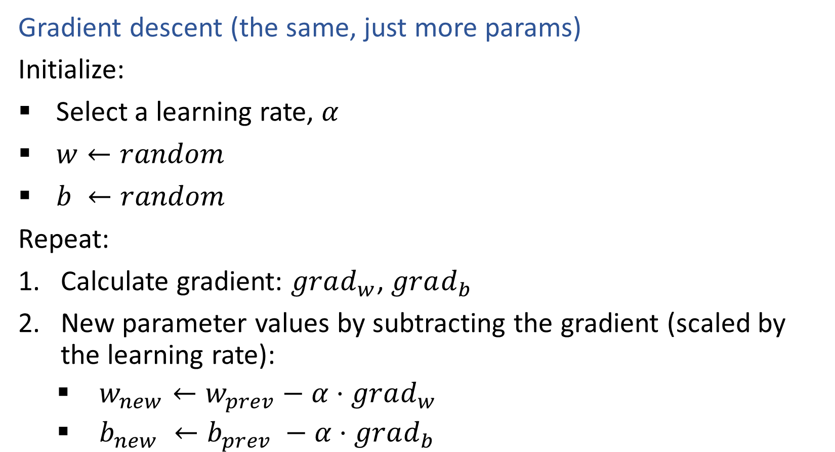



Neural Network Optimization
$$MSE$$
Gradient descent (the same, just more params)
Initialize:
Select a learning rate, $α$
$w←random$
$b ←random$
Repeat:
Calculate gradient: $grad_{w}$, $grad_{b}$
New parameter values by subtracting the gradient (scaled by the learning rate):
    $w_{new}←w_{prev}−α⋅grad_{w}$
    $b_{new} ←b_{prev} −α⋅grad_{b}$
$$b$$
$$w$$

