Slide 1

Demystifying AI Neural Network Optimization
Instructor: Pat Virtue

Slide 2
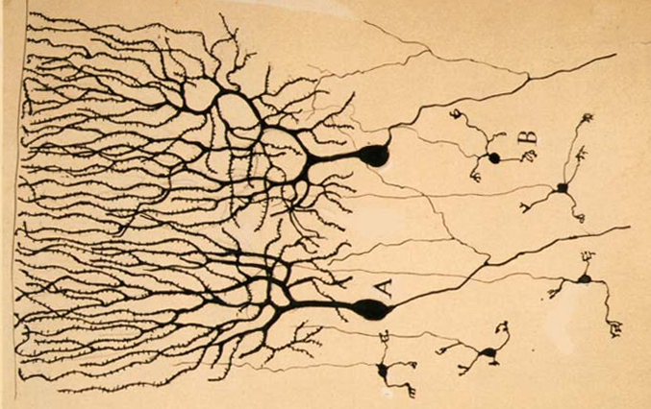

Neural Networks
Inspired by actual human brain
Output
Signal
Input Signal
DOG
CAT
TREE
CAR
SKY
Image: https://en.wikipedia.org/wiki/Neuron

Slide 3
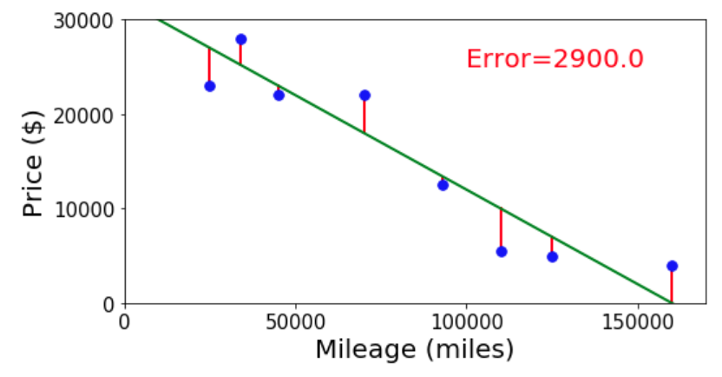
Neural Networks
Simple single neuron example:
Selling my car

Slide 4
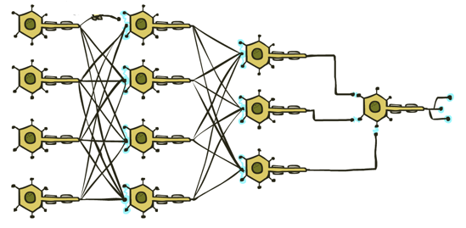

Neural Networks
Many layers of neurons, millions of parameters
Output
Signal
Input Signal
DOG
CAT
TREE
CAR
SKY

Slide 5
Neural Networks
Many layers of neurons, millions of parameters
Output
Signal
Input Signal
DOG
CAT
TREE
CAR
SKY

Slide 6

Neural Networks
Many layers of neurons, millions of parameters
Output
Signal
Input Signal
LEFT
RIGHT
UP
DOWN
BUTTON

Slide 7
Reminder: Training: Finding the Best Parameters
Searching for parameters that minimize mean squared error
y
x

Slide 8
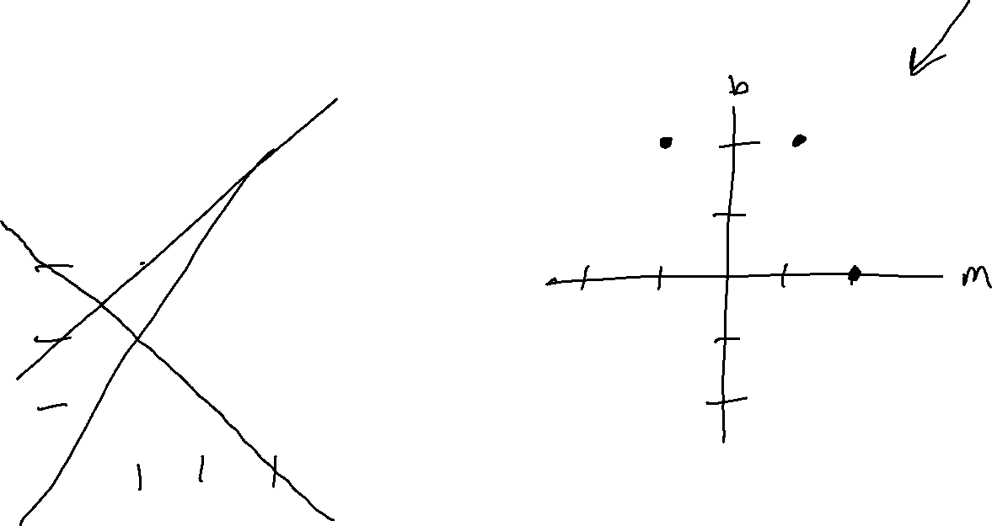
Reminder: Training: Finding the Best Parameters
Searching for parameters that minimize mean squared error
y
x

Slide 9
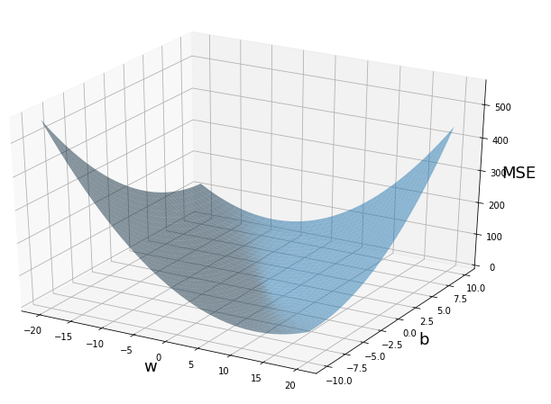
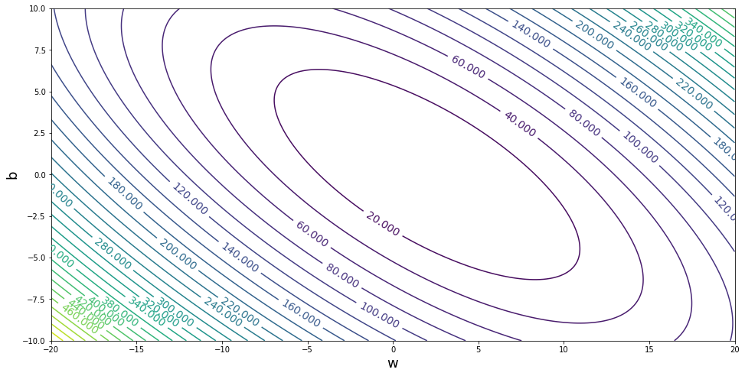



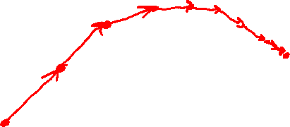

Reminder: Linear Regression
Gradient descent
$$b$$
$$m$$
$$b$$
$$m$$

Slide 10


Reminder: Linear Regression
Methods for optimizing the objective
Grid search
Random search
(Solve for the minimum of this paraboloid)
Gradient descent
Performance measure:
Mean Squared Error
$$b$$
$$m$$

Slide 11
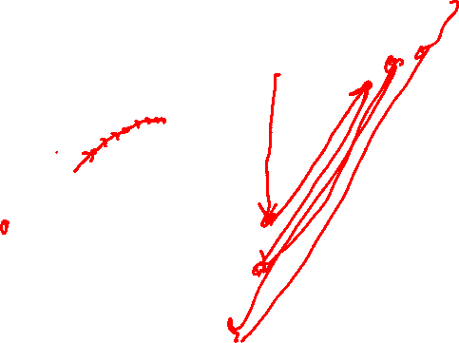
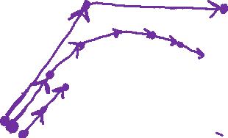
Reminder: Linear Regression
Methods for optimizing the objective
Grid search
Random search
(Solve for the minimum of this parabaloid)
Gradient descent
Low learning rate
Med learning rate
High learning rate
Performance measure:
Mean Squared Error
$$b$$
$$m$$

Slide 12
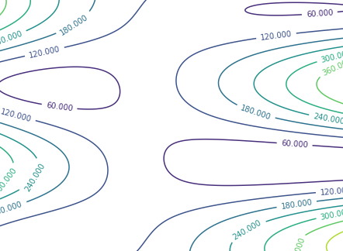

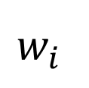

Neural Network Optimization
Methods for minimizing the mean squared error for a neural network
Grid search
Random search
☹ Can’t solve for the minimum
Gradient descent
Can get stuck
Different starting points can lead to different results
$$MSE$$
$$w_{j}$$
$$w_{i}$$

Slide 13
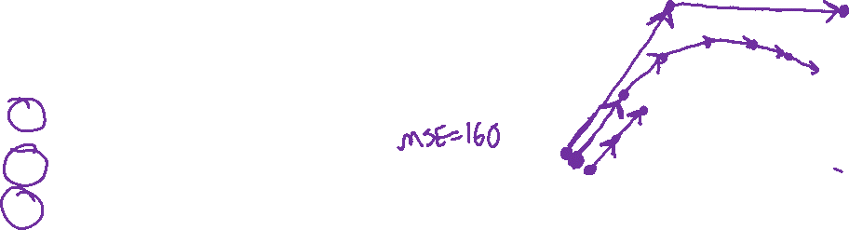
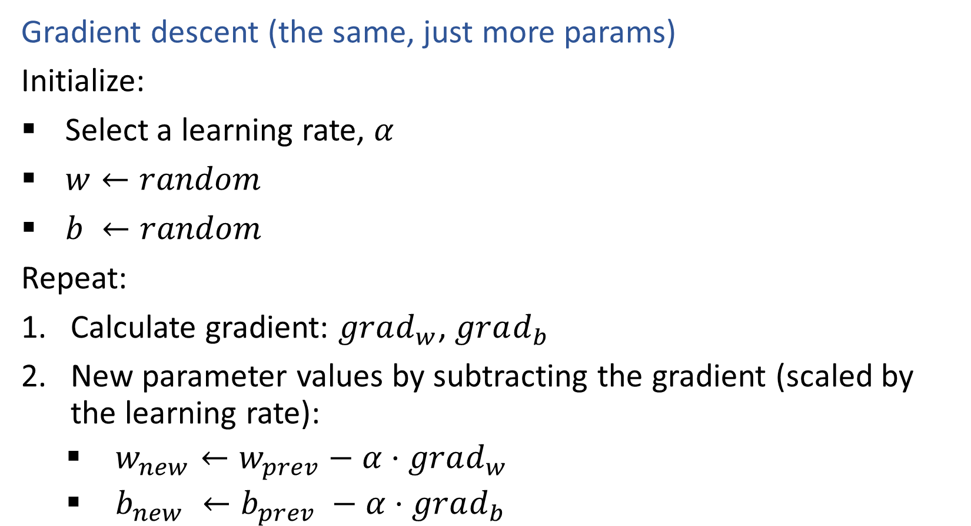



Neural Network Optimization
$$MSE$$
Gradient descent (the same, just more params)
Initialize:
Select a learning rate, $α$
$w←random$
$b ←random$
Repeat:
Calculate gradient: $grad_{w}$, $grad_{b}$
New parameter values by subtracting the gradient (scaled by the learning rate):
$w_{new}←w_{prev}−α⋅grad_{w}$
$b_{new} ←b_{prev} −α⋅grad_{b}$
$$b$$
$$w$$

