Slide 1
Plan
Wrap up exercise on linear regression with more features
AI applications
Review our Wordle design ideas
Subtasks: Example distracted politician detection
Regression task scavenger hunt
AI Ethics Timeout
Focus: Safety and Legal Liability

Slide 2

Demystifying AI
Regression Applications
&
AI Ethics Timeout
Instructor: Pat Virtue

Slide 3
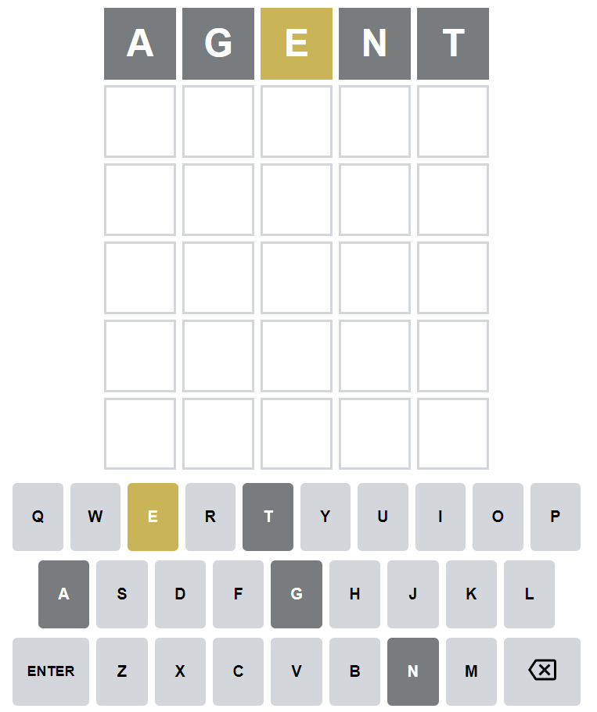
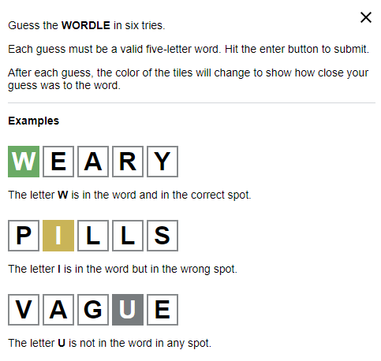
Review: Wordle Design Challenge
https://www.powerlanguage.co.uk/wordle/

Slide 4
Review: Wordle Design Challenge
Agent design
Input: Results of previous guess: list of five integers, each 0 or 1 or 2
Output: Next guess: five-character string
Loop with environment: Yes
Data
Vocabulary: list of five-character strings that are valid words
Vocabulary frequency: dictionary mapping each word to the number of times it appears in a giant text dataset.
https://www.powerlanguage.co.uk/wordle/

Slide 5
Review: Wordle Design Challenge
Agent design
Performance measure options
1 for winning within six guesses and 0 otherwise
Number of guesses before winning (handle > 6 somehow?)
Reminder: Design agent to maximize (or minimize) performance measure
https://www.powerlanguage.co.uk/wordle/

Slide 6
Review: Wordle Design Challenge
Potential design components
Filter invalid words:
Input: current vocab list, previous guess, previous result
Output: vocab list with inconsistent words removed
Choose random word from current vocab
Input: current vocab list
Output: string
Choose random word from current vocab based on frequency data
https://www.powerlanguage.co.uk/wordle/

Slide 7
Review: Wordle Design Challenge
Potential design components
https://www.powerlanguage.co.uk/wordle/

Slide 8

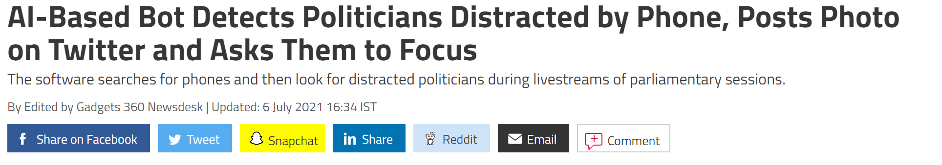
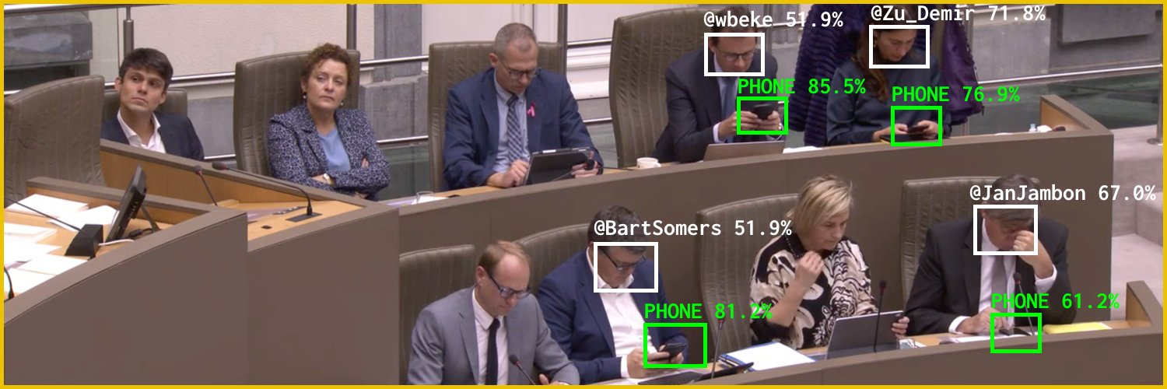
Reminder: Design Challenge
News:
https://gadgets.ndtv.com/social-networking/news/flemish-scrollers-ai-ml-bot-tool-software-belgium-politicians-distracted-phone-detect-troll-twitter-2480493
Source: Twitter @Flemish Scroller

Slide 9
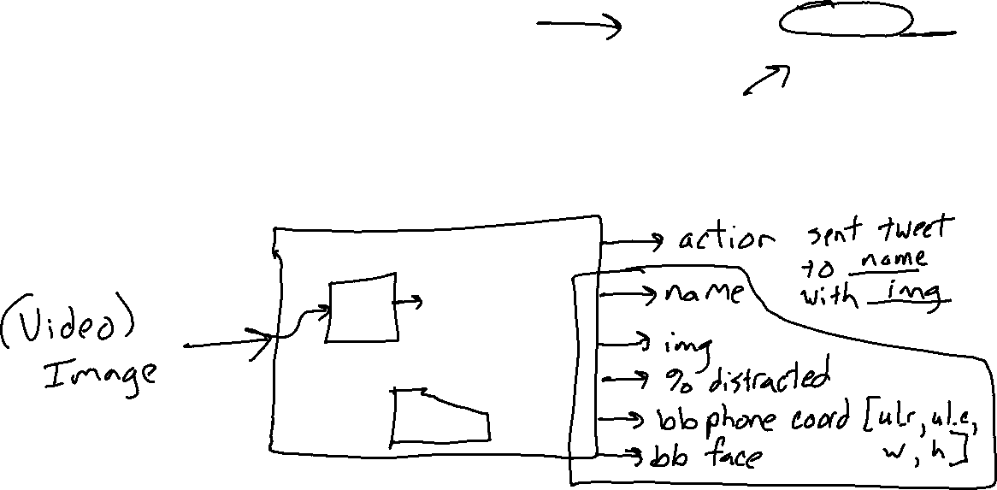
Reminder: Design Challenge
Distracted Politician Detection
What is the input and output for this task?
Image credit: Twitter @Flemish Scroller

Slide 10
Sub Tasks within an Agent
Distracted Politician Detection
What smaller pieces could potentially be designed, trained, tested independently
Image credit: Twitter @Flemish Scroller

Slide 11
Regression Application Scavenger Hunt
Find real-world regression tasks (or sub-tasks)
May have one or many outputs as long as they are all numerical (can be placed on a meaningful number line and not categories like 1 for Red and 2 for Blue)
Doesn’t have to be linear (could be much more complex than that)
Bonus points for the following industries:
    Travel
    Healthcare
Tips for searching on the internet:
“ML applications”
“regression datasets”
To get credit: Complete google slide for each application you find!

Slide 12
AI Ethics Timeout
Focus: Safety and Legal Liability

Slide 13


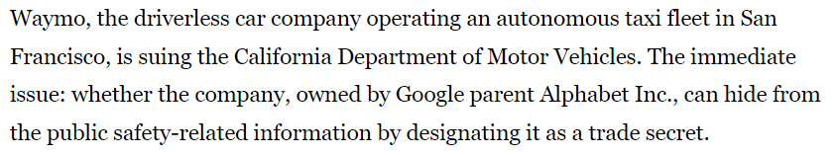
AI Ethics Timeout
Focus: Safety and Legal Liability
Case study: Autonomous Driving
https://www.latimes.com/business/story/2022-01-28/waymo-robot-taxi-sues-state-secret-black-ice

Slide 14

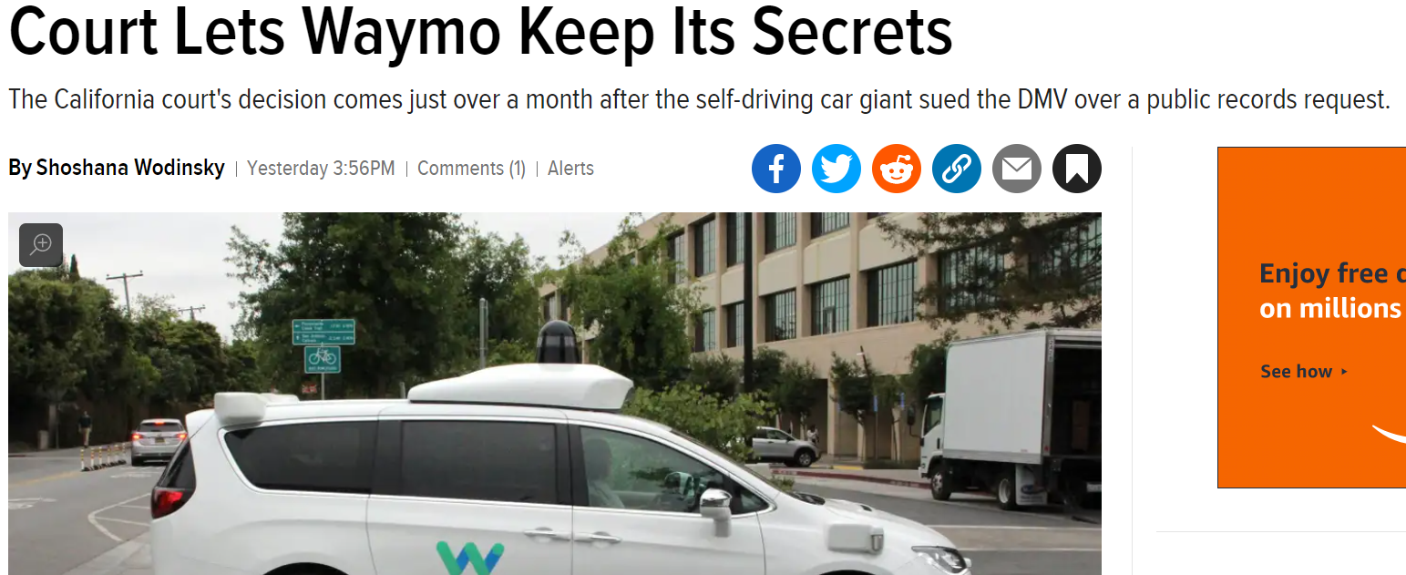
AI Ethics Timeout
Focus: Safety and Legal Liability
Case study: Autonomous Driving
https://gizmodo.com/court-lets-waymo-keep-its-secrets-1848581918

Slide 15
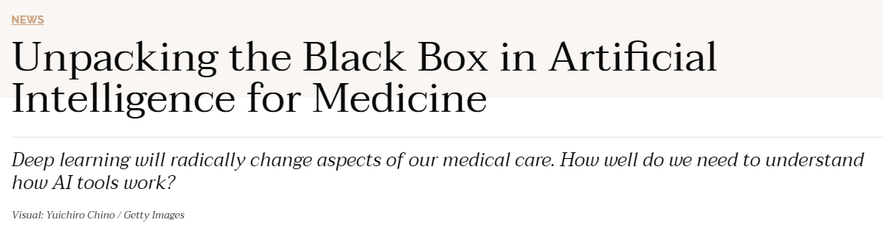

AI Ethics Timeout
Focus: Safety and Legal Liability
https://undark.org/2019/12/04/black-box-artificial-intelligence/

Slide 16
AI Ethics Timeout
Focus: Safety and Legal Liability
How do we determine what went wrong (or right) in deployed AI systems?
What does it mean to have explainable results from an AI system?
Who is responsible for “mistakes” that AI systems make?
What if someone or another AI misuses AI technology? Who is responsible?
Once autonomous vehicles are readily available, should it be illegal for humans to drive?
Domains to think about:
Self-driving cars
Healthcare decision-making
Land and Air traffic control

