Slide 1
Machine Learning for Signal Processing Clustering
Bhiksha Raj
Class 11. 31 Mar 2015

Slide 2
Statistical Modelling and Latent Structure
Much of statistical modelling attempts to identify latent structure in the data
Structure that is not immediately apparent from the observed data
But which, if known, helps us explain it better, and make predictions from or about it
Clustering methods attempt to extract such structure from proximity
First-level structure (as opposed to deep structure)
We will see other forms of latent structure discovery later in the course

Slide 3

Clustering

Slide 4
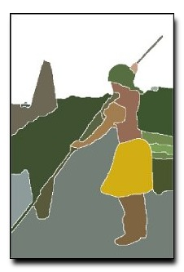


How

Slide 5
Clustering
What is clustering
Clustering is the determination of naturally occurring grouping of data/instances (with low within-group variability and high between-group variability)

Slide 6
Clustering
What is clustering
Clustering is the determination of naturally occurring grouping of data/instances (with low within-group variability and high between-group variability)

Slide 7
Clustering
What is clustering
Clustering is the determination of naturally occurring grouping of data/instances (with low within-group variability and high between-group variability)
How is it done
Find groupings of data such that the groups optimize a “within-group-variability” objective function of some kind

Slide 8
Clustering
What is clustering
Clustering is the determination of naturally occurring grouping of data/instances (with low within-group variability and high between-group variability)
How is it done
Find groupings of data such that the groups optimize a “within-group-variability” objective function of some kind
The objective function used affects the nature of the discovered clusters
E.g. Euclidean distance vs.

Slide 9
Clustering
What is clustering
Clustering is the determination of naturally occurring grouping of data/instances (with low within-group variability and high between-group variability)
How is it done
Find groupings of data such that the groups optimize a “within-group-variability” objective function of some kind
The objective function used affects the nature of the discovered clusters
E.g. Euclidean distance vs.
Distance from center

Slide 10
Why Clustering
Automatic grouping into “Classes”
Different clusters may show different behavior
Quantization
All data within a cluster are represented by a single point
Preprocessing step for other algorithms
Indexing, categorization, etc.

Slide 11
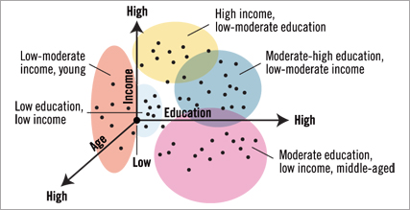
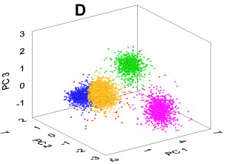
Finding natural structure in data
Find natural groupings in data for further analysis
Discover latent structure in data

Slide 12
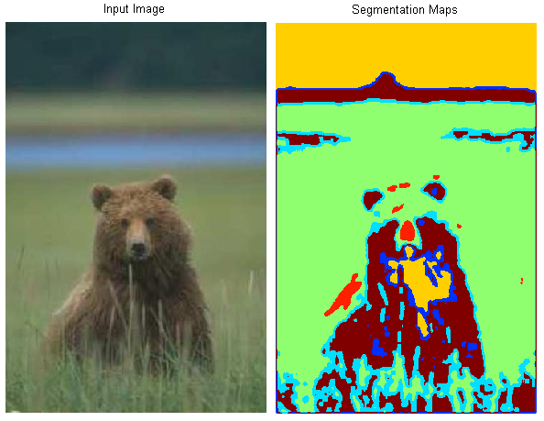
Some Applications of Clustering
Image segmentation

Slide 13
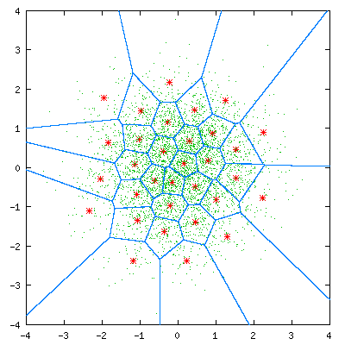
Representation: Quantization
TRAINING
QUANTIZATION
x
x
Quantize every vector to one of K (vector) values
What are the optimal K vectors? How do we find them? How do we perform the quantization?
LBG algorithm

Slide 14
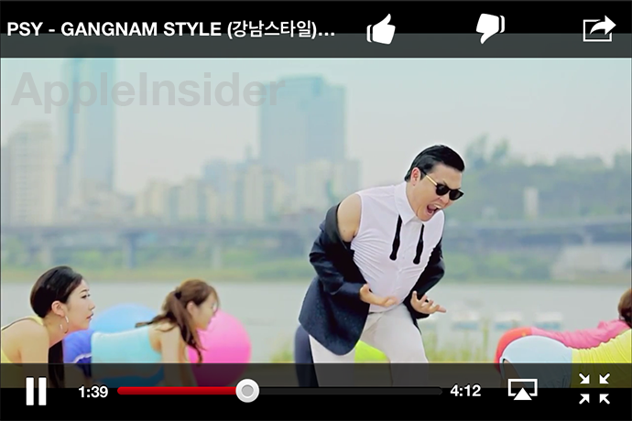
Representation: BOW
How to retrieve all music videos by this guy?
Build a classifier
But how do you represent the video?

Slide 15

Representation: BOW
Representation: Each number is the #frames assigned to the codeword
Training: Each point is a video frame
17
30
16
12
4
Bag of words representations of video/audio/data

Slide 16
Obtaining “Meaningful” Clusters
Two key aspects:
1. The feature representation used to characterize your data
2. The “clustering criteria” employed

Slide 17
Clustering Criterion
The “Clustering criterion” actually has two aspects
Cluster compactness criterion
Measure that shows how “good” clusters are
The objective function
Distance of a point from a cluster
To determine the cluster a data vector belongs to

Slide 18
“Compactness” criteria for clustering
Distance based measures
Total distance between each element in the cluster and every other element in the cluster

Slide 19
“Compactness” criteria for clustering
Distance based measures
Total distance between each element in the cluster and every other element in the cluster

Slide 20
“Compactness” criteria for clustering
Distance based measures
Total distance between each element in the cluster and every other element in the cluster
Distance between the two farthest points in the cluster

Slide 21
“Compactness” criteria for clustering
Distance based measures
Total distance between each element in the cluster and every other element in the cluster
Distance between the two farthest points in the cluster
Total distance of every element in the cluster from the centroid of the cluster

Slide 22
“Compactness” criteria for clustering
Distance based measures
Total distance between each element in the cluster and every other element in the cluster
Distance between the two farthest points in the cluster
Total distance of every element in the cluster from the centroid of the cluster

Slide 23
“Compactness” criteria for clustering
Distance based measures
Total distance between each element in the cluster and every other element in the cluster
Distance between the two farthest points in the cluster
Total distance of every element in the cluster from the centroid of the cluster

Slide 24
“Compactness” criteria for clustering
Distance based measures
Total distance between each element in the cluster and every other element in the cluster
Distance between the two farthest points in the cluster
Total distance of every element in the cluster from the centroid of the cluster
Distance measures are often weighted Minkowski metrics

Slide 25
Clustering: Distance from cluster
How far is a data point from a cluster?
Euclidean or Minkowski distance from the centroid of the cluster
Distance from the closest point in the cluster
Distance from the farthest point in the cluster
Probability of data measured on cluster distribution

Slide 26
Clustering: Distance from cluster
How far is a data point from a cluster?
Euclidean or Minkowski distance from the centroid of the cluster
Distance from the closest point in the cluster
Distance from the farthest point in the cluster
Probability of data measured on cluster distribution

Slide 27
Clustering: Distance from cluster
How far is a data point from a cluster?
Euclidean or Minkowski distance from the centroid of the cluster
Distance from the closest point in the cluster
Distance from the farthest point in the cluster
Probability of data measured on cluster distribution

Slide 28
Clustering: Distance from cluster
How far is a data point from a cluster?
Euclidean or Minkowski distance from the centroid of the cluster
Distance from the closest point in the cluster
Distance from the farthest point in the cluster
Probability of data measured on cluster distribution

Slide 29
Clustering: Distance from cluster
How far is a data point from a cluster?
Euclidean or Minkowski distance from the centroid of the cluster
Distance from the closest point in the cluster
Distance from the farthest point in the cluster
Probability of data measured on cluster distribution
Fit of data to cluster-based regression

Slide 30
Optimal clustering: Exhaustive enumeration
All possible combinations of data must be evaluated
If there are M data points, and we desire N clusters, the number of ways of separating M instances into N clusters is
Exhaustive enumeration based clustering requires that the objective function (the “Goodness measure”) be evaluated for every one of these, and the best one chosen
This is the only correct way of optimal clustering
Unfortunately, it is also computationally unrealistic

Slide 31
Not-quite non sequitur: Quantization
Signal Value | Bits | Mapped to
S >= 3.75v | 11 | 3 * const
3.75v > S >= 2.5v | 10 | 2 * const
2.5v > S >= 1.25v | 01 | 1 * const
1.25v > S >= 0v | 0 | 0
Probability of analog value
Analog value (arrows are quantization levels)
Linear quantization (uniform quantization):
Each digital value represents an equally wide range of analog values
Regardless of distribution of data
Digital-to-analog conversion represented by a “uniform” table

Slide 32
Not-quite non sequitur: Quantization
Signal Value | Bits | Mapped to
S >= 4v | 11 | 4.5
4v > S >= 2.5v | 10 | 3.25
2.5v > S >= 1v | 01 | 1.25
1.0v > S >= 0v | 0 | 0.5
Probability of analog value
Analog value (arrows are quantization levels)
Non-Linear quantization:
Each digital value represents a different range of analog values
Finer resolution in high-density areas
Mu-law / A-law assumes a Gaussian-like distribution of data
Digital-to-analog conversion represented by a “non-uniform” table

Slide 33
Non-uniform quantization
Probability of analog value
Analog value
If data distribution is not Gaussian-ish?
Mu-law / A-law are not optimal
How to compute the optimal ranges for quantization?
Or the optimal table

Slide 34
The Lloyd Quantizer
Probability of analog value
Analog value (arrows show quantization levels)
Lloyd quantizer: An iterative algorithm for computing optimal quantization tables for non-uniformly distributed data
Learned from “training” data

Slide 35
Lloyd Quantizer
Randomly initialize quantization points
Right column entries of quantization table
Assign all training points to the nearest quantization point
Reestimate quantization points
Iterate until convergence

Slide 36
Lloyd Quantizer
Randomly initialize quantization points
Right column entries of quantization table
Assign all training points to the nearest quantization point
Draw boundaries
Reestimate quantization points
Iterate until convergence

Slide 37
Lloyd Quantizer
Randomly initialize quantization points
Right column entries of quantization table
Assign all training points to the nearest quantization point
Draw boundaries
Reestimate quantization points
Iterate until convergence

Slide 38
Lloyd Quantizer
Randomly initialize quantization points
Right column entries of quantization table
Assign all training points to the nearest quantization point
Draw boundaries
Reestimate quantization points
Iterate until convergence

Slide 39
Generalized Lloyd Algorithm: K–means clustering
K means is an iterative algorithm for clustering vector data
McQueen, J. 1967. “Some methods for classification and analysis of multivariate observations.” Proceedings of the Fifth Berkeley Symposium on Mathematical Statistics and Probability, 281-297
General procedure:
Initially group data into the required number of clusters somehow (initialization)
Assign each data point to the closest cluster
Once all data points are assigned to clusters, redefine clusters
Iterate

Slide 40
K–means
Problem: Given a set of data vectors, find natural clusters
Clustering criterion is scatter: distance from the centroid
Every cluster has a centroid
The centroid represents the cluster
Definition: The centroid is the weighted mean of the cluster
Weight = 1 for basic scheme

Slide 41
K–means
Initialize a set of centroids randomly
For each data point x, find the distance from the centroid for each cluster
Put data point in the cluster of the closest centroid
Cluster for which d_{cluster} is minimum
When all data points clustered, recompute cluster centroid
If not converged, go back to 2

Slide 42
K–means
Initialize a set of centroids randomly
For each data point x, find the distance from the centroid for each cluster
Put data point in the cluster of the closest centroid
Cluster for which d_{cluster} is minimum
When all data points clustered, recompute cluster centroid
If not converged, go back to 2

Slide 43
K–means
Initialize a set of centroids randomly
For each data point x, find the distance from the centroid for each cluster
Put data point in the cluster of the closest centroid
Cluster for which d_{cluster} is minimum
When all data points clustered, recompute cluster centroid
If not converged, go back to 2

Slide 44
K–means
Initialize a set of centroids randomly
For each data point x, find the distance from the centroid for each cluster
Put data point in the cluster of the closest centroid
Cluster for which d_{cluster} is minimum
When all data points clustered, recompute cluster centroid
If not converged, go back to 2

Slide 45
K–means
Initialize a set of centroids randomly
For each data point x, find the distance from the centroid for each cluster
Put data point in the cluster of the closest centroid
Cluster for which d_{cluster} is minimum
When all data points clustered, recompute cluster centroid
If not converged, go back to 2

Slide 46
K–means
Initialize a set of centroids randomly
For each data point x, find the distance from the centroid for each cluster
Put data point in the cluster of the closest centroid
Cluster for which d_{cluster} is minimum
When all data points clustered, recompute cluster centroid
If not converged, go back to 2

Slide 47
K–means
Initialize a set of centroids randomly
For each data point x, find the distance from the centroid for each cluster
Put data point in the cluster of the closest centroid
Cluster for which d_{cluster} is minimum
When all data points clustered, recompute cluster centroid
If not converged, go back to 2

Slide 48
K–means
Initialize a set of centroids randomly
For each data point x, find the distance from the centroid for each cluster
Put data point in the cluster of the closest centroid
Cluster for which d_{cluster} is minimum
When all data points clustered, recompute cluster centroid
If not converged, go back to 2

Slide 49
K–means
Initialize a set of centroids randomly
For each data point x, find the distance from the centroid for each cluster
Put data point in the cluster of the closest centroid
Cluster for which d_{cluster} is minimum
When all data points clustered, recompute cluster centroid
If not converged, go back to 2

Slide 50
K–means
Initialize a set of centroids randomly
For each data point x, find the distance from the centroid for each cluster
Put data point in the cluster of the closest centroid
Cluster for which d_{cluster} is minimum
When all data points are clustered, recompute centroids
If not converged, go back to 2

Slide 51
K–means
Initialize a set of centroids randomly
For each data point x, find the distance from the centroid for each cluster
Put data point in the cluster of the closest centroid
Cluster for which d_{cluster} is minimum
When all data points are clustered, recompute centroids
If not converged, go back to 2

Slide 52
K-Means comments
The distance metric determines the clusters
In the original formulation, the distance is L₂ distance
Euclidean norm, w_{i} = 1
If we replace every x by m_{cluster}(x), we get Vector Quantization
K-means is an instance of generalized EM
Not guaranteed to converge for all distance metrics

Slide 53
Initialization
Random initialization
Top-down clustering
Initially partition the data into two (or a small number of) clusters using K means
Partition each of the resulting clusters into two (or a small number of) clusters, also using K means
Terminate when the desired number of clusters is obtained

Slide 54
K-Means for Top–Down clustering
Start with one cluster
Split each cluster into two:
Perturb centroid of cluster slightly (by < 5%) to generate two centroids
Initialize K means with new set of centroids
Iterate Kmeans until convergence
If the desired number of clusters is not obtained, return to 2

Slide 55
K-Means for Top–Down clustering
Start with one cluster
Split each cluster into two:
Perturb centroid of cluster slightly (by < 5%) to generate two centroids
Initialize K means with new set of centroids
Iterate Kmeans until convergence
If the desired number of clusters is not obtained, return to 2

Slide 56
K-Means for Top–Down clustering
Start with one cluster
Split each cluster into two:
Perturb centroid of cluster slightly (by < 5%) to generate two centroids
Initialize K means with new set of centroids
Iterate Kmeans until convergence
If the desired number of clusters is not obtained, return to 2

Slide 57
K-Means for Top–Down clustering
Start with one cluster
Split each cluster into two:
Perturb centroid of cluster slightly (by < 5%) to generate two centroids
Initialize K means with new set of centroids
Iterate Kmeans until convergence
If the desired number of clusters is not obtained, return to 2

Slide 58
K-Means for Top–Down clustering
Start with one cluster
Split each cluster into two:
Perturb centroid of cluster slightly (by < 5%) to generate two centroids
Initialize K means with new set of centroids
Iterate Kmeans until convergence
If the desired number of clusters is not obtained, return to 2

Slide 59
K-Means for Top–Down clustering
Start with one cluster
Split each cluster into two:
Perturb centroid of cluster slightly (by < 5%) to generate two centroids
Initialize K means with new set of centroids
Iterate Kmeans until convergence
If the desired number of clusters is not obtained, return to 2

Slide 60
K-Means for Top–Down clustering
Start with one cluster
Split each cluster into two:
Perturb centroid of cluster slightly (by < 5%) to generate two centroids
Initialize K means with new set of centroids
Iterate Kmeans until convergence
If the desired number of clusters is not obtained, return to 2

Slide 61
K-Means for Top–Down clustering
Start with one cluster
Split each cluster into two:
Perturb centroid of cluster slightly (by < 5%) to generate two centroids
Initialize K means with new set of centroids
Iterate Kmeans until convergence
If the desired number of clusters is not obtained, return to 2

Slide 62
Non-Euclidean clusters
Basic K-means results in good clusters in Euclidean spaces
Alternately stated, will only find clusters that are “good” in terms of Euclidean distances
Will not find other types of clusters

Slide 63
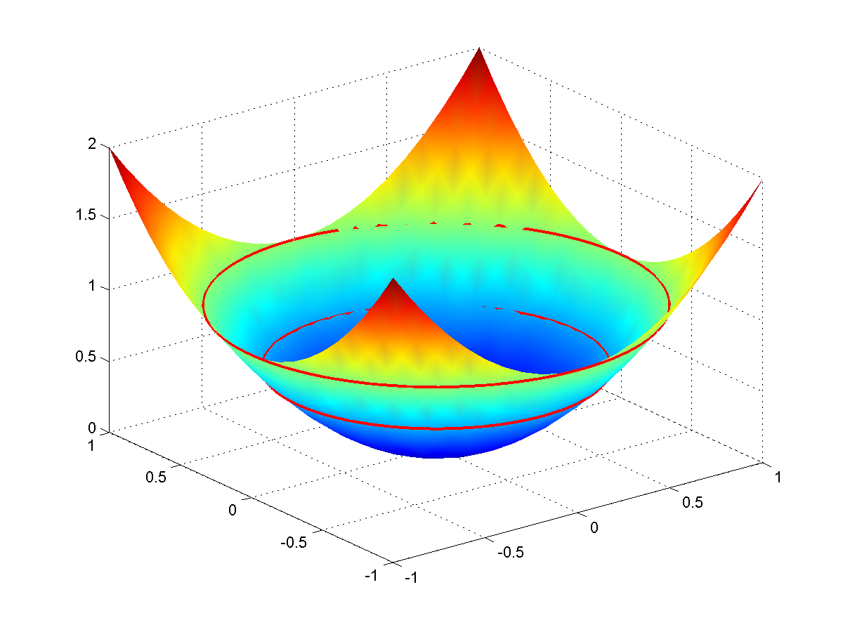
Non-Euclidean clusters
f([x,y]) -> [x,y,z]
x = x
y = y
z = α(x² + y²)
For other forms of clusters we must modify the distance measure
E.g. distance from a circle
May be viewed as a distance in a higher dimensional space
I.e Kernel distances
Kernel K-means
Other related clustering mechansims:
Spectral clustering
Non-linear weighting of adjacency
Normalized cuts..

Slide 64
The Kernel Trick
f([x,y]) -> [x,y,z]
x = x
y = y
z = α(x² + y²)
Transform the data into a synthetic higher-dimensional space where the desired patterns become natural clusters
E.g. the quadratic transform above
Problem: What is the function/space?
Problem: Distances in higher dimensional-space are more expensive to compute
Yet only carry the same information in the lower-dimensional space

Slide 65
Distance in higher-dimensional space
Transform data x through a possibly unknown function Φ(x) into a higher (potentially infinite) dimensional space
z = Φ(x)
The distance between two points is computed in the higher-dimensional space
d(x₁, x₂) = ||z₁- z₂||² = ||Φ(x₁) – Φ(x₂)||²
d(x₁, x₂) can be computed without computing z
Since it is a direct function of x₁ and x₂

Slide 66
Distance in higher-dimensional space
Distance in lower-dimensional space: A combination of dot products
||z₁- z₂||² = (z₁- z₂)^{T}(z₁- z₂) = z₁.z₁ + z₂.z₂ -2 z₁.z₂
Distance in higher-dimensional space
d(x₁, x₂) =||Φ(x₁) – Φ(x₂)||² = Φ(x₁). Φ(x₁) + Φ(x₂). Φ(x₂) -2 Φ(x₁). Φ(x₂)
d(x₁, x₂) can be computed without knowing Φ(x) if:
Φ(x₁). Φ(x₂) can be computed for any x₁ and x₂ without knowing Φ(.)

Slide 67
The Kernel function
A kernel function K(x₁,x₂) is a function such that:
K(x₁,x₂) = Φ(x₁). Φ(x₂)
Once such a kernel function is found, the distance in higher-dimensional space can be found in terms of the kernels
d(x₁, x₂) =||Φ(x₁) – Φ(x₂)||² = Φ(x₁). Φ(x₁) + Φ(x₂). Φ(x₂) -2 Φ(x₁). Φ(x₂) = K(x₁,x₁) + K(x₂,x₂) - 2K(x₁,x₂)
But what is K(x₁,x₂)?

Slide 68
A property of the dot product
For any vector v, v^{T}v = ||v||² >= 0
This is just the length of v and is therefore non-negative
For any vector u = Σ_{i} a_{i} v_{i}, ||u||² >=0
=> (Σ_{i} a_{i} v_{i})^{T}(Σ_{i} a_{i} v_{i}) >= 0
=> Σ_{i} Σ_{j} a_{i} a_{j} v_{i} .v_{j} >= 0
This holds for ANY real {a₁, a₂, …}

Slide 69
The Mercer Condition
If z = Φ(x) is a high-dimensional vector derived from x then for all real {a₁, a₂, …} and any set {z₁, z₂, … } = {Φ(x₁), Φ(x₂),…}
Σ_{i} Σ_{j} a_{i} a_{j} z_{i} .z_{j} >= 0
Σ_{i} Σ_{j} a_{i} a_{j} Φ(x_{i}).Φ(x_{j}) >= 0
If K(x₁,x₂) = Φ(x₁). Φ(x₂)
=> Σ_{i} Σ_{j} a_{i} a_{j} K(x_{i},x_{j}) >= 0
Any function K() that satisfies the above condition is a valid kernel function

Slide 70
The Mercer Condition
K(x₁,x₂) = Φ(x₁). Φ(x₂)
=> Σ_{i} Σ_{j} a_{i} a_{j} K(x_{i},x_{j}) >= 0
A corollary: If any kernel K(.) satisfies the Mercer condition d(x₁, x₂) = K(x₁,x₁) + K(x₂,x₂) - 2K(x₁,x₂) satisfies the following requirements for a “distance”
d(x,x) = 0
d(x,y) >= 0
d(x,w) + d(w,y) >= d(x,y)

Slide 71
Typical Kernel Functions
Linear: K(x,y) = x^{T}y + c
Polynomial K(x,y) = (ax^{T}y + c)^{n}
Gaussian: K(x,y) = exp(-||x-y||²/σ²)
Exponential: K(x,y) = exp(-||x-y||/λ)
Several others
Choosing the right Kernel with the right parameters for your problem is an artform

Slide 72
Kernel K-means
K(x,y)= (x^{T} y + c)²
Perform the K-mean in the Kernel space
The space of z = Φ(x)
The algorithm..

Slide 73
The mean of a cluster
The average value of the points in the cluster computed in the high-dimensional space
Alternately the weighted average

Slide 74
The mean of a cluster
The average value of the points in the cluster computed in the high-dimensional space
Alternately the weighted average
RECALL: We may never actually be able to compute this mean because Φ(x) is not known

Slide 75
K–means
Initialize the clusters with a random set of K points
Cluster has 1 point
For each data point x, find the closest cluster
Computed entirely using only the kernel function!

Slide 76
K–means
Initialize a set of clusters randomly
For each data point x, find the distance from the centroid for each cluster
Put data point in the cluster of the closest centroid
Cluster for which d_{cluster} is minimum
When all data points clustered, recompute cluster centroid
If not converged, go back to 2

Slide 77
K–means
Initialize a set of clusters randomly
For each data point x, find the distance from the centroid for each cluster
Put data point in the cluster of the closest centroid
Cluster for which d_{cluster} is minimum
When all data points clustered, recompute cluster centroid
If not converged, go back to 2
The centroids are virtual: we don’t actually compute them explicitly!

Slide 78
K–means
Initialize a set of clusters randomly
For each data point x, find the distance from the centroid for each cluster
Put data point in the cluster of the closest centroid
Cluster for which d_{cluster} is minimum
When all data points clustered, recompute cluster centroid
If not converged, go back to 2

Slide 79
K–means
Initialize a set of clusters randomly
For each data point x, find the distance from the centroid for each cluster
Put data point in the cluster of the closest centroid
Cluster for which d_{cluster} is minimum
When all data points clustered, recompute cluster centroid
If not converged, go back to 2

Slide 80
K–means
Initialize a set of clusters randomly
For each data point x, find the distance from the centroid for each cluster
Put data point in the cluster of the closest centroid
Cluster for which d_{cluster} is minimum
When all data points clustered, recompute cluster centroid
If not converged, go back to 2

Slide 81
K–means
Initialize a set of clusters randomly
For each data point x, find the distance from the centroid for each cluster
Put data point in the cluster of the closest centroid
Cluster for which d_{cluster} is minimum
When all data points clustered, recompute cluster centroid
If not converged, go back to 2

Slide 82
K–means
Initialize a set of clusters randomly
For each data point x, find the distance from the centroid for each cluster
Put data point in the cluster of the closest centroid
Cluster for which d_{cluster} is minimum
When all data points clustered, recompute cluster centroid
If not converged, go back to 2

Slide 83
K–means
Initialize a set of clusters randomly
For each data point x, find the distance from the centroid for each cluster
Put data point in the cluster of the closest centroid
Cluster for which d_{cluster} is minimum
When all data points clustered, recompute cluster centroid
If not converged, go back to 2

Slide 84
K–means
Initialize a set of clusters randomly
For each data point x, find the distance from the centroid for each cluster
Put data point in the cluster of the closest centroid
Cluster for which d_{cluster} is minimum
When all data points clustered, recompute cluster centroid
If not converged, go back to 2

Slide 85
K–means
Initialize a set of clusters randomly
For each data point x, find the distance from the centroid for each cluster
Put data point in the cluster of the closest centroid
Cluster for which d_{cluster} is minimum
When all data points clustered, recompute cluster centroid
If not converged, go back to 2

Slide 86
K–means
Initialize a set of clusters randomly
For each data point x, find the distance from the centroid for each cluster
Put data point in the cluster of the closest centroid
Cluster for which d_{cluster} is minimum
When all data points are clustered, recompute centroids
If not converged, go back to 2
We do not explicitly compute the means
May be impossible – we do not know the high-dimensional space
We only know how to compute inner products in it

Slide 87
Kernel K–means
Initialize a set of clusters randomly
For each data point x, find the distance from the centroid for each cluster
Put data point in the cluster of the closest centroid
Cluster for which d_{cluster} is minimum
When all data points are clustered, recompute centroids
If not converged, go back to 2
We do not explicitly compute the means
May be impossible – we do not know the high-dimensional space
We only know how to compute inner products in it

Slide 88
How many clusters?
Assumptions:
Dimensionality of kernel space > no. of clusters
Clusters represent separate directions in Kernel spaces
Kernel correlation matrix K
K_{ij} = K(x_{i},x_{j})
Find Eigen values Λ and Eigen vectors e of kernel matrix
No. of clusters = no. of dominant λ_{i} (1^{T}e_{i}) terms

Slide 89
Spectral Methods
“Spectral” methods attempt to find “principal” subspaces of the high-dimensional kernel space
Clustering is performed in the principal subspaces
Normalized cuts
Spectral clustering
Involves finding Eigenvectors and Eigen values of Kernel matrix
Fortunately, provably analogous to Kernel K-means

Slide 90
Other clustering methods
Regression based clustering
Find a regression representing each cluster
Associate each point to the cluster with the best regression
Related to kernel methods

Slide 91
Clustering..
Many many other variants
Many applications..
Important: Appropriate choice of feature
Appropriate choice of feature may eliminate need for kernel trick..
Google is your friend.

