Slide 1
Machine Learning for Signal Processing Non-negative Matrix Factorization
Class 10. 17 Mar 2015
Instructor: Bhiksha Raj
With examples from Paris Smaragdis

Slide 2




The Engineer and the Musician
Once upon a time a rich potentate discovered a previously unknown recording of a beautiful piece of music. Unfortunately it was badly damaged.
He greatly wanted to find out what it would sound like if it were not.
So he hired an engineer and a musician to solve the problem..

Slide 3


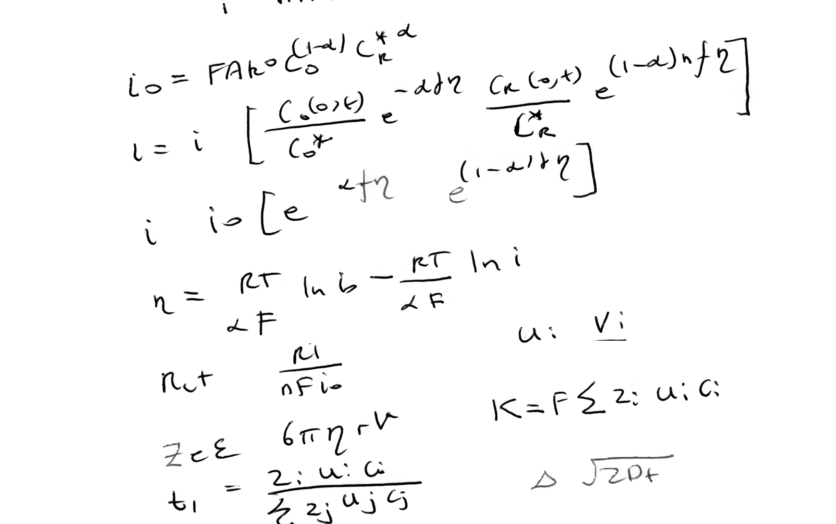






The Engineer and the Musician
The engineer worked for many years. He spent much money and published many papers.
Finally he had a somewhat scratchy restoration of the music..
The musician listened to the music carefully for a day, transcribed it, broke out his trusty keyboard and replicated the music.

Slide 4

The Prize
Who do you think won the princess?

Slide 5

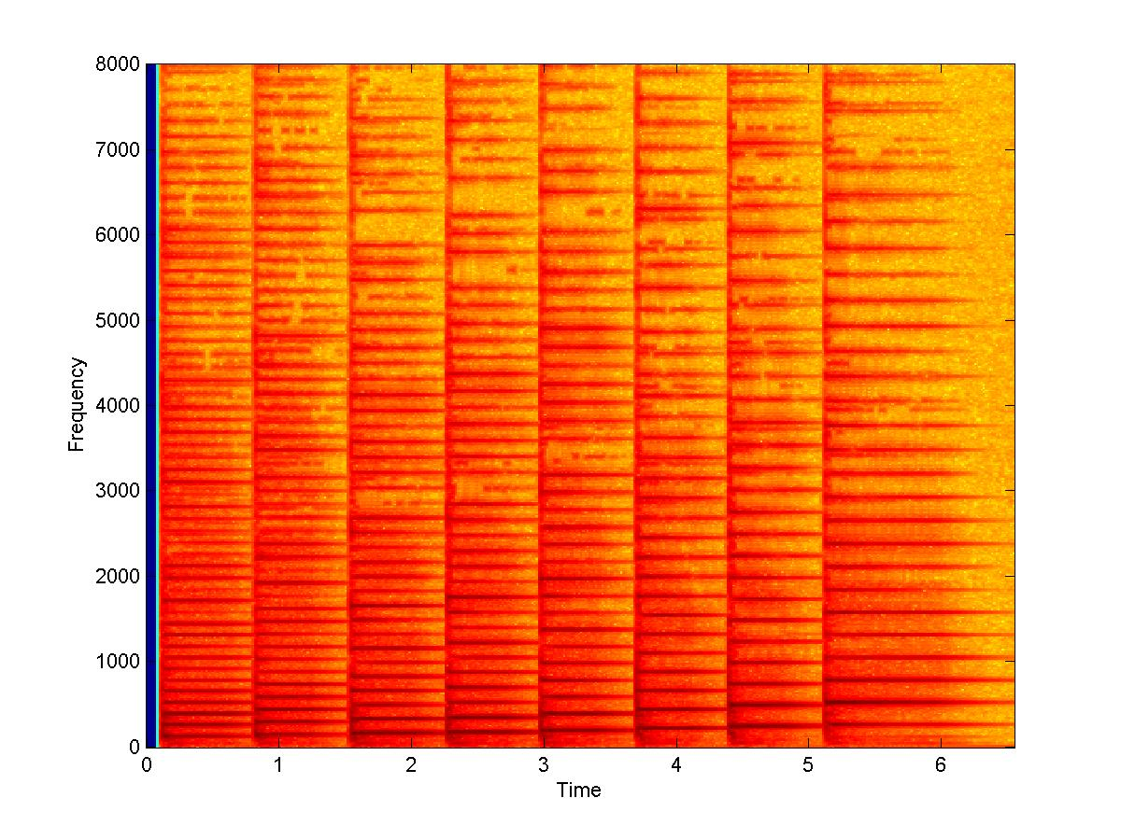
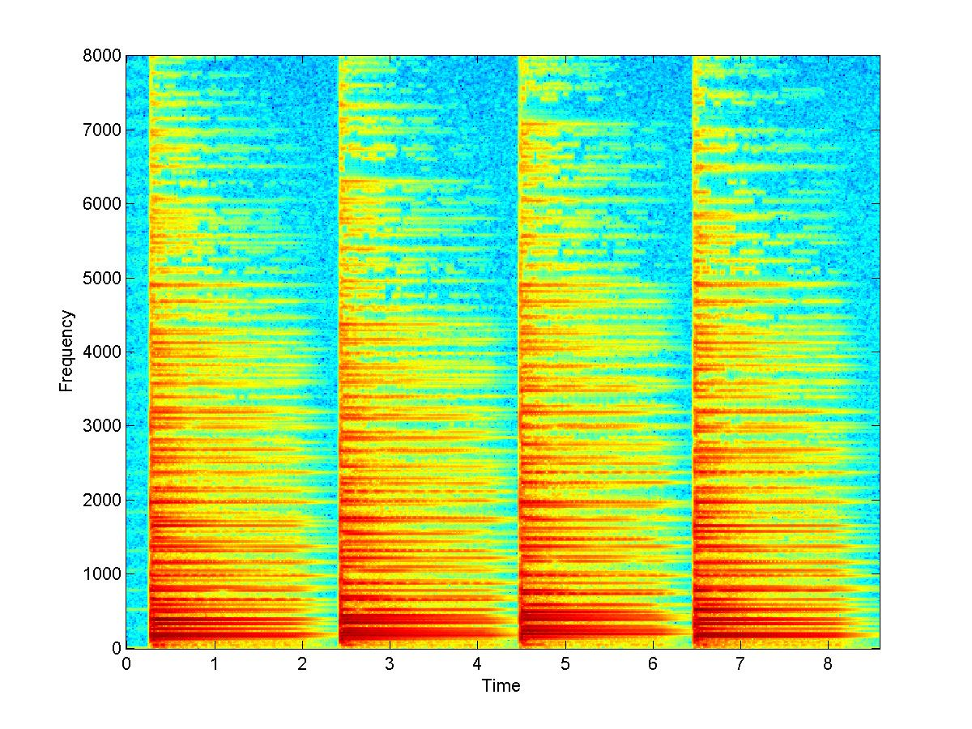
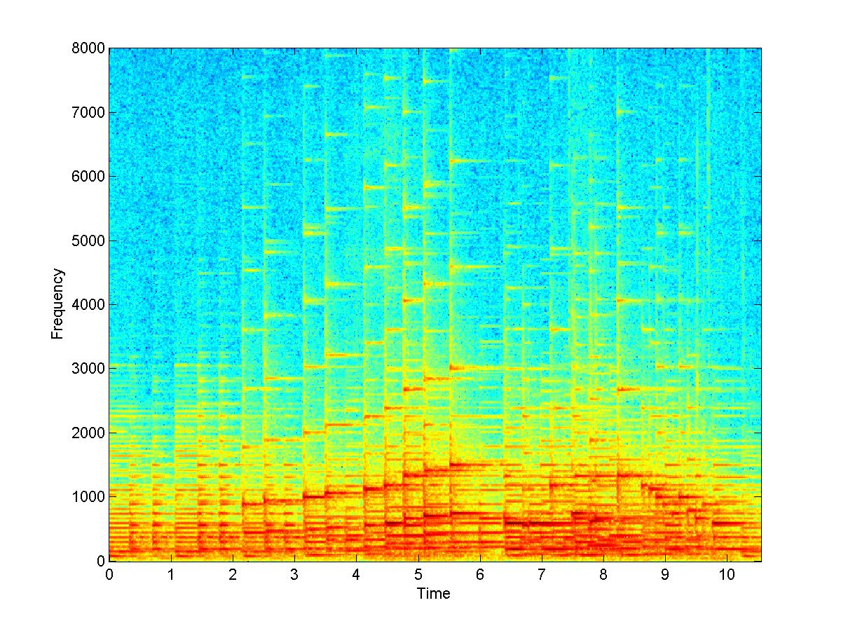
The search for building blocks
What composes an audio signal?
E.g. notes compose music

Slide 6

The properties of building blocks
Constructive composition
A second note does not diminish a first note
Linearity of composition
Notes do not distort one another

Slide 7
Looking for building blocks in sound
?
Can we compute the building blocks from sound itself

Slide 8
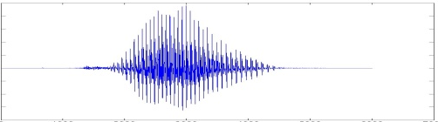
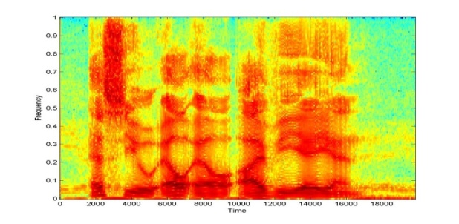
A property of spectrograms
+
=
+
=
The spectrogram of the sum of two signals is the sum of their spectrograms
This is a property of the Fourier transform that is used to compute the columns of the spectrogram
The individual spectral vectors of the spectrograms add up
Each column of the first spectrogram is added to the same column of the second
Building blocks can be learned by using this property
Learn the building blocks of the “composed” signal by finding what vectors were added to produce it

Slide 9
Another property of spectrograms
+
=
+
=
We deal with the power in the signal
The power in the sum of two signals is the sum of the powers in the individual signals
The power of any frequency component in the sum at any time is the sum of the powers in the individual signals at that frequency and time
The power is strictly non-negative (real)

Slide 10
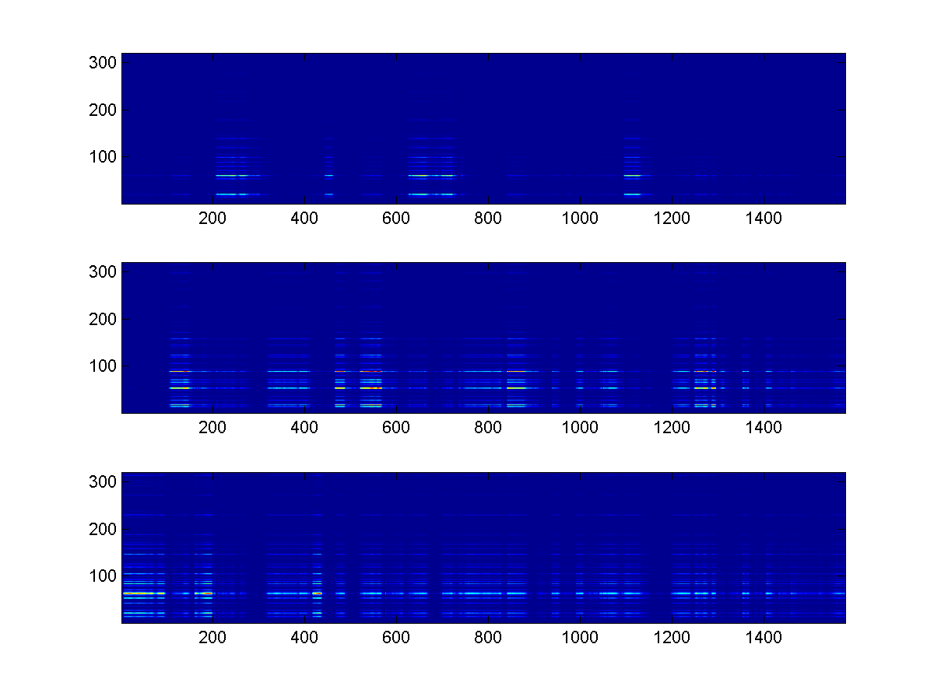
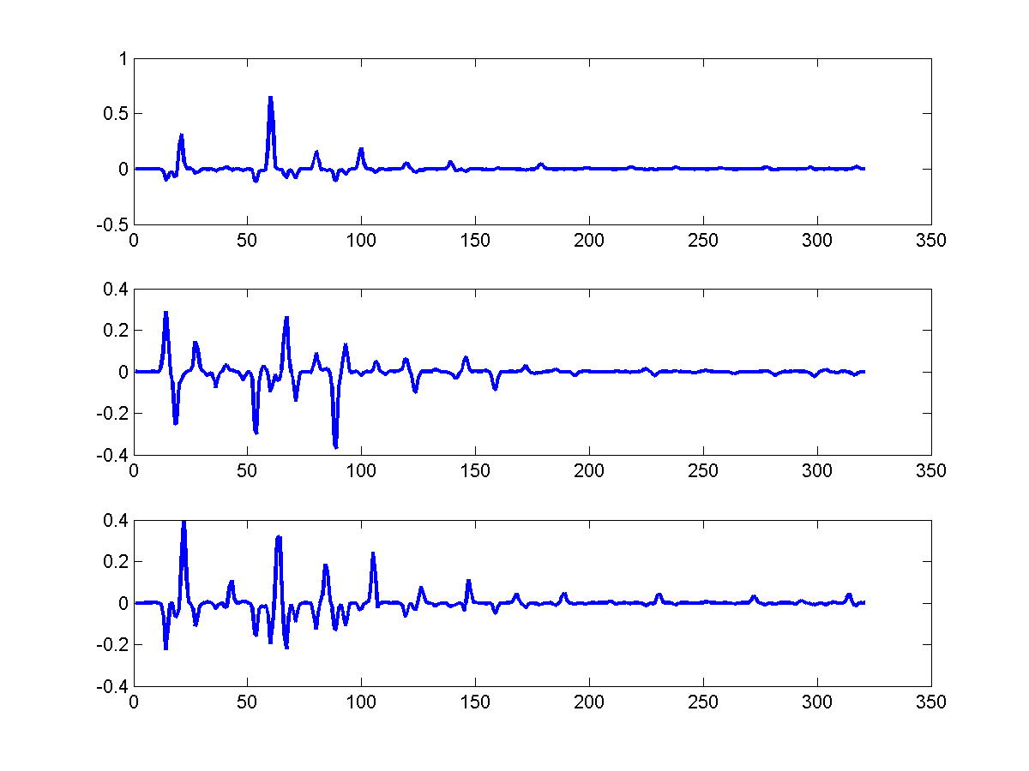
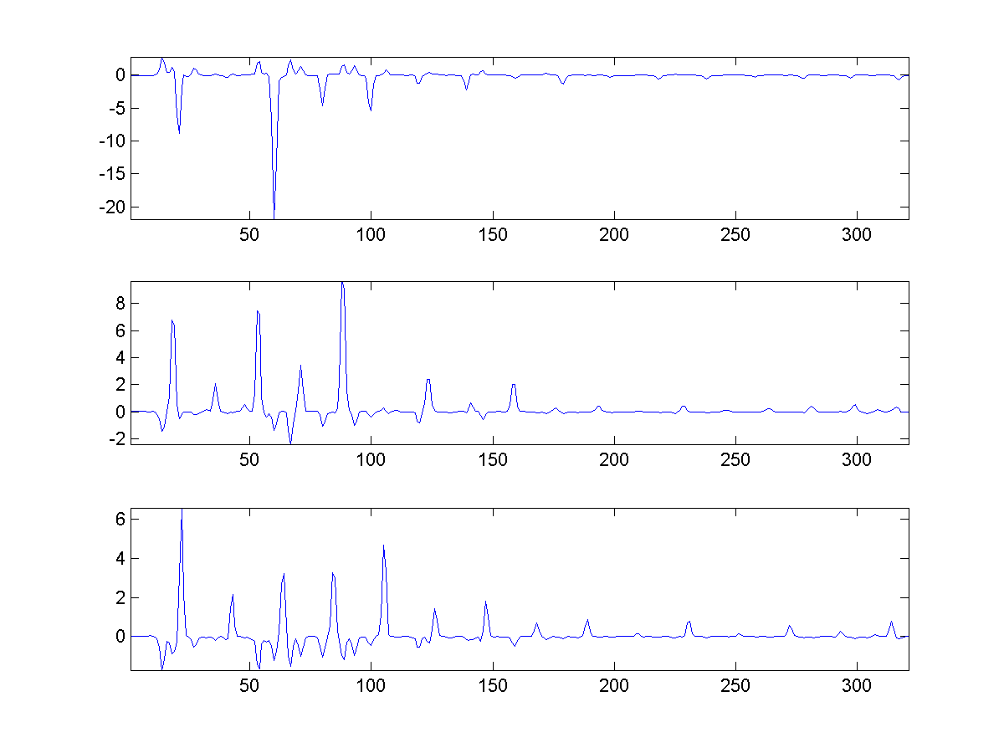

Why PCA and ICA won’t suffice
PCA
ICA
Negative components imply cancellation
Sounds never cancel

Slide 11

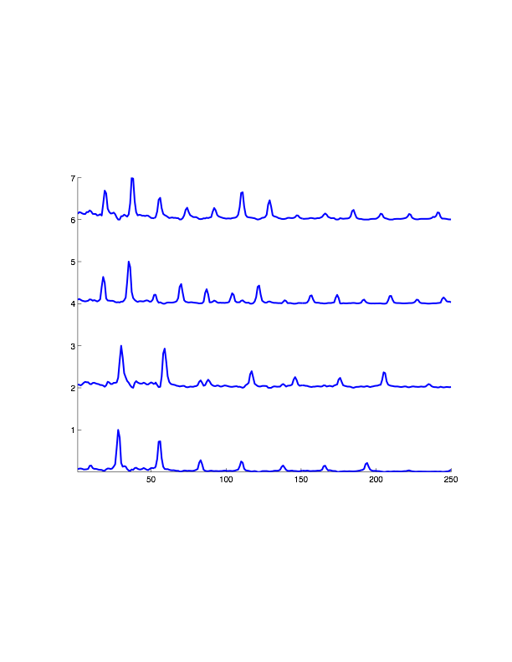
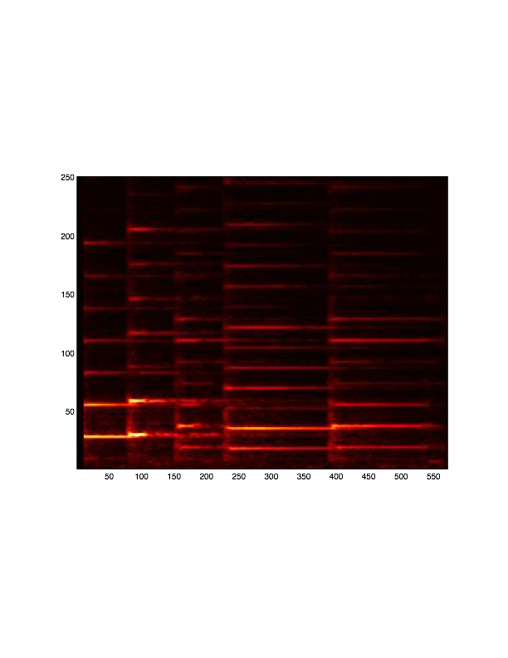
Building Blocks of Sound
The building blocks of sound are (power) spectral structures
E.g. notes build music
The spectra are entirely non-negative
The complete sound is composed by constructive combination of the building blocks scaled to different non-negative gains
E.g. notes are played with varying energies through the music
The sound from the individual notes combines to form the final spectrogram
The final spectrogram is also non-negative

Slide 12
Building Blocks of Sound
w₁₁
w₁₂
w₁₃
w₁₄
Each frame of sound is composed by activating each spectral building block by a frame-specific amount
Individual frames are composed by activating the building blocks to different degrees
E.g. notes are strummed with different energies to compose the frame

Slide 13
Composing the Sound
w₂₁
w₂₂
w₂₃
w₂₄
Each frame of sound is composed by activating each spectral building block by a frame-specific amount
Individual frames are composed by activating the building blocks to different degrees
E.g. notes are strummed with different energies to compose the frame

Slide 14
Building Blocks of Sound
w₃₁
w₃₂
w₃₃
w₃₄
Each frame of sound is composed by activating each spectral building block by a frame-specific amount
Individual frames are composed by activating the building blocks to different degrees
E.g. notes are strummed with different energies to compose the frame

Slide 15
Building Blocks of Sound
w₄₁
w₄₂
w₄₃
w₄₄
Each frame of sound is composed by activating each spectral building block by a frame-specific amount
Individual frames are composed by activating the building blocks to different degrees
E.g. notes are strummed with different energies to compose the frame

Slide 16
Building Blocks of Sound
Each frame of sound is composed by activating each spectral building block by a frame-specific amount
Individual frames are composed by activating the building blocks to different degrees
E.g. notes are strummed with different energies to compose the frame

Slide 17
The Problem of Learning
Given only the final sound, determine its building blocks
From only listening to music, learn all about musical notes!

Slide 18
In Math
w₁₁
w₂₁
w₃₁
w₄₁
Each frame is a non-negative power spectral vector
Each note is a non-negative power spectral vector
Each frame is a non-negative combination of the notes

Slide 19
Expressing a vector in terms of other vectors
B₁
V
B₂

Slide 20
Expressing a vector in terms of other vectors
B₁
V
a.B₁
b.B₂
B₂

Slide 21
Expressing a vector in terms of other vectors
2.a + 5.b = 4
3.a + -3.b = 2
B₁
V
a.B₁
b.B₂
B₂

Slide 22
Power spectral vectors: Requirements
V has only non-negative components
Is a power spectrum
B₁ and B₂ have only non-negative components
Power spectra of building blocks of audio
E.g. power spectra of notes
a and b are strictly non-negative
Building blocks don’t subtract from one another
B₁
V
B₂
a.B₁
b.B₂

Slide 23
Learning building blocks: Restating the problem
Given a collection of spectral vectors (from the composed sound) …
Find a set of “basic” sound spectral vectors such that …
All of the spectral vectors can be composed through constructive addition of the bases
We never have to flip the direction of any basis

Slide 24
Learning building blocks: Restating the problem
Each column of V is one “composed” spectral vector
Each column of B is one building block
One spectral basis
Each column of W has the scaling factors for the building blocks to compose the corresponding column of V
All columns of V are non-negative
All entries of B and W must also be non-negative

Slide 25
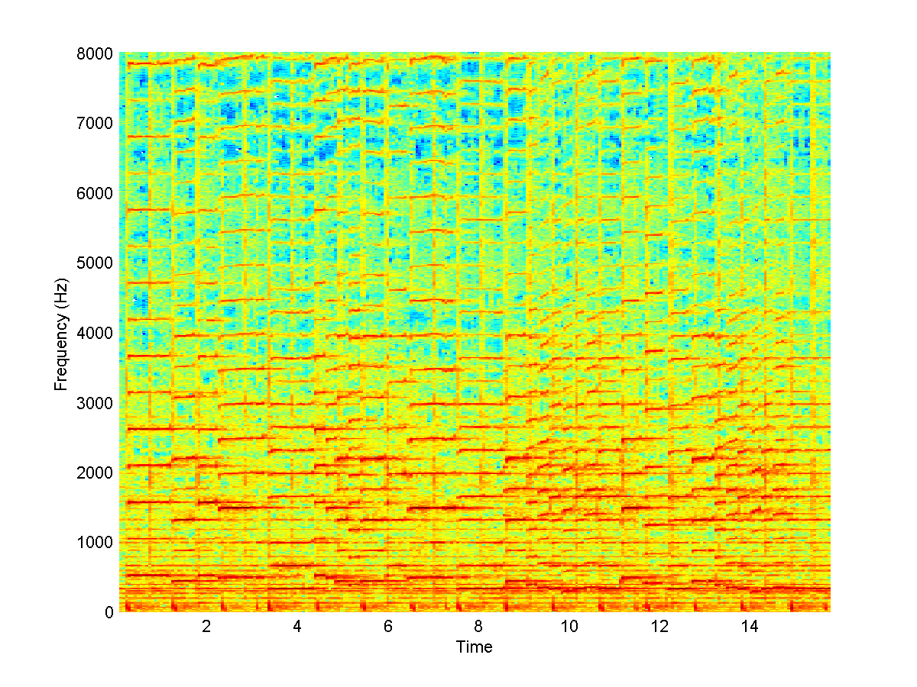
NMF
M =
?
H =
?
?
W =
U =
M ~ WH But, W and H must be entirely non-negative

Slide 26
Non-negative matrix factorization: Basics
NMF is used in a compositional model
Data are assumed to be non-negative
E.g. power spectra
Every data vector is explained as a purely constructive linear composition of a set of bases
V = Σ_{i} w_{i} B_{i}
The bases B_{i} are in the same domain as the data
I.e. they are power spectra
Constructive composition: no subtraction allowed
Weights w_{i} must all be non-negative
All components of bases B_{i} must also be non-negative

Slide 27
Interpreting non-negative factorization
B₂
B₁
Bases are non-negative, lie in the positive quadrant
Blue lines represent bases, blue dots represent vectors
Any vector that lies between the bases (highlighted region) can be expressed as a non-negative combination of bases
E.g. the black dot

Slide 28
Interpreting non-negative factorization
−βB₂
αB₁
Vectors outside the shaded enclosed area can only be expressed as a linear combination of the bases by reversing a basis
I.e. assigning a negative weight to the basis
E.g. the red dot
Alpha and beta are scaling factors for bases
Beta weighting is negative

Slide 29
Interpreting non-negative factorization
−βB₂
αB₁
If we approximate the red dot as a non-negative combination of the bases, the approximation will lie in the shaded region
On or close to the boundary
The approximation has error

Slide 30
The NMF representation
The representation characterizes all data as lying within a compact convex region
“Compact” → enclosing only a small fraction of the entire space
The more compact the enclosed region, the more it localizes the data within it
Represents the boundaries of the distribution of the data better
Conventional statistical models represent the mode of the distribution
The bases must be chosen to
Enclose the data as compactly as possible
And also enclose as much of the data as possible
Data that are not enclosed are not represented correctly

Slide 31
Data need not be non-negative
The general principle of enclosing data applies to any one-sided data
Whose distribution does not cross the origin.
The only part of the model that must be non-negative are the weights.
Examples
Blue bases enclose blue region in negative quadrant
Red bases enclose red region in positive-negative quadrant
Notions of compactness and enclosure still apply
This is a generalization of NMF
We wont discuss it further

Slide 32
NMF: Learning Bases
Given a collection of data vectors (blue dots)
Goal: find a set of bases (blue arrows) such that they enclose the data.
Ideally, they must simultaneously enclose the smallest volume
This “enclosure” constraint is usually not explicitly imposed in the standard NMF formulation

Slide 33
NMF: Learning Bases
Express every training vector as non-negative combination of bases
V = Σ_{i} w_{i} B_{i}
In linear algebraic notation, represent:
Set of all training vectors as a data matrix V
A DxN matrix, D = dimensionality of vectors, N = No. of vectors
All basis vectors as a matrix B
A DxK matrix , K is the number of bases
The K weights for any vector V as a Kx1 column vector W
The weight vectors for all N training data vectors as a matrix W
KxN matrix
Ideally V = BW

Slide 34
NMF: Learning Bases
V = BW will only hold true if all training vectors in V lie inside the region enclosed by the bases
Learning bases is an iterative algorithm
Intermediate estimates of B do not satisfy V = BW
Algorithm updates B until V = BW is satisfied as closely as possible

Slide 35
NMF: Minimizing Divergence
Define a Divergence between data V and approximation BW
Divergence(V, BW) is the total error in approximating all vectors in V as BW
Must estimate B and W so that this error is minimized
Divergence(V, BW) can be defined in different ways
L2: Divergence = Σ_{i}Σ_{j} (V_{ij} – (BW)_{ij})²
Minimizing the L2 divergence gives us an algorithm to learn B and W
KL: Divergence(V,BW) = Σ_{i}Σ_{j} V_{ij} log(V_{ij} / (BW)_{ij})+ Σ_{i}Σ_{j} V_{ij} − Σ_{i}Σ_{j} (BW)_{ij}
This is a generalized KL divergence that is minimum when V = BW
Minimizing the KL divergence gives us another algorithm to learn B and W
Other divergence forms can also be used

Slide 36
NMF: Minimizing Divergence
Define a Divergence between data V and approximation BW
Divergence(V, BW) is the total error in approximating all vectors in V as BW
Must estimate B and W so that this error is minimized
Divergence(V, BW) can be defined in different ways
L2: Divergence = Σ_{i}Σ_{j} (V_{ij} – (BW)_{ij})²
Minimizing the L2 divergence gives us an algorithm to learn B and W
KL: Divergence(V,BW) = Σ_{i}Σ_{j} V_{ij} log(V_{ij} / (BW)_{ij})+ Σ_{i}Σ_{j} V_{ij} − Σ_{i}Σ_{j} (BW)_{ij}
This is a generalized KL divergence that is minimum when V = BW
Minimizing the KL divergence gives us another algorithm to learn B and W
Other divergence forms can also be used

Slide 37
NMF: Minimizing L₂ Divergence
Divergence(V, BW) is defined as
E = ||V – BW||_{F}²
E = Σ_{i}Σ_{j} (V_{ij} – (BW)_{ij})²
Iterative solution: Minimize E such that B and W are strictly non-negative

Slide 38
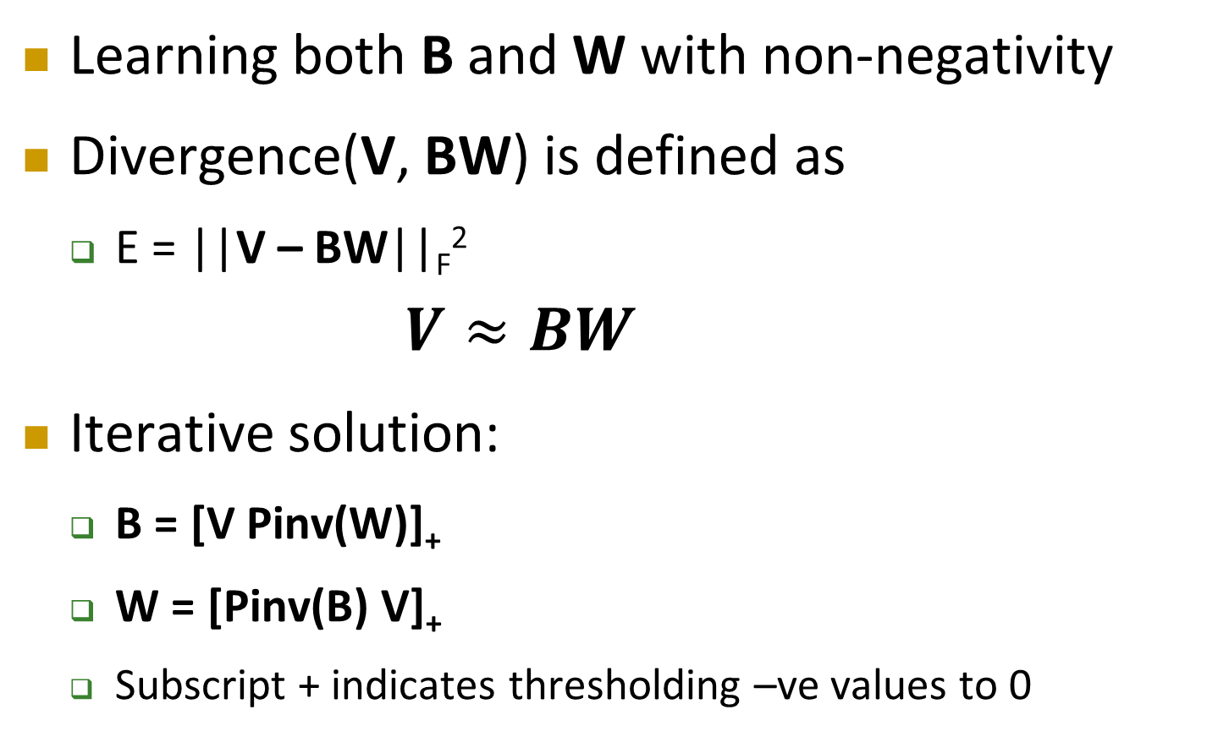
NMF: Minimizing L₂ Divergence
Learning both B and W with non-negativity
Divergence(V, BW) is defined as
E = ||V – BW||_{F}²
$$V≈BW$$
Iterative solution:
B = [V Pinv(W)]₊
W = [Pinv(B) V]₊
Subscript + indicates thresholding –ve values to 0

Slide 39
NMF: Minimizing Divergence
Define a Divergence between data V and approximation BW
Divergence(V, BW) is the total error in approximating all vectors in V as BW
Must estimate B and W so that this error is minimized
Divergence(V, BW) can be defined in different ways
L2: Divergence = Σ_{i}Σ_{j} (V_{ij} – (BW)_{ij})²
Minimizing the L2 divergence gives us an algorithm to learn B and W
KL: Divergence(V,BW) = Σ_{i}Σ_{j} V_{ij} log(V_{ij} / (BW)_{ij})+ Σ_{i}Σ_{j} V_{ij} − Σ_{i}Σ_{j} (BW)_{ij}
This is a generalized KL divergence that is minimum when V = BW
Minimizing the KL divergence gives us another algorithm to learn B and W
For many kinds of signals, e.g. sound, NMF-based representations work best when we minimize the KL divergence

Slide 40
NMF: Minimizing KL Divergence
Divergence(V, BW) defined as
E = Σ_{i}Σ_{j} V_{ij} log(V_{ij} / (BW)_{ij})+ Σ_{i}Σ_{j} V_{ij} − Σ_{i}Σ_{j} (BW)_{ij}
Iterative update rules
Number of iterative update rules have been proposed
The most popular one is the multiplicative update rule..

Slide 41
NMF Estimation: Learning bases
The algorithm to estimate B and W to minimize the KL divergence between V and BW:
Initialize B and W (randomly)
Iteratively update B and W using the following formulae
Iterations continue until divergence converges
In practice, continue for a fixed no. of iterations

Slide 42
Reiterating
NMF learns the optimal set of basis vectors B_{k} to approximate the data in terms of the bases
It also learns how to compose the data in terms of these bases
Compositions can be inexact
B₁
The columns of B are the bases
The columns of V are the data
B₂
w_{L,1}
w_{L,2}

Slide 43
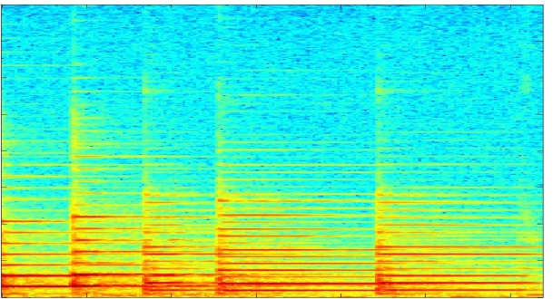

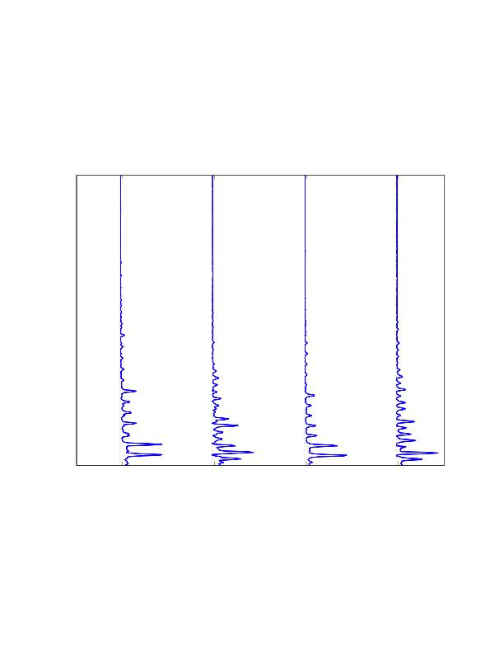
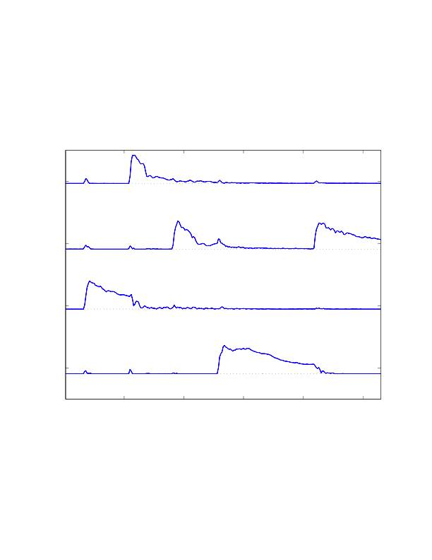
Learning building blocks of sound
From Bach’s Fugue in Gm
Each column of V is one spectral vector
Each column of B is one building block/basis
Each column of W has the scaling factors for the bases to compose the corresponding column of V
All terms are non-negative
Learn B (and W) by applying NMF to V
bases
Frequency →
Time →

Slide 44
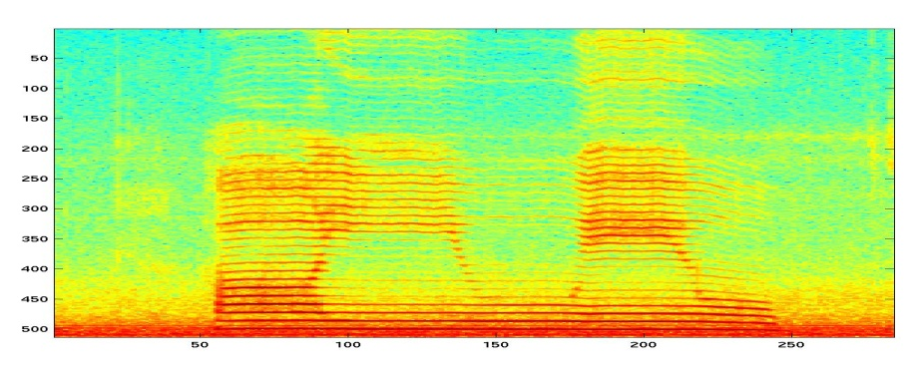
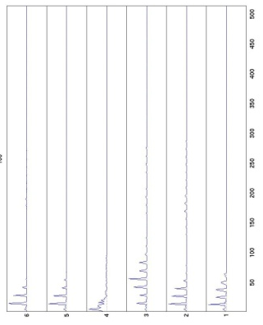
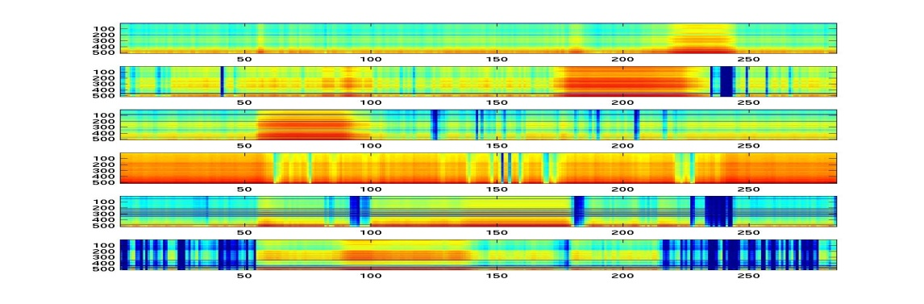
Learning Building Blocks
Speech Signal
bases
Basis-specific spectrograms

Slide 45
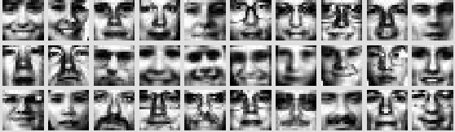

What about other data
Faces
Trained 49 multinomial components on 2500 faces
Each face unwrapped into a 361-dimensional vector
Discovers parts of faces

Slide 46
There is no “compactness” constraint
No explicit “compactness” constraint on bases
The red lines would be perfect bases:
Enclose all training data without error
Algorithm can end up with these bases
If no. of bases K >= dimensionality D, can get uninformative bases
B₁
B₂
If K < D, we usually learn compact representations
NMF becomes a dimensionality reducing representation
Representing D-dimensional data in terms of K weights, where K < D

Slide 47
Representing Data using Known Bases
B₁
B₂
w₁
w₂
If we already have bases B_{k} and are given a vector that must be expressed in terms of the bases:
Estimate weights as:
Initialize weights
Iteratively update them using

Slide 48
What can we do knowing the building blocks
Signal Representation
Signal Separation
Signal Completion
Denoising
Signal recovery
Music Transcription
Etc.

Slide 49


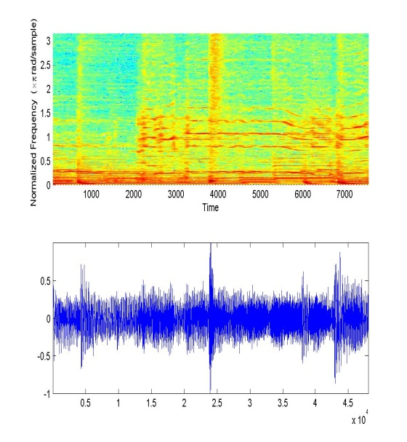
Signal Separation
Can we separate mixed signals?

Slide 50


Undoing a Jigsaw Puzzle
Composition
From green blocks
From red blocks
Building blocks
Given two distinct sets of building blocks, can we find which parts of a composition were composed from which blocks

Slide 51
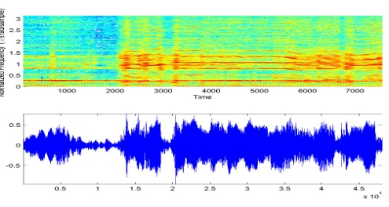
Separating Sounds
estimate
given
estimate
From example of A, learn blocks A (NMF)

Slide 52

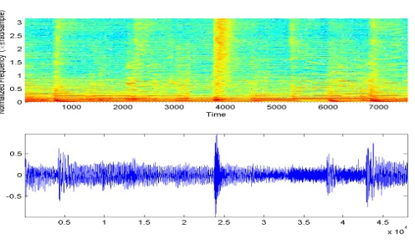
Separating Sounds
estimate
given
estimate
From example of A, learn blocks A (NMF)
From example of B, learn B (NMF)

Slide 53
Separating Sounds
given
given
estimate
From mixture, separate out (NMF)
Use known “bases” of both sources
Estimate the weights with which they combine in the mixed signal

Slide 54
Separating Sounds
estimate
given
estimate
Separated signals are estimated as the contributions of the source-specific bases to the mixed signal
estimate

Slide 55
Separating Sounds
estimate
given
estimate
estimate
It is sometimes sufficient to know the bases for only one source
The bases for the other can be estimated from the mixed signal itself
estimate

Slide 56
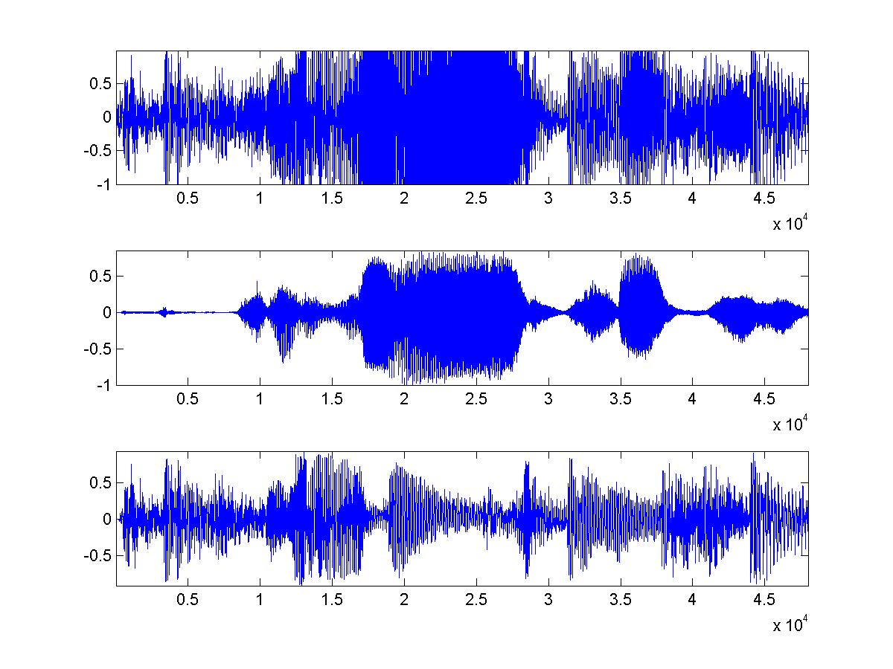
Separating Sounds
“Raise my rent” by David Gilmour
Background music “bases” learnt from 5-seconds of music-only segments within the song
Lead guitar “bases” bases learnt from the rest of the song
Norah Jones singing “Sunrise”
Background music bases learnt from 5 seconds of music-only segments

Slide 57


Predicting Missing Data
Use the building blocks to fill in “holes”

Slide 58


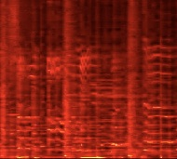
Filling in
Some frequency components are missing (left panel)
We know the bases
But not the mixture weights for any particular spectral frame
We must “fill in” the holes in the spectrogram
To obtain the one to the right

Slide 59
Learn building blocks
estimate
given
estimate
Learn the building blocks from other examples of similar sounds
E.g. music by same singer
E.g. from undamaged regions of same recording

Slide 60

Predict data
estimate
estimate
Modified bases (given)
Full bases
“Modify” bases to look like damaged spectra
Remove appropriate spectral components
Learn how to compose damaged data with modified bases
Reconstruct missing regions with complete bases

Slide 61
Filling in : An example
Madonna…
Bases learned from other Madonna songs

Slide 62
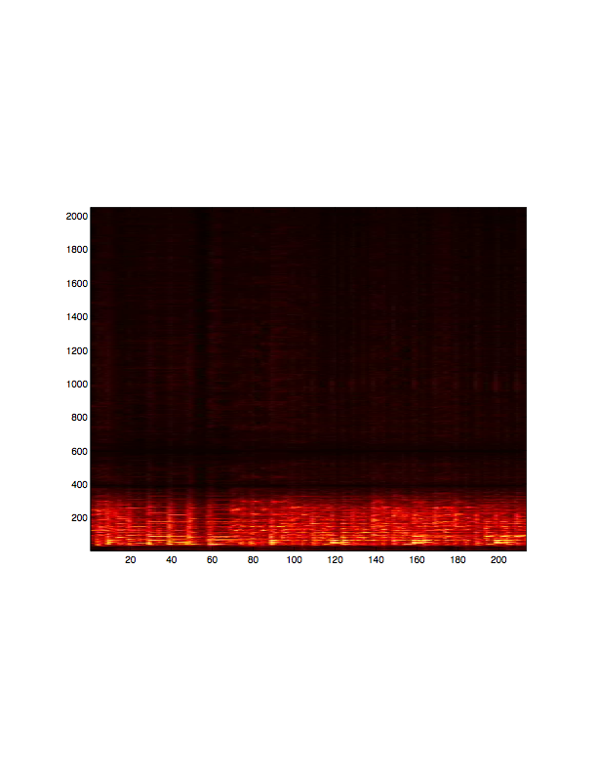
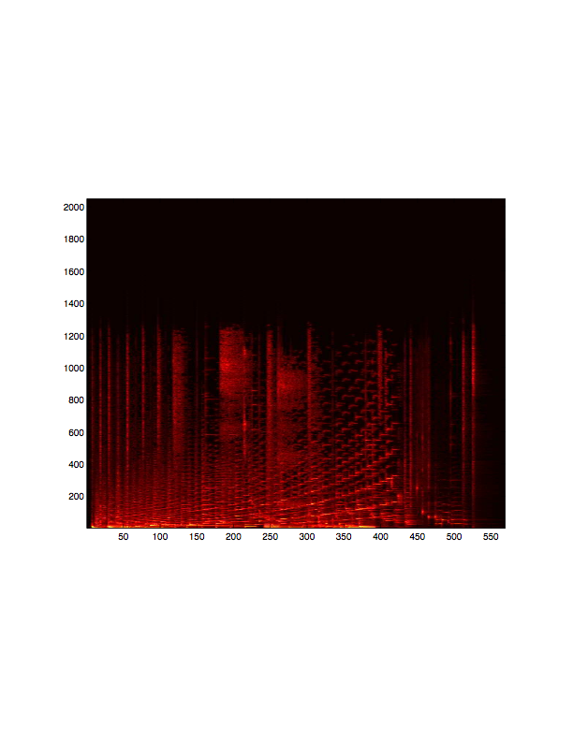
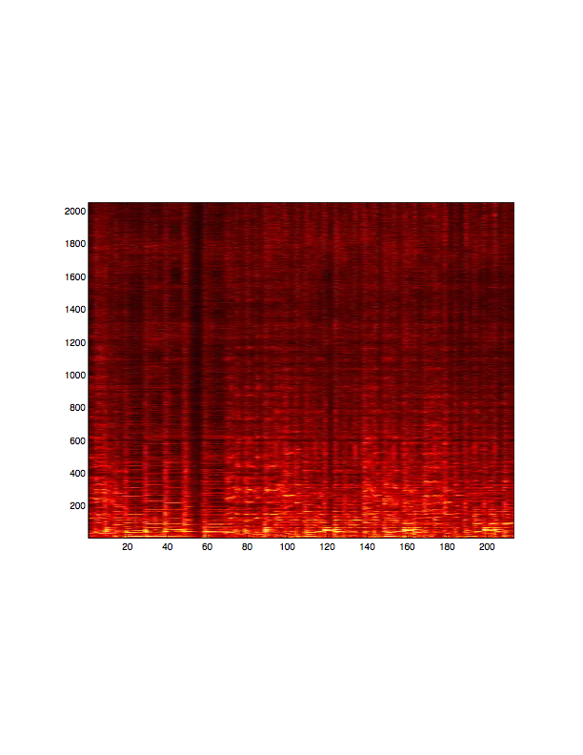
A more fun example
Reduced BW data
Bases learned from this
Bandwidth expanded version

Slide 63
A Natural Restriction
B₁
B₂
For K-dimensional data, can learn no more than K-1 bases meaningufully
At K bases, simply select the axes as bases
The bases will represent all data exactly

Slide 64
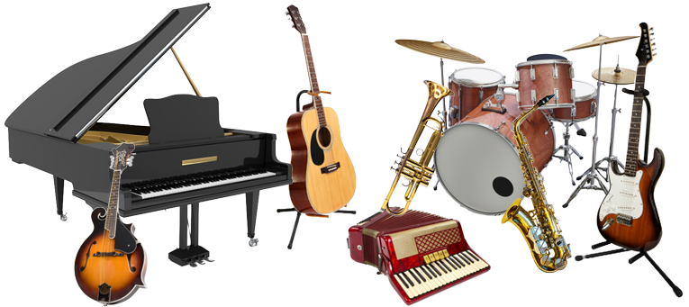
Its an unnatural restriction
For K-dimensional spectra, can learn no more than K-1 bases
Nature does not respect the dimensionality of your spectrogram
E.g. Music: There are tens of instruments
Each can produce dozens of unique notes
Amounting to a total of many thousands of notes
Many more than the dimensionality of the spectrum
E.g. images: a 1024 pixel image can show millions of recognizable pictures!
Many more than the number of pixels in the image

Slide 65

Fixing the restriction: Updated model
Can have a very large number of building blocks (bases)
E.g. notes
But any particular frame is composed of only a small subset of bases
E.g. any single frame only has a small set of notes

Slide 66
The Modified Model
For one vector
Modification 1:
In any column of W, only a small number of entries have non-zero value
I.e. the columns of W are sparse
These are sparse representations
Modification 2:
B may have more columns than rows
These are called overcomplete representations
Sparse representations need not be overcomplete, but the reverse will generally not provide useful decompositions

Slide 67
Imposing Sparsity
Minimize a modified objective function
Combines divergence and ell-0 norm of W
The number of non-zero elements in W
Minimize Q instead of E
Simultaneously minimizes both divergence and number of active bases at any time

Slide 68
Imposing Sparsity
Minimize the ell-0 norm is hard
Combinatorial optimization
Minimize ell-1 norm instead
The sum of all the entries in W
Relaxation
Is equivalent to minimize ell-0
We cover this equivalence later
Will also result in sparse solutions

Slide 69
Update Rules
Modified Iterative solutions
In gradient based solutions, gradient w.r.t any W term now includes λ
I.e. if dQ/dW = dE/dW + λ
For KL Divergence, results in following modified update rules
Increasing λ makes the weights increasingly sparse

Slide 70
Update Rules
Modified Iterative solutions
In gradient based solutions, gradient w.r.t any W term now includes λ
I.e. if dQ/dW = dE/dW + λ
Both B and W can be made sparse

Slide 71
What about Overcompleteness?
Use the same solutions
Simply make B wide!
W must be made sparse

Slide 72
Sparsity: What do we learn
Without Sparsity
With Sparsity
B₁
B₁
B₂
B₂
Without sparsity: The model has an implicit limit: can learn no more than D-1 useful bases
If K >= D, we can get uninformative bases
Sparsity: The bases are “pulled towards” the data
Representing the distribution of the data much more effectively

Slide 73
Sparsity: What do we learn
Each dot represents a location where a vector “pierces” the simplex
Top and middle panel: Compact (non-sparse) estimator
As the number of bases increases, bases migrate towards corners of the orthant
Bottom panel: Sparse estimator
Cone formed by bases shrinks to fit the data

Slide 74

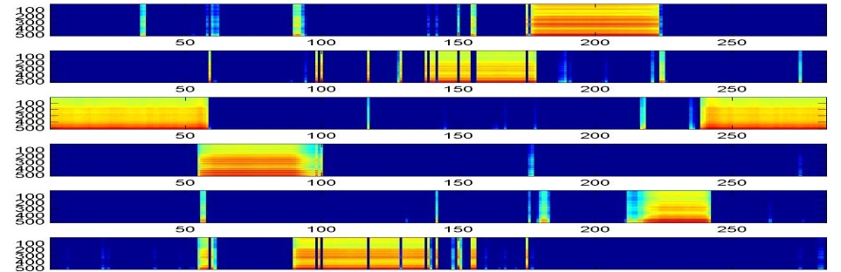

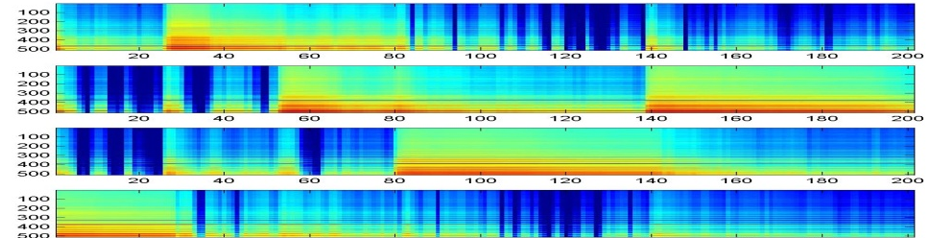
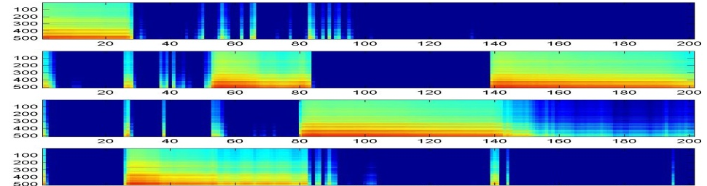

The Vowels and Music Examples
Left panel, Compact learning: most bases have significant energy in all frames
Right panel, Sparse learning: Fewer bases active within any frame
Decomposition into basic sounds is cleaner

Slide 75
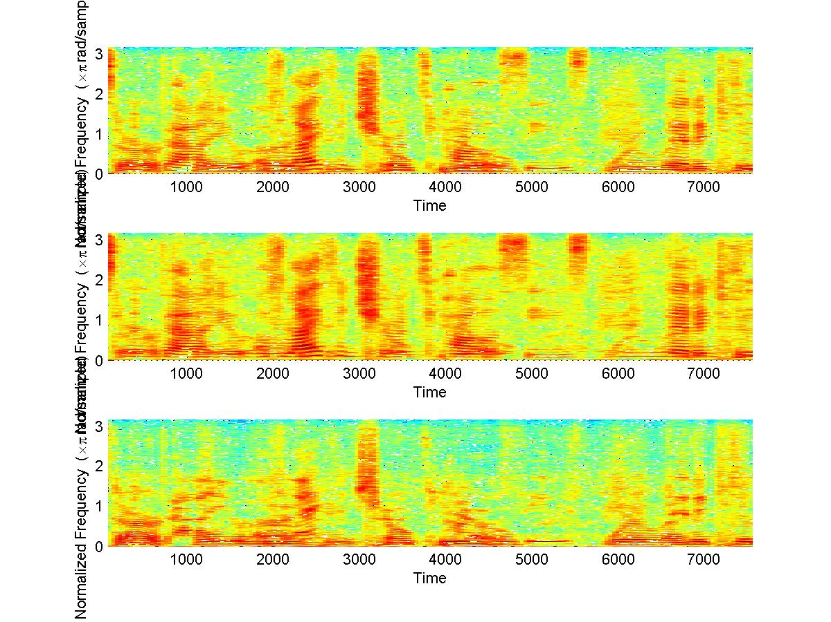
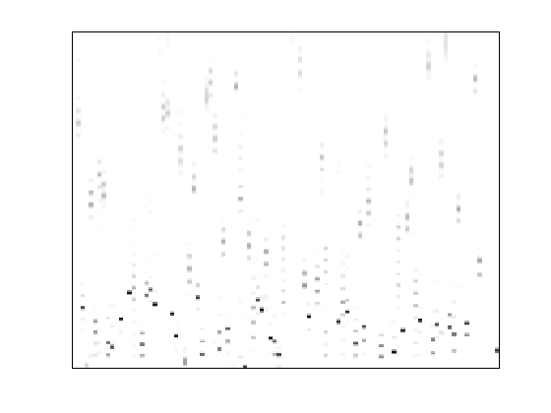
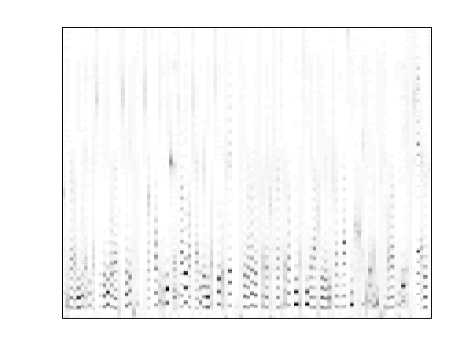
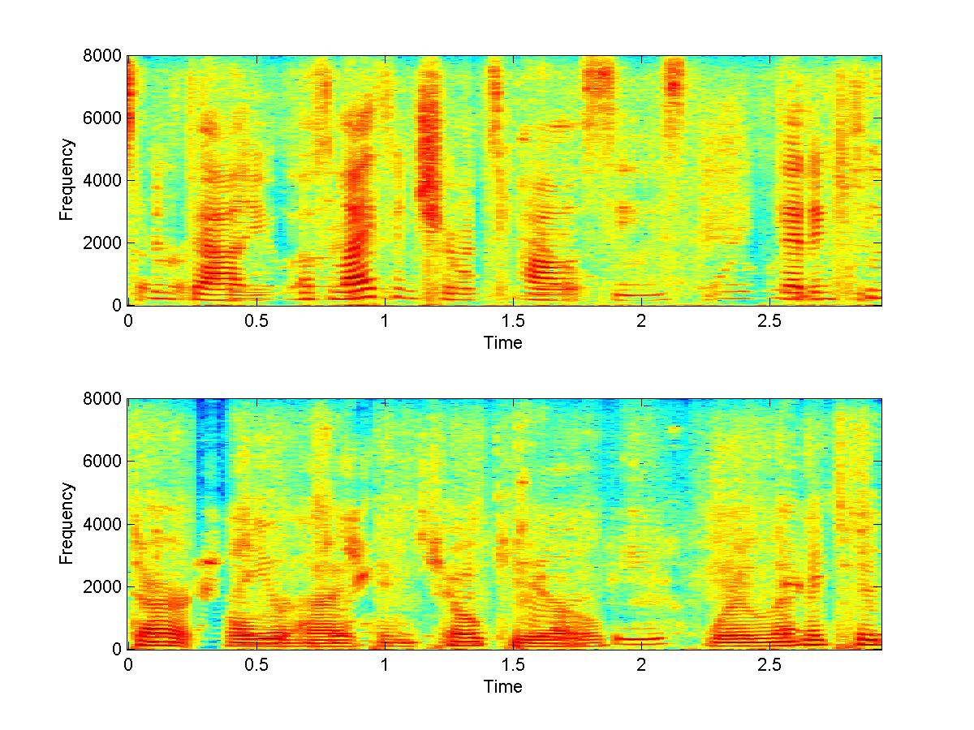
Sparse Overcomplete Bases: Separation
3000 bases for each of the speakers
The speaker-to-speaker ratio typically doubles (in dB) w.r.t compact bases
Regular bases
Panels 2 and 3: Regular learning
Sparse bases
Panels 4 and 5: Sparse learning

Slide 76
Sparseness: what do we learn
As solutions get more sparse, bases become more informative
In the limit, each basis is a complete face by itself.
Mixture weights simply select face
Sparse bases
“Dense” weights
Dense bases
Sparse weights

Slide 77
Filling in missing information
19x19 pixel images (361 pixels)
1000 bases trained from 2000 faces
SNR of reconstruction from overcomplete basis set more than 10dB better than reconstruction from corresponding “compact” (regular) basis set

Slide 78
Sparse decomposition for classification
Given a number of examples of handwritten instances of numbers “2” and “3”
Find bases for “2” and “3”
For any test instance, attempt to construct it using the bases for 2 and (separately) the bases for 3
The set whose bases result in the better reconstruction is selected
Accuracy improves with increasing sparsity

Slide 79
Extending the model
In reality our building blocks are not spectra
They are spectral patterns!
Which change with time

Slide 80
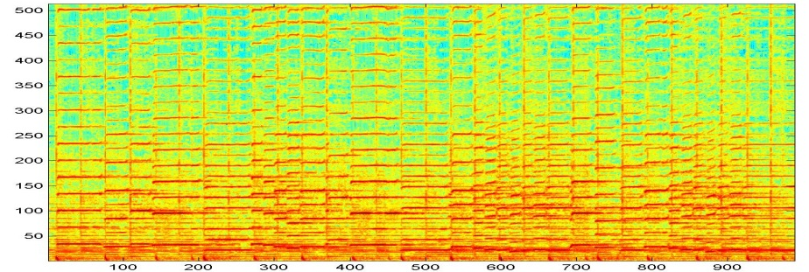
Convolutive NMF
The building blocks of sound are spectral patches!

Slide 81
Convolutive NMF
w₁₁
w₂₁
w₃₁
w₄₁
The building blocks of sound are spectral patches!
At each time, they combine to compose a patch starting from that time
Overlapping patches add

Slide 82
Convolutive NMF
w₁₂
w₂₂
w₃₂
w₄₂
The building blocks of sound are spectral patches!
At each time, they combine to compose a patch starting from that time
Overlapping patches add

Slide 83
Convolutive NMF
w₁₃
w₂₃
w₃₃
w₄₃
The building blocks of sound are spectral patches!
At each time, they combine to compose a patch starting from that time
Overlapping patches add

Slide 84
Convolutive NMF
w₁₄
w₂₄
w₃₄
w₄₄
The building blocks of sound are spectral patches!
At each time, they combine to compose a patch starting from that time
Overlapping patches add

Slide 85
Convolutive NMF
The building blocks of sound are spectral patches!
At each time, they combine to compose a patch starting from that time
Overlapping patches add

Slide 86
In Math
Each spectral frame has contributions from several previous shifts

Slide 87
An Alternate Repesentation
τ
B(t) is a matrix composed of the t-th columns of all bases
The i-th column represents the i-th basis
W is a matrix whose i-th row is sequence of weights applied to the i-th basis
The superscript t→ represents a right shift by t

Slide 88
Convolutive NMF
t
t
t
Simple learning rules for B and W
Identical rules to estimate W given B
Simply don’t update B
Sparsity can be imposed on W as before if desired

Slide 89

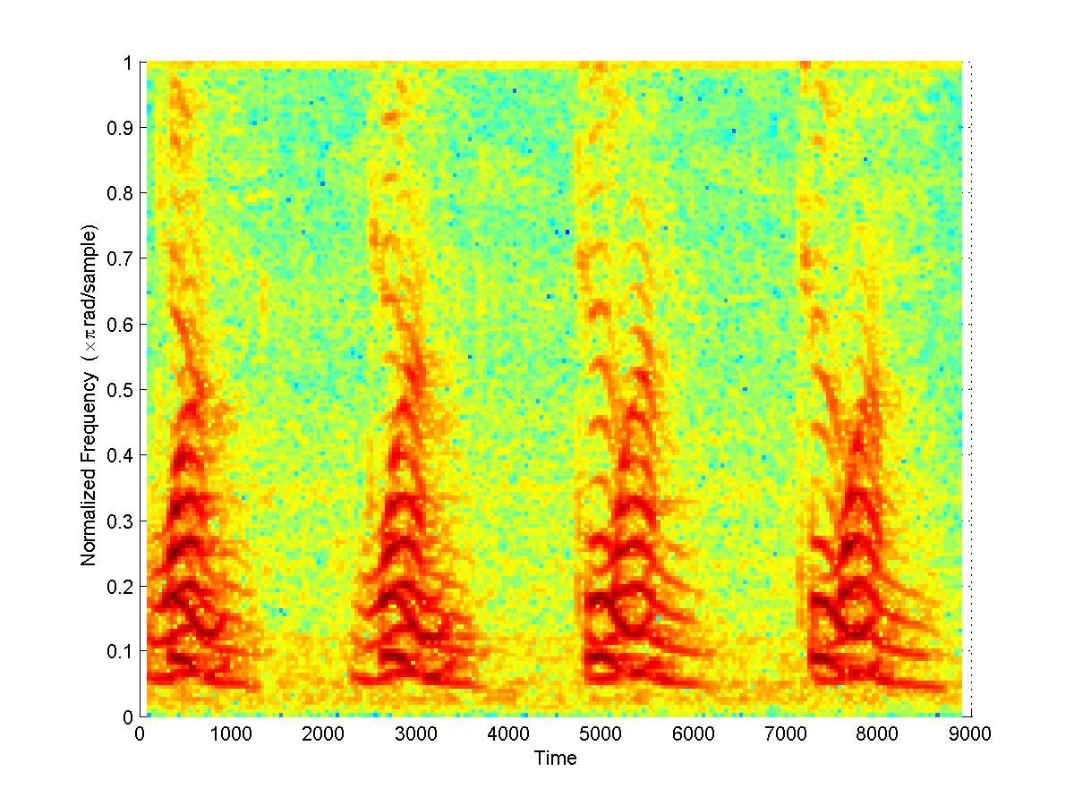
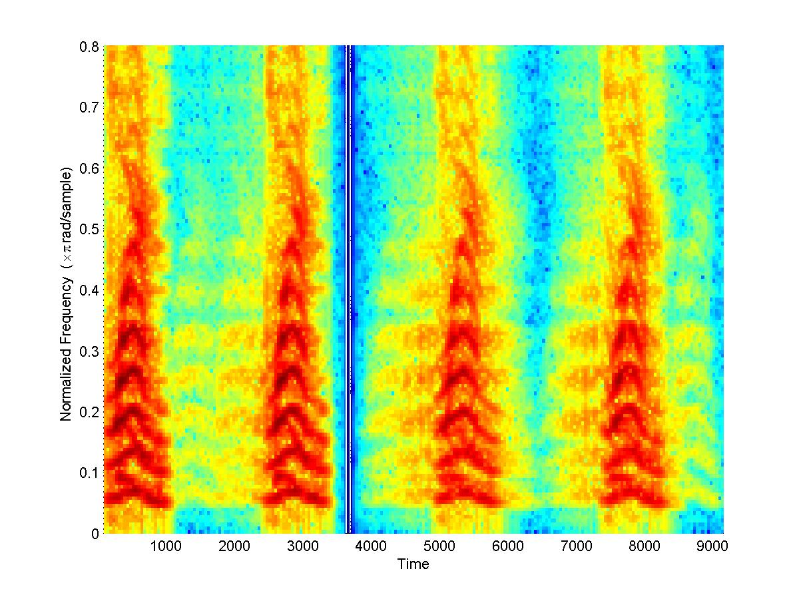
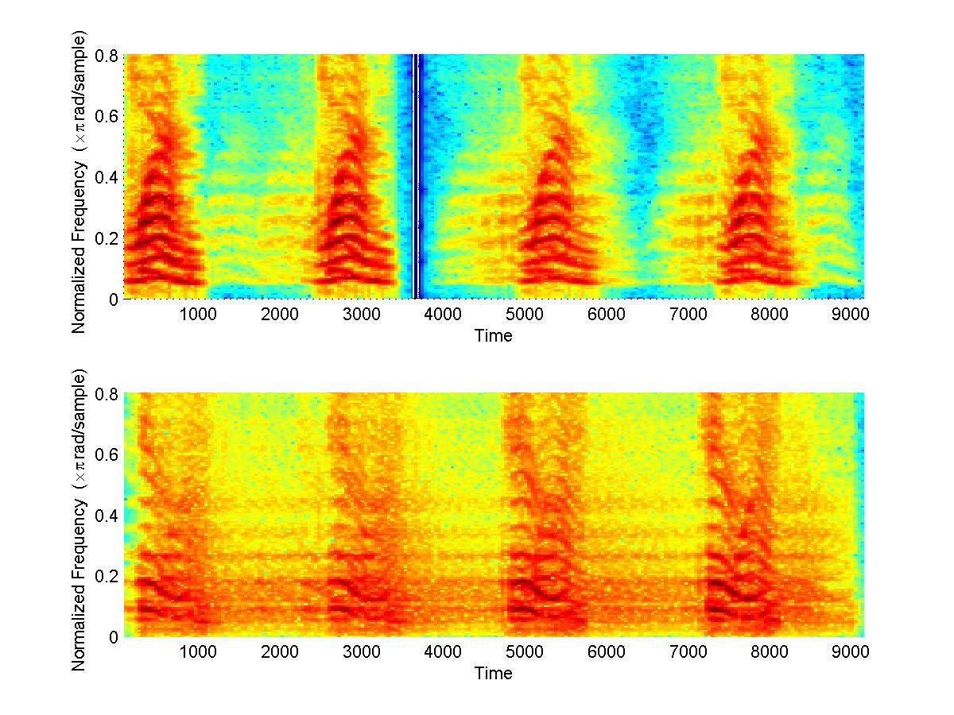
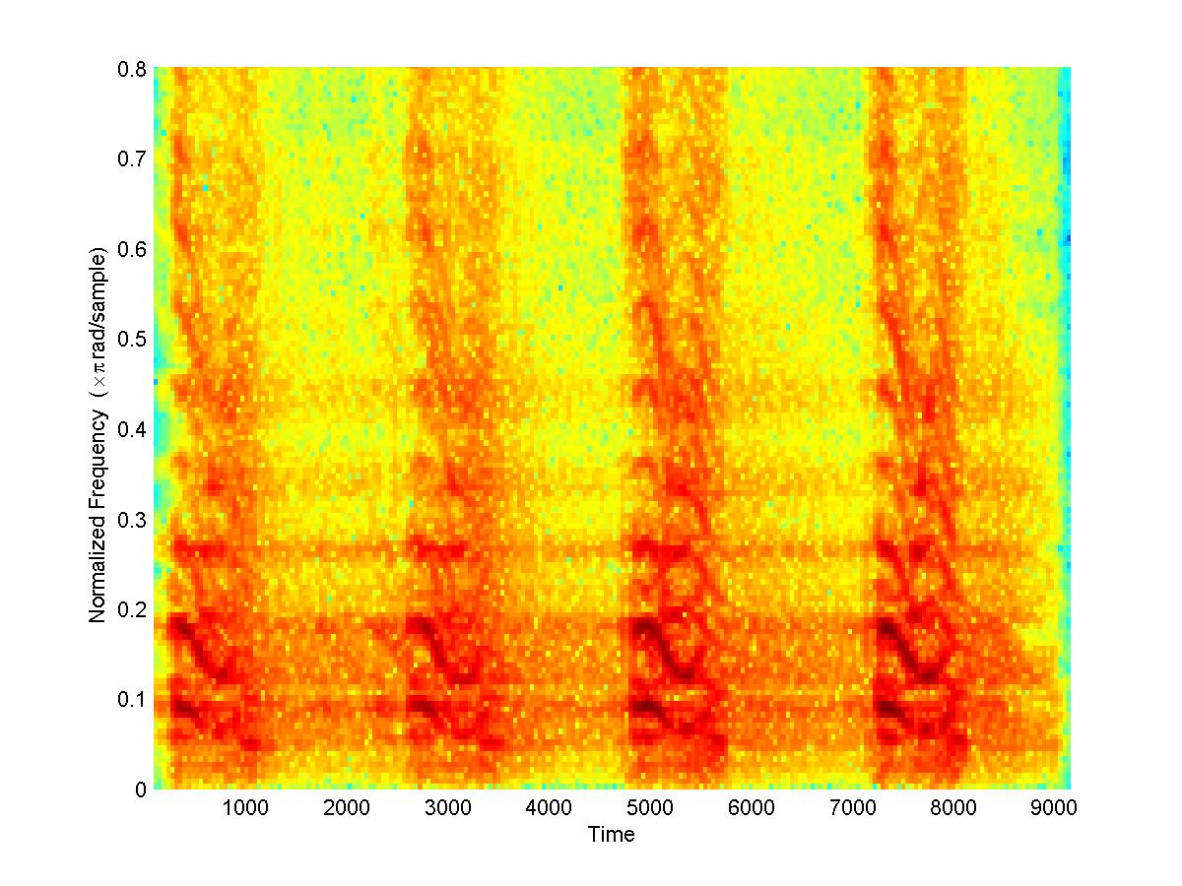

The Convolutive Model
An Example: Two distinct sounds occurring with different repetition rates within a signal
Each sound has a time-varying spectral structure
INPUT SPECTROGRAM
Discovered “patch” bases
Contribution of individual bases to the recording

Slide 90
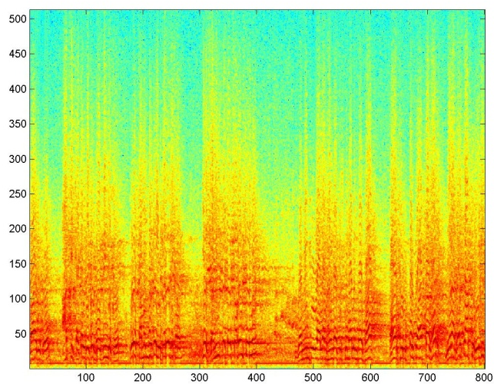
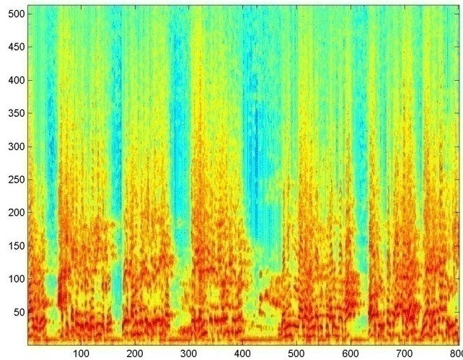
Example applications: Dereverberation
From “Adrak ke Panje” by Babban Khan
Treat the reverberated spectrogram as a composition of many shifted copies of a “clean” spectrogram
“Shift-invariant” analysis
NMF to estimate clean spectrogram

Slide 91
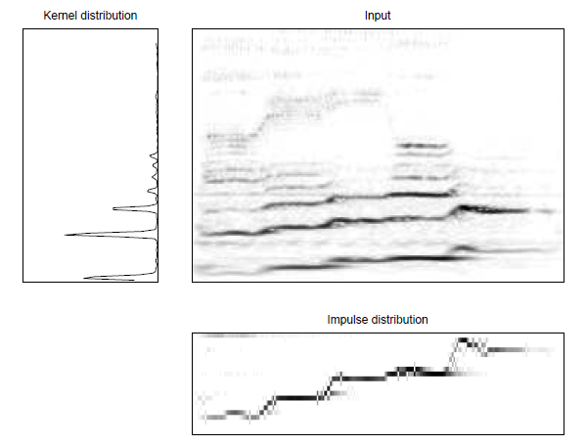
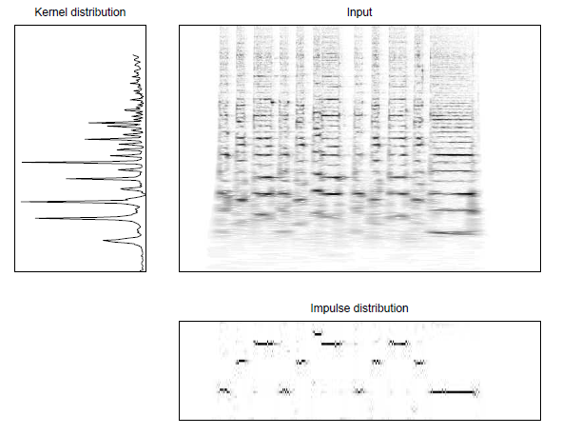
Pitch Tracking
Left: A segment of a song
Right: Smoke on the water
“Impulse” distribution captures the “melody”!

Slide 92
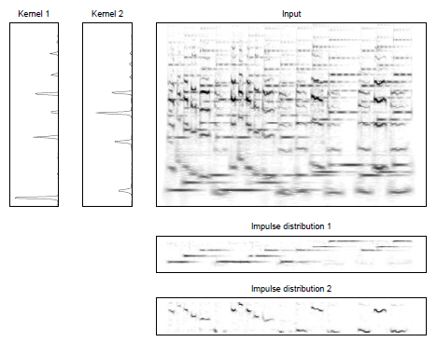
Pitch Tracking
Simultaneous pitch tracking on multiple instruments
Can be used to find the velocity of cars on the highway!!
“Pitch track” of sound tracks Doppler shift (and velocity)

Slide 93
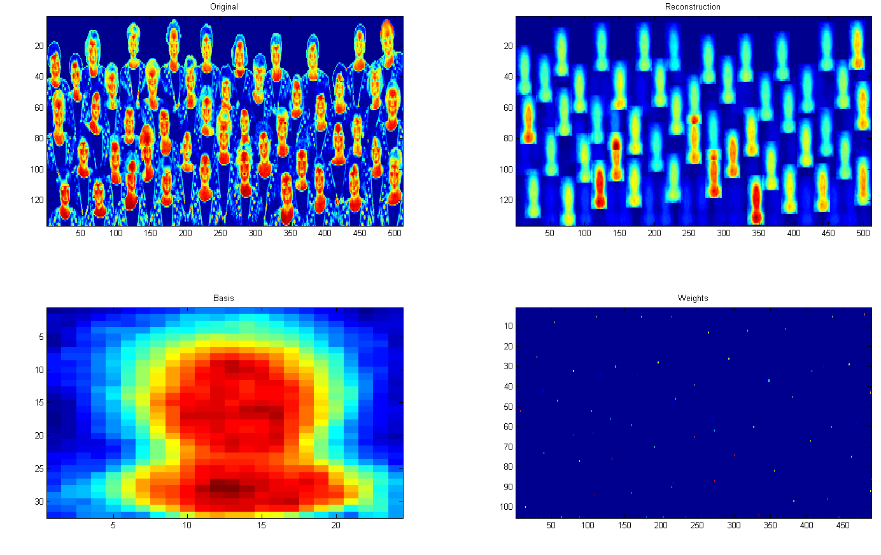
Example: 2-D shift invariance
Sparse decomposition employed in this example
Otherwise locations of faces (bottom right panel) are not precisely determined

Slide 94
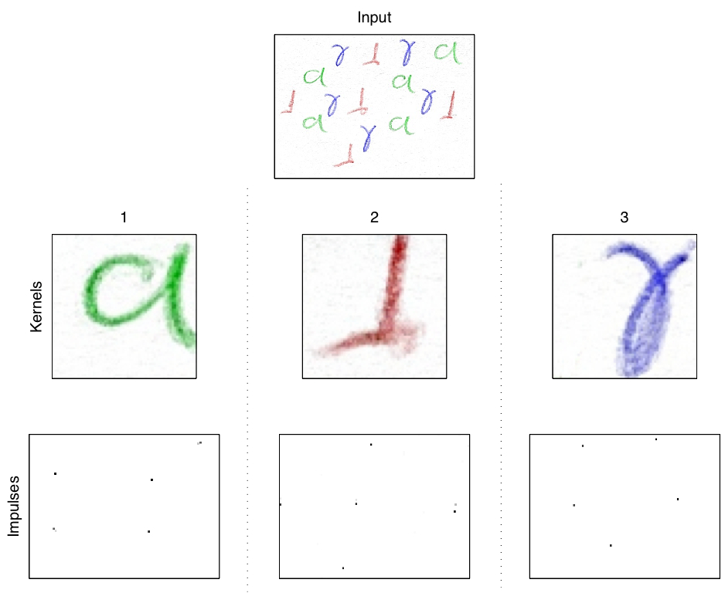
Example: 2-D shift invarince
The original figure has multiple handwritten renderings of three characters
In different colours
The algorithm learns the three characters and identifies their locations in the figure
Input data
Discovered Patches
Patch Locations

Slide 95
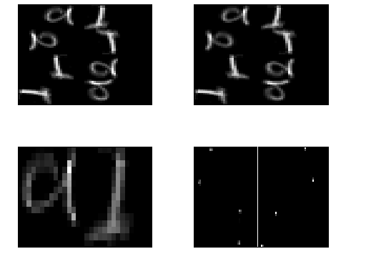
Example: Transform Invariance
Top left: Original figure
Bottom left – the two bases discovered
Bottom right –
Left panel, positions of “a”
Right panel, positions of “l”
Top right: estimated distribution underlying original figure

Slide 96
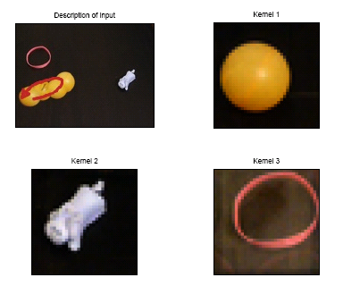
Example: Higher dimensional data
Video example

Slide 97
Lessons learned
Useful compositional model of data
Really effective when the data obey compositional rules..

