Slide 1

Machine Learning for Signal Processing
Detecting faces (& other objects) in images
Class 7. 17 Feb 2015
Slides partially from Gary Overett
Notes:
Sorry to say it’s a repeat of Tuesdays lecture. We had so many technical issues and delays that I only managed to cover about 30 minutes of the lecture. Since it didn’t make sense to present half a lecture and then have an ongoing mixup of lectures I’m going to be giving Tuesdays talk from the top. Hopefully without the issues we had last week. It should be better. You’re warmed up, I’m warmed up, even the freaking video conference has had a chance to work through its issues.

Slide 2
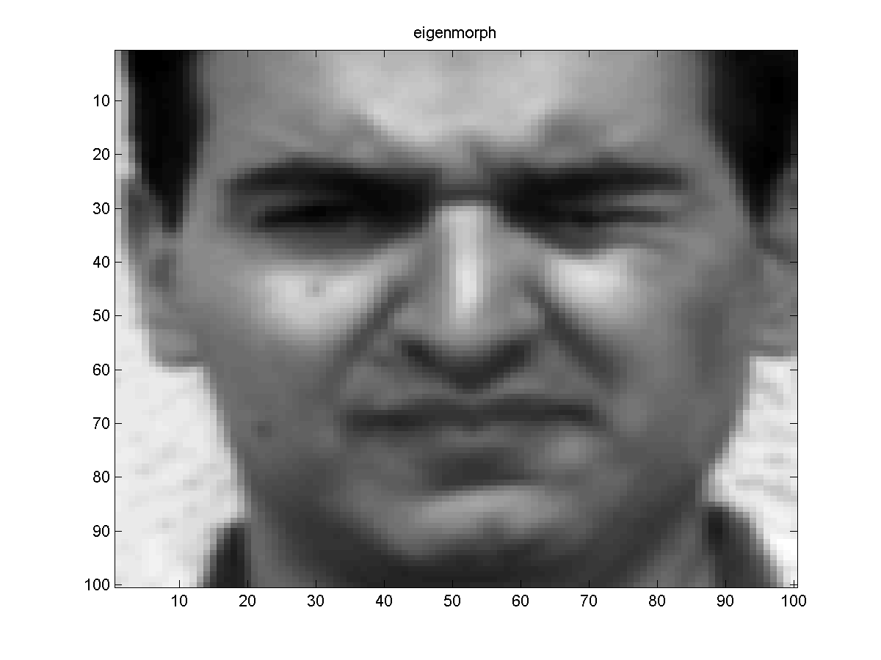



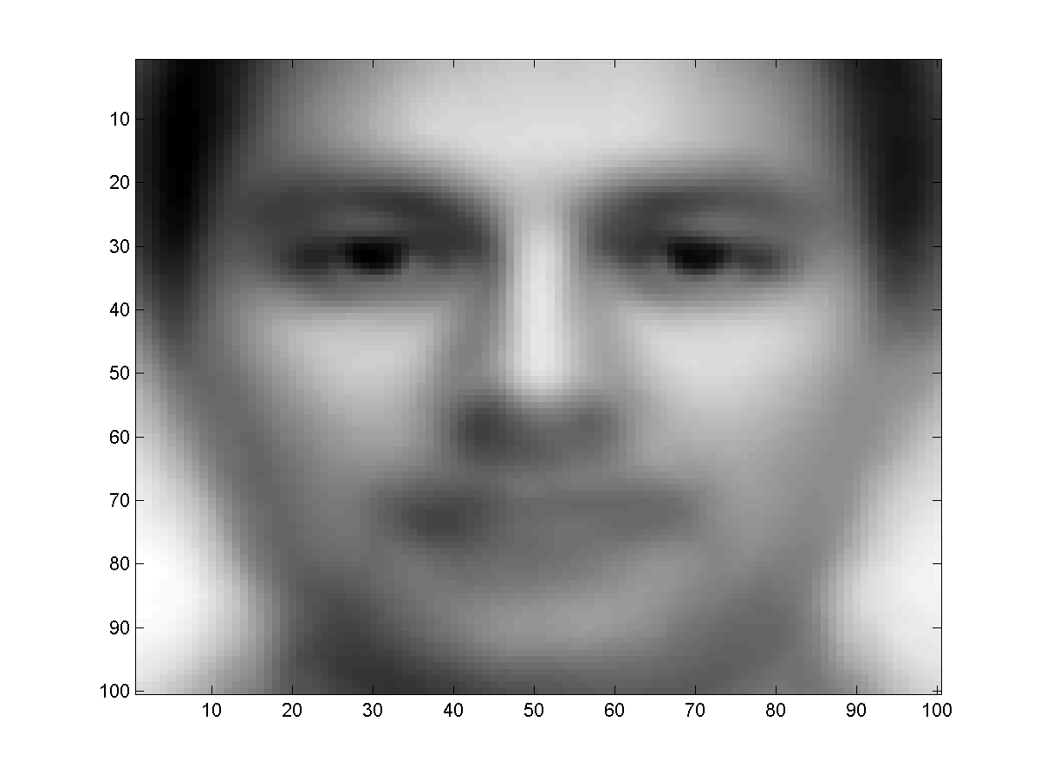




Last Lecture: How to describe a face
The typical face
A “typical face” that captures the essence of “facehood”..
The principal Eigen face..
Notes:
Recap. Eigenfaces, an optimal basis for describing a set of faces. Why do they so many look like criminals? Noted the idea of a typical or “principal” eigen face.

Slide 3
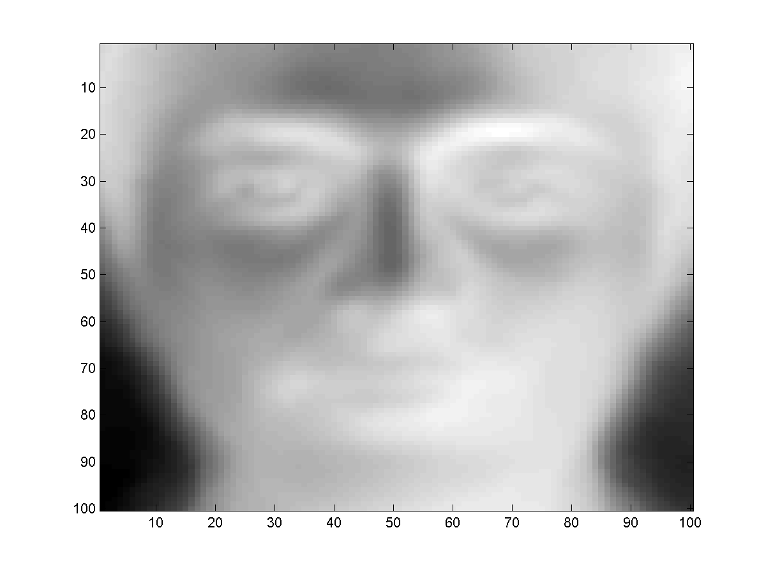
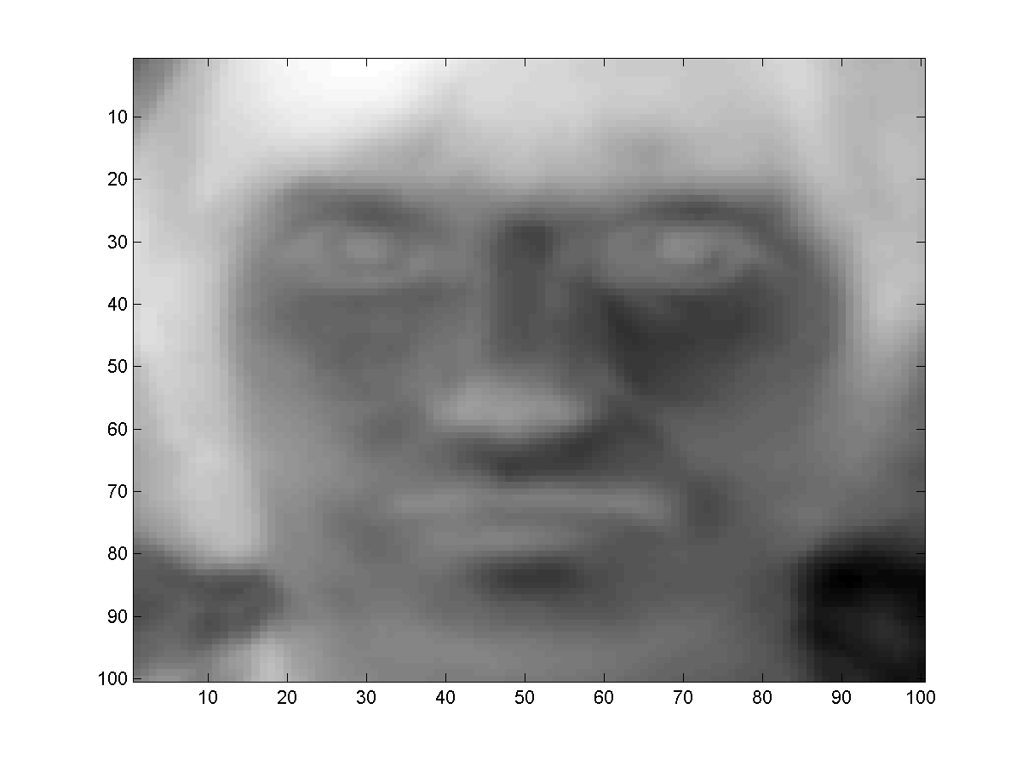
A collection of least squares typical faces
Extension: Many Eigenfaces
Approximate every face f as f = w_{f,1} V₁+ w_{f,2} V₂ +.. + w_{f,k} V_{k}
  V₂ is used to “correct” errors resulting from using only V₁
  V₃ corrects errors remaining after correction with V₂
  And so on..
V = [V₁ V₂ V₃] can be computed through Eigen analysis
Notes:
Any face can be approximated as a weighted sum of Eigenfaces. Weights can be negative

Slide 4
Detecting Faces in Images
Notes:
So first we are going to explore some basic ideas about how you might go about finding faces in an image.

Slide 5
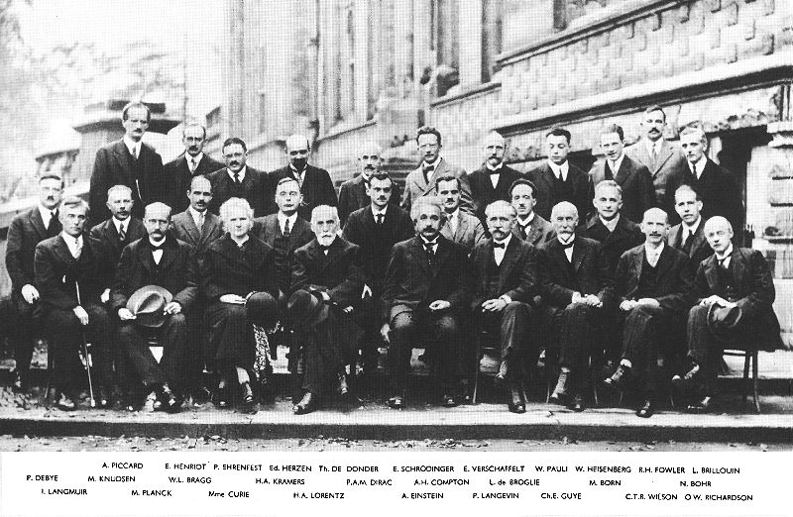
Detecting Faces in Images
Finding face like patterns
  How do we find if a picture has faces in it
  Where are the faces?
A simple solution:
  Define a “typical face”
  Find the “typical face” in the image
Notes:
So if we have an image like this and we want to find a face. It makes sense that we’d simply look for face-like patterns in the image. How do you define face-like patterns? Well, one idea is to consider a typical face. Which you can come up with via the Eigenface method from last week.

Slide 6
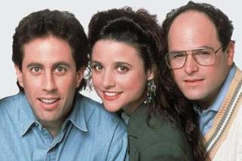
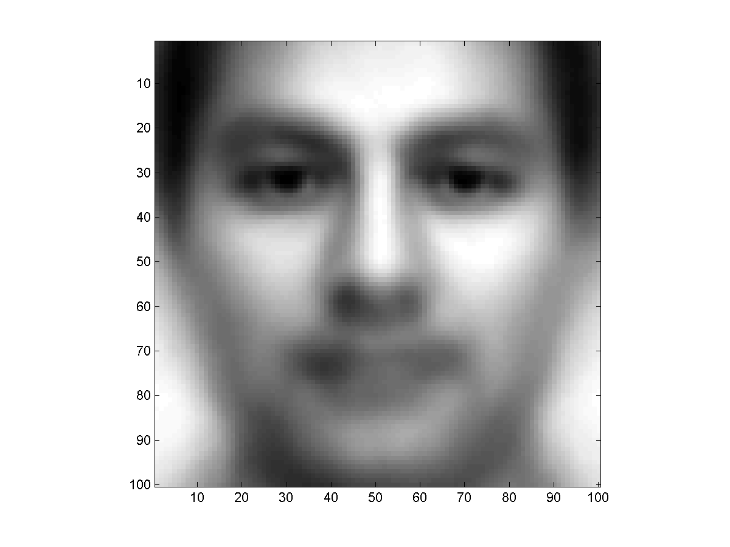
Given an image and a ‘typical’ face how do I find the faces?
?
+
+
100×100
400×200 (RGB)
Notes:
As we discussed on Tuesday one of the first moves is to dispense with information that you don’t need. Such as color. And then deal with other issues such as the differences in scale, size of images etc.

Slide 7
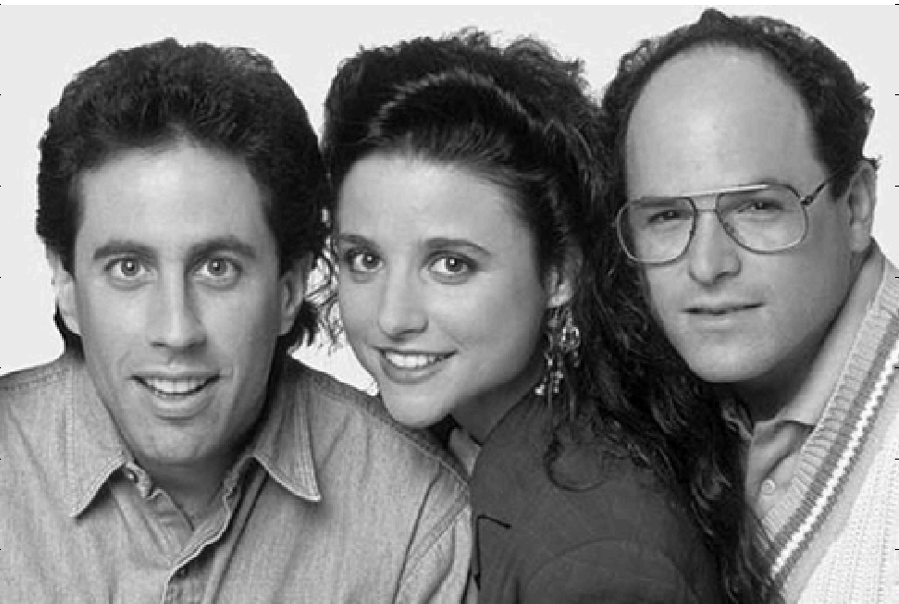
Finding faces in an image
Picture is larger than the “typical face”
  E.g. typical face is 100x100, picture is 600x800
First convert to greyscale
  R + G + B
  Not very useful to work in color

Slide 8
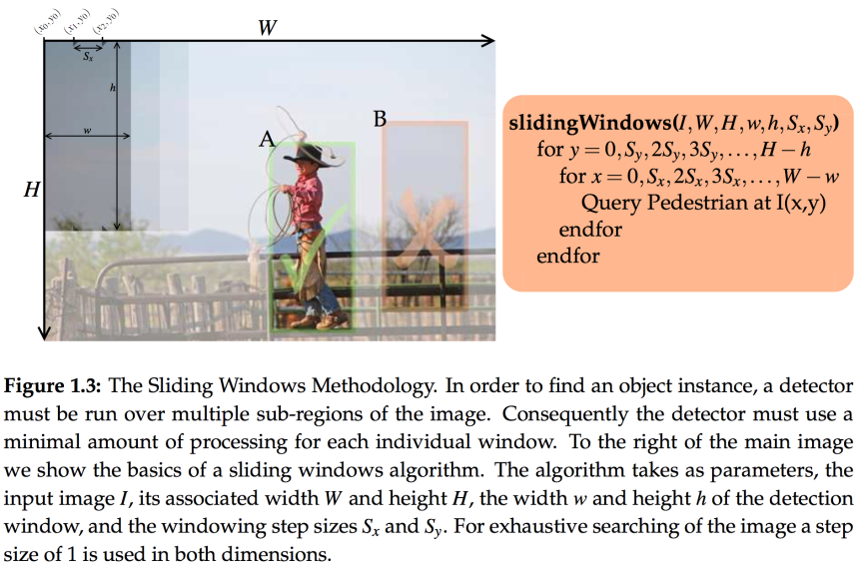
Sliding Windows
Notes:
So then first up we had the quite simple idea of the Sliding windows search. Which is your basic raster scan of the image.

Slide 9
Finding faces in an image
Goal .. To find out if and where images that look like the “typical” face occur in the picture

Slide 10
Finding faces in an image
Try to “match” the typical face to each location in the picture
Notes:
Quite literally you start at the top left of the image and go row by row over the image trying to find a match

Slide 11
Finding faces in an image
Try to “match” the typical face to each location in the picture

Slide 12
Finding faces in an image
Try to “match” the typical face to each location in the picture

Slide 13
Finding faces in an image
Try to “match” the typical face to each location in the picture

Slide 14
Finding faces in an image
Try to “match” the typical face to each location in the picture

Slide 15
Finding faces in an image
Try to “match” the typical face to each location in the picture

Slide 16
Finding faces in an image
Try to “match” the typical face to each location in the picture

Slide 17
Finding faces in an image
Try to “match” the typical face to each location in the picture

Slide 18
Finding faces in an image
Try to “match” the typical face to each location in the picture

Slide 19
Finding faces in an image
Try to “match” the typical face to each location in the picture
The “typical face” will explain some spots on the image much better than others
  These are the spots at which we probably have a face!
Notes:
As you do this the typical face will match some parts of the image quite well, while other portions of the image less well. And the hope is that this way you’ll find most of the face-like regions of the image…

Slide 20
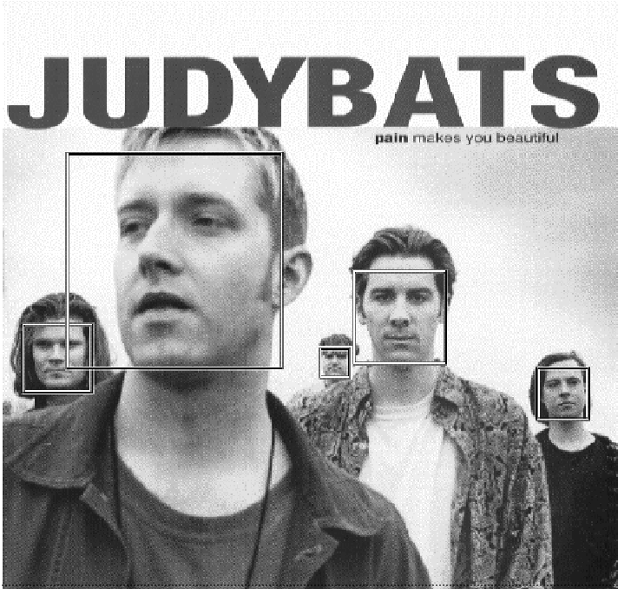
Sliding windows solves only the issue of location – what about scale?
Not all faces are the same size
Some people have bigger faces
The size of the face on the image changes with perspective
Our “typical face” only represents one of these sizes

Slide 21
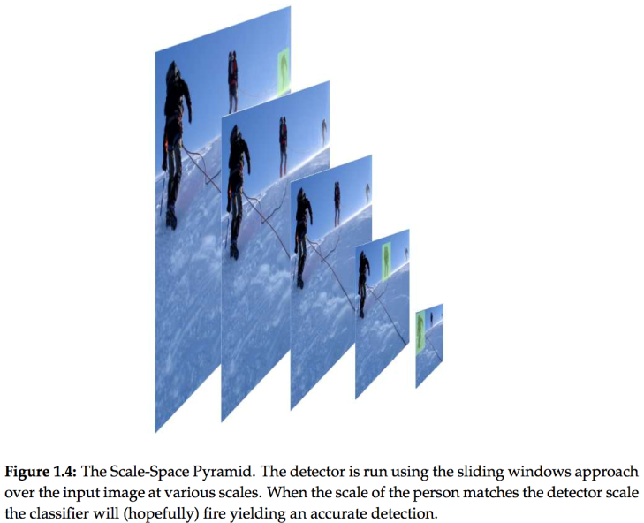
Scale-Space Pyramid
Notes:
What do you think is an optimal fraction for each layer of the scale space pyramid. If I wanted fewer layers what should I do? Tradeoff between classification variance and search space!

Slide 22
Speed concerns
Sliding windows AND Scale-space pyramid may yield million’s of ‘windows’ to investigate!
Especially for small objects in large images
Notes:
And we noted…

Slide 23
How to “match”
What exactly is the “match”
  What is the match “score”
Notes:
We asked about how to determine what is a match between the face like pattern and the query patch. And you answered correctly that the dot product was an obvious choice. correlation

Slide 24
How to “match”
What exactly is the “match”
  What is the match “score”
The DOT Product
  Express the typical face as a vector
  Express the region of the image being evaluated as a vector
    But first histogram equalize the region
      Just the section being evaluated, without considering the rest of the image
  Compute the dot product of the typical face vector and the “region” vector

Slide 25
How to “match”
I hate this! ☺
What exactly is the “match”
  What is the match “score”
The DOT Product
  Express the typical face as a vector
  Express the region of the image being evaluated as a vector
    But first histogram equalize the region
      Just the section being evaluated, without considering the rest of the image
  Compute the dot product of the typical face vector and the “region” vector
Notes:
HEQ may create noise

Slide 26
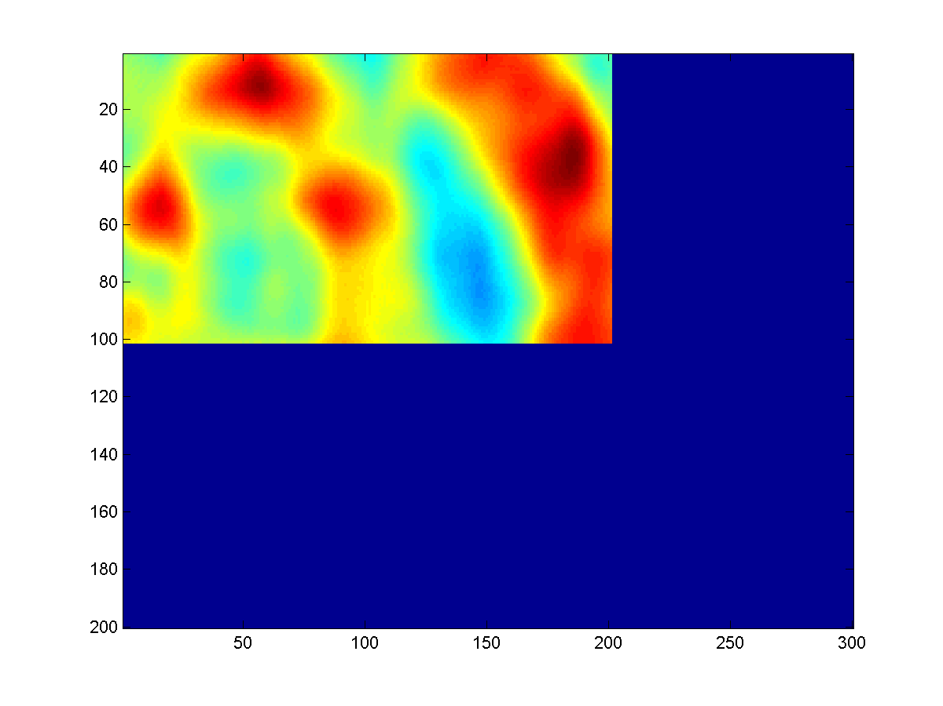
What do we get
The right panel shows the dot product at various locations
  Redder is higher
    The locations of peaks indicate locations of faces!
Notes:
And this is what you get. A kind of heat map where red here is showing areas of higher correlation between the principal eigenface and the query region. Because the principal eigenface is 100x100 you get this reduced map because it doesn’t make sense to compute the correlation beyond the border of the image

Slide 27
What do we get
The right panel shows the dot product at various locations
  Redder is higher
    The locations of peaks indicate locations of faces!
Correctly detects all three faces
  Likes George’s face most
    He looks most like the typical face
Also finds a face where there is none!
  A false alarm
Notes:
Hopefully the regions with a face light up. But its not the best option, can get false alarms. Eg. The false alarms can have higher correlation than the real faces. Issues with finding maxima

Slide 28
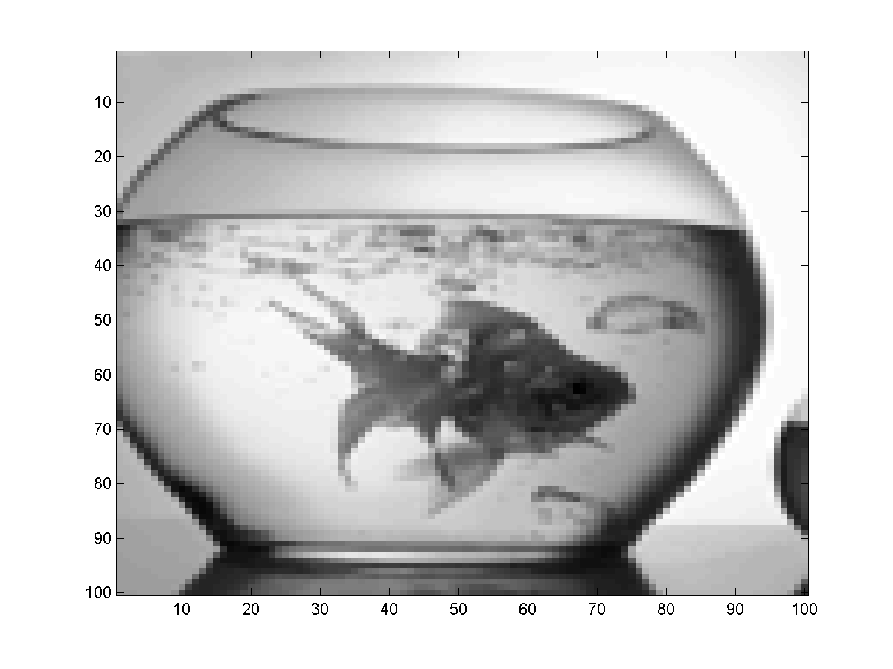
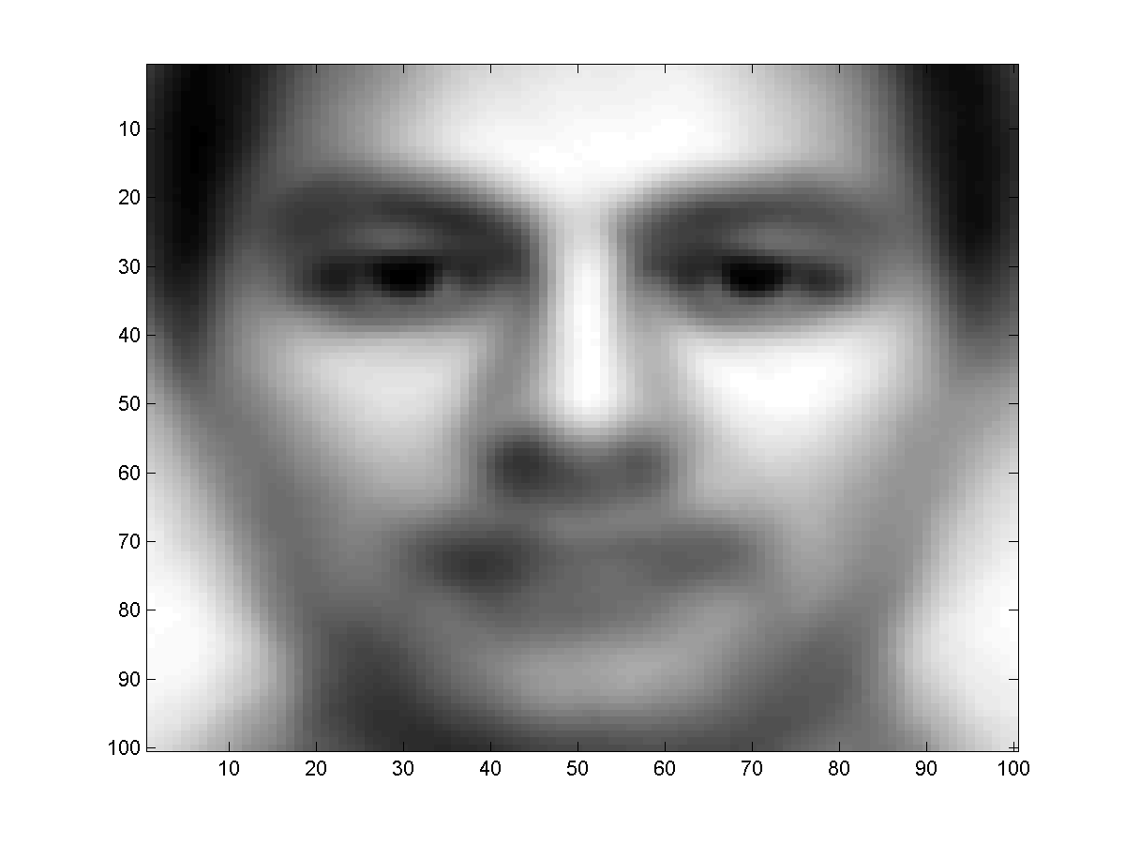
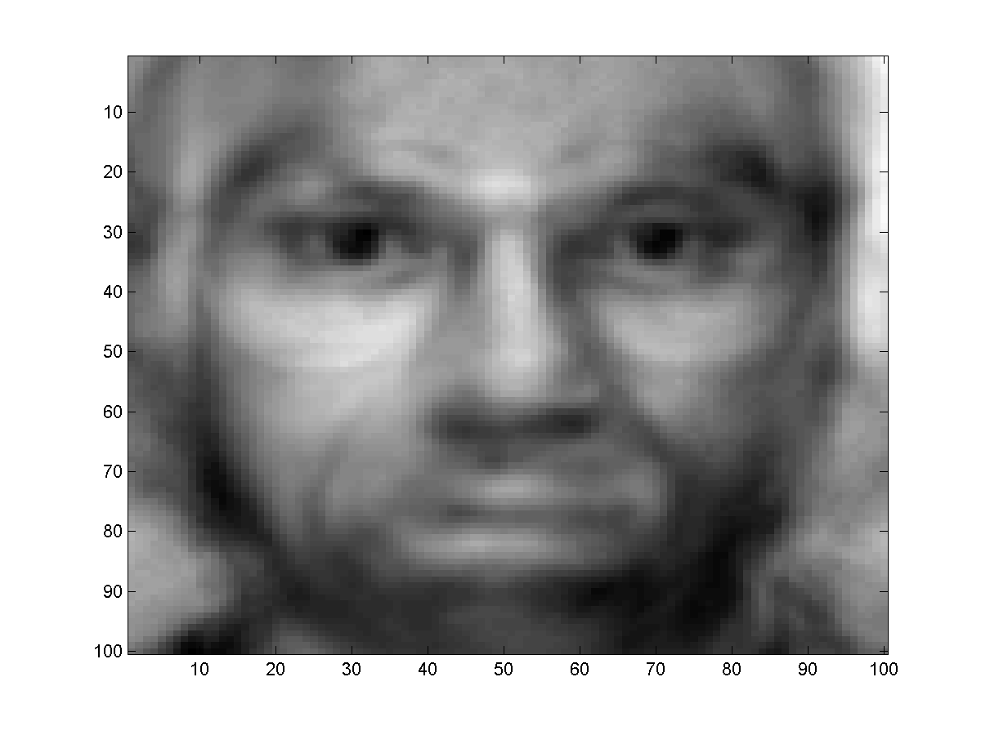
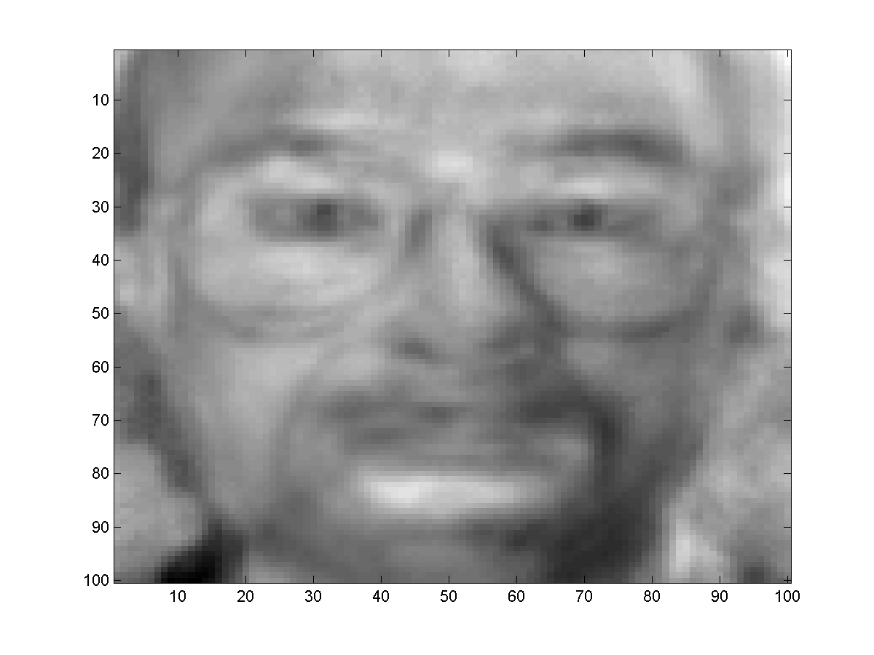
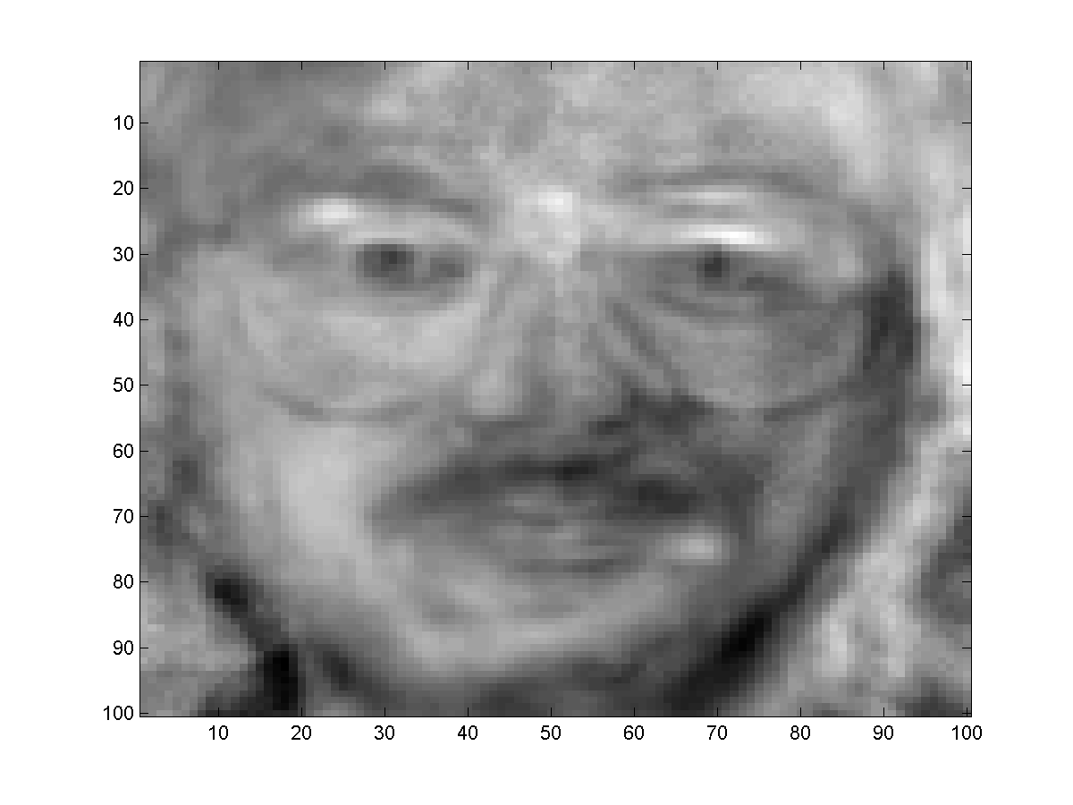
What do we get
The right panel shows the dot product at various locations
  Redder is higher
    The locations of peaks indicate locations of faces!
Correctly detects all three faces
  Likes George’s face most
    He looks most like the typical face
Also finds a face where there is none!
  A false alarm
Notes:
Hopefully the regions with a face light up. But its not the best option, can get false alarms. Eg. The false alarms can have higher correlation than the real faces. Issues with finding maxima

Slide 29
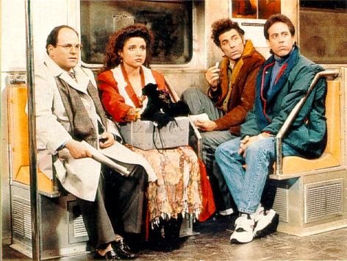
Location – Scale – What about Rotation?
The head need not always be upright!
    Our typical face image was upright
Notes:
Remember the fishbowl. Trained on faces but not faces to the exclusion of not-faces. Later we introduce the idea of training specifically for faces and against non-faces

Slide 30
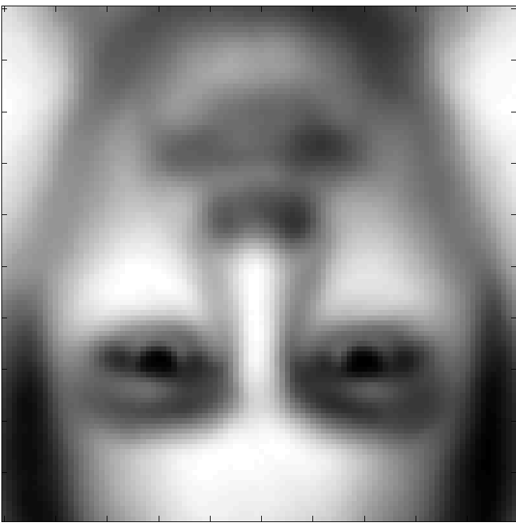
Solution
Create many “typical faces”
  One for each scaling factor
  One for each rotation
    How will we do this?
Match them all
Does this work
  Kind of .. Not well enough at all
  We need more sophisticated models
Notes:
Sliced models vs all-in-one rotation vs rotate images vs rotate bases

Slide 31
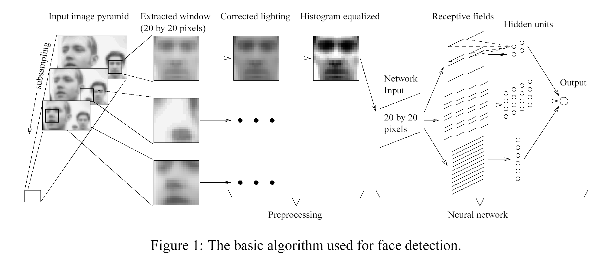
Face Detection: A Quick Historical Perspective
Many more complex methods
  Use edge detectors and search for face like patterns
  Find “feature” detectors (noses, ears..) and employ them in complex neural networks..
The Viola Jones method
  Boosted cascaded classifiers
Notes:
Ok, that was a toy example of how you might do it. How is it really done?

Slide 32
Face Detection: A Quick Historical Perspective
Many more complex methods
  Use edge detectors and search for face like patterns
  Find “feature” detectors (noses, ears..) and employ them in complex neural networks..
The Viola Jones method (20K+ Citations!)
  Boosted cascaded classifiers

Slide 33
And even before that – what is classification?
Given “features” describing an entity, determine the category it belongs to
  Walks on two legs, has no hair. Is this
    A Chimpanizee
    A Human
  Has long hair, is 5’6” tall, is this
    A man
    A woman
  Matches “eye” pattern with score 0.5, “mouth pattern” with score 0.25, “nose” pattern with score 0.1. Are we looking at
    A face
    Not a face?

Slide 34
Classification
Multi-class classification
  Many possible categories
    E.g. Sounds “AH, IY, UW, EY..”
    E.g. Images “Tree, dog, house, person..”
Classes may overlap
  Phoneme Classification vs Emotive State Classification vs Accents etc.
Binary classification
  Only two categories
    Man vs. Woman
    Face vs. not a face…
Notes:
Overlaps, phoneme classification, vs emotive classification, vs accent classification

Slide 35
Classification
Multi-class classification
  Many possible categories
    E.g. Sounds “AH, IY, UW, EY..”
    E.g. Images “Tree, dog, house, person..”
Classes may overlap
  Phoneme Classification vs Emotive State Classification vs Accents etc.
Binary classification
  Only two categories
    Man vs. Woman
    Face vs. not a face…
Notes:
Overlaps, phoneme classification, vs emotive classification, vs accent classification

Slide 36
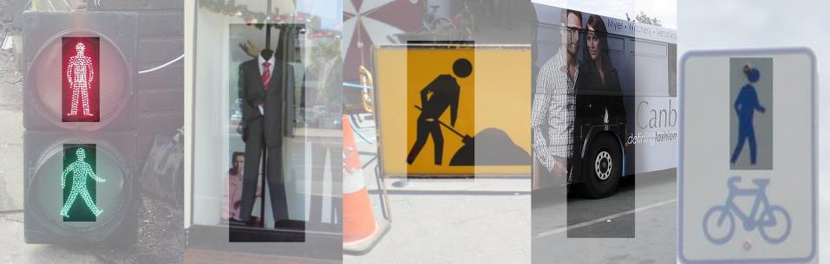
Negative Classes (Not an X)
Which of these IS NOT a Person/Pedestrian?
Notes:
These aren’t pedestrians, but they militate against a good solution by making it harder. So we remove them – we don’t want to hit them anyway!

Slide 37
Detection vs Classification
Detection: Find an X
Classification: Find the correct label X,Y,Z etc.

Slide 38
Detection vs Classification
Detection: Find an X
Classification: Find the correct label X,Y,Z etc.
Binary Classification as Detection: Find the correct label X or notX

Slide 39
Face Detection as Classification
For each square, run a
classifier to find out if it
is a face or not
Faces can be many sizes
They can happen anywhere in the image
For each face size
  For each location
    Classify a rectangular region of the face size, at that location, as a face or not a face
This is a series of binary classification problems

Slide 40
Binary classification
Classification can be abstracted as follows
H: X → (+1,-1)
A function H that takes as input some X and outputs a +1 or -1
  X is the set of “features”
  +1/-1 represent the two classes
Many mechanisms (may types of “H”)
  Any many ways of characterizing “X”
We’ll look at a specific method based on voting with simple rules
  A “META” method

Slide 41
Introduction to Boosting
An ensemble method that sequentially combines many simple BINARY classifiers to construct a final complex classifier
  Simple classifiers are often called “weak” learners
  The complex classifiers are called “strong” learners
Each weak learner focuses on instances where the previous classifier failed
  Give greater weight to instances that have been incorrectly classified by previous learners
Restrictions for weak learners
  Better than 50% correct
Final classifier is weighted sum of weak classifiers
Notes:
Basic idea of boosting is to combine many simple binary classifiers into a single strong more complex classifier. The big contribution is that there aren’t any constraints on the weak learners. They really need only slightly better than random.

Slide 42
Boosting: A very simple idea
One can come up with many rules to classify
  E.g. Chimpanzee vs. Human classifier:
  If arms == long, entity is chimpanzee
  If height > 5’6” entity is human
  If lives in house == entity is human
  If lives in zoo == entity is chimpanzee
Each of them is a reasonable rule, but makes many mistakes
  Each rule has an intrinsic error rate
Combine the predictions of these rules
  But not equally
  Rules that are less accurate should be given lesser weight
Notes:
So for many problems its possible to come up with a lot of basic simple rules for classification. The trick that the world was waiting for was a good way of determining the weights. Because obviously for a large number of weak classifiers finding an optimal set of weights is a highly non-trivial problem. In fact its N-P hard. So only some kind of brute force approach would achieve true optimality.

Slide 43
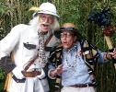
Boosting and the Chimpanzee Problem
Arm length?
α_{armlength}
Height?
α_{height}
Lives in house?
α_{house}
Lives in zoo?
α_{zoo}
human
human
chimp
chimp
The total confidence in all classifiers that classify the entity as a chimpanzee is
The total confidence in all classifiers that classify it as a human is
If Score_{chimpanzee} > Score_{human} then the our belief that we have a chimpanzee is greater than the belief that we have a human
Notes:
Here in this example we have some rules which imply human classification and others implying chimp classifications. To each of these rules I can assign some kind of confidence (the alpha). Then at the end I’m able to sum up the confidences of the rules which imply chimpdom and compare these to the confidences assigned to the rules implying humanity. Then if the confidence is greater in favor of the chimpanzee classification then that becomes my classification and vica-versa. What is the notion of confidence itself? In the simplest form this is just “How accurate does this single classifier tend to be?” If it tends to be correct most often then this can be a reasonable confidence. So there are 2 aspects to it. I can look at each classifier in isolation … or I can look at the classifiers as part of the ensemble, the group of classifiers. If the problem I really want to solve is the ensemble then this is the N-P hard problem that we face. And as we so often find, when you have an N-P hard problem you can often compromise with a greedy algorithm. E.g packing bags.

Slide 44
Boosting as defined by Freund
A gambler wants to write a program to predict winning horses. His program must encode the expertise of his brilliant winner friend
The friend has no single, encodable algorithm. Instead he has many rules of thumb
  He uses a different rule of thumb for each set of races
    E.g. “in this set, go with races that have black horses with stars on their foreheads”
  But cannot really enumerate what rules of thumbs go with what sets of races: he simply “knows” when he encounters a set
    A common problem that faces us in many situations
Problem:
  How best to combine all of the friend’s rules of thumb
  What is the best set of races to present to the friend, to extract the various rules of thumb
Notes:
So Freund’s initial intuition here. Is, gambler with many rules of thumb. For each set of races he asks his friend to indicate which rules of thumb to apply. And the intuition coming out of it was in how to select the best set of races to present to the friend in order to extract the various rules of thumb.

Slide 45
Boosting
The basic idea: Can a “weak” learning algorithm that performs just slightly better than a random guess be boosted into an arbitrarily accurate “strong” learner
  Each of the weak classifiers may be just better than random guessing
This is a “meta” algorithm, that poses no constraints on the form of the weak learners themselves
  The weak classifiers can be anything
Notes:
The benefit of this is that we aren’t placing ANY constraints on the weak learner AT ALL! It’s a meta algorithm.

Slide 46
Boosting: A Voting Perspective
Boosting can be considered a form of voting
  Let a number of different classifiers classify the data
  Go with the majority
  Intuition says that as the number of classifiers increases, the dependability of the majority vote increases
The corresponding algorithms were called Boosting by majority
  A (weighted) majority vote taken over all the classifiers
  How do we compute weights for the classifiers?
  How do we actually train the classifiers
Notes:
So boosting is the broad set of algorithms which are formulated in this manner. We employ a set of weak learners and apply something analogous to a voting scheme and go with the majority. More classifiers – higher dependability. The issues we have to work through are. How to compute the weights? And How do we actually train the classifiers?

Slide 47
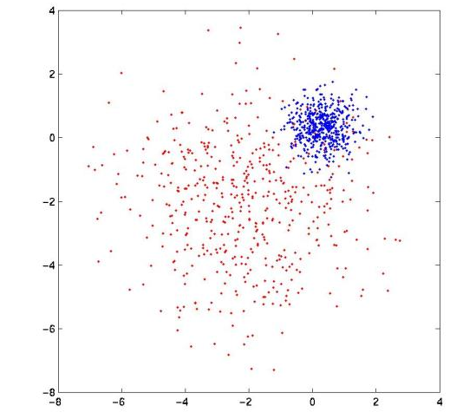
Boosting: An Example
Red dots represent training data from Red class
Blue dots represent training data from Blue class
Notes:
So in this example – we have a basic representation of a binary classification problems. Red vs Blue

Slide 48
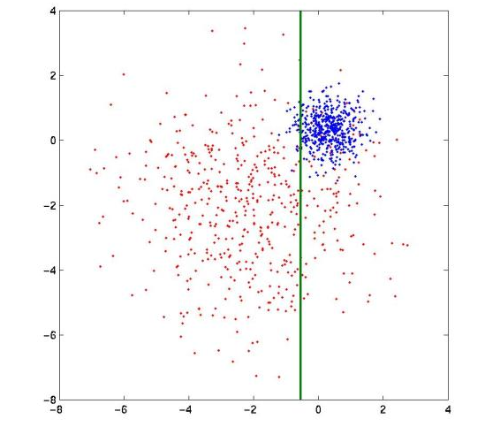
Boosting: An Example
Red class
Blue class
Very simple weak learner
  A line that is parallel to one of the two axes
Notes:
And suppose we have a set of weak learners which is a simple decision stump parallel to either of the 2 axes. So initially we simply choose the single strongest rule available.

Slide 49

Boosting: An Example
Red class
Blue class
First weak learner makes many mistakes
  Errors coloured black
Notes:
But it makes some mistakes. So let’s suppose we look for a classifier that focuses on correcting these mistakes.

Slide 50
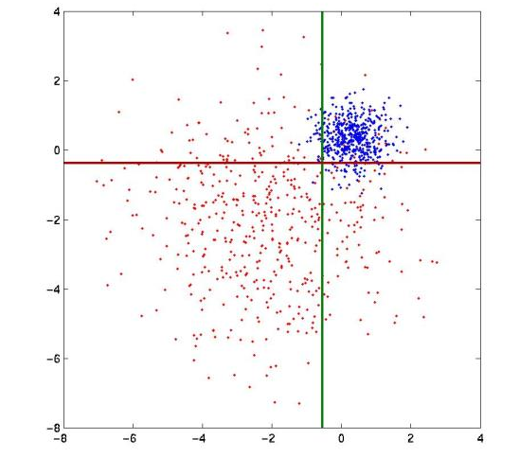
Boosting: An Example
Blue class
Red class
Red class
Blue class
Second weak learner focuses on errors made by first learner

Slide 51
Boosting: An Example
BLUE
RED
RED
RED
Second strong learner: weighted combination of first and second weak learners
  Decision boundary shown by black lines
Notes:
These 2 weak classifiers become the second strong learner.

Slide 52
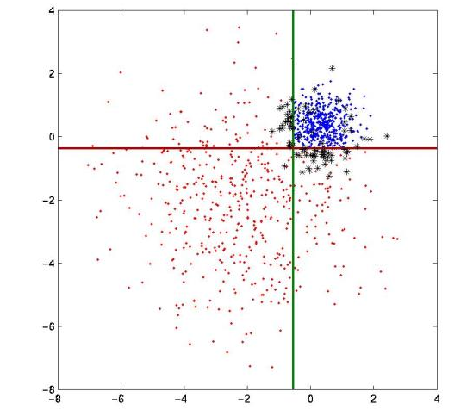
Boosting: An Example
BLUE
RED
RED
RED
The second strong learner also makes mistakes
  Errors colored black
Notes:
But again this stronger rule ALSO makes some mistakes.

Slide 53
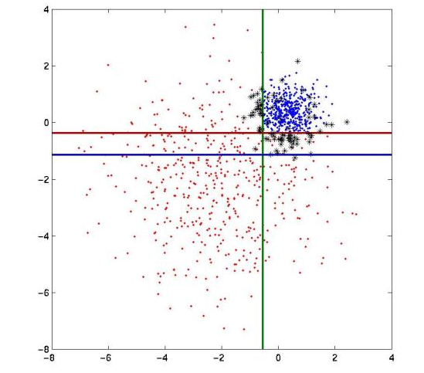
Boosting: An Example
BLUE
RED
Blue class
Red class
RED
RED
Third weak learner concentrates on errors made by second strong learner
Notes:
So we pick a third focused on correcting these.

Slide 54
Boosting: An Example
Blue class
Blue class
Red class
Red class
Red class
Blue class
Third weak learner concentrates on errors made by combination of previous weak learners
Continue adding weak learners until….

Slide 55

Boosting: An Example
Voila! Final strong learner: very few errors on the training data

Slide 56
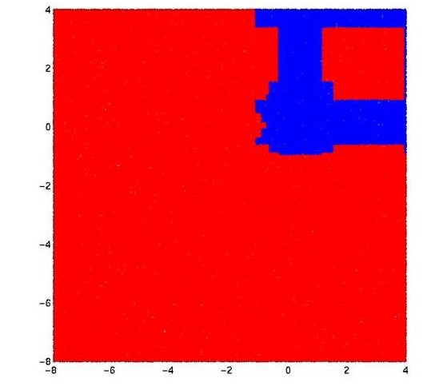
Boosting: An Example
The final strong learner has learnt a complicated decision boundary

Slide 57

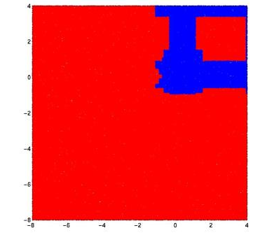
Boosting: An Example
The final strong learner has learnt a complicated decision boundary
Decision boundaries in areas with low density of training points assumed inconsequential
Notes:
Point out low density regions
All of the decision boundary edges are horizontal or vertical because this is a property of my available features.

Slide 58
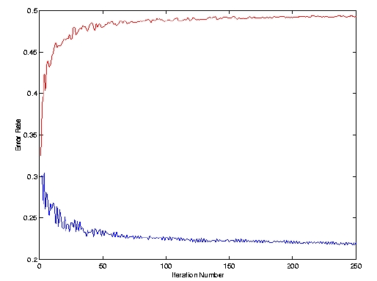
Overall Learning Pattern
Strong learner increasingly accurate with increasing number of weak learners
Residual errors increasingly difficult to correct
  Additional weak learners less and less effective
Error of n^{th} weak learner
Error of n^{th} strong learner
number of weak learners
Notes:
So the overall picture here is one where the STRONG LEARNER continues to have lower and lower error. Meanwhile the Nth WEAK LEARNER is getting weaker because its having to focus on the samples which aren’t being correctly classified by the emerging strong classifier. And these samples are, by definition, really hard to classify.

Slide 59
AdaBoost
No relation to Ada Lovelace
Adaptive Boosting
Adaptively Selects Weak Learners
~10K citations Freund and Schapire

Slide 60
The ADABoost Algorithm
Initialize D₁(x_{i}) = 1/N
For t = 1, …, T
  Train a weak classifier h_{t} using distribution D_{t}
  Compute total error on training data
    ε_{t} = Sum {D_{t} (x_{i}) ½(1 – y_{i} h_{t}(x_{i}))}
  Set α_{t} = ½ ln ((1 – ε_{t}) / ε_{t})
  For i = 1… N
    set D_{t+1}(x_{i}) = D_{t}(x_{i}) exp(- α_{t} y_{i} h_{t}(x_{i}))
  Normalize D_{t+1} to make it a distribution
The final classifier is
  H(x) = sign(Σ_{t} α_{t} h_{t}(x))
Notes:
So this is the Adaboost algorithm. We’re not going through the details now but rather we’ll just go through it in an example. But the basic intuition as that in order to “focus” on the mistakes of the strong classification rule up to this point – we employ a weighting scheme. This works as follows.

Slide 61
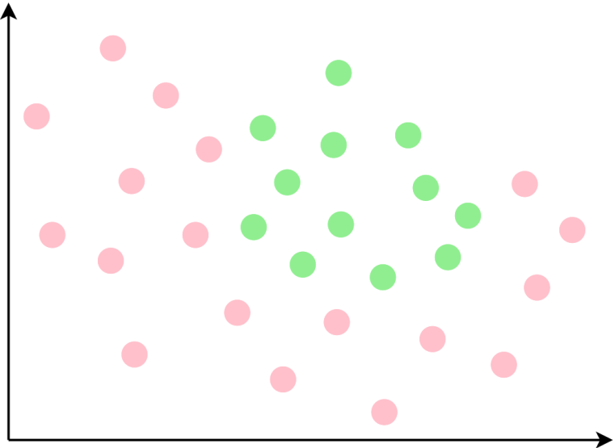
AdaBoost

Slide 62
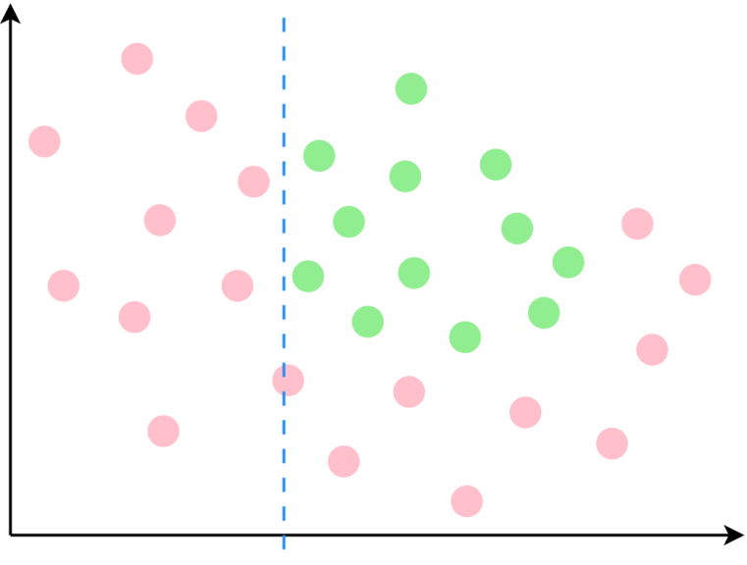
AdaBoost

Slide 63
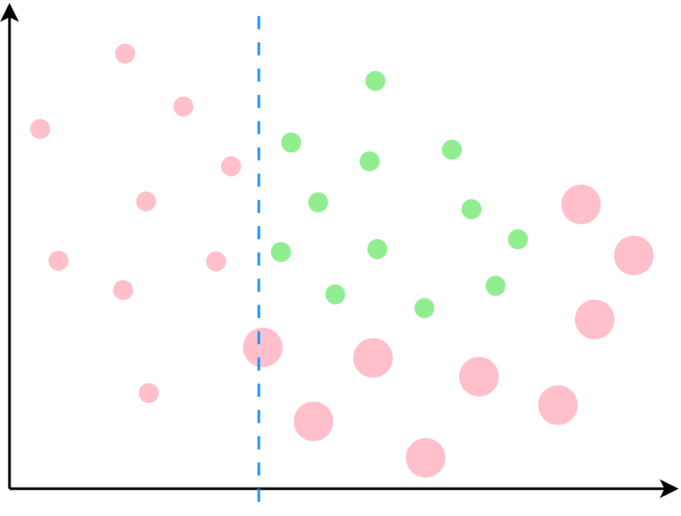
AdaBoost

Slide 64
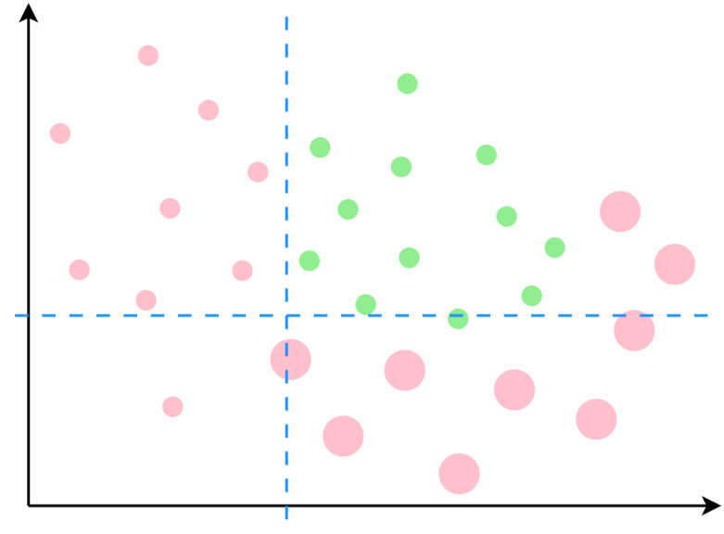
AdaBoost

Slide 65
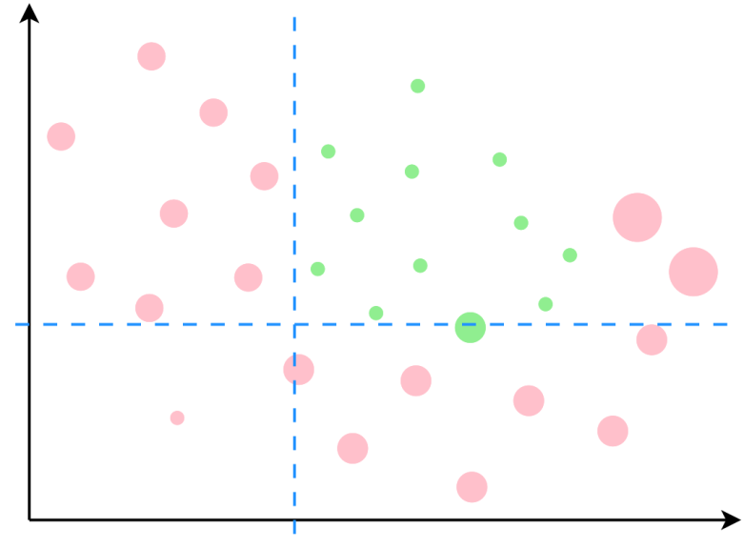
AdaBoost

Slide 66
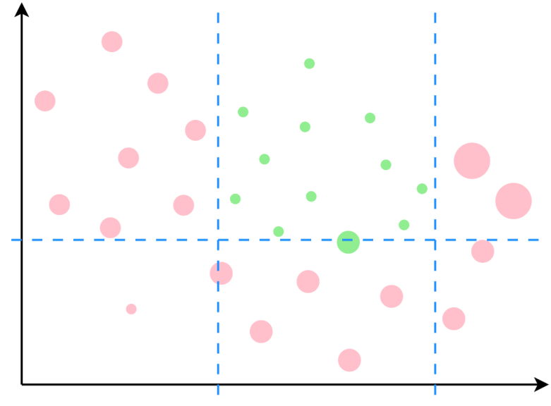
AdaBoost

Slide 67
AdaBoost

Slide 68

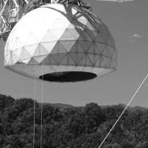

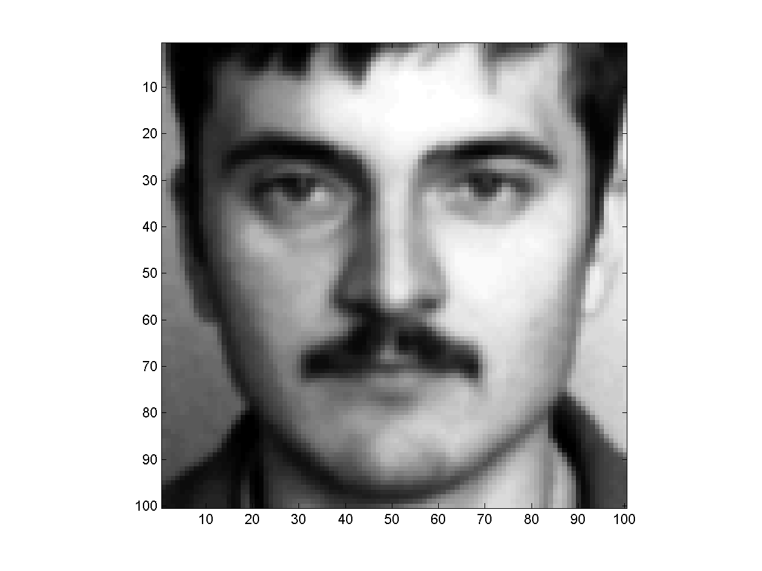
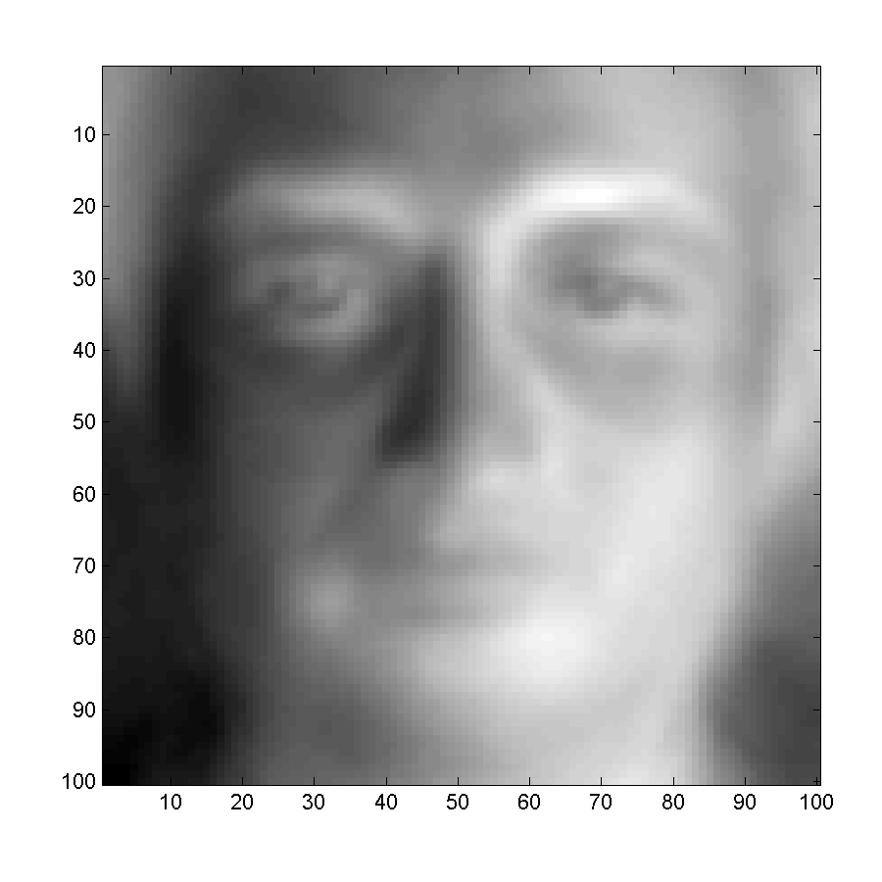
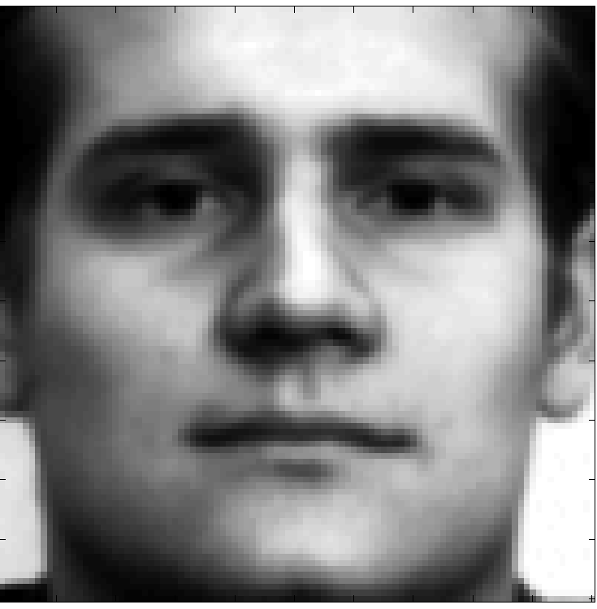
First, some example data
= 0.3 E1 - 0.6 E2
= 0.2 E1 + 0.4 E2
= 0.5 E1 - 0.5 E2
= -0.8 E1 - 0.1 E2
E₁
= 0.7 E1 - 0.1 E2
= 0.4 E1 - 0.9 E2
= 0.6 E1 - 0.4 E2
= 0.2 E1 + 0.5 E2
Image = a*E1 + b*E2 → a = Image.E1
E₂
Face detection with multiple Eigen faces
Step 0: Derived top 2 Eigen faces from Eigen face training data
Step 1: On a (different) set of examples, express each image as a linear combination of Eigen faces
  Examples include both faces and non faces
  Even the non-face images are explained in terms of the Eigen faces
Notes:
Suppose we have 2 face features – being or first and second eigenfaces. Each of these training instances can be approximated as a weighted sum of the Eigenfaces. These weights become our feature responses which Adaboost is going to work on.

Slide 69
Training Data
A
B
C
D
= 0.3 E1 - 0.6 E2
D
E
F
G
= 0.2 E1 + 0.4 E2
= 0.5 E1 - 0.5 E2
= -0.8 E1 - 0.1 E2
= 0.7 E1 - 0.1 E2
= 0.4 E1 - 0.9 E2
= 0.6 E1 - 0.4 E2
= 0.2 E1 + 0.5 E2
ID | E1 | E2. | Class
A | 0.3 | -0.6 | +1
B | 0.5 | -0.5 | +1
C | 0.7 | -0.1 | +1
D | 0.6 | -0.4 | +1
E | 0.2 | 0.4 | -1
F | -0.8 | -0.1 | -1
G | 0.4 | -0.9 | -1
H | 0.2 | 0.5 | -1
Face = +1
Non-face = -1
Notes:
So I have a table of these weights, and a set of labels +1 & -1 denoting their class.

Slide 70
The ADABoost Algorithm
Initialize D₁(x_{i}) = 1/N
For t = 1, …, T
  Train a weak classifier h_{t} using distribution D_{t}
  Compute total error on training data
    ε_{t} = Sum {D_{t} (x_{i}) ½(1 – y_{i} h_{t}(x_{i}))}
  Set α_{t} = ½ ln ((1 – ε_{t}) / ε_{t})
  For i = 1… N
    set D_{t+1}(x_{i}) = D_{t}(x_{i}) exp(- α_{t} y_{i} h_{t}(x_{i}))
  Normalize D_{t+1} to make it a distribution
The final classifier is
  H(x) = sign(Σ_{t} α_{t} h_{t}(x))
Notes:
Follow the yellow

Slide 71
Initialize D₁(x_{i}) = 1/N

Slide 72
Training Data
= 0.3 E1 - 0.6 E2
= 0.2 E1 + 0.4 E2
= 0.5 E1 - 0.5 E2
= -0.8 E1 - 0.1 E2
= 0.7 E1 - 0.1 E2
= 0.4 E1 - 0.9 E2
= 0.6 E1 - 0.4 E2
= 0.2 E1 + 0.5 E2
ID | E1 | E2. | Class | Weight
A | 0.3 | -0.6 | +1 | 1/8
B | 0.5 | -0.5 | +1 | 1/8
C | 0.7 | -0.1 | +1 | 1/8
D | 0.6 | -0.4 | +1 | 1/8
E | 0.2 | 0.4 | -1 | 1/8
F | -0.8 | -0.1 | -1 | 1/8
G | 0.4 | -0.9 | -1 | 1/8
H | 0.2 | 0.5 | -1 | 1/8

Slide 73
The ADABoost Algorithm
Initialize D₁(x_{i}) = 1/N
For t = 1, …, T
  Train a weak classifier h_{t} using distribution D_{t}
  Compute total error on training data
    ε_{t} = Sum {D_{t} (x_{i}) ½(1 – y_{i} h_{t}(x_{i}))}
  Set α_{t} = ½ ln (ε_{t} /(1 – ε_{t}))
  For i = 1… N
    set D_{t+1}(x_{i}) = D_{t}(x_{i}) exp(- α_{t} y_{i} h_{t}(x_{i}))
  Normalize D_{t+1} to make it a distribution
The final classifier is
  H(x) = sign(Σ_{t} α_{t} h_{t}(x))

Slide 74
The E1 “Stump”
F
E
H
A
G
B
C
D
Classifier based on E1:
if ( sign*wt(E1) > thresh) > 0)
face = true
sign = +1 or -1
-0.8
0.2
0.2
0.3
0.4
0.5
0.6
0.7
1/8
1/8
1/8
1/8
1/8
1/8
1/8
1/8
threshold
Sign = +1, error = 3/8
Sign = -1, error = 5/8
ID | E1 | E2. | Class | Weight
A | 0.3 | -0.6 | +1 | 1/8
B | 0.5 | -0.5 | +1 | 1/8
C | 0.7 | -0.1 | +1 | 1/8
D | 0.6 | -0.4 | +1 | 1/8
E | 0.2 | 0.4 | -1 | 1/8
F | -0.8 | -0.1 | -1 | 1/8
G | 0.4 | -0.9 | -1 | 1/8
H | 0.2 | 0.5 | -1 | 1/8
Notes:
So HERE, I’ve written these numerical weights for the E1 Eigenface for each of the training instances. I’ve also sorted them according to their weight – lowest to highest. I’ve also written their weight 1/8 below them. The labels are indicated by the color. What I’m going to do is check a threshold against these values. In essensce, saying everything above this threshold is a face. Everything below it is not a face.

Slide 75
The E1 “Stump”
F
E
H
A
G
B
C
D
Classifier based on E1:
if ( sign*wt(E1) > thresh) > 0)
face = true
sign = +1 or -1
-0.8
0.2
0.2
0.3
0.4
0.5
0.6
0.7
1/8
1/8
1/8
1/8
1/8
1/8
1/8
1/8
threshold
Sign = +1, error = 3/8
Sign = -1, error = 5/8
ID | E1 | E2. | Class | Weight
A | 0.3 | -0.6 | +1 | 1/8
B | 0.5 | -0.5 | +1 | 1/8
C | 0.7 | -0.1 | +1 | 1/8
D | 0.6 | -0.4 | +1 | 1/8
E | 0.2 | 0.4 | -1 | 1/8
F | -0.8 | -0.1 | -1 | 1/8
G | 0.4 | -0.9 | -1 | 1/8
H | 0.2 | 0.5 | -1 | 1/8
Notes:
So if I say everything above zero is a face. What do I get.

Slide 76
The E1 “Stump”
F
E
H
A
G
B
C
D
Classifier based on E1:
if ( sign*wt(E1) > thresh) > 0)
face = true
sign = +1 or -1
-0.8
0.2
0.2
0.3
0.4
0.5
0.6
0.7
1/8
1/8
1/8
1/8
1/8
1/8
1/8
1/8
threshold
Sign = +1, error = 3/8
Sign = -1, error = 5/8
ID | E1 | E2. | Class | Weight
A | 0.3 | -0.6 | +1 | 1/8
B | 0.5 | -0.5 | +1 | 1/8
C | 0.7 | -0.1 | +1 | 1/8
D | 0.6 | -0.4 | +1 | 1/8
E | 0.2 | 0.4 | -1 | 1/8
F | -0.8 | -0.1 | -1 | 1/8
G | 0.4 | -0.9 | -1 | 1/8
H | 0.2 | 0.5 | -1 | 1/8
Notes:
. E H and G are wrong. Alternatively, ….

Slide 77
The E1 “Stump”
F
E
H
A
G
B
C
D
Classifier based on E1:
if ( sign*wt(E1) > thresh) > 0)
face = true
sign = +1 or -1
-0.8
0.2
0.2
0.3
0.4
0.5
0.6
0.7
1/8
1/8
1/8
1/8
1/8
1/8
1/8
1/8
threshold
Sign = +1, error = 3/8
Sign = -1, error = 5/8
ID | E1 | E2. | Class | Weight
A | 0.3 | -0.6 | +1 | 1/8
B | 0.5 | -0.5 | +1 | 1/8
C | 0.7 | -0.1 | +1 | 1/8
D | 0.6 | -0.4 | +1 | 1/8
E | 0.2 | 0.4 | -1 | 1/8
F | -0.8 | -0.1 | -1 | 1/8
G | 0.4 | -0.9 | -1 | 1/8
H | 0.2 | 0.5 | -1 | 1/8
Notes:
If I reverse the threshold and say that everything below zero is a face than F A B C and D are wrong. 5 Errors.

Slide 78
The E1 “Stump”
Classifier based on E1:
if ( sign*wt(E1) > thresh) > 0)
face = true
sign = +1 or -1
F
E
H
A
G
B
C
D
-0.8
0.2
0.2
0.3
0.4
0.5
0.6
0.7
1/8
1/8
1/8
1/8
1/8
1/8
1/8
1/8
threshold
Sign = +1, error = 3/8
Sign = -1, error = 5/8
ID | E1 | E2. | Class | Weight
A | 0.3 | -0.6 | +1 | 1/8
B | 0.5 | -0.5 | +1 | 1/8
C | 0.7 | -0.1 | +1 | 1/8
D | 0.6 | -0.4 | +1 | 1/8
E | 0.2 | 0.4 | -1 | 1/8
F | -0.8 | -0.1 | -1 | 1/8
G | 0.4 | -0.9 | -1 | 1/8
H | 0.2 | 0.5 | -1 | 1/8
Notes:
But that is just one threshold. We can try others.

Slide 79
The E1 “Stump”
Classifier based on E1:
if ( sign*wt(E1) > thresh) > 0)
face = true
sign = +1 or -1
F
E
H
A
G
B
C
D
-0.8
0.2
0.2
0.3
0.4
0.5
0.6
0.7
1/8
1/8
1/8
1/8
1/8
1/8
1/8
1/8
threshold
Sign = +1, error = 2/8
Sign = -1, error = 6/8
ID | E1 | E2. | Class | Weight
A | 0.3 | -0.6 | +1 | 1/8
B | 0.5 | -0.5 | +1 | 1/8
C | 0.7 | -0.1 | +1 | 1/8
D | 0.6 | -0.4 | +1 | 1/8
E | 0.2 | 0.4 | -1 | 1/8
F | -0.8 | -0.1 | -1 | 1/8
G | 0.4 | -0.9 | -1 | 1/8
H | 0.2 | 0.5 | -1 | 1/8

Slide 80
The E1 “Stump”
Classifier based on E1:
if ( sign*wt(E1) > thresh) > 0)
face = true
sign = +1 or -1
F
E
H
A
G
B
C
D
-0.8
0.2
0.2
0.3
0.4
0.5
0.6
0.7
1/8
1/8
1/8
1/8
1/8
1/8
1/8
1/8
threshold
Sign = +1, error = 1/8
Sign = -1, error = 7/8
ID | E1 | E2. | Class | Weight
A | 0.3 | -0.6 | +1 | 1/8
B | 0.5 | -0.5 | +1 | 1/8
C | 0.7 | -0.1 | +1 | 1/8
D | 0.6 | -0.4 | +1 | 1/8
E | 0.2 | 0.4 | -1 | 1/8
F | -0.8 | -0.1 | -1 | 1/8
G | 0.4 | -0.9 | -1 | 1/8
H | 0.2 | 0.5 | -1 | 1/8

Slide 81
The E1 “Stump”
Classifier based on E1:
if ( sign*wt(E1) > thresh) > 0)
face = true
sign = +1 or -1
F
E
H
A
G
B
C
D
-0.8
0.2
0.2
0.3
0.4
0.5
0.6
0.7
1/8
1/8
1/8
1/8
1/8
1/8
1/8
1/8
threshold
Sign = +1, error = 2/8
Sign = -1, error = 6/8
ID | E1 | E2. | Class | Weight
A | 0.3 | -0.6 | +1 | 1/8
B | 0.5 | -0.5 | +1 | 1/8
C | 0.7 | -0.1 | +1 | 1/8
D | 0.6 | -0.4 | +1 | 1/8
E | 0.2 | 0.4 | -1 | 1/8
F | -0.8 | -0.1 | -1 | 1/8
G | 0.4 | -0.9 | -1 | 1/8
H | 0.2 | 0.5 | -1 | 1/8

Slide 82
The E1 “Stump”
Classifier based on E1:
if ( sign*wt(E1) > thresh) > 0)
face = true
sign = +1 or -1
F
E
H
A
G
B
C
D
-0.8
0.2
0.2
0.3
0.4
0.5
0.6
0.7
1/8
1/8
1/8
1/8
1/8
1/8
1/8
1/8
threshold
Sign = +1, error = 1/8
Sign = -1, error = 7/8
ID | E1 | E2. | Class | Weight
A | 0.3 | -0.6 | +1 | 1/8
B | 0.5 | -0.5 | +1 | 1/8
C | 0.7 | -0.1 | +1 | 1/8
D | 0.6 | -0.4 | +1 | 1/8
E | 0.2 | 0.4 | -1 | 1/8
F | -0.8 | -0.1 | -1 | 1/8
G | 0.4 | -0.9 | -1 | 1/8
H | 0.2 | 0.5 | -1 | 1/8

Slide 83
The E1 “Stump”
Classifier based on E1:
if ( sign*wt(E1) > thresh) > 0)
face = true
sign = +1 or -1
F
E
H
A
G
B
C
D
-0.8
0.2
0.2
0.3
0.4
0.5
0.6
0.7
1/8
1/8
1/8
1/8
1/8
1/8
1/8
1/8
threshold
Sign = +1, error = 2/8
Sign = -1, error = 6/8
ID | E1 | E2. | Class | Weight
A | 0.3 | -0.6 | +1 | 1/8
B | 0.5 | -0.5 | +1 | 1/8
C | 0.7 | -0.1 | +1 | 1/8
D | 0.6 | -0.4 | +1 | 1/8
E | 0.2 | 0.4 | -1 | 1/8
F | -0.8 | -0.1 | -1 | 1/8
G | 0.4 | -0.9 | -1 | 1/8
H | 0.2 | 0.5 | -1 | 1/8

Slide 84
The Best E1 “Stump”
F
E
H
A
G
B
C
D
Classifier based on E1:
if ( sign*wt(E1) > thresh) > 0)
face = true
Sign = +1
Threshold = 0.45
-0.8
0.2
0.2
0.3
0.4
0.5
0.6
0.7
1/8
1/8
1/8
1/8
1/8
1/8
1/8
1/8
threshold
Sign = +1, error = 1/8
ID | E1 | E2. | Class | Weight
A | 0.3 | -0.6 | +1 | 1/8
B | 0.5 | -0.5 | +1 | 1/8
C | 0.7 | -0.1 | +1 | 1/8
D | 0.6 | -0.4 | +1 | 1/8
E | 0.2 | 0.4 | -1 | 1/8
F | -0.8 | -0.1 | -1 | 1/8
G | 0.4 | -0.9 | -1 | 1/8
H | 0.2 | 0.5 | -1 | 1/8
Notes:
Find the best. Now I have a sign and a threshold

Slide 85
The E2“Stump”
Classifier based on E2:
if ( sign*wt(E2) > thresh) > 0)
face = true
sign = +1 or -1
Note order
G
A
B
D
C
F
E
H
-0.9
-0.6
-0.5
-0.4
-0.1
-0.1
0.4
0.5
1/8
1/8
1/8
1/8
1/8
1/8
1/8
1/8
threshold
Sign = +1, error = 3/8
Sign = -1, error = 5/8
ID | E1 | E2. | Class | Weight
A | 0.3 | -0.6 | +1 | 1/8
B | 0.5 | -0.5 | +1 | 1/8
C | 0.7 | -0.1 | +1 | 1/8
D | 0.6 | -0.4 | +1 | 1/8
E | 0.2 | 0.4 | -1 | 1/8
F | -0.8 | -0.1 | -1 | 1/8
G | 0.4 | -0.9 | -1 | 1/8
H | 0.2 | 0.5 | -1 | 1/8
Notes:
So that trains the E1 classifier, but what about E2?

Slide 86
The Best E2“Stump”
Classifier based on E2:
if ( sign*wt(E2) > thresh) > 0)
face = true
sign = -1
Threshold = 0.15
G
A
B
D
C
F
E
H
-0.9
-0.6
-0.5
-0.4
-0.1
-0.1
0.4
0.5
1/8
1/8
1/8
1/8
1/8
1/8
1/8
1/8
threshold
Sign = -1, error = 2/8
ID | E1 | E2. | Class | Weight
A | 0.3 | -0.6 | +1 | 1/8
B | 0.5 | -0.5 | +1 | 1/8
C | 0.7 | -0.1 | +1 | 1/8
D | 0.6 | -0.4 | +1 | 1/8
E | 0.2 | 0.4 | -1 | 1/8
F | -0.8 | -0.1 | -1 | 1/8
G | 0.4 | -0.9 | -1 | 1/8
H | 0.2 | 0.5 | -1 | 1/8
Notes:
Why not 1/8 – duplicate value!!

Slide 87
The Best “Stump”
F
E
H
A
G
B
C
D
The Best overall classifier
based on a single feature is
based on E1
If (wt(E1) > 0.45) → Face
-0.8
0.2
0.2
0.3
0.4
0.5
0.6
0.7
1/8
1/8
1/8
1/8
1/8
1/8
1/8
1/8
threshold
Sign = +1, error = 1/8
ID | E1 | E2. | Class | Weight
A | 0.3 | -0.6 | +1 | 1/8
B | 0.5 | -0.5 | +1 | 1/8
C | 0.7 | -0.1 | +1 | 1/8
D | 0.6 | -0.4 | +1 | 1/8
E | 0.2 | 0.4 | -1 | 1/8
F | -0.8 | -0.1 | -1 | 1/8
G | 0.4 | -0.9 | -1 | 1/8
H | 0.2 | 0.5 | -1 | 1/8
Notes:
So because here the threshold is between 0.4 and 0.5 we set the threshold to 0.45

Slide 88
The Best “Stump”

Slide 89
The ADABoost Algorithm
Initialize D₁(x_{i}) = 1/N
For t = 1, …, T
  Train a weak classifier h_{t} using distribution D_{t}
  Compute total error on training data
    ε_{t} = Sum {D_{t} (x_{i}) ½(1 – y_{i} h_{t}(x_{i}))}
  Set α_{t} = ½ ln (ε_{t} /(1 – ε_{t}))
  For i = 1… N
    set D_{t+1}(x_{i}) = D_{t}(x_{i}) exp(- α_{t} y_{i} h_{t}(x_{i}))
  Normalize D_{t+1} to make it a distribution
The final classifier is
  H(x) = sign(Σ_{t} α_{t} h_{t}(x))
Notes:
0 and 1. just the error

Slide 90
The Best “Stump”
Notes:
Draw on the slide, EMPH AREA

Slide 91
The Best Error
F
E
H
A
G
B
C
D
The Error of the classifier
is the sum of the weights of
the misclassified instances
-0.8
0.2
0.2
0.3
0.4
0.5
0.6
0.7
1/8
1/8
1/8
1/8
1/8
1/8
1/8
1/8
threshold
Sign = +1, error = 1/8
ID | E1 | E2. | Class | Weight
A | 0.3 | -0.6 | +1 | 1/8
B | 0.5 | -0.5 | +1 | 1/8
C | 0.7 | -0.1 | +1 | 1/8
D | 0.6 | -0.4 | +1 | 1/8
E | 0.2 | 0.4 | -1 | 1/8
F | -0.8 | -0.1 | -1 | 1/8
G | 0.4 | -0.9 | -1 | 1/8
H | 0.2 | 0.5 | -1 | 1/8
NOTE: THE ERROR IS THE SUM OF THE WEIGHTS OF MISCLASSIFIED
INSTANCES
Notes:
Read green point to 1/8

Slide 92
The ADABoost Algorithm
Initialize D₁(x_{i}) = 1/N
For t = 1, …, T
  Train a weak classifier h_{t} using distribution D_{t}
  Compute total error on training data
    ε_{t} = Sum {D_{t} (x_{i}) ½(1 – y_{i} h_{t}(x_{i}))}
  Set α_{t} = ½ ln ((1 – ε_{t}) / ε_{t})
  For i = 1… N
    set D_{t+1}(x_{i}) = D_{t}(x_{i}) exp(- α_{t} y_{i} h_{t}(x_{i}))
  Normalize D_{t+1} to make it a distribution
The final classifier is
  H(x) = sign(Σ_{t} α_{t} h_{t}(x))
Notes:
But why!!! Draw on board. If completely perfect – inf. If completely random go to zero

Slide 93
Computing Alpha
F
E
H
A
G
B
C
D
Alpha = 0.5ln((1-1/8) / (1/8))
= 0.5 ln(7) = 0.97
-0.8
0.2
0.2
0.3
0.4
0.5
0.6
0.7
1/8
1/8
1/8
1/8
1/8
1/8
1/8
1/8
threshold
Sign = +1, error = 1/8

Slide 94
The Boosted Classifier Thus Far
F
E
H
A
G
B
C
D
Alpha = 0.5ln((1-1/8) / (1/8))
= 0.5 ln(7) = 0.97
-0.8
0.2
0.2
0.3
0.4
0.5
0.6
0.7
1/8
1/8
1/8
1/8
1/8
1/8
1/8
1/8
threshold
Sign = +1, error = 1/8
h1(X) = wt(E1) > 0.45 ? +1 : -1
H(X) = sign(0.97 * h1(X))
It’s the same as h1(x)
Notes:
So I have the first iteration of my strong classifier. Its still quite weak now right?

Slide 95
The ADABoost Algorithm
Initialize D₁(x_{i}) = 1/N
For t = 1, …, T
  Train a weak classifier h_{t} using distribution D_{t}
  Compute total error on training data
    ε_{t} = Average {½ (1 – y_{i} h_{t}(x_{i}))}
  Set α_{t} = ½ ln ((1 – ε_{t}) / ε_{t})
  For i = 1… N
    set D_{t+1}(x_{i}) = D_{t}(x_{i}) exp(- α_{t} y_{i} h_{t}(x_{i}))
  Normalize D_{t+1} to make it a distribution
The final classifier is
  H(x) = sign(Σ_{t} α_{t} h_{t}(x))
Notes:
Write on board. If correct it gets scaled down. If misclassified you’re gonna scale it up.

Slide 96
The Best Error
F
E
H
A
G
B
C
D
D_{t+1}(x_{i}) = D_{t}(x_{i}) exp(- α_{t} y_{i} h_{t} (x_{i}))
exp(α_{t}) = exp(0.97) = 2.63
exp(-α_{t}) = exp(-0.97) = 0.38
-0.8
0.2
0.2
0.3
0.4
0.5
0.6
0.7
1/8
1/8
1/8
1/8
1/8
1/8
1/8
1/8
threshold
ID | E1 | E2. | Class | Weight | Weight
A | 0.3 | -0.6 | +1 | 1/8 * 2.63 | 0.33
B | 0.5 | -0.5 | +1 | 1/8 * 0.38 | 0.05
C | 0.7 | -0.1 | +1 | 1/8 * 0.38 | 0.05
D | 0.6 | -0.4 | +1 | 1/8 * 0.38 | 0.05
E | 0.2 | 0.4 | -1 | 1/8 * 0.38 | 0.05
F | -0.8 | 0.1 | -1 | 1/8 * 0.38 | 0.05
G | 0.4 | -0.9 | -1 | 1/8 * 0.38 | 0.05
H | 0.2 | 0.5 | -1 | 1/8 * 0.38 | 0.05
Multiply the correctly classified instances by 0.38
Multiply incorrectly classified instances by 2.63
Notes:
Here we go. We multiply out the weights. And voila the incorrectly classified sample has much higher weight than those classified correctly

Slide 97
AdaBoost
Notes:
In other words – THIS HAPPENED! ☺

Slide 98
AdaBoost

Slide 99
The ADABoost Algorithm
Initialize D₁(x_{i}) = 1/N
For t = 1, …, T
  Train a weak classifier h_{t} using distribution D_{t}
  Compute total error on training data
    ε_{t} = Average {½ (1 – y_{i} h_{t}(x_{i}))}
  Set α_{t} = ½ ln ((1 – ε_{t}) / ε_{t})
  For i = 1… N
    set D_{t+1}(x_{i}) = D_{t}(x_{i}) exp(- α_{t} y_{i} h_{t}(x_{i}))
  Normalize D_{t+1} to make it a distribution
The final classifier is
  H(x) = sign(Σ_{t} α_{t} h_{t}(x))

Slide 100
The Best Error
F
E
H
A
G
B
C
D
D’ = D / sum(D)
-0.8
0.2
0.2
0.3
0.4
0.5
0.6
0.7
1/8
1/8
1/8
1/8
1/8
1/8
1/8
1/8
threshold
ID | E1 | E2. | Class | Weight | Weight | Weight
A | 0.3 | -0.6 | +1 | 1/8 * 2.63 | 0.33 | 0.48
B | 0.5 | -0.5 | +1 | 1/8 * 0.38 | 0.05 | 0.074
C | 0.7 | -0.1 | +1 | 1/8 * 0.38 | 0.05 | 0.074
D | 0.6 | -0.4 | +1 | 1/8 * 0.38 | 0.05 | 0.074
E | 0.2 | 0.4 | -1 | 1/8 * 0.38 | 0.05 | 0.074
F | -0.8 | 0.1 | -1 | 1/8 * 0.38 | 0.05 | 0.074
G | 0.4 | -0.9 | -1 | 1/8 * 0.38 | 0.05 | 0.074
H | 0.2 | 0.5 | -1 | 1/8 * 0.38 | 0.05 | 0.074
Multiply the correctly classified instances by 0.38
Multiply incorrectly classified instances by 2.63
Normalize to sum to 1.0
Notes:
Apply the normalization

Slide 101
The Best Error
F
E
H
A
G
B
C
D
D’ = D / sum(D)
-0.8
0.2
0.2
0.3
0.4
0.5
0.6
0.7
1/8
1/8
1/8
1/8
1/8
1/8
1/8
1/8
threshold
ID | E1 | E2. | Class | Weight
A | 0.3 | -0.6 | +1 | 0.48
B | 0.5 | -0.5 | +1 | 0.074
C | 0.7 | -0.1 | +1 | 0.074
D | 0.6 | -0.4 | +1 | 0.074
E | 0.2 | 0.4 | -1 | 0.074
F | -0.8 | 0.1 | -1 | 0.074
G | 0.4 | -0.9 | -1 | 0.074
H | 0.2 | 0.5 | -1 | 0.074
Multiply the correctly classified instances by 0.38
Multiply incorrectly classified instances by 2.63
Normalize to sum to 1.0
Notes:
And these become the new weights

Slide 102
The ADABoost Algorithm
Initialize D₁(x_{i}) = 1/N
For t = 1, …, T
  Train a weak classifier h_{t} using distribution D_{t}
  Compute total error on training data
    ε_{t} = Average {½ (1 – y_{i} h_{t}(x_{i}))}
  Set α_{t} = ½ ln (ε_{t} /(1 – ε_{t}))
  For i = 1… N
    set D_{t+1}(x_{i}) = D_{t}(x_{i}) exp(- α_{t} y_{i} h_{t}(x_{i}))
  Normalize D_{t+1} to make it a distribution
The final classifier is
  H(x) = sign(Σ_{t} α_{t} h_{t}(x))

Slide 103
E1 classifier
Classifier based on E1:
if ( sign*wt(E1) > thresh) > 0)
face = true
sign = +1 or -1
F
E
H
A
G
B
C
D
-0.8
0.2
0.2
0.3
0.4
0.5
0.6
0.7
.074
.074
.074
.48
.074
.074
.074
.074
threshold
Sign = +1, error = 0.222
Sign = -1, error = 0.778
ID | E1 | E2. | Class | Weight
A | 0.3 | -0.6 | +1 | 0.48
B | 0.5 | -0.5 | +1 | 0.074
C | 0.7 | -0.1 | +1 | 0.074
D | 0.6 | -0.4 | +1 | 0.074
E | 0.2 | 0.4 | -1 | 0.074
F | -0.8 | 0.1 | -1 | 0.074
G | 0.4 | -0.9 | -1 | 0.074
H | 0.2 | 0.5 | -1 | 0.074
Notes:
So we start again but NOTE THE NEW WEIGHTS. So its not the same as before. If I call everything this side a face then … its plus plus plus

Slide 104
E1 classifier
Classifier based on E1:
if ( sign*wt(E1) > thresh) > 0)
face = true
sign = +1 or -1
F
E
H
A
G
B
C
D
-0.8
0.2
0.2
0.3
0.4
0.5
0.6
0.7
.074
.074
.074
.48
.074
.074
.074
.074
threshold
Sign = +1, error = 0.148
Sign = -1, error = 0.852
ID | E1 | E2. | Class | Weight
A | 0.3 | -0.6 | +1 | 0.48
B | 0.5 | -0.5 | +1 | 0.074
C | 0.7 | -0.1 | +1 | 0.074
D | 0.6 | -0.4 | +1 | 0.074
E | 0.2 | 0.4 | -1 | 0.074
F | -0.8 | 0.1 | -1 | 0.074
G | 0.4 | -0.9 | -1 | 0.074
H | 0.2 | 0.5 | -1 | 0.074

Slide 105
The Best E1 classifier
Classifier based on E1:
if ( sign*wt(E1) > thresh) > 0)
face = true
sign = +1 or -1
F
E
H
A
G
B
C
D
-0.8
0.2
0.2
0.3
0.4
0.5
0.6
0.7
.074
.074
.074
.48
.074
.074
.074
.074
threshold
Sign = +1, error = 0.074
ID | E1 | E2. | Class | Weight
A | 0.3 | -0.6 | +1 | 0.48
B | 0.5 | -0.5 | +1 | 0.074
C | 0.7 | -0.1 | +1 | 0.074
D | 0.6 | -0.4 | +1 | 0.074
E | 0.2 | 0.4 | -1 | 0.074
F | -0.8 | 0.1 | -1 | 0.074
G | 0.4 | -0.9 | -1 | 0.074
H | 0.2 | 0.5 | -1 | 0.074
Notes:
Note that A is the BIG item. They others have small weights. So E1 is able to classify it correctly with a cost of 0.074

Slide 106
The Best E2 classifier
Classifier based on E2:
if ( sign*wt(E2) > thresh) > 0)
face = true
sign = +1 or -1
G
A
B
D
C
F
E
H
-0.9
-0.6
-0.5
-0.4
-0.1
-0.1
0.4
0.5
.074
.48
.074
.074
.074
.074
.074
.074
threshold
Sign = -1, error = 0.148
ID | E1 | E2. | Class | Weight
A | 0.3 | -0.6 | +1 | 0.48
B | 0.5 | -0.5 | +1 | 0.074
C | 0.7 | -0.1 | +1 | 0.074
D | 0.6 | -0.4 | +1 | 0.074
E | 0.2 | 0.4 | -1 | 0.074
F | -0.8 | 0.1 | -1 | 0.074
G | 0.4 | -0.9 | -1 | 0.074
H | 0.2 | 0.5 | -1 | 0.074
Notes:
In contrast the E2 classifier has A in a somewhat awkward position down there. So its optimal threshold and sign leave it with 0.148 error.

Slide 107
The Best Classifier
Classifier based on E1:
if (wt(E1) > 0.45) face = true
F
E
H
A
G
B
C
D
-0.8
0.2
0.2
0.3
0.4
0.5
0.6
0.7
.074
.074
.074
.48
.074
.074
.074
.074
Alpha = 0.5ln((1-0.074) / 0.074)
= 1.26
threshold
Sign = +1, error = 0.074
ID | E1 | E2. | Class | Weight
A | 0.3 | -0.6 | +1 | 0.48
B | 0.5 | -0.5 | +1 | 0.074
C | 0.7 | -0.1 | +1 | 0.074
D | 0.6 | -0.4 | +1 | 0.074
E | 0.2 | 0.4 | -1 | 0.074
F | -0.8 | 0.1 | -1 | 0.074
G | 0.4 | -0.9 | -1 | 0.074
H | 0.2 | 0.5 | -1 | 0.074
Notes:
So it may be a surprise that the best classifier was based on the E1 eigenface a second time round. This is unusual but not impossible. Remember the decision stump my choose an alternative threshold AND polarity and the weights are now different! 1.26 confidence. Computed in the same way.

Slide 108
The Boosted Classifier Thus Far
F
E
H
A
G
B
C
D
-0.8
0.2
0.2
0.3
0.4
0.5
0.6
0.7
.074
.074
.074
.48
.074
.074
.074
.074
threshold
h1(X) = wt(E1) > 0.45 ? +1 : -1
threshold
h2(X) = wt(E1) > 0.25 ? +1 : -1
H(X) = sign(0.97 * h1(X) + 1.26 * h2(X))

Slide 109
Reweighting the Data
F
E
H
A
G
B
C
D
-0.8
0.2
0.2
0.3
0.4
0.5
0.6
0.7
.074
.074
.074
.48
.074
.074
.074
.074
Exp(alpha) = exp(1.26) = 3.5
Exp(-alpha) = exp(-1.26) = 0.28
threshold
Sign = +1, error = 0.074
ID | E1 | E2. | Class | Weight
A | 0.3 | -0.6 | +1 | 0.48*0.28 | 0.32
B | 0.5 | -0.5 | +1 | 0.074*0.28 | 0.05
C | 0.7 | -0.1 | +1 | 0.074*0.28 | 0.05
D | 0.6 | -0.4 | +1 | 0.074*0.28 | 0.05
E | 0.2 | 0.4 | -1 | 0.074*0.28 | 0.05
F | -0.8 | 0.1 | -1 | 0.074*0.28 | 0.05
G | 0.4 | -0.9 | -1 | 0.074*3.5 | 0.38
H | 0.2 | 0.5 | -1 | 0.074*0.28 | 0.05
RENORMALIZE

Slide 110
Reweighting the Data
F
E
H
A
G
B
C
D
NOTE: THE WEIGHT OF “G”
WHICH WAS MISCLASSIFIED
BY THE SECOND CLASSIFIER
IS NOW SUDDENLY HIGH
-0.8
0.2
0.2
0.3
0.4
0.5
0.6
0.7
.074
.074
.074
.48
.074
.074
.074
.074
threshold
Sign = +1, error = 0.074
ID | E1 | E2. | Class | Weight
A | 0.3 | -0.6 | +1 | 0.48*0.28 | 0.32
B | 0.5 | -0.5 | +1 | 0.074*0.28 | 0.05
C | 0.7 | -0.1 | +1 | 0.074*0.28 | 0.05
D | 0.6 | -0.4 | +1 | 0.074*0.28 | 0.05
E | 0.2 | 0.4 | -1 | 0.074*0.28 | 0.05
F | -0.8 | 0.1 | -1 | 0.074*0.28 | 0.05
G | 0.4 | -0.9 | -1 | 0.074*3.5 | 0.38
H | 0.2 | 0.5 | -1 | 0.074*0.28 | 0.05
RENORMALIZE

Slide 111
AdaBoost
In this example both of our first two classifiers were based on E1
  Additional classifiers may switch to E2
In general, the reweighting of the data will result in a different feature being picked for each classifier
This also automatically gives us a feature selection strategy
  In this data the wt(E1) is the most important feature

Slide 112
AdaBoost
NOT required to go with the best classifier so far
For instance, for our second classifier, we might use the best E2 classifier, even though its worse than the E1 classifier
  So long as its right more than 50% of the time
We can continue to add classifiers even after we get 100% classification of the training data
  Because the weights of the data keep changing
  Adding new classifiers beyond this point is often a good thing to do

Slide 113
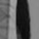
ADA Boost
= 0.4 E1 - 0.4 E2
E₁
E₂
The final classifier is
  H(x) = sign(Σ_{t} α_{t} h_{t}(x))
The output is 1 if the total weight of all weak learners that classify x as 1 is greater than the total weight of all weak learners that classify it as -1

Slide 114
Boosting and Face Detection
Boosting is the basis of one of the most popular methods for face detection: The Viola-Jones algorithm
  Current methods use other classifiers like SVMs, but Adaboost classifiers remain easy to implement and popular
  OpenCV implements Viola Jones..
Notes:
OpenCV implementation that… burning spoon…

Slide 115
The problem of face detection
1. Defining Features
  Should we be searching for noses, eyes, eyebrows etc.?
    Nice, but expensive
  Or something simpler
2. Selecting Features
  Of all the possible features we can think of, which ones make sense
3. Classification: Combining evidence
  How does one combine the evidence from the different features?

Slide 116
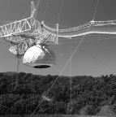






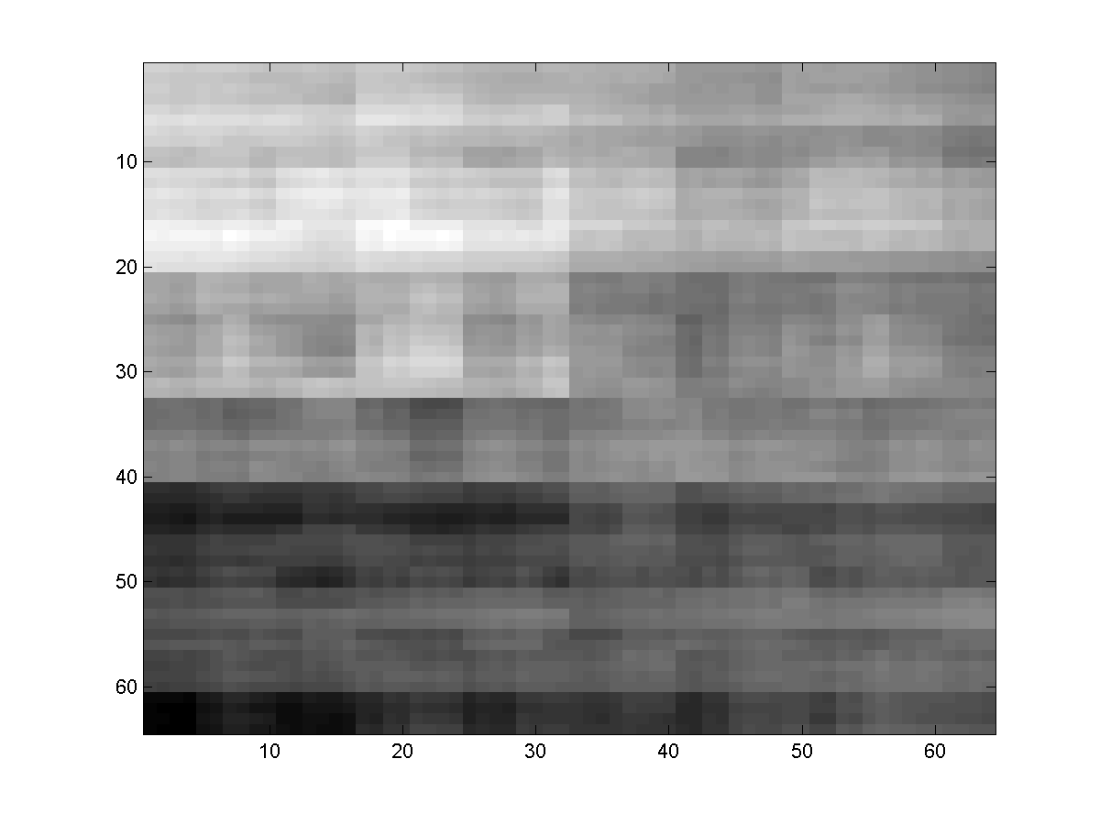
Features: The Viola Jones Method
B₁
B₂
B₃
B₄
B₅
B₆
Integral Features!!
  Like the Checkerboard
The same principle as we used to decompose images in terms of checkerboards:
  The image of any object has changes at various scales
  These can be represented coarsely by a checkerboard pattern
The checkerboard patterns must however now be localized
  Stay within the region of the face
Notes:
Was anyone in Martial Hebert’s comp vis lecture yesterday on haar features. It just so happens that these are

Slide 117
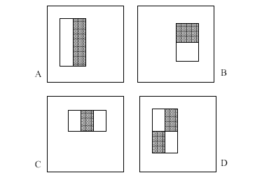
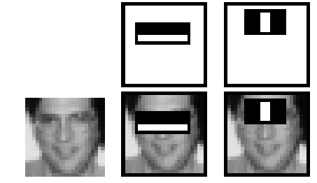
Features
Checkerboard Patterns to represent facial features
  The white areas are subtracted from the black ones.
  Each checkerboard explains a localized portion of the image
Four types of checkerboard patterns (only)

Slide 118
Explaining a portion of the face with a checker..
How much is the difference in average intensity of the image in the black and white regions
  Sum(pixel values in white region) – Sum(pixel values in black region)
This is actually the dot product of the region of the face covered by the rectangle and the checkered pattern itself
  White = 1, Black = -1

Slide 119
“Integral” features
Each checkerboard has the following characteristics
  Length
  Width
  Type
    Specifies the number and arrangement of bands
The four checkerboards above are the four used by Viola and Jones

Slide 120
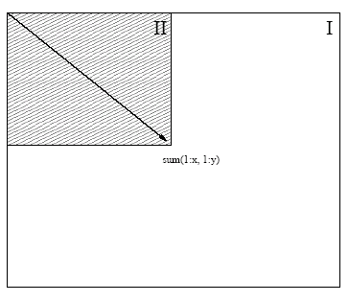
Integral images
Summed area tables
For each pixel store the sum of ALL pixels to the left of and above it.

Slide 121
Fast Computation of Pixel Sums
A
B
1
2
C
D
3
4
To compute the sum of the pixels within “D”:
  Pixelsum(1) = Area(A)
  Pixelsum(2) = Area(A) + Area(B)
  Pixelsum(3) = Area(A) + Area(C)
  Pixelsum(4) = Area(A)+Area(B)+Area(C) +Area(D)
Area(D) = Pixelsum(4) – Pixelsum(2) – Pixelsum(3) + Pixelsum(1)
Notes:
Draw on board

Slide 122
A Fast Way to Compute the Feature
A
B
D
C
F
E
Store pixel table for every pixel in the image
  The sum of all pixel values to the left of and above the pixel
Let A, B, C, D, E, F be the pixel table values at the locations shown
  Total pixel value of black area = D + A – B – C
  Total pixel value of white area = F + C – D – E
  Feature value = (F + C – D – E) – (D + A – B – C)

Slide 123
How many features?
PxH
MxN
Each checker board of width P and height H can start at any of (N-P)(M-H) pixels
(M-H)*(N-P) possible starting locations
  Each is a unique checker feature
    E.g. at one location it may measure the forehead, at another the chin

Slide 124
How many features
Each feature can have many sizes
  Width from (min) to (max) pixels
  Height from (min ht) to (max ht) pixels
At each size, there can be many starting locations
  Total number of possible checkerboards of one type:
  No. of possible sizes x No. of possible locations
There are four types of checkerboards
  Total no. of possible checkerboards: VERY VERY LARGE!

Slide 125
Learning: No. of features
Analysis performed on images of 24x24 pixels only
  Reduces the no. of possible features to about 180000
Restrict checkerboard size
  Minimum of 8 pixels wide
  Minimum of 8 pixels high
    Other limits, e.g. 4 pixels may be used too
  Reduces no. of checkerboards to about 50000

Slide 126
No. of features
 | F1 | F2 | F3 | F4 | ….. | F180000
 | 7 | 9 | 2 | -1 | ….. | 12
 | -11 | 3 | 19 | 17 | ….. | 2
Each possible checkerboard gives us one feature
A total of up to 180000 features derived from a 24x24 image!
Every 24x24 image is now represented by a set of 180000 numbers
  This is the set of features we will use for classifying if it is a face or not!
Notes:
Not really all used. Greedily selected from

Slide 127
The Classifier
The Viola-Jones algorithm uses a simple Boosting based classifier
Each “weak learner” is a simple threshold
At each stage find the best feature to classify the data with
  I.e the feature that gives us the best classification of all the training data
    Training data includes many examples of faces and non-face images
  The classification rule is of the kind
    If feature > threshold, face (or if feature < threshold, face)
    The optimal value of “threshold” must also be determined.

Slide 128
The Weak Learner
Training (for each weak learner):
  For each feature f (of all 180000 features)
    Find a threshold θ(f) and polarity p(f) (p(f) = -1 or p(f) = 1) such that (f > p(f) θ(f)) performs the best classification of faces
      Lowest overall error in classifying all training data
        Error counted over weighted samples
    Let the optimal overall error for f be error(f)
  Find the feature f’ such that error(f’) is lowest
  The weak learner is the test (f’ > p(f’) θ(f’)) => face
Note that the procedure for learning weak learners also identifies the most useful features for face recognition

Slide 129
The Viola Jones Classifier
A boosted threshold-based classifier
First weak learner: Find the best feature, and its optimal threshold
  Second weak learner: Find the best feature, for the weighted training data, and its threshold (weighting from one weak learner)
    Third weak learner: Find the best feature for the weighted data and its optimal threshold (weighting from two weak learners)
      Fourth weak learner: Find the best feature for the weighted data and its optimal threhsold (weighting from three weak learners)
        ..

Slide 130
To Train
Collect a large number of facial images
  Resize all of them to 24x24
  These are our “face” training set
Collect a much much much larger set of 24x24 non-face images of all kinds
  Each of them is
  These are our “non-face” training set
Train a boosted classifier

Slide 131
The Viola Jones Classifier
During tests:
  Given any new 24x24 image
    R = Σ_{f} α_{f} (f > p_{f} θ(f))
    Only a small number of features (f < 100) typically used
Problems:
  Only classifies 24 x 24 images entirely as faces or non-faces
    Pictures are typically much larger
    They may contain many faces
    Faces in pictures can be much larger or smaller
  Not accurate enough

Slide 132
Multiple faces in the picture
Scan the image
  Classify each 24x24 rectangle from the photo
  All rectangles that get classified as having a face indicate the location of a face
For an NxM picture, we will perform (N-24)*(M-24) classifications
If overlapping 24x24 rectangles are found to have faces, merge them

Slide 133
Multiple faces in the picture
Scan the image
  Classify each 24x24 rectangle from the photo
  All rectangles that get classified as having a face indicate the location of a face
For an NxM picture, we will perform (N-24)*(M-24) classifications
If overlapping 24x24 rectangles are found to have faces, merge them

Slide 134
Multiple faces in the picture
Scan the image
  Classify each 24x24 rectangle from the photo
  All rectangles that get classified as having a face indicate the location of a face
For an NxM picture, we will perform (N-24)*(M-24) classifications
If overlapping 24x24 rectangles are found to have faces, merge them

Slide 135
Multiple faces in the picture
Scan the image
  Classify each 24x24 rectangle from the photo
  All rectangles that get classified as having a face indicate the location of a face
For an NxM picture, we will perform (N-24)*(M-24) classifications
If overlapping 24x24 rectangles are found to have faces, merge them

Slide 136
Picture size solution
We already have a classifier
  That uses weak learners
Scale each classifier
  Every weak learner
  Scale its size up by factor α. Scale the threshold up to αθ.
  Do this for many scaling factors
f, θ
2x
f, 2θ

Slide 137
Picture size solution
We already have a classifier
  That uses weak learners
Scale each classifier
  Every weak learner
  Scale its size up by factor α. Scale the threshold up to αθ.
  Do this for many scaling factors
f, θ
2x
f, 2θ

Slide 138
Overall solution
Scan the picture with classifiers of size 24x24
Scale the classifier to 26x26 and scan
Scale to 28x28 and scan etc.
Faces of different sizes will be found at different scales

Slide 139
False Rejection vs. False Detection
False Rejection: There’s a face in the image, but the classifier misses it
  Rejects the hypothesis that there’s a face
False detection: Recognizes a face when there is none.
Classifier:
  Standard boosted classifier: H(x) = sign(Σ_{t} α_{t} h_{t}(x))
  Modified classifier H(x) = sign(Σ_{t} α_{t} h_{t}(x) + Y)
    Σ_{t} α_{t} h_{t}(x) is a measure of certainty
      The higher it is, the more certain we are that we found a face
    If Y is large, then we assume the presence of a face even when we are not sure
  By increasing Y, we can reduce false rejection, while increasing false detection
Notes:
Add Y or throw away the sign operator

Slide 140
ROC
% False detection
0
100
vs
false
neg
determined by
As Y increases
0 100
%False Rejectin
Ideally false rejection will be 0%, false detection will also be 0%
As Y increaases, we reject faces less and less
  But accept increasing amounts of garbage as faces
Can set Y so that we rarely miss a face

Slide 141
Problem: Not accurate enough, too slow
Classifier 1
Classifier 2
Not a face
Not a face
If we set Y high enough, we will never miss a face
  But will classify a lot of junk as faces
Solution: Classify the output of the first classifier with a second classifier
  And so on.

Slide 142
Problem: Not accurate enough, too slow
If we set Y high enough, we will never miss a face
  But will classify a lot of junk as faces
Solution: Classify the output of the first classifier with a second classifier
  And so on.

Slide 143
Useful Features Learned by Boosting

Slide 144
A Cascade of Classifiers
Notes:
The cascade formulation really really SINGS together with Boosting. Why? Because its greedy. If you do the strongest features first – You can make good early decisions! If you have simple aka fast features you can make fast classifiers. This is harder to do with things like SVM and Neural networks.

Slide 145
Detection in Real Images
Basic classifier operates on 24 x 24 subwindows
Scaling:
  Scale the detector (rather than the images)
  Features can easily be evaluated at any scale
  Scale by factors of 1.25
Location:
  Move detector around the image (e.g., 1 pixel increments)
Final Detections
  A real face may result in multiple nearby detections
  Postprocess detected subwindows to combine overlapping detections into a single detection

Slide 146
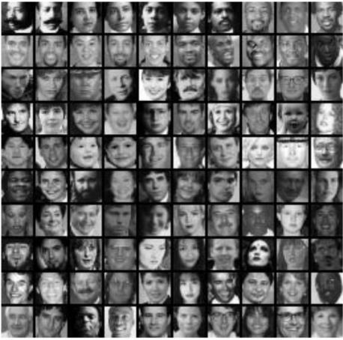
Training
In paper, 24x24 images of faces and non faces (positive and negative examples).

Slide 147
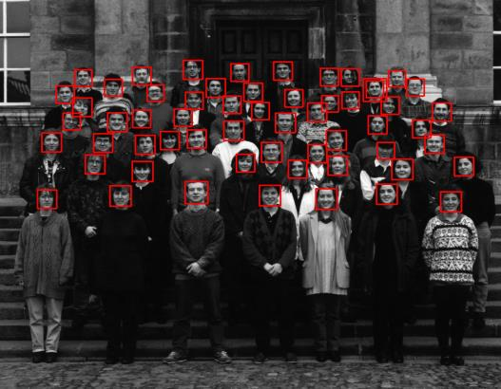
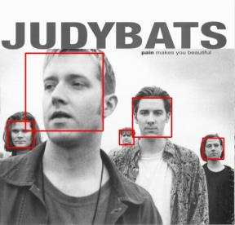
Sample results using the Viola-Jones Detector
Notice detection at multiple scales

Slide 148
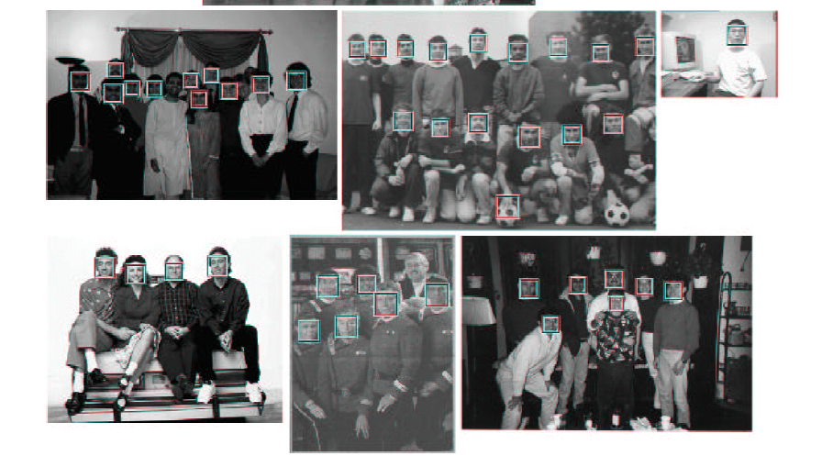
More Detection Examples

Slide 149
Practical implementation
Details discussed in Viola-Jones paper
Training time = weeks (with 5k faces and 9.5k non-faces)
Final detector has 38 layers in the cascade, 6060 features
700 Mhz processor:
  Can process a 384 x 288 image in 0.067 seconds (in 2003 when paper was written)

Slide 150

Best Window/Background Issues

Slide 151

Best Window/Background Issues

Slide 152

Best Window/Background Issues

Slide 153
Key Ideas
EigenFace feature
Sliding windows & scale-space pyramid
Boosting an ensemble of weak classifiers
Integral Image / Haar Features
Cascaded Strong Classifiers

