Slide 1

Machine Learning for Signal Processing Lecture 1: Introduction Representing sound and images
Class 1. 20 Jan 2015
Instructor: Bhiksha Raj
TA: Pallavi Baljekar

Slide 2



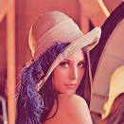
What is a signal
A mechanism for conveying information
Semaphores, gestures, traffic lights..
Electrical engineering: currents, voltages
Digital signals: Ordered collections of numbers that convey information
from a source to a destination
about a real world phenomenon
Sounds, images

Slide 3
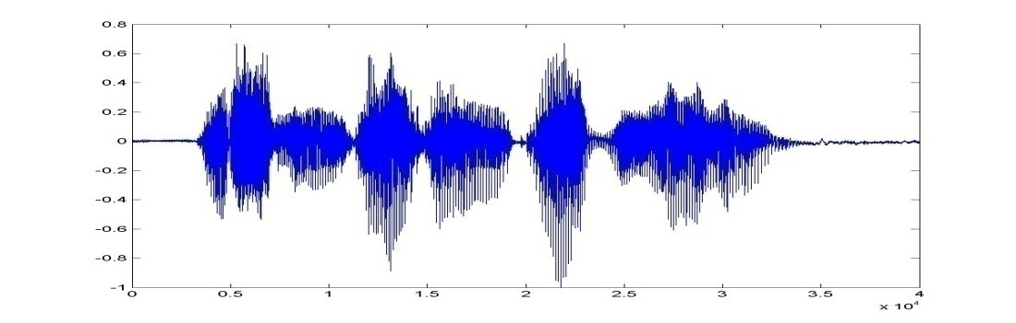
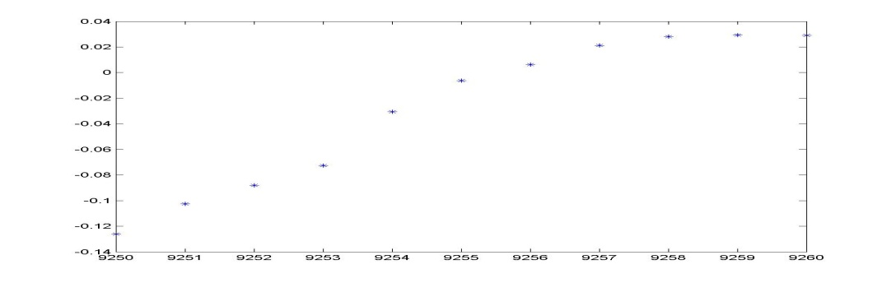
Signal Examples: Audio
A sequence of numbers
[n₁ n₂ n₃ n₄ …]
The order in which the numbers occur is important
Ordered
In this case, a time series
Represent a perceivable sound

Slide 4
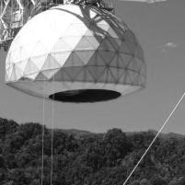

Example: Images
Pixel = 0.5
A rectangular arrangement (matrix) of numbers
Or sets of numbers (for color images)
Each pixel represents a visual representation of one of these numbers
0 is minimum / black, 1 is maximum / white
Position / order is important

Slide 5
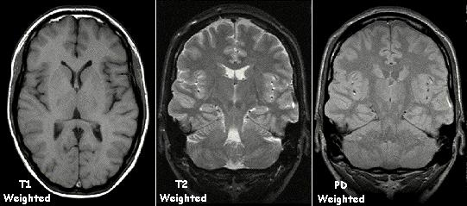
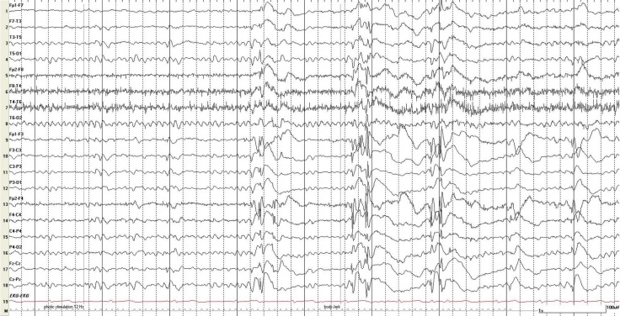
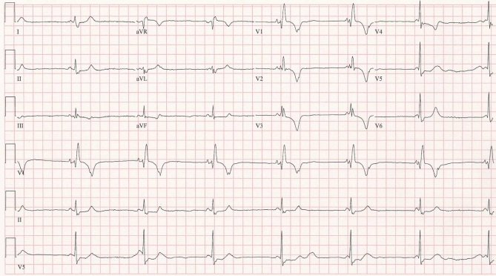
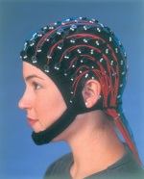
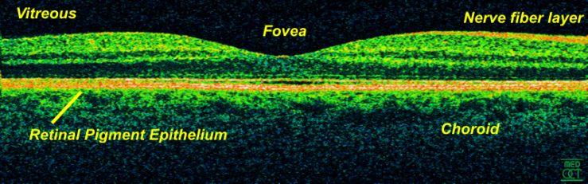
Example: Biosignals
MRI
EEG
ECG
Optical Coherence Tomography
Biosignals
MRI: “k-space” → 3D Fourier transform
Invert to get image
EEG: Many channels of brain electrical activity
ECG: Cardiac activity
OCT, Ultrasound, Echo cardiogram: Echo-based imaging
Others..
Challenges: denoising, prediction, classification..

Slide 6
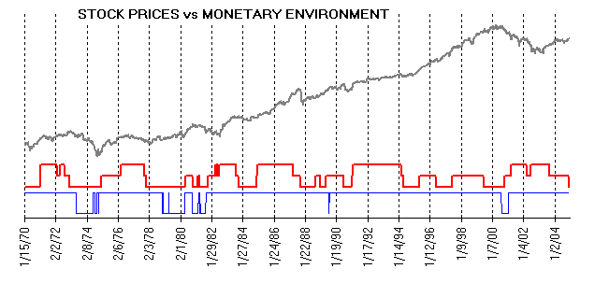
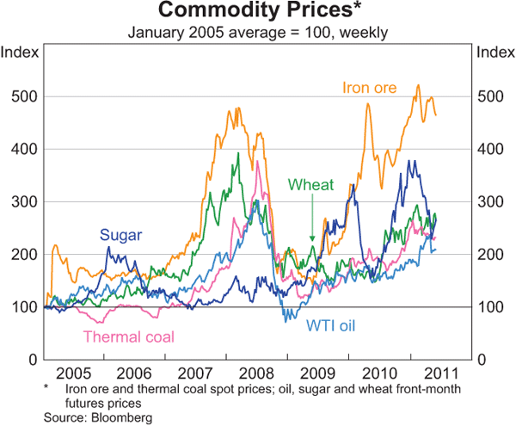
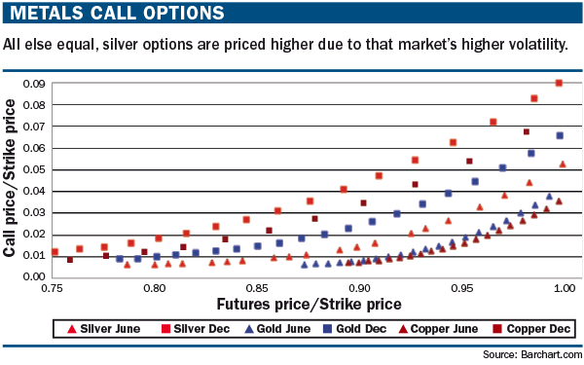
Financial Data
Stocks, options, other derivatives
Analyze trends and make predictions
Recent special issue:
IEEE Journal of Selected Topics in Signal Processing, Aug 2012: Introduction to the Issue on Signal Processing Methods in Finance and Electronic Trading

Slide 7
Ebb and flow of Movie revenues
Link to NYT page

Slide 8
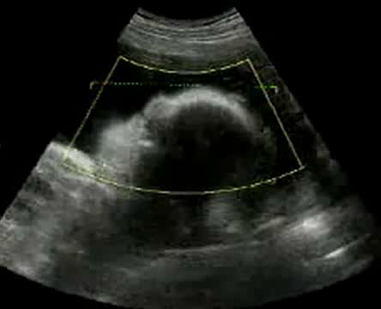
4D signal

Slide 9
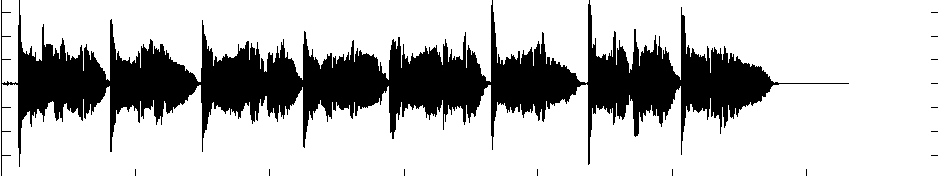

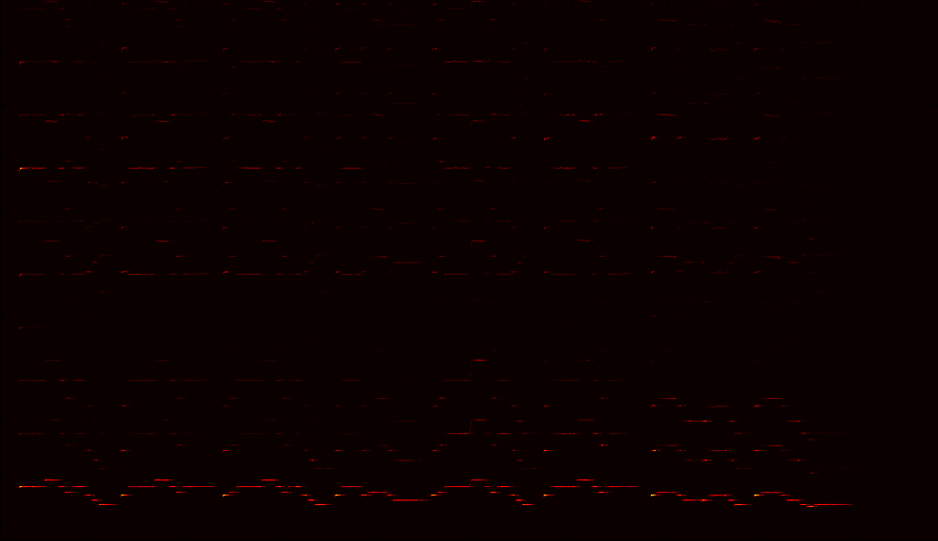
Sinusoids

Slide 10
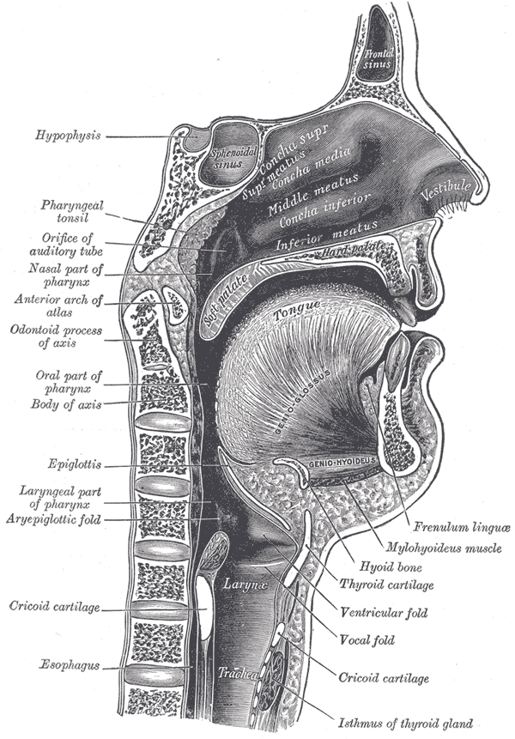
Human Vocal Tract

Slide 11
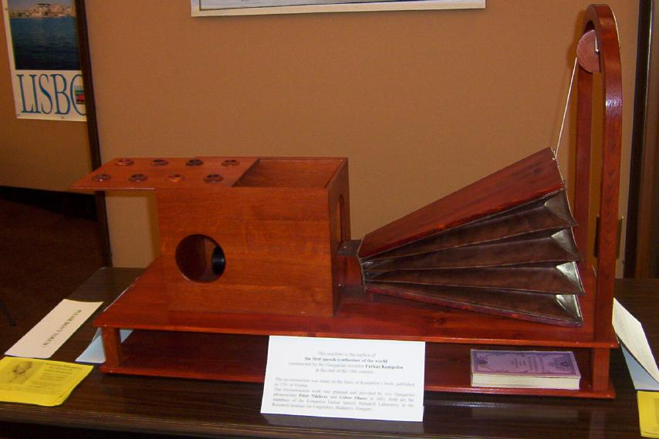

Physical Model

Slide 12
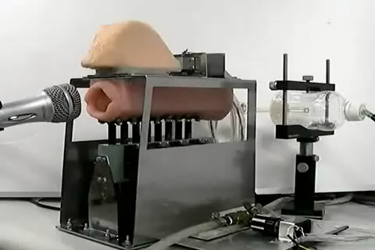
Newer Physical Model

Slide 13
Many others
Network data..
Weather..
Any stochastic time series
Etc.

Slide 14
What is Signal Processing
Acquisition, Analysis, Interpretation, and Manipulation of signals.
Acquisition: Sampling, sensing
Decomposition: Fourier transforms, wavelet transforms, dictionary-based representations, PCA/NMF/ICA/PLSA/..
Denoising signals
Coding: GSM, Jpeg, Mpeg, Ogg Vorbis
Detection: Radars, Sonars
Pattern matching: Biometrics, Iris recognition, finger print recognition
Prediction
Etc.

Slide 15

The Tasks in a typical Signal Processing Paradigm
sensor
Signal Capture
Channel
Feature Extraction
Modeling/Regression
Capture: Recovery, enhancement
Channel: Coding-decoding, compression-decompression, storage
Regression: Prediction, classification

Slide 16
What is Machine Learning
The science that deals with the development of algorithms that can learn from data
Learning patterns in data
Automatic categorization of text into categories; Market basket analysis
Learning to classify between different kinds of data
Spam filtering: Valid email or junk?
Learning to predict data
Weather prediction, movie recommendation
Statistical analysis and pattern recognition when performed by a computer scientist..

Slide 17
MLSP
Application of Machine Learning techniques to the analysis of signals
Can be applied to each component of the chain
sensor
Signal Capture
Channel
Feature Extraction
Modeling/Regression

Slide 18
MLSP
Application of Machine Learning techniques to the analysis of signals
Can be applied to each component of the chain
Sensing
Compressed sensing, dictionary based representations
Denoising
ICA, filtering, separation
sensor
Signal Capture
Channel
Feature Extraction
Modeling/Regression

Slide 19
MLSP
Application of Machine Learning techniques to the analysis of signals
Can be applied to each component of the chain
Channel: Compression, coding
sensor
Signal Capture
Channel
Feature Extraction
Modeling/Regression

Slide 20
MLSP
Application of Machine Learning techniques to the analysis of signals
Can be applied to each component of the chain
Feature Extraction:
Dimensionality reduction
Linear models, non-linear models
sensor
Signal Capture
Channel
Feature Extraction
Modeling/Regression

Slide 21
MLSP
Application of Machine Learning techniques to the analysis of signals
Can be applied to each component of the chain
Classification, Modelling and Interpretation, Prediction
sensor
Signal Capture
Channel
Feature Extraction
Modeling/Regression

Slide 22
In this course
Jetting through fundamentals:
Linear Algebra, Signal Processing, Probability
Machine learning concepts
Methods of modelling, estimation, classification, prediction
Applications:
Representation
Sensing and recovery
Prediction and Classification
Sounds, Images, Other forms of data
Topics covered are representative

Slide 23
Recommended Background
DSP
Fourier transforms, linear systems, basic statistical signal processing
Linear Algebra
Definitions, vectors, matrices, operations, properties
Probability
Basics: what is an random variable, probability distributions, functions of a random variable
Machine learning
Learning, modelling and classification techniques

Slide 24
Schedule of Other Lectures
Tentative Schedule on Website
http://mlsp.cs.cmu.edu/courses/spring2015

Slide 25
Grading
Homework assignments : 50%
Mini projects
Will be assigned during course
Minimum 3, Maximum 4
You will not catch up if you slack on any homework
Those who didn’t slack will also do the next homework
Attendance counts..
Final project: 50%
Will be assigned early in course
May 5: Poster presentation for all projects, with demos (if possible)

Slide 26
Instructor and TA
Hillman
Windows
Instructor: Prof. Bhiksha Raj
Room 6705 Hillman Building
bhiksha@cs.cmu.edu
412 268 9826
TA:
Pallavi Baljekar
pbaljeka@cs.cmu.edu
Office Hours:
Bhiksha Raj: Wed 1-2.00
TA: TBD
My office
Forbes

Slide 27
Additional Administrivia
Website:
http://mlsp.cs.cmu.edu/courses/spring2015/
Lecture material will be posted on the day of each class on the website
Reading material and pointers to additional information will be on the website
Mailing list: Piazza

Slide 28
Representing Data
Audio
Images
Video
Other types of signals
In a manner similar to one of the above

Slide 29
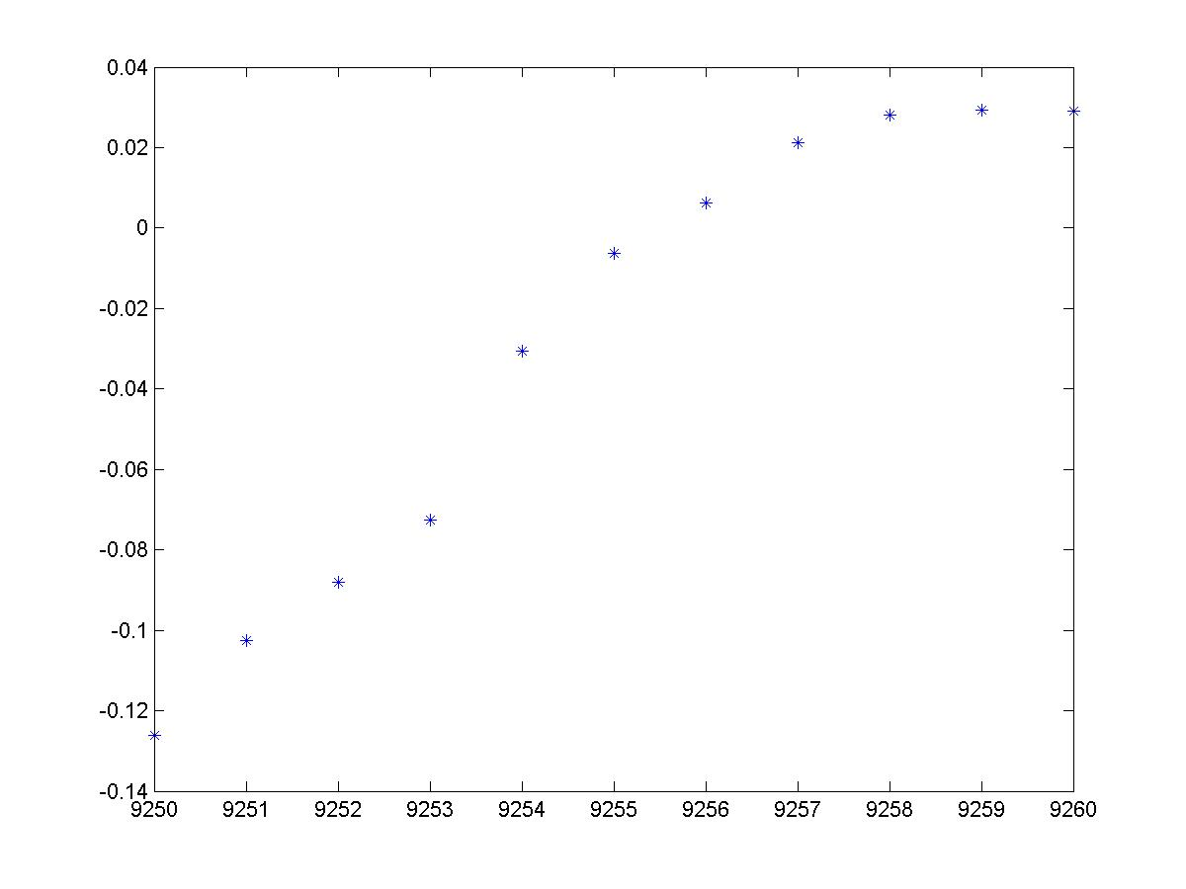
What is an audio signal
A typical digital audio signal
It’s a sequence of points

Slide 30


Where do these numbers come from?
Pressure highs
Spaces between arcs show pressure
lows
Any sound is a pressure wave: alternating highs and lows of air pressure moving through the air
When we speak, we produce these pressure waves
Essentially by producing puff after puff of air
Any sound producing mechanism actually produces pressure waves
These pressure waves move the eardrum
Highs push it in, lows suck it out
We sense these motions of our eardrum as “sound”

Slide 31
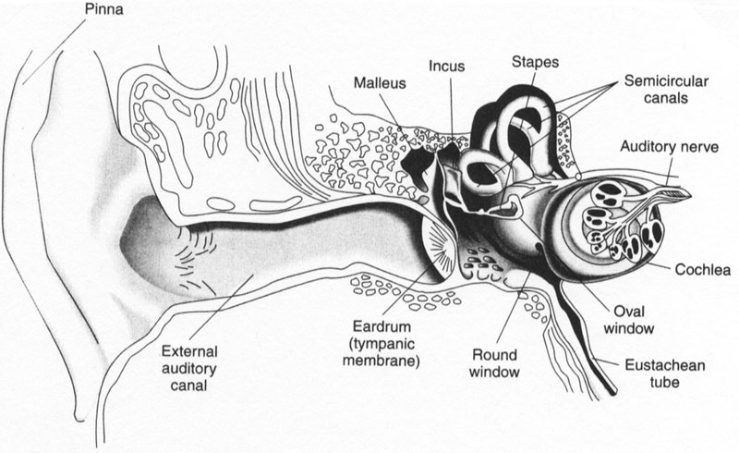
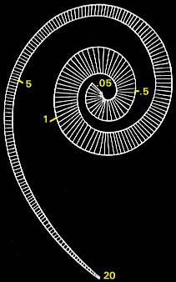
SOUND PERCEPTION

Slide 32
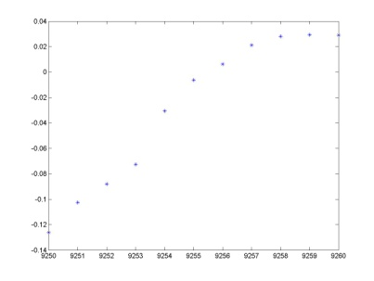
Storing pressure waves on a computer
The pressure wave moves a diaphragm
On the microphone
The motion of the diaphragm is converted to continuous variations of an electrical signal
Many ways to do this
A “sampler” samples the continuous signal at regular intervals of time and stores the numbers

Slide 33
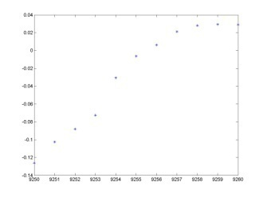
Are these numbers sound?
How do we even know that the numbers we store on the computer have anything to do with the recorded sound really?
Recreate the sense of sound
The numbers are used to control the levels of an electrical signal
The electrical signal moves a diaphragm back and forth to produce a pressure wave
That we sense as sound
*
*
*
*
*
*
*
*
*
*
*
*
*
*
*
*
*
*
*
*
*
*
*
*
*
*

Slide 34
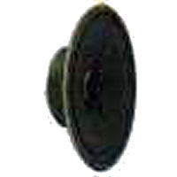
Are these numbers sound?
How do we even know that the numbers we store on the computer have anything to do with the recorded sound really?
Recreate the sense of sound
The numbers are used to control the levels of an electrical signal
The electrical signal moves a diaphragm back and forth to produce a pressure wave
That we sense as sound
*
*
*
*
*
*
*
*
*
*
*
*
*
*
*
*
*
*
*
*
*
*
*
*
*
*

Slide 35
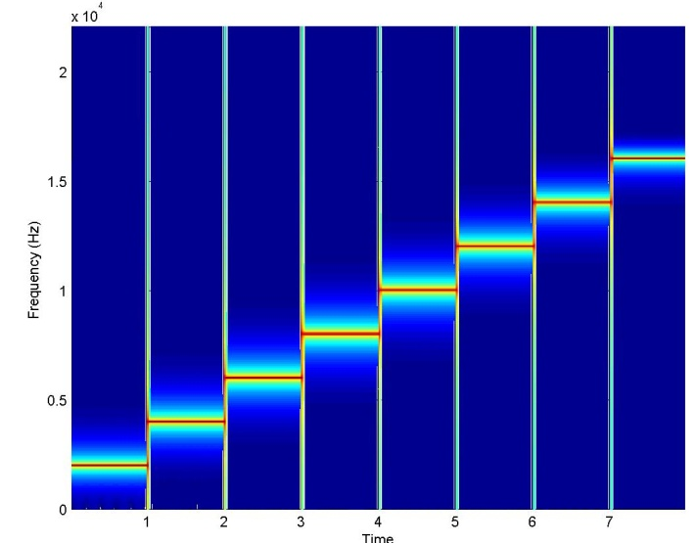

How many samples a second
Convenient to think of sound in terms of sinusoids with frequency
Sounds may be modelled as the sum of many sinusoids of different frequencies
Frequency is a physically motivated unit
Each hair cell in our inner ear is tuned to specific frequency
Any sound has many frequency components
We can hear frequencies up to 16000Hz
Frequency components above 16000Hz can be heard by children and some young adults
Nearly nobody can hear over 20000Hz.
A sinusoid
1
0.5
←Pressure →
0
-0.5
-1
0
10
20
30
40
50
60
70
80
90
100

Slide 36
Signal representation - Sampling
Sampling frequency (or sampling rate) refers to the number of samples taken a second
Sampling rate is measured in Hz
We need a sample rate twice as high as the highest frequency we want to represent (Nyquist freq)
For our ears this means a sample rate of at least 40kHz
Because we hear up to 20kHz
*
*
*
*
*
*
*
*
*
*
*
*
*
Time in secs.

Slide 37
Aliasing
Low sample rates result in aliasing
High frequencies are misrepresented
Frequency f₁ will become (sample rate – f₁ )
In video also when you see wheels go backwards

Slide 38
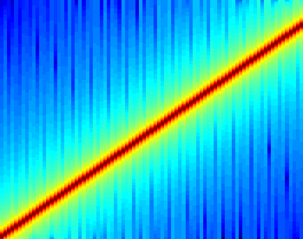
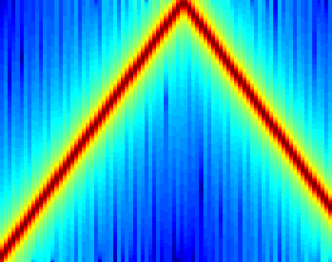
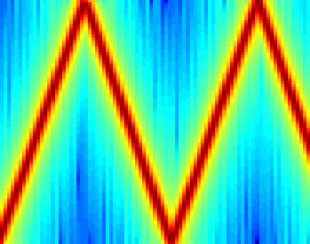
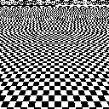
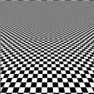

Aliasing examples
Sinusoid sweeping from 0Hz to 20kHz
44.1kHz SR, is ok
22kHz SR, aliasing!
11kHz SR, double aliasing!
x 10
4
2
10000
5000
1.5
8000
4000
6000
3000
Frequency
Frequency
Frequency
1
4000
2000
0.5
2000
1000
0
0
0.1
0.2
0.3
0.4
0.5
0.6
0.7
0.8
0.9
0
0
0.1
0.2
0.3
0.4
0.5
0.6
0.7
0.8
0.9
0
0
0.1
0.2
0.3
0.4
0.5
0.6
0.7
0.8
0.9
Time
Time
Time
On images
On video
On real sounds
at 44kHz
at 11kHz
at 4kHz
at 22kHz
at 5kHz
at 3kHz

Slide 39
Avoiding Aliasing
Analog signal
Digital signal
Antialiasing Filter
Sampling
Sound naturally has all perceivable frequencies
And then some
Cannot control the rate of variation of pressure waves in nature
Sampling at any rate will result in aliasing
Solution: Filter the electrical signal before sampling it
Cut off all frequencies above sampling.frequency/2
E.g., to sample at 44.1Khz, filter the signal to eliminate all frequencies above 22050 Hz

Slide 40
Typical Sampling Rates
Common sample rates
For speech 8kHz to 16kHz
For music 32kHz to 44.1kHz
Pro-equipment 96kHz

Slide 41
Storing numbers on the Computer
Sound is the outcome of a continuous range of variations
The pressure wave can take any value (within limits)
The diaphragm can also move continuously
The electrical signal from the diaphragm has continuous variations
A computer has finite resolution
Numbers can only be stored to finite resolution
E.g. a 16-bit number can store only 65536 values, while a 4-bit number can store only 16 values
To store the sound wave on the computer, the continuous variation must be “mapped” on to the discrete set of numbers we can store

Slide 42
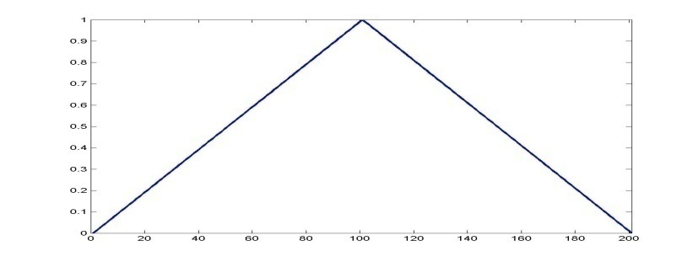
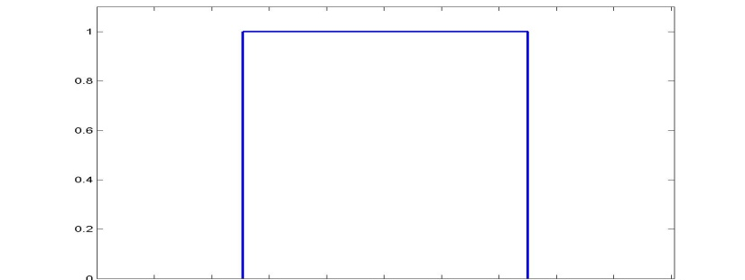
Mapping signals into bits
Example of 1-bit sampling table
Signal Value | Bit sequence | Mapped to
S > 2.5v | 1 | 1 * const
S <=2.5v | 0 | 0
Original Signal
Quantized approximation

Slide 43
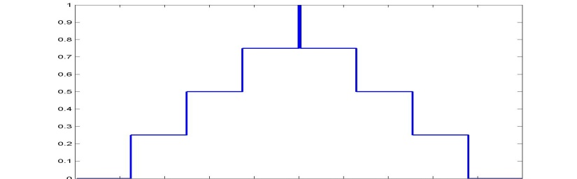
Mapping signals into bits
Example of 2-bit sampling table
Signal Value | Bit sequence | Mapped to
S >= 3.75v | 11 | 3 * const
3.75v > S >= 2.5v | 10 | 2 * const
2.5v > S >= 1.25v | 01 | 1 * const
1.25v > S >= 0v | 0 | 0
Original Signal
Quantized approximation

Slide 44
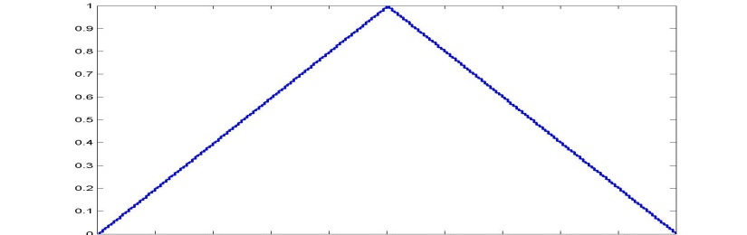
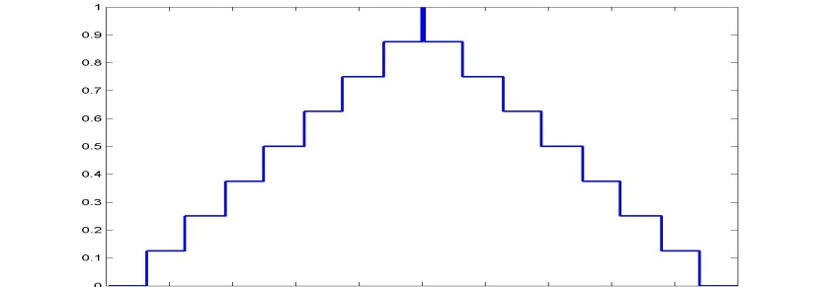

Storing the signal on a computer
The original signal
8 bit quantization
3 bit quantization
2 bit quantization
1 bit quantization

Slide 45

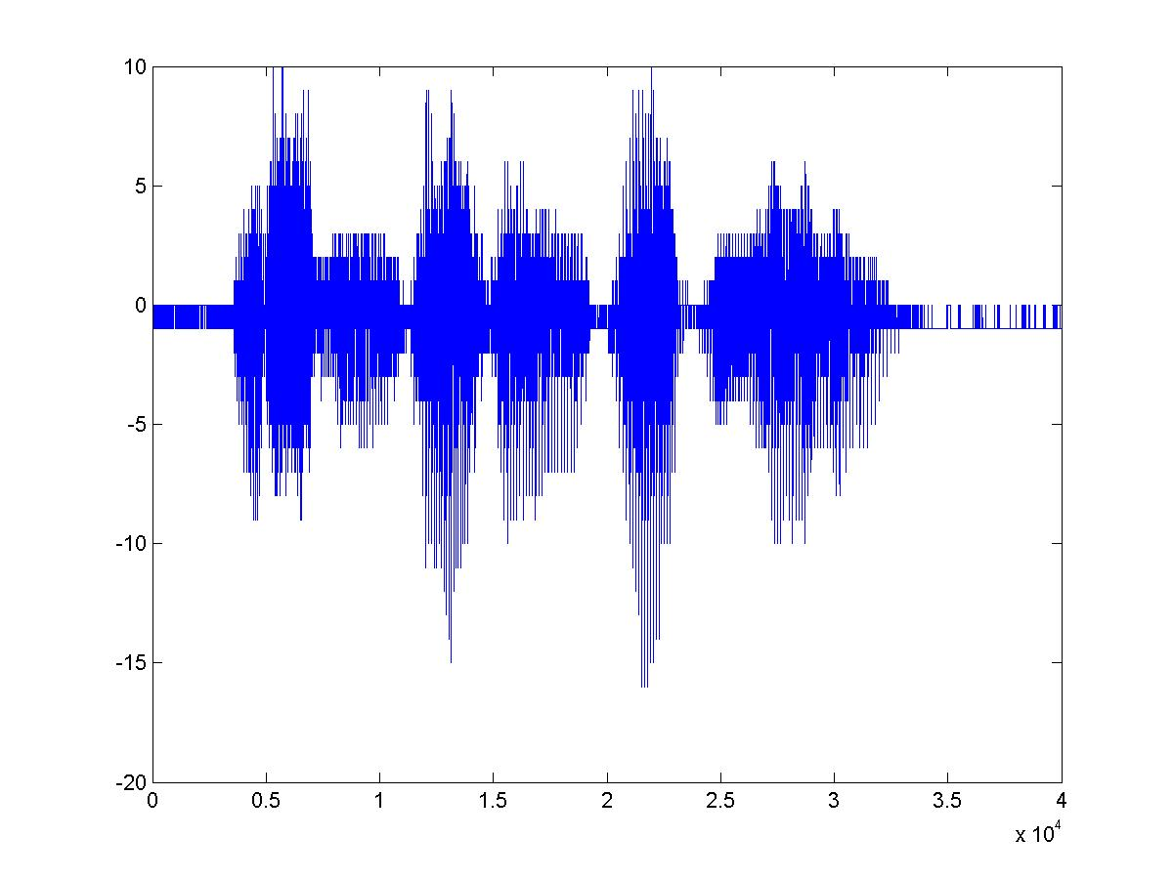
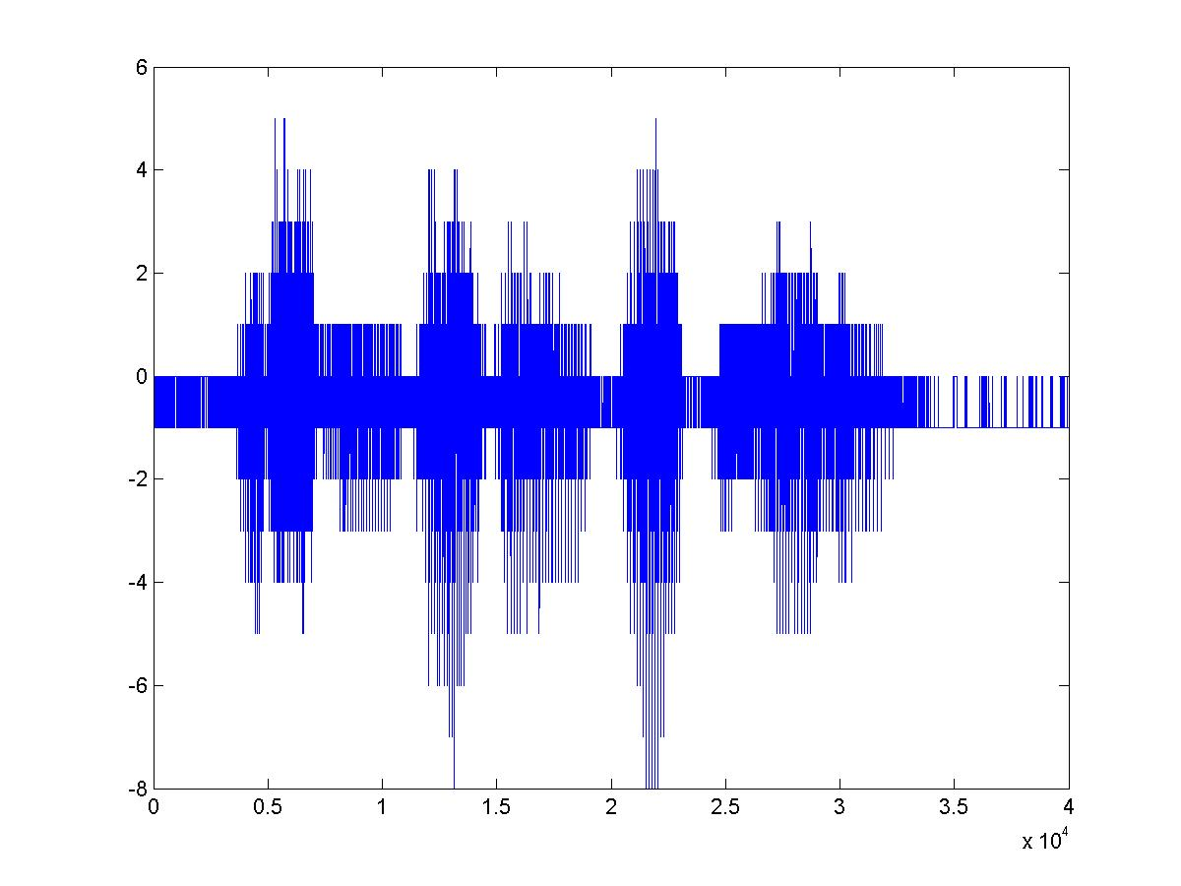
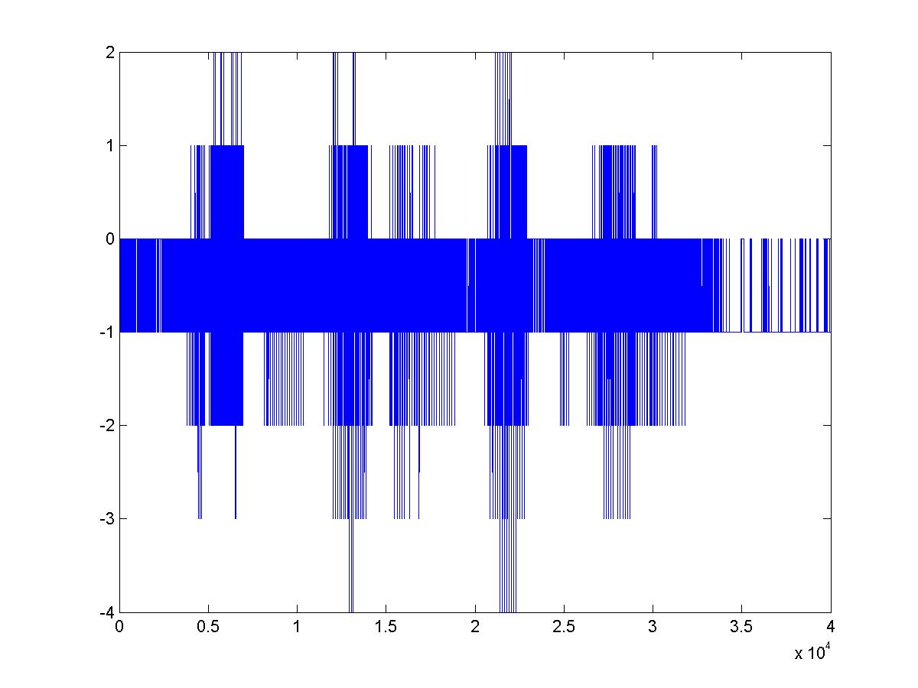
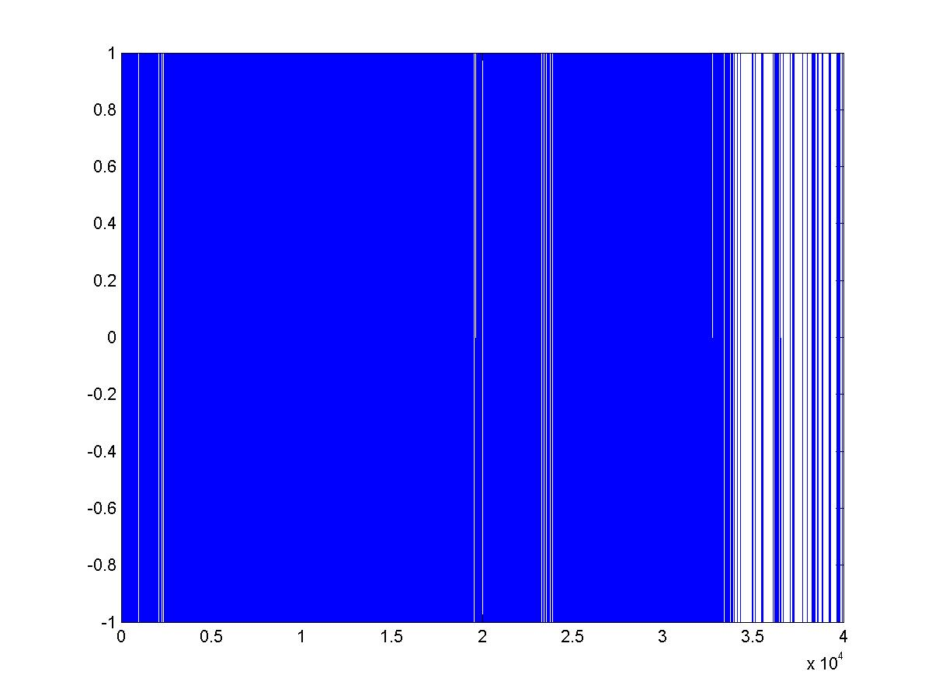
Tom Sullivan Says his Name
16 bit sampling
5 bit sampling
4 bit sampling
3 bit sampling
1 bit sampling

Slide 46
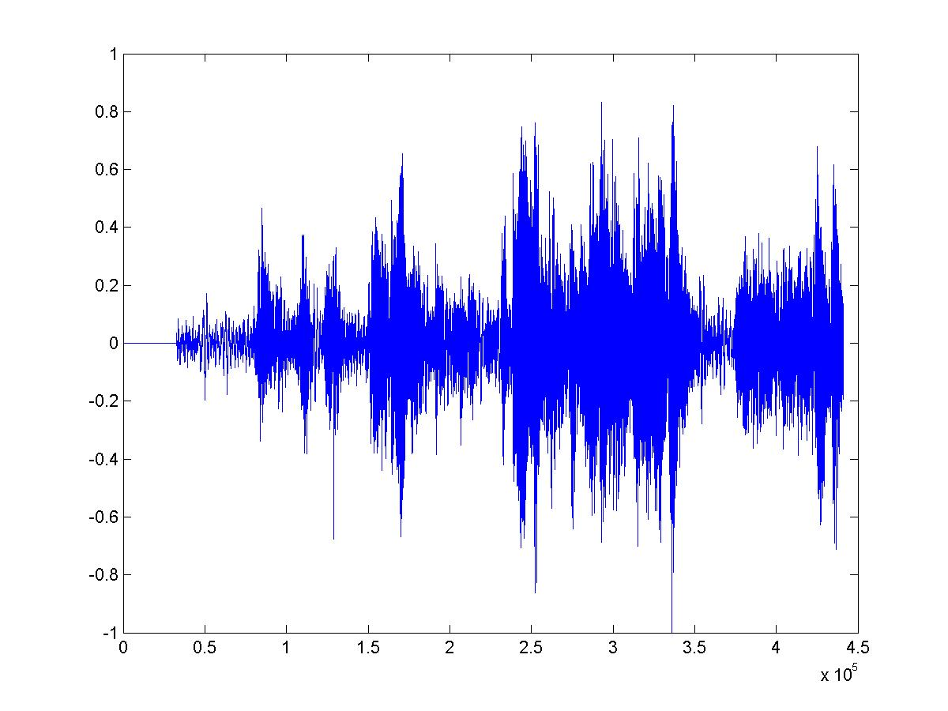
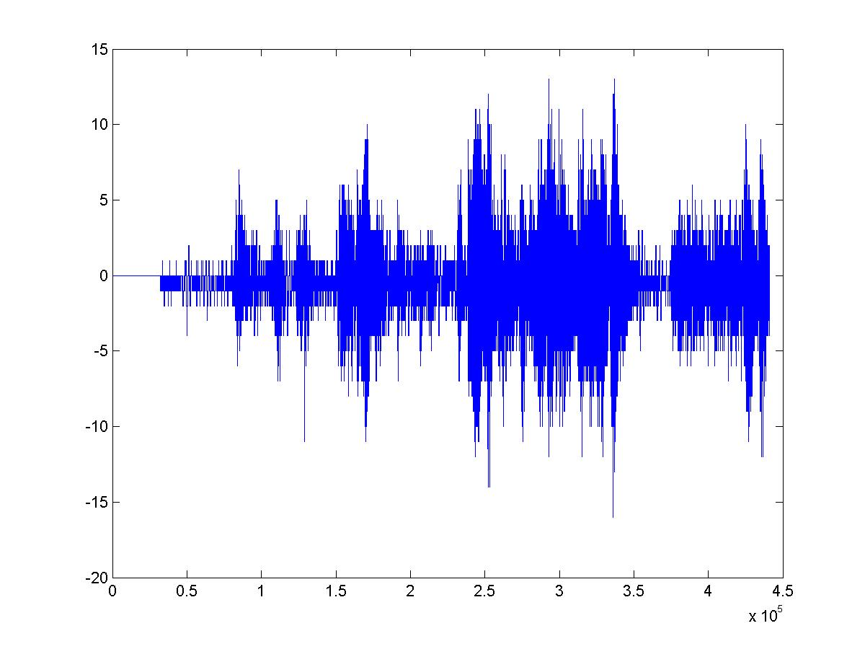
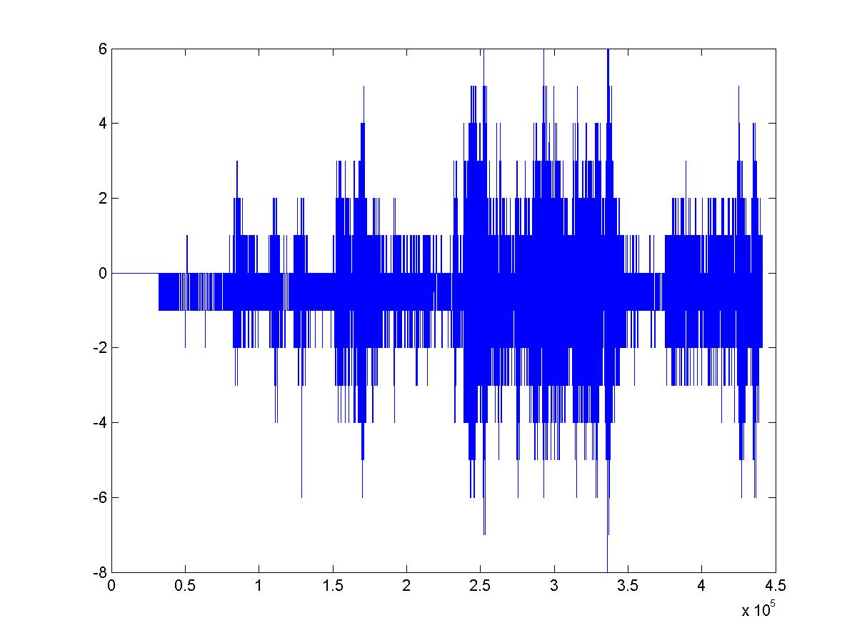
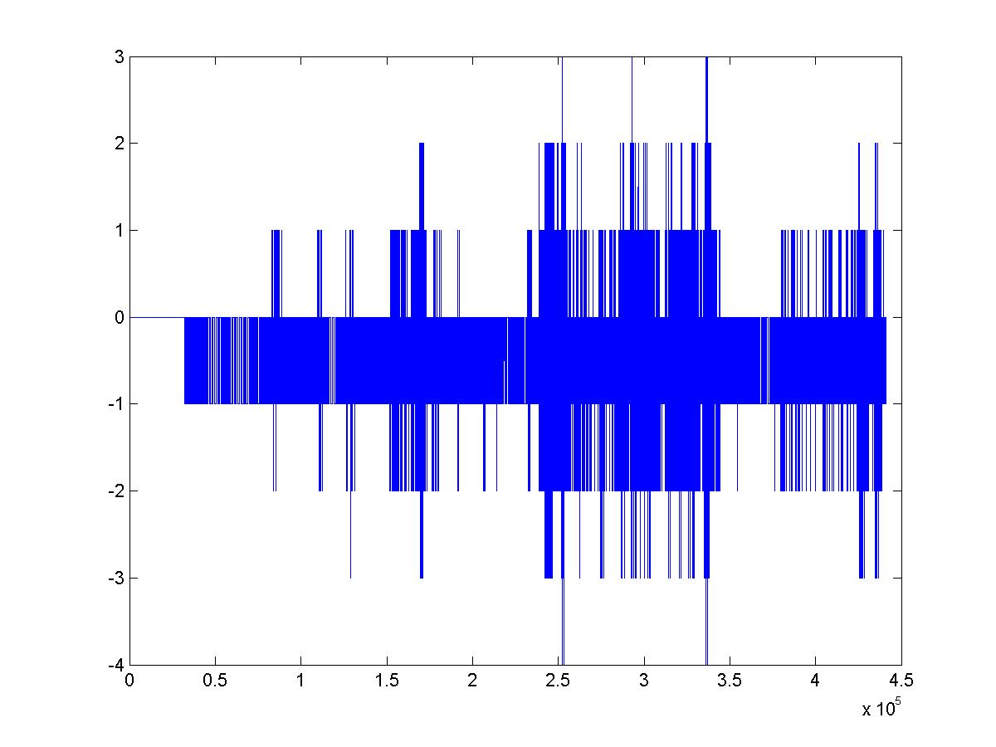
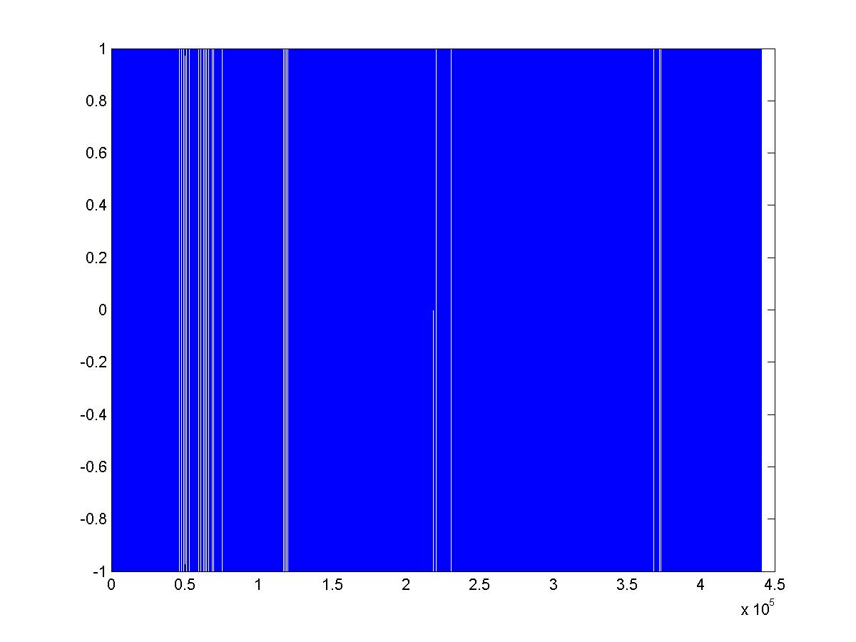
A Schubert Piece
16 bit sampling
5 bit sampling
4 bit sampling
3 bit sampling
1 bit sampling

Slide 47
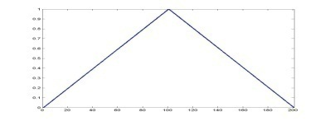
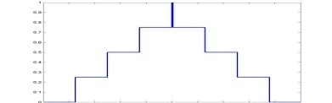
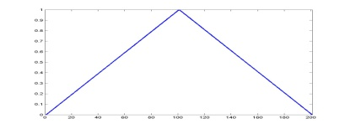
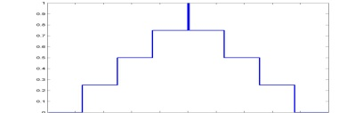
Quantization Formats
Sampling can be uniform
Sample values equally spaced out
Or nonuniform
Signal Value | Bits | Mapped to
S >= 3.75v | 11 | 3 * const
3.75v > S >= 2.5v | 10 | 2 * const
2.5v > S >= 1.25v | 01 | 1 * const
1.25v > S >= 0v | 0 | 0
Signal Value | Bits | Mapped to
S >= 4v | 11 | 4.5 * const
4v > S >= 2.5v | 10 | 3.25 * const
2.5v > S >= 1v | 01 | 1.25 * const
1.0v > S >= 0v | 0 | 0.5 * const

Slide 48
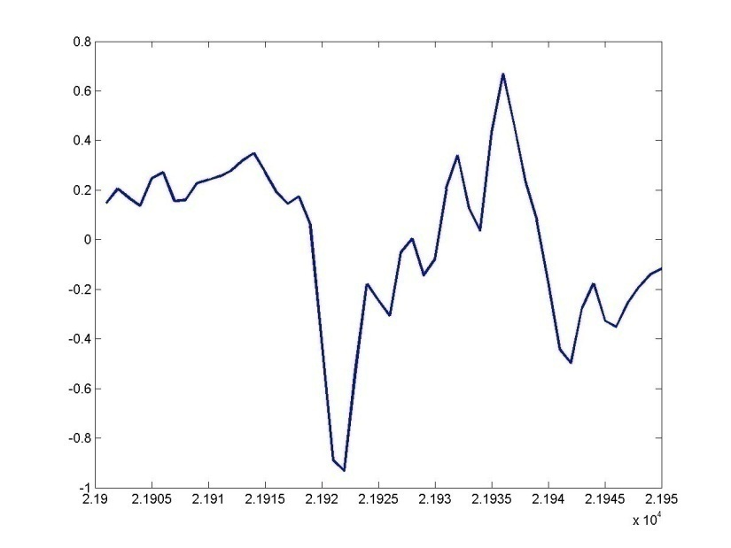
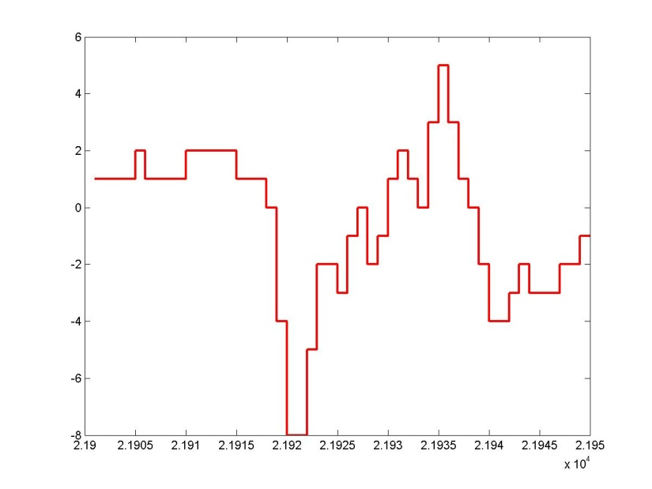
Uniform Quantization
At the sampling instant, the actual value of the waveform is rounded off to the nearest level permitted by the quantization
Values entirely outside the range are quantized to either the highest or lowest values

Slide 49


Non-uniform Quantiztion
Original
Uniform
Nonuniform
Quantization levels are non-uniformly spaced
At the sampling instant, the actual value of the waveform is rounded off to the nearest level permitted by the quantization
Values entirely outside the range are quantized to either the highest or lowest values

Slide 50

Uniform Quantization
UPON BEING SAMPLED AT ONLY 3 BITS (8 LEVELS)

Slide 51
Uniform Quantization
There is a lot more action in the central region than outside.
Assigning only four levels to the busy central region and four entire levels to the sparse outer region is inefficient
Assigning more levels to the central region and less to the outer region can give better fidelity
for the same storage

Slide 52

Non-uniform Quantization
Assigning more levels to the central region and less to the outer region can give better fidelity for the same storage

Slide 53
Non-uniform Quantization
Uniform
Non-uniform
Assigning more levels to the central region and less to the outer region can give better fidelity for the same storage

Slide 54


Non-uniform Sampling
Uniform
Nonlinear
quantized value
quantized value
Analog value
Analog value
Uniform sampling maps uniform widths of the analog signal to units steps of the quantized signal
In “standard” non-uniform sampling the step sizes are smaller near 0 and wider farther away
The curve that the steps are drawn on follow a logarithmic law:
Mu Law: Y = C. log(1 + mX/C)/(1+m)
A Law: Y = C. (1 + log(a.X)/C)/(1+a)
One can get the same perceptual effect with 8bits of non-uniform sampling as 12bits of uniform sampling

Slide 55
Dealing with audio
Signal Value | Bits | Mapped to
S >= 3.75v | 11 | 3
3.75v > S >= 2.5v | 10 | 2
2.5v > S >= 1.25v | 01 | 1
1.25v > S >= 0v | 0 | 0
Signal Value | Bits | Mapped to
S >= 4v | 11 | 4.5
4v > S >= 2.5v | 10 | 3.25
2.5v > S >= 1v | 01 | 1.25
1.0v > S >= 0v | 0 | 0.5
Capture / read audio in the format provided by the file or hardware
Linear PCM, Mu-law, A-law,
Convert to 16-bit PCM value
I.e. map the bits onto the number on the right column
This mapping is typically provided by a table computed from the sample compression function
No lookup for data stored in PCM
Conversion from Mu law:
http://www.speech.cs.cmu.edu/comp.speech/Section2/Q2.7.html

Slide 56

Images

Slide 57

Images

Slide 58

The Eye
Retina
Basic Neuroscience: Anatomy and Physiology Arthur C. Guyton, M.D. 1987 W.B.Saunders Co.

Slide 59

The Retina
http://www.brad.ac.uk/acad/lifesci/optometry/resources/modules/stage1/pvp1/Retina.html

Slide 60

Rods and Cones
Separate Systems
Rods
Fast
Sensitive
Grey scale
predominate in the periphery
Cones
Slow
Not so sensitive
Fovea / Macula
COLOR!
Basic Neuroscience: Anatomy and Physiology Arthur C. Guyton, M.D. 1987 W.B.Saunders Co.

Slide 61

The Eye
The density of cones is highest at the fovea
The region immediately surrounding the fovea is the macula
The most important part of your eye: damage == blindness
Peripheral vision is almost entirely black and white
Eagles are bifoveate
Dogs and cats have no fovea, instead they have an elongated slit

Slide 62

Spatial Arrangement of the Retina
(From Foundations of Vision, by Brian Wandell, Sinauer Assoc.)

Slide 63

Three Types of Cones (trichromatic vision)
Normalized reponse
Wavelength in nm

Slide 64
Trichromatic Vision
So-called “blue” light sensors respond to an entire range of frequencies
Including in the so-called “green” and “red” regions
The difference in response of “green” and “red” sensors is small
Varies from person to person
Each person really sees the world in a different color
If the two curves get too close, we have color blindness
Ideally traffic lights should be red and blue

Slide 65


White Light

Slide 66
Response to White Light
?

Slide 67

Response to White Light

Slide 68

Response to Sparse Light
?

Slide 69
Response to Sparse Light

Slide 70

Human perception anomalies
Dim
Bright
The same intensity of monochromatic light will result in different perceived brightness at different wavelengths
Many combinations of wavelengths can produce the same sensation of colour.
Yet humans can distinguish 10 million colours

Slide 71




Representing Images
Utilize trichromatic nature of human vision
Sufficient to trigger each of the three cone types in a manner that produces the sensation of the desired color
A tetrachromatic animal would be very confused by our computer images
Some new-world monkeys are tetrachromatic
The three “chosen” colors are red (650nm), green (510nm) and blue (475nm)
By appropriate combinations of these colors, the cones can be excited to produce a very large set of colours
Which is still a small fraction of what we can actually see
How many colours? …

Slide 72


The “CIE” colour space
International council on illumination, 1931
From experiments done in the 1920s by W. David Wright and John Guild
Subjects adjusted x,y,and z on the right of a circular screen to match a colour on the left
X, Y and Z are normalized responses of the three sensors
X + Y + Z is 1.0
Normalized to have to total net intensity
The image represents all colours we can see
The outer curve represents monochromatic light
X,Y and Z as a function of λ
The lower line is the line of purples
End of visual spectrum
The CIE chart was updated in 1960 and 1976
The newer charts are less popular

Slide 73

What is displayed
The RGB triangle
Colours outside this area cannot be matched by additively combining only 3 colours
Any other set of monochromatic colours would have a differently restricted area
TV images can never be like the real world
Each corner represents the (X,Y,Z) coordinate of one of the three “primary” colours used in images
In reality, this represents a very tiny fraction of our visual acuity
Also affected by the quantization of levels of the colours

Slide 74
Representing Images on Computers
Greyscale: a single matrix of numbers
Each number represents the intensity of the image at a specific location in the image
Implicitly, R = G = B at all locations
Color: 3 matrices of numbers
The matrices represent different things in different representations
RGB Colorspace: Matrices represent intensity of Red, Green and Blue
CMYK Colorspace: Cyan, Magenta, Yellow
YIQ Colorspace..
HSV Colorspace..

Slide 75

Computer Images: Grey Scale
R = G = B. Only a single number need be stored per pixel
Picture Element (PIXEL)
Position & gray value (scalar)

Slide 76

What we see
What the computer “sees”
10
10

Slide 77



Color Images
Picture Element (PIXEL)
Position & color value (red, green, blue)

Slide 78




RGB Representation
R
R
G
G
original
B
B

Slide 79



RGB Manipulation Example: Color Balance
R
R
G
G
original
B
B

Slide 80

The CMYK color space
Represent colors in terms of cyan, magenta, and yellow
The “K” stands for “Key”, not “black”
Blue

Slide 81

CMYK is a subtractive representation
RGB is based on composition, i.e. it is an additive representation
Adding equal parts of red, green and blue creates white
What happens when you mix red, green and blue paint?
Clue – paint colouring is subtractive..
CMYK is based on masking, i.e. it is subtractive
The base is white
Masking it with equal parts of C, M and Y creates Black
Masking it with C and Y creates Green
Yellow masks blue
Masking it with M and Y creates Red
Magenta masks green
Masking it with M and C creates Blue
Cyan masks green
Designed specifically for printing
As opposed to rendering

Slide 82

An Interesting Aside
Paints create subtractive coloring
Each paint masks out some colours
Mixing paint subtracts combinations of colors
Paintings represent subtractive colour masks
In the 1880s Georges-Pierre Seurat pioneered an additive-colour technique for painting based on “pointilism”
How do you think he did it?

Slide 83
Quantization and Saturation
Captured images are typically quantized to N-bits
Standard value: 8 bits
8-bits is not very much < 1000:1
Humans can easily accept 100,000:1
And most cameras will give you 6-bits anyway…

Slide 84
Processing Colour Images
Typically work only on the Grey Scale image
Decode image from whatever representation to RGB
GS = R + G + B
For specific algorithms that deal with colour, individual colours may be maintained
Or any linear combination that makes sense may be maintained.

Slide 85
Other Signals
Direct measurement (like sound):
ECG, EMG, EKG
Indirect measurement (through a transform)
MRI
Takes measurements in the Fourier domain

Slide 86
The General Theory of Sensing
Actual signal : y( j)
j may be time, position, etc..
Usually continuously valued
Captured value:
; Θ is the space of all j
K( j) is a measurement kernel
Ideally a delta (which takes non-zero value only at the desired j)
Captures actual snapshots
But in reality not
More on this later..

Slide 87
Next Class..
Review of linear algebra..

