Slide 1


15-112 Lecture 2 Recursion
Instructor: Pat Virtue

Slide 2
Tuesday Logistics

Slide 3

As you walk in
Quiz will start at the beginning of lecture
Have pencil/pen ready
Silence phones

Slide 4
Quiz
Before we start
Don’t open until we start
Make sure your name and Andrew ID are on the front
Read instruction page
No questions (unless clarification on English)
Additional info
25 min

Slide 5

Fractals
Mandelbrot set
https://www.youtube.com/watch?v=u1pwtSBTnPU

Slide 6
Announcements
Democracy Day
Tue 11/7 – No class
TP
Ideation meetings
Special topic session
Scaffolded project – Bee project
HW9
VS Code graphics exercise → Turn in on Canvas

Slide 7
Thursday Logistics

Slide 8
Announcements
Quiz 8

Slide 9
Poll 1
What is the big O of the following function, which takes a list of length N? Note that some parts of the code are intentionally blanked out.
O(1)
O(2**N)
O(N**0.5)
O(N*log(N))
O(N**2)
O(N**3)
Need more information
to be sure
def f(L):
result = []
for i in range(_______):
for j in range(_______):
k = L[i] + L[j] result.append(k)
return result

Slide 10
Poll 2
Which of the following may require Python to visit all N elements in the list data, assuming N = len(data)? Select ALL that apply.
for x in data:
print(x)
for i in range(len(data)):
x = data[i]
print(x)
if x in data:
print(“Found it”)
x = data[-1]
x = max(data)
None of the above

Slide 11
Poll 3
Assume print(s) prints {2, 4, 6, 8, ???} for some set s.
Which of the follow will are possible replacements for ??? for some set?
Select ALL that apply.
1
[1]
2
'two'
10
{10}
Need more information to be sure

Slide 12

Announcements
Next Week
Tue 11/7: No class (Democracy Day)
Thu 11/9: Quiz 9
HW10
TP
Special topic sessions will be posted today
 | Sun | Mon | Tue | Wed | Thu | Fri | Sat
Week 9 |  |  | 🎃 |  | Recursion |  | HW9 due Hack112
Week 10 | Hack112 |  | No class Preread10 |  | Quiz 9 OOP Part1 |  | HW10 due
Week 11 |  |  | No quiz10 |  | Midterm 2

Slide 13
Recursion

Slide 14
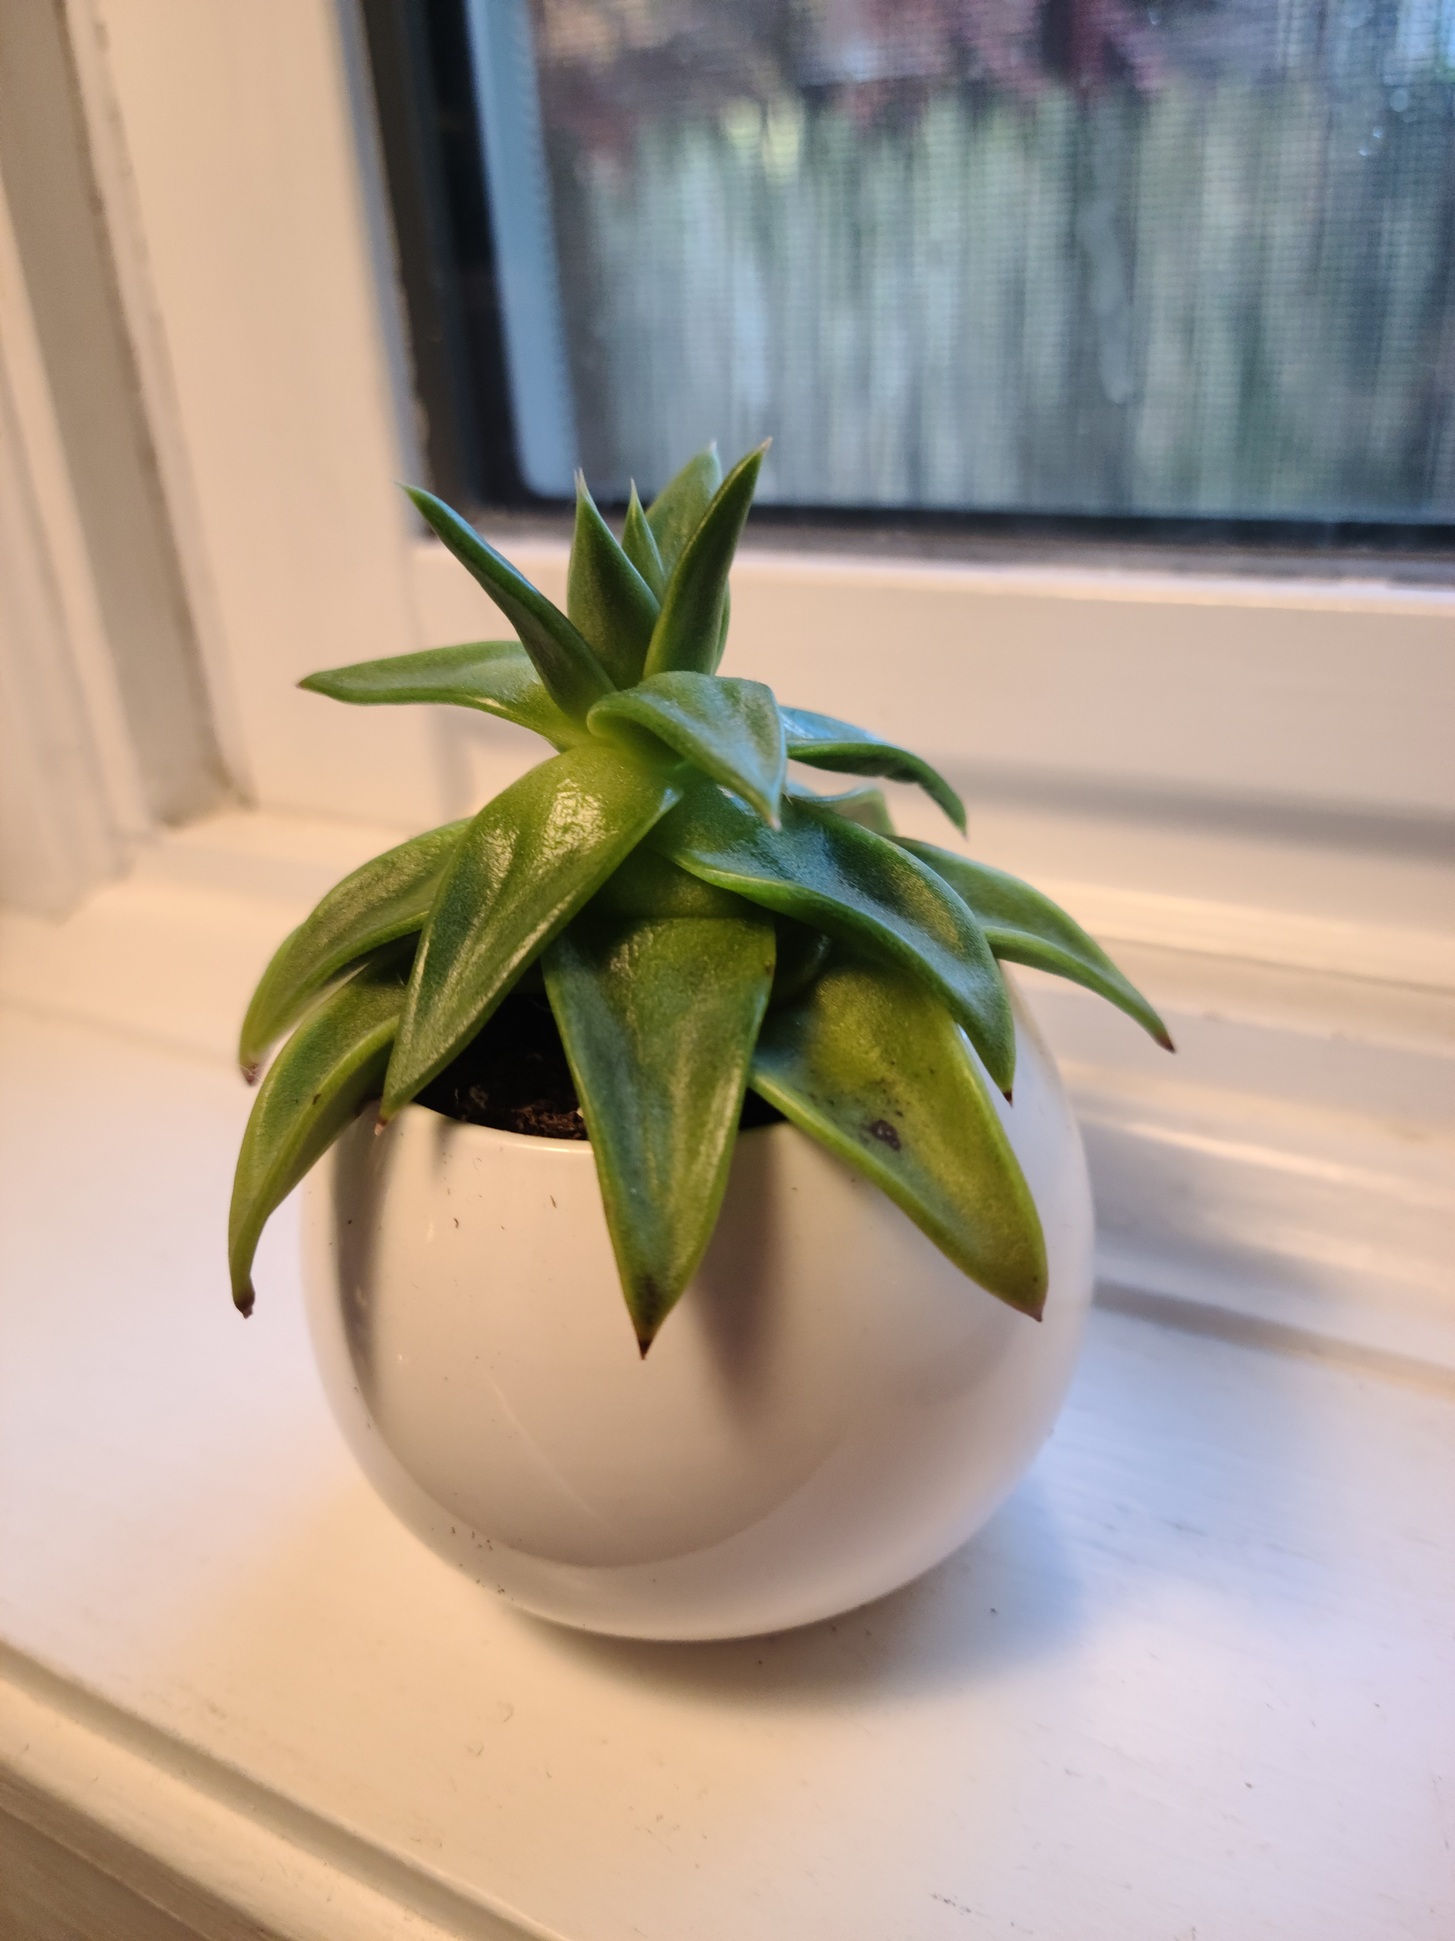
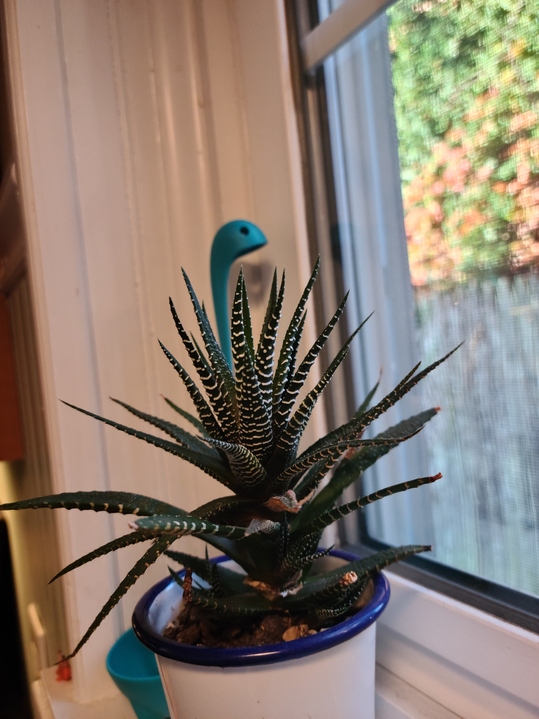
Recursion in the Wild

Slide 15
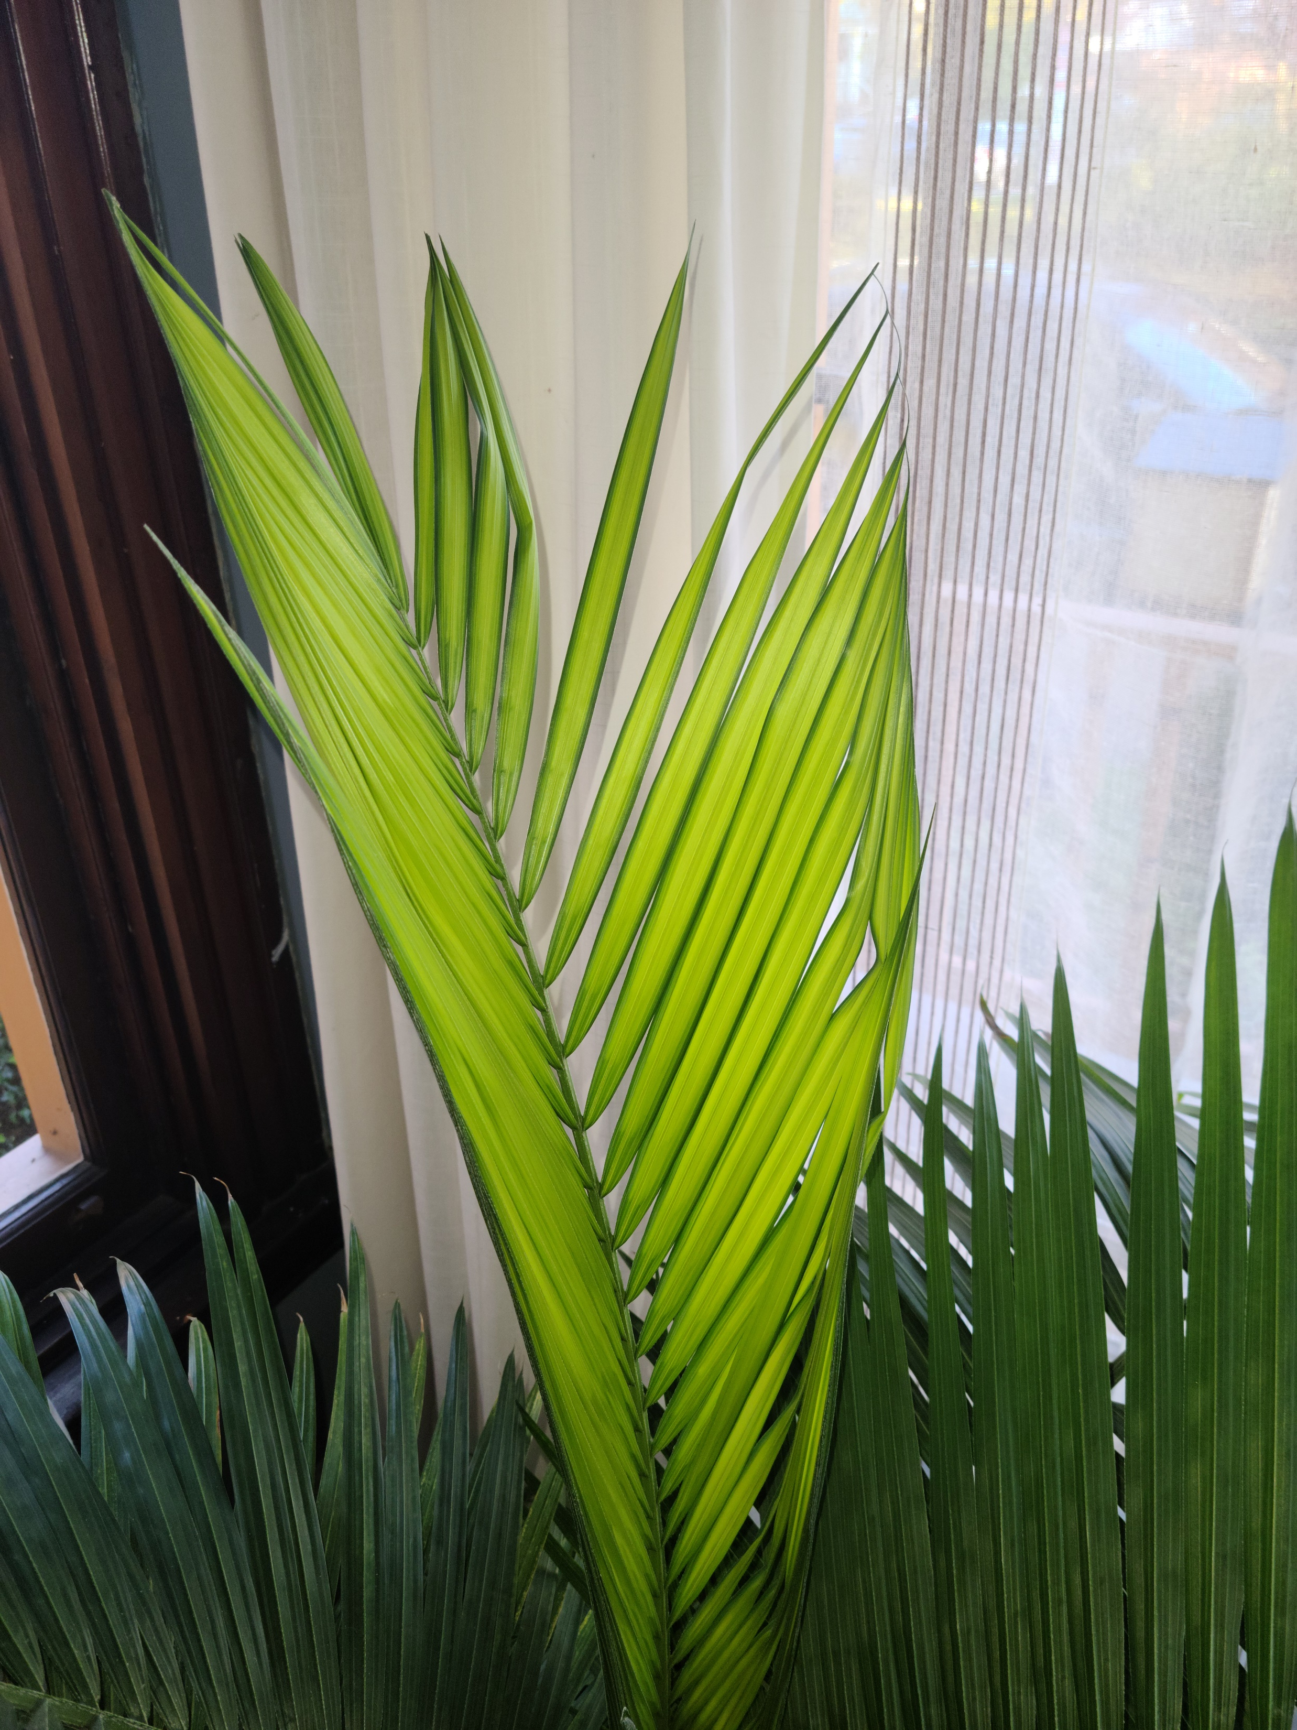
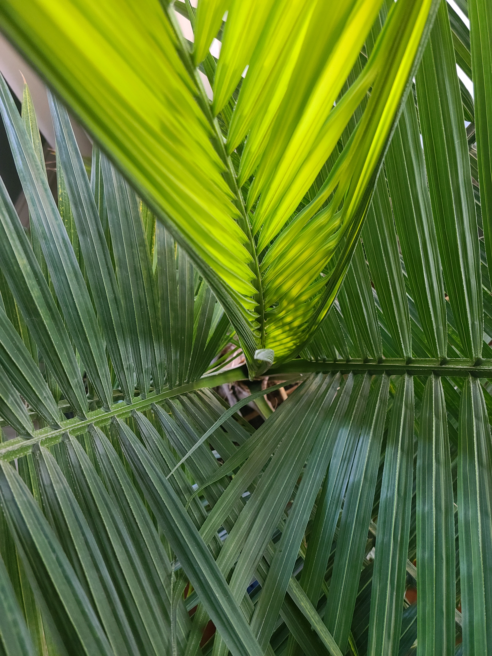
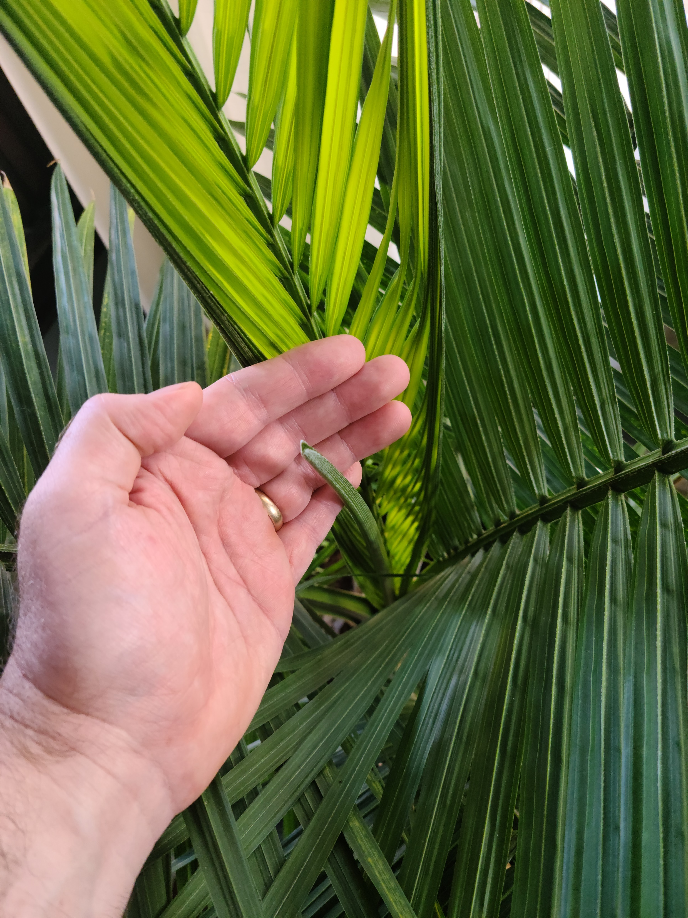

Recursion in the Wild

Slide 16
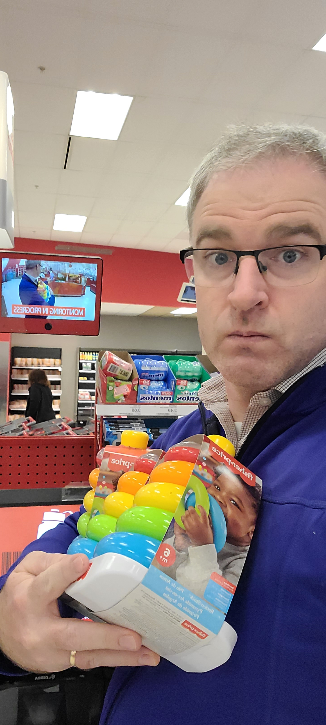
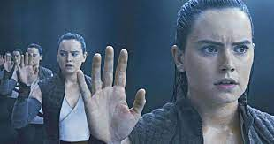
Recursion in the Wild

Slide 17
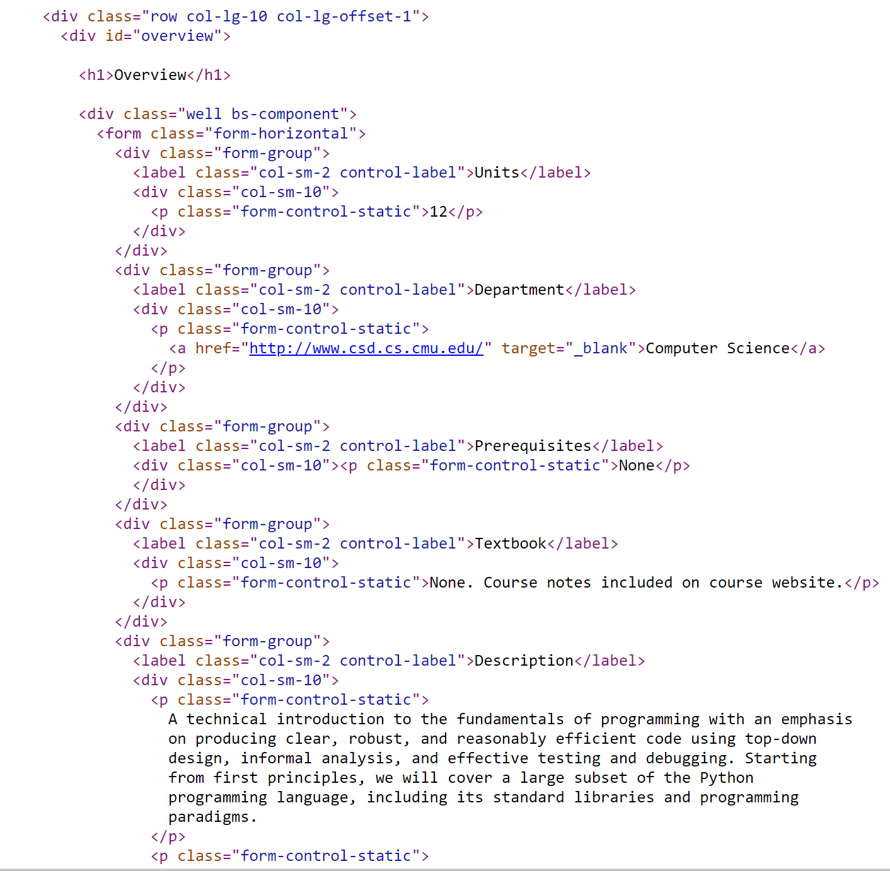

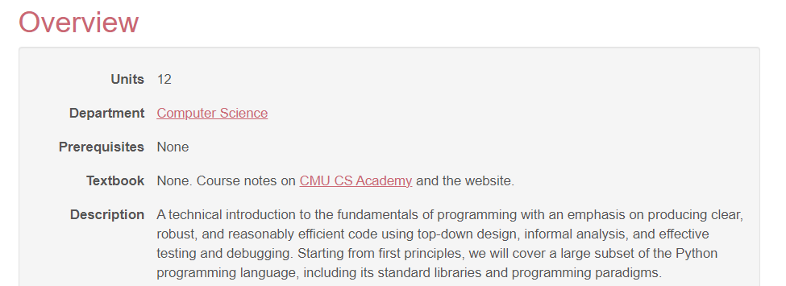
Recursion in the Wild

Slide 18
General Recursive Form
def recursiveFunction():
if (this is the base case):
do something non-recursive
else:
do something recursive

Slide 19

Recursive thinking
Suggestion: start with the recursive case
How can you reduce the problem into smaller problem(s) that have the same structure as the original?
Assume (magically) that next recursive cases will work

Slide 20
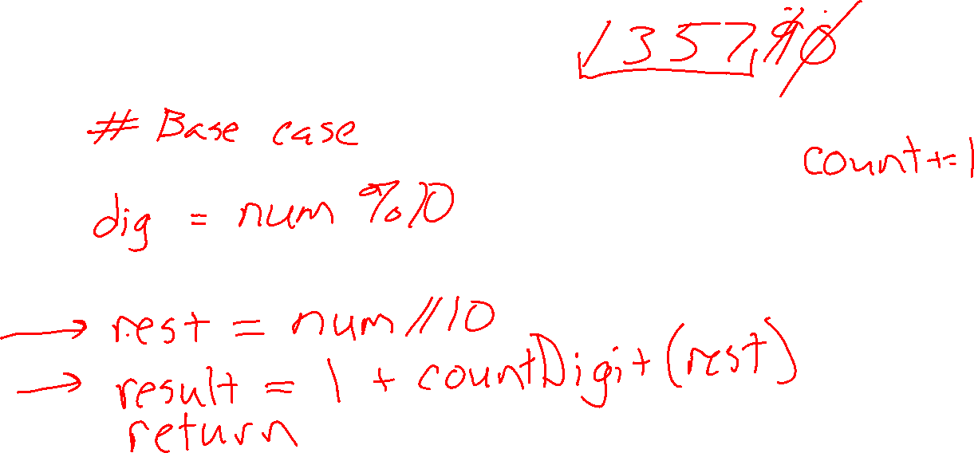
Recursive thinking (and recursive functions)
Count digits??
def countDigits(number):

Slide 21
Recursive thinking (and recursive functions)
Word search??
def wordSearch(board, word):
(rows, cols) = (len(board), len(board[0]))
for row in range(rows):
for col in range(cols):
result = wordSearchFromCell(board, word, row, col)
if (result != None):
return result
return None

Slide 22

Recursion Examples
Recursive case
Base case
Recursion errors
Call Stack
Visualizing recursion
Debugging recursion

Slide 23
Example: Factorial

Slide 24
Example: Factorial

Slide 25
Some Recursion Issues
Debugging alternatingCase
def alternatingCase(s):
# assume s is at least of length 1:
if len(s) == 1:
return s[0].upper()
else:
last = s[-1]
rest = s[:-1]
if alternatingCase(rest)[-1].isupper():
return alternatingCase(rest) + last.lower()
else:
return alternatingCase(rest) + last.upper()

Slide 26
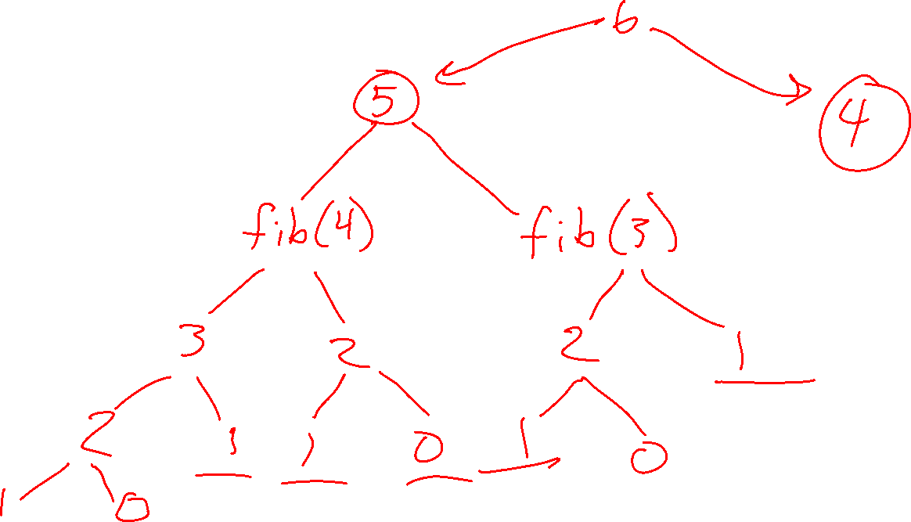
Example: Fibonacci

Slide 27
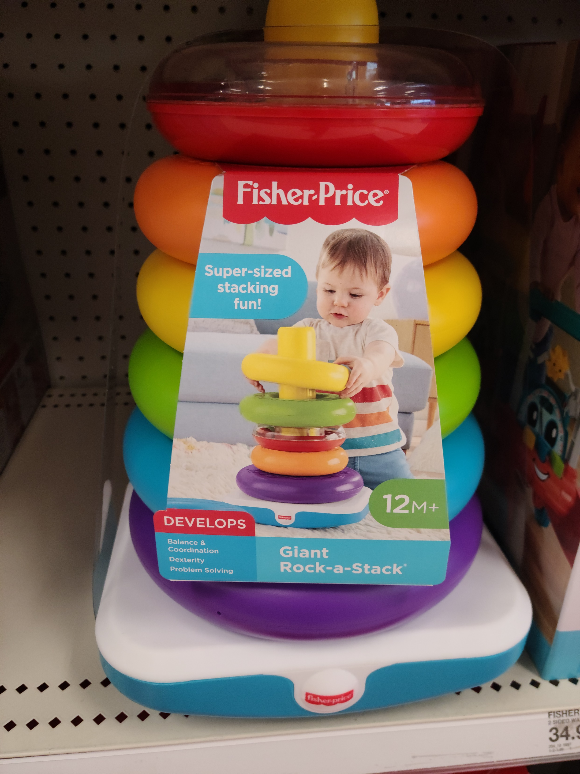
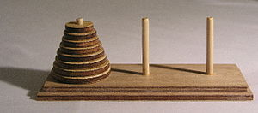
Towers of Hanoi
Goal: Move stack to a different peg
Restrictions
One piece at a time
Can’t put bigger piece on top of smaller
Image (left): https://commons.wikimedia.org/wiki/File:Tower_of_Hanoi.jpeg

Slide 28
Reminder General Recursive Form
def recursiveFunction():
if (this is the base case):
do something non-recursive
else:
do something recursive

Slide 29
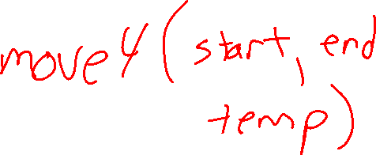
Towers of Hanoi
Recursive case
Let’s start with magic!

Slide 30
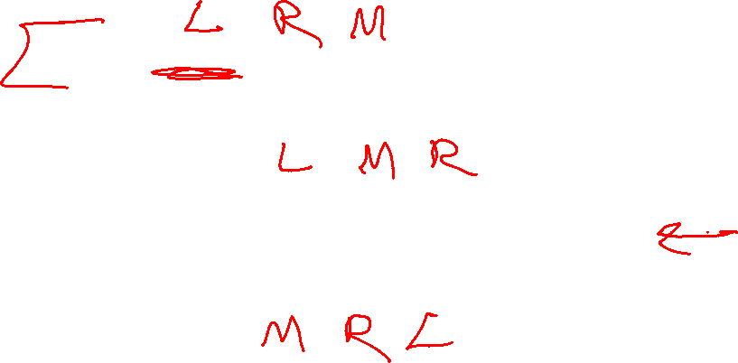
Towers of Hanoi
Recursive case
Let’s start with magic!
import magic # For now :)
def move5(start, end, temp):
# Move 5 pieces from start to end
magic.move4(start, temp, end)
print(f"Move piece from {start} to {end}")
magic.move4(temp, end, start)

Slide 31

Towers of Hanoi
Recursive case
Let’s start with magic!
import magic # For now :)
def move(start, end, temp):
# TODO Base case
# Move n pieces from start to end
move(n-1 start, temp, end)
print(f"Move piece from {start} to {end}")
move(n-1, temp, end, start)

Slide 32
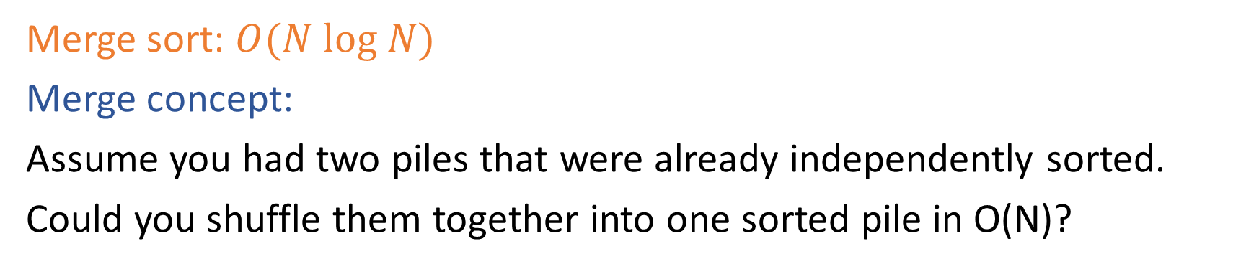
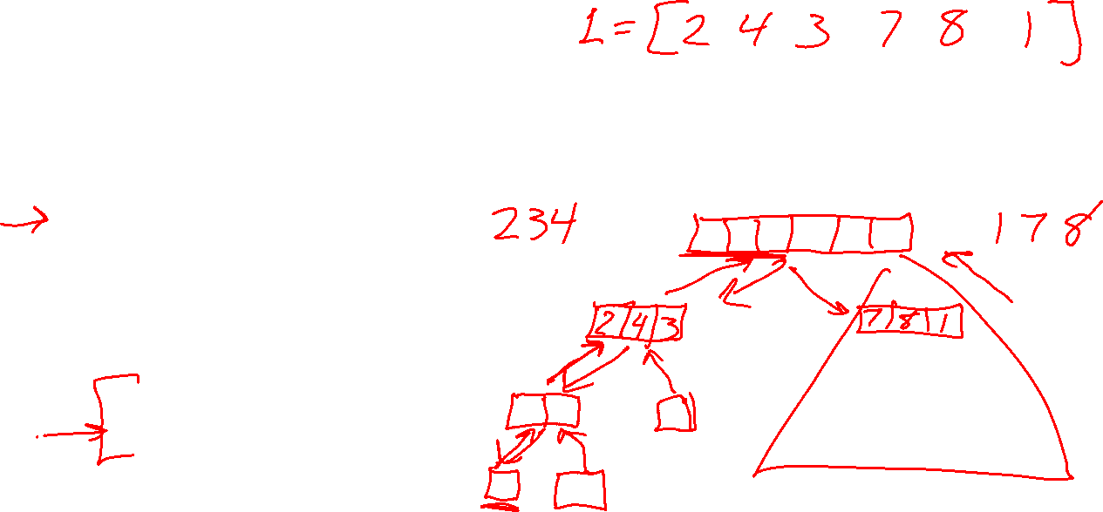
Revisit Merge Sort
Merge sort: $O(N log N)$
Merge concept:
Assume you had two piles that were already independently sorted.
Could you shuffle them together into one sorted pile in O(N)?
def mergesort(L):
if len(L) < 2:
return L
else:
mid = len(L)//2
left = mergesort(L[:mid])
right = mergesort(L[mid:])
return merge(left, right)
print(mergesort([1,5,3,4,2,0]))

Slide 33
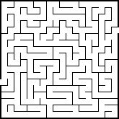
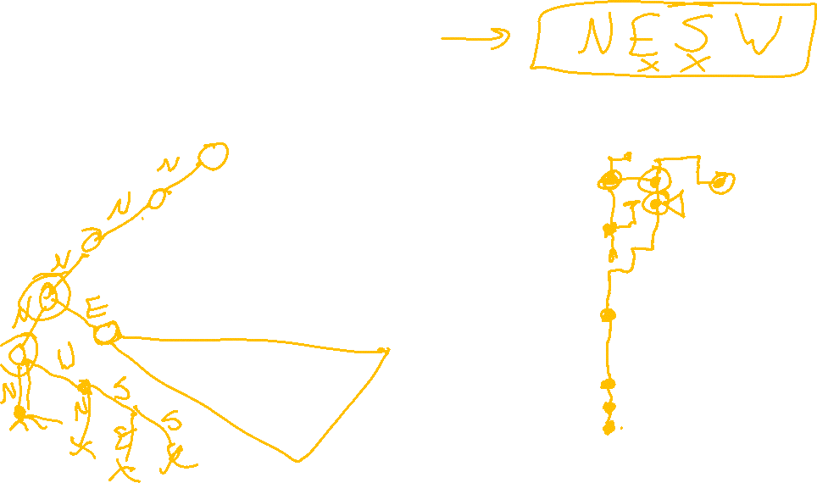
Backtracking
Incredibly generic problem-solving algorithm

Slide 34
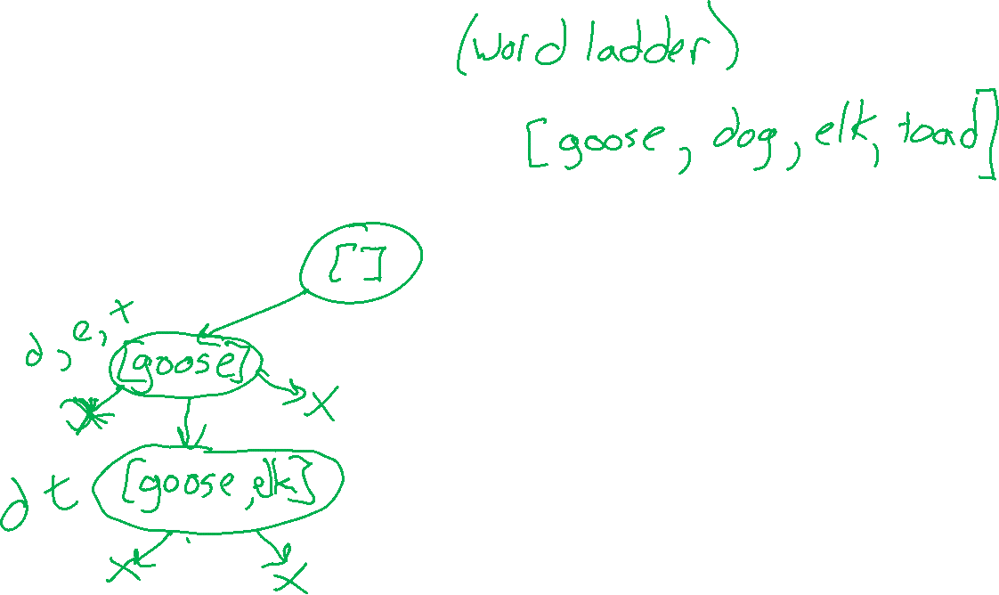
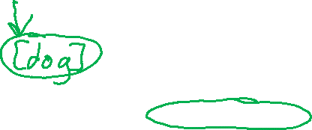

Backtracking: Word chain
List of words
Return an ordered list of words such that
Last letter of each word is the first letter of the next word
Debug output should matched tree!
CHAIN: [], REMAINING: ['goose', 'dog', 'elk', 'toad']
|CHAIN: ['goose'], REMAINING: ['dog', 'elk', 'toad']
| |CHAIN: ['goose', 'elk'], REMAINING: ['dog', 'toad']
| |Result: False
|Result: False
|CHAIN: ['dog'], REMAINING: ['goose', 'elk', 'toad']
| |CHAIN: ['dog', 'goose'], REMAINING: ['elk', 'toad']
| | |CHAIN: ['dog', 'goose', 'elk'], REMAINING: ['toad']
| | |Result: False
| |Result: False
|Result: False
|CHAIN: ['elk'], REMAINING: ['goose', 'dog', 'toad']
|Result: False
|CHAIN: ['toad'], REMAINING: ['goose', 'dog', 'elk']
| |CHAIN: ['toad', 'dog'], REMAINING: ['goose', 'elk']
| | |CHAIN: ['toad', 'dog', 'goose'], REMAINING: ['elk']
| | | |CHAIN: ['toad', 'dog', 'goose', 'elk'], REMAINING: []
| | | |Result: True (BASE)
| | |Result: True
| |Result: True
|Result: True
Result: True
['toad', 'dog', 'goose', 'elk']

Slide 35
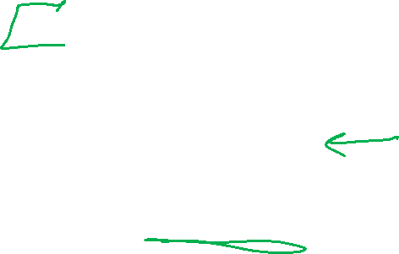
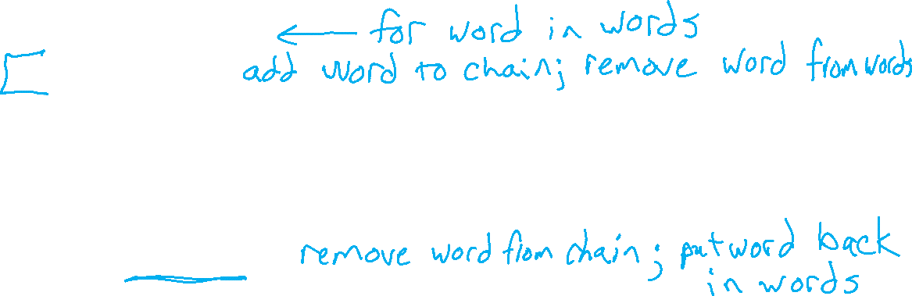
Backtracking: Word chain
solve(chain, words)
If no more words
Return chain as solution!
For each valid action
Apply action
Recurse: result = solve(chain, words)
If result is success
Return result
Else
Undo action
Return failure

Slide 36
Backtracking: N-Queens Example

Slide 37
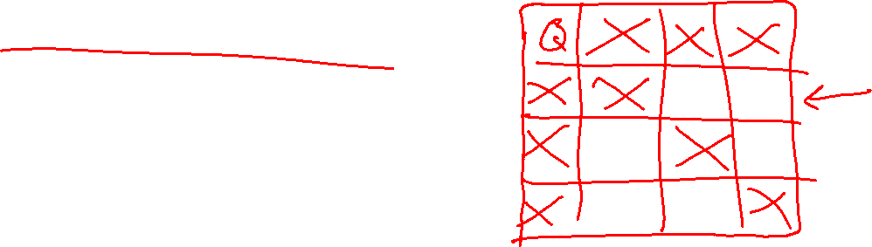
Backtracking: N-Queens Example
N-by-N chessboard
Place exactly N queen pieces on the board, such that no queens are in positions to attack each other
Queens can move any number of spaces:
Horizontally
Vertically
Diagonally

Slide 38
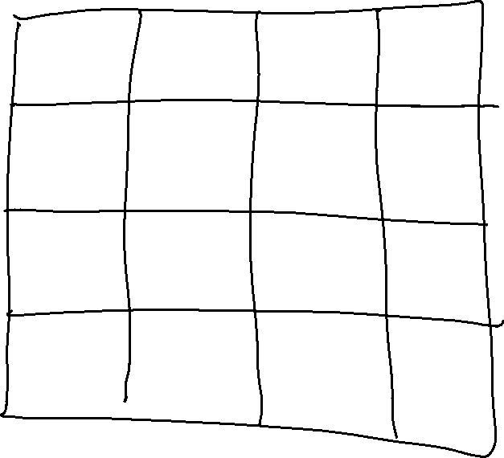
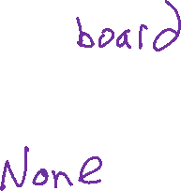
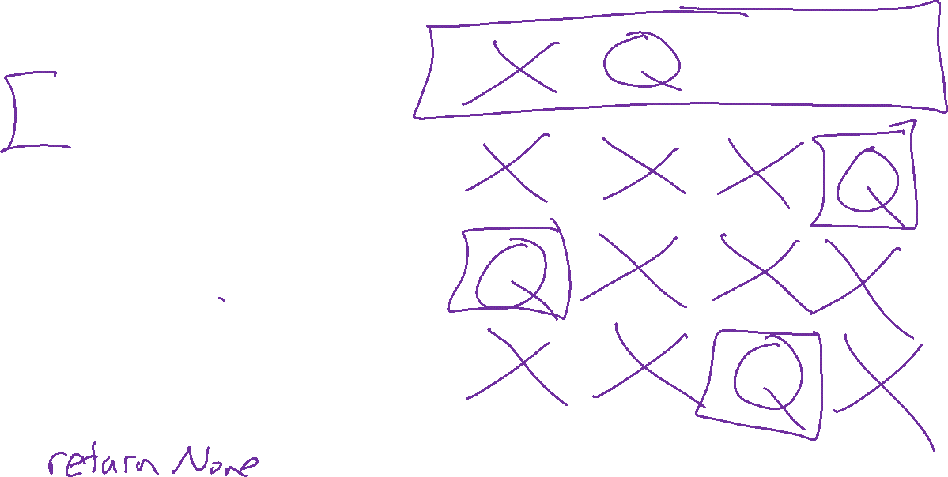
Backtracking: N-Queens Example
solve(board)
If all Qs placed
Return board as solution!
For each valid action
Apply action
Recurse: result = solve(board)
If result is success
Return result
Else
Undo action
Return failure

Slide 39
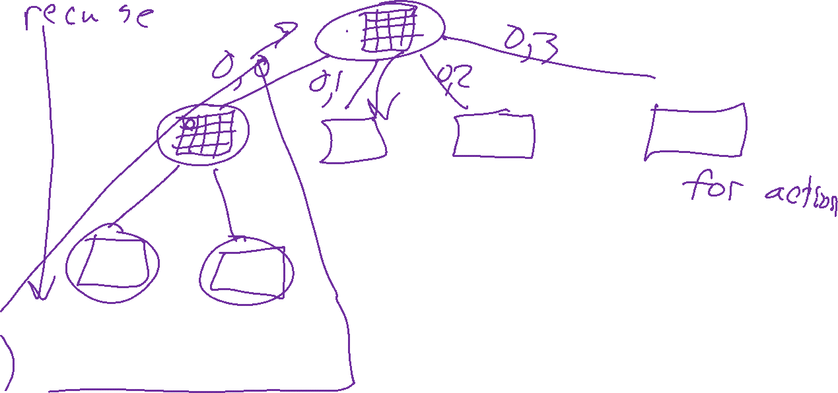
Backtracking: N-Queens Example

Slide 40
Backtracking: N-Queens example
Code demo
https://www.cs.cmu.edu/~112/notes/notes-recursion-part2.html#nQueens

Slide 41


Backtracking: Solving maze example
Start: top-left
Goal: bottom-right
Strategy
Path: Keep ordered list of locations representing the current path
Visited: Avoid revisiting same locations by storing
Try actions in order: N, S, E, W
Recursively solve from next location

Slide 42
Backtracking: Solving maze example
solve(maze, path, visited)
If at goal
Return path as solution!
For each valid action
Apply action
Recurse:
result = solve(maze, path, visited)
If result is success
Return result
Else
Undo action
Return failure

Slide 43
Backtracking pattern
Maze
N-Queens
solve(maze, path, visited)
If at goal
Return path as solution!
For each valid action
Apply action
Recurse:
result = solve(maze, path, visited)
If result is success
Return result
Else
Undo action
Return failure
solve(board)
If all Qs placed
Return board as solution!
For each valid action
Apply action
Recurse:
result = solve(board)
If result is success
Return result
Else
Undo action
Return failure

Slide 44


Backtracking: Performance
Map coloring example
Goal: color all states with {red, green, blue} such that adjacent states have different colors.
Classic example: Australia
Image credit: ai.berkeley.edu, Ketrina Yim

Slide 45

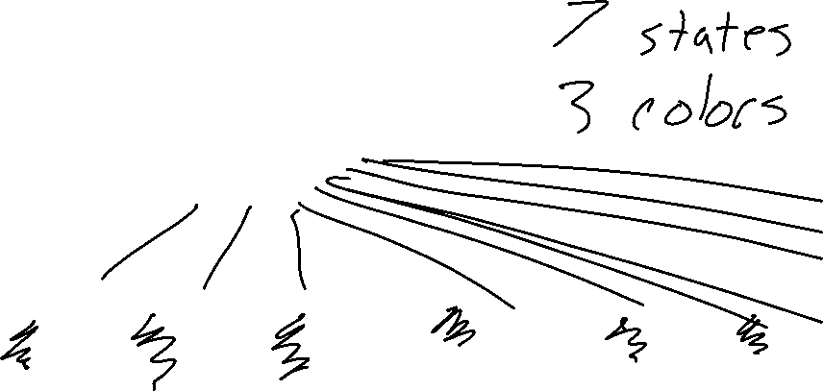
Backtracking: Performance
Map coloring example
"for each valid action"
But, what are the actions??

Slide 46
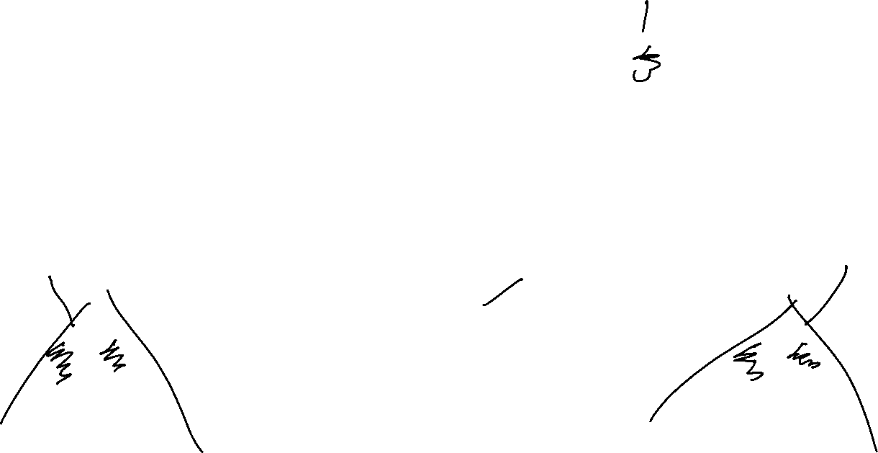
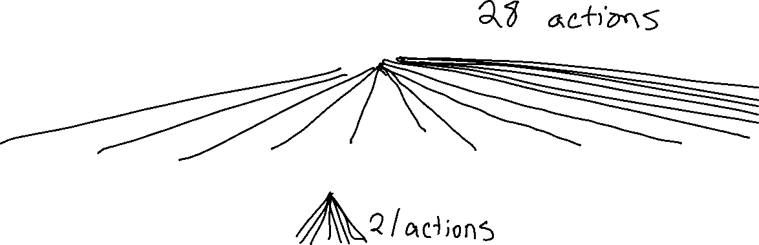
Backtracking: Performance
Map coloring example
"for each valid action"
But, what are the actions??

Slide 47
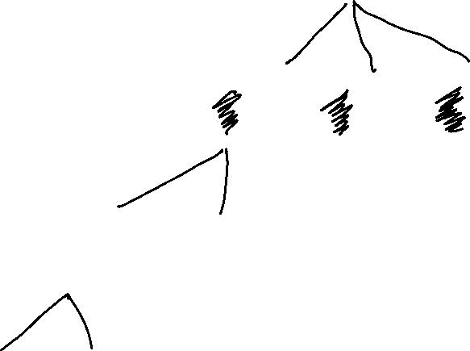

Backtracking: Performance
Map coloring example
"for each valid action"
But, what are the actions??

Slide 48
Fractals!

