Slide 1
15-112 Lecture 2 Animations
Instructor: Pat Virtue

Slide 2
Tuesday Logistics

Slide 3
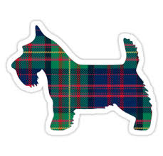
As you walk in
Quiz will start at the beginning of lecture
Have pencil/pen ready
Silence phones

Slide 4
Quiz
Before we start
Don’t open until we start
Make sure your name and Andrew ID are on the front
Read instruction page
No questions (unless clarification on English)
Additional info
25 min

Slide 5
Announcements
Same as usual ☺

Slide 6
HW 4 Tips
VS Code set up
Read instructions carefully
Autograder with animations
Read piazza post
Video different than current CS Academy autograder
Start early
It’s a lot of code to write

Slide 7
Thursday Logistics

Slide 8
Announcements
Quiz 3 debrief
5 point bump applied in Gradescope
Unit 3 Sections
3.7-3.9 Helpful (and fun!) but won’t block your from proceeding to exercises
You should still be able to do basic bounded motion though, 3.8

Slide 9
Basic Shapes

Slide 10
Rectangles, Ovals, Lines, and Labels
Reference slide
drawRect(x0, y0, width, height)
drawOval(centerX, centerY, width, height)
drawLine(x0, y0, x1, y1)
drawLabel(text, centerX, centerY)

Slide 11
Rectangles, Ovals, Lines, and Labels
Reference slide
drawRect(x0, y0, width, height, fill='black', opacity=100,
border=None, borderWidth=2, rotateAngle=0)
drawOval(centerX, centerY, width, height, fill='black', opacity=100,
border=None, borderWidth=2, rotateAngle=0)
drawLine(x0, y0, x1, y1, fill='black', lineWidth=2, opacity=100,
dashes=False, arrowStart=False, arrowEnd=False)
drawLabel(text, centerX, centerY, fill='black’, opacity=100,
border=None, borderWidth=2, rotateAngle=0,
size=12, font='arial', bold=False, italic=False, align='center')

Slide 12
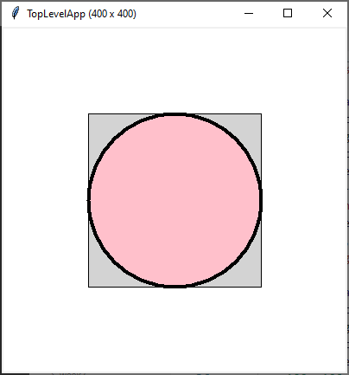
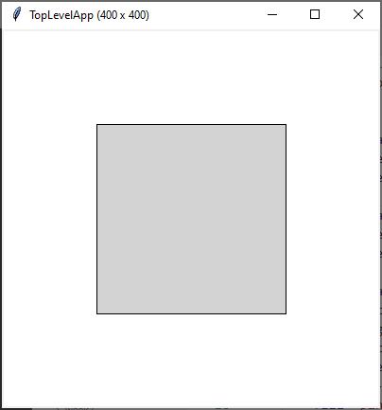
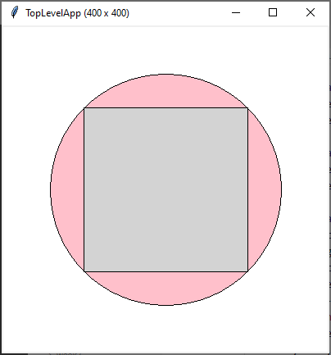
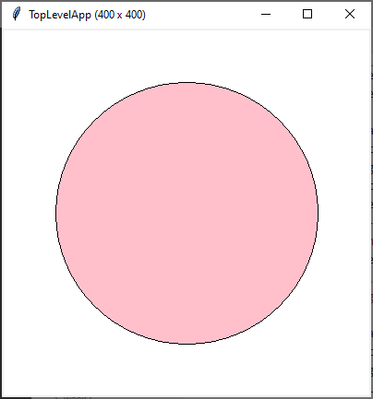
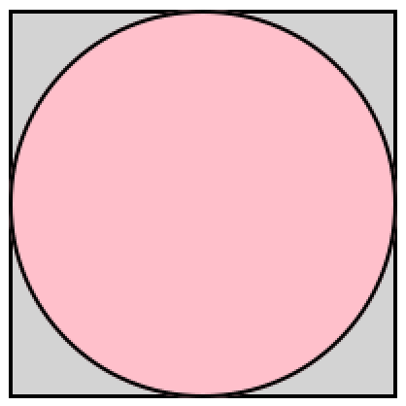
Poll 1
Which does this draw?
def drawBubble(app):
drawOval(200, 200, 200, 200, fill='pink', border='black')
drawRect(100, 100, 200, 200, fill='lightgray', border='black')
A.
B.
C.
D.
E. I have no idea

Slide 13


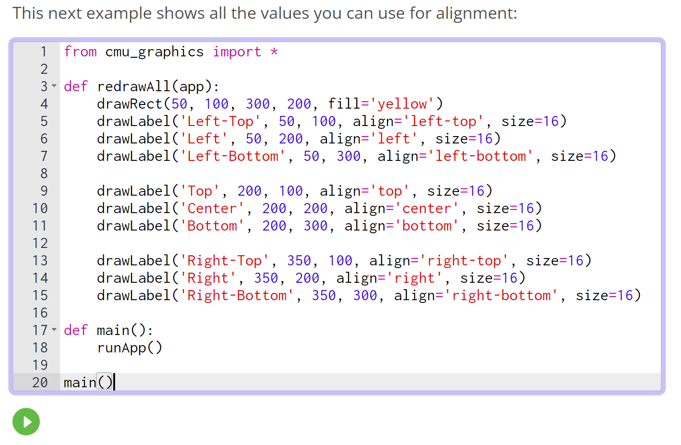
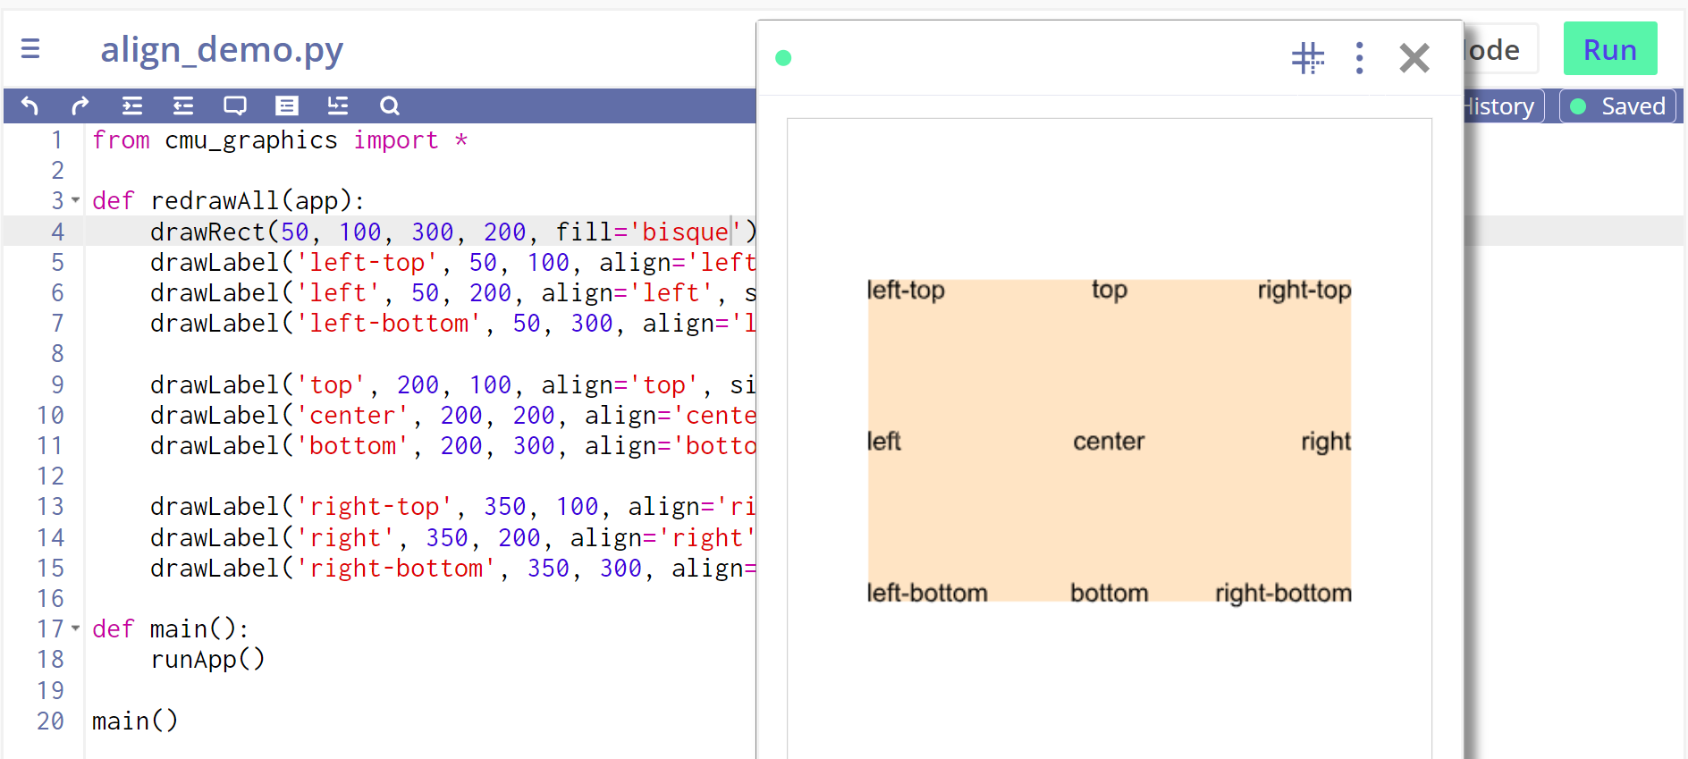
Tip: Create Sandbox Cheatsheets for Yourself!

Slide 14
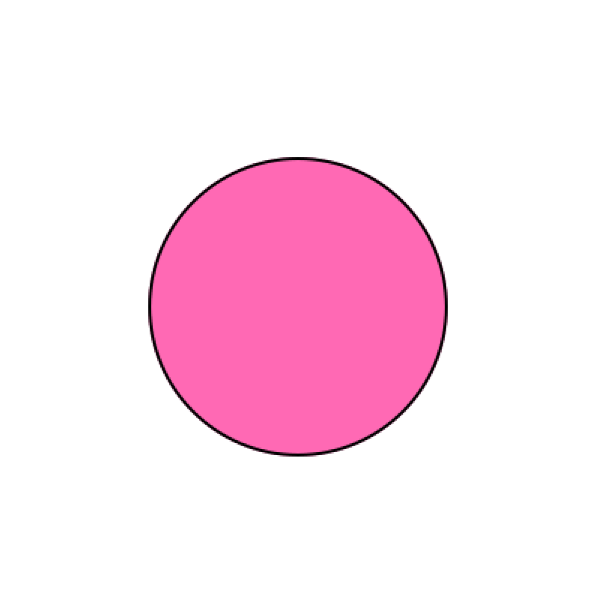
Poll 2
Which of these is best?
Left
Right
def drawBubbleA(app):
drawOval(200, 200, 200, 200,
fill='hotpink', border='black')
def drawBubbleB(app):
cx = 200
cy = 200
width = 200
height = 200
drawOval(cx, cy, width, height,
fill='hotpink', border='black')

Slide 15
Poll 3
Which of these is best?
Left
Right
def drawBubbleC(app):
cx = app.width/2
cy = app.height/2
d = app.width/2
drawOval(cx, cy, d, d,
fill='hotpink', border='black')
def drawBubbleB(app):
cx = 200
cy = 200
width = 200
height = 200
drawOval(cx, cy, width, height,
fill='hotpink', border='black')

Slide 16
Poll 4
Which of these is best?
Left
Right
def drawBubbleC(app):
cx = app.width/2
cy = app.height/2
d = app.width/2
drawOval(cx, cy, d, d,
fill='hotpink', border='black')
def drawBubbleD(app):
cx = app.width/2
cy = app.height/2
d = min(app.width/2, app.height/2)
drawOval(cx, cy, d, d,
fill='hotpink', border='black')

Slide 17
Exercise: Bigger Smaller
Guided exercise in notes

Slide 18
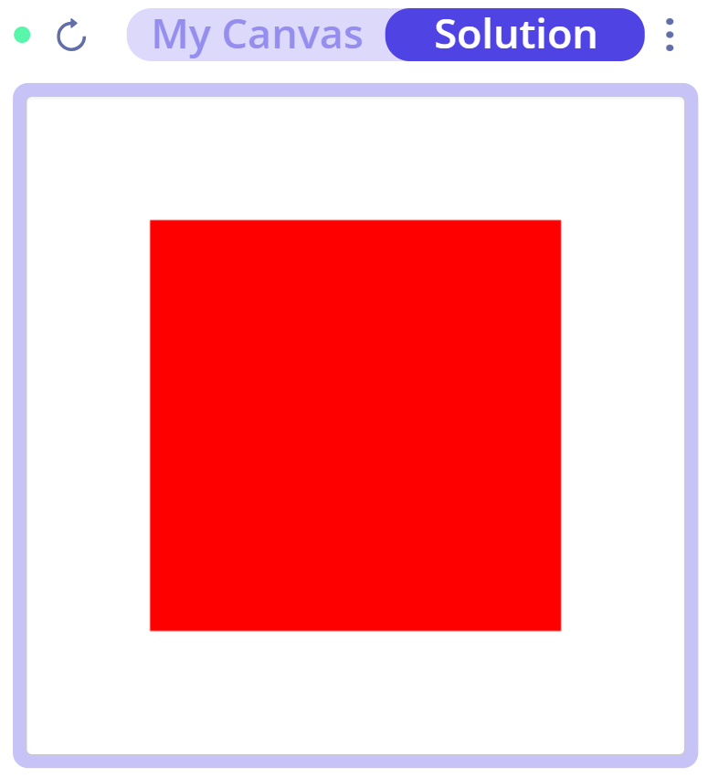
Poll 5
Exercise: Bigger Smaller
(This was not explicitly part of the pre-reading, I just want to know how much I’m repeating things from the notes)
What happens when I click on the white space outside the red square? Select all that apply
Nothing (Hint: it isn’t this one. Do NOT select this one)
Square gets bigger
Square gets smaller
Square turns green
Square turns pink

Slide 19
Rectangles, Ovals, Lines, and Labels
drawRect(x0, y0, width, height, fill='black', opacity=100,
border=None, borderWidth=2, rotateAngle=0)
drawRect(x?, y?, width, height, fill='black', opacity=100,
border=None, borderWidth=2, rotateAngle=0,
align='???’)
drawRect(centerX, centerY, width, height, fill='black', opacity=100,
border=None, borderWidth=2, rotateAngle=0,
align='center')

Slide 20
CS Academy Autograder

Slide 21
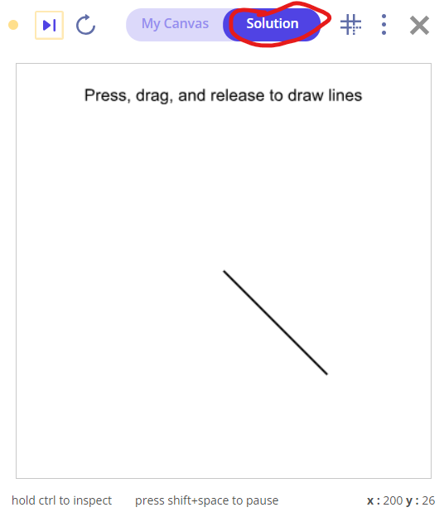
CS Academy Autograder with Animations

Slide 22
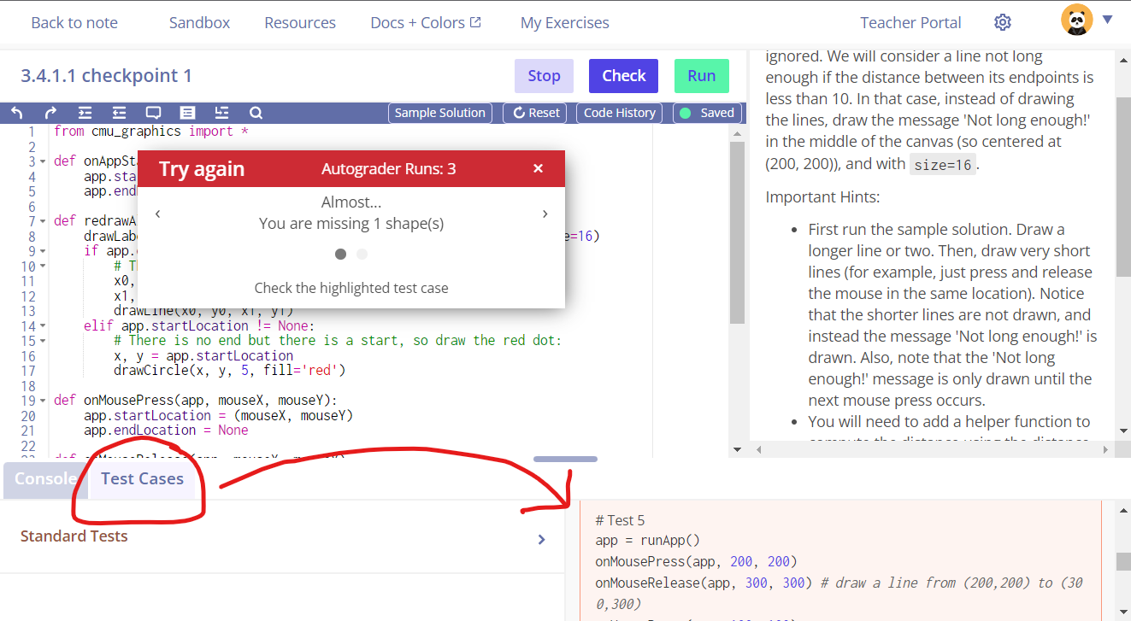
CS Academy Autograder with Animations

Slide 23
Events

Slide 24

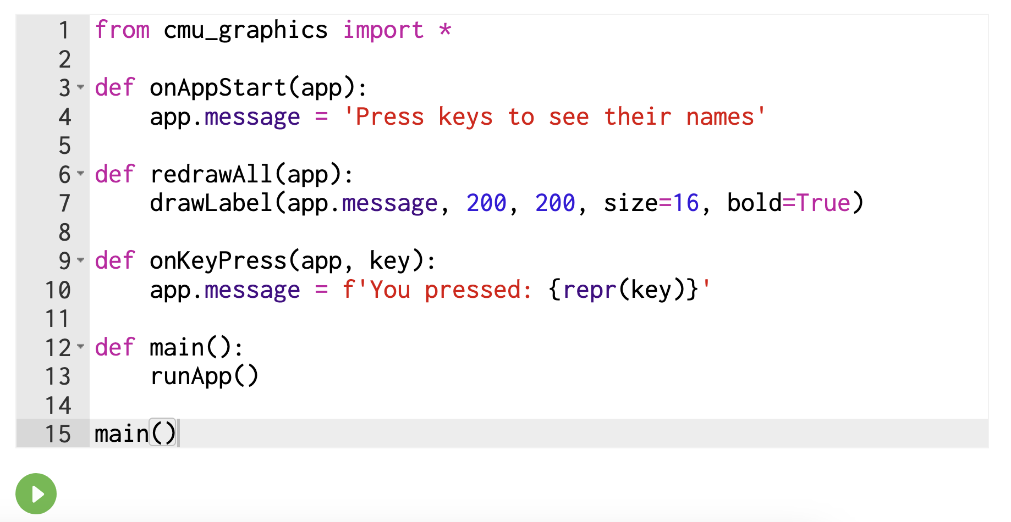
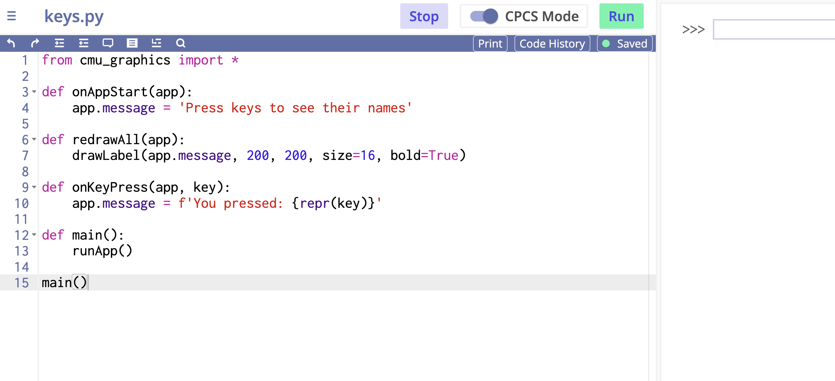
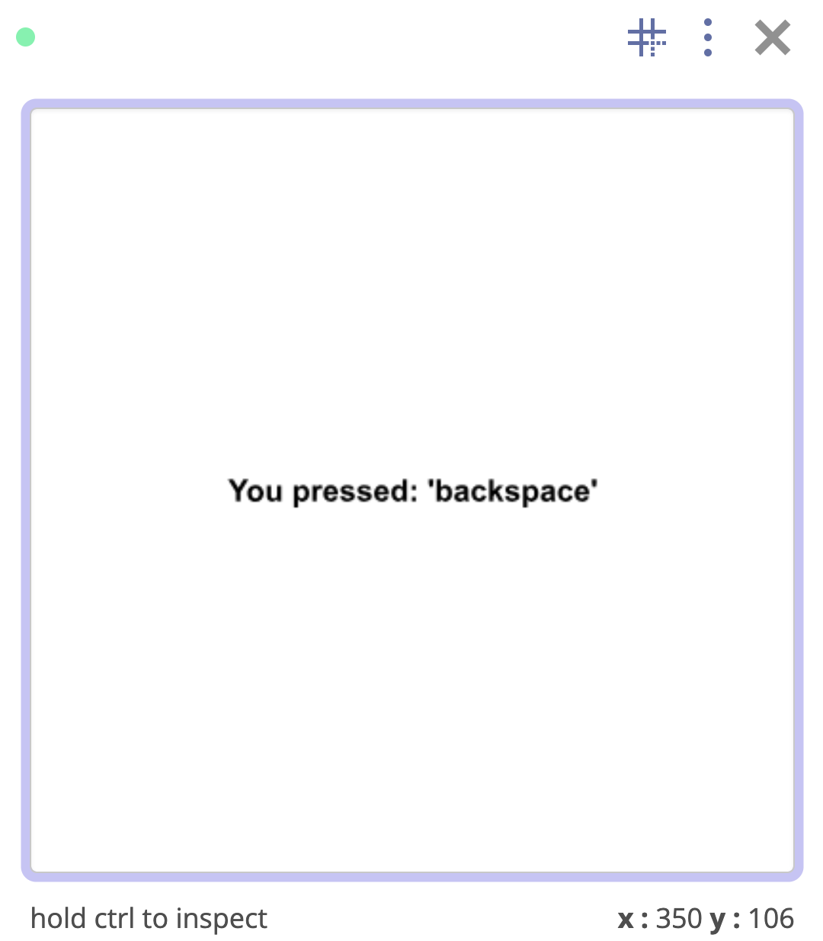
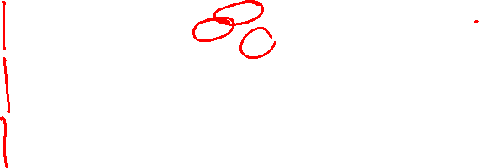
Another good reference for the sandbox

Slide 25
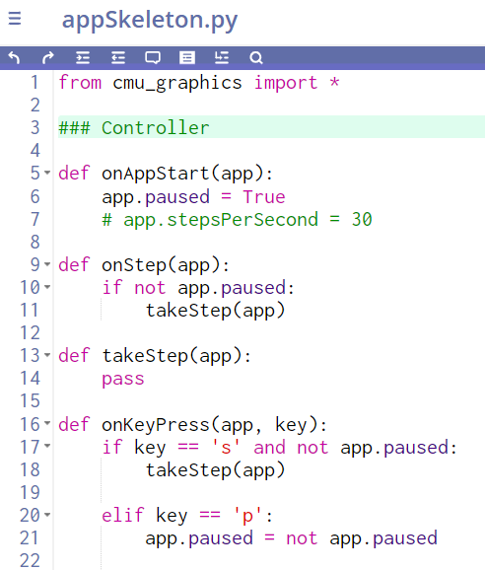
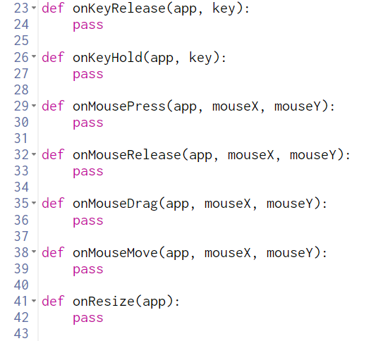
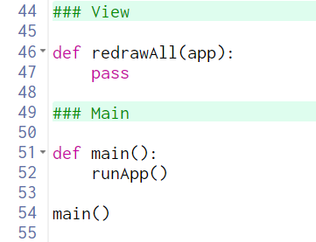
App Skeleton
Tip: Super convenient for sandbox
Note: Next quiz we’ll provide function names
Important: Don’t call event functions or redrawAll!

Slide 26
Debugging:
Even more debugging options with graphics
Good old print debugging still works
Can also create a temporary debug label: drawLabel(app.debugText, …)
def onAppStart(app):
print('onAppStart')
app.text = ''
def onKeyPress(app, key):
print(f'onKeyPress: {key} ')
app.text += key
def redrawAll(app):
print('REDRAW ALL')
drawLabel(app.text, app.width/2,
app.height/2, size=50)

Slide 27
Poll 6
How many times will REDRAW ALL print after I start the app and press the letters A and then Q?
0
1
2
3
4
5
A lot!
I have no idea
def onAppStart(app):
print('onAppStart')
app.text = ''
def onKeyPress(app, key):
print(f'onKeyPress: {key}')
app.text += key
def redrawAll(app):
print('REDRAW ALL')
drawLabel(app.text, app.width/2,
app.height/2, size=50)

Slide 28
Model-View-Controller

Slide 29
MVC (Model-View-Controller)
runApp()
appStarted(app)
clearCanvas()
onMousePress(app, mx, my)
onKeyPress(app, mx, my)
redrawAll(app)
Event Loop
onStep(app, mx, my)
...

Slide 30
MVC (Model-View-Controller)
Important!
Helper functions are part of:
View (if they draw anything)
Model (if they modify app)
runApp()
appStarted(app)
Clear canvas
onMousePress(app, mx, my)
updateDot(app)
redrawAll(app)
Event Loop
updatePos(app)
drawFace()
updateColor(app)
drawEyes()
...
drawMouth()

Slide 31
MVC (Model-View-Controller)
Rules
View cannot change the Model (app)
Controller cannot change the View (redrawAll or draw***)
runApp()
appStarted(app)
Clear canvas
onMousePress(app, mx, my)
redrawAll(app)
Event Loop
...

Slide 32
Poll 7
Which of the following are true?
Select all that apply
onMousePress and onKeyPress can run at the exact same time
redrawAll and onKeyPress can run at the exact same time
Python crashes if we return a value in onKeyPress
None of the above
I have no idea
def onKeyPress(app, key):
app.text += key
return key

Slide 33

Animation
Examples:
Bouncing DVD Logo
Pong

Slide 34
Debugging: Pause Animation
Even more debugging options with graphics
(but animations can make it more challenging)
def onAppStart(app):
app.paused = True
def onStep(app):
if not app.paused:
takeStep(app)
def takeStep(app):
# Update app for one step
pass
def onKeyPress(app, key):
if key == 's' and app.paused:
takeStep(app)
elif key == 'p':
# Flip paused stats
app.paused = not app.paused

Slide 35
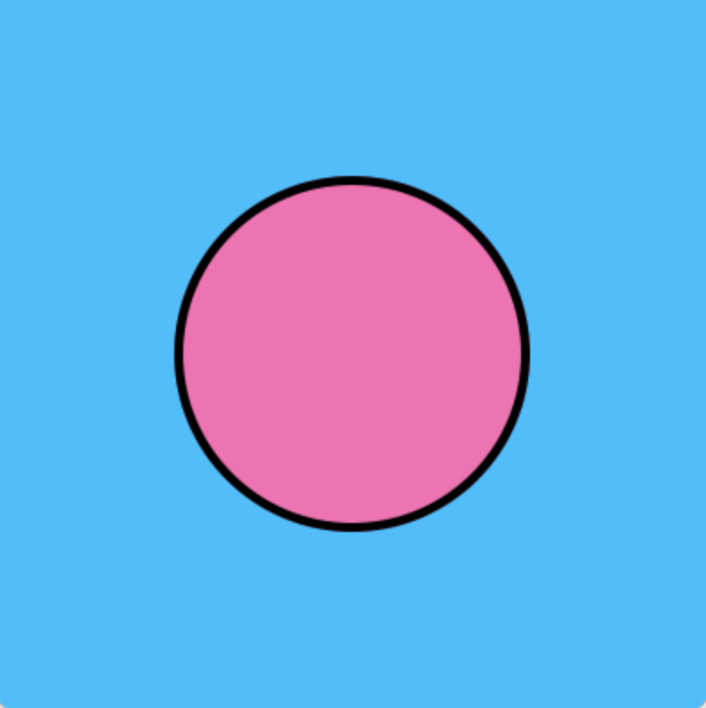
Debugging: Pause Animation
Even more debugging options with graphics
(but animations can make it more challenging)
def onAppStart(app):
app.ballX = app.width/2
app.ballY = app.height/2
app.ballR = 0.25*app.width
app.dX = app.ballR
def takeStep(app):
app.ballX += app.dX
def reDrawAll(app):
drawCircle(app.ballX, app.ballY,
app.ballR, fill=app.ballColor,
border='black', borderWidth=5)

Slide 36

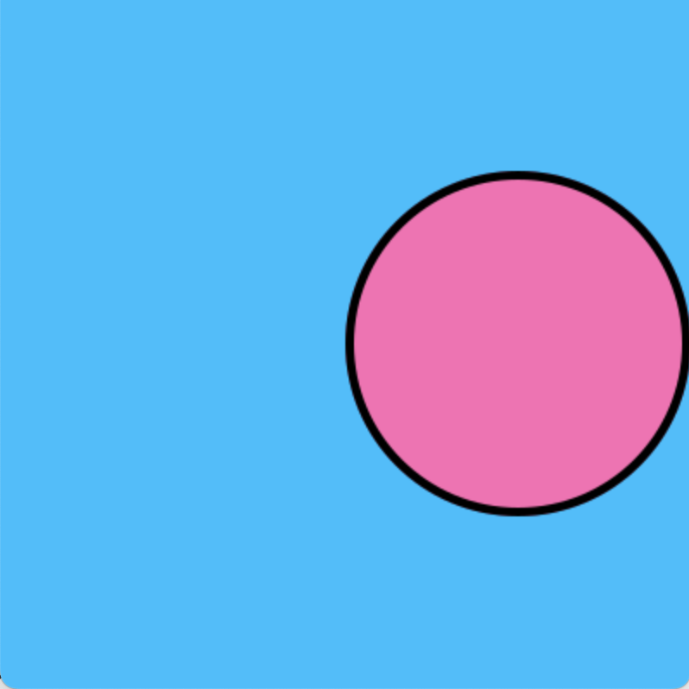
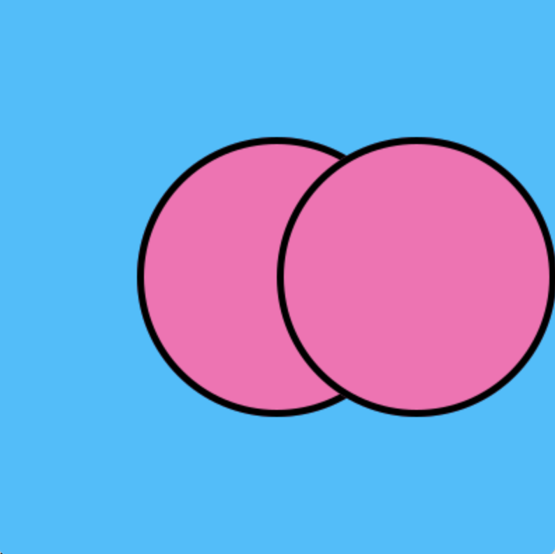

Poll 8
def onAppStart(app):
... app.dX = app.ballR
def onKeyPress(app, key):
app.ballX += app.dX
def reDrawAll(app):
drawCircle(app.ballX, app.ballY, app.ballR)
What happens after we press ‘s’?
A) B) C) D)
?

Slide 37

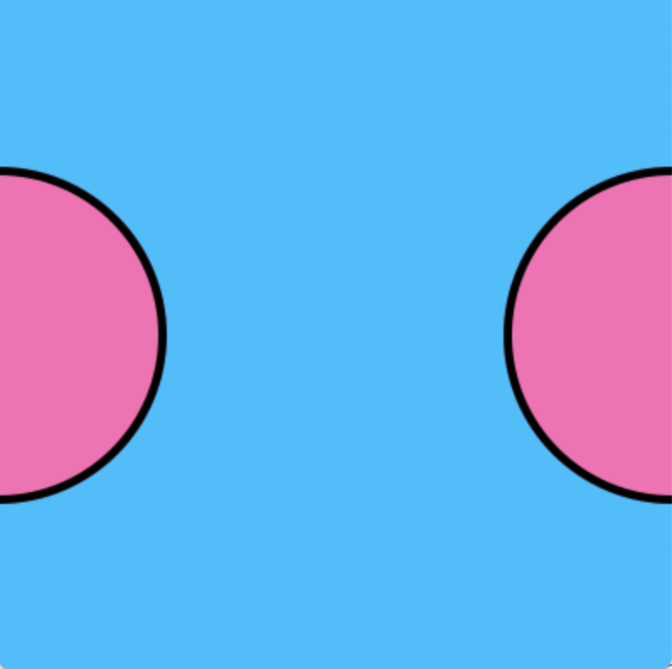
Poll 9
def onAppStart(app):
... app.dX = app.ballR
def takeStep(app):
app.ballX += app.dX
def reDrawAll(app):
drawCircle(app.ballX, app.ballY, app.ballR)
After pressing ‘s’ once, what happens after we press ‘s’ again?
A) B) C) D)
crash!
?

Slide 38
App Skeleton
Tip: Super convenient for sandbox
Note: Next quiz we’ll provide function names

Slide 39
Relative Sizes
printThing(canvas, x0, y0, x1, y1)

Slide 40
Relative Sizes
drawFly(app, x, y, r):

