Slide 1
15-112
Lecture 2
Strings
Instructor: Pat Virtue

Slide 2
Tuesday Logistics

Slide 3

As you walk in
Quiz will start at the beginning of lecture
Have pencil/pen ready
Silence phones

Slide 4
Quiz
Before we start
Don’t open until we start
Make sure your name and Andrew ID are on the front
Read instruction page
No questions (unless clarification on English)
Additional info
25 min

Slide 5
Announcements
Quiz
Grades
Regrade requests, same as last week
Fix-its, same as last week
Canvas
We’re still organizing and getting basics setup
Participation is next to setup
    Participation will start to include recitation attendance
Course
It will keep ramping up
Come get help

Slide 6
Announcements
Weekly Rhythm Assignments/Quizzes
Today, HW3 released
Thu, Pre-reading 4 released
Sat, 8 pm: HW 4
Mon, 8 pm: Pre-reading 4
Next Tue, in-lec: Quiz 3

Slide 7
Thursday Logistics

Slide 8

Announcements
Quiz
Review quiz results in Gradescope
Watch solution session recording if you missed the live zoom session
Regrade requests
    See Piazza for details
Fix-its!
    See Piazza for details
Canvas
Work in progress: we’re getting scripts setup to sync Canvas Grades
TODO: Participation: Lecture Polls + Recitation Attendance

Slide 9
Announcements
Weekly Rhythm Assignments/Quizzes
Today, Pre-reading 4 released soon
Fri: Fix-its due
Sat, 8 pm: HW 3
Mon, 8 pm: Pre-reading 4
Next Tue, in-lec: Quiz 3

Slide 10
Strings

Slide 11
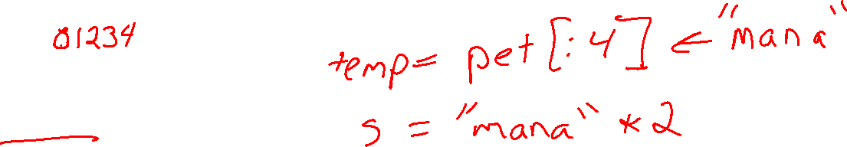
Post-quiz Exercise
What is the correct response to the following?
pet = "manatee"
s = pet[:4]*2
Then Google search: s

Slide 12
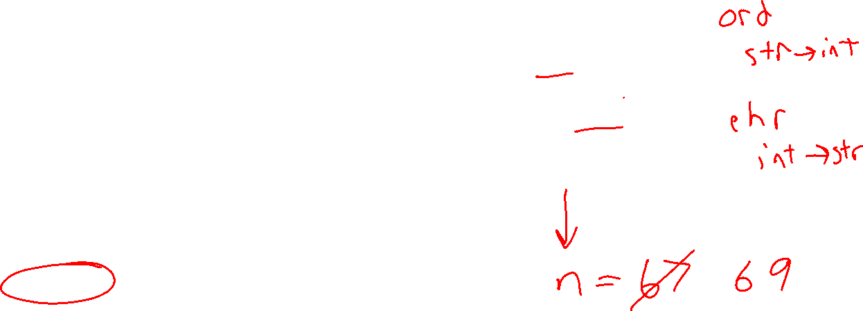
Poll 1
def ct(s):
n = ord(s)
n += 2
return chr(n)
print(ct('C'))
What does this print?
A
B
C
D
E
F
G
None of the above

Slide 13

Ascii, Unicode, and Emojis!
(and a tiny bit of hexadecimal)

Slide 14
Viewing invisible characters
repr(s)

Slide 15
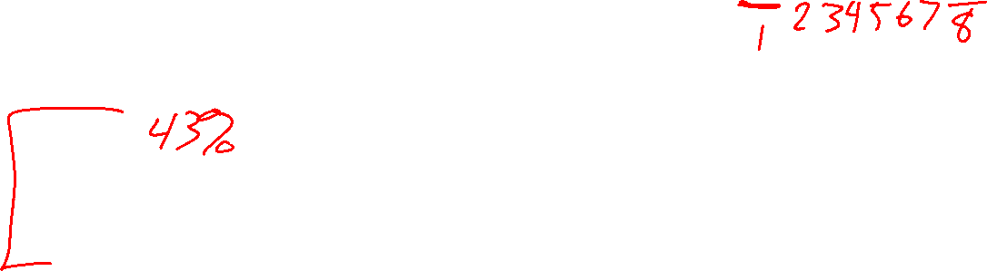
Poll 2
# 1234567890
print(len('\noodles\\'))
What does this code print?
6
7
8
9
10
11
(Python crashes)
I have no idea

Slide 16
Esacape characters
Popular escape characters
\n New line
\t Tab
\\ \

Slide 17
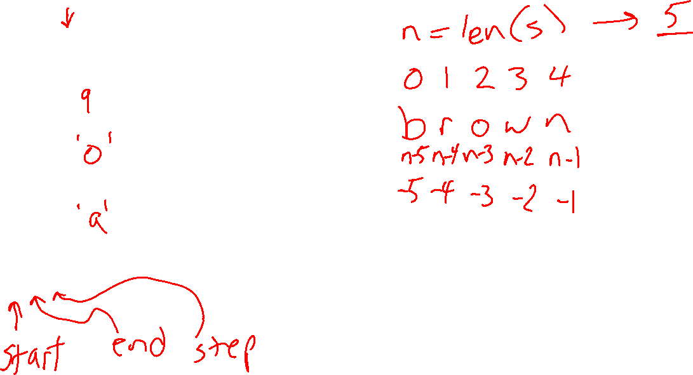
String length, indexing, and slicing
012345678
s = 'brown cat'
len(s)
s[2]
s[-2]
s[1:7:3]

Slide 18
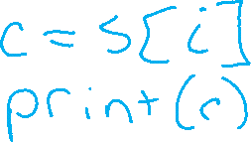
Poll 3 (unused)
Which is better?
A)
# Given string s
for i in range(len(s)):
# Do stuff
B)
# Given string s
for c in s:
# Do stuff

Slide 19
Poll 4
def ct(s):
return s[1:-1] + s[0]
print(ct('abcde’))
What does this code print?
abcde
edcba
bcdea
bcda
ba
ab
(Python crashes)
I have no idea

Slide 20
String indexing and slicing
Reference slide
Indexing
c = s[index] # c will be character at position index
Valid indices
Positive: 0 to len(s)-1 (but not len(s))
Negative: -len(s) to -1
Slicing
s[start:end:step]
Similar to range arguments
Doesn’t include end
There are default values if any of these are left blank
(Gets a bit goofy with a negative step)

Slide 21
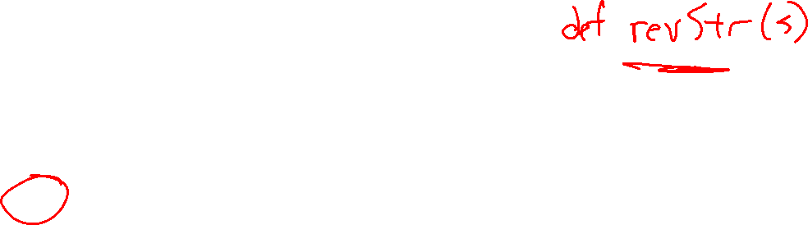
Poll 5
def mystery(s):
return s[::-1]
What does this function do?
Return a copy of s
Return the reverse of s
Return string that is only the last character of s
Return string that is only the first character of s
Return None
(Python crashes)
I have no idea

Slide 22

Pattern: Building up a result
String operations
sNew = s1 + s2
sNew += s3
Building up a string
Sketch:
Start with empty string: result = ''
Loop
    adding to string as needed: result += nextChar

Slide 23
Example: reverseString(s)

Slide 24
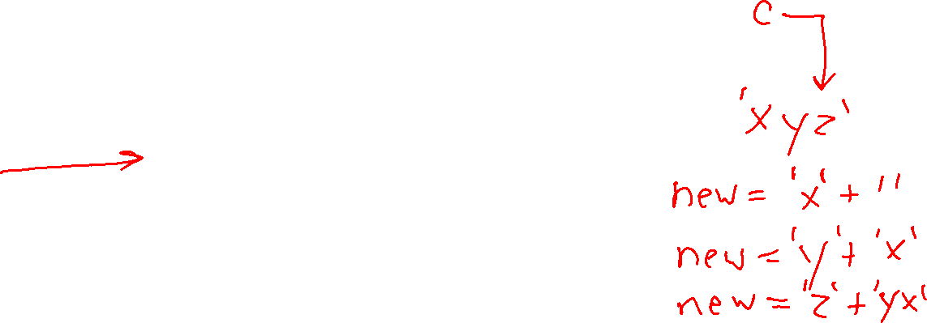
Pattern: Building up a result
String operations
sNew = s1 + s2
sNew += s3
Building up a string
Sketch:
Start with empty string: result = ''
Loop
    adding to string as needed: result += nextChar
Example:
def reverseString(s):
newString = ''
for c in s:
newString = c + newString
return newString

Slide 25
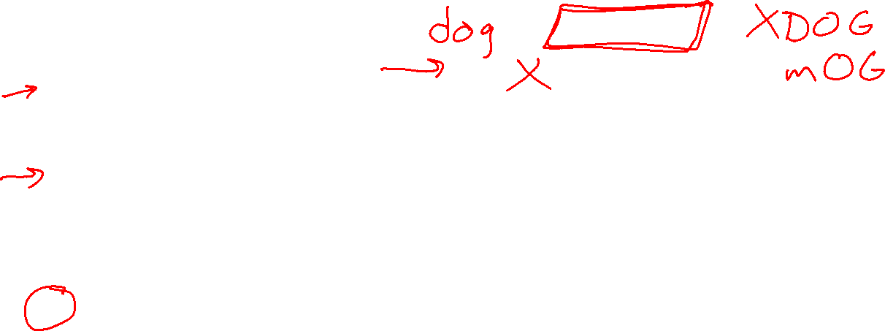
Poll 6
s = 'dog'
s.upper()
s[0] = 'm'
print(s)
What does this print?
dog
DOG
mog
MOG
mOG
(Python crashes)
I have no idea

Slide 26
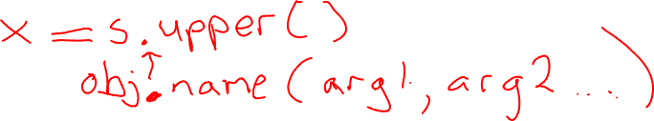
Functions vs Methods
String functions take in a string (return something useful)
Like a all the functions that we’ve been working with
chr(s)
ord(s)
len(s)
repr(s)
Methods on the other hand have a different syntax:

Slide 27

String methods
Reference slide
Some convenient methods that return Boolean values
s isalnum isalpha isdigit islower isspace isupper
ABCD True True False False False True
ABcd True True False False False False
abcd True True False True False False
ab12 True False False True False False
1234 True False True False False False
False False False False True False
AB?! False False False False False True

Slide 28
Strings are immutable
Once a string object is created, we can’t change it.
This is what we call “immutable”
Actually, everything we have used so far is immutable: ints, floats, etc. (they just aren’t very interesting objects)
It might see as though you can change strings but we can’t. It always ends up as some new string object.
This will be much more relevant once we get to our first mutable object type, lists!

Slide 29
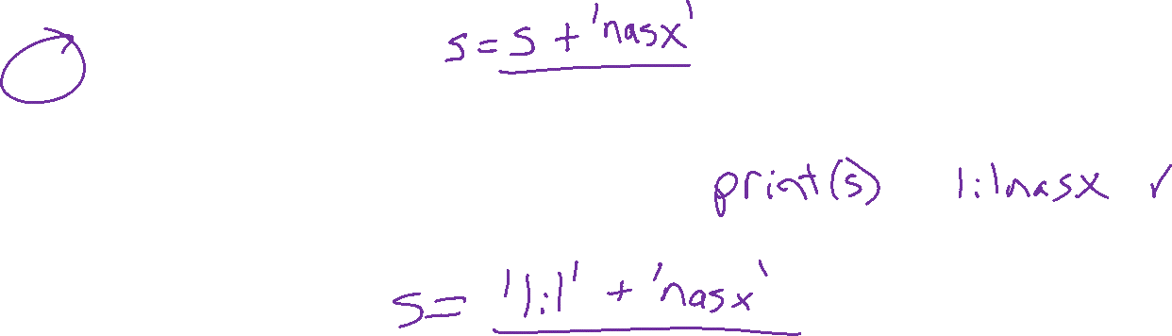
Poll 7
s = 'lil'
t = s
s += 'nasx'
print(t)
What does this print?
lil
nasx
lilnasx
(Python crashes)
I have no idea

Slide 30
Strings and aliases
Two variables are “aliases” are when they reference the exact same object.
This happens when you assign a variable to another variable:
s = 'abc'
t = s
s and t are aliases referencing the same to the same exact string object 'abc’
But…strings are immutable. We can’t possibly change s without making a new string.
s += 'def' # Assigns s to a new string 'abcdef’
# The string t is referencing remains 'abc'

Slide 31
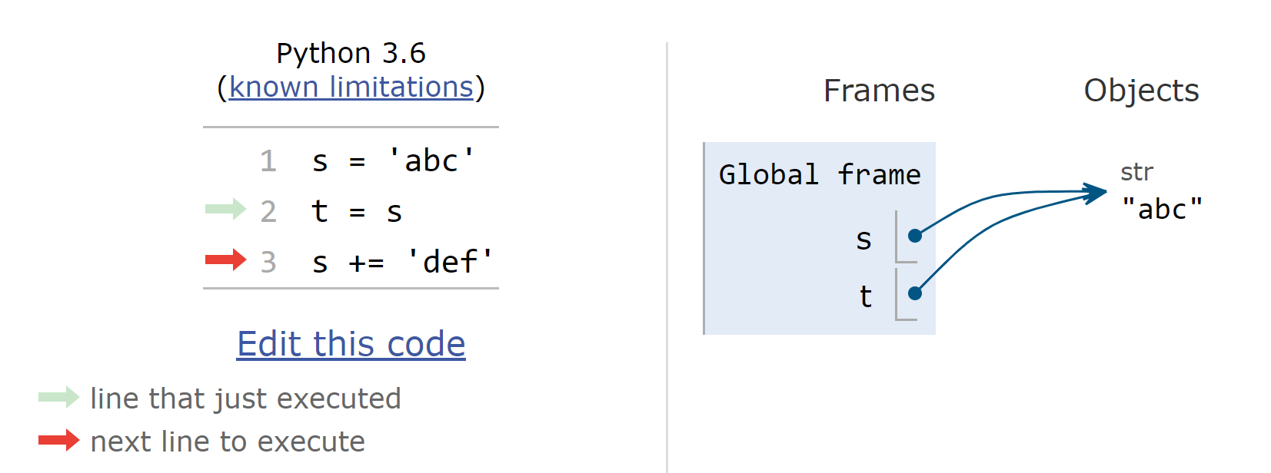
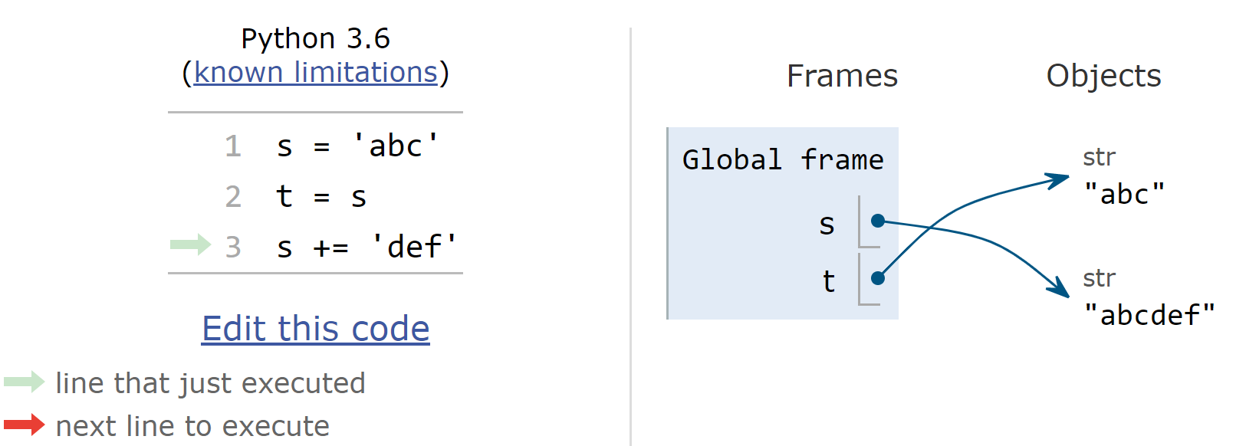
Strings and aliases
Two variables are “aliases” are when they reference the exact same object.
This happens when you assign a variable to another variable
But…strings are immutable. We can’t possibly change s without making a new string.

Slide 32
Pattern: Building up a result
String operations
sNew = s1 + s2
sNew += s3
Building up a string
Sketch:
Start with empty string: result = ''
Loop
    adding to string as needed: result += nextChar
Example:
def reverseString(s):
newString = ''
for c in s:
newString = c + newString
return newString

Slide 33

Pattern: Keeping track of state in a loop
Use a variable to keep track of the state you are in during a loop
Sketch:
Start with initial state: currentState = False
Loop
    Check for changes and adjust state variable
Example:
Collapse consecutive whitespace down to a single space
def collapseWhitespace(s):
result = ''
isWhite = False
for c in s:
if c.isspace():
if not isWhite:
result += ' '
isWhite = True
else:
isWhite = False
result += c
return result

Slide 34
Design Challenge
Style: variable/function names
Camel case: myNewVariable
Snake case: my_new_variable
def toCamelCase(s):
pass
assert(toCamelCase('goodToGo') == 'goodToGo')
assert(toCamelCase(‘Hi Walter') == 'hiWalter')
assert(toCamelCase('add_all_the_numbers') == 'addAllTheNumbers')

Slide 35

Design Challenge
Style: variable/function names
Camel case: myNewVariable
Snake case: my_new_variable
def toCamelCase(s):
pass
assert(toCamelCase('goodToGo') == 'goodToGo')
assert(toCamelCase('goodtogo') == 'goodtogo') # Oh well
assert(toCamelCase('Hi Walter') == 'hiWalter')
assert(toCamelCase('add_all_the_numbers') == 'addAllTheNumbers')

Slide 36
Poll 8 (unused)
Which of the following would you want to use in your toCamelCase(s) implementation?
Select ALL that apply
For loop over the characters in the string
isalnum
isalpha
isdigit
islower
isspace
isupper
None of the above

Slide 37
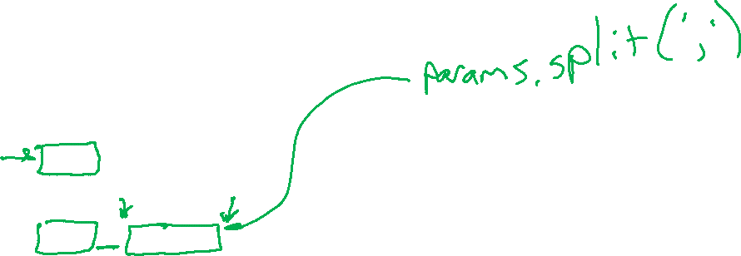
Design Challenge
def printFunctionInfo(code):
pass
Output
code = """\
def f(x):
return 4*x
def ct(x, y, z):
return f(x) + f(y+1) + f(x+2)
print(ct(2))
"""
print(code)
#print(repr(code))
printFunctions(code)
Function f takes parameters:
x
Function ct takes parameters:
x
y
z

Slide 38
Design Challenge
Output
Function f takes parameters:
x
Function ct takes parameters:
x
y
z
def printFunctionInfo(code):
for line in code.splitlines():
name, params = parseLine(line)
if name is not None:
print(f'Function {name} takes parameters:’)
for param in params.split(',’):
param = param.strip()
print(f"\t{param}")
Top-down design
def parseLine(line):
  '''
  Extract the function name and parameters given a line of code
  Returns two strings:
  -- Function name (no def, no parentheses)
  -- parameters (one string that includes any commas; may be empty string)
  Returns None, None if no function defined on the line
  '''

Slide 39
Design Challenge
def parseLine(line):
''' Function comment ... '''
  line = line.strip()
  if line[4:] != "def ":
  return None
  remainingLine = line[4:]
  name = ""
  params = ""
  foundOpenParenthesis = False
  for c in remainingLine:
  if c == '(‘:
  foundOpenParenthesis = True
  continue
    if c == ')’:
    break
    if not foundOpenParenthesis:
    name += c
    else:
    params += c
  return name, params
Pattern: Building up a result

Slide 40
Design Challenge
def parseLine(line):
''' Function comment ... '''
  line = line.strip()
  if line[4:] != "def ":
  return None
  remainingLine = line[4:]
  name = ""
  params = ""
  foundOpenParenthesis = False
  for c in remainingLine:
  if c == '(‘:
  foundOpenParenthesis = True
  continue
    if c == ')’:
    break
    if not foundOpenParenthesis:
    name += c
    else:
    params += c
  return name, params
Pattern: State in a loop

