Slide 1
15-112 Lecture 2 112 Graphics
Instructor: Pat Virtue

Slide 2
Graphics (CS Academy)

Slide 3
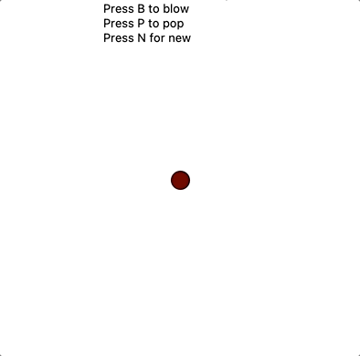
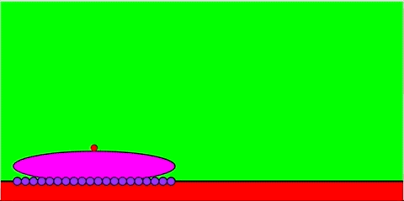
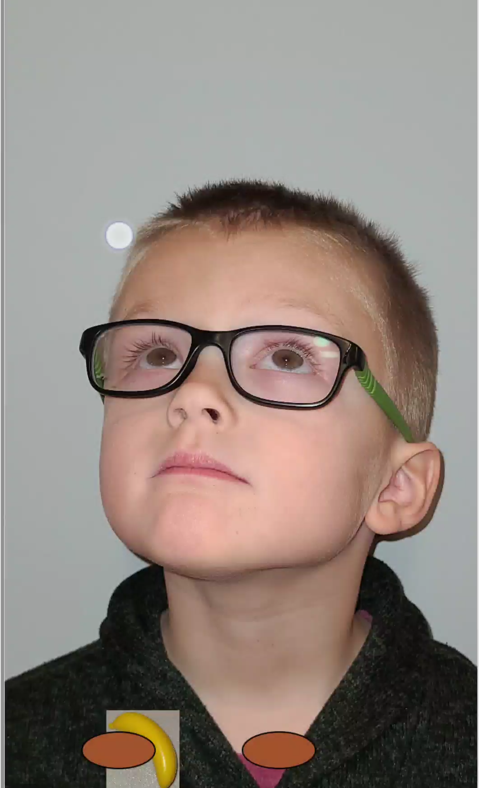
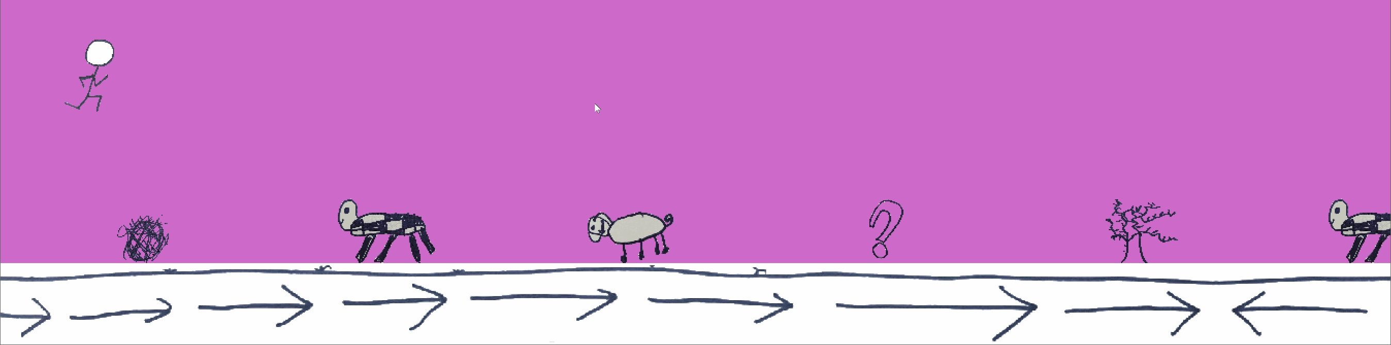
Coding with Pat’s Minions
Grace
Elliot
Jay
Ellie, Ryan, Lucy, and Uncle Pat

Slide 4
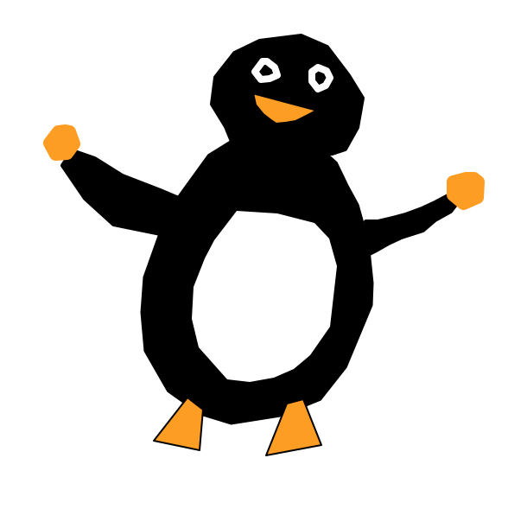
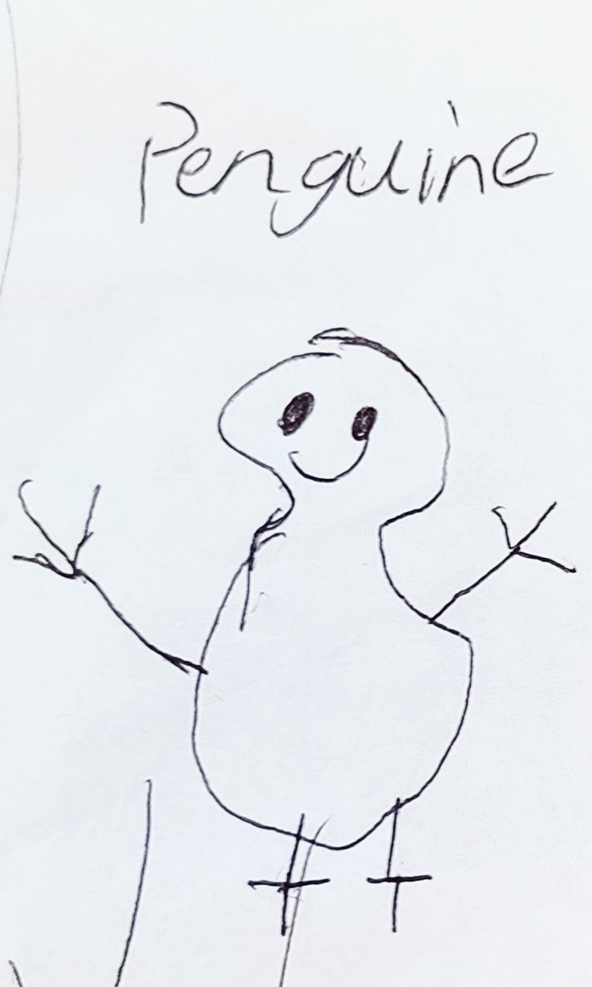
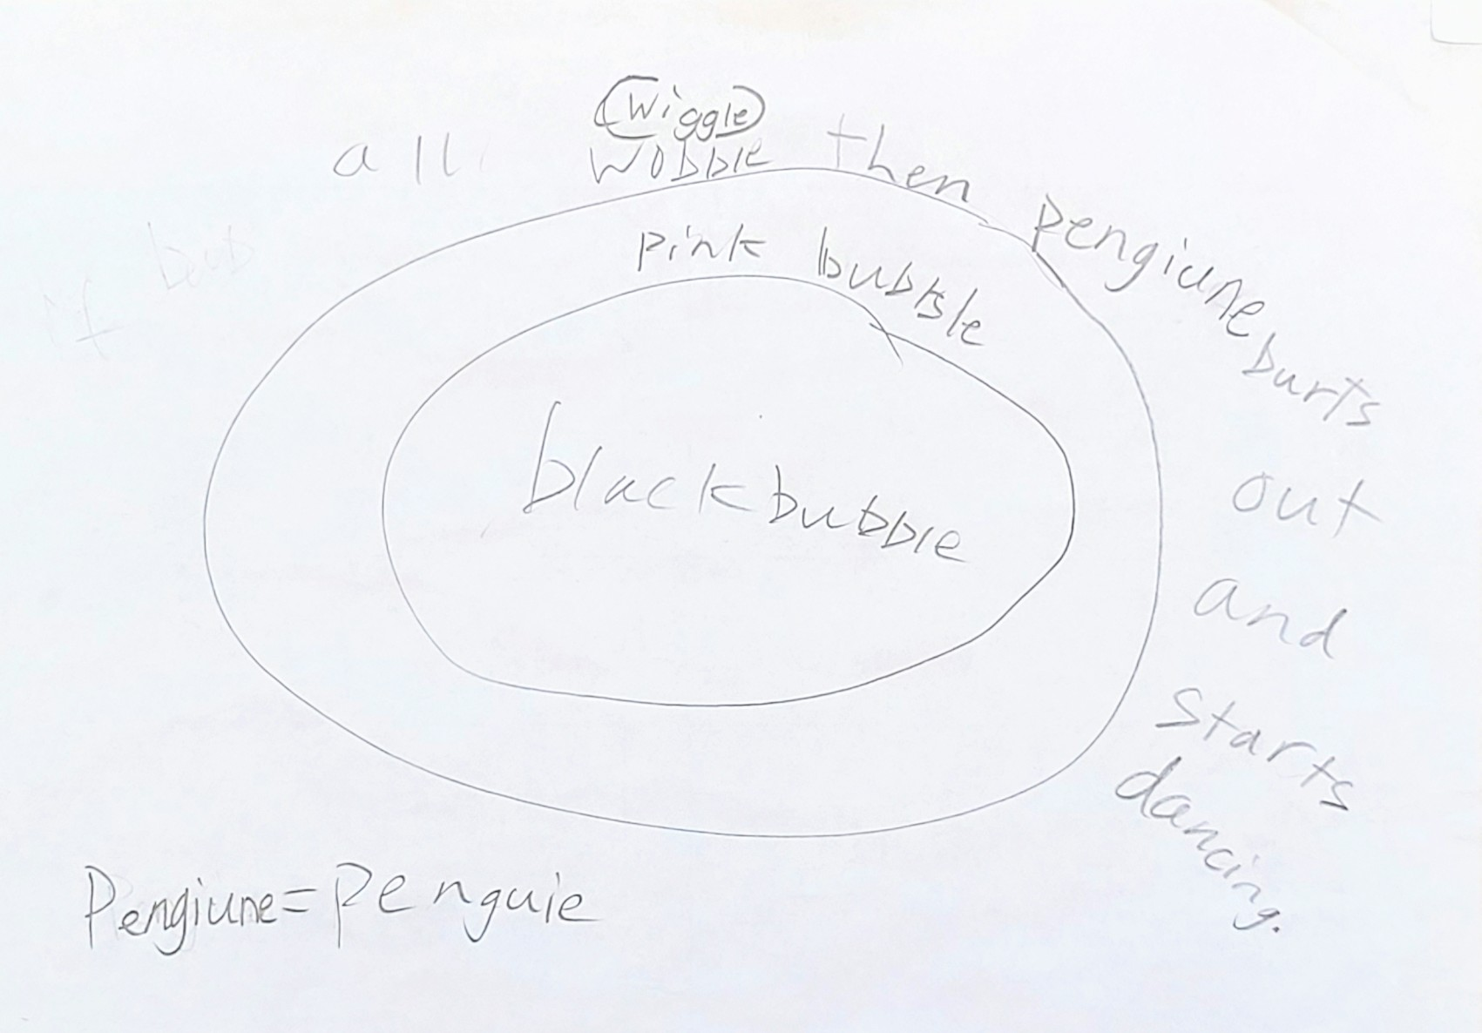
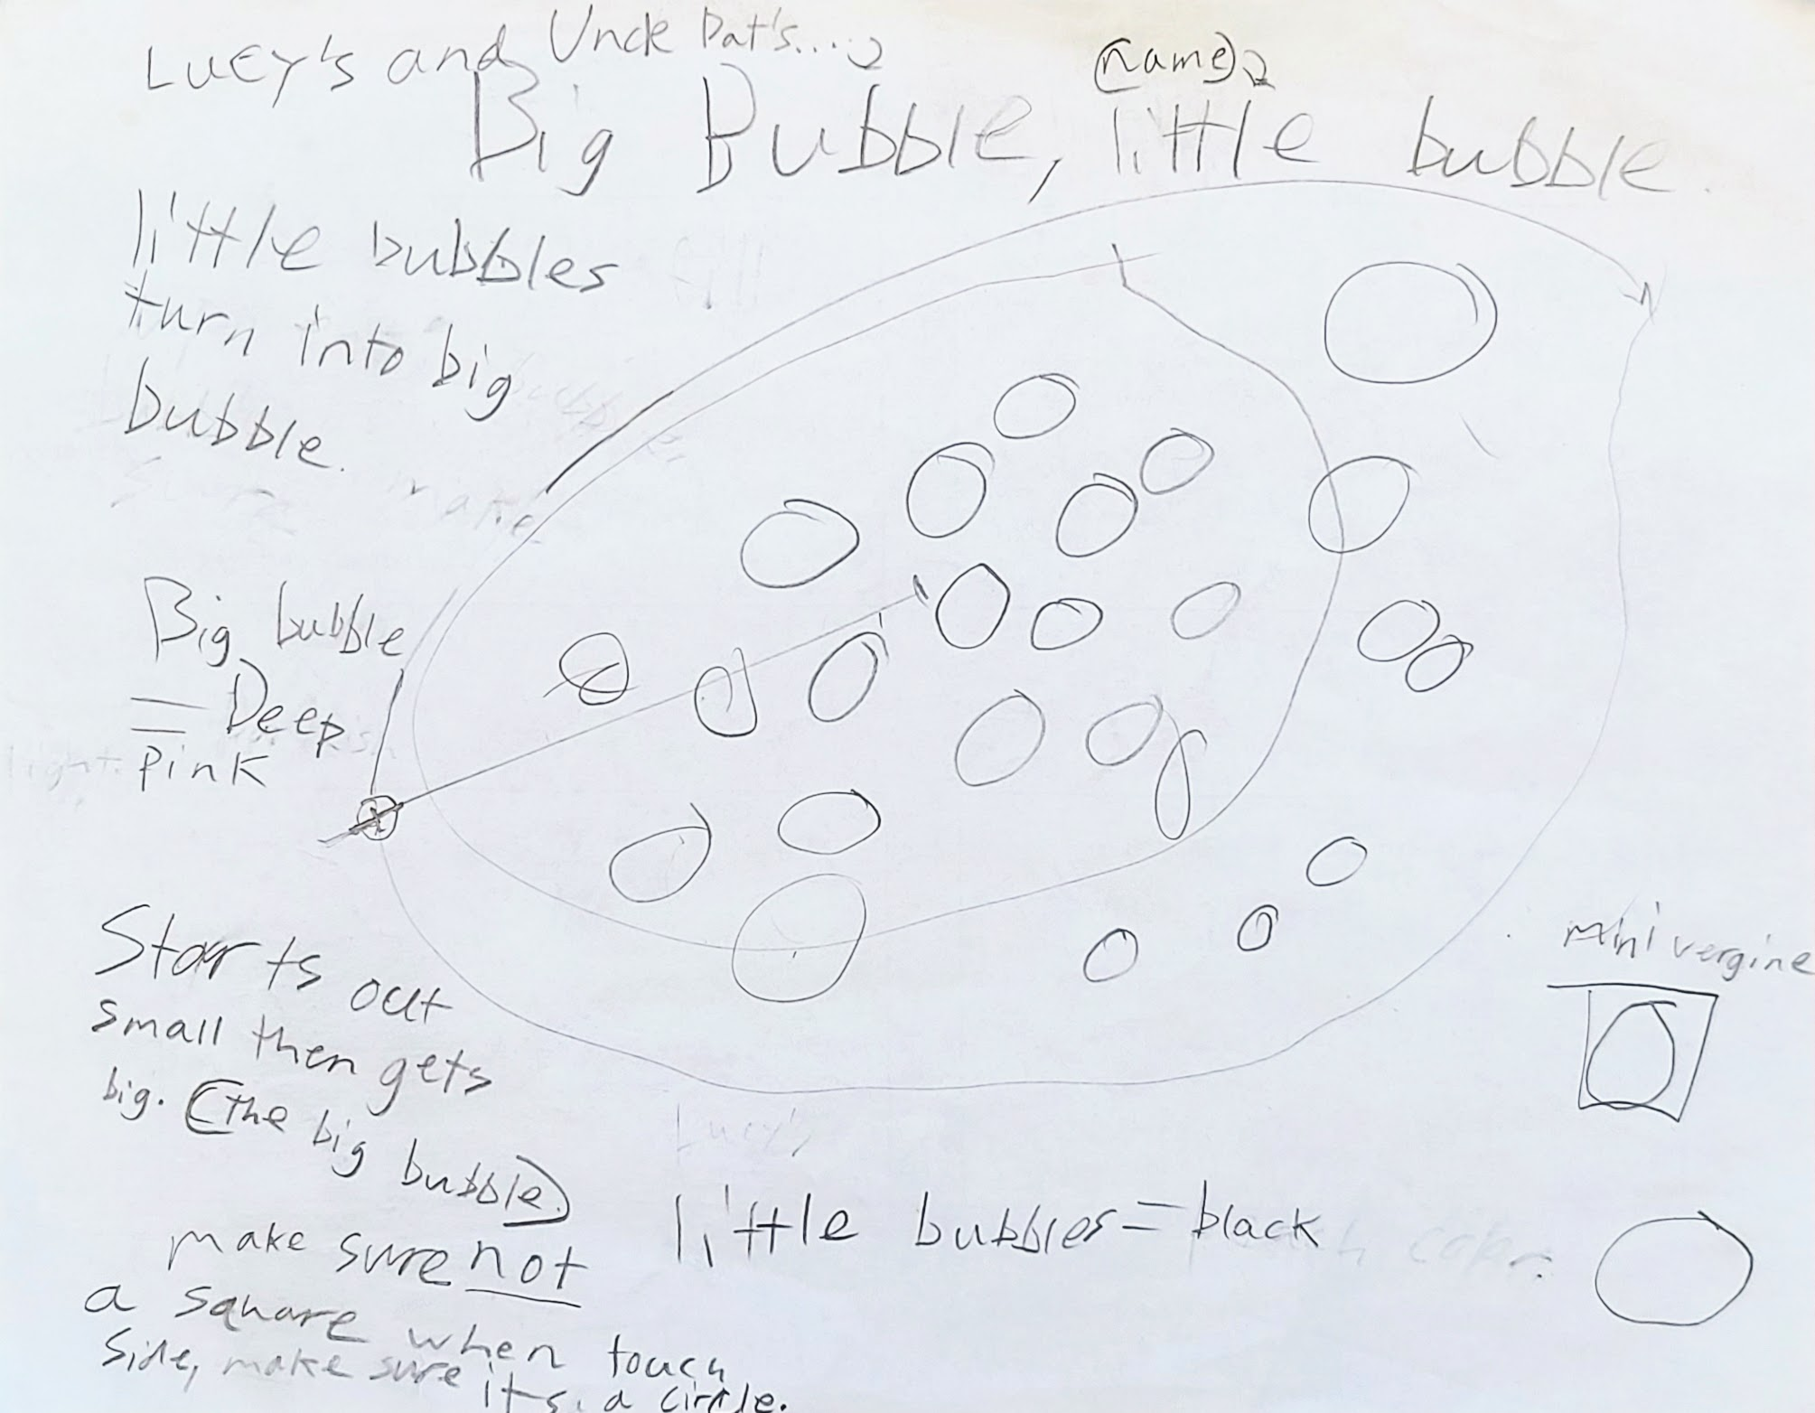
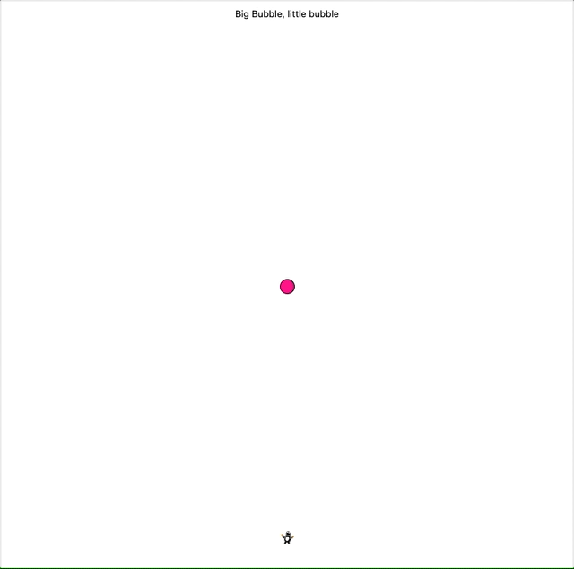
Coding with Pat’s Minions
Lucy (and Uncle Pat just trying to keep up)

Slide 5
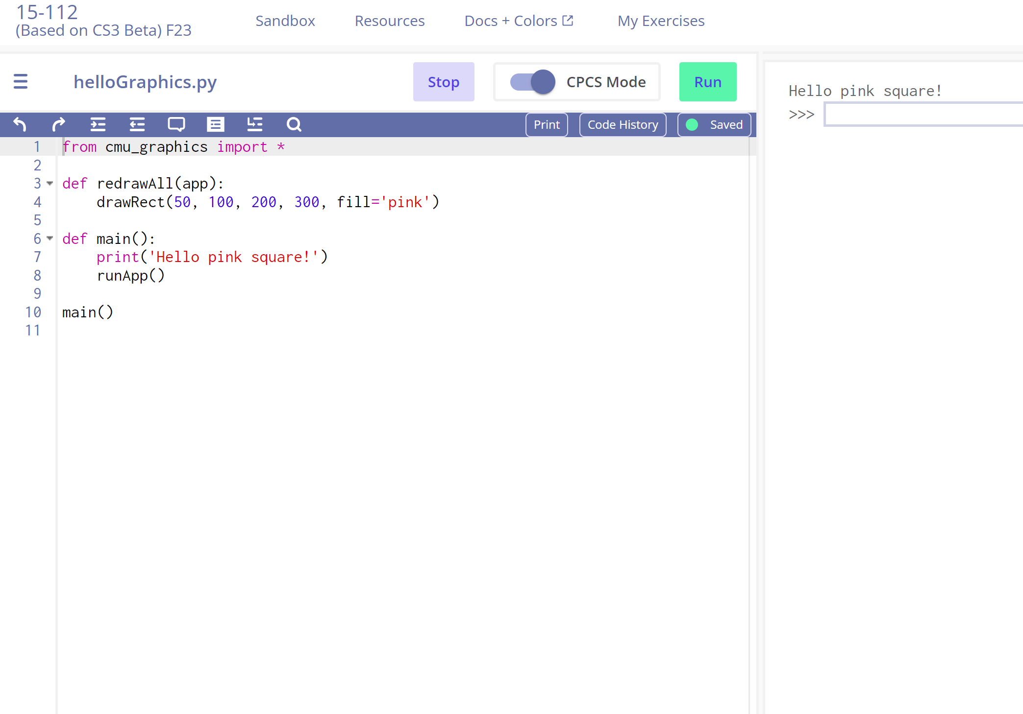
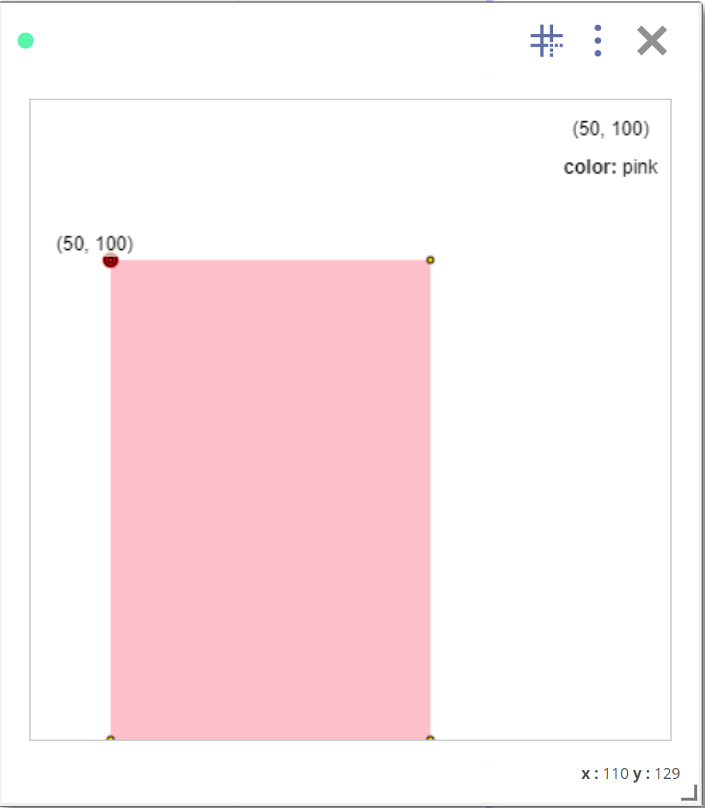
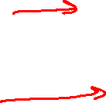
CMU 112 Graphics

Slide 6

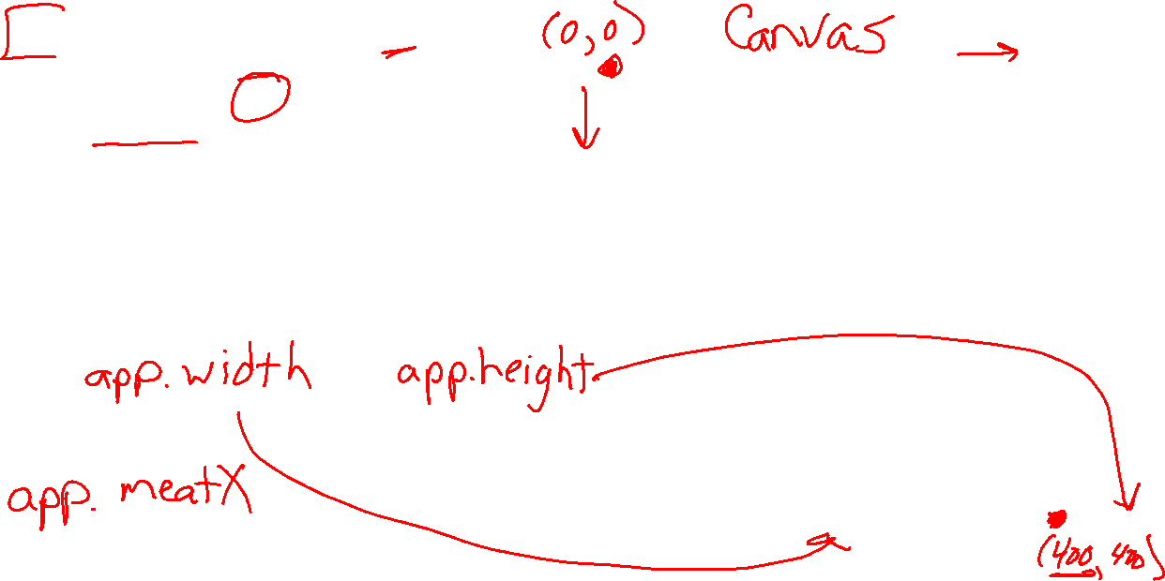
Canvas and Coordinates for Graphics
from cmu_graphics import *
def redrawAll(app):
drawRect(50, 100, 200, 300,
fill='pink')
def main():
runApp()
main()

Slide 7
Rectangles, Ovals, Lines, and Labels
Reference slide
drawRect(x0, y0, width, height)
drawOval(centerX, centerY, width, height)
drawLine(x0, y0, x1, y1)
drawLabel(text, centerX, centerY)

Slide 8
Rectangles, Ovals, Lines, and Labels
Reference slide
drawRect(x0, y0, width, height, fill='black', opacity=100,
border=None, borderWidth=2, rotateAngle=0))
drawOval(centerX, centerY, width, height, fill='black', opacity=100,
border=None, borderWidth=2, rotateAngle=0)
drawLine(x0, y0, x1, y1, fill='black', lineWidth=2, opacity=100,
dashes=False, arrowStart=False, arrowEnd=False)
drawLabel(text, centerX, centerY, fill='black’, opacity=100,
border=None, borderWidth=2, rotateAngle=0,
size=12, font='arial', bold=False, italic=False, align='center')

