Slide 1

15-112 Lecture 2 Loops
Instructor: Pat Virtue

Slide 2
Tuesday Logistics

Slide 3

As you walk in
Quiz will start at the beginning of lecture
Have pencil/pen ready
Don’t use your own scratch paper
We have some if you need it
Silence phones

Slide 4
Quiz
Before we start
Don’t open until we start
Make sure your name and Andrew ID are on the front
Read instruction page
No questions (unless clarification on English)
Additional info
25 min

Slide 5
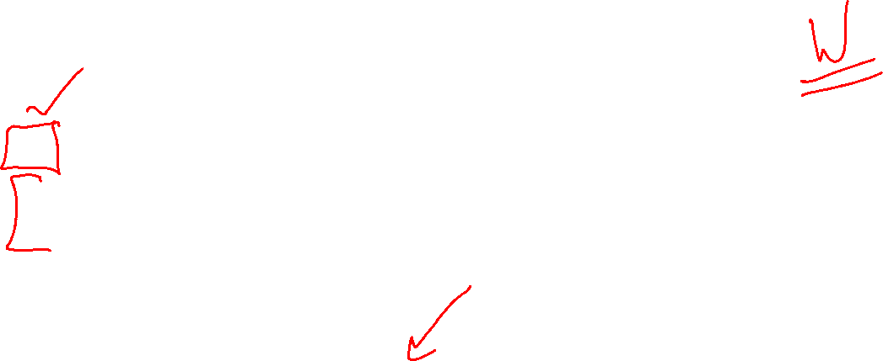
Announcements
Quiz
Grades
Likely ready Wednesday
Superhero TAs!
Very small impact on final grade
Fix-its!
More information coming on Piazza
From Syllabus

Slide 6
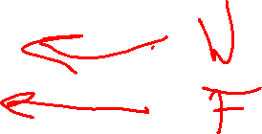
Announcements
Weekly Rhythm Assignments/Quizzes
Today, HW2 released
Thu, Pre-reading 3 released
Sat, 8 pm: HW 2
Mon, 8 pm: Pre-reading 3
Next Tue, in-lec: Quiz 2

Slide 7
Thursday Logistics

Slide 8
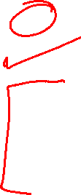
Announcements
Quiz
Review quiz results in Gradescope!
Watch solution session recording if you missed the live zoom session
Regrade requests
See Piazza for details
Fix-its!
See Piazza for details
Canvas
Work in progress: we’re getting scripts setup to sync Canvas Grades

Slide 9
Announcements
Weekly Rhythm Assignments/Quizzes
Today, Pre-reading 3 released soon
Fri: Fix-its due
Sat, 8 pm: HW 2
Mon, 8 pm: Pre-reading 3
Next Tue, in-lec: Quiz 2

Slide 10
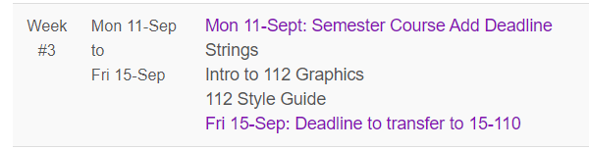
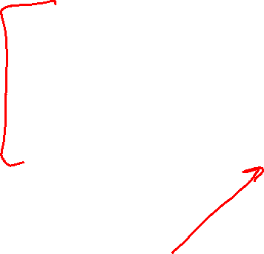
Announcements
Registration deadlines next week
From Schedule on course website

Slide 11
Loops

Slide 12
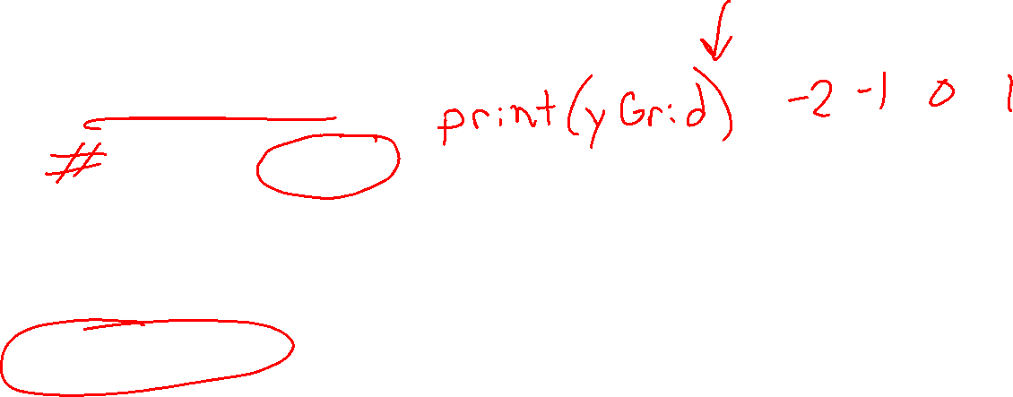
Poll 1
What does this code print?
for yGrid in range(-2, 2):
pixel = '+'
print('+', end=" ")
A)
+ +
D)
E)
F)
G) I have no idea
+
+
+
+
+
+
+
+
+
+
+
B)
+ + + +
C)
+ + + + +

Slide 13
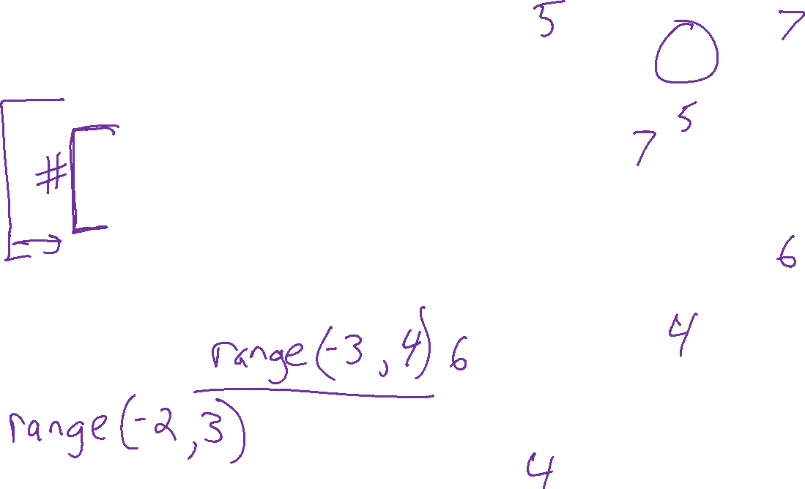
Poll 2
What does this code print?
def printPlot(xMin, xMax, yMin, yMax):
for yGrid in range(yMin, yMax+1):
for xGrid in range(xMin, xMax+1):
pixel = '+'
print(pixel, end=" ")
print()
printPlot(-3, 3, -2, 2)
A)
+ + + + +
+ + + + +
+ + + + +
+ + + + +
+ + + + +
+ + + + +
+ + + + +
B)
+ + + + + + +
+ + + + + + +
+ + + + + + +
+ + + + + + +
+ + + + + + +
C)
+ + + +
+ + + +
+ + + +
+ + + +
+ + + +
+ + + +
D)
+ + + + + +
+ + + + + +
+ + + + + +
+ + + + + +
E) I have no idea

Slide 14
Poll 3 (unused)
What does this code print?
def printPlot(xMin, xMax, yMin, yMax):
for yGrid in range(yMin, yMax+1):
for xGrid in range(xMin, xMax+1):
if xGrid == 0 and yGrid == 0:
pixel = '+'
elif xGrid == 0:
pixel = '|'
elif yGrid == 0:
pixel = '-'
else:
pixel = '.'
print(pixel, end=" ")
print()
printPlot(-3, 3, -2, 2)
A)
. . | . .
. . | . .
. . | . .
- - + - -
. . | . .
. . | . .
. . | . .
B)
. . . | . . .
. . . | . . .
- - - + - - -
. . . | . . .
. . . | . . .
C)
. . - . .
. . - . .
. . - . .
| | + | |
. . - . .
. . - . .
. . - . .
D)
. . . - . . .
. . . - . . .
| | | + | | |
. . . - . . .
. . . - . . .
E) I have no idea

Slide 15
Poll 3 (unused)
What does this code print?
def printPlot(xMin, xMax, yMin, yMax):
for yGrid in range(yMin, yMax+1):
for xGrid in range(xMin, xMax+1):
if xGrid == 0 and yGrid == 0:
pixel = '+'
elif xGrid == 0:
pixel = '|'
elif yGrid == 0:
pixel = '-'
else:
pixel = '.'
print(pixel, end=" ")
print()
printPlot(-3, 3, -2, 2)
A)
. . | . .
. . | . .
. . | . .
- - + - -
. . | . .
. . | . .
. . | . .
B)
. . . | . . .
. . . | . . .
- - - + - - -
. . . | . . .
. . . | . . .
C)
. . - . .
. . - . .
. . - . .
| | + | |
. . - . .
. . - . .
. . - . .
D)
. . . - . . .
. . . - . . .
| | | + | | |
. . . - . . .
. . . - . . .
E) I have no idea

Slide 16
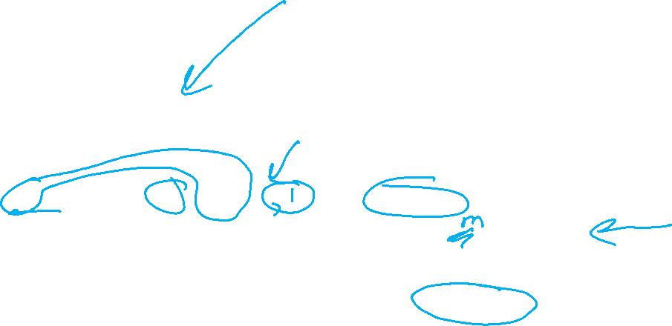

Poll 4
Which code is better
A)
def sumFromMToN(m, n):
total = 0
for x in range(m, n+1):
total += x
return total
B)
def sumFromMToN(m, n):
total = 0
x = m
while x <= n:
total += x
x += 1
return total

Slide 17
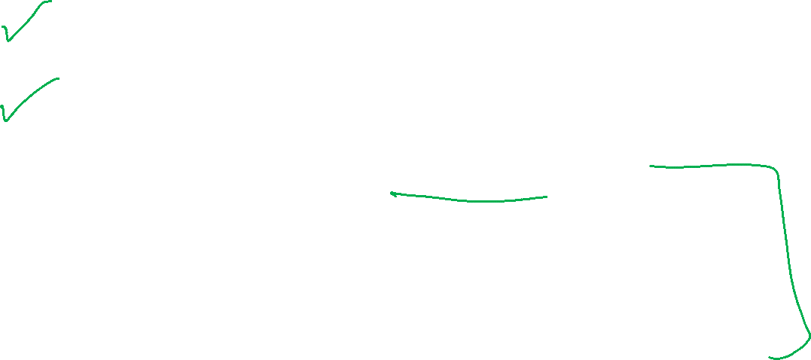
For Loops vs While Loops
Often, we can write our code using either
How do we choose
For loops are often easier to reason about, especially if were looping over a known sequence
While loops work well when we don’t know how many loops we need to do
Easier to make mistakes with while loops
“Help! I run my code, but it doesn’t do anything!!”
Infinite loop!!
Tip: Use ctrl-C to interrupt program execution in the console
Tip: Include some print statements to see the loop in action

Slide 18
While Loops
Pick a number between 0 and 1000 (Unknown number of loops)
guessStr = input("Enter new guess: ")
guess = int(guessStr)
numAttempts = 1
while guess != secret: if guess > secret:
print("--- Too high!")
else:
print("--- Too low!")
guessStr = input(("Enter new guess: ")
guess = int(guessStr)
numAttempts += 1
print(f"You got it in {numAttemps}! The secret number was {secret}!")

Slide 19
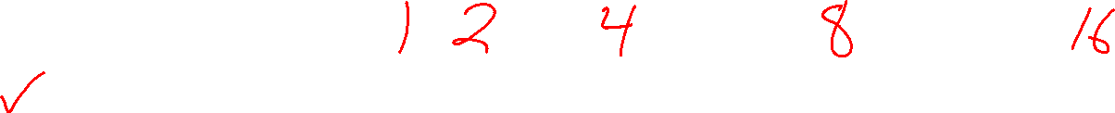
Poll 5 (unused)
How many factors does the numer 16 have?
2
3
4
5
6
7
8
16

Slide 20



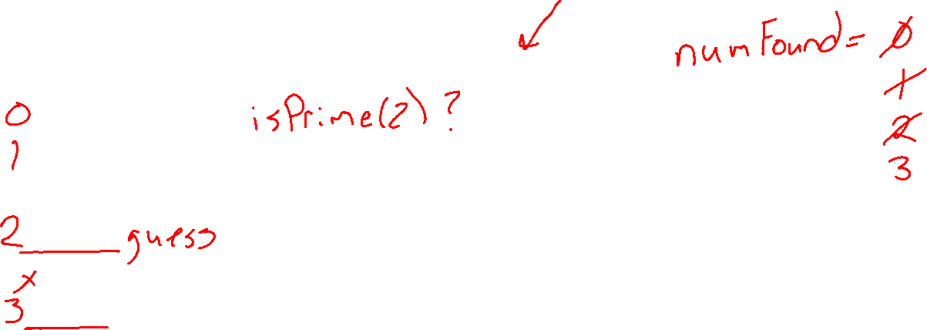

Poll 6 (unused)
What is the n-th prime number when n=3?
2
3
4
5
6
7
8
9
10
11

Slide 21
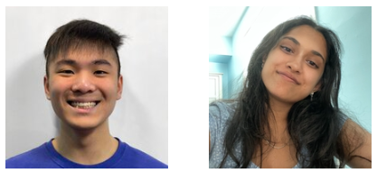







Pattern: Find the n-th thing
Find the n-th dino

Slide 22
Pattern: Find the n-th thing
Need
A way to get to the next guess
A way to check it: isThing(guess)
Sketch
Loop from guess to guess until you’ve found n (well actually n+1) things
if isThing(guess):
numFound += 1

Slide 23
Pattern: Find the n-th thing
Find the n-th prime
NEED: isPrime(number)
1 2 3 4 5 6 7 8 9 10 11 12 13 14 15 16 17

Slide 24
Design: isPrime(n)
Use paper (or equivalent) to design your solutions!

Slide 25
Design: isPrime(n)
Then you can compare your code your paper examples
def isPrime(n):
if n < 2:
return False
for factor in range(2, n):
if n % factor == 0:
return False
return True

Slide 26
Pattern: Find the n-th thing
Find the n-th prime
Assume we have isPrime(number)
1 2 3 4 5 6 7 8 9 10 11 12 13 14 15 16 17

Slide 27
Pattern: Find the n-th thing
Find the n-th prime
Assume we have isPrime(number)
def nthPrime(n):
numFound = 0
guess = 0 # First guess - 1
while numFound <= n: # Note: Does one more loop when numFound == n !!
guess += 1 # Next guess
if isPrime(guess):
numFound += 1
return guess
1 2 3 4 5 6 7 8 9 10 11 12 13 14 15 16 17

Slide 28
Bisection

Slide 29
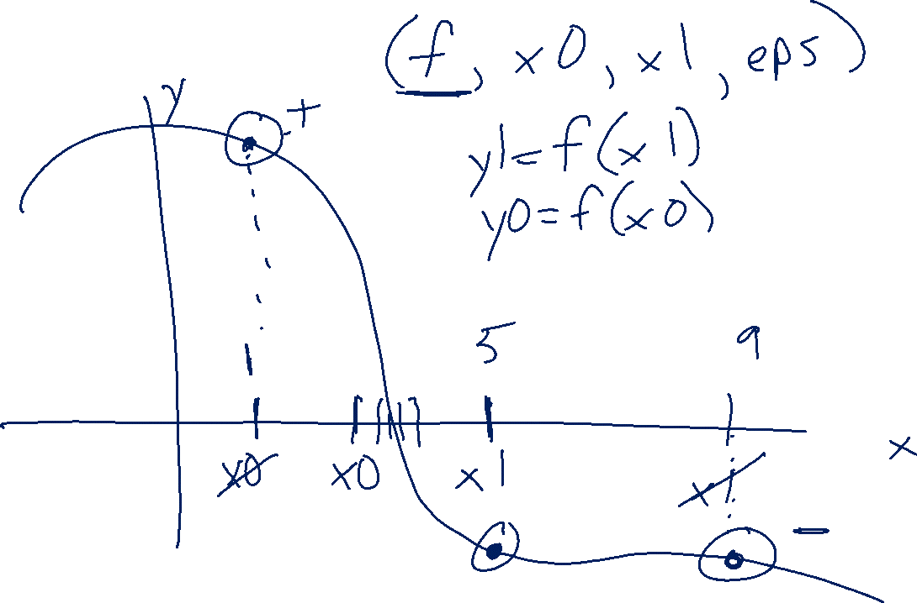
findZeroWithBisection

Slide 30
Loops: Break and Continue

Slide 31
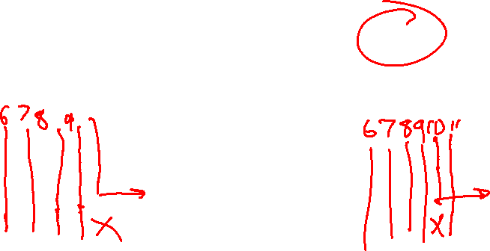
Poll 7
Which of these prints more lines?
A) B) C) Same D) I have no idea
x = 0
while True:
x += 1
if x % 10 == 0:
break
print(x)
print('Done')
x = 0
while True:
x += 1
if x % 10 == 0:
continue
print(x)
print('Done')

Slide 32
Previous Poll 2
What does this code print?
def printPlot(xMin, xMax, yMin, yMax):
for yGrid in range(yMin, yMax+1):
for xGrid in range(xMin, xMax+1):
pixel = '+'
print(pixel, end=" ")
print()
printPlot(-3, 3, -2, 2)
A)
+ + + + +
+ + + + +
+ + + + +
+ + + + +
+ + + + +
+ + + + +
+ + + + +
B)
+ + + + + + +
+ + + + + + +
+ + + + + + +
+ + + + + + +
+ + + + + + +
C)
+ + + +
+ + + +
+ + + +
+ + + +
+ + + +
+ + + +
D)
+ + + + + +
+ + + + + +
+ + + + + +
+ + + + + +
E) I have no idea

Slide 33
Previous Poll 3
What does this code print?
def printPlot(xMin, xMax, yMin, yMax):
for yGrid in range(yMin, yMax+1):
for xGrid in range(xMin, xMax+1):
if xGrid == 0 and yGrid == 0:
pixel = '+'
elif xGrid == 0:
pixel = '|'
elif yGrid == 0:
pixel = '-'
else:
pixel = '.'
print(pixel, end=" ")
print()
printPlot(-3, 3, -2, 2)
A)
. . | . .
. . | . .
. . | . .
- - + - -
. . | . .
. . | . .
. . | . .
B)
. . . | . . .
. . . | . . .
- - - + - - -
. . . | . . .
. . . | . . .
C)
. . - . .
. . - . .
. . - . .
| | + | |
. . - . .
. . - . .
. . - . .
D)
. . . - . . .
. . . - . . .
| | | + | | |
. . . - . . .
. . . - . . .
E) I have no idea

Slide 34
Previous Poll 3
What does this code print?
def printPlot(xMin, xMax, yMin, yMax):
for yGrid in range(yMin, yMax+1):
for xGrid in range(xMin, xMax+1):
if xGrid == 0 and yGrid == 0:
pixel = '+'
elif xGrid == 0:
pixel = '|'
elif yGrid == 0:
pixel = '-'
else:
pixel = '.'
print(pixel, end=" ")
print()
printPlot(-3, 3, -2, 2)
A)
. . | . .
. . | . .
. . | . .
- - + - -
. . | . .
. . | . .
. . | . .
B)
. . . | . . .
. . . | . . .
- - - + - - -
. . . | . . .
. . . | . . .
C)
. . - . .
. . - . .
. . - . .
| | + | |
. . - . .
. . - . .
. . - . .
D)
. . . - . . .
. . . - . . .
| | | + | | |
. . . - . . .
. . . - . . .
E) I have no idea

Slide 35

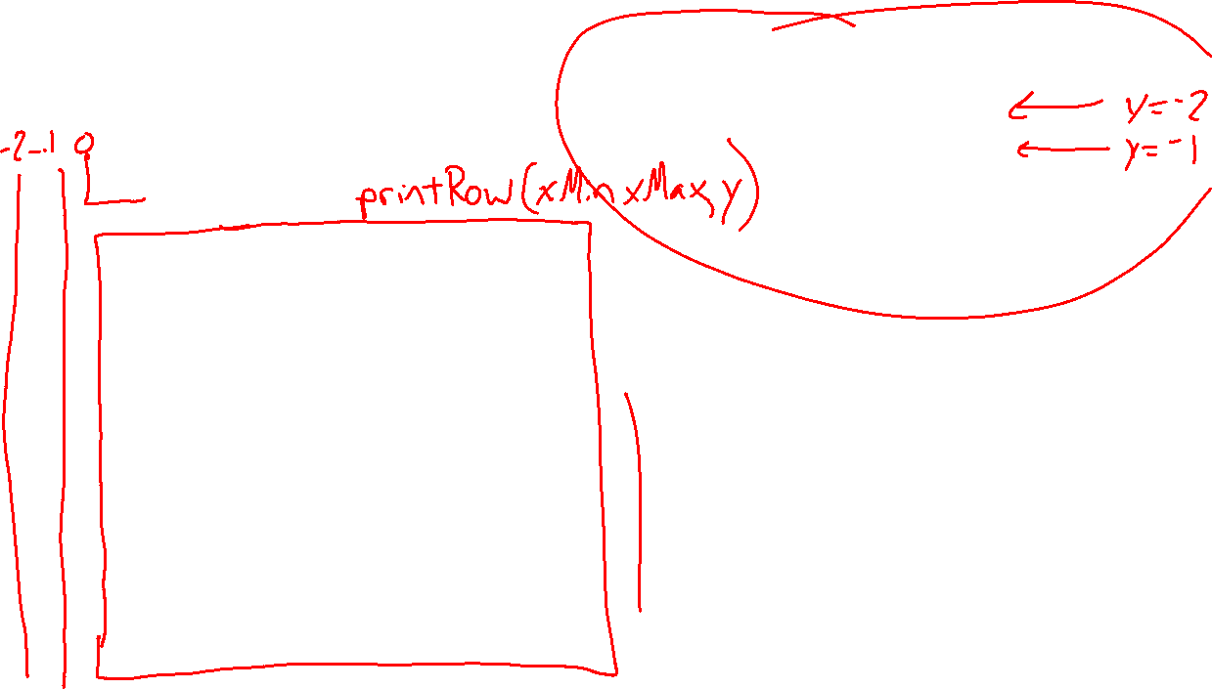
Poll 8
Original for printPlot(-3, 3, -2, 2)
def printPlot(xMin, xMax, yMin, yMax):
for yGrid in range(yMin, yMax+1):
if yGrid == 0:
break
for xGrid in range(xMin, xMax+1):
if xGrid == 0 and yGrid == 0:
pixel = '+'
elif xGrid == 0:
pixel = '|'
elif yGrid == 0:
pixel = '-'
else:
pixel = '.'
print(pixel, end=" ")
print()
. . . | . . .
. . . | . . .
- - - + - - -
. . . | . . .
. . . | . . .
The added code will result in…?
Select ALL that apply
Fewer rows
Fewer columns
A blank row in the center
A blank column in the center
None of the above

Slide 36

Poll 8
Original for printPlot(-3, 3, -2, 2)
def printPlot(xMin, xMax, yMin, yMax):
for yGrid in range(yMin, yMax+1):
if yGrid == 0:
break
printRow(xMin, xMax, yGrid)
. . . | . . .
. . . | . . .
- - - + - - -
. . . | . . .
. . . | . . .
The added code will result in…?
Select ALL that apply
Fewer rows
Fewer columns
A blank row in the center
A blank column in the center
None of the above

Slide 37
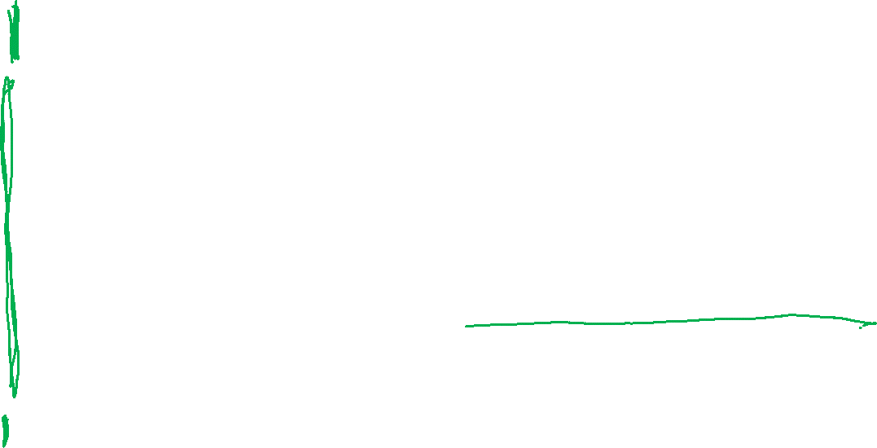
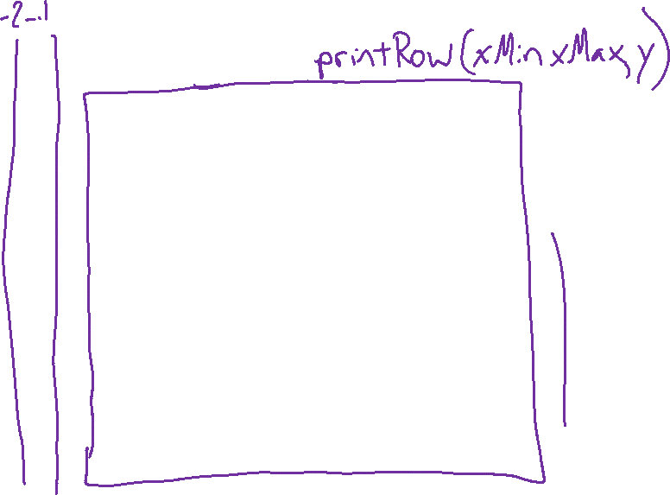


Poll 9
Original for printPlot(-3, 3, -2, 2)
def printPlot(xMin, xMax, yMin, yMax):
for yGrid in range(yMin, yMax+1):
if yGrid == 0:
continue
for xGrid in range(xMin, xMax+1):
if xGrid == 0 and yGrid == 0:
pixel = '+'
elif xGrid == 0:
pixel = '|'
elif yGrid == 0:
pixel = '-'
else:
pixel = '.'
print(pixel, end=" ")
print()
. . . | . . .
. . . | . . .
- - - + - - -
. . . | . . .
. . . | . . .
The added code will result in…?
Select ALL that apply
Fewer rows
Fewer columns
A blank row in the center
A blank column in the center
None of the above

Slide 38
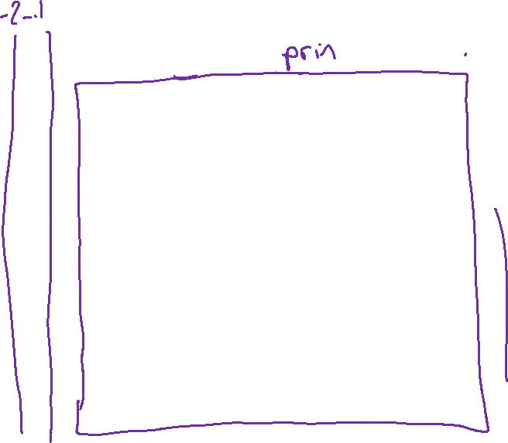


Poll 9
Original for printPlot(-3, 3, -2, 2)
def printPlot(xMin, xMax, yMin, yMax):
for yGrid in range(yMin, yMax+1):
if yGrid == 0:
continue
printRow(xMin, xMax, yGrid)
. . . | . . .
. . . | . . .
- - - + - - -
. . . | . . .
. . . | . . .
The added code will result in…?
Select ALL that apply
Fewer rows
Fewer columns
A blank row in the center
A blank column in the center
None of the above

Slide 39
Break and Continue in Nested Loops
Break and continue will only affect their immediate surrounding loop
for tensDigit in range(1,6):
for onesDigit in range(1, 6):
value = 10*tensDigit + onesDigit
print(value, end=' ‘)
print()
11 12 13 14 15
21 22 23 24 25
31 32 33 34 35
41 42 43 44 45
51 52 53 54 55
for tensDigit in range(1,6):
for onesDigit in range(1, 6):
if onesDigit == 3:
break
value = 10*tensDigit + onesDigit
print(value, end=' ‘)
print()
11 12
21 22
31 32
41 42
51 52

Slide 40
Break and Continue in Nested Loops
Break and continue will only affect their immediate surrounding loop
for tensDigit in range(1,6):
for onesDigit in range(1, 6):
value = 10*tensDigit + onesDigit
print(value, end=' ‘)
print()
11 12 13 14 15
21 22 23 24 25
31 32 33 34 35
41 42 43 44 45
51 52 53 54 55
for tensDigit in range(1,6):
for onesDigit in range(1, 6):
if onesDigit == 3:
continue
value = 10*tensDigit + onesDigit
print(value, end=' ‘)
print()
11 12 14 15
21 22 24 25
31 32 34 35
41 42 44 45
51 52 54 55

Slide 41
Break and Continue in Nested Loops
for tensDigit in range(1,6):
for onesDigit in range(1, 6):
value = 10*tensDigit + onesDigit
print(value, end=' ')
print()
11 12 13 14 15
21 22 23 24 25
31 32 33 34 35
41 42 43 44 45
51 52 53 54 55
for tensDigit in range(1,6):
for onesDigit in range(1, 6):
if onesDigit == 3:
break
value = 10*tensDigit + onesDigit
print(value, end=' ')
print()
11 12
21 22
31 32
41 42
51 52
for tensDigit in range(1,6):
for onesDigit in range(1, 6):
if onesDigit == 3:
continue
value = 10*tensDigit + onesDigit
print(value, end=' ')
print()
11 12 14 15
21 22 24 25
31 32 34 35
41 42 44 45
51 52 54 55

Slide 42
Break in Nested Loops
Original for printPlot(-3, 3, -2, 2)
def printPlot(xMin, xMax, yMin, yMax):
for yGrid in range(yMin, yMax+1):
for xGrid in range(xMin, xMax+1):
if yGrid == 0:
break
if xGrid == 0 and yGrid == 0:
pixel = '+'
elif xGrid == 0:
pixel = '|'
elif yGrid == 0:
pixel = '-'
else:
pixel = '.'
print(pixel, end=" ")
print()
. . . | . . .
. . . | . . .
- - - + - - -
. . . | . . .
. . . | . . .
The added code will result in…?
Select ALL that apply
Fewer rows
Fewer columns
A blank row in the center
A blank column in the center
None of the above

Slide 43
Break in Nested Loops
Original for printPlot(-3, 3, -2, 2)
def printPlot(xMin, xMax, yMin, yMax):
for yGrid in range(yMin, yMax+1):
for xGrid in range(xMin, xMax+1):
if yGrid == 0:
break
if xGrid == 0 and yGrid == 0:
pixel = '+'
elif xGrid == 0:
pixel = '|'
elif yGrid == 0:
pixel = '-'
else:
pixel = '.'
print(pixel, end=" ")
print()
. . . | . . .
. . . | . . .
- - - + - - -
. . . | . . .
. . . | . . .
The added code will result in…?
Select ALL that apply
Fewer rows
Fewer columns
A blank row in the center
A blank column in the center
None of the above
printPixel(xGrid, yGrid)

Slide 44
Break in Nested Loops
Original for printPlot(-3, 3, -2, 2)
def printPlot(xMin, xMax, yMin, yMax):
for yGrid in range(yMin, yMax+1):
for xGrid in range(xMin, xMax+1):
if yGrid == 0:
break
printPixel(xGrid, yGrid)
print()
. . . | . . .
. . . | . . .
- - - + - - -
. . . | . . .
. . . | . . .
yGrid: -2
yGrid: -1
yGrid: 0
yGrid: 1
yGrid: 2
The added code will result in…?
Select ALL that apply
Fewer rows
Fewer columns
A blank row in the center
A blank column in the center
None of the above

Slide 45
Design: Patterns and Top-Down Design

Slide 46
Pattern: Find the n-th thing
Find the n-th prime
More than one way to write it
def nthPrime(n):
numFound = 0
guess = 0 # First guess - 1
while numFound <= n:
guess += 1 # Next guess
if isPrime(guess):
numFound += 1
return guess
def nthPrime(n):
numFound = 0
guess = 1 # First guess
while True:
if isPrime(guess):
numFound += 1
if numFound == n+1:
return guess
guess += 1 # Next guess

Slide 47
Poll 10 (unused)
Which version is better?
A) B)
def nthPrime(n):
numFound = 0
guess = 0 # First guess - 1
while numFound <= n:
guess += 1 # Next guess
if isPrime(guess):
numFound += 1
return guess
def nthPrime(n):
numFound = 0
guess = 1 # First guess
while True:
if isPrime(guess):
numFound += 1
if numFound == n+1:
return guess
guess += 1 # Next guess

Slide 48
Top-down Design
Start coding with a birds-eye-view of the task
As you code, assume you have completed versions of lower level tasks
Example: Find nthDooDad(n):
def nthDooDad(n):
numFound = 0
guess = 1 # First guess
while True:
if ???

Slide 49
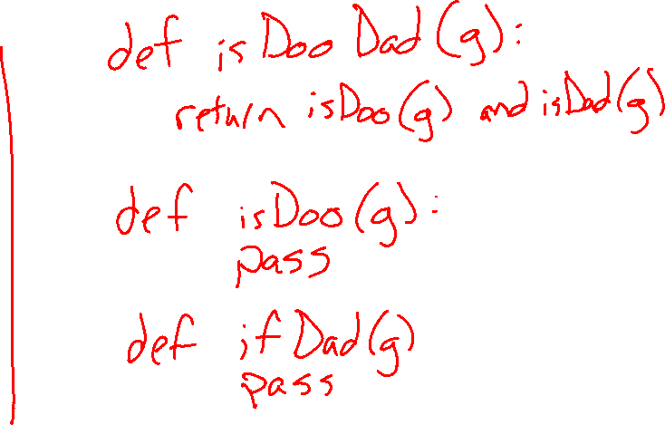
Top-down Design
Start coding with a birds-eye-view of the task
As you code, assume you have completed versions of lower level tasks
Example: Find nthDooDad(n):
def nthDooDad(n):
numFound = 0
guess = 1 # First guess
while True:
if
isDooDad(guess)
numFound += 1
if numFound == n+1:
return guess
guess += 1 # Next guess

Slide 50
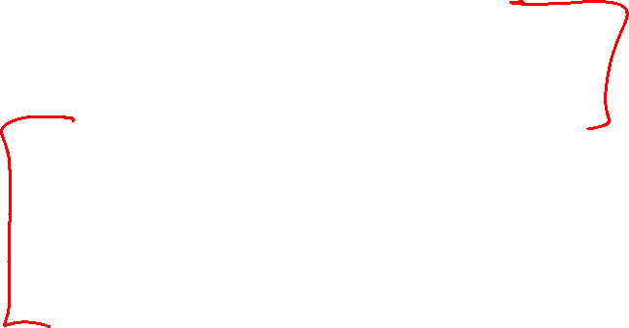
n-th Pattern
Need
A way to get to the next guess
A way to check it: isThing(guess)
Sketch
Loop from guess to guess until you’ve found n (well actually n+1) things
if isThing(guess):
numFound += 1

Slide 51
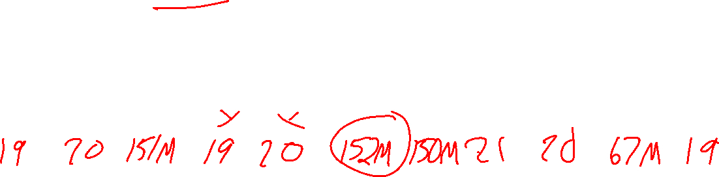
Best Pattern
Find the “best” thing in some collection
What “best” means depends on the application.
Example: Find the oldest TA

Slide 52
Best Pattern
Need
Ability to loop through all items
Ability to compare value of items
Sketch
Initialize bestValue (often some extreme or impossible value, like None)
Loop through all items:
if item value is “better” than bestValue
Update bestValue to value of current item
Note: (Sometimes you also need to keep track of the item itself
in cases where the item and the value of the item differ)

Slide 53
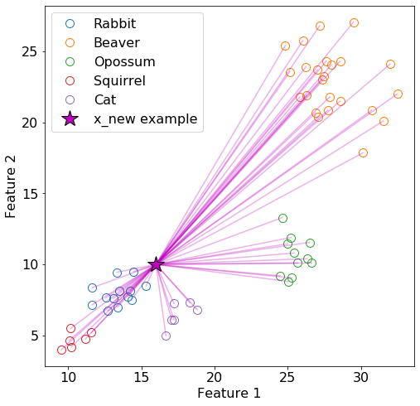
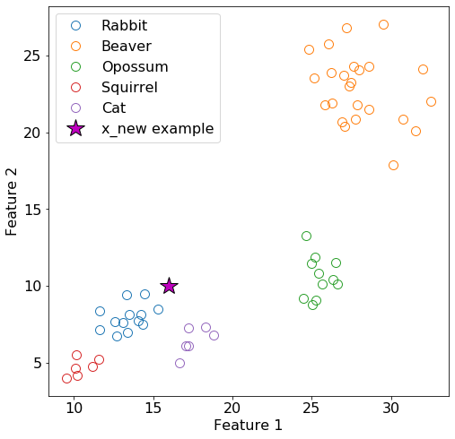
Top-down Design
Example: Best Pattern + Top-down Design
nearestNeighbor(newPoint, trainingPoints):

Slide 54
Top-down Design
def getNumPoints(points):
pass
def getPointFromPoints(points, i):
pass
def distance(point1, point2):
pass
Example: Best Pattern + Top-down Design
nearestNeighbor(newPoint, trainingPoints):
def nearestNeighbor(newPoint, trainingPoints):
bestDistance = math.inf
bestPoint = None
numPoints = getNumPoints(trainingPoints)
for i in range(numPoints):
trainingPoint = getPoint(trainingPoints, i)
dist = distance(newPoint, trainingPoint)
if dist <= bestDistance:
bestDistance = dist
bestPoint = trainingPoint
return bestPoint

Slide 55
Style

Slide 56
Poll 11 (unused)
A)
def distance(x1, y1, x2, y2):
return ((x1-x2)**2 + (y1-y2)**2)**0.5
Which code is better?
B)
def distance(x1, y1, x2, y2):
xDiff = x1 - x2
yDiff = y1 - y2
xDiffSquared = xDiff**2
yDiffSquared = yDiff**2
sumOfSquares = xDiffSquared + yDiffSquared
result = sumOfSquares**0.5
return result

Slide 57
Algorithm Design: Faster isPrime

Slide 58
Algorithm Design: isPrime(n)
This version is actually *really* slow
def isPrime(n):
if n < 2:
return False
for factor in range(2, n):
if n % factor == 0:
return False
return True
isPrime(17)
1 2 3 4 5 6 7 8 9 10 11 12 13 14 15 16 17

Slide 59
Algorithm Design: isPrime(n)
We can do better
def isPrime(n):
if n < 2:
return False
for factor in range(2, n):
if n % factor == 0:
return False
return True
isPrime(17)
def fasterIsPrime(n):
if n < 2:
return False
for factor in range(2, int(n**0.5)+1):
if n % factor == 0:
return False
return True
fasterIsPrime(17)
1 2 3 4 5 6 7 8 9 10 11 12 13 14 15 16 17

Slide 60
Algorithm Design: isPrime(n)
Timing with the time library
import time
startTime = time.time()
result = isPrime(7368791)
endTime = time.time()
elapsedTime = endTime - startTime
print(f'isPrime: {elapsedTime} sec')
import time
startTime = time.time()
result = fasterIsPrime(7368791)
endTime = time.time()
elapsedTime = endTime - startTime
print(f’fasterIsPrime: {elapsedTime} sec')
isPrime: 1.1695044040679932 sec
fasterIsPrime: 0.001009225845336914 sec
Over 1000x faster for isPrime(7368791)

