Slide 1
Final Review
10-607

Slide 2
Outline
Propositional Logic
Proof Techniques
  Proof by Cases
  Proof by Contradiction
  Proof by Induction
Computational Complexity
Recursion
Data Structures
  Stacks and Queues
  Trees
  Graphs
Algorithms
  Perceptron
  Variable Elimination

Slide 3


Propositional Logic
Some important things to know:
  Properties from the hand out
    Distributivity:
    Associativity
    Etc…
  Know how to make truth tables show if statements are equivalent or not
  Contrapositive
  DeMorgan’s Law

Slide 4
Any Logic Questions?

Slide 5
Proof Techniques
Big ones we covered in class
  Proof by cases
    When there are a few cases, prove the statement under the assumption that each one is true.
    This is a good choice in strategy when you can think of a few different cases that could happen in the statement.
  Proof by contrapositive
    Formulate the contrapositive of the statement and prove that instead.
  Proof by contradiction
    Assume that the opposite statement holds, then show there is a logical contradiction.
    Know the difference between disproof by counter example, proof by contrapositive, and proof by contradiction! They are all very different!
  Proof by induction
    Prove the base case, assume true for n = k, show it is true for n = k + 1.
    This is a good choice for statements of the form “A(n) is true for n >= n_0”

Slide 6
Proof Techniques (Disprove by Counterexample)
Which of the following can be disproved by counterexample?
Let a, b be odd integers. Then a + b is odd.
There exists odd integers a and b such that a + b is odd.
Both a) and b)
None of the above

Slide 7
Proof Techniques (Disprove by Counterexample)
Which of the following can be disproved by counterexample?
Let a, b be odd integers. Then a + b is odd.
There exists odd integers a and b such that a + b is odd.
Both a) and b)
None of the above
The first statement implies that it is true for all possible odd integers, so a counterexample shows this is not true. A counterexample will not prove the existence of such odd integers for b)

Slide 8
Proof Techniques (Proof by Contrapositive)
What is the contrapositive statement of : If it is cloudy then it is raining.
If it is not cloudy then it is not raining.
If it is not raining then it is not cloudy.
If it is raining then it is cloudy.
None of the above.

Slide 9
Proof Techniques (Proof by Contrapositive)
What is the contrapositive statement of : If it is cloudy then it is raining.
If it is not cloudy then it is not raining.
If it is not raining then it is not cloudy.
If it is raining then it is cloudy.
None of the above.

Slide 10
Proof Techniques (Proof by Contrapositive)
What is the contrapositive statement of : If there exists an x such that f(x) = 3, then g(y) = 2 for all y
If there exists an x such that f(x) ≠ 3, then g(y) ≠ 2 for all y.
If, for all x, f(x) ≠ 3, then there exists a y such that g(y) ≠ 2.
If, for all y, g(y) ≠ 2, then there exists an x such that g(x) ≠ 3.
If there exists a y such that g(y) ≠ 2, then f(x) ≠ 3 for all x.

Slide 11
Proof Techniques (Proof by Contrapositive)
What is the contrapositive statement of : If there exists an x such that f(x) = 3, then g(y) = 2 for all y
If there exists an x such that f(x) ≠ 3, then g(y) ≠ 2 for all y.
If, for all x, f(x) ≠ 3, then there exists a y such that g(y) ≠ 2.
If, for all y, g(y) ≠ 2, then there exists an x such that g(x) ≠ 3.
If there exists a y such that g(y) ≠ 2, then f(x) ≠ 3 for all x.
Note that usually “for all” turns into “there exists” and vice versa when negation is applied.

Slide 12
Proof Techniques (The Recipe for Induction)
This recipe can be followed exactly.
Prove that A(n) is true for all n ≥ n’
Base Case
We first prove that A(n) is true for when n = n’
YOUR PROOF HERE
Inductive Assumption
Let n=k and assume that A(k) is true.
Inductive Step
We now prove that, where n = k + 1, that A(k + 1) is true.
YOUR PROOF HERE
Thus the statement holds true by induction.

Slide 13
Any Proof Questions?

Slide 14
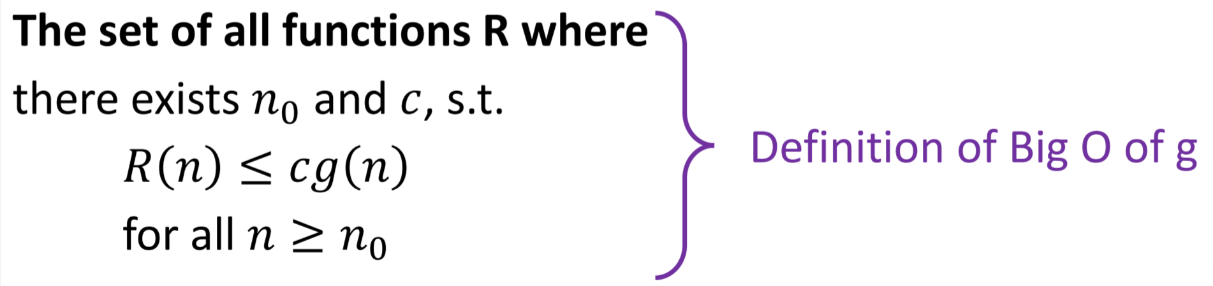
Computational Complexity
Know the definition of big-O:
Be able to analyze code complexity
  Tips:
    Try writing the number of operations in terms of math with sum notation.
    Count the number of for loops/recursive calls this will often (but not always) correspond to the order of a polynomial. E.g. two for loops often means O(n²)
Be able to count number of operations

Slide 15


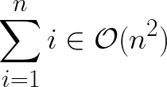



Computational Complexity
Which of the following are true?
a)
b)
c)
d)
e)
f)

Slide 16
Computational Complexity
Which of the following are true?
a)
b)
c)
d)
Remember with logarithms you can take exponent out as coefficients.
e)
2^{2n} is the same as 2^n squared.
f)
Logarithm grows slower than any polynomial

Slide 17
Any Complexity Questions?

Slide 18
Recursion
Strategy for writing recursive functions:
  Identify what your base case is
  Usually when you recursively call the function, the arguments that you pass are for a smaller/easier problem. How are you making the problem easier?
Other things to know
  Memoization. This is something that should be added onto the regular recursive approach.

Slide 19

Recursion: A Practice Problem
Suppose you are in a grid environment where you can either move right or up. How many ways are there to get to the heart at some arbitrary (x, y) coordinate (assume x >= 0 and y >= 0).
From “Cracking the Coding Interview”

Slide 20
Recursion: A Practice Problem
What is a good base case for this problem?
How would you break the problem down to make it easier?
How could you memoize your recursive solution?

Slide 21
Recursion: A Practice Problem
What is a good base case for this problem?
How would you break the problem down to make it easier?
How could you memoize your recursive solution?
When you are on top of the goal. Depending on your solution also if you have moved past the goal.
After you go right or up you are left with the same problem but with a close goal target. E.g. if you go one step up now it is the same problem but the goal is at (x, y - 1)
Keep a dictionary mapping (x, y) coordinate of the goal to the number of ways to get there. Look this up every call of the function to see if you already have the answer.
Solution at end of slides

Slide 22
Any Recursion Questions?

Slide 23
Data Structures
What to know:
  Stacks, queues, trees, graphs definition and the ways that they can be implemented
    For graph: adjacency matrix vs using a class-based implementation.
  BFS and DFS
    What the order things will be expanded, what data structures to use.
  Properties of graphs
    Directed vs undirected: Whether there is an arrow on the edges. What does each mean for how we implement a graph?
    acyclic vs cyclic: acyclic means that there are no loops
    Tree vs graph (maybe wasn’t covered?): Tree is a DAG where each node can only have one parent.

Slide 24
Data Structures (Graphs)
Which graphs are DAGs?
(a)
(b)
(c)

Slide 25
Data Structures (Graphs)
Which graphs are DAGs?
(a)
(b)
(c)

Slide 26
Any Data Structures Questions?

Slide 27
Algorithms (Bayes Nets)
Things to know
  From a picture of a Bayes net, be able to tell what probability tables are being stored.
  Know how to get the joint probability from those probability tables.
  Compute the number of entries of a table/how many operations are needed.
  Basic idea of Variable Elimination
Might be good to brush up on basic probability. In particular
  The Chain Rule for Probability
  Marginalization

Slide 28
Algorithms (Bayes Nets: Variable Elimination)
How can we rearrange the terms in the following expression to use as few operations as possible?

Slide 29
Algorithms (Bayes Nets: Variable Elimination)
How can we rearrange the terms in the following expression to use as few operations as possible?

Slide 30
Perceptron Algorithm
Things to know
  Be able to do the perceptron algorithm by hand
  Understand definition of margin

Slide 31
Questions?

Slide 32
