Slide 1


10-607
Computational Foundations for Machine Learning
Data Structures
Instructor: Pat Virtue

Slide 2

Plan
Dynamic Programming
Overlapping subproblems
Examples
Data Structures
Dense vs sparse structures
Trees
BFS and DFS
Stacks and Queues
Other tree implementations
Graphs (next time)

Slide 3
Dynamic Programming
Previous lecture slides

Slide 4

Abstractions vs. Data Structures
Abstractions
Data Structures
List
Set
Map (Dictionary)
Tree
Queue (FIFO)
Stack (LIFO)
Priority Queue
Graph
Array (fixed size)
Array (variable size)
Linked List
Doubly-Linked List
Multidimensional Array
Tensor
Hash Map
Binary Search Tree
Balanced Tree
Trie
Stack
Heap
Graph
Bipartite Graph
Sparse Vector
Sparse Matrix

Slide 5
Data Structures for ML
Examples…
Data:
  Dense feature vector (array)
  Sparse feature vector (sparse vector)
  Design matrix (multidimensional array)
Models:
  Decision Trees (tree)
  Bayesian Network (directed acyclic graph)
  Factor Graph (bipartite graph)
Algorithms:
  Greedy Search (weighted graph)
  A* Search (priority queue/heap)
  Forward-backward for HMM (trellis)
Notes:
TODO: Bloom Filter
TODO: Locality Sensitive Hashing

Slide 6
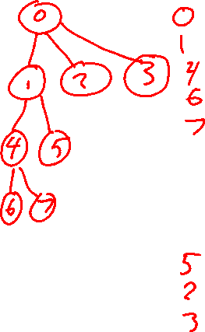
Tree to Predict C-Section Risk
(Sims et al., 2000)
Figure from Tom Mitchell

Slide 7
Plan
Dynamic Programming
Overlapping subproblems
Examples
Data Structures
Dense vs sparse structures
Trees
BFS and DFS
Stacks and Queues
Other tree implementations
Graphs (next time)

Slide 8

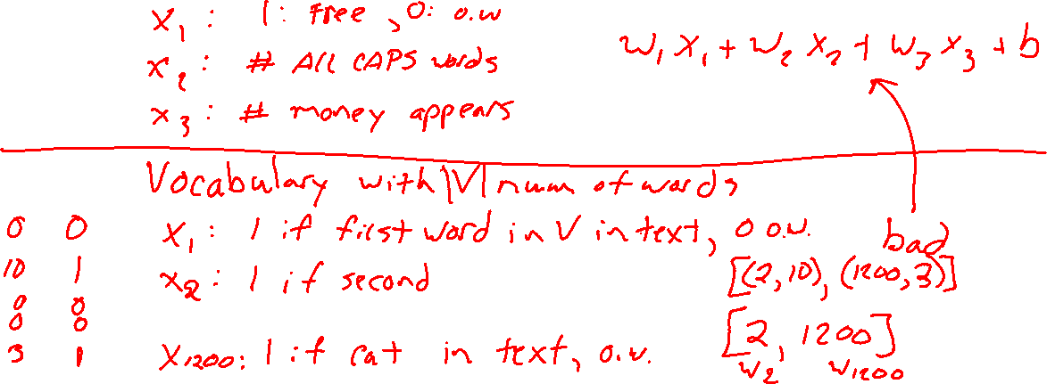
Dense vs sparse structures
Vector dot product example
Linear regression model $y=w^{T}x+b$
Where $x$ represents the contents of text data, e.g., e-mail or book review

Slide 9
Dense vs sparse structures
Matrix multiplication with special structure
Example: diagonal matrices

Slide 10
Plan
Dynamic Programming
Overlapping subproblems
Examples
Data Structures
Dense vs sparse structures
Trees
BFS and DFS
Stacks and Queues
Other tree implementations
Graphs (next time)

Slide 11
Trees
Notebook

Slide 12
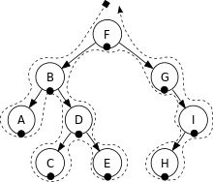
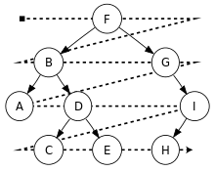
Tree Traversals
Depth First Search
Breadth First Search
Figures from Wikipedia

