Slide 1


10-607
Computational Foundations for Machine Learning
Recursion, Induction, & Dynamic Programming
Instructor: Pat Virtue

Slide 2
Plan
Recursion
Recursion
Practical considerations
Proof by induction
Divide and Conquer
Sorting example
Dynamic Programming
Overlapping subproblems
Examples

Slide 3
Factorial
Complete the recursive function for factorial!
Note: A recursive function calls itself
def factorial(int n):
if ___________:
return ___________
return ___________________
0! = 1
1! = 1
2! = 2
3! = 6
4! = 24

Slide 4

Recursion
https://www.cs.cmu.edu/~112/notes/notes-recursion-part1.html
Template
def recursiveFunction():
if (this is the base case):
do something non-recursive
else:
do something recursive

Slide 5

Recursion Examples
List sum
# Problem: sum all of the numbers in a given list
def listSum(L):
# Base Case: the list is empty, so the sum is 0
if (len(L) == 0):
return 0
else:
# Recursive Case: assume we already know the sum of the entire list
# after the first element. Add that sum to the first element.
return L[0] + listSum(L[1:])
print(listSum([2,3,5,7,11])) # 28
Slide credit: CMU 15-112

Slide 6
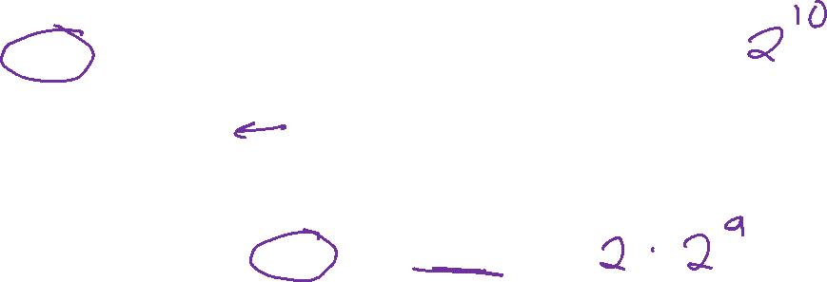
Recursion Examples
Power
# Problem: raise the number base to the given exponent
def power(base, expt):
# assume expt is non-negative integer
if (expt == 0):
return 1
else:
return base * power(base, expt-1)
print(power(2,5)) # 32
Slide credit: CMU 15-112

Slide 7
Recursion Examples
Power – Multiple base cases!
def power(base, expt):
# This version allows for negative exponents
# It still assumes that expt is an integer, however.
if (expt == 0):
return 1
elif (expt < 0): # new recursive case!
return 1.0 / power(base, abs(expt))
else:
return base * power(base, expt-1)
print(power(2,5)) # 32
print(power(2,-5)) # 1/32 = 0.03125
Slide credit: CMU 15-112

Slide 8
Plan
Recursion
Recursion
Practical considerations
Proof by induction
Divide and Conquer
Sorting example
Dynamic Programming
Overlapping subproblems
Examples

Slide 9
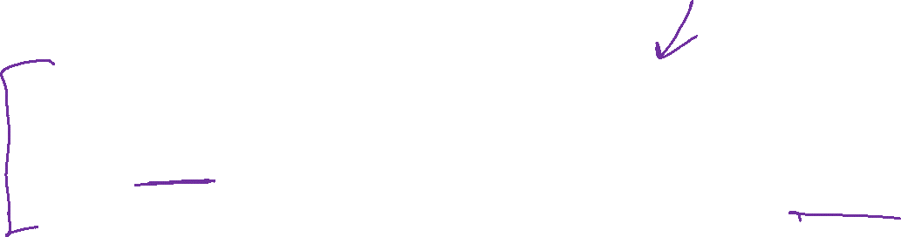
Iterative vs Recursive
Factorial
Iterative
def factorial(n):
result = 1
for i in range(2, n + 1):
result *= i
return result
print(factorial(5))
Recursive
def factorial(n):
if (n < 2):
return 1
else:
return n * factorial(n - 1)
print(factorial(5))

Slide 10
How does this look in memory?
Memory
Stack
long factorial(int n) {
if (n == 0) {
return 1;
}
return n * factorial(n-1);
}
int main() {
int n = 4;
long result;
result = factorial(n);
cout << result << endl;
}
Heap
0

Slide 11
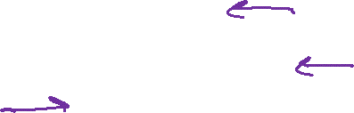
How does this look in memory?
Memory
main()
long factorial(int n) {
if (n == 0) {
return 1;
}
return n * factorial(n-1);
}
int main() {
int n = 4;
long result = 0;
result = factorial(n);
cout << result << endl;
}
n:
4
result:
0
Heap
0

Slide 12
The “stack” part of memory is a stack
Function call: push
Return: pop

Slide 13
“Stack” part of memory is a stack
Memory
main()
long factorial(int n) {
if (n == 0) {
return 1;
}
return n * factorial(n-1);
}
int main() {
int n = 4;
long result = 0;
result = factorial(n);
cout << result << endl;
}
n:
4
result:
0
factorial()
n:
4

Slide 14
“Stack” part of memory is a stack
Memory
main()
long factorial(int n) {
if (n == 0) {
return 1;
}
return n * factorial(n-1);
}
int main() {
int n = 4;
long result = 0;
result = factorial(n);
cout << result << endl;
}
n:
4
result:
0
factorial()
n:
4
factorial()
n:
3
factorial()
n:
2
factorial()
n:
1
factorial()
n:
0

Slide 15

“Stack” part of memory is a stack
Memory
main()
long factorial(int n) {
if (n == 0) {
return 1;
}
return n * factorial(n-1);
}
int main() {
int n = 4;
long result = 0;
result = factorial(n);
cout << result << endl;
}
n:
4
result:
0
factorial()
n:
4
factorial()
n:
3
factorial()
n:
2
factorial()
n:
1
1
factorial()
n:
0

Slide 16
“Stack” part of memory is a stack
Memory
main()
long factorial(int n) {
if (n == 0) {
return 1;
}
return n * factorial(n-1);
}
int main() {
int n = 4;
long result = 0;
result = factorial(n);
cout << result << endl;
}
n:
4
result:
0
24
factorial()
n:
4
6
factorial()
n:
3
2
factorial()
n:
2
1
factorial()
n:
1

Slide 17
“Stack” part of memory is a stack
Memory
main()
long factorial(int n) {
if (n == 0) {
return 1;
}
return n * factorial(n-1);
}
int main() {
int n = 4;
long result = 0;
result = factorial(n);
cout << result << endl;
}
n:
4
result:
24

Slide 18
What can go wrong?
Memory
Stack
long factorial(int n) {
if (n == 0) {
return 1;
}
return n * factorial(n-1);
}
int main() {
int n = 4;
long result = 0;
result = factorial(n);
cout << result << endl;
}
STACK SIZE LIMIT
Heap
0

Slide 19
Demo: Stack of elephants
Memory
Stack
STACK SIZE LIMIT
Heap
0

Slide 20

Demo: Stack of elephants
Memory
main()
void stack_of_elephants(
int num, int size) {
if (num == 0) {
return;
}
int elephant_array[size]
stack_of_elephants(num-1, size);
}
int main() {
int num = 10;
int size = 50;
stack_of_elephants(num, size)
}
num:
10
size:
50
stack_of_elephants
num:
10
size:
50
STACK SIZE LIMIT

Slide 21

Demo: Stack of elephants
Memory
main()
void stack_of_elephants(
int num, int size) {
if (num == 0) {
return;
}
int elephant_array[size]
stack_of_elephants(num-1, size);
}
int main() {
int num = 10;
int size = 50;
stack_of_elephants(num, size)
}
num:
10
size:
50
STACK SIZE LIMIT

Slide 22

Demo: Stack of elephants
Memory
main()
void stack_of_elephants(
int num, int size) {
if (num == 0) {
return;
}
int elephant_array[size]
stack_of_elephants(num-1, size);
}
int main() {
int num = 10;
int size = 50;
stack_of_elephants(num, size)
}
num:
10
size:
50
STACK SIZE LIMIT

Slide 23
Demo: Stack of elephants

Slide 24
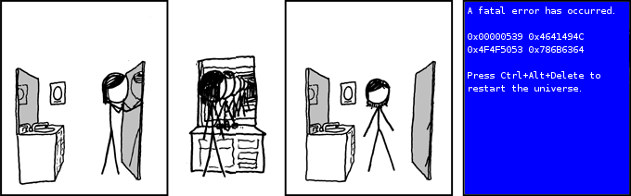
Images: http://xkcdsw.com/1361 (https://xkcd.com/555/)

Slide 25

Plan
Recursion
Recursion
Practical considerations
Proof by induction
Divide and Conquer
Sorting example
Dynamic Programming
Overlapping subproblems
Examples

Slide 26
Proof by Induction
Template
Prove proposition for base case, e.g., n=0
Inductive step
    Assume proposition holds for n=k
    Prove proposition holds for n=k+1

Slide 27
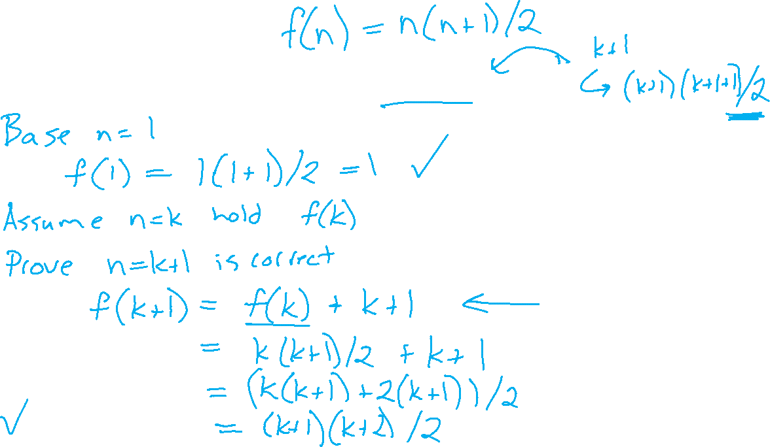
Proof by Induction
Example: Prove sum of integers 1 to n is n(n+1)/2

Slide 28

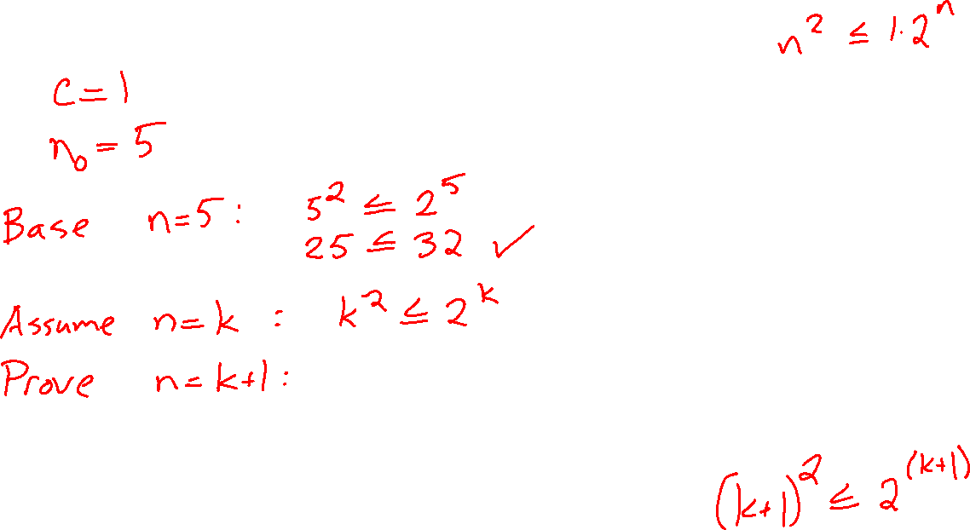
Exercise 1
Use induction to prove that for $f\left(n\right)=n^{2}$ in $O(2^{n})$

Slide 29

Exercise 1
Use induction to prove that for $−1<r<1$, the geometric series summation is:
$$\sum_{i=1}^{n}{ar^{i}}=\frac{ar^{n}−a}{r−1}$$

Slide 30
Plan
Recursion
Recursion
Practical considerations
Proof by induction
Divide and Conquer
Sorting example
Dynamic Programming
Overlapping subproblems
Examples

Slide 31

Divide and Conquer
def mergesort(L):
if (len(L) < 2):
return L
else:
mid = len(L)//2
left = mergesort(L[:mid])
right = mergesort(L[mid:])
return merge(left, right)
print(mergesort([1,5,3,4,2,0]))
Merge sort
Detailed code: 15-112 Merge Sort

Slide 32

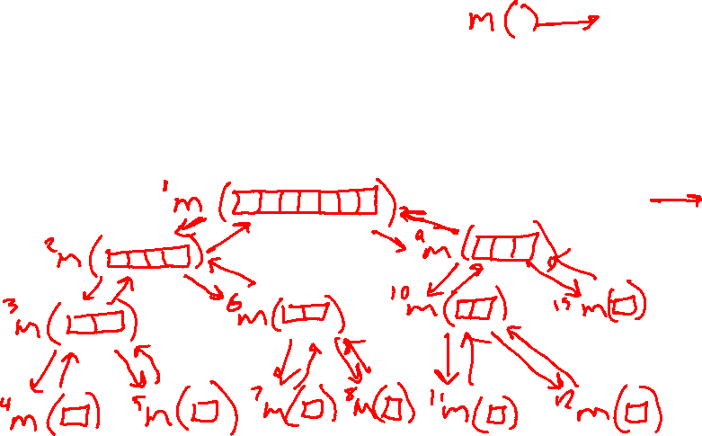
Divide and Conquer
def mergesort(L):
if (len(L) < 2):
return L
else:
mid = len(L)//2
left = mergesort(L[:mid])
right = mergesort(L[mid:])
return merge(left, right)
print(mergesort([1,5,3,4,2,0]))
Merge sort
Detailed code: 15-112 Merge Sort

Slide 33

Plan
Recursion
Recursion
Practical considerations
Proof by induction
Divide and Conquer
Sorting example
Dynamic Programming
Overlapping subproblems
Examples

Slide 34
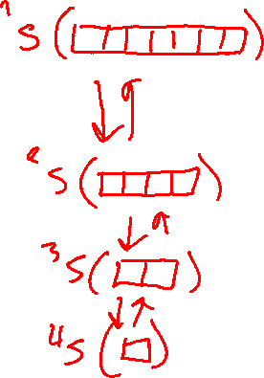
Reminder Binary Search
Graph of recursive calls
binarySearch2(data, key, first, last) {
// TODO base case
int mid = (first + last) // 2;
if (data[mid] == key)
return true;
else if (data[mid] > key)
return binarySearch2(data, key, first, mid-1);
else
return binarySearch2(data, key, mid+1, last)
}

Slide 35
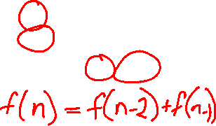
Exercise 2: Fibonacci Naïve
Fibonacci
N Value
0 1
1
2 = 1+1
3 = 1+2
5 = 2+3
8 = 3+5
13 = 5+8
21 = 8+13
Notebook
https://www.cs.cmu.edu/~112/notes/notes-recursion-part2.html#memoization

Slide 36
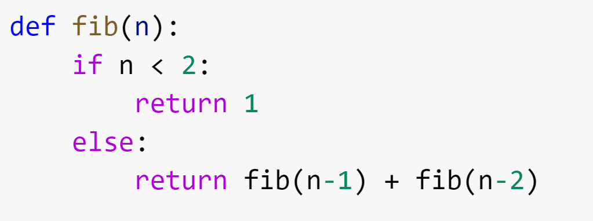
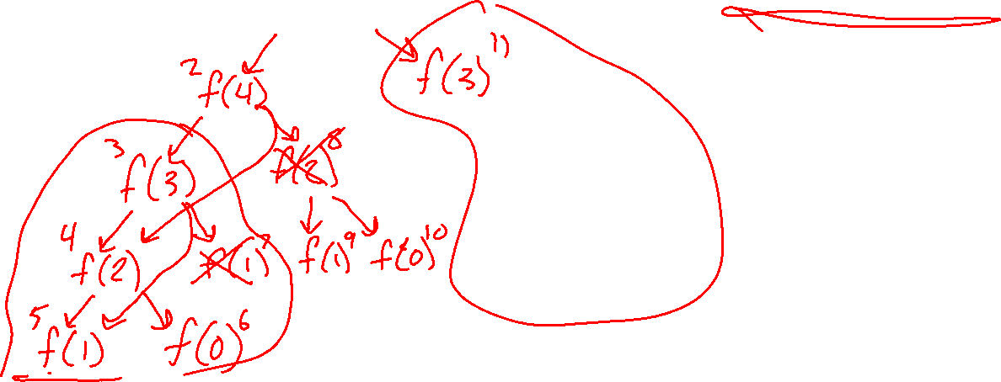

Exercise 3: Fibonacci Naïve
Graph of recursive calls
https://www.cs.cmu.edu/~112/notes/notes-recursion-part2html#memoization

Slide 37
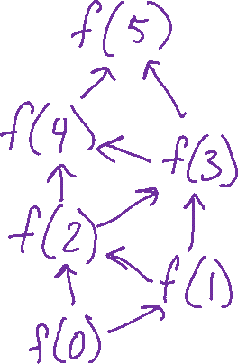
Fibonacci Dynamic Programming
Graph with overlapping subproblems
https://www.cs.cmu.edu/~112/notes/notes-recursion-part2.html#memoization

Slide 38
Fibonacci Dynamic Programming
Notebook
https://www.cs.cmu.edu/~112/notes/notes-recursion-part2.html#memoization

Slide 39
Dynamic Programming
Efficient way to solve problems that can take a long time
Dividing them into a set of smaller problems
Optimal solutions of each subproblem are stored and used to find the optimal solution for the larger problem
Unlike divide and conquer, these problems can overlap.
Slide credit: Avrim Blum and Anupam Gupta

Slide 40
Examples from ML
Dynamic Programming

Slide 41

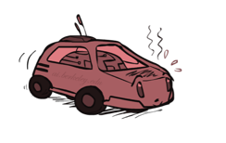

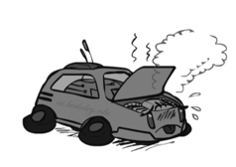
MDP: Racing Search Tree
10-601 Example
Slide: ai.berkeley.edu

Slide 42


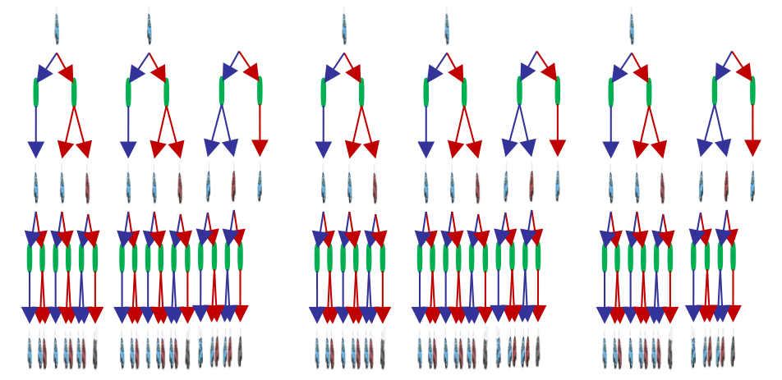

MDP: Racing Search Tree
10-601 Example
Slide: ai.berkeley.edu

Slide 43
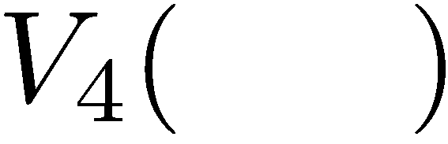



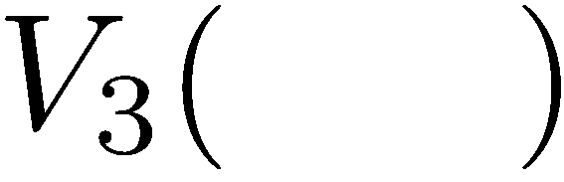

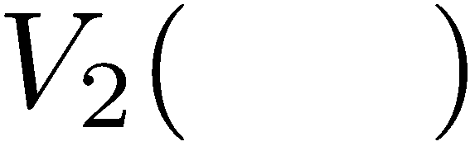
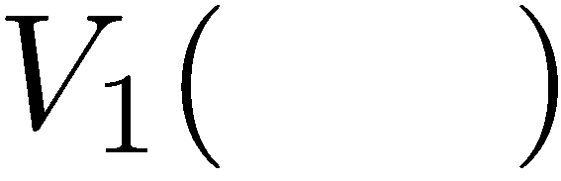
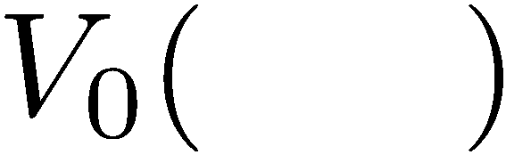
MDP: Racing Tree Example
Slide: ai.berkeley.edu
10-601 Example

Slide 44
MDP: Value Iteration
Start with V₀(s) = 0: no time steps left means an expected reward sum of zero
Given vector of V_{k}(s) values, do one ply of expectimax from each state:
Repeat until convergence
V_{k+1}(s)
a
s, a
s,a,s’
V_{k}(s’)
10-601 Example
Slide: ai.berkeley.edu
Notes:
Discuss computational complexity: S * A * S times number of iterations
Note: updates not in place [if in place, it means something else and not even clear what it means]

Slide 45
Hidden Markov Model
A Hidden Markov Model (HMM) provides a joint distribution over the the tunnel states / travel times with an assumption of dependence between adjacent tunnel states.
p(O, S, S, O, C, 2m, 3m, 18m, 9m, 27m) = (.8 * .08 * .2 * .7 * .03 * …)
 | O | S | C
O | .9 | .08 | .02
S | .2 | .7 | .1
C | .9 | 0 | .1
 | O | S | C
O | .9 | .08 | .02
S | .2 | .7 | .1
C | .9 | 0 | .1
O | .8
S | .1
C | .1
O
S
S
O
C
 | 1min | 2min | 3min | …
O | .1 | .2 | .3
S | .01 | .02 | .03
C | 0 | 0 | 0
 | 1min | 2min | 3min | …
O | .1 | .2 | .3
S | .01 | .02 | .03
C | 0 | 0 | 0
2m
3m
18m
9m
27m
10-601 Example

Slide 46
Forward-Backward Algorithm: Finds Marginals
Y₁
Y₂
Y₃
v
v
v
START
n
n
n
END
a
a
a
X₁
X₂
X₃
find
preferred
tags
10-601 Example
So p(v a n) = (1/Z) * product weight of one path
Marginal probability p(Y₂ = a)
= (1/Z) * total weight of all paths through
a
46

