Slide 1
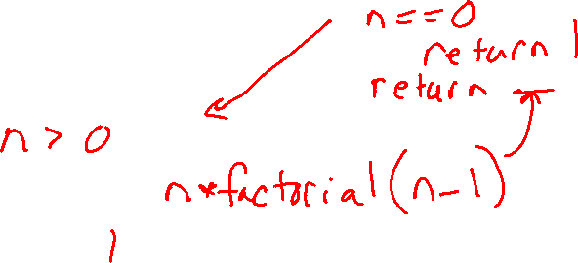
Warm-up as you walk in
Complete the recursive function for factorial!
Note: A recursive function calls itself
def factorial(int n):
if ___________:
return ___________
return ___________________
0! = 1
1! = 1
2! = 2
3! = 6
4! = 24

Slide 2

10-607
Computational Foundations for Machine Learning
Recursion
Instructor: Pat Virtue

Slide 3
Plan
Computational Complexity
Dealing with multiple inputs
Exercises
Recursion
Guess a number
Binary search
Computational complexity
Recursion
Practical considerations
Proof by induction

Slide 4
Computation Complexity
Previous lecture slides

Slide 5
Plan
Computational Complexity
Dealing with multiple inputs
Exercises
Recursion
Guess a number
Binary search
Computational complexity
Recursion
Practical considerations
Proof by induction

Slide 6
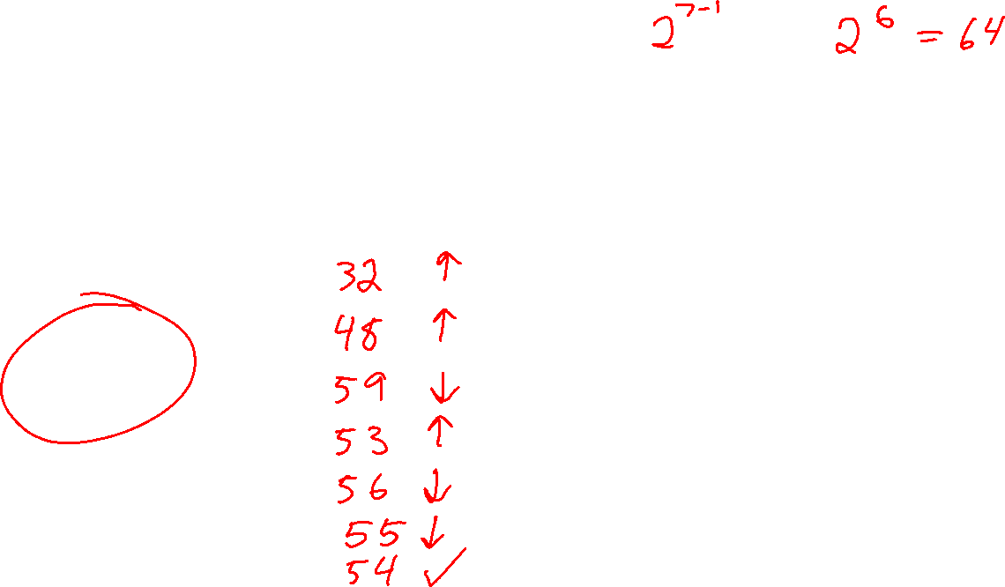
Poll 1
I’m thinking of a number between 1 and 64. After each guess, I’ll tell you if you’re correct or if my number is higher or lower.
What is the maximum number of guesses you’ll need to play this game?
A: 6
B: 7
C: 32
D: 64

Slide 7
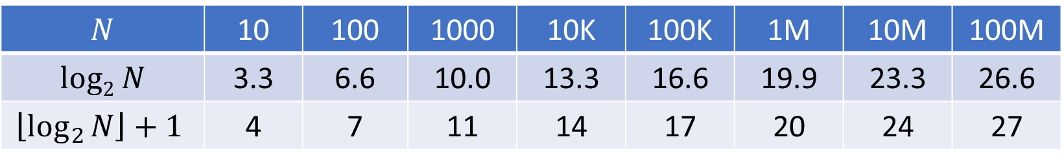
Guess a Number
I’m thinking of a number between 1 and N. After each guess, I’ll tell you if you’re correct or if my number is higher or lower.
What is the maximum number of guesses you’ll need to play this game?
$$N$$ | 10 | 100 | 1000 | 10K | 100K | 1M | 10M | 100M
$$log2 N$$ | 3.3 | 6.6 | 10.0 | 13.3 | 16.6 | 19.9 | 23.3 | 26.6
$$\left\lfloor \log_{2}{N}\right\rfloor +1$$ | 4 | 7 | 11 | 14 | 17 | 20 | 24 | 27

Slide 8
Classic CS problem:
Searching

Slide 9
Imagine storing sorted data in an array
How long does it take us to find a number we are looking for?
0 | 1 | 2 | 3 | 4 | 5 | 6 | 7 | 8 | 9 | 10
2 | 7 | 8 | 13 | 25 | 29 | 33 | 51 | 89 | 90 | 95
Slide credit: http://www.peerinstruction4cs.org/2013/07/13/cs2-in-c-peer-instruction-materials/

Slide 10
Imagine storing sorted data in an array
How long does it take us to find a number we are looking for?
If you start at the front and proceed forward, each item you examine rules out 1 item
0 | 1 | 2 | 3 | 4 | 5 | 6 | 7 | 8 | 9 | 10
2 | 7 | 8 | 13 | 25 | 29 | 33 | 51 | 89 | 90 | 95
Slide credit: http://www.peerinstruction4cs.org/2013/07/13/cs2-in-c-peer-instruction-materials/

Slide 11
Imagine storing sorted data in an array
0 | 1 | 2 | 3 | 4 | 5 | 6 | 7 | 8 | 9 | 10
2 | 7 | 8 | 13 | 25 | 29 | 33 | 51 | 89 | 90 | 95
If instead we jump right to the middle, one of three things can happen:
  The middle one happens to be the number we were looking for, yay!
  We realize we went too far
  We realize we didn’t go far enough
  Ruling out HALF the options in one step is so much faster than only ruling out one!
Slide credit: http://www.peerinstruction4cs.org/2013/07/13/cs2-in-c-peer-instruction-materials/

Slide 12
Imagine storing sorted data in an array
0 | 1 | 2 | 3 | 4 | 5 | 6 | 7 | 8 | 9 | 10
2 | 7 | 8 | 13 | 25 | 29 | 33 | 51 | 89 | 90 | 95
If instead we jump right to the middle, one of three things can happen:
  The middle one happens to be the number we were looking for, yay!
  We realize we went too far
  We realize we didn’t go far enough
  Ruling out HALF the options in one step is so much faster than only ruling out one!
Slide credit: http://www.peerinstruction4cs.org/2013/07/13/cs2-in-c-peer-instruction-materials/

Slide 13
Binary search
0 | 1 | 2 | 3 | 4 | 5 | 6 | 7 | 8 | 9 | 10
2 | 7 | 8 | 13 | 25 | 29 | 33 | 51 | 89 | 90 | 95
Let’s say the answer was C, “we didn’t go far enough”
We ruled out the entire first half, and now only have the second half to search
We could start at the front of the second half and proceed forward…
Slide credit: http://www.peerinstruction4cs.org/2013/07/13/cs2-in-c-peer-instruction-materials/

Slide 14
Binary search
0 | 1 | 2 | 3 | 4 | 5 | 6 | 7 | 8 | 9 | 10
2 | 7 | 8 | 13 | 25 | 29 | 33 | 51 | 89 | 90 | 95
Let’s say the answer was C, “we didn’t go far enough”
We ruled out the entire first half, and now only have the second half to search
We could start at the front of the second half and proceed forward…but why do that when we know we have a better way?
Jump right to the middle of the region to search
Slide credit: http://www.peerinstruction4cs.org/2013/07/13/cs2-in-c-peer-instruction-materials/

Slide 15
Binary search
0 | 1 | 2 | 3 | 4 | 5 | 6 | 7 | 8 | 9 | 10
2 | 7 | 8 | 13 | 25 | 29 | 33 | 51 | 89 | 90 | 95
Let’s say the answer was C, “we didn’t go far enough”
We ruled out the entire first half, and now only have the second half to search
We could start at the front of the second half and proceed forward…but why do that when we know we have a better way?
Jump right to the middle of the region to search
RECURSION!!
Slide credit: http://www.peerinstruction4cs.org/2013/07/13/cs2-in-c-peer-instruction-materials/

Slide 16

Binary search
bool binarySearch(list data, int key) {
return binarySearch2(data, key, 0, len(data)-1);
}
bool binarySearch2(list data, int key, int first, int last) {
// TODO base case
int mid = (first + last) // 2;
if (data[mid] == key)
return true;
else if (data[mid] > key)
return binarySearch2(data, key, first, mid-1);
else
return binarySearch2(data, key, mid+1, last)
}

Slide 17
Poll 2
What would be a good base case for our Binary Search function?
Select all that apply
Only three items remain: save yourself an unnecessary function call that would trivially divide them into halves of size 1, and just check all three.
Only two items remain: can’t divide into two halves with a middle, so just check the two.
Only one item remains: just check it.
No items remain: obviously we didn’t find it.
Slide credit: http://www.peerinstruction4cs.org/2013/07/13/cs2-in-c-peer-instruction-materials/

Slide 18

Poll 3
What is the time complexity of binary search?
A: O(1)
B: O(N)
C: O(N/2)
D: O(log N)
E: None of the above

Slide 19
Plotting log functions
Notebook

Slide 20
Plan
Computational Complexity
Dealing with multiple inputs
Exercises
Recursion
Guess a number
Binary search
Computational complexity O(log n)
Recursion
Practical considerations
Proof by induction

Slide 21
Factorial
Complete the recursive function for factorial!
Note: A recursive function calls itself
def factorial(int n):
if ___________:
return ___________
return ___________________
0! = 1
1! = 1
2! = 2
3! = 6
4! = 24

Slide 22
Recursion
https://www.cs.cmu.edu/~112/notes/notes-recursion-part1.html
Template
def recursiveFunction():
if (this is the base case):
do something non-recursive
else:
do something recursive

