Slide 1

10-607
Computational Foundations for Machine Learning
Computational Complexity
Instructor: Pat Virtue

Slide 2
Plan
Computational Complexity
Counting operations
Big-O
Complexity classes
Proving a Big-O relationship holds
Proving a Big-O relationship does not hold

Slide 3
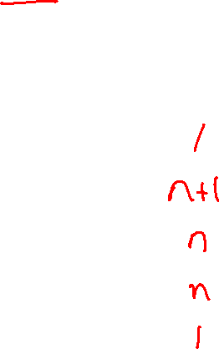
How many statements are executed?
15 int search(int x, int[] A, int n)
16 {
17 for (int i = 0; i < n; i++)
18 {
19 if (A[i] == x) {
20 return i;
21 }
22 }
23 return -1;
24 }
If x is not in A…
how times are these statements executed?
i = 0
i < n
if (A[i] == x)
i++
return -1
Slide credit: CMU 15-122

Slide 4
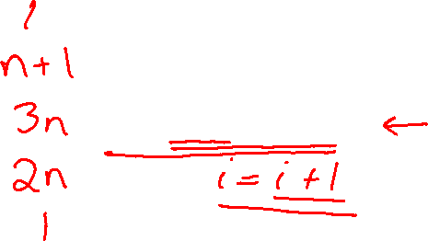
How many operations are executed?
15 int search(int x, int[] A, int n)
16 {
17 for (int i = 0; i < n; i++)
18 {
19 if (A[i] == x) {
20 return i;
21 }
22 }
23 return -1;
24 }
If x is not in A…
how times operations are executed?
i = 0
i < n
if (A[i] == x)
i++
return -1
Slide credit: CMU 15-122

Slide 5

How many operations are executed?
How many program operations are required to compute:
L2 norm of vector
Vector dot product
Frobenius norm of matrix
Matrix-vector multiplication
Matrix-matrix multiplication
Operations:
Arithmetic operations (e.g. + or **)
Logical operations (e.g., and)
Comparison operations (e.g., <=)
Structure accessing operations (e.g. array indexing like A[i])
Simple assignment such as copying a value into a variable
Calls to library functions that don’t depend on size of input (e.g., print)
Control Statements (e.g. if X>5)
Be careful with function calls that scale with the size of the input
def norm(a):
ss=0
for i in range(len(a)):
ss = ss + a[i]*a[i]
norm = np.sqrt(ss)
return norm

Slide 6
Exercise
Counting operations handout

Slide 7
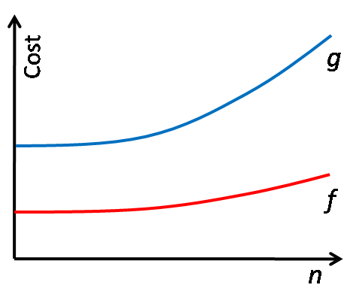
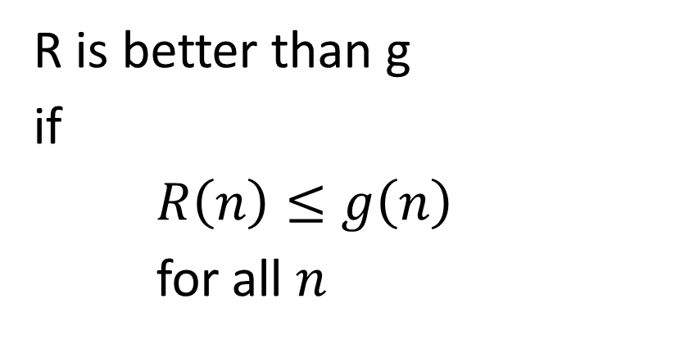

Comparing functions of n
Which is better?
R is better than g
if
$R\left(n\right)≤g\left(n\right)$
for all $n$
$$R$$
Slide credit: CMU 15-122

Slide 8
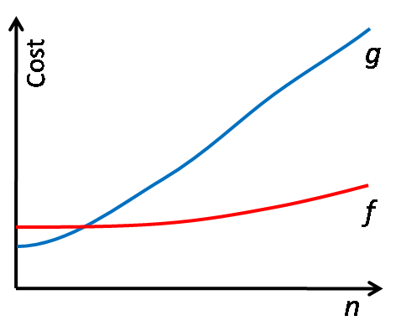


Comparing functions of n
Which is better?
R is better than g
if
$R\left(n\right)≤g\left(n\right)$
for all $n$
$$R$$
$$n_{0}$$
Slide credit: CMU 15-122

Slide 9
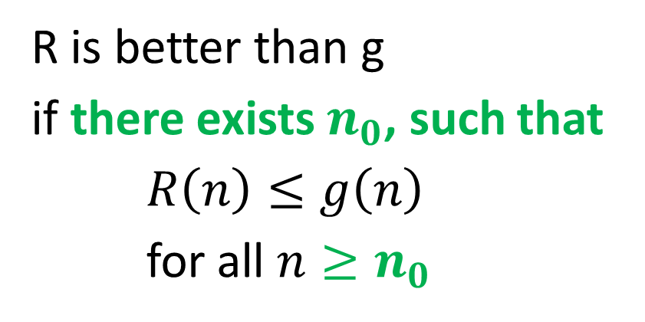
Comparing functions of n
Which is better?
R is better than g
if there exists $n_{0}$, such that
$R\left(n\right)≤g\left(n\right)$
for all $n≥n_{0}$
$$R$$
$$n_{0}$$
Slide credit: CMU 15-122

Slide 10
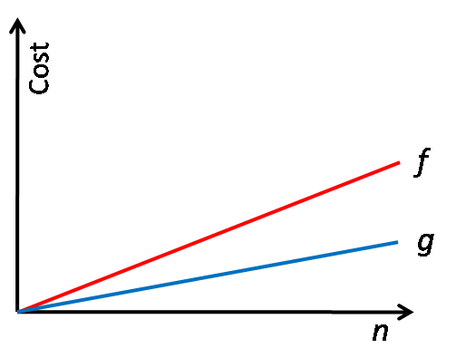
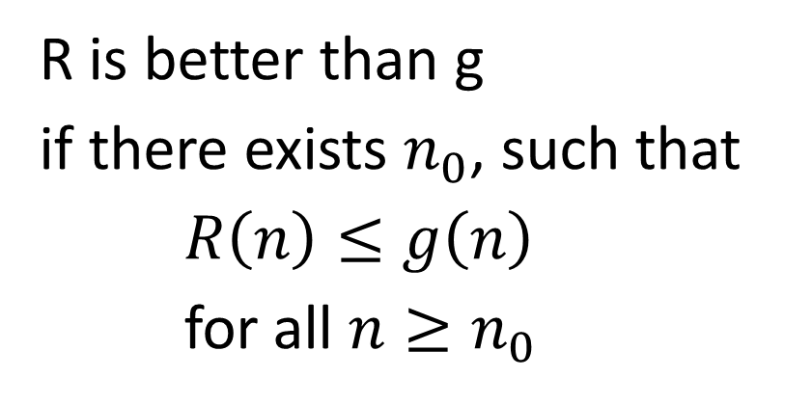

Comparing functions of n
Which is better?
R is better than g
if there exists $n_{0}$, such that
$R\left(n\right)≤g\left(n\right)$
for all $n≥n_{0}$
$$R$$
Slide credit: CMU 15-122

Slide 11
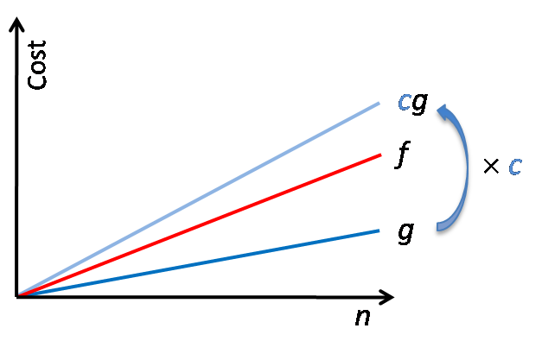
Comparing functions of n
Which is better?
R is better than g
if there exists $n_{0}$, such that
$R\left(n\right)≤g\left(n\right)$
for all $n≥n_{0}$
$$R$$
Slide credit: CMU 15-122

Slide 12
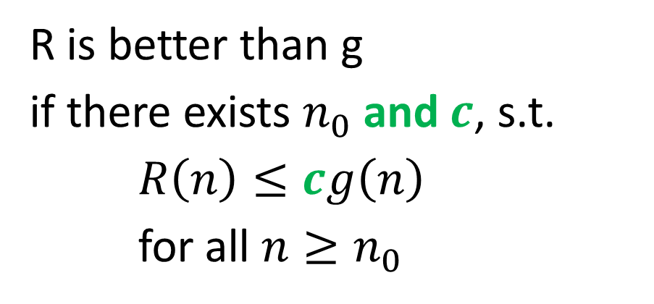
Comparing functions of n
Which is better?
R is better than g
if there exists $n_{0}$ and $c$, s.t.
$R\left(n\right)≤cg\left(n\right)$
for all $n≥n_{0}$
$$R$$
Slide credit: CMU 15-122

Slide 13
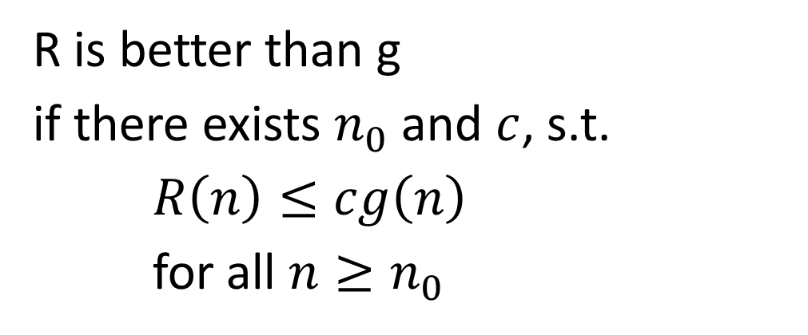
A set of better functions
R is better than g
if there exists $n_{0}$ and $c$, s.t.
$R\left(n\right)≤cg\left(n\right)$
for all $n≥n_{0}$
Slide credit: CMU 15-122

Slide 14
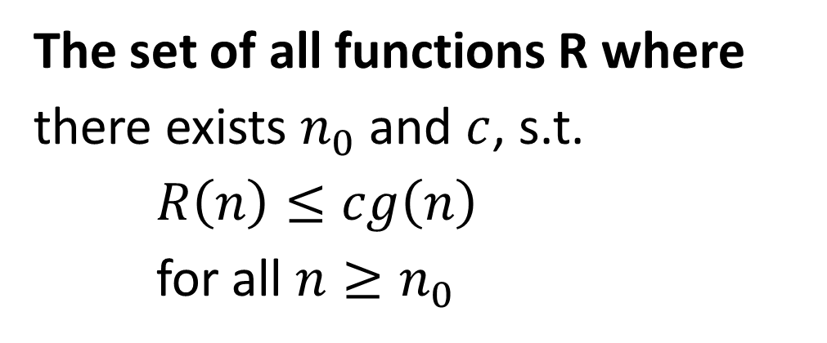
A set of better functions
The set of all functions R where
there exists $n_{0}$ and $c$, s.t.
$R\left(n\right)≤cg\left(n\right)$
for all $n≥n_{0}$
Definition of Big O of g
Slide credit: CMU 15-122

Slide 15
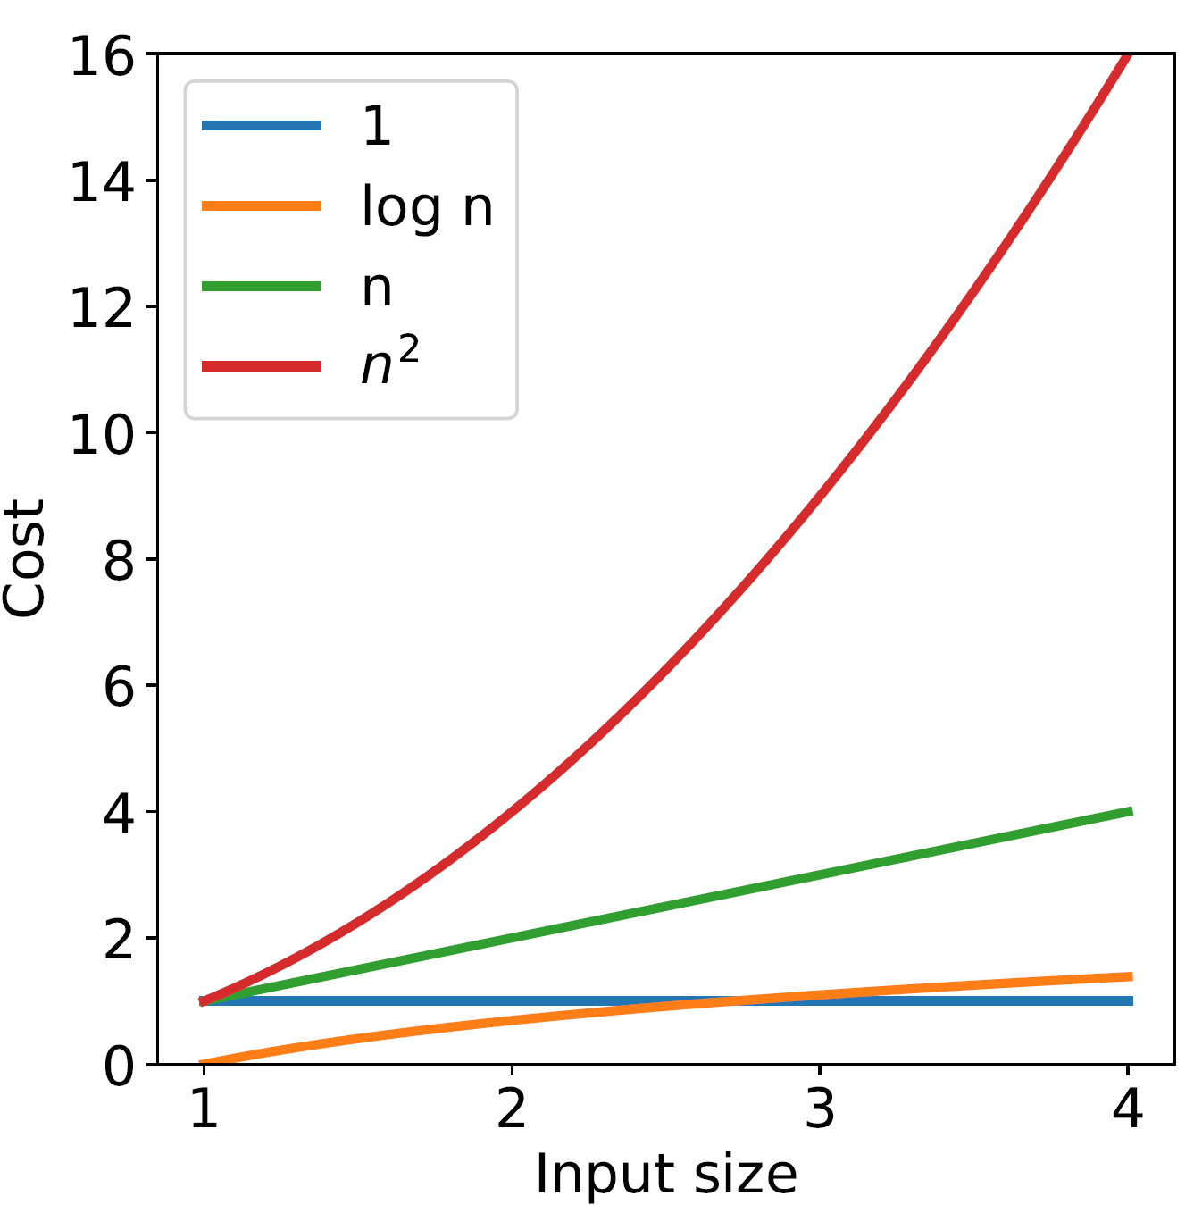
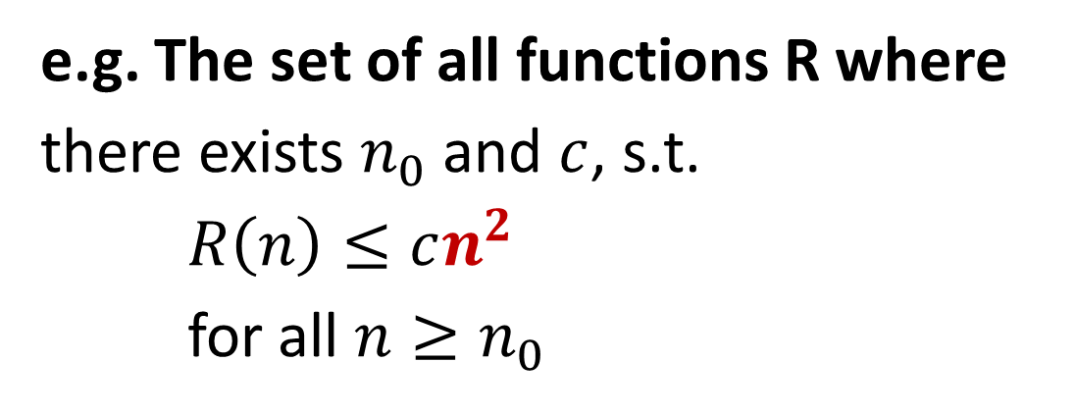
A set of better functions
Definition of Big O of g
The set of all functions R where
there exists $n_{0}$ and $c$, s.t.
$R\left(n\right)≤cg\left(n\right)$
for all $n≥n_{0}$
e.g. The set of all functions R where
there exists $n_{0}$ and $c$, s.t.
$R\left(n\right)≤cn^{2}$
for all $n≥n_{0}$

Slide 16
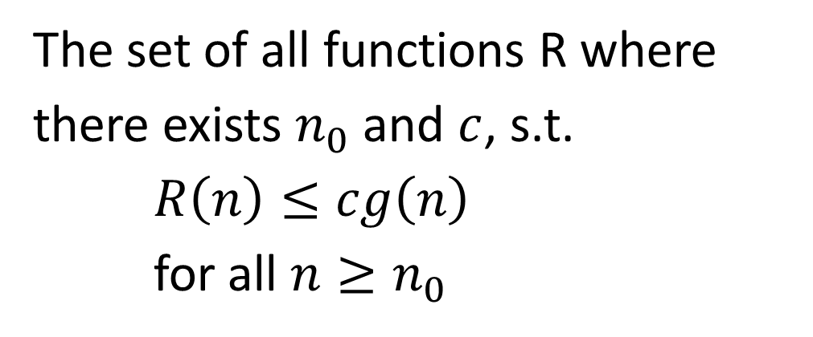
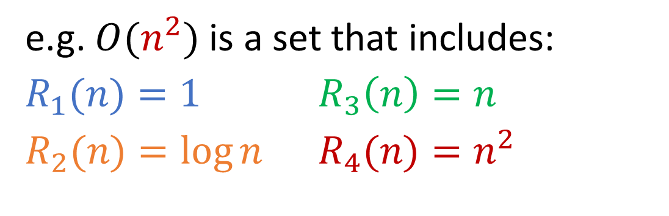
A set of better functions
Definition of Big O of g
The set of all functions R where
there exists $n_{0}$ and $c$, s.t.
$R\left(n\right)≤cg\left(n\right)$
for all $n≥n_{0}$
e.g. $O(n^{2})$ is a set that includes:
$R_{1}(n)=1$ $R_{3}\left(n\right)=n$
$R_{2}(n)=\log{n}$ $R_{4}(n)=n^{2}$
Slide credit: CMU 15-122

Slide 17
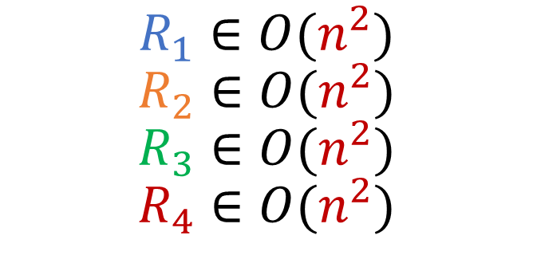
A set of better functions
Definition of Big O of g
The set of all functions R where
there exists $n_{0}$ and $c$, s.t.
$R\left(n\right)≤cg\left(n\right)$
for all $n≥n_{0}$
e.g. $O(n^{2})$ is a set that includes:
$R_{1}(n)=1$ $R_{3}\left(n\right)=n$
$R_{2}(n)=\log{n}$ $R_{4}(n)=n^{2}$
$$R_{1}∈O(n^{2})$$
$$R_{2}∈O(n^{2})$$
$$R_{3}∈O(n^{2})$$
$$R_{4}∈O(n^{2})$$
Slide credit: CMU 15-122

Slide 18
Complexity Classes

Slide 19
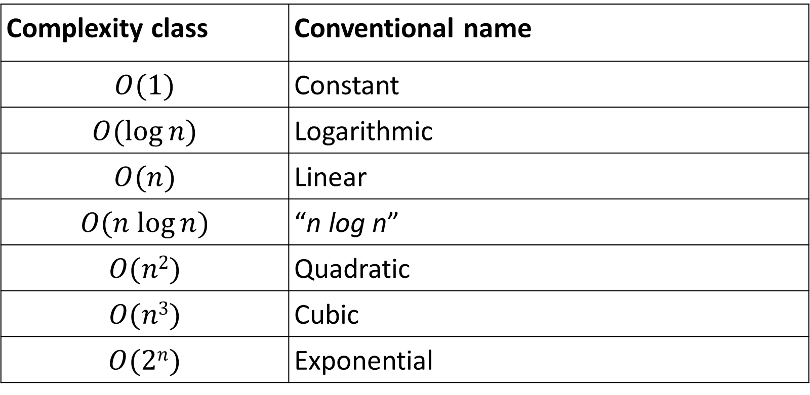
Complexity Classes
Complexity class | Conventional name
$$O(1)$$ | Constant
$$O(log⁡n)$$ | Logarithmic
$$O(n)$$ | Linear
$$O(n log⁡n)$$ | “n log n”
$$O(n2)$$ | Quadratic
$$O(n3)$$ | Cubic
$$O(2n)$$ | Exponential
$O\left(1\right)⊆O\left(\log{n}\right)⊆$ $O\left(n\right)⊆$ $O\left(n\log{n}\right)⊆$ $O\left(n^{2}\right)⊆$ $O\left(n^{3}\right)⊆$ $O\left(2^{n}\right)$
Slide credit: CMU 15-122

Slide 20
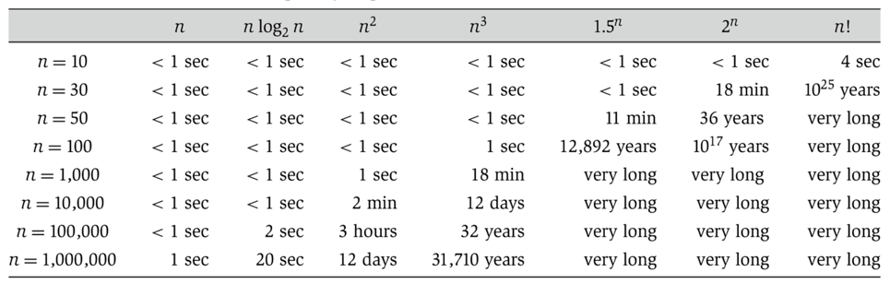

Complexity Classes
Can determine whether or not a problem can be solved at all!
Slide credit: Algorithm Design, Tardos, Kleinberg (table), UC Berkeley CS 61B, Hug (slide)

Slide 21

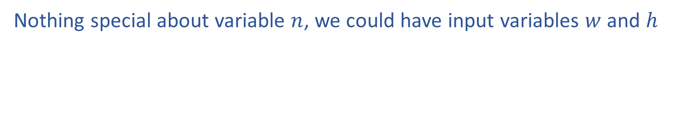

Input
Nothing special about variable $n$, we could have input variables $w$ and $h$
$$O(w+h)$$
$$O(wh)$$
Slide credit: CMU 15-122

Slide 22
Plan
Computational Complexity
Counting operations
Big-O
Complexity classes
Proving a Big-O relationship holds
Proving a Big-O relationship does not hold

Slide 23
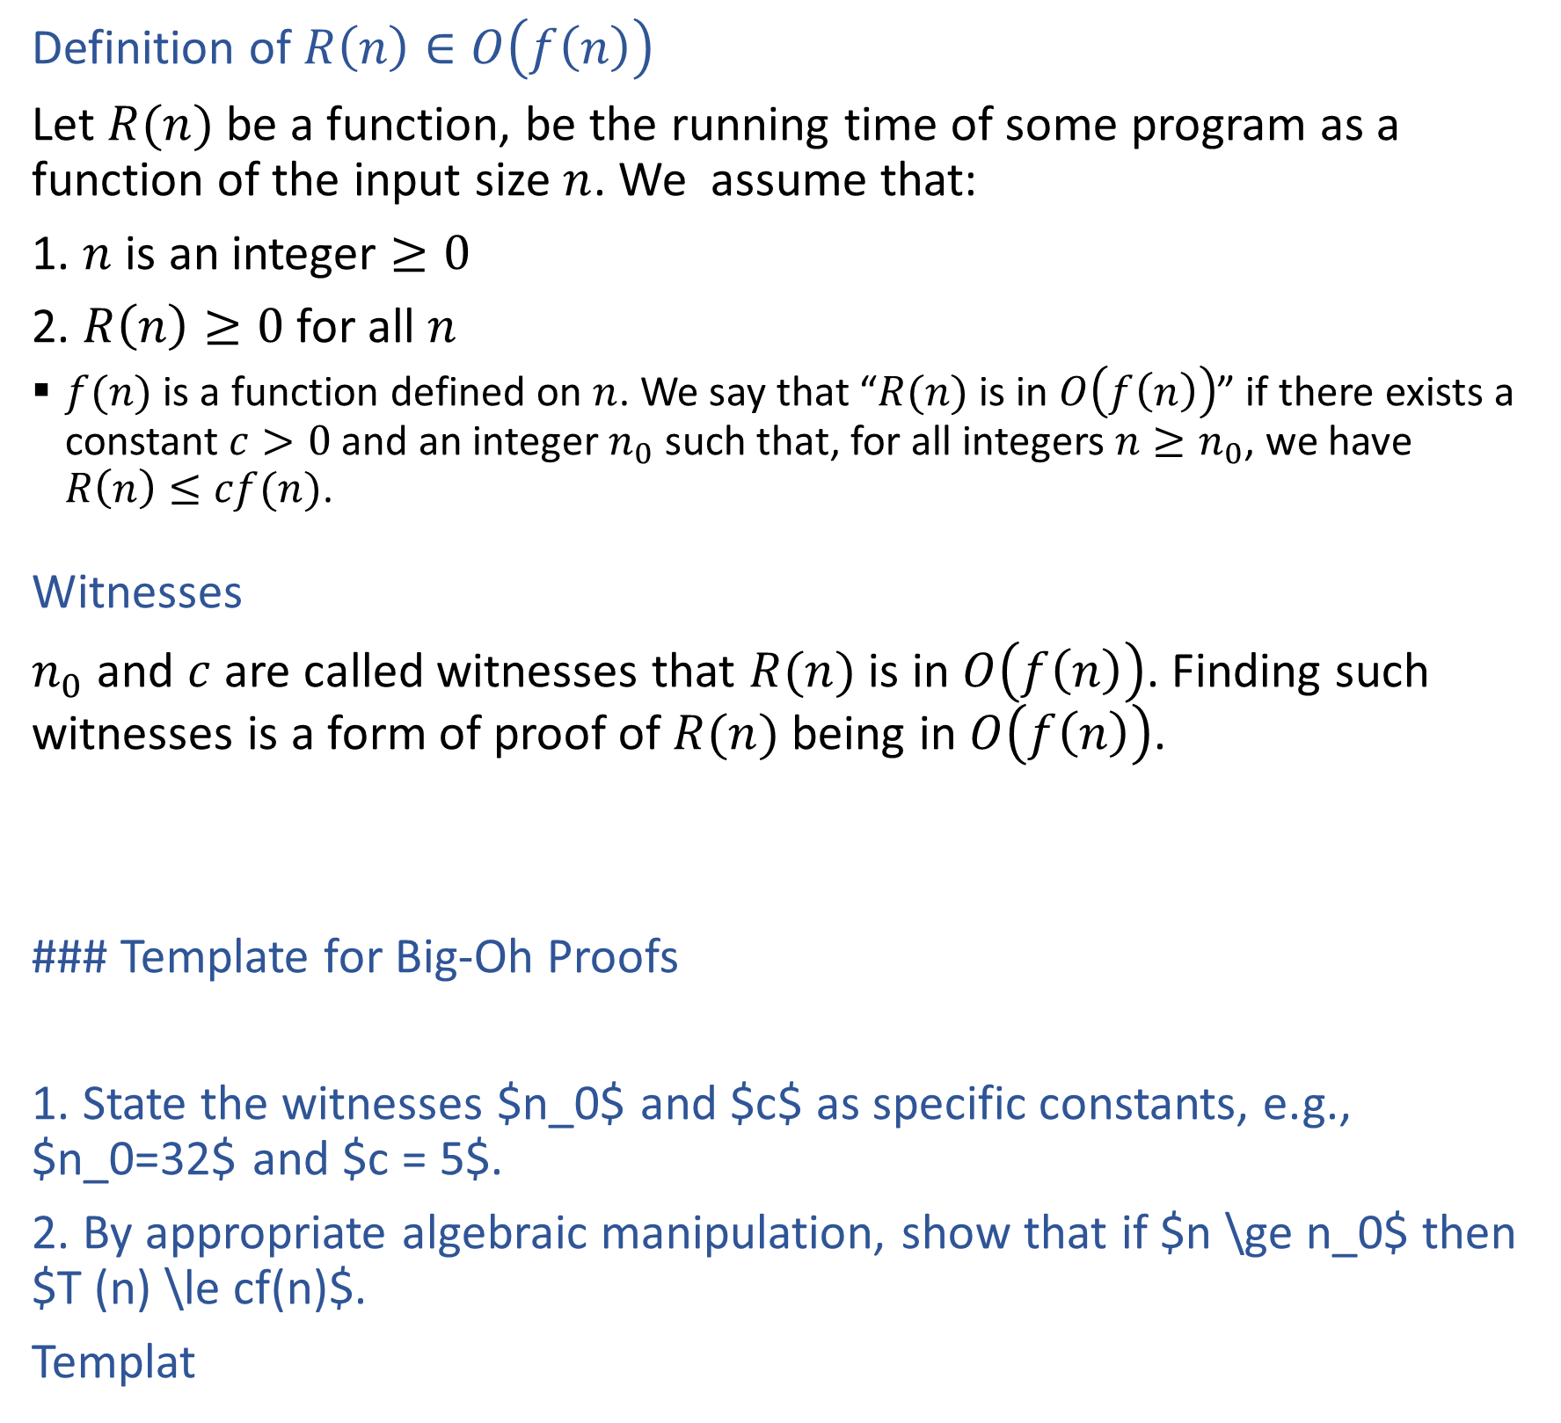
Definition of Big O
Definition of $R\left(n\right)∈O\left(f\left(n\right)\right)$
Let $R(n)$ be a function, be the running time of some program as a function of the input size $n$. We assume that:
1. $n$ is an integer $≥0$
2. $R\left(n\right)≥0$ for all $n$
  $f(n)$ is a function defined on $n$. We say that “$R(n)$ is in $O\left(f\left(n\right)\right)$” if there exists a constant $c>0$ and an integer $n_{0}$ such that, for all integers $n≥n_{0}$, we have $R\left(n\right)≤cf(n)$.
Witnesses
$n_{0}$ and $c$ are called witnesses that $R(n)$ is in $O\left(f\left(n\right)\right)$. Finding such witnesses is a form of proof of $R(n)$ being in $O\left(f\left(n\right)\right)$.
### Template for Big-Oh Proofs
1. State the witnesses $n_0$ and $c$ as specific constants, e.g., $n_0=32$ and $c = 5$.
2. By appropriate algebraic manipulation, show that if $n \ge n_0$ then $T (n) \le cf(n)$.
Templat

Slide 24

Proving a Big-O Relationship Holds
Template to prove $R\left(n\right)∈O\left(f\left(n\right)\right)$
State the witnesses $n_{0}$ and $c$ as specific constants, e.g., $n_{0}=32$ and $c=5$.
By appropriate algebraic manipulation, show that if $n≥n_{0}$ then $R\left(n\right)≤cf(n)$.

Slide 25

Proving a Big-O Relationship Holds
Example: Prove ${\left(n+1\right)}^{2}∈O\left(n^{2}\right)$
Suppose $R(0)=1$, $R(1)=4$, $R(2)=9$, and in general $R(n)={\left(n+1\right)}^{2}$.

Slide 26
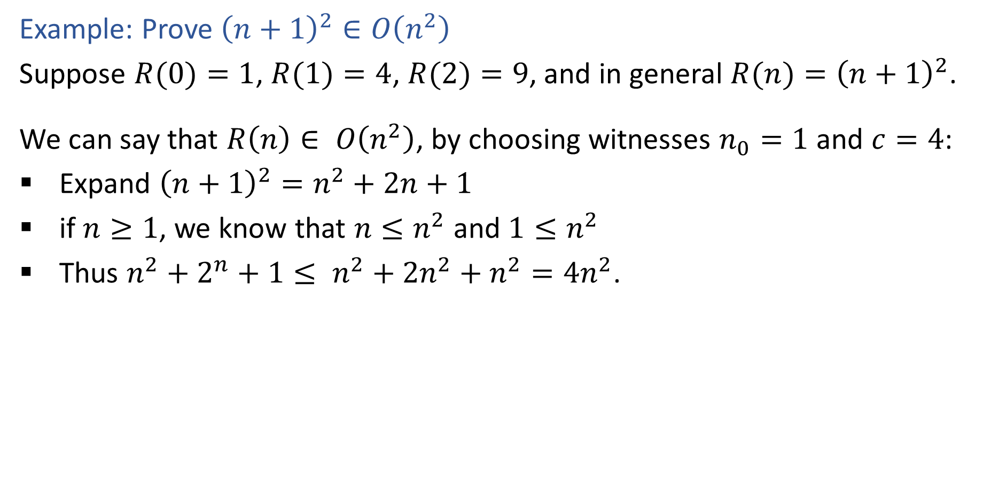
Proving a Big-O Relationship Holds
Example: Prove ${\left(n+1\right)}^{2}∈O\left(n^{2}\right)$
Suppose $R(0)=1$, $R(1)=4$, $R(2)=9$, and in general $R(n)={\left(n+1\right)}^{2}$.
We can say that $R\left(n\right)∈ O\left(n^{2}\right)$, by choosing witnesses $n_{0}=1$ and $c=4$:
Expand ${\left(n+1\right)}^{2}=n^{2}+2n+1$
if $n≥1$, we know that $n≤n^{2}$ and $1≤n^{2}$
Thus $n^{2}+2^{n}+1≤ n^{2}+2n^{2}+n^{2}=4n^{2}$.

Slide 27
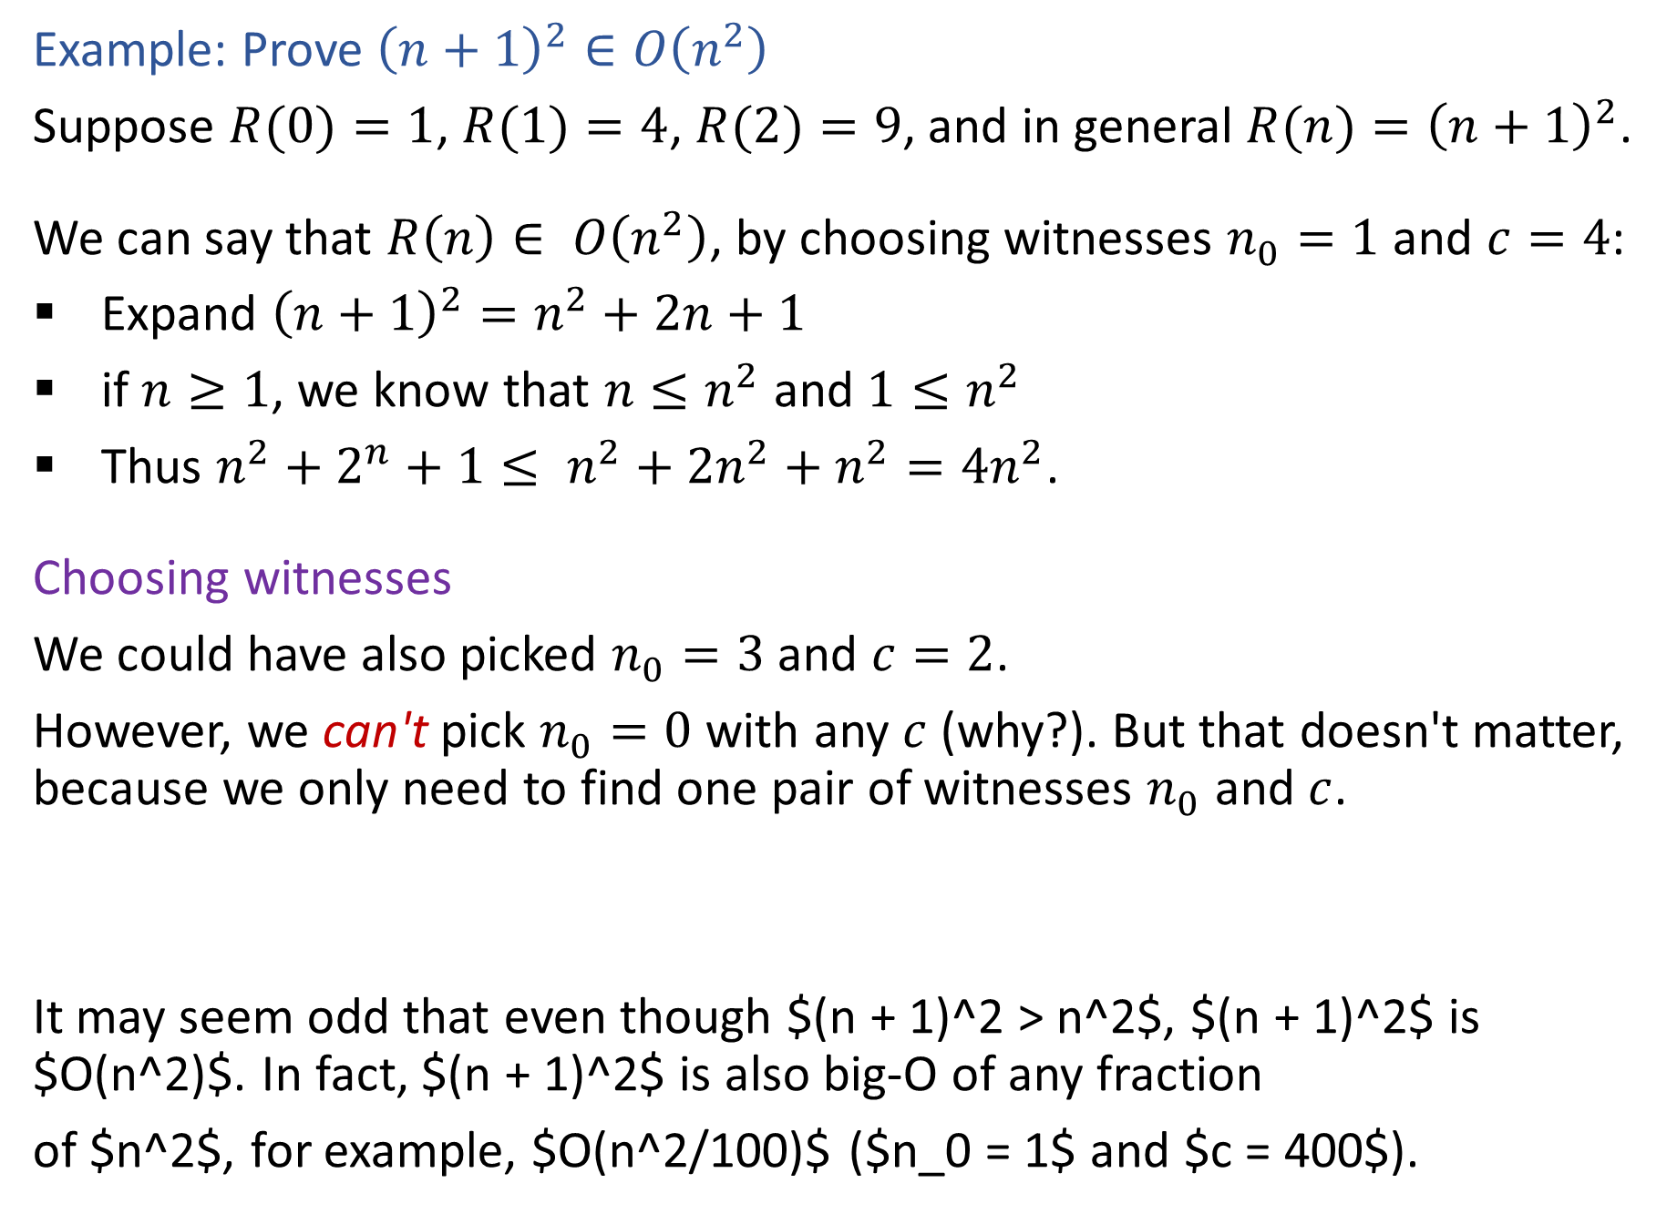
Proving a Big-O Relationship Holds
Example: Prove ${\left(n+1\right)}^{2}∈O\left(n^{2}\right)$
Suppose $R(0)=1$, $R(1)=4$, $R(2)=9$, and in general $R(n)={\left(n+1\right)}^{2}$.
We can say that $R\left(n\right)∈ O\left(n^{2}\right)$, by choosing witnesses $n_{0}=1$ and $c=4$:
Expand ${\left(n+1\right)}^{2}=n^{2}+2n+1$
if $n≥1$, we know that $n≤n^{2}$ and $1≤n^{2}$
Thus $n^{2}+2^{n}+1≤ n^{2}+2n^{2}+n^{2}=4n^{2}$.
Choosing witnesses
We could have also picked $n_{0}=3$ and $c=2$.
However, we can't pick $n_{0}=0$ with any $c$ (why?). But that doesn't matter, because we only need to find one pair of witnesses $n_{0}$ and $c$.
It may seem odd that even though $(n + 1)^2 > n^2$, $(n + 1)^2$ is $O(n^2)$. In fact, $(n + 1)^2$ is also big-O of any fraction
of $n^2$, for example, $O(n^2/100)$ ($n_0 = 1$ and $c = 400$).

Slide 28
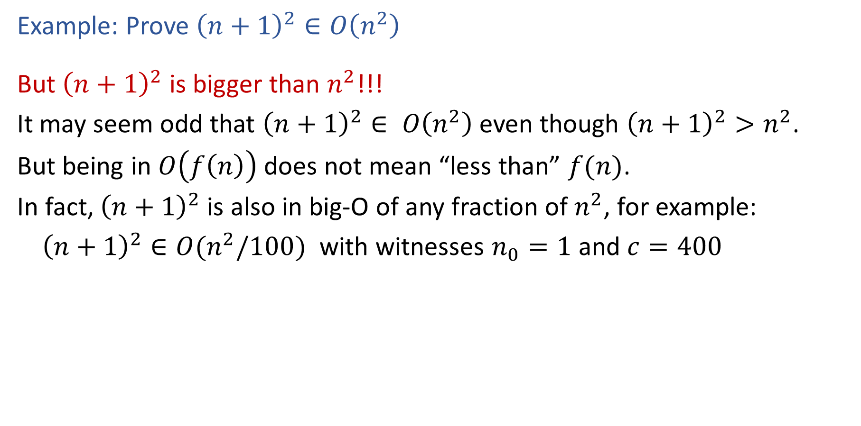
Proving a Big-O Relationship Holds
Example: Prove ${\left(n+1\right)}^{2}∈O\left(n^{2}\right)$
But ${\left(n+1\right)}^{2}$ is bigger than $n^{2}$!!!
It may seem odd that ${\left(n+1\right)}^{2}∈ O\left(n^{2}\right)$ even though ${\left(n+1\right)}^{2}>n^{2}$.
But being in $O\left(f\left(n\right)\right)$ does not mean “less than” $f(n)$.
In fact, ${\left(n+1\right)}^{2}$ is also in big-O of any fraction of $n^{2}$, for example:
${\left(n+1\right)}^{2}∈O(n^{2}/100)$ with witnesses $n_{0}=1$ and $c=400$

Slide 29
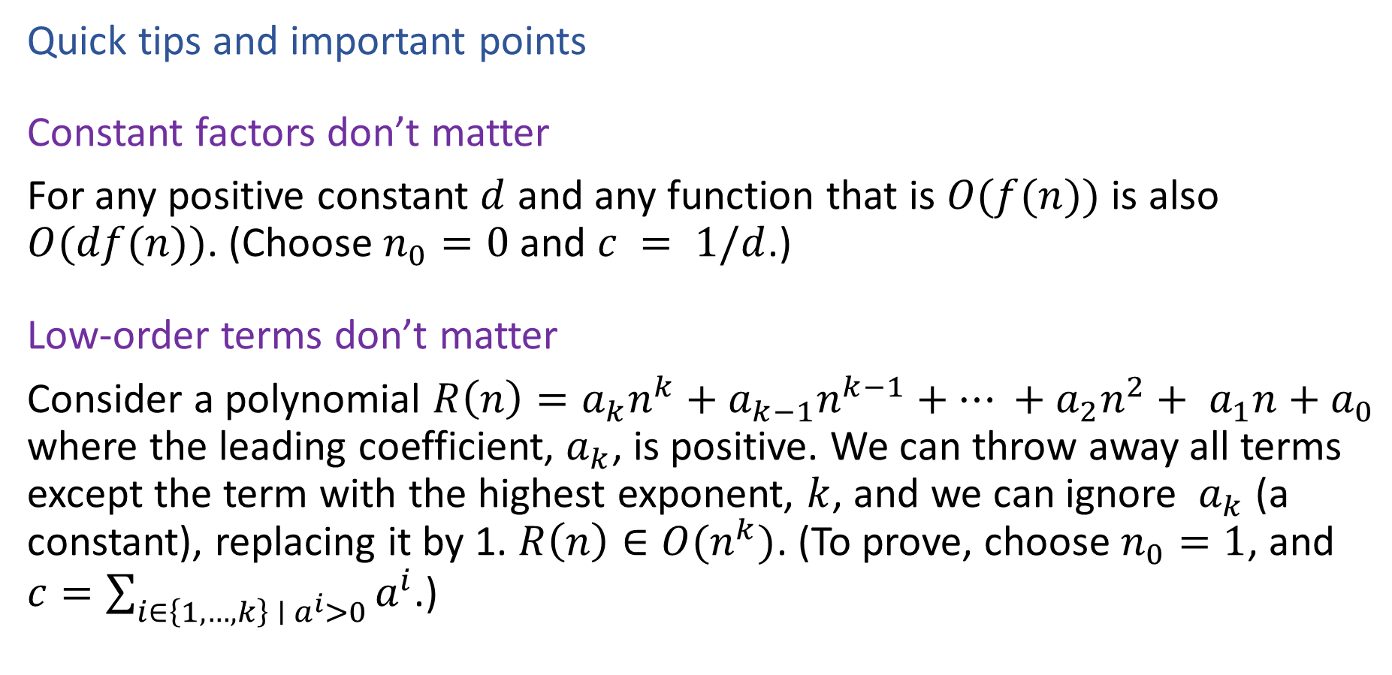
Proving a Big-O Relationship Holds
Quick tips and important points
Constant factors don’t matter
For any positive constant $d$ and any function that is $O(f(n))$ is also $O(df(n))$. (Choose $n_{0}=0$ and $c = 1/d$.)
Low-order terms don’t matter
Consider a polynomial $R\left(n\right)=a_{k}n^{k}+a_{k−1}n^{k−1}+… +a_{2}n^{2}+ a_{1}n+a_{0}$ where the leading coefficient, $a_{k}$, is positive. We can throw away all terms except the term with the highest exponent, $k$, and we can ignore $a_{k}$ (a constant), replacing it by 1. $R\left(n\right)∈O(n^{k})$. (To prove, choose $n_{0}=1$, and $c=\sum_{i∈\left\{1,…,k\right\} ∣ a^{i}>0}{a^{i}}$.)

Slide 30
Poll 1
Which of the following functions are in O(n²)?
Select all that apply.
1
n
n log(n)
n²
4n²
4n² + n log(n)
4n² + n log(n) + n
n³
n³+ n²

Slide 31

Proving a Big-O Relationship Does Not Hold
Template to disprove $R\left(n\right)∈O\left(f\left(n\right)\right)$
Assume that witnesses $n_{0}$ and $c$ exist
Derive a contradiction

Slide 32

Proving a Big-O Relationship Does Not Hold
Example: Prove that $n^{2}$ is not in $O(n)$
Assume $n^{2}∈O\left(n\right)$
Then there exist $n_{0}$ and $c$ such that $n^{2}≤cn$ for all $n≥n_{0}$.

Slide 33
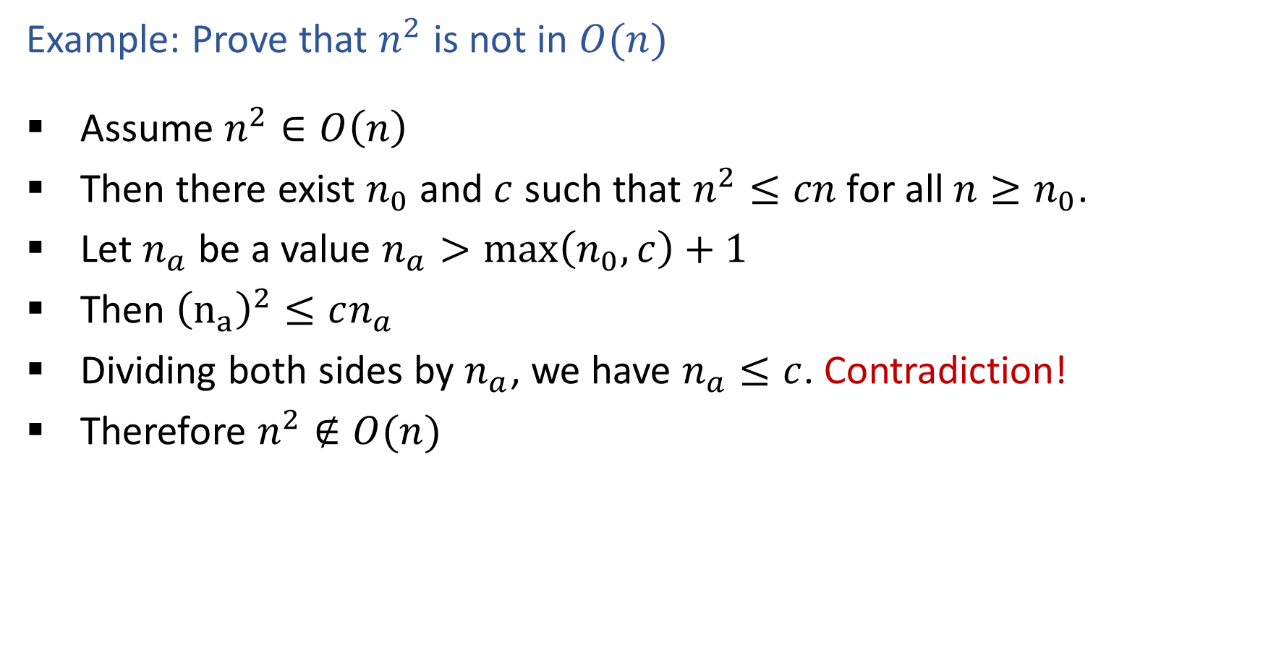
Proving a Big-O Relationship Does Not Hold
Example: Prove that $n^{2}$ is not in $O(n)$
Assume $n^{2}∈O\left(n\right)$
Then there exist $n_{0}$ and $c$ such that $n^{2}≤cn$ for all $n≥n_{0}$.
Let $n_{a}$ be a value $n_{a}>\max\left(n_{0},c\right)+1$
Then ${\left(n_{a}\right)}^{2}≤cn_{a}$
Dividing both sides by $n_{a}$, we have $n_{a}≤c$. Contradiction!
Therefore $n^{2}∉O(n)$

Slide 34
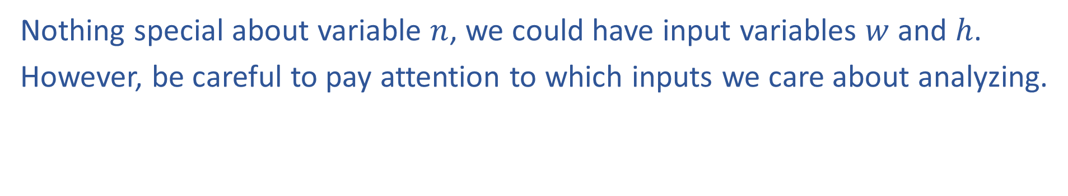
Input
Nothing special about variable $n$, we could have input variables $w$ and $h$.
However, be careful to pay attention to which inputs we care about analyzing.
$$O(w+h)$$

Slide 35
Input
Nothing special about variable $n$, we could have input variables $w$ and $h$.
However, be careful to pay attention to which inputs we care about analyzing.
Nearest neighbor example

Slide 36
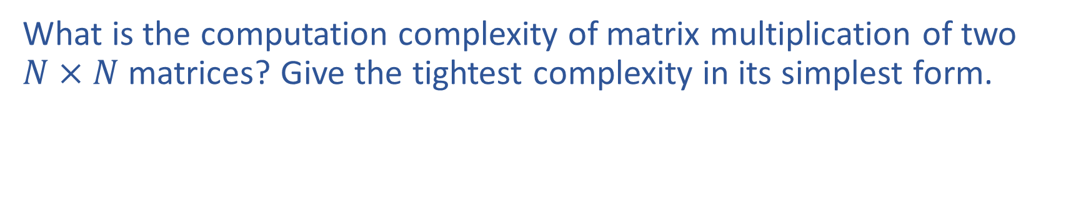
Exercise
What is the computation complexity of matrix multiplication of two $N×N$ matrices? Give the tightest complexity in its simplest form.

Slide 37
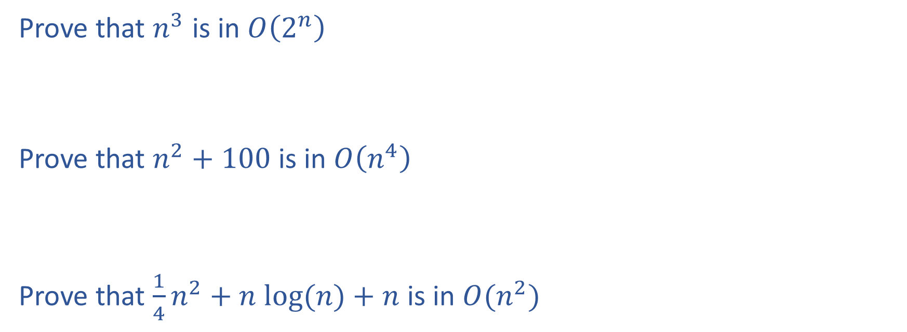
Exercise
Prove that $n^{3}$ is in $O\left(2^{n}\right)$
Prove that $n^{2}+100$ is in $O\left(n^{4}\right)$
Prove that $\frac{1}{4}n^{2}+n log⁡(n)+n$ is in $O(n^{2})$

