Slide 1


10-607
Computational Foundations for Machine Learning
Perceptron Mistake Bound &
Computational Complexity
Instructor: Pat Virtue

Slide 2

Plan
Perceptron Algorithm
Perceptron Mistake Bound Theory
Background: projections, distances, and margin
Proof of mistake bound as an example application
Computational Complexity
How fast is your code/algorithm?
Counting operations
Big-O
Complexity classes

Slide 3
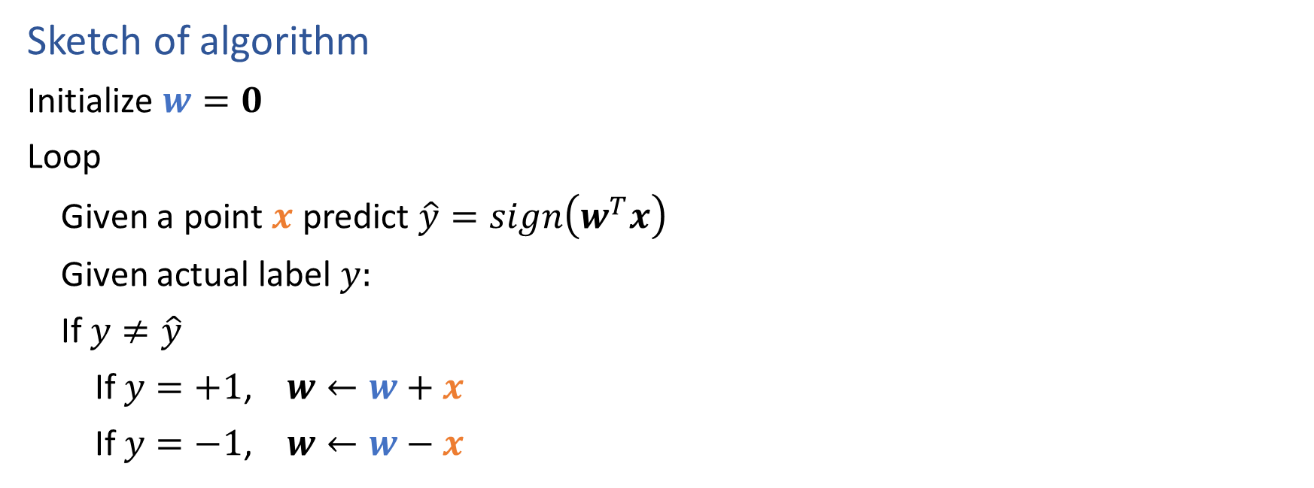
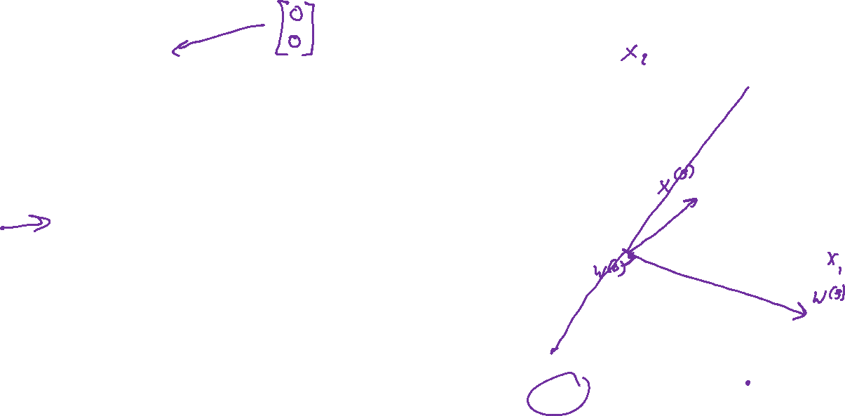
Perceptron Algorithm
Sketch of algorithm
Initialize $w=0$
Loop
Given a point $x$ predict $\hat{y}=sign\left(w^{T}x\right)$
Given actual label $y:$
If $y≠\hat{y}$
If $y=+1$, $w←w+x$
If $y=−1$, $w←w−x$

Slide 4


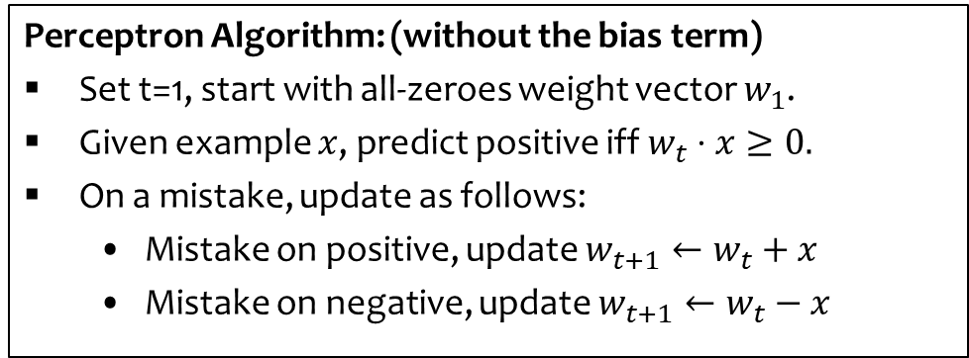








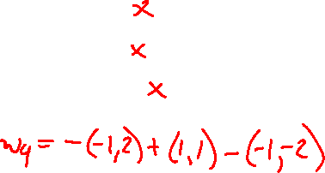
Perceptron Algorithm: Example
Example:
$$\left(−1,2\right)−$$
X
$$\left(1,0\right)+$$

-
$$\left(1,1\right)+$$
X
+
$$\left(−1,0\right)−$$

-
+
$$\left(−1,−2\right)−$$
X
$$\left(1,−1\right)+$$

+
-
Perceptron Algorithm: (without the bias term)
Set t=1, start with all-zeroes weight vector $w_{1}$.
Given example $x$, predict positive iff $w_{t}⋅x≥0.$
On a mistake, update as follows:
  Mistake on positive, update $w_{t+1}←w_{t}+x$
  Mistake on negative, update $w_{t+1}←w_{t}−x$
$$w_{1}=(0,0)$$
$$w_{2}=w_{1}−\left(−1,2\right)=(1,−2)$$
$$w_{3}=w_{2}+\left(1,1\right)=(2,−1)$$
$$w_{4}=w_{3}−\left(−1,−2\right)=(3,1)$$
Slide credit: CMU MLD Nina Balcan

Slide 5
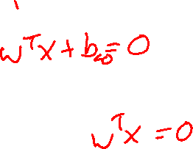
Intercept Term
Q: Why do we need an intercept term?
A: It shifts the decision boundary off the origin
w
Q: What should happen to b during the perceptron algorithm
A: Two cases
Increasing b shifts the decision boundary towards the negative side
Decreasing b shifts the decision boundary towards the positive side
b < 0
b = 0
b > 0
Slide credit: CMU MLD Matt Gormley

Slide 6
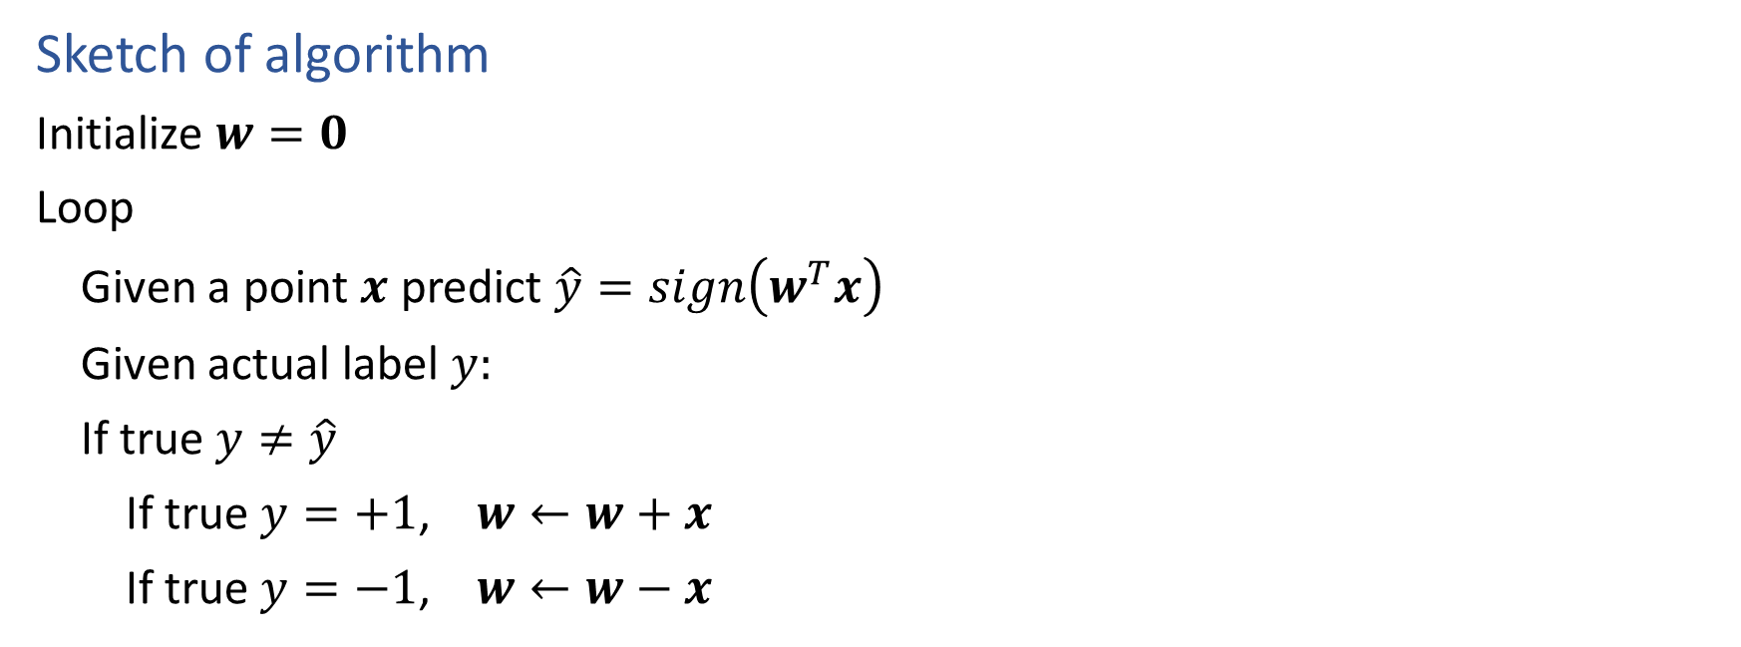
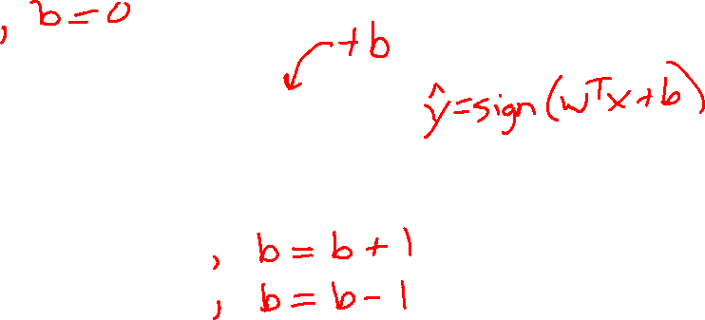
Perceptron Algorithm
Sketch of algorithm
Initialize $w=0$
Loop
Given a point $x$ predict $\hat{y}=sign\left(w^{T}x\right)$
Given actual label $y:$
If true $y≠\hat{y}$
If true $y=+1$, $w←w+x$
If true $y=−1$, $w←w−x$

Slide 7

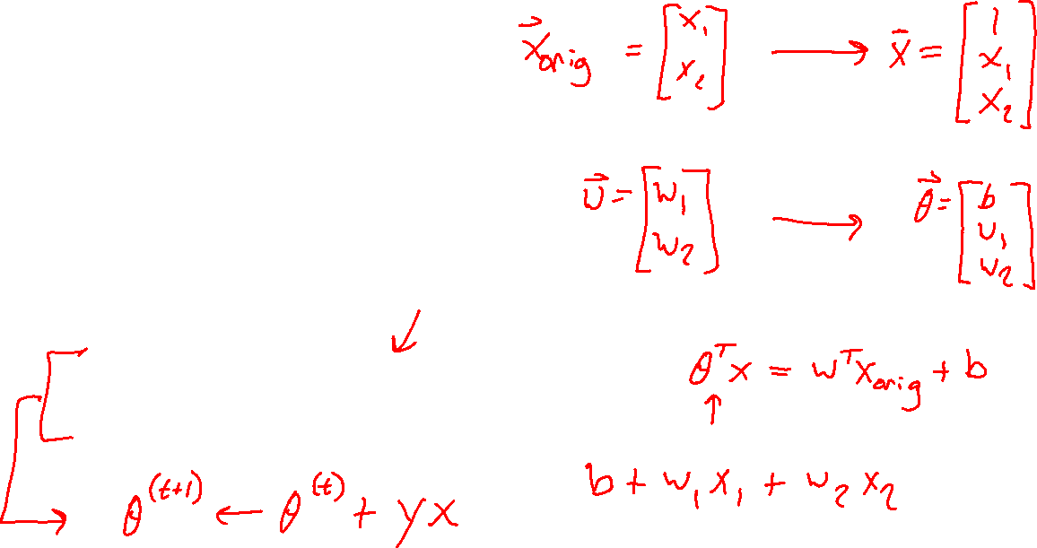
Perceptron Algorithm
Sketch of algorithm
Initialize $θ=0$
Loop
Given a point $x$ predict $\hat{y}=sign\left(θ^{T}x\right)$
Given actual label $y:$
If true $y≠\hat{y}$
If true $y=+1$, $θ←θ+x$
If true $y=−1$, $θ←θ−x$

Slide 8
Perceptron Algorithm
Learning for Perceptron if we have a fixed training dataset, D.
Slide credit: CMU MLD Matt Gormley

Slide 9
Perceptron Algorithm
Learning for Perceptron if we have a fixed training dataset, D.
Implementation Trick: same behavior as our “add on positive mistake and subtract on negative mistake” version, because y^{(i)} takes care of the sign
Slide credit: CMU MLD Matt Gormley

Slide 10
Plan
Perceptron Algorithm
Perceptron Mistake Bound Theory
Background: projections, distances, and margin
Proof of mistake bound as an example application
Computational Complexity
How fast is your code/algorithm?
Counting operations
Big-O
Complexity classes

Slide 11

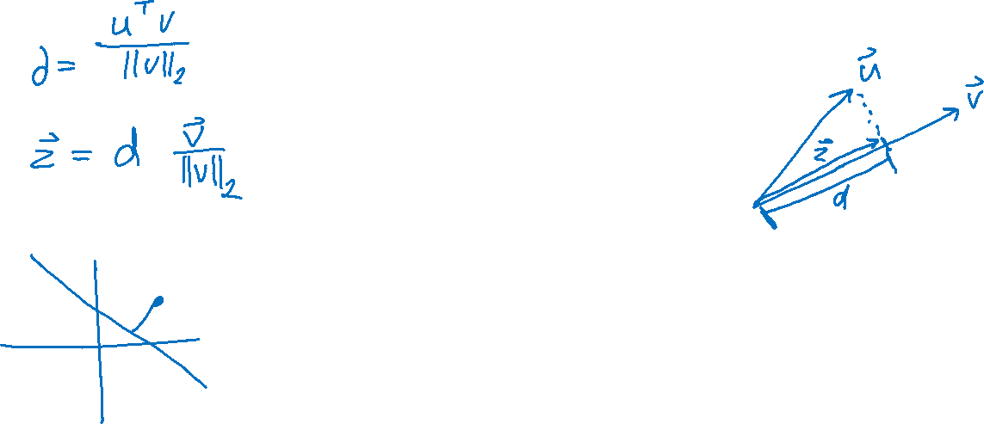
Projection
Projection of $u$ on to $v$

Slide 12
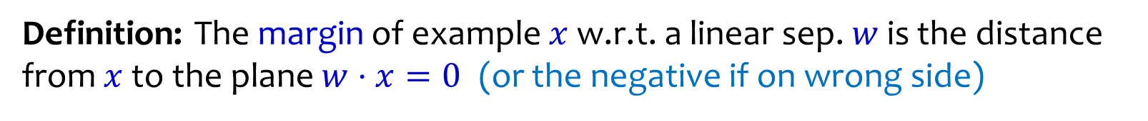


Geometric Margin
Definition: The margin of example $x$ w.r.t. a linear sep. $w$ is the distance from $x$to the plane $w⋅x=0$ (or the negative if on wrong side)
Margin of positive example $x_{1}$
$$x_{1}$$
w
Margin of negative example $x_{2}$
$$x_{2}$$
Slide credit: CMU MLD Nina Balcan

Slide 13
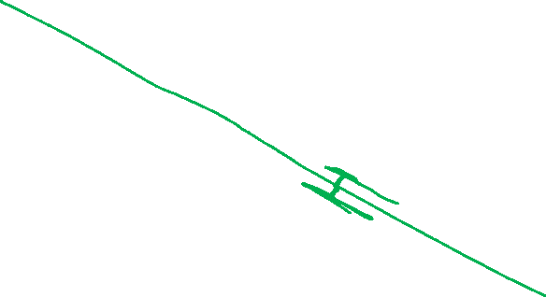
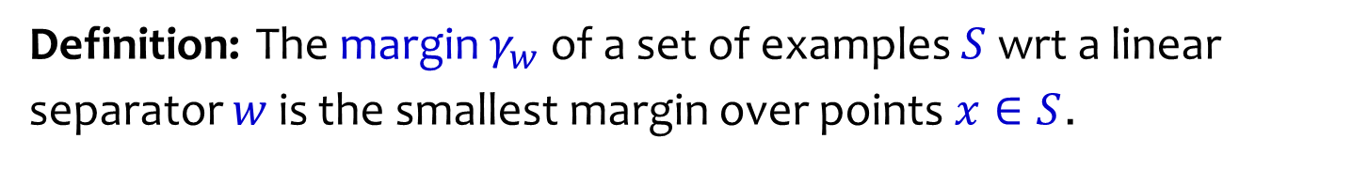
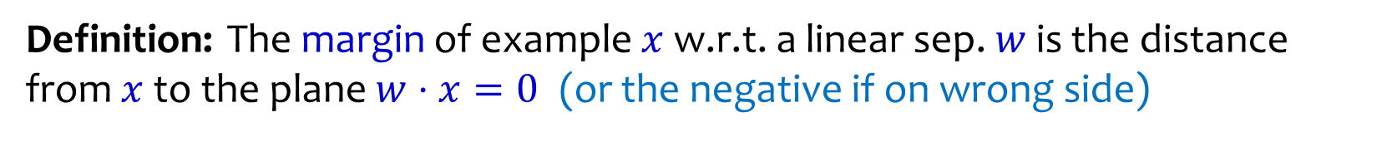
Geometric Margin
Definition: The margin of example $x$ w.r.t. a linear sep. $w$ is the distance from $x$to the plane $w⋅x=0$ (or the negative if on wrong side)
Definition: The margin $γ_{w}$ of a set of examples $S$ wrt a linear separator $w$ is the smallest margin over points $x∈S$.
+
+
+
+
w
$$γ_{w}$$
$$γ_{w}$$
+
-
+
-
+
-
-
-
+
-
-
-
-
Slide credit: CMU MLD Nina Balcan

Slide 14
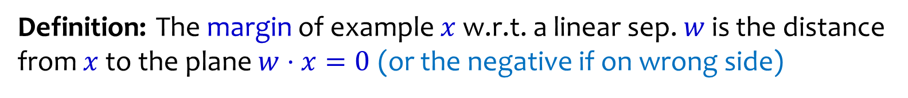
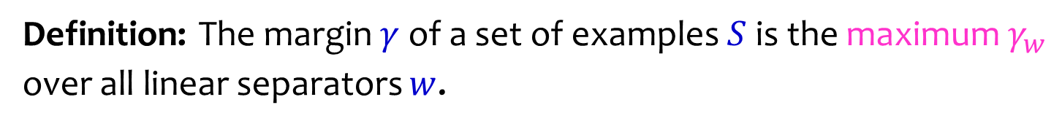
Geometric Margin
Definition: The margin of example $x$ w.r.t. a linear sep. $w$ is the distance from $x$to the plane $w⋅x=0$ (or the negative if on wrong side)
Definition: The margin $γ_{w}$ of a set of examples $S$ wrt a linear separator $w$ is the smallest margin over points $x∈S$.
Definition: The margin $γ$ of a set of examples $S$ is the maximum $γ_{w}$ over all linear separators $w$.
+
w
$$γ$$
$$γ$$
+
-
+
-
+
-
-
-
+
-
-
-
-
Slide credit: CMU MLD Nina Balcan

Slide 15
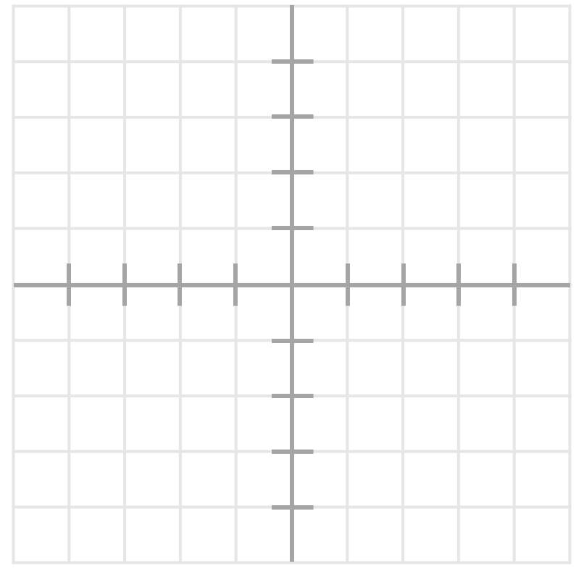
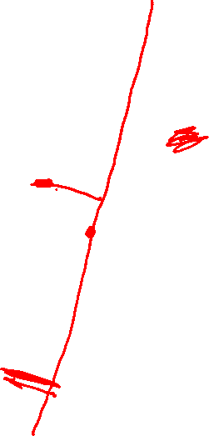
Geometric Margin
What is the margin for this dataset?

Slide 16
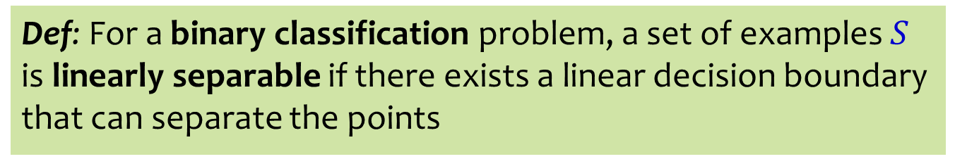
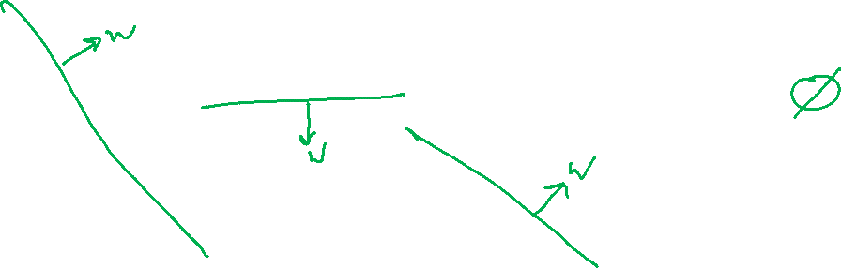
Linear Separability
Def: For a binary classification problem, a set of examples $S$ is linearly separable if there exists a linear decision boundary that can separate the points
Case 1:
Case 2:
Case 3:
Case 4:
+
-
+
+
-
-
+
+
+
+
+
-
+
Slide credit: CMU MLD Matt Gormley

Slide 17
Analysis oF Perceptron

Slide 18
Analysis: Perceptron
Perceptron Mistake Bound
(Normalized margin: multiplying all points by 100, or dividing all points by 100, doesn’t change the number of mistakes; algo is invariant to scaling.)
+
+
+
+
Slide credit: CMU MLD Nina Balcan and Matt Gormley
γ
+
γ
+
-
+
-
+
-
-
-
R
-
-
-
-

Slide 19
Analysis: Perceptron
Perceptron Mistake Bound
(Normalized margin: multiplying all points by 100, or dividing all points by 100, doesn’t change the number of mistakes; algo is invariant to scaling.)
+
+
+
+
Slide credit: CMU MLD Nina Balcan and Matt Gormley
Def: We say that the perceptron algorithm has converged if it stops making mistakes on the training data (perfectly classifies the training data).
Main Takeaway: For linearly separable data, if the perceptron algorithm cycles repeatedly through the data, it will converge in a finite # of steps.
γ
+
γ
+
-
+
-
+
-
-
-
R
-
-
-
-

Slide 20

Analysis: Perceptron
Perceptron Mistake Bound
Slide credit: CMU MLD Nina Balcan and Matt Gormley
+
+
+
+
γ
+
-
γ
+
+
-
+
-
-
R
-
-
-
-
-

Slide 21
Analysis: Perceptron
Common Misunderstanding:
The radius is centered at the origin, not at the center of the points.
Perceptron Mistake Bound
Slide credit: CMU MLD Nina Balcan and Matt Gormley
+
+
+
+
γ
+
-
γ
+
+
-
+
-
-
R
-
-
-
-
-

Slide 22
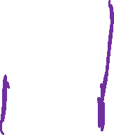
Analysis: Perceptron
Proof of Perceptron Mistake Bound:
We will show that there exist constants A and B s.t.
Slide credit: CMU MLD Nina Balcan and Matt Gormley

Slide 23
Analysis: Perceptron
+
+
+
+
γ
+
-
γ
+
+
-
+
-
-
R
-
-
-
-
-
Slide credit: CMU MLD Nina Balcan and Matt Gormley

Slide 24
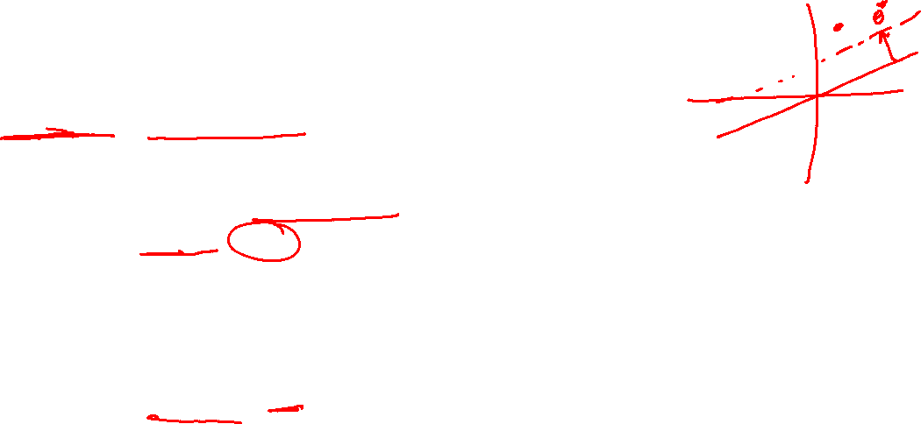
Analysis: Perceptron
Proof of Perceptron Mistake Bound:
Part 1: for some A,
Slide credit: CMU MLD Matt Gormley
Cauchy-Schwartz inequality
Notes:
Intuition \theta is gradually approaching \theta*
Part 1: The dot product of \theta and \theta* increases rapidly O(k)
Part 2: The norm of \theta increases slowly \Omega(\sqrt(k))

Slide 25
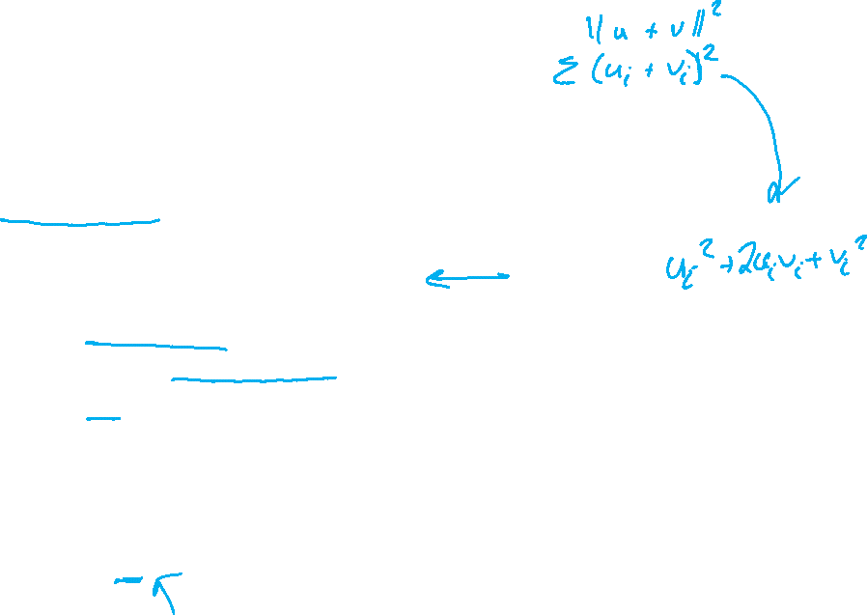
Analysis: Perceptron
Proof of Perceptron Mistake Bound:
Part 2: for some B,
Slide credit: CMU MLD Matt Gormley
Notes:
Intuition \theta is gradually approaching \theta*
Part 1: The dot product of \theta and \theta* increases rapidly O(k)
Part 2: The norm of \theta increases slowly \Omega(\sqrt(k))

Slide 26
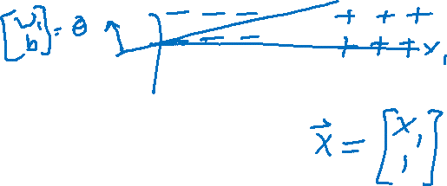
Analysis: Perceptron
Proof of Perceptron Mistake Bound:
Part 3: Combining the bounds finishes the proof.
Slide credit: CMU MLD Matt Gormley
The total number of mistakes must be less than this

Slide 27
Plan
Perceptron Algorithm
Perceptron Mistake Bound Theory
Background: projections, distances, and margin
Proof of mistake bound as an example application
Computational Complexity
How fast is your code/algorithm?
Counting operations
Big-O
Complexity classes

Slide 28
How fast is this code?
15 int search(int x, int[] A, int n)
16 {
17 for (int i = 0; i < n; i++)
18 {
19 if (A[i] == x) {
20 return i;
21 }
22 }
23 return -1;
24 }
Slide credit: CMU 15-122

Slide 29
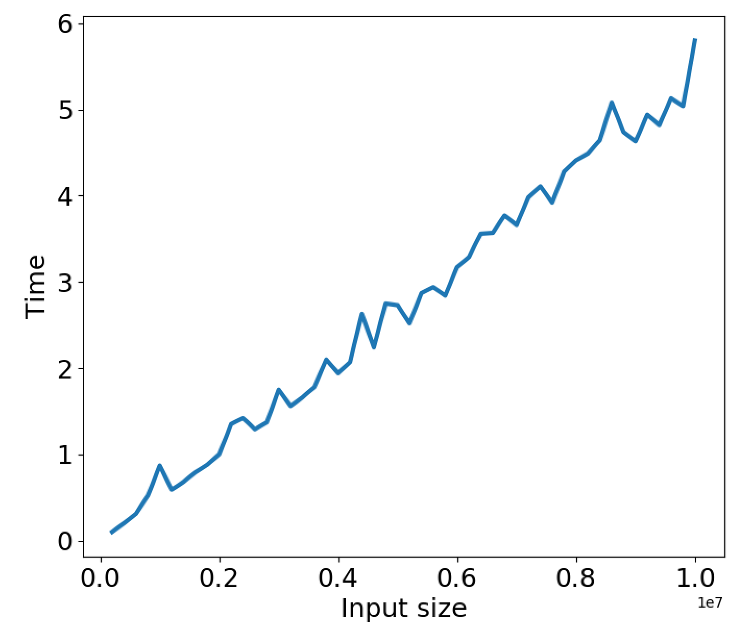
How fast is this code?

Slide 30
Need a better way to measure
Permanent
Independent of hardware or other running processes, etc.
General
Applicable to a large class of programs/algorithms/problems
Resources: time, space
Mathematically rigorous
Useful
Not for actual run time,
But help us select best algorithm for the task

Slide 31
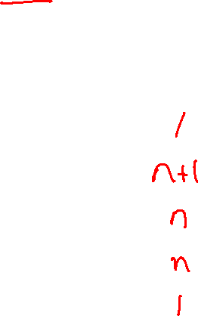
How many statements are executed?
15 int search(int x, int[] A, int n)
16 {
17 for (int i = 0; i < n; i++)
18 {
19 if (A[i] == x) {
20 return i;
21 }
22 }
23 return -1;
24 }
If x is not in A…
how times are these statements executed?
i = 0
i < n
if (A[i] == x)
i++
return -1
Slide credit: CMU 15-122

Slide 32
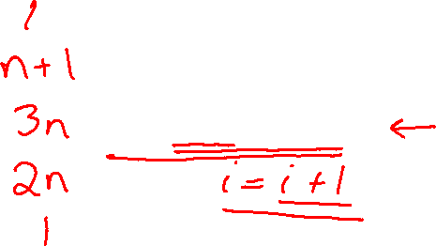
How many operations are executed?
15 int search(int x, int[] A, int n)
16 {
17 for (int i = 0; i < n; i++)
18 {
19 if (A[i] == x) {
20 return i;
21 }
22 }
23 return -1;
24 }
If x is not in A…
how times operations are executed?
i = 0
i < n
if (A[i] == x)
i++
return -1
Slide credit: CMU 15-122

Slide 33
How many operations are executed?
How many program operations are required to compute:
L2 norm of vector
Vector dot product
Frobenius norm of matrix
Matrix-vector multiplication
Matrix-matrix multiplication
Operations:
Arithmetic operations (e.g. + or **)
Logical operations (e.g., and)
Comparison operations (e.g., <=)
Structure accessing operations (e.g. array indexing like A[i])
Simple assignment such as copying a value into a variable
Calls to library functions that don’t depend on size of input (e.g., print)
Control Statements (e.g. if X>5)
Be careful with function calls that scale with the size of the input
def norm(a):
ss=0
for i in range(len(a)):
ss = ss + a[i]*a[i]
norm = np.sqrt(ss)
return norm

