Slide 1

10-607
Computational Foundations for Machine Learning
Perceptron Mistake Bound
Instructor: Pat Virtue

Slide 2
Plan
Perceptron Background
ML Data, Tasks, Notation
Vectors, dot products
Geometry with linear functions
Perceptron (and the sign() function)
Decision boundaries and errors
Perceptron Algorithm
Perceptron Mistake Bound Theory
Background: projections, distances, and margin

Slide 3
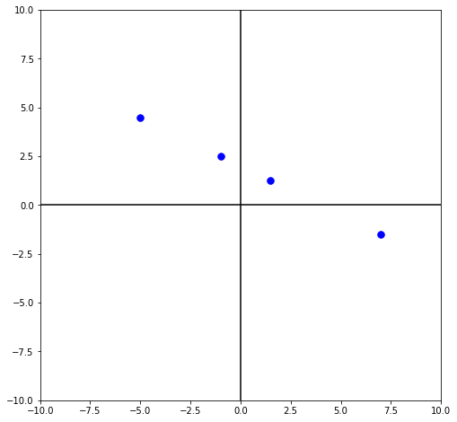

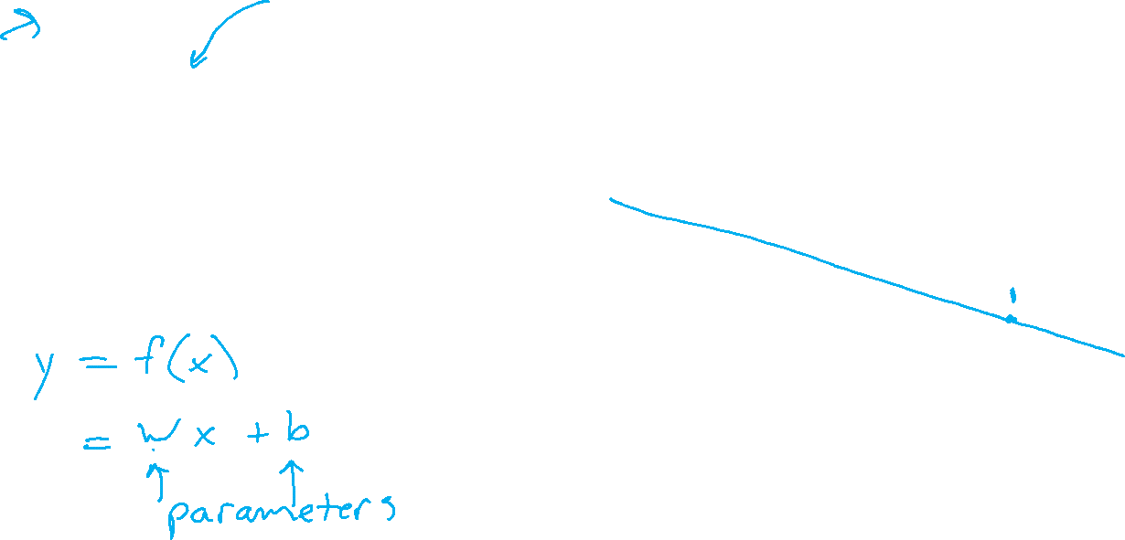
ML Data, Tasks, Notation
Notation alert!
Regression
$𝒟={\left\{\left(x^{\left(i\right)}, { y}^{\left(i\right)}\right)\right\}}_{i=1}^{4}$
$=\{\left(−1, 2.5\right),$
($7, −1.5),$
($−5, 4.5),$
($1.5, 1.25)\}$

Slide 4

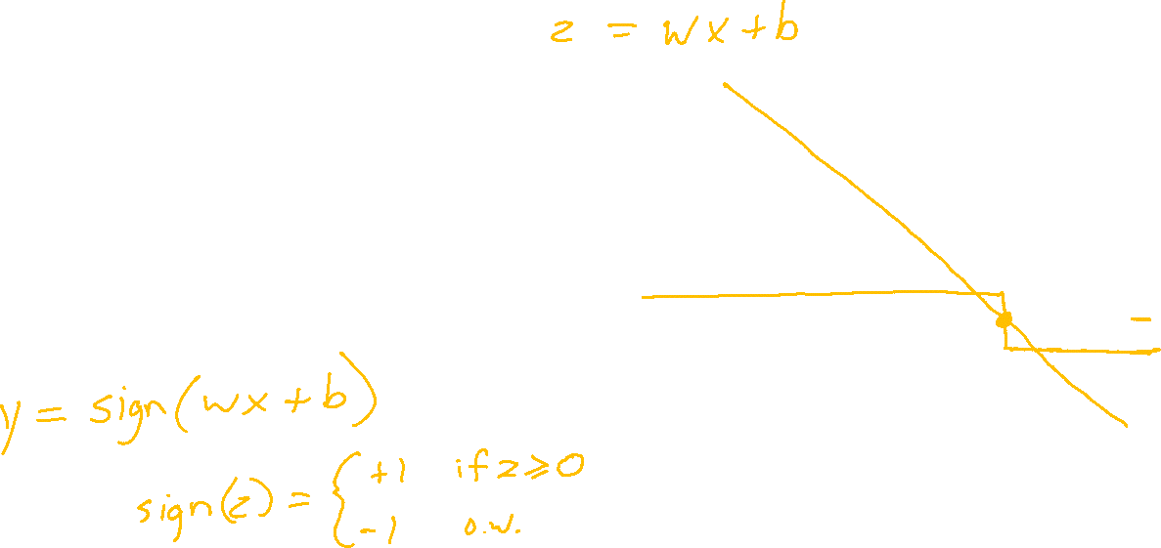
ML Data, Tasks, Notation
Classification
$𝒟={\left\{\left(x^{\left(i\right)}, { y}^{\left(i\right)}\right)\right\}}_{i=1}^{4}$
$=\{\left(−1, 1\right),$
($7, −1),$
($−5, 1),$
($1.5, 1)\}$

Slide 5
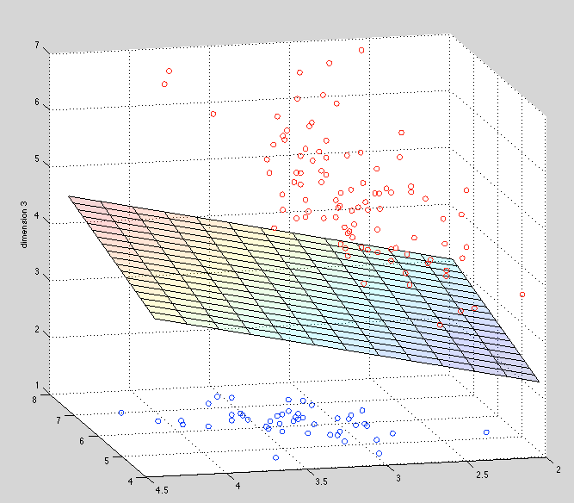
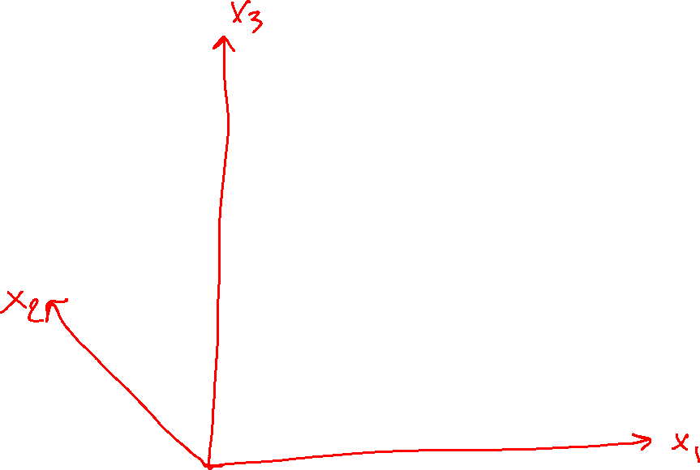
Perceptron

Slide 6

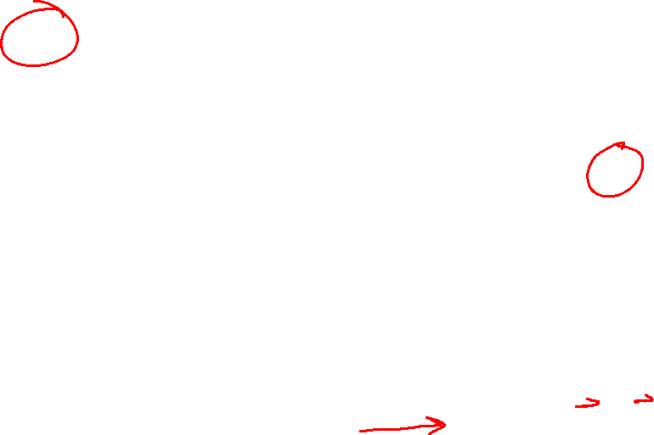
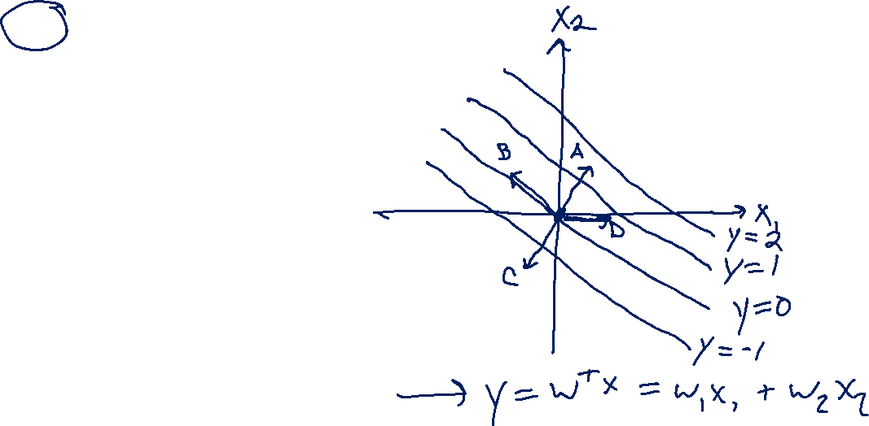
Previous Poll
Which is the correct vector $w$?
  I don’t know

Slide 7
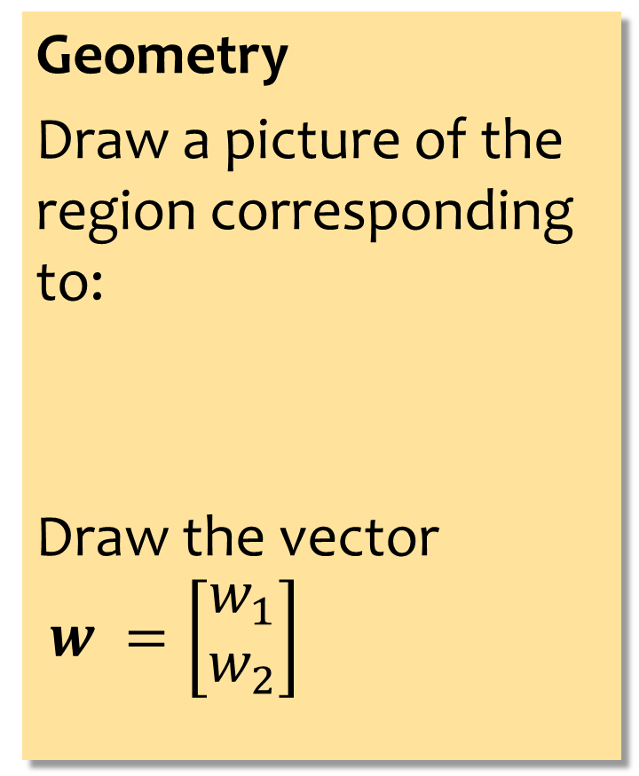
Previous Exercise
Geometry
Draw a picture of the region corresponding to:
Draw the vector
$w =\left[\begin{aligned}w_{1} \\ w_{2}\end{aligned}\right]$
Answer Here:
Slide credit: CMU MLD Matt Gormley

Slide 8

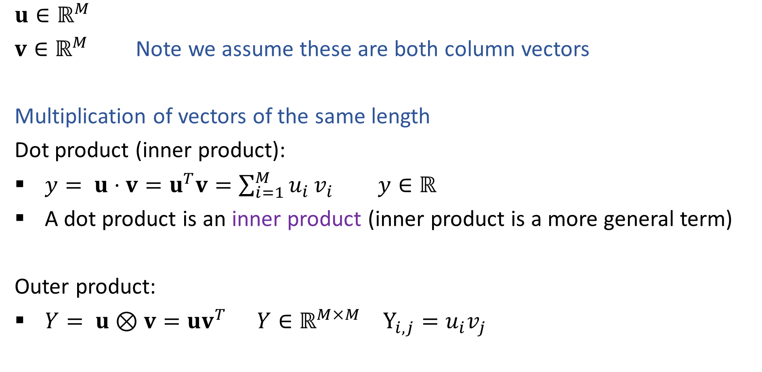
Vectors
Notation alert!
$$ℝ^{M}$$
$u∈ℝ^{M}$
$v∈ℝ^{M}$ Note we assume these are both column vectors
Multiplication of vectors of the same length
Dot product (inner product):
$y= u⋅v=u^{T}v=\sum_{i=1}^{M}{u_{i}}v_{i}$ $y∈ℝ$
A dot product is an inner product (inner product is a more general term)
Outer product:
$Y= u⊗v=uv^{T}$ $Y∈ℝ^{M×M}$ $Y_{i,j}=u_{i}v_{j}$

Slide 9
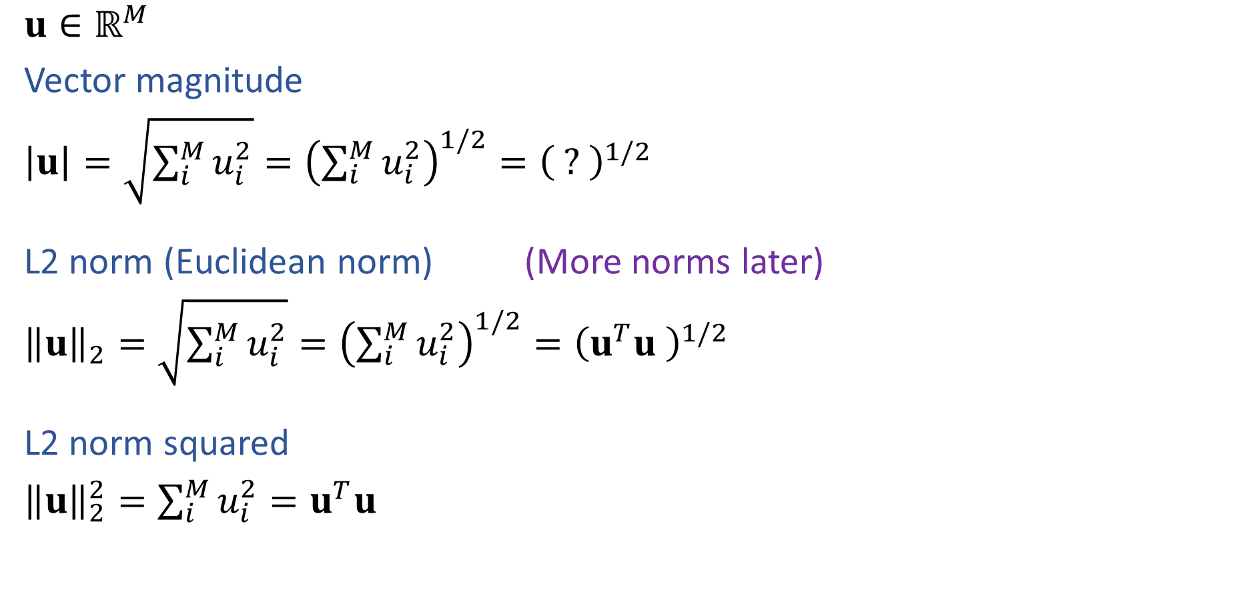
Vectors
$u∈ℝ^{M}$
Vector magnitude
$\left|u\right|=\sqrt{\sum_{i}^{M}{u_{i}^{2}}}={\left(\sum_{i}^{M}{u_{i}^{2}}\right)}^{1/2}={\left( ? \right)}^{1/2}$
L2 norm (Euclidean norm) (More norms later)
${\left\|u\right\|}_{2}=\sqrt{\sum_{i}^{M}{u_{i}^{2}}}={\left(\sum_{i}^{M}{u_{i}^{2}}\right)}^{1/2}={\left(u^{T}u \right)}^{1/2}$
L2 norm squared
${\left\|u\right\|}_{2}^{2}=\sum_{i}^{M}{u_{i}^{2}}=u^{T}u$

Slide 10

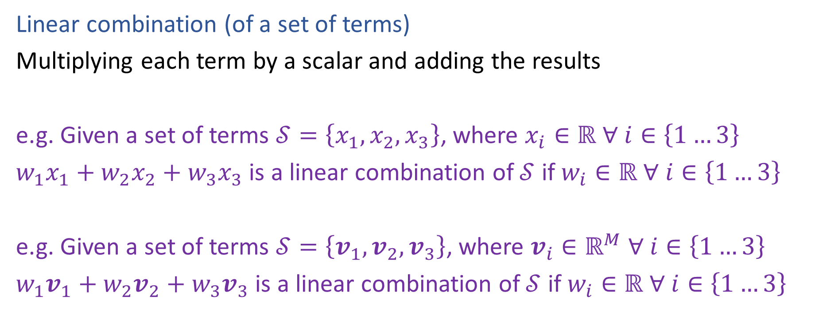
Linear and Affine
Notation alert!
$$∀$$
Linear combination (of a set of terms)
Multiplying each term by a scalar and adding the results
e.g. Given a set of terms $𝒮=\left\{x_{1},x_{2},x_{3}\right\}$, where $x_{i}∈ℝ ∀ i∈\left\{1…3\right\}$
$w_{1}x_{1}+w_{2}x_{2}+w_{3}x_{3}$ is a linear combination of $𝒮$ if $w_{i}∈ℝ ∀ i∈\left\{1…3\right\}$
e.g. Given a set of terms $𝒮=\left\{v_{1},v_{2},v_{3}\right\}$, where $v_{i}∈ℝ^{M} ∀ i∈\left\{1…3\right\}$
$w_{1}v_{1}+w_{2}v_{2}+w_{3}v_{3}$ is a linear combination of $𝒮$ if $w_{i}∈ℝ ∀ i∈\left\{1…3\right\}$

Slide 11
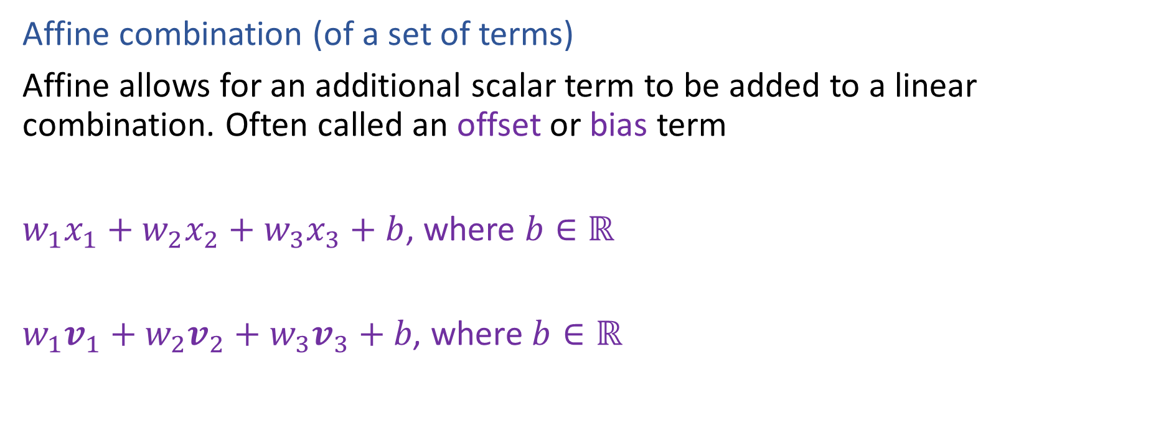
Linear and Affine
Affine combination (of a set of terms)
Affine allows for an additional scalar term to be added to a linear combination. Often called an offset or bias term
$w_{1}x_{1}+w_{2}x_{2}+w_{3}x_{3}+b$, where $b∈ℝ$
$w_{1}v_{1}+w_{2}v_{2}+w_{3}v_{3}+b\text{, }\text{where} b∈ℝ$

Slide 12
Linear vs Affine Models
What linear usually means depends on the domain:
Linear algebra:
Linear usually means strictly linear
Geometry, algebra:
Linear usually means affine
Machine learning:
Linear usually means affine but we often transform affine to strictly linear
to make the linear algebra and notation easier

Slide 13

Shapes in higher dimensions
What are these linear (affine) shapes called for 1-D, 2-D, 3-D, N-D input?
$y=w^{T}x+b$
$w^{T}x+b=0$
$w^{T}x+b≥0$

Slide 14
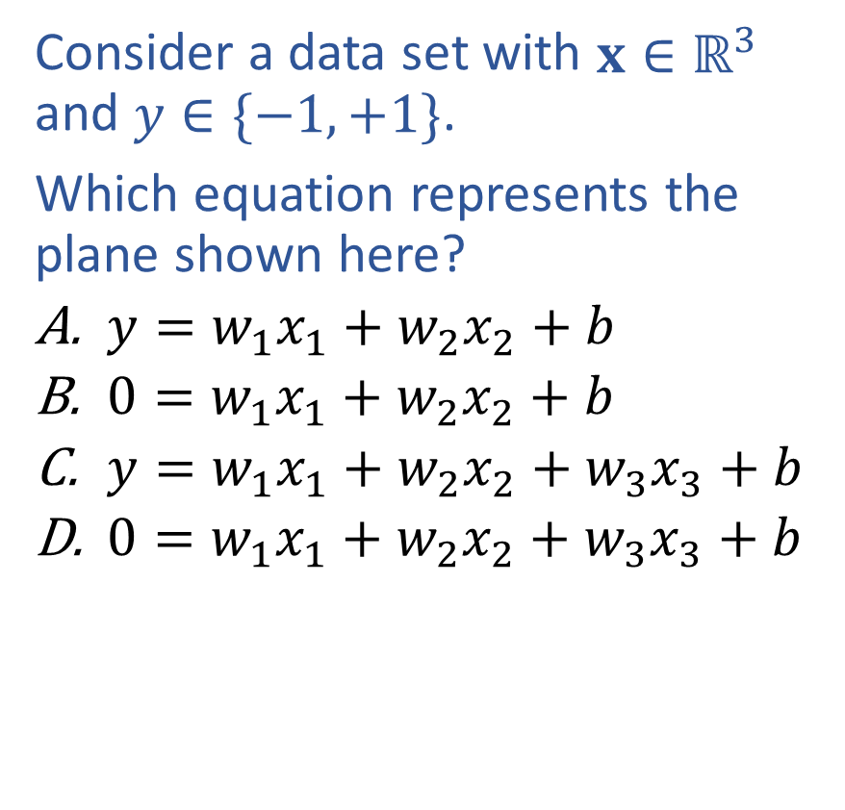
Poll 1
Consider a data set with $x∈ℝ^{3}$ and $y∈\{−1, +1\}$.
Which equation represents the plane shown here?
  $y={w_{1}x}_{1}+w_{2}x_{2}+b$
  $0={w_{1}x}_{1}+w_{2}x_{2}+b$
  $y={w_{1}x}_{1}+w_{2}x_{2}+w_{3}x_{3}+b$
  $0={w_{1}x}_{1}+w_{2}x_{2}+w_{3}x_{3}+b$
Notes:
0

Slide 15

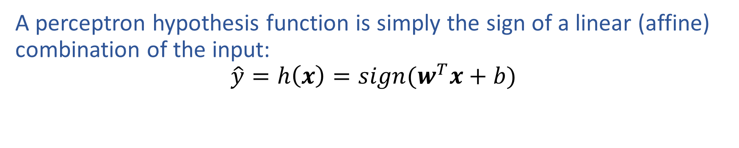
Perceptron
$$sign\left(z\right)= \left\{\begin{aligned} 1 if z>0 \\ 0 if z=0 \\ −1 if z<0\end{aligned}\right.$$
A perceptron hypothesis function is simply the sign of a linear (affine) combination of the input:
$$\hat{y}=h\left(x\right)=sign(w^{T}x+b)$$

Slide 16
Dot Product
How does the dot product relate to a linear decision boundary?

Slide 17
Dot Product
How does the dot product relate to linear decision boundary?

Slide 18
Exercise

Slide 19
Perceptron Algorithm
Sketch of algorithm

Slide 20
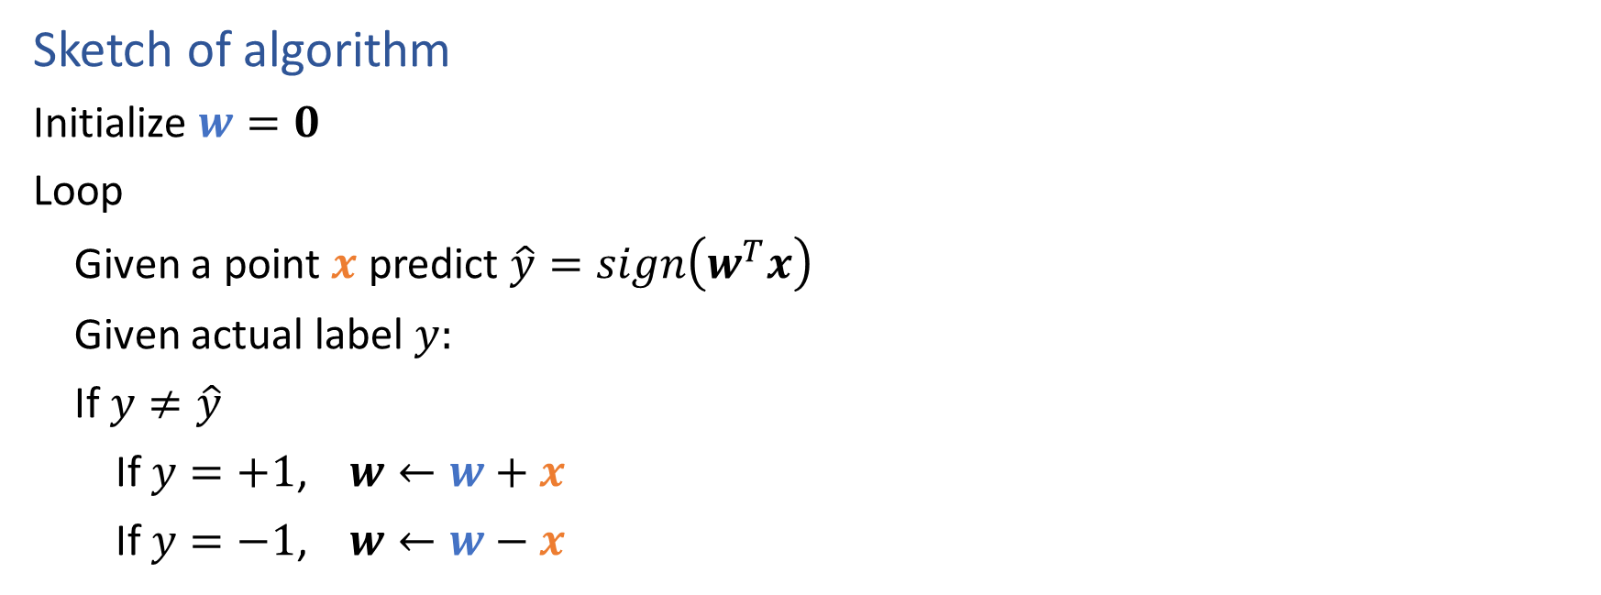
Perceptron Algorithm
Sketch of algorithm
Initialize $w=0$
Loop
Given a point $x$ predict $\hat{y}=sign\left(w^{T}x\right)$
Given actual label $y:$
If $y≠\hat{y}$
If $y=+1$, $w←w+x$
If $y=−1$, $w←w−x$

Slide 21


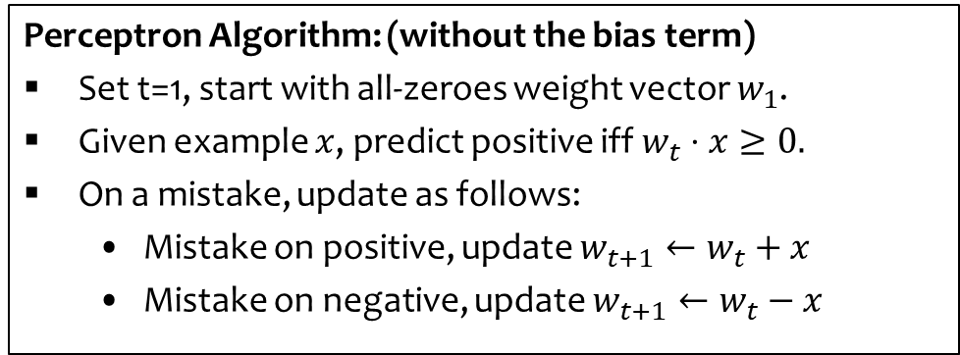








Perceptron Algorithm: Example
Example:
$$\left(−1,2\right)−$$
X
$$\left(1,0\right)+$$

-
$$\left(1,1\right)+$$
X
+
$$\left(−1,0\right)−$$

-
+
$$\left(−1,−2\right)−$$
X
$$\left(1,−1\right)+$$

+
-
Perceptron Algorithm: (without the bias term)
Set t=1, start with all-zeroes weight vector $w_{1}$.
Given example $x$, predict positive iff $w_{t}⋅x≥0.$
On a mistake, update as follows:
  Mistake on positive, update $w_{t+1}←w_{t}+x$
  Mistake on negative, update $w_{t+1}←w_{t}−x$
$$w_{1}=(0,0)$$
$$w_{2}=w_{1}−\left(−1,2\right)=(1,−2)$$
$$w_{3}=w_{2}+\left(1,1\right)=(2,−1)$$
$$w_{4}=w_{3}−\left(−1,−2\right)=(3,1)$$
Slide credit: CMU MLD Nina Balcan

Slide 22
Intercept Term
Q: Why do we need an intercept term?
A: It shifts the decision boundary off the origin
w
Q: What should happen to b during the perceptron algorithm
A: Two cases
Increasing b shifts the decision boundary towards the negative side
Decreasing b shifts the decision boundary towards the positive side
b < 0
b = 0
b > 0
Slide credit: CMU MLD Matt Gormley

Slide 23
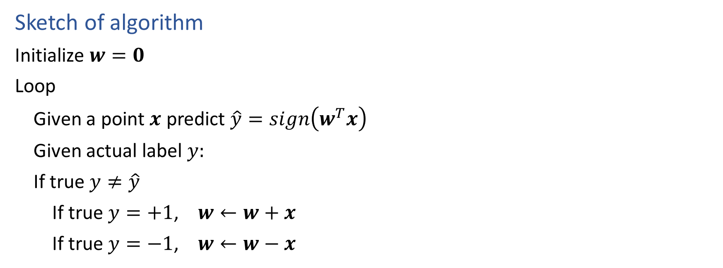
Perceptron Algorithm
Sketch of algorithm
Initialize $w=0$
Loop
Given a point $x$ predict $\hat{y}=sign\left(w^{T}x\right)$
Given actual label $y:$
If true $y≠\hat{y}$
If true $y=+1$, $w←w+x$
If true $y=−1$, $w←w−x$

Slide 24

Perceptron Algorithm
Sketch of algorithm
Initialize $θ=0$
Loop
Given a point $x$ predict $\hat{y}=sign\left(θ^{T}x\right)$
Given actual label $y:$
If true $y≠\hat{y}$
If true $y=+1$, $θ←θ+x$
If true $y=−1$, $θ←θ−x$

Slide 25
Perceptron Algorithm
Learning for Perceptron also works if we have a fixed training dataset, D.
Slide credit: CMU MLD Matt Gormley

Slide 26
Perceptron Algorithm
Learning for Perceptron also works if we have a fixed training dataset, D.
Implementation Trick: same behavior as our “add on positive mistake and subtract on negative mistake” version, because y^{(i)} takes care of the sign
Slide credit: CMU MLD Matt Gormley

Slide 27
Plan
Perceptron Background
ML Data, Tasks, Notation
Vectors, dot products
Geometry with linear functions
Perceptron (and the sign() function)
Decision boundaries and errors
Perceptron Algorithm
Perceptron Mistake Bound Theory
Background: projections, distances, and margin

Slide 28
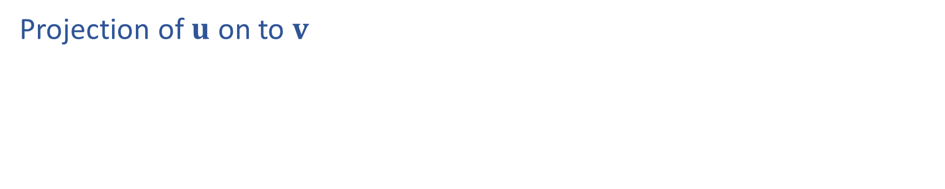
Projection
Projection of $u$ on to $v$

Slide 29
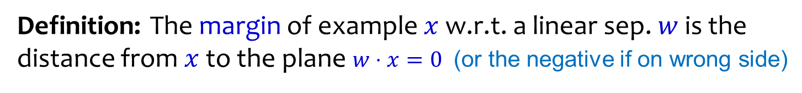


Geometric Margin
Definition: The margin of example $x$ w.r.t. a linear sep. $w$ is the distance from $x$to the plane $w⋅x=0$ (or the negative if on wrong side)
Margin of positive example $x_{1}$
$$x_{1}$$
w
Margin of negative example $x_{2}$
$$x_{2}$$
Slide credit: CMU MLD Nina Balcan

Slide 30
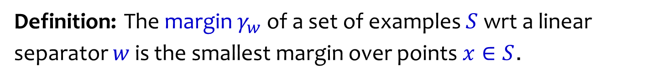
Geometric Margin
Definition: The margin of example $x$ w.r.t. a linear sep. $w$ is the distance from $x$to the plane $w⋅x=0$ (or the negative if on wrong side)
Definition: The margin $γ_{w}$ of a set of examples $S$ wrt a linear separator $w$ is the smallest margin over points $x∈S$.
+
+
+
+
w
$$γ_{w}$$
$$γ_{w}$$
+
-
+
-
+
-
-
-
+
-
-
-
-
Slide credit: CMU MLD Nina Balcan

Slide 31
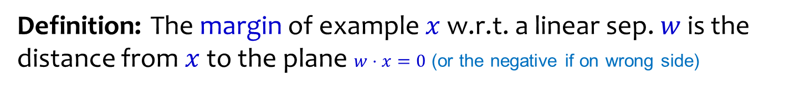
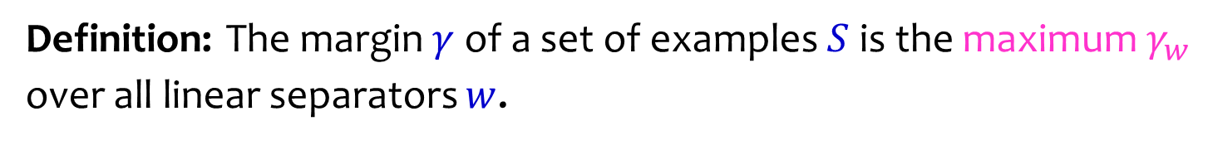
Geometric Margin
Definition: The margin of example $x$ w.r.t. a linear sep. $w$ is the distance from $x$to the plane $w⋅x=0$ (or the negative if on wrong side)
Definition: The margin $γ_{w}$ of a set of examples $S$ wrt a linear separator $w$ is the smallest margin over points $x∈S$.
Definition: The margin $γ$ of a set of examples $S$ is the maximum $γ_{w}$ over all linear separators $w$.
+
w
$$γ$$
$$γ$$
+
-
+
-
+
-
-
-
+
-
-
-
-
Slide credit: CMU MLD Nina Balcan

Slide 32
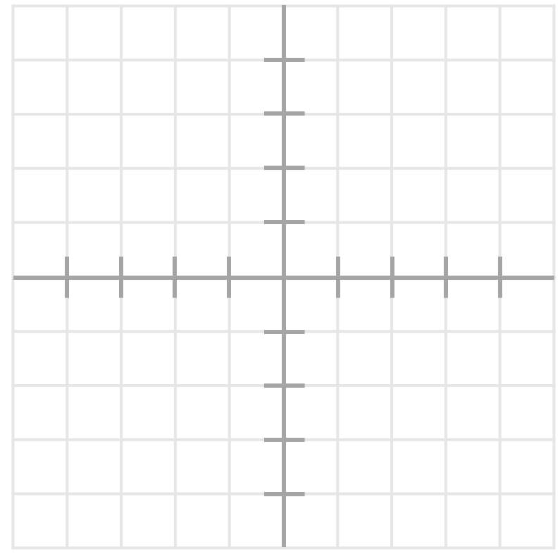
Geometric Margin
What is the margin for this dataset?

Slide 33
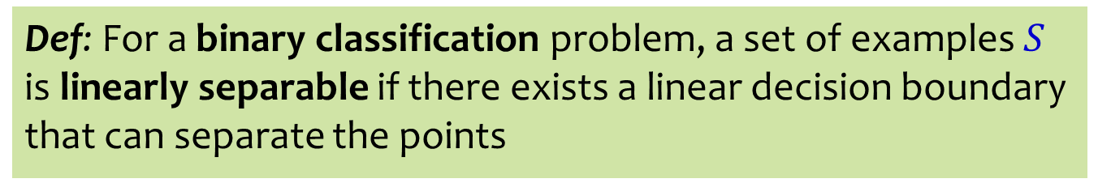
Linear Separability
Def: For a binary classification problem, a set of examples $S$ is linearly separable if there exists a linear decision boundary that can separate the points
Case 1:
Case 2:
Case 3:
Case 4:
+
-
+
+
-
-
+
+
+
+
+
-
+
Slide credit: CMU MLD Matt Gormley

Slide 34
Analysis oF Perceptron

Slide 35
Analysis: Perceptron
Perceptron Mistake Bound
(Normalized margin: multiplying all points by 100, or dividing all points by 100, doesn’t change the number of mistakes; algo is invariant to scaling.)
+
+
+
+
Slide credit: CMU MLD Nina Balcan and Matt Gormley
γ
+
γ
+
-
+
-
+
-
-
-
R
-
-
-
-

Slide 36
Analysis: Perceptron
Perceptron Mistake Bound
(Normalized margin: multiplying all points by 100, or dividing all points by 100, doesn’t change the number of mistakes; algo is invariant to scaling.)
+
+
+
+
Slide credit: CMU MLD Nina Balcan and Matt Gormley
Def: We say that the (batch) perceptron algorithm has converged if it stops making mistakes on the training data (perfectly classifies the training data).
Main Takeaway: For linearly separable data, if the perceptron algorithm cycles repeatedly through the data, it will converge in a finite # of steps.
γ
+
γ
+
-
+
-
+
-
-
-
R
-
-
-
-

Slide 37
Analysis: Perceptron
Perceptron Mistake Bound
Slide credit: CMU MLD Nina Balcan and Matt Gormley
+
+
+
+
γ
+
-
γ
+
+
-
+
-
-
R
-
-
-
-
-

Slide 38
Analysis: Perceptron
Common Misunderstanding:
The radius is centered at the origin, not at the center of the points.
Perceptron Mistake Bound
Slide credit: CMU MLD Nina Balcan and Matt Gormley
+
+
+
+
γ
+
-
γ
+
+
-
+
-
-
R
-
-
-
-
-

Slide 39
Analysis: Perceptron
Proof of Perceptron Mistake Bound:
We will show that there exist constants A and B s.t.
Slide credit: CMU MLD Nina Balcan and Matt Gormley

Slide 40
Analysis: Perceptron
+
+
+
+
γ
+
-
γ
+
+
-
+
-
-
R
-
-
-
-
-
Slide credit: CMU MLD Nina Balcan and Matt Gormley

Slide 41
Analysis: Perceptron
Proof of Perceptron Mistake Bound:
Part 1: for some A,
Slide credit: CMU MLD Matt Gormley
Cauchy-Schwartz inequality
Notes:
Intuition \theta is gradually approaching \theta*
Part 1: The dot product of \theta and \theta* increases rapidly O(k)
Part 2: The norm of \theta increases slowly \Omega(\sqrt(k))

Slide 42
Analysis: Perceptron
Proof of Perceptron Mistake Bound:
Part 2: for some B,
Slide credit: CMU MLD Matt Gormley
Notes:
Intuition \theta is gradually approaching \theta*
Part 1: The dot product of \theta and \theta* increases rapidly O(k)
Part 2: The norm of \theta increases slowly \Omega(\sqrt(k))

Slide 43
Analysis: Perceptron
Proof of Perceptron Mistake Bound:
Part 3: Combining the bounds finishes the proof.
Slide credit: CMU MLD Matt Gormley
The total number of mistakes must be less than this

