Slide 1

Plan
Wrap-up Overview → Lecture 1 slides
Proof Techniques
Proof by cases
Disprove by counterexample
Proof by contrapositive
Proof by contradiction
Perceptron Algorithm

Slide 2

10-607
Computational Foundations for Machine Learning
Proof Techniques & Perceptron Algorithm
Instructor: Pat Virtue

Slide 3
Proof Techniques
Proof by cases
Disproof by counterexample
One example is not sufficient to prove
One counterexample is sufficient to disprove
Proof by contrapositive

Slide 4
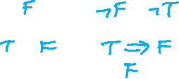
Previous Poll
Given model m: {A: True, B: False}
Does m satisfy the following sentence:
(A⇒B)⇔(¬B⇒¬A)
i. Yes
ii. No
iii. Not enough information
iv. Syntax error in sentence

Slide 5
Previous Poll
Truth table for (A⇒B)⇔(¬B⇒¬A)
How many rows do we need (excluding a header)?
2
4
6
8
16

Slide 6
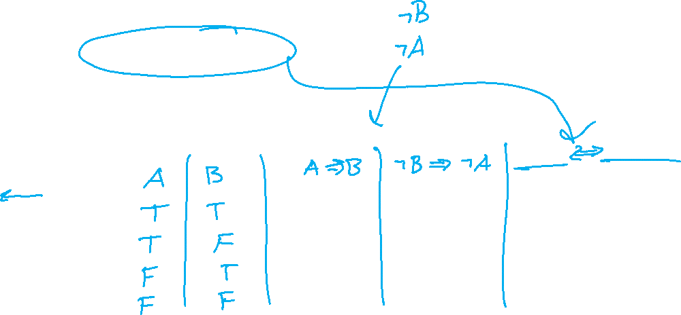
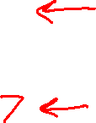
Previous Poll
Truth table for (A⇒B)⇔(¬B⇒¬A)
How many columns should we have?
2
3
4
5
6

Slide 7
Exercise
Truth table for (A⇒B)⇔(¬B⇒¬A)

Slide 8
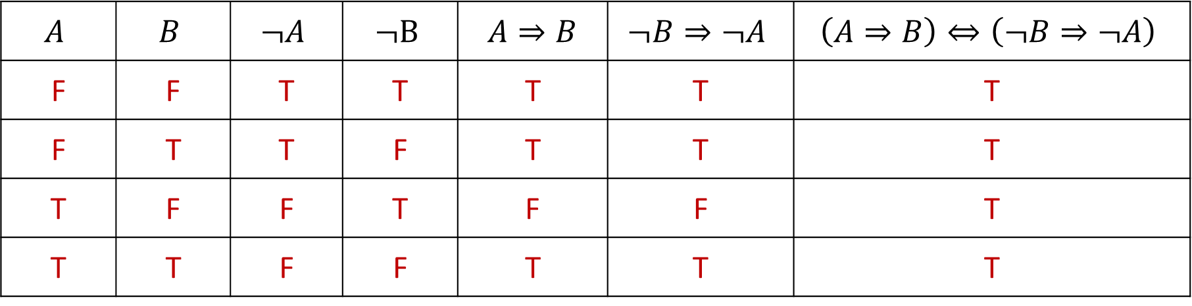
Exercise
Truth table for (A⇒B)⇔(¬B⇒¬A)
$$A$$ | $$B$$ | $$¬A$$ | $$¬B$$ | $A⇒B$ | $$¬B⇒¬A$$ | $$\left(A⇒B\right)⇔\left(¬B⇒¬A\right)$$
F | F | T | T | T | T | T
F | T | T | F | T | T | T
T | F | F | T | F | F | T
T | T | F | F | T | T | T

Slide 9
Proof Techniques
Proof by cases
Disproof by counterexample
One example is not sufficient to prove
One counterexample is sufficient to disprove
Proof by contrapositive
Law of contrapositive
(A⇒B)⇔(¬B⇒¬A)
Prove (¬B⇒¬A) → Conclude (A⇒B)

Slide 10
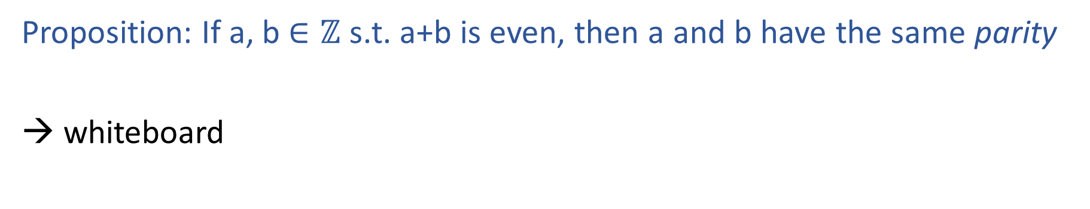
Proof by Contrapositive
Proposition: If a, b $∈ℤ$ s.t. a+b is even, then a and b have the same parity
→ whiteboard

Slide 11
Proof Techniques
Proof by cases
Disproof by counterexample
One example is not sufficient to prove
One counterexample is sufficient to disprove
Proof by contrapositive
Law of contrapositive
(A⇒B)⇔(¬B⇒¬A)
Prove (¬B⇒¬A) → Conclude (A⇒B)
Proof by contradiction

Slide 12
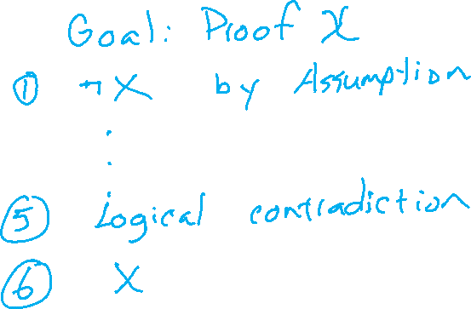
Proof by Contradiction
Template

Slide 13
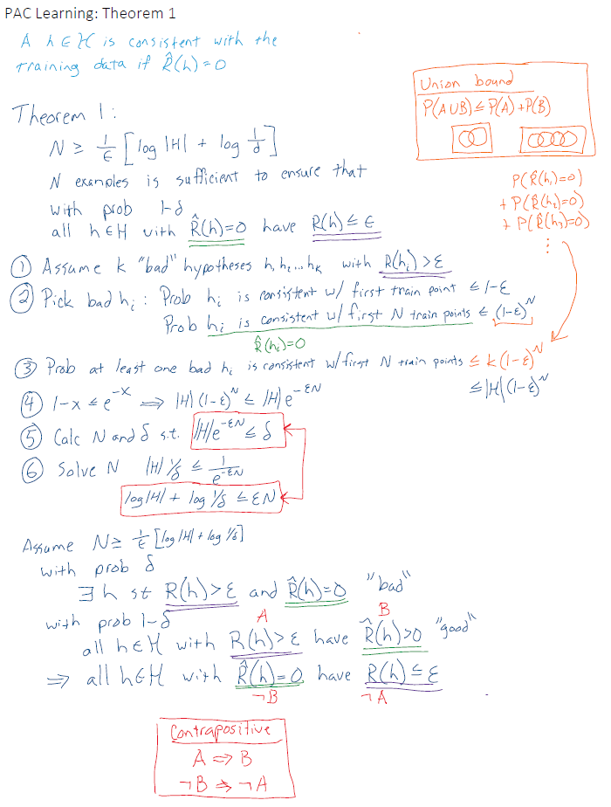
Example from Intro ML
Note: Just an example. Out of scope.

Slide 14
Plan
Wrap-up Overview → Lecture 1 slides
Proof Techniques
Proof by cases
Disprove by counterexample
Proof by contrapositive
Proof by contradiction
Perceptron Algorithm
Prep: ML tasks, data, notation
Prep: Geometry of linear models

Slide 15
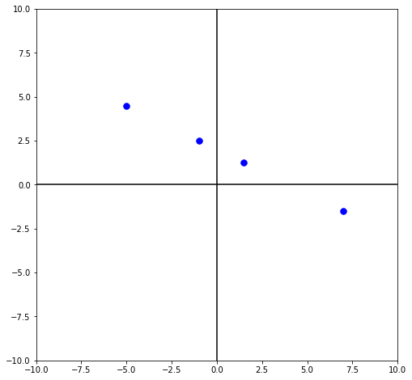

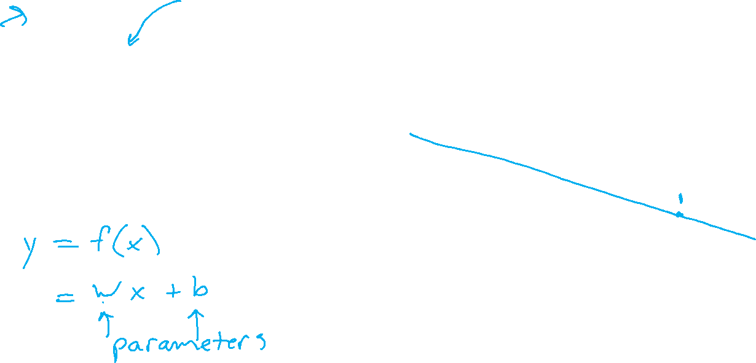
ML Data, Tasks, Notation
Notation alert!
Regression
$𝒟={\left\{\left(x^{\left(i\right)}, { y}^{\left(i\right)}\right)\right\}}_{i=1}^{4}$
$=\{\left(−1, 2.5\right),$
($7, −1.5),$
($−5, 4.5),$
($1.5, 1.25)\}$

Slide 16

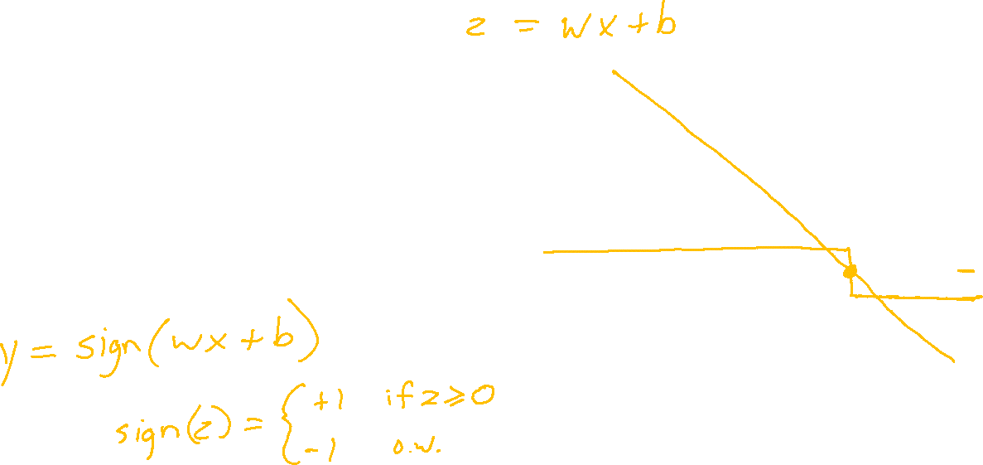
ML Data, Tasks, Notation
Classification
$𝒟={\left\{\left(x^{\left(i\right)}, { y}^{\left(i\right)}\right)\right\}}_{i=1}^{4}$
$=\{\left(−1, 1\right),$
($7, −1),$
($−5, 1),$
($1.5, 1)\}$

Slide 17
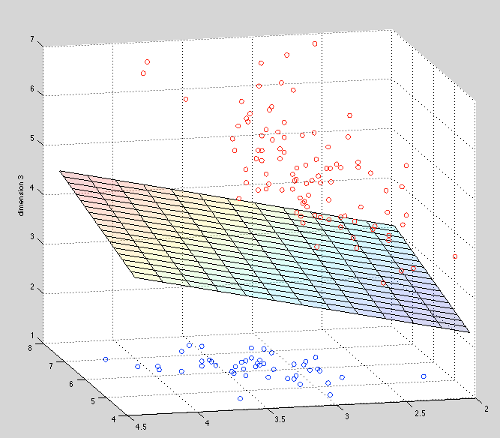
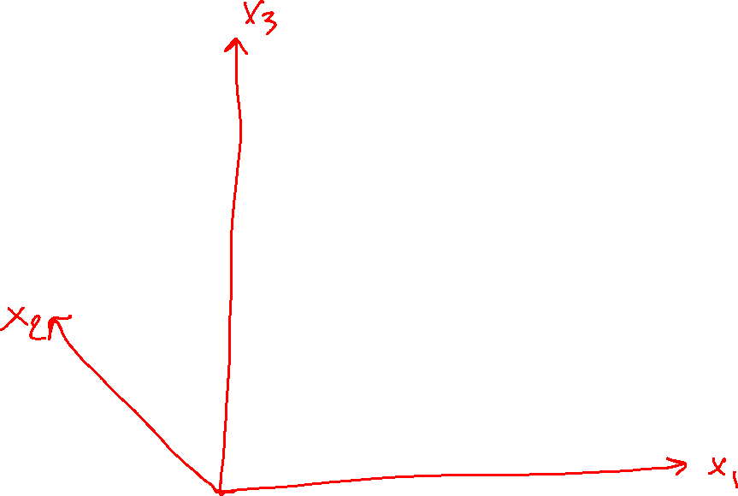
Perceptron

Slide 18
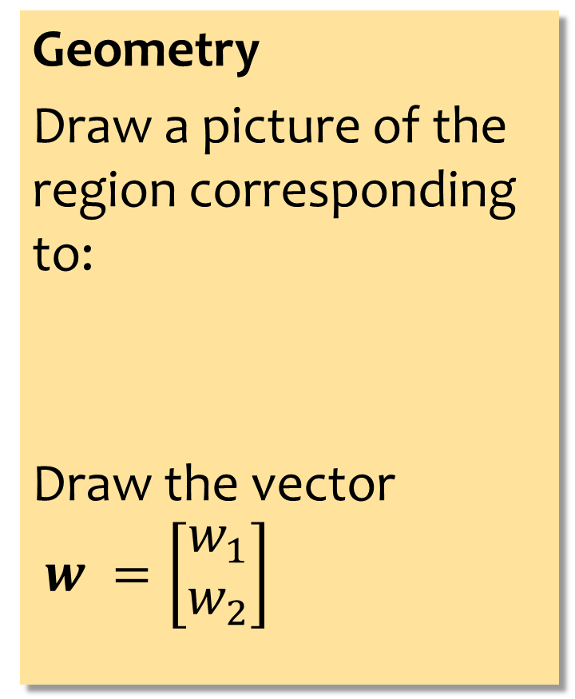
Exercise
Geometry
Draw a picture of the region corresponding to:
Draw the vector
$w =\left[\begin{aligned}w_{1} \\ w_{2}\end{aligned}\right]$
Answer Here:
Slide credit: CMU MLD Matt Gormley

Slide 19


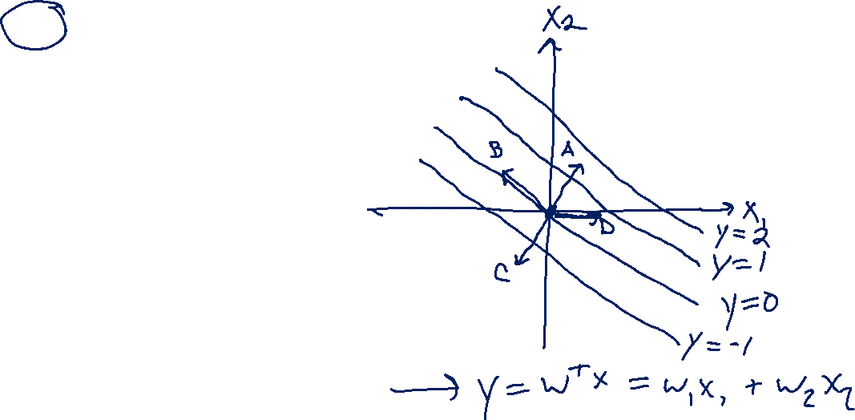
Poll 1
Which is the correct vector $w$?
  I don’t know

