Slide 1
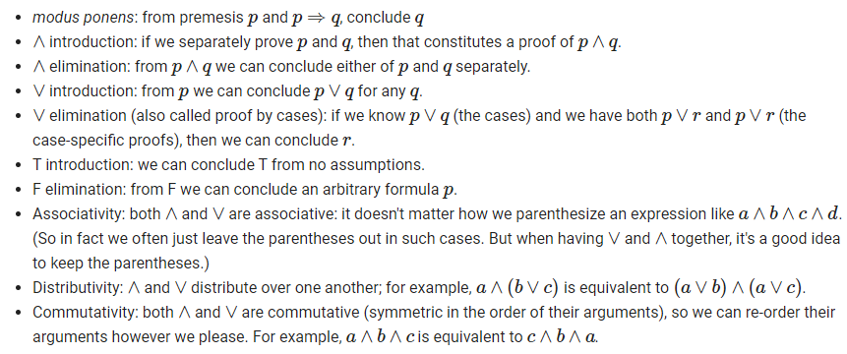
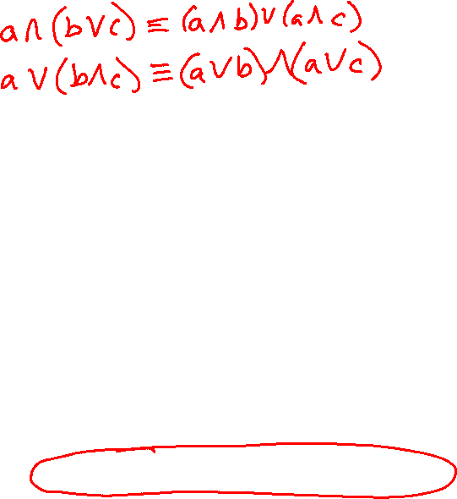
Correction
Propositional logic inference rules

Slide 2
Plan
Wrap-up Overview → Lecture 1 slides
Proof Techniques
Proof by cases
Disprove by counterexample
Proof by contrapositive

Slide 3

10-607 Computational Foundations for Machine Learning Proof Techniques
Instructor: Pat Virtue

Slide 4
Proof Techniques
Proof by Cases

Slide 5
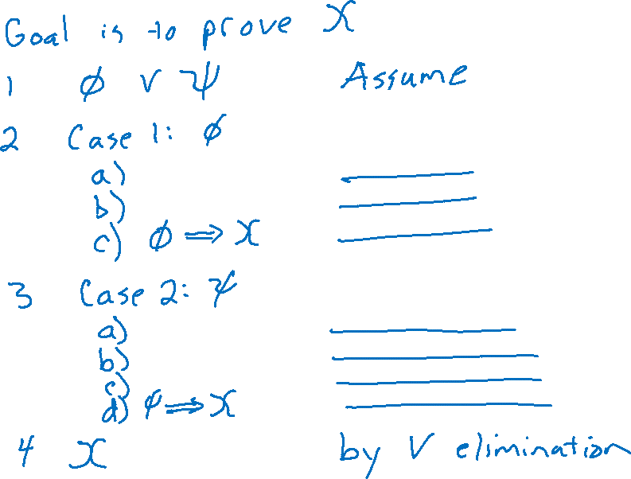
Proof by Cases

Slide 6
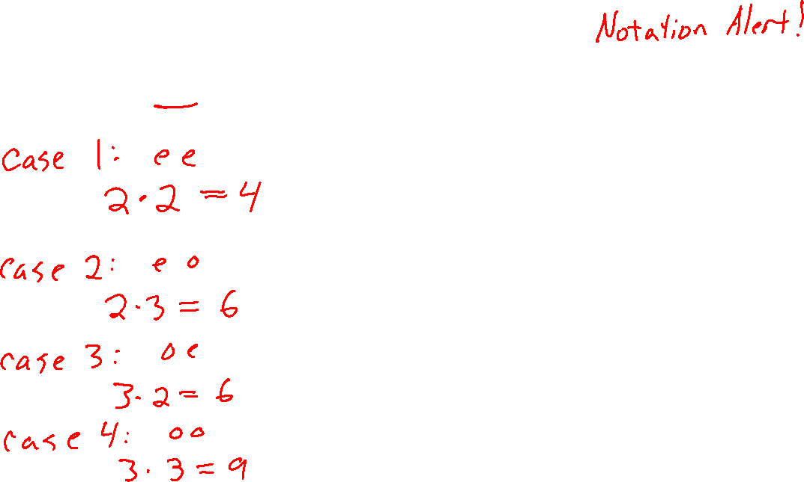
Proof by Cases
Proposition: Let a, b $∈ℤ$. If ab is even, then either a is even or b is even (or both).

Slide 7
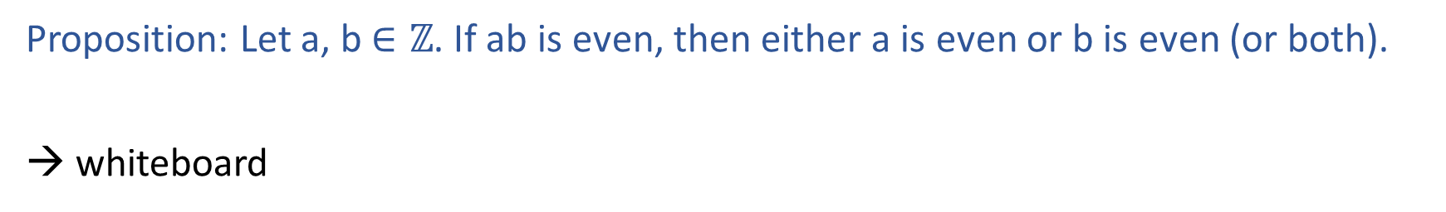
Proof by Cases
Proposition: Let a, b $∈ℤ$. If ab is even, then either a is even or b is even (or both).
→ whiteboard

Slide 8
Proof Techniques
Proof by cases
Disproof by counterexample
One example is not sufficient to prove
One counterexample is sufficient to disprove

Slide 9
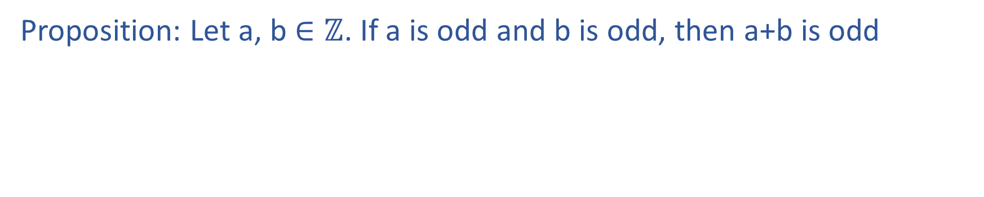
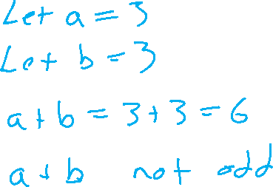
Disprove by counterexample
Proposition: Let a, b $∈ℤ$. If a is odd and b is odd, then a+b is odd

Slide 10
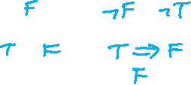

Poll 1
Given model m: {A: True, B: False}
Does m satisfy the following sentence:
(A⇒B)⇔(¬B⇒¬A)
i. Yes
ii. No
iii. Not enough information
iv. Syntax error in sentence

Slide 11

Poll 2
Truth table for (A⇒B)⇔(¬B⇒¬A)
How many rows do we need (excluding a header)?
2
4
6
8
16

Slide 12
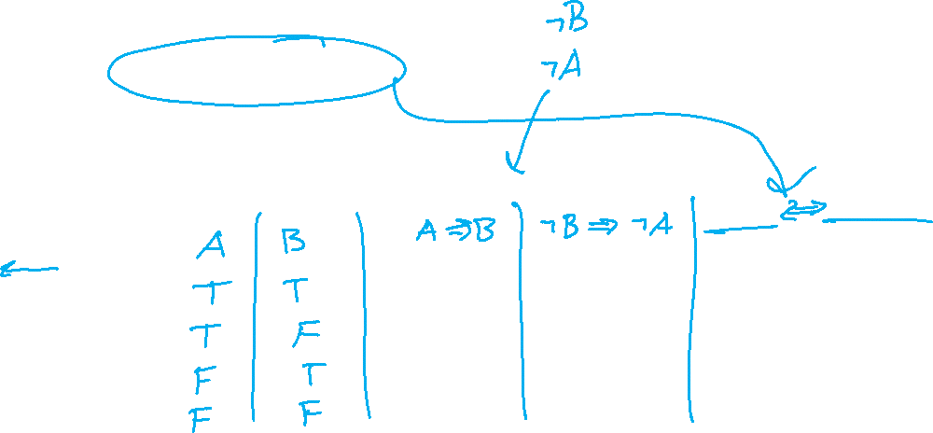

Poll 3
Truth table for (A⇒B)⇔(¬B⇒¬A)
How many columns should we have?
2
3
4
5
6

