Slide 1
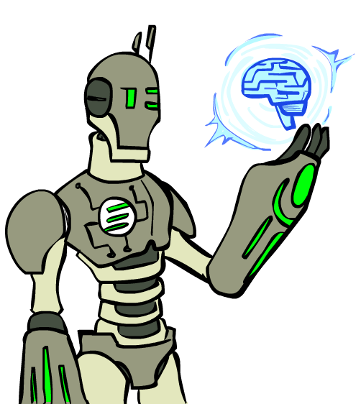

As you walk in
Welcome!
Sit at a table next to another student
Make name plate
Fold paper in half
Write preferred name
Below write you favorite fictional AI/robot
Images: ai.berkeley.edu

Slide 2

10-607 Computational Foundations for Machine Learning
Instructor: Pat Virtue

Slide 3

Today
Course Info
Warm-up exercise
Propositional Logic and Proofs
ML and 606/607 Intro
More Course Info
Images: ai.berkeley.edu

Slide 4
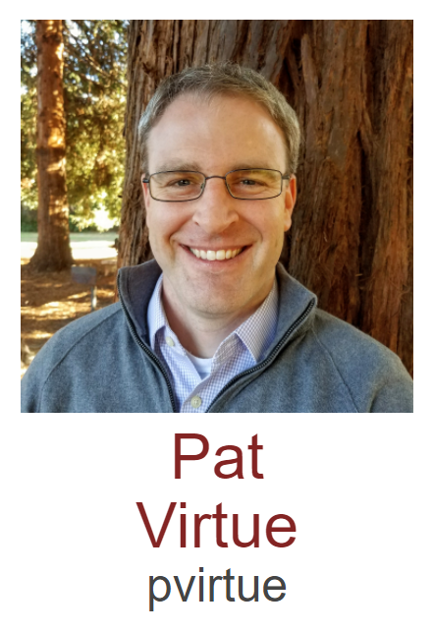

Course Team
Instructor
Teaching Assistants

Slide 5
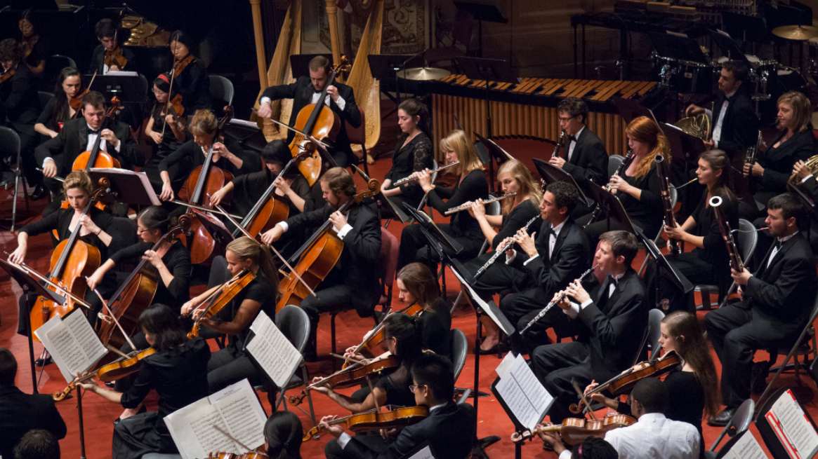
Course Team
Students!!

Slide 6
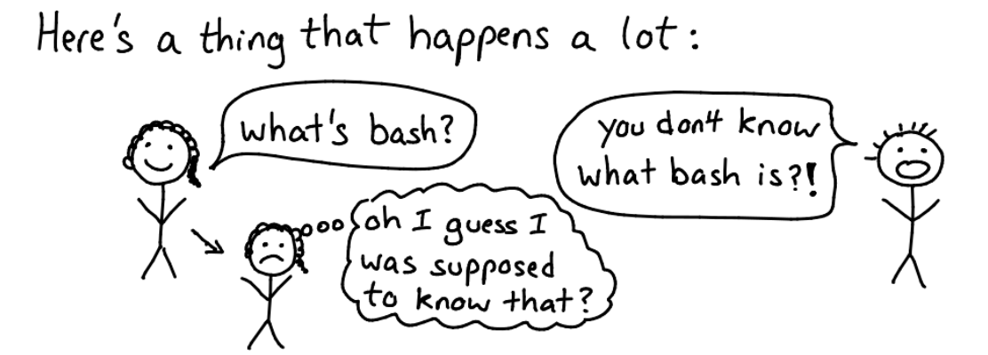
Team Tips
Try not to act surprised
https://jvns.ca/blog/2017/04/27/no-feigning-surprise/

Slide 7
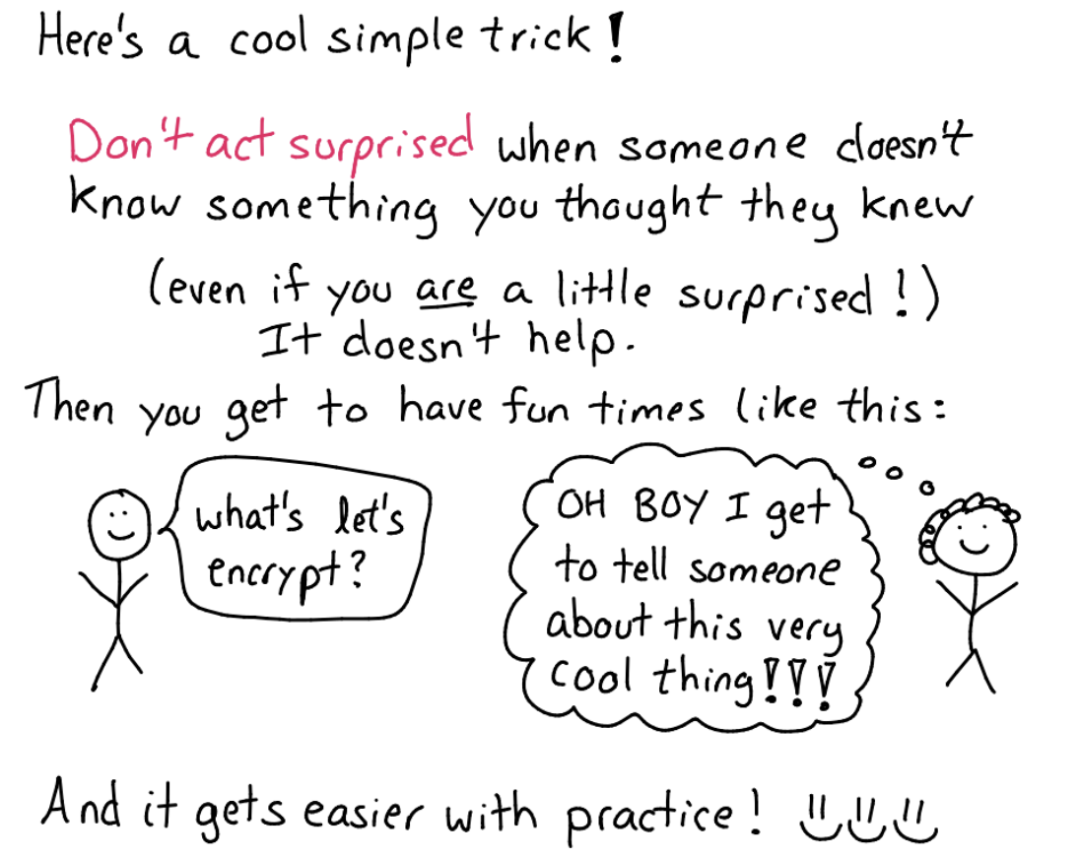
Team Tips
Try not to act surprised
https://jvns.ca/blog/2017/04/27/no-feigning-surprise/

Slide 8
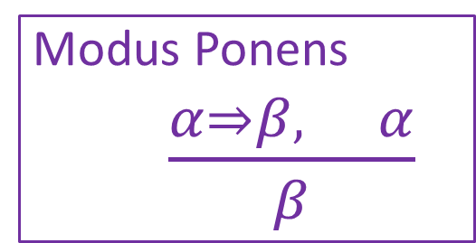
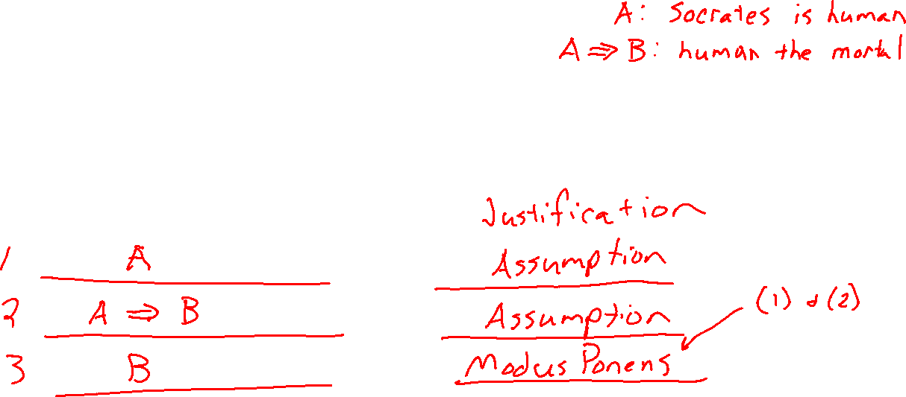
Two-column Proof
Give an explicit justification for each statement based on previous statements
Prove Socrates is mortal
Notation Alert!
Modus Ponens
$\frac{α⇒β, α}{β}$

Slide 9
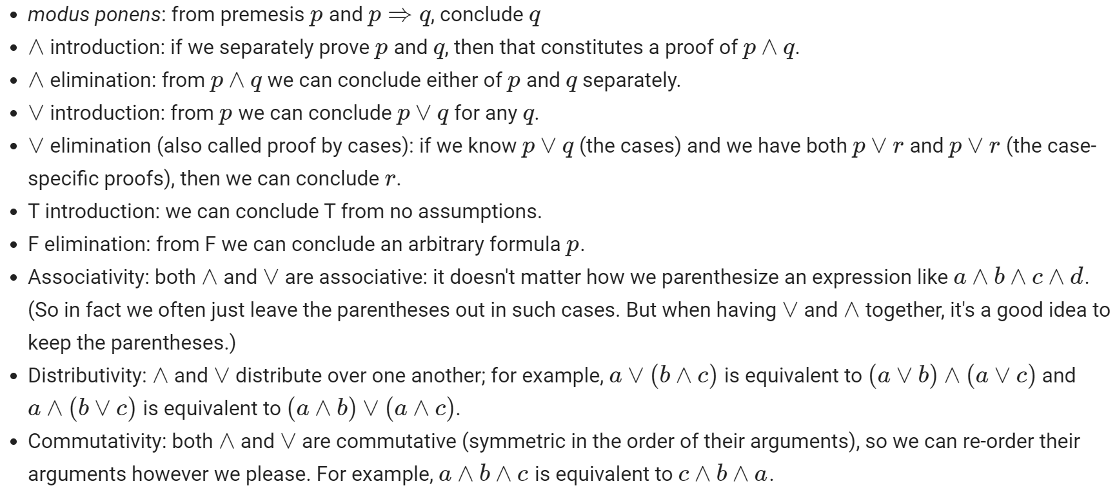
Warm-up Exercise
Propositional logic inference rules

Slide 10

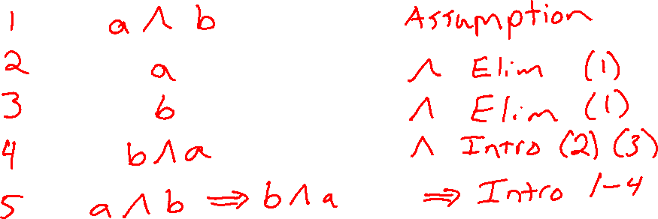
Warm-up Exercise
Use the propositional logic inference rules provided to prove:
$$\left(a∧ b\right)⇒(b∧a)$$
However, you cannot use the commutativity rule.
Write your proof in two-column format, i.e., give an explicit justification for each statement based on previous statements

Slide 11

Warm-up Exercise
Use the propositional logic inference rules provided to prove:
$$\left(a∧ b\right)⇒(b∧a)$$
However, you cannot use the commutativity rule.
Write your proof in two-column format, i.e., give an explicit justification for each statement based on previous statements

Slide 12
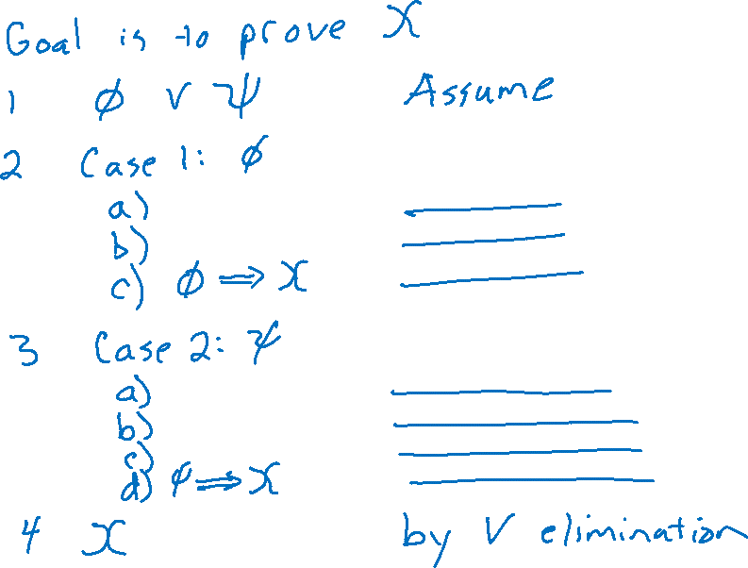
Proof by Cases

Slide 13
Today
Course Info
Warm-up exercise
Propositional Logic and Proofs
ML and 606/607 Intro
More Course Info
Images: ai.berkeley.edu

Slide 14
Analysis: Perceptron
Perceptron Mistake Bound
+
+
+
+
γ
+
-
γ
+
+
-
+
-
-
Note: This is just motivation – we’ll cover the background need to understand these topics later!
-
R
-
-
-
-
Figure from Nina Balcan

Slide 15
Analysis: Perceptron
Proof of Perceptron Mistake Bound:
We will show that there exist constants A and B s.t.
Note: This is just motivation – we’ll cover the background need to understand these topics later!

Slide 16
Analysis: Perceptron
+
+
+
+
γ
+
-
γ
+
+
-
+
-
-
R
-
-
-
-
-
Note: This is just motivation – we’ll cover the background need to understand these topics later!

Slide 17
Analysis: Perceptron
Proof of Perceptron Mistake Bound: Part 1: for some A,
Note: This is just motivation – we’ll cover the background need to understand these topics later!
Cauchy-Schwartz inequality
Notes:
Intuition \theta is gradually approaching \theta*
Part 1: The dot product of \theta and \theta* increases rapidly O(k)
Part 2: The norm of \theta increases slowly \Omega(\sqrt(k))

Slide 18
Analysis: Perceptron
Proof of Perceptron Mistake Bound: Part 2: for some B,
Note: This is just motivation – we’ll cover the background need to understand these topics later!
Notes:
Intuition \theta is gradually approaching \theta*
Part 1: The dot product of \theta and \theta* increases rapidly O(k)
Part 2: The norm of \theta increases slowly \Omega(\sqrt(k))

Slide 19
Analysis: Perceptron
Proof of Perceptron Mistake Bound: Part 3: Combining the bounds finishes the proof.
The total number of mistakes must be less than this
Note: This is just motivation – we’ll cover the background need to understand these topics later!

Slide 20
Logic Language
Natural language?
Propositional logic
Syntax: P ∨ (¬Q ∧ R); X₁ ⇔ (Raining ⇒ Sunny)
Possible world: {P=true, Q=true, R=false, S=true} or 1101
Semantics: α ∧ β is true in a world iff is α true and β is true (etc.)
First-order logic
Syntax: ∀x ∃y P(x,y) ∧ ¬Q(Joe,f(x)) ⇒ f(x)=f(y)
Possible world: Objects o₁, o₂, o₃; P holds for <o₁,o₂>; Q holds for <o₃>; f(o₁)=o₁; Joe=o₃; etc.
Semantics: φ(σ) is true in a world if σ=o_{j} and φ holds for o_{j}; etc.

Slide 21
Propositional Logic

Slide 22
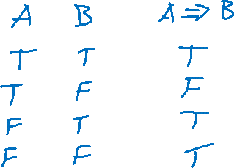
Propositional Logic
Symbol:
Variable that can be true or false
We’ll try to use capital letters, e.g. A, B, P_{1,2}
Often include True and False
Operators:
¬ A: not A
A ∧ B: A and B (conjunction)
A ∨ B: A or B (disjunction) Note: this is not an “exclusive or”
A ⇒ B: A implies B (implication). If A then B
A ⇔ B: A if and only if B (biconditional)
Sentences

Slide 23
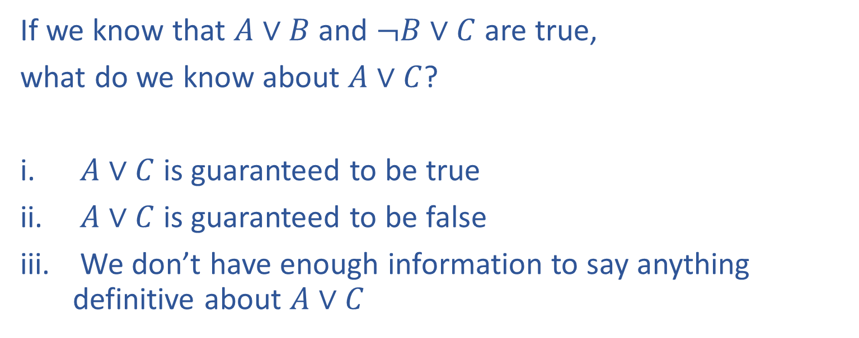
Poll 1
If we know that $A∨B$ and $¬B∨C$ are true,
what do we know about $A∨C$?
$A∨C$ is guaranteed to be true
$A∨C$ is guaranteed to be false
We don’t have enough information to say anything definitive about $A∨C$

Slide 24
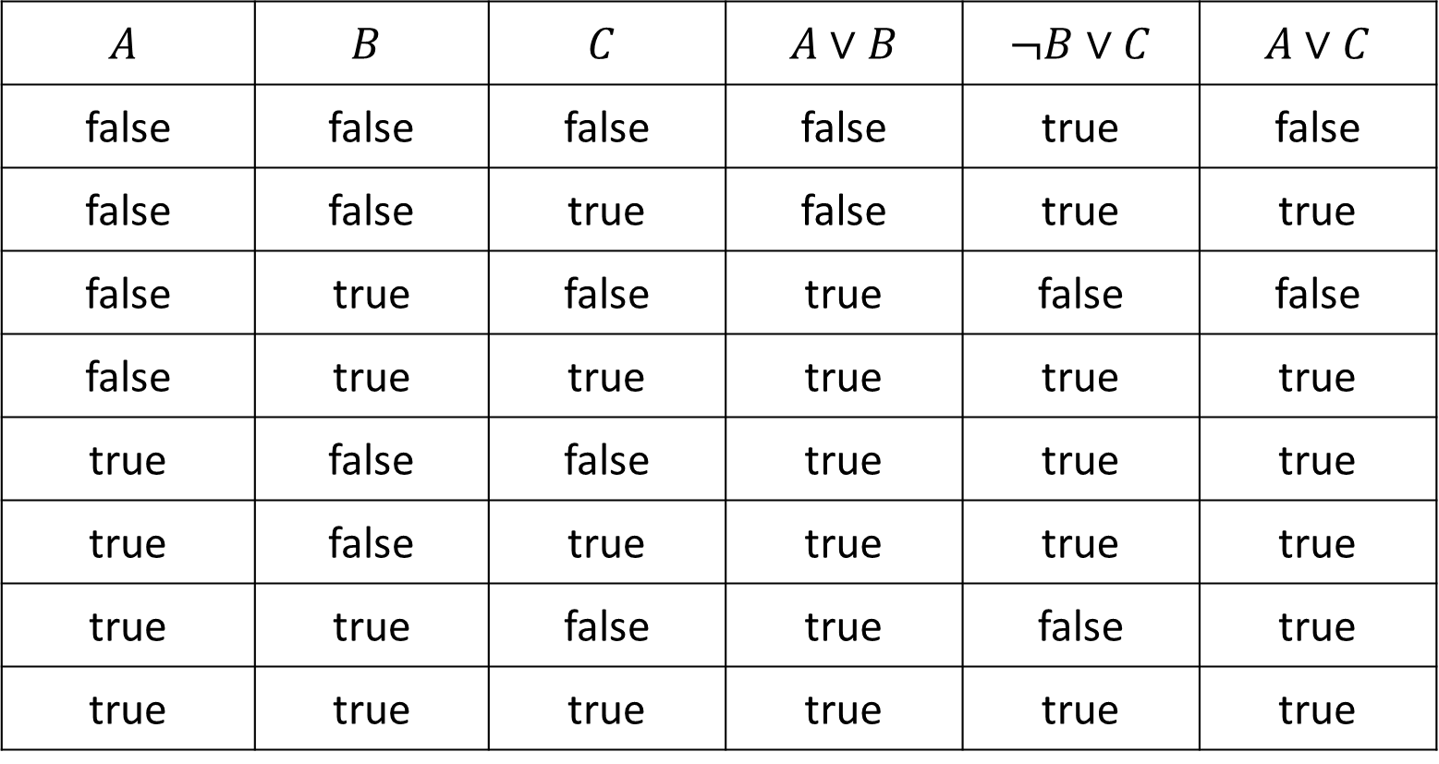

Poll 1
If we know that $A∨B$ and $¬B∨C$ are true, what do we know about $A∨C$?
$$A$$ | $$B$$ | $$C$$ | $A∨B$ | $¬B∨C$ | $A∨C$
false | false | false | false | true | false
false | false | true | false | true | true
false | true | false | true | false | false
false | true | true | true | true | true
true | false | false | true | true | true
true | false | true | true | true | true
true | true | false | true | false | true
true | true | true | true | true | true

Slide 25
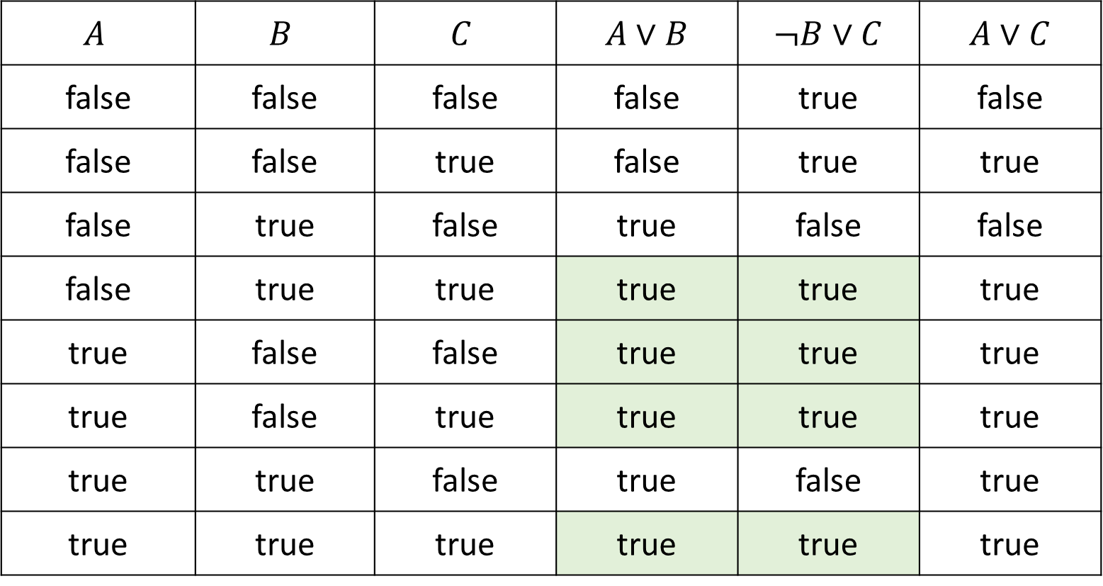
Poll 1
If we know that $A∨B$ and $¬B∨C$ are true, what do we know about $A∨C$?
$$A$$ | $$B$$ | $$C$$ | $A∨B$ | $¬B∨C$ | $A∨C$
false | false | false | false | true | false
false | false | true | false | true | true
false | true | false | true | false | false
false | true | true | true | true | true
true | false | false | true | true | true
true | false | true | true | true | true
true | true | false | true | false | true
true | true | true | true | true | true

Slide 26
Poll 1
If we know that $A∨B$ and $¬B∨C$ are true,
what do we know about $A∨C$?
$A∨C$ is guaranteed to be true
$A∨C$ is guaranteed to be false
We don’t have enough information to say anything definitive about $A∨C$

Slide 27
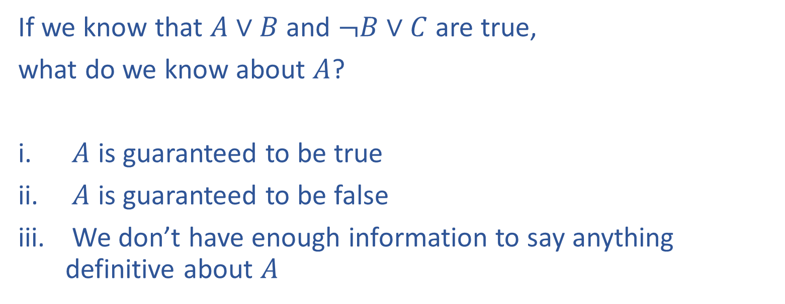
Poll 2
If we know that $A∨B$ and $¬B∨C$ are true,
what do we know about $A$?
$A$ is guaranteed to be true
$A$ is guaranteed to be false
We don’t have enough information to say anything definitive about $A$

Slide 28
Poll 2
If we know that $A∨B$ and $¬B∨C$ are true, what do we know about $A$?
$$A$$ | $$B$$ | $$C$$ | $A∨B$ | $¬B∨C$ | $A∨C$
false | false | false | false | true | false
false | false | true | false | true | true
false | true | false | true | false | false
false | true | true | true | true | true
true | false | false | true | true | true
true | false | true | true | true | true
true | true | false | true | false | true
true | true | true | true | true | true

Slide 29
Poll 2
If we know that $A∨B$ and $¬B∨C$ are true,
what do we know about $A$?
$A$ is guaranteed to be true
$A$ is guaranteed to be false
We don’t have enough information to say anything definitive about $A$

Slide 30
Propositional Logic
Symbol:
Variable that can be true or false
We’ll try to use capital letters, e.g. A, B, P_{1,2}
Often include True and False
Operators:
¬ A: not A
A ∧ B: A and B (conjunction)
A ∨ B: A or B (disjunction) Note: this is not an “exclusive or”
A ⇒ B: A implies B (implication). If A then B
A ⇔ B: A if and only if B (biconditional)
Sentences

Slide 31
Propositional Logic Syntax
Given: a set of proposition symbols {X₁, X₂, …, X_{n}}
(we often add True and False for convenience)
X_{i} is a sentence
If α is a sentence then ¬α is a sentence
If α and β are sentences then α ∧ β is a sentence
If α and β are sentences then α ∨ β is a sentence
If α and β are sentences then α ⇒ β is a sentence
If α and β are sentences then α ⇔ β is a sentence
And p.s. there are no other sentences!

Slide 32
Notes on Operators
𝛂 ∨ 𝛃 is inclusive or, not exclusive

Slide 33
Truth Tables
𝛂 ∨ 𝛃 is inclusive or, not exclusive
𝛂 | 𝛃 | 𝛂 ∧ 𝛃
F | F | F
F | T | F
T | F | F
T | T | T
𝛂 | 𝛃 | 𝛂 ∨ 𝛃
F | F | F
F | T | T
T | F | T
T | T | T

Slide 34
Notes on Operators
𝛂 ∨ 𝛃 is inclusive or, not exclusive
𝛂 ⇒ 𝛃 is equivalent to ¬𝛂 ∨ 𝛃
Says who?

Slide 35
Truth Tables
𝛂 ⇒ 𝛃 is equivalent to ¬𝛂 ∨ 𝛃
𝛂 | 𝛃 | 𝛂 ⇒ 𝛃 | ¬𝛂 | ¬𝛂 ∨ 𝛃
F | F | T | T | T
F | T | T | T | T
T | F | F | F | F
T | T | T | F | T

Slide 36
Notes on Operators
𝛂 ∨ 𝛃 is inclusive or, not exclusive
𝛂 ⇒ 𝛃 is equivalent to ¬𝛂 ∨ 𝛃
Says who?
𝛂 ⇔ 𝛃 is equivalent to (𝛂 ⇒ 𝛃) ∧ (𝛃 ⇒ 𝛂)
Prove it!

Slide 37
Truth Tables
𝛂 ⇔ 𝛃 is equivalent to (𝛂 ⇒ 𝛃) ∧ (𝛃 ⇒ 𝛂)
𝛂 | 𝛃 | 𝛂 ⇔ 𝛃 | 𝛂 ⇒ 𝛃 | 𝛃 ⇒ 𝛂 | (𝛂⇒𝛃) ∧ (𝛃⇒𝛂)
F | F | T | T | T | T
F | T | F | T | F | F
T | F | F | F | T | F
T | T | T | T | T | T
Equivalence: it’s true in all models. Expressed as a logical sentence:
(𝛂 ⇔ 𝛃) ⇔ [(𝛂 ⇒ 𝛃) ∧ (𝛃 ⇒ 𝛂)]

Slide 38


Inference Rules
Modus Ponens
$\frac{α⇒β, α}{β}$
Unit Resolution
$\frac{a∨b, ¬b∨c}{a∨c}$
General Resolution
$\frac{a_{1}∨…∨a_{m}∨b, ¬b∨c_{1}∨…∨c_{n}}{a_{1}∨…∨a_{m}∨c_{1}∨…∨c_{n}}$
Notation Alert!

Slide 39
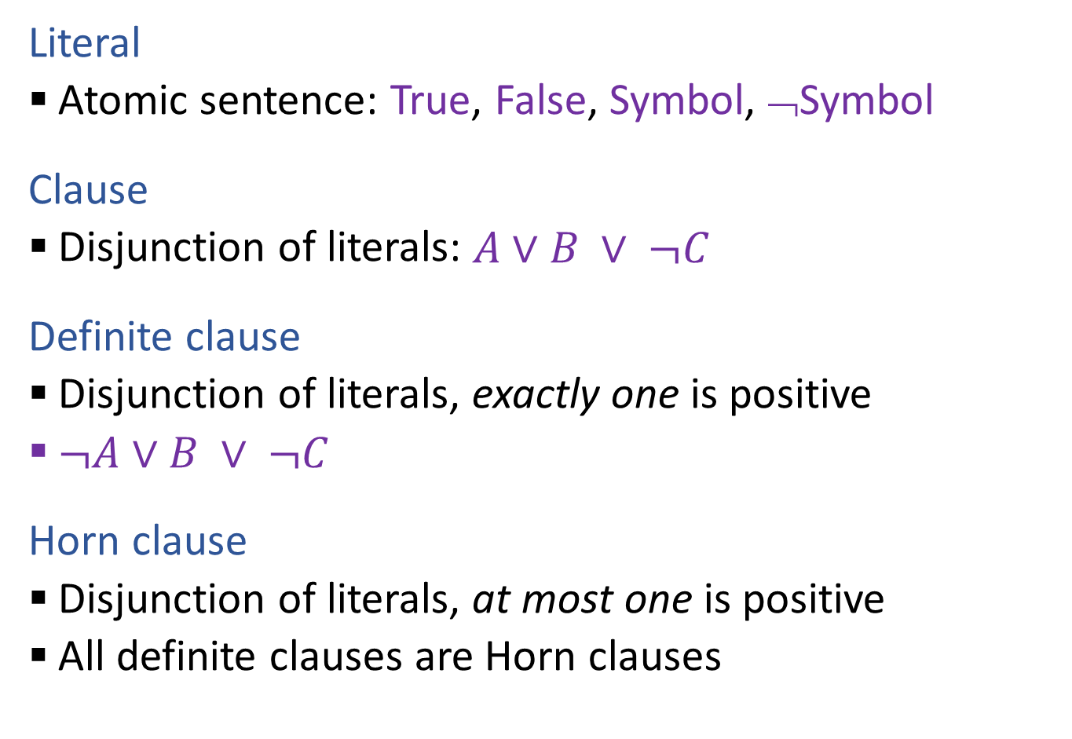
Propositional Logical Vocab
Literal
Atomic sentence: True, False, Symbol, ¬Symbol
Clause
Disjunction of literals: $A∨B ∨ ¬C$
Definite clause
Disjunction of literals, exactly one is positive
$¬A∨B ∨ ¬C$
Horn clause
Disjunction of literals, at most one is positive
All definite clauses are Horn clauses
Vocab Alert!

Slide 40

Propositional Logic
Check if sentence is true in given model
In other words, does the model satisfy the sentence?
function PL-TRUE?(α,model) returns true or false
if α is a symbol then return Lookup(α, model)
if Op(α) = ¬ then return not(PL-TRUE?(Arg1(α),model))
if Op(α) = ∧ then return and(PL-TRUE?(Arg1(α),model),
PL-TRUE?(Arg2(α),model))
etc.
(Sometimes called “recursion over syntax”)

Slide 41
Today
Course Info
Warm-up exercise
Propositional Logic and Proofs
ML and 606/607 Intro
More Course Info
Images: ai.berkeley.edu

Slide 42
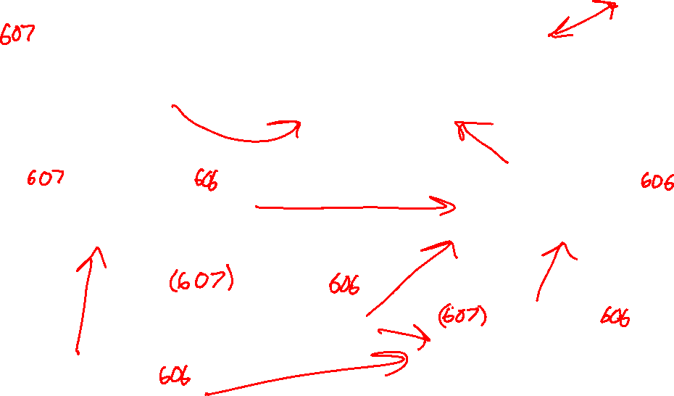
What is ML?
Domain of Interest
Computer Science
Computer Science
Machine Learning
Optimization
Optimization
Statistics
Statistics
Linear Algebra
Linear Algebra
Probability
Probability
Calculus
Calculus
Measure Theory

Slide 43
Why Computer Science for ML?
10-607
To best understand A we need B
A | B
Slide credit: CMU MLD Matt Gormley

Slide 44
Why Computer Science for ML?
10-607
To best understand A we need B
A | B
Analysis of Exact Inference in Graphical Models | Computation Computational Complexity Recursion; Dynamic Programming Data Structures for ML Algorithms
Slide credit: CMU MLD Matt Gormley

Slide 45
Factor Graph Notation
X₉
ψ_{{1,8,9}}
ψ_{{1,8,9}}
ψ_{{1,8,9}}
ψ_{{1,8,9}}
ψ_{{1,8,9}}
ψ_{{1,8,9}}
ψ_{{1,8,9}}
ψ_{{1,8,9}}
ψ_{{1,8,9}}
ψ_{{1,8,9}}
ψ_{{1,8,9}}
ψ_{{1,8,9}}
Slide credit: CMU MLD Matt Gormley
X₈
ψ_{{2,7,8}}
X₇
ψ_{{3,6,7}}
X₆
Joint Distribution
ψ₁₀
ψ₁₀
ψ₁₀
X₁
ψ₂
X₂
X₃
ψ_{{3,4}}
X₄
X₅
ψ₂
ψ₂
ψ₂
ψ₂
ψ₂
ψ₂
ψ₂
ψ₂
ψ₂
ψ₈
ψ₈
ψ₈
ψ_{{1,2}}
ψ_{{2,3}}
ψ₈
Note: This is just motivation – we’ll cover the math need to understand these topics later!
ψ₅
ψ₅
ψ₅
ψ₅
ψ₅
ψ₅
ψ₅
ψ₉
ψ₉
ψ₉
ψ₁
ψ₉
ψ₁
ψ₁
ψ₁
ψ₁
ψ₁
ψ₁
ψ₁
ψ₁
ψ₁
ψ₁
ψ₃
ψ₃
ψ₃
ψ₃
ψ₃
ψ₃
ψ₃
ψ₃
ψ₃
ψ₇
ψ₇
ψ₇
ψ₇
ψ₇
ψ_{{1}}
ψ_{{2}}
ψ_{{3}}
ψ₇
time
flies
like
an
arrow
45
Variables:
Factors:

Slide 46
Factors are Tensors
 | s | vp | pp | …
s | 0 | 2 | .3
vp | 3 | 4 | 2
pp | .1 | 2 | 1
…
X₉
 | s | vp | pp | …
s | 0 | 2 | .3
vp | 3 | 4 | 2
pp | .1 | 2 | 1
…
 | s | vp | pp | …
s | 0 | 2 | .3
vp | 3 | 4 | 2
pp | .1 | 2 | 1
…
ψ_{{1,8,9}}
ψ_{{1,8,9}}
ψ_{{1,8,9}}
ψ_{{1,8,9}}
ψ_{{1,8,9}}
ψ_{{1,8,9}}
ψ_{{1,8,9}}
ψ_{{1,8,9}}
ψ_{{1,8,9}}
ψ_{{1,8,9}}
ψ_{{1,8,9}}
ψ_{{1,8,9}}
Slide credit: CMU MLD Matt Gormley
X₈
s
vp
ψ_{{2,7,8}}
pp
X₇
 | v | n | p | d
v | 1 | 6 | 3 | 4
n | 8 | 4 | 2 | 0.1
p | 1 | 3 | 1 | 3
d | 0.1 | 8 | 0 | 0
ψ_{{3,6,7}}
X₆
ψ₁₀
ψ₁₀
ψ₁₀
X₁
ψ₂
X₂
X₃
ψ_{{3,4}}
X₄
X₅
ψ₂
ψ₂
ψ₂
ψ₂
ψ₂
ψ₂
ψ₂
ψ₂
ψ₂
ψ₈
ψ₈
ψ₈
ψ_{{1,2}}
ψ_{{2,3}}
ψ₈
v | 3
n | 4
p | 0.1
d | 0.1
Note: This is just motivation – we’ll cover the math need to understand these topics later!
ψ₅
ψ₅
ψ₅
ψ₅
ψ₅
ψ₅
ψ₅
ψ₉
ψ₉
ψ₉
ψ₁
ψ₉
ψ₁
ψ₁
ψ₁
ψ₁
ψ₁
ψ₁
ψ₁
ψ₁
ψ₁
ψ₁
ψ₃
ψ₃
ψ₃
ψ₃
ψ₃
ψ₃
ψ₃
ψ₃
ψ₃
ψ₇
ψ₇
ψ₇
ψ₇
ψ₇
ψ_{{1}}
ψ_{{2}}
ψ_{{3}}
ψ₇
time
flies
like
an
arrow
46
Factors:

Slide 47
Inference
Given a factor graph, two common tasks …
Compute the most likely joint assignment, x* = argmax_{x} p(X=x)
Compute the marginal distribution of variable X_{i}: p(X_{i}=x_{i}) for each value x_{i}
Both consider all joint assignments.
Both are NP-Hard in general.
So, we turn to approximations.
Slide credit: CMU MLD Matt Gormley
p(X_{i}=x_{i}) = sum of p(X=x) over joint assignments with X_{i}=x_{i}
Note: This is just motivation – we’ll cover the math need to understand these topics later!
47
Notes:
MAP -- OptP-Complete
Marginal -- #P Complete
47

Slide 48
Marginals by Sampling on Factor Graph
Suppose we took many samples from the distribution over taggings:
Sample 1:
n
v
p
d
n
Sample 2:
n
n
v
d
n
Sample 3:
n
v
p
d
n
Sample 4:
v
n
p
d
n
Slide credit: CMU MLD Matt Gormley
Sample 5:
v
n
v
d
n
Sample 6:
n
v
p
d
n
X₀
X₁
ψ₂
X₂
ψ₄
X₃
ψ₆
X₄
ψ₈
X₅
ψ₀
Note: This is just motivation – we’ll cover the math need to understand these topics later!
<START>
ψ₁
ψ₃
ψ₅
ψ₇
ψ₉
time
flies
like
an
arrow

Slide 49
Marginals by Sampling on Factor Graph
The marginal p(X_{i} = x_{i}) gives the probability that variable X_{i} takes value x_{i} in a random sample
Sample 1:
n
v
p
d
n
Sample 2:
n
n
v
d
n
Sample 3:
n
v
p
d
n
Sample 4:
v
n
p
d
n
Slide credit: CMU MLD Matt Gormley
Sample 5:
v
n
v
d
n
Sample 6:
n
v
p
d
n
X₀
X₁
ψ₂
X₂
ψ₄
X₃
ψ₆
X₄
ψ₈
X₅
ψ₀
Note: This is just motivation – we’ll cover the math need to understand these topics later!
<START>
ψ₁
ψ₃
ψ₅
ψ₇
ψ₉
time
flies
like
an
arrow

Slide 50
Marginals by Sampling on Factor Graph
Estimate the marginals as:
n | 4/6
v | 2/6
n | 3/6
v | 3/6
p | 4/6
v | 2/6
d | 6/6
n | 6/6
Sample 1:
n
v
p
d
n
Sample 2:
n
n
v
d
n
Sample 3:
n
v
p
d
n
Sample 4:
v
n
p
d
n
Slide credit: CMU MLD Matt Gormley
Sample 5:
v
n
v
d
n
Sample 6:
n
v
p
d
n
X₀
X₁
ψ₂
X₂
ψ₄
X₃
ψ₆
X₄
ψ₈
X₅
ψ₀
Note: This is just motivation – we’ll cover the math need to understand these topics later!
<START>
ψ₁
ψ₃
ψ₅
ψ₇
ψ₉
time
flies
like
an
arrow

Slide 51
Why Computer Science for ML?
10-607
To best understand A we need B
A | B
Analysis of Exact Inference in Graphical Models | Computation Computational Complexity Recursion; Dynamic Programming Data Structures for ML Algorithms
Implementation Design of a Deep Learning Library | Programming & Efficiency Debugging for Machine Learning Efficient Implementation / Profiling ML Algorithms
Slide credit: CMU MLD Matt Gormley

Slide 52
Finite Difference Method
Notes:
Suffers from issues of floating point precision, in practice
Typically only appropriate to use on small examples with an appropriately chosen epsilon
Slide credit: CMU MLD Matt Gormley
Note: This is just motivation – we’ll cover the math need to understand these topics later!

Slide 53
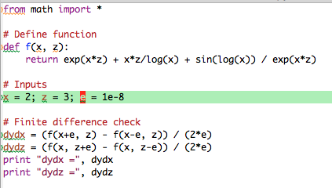
Differentiation
Chain Rule Quiz #1:
Suppose x = 2 and z = 3, what are dy/dx and dy/dz for the function below?
Finite
Difference
Solution:
Slide credit: CMU MLD Matt Gormley
Note: This is just motivation – we’ll cover the math need to understand these topics later!

Slide 54
Backpropagation
Training
Automatic Differentiation – Reverse Mode (aka. Backpropagation)
Forward Computation
Write an algorithm for evaluating the function y = f(x). The algorithm defines a directed acyclic graph, where each variable is a node (i.e. the “computation graph”)
Visit each node in topological order. For variable u_{i} with inputs v₁,…, v_{N}
Compute u_{i} = g_{i}(v₁,…, v_{N})
Store the result at the node
Backward Computation
Initialize all partial derivatives dy/du_{j} to 0 and dy/dy = 1.
Visit each node in reverse topological order. For variable u_{i} = g_{i}(v₁,…, v_{N})
We already know dy/du_{i}
Increment dy/dv_{j} by (dy/du_{i})(du_{i}/dv_{j}) (Choice of algorithm ensures computing (du_{i}/dv_{j}) is easy)
Slide credit: CMU MLD Matt Gormley
Note: This is just motivation – we’ll cover the math need to understand these topics later!
Return partial derivatives dy/du_{i} for all variables

Slide 55
Why Computer Science for ML?
10-607
To best understand A we need B
A | B
Analysis of Exact Inference in Graphical Models | Computation Computational Complexity Recursion; Dynamic Programming Data Structures for ML Algorithms
Implementation Design of a Deep Learning Library | Programming & Efficiency Debugging for Machine Learning Efficient Implementation / Profiling ML Algorithms
Optimization for Support Vector Machines (SVMs) | Optimization Unconstrained Optimization Preconditioning Constrained Optimization
Slide credit: CMU MLD Matt Gormley

Slide 56
Support Vector Machines (SVMs)
Hard-margin SVM (Primal)
Hard-margin SVM (Lagrangian Dual)
Instead of minimizing the primal, we can maximize the dual problem
For the SVM, these two problems give the same answer (i.e. the minimum of one is the maximum of the other)
Definition: support vectors are those points x^{(i)} for which α^{(i)} ≠ 0
Slide credit: CMU MLD Matt Gormley
Note: This is just motivation – we’ll cover the math need to understand these topics later!

Slide 57
SVM QP
Slide credit: CMU MLD Matt Gormley
Note: This is just motivation – we’ll cover the math need to understand these topics later!

Slide 58
SVM QP
Slide credit: CMU MLD Matt Gormley
Note: This is just motivation – we’ll cover the math need to understand these topics later!

Slide 59
SVM QP
Slide credit: CMU MLD Matt Gormley
Note: This is just motivation – we’ll cover the math need to understand these topics later!

Slide 60
SVM QP
Slide credit: CMU MLD Matt Gormley
Note: This is just motivation – we’ll cover the math need to understand these topics later!

Slide 61
SVM QP
Slide credit: CMU MLD Matt Gormley
Note: This is just motivation – we’ll cover the math need to understand these topics later!

Slide 62
SVM QP
Slide credit: CMU MLD Matt Gormley
Note: This is just motivation – we’ll cover the math need to understand these topics later!

Slide 63
Why Computer Science for ML?
10-607
To best understand A we need B
A | B
Analysis of Exact Inference in Graphical Models | Computation Computational Complexity Recursion; Dynamic Programming Data Structures for ML Algorithms
Implementation Design of a Deep Learning Library | Programming & Efficiency Debugging for Machine Learning Efficient Implementation / Profiling ML Algorithms
Optimization for Support Vector Machines (SVMs) | Optimization Unconstrained Optimization Preconditioning Constrained Optimization
Slide credit: CMU MLD Matt Gormley
The core content for this course is the computer science (Column B), but you will apply what you learn to real problems in machine learning (Column A)

Slide 64
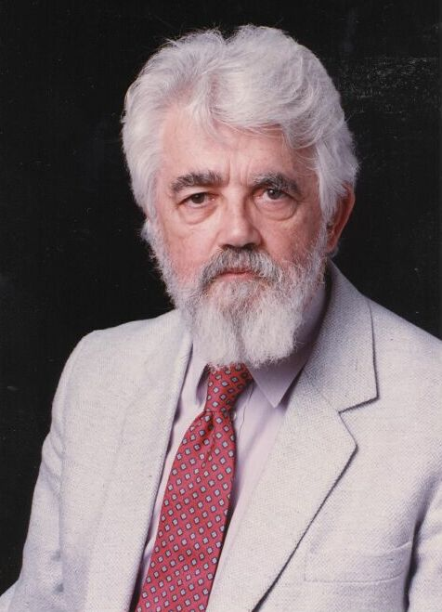
AI Definition by John McCarthy
What is artificial intelligence
It is the science and engineering of making intelligent machines, especially intelligent computer programs
What is intelligence
Intelligence is the computational part of the ability to achieve goals in the world
http://www-formal.stanford.edu/jmc/whatisai/whatisai.html

Slide 65
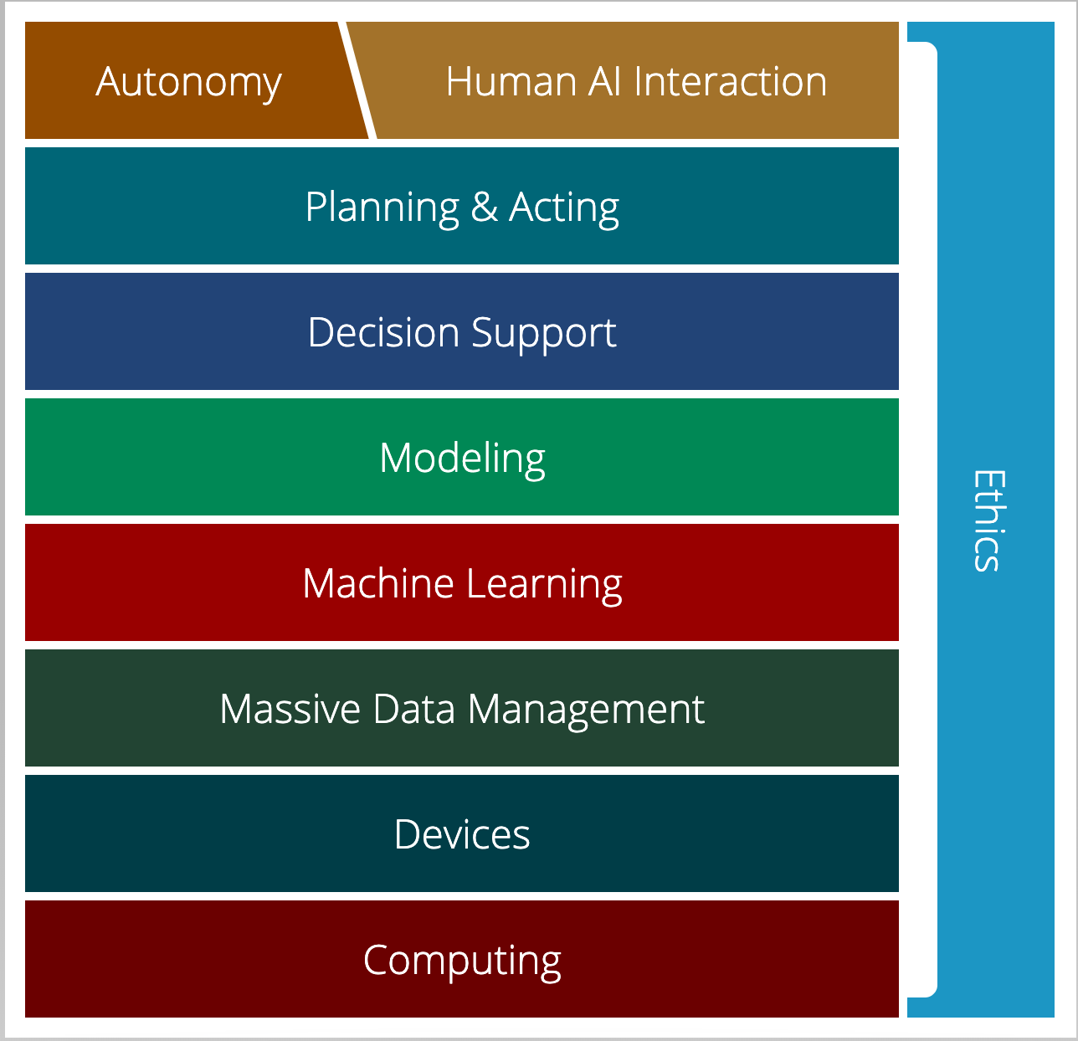
AI Stack for CMU AI
“AI must understand the human needs and it must make smart design decisions based on that understanding”
AI Stack
https://ai.cs.cmu.edu/about
Notes:
Proposed by Andrew Moore, CMU is using AI Stack to illustrate what they consider as AI. AI must understand the human needs and it must make smart design decisions based on that understanding. Despite the simple definition, though, AI isn't just one thing. It's a giant thing, built from technology blocks we call the AI Stack. At Carnegie Mellon, we view it as a toolbox — each block houses a set of technologies that scientists and researchers can reach for as they work on new initiatives. Expertise in all areas? Not required. Instead, we believe you can focus on one area and draw on other parts of the stack for help. Each block depends on the other for support. And AI endeavors that ignore parts of the stack won't succeed.

Slide 66
AI Stack for CMU AI
“Machine learning focuses on creating programs that learn from experience.”
“It advances computing through exposure to new scenarios, testing and adaptation, while using pattern- and trend-detection to help the computer make better decisions in similar, subsequent situations.”
AI Stack
https://ai.cs.cmu.edu/about

Slide 67
Artificial Intelligence vs Machine Learning?
Artificial Intelligence
Machine Learning
Deep Learning

Slide 68
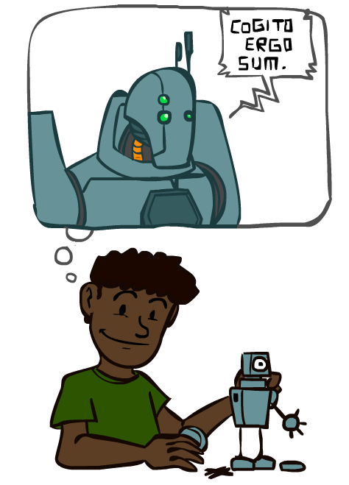
A Brief History of AI
Images: ai.berkeley.edu

Slide 69
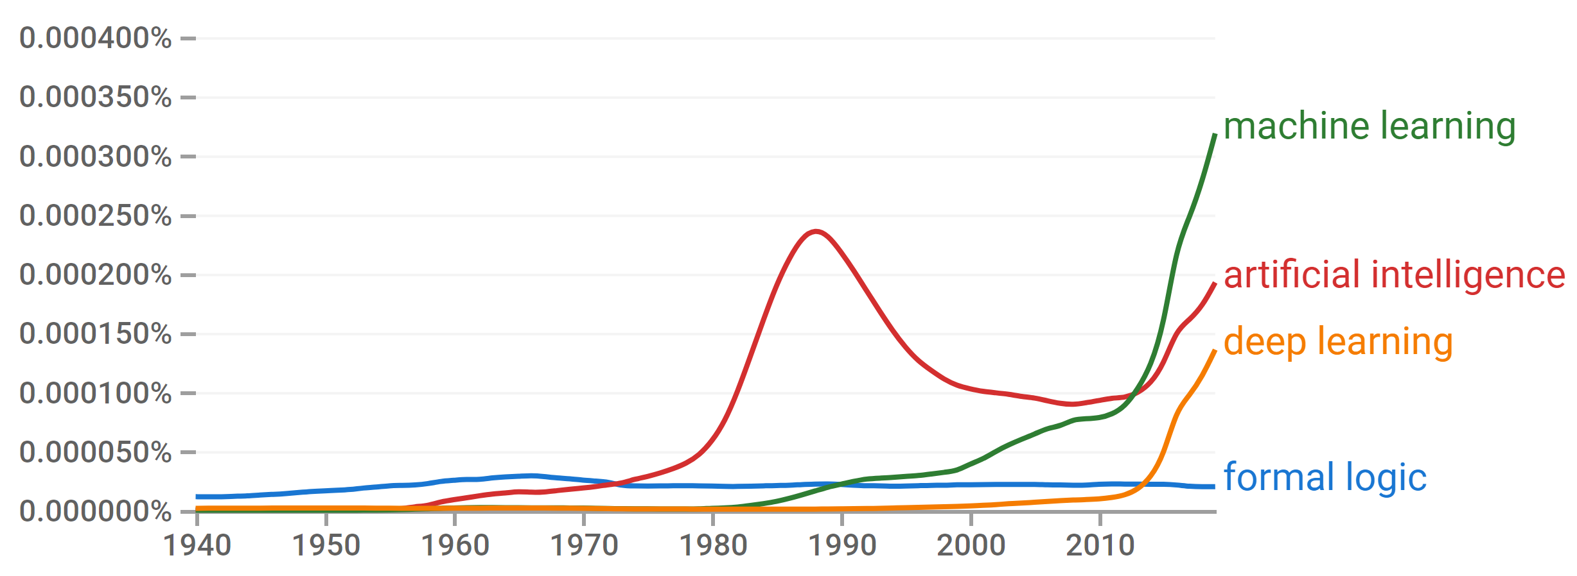
A Brief History of AI
Knowledge Based
Systems
1970-1990
Statistical Approaches
1990-
Deep Learning Era
2012-
AI
Excitement!
1950-1970
https://books.google.com/ngrams

Slide 70
A Brief History of AI
1940-1950: Early days
1943: McCulloch & Pitts: Boolean circuit model of brain
1950: Turing's “Computing Machinery and Intelligence”
1950—70: Excitement: Look, Ma, no hands!
1950s: Early AI programs, including Samuel's checkers program, Newell & Simon's Logic Theorist, Gelernter's Geometry Engine
1956: Dartmouth meeting: “Artificial Intelligence” adopted
1970—90: Knowledge-based approaches
1969—79: Early development of knowledge-based systems
1980—88: Expert systems industry booms
1988—93: Expert systems industry busts: “AI Winter”
1990—: Statistical approaches
Resurgence of probability, focus on uncertainty
General increase in technical depth
Agents and learning systems… “AI Spring”?
2012—: Deep learning
2012: ImageNet & AlexNet
Images: ai.berkeley.edu
Notes:
Million dollar computer with less computation than your phone
MT was

Slide 71
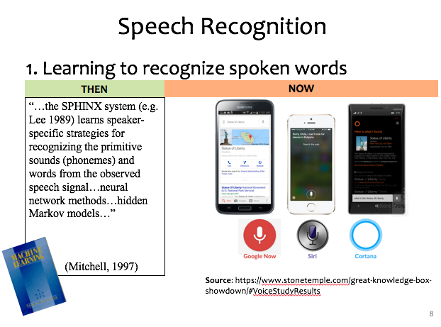
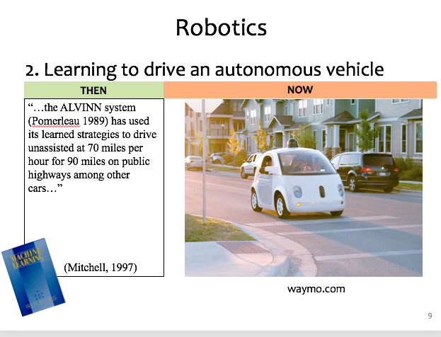
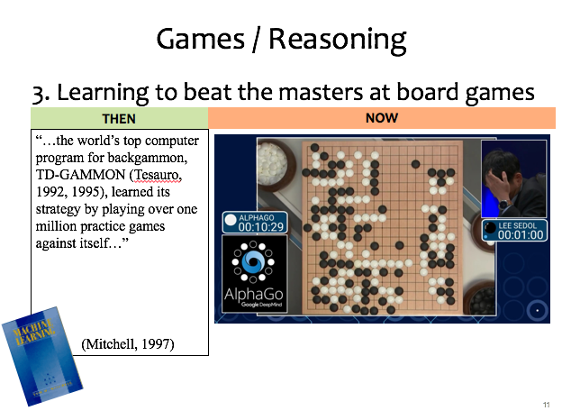
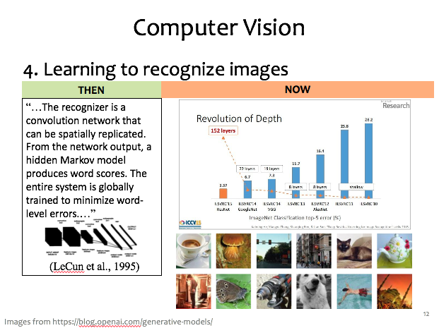
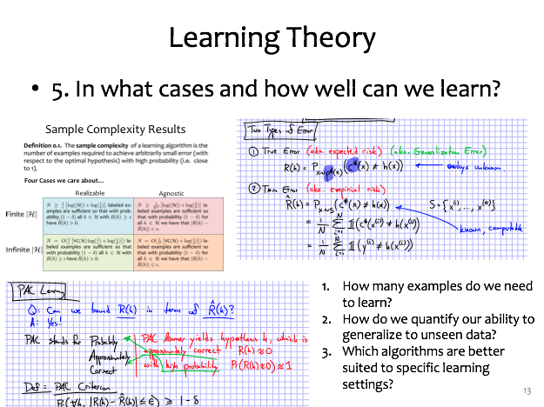
ML Applications?
Slide credit: CMU MLD Matt Gormley

Slide 72


Speech Recognition
1. Learning to recognize spoken words
THEN
NOW
“…the SPHINX system (e.g. Lee 1989) learns speaker-specific strategies for recognizing the primitive sounds (phonemes) and words from the observed speech signal…neural network methods…hidden Markov models…”
(Mitchell, 1997)
Source: https://www.stonetemple.com/great-knowledge-box- showdown/#VoiceStudyResults
Slide credit: CMU MLD Matt Gormley

Slide 73
Robotics
2. Learning to drive an autonomous vehicle
NOW
THEN
NOW
“…the ALVINN system (Pomerleau 1989) has used its learned strategies to drive unassisted at 70 miles per hour for 90 miles on public highways among other cars…”
(Mitchell, 1997)
https://www.geek.com/wp-content/uploads/2016/03/uber.jpg
waymo.com
Slide credit: CMU MLD Matt Gormley
Notes:
This a Google self-driving car; it looks really cute and friendly.
But these things weigh a *ton* and there is a person sitting inside this thing!
So this machine needs to know a lot about its environment, what actions to take, or policy to follow.
If a person were to enter the crosswalk, it would need to know how to slow down, or that person would learn a very uncomfortable lesson about physics

Slide 74
Games / Reasoning
3. Learning to beat the masters at board games
THEN
NOW
“…the world’s top computer program for backgammon, TD-GAMMON (Tesauro, 1992, 1995), learned its strategy by playing over one million practice games against itself…”
(Mitchell, 1997)
Slide credit: CMU MLD Matt Gormley

Slide 75
Computer Vision
4. Learning to recognize images
THEN
NOW
“…The recognizer is a convolution network that can be spatially replicated. From the network output, a hidden Markov model produces word scores. The entire system is globally trained to minimize word-level errors.…”
(LeCun et al., 1995)
Slide credit: CMU MLD Matt Gormley
Images from https://blog.openai.com/generative-models/

Slide 76
Learning Theory
5. In what cases and how well can we learn?
Slide credit: CMU MLD Matt Gormley
How many examples do we need to learn?
How do we quantify our ability to generalize to unseen data?
Which algorithms are better suited to specific learning settings?

Slide 77
Machine Learning and Statistics
Statistics is also about learning from data
Statistics has been around from much longer!
What’s the difference?
Until the mid 1990s:
Statistics:
A branch of mathematics
Emphasized rigor, correctness, provable properties (“is it correct?”)
Was not very concerned with scaling
Not much awareness of computational complexity
Machine Learning:
A branch of Computer Science / AI
Focus on heuristics, making things work in practice (“does it work?”)
Not much awareness of statistical theory
Slide: CMU ML, Roni Rosenfeld

Slide 78
Machine Learning and Statistics
From the mid 1990s:
The two fields have effectively merged
Carnegie Mellon has led the way!
ML is now often called “Statistical Machine Learning”
There is very little non-statistical ML today
Slide: CMU ML, Roni Rosenfeld

Slide 79
10-606 and 10-607
Mini Courses
10-606
10-607
Intro ML Courses
10-315
10-301/601
10-701
10-715
Prerequisites

Slide 80
Today
Course Info
Warm-up exercise
Propositional Logic and Proofs
ML and 606/607 Intro
More Course Info
Images: ai.berkeley.edu

Slide 81



Course Information
Website: https://www.cs.cmu.edu/~10607
Canvas: canvas.cmu.edu
Gradescope: gradescope.com
Communication:
piazza.com
E-mail (if piazza doesn’t work):
pvirtue@andrew.cmu.edu

Slide 82
Course Information
Lectures
Lectures are recorded
Shared with our course and ML course staff only
Participation point earned by answering Piazza polls in lecture
Quizzes will in lecture, announced two days ahead of time
Slides will be posted
Recitations
Recommended attendance
No plans to record at this point
No participation points in recitation
Recitation materials are in-scope for quizzes and exams

Slide 83
Course Information
Office Hours
OH calendar on course website
OH-by-appointment requests are certainly welcome
Mental Health

