Slide 1

10-607
Computational Foundations for Machine Learning
Data Structures
Instructor: Pat Virtue

Slide 2

Plan
Data Structures
Dense vs sparse structures
Trees
BFS and DFS
Stacks and Queues
Other tree implementations
Graphs

Slide 3

Abstractions vs. Data Structures
Abstractions
Data Structures
List
Set
Map (Dictionary)
Tree
Queue (FIFO)
Stack (LIFO)
Priority Queue
Graph
Array (fixed size)
Array (variable size)
Linked List
Doubly-Linked List
Multidimensional Array
Tensor
Hash Map
Binary Search Tree
Balanced Tree
Trie
Stack
Heap
Graph
Bipartite Graph
Sparse Vector
Sparse Matrix

Slide 4
Data Structures for ML
Examples…
Data:
  Dense feature vector (array)
  Sparse feature vector (sparse vector)
  Design matrix (multidimensional array)
Models:
  Decision Trees (tree)
  Bayesian Network (directed acyclic graph)
  Factor Graph (bipartite graph)
Algorithms:
  Greedy Search (weighted graph)
  A* Search (priority queue/heap)
  Forward-backward for HMM (trellis)
Notes:
TODO: Bloom Filter
TODO: Locality Sensitive Hashing

Slide 5
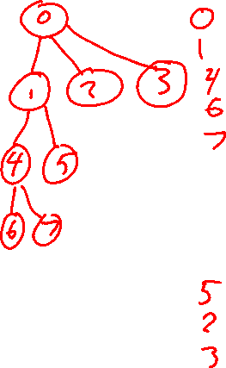
Tree to Predict C-Section Risk
(Sims et al., 2000)
Figure from Tom Mitchell

Slide 6
Plan
Data Structures
Dense vs sparse structures
Trees
BFS and DFS
Stacks and Queues
Other tree implementations
Graphs

Slide 7

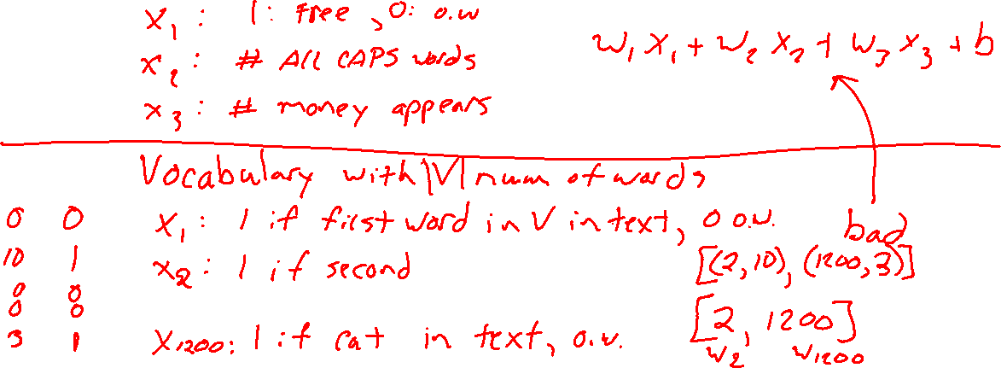
Dense vs sparse structures
Vector dot product example
Linear regression model $y=w^{T}x+b$
Where $x$ represents the contents of text data, e.g., e-mail or book review

Slide 8
Dense vs sparse structures
Matrix multiplication with special structure
Example: diagonal matrices

Slide 9
Plan
Data Structures
Dense vs sparse structures
Trees
BFS and DFS
Stacks and Queues
Other tree implementations
Graphs

Slide 10
Trees
Notebook

Slide 11
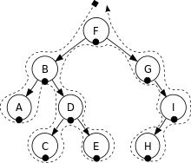
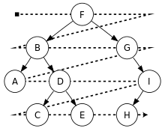
Tree Traversals
Depth First Search
Breadth First Search
Figures from Wikipedia

Slide 12




Stacks and Queus
LIFO vs FIFO

Slide 13
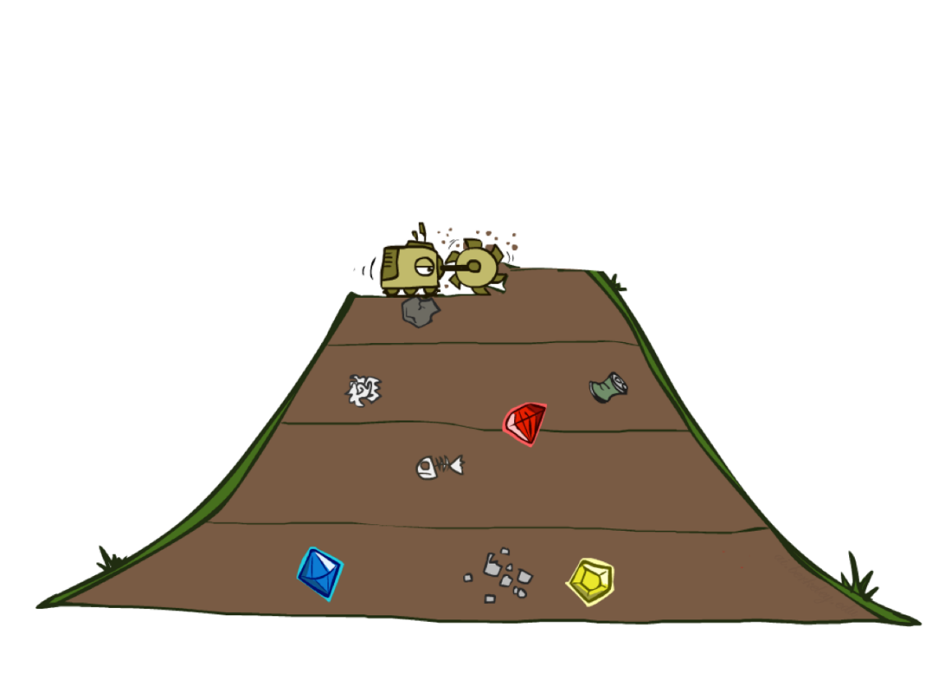
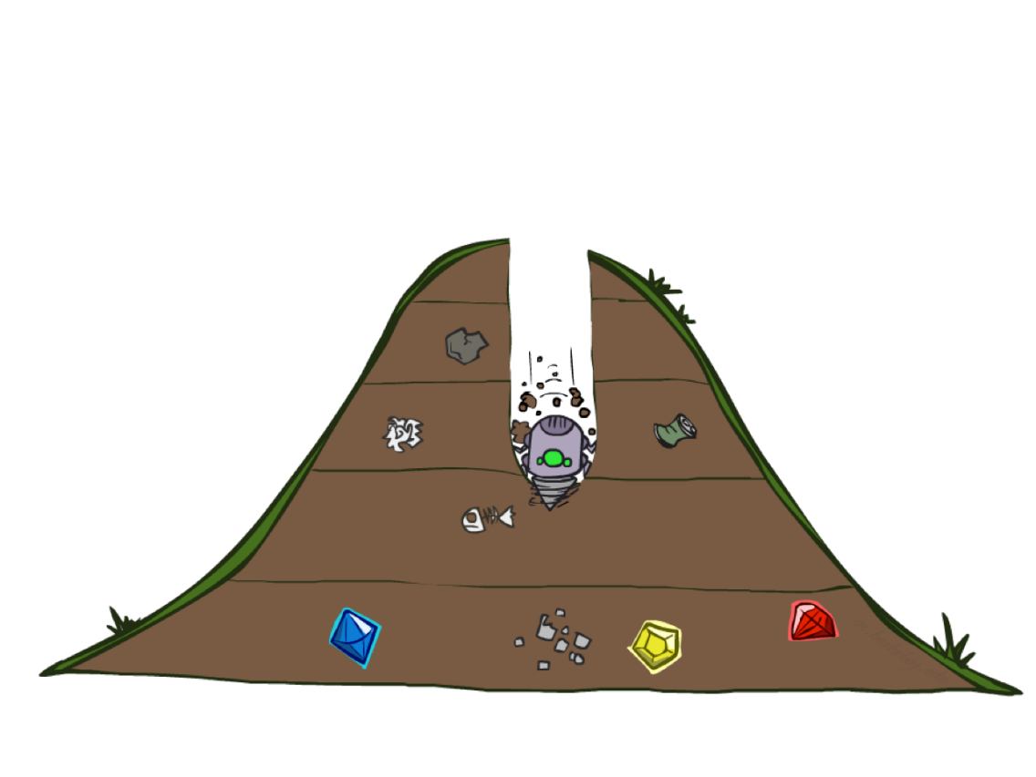
Poll 1
Is the following demo using BFS or DFS
Slide credit: ai.berkeley.edu
[Demo: dfs/bfs maze water (L2D6)]

Slide 14
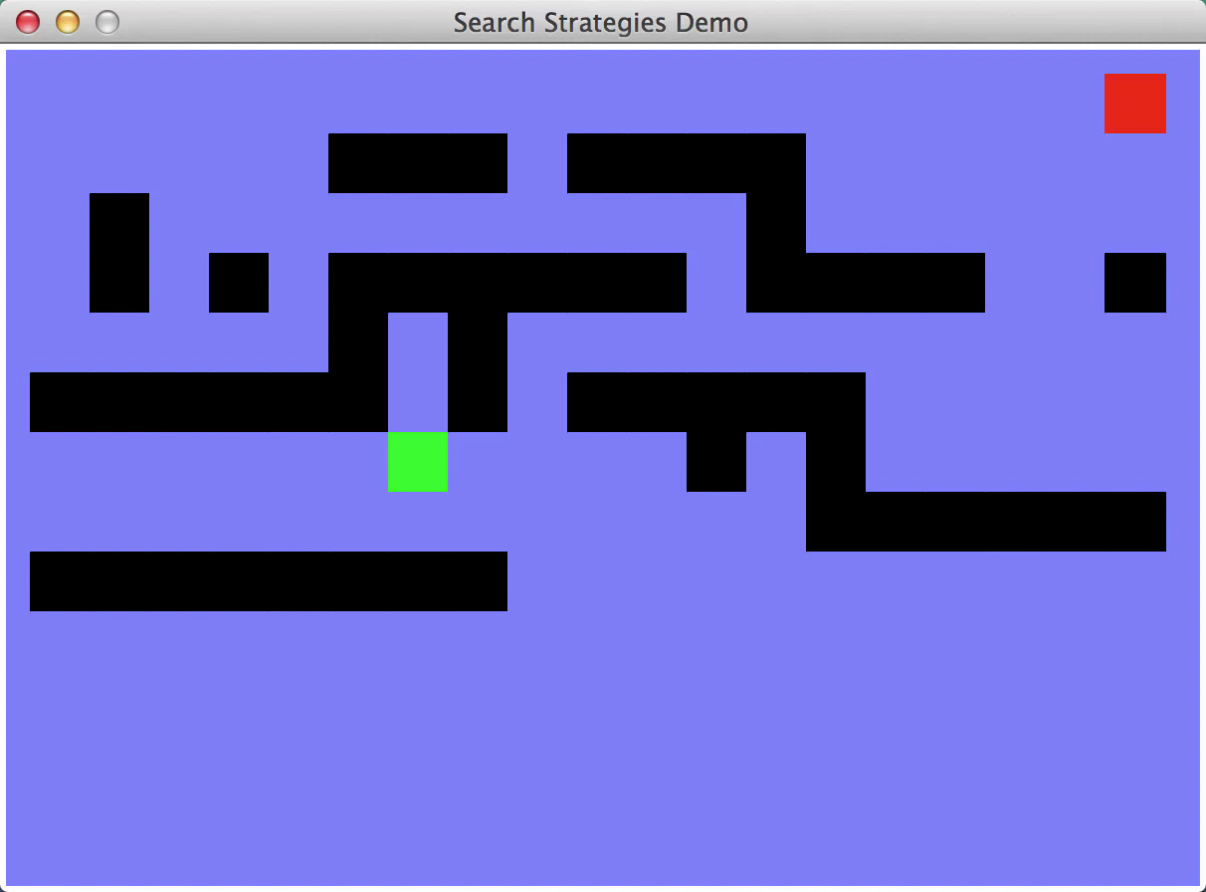
Video of Demo Maze Water DFS/BFS (part 1)
Slide credit: ai.berkeley.edu

Slide 15

Video of Demo Maze Water DFS/BFS (part 2)
Slide credit: ai.berkeley.edu

Slide 16
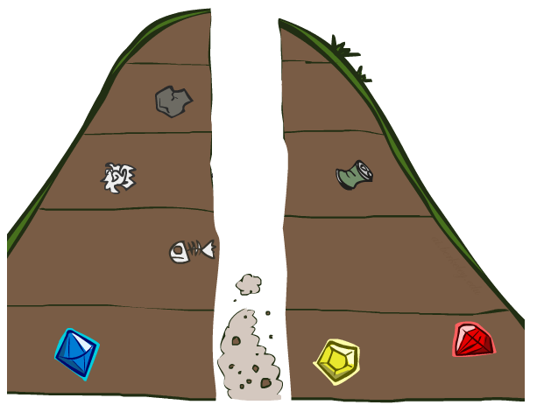
Search Algorithm Properties
Slide credit: ai.berkeley.edu

Slide 17

Search Algorithm Properties
Complete: Guaranteed to find a solution if one exists?
Optimal: Guaranteed to find the least cost path?
Time complexity?
Space complexity?
Cartoon of search tree:
  b is the branching factor
  m is the maximum depth
  solutions at various depths
Number of nodes in entire tree?
  1 + b + b² + …. b^{m} = O(b^{m})
1 node
b
…
b nodes
b² nodes
m tiers
b^{m} nodes
Slide credit: ai.berkeley.edu

Slide 18
Search Algorithm Properties
Complete: Guaranteed to find a solution if one exists?
Optimal: Guaranteed to find the least cost path?
Time complexity?
Space complexity?
Cartoon of search tree:
  b is the branching factor
  m is the maximum depth
  solutions at various depths
Number of nodes in entire tree?
  1 + b + b² + …. b^{m} = O(b^{m})
1 node
b
…
b nodes
b² nodes
m tiers
b^{m} nodes
Slide credit: ai.berkeley.edu

Slide 19
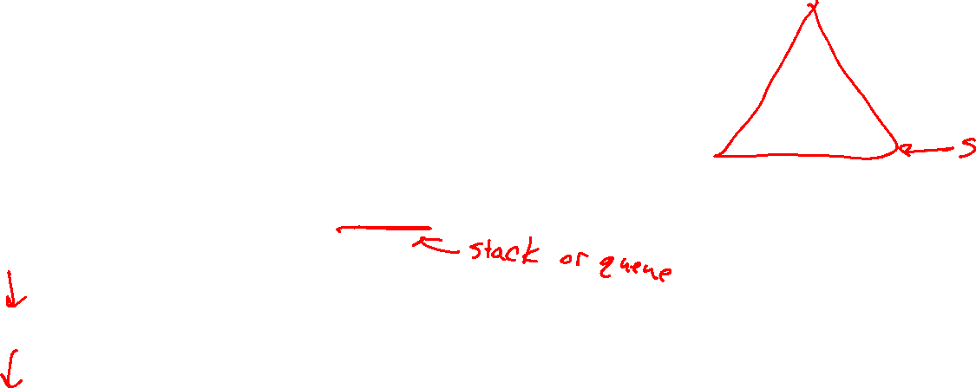
Poll 2
1 node
Are these the properties for BFS or DFS?
  Takes O(b^{m}) time
  Uses O(bm) space on frontier
  Complete with graph search
  Not optimal unless all goals are in the same level (and the same step cost everywhere)
b
…
b nodes
b² nodes
m tiers
b^{m} nodes
Slide credit: ai.berkeley.edu

Slide 20

Depth-First Search (DFS) Properties
What nodes does DFS expand?
  Some left prefix of the tree.
  Could process the whole tree!
  If m is finite, takes time O(b^{m})
How much space does the frontier take?
  Only has siblings on path to root, so O(bm)
Is it complete?
  m could be infinite, so only if we prevent cycles (graph search)
Is it optimal?
  No, it finds the “leftmost” solution, regardless of depth or cost
1 node
b
…
b nodes
b² nodes
m tiers
b^{m} nodes
Slide credit: ai.berkeley.edu

Slide 21
Breadth-First Search (BFS) Properties
What nodes does BFS expand?
  Processes all nodes above shallowest solution
  Let depth of shallowest solution be s
  Search takes time O(b^{s})
How much space does the frontier take?
  Has roughly the last tier, so O(b^{s})
Is it complete?
  s must be finite if a solution exists, so yes!
Is it optimal?
  Only if costs are all the same (more on costs later)
1 node
b
…
b nodes
s tiers
b² nodes
b^{s} nodes
b^{m} nodes
Slide credit: ai.berkeley.edu

Slide 22

Iterative Deepening
Idea: get DFS’s space advantage with BFS’s time / shallow-solution advantages
  Run a DFS with depth limit 1. If no solution…
  Run a DFS with depth limit 2. If no solution…
  Run a DFS with depth limit 3. …..
Isn’t that wastefully redundant?
  Generally most work happens in the lowest level searched, so not so bad!
b
…
Slide credit: ai.berkeley.edu

Slide 23
Plan
Data Structures
Dense vs sparse structures
Trees
BFS and DFS
Stacks and Queues
Other tree implementations
Graphs

Slide 24
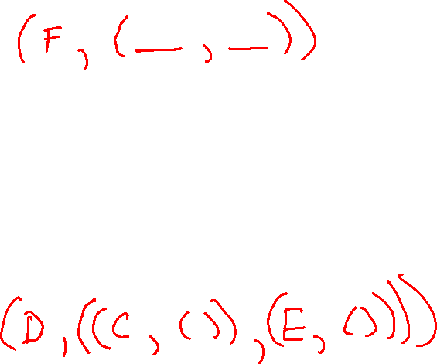
Trees
Other data structures for trees
Figure from Wikipedia

Slide 25
Trees
Storing information in trees

Slide 26

Example: Data Structure for Search (out of scope)
Nodes have
state, parent, action, path-cost
A child of node by action a has
state = result(node.state,a)
parent = node
action = a
path-cost = node.path_cost + step_cost(node.state, a, self.state)
Slide credit: ai.berkeley.edu
Extract solution by tracing back parent pointers, collecting actions

Slide 27
State Space Graphs vs. Search Trees
Consider this 4-state graph:
How big is its search tree (from S)?
S
a
a
b
S
G
b
G
G
a
b
G
a
b
G
∞
Important: Lots of repeated structure in the search tree!
Slide credit: ai.berkeley.edu

Slide 28
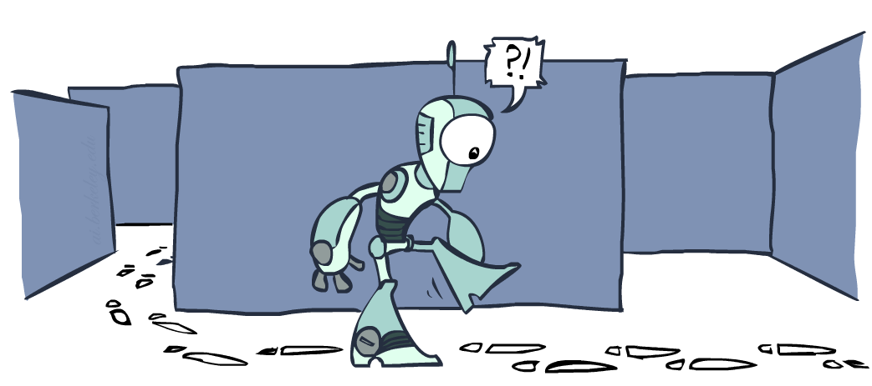
Tree Search vs Graph Search
Slide credit: ai.berkeley.edu

