Slide 1
Announcements
HW2
Due Sat 10/2
Quizzes
Mon 10/4, last 15 min. of class (calculus, optimization, Lagrange)
Mon 10/11, last 15 min. of class (probability, statistics)

Slide 2

Mathematical Foundations for Machine Learning Probability
Instructor: Pat Virtue

Slide 3
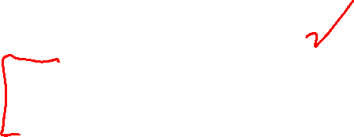
Plan
Today
Probability
Probability exercises
Chain rule
Independence
i.i.d.
Statistics
Finding the best parameters

Slide 4
Probability

Slide 5
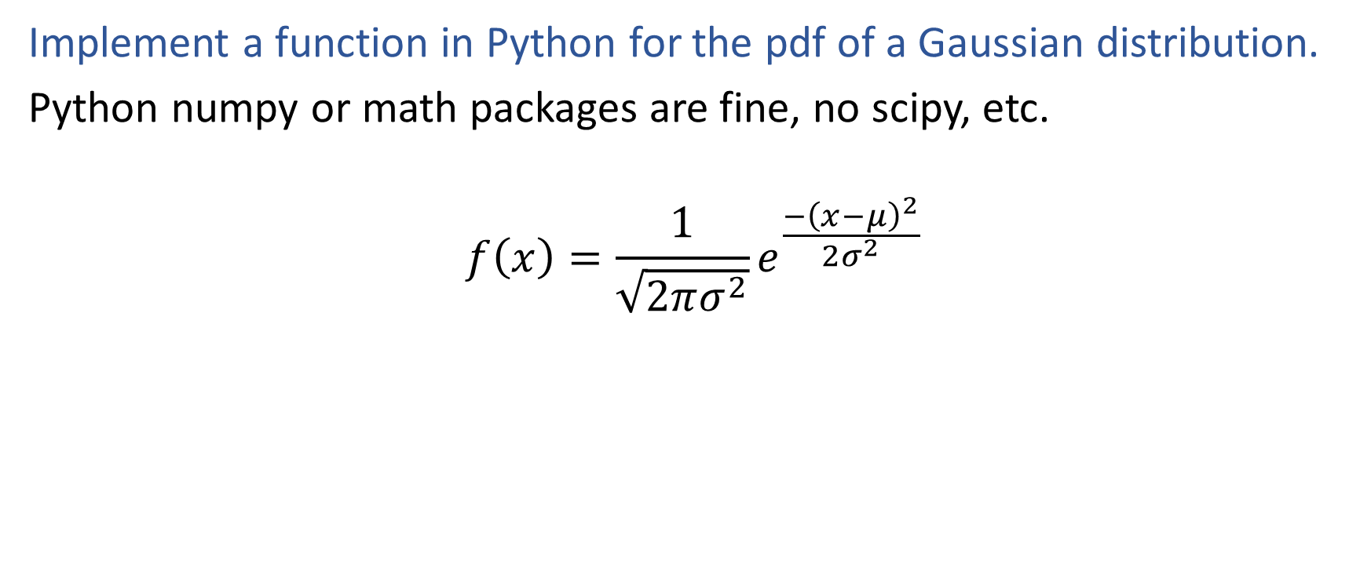
Poll 1: Exercise
Implement a function in Python for the pdf of a Gaussian distribution.
Python numpy or math packages are fine, no scipy, etc.
$$f\left(x\right)=\frac{1}{\sqrt{2πσ^{2}}}e^{\frac{−{\left(x−μ\right)}^{2}}{2σ^{2}}}$$

Slide 6
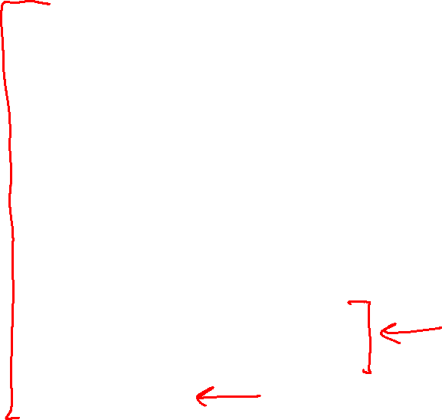
Probability Vocab
Outcomes
Sample space
Events
Probability
Random variable
Discrete random variable
Continuous random variable
Probability mass function
Probability density function
Parameters

Slide 7
Probability Toolbox
Algebra
Three axioms of probability
Theorem of total probability
Definition of conditional probability
Product rule
Bayes’ theorem
Chain rule
Independence
Conditional independence

Slide 8

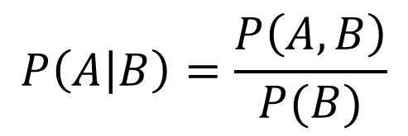

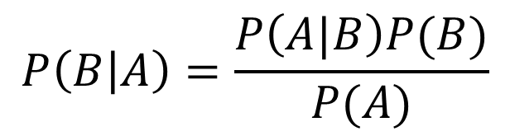
Tools Summary
Adding to our toolbox
Definition of conditional probability
Product Rule
Bayes’ theorem
Chain Rule…
$$P\left(A | B\right)=\frac{P\left(A, B\right)}{P(B)}$$
$$P(A,B)=P\left(A | B\right)P(B)$$
$$P\left(B | A\right)=\frac{P\left(A|B\right)P(B)}{P(A)}$$

Slide 9
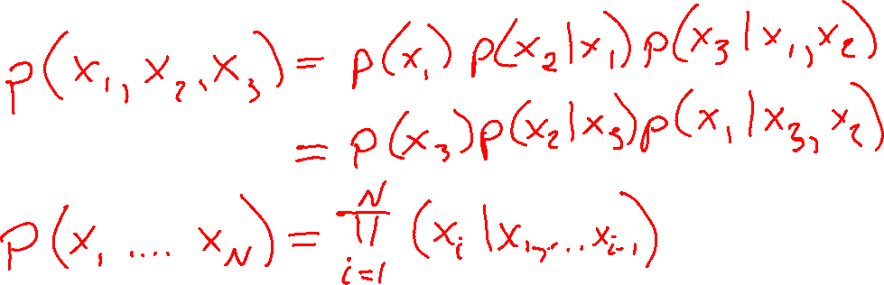
The Chain Rule
More generally, can always write any joint distribution as an incremental product of conditional distributions

Slide 10
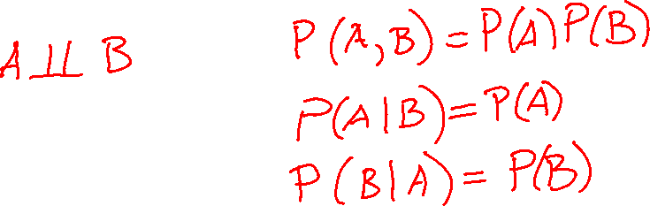
Independence

Slide 11
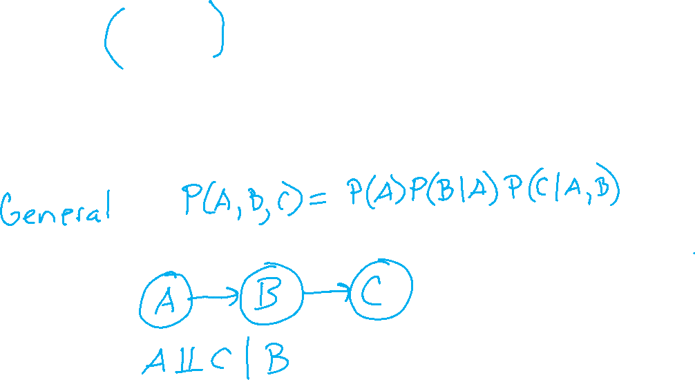
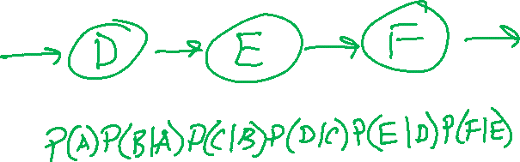

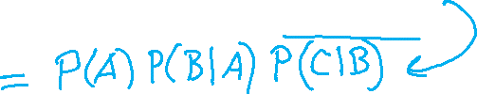
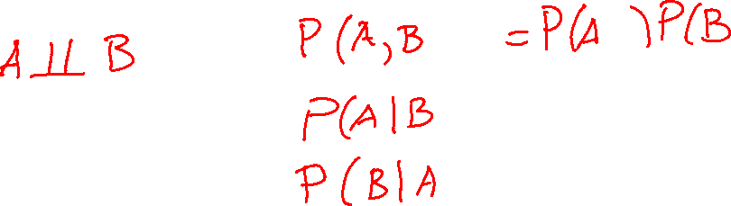
Conditional Independence

Slide 12
Conditional Independence

Slide 13
Probability Notation
Notation doc

Slide 14









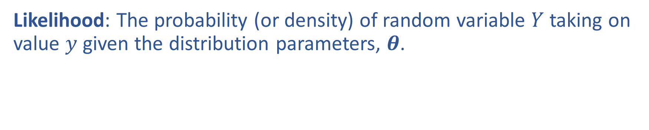
Likelihood
Likelihood: The probability (or density) of random variable $Y$ taking on value $y$ given the distribution parameters, $θ$.

Slide 15
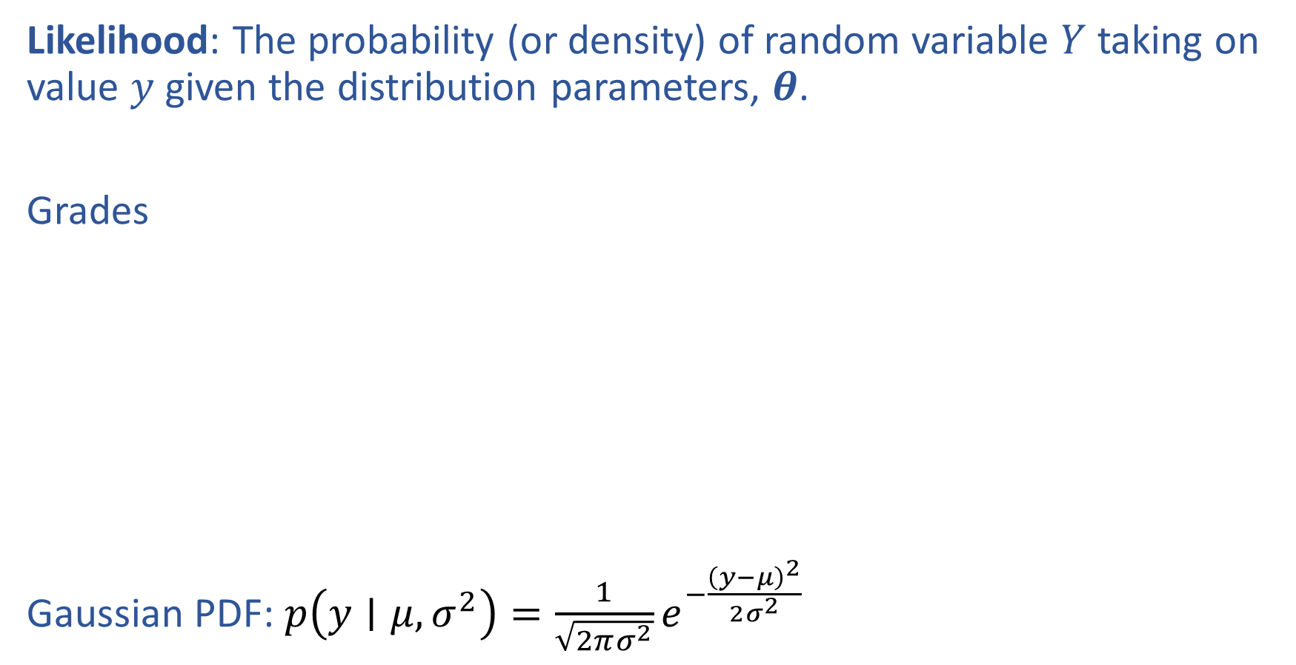
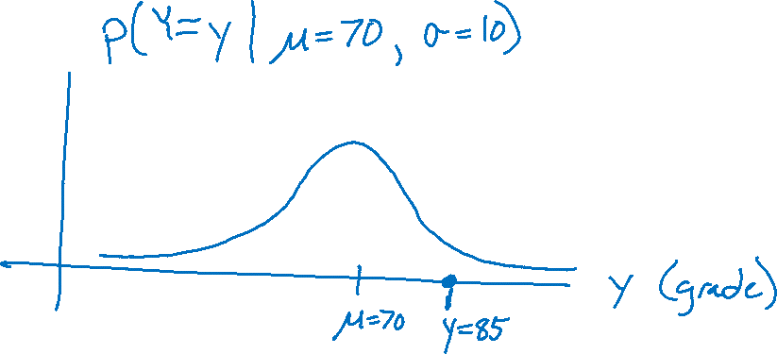
Likelihood
Likelihood: The probability (or density) of random variable $Y$ taking on value $y$ given the distribution parameters, $θ$.
Grades
Gaussian PDF: $p\left(y∣μ, σ^{2}\right)=\frac{1}{\sqrt{2πσ^{2}}}e^{−\frac{{\left(y−μ\right)}^{2}}{2σ^{2}}}$

Slide 16
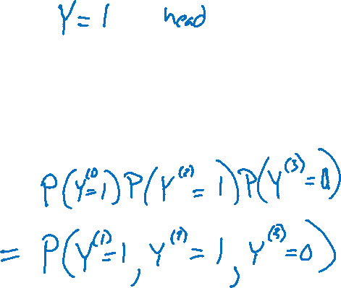
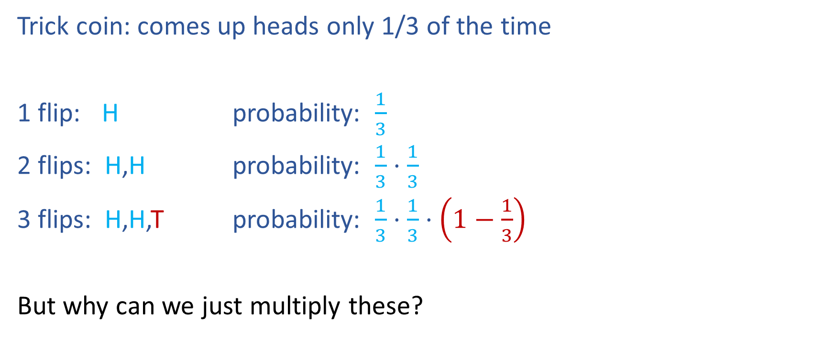
Likelihood
Trick coin: comes up heads only 1/3 of the time
1 flip: H probability: $\frac{1}{3}$
2 flips: H,H probability: $\frac{1}{3}⋅\frac{1}{3}$
3 flips: H,H,T probability: $\frac{1}{3}⋅\frac{1}{3}⋅\left(1−\frac{1}{3}\right)$
But why can we just multiply these?

Slide 17

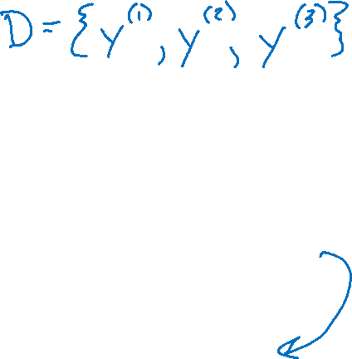


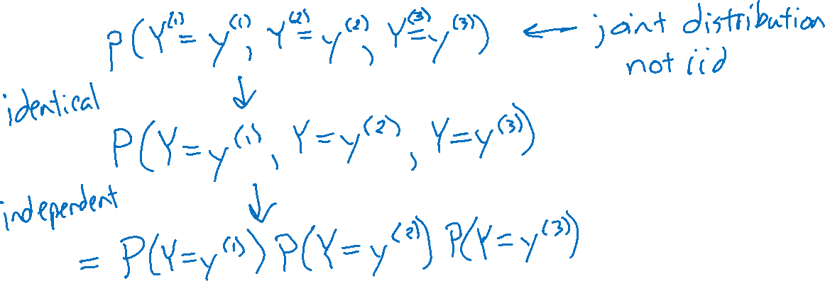
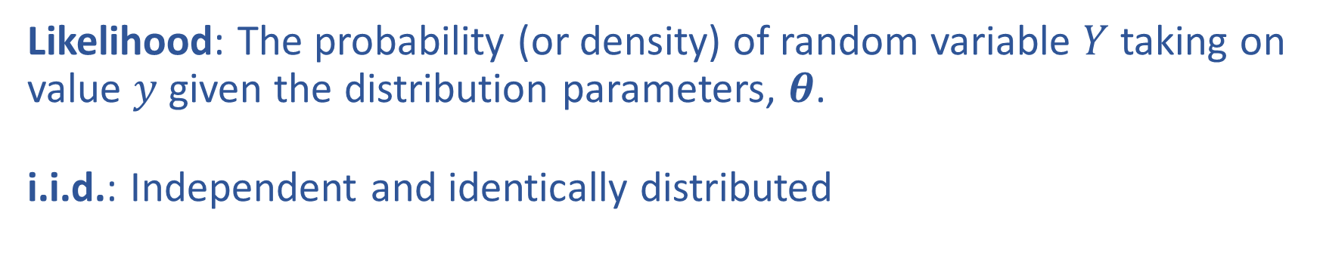
Likelihood and i.i.d
Likelihood: The probability (or density) of random variable $Y$ taking on value $y$ given the distribution parameters, $θ$.
i.i.d.: Independent and identically distributed

Slide 18
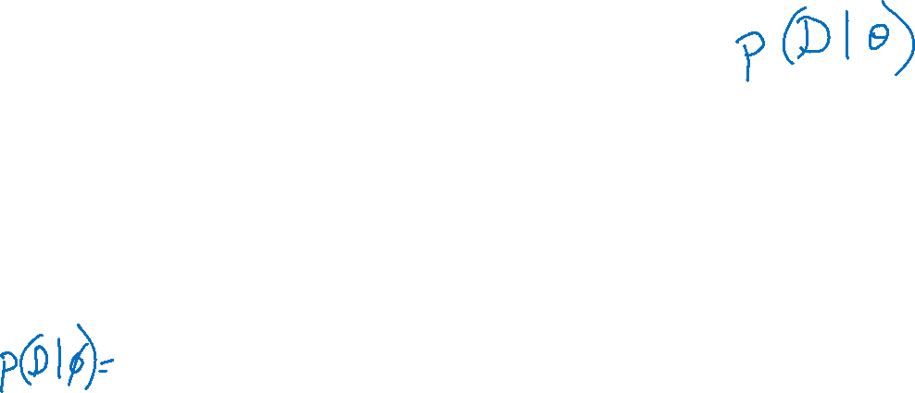
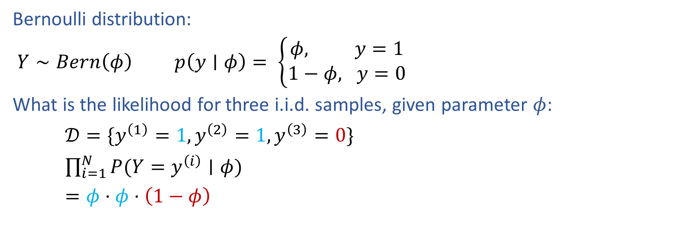
Bernoulli Likelihood
Bernoulli distribution:
$Y∼Bern\left(φ\right)$ $p\left(y∣φ\right)= \left\{\begin{aligned}φ, y=1 \\ 1−φ, y=0\end{aligned}\right.$
What is the likelihood for three i.i.d. samples, given parameter $φ$:
$𝒟=\{y^{\left(1\right)}=1, y^{\left(2\right)}=1,y^{\left(3\right)}=0\}$
$\prod_{i=1}^{N}{P(Y=y^{\left(i\right)}∣φ)}$
$=φ⋅φ⋅\left(1−φ\right)$

Slide 19
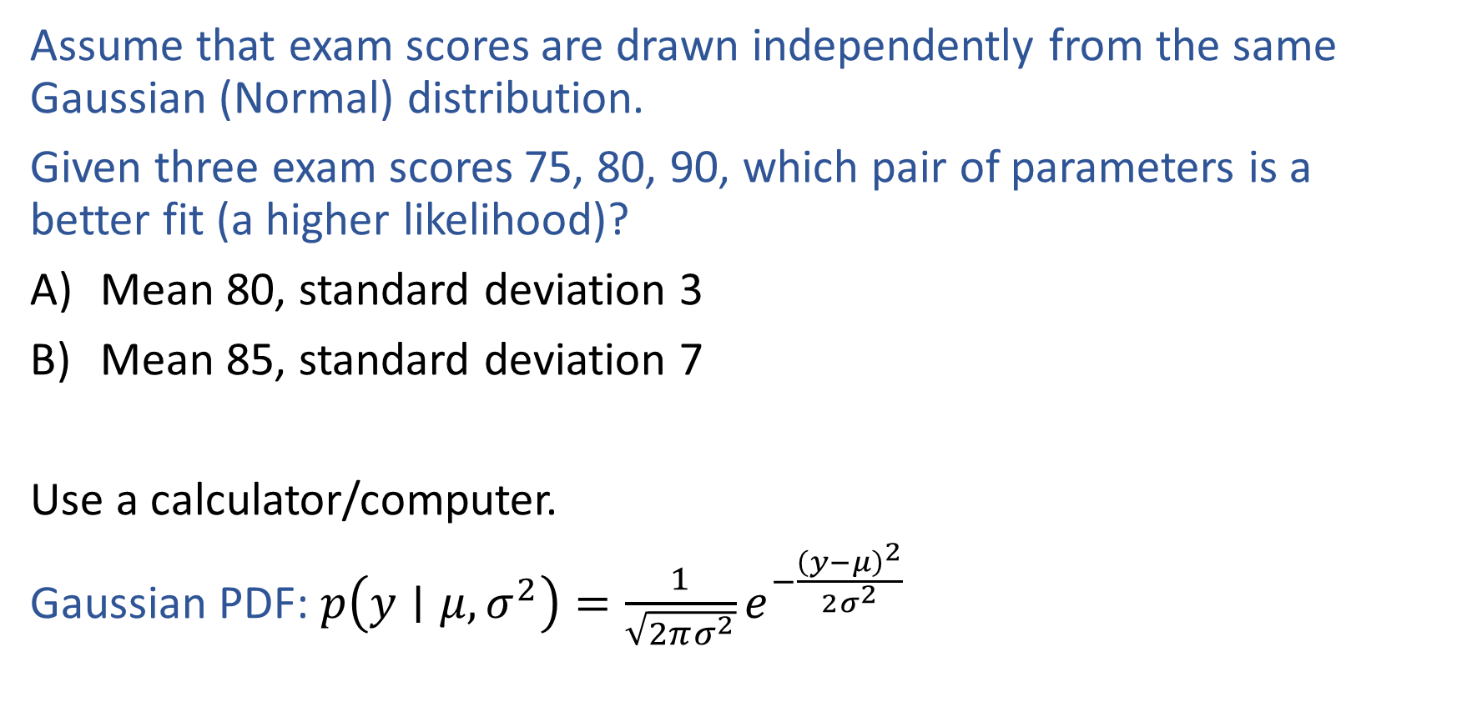
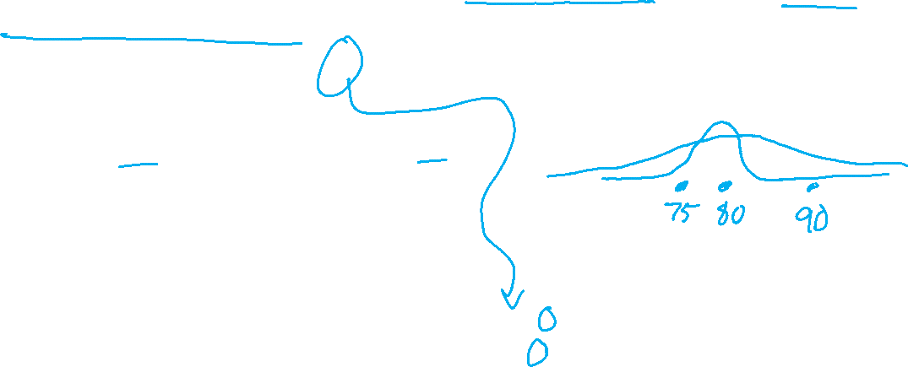
Challenge
Assume that exam scores are drawn independently from the same Gaussian (Normal) distribution.
Given three exam scores 75, 80, 90, which pair of parameters is a better fit (a higher likelihood)?
Mean 80, standard deviation 3
Mean 85, standard deviation 7
Use a calculator/computer.
Gaussian PDF: $p\left(y∣μ, σ^{2}\right)=\frac{1}{\sqrt{2πσ^{2}}}e^{−\frac{{\left(y−μ\right)}^{2}}{2σ^{2}}}$

