Slide 1

Announcements
HW1 & Quiz 1
Graded
Regrade requests
Hours, performance
HW2
Due Sat 10/2
Quizzes
Mon 10/4, last 15 min. of class (calculus, optimization, Lagrange)
Mon 10/11, last 15 min. of class (probability, statistics)

Slide 2
Constrained Optimization Clarification
Previous lecture slides

Slide 3

Mathematical Foundations for Machine Learning Probability
Instructor: Pat Virtue

Slide 4
Plan
Today
Probability
Vocab
Notation
Discrete distributions
Continuous distributions
Chain rule
Independence

Slide 5
Probability

Slide 6
Probability Vocab
Outcomes
Sample space
Events
Probability
Random variable
Discrete random variable
Continuous random variable
Probability mass function
Probability density function
Parameters

Slide 7
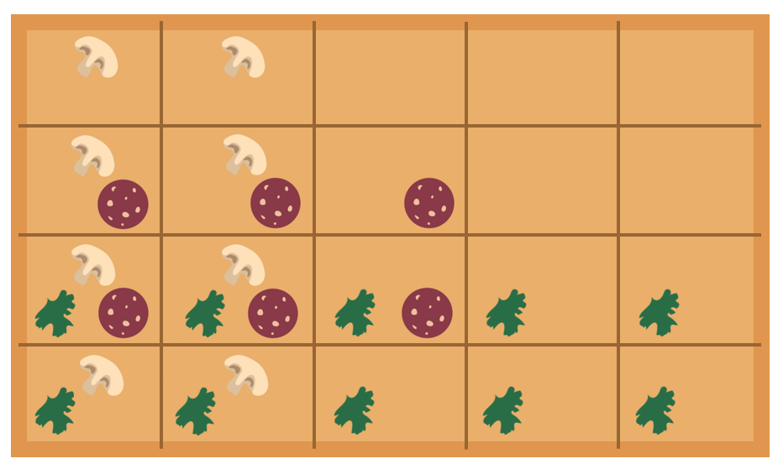




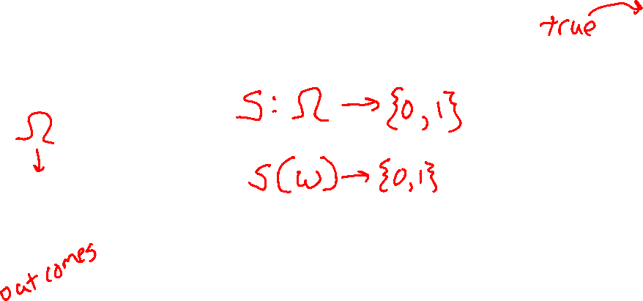
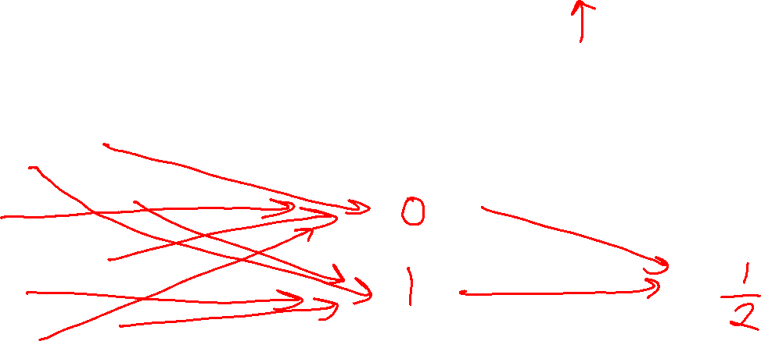
Example
Random variable for spinach or no spinach
Random variable
Distribution
Sample space
Values
Probabilities or Densities
Icons: CC, https://openclipart.org/detail/296791/pizza-slice

Slide 8
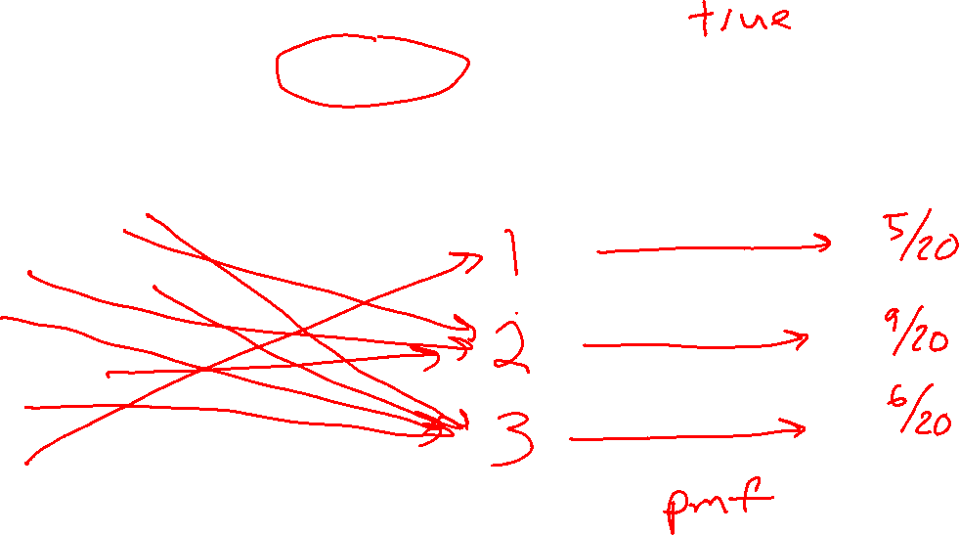
Example
Random variable for topping type with
three categories: none, non-meat, meat
Random variable
Distribution
Sample space
Values
Probabilities or Densities
Icons: CC, https://openclipart.org/detail/296791/pizza-slice

Slide 9
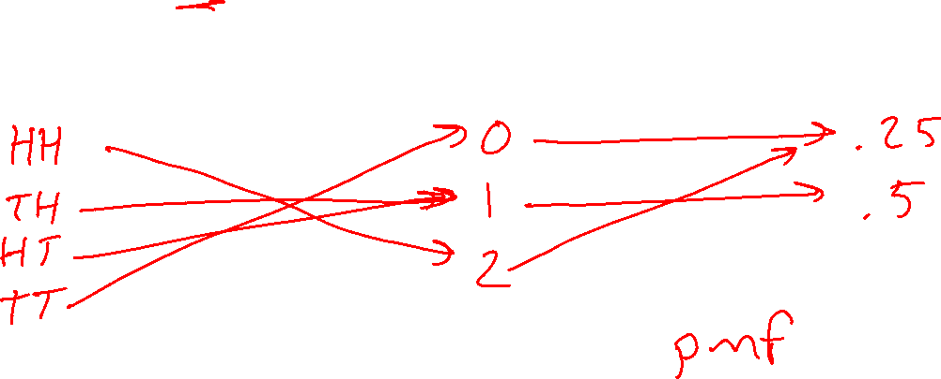
Example
Random variable for number of heads after two flips of a fair coin
Random variable
Distribution
Sample space
Values
Probabilities or Densities
Icons: CC, https://openclipart.org/detail/296791/pizza-slice

Slide 10
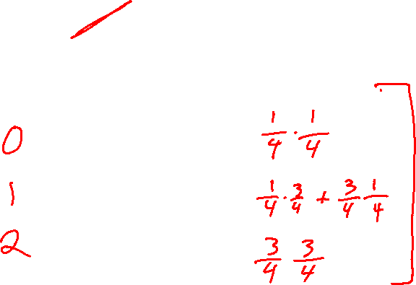
Example
Random variable for number of heads after two flips of a biased coin that lands heads 75%
Random variable
Distribution
Sample space
Values
Probabilities or Densities
Icons: CC, https://openclipart.org/detail/296791/pizza-slice

Slide 11
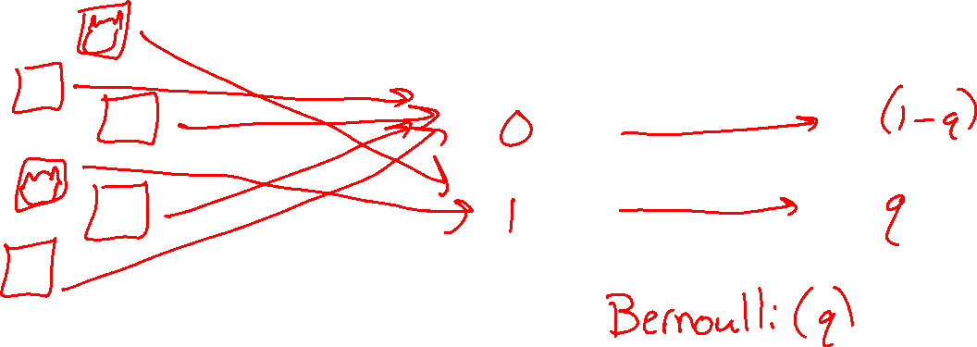
Example
Random variable for cat in picture or not
Random variable
Distribution
Sample space
Values
Probabilities or Densities
Icons: CC, https://openclipart.org/detail/296791/pizza-slice

Slide 12
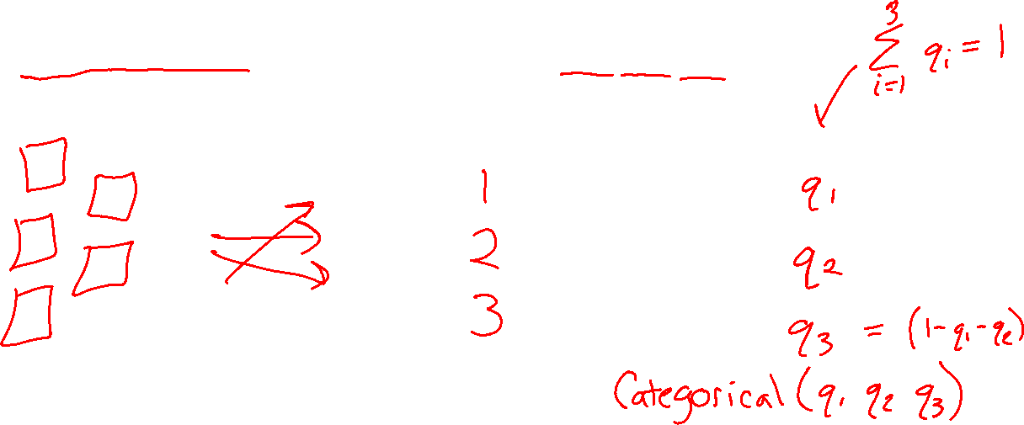
Example
Random variable for animal species in picture assuming one animal picture and available species: dog, cat, pig
Random variable
Distribution
Sample space
Values
Probabilities or Densities
Icons: CC, https://openclipart.org/detail/296791/pizza-slice

Slide 13
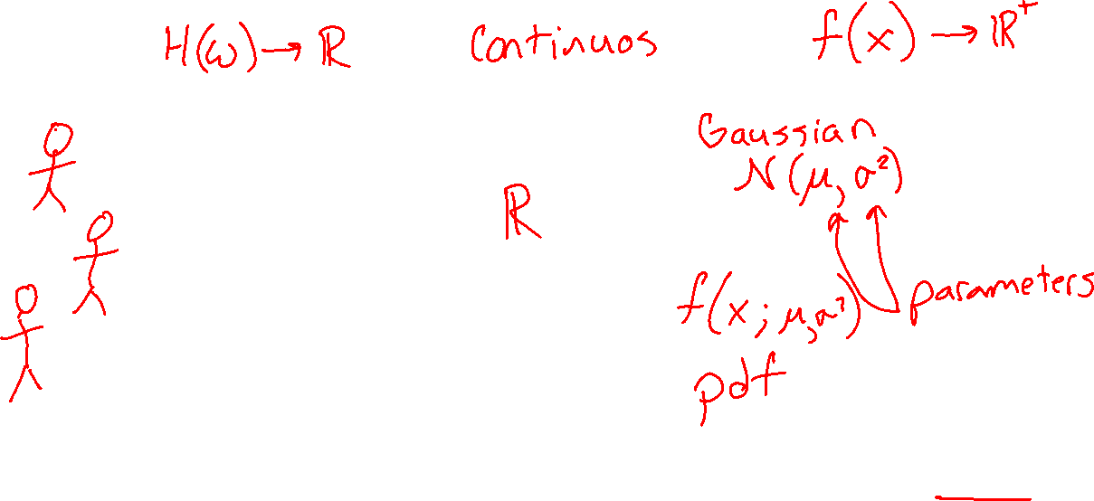
Example
Random variable for height of student
Random variable
Distribution
Sample space
Values
Probabilities or Densities
Icons: CC, https://openclipart.org/detail/296791/pizza-slice

Slide 14
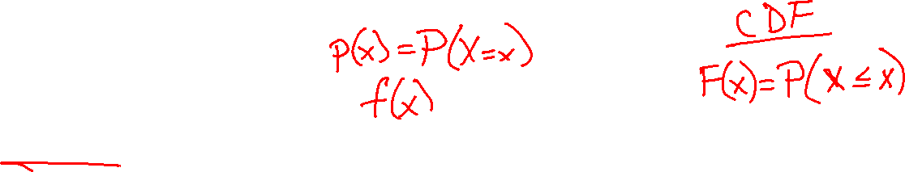
Probability Vocab
Outcomes
Sample space
Events
Probability
Random variable
Discrete random variable
Continuous random variable
Probability mass function
Probability density function
Parameters

Slide 15
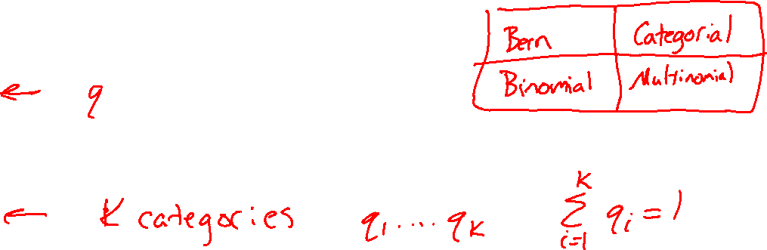
Example Discrete Distributions
Bernoulli
Categorical
Binomial
Multinomial
Uniform

Slide 16
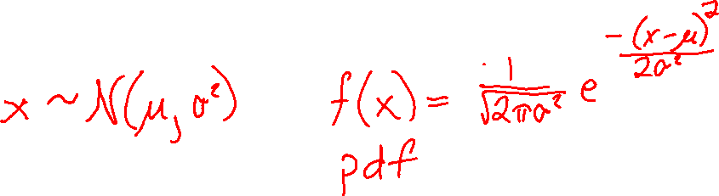
Example Continuous Distributions
Gaussian
Beta
Laplace

Slide 17
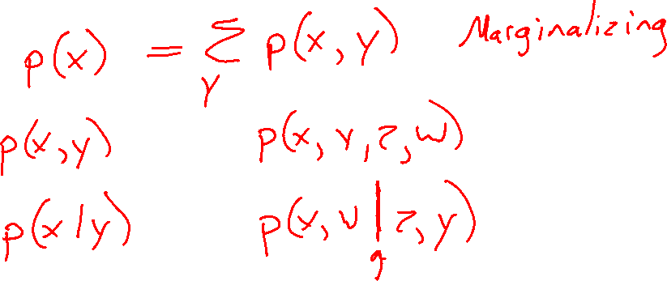
Probability Vocab
Marginal
Joint
Conditional

Slide 18
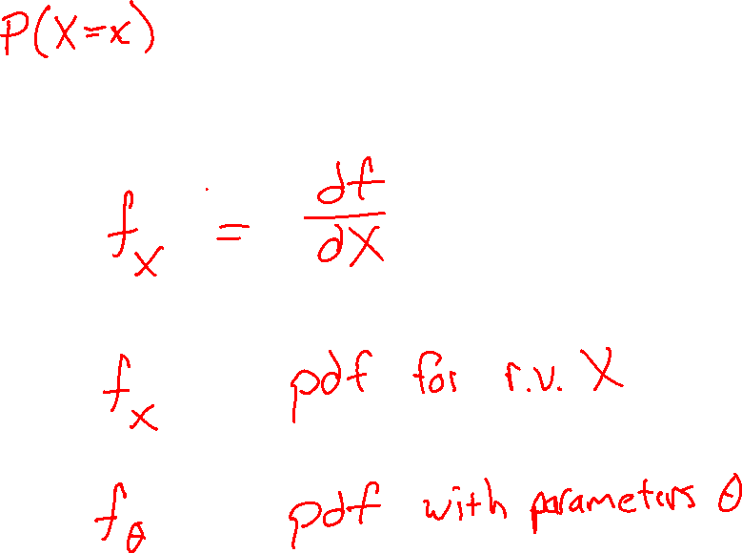
Notation
Notation doc

Slide 19

Probability Toolbox
Algebra
Three axioms of probability
Theorem of total probability
Definition of conditional probability
Product rule
Bayes’ theorem
Chain rule
Independence
Conditional independence

Slide 20

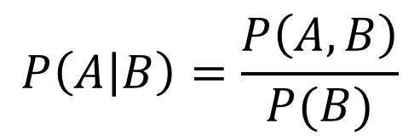
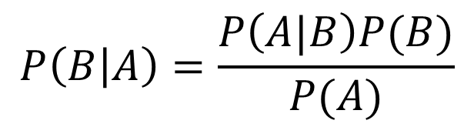
Tools Summary
Adding to our toolbox
Definition of conditional probability
Product Rule
Bayes’ theorem
Chain Rule…
$$P\left(A | B\right)=\frac{P\left(A, B\right)}{P(B)}$$
$$P(A,B)=P\left(A | B\right)P(B)$$
$$P\left(B | A\right)=\frac{P\left(A|B\right)P(B)}{P(A)}$$

