Slide 1
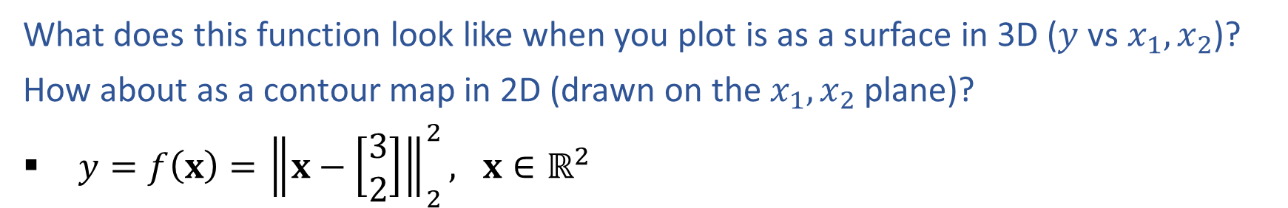
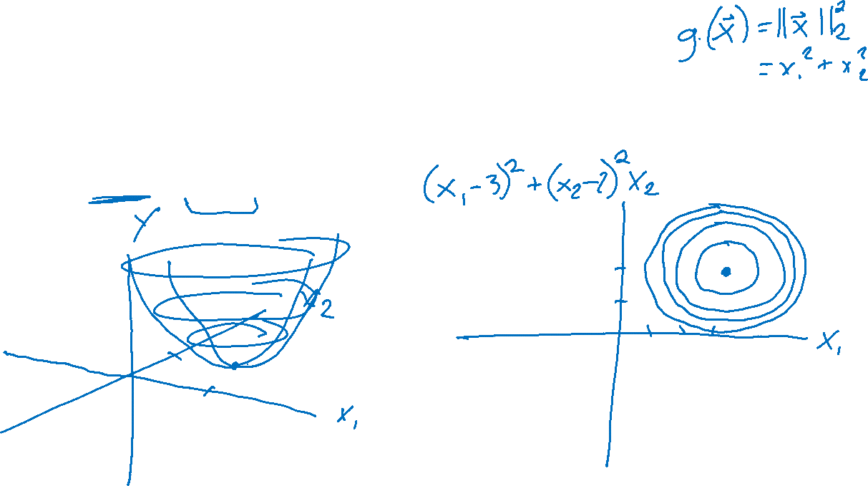
Warm-up As You Walk In
What does this function look like when you plot is as a surface in 3D ($y$ vs $x_{1},x_{2}$)?
How about as a contour map in 2D (drawn on the $x_{1},x_{2}$ plane)?
$y=f\left(x\right)={\left\|x−\left[\begin{matrix}3 \\ 2\end{matrix}\right]\right\|}_{2}^{2}, x∈ℝ^{2}$

Slide 2
Announcements
HW1
Grades can be released after second slip day expires
HW2
Out this week
Quiz
Today, last 15 min. of class
Survey
Thanks for the feedback!

Slide 3

Mathematical Foundations for Machine Learning
Lagrange Multipliers & Probability
Instructor: Pat Virtue

Slide 4
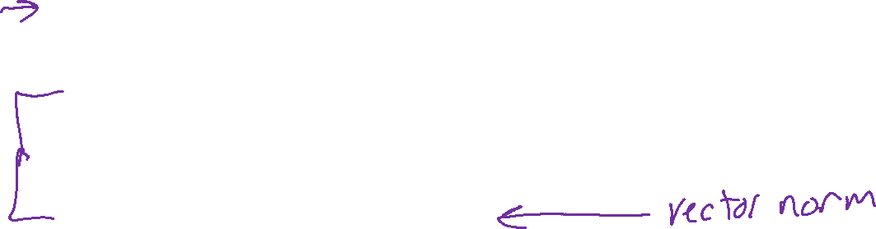
Plan
Last time
End class with minimax game
Today
Constrained optimization
Formulation
Solving with Lagrange multipliers
Probability
Vocab
Properties
Discrete distributions

Slide 5
Constrained Optimization
Method of Lagrange multipliers

Slide 6
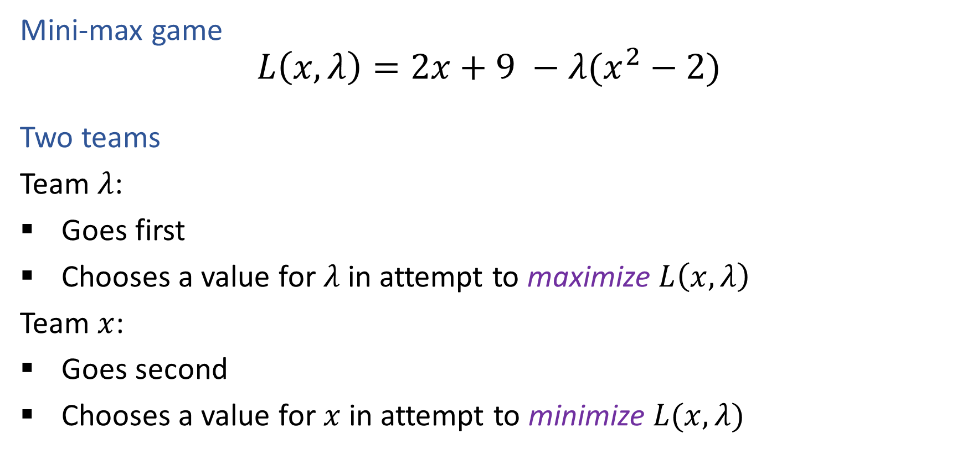
Exercise
Mini-max game
$$L\left(x, λ\right)=2x+9 −λ(x^{2}−2)$$
Two teams
Team $λ$:
Goes first
Chooses a value for $λ$ in attempt to maximize $L\left(x, λ\right)$
Team $x$:
Goes second
Chooses a value for $x$ in attempt to minimize $L(x, λ)$

Slide 7
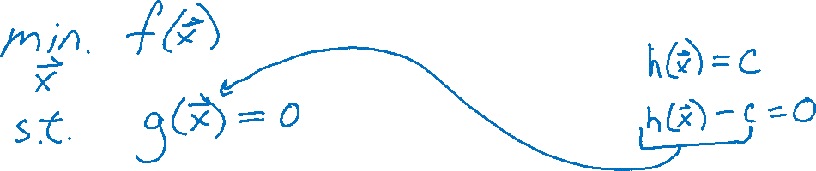
Constrained Optimization
Notation

Slide 8
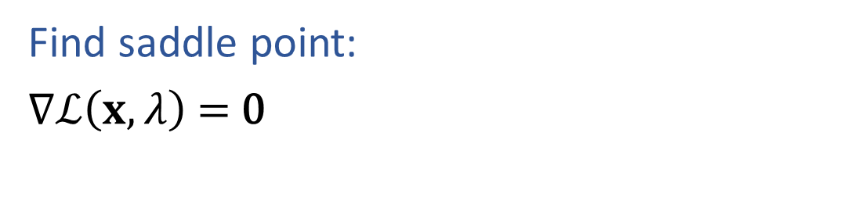
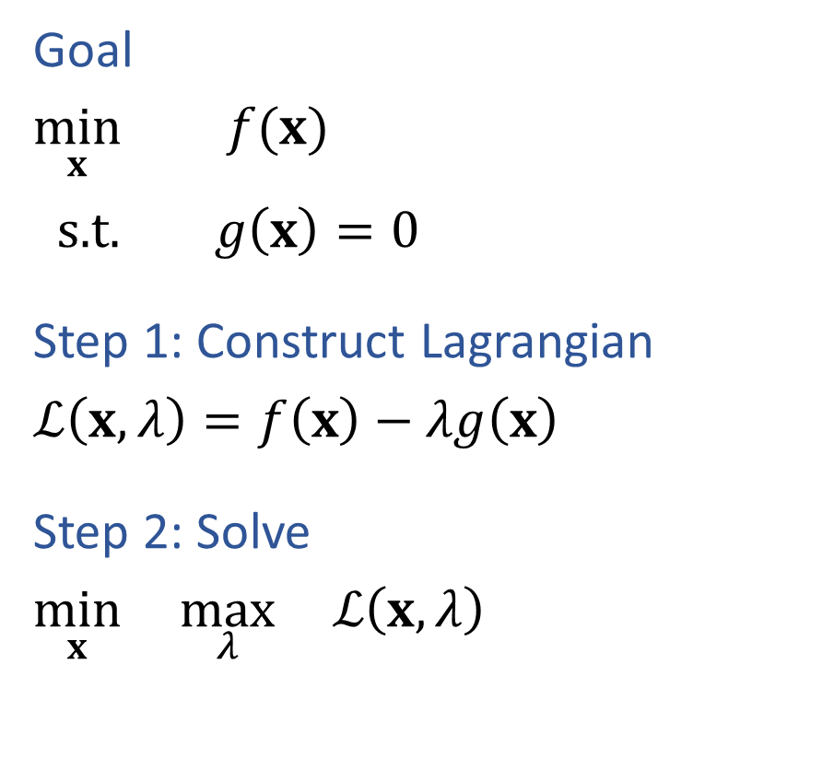
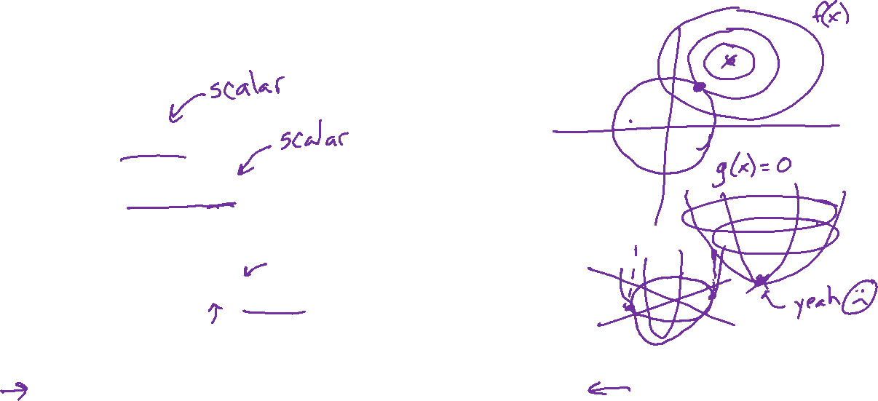
Method of Lagrange Multipliers
Goal
$\min_{x}{ f(x)}$
$\text{s}\text{.}\text{t}\text{. } g\left(x\right)=0$
Step 1: Construct Lagrangian
$ℒ\left(x, λ\right)=f\left(x\right)−λg\left(x\right)$
Step 2: Solve
$\min_{x}{ \max_{λ}{ ℒ\left(x, λ\right)}}$
Find saddle point:
$∇ℒ\left(x, λ\right)\text{ = }\text{0}$

Slide 9
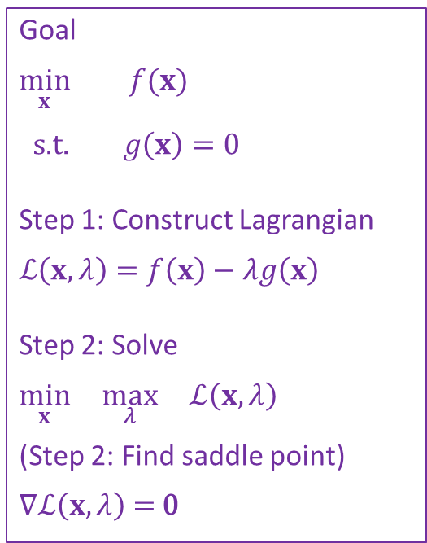
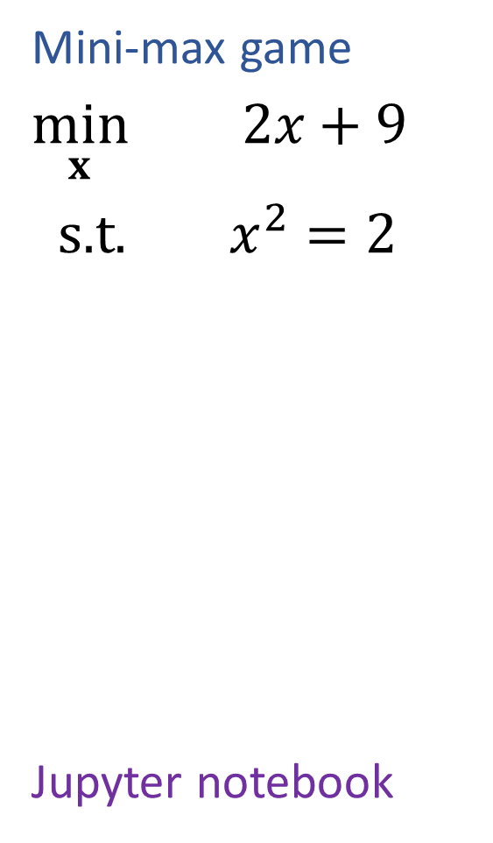
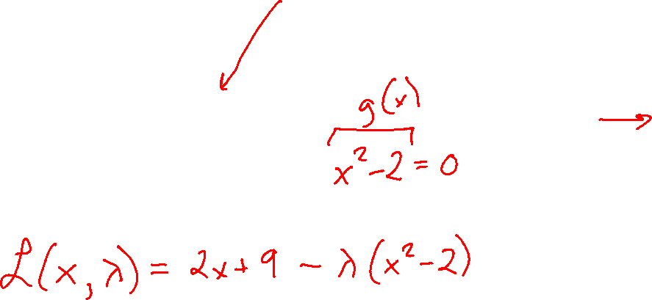
Example
Goal
$\min_{x}{ f(x)}$
$\text{s}\text{.}\text{t}\text{. } g\left(x\right)=0$
Step 1: Construct Lagrangian
$ℒ\left(x, λ\right)=f\left(x\right)−λg\left(x\right)$
Step 2: Solve
$\min_{x}{ \max_{λ}{ ℒ\left(x, λ\right)}}$
(Step 2: Find saddle point)
$∇ℒ\left(x, λ\right)\text{ = }\text{0}$
Mini-max game
$\min_{x}{ 2x+9}$
$\text{s}\text{.}\text{t}\text{. } x^{2}=2$
Jupyter notebook

Slide 10

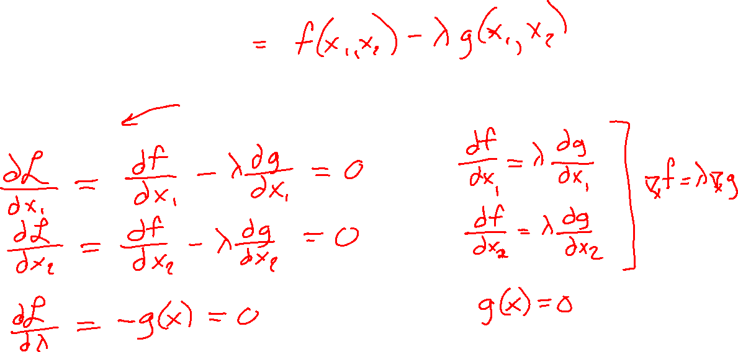
Method of Lagrange Multipliers
Lagrangian
$ℒ\left(x, λ\right)=f\left(x\right)−λg\left(x\right)$
Find saddle point:
$∇ℒ\left(x, λ\right)\text{ = }\text{0}$

Slide 11
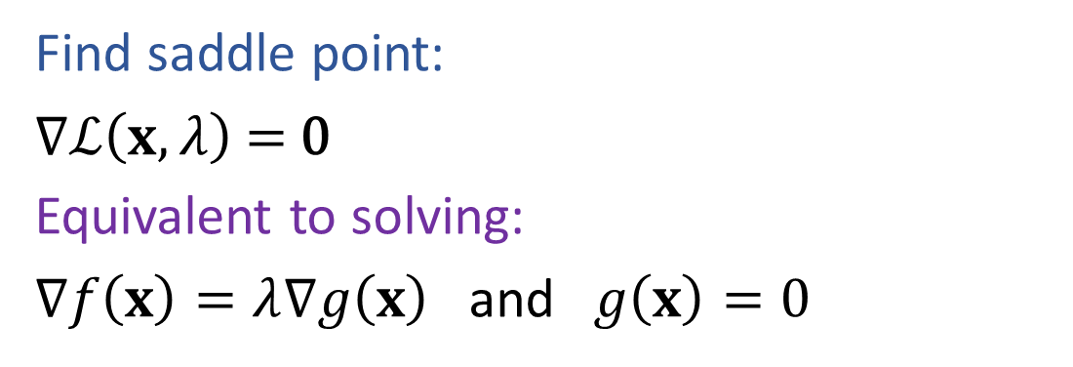

Method of Lagrange Multipliers
Goal
$\min_{x}{ f(x)}$
$\text{s}\text{.}\text{t}\text{. } g\left(x\right)=0$
Step 1: Construct Lagrangian
$ℒ\left(x, λ\right)=f\left(x\right)−λg\left(x\right)$
Step 2: Solve
$\min_{x}{ \max_{λ}{ ℒ\left(x, λ\right)}}$
Find saddle point:
$∇ℒ\left(x, λ\right)\text{ = }\text{0}$
Equivalent to solving:
$∇f\left(x\right)=λ∇g\left(x\right)$ and $g\left(x\right)=0$

Slide 12
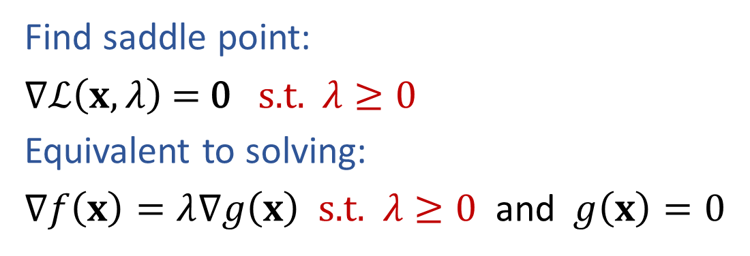

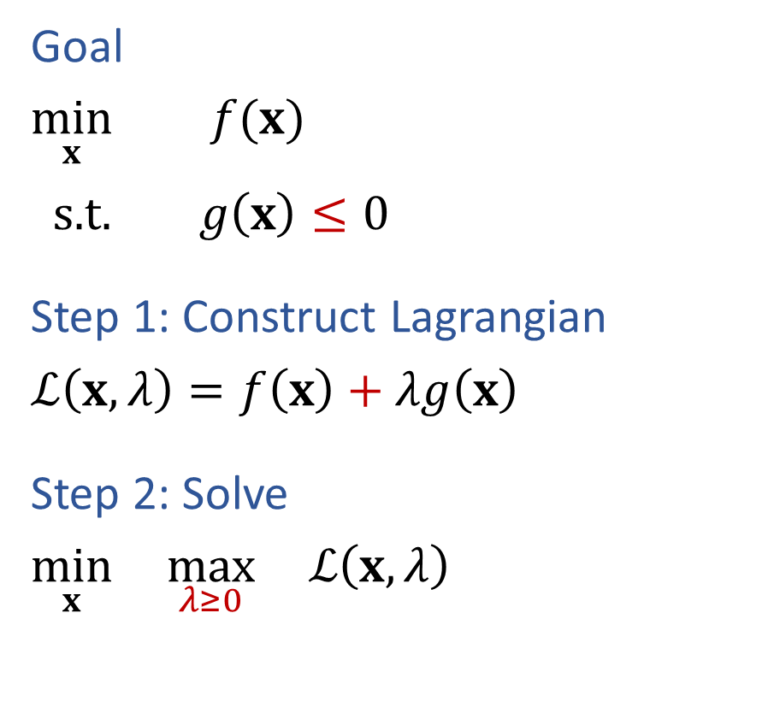

Method of Lagrange Multipliers (Inequality)
Goal
$\min_{x}{ f(x)}$
$\text{s}\text{.}\text{t}\text{. } g\left(x\right)≤0$
Step 1: Construct Lagrangian
$ℒ\left(x, λ\right)=f\left(x\right)+λg\left(x\right)$
Step 2: Solve
$\min_{x}{ \max_{λ≥0}{ ℒ\left(x, λ\right)}}$
Find saddle point:
$∇ℒ\left(x, λ\right)\text{ = }\text{0} \text{s}\text{.}\text{t}\text{.} λ≥0$
Equivalent to solving:
$∇f\left(x\right)=λ∇g\left(x\right) \text{s}\text{.}\text{t}\text{.} λ≥0$ and $g\left(x\right)=0$

Slide 13
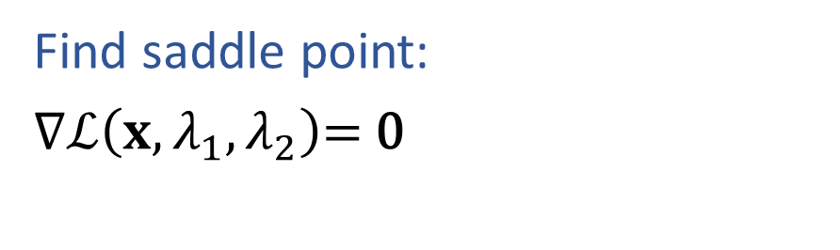
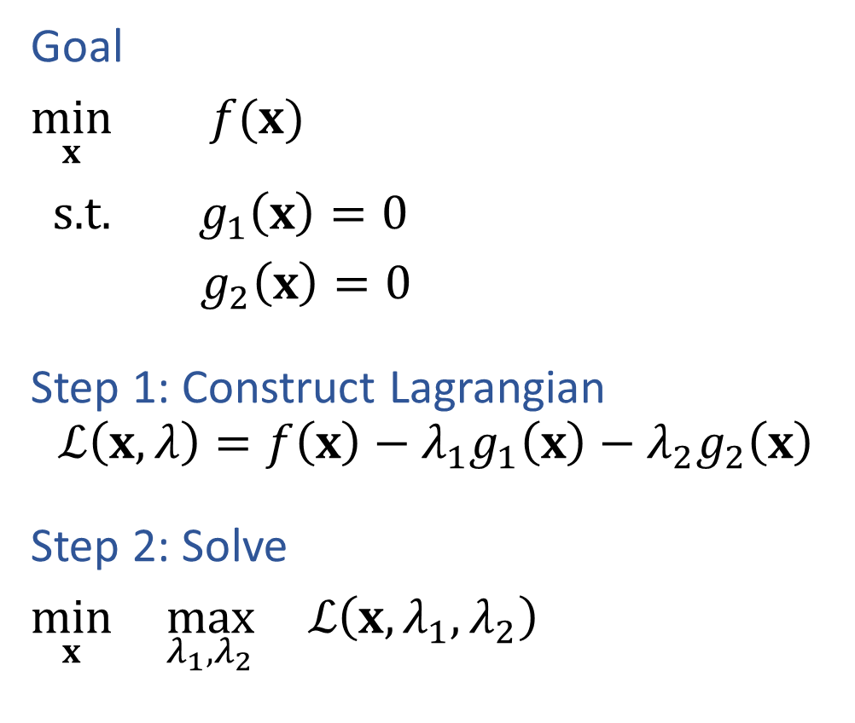

Method of Lagrange Multipliers (multiple constraints)
Goal
$\min_{x}{ f(x)}$
$\text{s}\text{.}\text{t}\text{. } g_{1}\left(x\right)=0$
$g_{2}\left(x\right)=0$
Step 1: Construct Lagrangian
$$ℒ\left(x, λ\right)=f\left(x\right)−λ_{1}g_{1}\left(x\right)−λ_{2}g_{2}\left(x\right)$$
Step 2: Solve
$\min_{x}{ \max_{λ_{1},λ_{2}}{ ℒ\left(x, λ_{1},λ_{2}\right)}}$
Find saddle point:
$∇ℒ\left(x, λ_{1},λ_{2}\right)\text{= }\text{0}$

Slide 14
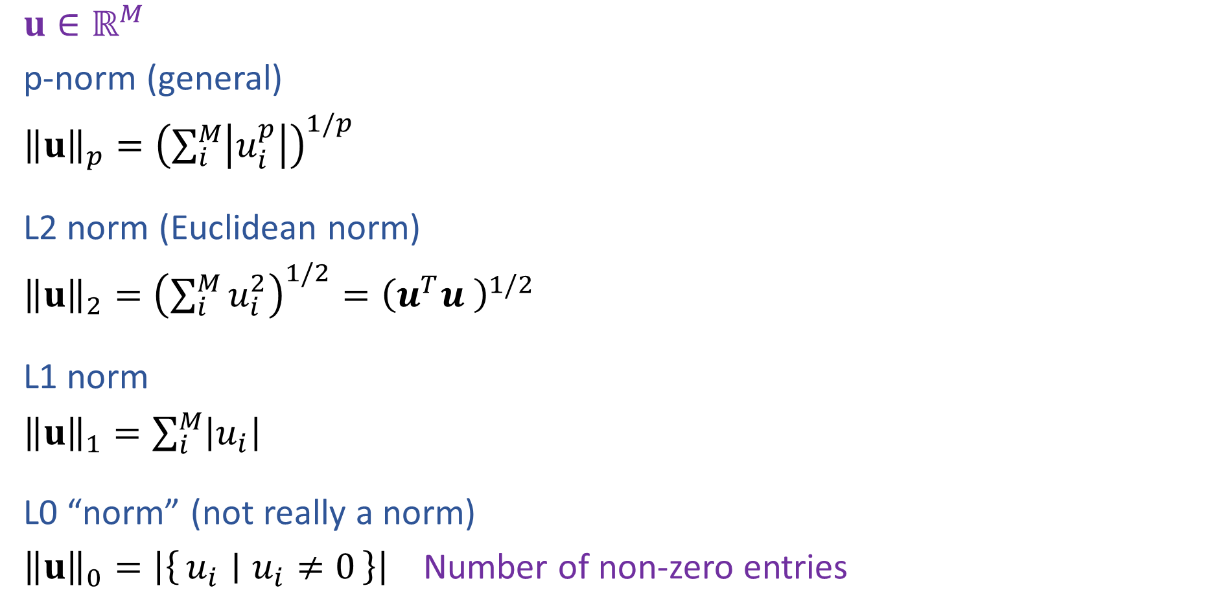
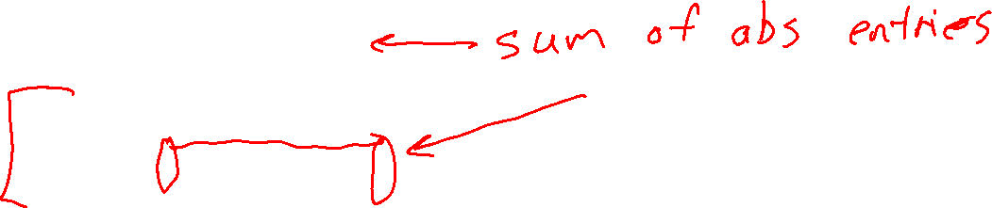
Vector Norms
$u∈ℝ^{M}$
p-norm (general)
${\left\|u\right\|}_{p}={\left(\sum_{i}^{M}{\left|u_{i}^{p}\right|}\right)}^{1/p}$
L2 norm (Euclidean norm)
${\left\|u\right\|}_{2}={\left(\sum_{i}^{M}{u_{i}^{2}}\right)}^{1/2}={\left(u^{T}u \right)}^{1/2}$
L1 norm
${\left\|u\right\|}_{1}=\sum_{i}^{M}{\left|u_{i}\right|}$
L0 “norm” (not really a norm)
${\left\|u\right\|}_{0}=\left|\left\{u_{i} ∣ u_{i}≠0\right\}\right|$ Number of non-zero entries

Slide 15
Probability

Slide 16
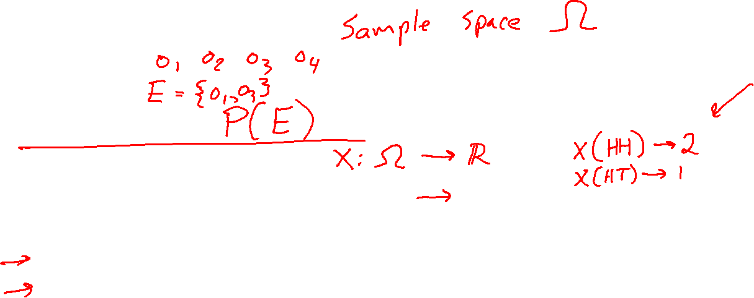
Probability Vocab
Outcomes
Events
Probability
Random variable
Discrete random variable
Continuous random variable
Probability mass function
Probability density function

Slide 17
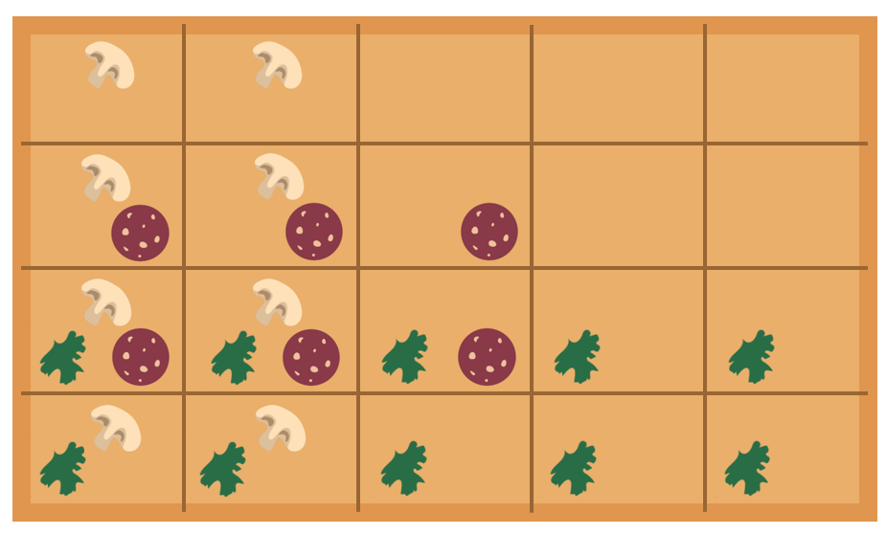
Probability Vocab
Outcomes
Events
Probability
Random variable
Discrete random variable
Probability mass function

Slide 18
Probability Toolbox
  Algebra
  Three axioms of probability
  Theorem of total probability
  Definition of conditional probability
  Product rule
  Bayes’ theorem
  Chain rule
  Independence
  Conditional independence

Slide 19



Omega Pizzeria
Three questions: What is the probability of getting a slice with:
  No mushrooms
  Spinach and no mushrooms
  Spinach, when asking for slice with no mushrooms
  New information (condition)
  Adjust sample space
Icons: CC, https://openclipart.org/detail/296791/pizza-slice

Slide 20
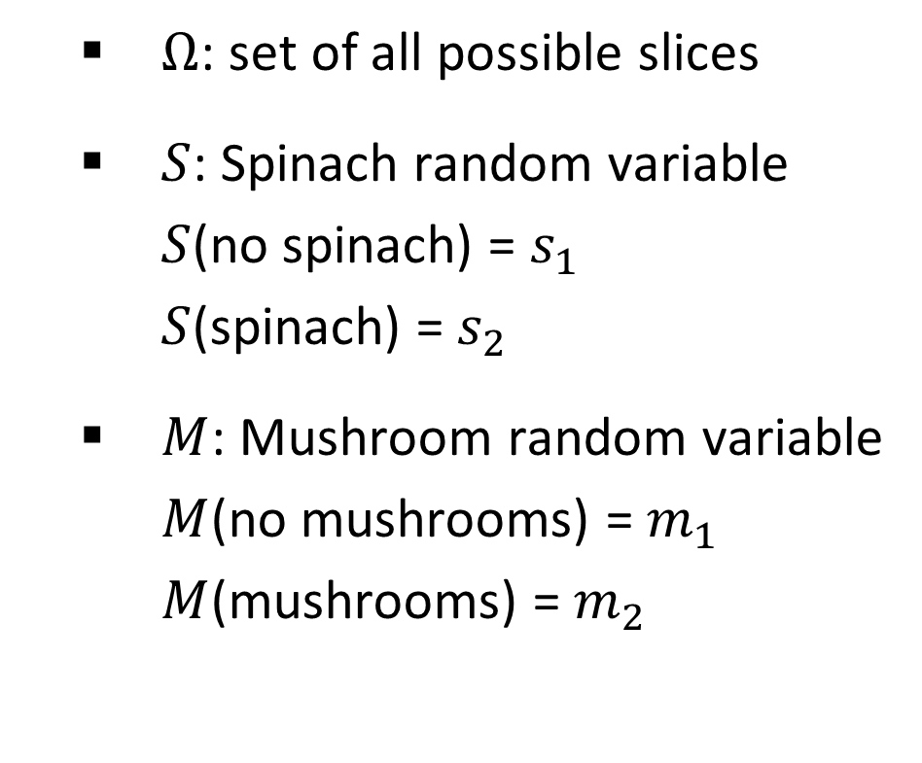
Omega Pizzeria
Formalize this a bit
  $Ω$: set of all possible slices
  $S$: Spinach random variable
  $S$(no spinach) = $s_{1}$
  $S$(spinach) = $s_{2}$
  $M$: Mushroom random variable
  $M$(no mushrooms) = $m_{1}$
  $M$(mushrooms) = $m_{2}$
Icons: CC, https://openclipart.org/detail/296791/pizza-slice

Slide 21
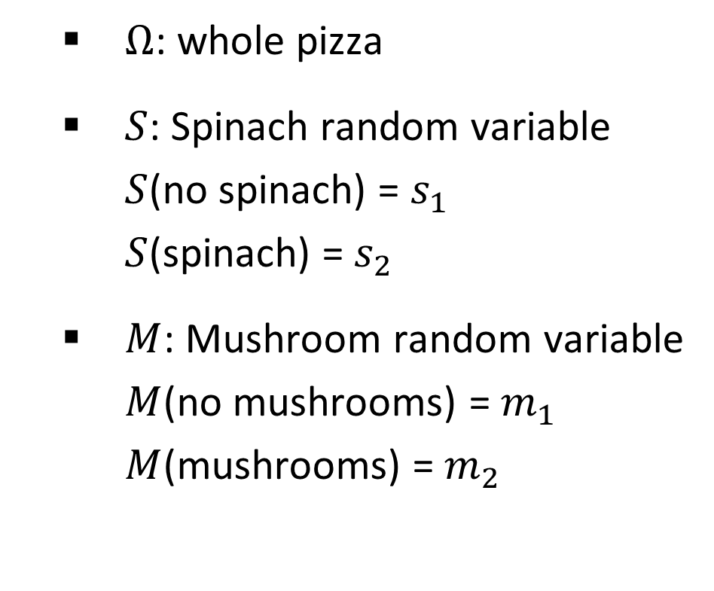
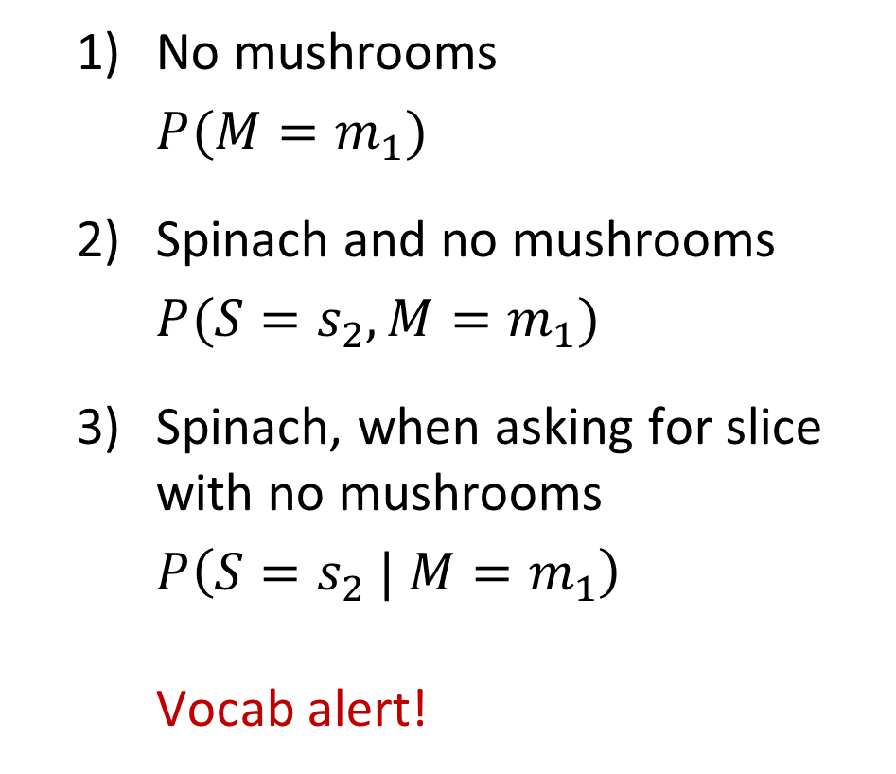
Omega Pizzeria
Formalize this a bit
  $Ω$: whole pizza
  $S$: Spinach random variable
  $S$(no spinach) = $s_{1}$
  $S$(spinach) = $s_{2}$
  $M$: Mushroom random variable
  $M$(no mushrooms) = $m_{1}$
  $M$(mushrooms) = $m_{2}$
  No mushrooms
  $P(M=m_{1})$
  Spinach and no mushrooms
  $P(S=s_{2}, {M=m}_{1})$
  Spinach, when asking for slice with no mushrooms
  $P\left({S=s}_{2} |{ M=m}_{1}\right)$
  Vocab alert!

Slide 22
Probability Vocab
Marginal
Joint
Conditional

Slide 23
Omega Pizzeria
More questions: What is the probability of getting a slice with:
  No mushrooms
  Spinach and no mushrooms
  Spinach, when asking for slice with no mushrooms
  Mushrooms
  Spinach
  No spinach
  No spinach and mushrooms
  No spinach when asking for no mushrooms
  No spinach when asking for mushrooms
  Spinach when asking for mushrooms
  No mushrooms and no spinach
Icons: CC, https://openclipart.org/detail/296791/pizza-slice

Slide 24

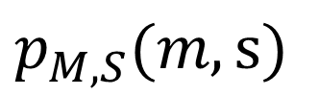
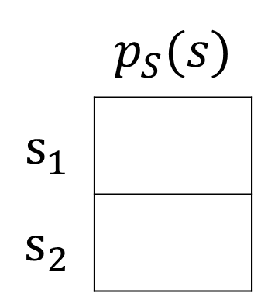
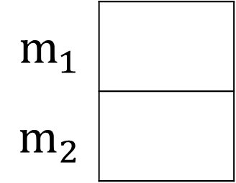

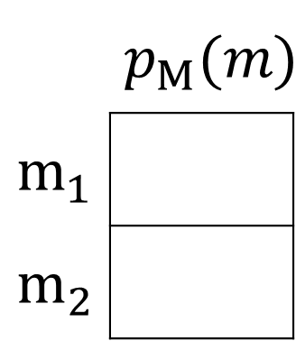


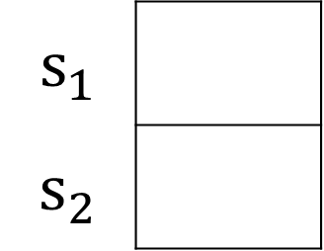
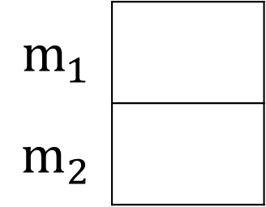


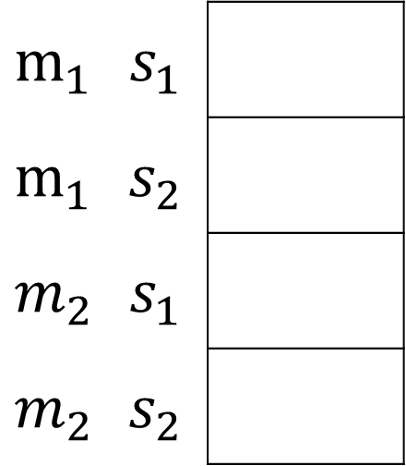
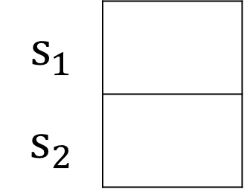

Omega Pizzeria
You can fill out all of these probability mass functions
$p_{M∣S}(m∣s_{1})$
$p_{M∣S}(m|s_{2})$
 | $$p_{M}(m)$$
$$m_{1}$$
$$m_{2}$$
$p_{M,S}(m,s)$
$$m_{1}$$
$$m_{2}$$
$$m_{1}$$
$$m_{2}$$
$$12/20$$
$$m_{1}$$ | $$s_{1}$$
$$m_{1}$$ | $$s_{2}$$
$$m_{2}$$ | $$s_{1}$$
$$m_{2}$$ | $$s_{2}$$
$$6/20$$
$p_{S∣M}(s∣m_{1})$
$p_{S∣M}(s|m_{2})$
 | $$p_{S}(s)$$
$$s_{1}$$
$$s_{2}$$
$$s_{1}$$
$$s_{2}$$
$$s_{1}$$
$$s_{2}$$
$$6/12$$

Slide 25

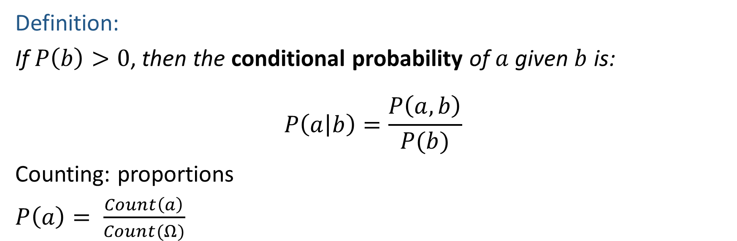


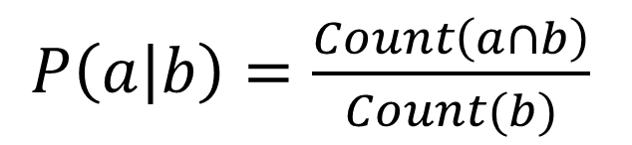
Definition of Conditional Probability
Definition:
If $P\left(b\right)>0$, then the conditional probability of $a$ given $b$ is:
$$P\left(a | b\right)=\frac{P\left(a, b\right)}{P(b)}$$
Counting: proportions
$P\left(a\right)= \frac{Count\left(a\right)}{Count(Ω)}$
$P\left(a | b\right)=\frac{Count\left(a∩b\right)}{Count(b)}$
$$a$$
$$b$$
$$a∩b$$

Slide 26



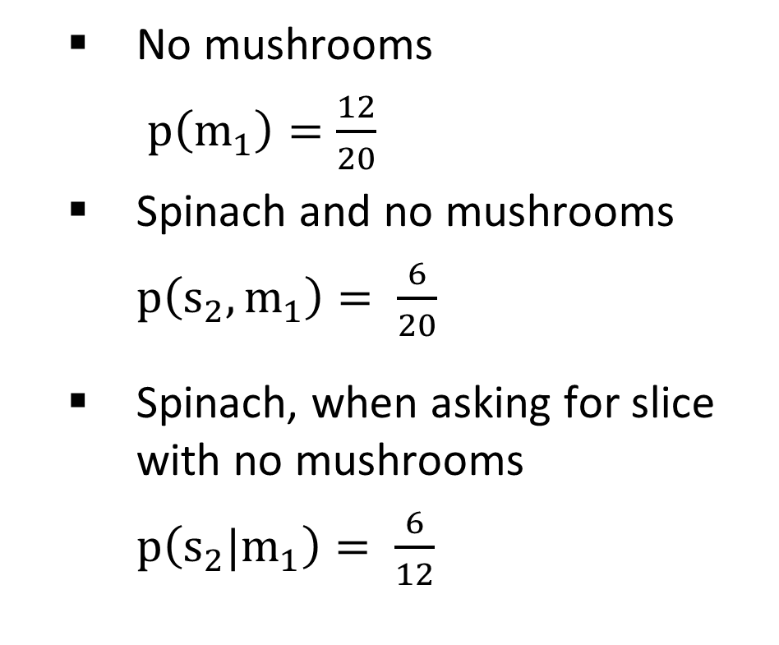
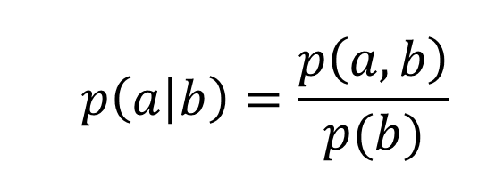
Omega Pizzeria
Apply definition of conditional probability
  No mushrooms
  $p\left(m_{1}\right)=\frac{12}{20}$
  Spinach and no mushrooms
  $p\left(s_{2}, m_{1}\right)= \frac{6}{20}$
  Spinach, when asking for slice with no mushrooms
  $p\left(s_{2}|m_{1}\right)= \frac{6}{12}$
  $$p\left(a | b\right)=\frac{p\left(a, b\right)}{p(b)}$$
Conditional
Probability:

Slide 27
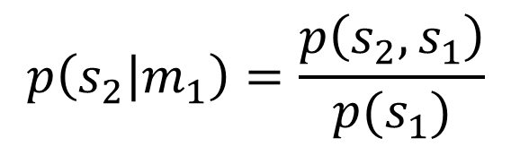
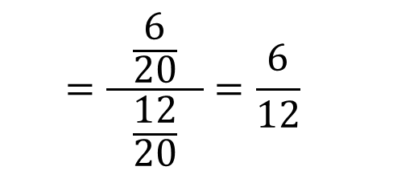
Omega Pizzeria
Apply definition of conditional probability
  No mushrooms
  $p\left(m_{1}\right)=\frac{12}{20}$
  Spinach and no mushrooms
  $p\left(s_{2}, m_{1}\right)= \frac{6}{20}$
  Spinach, when asking for slice with no mushrooms
  $p\left(s_{2}|m_{1}\right)= \frac{6}{12}$
  $$p\left(a | b\right)=\frac{p\left(a, b\right)}{p(b)}$$
Conditional
Probability:
$$p\left(s_{2} | m_{1}\right)=\frac{p\left(s_{2}, s_{1}\right)}{p(s_{1})}$$
  $$=\frac{\frac{6}{20}}{ \frac{12}{20} }=\frac{6}{12}$$

Slide 28

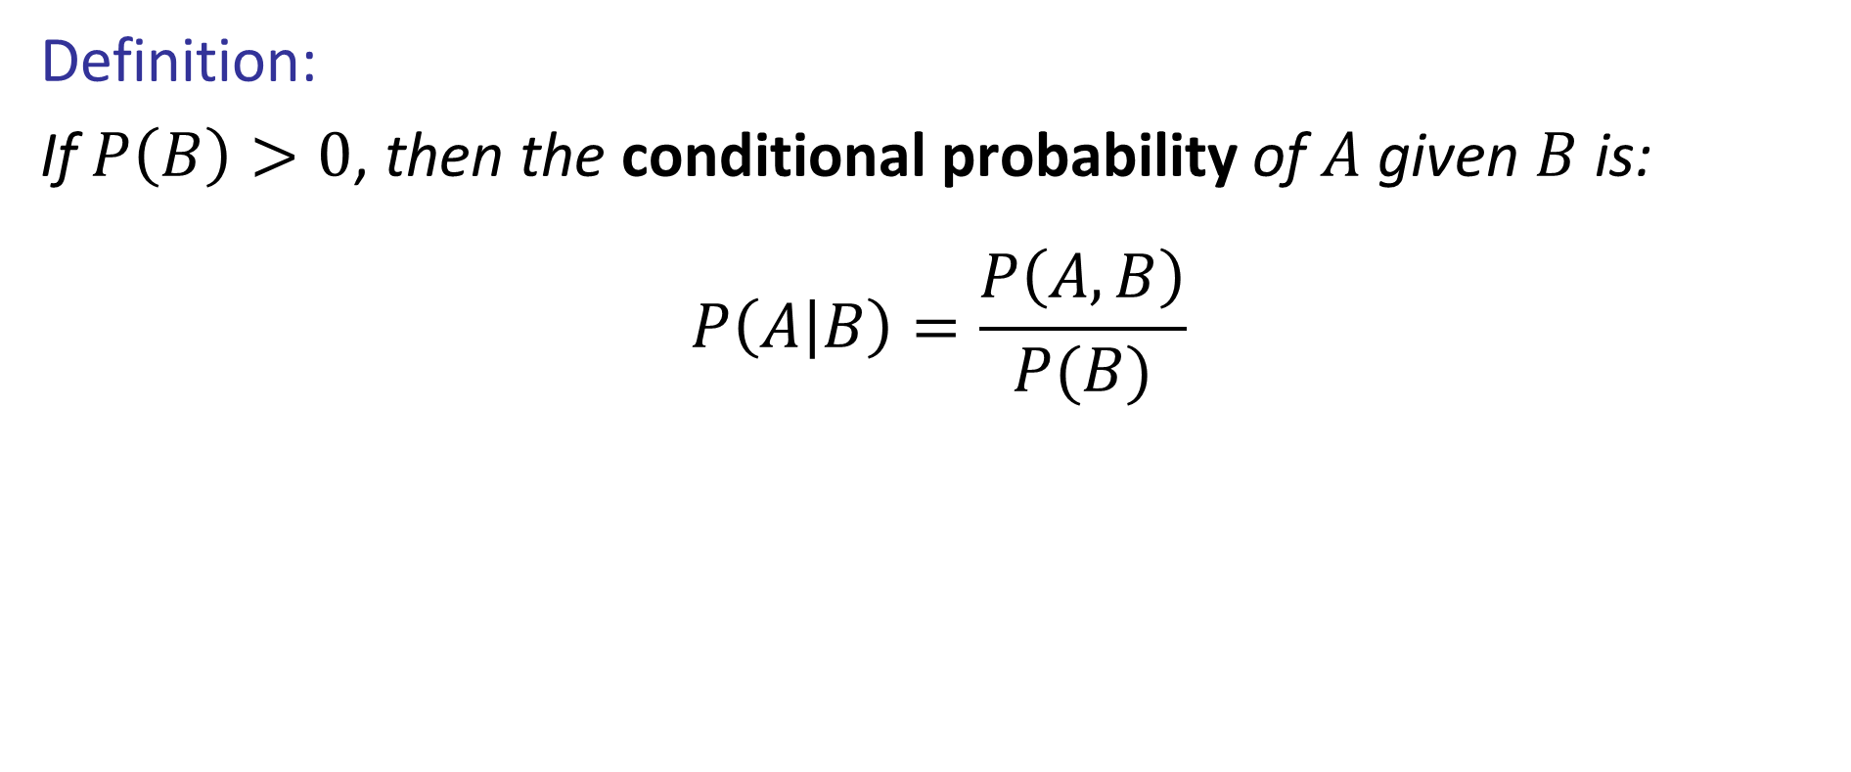
Definition of Conditional Probability
Definition:
If $P\left(B\right)>0$, then the conditional probability of $A$ given $B$ is:
$$P\left(A | B\right)=\frac{P\left(A, B\right)}{P(B)}$$
http://achievementgen.com/360/

Slide 29

Normalization Trick
P(X | Y=0) ?
  SELECT the joint probabilities matching the evidence
  NORMALIZE the selection
  (make it sum to one)
X | Y | P
1 | 1 | 0.2
1 | 0 | 0.3
0 | 1 | 0.4
0 | 0 | 0.1

Slide 30
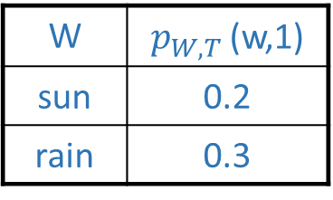
To Normalize
(Dictionary) To bring or restore to a normal condition
Procedure:
  Step 1: Compute Z = sum over all entries
  Step 2: Divide every entry by Z
Example 1
All entries sum to ONE
Example 2
W | $p_{W,T }$(w,1)
sun | 0.2
rain | 0.3
Normalize
W | p(w)
sun | 0.4
rain | 0.6
T | W | Count
hot | sun | 20
hot | rain | 5
cold | sun | 10
cold | rain | 15
T | W | P(t,w)
hot | sun | 0.4
hot | rain | 0.1
cold | sun | 0.2
cold | rain | 0.3
Normalize
Z = 0.5
Z = 50

Slide 31
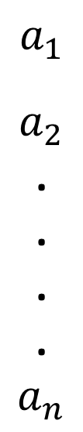
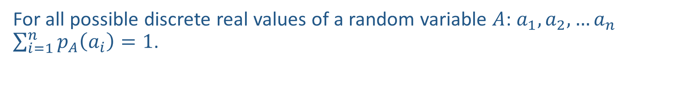



Sum over all values of a discrete random variable
For all possible discrete real values of a random variable $A$: $a_{1},a_{2},…a_{n}$ $\sum_{i=1}^{n}{p_{A}\left(a_{i}\right)}=1$.
$$a_{1}$$
$$a_{2}$$
.
.
.
.
$$a_{n}$$
$$p_{A}\left(a_{1}\right)$$
$$p_{A}\left(a_{2}\right)$$
$$p_{A}\left(a_{n}\right)$$

Slide 32
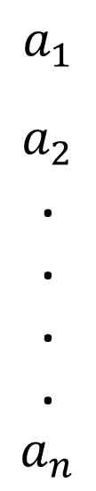

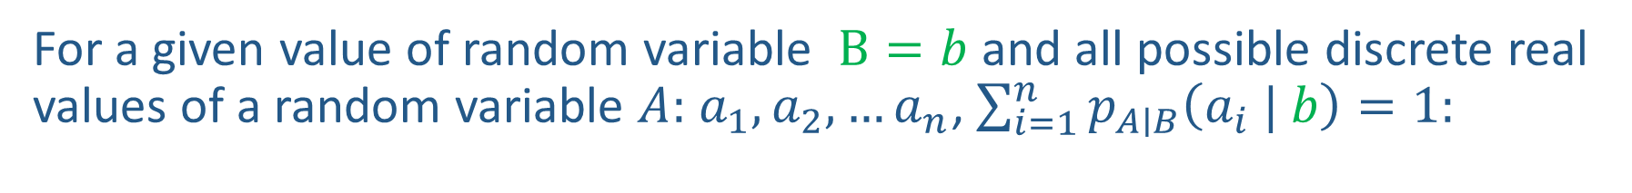



Partition given Event, Still Sums to One
For a given value of random variable $B=b$ and all possible discrete real values of a random variable $A:$ $a_{1},a_{2},…a_{n}$, $\sum_{i=1}^{n}{p_{A∣B}\left(a_{i} | b\right)}=1:$
$$p_{A∣B}\left(a_{1}\right|b)$$
$$a_{1}$$
$$a_{2}$$
.
.
.
.
$$a_{n}$$
$$b$$
$$p_{A∣B}\left(a_{2} | b\right)$$
$$p_{A∣B}\left(a_{n} | b\right)$$

Slide 33




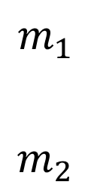
Partition given Event, Still Sums to One
For a given value of random variable $B=b$ and all possible discrete real values of a random variable $A:$ $a_{1},a_{2},…a_{n}$, $\sum_{i=1}^{n}{p_{A∣B}\left(a_{i} | b\right)}=1:$
$$p\left(m_{1}\right|s_{2})$$
$$m_{1}$$
$$m_{2}$$
$$s_{2}$$
$$p\left(m_{2} | s_{2}\right)$$
$$p\left(m_{1} | s_{2}\right)+p\left(m_{2} | s_{2}\right)$$
Icons: CC, https://openclipart.org/detail/296791/pizza-slice

Slide 34
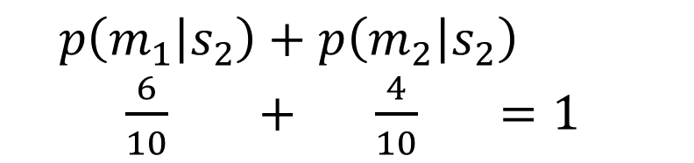
Partition given Event, Still Sums to One
For a given value of random variable $B=b$ and all possible discrete real values of a random variable $A:$ $a_{1},a_{2},…a_{n}$, $\sum_{i=1}^{n}{p_{A∣B}\left(a_{i} | b\right)}=1:$
$$p\left(m_{1}\right|s_{2})$$
$$m_{1}$$
$$m_{2}$$
$$s_{2}$$
$$p\left(m_{2} | s_{2}\right)$$
$$p\left(m_{1} | s_{2}\right)+p\left(m_{2} | s_{2}\right)$$
$\frac{6}{10} + \frac{4}{10} =1$
Icons: CC, https://openclipart.org/detail/296791/pizza-slice

Slide 35


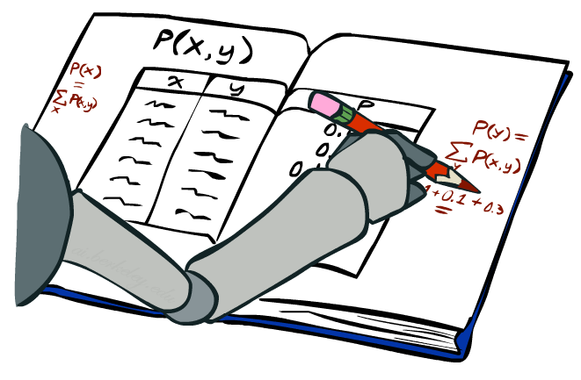
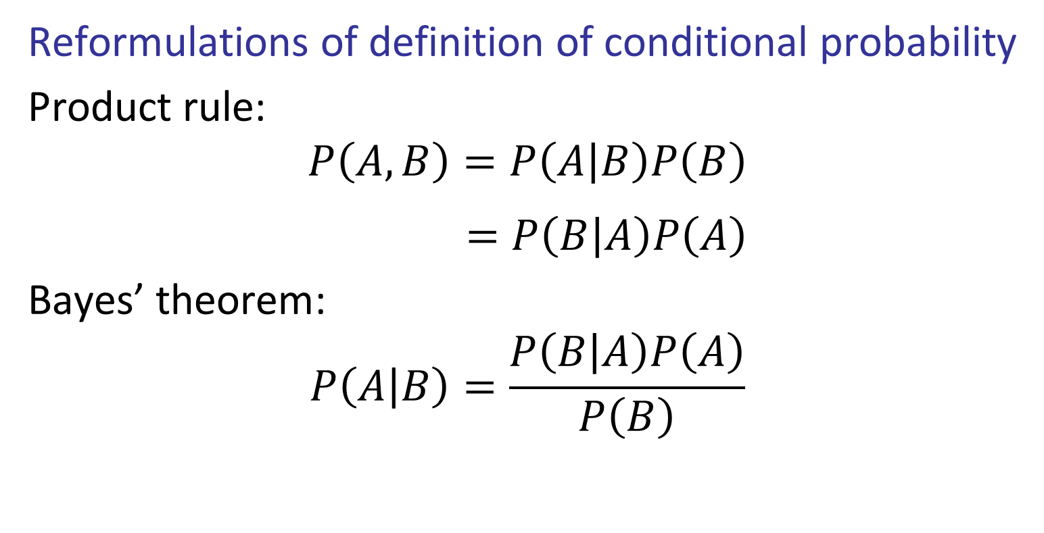
Product Rule and Bayes’ Theorem
Reformulations of definition of conditional probability
Product rule:
$$P\left(A,B\right)=P\left(A | B\right)P\left(B\right)$$
$$=P\left(B | A\right)P\left(A\right)$$
Bayes’ theorem:
$$P\left(A | B\right)=\frac{P\left(B | A\right)P\left(A\right)}{P\left(B\right)}$$
http://achievementgen.com/360/

Slide 36





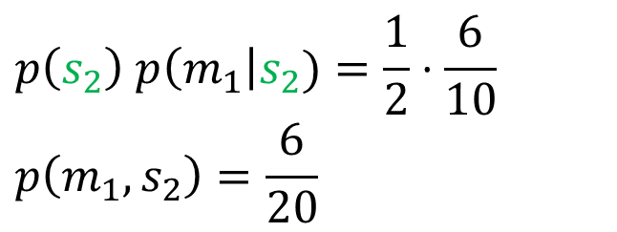











Product Rule: Tree
Product rule:
$$p\left(a,b\right)=p\left(a | b\right)p\left(b\right)$$
$$p\left(m_{1}\right|s_{1})$$
$$m_{1}$$
$$m_{2}$$
$$p(s_{1})$$
$$s_{1}$$
$$p\left(m_{2} | s_{1}\right)$$
$$Ω$$
$$p\left(s_{2}\right) p\left(m_{1}\right|s_{2})=\frac{1}{2}⋅\frac{6}{10}$$
$$p\left(m_{1},s_{2}\right)=\frac{6}{20}$$
$$p\left(m_{1}\right|s_{2})$$
$$m_{1}$$
$$p(s_{2})$$
$$s_{2}$$
$$m_{2}$$
$$p\left(m_{2} | s_{2}\right)$$
Icons: CC, https://openclipart.org/detail/296791/pizza-slice

Slide 37

Exercise: Product Rule: Tree
Demonstrate, using trees, that product rule works both ways:
$$P\left(A,B\right)=P\left(A | B\right)P\left(B\right)$$
$=P\left(B | A\right)P\left(A\right)$
Icons: CC, https://openclipart.org/detail/296791/pizza-slice

Slide 38


Bayes’ Theorem
Bayes’ theorem:
$$P\left(a_{1} | b\right)=\frac{P\left(b | a_{1}\right)P\left(a_{1}\right)}{P\left(b\right)}$$
Also:
$$P\left(a_{1} | b\right)=\frac{P\left(b | a_{1}\right)P\left(a_{1}\right)}{\sum_{i=1}^{n}{P\left(b | a_{i}\right)P\left(a_{i}\right)}}$$
Why is this at all helpful?
  Lets us build one conditional from its reverse
  Often one conditional is tricky but the other one is simple
  Describes an “update” step from prior $P(a)$ to posterior $P(a | b)$
  Foundation of many probabilistic systems
That’s my rule!

Slide 39





Inference with Bayes’ Theorem
Example: Diagnostic probability from causal probability:
$P\left(cause \right| effect)=\frac{P\left(effect \right| cause) P\left(cause\right)}{P\left(effect\right)}$
Example:
  Your friend has a stiff neck ($+s$)
  Knowledge:
  What are the chances your friend has meningitis ($+m$)?
$$= \frac{P\left(+s | +m\right) P\left(+m\right)}{P\left(+s\right)}$$
$$P(+m |+s)$$
$$P\left(+s\right)= 0.01$$
$$P\left(+m\right)= 0.0001$$
$$P(+s |+m) = 0.8$$
$=\frac{0.8 × 0.0001}{0.01}=0.008$

Slide 40



Tools Summary
Adding to our toolbox
Definition of conditional probability
Product Rule
Bayes’ theorem
Chain Rule…
$$P\left(A | B\right)=\frac{P\left(A, B\right)}{P(B)}$$
$$P(A,B)=P\left(A | B\right)P(B)$$
$$P\left(B | A\right)=\frac{P\left(A|B\right)P(B)}{P(A)}$$

Slide 41



The Product Rule
Sometimes have conditional distributions but want the joint

Slide 42



The Product Rule
Example:
D | W | P
wet | sun | 0.1
dry | sun | 0.9
wet | rain | 0.7
dry | rain | 0.3
D | W | P
wet | sun | 0.08
dry | sun | 0.72
wet | rain | 0.14
dry | rain | 0.06
R | P
sun | 0.8
rain | 0.2

Slide 43

The Chain Rule
More generally, can always write any joint distribution as an incremental product of conditional distributions

