Slide 1
As You Walk In
Please complete survey
See Piazza for link

Slide 2
Announcements
HW1
Due Today, 11:59 pm
Online + Written components
Probability
Reach out for help on HW1 probability before Wednesday!
Quiz
First quiz on Wed 9/22
Details posted on Piazza

Slide 3

Mathematical Foundations for Machine Learning Calculus & Lagrange Multipliers
Instructor: Pat Virtue

Slide 4
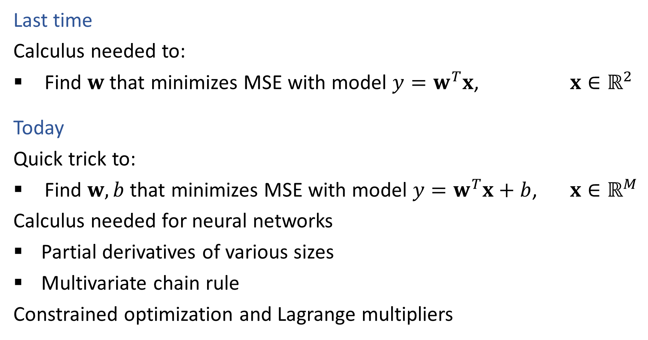
Linear Regression
Last time
Calculus needed to:
Find $w$ that minimizes MSE with model $y=w^{T}x$, $x∈ℝ^{2}$
Today
Quick trick to:
Find $w,b$ that minimizes MSE with model $y=w^{T}x+b$, $x∈ℝ^{M}$
Calculus needed for neural networks
Partial derivatives of various sizes
Multivariate chain rule
Constrained optimization and Lagrange multipliers

Slide 5
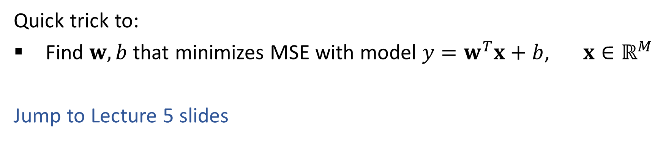
Linear Regression
Quick trick to:
Find $w,b$ that minimizes MSE with model $y=w^{T}x+b$, $x∈ℝ^{M}$
Jump to Lecture 5 slides

Slide 6
Calculus
Partial derivatives

Slide 7
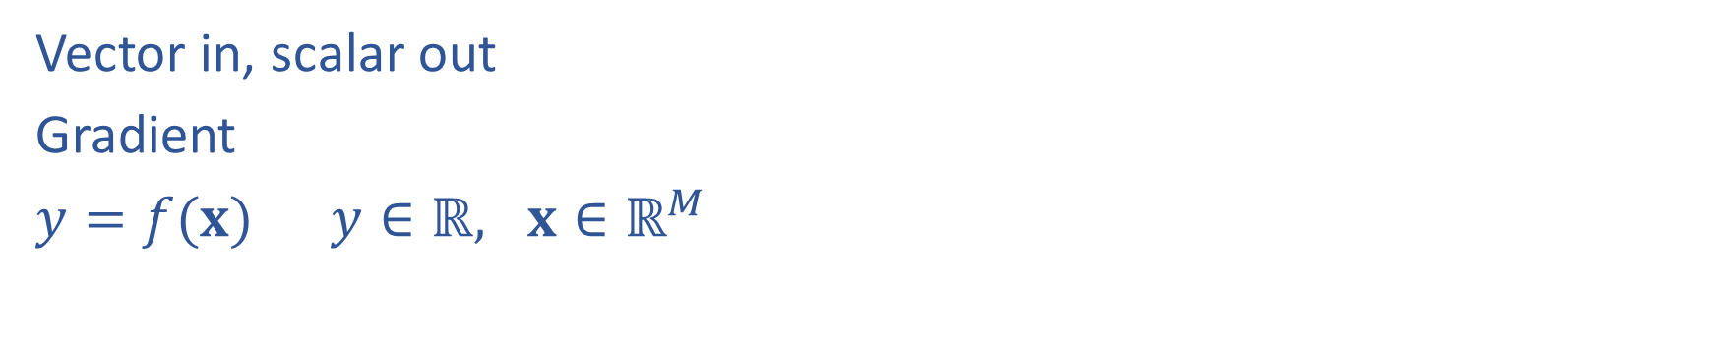
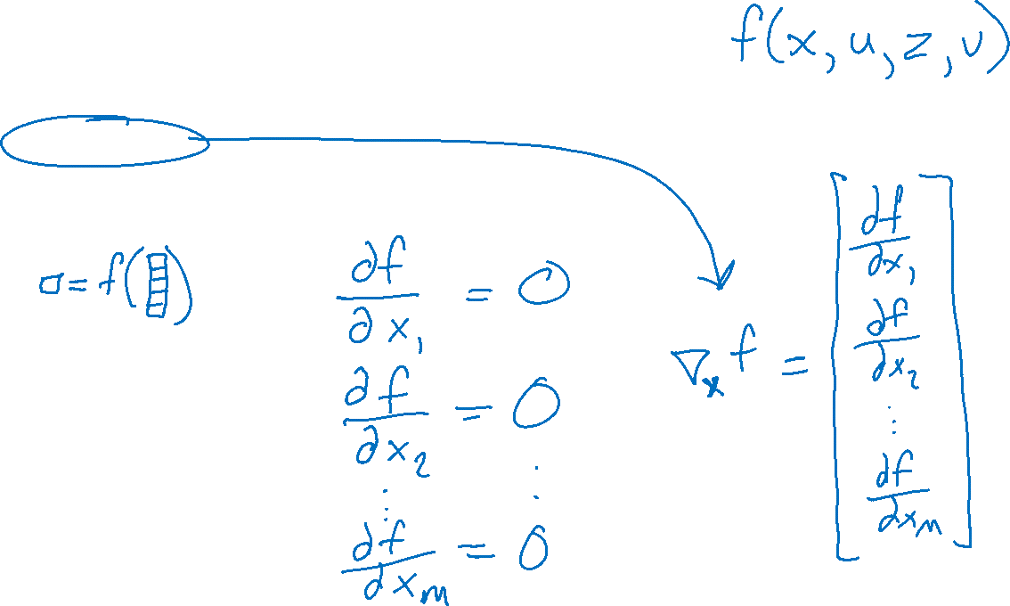
Calculus with Linear Algebra
Vector in, scalar out
Gradient
$y=f(x)$ $y∈ℝ, x∈ℝ^{M}$

Slide 8
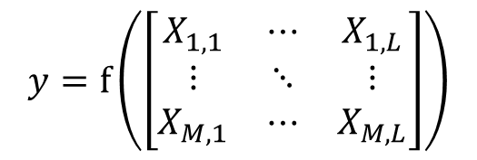

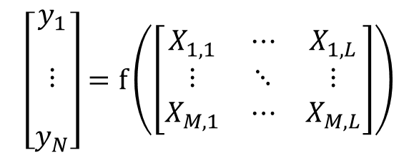
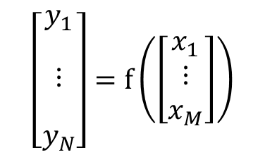
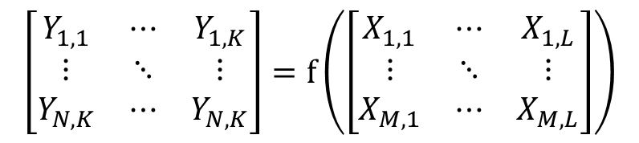
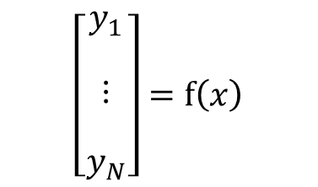
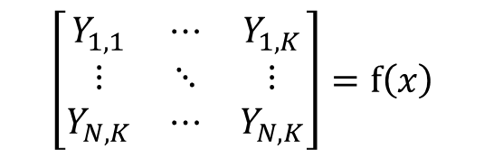

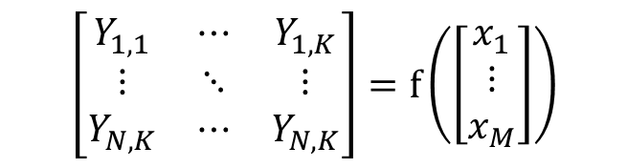
Calculus with Linear Algebra
Functions with linear algebra
$$y=f\left(\left[\begin{matrix}x_{1} \\ ⋮ \\ x_{M}\end{matrix}\right]\right)$$
$$y=f\left(\left[\begin{matrix}X_{1,1} & ⋯ & X_{1,L} \\ ⋮ & ⋱ & ⋮ \\ X_{M,1} & ⋯ & X_{M,L}\end{matrix}\right]\right)$$
$$y=f\left(x\right)$$
$$\left[\begin{matrix}\begin{aligned}y_{1} \\ \end{aligned} \\ \begin{aligned}⋮ \\ \end{aligned} \\ y_{N}\end{matrix}\right]=f\left(x\right)$$
$$\left[\begin{matrix}\begin{aligned}y_{1} \\ \end{aligned} \\ \begin{aligned}⋮ \\ \end{aligned} \\ y_{N}\end{matrix}\right]=f\left(\left[\begin{matrix}x_{1} \\ ⋮ \\ x_{M}\end{matrix}\right]\right)$$
$$\left[\begin{matrix}\begin{aligned}y_{1} \\ \end{aligned} \\ \begin{aligned}⋮ \\ \end{aligned} \\ y_{N}\end{matrix}\right]=f\left(\left[\begin{matrix}X_{1,1} & ⋯ & X_{1,L} \\ ⋮ & ⋱ & ⋮ \\ X_{M,1} & ⋯ & X_{M,L}\end{matrix}\right]\right)$$
$$\left[\begin{matrix}Y_{1,1} & ⋯ & Y_{1,K} \\ ⋮ & ⋱ & ⋮ \\ Y_{N,K} & ⋯ & Y_{N,K}\end{matrix}\right]=f\left(x\right)$$
$$\left[\begin{matrix}Y_{1,1} & ⋯ & Y_{1,K} \\ ⋮ & ⋱ & ⋮ \\ Y_{N,K} & ⋯ & Y_{N,K}\end{matrix}\right]=f\left(\left[\begin{matrix}x_{1} \\ ⋮ \\ x_{M}\end{matrix}\right]\right)$$
$$\left[\begin{matrix}Y_{1,1} & ⋯ & Y_{1,K} \\ ⋮ & ⋱ & ⋮ \\ Y_{N,K} & ⋯ & Y_{N,K}\end{matrix}\right]=f\left(\left[\begin{matrix}X_{1,1} & ⋯ & X_{1,L} \\ ⋮ & ⋱ & ⋮ \\ X_{M,1} & ⋯ & X_{M,L}\end{matrix}\right]\right)$$

Slide 9
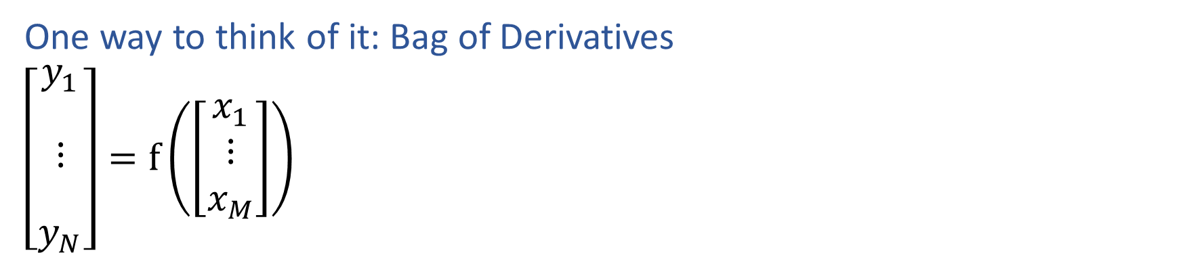
Calculus with Linear Algebra
One way to think of it: Bag of Derivatives
$\left[\begin{matrix}\begin{aligned}y_{1} \\ \end{aligned} \\ \begin{aligned}⋮ \\ \end{aligned} \\ y_{N}\end{matrix}\right]=f\left(\left[\begin{matrix}x_{1} \\ ⋮ \\ x_{M}\end{matrix}\right]\right)$

Slide 10
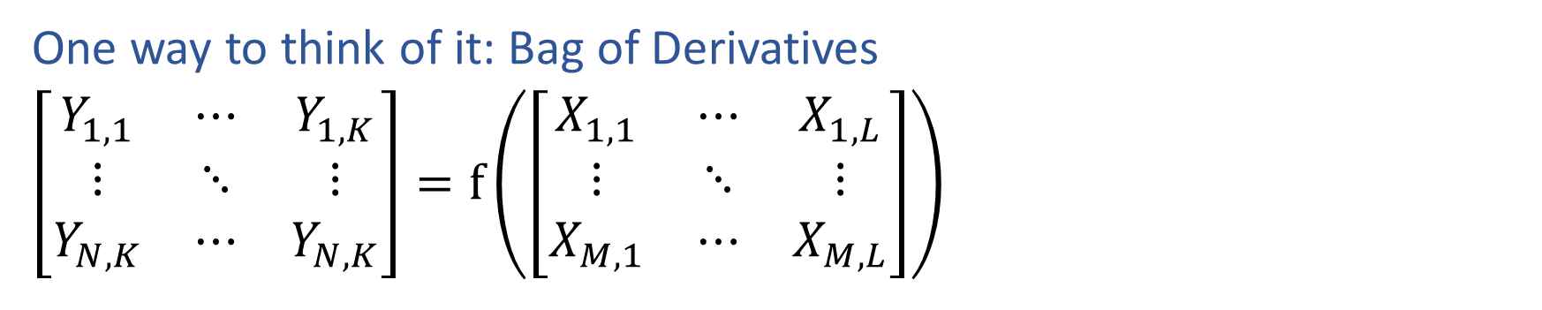
Calculus with Linear Algebra
One way to think of it: Bag of Derivatives
$\left[\begin{matrix}Y_{1,1} & ⋯ & Y_{1,K} \\ ⋮ & ⋱ & ⋮ \\ Y_{N,K} & ⋯ & Y_{N,K}\end{matrix}\right]=f\left(\left[\begin{matrix}X_{1,1} & ⋯ & X_{1,L} \\ ⋮ & ⋱ & ⋮ \\ X_{M,1} & ⋯ & X_{M,L}\end{matrix}\right]\right)$

Slide 11
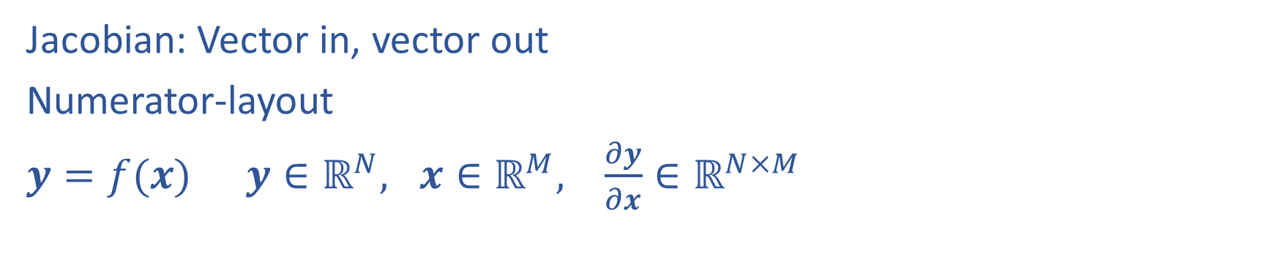
Calculus with Linear Algebra
Jacobian: Vector in, vector out
Numerator-layout
$y=f(x)$ $y∈ℝ^{N}, x∈ℝ^{M}, \frac{∂y}{∂x}∈ℝ^{N×M}$

Slide 12
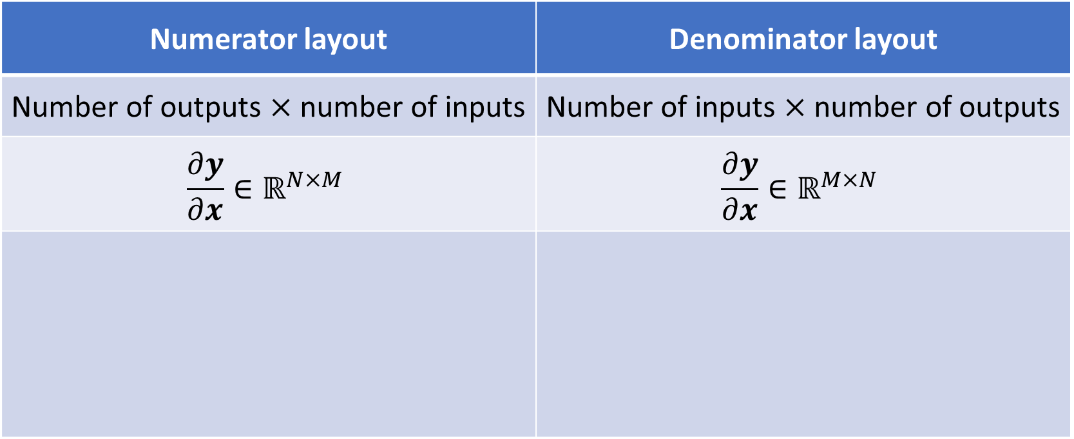
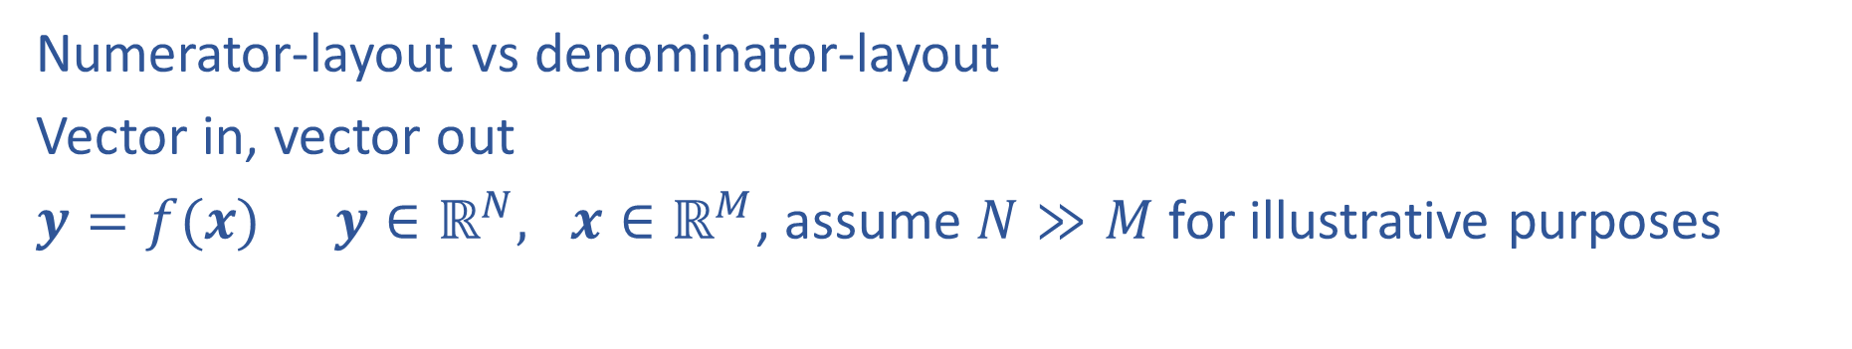
Calculus with Linear Algebra
Numerator-layout vs denominator-layout
Vector in, vector out
$y=f(x)$ $y∈ℝ^{N}, x∈ℝ^{M}$, assume $N≫M$ for illustrative purposes
Numerator layout | Denominator layout
Number of outputs $×$ number of inputs | Number of inputs $×$ number of outputs
$$\frac{∂y}{∂x}∈ℝ^{N×M}$$ | $$\frac{∂y}{∂x}∈ℝ^{M×N}$$

Slide 13
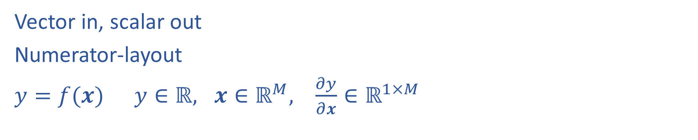
Calculus with Linear Algebra
Vector in, scalar out
Numerator-layout
$y=f(x)$ $y∈ℝ, x∈ℝ^{M}, \frac{∂y}{∂x}∈ℝ^{1×M}$

Slide 14

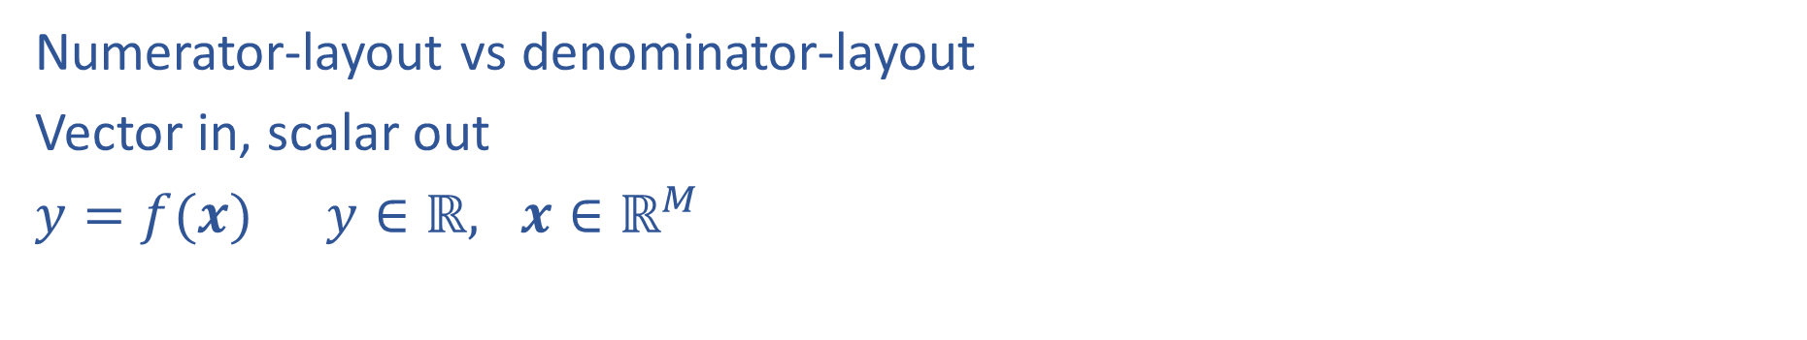
Calculus with Linear Algebra
Numerator-layout vs denominator-layout
Vector in, scalar out
$y=f(x)$ $y∈ℝ, x∈ℝ^{M}$
Numerator layout | Denominator layout
Number of outputs $×$ number of inputs | Number of inputs $×$ number of outputs
$$\frac{∂y}{∂x}∈ℝ^{1×M}$$ | $$\frac{∂y}{∂x}∈ℝ^{M×1}$$

Slide 15
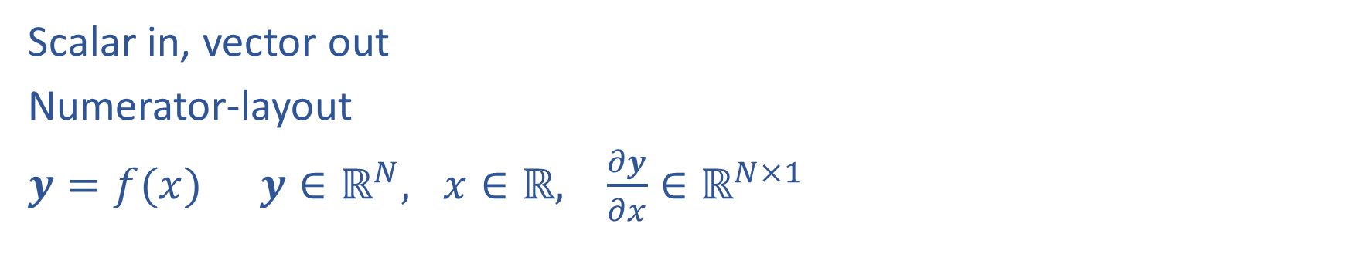
Calculus with Linear Algebra
Scalar in, vector out
Numerator-layout
$y=f(x)$ $y∈ℝ^{N}, x∈ℝ, \frac{∂y}{∂x}∈ℝ^{N×1}$

Slide 16
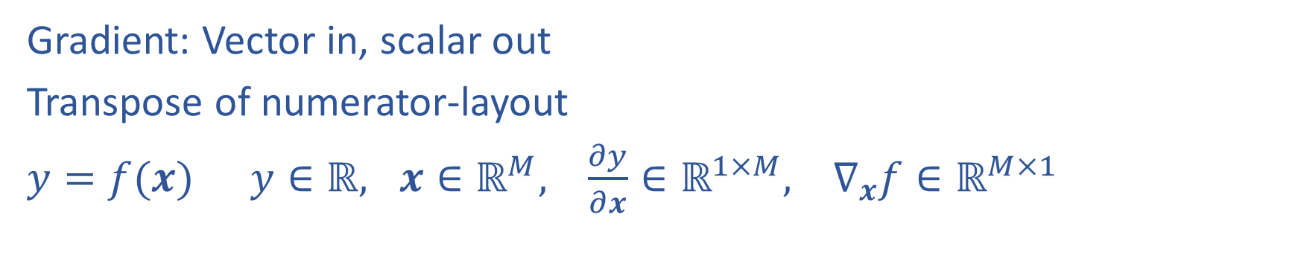
Calculus with Linear Algebra
Gradient: Vector in, scalar out
Transpose of numerator-layout
$y=f(x)$ $y∈ℝ, x∈ℝ^{M}, \frac{∂y}{∂x}∈ℝ^{1×M}, ∇_{x}f∈ℝ^{M×1}$

Slide 17
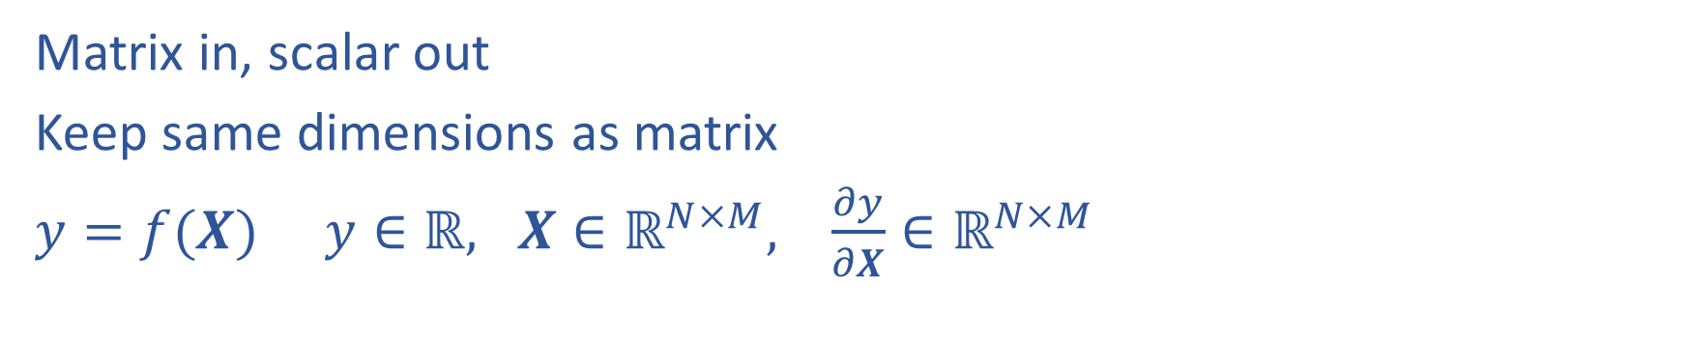
Calculus with Linear Algebra
Matrix in, scalar out
Keep same dimensions as matrix
$y=f(X)$ $y∈ℝ, X∈ℝ^{N×M}, \frac{∂y}{∂X}∈ℝ^{N×M}$

Slide 18
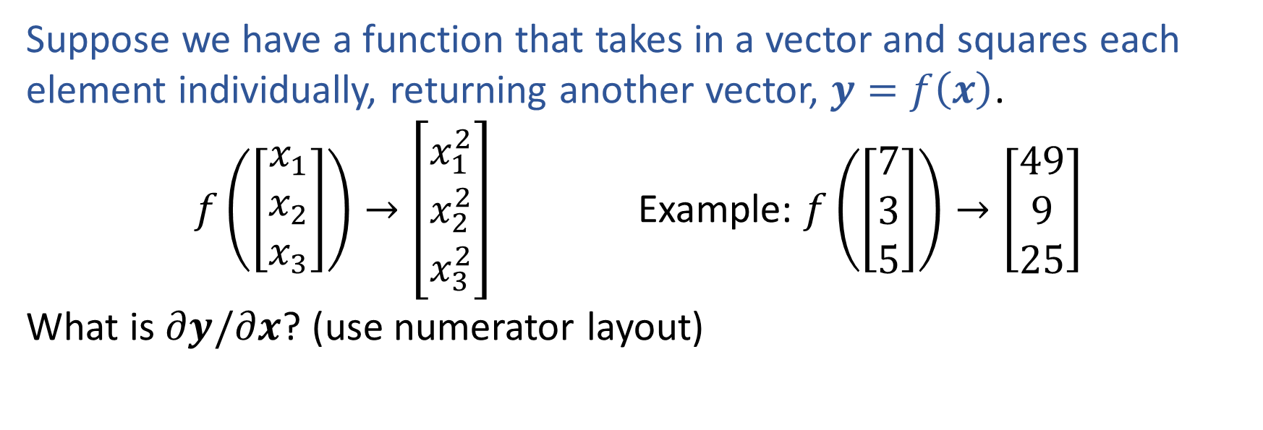
Exercise 1
Suppose we have a function that takes in a vector and squares each element individually, returning another vector, $y=f\left(x\right)$.
$f\left(\left[\begin{aligned}x_{1} \\ x_{2} \\ x_{3}\end{aligned}\right]\right)→\left[\begin{aligned}x_{1}^{2} \\ x_{2}^{2} \\ x_{3}^{2}\end{aligned}\right]$ Example: $f\left(\left[\begin{aligned}7 \\ 3 \\ 5\end{aligned}\right]\right)→\left[\begin{aligned}49 \\ 9 \\ 25\end{aligned}\right]$
What is $∂y/∂x$? (use numerator layout)

Slide 19
Calculus
Chain rule

Slide 20
Reminder: Calculus Chain Rule (scalar version)
$$y=f\left(z\right)$$
$$z=g\left(x\right)$$
$$\frac{dy}{dx}=\frac{dy}{dz}\frac{dz}{dx}$$

Slide 21
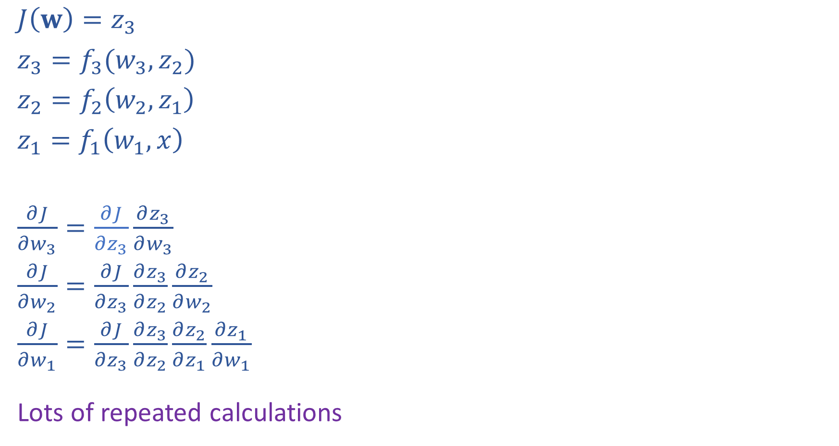

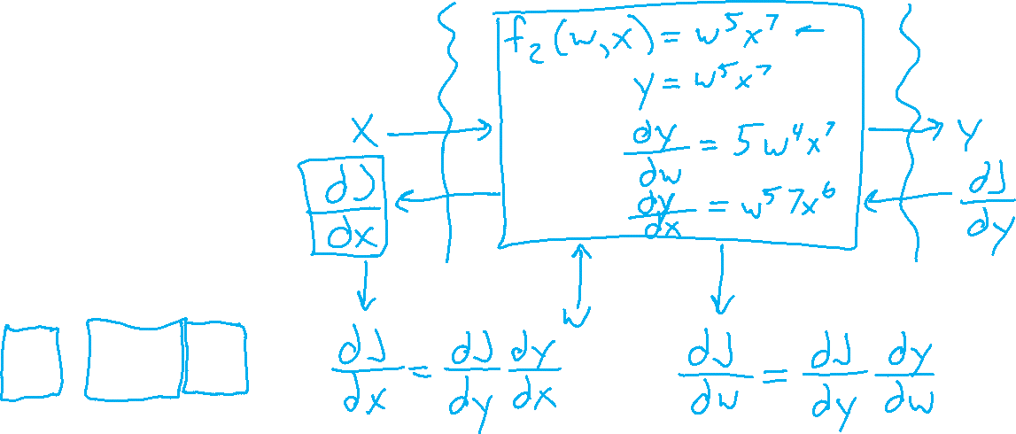
Network Optimization: Layer Implementation
$J\left(w\right)=z_{3}$
$z_{3}=f_{3}(w_{3}, z_{2})$
$z_{2}=f_{2}\left(w_{2}, z_{1}\right)$
$z_{1}=f_{1}\left(w_{1}, x\right)$
$\frac{∂J}{∂w_{3}}=\frac{∂J}{∂z_{3}}\frac{∂z_{3}}{∂w_{3}}$
$\frac{∂J}{∂w_{2}}=\frac{∂J}{∂z_{3}}\frac{∂z_{3}}{∂z_{2}}\frac{∂z_{2}}{∂w_{2}}$
$\frac{∂J}{∂w_{1}}=\frac{∂J}{∂z_{3}}\frac{∂z_{3}}{∂z_{2}}\frac{∂z_{2}}{∂z_{1}}\frac{∂z_{1}}{∂w_{1}}$
Lots of repeated calculations
Example slide from 10-601

Slide 22
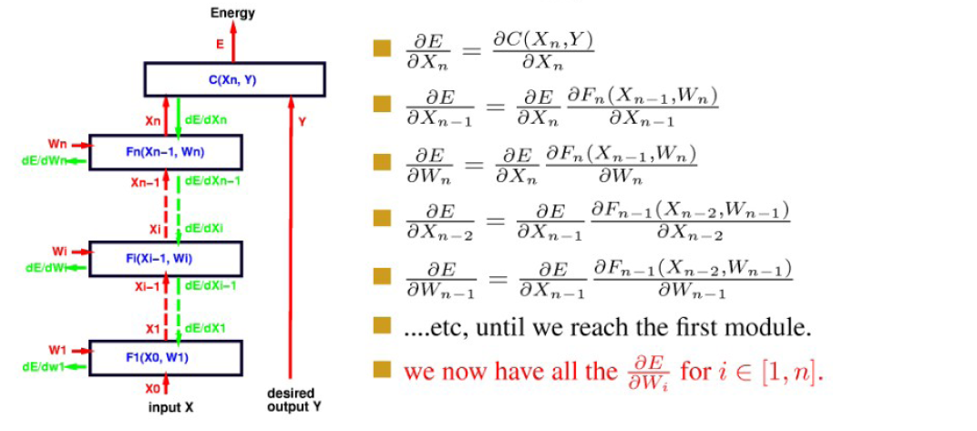

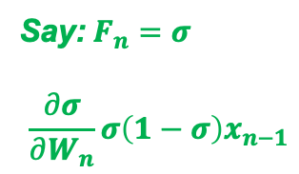
Backpropagation (continue)
Example slide from 10-701
$$\frac{∂σ}{∂X_{n−1}}σ\left(1−σ\right)W_{n}$$
Say: $F_{n}=$ $σ$
$$\frac{∂σ}{∂W_{n}}σ\left(1−σ\right)x_{n−1}$$

Slide 23
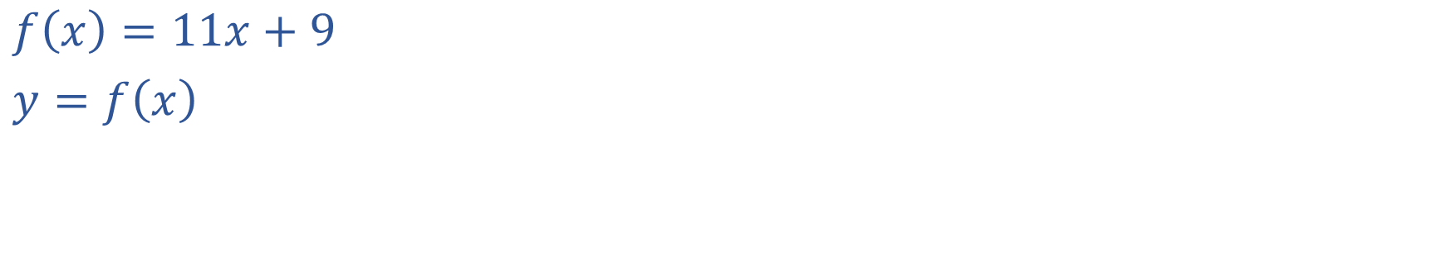
What is a Derivative?
$f\left(x\right)=11x+9$
$y=f\left(x\right)$

Slide 24
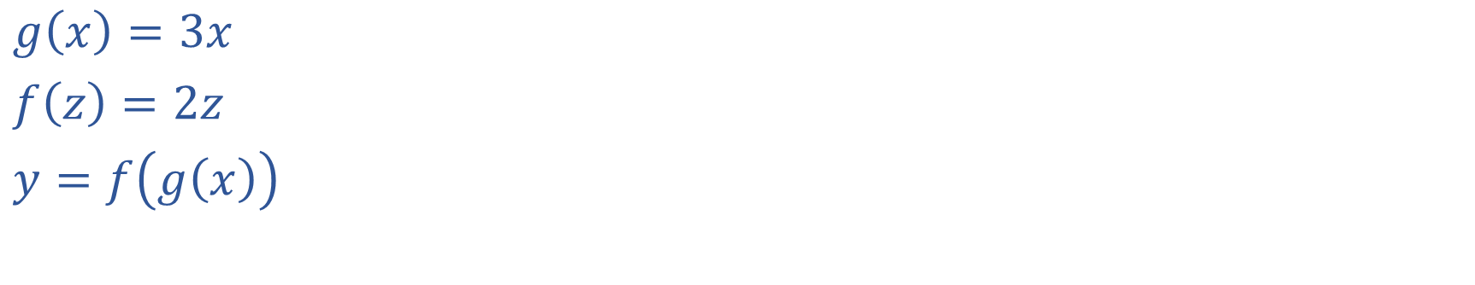
What is a Derivative?
$g\left(x\right)=3x$
$f\left(z\right)=2z$
$y=f\left(g\left(x\right)\right)$

Slide 25
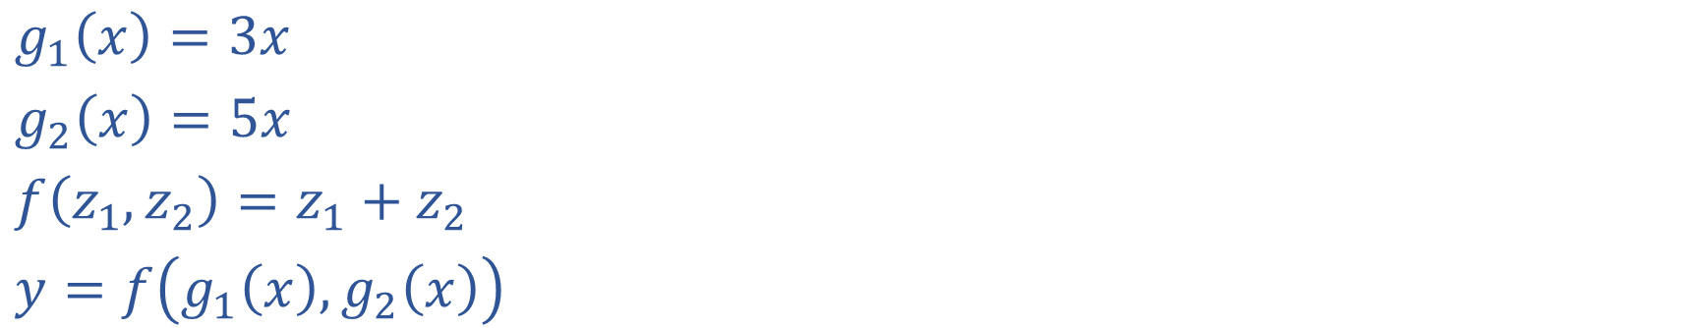
What is a Derivative?
$g_{1}\left(x\right)=3x$
$g_{2}\left(x\right)=5x$
$f\left(z_{1}, z_{2}\right)=z_{1}+z_{2}$
$y=f\left(g_{1}\left(x\right),g_{2}\left(x\right)\right)$

Slide 26
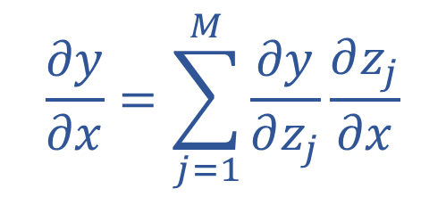
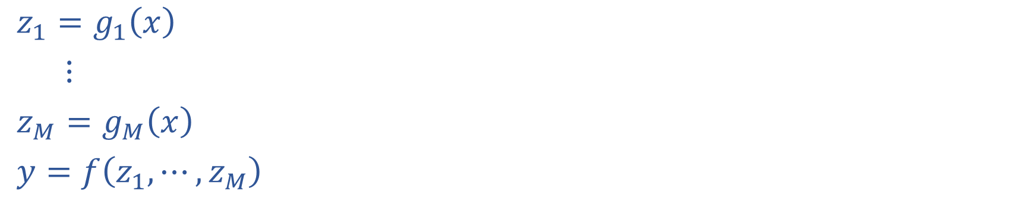
Multivariate Chain Rule
$z_{1}=g_{1}\left(x\right)$
$⋮$
$z_{M}=g_{M}\left(x\right)$
$y=f\left(z_{1}, ⋯, z_{M}\right)$
$$\frac{∂y}{∂x}=\sum_{j=1}^{M}{\frac{∂y}{∂z_{j}}}\frac{∂z_{j}}{∂x}$$

Slide 27
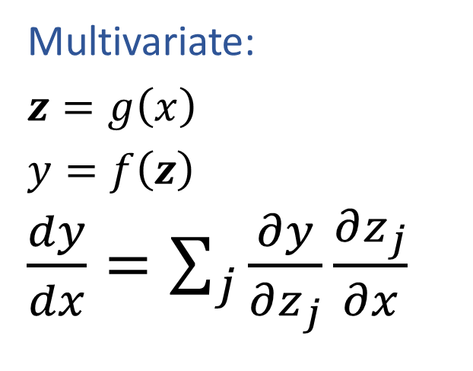
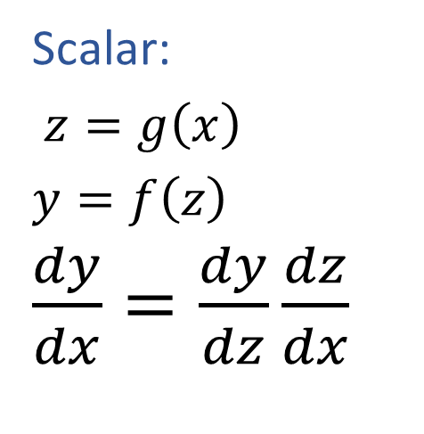
Calculus Chain Rule
Scalar:
$z=g\left(x\right)$
$y=f\left(z\right)$
$\frac{dy}{dx}=\frac{dy}{dz}\frac{dz}{dx}$
Multivariate:
$z=g\left(x\right)$
$y=f\left(z\right)$
$\frac{dy}{dx}=\sum_{j}{\frac{∂y}{∂z_{j}}\frac{∂z_{j}}{∂x}}$

Slide 28

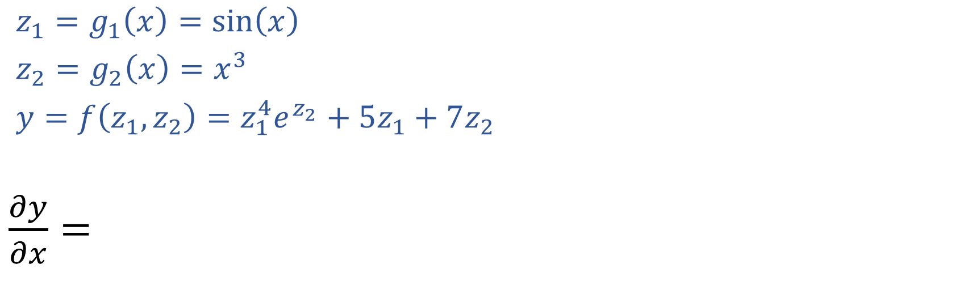
Exercise 2
Multivariate chain rule
$z=g\left(x\right)$
$y=f\left(z\right)$
$\frac{dy}{dx}=\sum_{j}{\frac{∂y}{∂z_{j}}\frac{∂z_{j}}{∂x}}$
$z_{1}=g_{1}\left(x\right)=sin\left(x\right)$
$z_{2}=g_{2}\left(x\right)=x^{3}$
$y=f\left(z_{1}, z_{2}\right)=z_{1}^{4}e^{z_{2}}+5z_{1}+7z_{2}$
$\frac{∂y}{∂x}=$

Slide 29
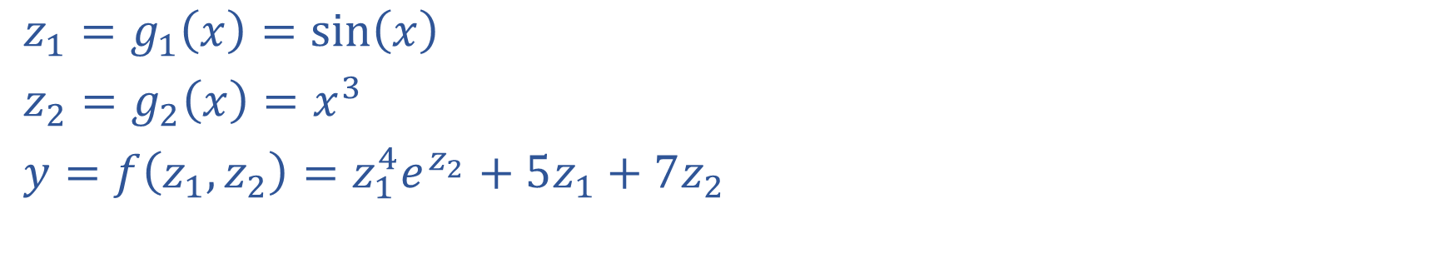
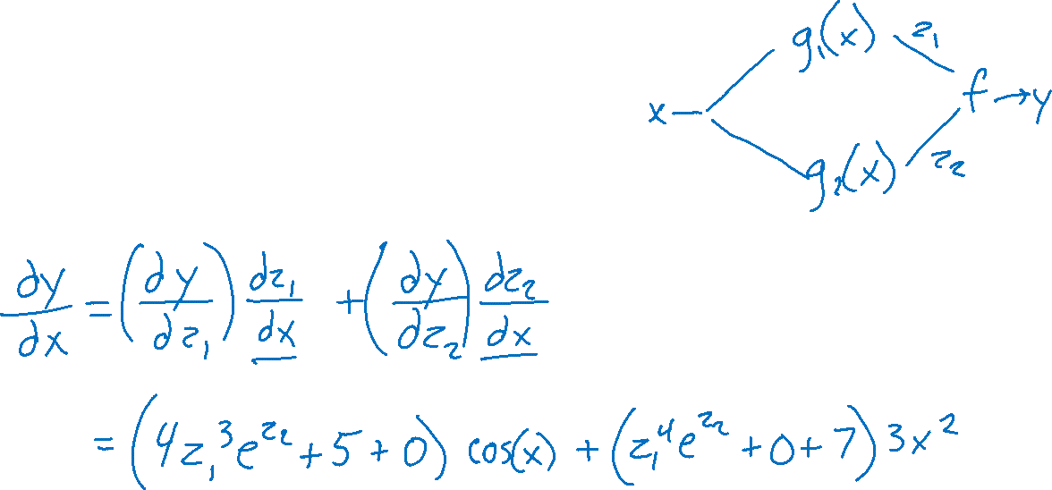
Exercise 2
$z_{1}=g_{1}\left(x\right)=sin\left(x\right)$
$z_{2}=g_{2}\left(x\right)=x^{3}$
$y=f\left(z_{1}, z_{2}\right)=z_{1}^{4}e^{z_{2}}+5z_{1}+7z_{2}$

Slide 30
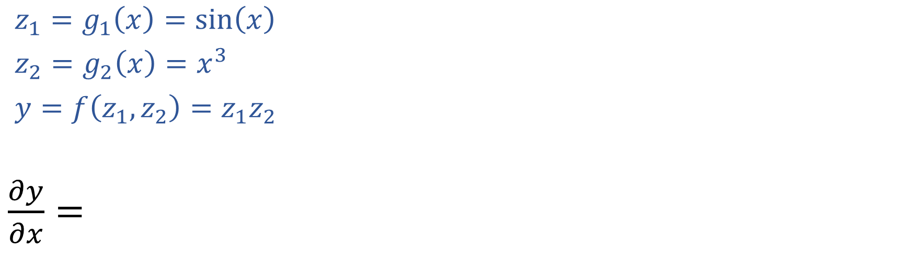
Exercise 3
Multivariate chain rule
$z=g\left(x\right)$
$y=f\left(z\right)$
$\frac{dy}{dx}=\sum_{j}{\frac{∂y}{∂z_{j}}\frac{∂z_{j}}{∂x}}$
$z_{1}=g_{1}\left(x\right)=sin\left(x\right)$
$z_{2}=g_{2}\left(x\right)=x^{3}$
$y=f\left(z_{1}, z_{2}\right)=z_{1}z_{2}$
$\frac{∂y}{∂x}=$

Slide 31
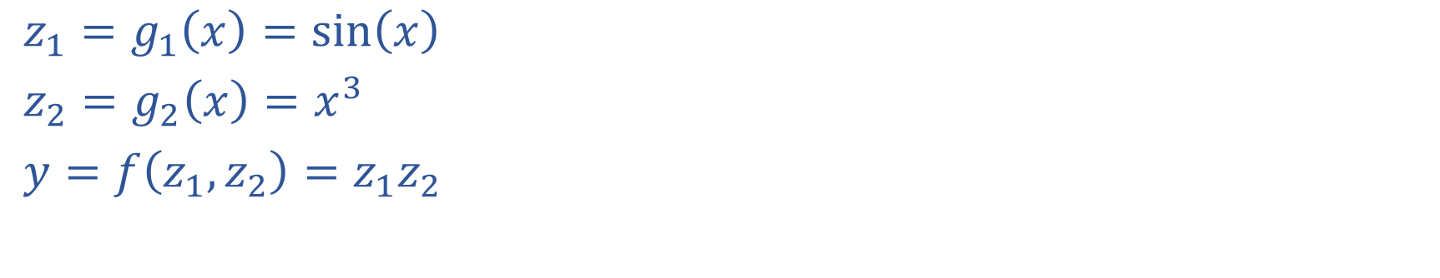
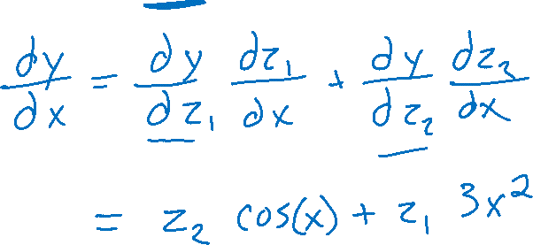
Exercise 3
$z_{1}=g_{1}\left(x\right)=sin\left(x\right)$
$z_{2}=g_{2}\left(x\right)=x^{3}$
$y=f\left(z_{1}, z_{2}\right)=z_{1}z_{2}$

Slide 32
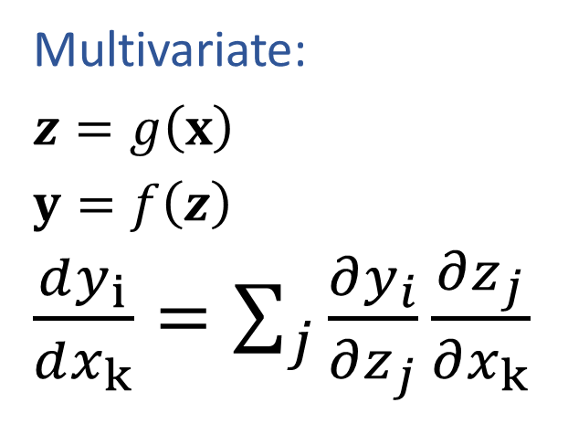
Calculus Chain Rule
Scalar:
$z=g\left(x\right)$
$y=f\left(z\right)$
$\frac{dy}{dx}=\frac{dy}{dz}\frac{dz}{dx}$
Multivariate:
$z=g\left(x\right)$
$y=f\left(z\right)$
$\frac{dy}{dx}=\sum_{j}{\frac{∂y}{∂z_{j}}\frac{∂z_{j}}{∂x}}$
Multivariate:
$z=g\left(x\right)$
$y=f\left(z\right)$
$\frac{dy_{i}}{dx_{k}}=\sum_{j}{\frac{∂y_{i}}{∂z_{j}}\frac{∂z_{j}}{∂x_{k}}}$

Slide 33
Linear Regression
Last time
Calculus needed to:
Find $w$ that minimizes MSE with model $y=w^{T}x$, $x∈ℝ^{2}$
Today
Quick trick to:
Find $w,b$ that minimizes MSE with model $y=w^{T}x+b$, $x∈ℝ^{M}$
Calculus needed for neural networks
Partial derivatives of various sizes
Multivariate chain rule
Constrained optimization and Lagrange multipliers

Slide 34
Constrained Optimization
Method of Lagrange multipliers

Slide 35
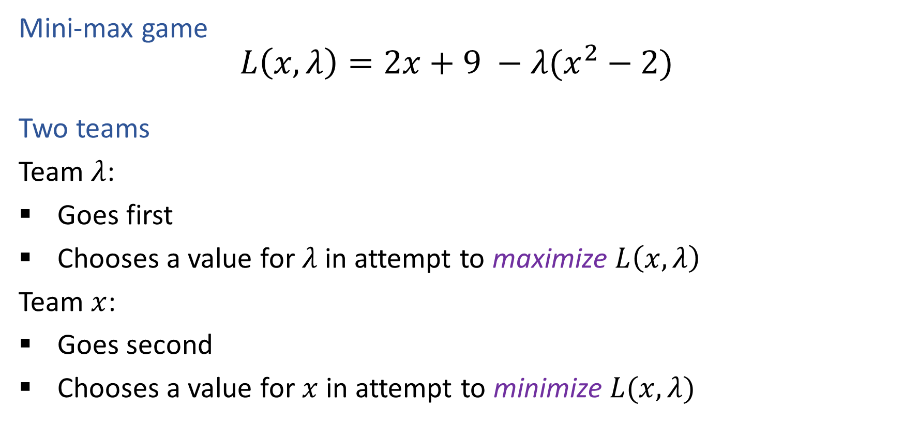
Exercise
Mini-max game
$$L\left(x, λ\right)=2x+9 −λ(x^{2}−2)$$
Two teams
Team $λ$:
Goes first
Chooses a value for $λ$ in attempt to maximize $L\left(x, λ\right)$
Team $x$:
Goes second
Chooses a value for $x$ in attempt to minimize $L(x, λ)$

