Slide 1
Announcements
HW1
Due Mon 9/20, 11:59 pm
Online + Written components
Reach out for help (probability, LaTeX, anything!)
Quiz
First quiz on Wed 9/22
Details posted on Piazza soon

Slide 2

Mathematical Foundations for Machine Learning
Calculus
Instructor: Pat Virtue

Slide 3
Today
Linear regression
Linear algebra formulation
    Linear algebra properties
Calculus
    Multivariate calculus
    Calculus with linear algebra
Optimization
    Convex functions (briefly)
    Closed-form solutions

Slide 4
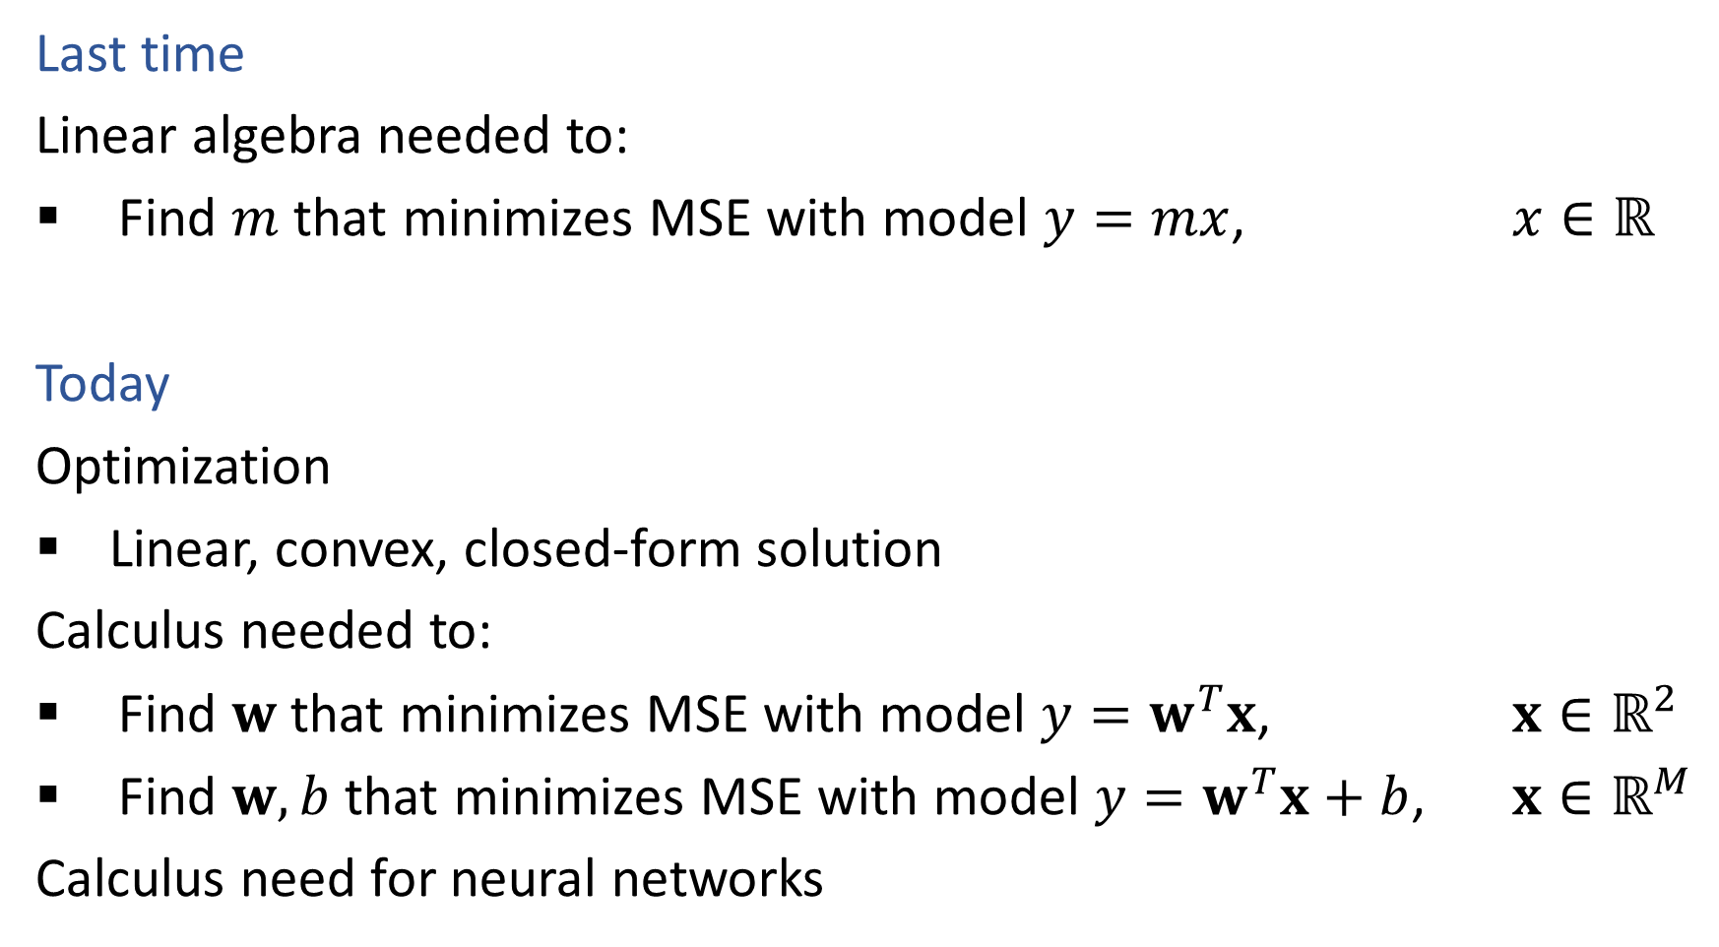
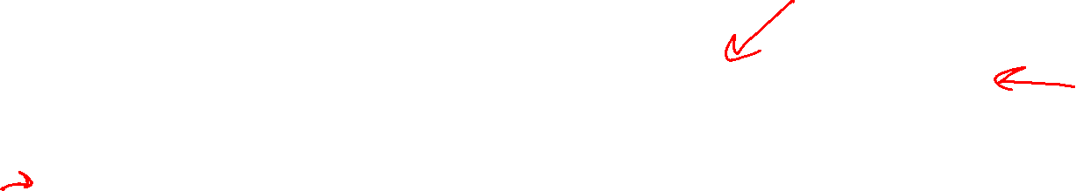
Linear Regression
Last time
Linear algebra needed to:
Find $m$ that minimizes MSE with model $y=mx$, $x∈ℝ$
Today
Optimization
Linear, convex, closed-form solution
Calculus needed to:
Find $w$ that minimizes MSE with model $y=w^{T}x$, $x∈ℝ^{2}$
Find $w,b$ that minimizes MSE with model $y=w^{T}x+b$, $x∈ℝ^{M}$
Calculus need for neural networks

Slide 5
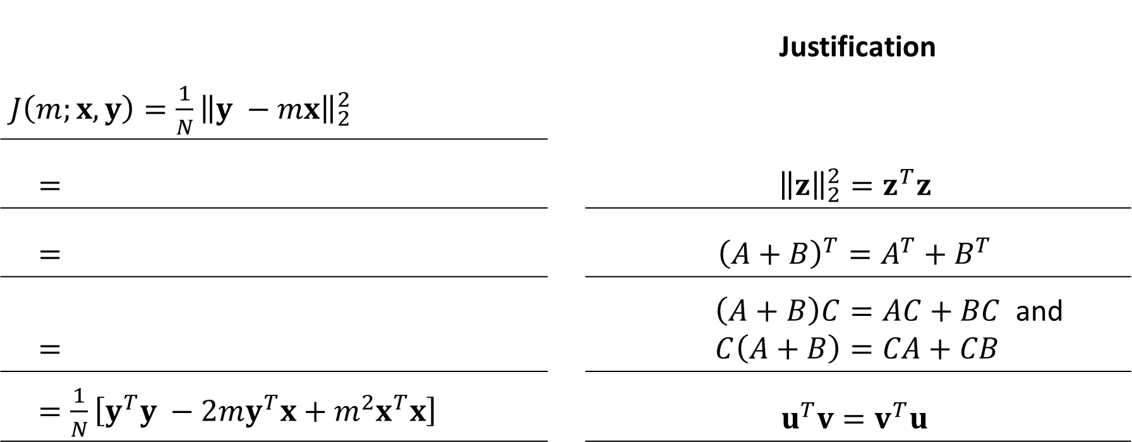
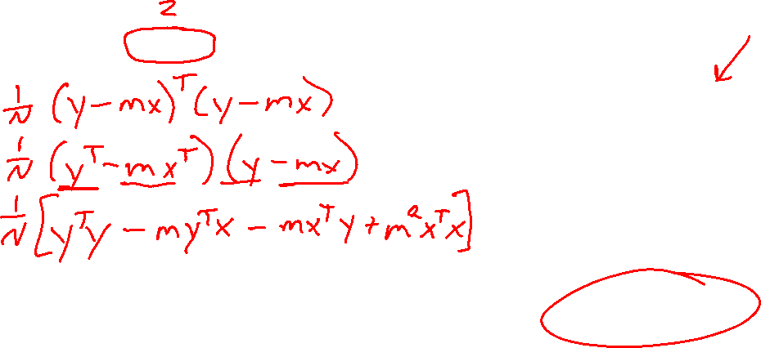

Reminder: Derive the following expansion
1 input feature
No bias term
$\hat{y}=mx$ $m,x∈ℝ$
All data
$y, x∈ℝ^{N}$
Figure out each step, given the provided justification
 |  | Justification
$J\left(m;x, y\right)=\frac{1}{N}{\left\|y −mx\right\|}_{2}^{2}$
$=$ |  | $${\left\|z\right\|}_{2}^{2}=z^{T}z$$
$=$ |  | $${\left(A+B\right)}^{T}=A^{T}+B^{T}$$
$=$ |  | $\left(A+B\right)C=AC+BC$ and $C\left(A+B\right)=CA+CB$
$=\frac{1}{N}\left[y^{T}y −2my^{T}x+m^{2}x^{T}x\right]$ |  | $$u^{T}v=v^{T}u$$

Slide 6
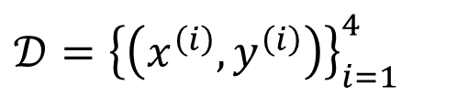
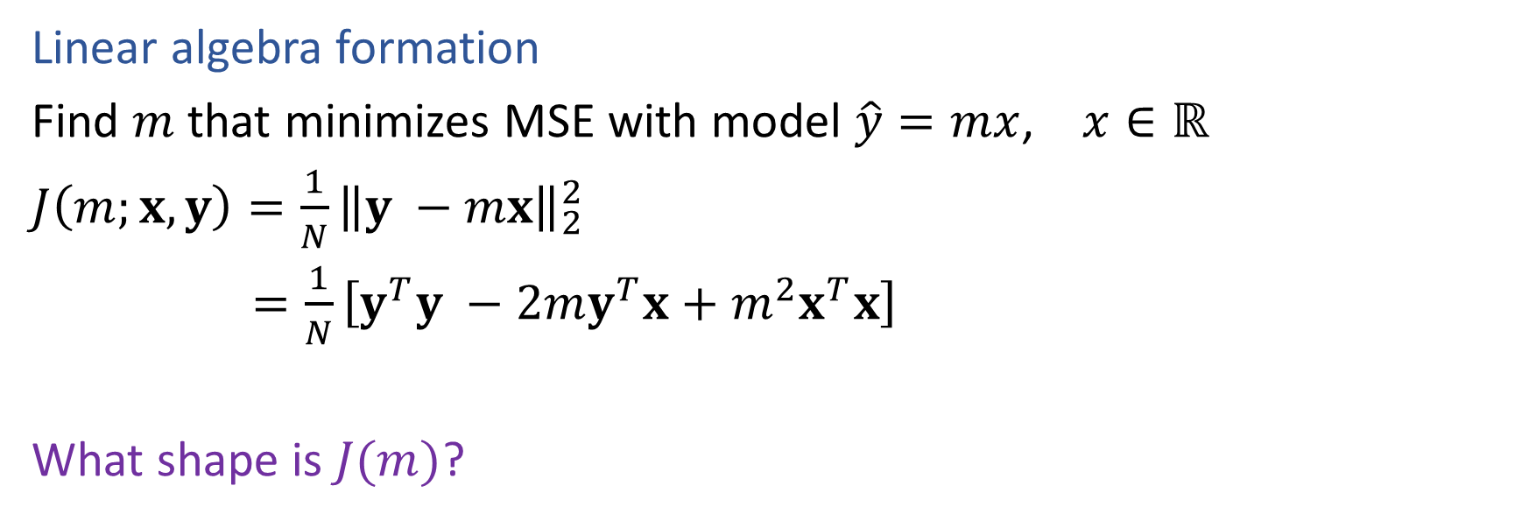
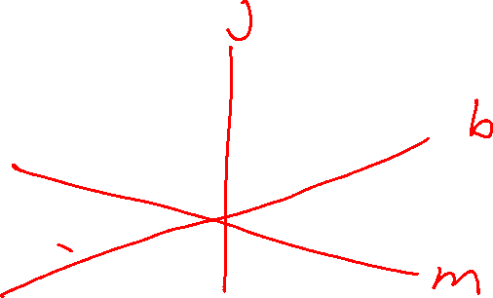
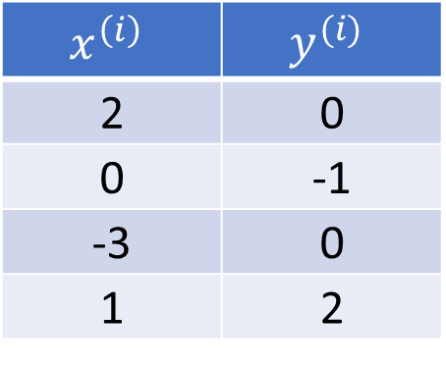
Reminder: Linear Regression
Linear algebra formation
Find $m$ that minimizes MSE with model $\hat{y}=mx$, $x∈ℝ$
$J\left(m;x, y\right)=\frac{1}{N}{\left\|y −mx\right\|}_{2}^{2}$
$=\frac{1}{N}\left[y^{T}y −2my^{T}x+m^{2}x^{T}x\right]$
What shape is $J(m)$?
$𝒟={\left\{\left(x^{\left(i\right)}, y^{\left(i\right)}\right)\right\}}_{i=1}^{4}$
$$x^{\left(i\right)}$$ | $$y^{(i)}$$
2 | 0
0 | -1
-3 | 0
1 | 2

Slide 7
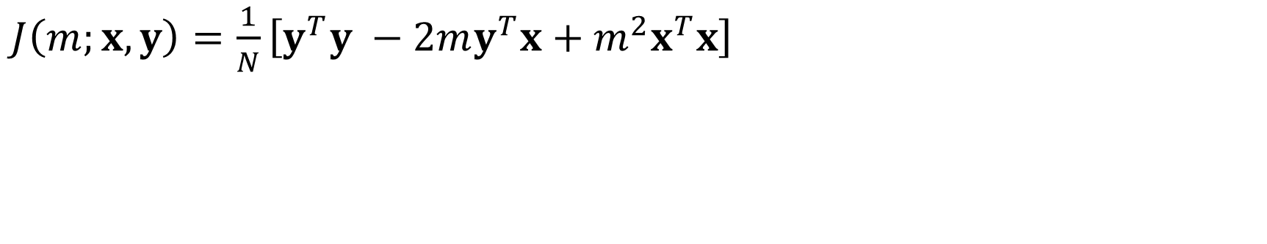
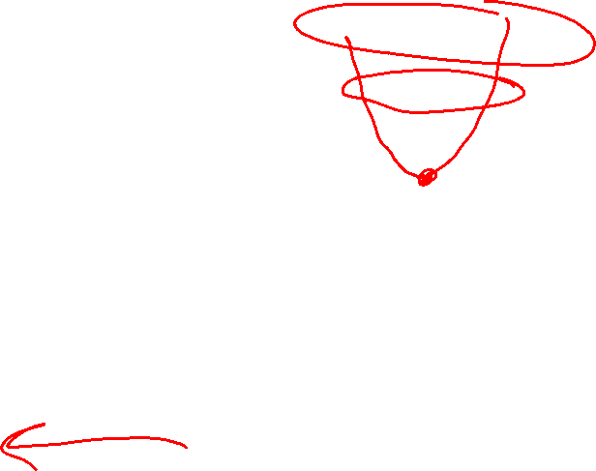
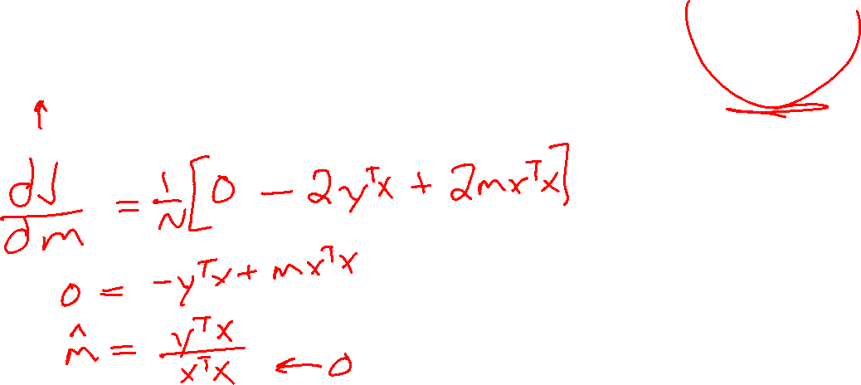
Reminder: Linear Regression
$J\left(m;x, y\right)=\frac{1}{N}\left[y^{T}y −2my^{T}x+m^{2}x^{T}x\right]$

Slide 8
Linear and Convex Functions

Slide 9
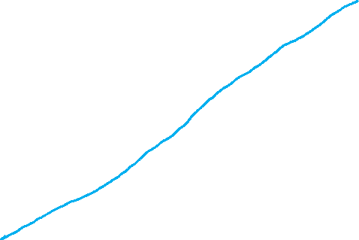


Optimization
Linear function
If $f(x)$ is linear, then for any $u, v$:
$f\left(u+z\right)=f\left(u\right)+f\left(z\right)$
$f\left(αz\right)=αf\left(z\right) ∀α$
$f\left(αu+\left(1−α\right)z\right)=αf\left(u\right)+\left(1−α\right)f\left(z\right) ∀α$

Slide 10


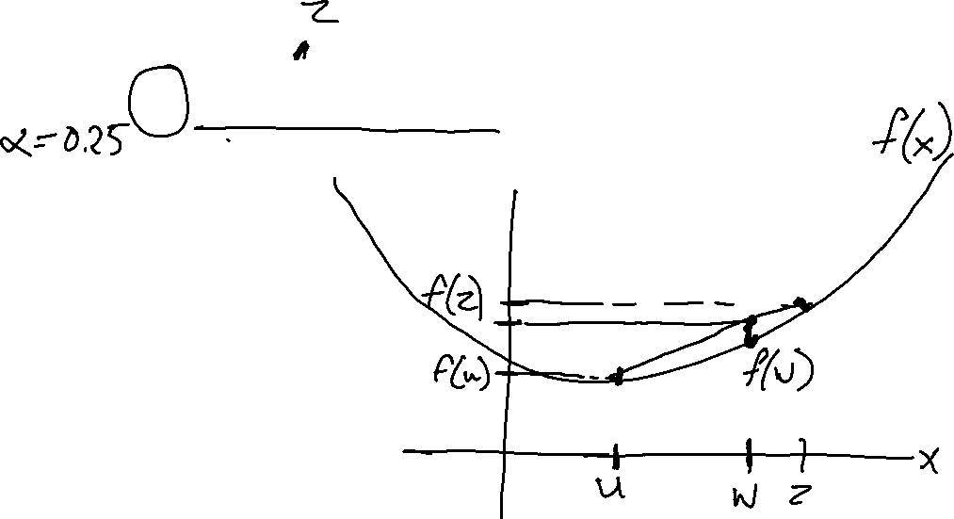
Optimization
Convex function
If $f(x)$ is convex, then for any $u, v$:
$f\left(αu+\left(1−α\right)z\right)≤αf\left(u\right)+\left(1−α\right)f\left(z\right) ∀ 0≤α≤1$
Convex optimization
If $f(x)$ is convex, then:
Every local minimum is also a global minimum ☺

Slide 11

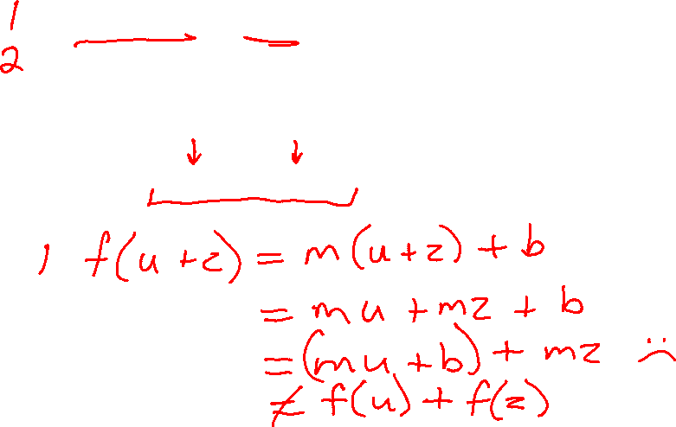
Optimization
Linear function
If $f(x)$ is linear, then for any $u, v$:
$f\left(u+z\right)=f\left(u\right)+f\left(z\right)$
$f\left(αz\right)=αf\left(z\right) ∀α$
$f\left(αu+\left(1−α\right)z\right)=αf\left(u\right)+\left(1−α\right)f\left(z\right) ∀α$
Proof: Is $f\left(x\right)=mx+b$ linear?

Slide 12
Optimization
Linear function
If $f(x)$ is linear, then for any $u, v$:
$f\left(u+z\right)=f\left(u\right)+f\left(z\right)$
$f\left(αz\right)=αf\left(z\right) ∀α$
$f\left(αu+\left(1−α\right)z\right)=αf\left(u\right)+\left(1−α\right)f\left(z\right) ∀α$
Proof: Is $f\left(x\right)=mx+b$ linear?

Slide 13
Linear Regression
Last time
Linear algebra needed to:
Find $m$ that minimizes MSE with model $y=mx$, $x∈ℝ$
Today
Optimization
Linear, convex, closed-form solution
Calculus needed to:
Find $w$ that minimizes MSE with model $y=w^{T}x$, $x∈ℝ^{2}$
Find $w,b$ that minimizes MSE with model $y=w^{T}x+b$, $x∈ℝ^{M}$
Calculus need for neural networks

Slide 14
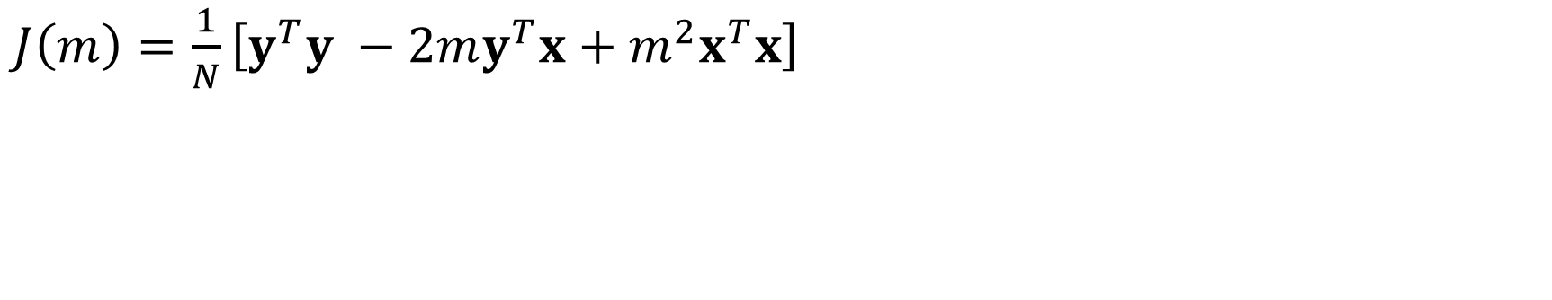
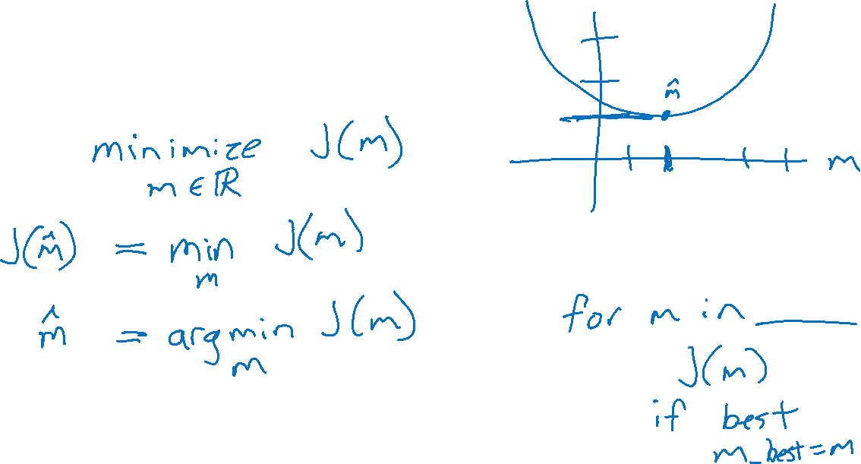
Optimization: Notation
$J\left(m\right)=\frac{1}{N}\left[y^{T}y −2my^{T}x+m^{2}x^{T}x\right]$

Slide 15
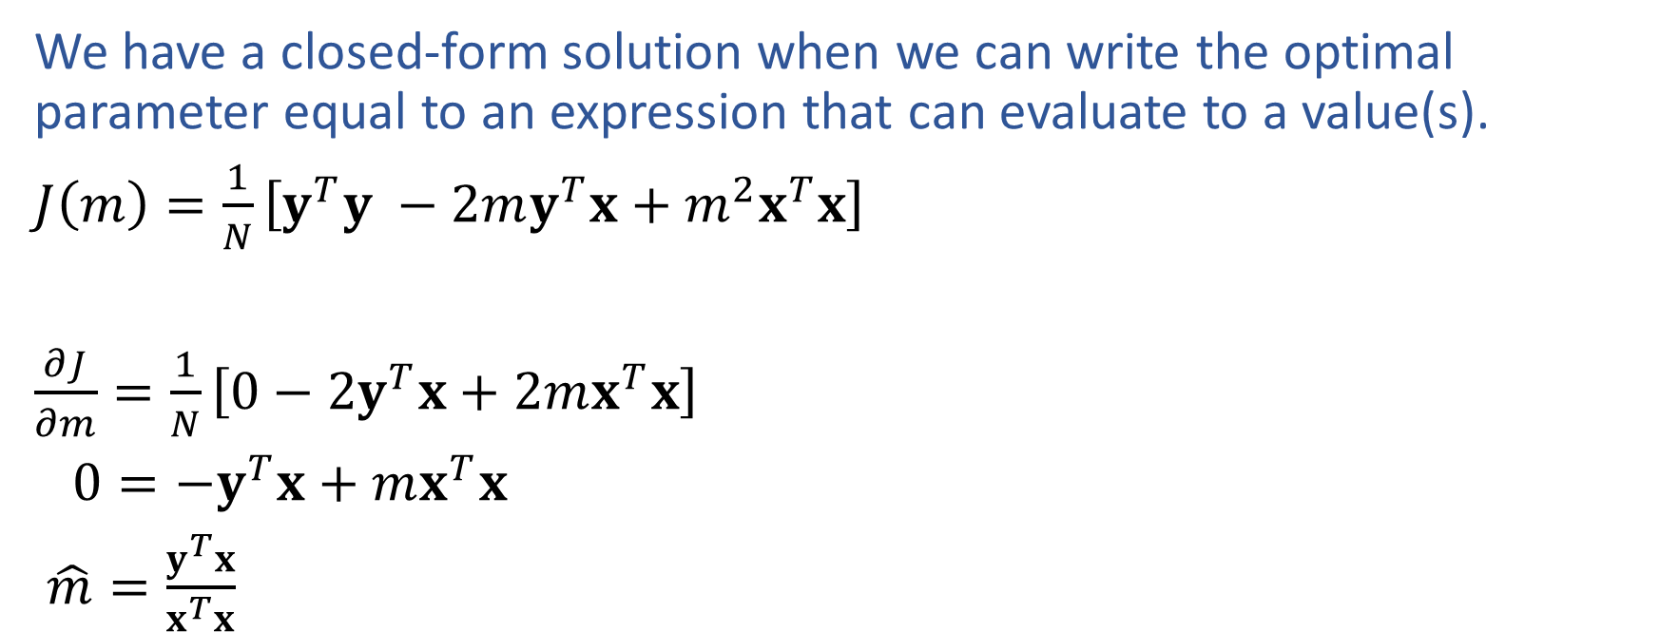
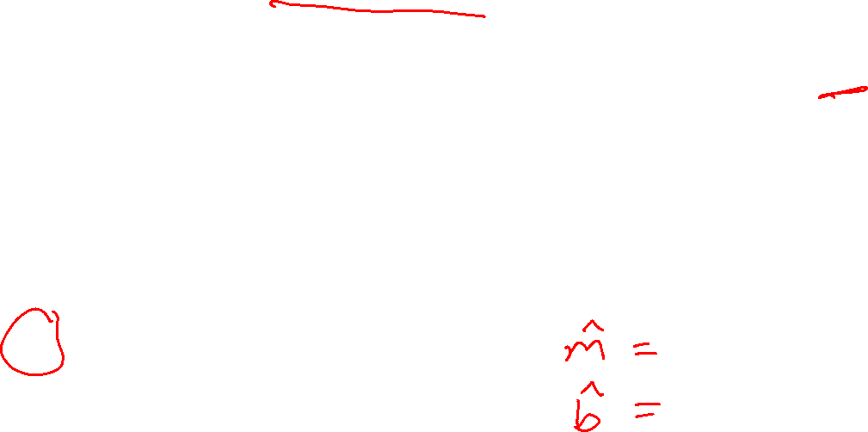
Optimization: Closed-form Solution
We have a closed-form solution when we can write the optimal parameter equal to an expression that can evaluate to a value(s).
$J\left(m\right)=\frac{1}{N}\left[y^{T}y −2my^{T}x+m^{2}x^{T}x\right]$
$\frac{∂J}{∂m}=\frac{1}{N}\left[0−2y^{T}x+2mx^{T}x\right]$
$0=−y^{T}x+mx^{T}x$
$\hat{m}=\frac{y^{T}x}{x^{T}x}$

Slide 16
Linear Regression

Slide 17
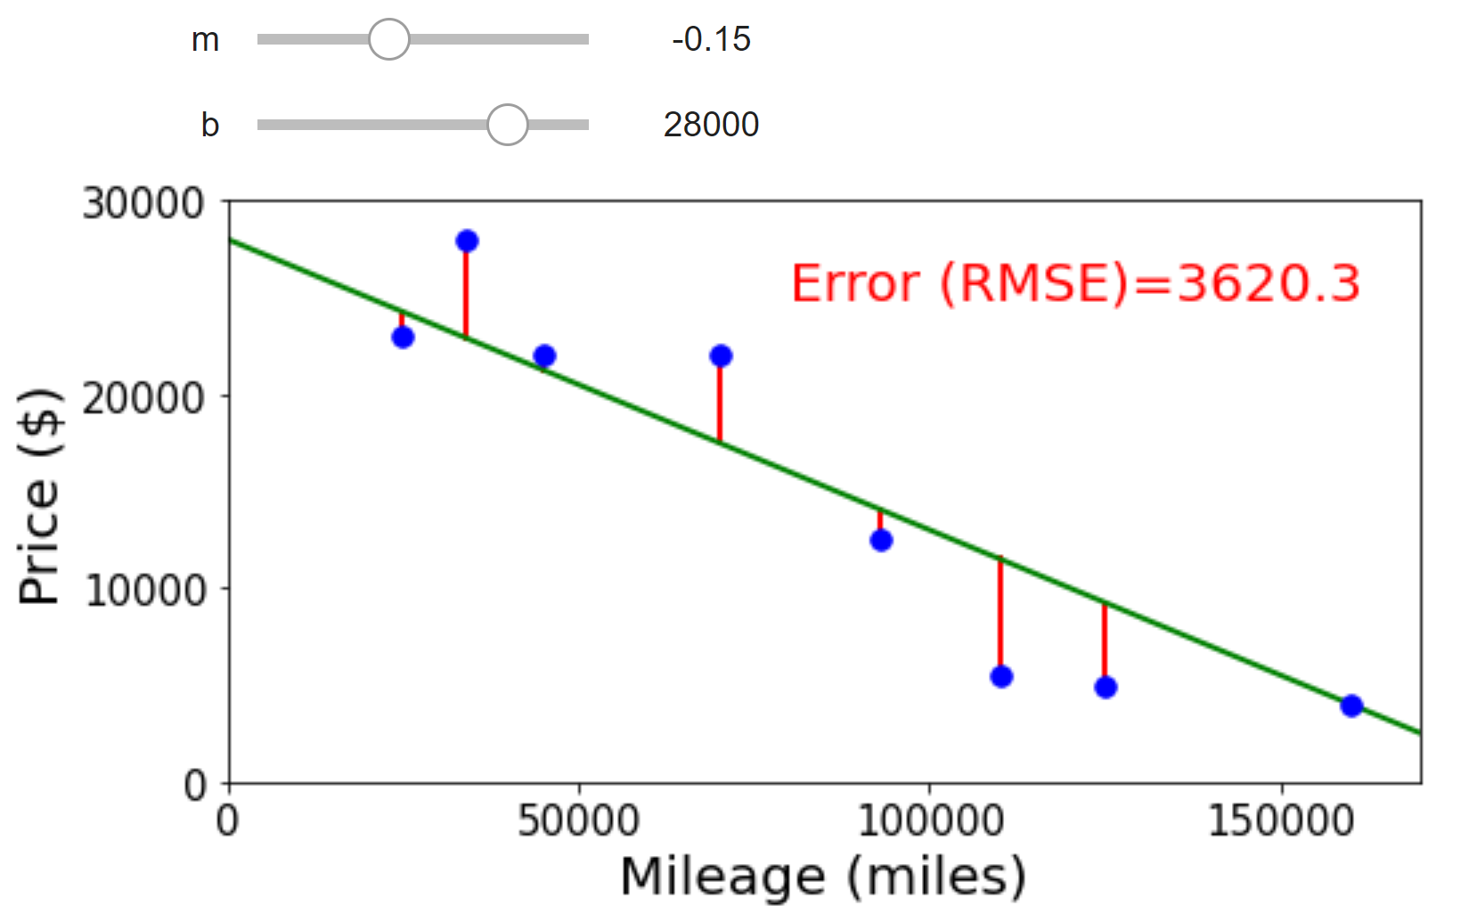
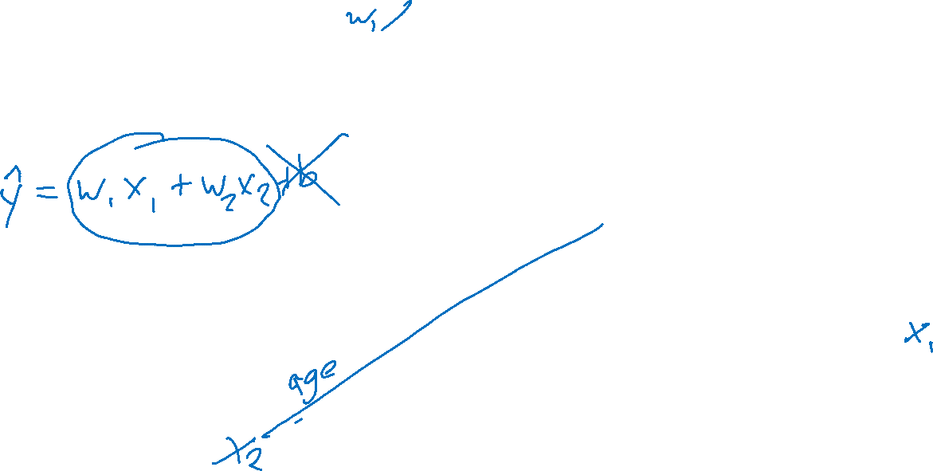
Adding Input Features

Slide 18
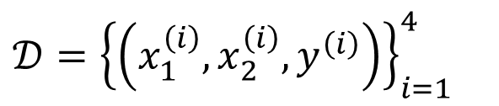
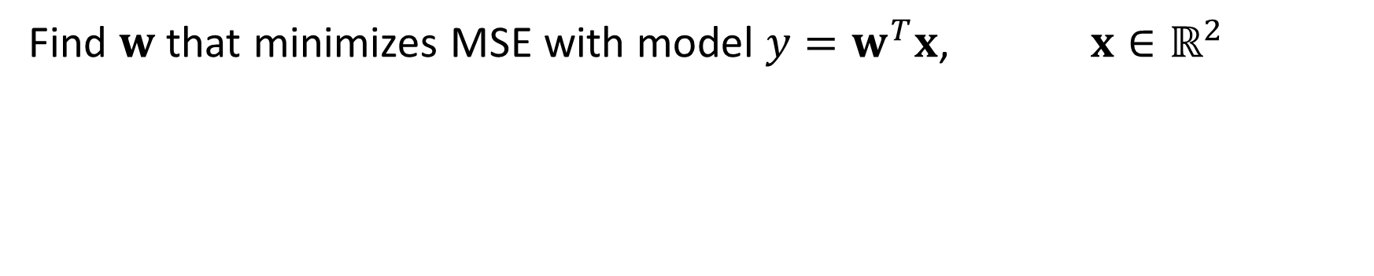
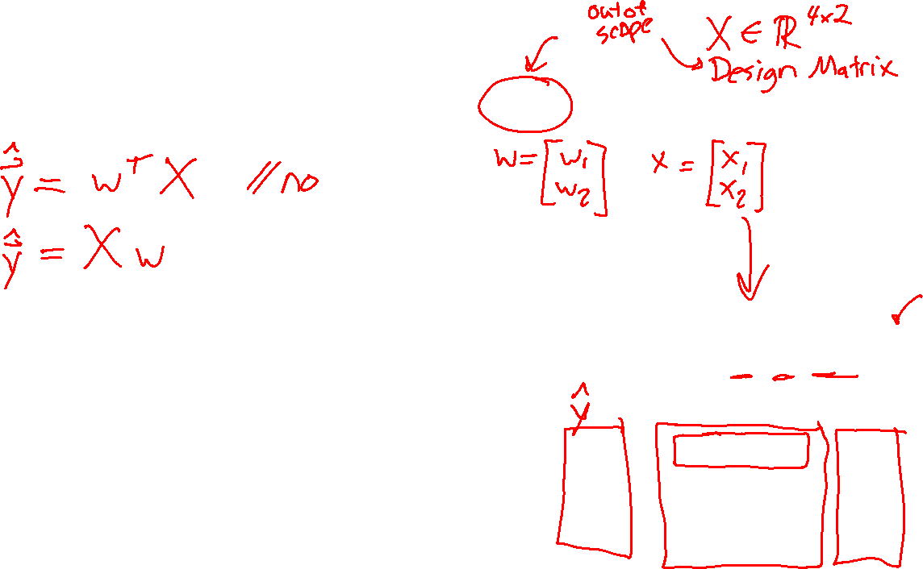
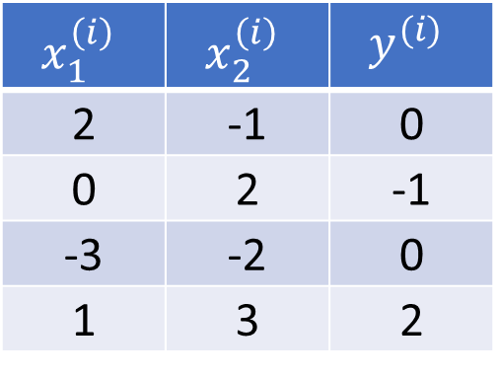
Linear Regression
Find $w$ that minimizes MSE with model $y=w^{T}x$, $x∈ℝ^{2}$
$𝒟={\left\{\left(x_{1}^{\left(i\right)},x_{2}^{\left(i\right)}, y^{\left(i\right)}\right)\right\}}_{i=1}^{4}$
$$x_{1}^{\left(i\right)}$$ | $$x_{2}^{\left(i\right)}$$ | $$y^{(i)}$$
2 | -1 | 0
0 | 2 | -1
-3 | -2 | 0
1 | 3 | 2

Slide 19

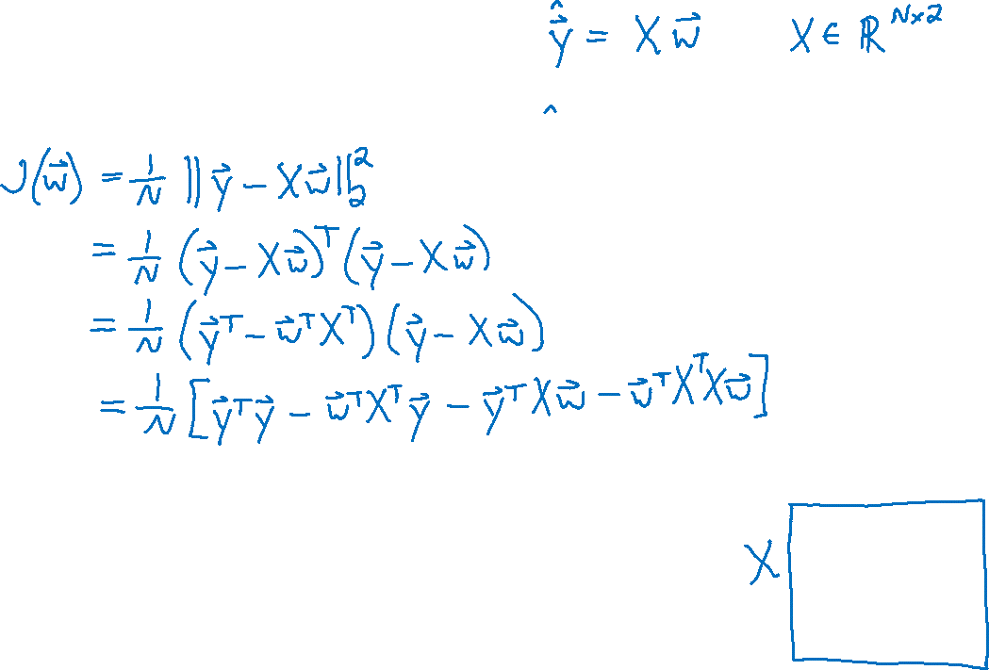
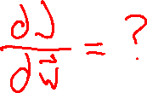
Linear Regression
Find $w$ that minimizes MSE with model $y=w^{T}x$, $x∈ℝ^{2}$
$𝒟={\left\{\left(x_{1}^{\left(i\right)},x_{2}^{\left(i\right)}, y^{\left(i\right)}\right)\right\}}_{i=1}^{4}$
$$x_{1}^{\left(i\right)}$$ | $$x_{2}^{\left(i\right)}$$ | $$y^{(i)}$$
2 | -1 | 0
0 | 2 | -1
-3 | -2 | 0
1 | 3 | 2

Slide 20
Calculus

Slide 21
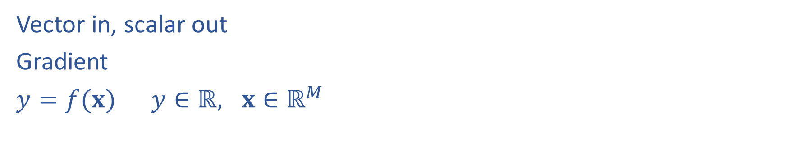
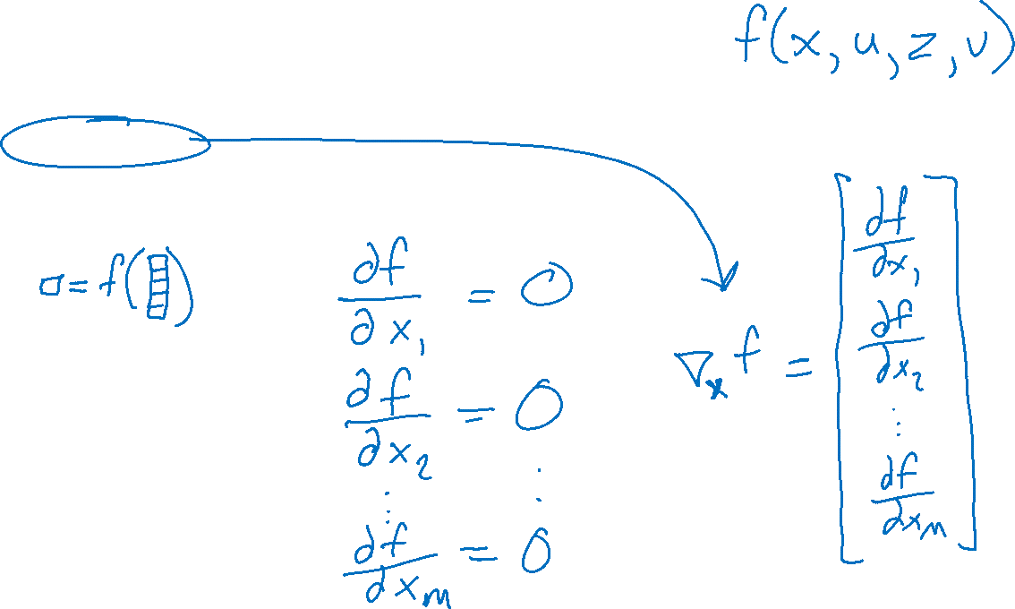
Calculus with Linear Algebra
Vector in, scalar out
Gradient
$y=f(x)$ $y∈ℝ, x∈ℝ^{M}$

Slide 22
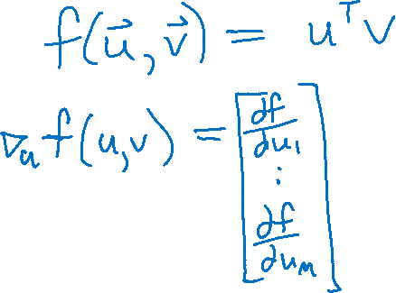
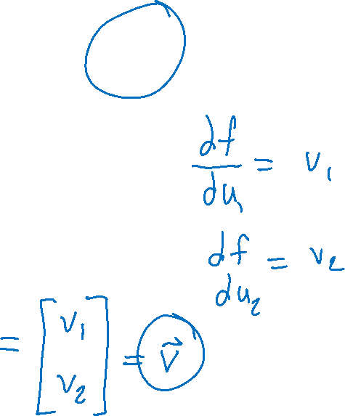
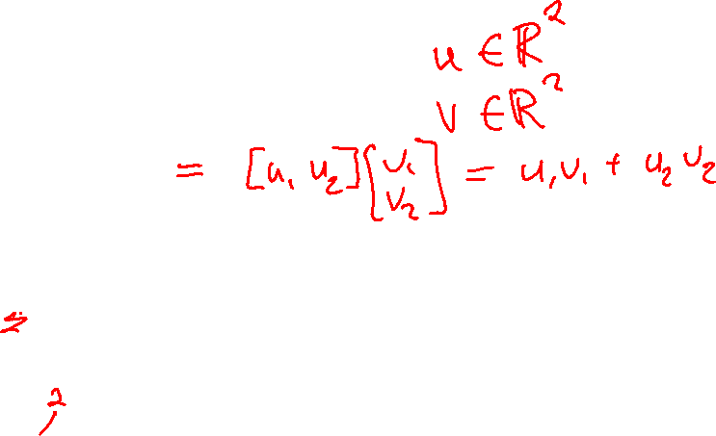
Calculus with Linear Algebra
Vector in, scalar out

Slide 23
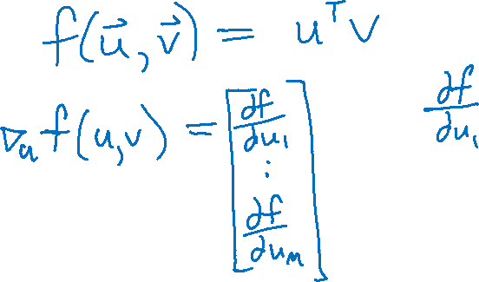

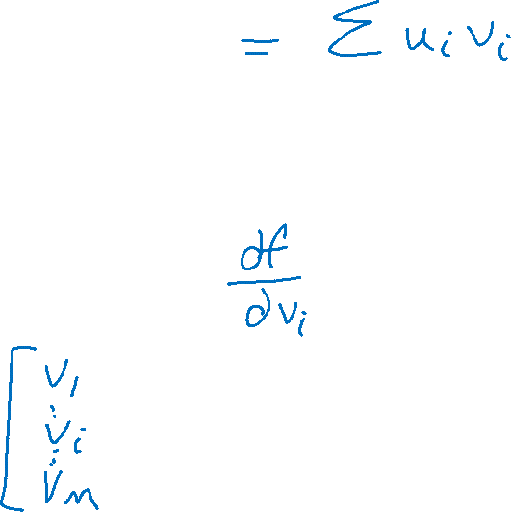
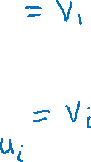
Calculus with Linear Algebra
Vector in, scalar out

Slide 24
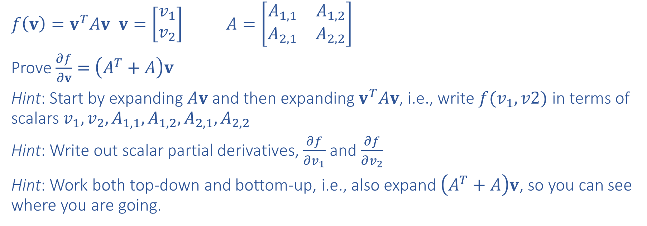
Exercise
Prove $\frac{∂}{∂v}v^{T}Av=\left(A^{T}+A\right)v$ for $v∈ℝ^{2}$ and $A∈ℝ^{2×2}$
$f\left(v\right)=v^{T}Av$ $v=\left[\begin{matrix}v_{1} \\ v_{2}\end{matrix}\right]$ $A=\left[\begin{matrix}A_{1,1} & A_{1,2} \\ A_{2,1} & A_{2,2}\end{matrix}\right]$
Prove $\frac{∂f}{∂v}=$ $\left(A^{T}+A\right)v$
Hint: Start by expanding $Av$ and then expanding $v^{T}Av$, i.e., write $f(v_{1},v2)$ in terms of scalars $v_{1}, v_{2}, A_{1,1}, A_{1,2}, A_{2,1}, A_{2,2}$
Hint: Write out scalar partial derivatives, $\frac{∂f}{∂v_{1}}$ and $\frac{∂f}{∂v_{2}}$
Hint: Work both top-down and bottom-up, i.e., also expand $\left(A^{T}+A\right)v$, so you can see where you are going.

Slide 25
Linear Regression

Slide 26



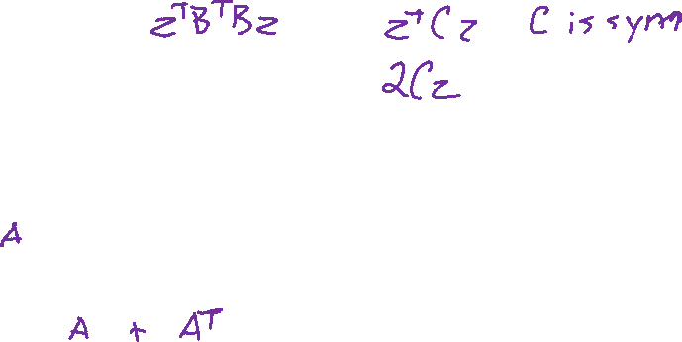

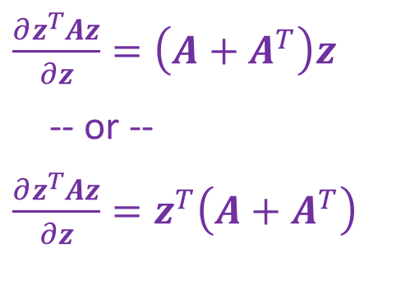
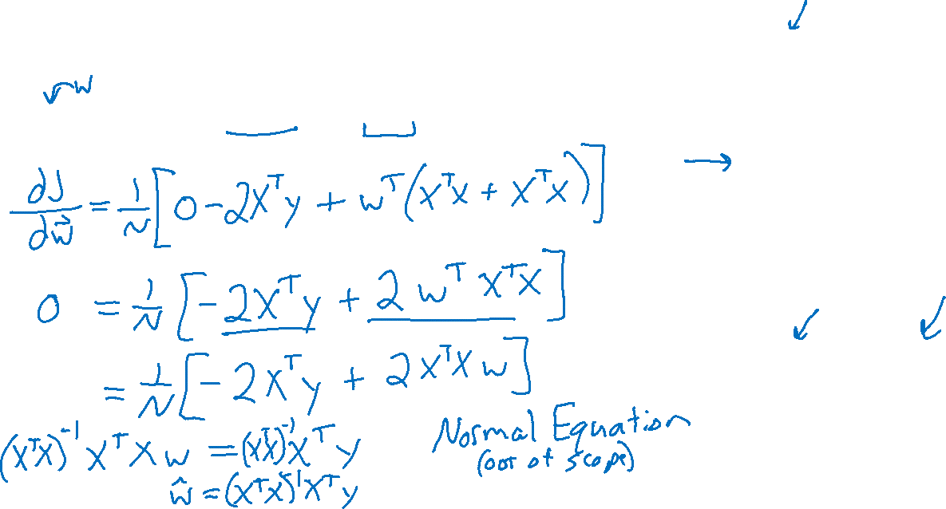
Linear Regression
Find $w$ that minimizes MSE with model $y=w^{T}x$, $x∈ℝ^{2}$
$J\left(w\right)=\frac{1}{N}\left(y^{T}y −2w^{T}X^{T}y+w^{T}X^{T}Xw\right)$
$\frac{∂z^{T}u}{∂z}=u$
-- or --
$\frac{∂z^{T}u}{∂z} =u^{T}$
$\frac{∂z^{T}Az}{∂z}=\left(A+A^{T}\right)z$
-- or --
$\frac{∂z^{T}Az}{∂z}=z^{T}\left(A+A^{T}\right)$

Slide 27

Linear Regression
Last time
Linear algebra needed to:
Find $m$ that minimizes MSE with model $y=mx$, $x∈ℝ$
Today
Optimization
Linear, convex, closed-form solution
Calculus needed to:
Find $w$ that minimizes MSE with model $y=w^{T}x$, $x∈ℝ^{2}$
Find $w,b$ that minimizes MSE with model $y=w^{T}x+b$, $x∈ℝ^{M}$
Calculus need for neural networks

Slide 28
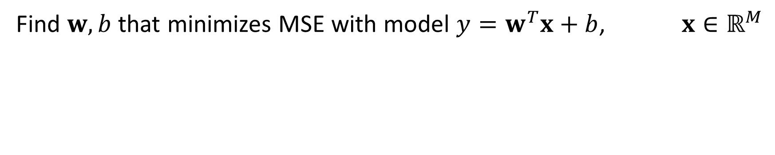

Linear Regression
Find $w,b$ that minimizes MSE with model $y=w^{T}x+b$, $x∈ℝ^{M}$
$𝒟={\left\{\left(x_{1}^{\left(i\right)},x_{2}^{\left(i\right)}, y^{\left(i\right)}\right)\right\}}_{i=1}^{4}$
$$x_{1}^{\left(i\right)}$$ | $$x_{2}^{\left(i\right)}$$ | $$y^{(i)}$$
2 | -1 | 0
0 | 2 | -1
-3 | -2 | 0
1 | 3 | 2

Slide 29
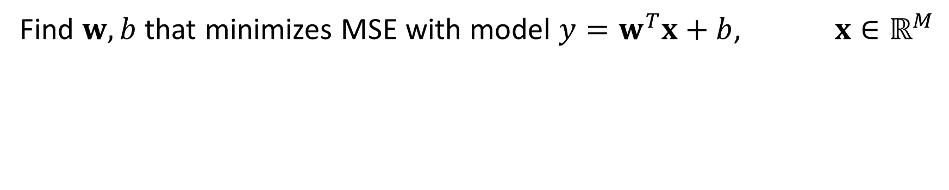
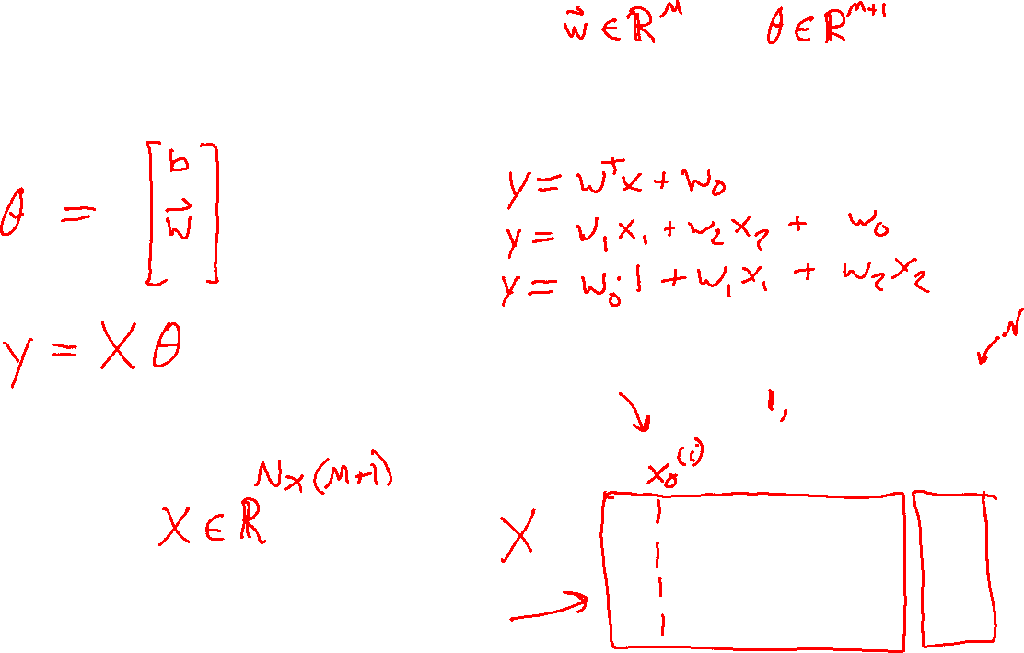
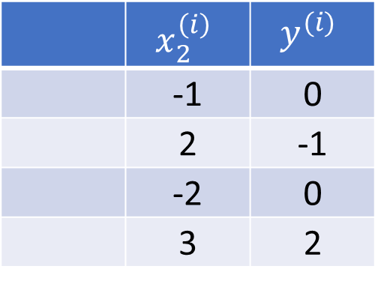
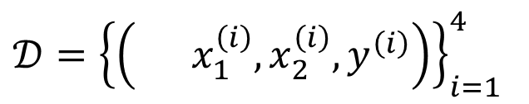

Linear Regression
Find $w,b$ that minimizes MSE with model $y=w^{T}x+b$, $x∈ℝ^{M}$
$𝒟={\left\{\left( x_{1}^{\left(i\right)},x_{2}^{\left(i\right)}, y^{\left(i\right)}\right)\right\}}_{i=1}^{4}$
 | $$x_{2}^{\left(i\right)}$$ | $$y^{(i)}$$
 | -1 | 0
 | 2 | -1
 | -2 | 0
 | 3 | 2
$$x_{1}^{\left(i\right)}$$ | $$x_{2}^{\left(i\right)}$$ | $$y^{(i)}$$
2 | -1 | 0
0 | 2 | -1
-3 | -2 | 0
1 | 3 | 2

Slide 30




Linear Regression
Expanding objective before computing gradient
$J\left(θ\right)=\frac{1}{N}{\left\|y−Xθ\right\|}_{2}^{2}$
$=\frac{1}{N}{\left(y−Xθ\right)}^{T}\left(y−Xθ\right)$
$=\frac{1}{N}\left(y^{T}−θ^{T}X^{T}\right)\left(y−Xθ\right)$
$=\frac{1}{N}\left(y^{T}y −θ^{T}X^{T}y −y^{T}Xθ+θ^{T}X^{T}Xθ\right)$
$=\frac{1}{N}\left(y^{T}y −2θ^{T}X^{T}y+θ^{T}X^{T}Xθ\right)$

Slide 31




Linear Regression
$\frac{∂z^{T}u}{∂z}=u$
-- or --
$\frac{∂z^{T}u}{∂z} =u^{T}$
Gradient of objective with respect to parameters
$J\left(θ\right)=\frac{1}{N}{\left\|y−Xθ\right\|}_{2}^{2}$
$=\frac{1}{N}\left(y^{T}y −2θ^{T}X^{T}y+θ^{T}X^{T}Xθ\right)$
$∇J\left(θ\right)=\frac{1}{N}\left(0 −2X^{T}y+2θ^{T}X^{T}X\right)$
$=\frac{1}{N}\left(0 −2X^{T}y+2X^{T}Xθ\right)$
$=\frac{2}{N}\left(−X^{T}y+X^{T}Xθ\right)$
$\frac{∂z^{T}Az}{∂z}=\left(A+A^{T}\right)z$
-- or --
$\frac{∂z^{T}Az}{∂z}=z^{T}\left(A+A^{T}\right)$

Slide 32





Linear Regression
Closed-form solution
$∇J\left(θ\right)=\frac{2}{N}\left(−X^{T}y+X^{T}Xθ\right)$
$$θ= \left[\begin{matrix}\begin{aligned} \\ \\ w \\ \end{aligned} \\ b\end{matrix}\right]$$
$𝒟={\left\{\left( 1, x_{1}^{\left(i\right)},x_{2}^{\left(i\right)}, y^{\left(i\right)}\right)\right\}}_{i=1}^{4}$
$$x_{0}^{\left(i\right)}$$ | $$x_{2}^{\left(i\right)}$$ | $$y^{(i)}$$
1 | -1 | 0
1 | 2 | -1
1 | -2 | 0
1 | 3 | 2
$$x_{1}^{\left(i\right)}$$ | $$x_{2}^{\left(i\right)}$$ | $$y^{(i)}$$
2 | -1 | 0
0 | 2 | -1
-3 | -2 | 0
1 | 3 | 2

