Slide 1
Announcements
HW1
Due Mon 9/20, 11:59 pm
Online + Written components
Reach out for help (probability, LaTeX, anything!)
Drop deadline
Fri 9/17
Quizzes
Vocab and Notation doc
Notes section added!

Slide 2

Mathematical Foundations for Machine Learning Linear Regression
Instructor: Pat Virtue

Slide 3
Today
Linear regression
Linear algebra formulation
Linear algebra properties
Calculus
Multivariate calculus
Calculus with linear algebra
Optimization
Convex functions (briefly)
Closed-form solutions

Slide 4
Linear Regression
As a reason to learn linear algebra, calculus, and optimization

Slide 5
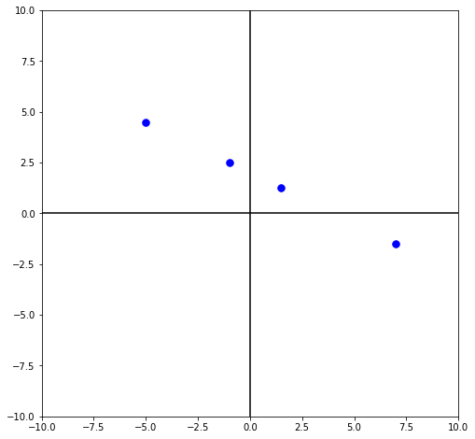

Last time: Fitting a linear model
$𝒟={\left\{\left(x^{\left(i\right)}, y^{\left(i\right)}\right)\right\}}_{i=1}^{4}$
$=\{\left(−1, 2.5\right),$
($7, −1.5),$
($−5, 4.5),$
($1.5, 1.25)\}$

Slide 6

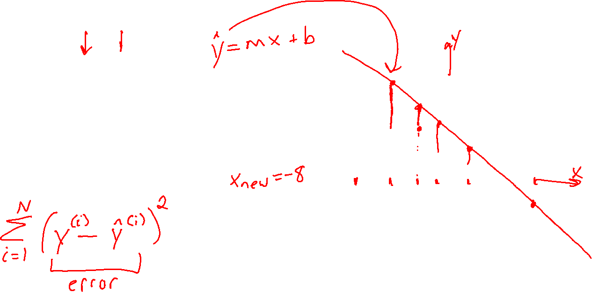
Last time
$𝒟={\left\{\left(x^{\left(i\right)}, y^{\left(i\right)}\right)\right\}}_{i=1}^{4}$
$=\{\left(−1, 2.5\right),$
($7, −1.5),$
($−5, 4.5),$
($1.5, 1.25)\}$

Slide 7
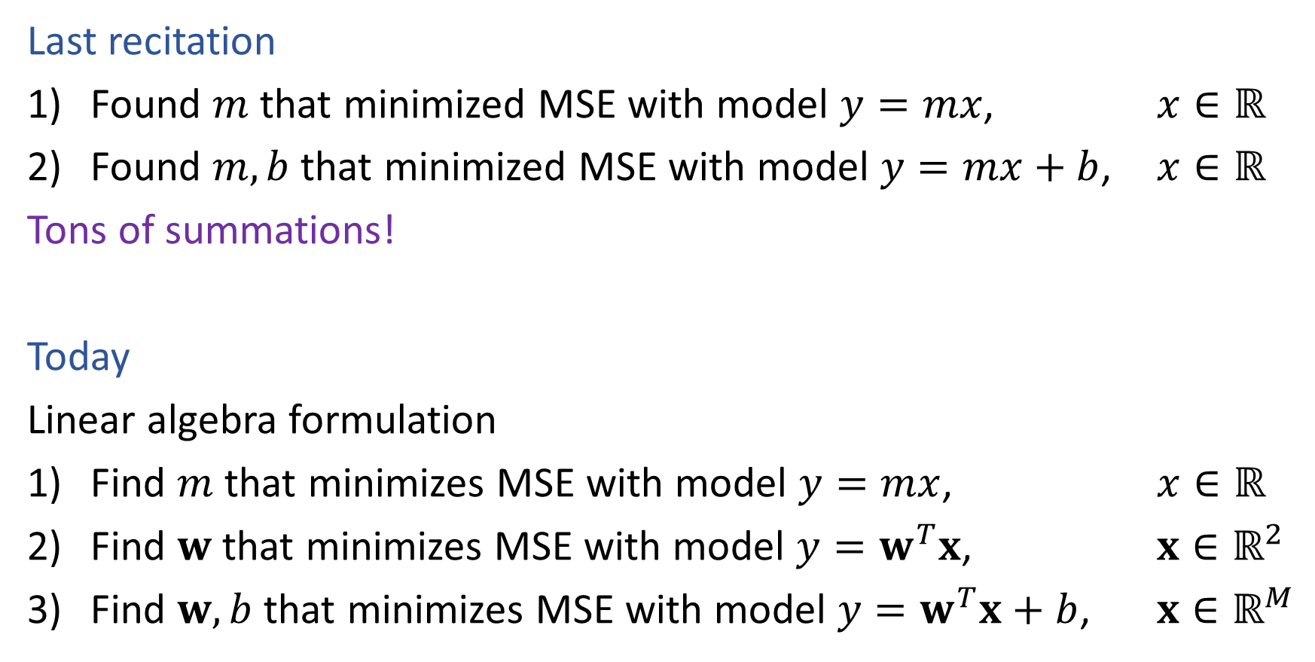

Linear Regression
Last recitation
Found $m$ that minimized MSE with model $y=mx$, $x∈ℝ$
Found $m,b$ that minimized MSE with model $y=mx+b$, $x∈ℝ$
Tons of summations!
Today
Linear algebra formulation
Find $m$ that minimizes MSE with model $y=mx$, $x∈ℝ$
Find $w$ that minimizes MSE with model $y=w^{T}x$, $x∈ℝ^{2}$
Find $w,b$ that minimizes MSE with model $y=w^{T}x+b$, $x∈ℝ^{M}$

Slide 8
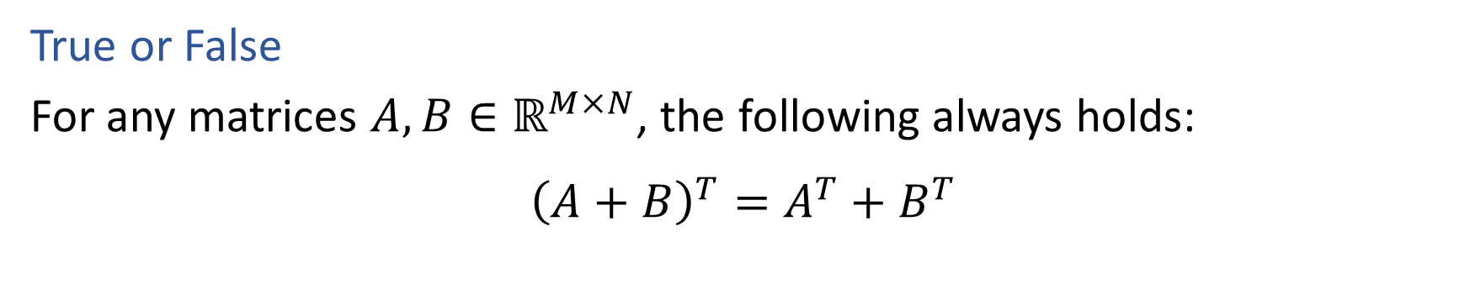

Poll 1
True or False
For any matrices $A, B∈ℝ^{M×N}$, the following always holds:
$${\left(A+B\right)}^{T}=A^{T}+B^{T}$$

Slide 9
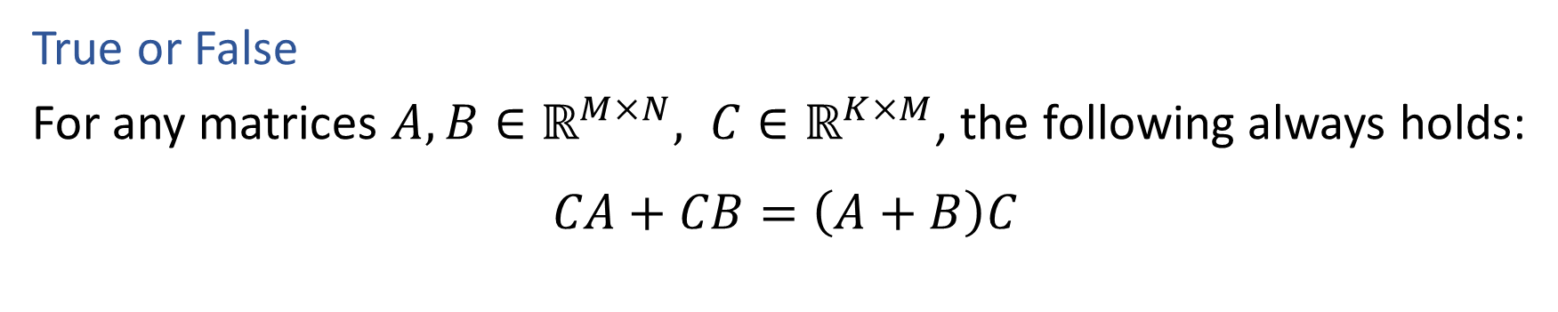
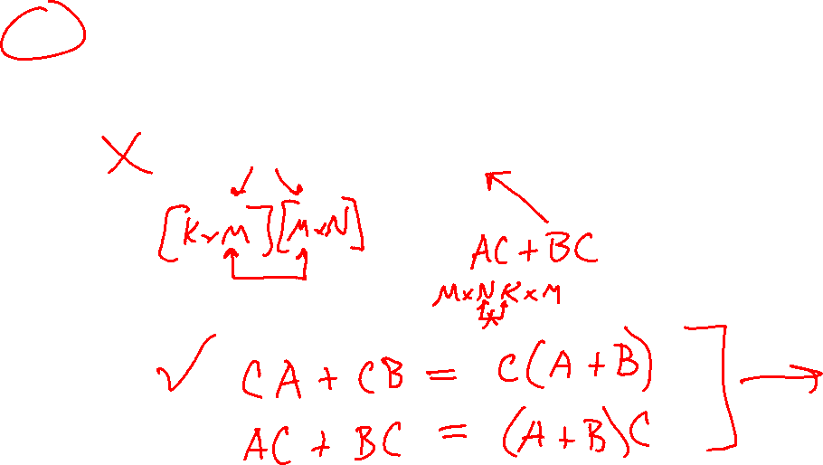
Poll 2
True or False
For any matrices $A, B∈ℝ^{M×N}, C∈ℝ^{K×M}$, the following always holds:
$$CA+CB=\left(A+B\right)C$$

Slide 10
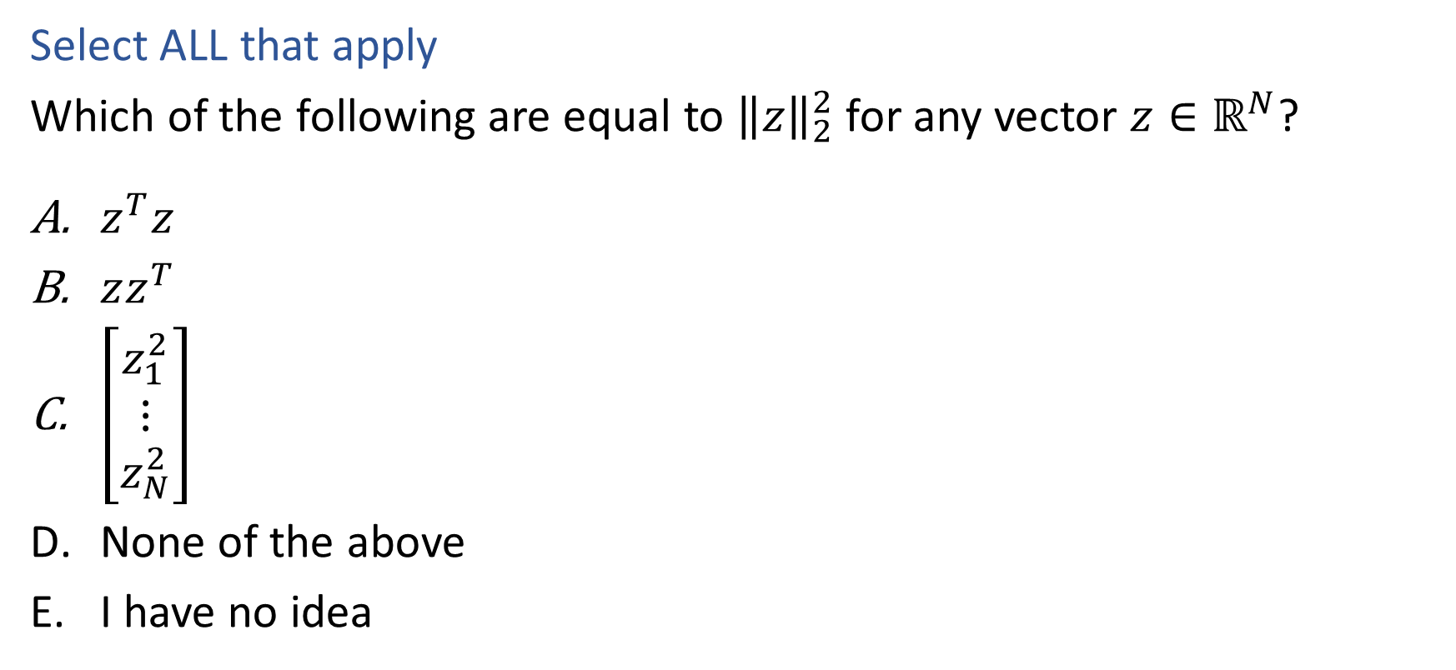
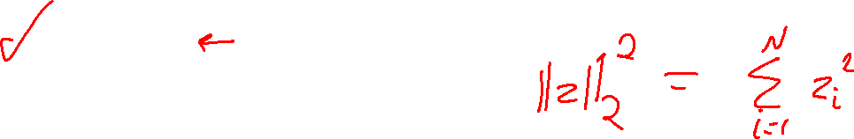
Poll 3
Select ALL that apply
Which of the following are equal to ${\left\|z\right\|}_{2}^{2}$ for any vector $z∈ℝ^{N}$?
$z^{T}z$
$zz^{T}$
$\left[\begin{matrix}z_{1}^{2} \\ ⋮ \\ z_{N}^{2}\end{matrix}\right]$
None of the above
I have no idea

Slide 11
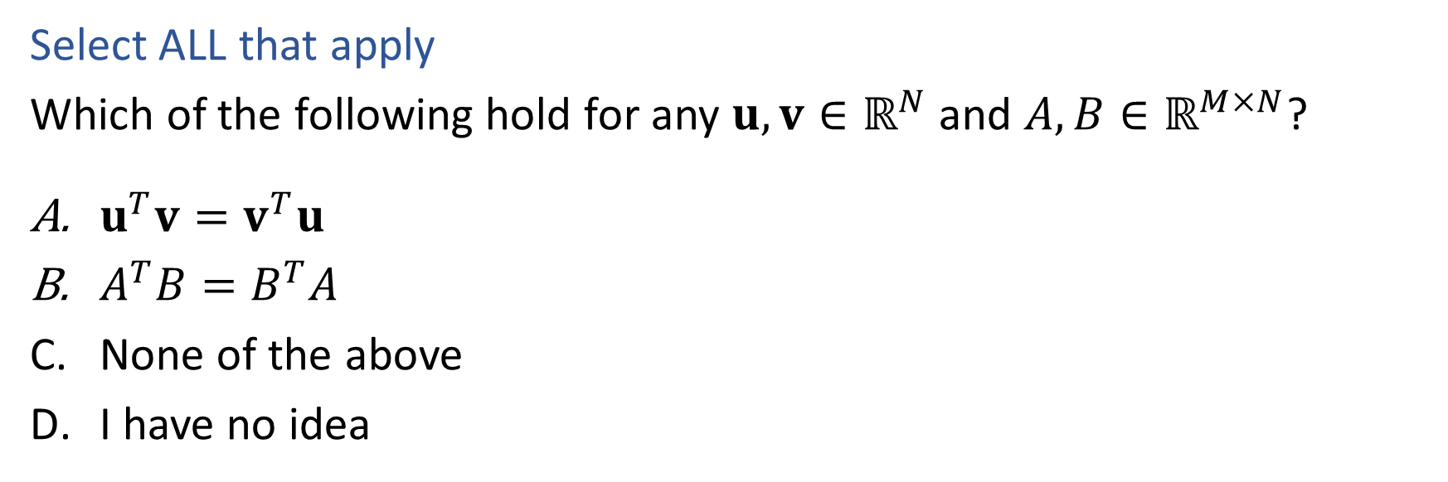
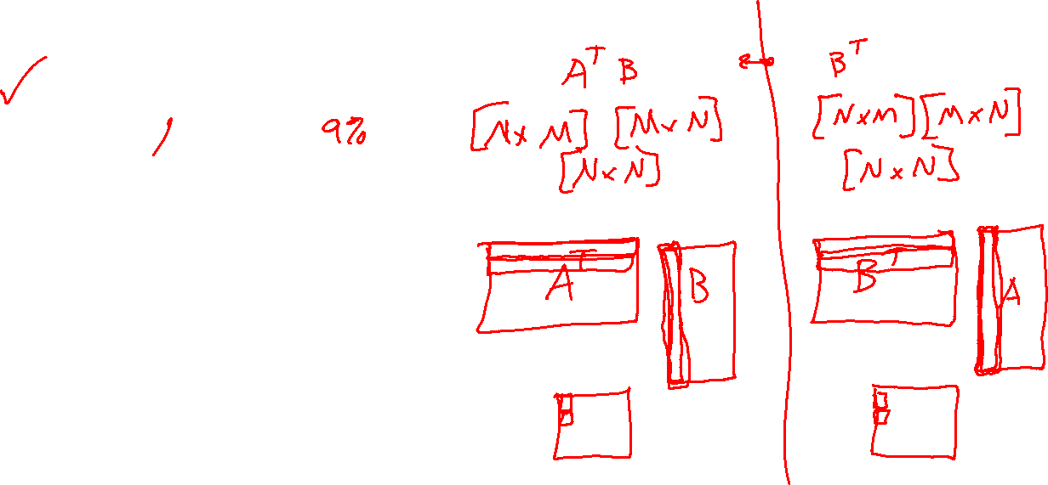
Poll 4
Select ALL that apply
Which of the following hold for any $u,v∈ℝ^{N}$ and $A, B∈ℝ^{M×N}$?
$u^{T}v=v^{T}u$
$A^{T}B=B^{T}A$
None of the above
I have no idea

Slide 12
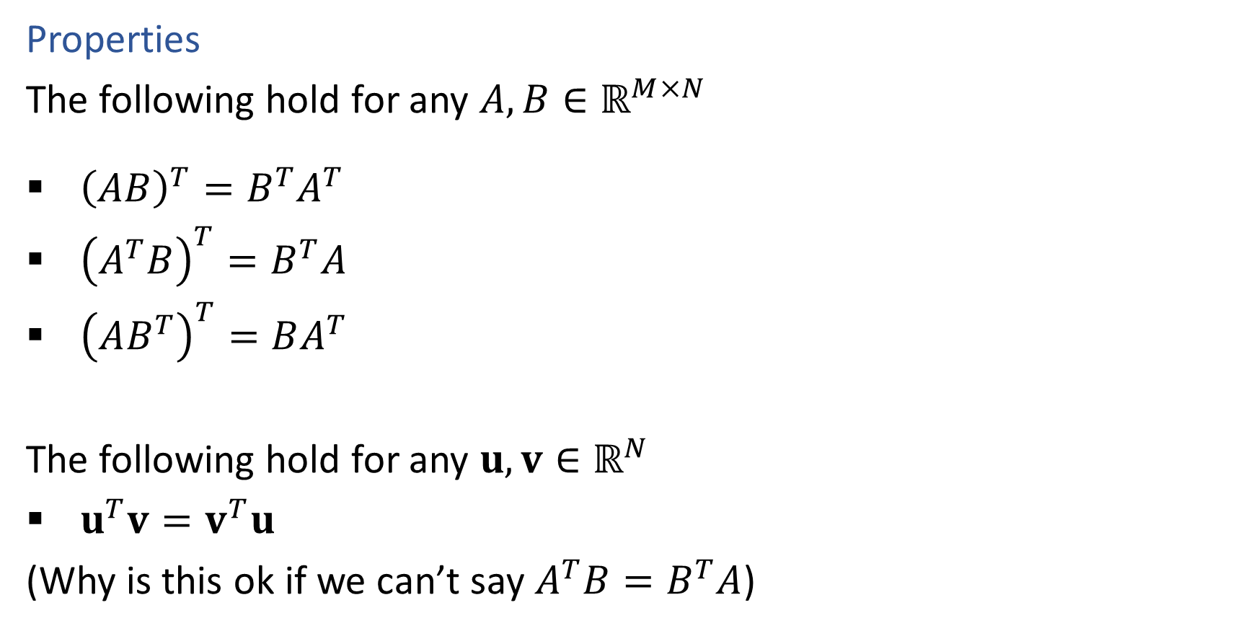
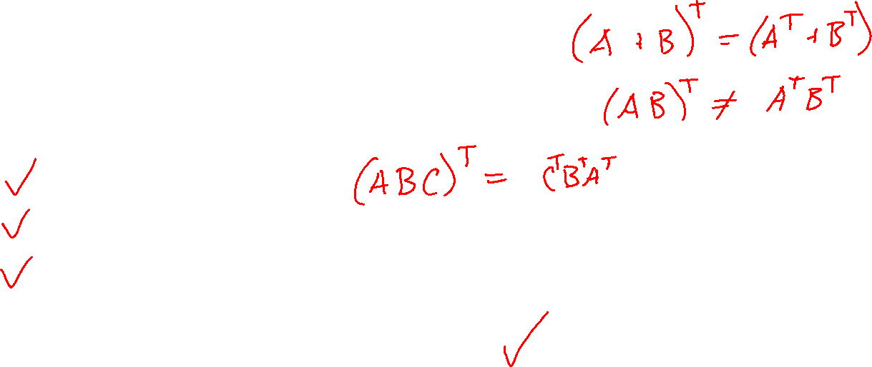
Linear Algebra
Properties
The following hold for any $A, B∈ℝ^{M×N}$
${\left(AB\right)}^{T}=B^{T}A^{T}$
${\left(A^{T}B\right)}^{T}=B^{T}A$
${\left(AB^{T}\right)}^{T}=BA^{T}$
The following hold for any $u,v∈ℝ^{N}$
$u^{T}v=v^{T}u$
(Why is this ok if we can’t say $A^{T}B=B^{T}A$)

Slide 13
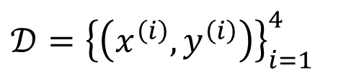
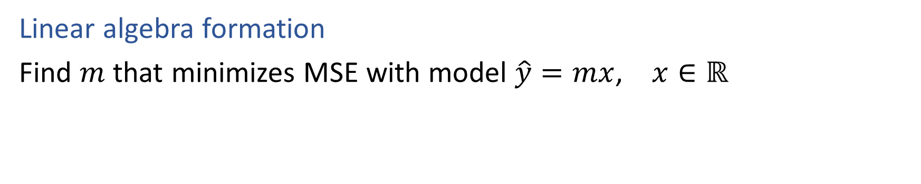
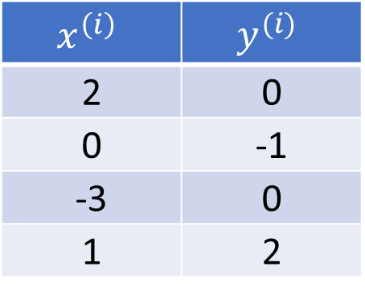
Linear Regression
Linear algebra formation
Find $m$ that minimizes MSE with model $\hat{y}=mx$, $x∈ℝ$
$𝒟={\left\{\left(x^{\left(i\right)}, y^{\left(i\right)}\right)\right\}}_{i=1}^{4}$
$$x^{\left(i\right)}$$ | $$y^{(i)}$$
2 | 0
0 | -1
-3 | 0
1 | 2

Slide 14
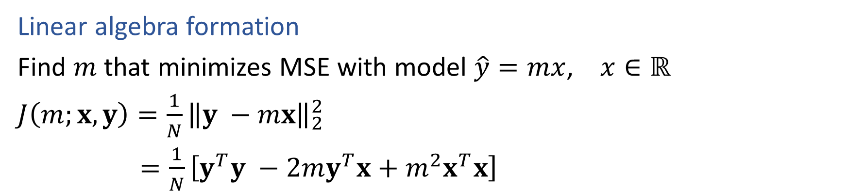
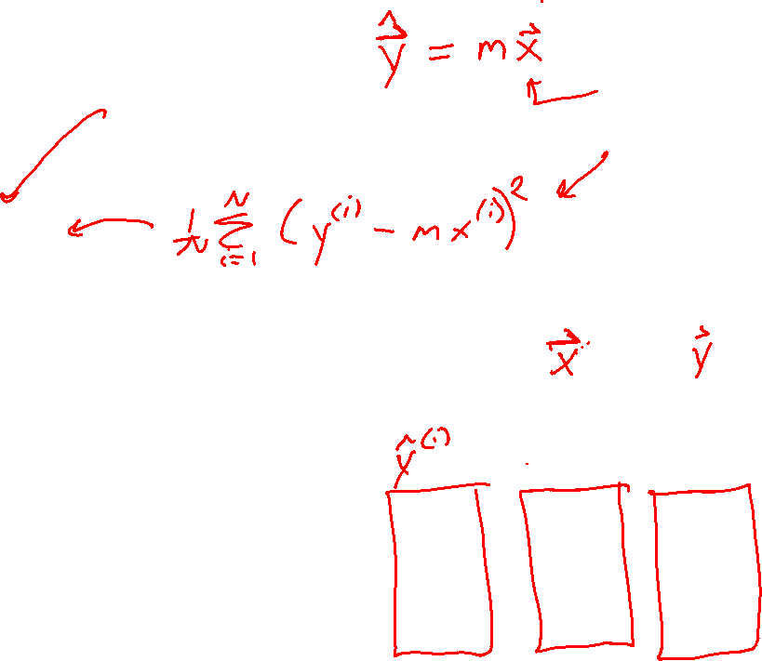
Linear Regression
Linear algebra formation
Find $m$ that minimizes MSE with model $\hat{y}=mx$, $x∈ℝ$
$J\left(m;x, y\right)=\frac{1}{N}{\left\|y −mx\right\|}_{2}^{2}$
$=\frac{1}{N}\left[y^{T}y −2my^{T}x+m^{2}x^{T}x\right]$
$𝒟={\left\{\left(x^{\left(i\right)}, y^{\left(i\right)}\right)\right\}}_{i=1}^{4}$
$$x^{\left(i\right)}$$ | $$y^{(i)}$$
2 | 0
0 | -1
-3 | 0
1 | 2

Slide 15
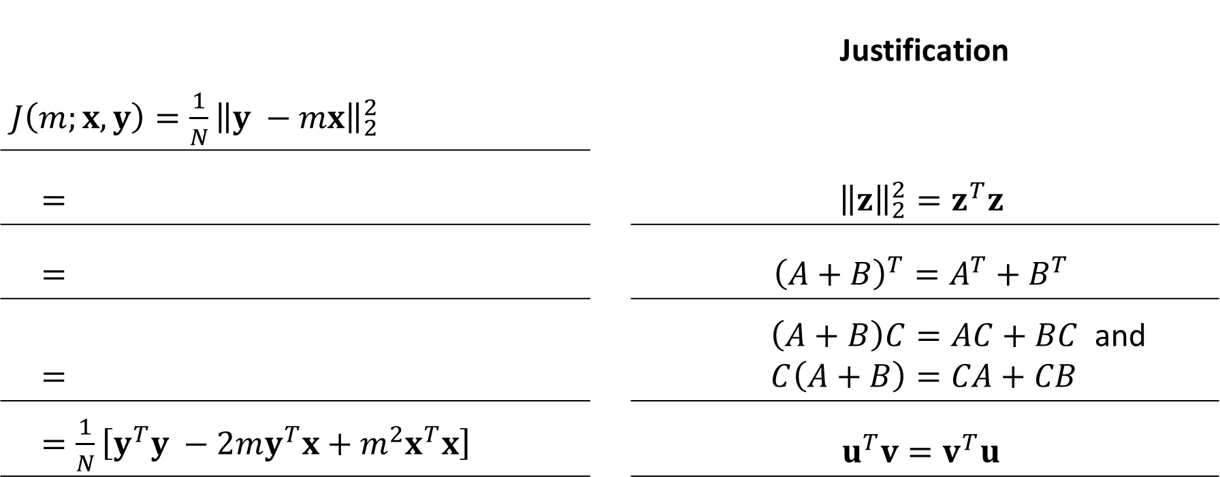
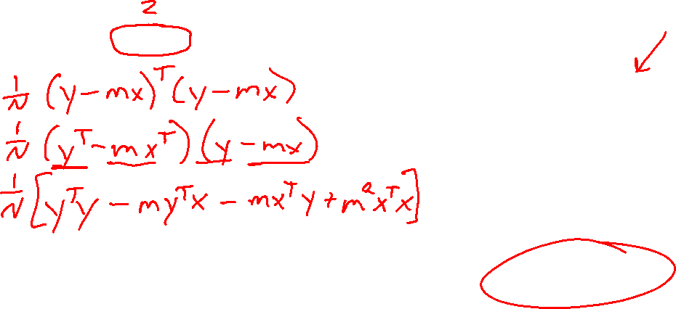

Derive the following expansion $J(m;𝒟)$
1 input feature
No bias term
$\hat{y}=mx$ $m,x∈ℝ$
All data
$y, x∈ℝ^{N}$
Figure out each step, given the provided justification
 |  | Justification
$J\left(m;x, y\right)=\frac{1}{N}{\left\|y −mx\right\|}_{2}^{2}$
$=$ |  | $${\left\|z\right\|}_{2}^{2}=z^{T}z$$
$=$ |  | $${\left(A+B\right)}^{T}=A^{T}+B^{T}$$
$=$ |  | $\left(A+B\right)C=AC+BC$ and $C\left(A+B\right)=CA+CB$
$=\frac{1}{N}\left[y^{T}y −2my^{T}x+m^{2}x^{T}x\right]$ |  | $$u^{T}v=v^{T}u$$

Slide 16
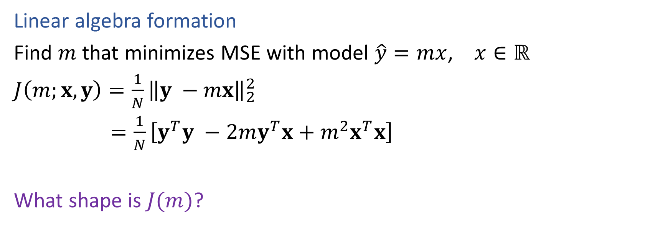

Linear Regression
Linear algebra formation
Find $m$ that minimizes MSE with model $\hat{y}=mx$, $x∈ℝ$
$J\left(m;x, y\right)=\frac{1}{N}{\left\|y −mx\right\|}_{2}^{2}$
$=\frac{1}{N}\left[y^{T}y −2my^{T}x+m^{2}x^{T}x\right]$
What shape is $J(m)$?
$𝒟={\left\{\left(x^{\left(i\right)}, y^{\left(i\right)}\right)\right\}}_{i=1}^{4}$
$$x^{\left(i\right)}$$ | $$y^{(i)}$$
2 | 0
0 | -1
-3 | 0
1 | 2

Slide 17
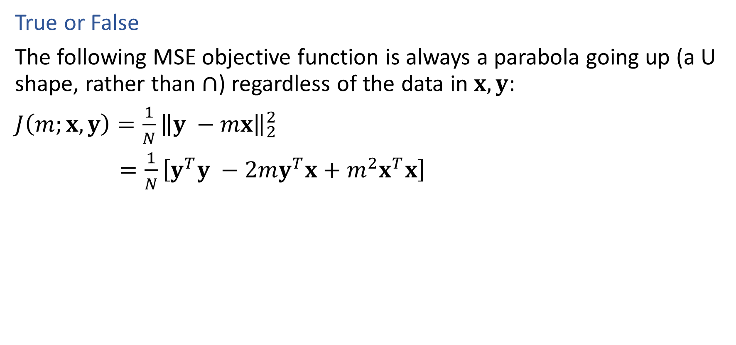
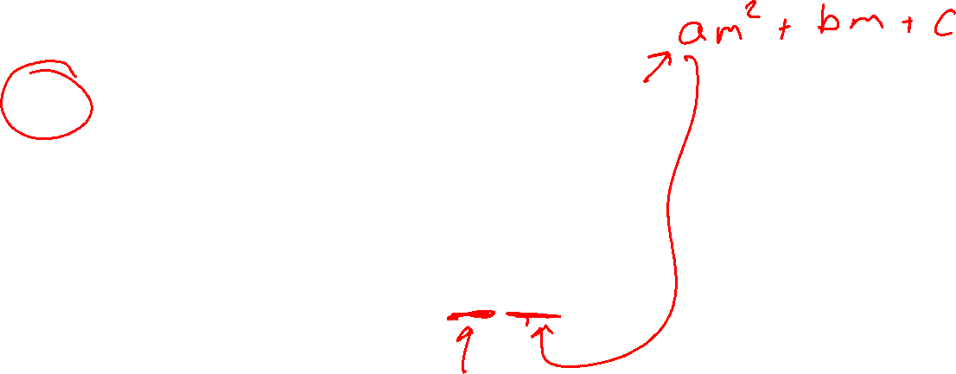
Poll 5
True or False
The following MSE objective function is always a parabola going up (a U shape, rather than $∩$) regardless of the data in $x, y$:
$J\left(m;x, y\right)=\frac{1}{N}{\left\|y −mx\right\|}_{2}^{2}$
$=\frac{1}{N}\left[y^{T}y −2my^{T}x+m^{2}x^{T}x\right]$

Slide 18
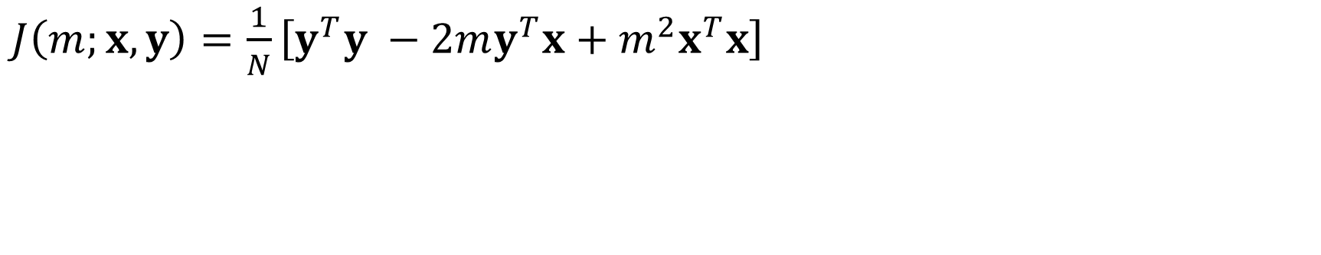
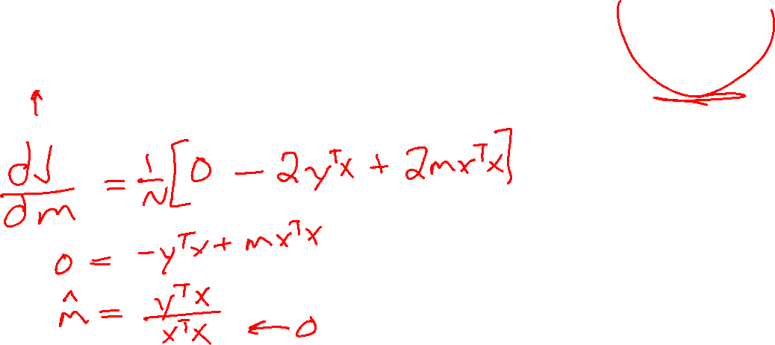
Linear Regression
$J\left(m;x, y\right)=\frac{1}{N}\left[y^{T}y −2my^{T}x+m^{2}x^{T}x\right]$

Slide 19
Linear and Convex Functions

Slide 20

Optimization
Linear function
If $f(x)$ is linear, then:
$f\left(x+z\right)=f\left(x\right)+f\left(z\right)$
$f\left(αx\right)=αf\left(x\right) ∀α$
$f\left(αx+\left(1−α\right)z\right)=αf\left(x\right)+\left(1−α\right)f\left(z\right) ∀α$

Slide 21


Optimization
Convex function
If $f(x)$ is convex, then:
$f\left(αx+\left(1−α\right)z\right)≤αf\left(x\right)+\left(1−α\right)f\left(z\right) ∀ 0≤α≤1$
Convex optimization
If $f(x)$ is convex, then:
Every local minimum is also a global minimum ☺

