Slide 1
Mathematical Foundations for Machine Learning Linear Algebra and Linear Regression
Instructor: Pat Virtue

Slide 2
Today
Linear algebra
Primer and highlighting key aspects
Linear regression
Calculus and optimization

Slide 3
Linear Algebra

Slide 4
Linear Algebra
Convenient and concise way to work with math involving linear operations
$3θ_{1}+0θ_{2}+5θ_{3}=36$
$4θ_{1}+3θ_{2}+2θ_{3}=46$
$2θ_{1}+2θ_{2}+1θ_{3}=25$
$Vθ=u$ $V=\left[\begin{matrix}3 & 0 & 5 \\ 4 & 3 & 2 \\ 2 & 2 & 1\end{matrix}\right]$ $u= \left[\begin{aligned}36 \\ 46 \\ 25\end{aligned}\right]$ $θ= \left[\begin{aligned}θ_{1} \\ θ_{2} \\ θ_{3}\end{aligned}\right]$
Possible way to solve: $θ=V^{−1}u$ (Actually a pretty unstable way to solve in general. More on this later.)

Slide 5
Matrix Multiplication
$A∈ℝ^{M×N}$
$B∈ℝ^{M×K}$
$C∈ℝ^{K×N}$
$A=BC$
The entry of A in row $m$ and column $n$ is:
$$A_{m,n}=\sum_{k=1}^{K}{B_{m,k}C_{k,n}}$$
i.e. multiply the elements of row $m$ of by the elements of column $n$ of $C$, and then sum those products
Width of $B$ must match height of $C$

Slide 6
Poll 1
What is the resulting dimension of $Z$, where $Z = uv^{T}$ and $u∈ℝ^{7×1}$ and $v∈ℝ^{7×1}$?
Select ALL that apply
$Z∈ℝ$
$Z∈ℝ^{49}$
$Z∈ℝ^{7×1}$
$Z∈ℝ^{1×7}$
$Z∈ℝ^{1×1}$
$Z∈ℝ^{7×7}$
I have no idea

Slide 7
Vectors
$u∈ℝ^{M×1}$ Column vector of length $M$
$v∈ℝ^{1×M}$ Row vector of length $M$
$z∈ℝ^{M}$ Ambiguous. In this course, assume column vector unless stated otherwise.
$u= \left[\begin{matrix}u_{1} \\ \begin{aligned}u_{2} \\ ⋮\end{aligned} \\ u_{M}\end{matrix}\right]$

Slide 8
Vectors
$u∈ℝ^{M}$
$v∈ℝ^{M}$ Note these are both column vectors
Multiplication of vectors of the same length
Dot product (inner product):
$y= u⋅v=u^{T}v=\sum_{i=1}^{M}{u_{i}}v_{i}$ $y∈ℝ$
A dot product is an inner product (inner product is a more general term)
Outer product (inner product):
$Y= u⊗v=uv^{T}$ $Y∈ℝ^{M×M}$ $Y_{i,j}=u_{i}v_{j}$

Slide 9
Vectors
$u∈ℝ^{M}$
What happens when we do the dot product of a vector with itself?

Slide 10
Vectors
$u∈ℝ^{M}$
Vector magnitude
$\left|u\right|=\sqrt{\sum_{i}^{M}{u_{i}^{2}}}={\left(\sum_{i}^{M}{u_{i}^{2}}\right)}^{1/2}={\left( ? \right)}^{1/2}$
L2 norm (Euclidean norm) (More norms later)
${\left\|u\right\|}_{2}=\sqrt{\sum_{i}^{M}{u_{i}^{2}}}={\left(\sum_{i}^{M}{u_{i}^{2}}\right)}^{1/2}={\left(u^{T}u \right)}^{1/2}$
L2 norm squared
${\left\|u\right\|}_{2}^{2}=\sum_{i}^{M}{u_{i}^{2}}=u^{T}u$

Slide 11
Vectors
$u∈ℝ^{M}$
$v∈ℝ^{M}$
$α∈ℝ$
Scalar multiplication
$αu= \left[\begin{matrix}αu_{1} \\ \begin{aligned}{αu}_{2} \\ ⋮\end{aligned} \\ {αu}_{M}\end{matrix}\right]$
Vector addition
$u+v= \left[\begin{matrix}u_{1}+v_{1} \\ \begin{aligned}u_{2}+v_{2} \\ ⋮\end{aligned} \\ u_{M}+v_{M}\end{matrix}\right]$

Slide 12
Vectors
Notation alert!
$u, v∈ℝ^{M}$
Linear combination of vectors
$z=αu+βv= \left[\begin{matrix}{αu}_{1}+βv_{1} \\ \begin{aligned}{αu}_{2}+{βv}_{2} \\ ⋮\end{aligned} \\ {αu}_{M}+{βv}_{M}\end{matrix}\right]$ for any $α,β∈ℝ$

Slide 13
Span
Notation alert!
Set of all linear combination of a set of vectors
Given a set of vectors $𝒮=\left\{v_{1},v_{2},v_{3}\right\}$, where $v_{i}∈ℝ^{M} ∀ i$
$$span\left(𝒮\right)=\left\{w_{1}v_{1}+w_{2}v_{2}+w_{3}v_{3} ∣ w_{i}∈ℝ\right\}$$
Span of a set of vectors is an example of a vector space. Vector space is a more general term.

Slide 14
Span, Dimensionality, and Rank

Slide 15
Span, Dimensionality, and Rank

Slide 16
Linear Regression

Slide 17
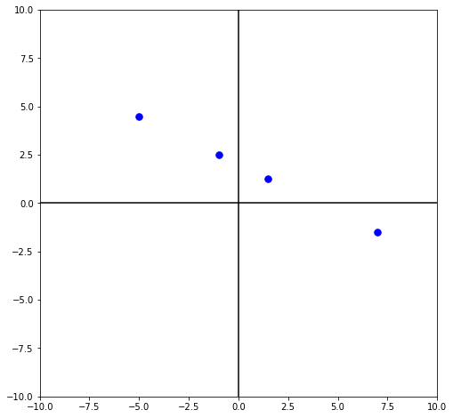
Fitting a linear model
$𝒟={\left\{\left(x^{\left(i\right)}, y^{\left(i\right)}\right)\right\}}_{i=1}^{4}$
$=\{\left(−1, 2.5\right),$
($7, −1.5),$
($−5, 4.5),$
($1.5, 1.25)\}$

Slide 18
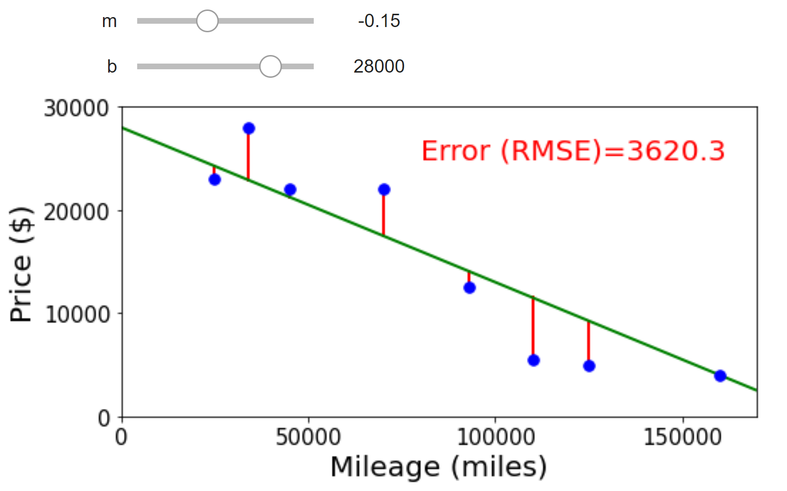
Jupyter Demo

