Slide 1
As you walk in
Welcome!
Sit at a table next to another student
Make name plate
Fold paper in half
Write preferred name

Slide 2

Mathematical Foundations for Machine Learning Linear Systems
Instructor: Pat Virtue

Slide 3
Today
Linear Systems
Systems of equations
Fitting linear models to data
Detailed course topics doc
https://docs.google.com/spreadsheets/d/1I8g9pR-krQNKVuiPrxGUEkSwdyDjBIpTr9inq6Dl8-U

Slide 4
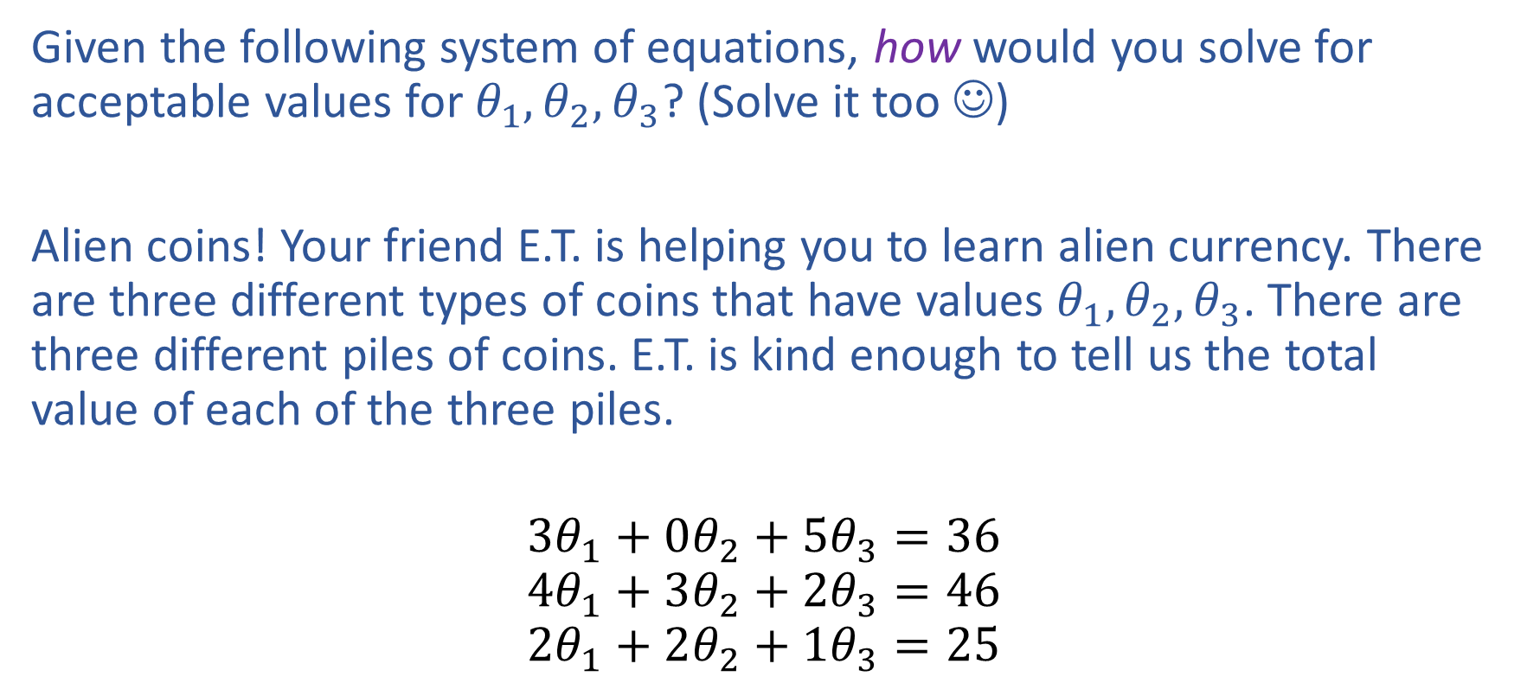
Exercise
Given the following system of equations, how would you solve for acceptable values for $θ_{1}, θ_{2}, θ_{3}$? (Solve it too ☺)
Alien coins! Your friend E.T. is helping you to learn alien currency. There are three different types of coins that have values $θ_{1}, θ_{2}, θ_{3}$. There are three different piles of coins. E.T. is kind enough to tell us the total value of each of the three piles.
$$3θ_{1}+0θ_{2}+5θ_{3}=36$$
$$4θ_{1}+3θ_{2}+2θ_{3}=46$$
$$2θ_{1}+2θ_{2}+1θ_{3}=25$$

Slide 5
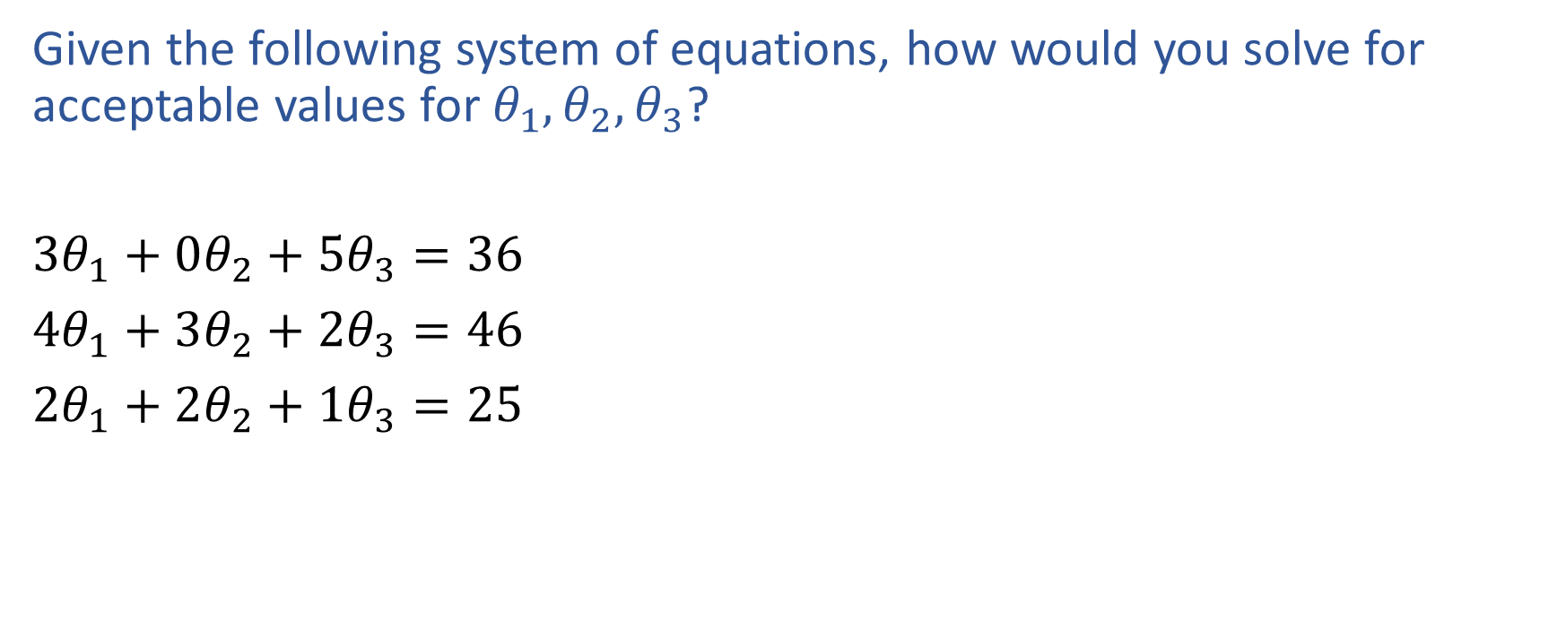
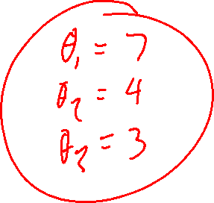
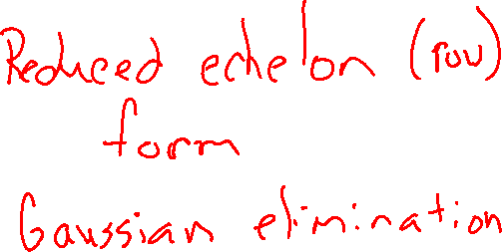
Exercise
Given the following system of equations, how would you solve for acceptable values for $θ_{1}, θ_{2}, θ_{3}$?
$3θ_{1}+0θ_{2}+5θ_{3}=36$
$4θ_{1}+3θ_{2}+2θ_{3}=46$
$2θ_{1}+2θ_{2}+1θ_{3}=25$

Slide 6
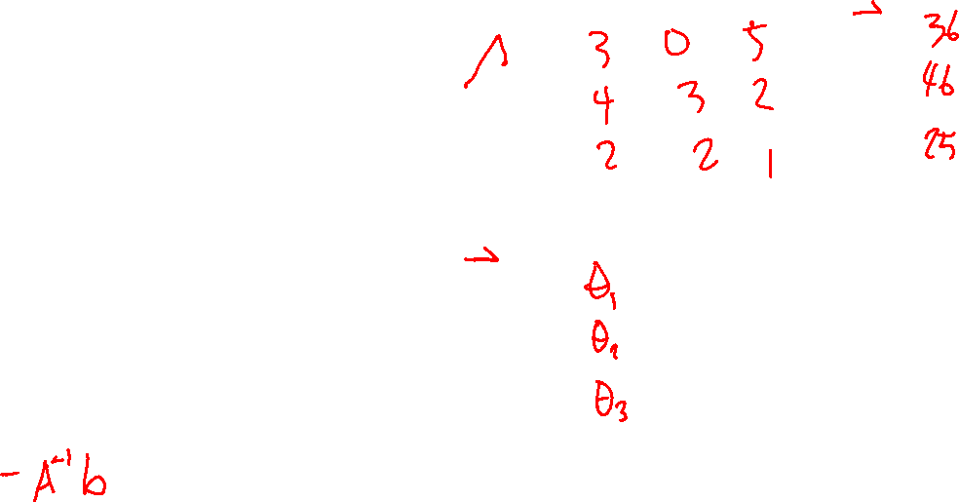
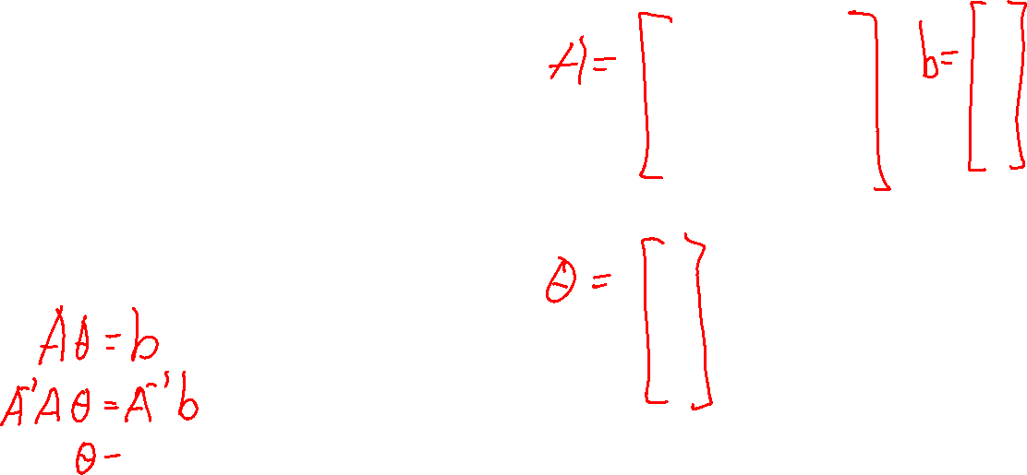
Exercise
Given the following system of equations, how would you solve for acceptable values for $θ_{1}, θ_{2}, θ_{3}$?
$3θ_{1}+0θ_{2}+5θ_{3}=36$
$4θ_{1}+3θ_{2}+2θ_{3}=46$
$2θ_{1}+2θ_{2}+1θ_{3}=25$

Slide 7
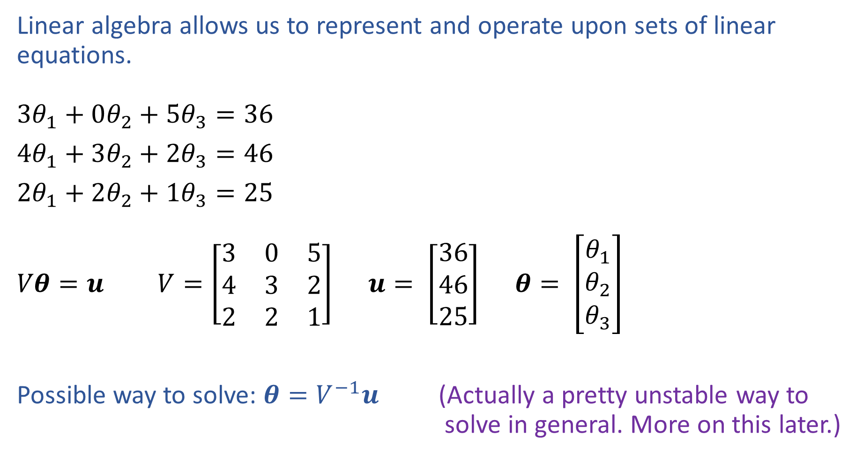
Linear Algebra
Notation alert!
Linear algebra allows us to represent and operate upon sets of linear equations.
$3θ_{1}+0θ_{2}+5θ_{3}=36$
$4θ_{1}+3θ_{2}+2θ_{3}=46$
$2θ_{1}+2θ_{2}+1θ_{3}=25$
$Vθ=u$ $V=\left[\begin{matrix}3 & 0 & 5 \\ 4 & 3 & 2 \\ 2 & 2 & 1\end{matrix}\right]$ $u= \left[\begin{aligned}36 \\ 46 \\ 25\end{aligned}\right]$ $θ= \left[\begin{aligned}θ_{1} \\ θ_{2} \\ θ_{3}\end{aligned}\right]$
Possible way to solve: $θ=V^{−1}u$ (Actually a pretty unstable way to solve in general. More on this later.)

Slide 8
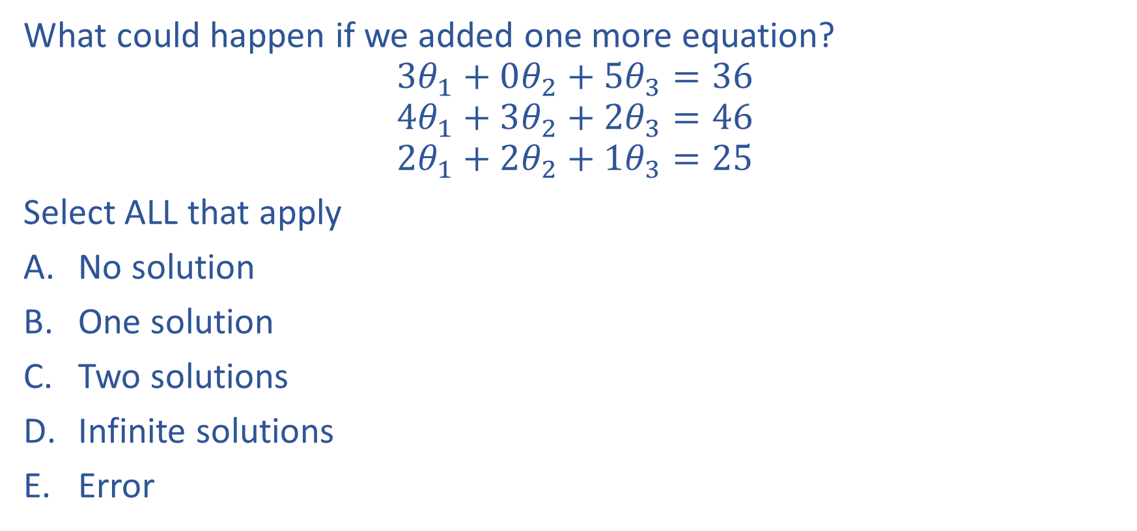
Poll 1
What could happen if we added one more equation?
$$3θ_{1}+0θ_{2}+5θ_{3}=36$$
$$4θ_{1}+3θ_{2}+2θ_{3}=46$$
$$2θ_{1}+2θ_{2}+1θ_{3}=25$$
Select ALL that apply
No solution
One solution
Two solutions
Infinite solutions
Error

Slide 9
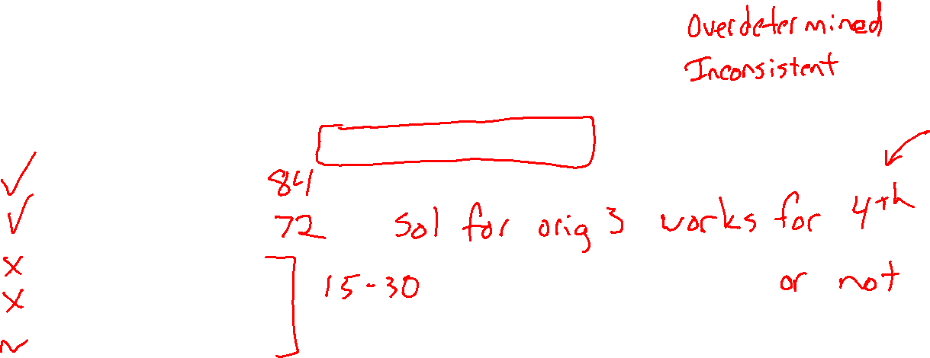
Poll 1
What could happen if we added one more equation?
$$3θ_{1}+0θ_{2}+5θ_{3}=36$$
$$4θ_{1}+3θ_{2}+2θ_{3}=46$$
$$2θ_{1}+2θ_{2}+1θ_{3}=25$$
Select ALL that apply
No solution
One solution
Two solutions
Infinite solutions
Error

Slide 10
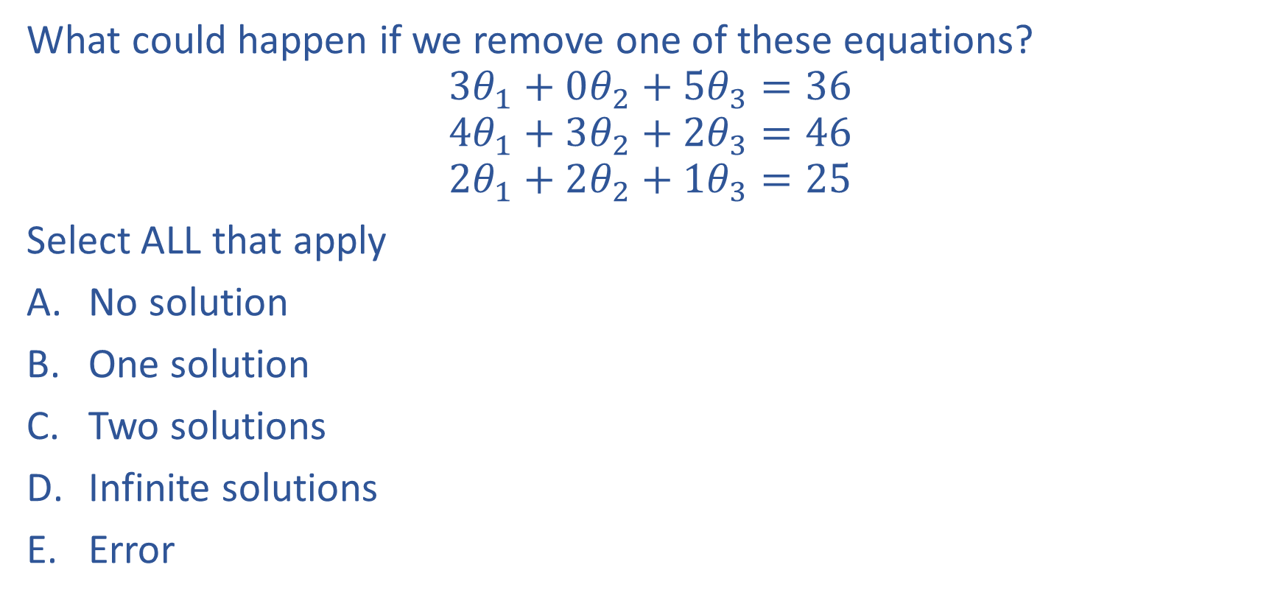
Poll 2
What could happen if we remove one of these equations?
$$3θ_{1}+0θ_{2}+5θ_{3}=36$$
$$4θ_{1}+3θ_{2}+2θ_{3}=46$$
$$2θ_{1}+2θ_{2}+1θ_{3}=25$$
Select ALL that apply
No solution
One solution
Two solutions
Infinite solutions
Error

Slide 11
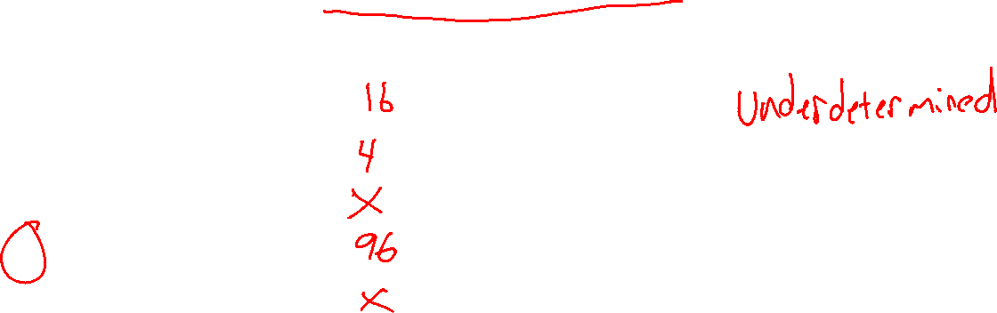
Poll 2
What could happen if we remove one of these equations?
$$3θ_{1}+0θ_{2}+5θ_{3}=36$$
$$4θ_{1}+3θ_{2}+2θ_{3}=46$$
$$2θ_{1}+2θ_{2}+1θ_{3}=25$$
Select ALL that apply
No solution
One solution
Two solutions
Infinite solutions
Error

Slide 12
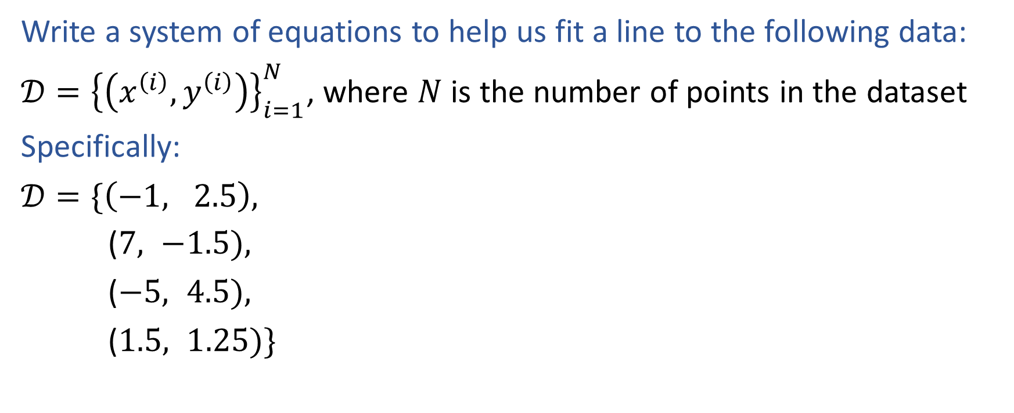
Exercise
Notation alert!
Write a system of equations to help us fit a line to the following data:
$𝒟={\left\{\left(x^{\left(i\right)}, y^{\left(i\right)}\right)\right\}}_{i=1}^{N}$, where $N$ is the number of points in the dataset
Specifically:
$𝒟=\{\left(−1, 2.5\right),$
($7, −1.5),$
($−5, 4.5),$
($1.5, 1.25)\}$

Slide 13
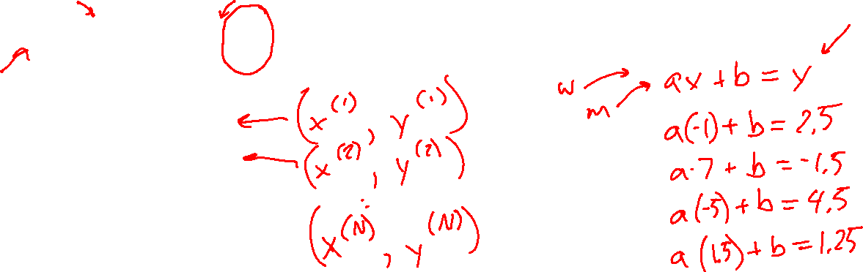
Exercise
Notation alert!
Write a system of equations to help us fit a line to the following data:
$𝒟={\left\{\left(x^{\left(i\right)}, y^{\left(i\right)}\right)\right\}}_{i=1}^{N}$, where $N$ is the number of points in the dataset
Specifically:
$𝒟=\{\left(−1, 2.5\right),$
($7, −1.5),$
($−5, 4.5),$
($1.5, 1.25)\}$

Slide 14
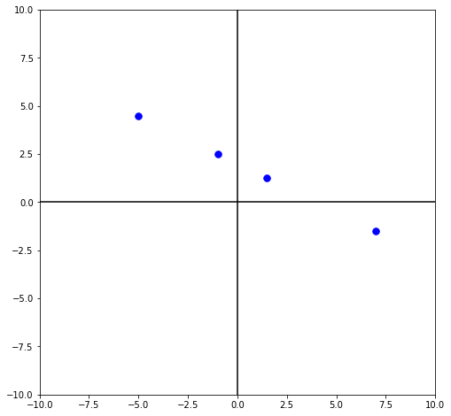

Poll 3
Can we fit a linear model to this data?
$𝒟={\left\{\left(x^{\left(i\right)}, y^{\left(i\right)}\right)\right\}}_{i=1}^{4}$
$=\{\left(−1, 2.5\right),$
($7, −1.5),$
($−5, 4.5),$
($1.5, 1.25)\}$

Slide 15

Poll 3
Can we fit a linear model to this data?
$𝒟={\left\{\left(x^{\left(i\right)}, y^{\left(i\right)}\right)\right\}}_{i=1}^{4}$
$=\{\left(−1, 2.5\right),$
($7, −1.5),$
($−5, 4.5),$
($1.5, 1.25)\}$

Slide 16
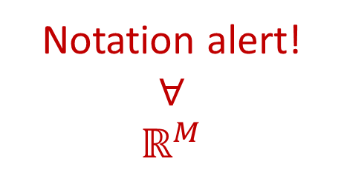
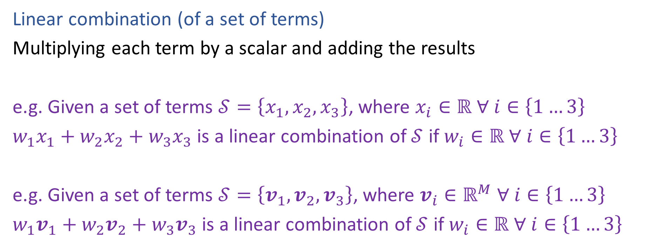
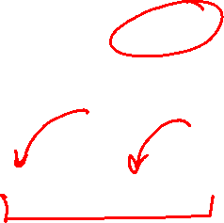
Linear and Affine
Notation alert!
$$∀$$
$$ℝ^{M}$$
Linear combination (of a set of terms)
Multiplying each term by a scalar and adding the results
e.g. Given a set of terms $𝒮=\left\{x_{1},x_{2},x_{3}\right\}$, where $x_{i}∈ℝ ∀ i∈\left\{1…3\right\}$
$w_{1}x_{1}+w_{2}x_{2}+w_{3}x_{3}$ is a linear combination of $𝒮$ if $w_{i}∈ℝ ∀ i∈\left\{1…3\right\}$
e.g. Given a set of terms $𝒮=\left\{v_{1},v_{2},v_{3}\right\}$, where $v_{i}∈ℝ^{M} ∀ i∈\left\{1…3\right\}$
$w_{1}v_{1}+w_{2}v_{2}+w_{3}v_{3}$ is a linear combination of $𝒮$ if $w_{i}∈ℝ ∀ i∈\left\{1…3\right\}$

Slide 17
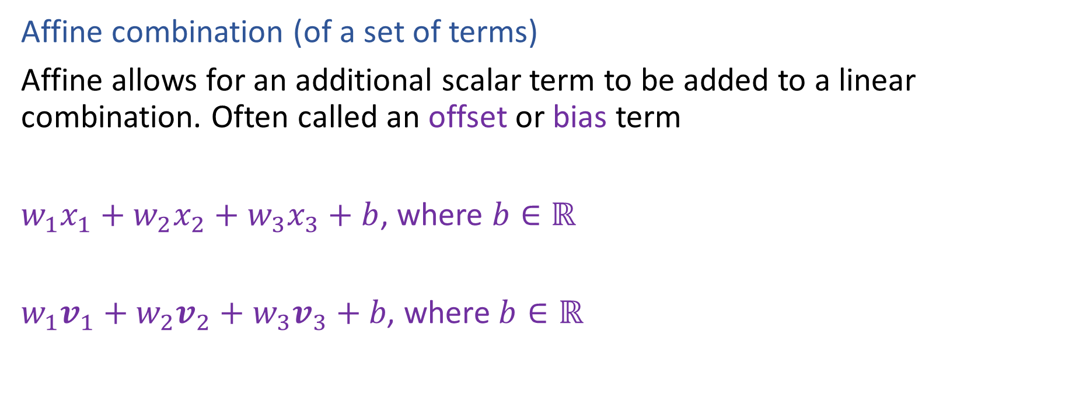

Linear and Affine
Affine combination (of a set of terms)
Affine allows for an additional scalar term to be added to a linear combination. Often called an offset or bias term
$w_{1}x_{1}+w_{2}x_{2}+w_{3}x_{3}+b$, where $b∈ℝ$
$w_{1}v_{1}+w_{2}v_{2}+w_{3}v_{3}+b\text{, }\text{where} b∈ℝ$

Slide 18
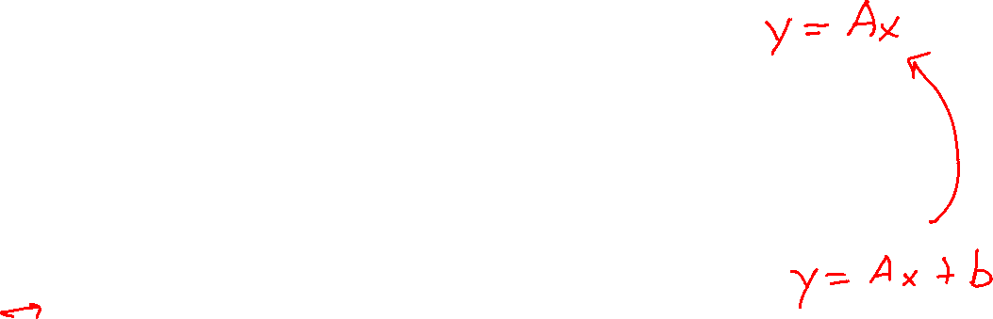
Linear vs Affine Models
What linear usually means depends on the domain:
Linear algebra:
Linear usually means strictly linear
Geometry, algebra:
Linear usually means affine
Machine learning:
Linear usually means affine but we often transform affine to strictly linear
to make the linear algebra and notation easier

Slide 19
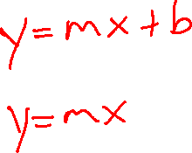
Poll 3
Can we fit a linear model to this data?
$𝒟={\left\{\left(x^{\left(i\right)}, y^{\left(i\right)}\right)\right\}}_{i=1}^{4}$
$=\{\left(−1, 2.5\right),$
($7, −1.5),$
($−5, 4.5),$
($1.5, 1.25)\}$

Slide 20
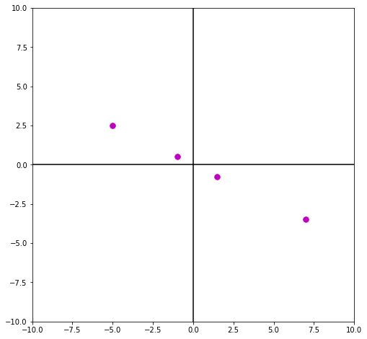


Linear (but not affine) model will include the origin
We don’t need an offset (or bias) term to fit this data
$𝒟={\left\{\left(x^{\left(i\right)}, y^{\left(i\right)}\right)\right\}}_{i=1}^{4}$
$=\{\left(−1, 0.5\right),$
($7, −3.5),$
($−5, 2.5),$
($1.5, −0.75)\}$

Slide 21
Linear (but not affine) model will include the origin
We don’t need an offset (or bias) term to fit this data
$𝒟={\left\{\left(x^{\left(i\right)}, y^{\left(i\right)}\right)\right\}}_{i=1}^{4}$
$=\{\left(−1, 0.5\right),$
($7, −3.5),$
($−5, 2.5),$
($1.5, −0.75)\}$

Slide 22
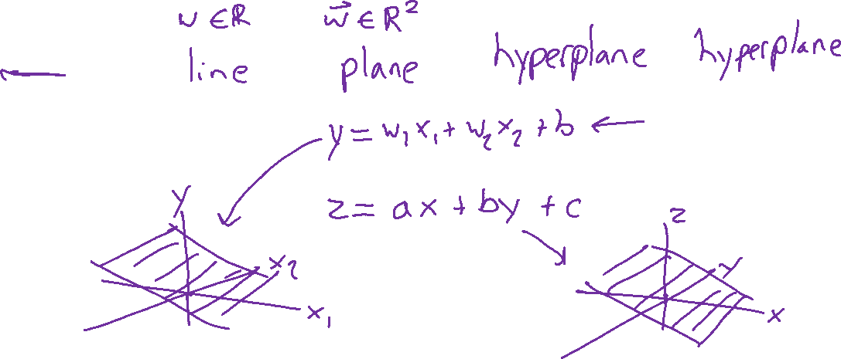





Linear (Affine) in Higher Dimensions
What are these linear shapes called for 1-D, 2-D, 3-D, M-D input?
$$x∈ℝ$$
$$x∈ℝ^{2}$$
$$x∈ℝ^{3}$$
$$x∈ℝ^{M}$$
$y=w^{T}x+b$

