Slide 1
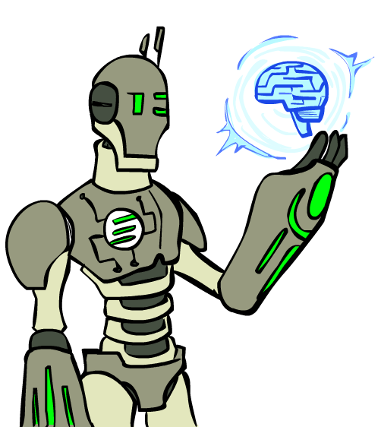
As you walk in
Welcome!
Sit at a table next to another student
Make name plate
    Fold paper in half
    Write preferred name
    Below write you favorite fictional AI/robot
Images: ai.berkeley.edu

Slide 2

10-606
Mathematical Foundations for Machine Learning
Instructor: Pat Virtue

Slide 3
Today
Course Info
Warm-up exercise
ML and Math Intro
Systems of equations
More Course Info
Images: ai.berkeley.edu

Slide 4
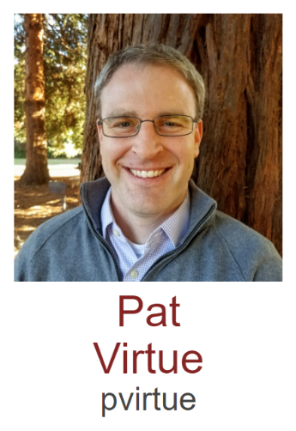
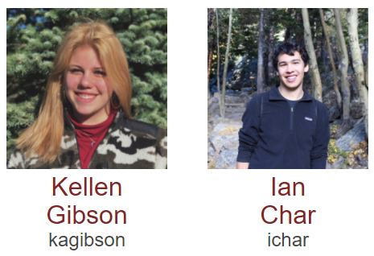
Course Team
Instructor
Teaching Assistants

Slide 5
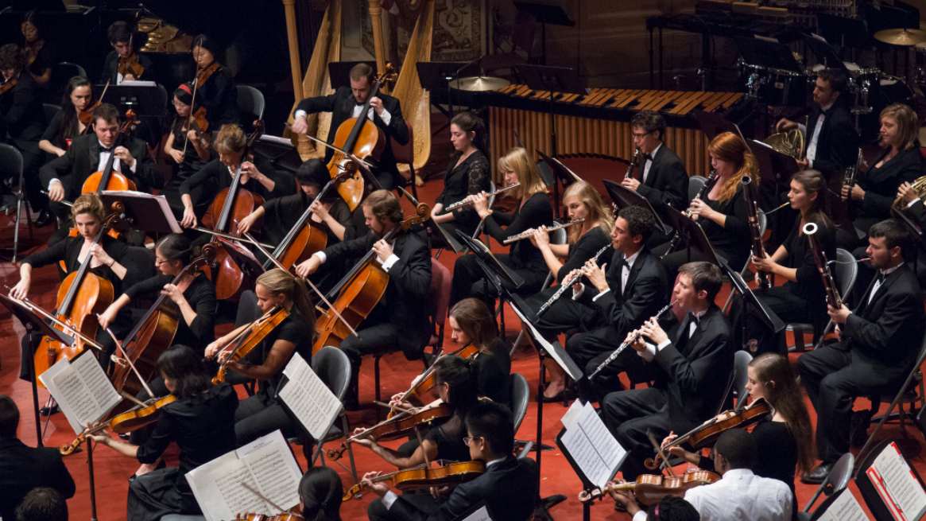
Course Team
Students!!

Slide 6
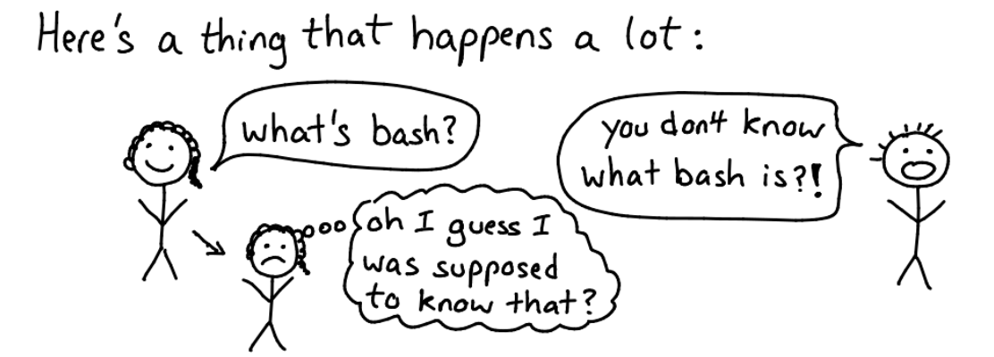
Team Tips
Try not to act surprised
https://jvns.ca/blog/2017/04/27/no-feigning-surprise/

Slide 7
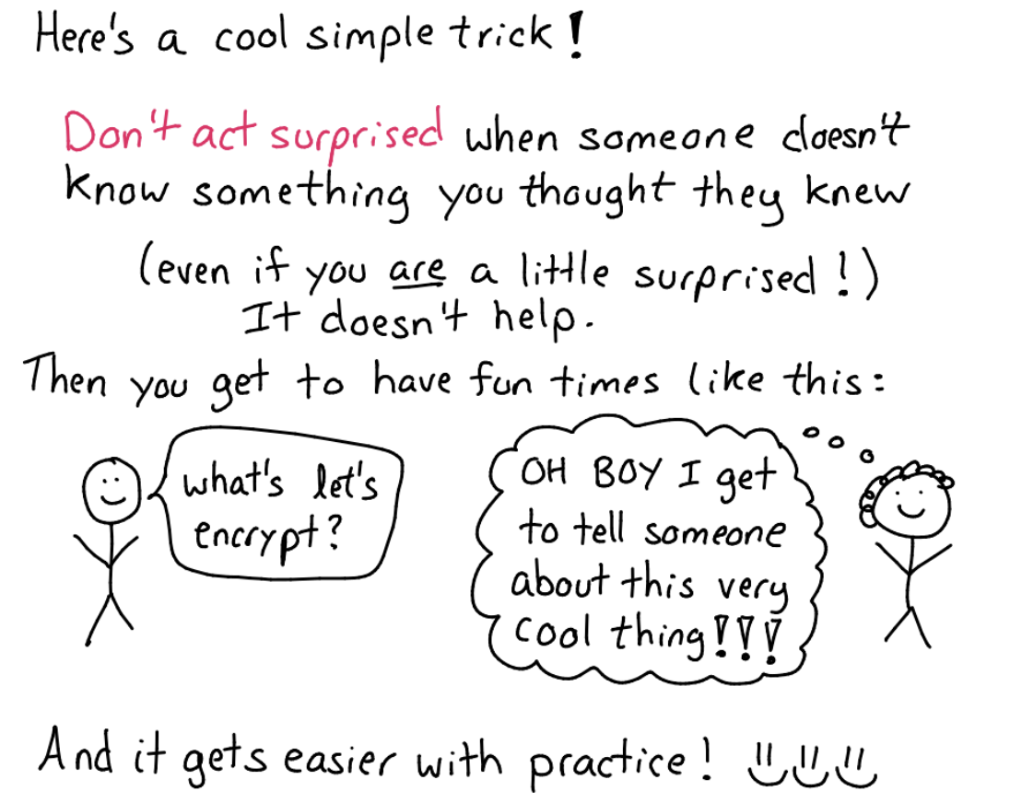
Team Tips
Try not to act surprised
https://jvns.ca/blog/2017/04/27/no-feigning-surprise/

Slide 8
Team Tips
Jargon card

Slide 9
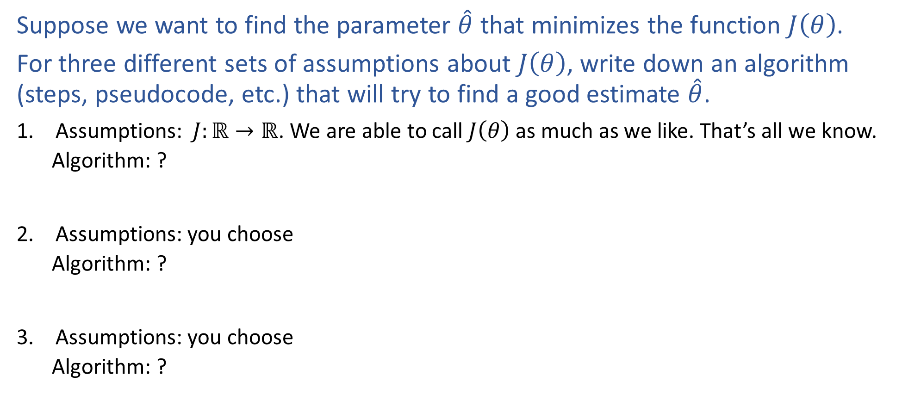
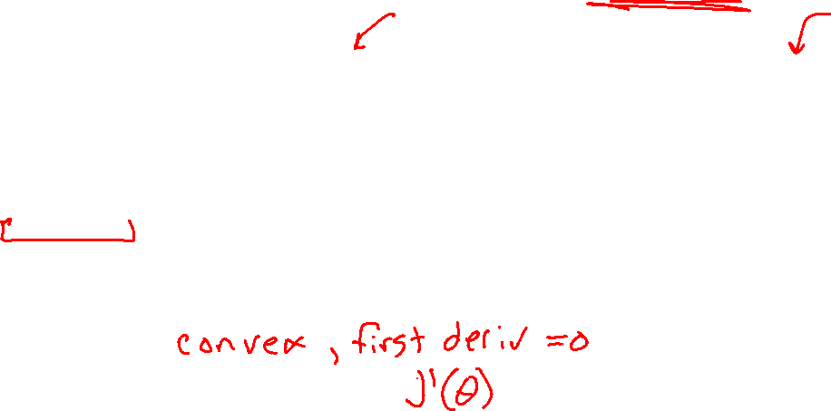

Warm-up Exercise
Notation alert!
Suppose we want to find the parameter $\hat{θ}$ that minimizes the function $J\left(θ\right)$.
For three different sets of assumptions about $J\left(θ\right)$, write down an algorithm (steps, pseudocode, etc.) that will try to find a good estimate $\hat{θ}$.
Assumptions: $J:ℝ→ℝ$. We are able to call $J\left(θ\right)$ as much as we like. That’s all we know.
      Algorithm: ?
Assumptions: you choose
      Algorithm: ?
Assumptions: you choose
      Algorithm: ?
Notation alert!

Slide 10
Today
Course Info
Warm-up exercise
ML and 606/607
Systems of equations
More Course Info
Images: ai.berkeley.edu

Slide 11
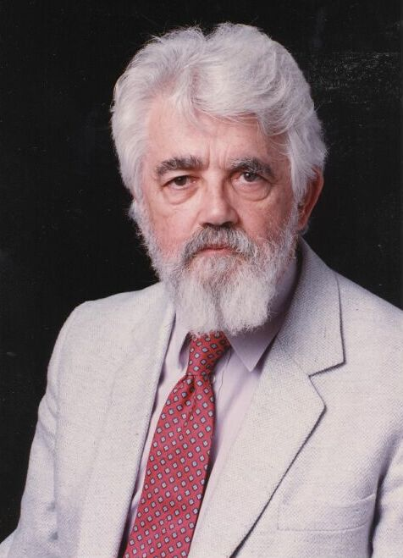
AI Definition by John McCarthy
What is artificial intelligence
  It is the science and engineering of making intelligent machines, especially intelligent computer programs
What is intelligence
  Intelligence is the computational part of the ability to achieve goals in the world
http://www-formal.stanford.edu/jmc/whatisai/whatisai.html

Slide 12
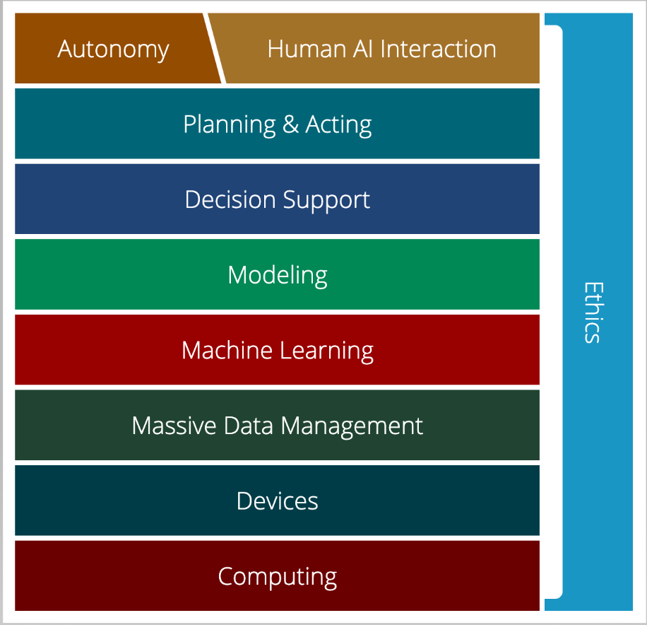
AI Stack for CMU AI
“AI must understand the human needs and it must make smart design decisions based on that understanding”
AI Stack
https://ai.cs.cmu.edu/about
Notes:
Proposed by Andrew Moore, CMU is using AI Stack to illustrate what they consider as AI. AI must understand the human needs and it must make smart design decisions based on that understanding. Despite the simple definition, though, AI isn't just one thing. It's a giant thing, built from technology blocks we call the AI Stack. At Carnegie Mellon, we view it as a toolbox — each block houses a set of technologies that scientists and researchers can reach for as they work on new initiatives. Expertise in all areas? Not required. Instead, we believe you can focus on one area and draw on other parts of the stack for help. Each block depends on the other for support. And AI endeavors that ignore parts of the stack won't succeed.

Slide 13
AI Stack for CMU AI
“Machine learning focuses on creating programs that learn from experience.”
“It advances computing through exposure to new scenarios, testing and adaptation, while using pattern- and trend-detection to help the computer make better decisions in similar, subsequent situations.”
AI Stack
https://ai.cs.cmu.edu/about

Slide 14
Artificial Intelligence vs Machine Learning?
Artificial Intelligence
Machine Learning
Deep Learning

Slide 15
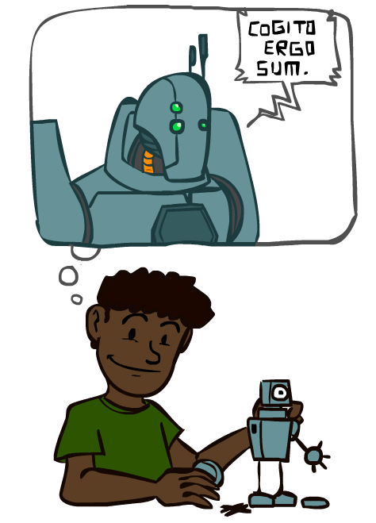
A Brief History of AI
Images: ai.berkeley.edu

Slide 16
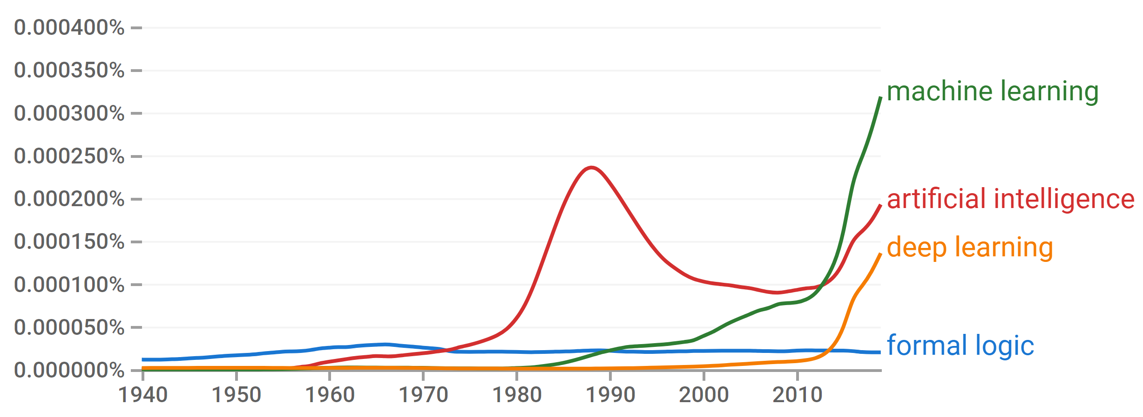
A Brief History of AI
Knowledge Based
Systems
1970-1990
Statistical Approaches
1990-
Deep Learning Era
2012-
AI
Excitement!
1950-1970
https://books.google.com/ngrams

Slide 17
A Brief History of AI
1940-1950: Early days
  1943: McCulloch & Pitts: Boolean circuit model of brain
  1950: Turing's “Computing Machinery and Intelligence”
1950—70: Excitement: Look, Ma, no hands!
  1950s: Early AI programs, including Samuel's checkers program, Newell & Simon's Logic Theorist, Gelernter's Geometry Engine
  1956: Dartmouth meeting: “Artificial Intelligence” adopted
1970—90: Knowledge-based approaches
  1969—79: Early development of knowledge-based systems
  1980—88: Expert systems industry booms
  1988—93: Expert systems industry busts: “AI Winter”
1990—: Statistical approaches
  Resurgence of probability, focus on uncertainty
  General increase in technical depth
  Agents and learning systems… “AI Spring”?
2012—: Deep learning
  2012: ImageNet & AlexNet
Images: ai.berkeley.edu

Slide 18
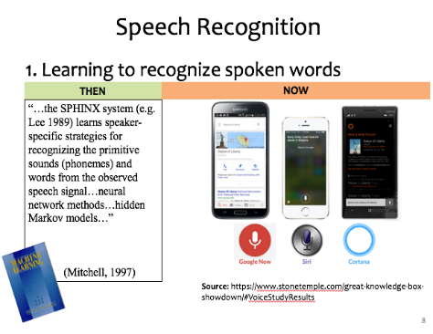
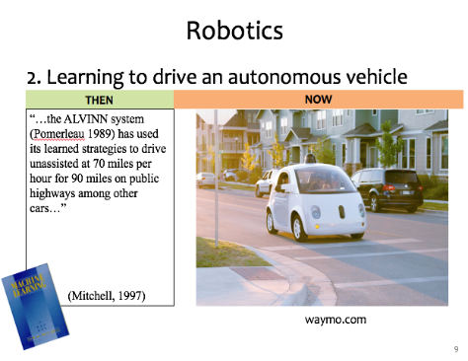
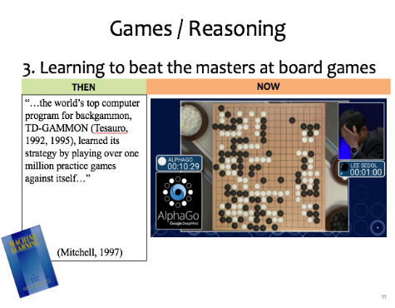
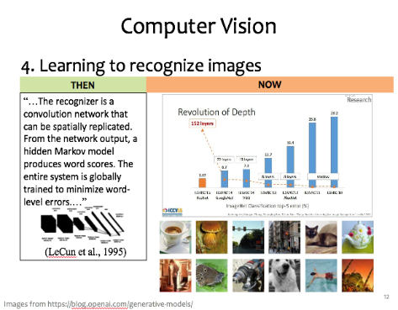
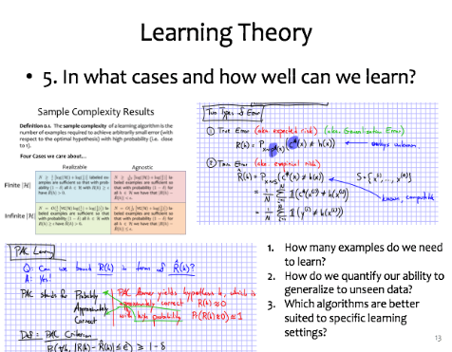

ML Applications?
Slide credit: CMU MLD Matt Gormley

Slide 19
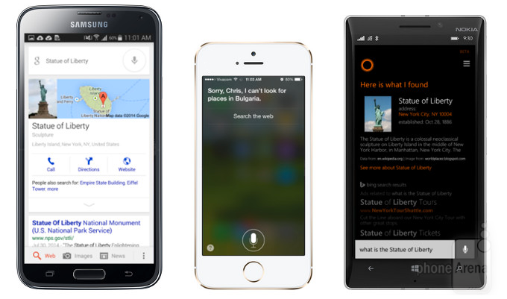

Speech Recognition
1. Learning to recognize spoken words
THEN
NOW
“…the SPHINX system (e.g. Lee 1989) learns speaker-specific strategies for recognizing the primitive sounds (phonemes) and words from the observed speech signal…neural network methods…hidden Markov models…”
(Mitchell, 1997)
Source: https://www.stonetemple.com/great-knowledge-box-
showdown/#VoiceStudyResults
Slide credit: CMU MLD Matt Gormley

Slide 20
Robotics
2. Learning to drive an autonomous vehicle
NOW
THEN
NOW
“…the ALVINN system (Pomerleau 1989) has used its learned strategies to drive unassisted at 70 miles per hour for 90 miles on public highways among other cars…”
(Mitchell, 1997)
https://www.geek.com/wp-content/uploads/2016/03/uber.jpg
waymo.com
Slide credit: CMU MLD Matt Gormley

Slide 21
Games / Reasoning
3. Learning to beat the masters at board games
THEN
NOW
“…the world’s top computer program for backgammon, TD-GAMMON (Tesauro, 1992, 1995), learned its strategy by playing over one million practice games against itself…”
(Mitchell, 1997)
Slide credit: CMU MLD Matt Gormley

Slide 22
Computer Vision
4. Learning to recognize images
THEN
NOW
“…The recognizer is a convolution network that can be spatially replicated. From the network output, a hidden Markov model produces word scores. The entire system is globally trained to minimize word-level errors.…”
(LeCun et al., 1995)
Slide credit: CMU MLD Matt Gormley
Images from https://blog.openai.com/generative-models/

Slide 23
Learning Theory
5. In what cases and how well can we learn?
Slide credit: CMU MLD Matt Gormley
How many examples do we need to learn?
How do we quantify our ability to generalize to unseen data?
Which algorithms are better suited to specific learning settings?

Slide 24
Machine Learning and Statistics
Statistics is also about learning from data
Statistics has been around from much longer!
What’s the difference?
Until the mid 1990s:
Statistics:
  A branch of mathematics
  Emphasized rigor, correctness, provable properties (“is it correct?”)
  Was not very concerned with scaling
    Not much awareness of computational complexity
Machine Learning:
  A branch of Computer Science / AI
  Focus on heuristics, making things work in practice (“does it work?”)
  Not much awareness of statistical theory
Slide: CMU ML, Roni Rosenfeld

Slide 25
Machine Learning and Statistics
From the mid 1990s:
The two fields have effectively merged
  Carnegie Mellon has led the way!
ML is now often called “Statistical Machine Learning”
  There is very little non-statistical ML today
Slide: CMU ML, Roni Rosenfeld

Slide 26
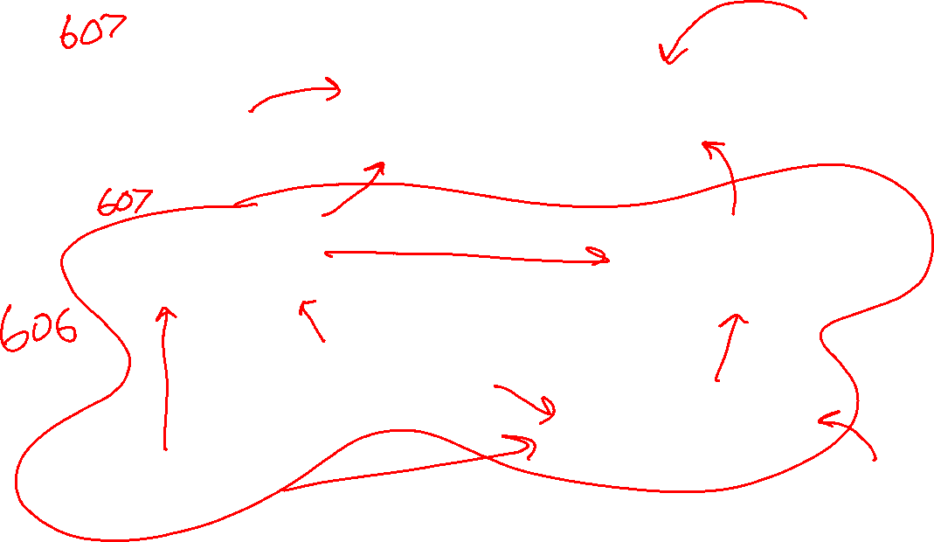
What is ML?
Domain of Interest
Computer Science
Computer Science
Machine Learning
Optimization
Optimization
Statistics
Statistics
Linear Algebra
Linear Algebra
Probability
Probability
Calculus
Calculus
Measure
Theory

Slide 27
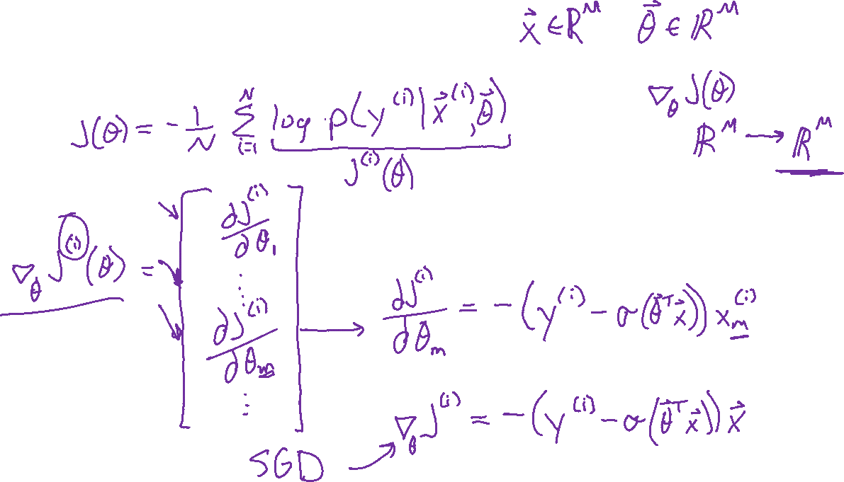
Binary Logistic Regression
Gradient
Example slide from 10-601

Slide 28

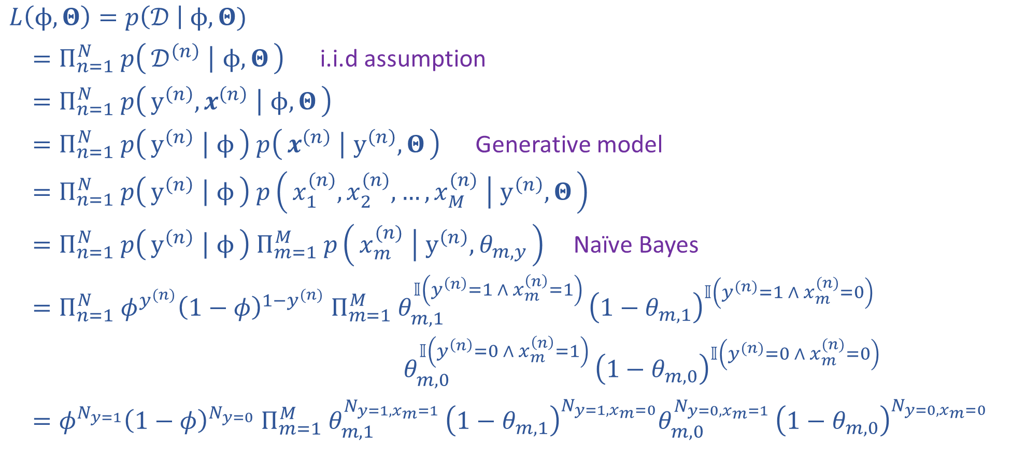
Naïve Bayes MLE
$𝒟={\left\{y^{\left(n\right)}, x^{(n)}\right\}}_{n=1}^{N}$
$y^{(n)}∈\{0,1\}$
$x^{(n)}∈{\left\{0,1\right\}}^{M}$
$φ∈[0,1]$
$Θ∈{\left[0,1\right]}^{Mx2}$
$L\left(ϕ, Θ\right)=p\left(𝒟 \right| ϕ, Θ)$
$=Π_{n=1}^{N} p\left(𝒟^{\left(n\right)} ∣ ϕ, Θ\right)$ i.i.d assumption
$=Π_{n=1}^{N} p\left(y^{\left(n\right)}, x^{\left(n\right)} ∣ ϕ, Θ\right)$
$=Π_{n=1}^{N} p\left(y^{\left(n\right)} ∣ ϕ\right) p\left(x^{\left(n\right)} ∣ y^{\left(n\right)}, Θ\right)$ Generative model
$=Π_{n=1}^{N} p\left(y^{\left(n\right)} ∣ ϕ\right) p\left(x_{1}^{(n)},x_{2}^{(n)},…,x_{M}^{(n)} ∣ y^{\left(n\right)}, Θ\right)$
$=Π_{n=1}^{N} p\left(y^{\left(n\right)} ∣ ϕ\right) Π_{m=1}^{M} p\left(x_{m}^{(n)} ∣ y^{\left(n\right)}, θ_{m,y}\right)$ Naïve Bayes
$=Π_{n=1}^{N} φ^{y^{(n)}}{\left(1−φ\right)}^{1−y^{(n)}} Π_{m=1}^{M} θ_{m,1}^{𝕀\left(y^{\left(n\right)}=1 ∧ x_{m}^{\left(n\right)}=1\right) }{\left(1−θ_{m,1}\right)}^{𝕀\left(y^{(n)}=1 ∧ x_{m}^{(n)}=0\right)}$
$θ_{m,0}^{𝕀\left(y^{\left(n\right)}=0 ∧ x_{m}^{\left(n\right)}=1\right) }{\left(1−θ_{m,0}\right)}^{𝕀\left(y^{(n)}=0 ∧ x_{m}^{(n)}=0\right)}$
$=φ^{N_{y=1}}{\left(1−φ\right)}^{N_{y=0}} Π_{m=1}^{M} θ_{m,1}^{N_{y=1,x_{m}=1} }{\left(1−θ_{m,1}\right)}^{N_{y=1,x_{m}=0}}θ_{m,0}^{N_{y=0,x_{m}=1} }{\left(1−θ_{m,0}\right)}^{N_{y=0,x_{m}=0}}$
Example slide from 10-601

Slide 29
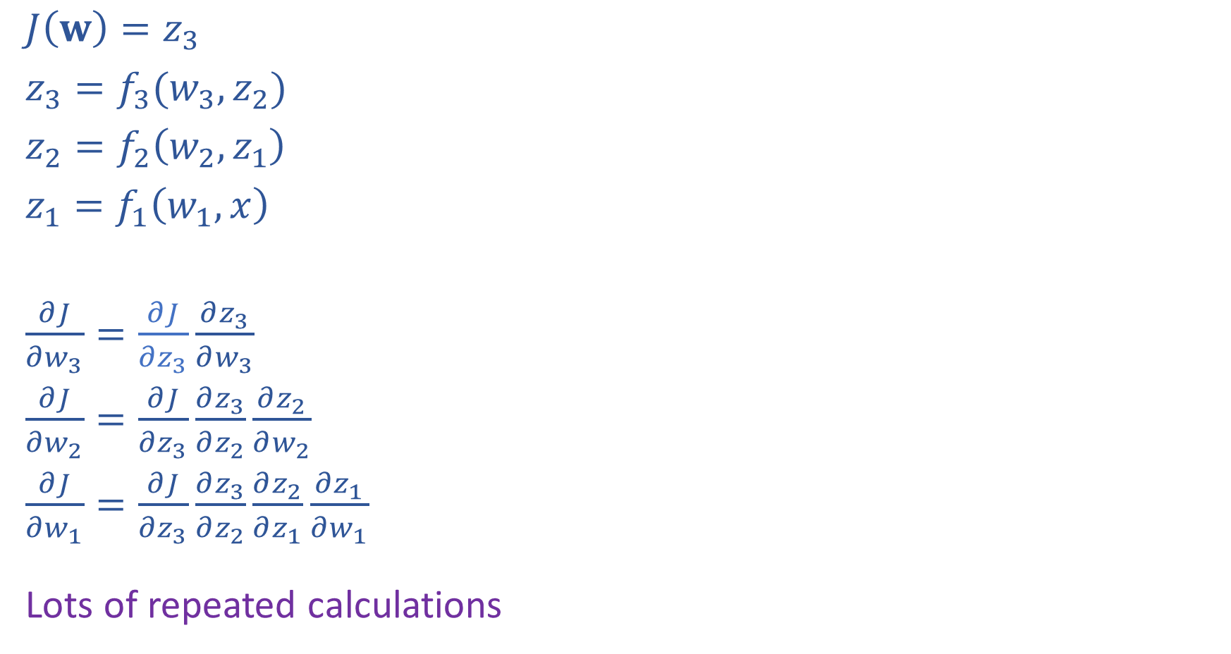

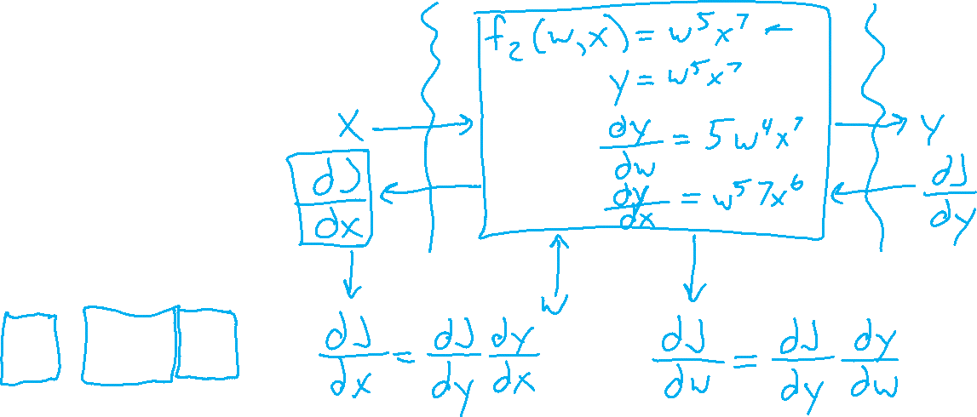
Network Optimization: Layer Implementation
$J\left(w\right)=z_{3}$
$z_{3}=f_{3}(w_{3}, z_{2})$
$z_{2}=f_{2}\left(w_{2}, z_{1}\right)$
$z_{1}=f_{1}\left(w_{1}, x\right)$
$\frac{∂J}{∂w_{3}}=\frac{∂J}{∂z_{3}}\frac{∂z_{3}}{∂w_{3}}$
$\frac{∂J}{∂w_{2}}=\frac{∂J}{∂z_{3}}\frac{∂z_{3}}{∂z_{2}}\frac{∂z_{2}}{∂w_{2}}$
$\frac{∂J}{∂w_{1}}=\frac{∂J}{∂z_{3}}\frac{∂z_{3}}{∂z_{2}}\frac{∂z_{2}}{∂z_{1}}\frac{∂z_{1}}{∂w_{1}}$
Lots of repeated calculations
Example slide from 10-601

Slide 30
PCA: the First Principal Component
Example slide from 10-601

Slide 31

10-606 and 10-607
Mini Courses
    10-606
    10-607
Intro ML Courses
    10-315
    10-301/601
    10-701
    10-715
Prerequisites

Slide 32
Today
Course Info
Warm-up exercise
ML and 606/607
Systems of equations
More Course Info
Images: ai.berkeley.edu

Slide 33
Today
Course Info
Warm-up exercise
ML and 606/607
Systems of equations
More Course Info
Images: ai.berkeley.edu

Slide 34



Course Information
Website: https://www.cs.cmu.edu/~10606
Canvas: canvas.cmu.edu
Gradescope: gradescope.com
Communication:
piazza.com
E-mail (if piazza doesn’t work):
pvirtue@andrew.cmu.edu

Slide 35

Course Information
Lectures
Lectures are recorded
    Shared with our course and ML course staff only
Participation point earned by answering Piazza polls in lecture
Quizzes will in lecture, announced two days ahead of time
Slides will be posted
Recitations
Recommended attendance
No plans to record at this point
No participation points in recitation
Recitation materials are in-scope for quizzes and exams

Slide 36
Course Information
Office Hours
OH calendar on course website
OH-by-appointment requests are certainly welcome
Mental Health

