Slide 1
Warm-up
https://www.sporcle.com/games/MrChewypoo/minimalist_disney
https://www.sporcle.com/games/Stanford0008/minimalist-cartoons-slideshow
https://www.sporcle.com/games/MrChewypoo/minimalist

Slide 2
Announcements
HW3
Due Sat 10/9
Quiz3
Mon 10/11, last 15 min. of class (probability, statistics)
Next week
Mon 10/11: Review session
Wed 10/13: No class
Thu 10/14: Final exam, 1-4 pm

Slide 3

Mathematical Foundations for Machine Learning
Probability/Statistics
& PCA Application
Instructor: Pat Virtue

Slide 4
Plan
Today
Probability/Statistics
Expectation
Variance
Covariance
Covariance matrix
10-606 Application: PCA

Slide 5
Expectation and Variance

Slide 6
Expectation and Variance
The expected value of X is E[X]. Also called the mean.
Discrete random variables:
Continuous random variables:
Slide credit: CMU MLD Matt Gormley

Slide 7
Expectation and Variance
The variance of X is Var(X).
Discrete random variables:
Continuous random variables:
Slide credit: CMU MLD Matt Gormley

Slide 8
Covariance
Expectation:
Variance:
Covariance:
Vector of random variables:
Covariance matrix:

Slide 9
Principal Component Analysis

Slide 10
Warm-up as you log in
https://www.sporcle.com/games/MrChewypoo/minimalist_disney
https://www.sporcle.com/games/Stanford0008/minimalist-cartoons-slideshow
https://www.sporcle.com/games/MrChewypoo/minimalist

Slide 11


Dimensionality Reduction

Slide 12
Dimensionality Reduction

Slide 13
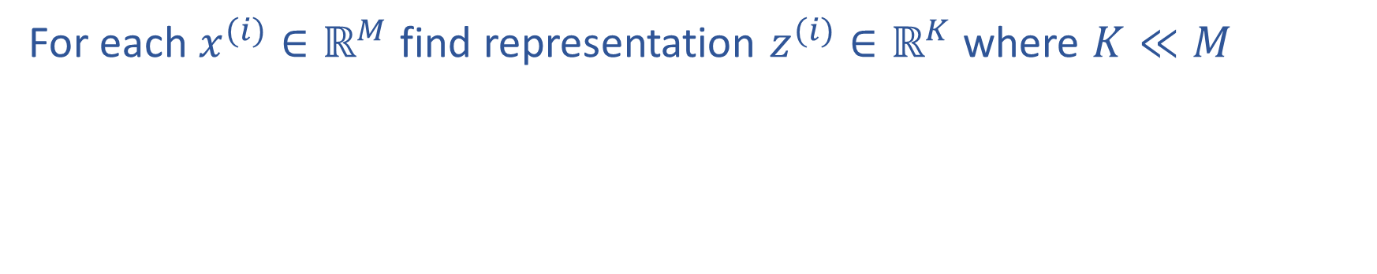
Dimensionality Reduction
For each $x^{(i)}∈ℝ^{M}$ find representation $z^{(i)}∈ℝ^{K}$ where $K≪M$

Slide 14
Dimensionality Reduction
http://timbaumann.info/svd-image-compression-demo/
https://cs.stanford.edu/people/karpathy/convnetjs/demo/autoencoder.html

Slide 15
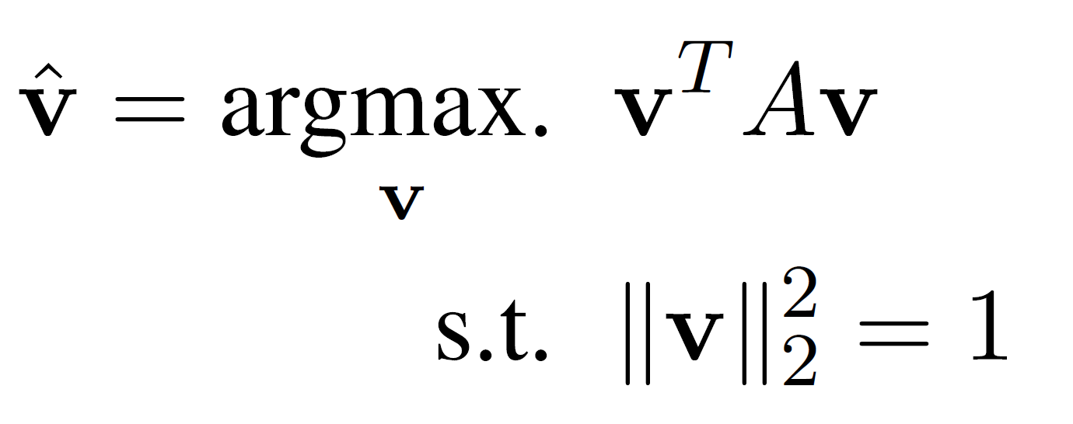
PCA Worksheet
Lagrange multipliers for PCA

Slide 16
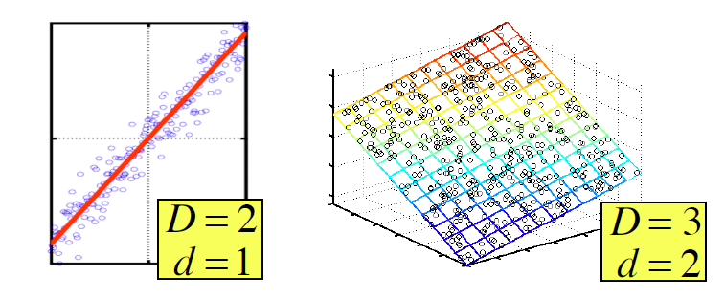
Principal Component Analysis (PCA)
In case where data lies on or near a low d-dimensional linear subspace, axes of this subspace are an effective representation of the data.
Identifying the axes is known as Principal Components Analysis, and can be obtained by using classic matrix computation tools (Eigen or Singular Value Decomposition).
Slide from Nina Balcan

Slide 17
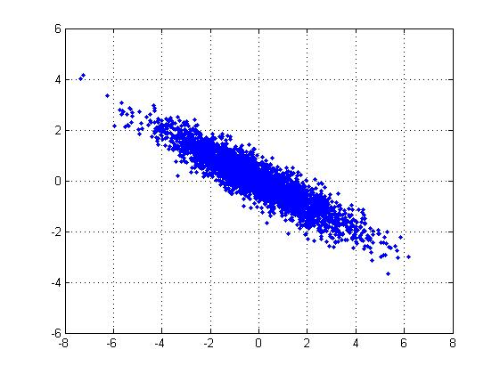
2D Gaussian dataset
Slide from Barnabas Poczos

Slide 18
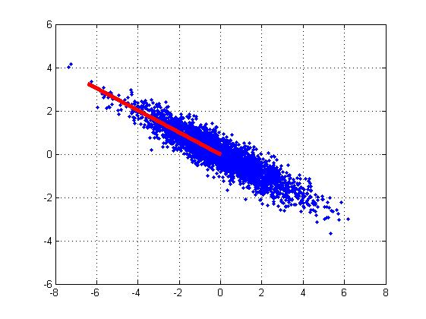
1st PCA axis
Slide from Barnabas Poczos

Slide 19

2nd PCA axis
Slide from Barnabas Poczos

Slide 20
Data for PCA
We assume the data is centered
Q: What if your data is not centered?
A: Subtract off the sample mean
Slide from Matt Gormley

Slide 21
Sample Covariance Matrix
The sample covariance matrix is given by:
Since the data matrix is centered, we rewrite as:
Slide from Matt Gormley

Slide 22
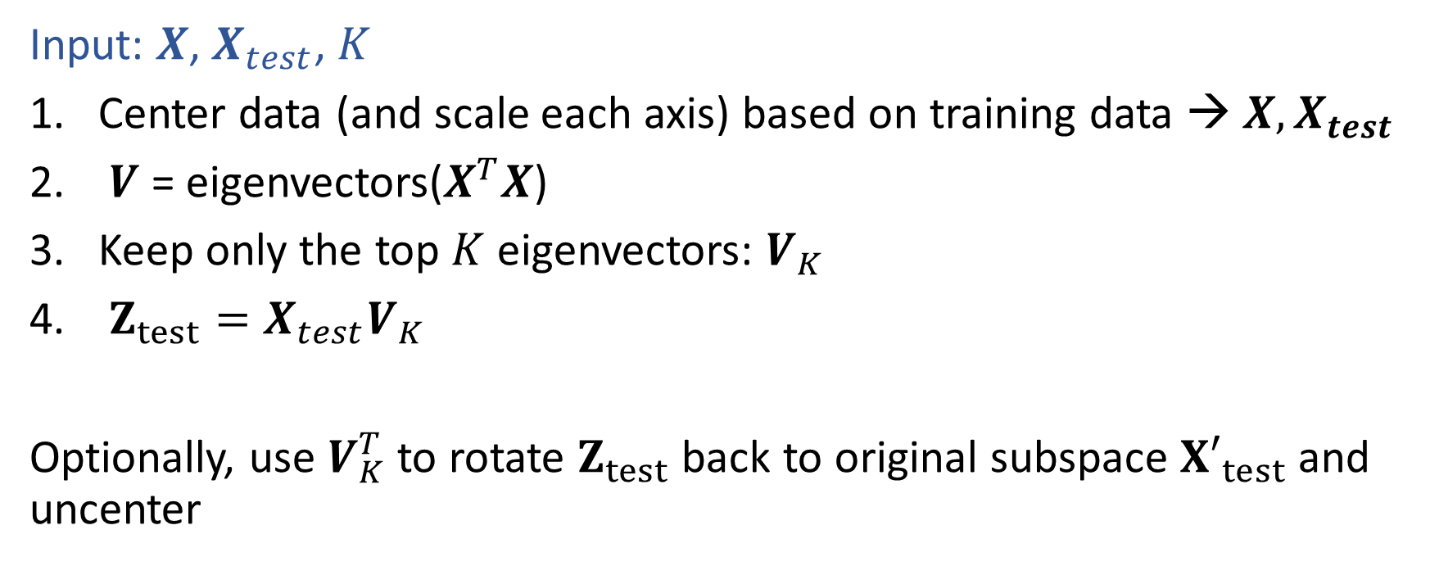
PCA Algorithm
Input: $X$, $X_{test}$, $K$
Center data (and scale each axis) based on training data → $X, X_{test}$
$V$ = eigenvectors($X^{T}X$)
Keep only the top $K$ eigenvectors: $V_{K}$
$Z_{test}=X_{test}V_{K}$
Optionally, use $V_{K}^{T}$ to rotate $Z_{test}$ back to original subspace ${X′}_{test}$and uncenter

