Slide 1

Announcements
Next week
HW3
Out late tonight
Due Sat 10/9
Quizzes
Mon 10/4, last 15 min. of class (calculus, optimization, Lagrange)
Mon 10/11, last 15 min. of class (probability, statistics)

Slide 2

Mathematical Foundations for Machine Learning
Statistics
Instructor: Pat Virtue

Slide 3
Plan
Recitation
Trick coin
Finding the best parameters
    Among five different buckets
    Plotting the log likelihood vs q
Today
Maximum likelihood estimation
Two applications of Bayes rule
Conditional likelihood
Expectation
Variance

Slide 4







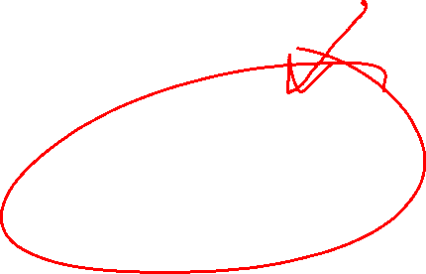



Likelihood
Likelihood: The probability (or density) of random variable $Y$ taking on value $y$ given the distribution parameters, $θ$.

Slide 5
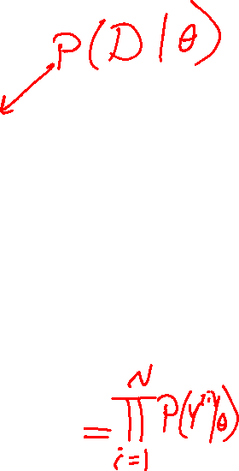

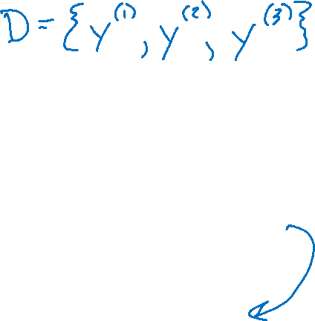


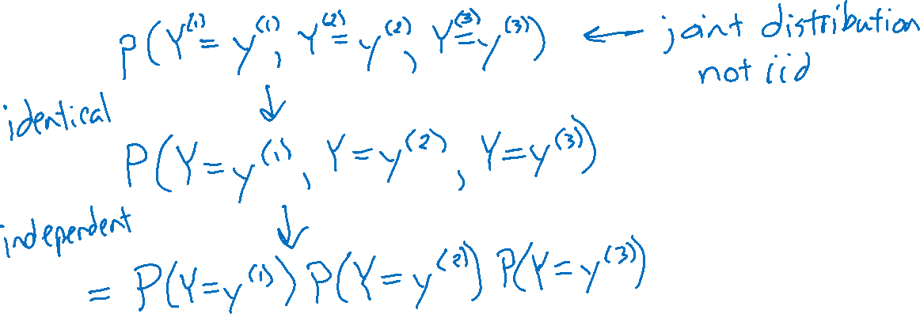
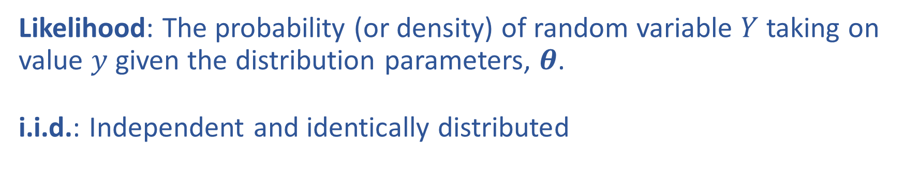
Likelihood and i.i.d
Likelihood: The probability (or density) of random variable $Y$ taking on value $y$ given the distribution parameters, $θ$.
i.i.d.: Independent and identically distributed

Slide 6
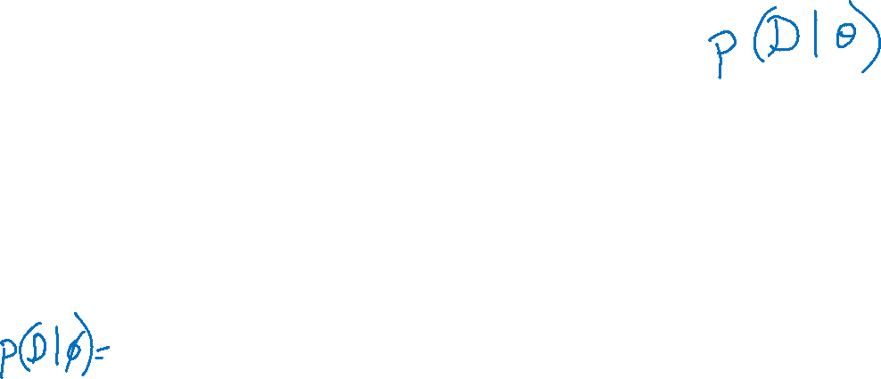
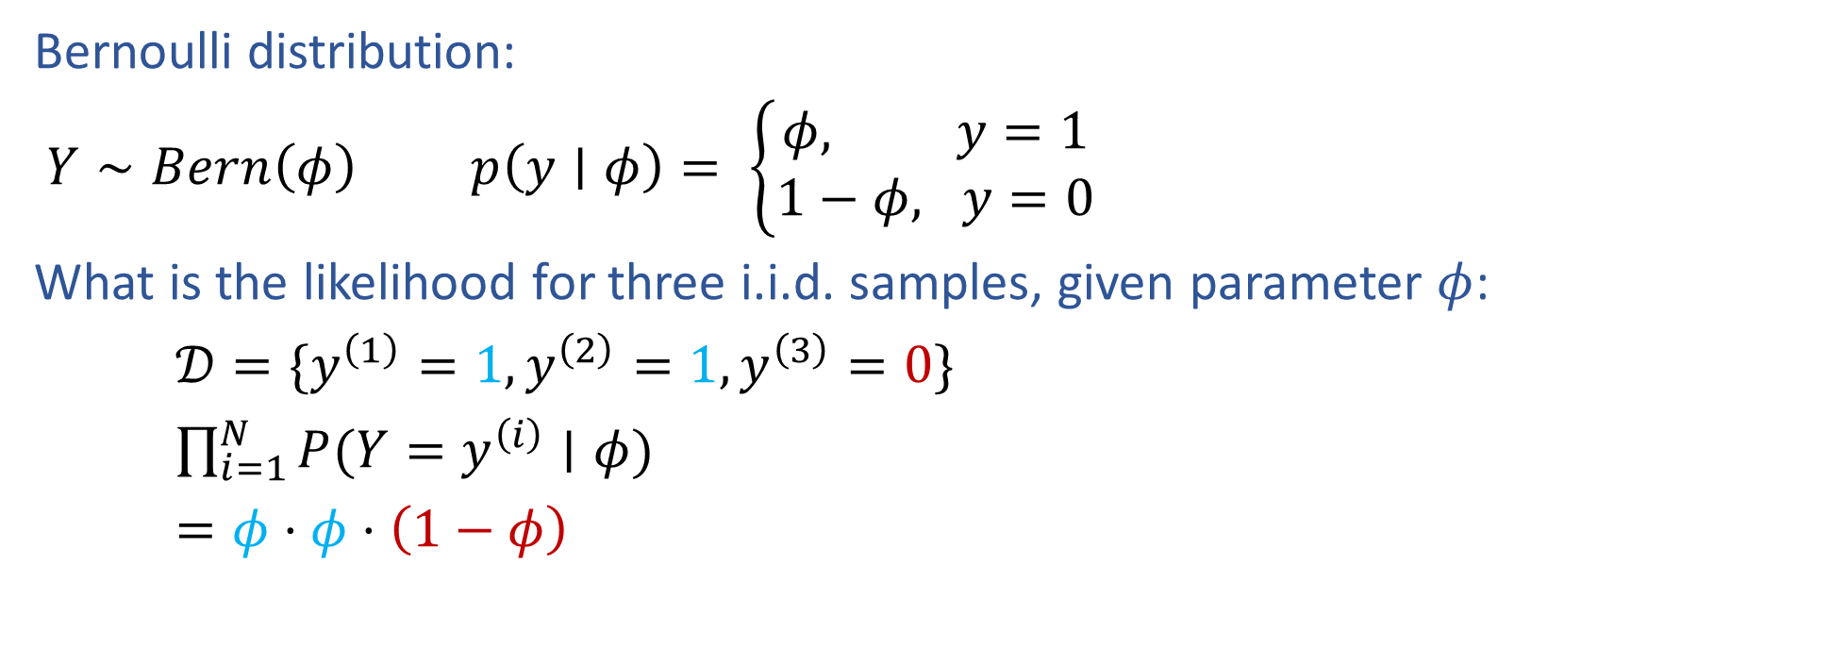
Bernoulli Likelihood
Bernoulli distribution:
$Y∼Bern\left(φ\right)$ $p\left(y∣φ\right)= \left\{\begin{aligned}φ, y=1 \\ 1−φ, y=0\end{aligned}\right.$
What is the likelihood for three i.i.d. samples, given parameter $φ$:
$𝒟=\{y^{\left(1\right)}=1, y^{\left(2\right)}=1,y^{\left(3\right)}=0\}$
$\prod_{i=1}^{N}{P(Y=y^{\left(i\right)}∣φ)}$
$=φ⋅φ⋅\left(1−φ\right)$

Slide 7
MLE

Slide 8
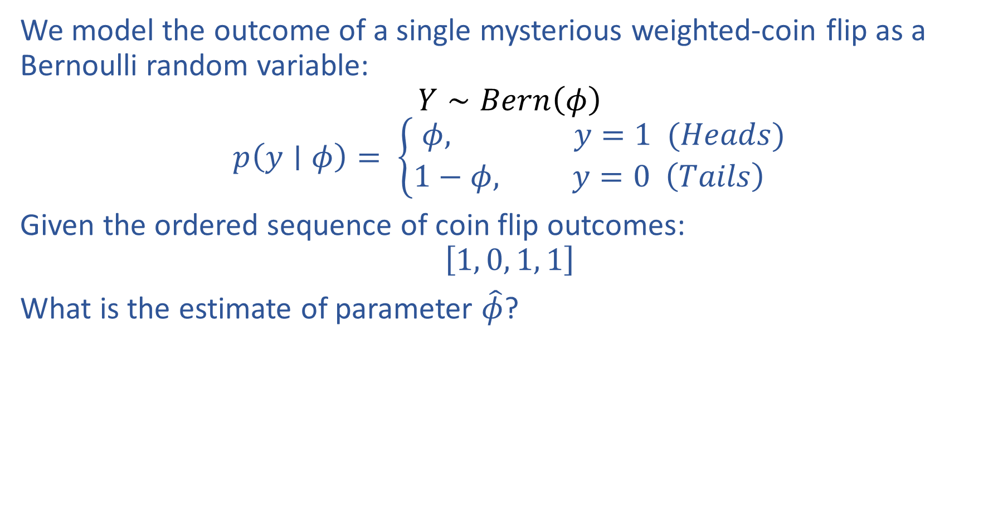
Estimating Parameters with Likelihood
We model the outcome of a single mysterious weighted-coin flip as a Bernoulli random variable:
$$Y∼Bern\left(φ\right)$$
$$p\left(y∣φ\right)= \left\{\begin{aligned}φ, y=1 (Heads) \\ 1−φ, y=0 \left(Tails\right) \end{aligned}\right.$$
Given the ordered sequence of coin flip outcomes:
$$\left[1, 0, 1, 1\right]$$
What is the estimate of parameter $\hat{φ}$?

Slide 9
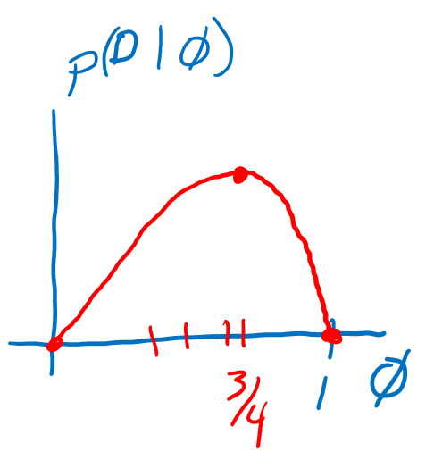
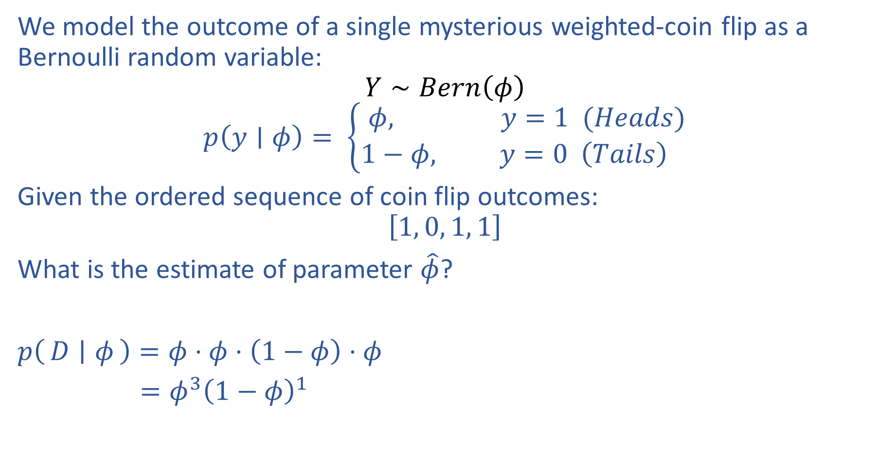
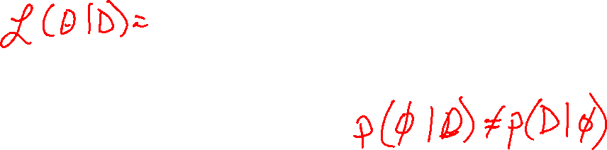
Estimating Parameters with Likelihood
We model the outcome of a single mysterious weighted-coin flip as a Bernoulli random variable:
$$Y∼Bern\left(φ\right)$$
$$p\left(y∣φ\right)= \left\{\begin{aligned}φ, y=1 (Heads) \\ 1−φ, y=0 \left(Tails\right) \end{aligned}\right.$$
Given the ordered sequence of coin flip outcomes:
$$\left[1, 0, 1, 1\right]$$
What is the estimate of parameter $\hat{φ}$?
$p\left(D ∣ φ\right)=φ⋅φ⋅\left(1−φ\right)⋅φ$
$=φ^{3}{\left(1−φ\right)}^{1}$

Slide 10
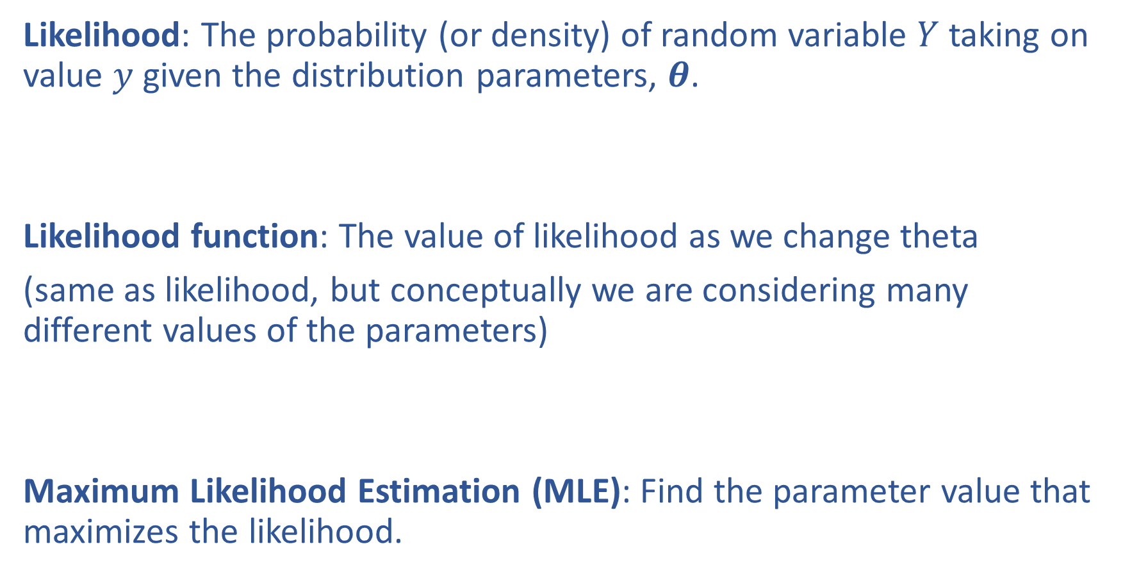
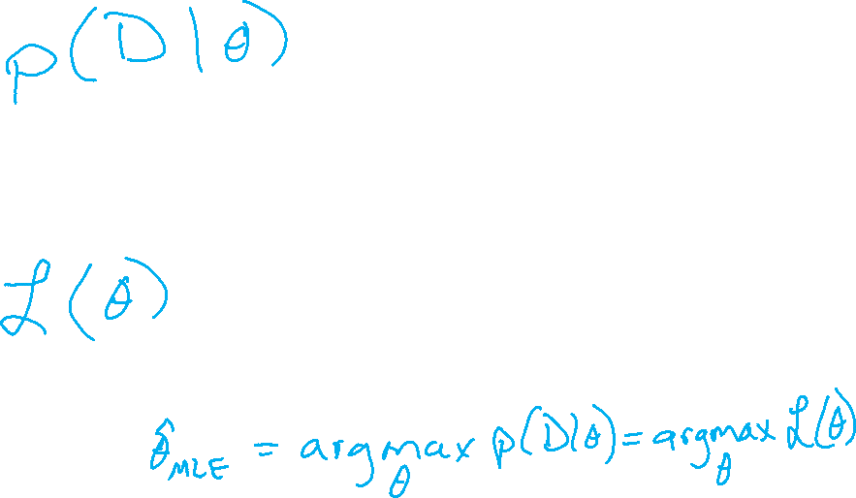
Likelihood and Maximum Likelihood Estimation
Likelihood: The probability (or density) of random variable $Y$ taking on value $y$ given the distribution parameters, $θ$.
Likelihood function: The value of likelihood as we change theta
(same as likelihood, but conceptually we are considering many different values of the parameters)
Maximum Likelihood Estimation (MLE): Find the parameter value that maximizes the likelihood.

Slide 11


MLE as Data Increases
Given the ordered sequence of coin flip outcomes:
$$\left[1, 0, 1, 1\right]$$
$$p(𝒟∣φ)=\prod_{i}^{N}{p\left(y^{\left(i\right)} ∣ φ\right)} = φ^{N_{y=1}}{\left(1−φ\right)}^{N_{y=0}}$$
What happens as we flip more coins?

Slide 12
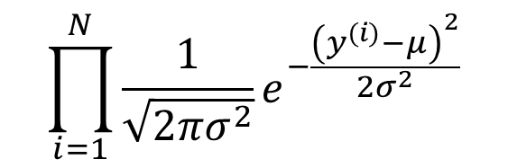

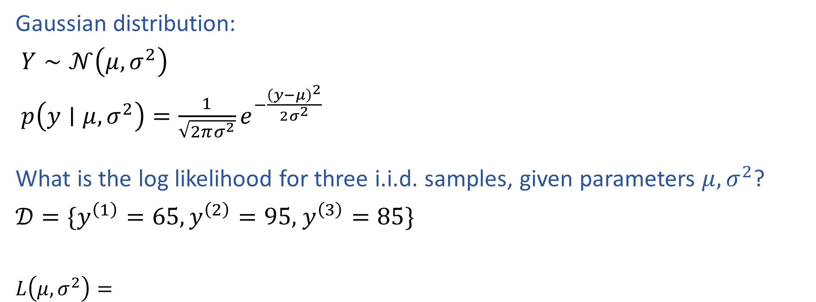
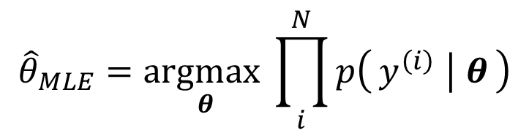
MLE for Gaussian
Gaussian distribution:
$Y∼𝒩\left(μ, σ^{2}\right)$
$p\left(y∣μ, σ^{2}\right)=\frac{1}{\sqrt{2πσ^{2}}}e^{−\frac{{\left(y−μ\right)}^{2}}{2σ^{2}}}$
What is the log likelihood for three i.i.d. samples, given parameters $μ, σ^{2}$?
$𝒟=\{y^{\left(1\right)}=65,y^{\left(2\right)}=95,$ $y^{\left(3\right)}=85\}$
$L\left(μ, σ^{2}\right)=$
$$\prod_{i=1}^{N}{\frac{1}{\sqrt{2πσ^{2}}}e^{−\frac{{\left(y^{(i)}−μ\right)}^{2}}{2σ^{2}}}}$$
$${\hat{θ}}_{MLE}=\underset{θ}{argmax}\prod_{i}^{N}{p\left(y^{\left(i\right)} ∣ θ\right)}$$

Slide 13
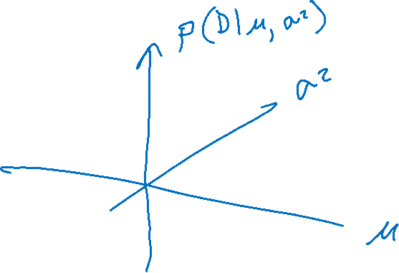
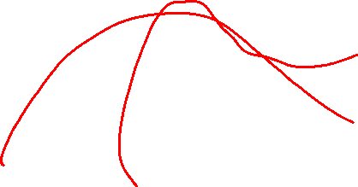
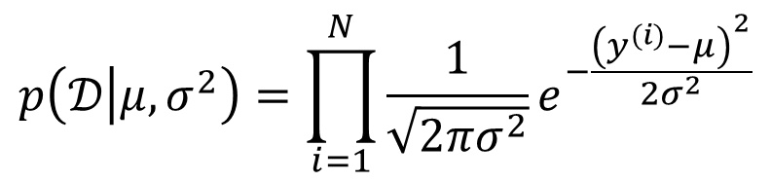
MLE for Gaussian
Assume that exam scores are drawn independently from the same Gaussian (Normal) distribution.
Given three exam scores 75, 80, 90, which pair of parameters is the best fit (the highest likelihood)?
$$p\left(𝒟 | μ, σ^{2}\right)=\prod_{i=1}^{N}{\frac{1}{\sqrt{2πσ^{2}}}e^{−\frac{{\left(y^{(i)}−μ\right)}^{2}}{2σ^{2}}}}$$

Slide 14
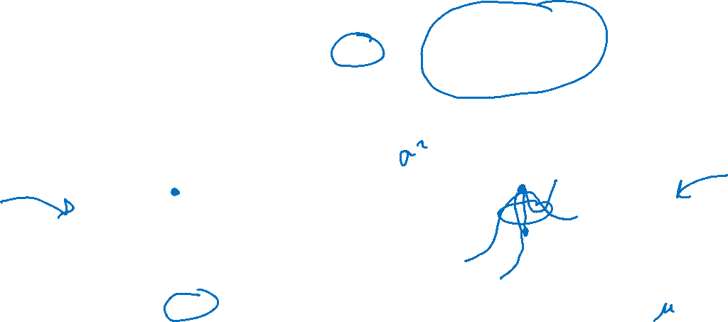
MLE
Principle of Maximum Likelihood Estimation:
Choose the parameters that maximize the likelihood of the data.
Maximum Likelihood Estimate (MLE)
θ₂
θ^{MLE}
L(θ)
L(θ₁, θ₂)
θ^{MLE}
θ₁
Slide credit: CMU MLD Matt Gormley

Slide 15
MLE Recipe

Slide 16

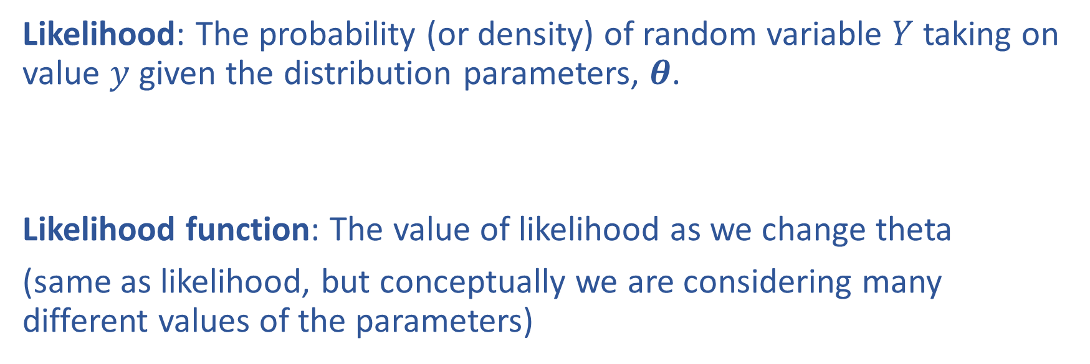
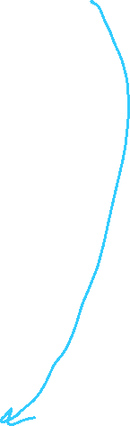
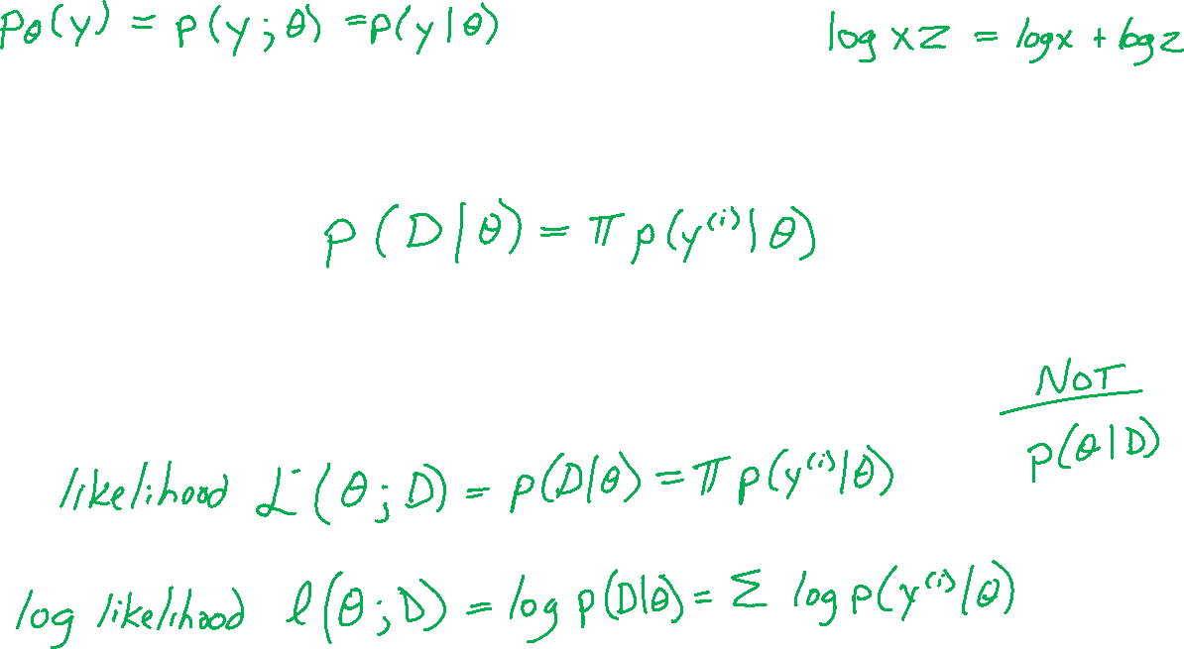
Likelihood and Log Likelihood
Likelihood: The probability (or density) of random variable $Y$ taking on value $y$ given the distribution parameters, $θ$.
Likelihood function: The value of likelihood as we change theta
(same as likelihood, but conceptually we are considering many different values of the parameters)

Slide 17
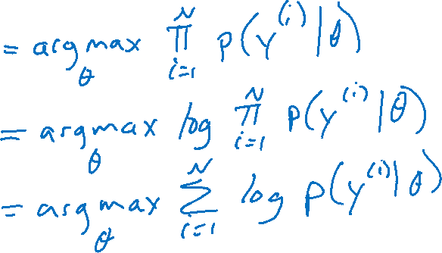

Maximum Likelihood Estimation
MLE of parameter $θ$ for i.i.d. dataset $𝒟={\left\{y^{(i)}\right\}}_{i=1}^{N}$
${\hat{θ}}_{MLE}=\underset{θ}{argmax}{p(𝒟∣θ)}$

Slide 18
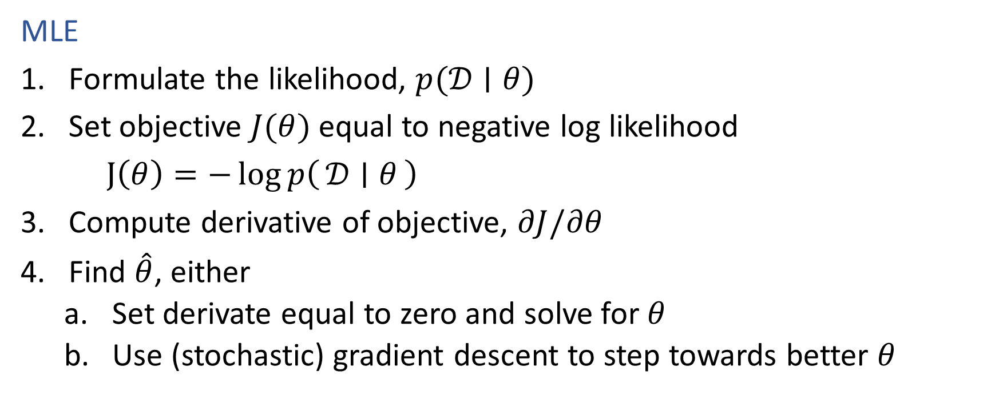
Recipe for Estimation
MLE
Formulate the likelihood, $p(𝒟∣θ)$
Set objective $J(θ)$ equal to negative log likelihood
$J\left(θ\right)=−\log{p\left(𝒟 ∣ θ\right)}$
Compute derivative of objective, $∂J/∂θ$
Find $\hat{θ}$, either
    Set derivate equal to zero and solve for $θ$
    Use (stochastic) gradient descent to step towards better $θ$

Slide 19
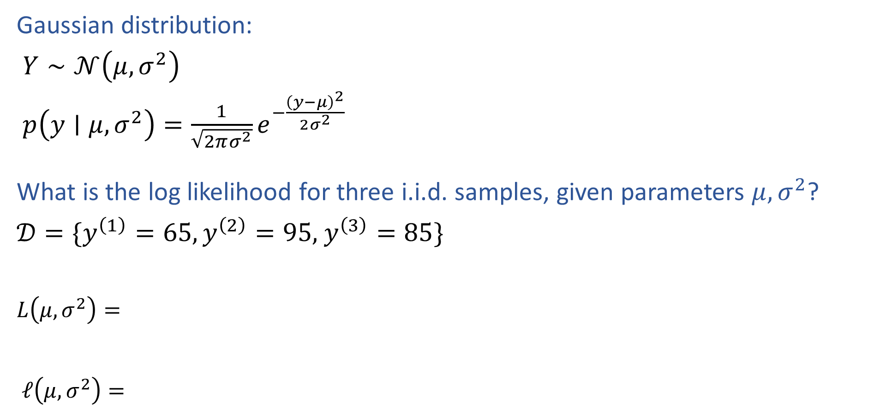
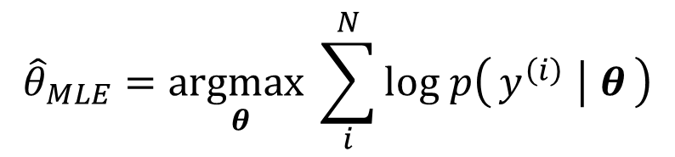
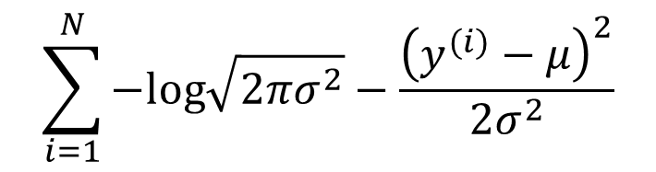
MLE for Gaussian
Gaussian distribution:
$Y∼𝒩\left(μ, σ^{2}\right)$
$p\left(y∣μ, σ^{2}\right)=\frac{1}{\sqrt{2πσ^{2}}}e^{−\frac{{\left(y−μ\right)}^{2}}{2σ^{2}}}$
What is the log likelihood for three i.i.d. samples, given parameters $μ, σ^{2}$?
$𝒟=\{y^{\left(1\right)}=65,y^{\left(2\right)}=95,$ $y^{\left(3\right)}=85\}$
$L\left(μ, σ^{2}\right)=$
$ℓ\left(μ, σ^{2}\right)=$
$$\prod_{i=1}^{N}{\frac{1}{\sqrt{2πσ^{2}}}e^{−\frac{{\left(y^{(i)}−μ\right)}^{2}}{2σ^{2}}}}$$
$${\hat{θ}}_{MLE}=\underset{θ}{argmax}\prod_{i}^{N}{p\left(y^{\left(i\right)} ∣ θ\right)}$$
$$\sum_{i=1}^{N}{−log\sqrt{2πσ^{2}}−\frac{{\left(y^{(i)}−μ\right)}^{2}}{2σ^{2}}}$$
$${\hat{θ}}_{MLE}=\underset{θ}{argmax}\sum_{i}^{N}{log p\left(y^{\left(i\right)} ∣ θ\right)}$$

Slide 20
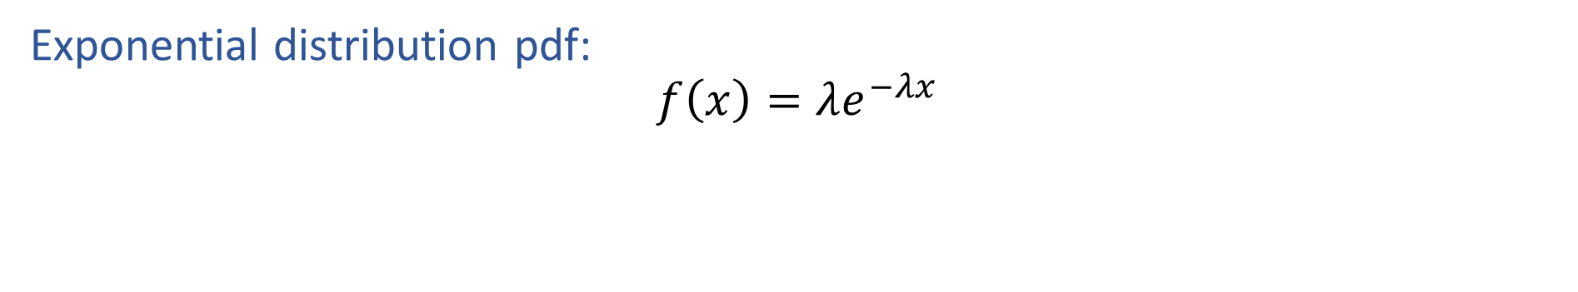
Exercise: MLE for Exponential
Exponential distribution pdf:
$$f\left(x\right)=λe^{−λx}$$

Slide 21
Two Applications of Bayes Rule

Slide 22
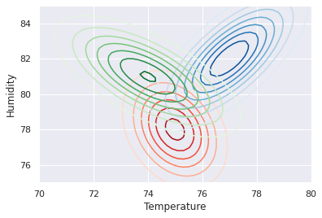
Prev Recitation
City classification

Slide 23

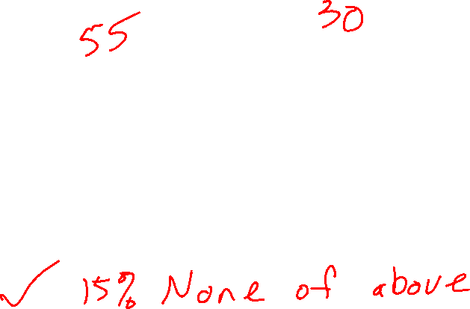
Poll 2
Which of these terms is the likelihood?
$$p\left(y ∣ x\right)=\frac{p\left(x ∣ y\right) p(y)}{p(x)}$$
B
C
A
D

Slide 24

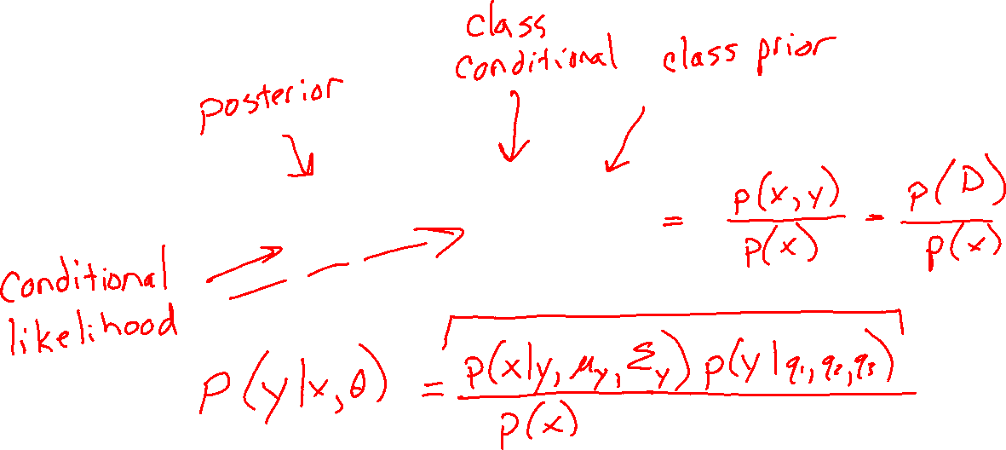
Bayes Rule
Terminology
$$p\left(y ∣ x\right)=\frac{p\left(x ∣ y\right)p(y)}{p(x)}$$

Slide 25

Bayes Rule
Inserting parameters
$$p\left(y ∣ x\right)=\frac{p\left(x ∣ y\right) p(y)}{p(x)}$$

Slide 26

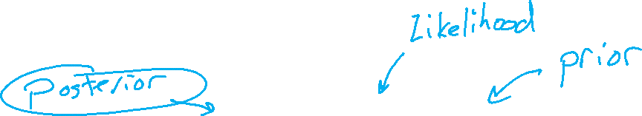
Bayes Rule
Another way to use Bayes rule
$$p\left(θ ∣ x\right)=\frac{p\left(x ∣ θ\right) p(θ)}{p(x)}$$

Slide 27

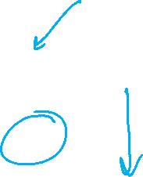
Poll 3
Where do we plug in the pdf, $f\left(x\right)=λe^{−λx}$
$$p\left(θ ∣ x\right)=\frac{p\left(x ∣ θ\right) p(θ)}{p(x)}$$
B
C
A
D

Slide 28

MLE vs. MAP
Maximum Likelihood Estimate (MLE)
Maximum a posteriori (MAP) estimate
Prior
Slide credit: CMU MLD Matt Gormley

Slide 29
Expectation and Variance

Slide 30
Expectation and Variance
The expected value of X is E[X]. Also called the mean.
Discrete random variables:
Continuous random variables:
Slide credit: CMU MLD Matt Gormley

Slide 31
Expectation and Variance
The variance of X is Var(X).
Discrete random variables:
Continuous random variables:
Slide credit: CMU MLD Matt Gormley

