Slide 1
Recitation - 3
10-601b Fall 2015
Slides borrowed from Seyoung Kim, Ryan Tibshirani, Carlos Guestrin, Doina Precup. Thanks!
Perceptron demo borrowed from Geoff Gordon

Slide 2
Topics for today
Convex functions and gradient descent
Overfitting and regularization
Update for L-2 regularized Logistic Regression
Perceptron learning

Slide 3
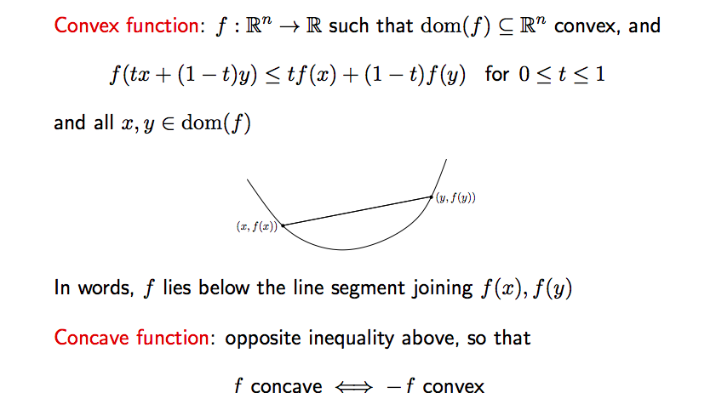
Convex functions

Slide 4
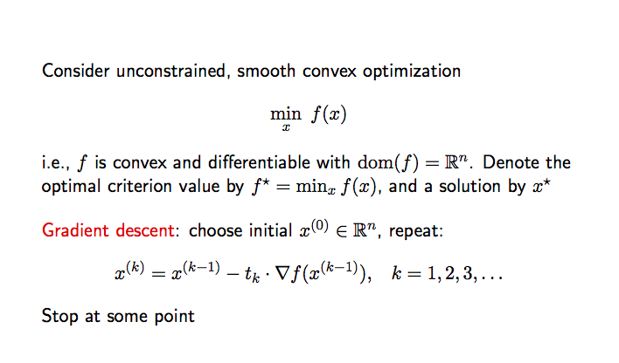
Gradient descent

Slide 5
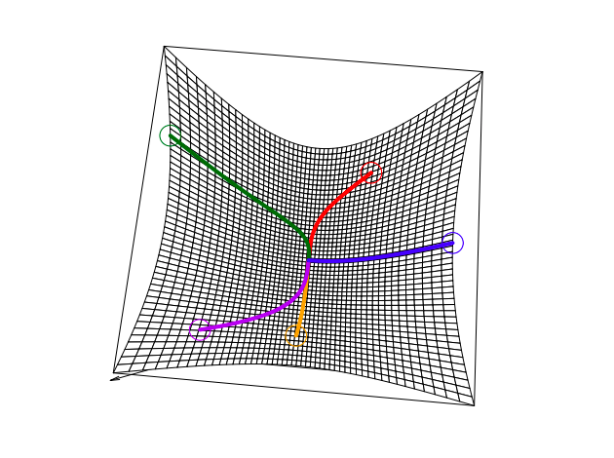

Slide 6
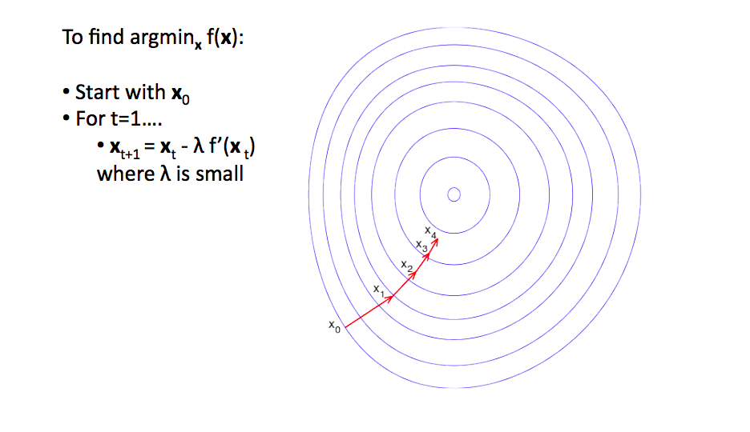
Gradient descent

Slide 7
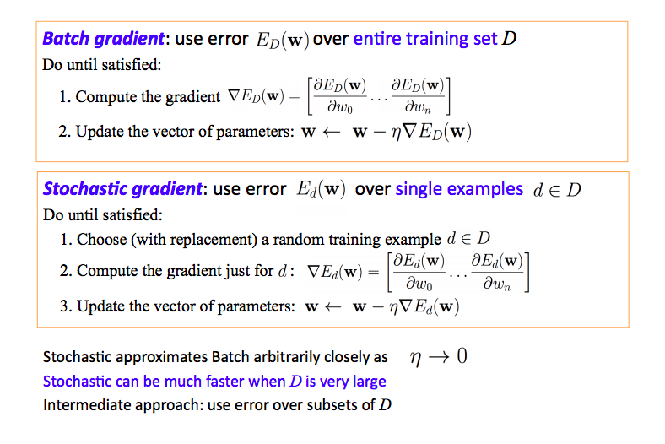
Gradient descent procedure

Slide 8
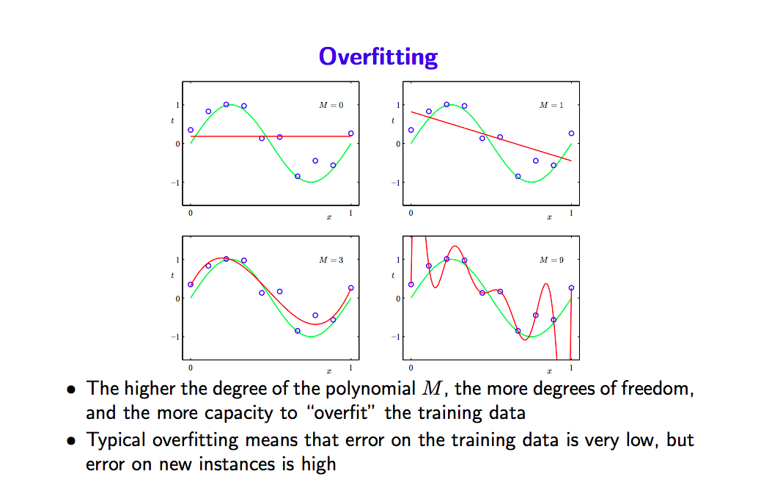
Overfitting

Slide 9
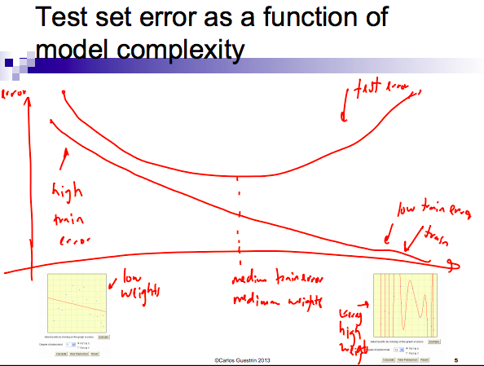
Model complexity

Slide 10
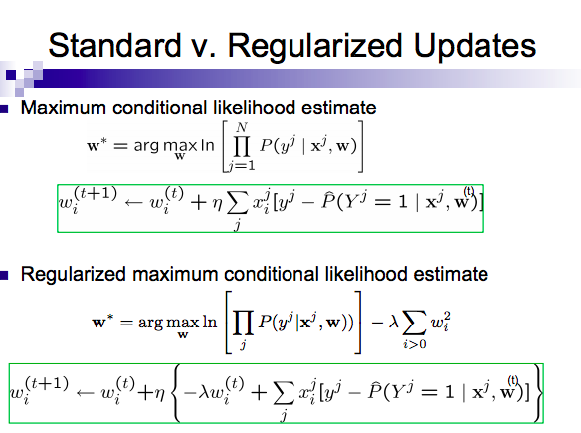
Regularization for LR

