Slide 1
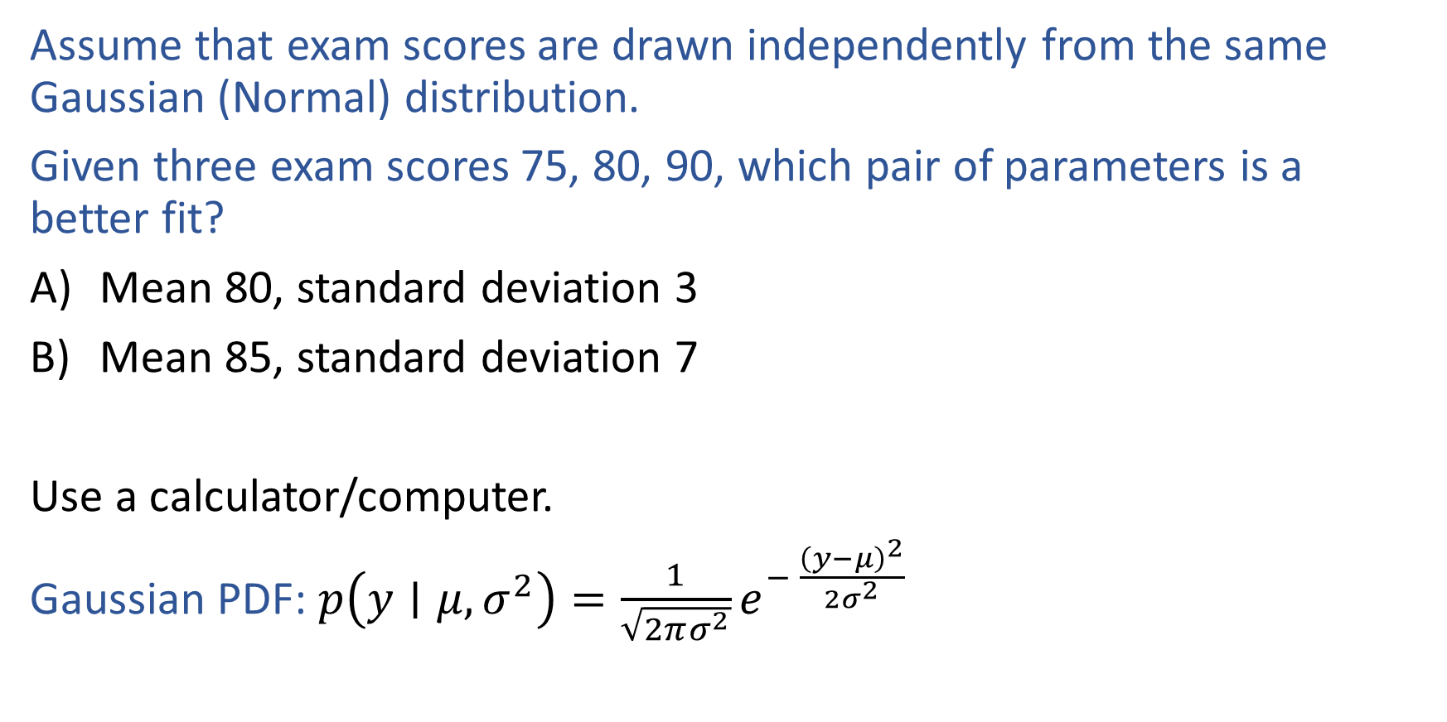

Warm-up as You Log In
Assume that exam scores are drawn independently from the same Gaussian (Normal) distribution.
Given three exam scores 75, 80, 90, which pair of parameters is a better fit?
Mean 80, standard deviation 3
Mean 85, standard deviation 7
Use a calculator/computer.
Gaussian PDF: $p\left(y∣μ, σ^{2}\right)=\frac{1}{\sqrt{2πσ^{2}}}e^{− \frac{{\left(y−μ\right)}^{2}}{2σ^{2}}}$

Slide 2
Announcements
Assignments
HW3
Mon, 9/28, 11:59 pm
HW4
Not out until after the midterm
Schedule change this week
Recitation slots this Friday will all be lecture (all three)

Slide 3
Announcements
Midterm 1
Mon, 10/5
See Piazza for details
SGD not in scope for Midterm 1
Practice exam
Timed (90 min) exam in Gradescope
Open for a 24 hour window only, Tue 7 pm to Wed 7 pm
Need to take the practice exam to have access to the questions
Also, practice exam zoom sessions
Tue 7 pm
Tue 11 pm

Slide 4

Plan
Last time
Optimization for linear regression
Linear and convex functions
(Batch) Gradient descent
Closed-form solution
Today
Stochastic gradient descent
Logistic Regression
Back to classification
Likelihood
MLE

Slide 5
Wrap-up (Stochastic) Gradient Descent
Previous lecture slides

Slide 6

Introduction to Machine Learning Logistic Regression
Instructor: Pat Virtue

Slide 7

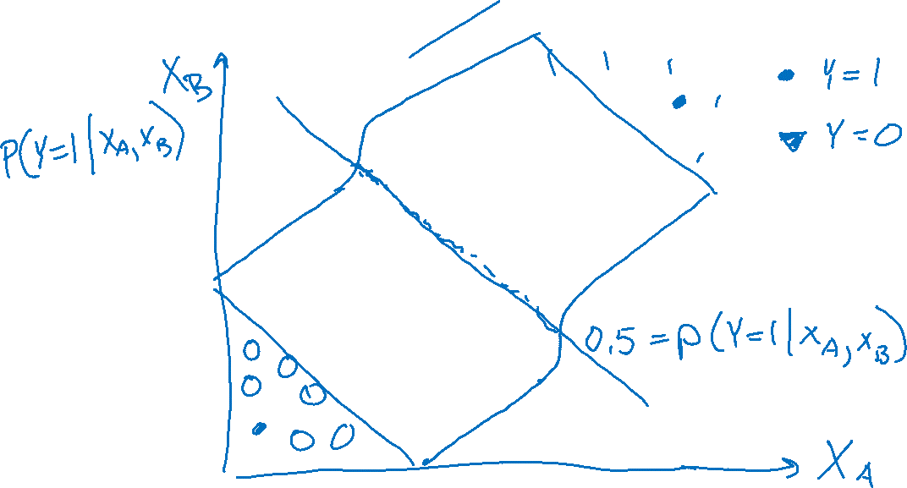
Prediction for Cancer Diagnosis
Learn to predict if a patient has cancer ($Y=1$) or not ($Y=0$) given the input of two test results, $X_{A}$ and $X_{B}$.

Slide 8

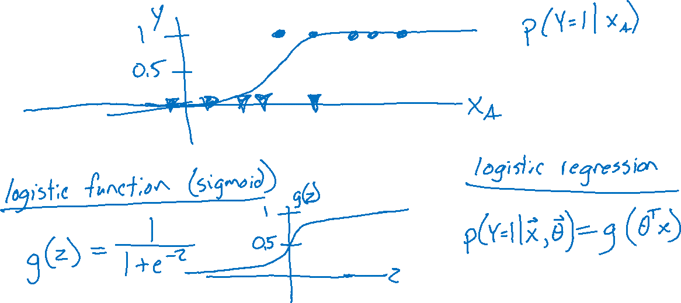
Prediction for Cancer Diagnosis
Learn to predict if a patient has cancer ($Y=1$) or not ($Y=0$) given the input of just one test result, $X_{A}$.

Slide 9
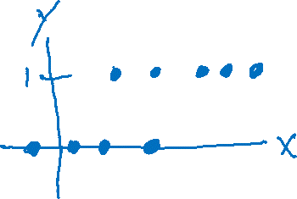
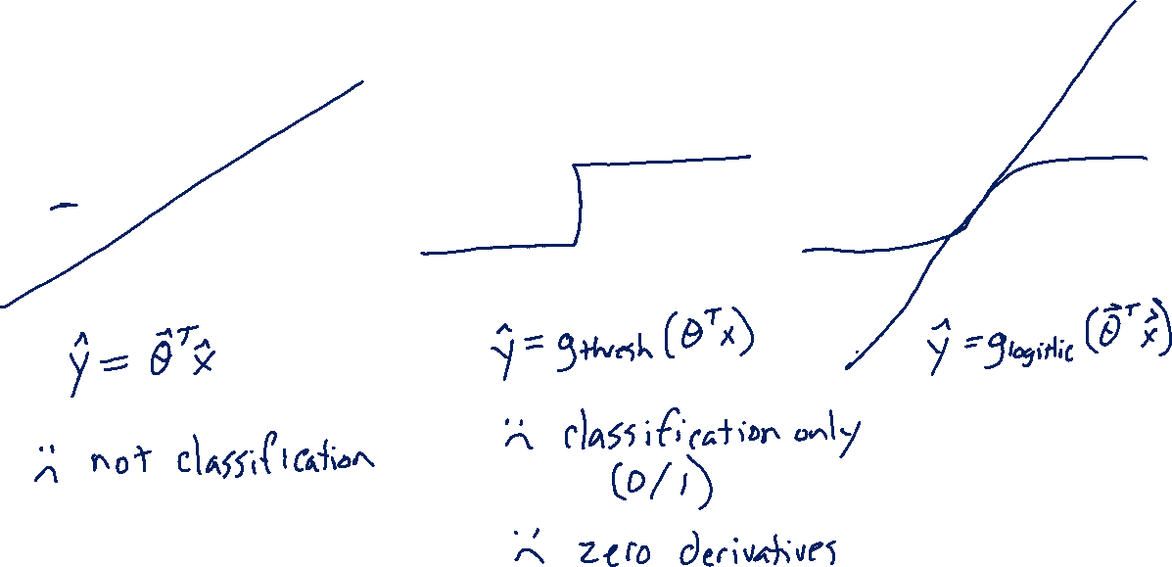
Building on a Linear Model
Linear vs Thresholded Linear vs Logistic Linear

Slide 10
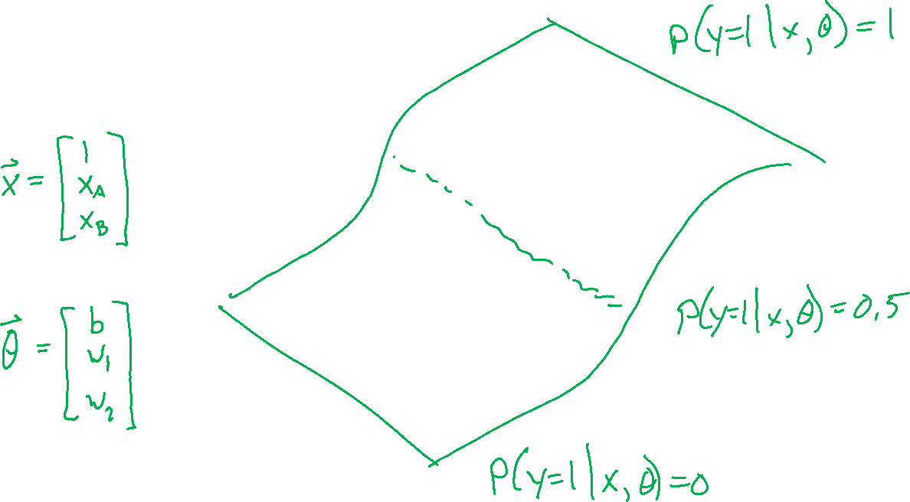
Building on a Linear Model

Slide 11
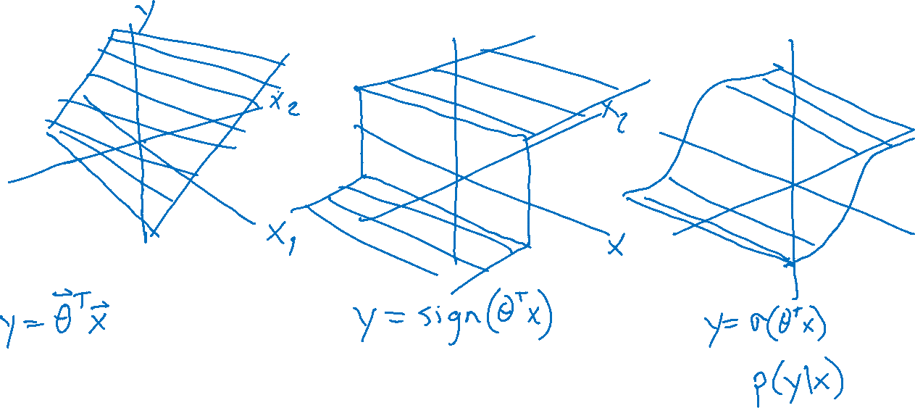
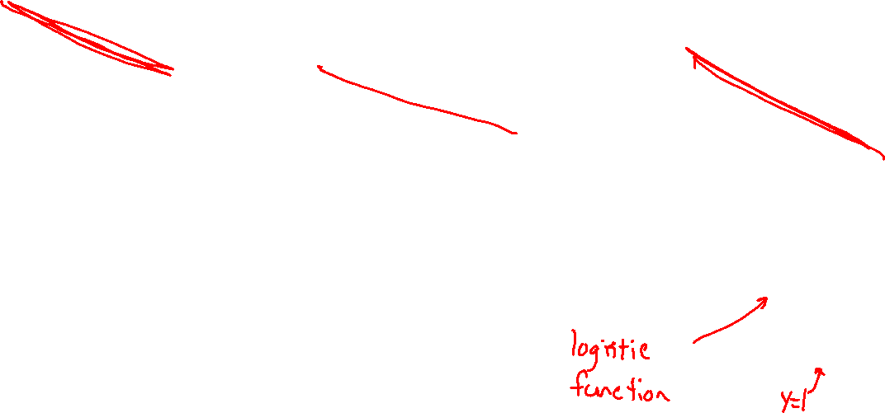
Building on a Linear Model

Slide 12
Logistic Regression
Slide credit: CMU MLD Matt Gormley
Notes:
Data are drawn from two Guassians.
There is irreducible error here b/c they overlap. SHOW: 3D representation with piece of paper.

Slide 13
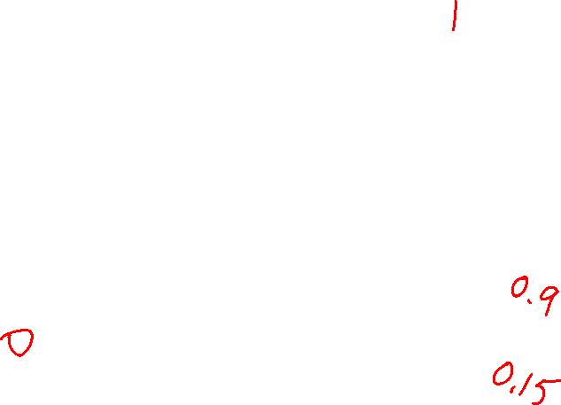
Logistic Regression
Slide credit: CMU MLD Matt Gormley

Slide 14
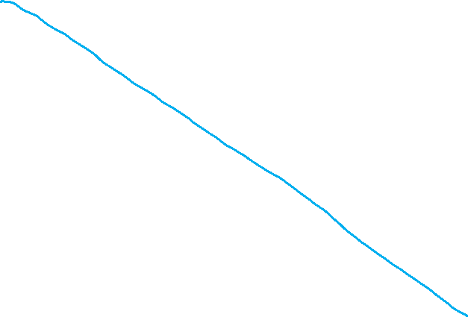
Logistic Regression
Slide credit: CMU MLD Matt Gormley

Slide 15

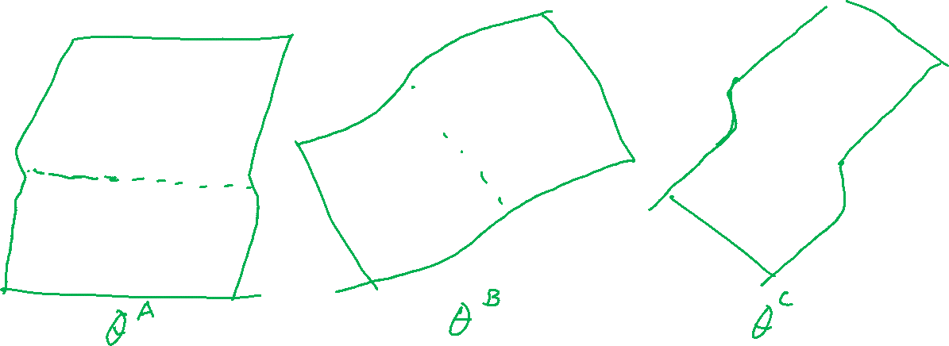
Prediction for Cancer Diagnosis
Learn to predict if a patient has cancer ($Y=1$) or not ($Y=0$) given the input of just one test result, $X_{A}$.
$$p\left(Y=1 ∣ x, θ\right)=\frac{1}{1+e^{−θ^{T}x}}$$

Slide 16
LIkeLiHOOD and MLE

Slide 17
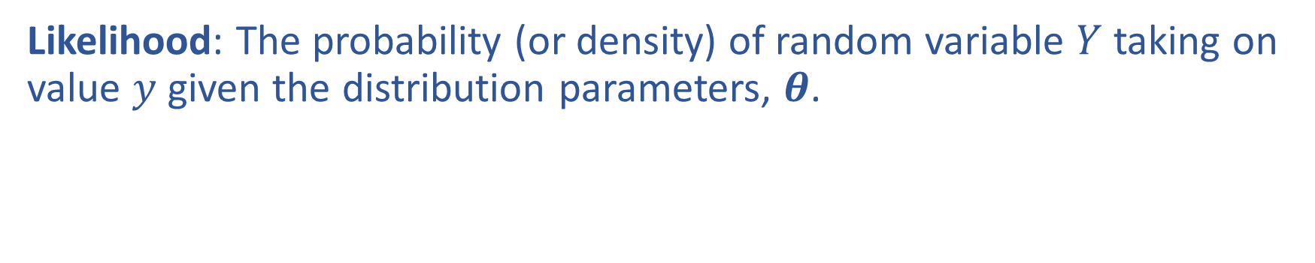

Likelihood
Likelihood: The probability (or density) of random variable $Y$ taking on value $y$ given the distribution parameters, $θ$.

Slide 18
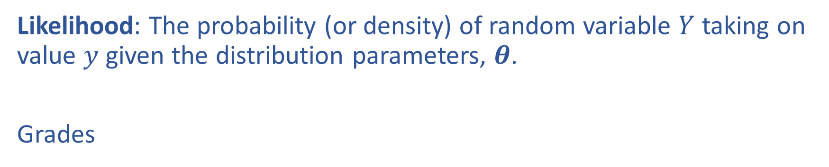
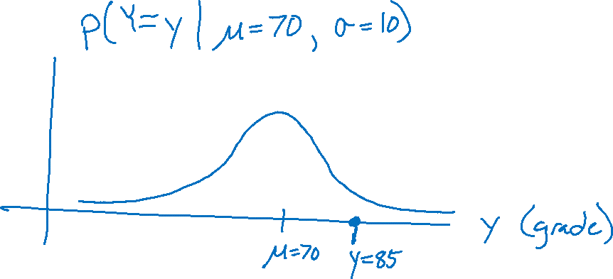
Likelihood
Likelihood: The probability (or density) of random variable $Y$ taking on value $y$ given the distribution parameters, $θ$.
Grades

Slide 19

Warm-up as You Log In
Assume that exam scores are drawn independently from the same Gaussian (Normal) distribution.
Given three exam scores 75, 80, 90, which pair of parameters is a better fit?
Mean 80, standard deviation 3
Mean 85, standard deviation 7
Use a calculator/computer.
Gaussian PDF: $p\left(y∣μ, σ^{2}\right)=\frac{1}{\sqrt{2πσ^{2}}}e^{−\frac{{\left(y−μ\right)}^{2}}{2σ^{2}}}$

Slide 20
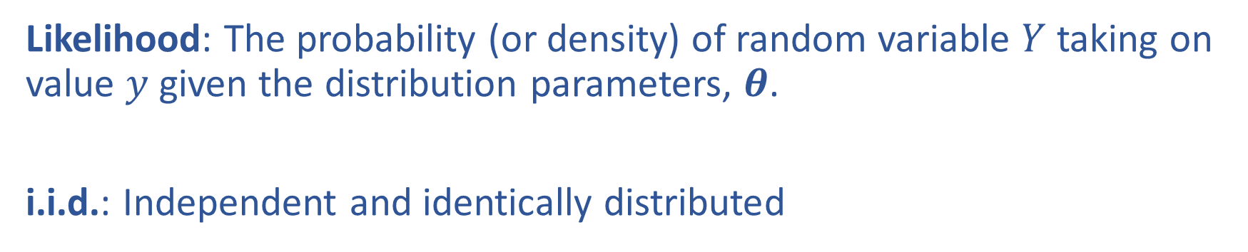
Likelihood
Likelihood: The probability (or density) of random variable $Y$ taking on value $y$ given the distribution parameters, $θ$.
i.i.d.: Independent and identically distributed

