Slide 1






Warm-up as you log in
What are these linear shapes called for 1-D, 2-D, 3-D, M-D input?
$$x∈ℝ$$
$$x∈ℝ^{2}$$
$$x∈ℝ^{3}$$
$$x∈ℝ^{M}$$
$y=w^{T}x+b$
$w^{T}x+b=0$
$w^{T}x+b≥0$

Slide 2
Announcements
Assignments
HW2
    Due Mon, 9/21, 11:59 pm
HW3
    Out tomorrow, due Mon, 9/28, 11:59 pm
    Written, but in Gradescope
Midterm 1
Mon, 10/5
In lecture; Gradescope exam (like HW1 written); proctored via Zoom
Content up to and including linear regression and optimization
Stay tuned to Piazza for details and a few forms to fill out

Slide 3
Plan
Last time
Model selection
    Parameters, Hyperparameters
    Train, Test, and Validation sets
Today
A few more things on model selection
Regression
Linear regression
Optimization for linear regression

Slide 4

Introduction to Machine Learning
Linear Regression and Optimization
Instructor: Pat Virtue

Slide 5
Model Selection
Two very similar definitions:
  Def: model selection is the process by which we choose the “best” model from among a set of candidates
  Def: hyperparameter optimization is the process by which we choose the “best” hyperparameters from among a set of candidates (could be called a special case of model selection)
Both assume access to a function capable of measuring the quality of a model
Both are typically done “outside” the main training algorithm --- typically training is treated as a black box
Slide credit: CMU MLD Matt Gormley

Slide 6
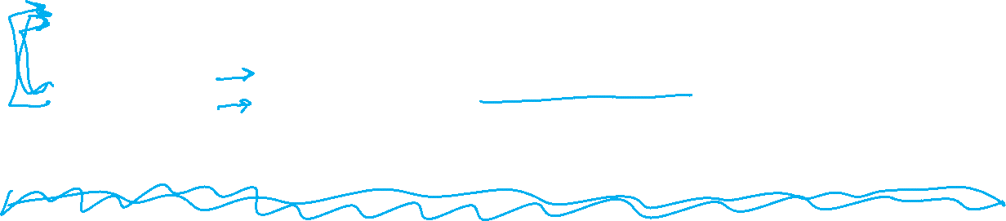
Experimental Design
 | Input | Output | Notes
Training | training dataset hyperparameters | best model parameters | We pick the best model parameters by learning on the training dataset for a fixed set of hyperparameters
Hyperparameter Optimization | training dataset validation dataset | best hyperparameters | We pick the best hyperparameters by learning on the training data and evaluating error on the validation error
Testing | test dataset hypothesis (i.e. fixed model parameters) | test error | We evaluate a hypothesis corresponding to a decision rule with fixed model parameters on a test dataset to obtain test error
Slide credit: CMU MLD Matt Gormley

Slide 7
Special Cases of k-NN
k=1: Nearest Neighbor
k=N: Majority Vote
Slide credit: CMU MLD Matt Gormley

Slide 8
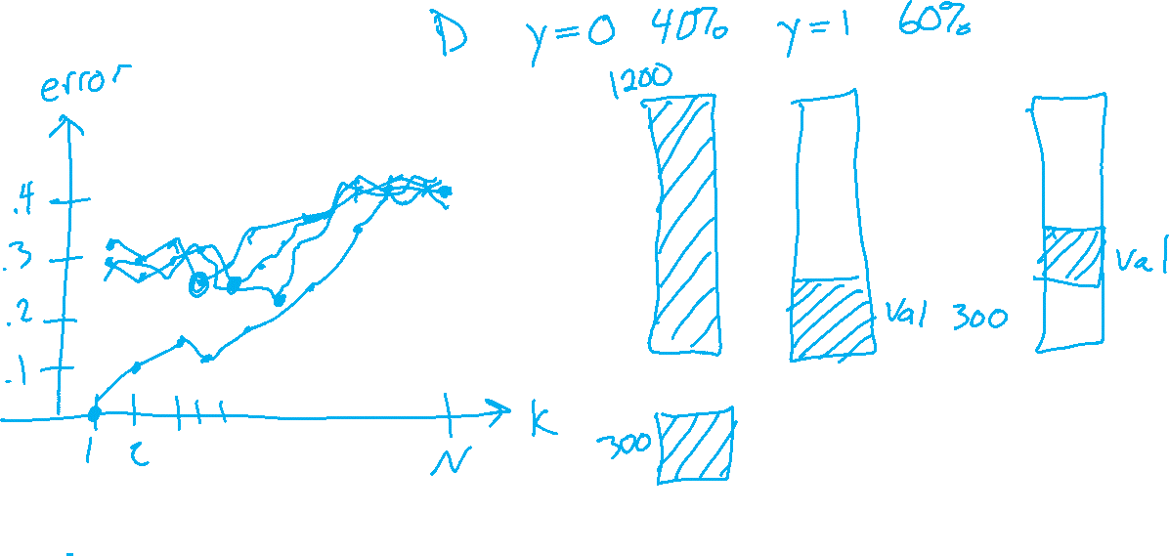
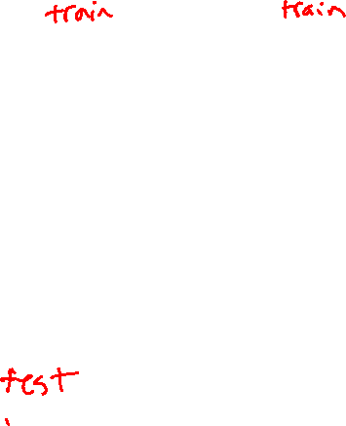
Example of Hyperparameter Optimization
Choosing k for k-NN
Slide credit: CMU MLD Matt Gormley

Slide 9
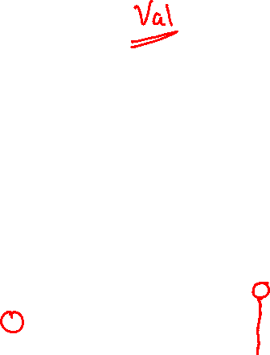
k-NN: Choosing k
Fisher Iris Data: varying the value of k
Slide credit: CMU MLD Matt Gormley

Slide 10

k-NN: Choosing k
Gaussian Data: varying the value of k
Slide credit: CMU MLD Matt Gormley

Slide 11
Validation
Why do we need validation?
  Choose hyperparameters
  Choose technique
  Help make any choices beyond our parameters
But now, we have another choice to make!
  How do we split training and validation?
Trade-offs
  More held-out data, better meaning behind validation numbers
  More held-out data, less data to train on!

Slide 12
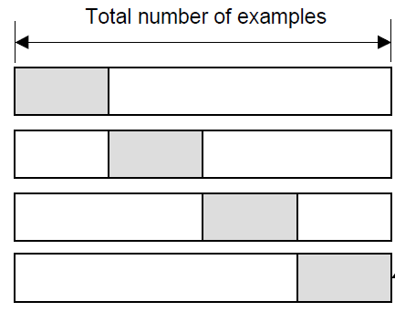
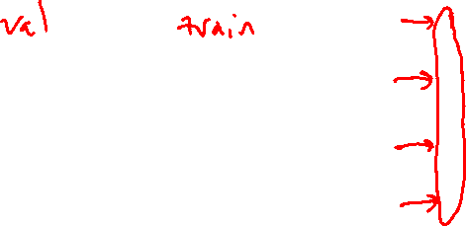
Cross-validation
K-fold cross-validation
Create K-fold partition of the dataset.
Do K runs: train using K-1 partitions and calculate validation error on remaining partition (rotating validation partition on each run).
Report average validation error
training
validation
Run 1
Run 2
Run K
Slide credit: CMU MLD Aarti Singh
TexPoint fonts used in EMF.
Read the TexPoint manual before you delete this box.: AAAAAAA

Slide 13
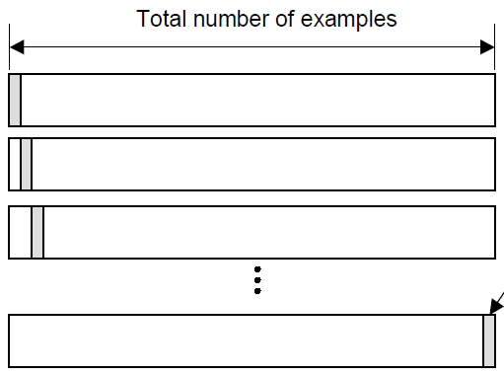
Cross-validation
Leave-one-out (LOO) cross-validation
Special case of K-fold with K=N partitions
Equivalently, train on N-1 samples and validate on only one sample per run for N runs
training
validation
Run 1
Run 2
Run K
Slide credit: CMU MLD Aarti Singh
TexPoint fonts used in EMF.
Read the TexPoint manual before you delete this box.: AAAAAAA

Slide 14
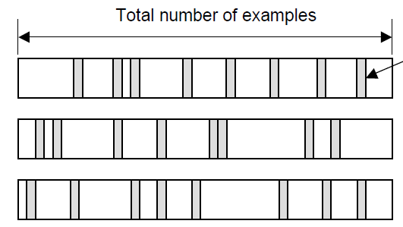

Cross-validation
Random subsampling
Randomly subsample a fixed fraction αN (0< α <1) of the dataset for validation.
Compute validation error with remaining data as training data.
Repeat K times
Report average validation error
training
validation
Run 1
Run 2
Run K
Slide credit: CMU MLD Aarti Singh
TexPoint fonts used in EMF.
Read the TexPoint manual before you delete this box.: AAAAAAA

Slide 15
Practical Issues in Cross-validation
How to decide the values for K and α ?
Large K
+ Validation error can approximate test error well
- Observed validation error will be unstable (few validation pts)
- The computational time will be very large as well (many experiments)
Small K
+ The # experiments and, therefore, computation time are reduced
+ Observed validation error will be stable (many validation pts)
- Validation error cannot approximate test error well
Common choice: K = 10, α = 0.1 ☺
Slide credit: CMU MLD Aarti Singh
TexPoint fonts used in EMF.
Read the TexPoint manual before you delete this box.: AAAAAAA

Slide 16
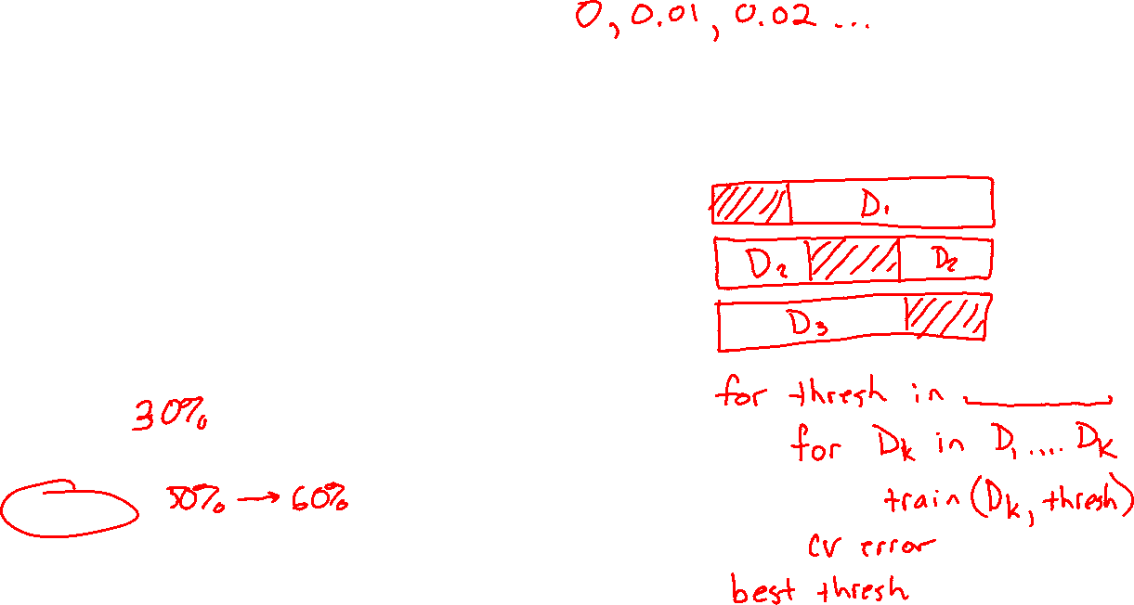
Piazza Poll 1
Say you are choosing amongst 10 discrete values of a decision tree mutual information threshold, and you want to do K=10-fold cross-validation.
How many times do I have to train my model?
  0
  1
  10
  20
  100
  10¹⁰
Notes:
0

Slide 17
Piazza Poll 1
Say you are choosing amongst 10 discrete values of a decision tree mutual information threshold, and you want to do K=10-fold cross-validation.
How many times do I have to train my model?
  0
  1
  10
  20
  100
  10¹⁰
Notes:
0

Slide 18
Model Selection
WARNING (again):
  This section is only scratching the surface!
  Lots of methods for hyperparameter optimization: (to talk about later)
    Grid search
    Random search
    Bayesian optimization
    Graduate-student descent
    …
Main Takeaway:
  Model selection / hyperparameter optimization is just another form of learning
Slide credit: CMU MLD Matt Gormley

Slide 19
Model Selection Learning Objectives
You should be able to…
Plan an experiment that uses training, validation, and test datasets to predict the performance of a classifier on unseen data (without cheating)
Explain the difference between (1) training error, (2) validation error, (3) cross-validation error, (4) test error, and (5) true error
For a given learning technique, identify the model, learning algorithm, parameters, and hyperparamters

Slide 20
Linear Regression and Optimization

Slide 21
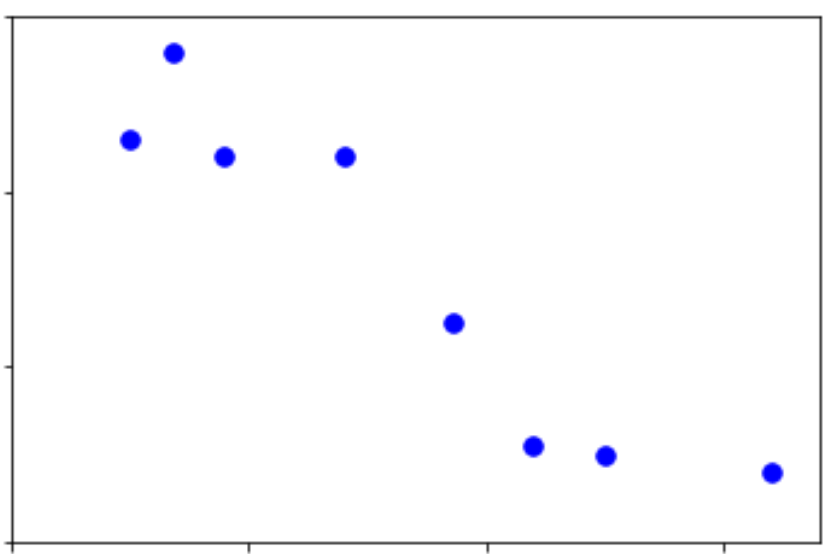
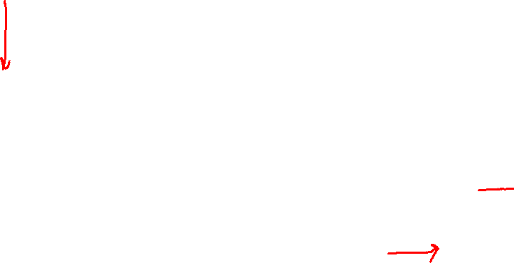
Breakout Room
In your breakout room
Come up with a story for this data
Output y
Input x

Slide 22
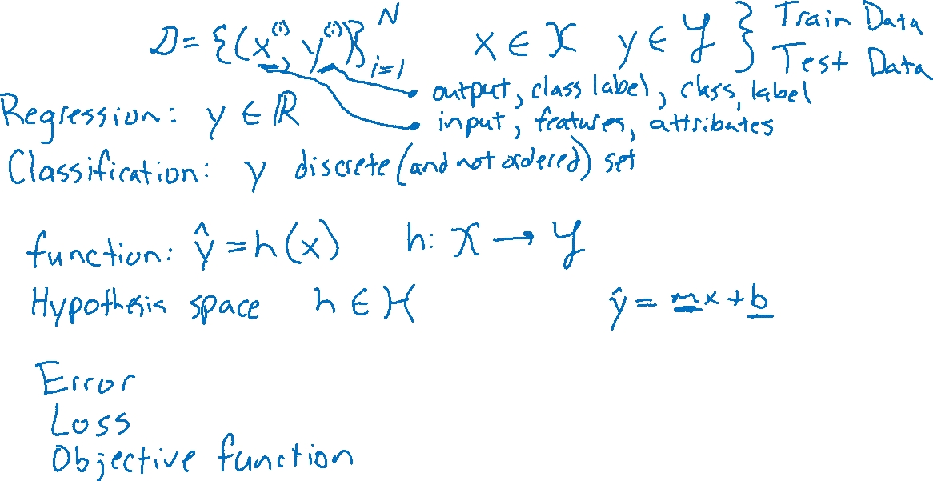
Lecture 2: Problem Formulation
Experience
Hypothesis
Performance measure

Slide 23
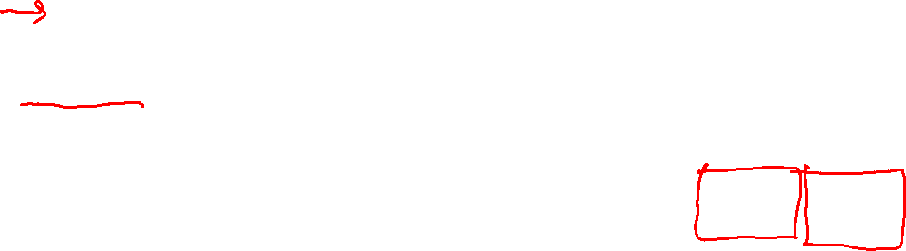
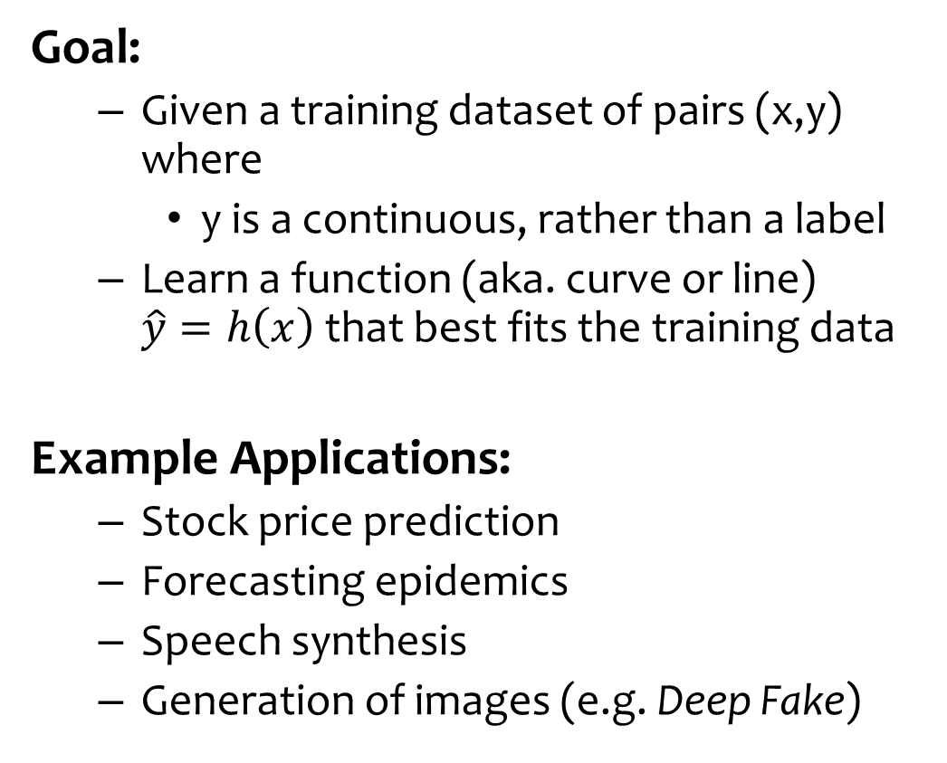
Regression
Goal:
  Given a training dataset of pairs (x,y) where
    y is a continuous, rather than a label
  Learn a function (aka. curve or line) $\hat{y}=h\left(x\right)$that best fits the training data
Example Applications:
  Stock price prediction
  Forecasting epidemics
  Speech synthesis
  Generation of images (e.g. Deep Fake)
Slide credit: CMU MLD Matt Gormley
Notes:
https://delphi.midas.cs.cmu.edu/files/brooks2015.pdf
https://pixabay.com/p-1781570/?no_redirect
https://deepdreamgenerator.com/#gallery

Slide 24
Lecture 2: Problem Formulation
Output y
Input x

Slide 25
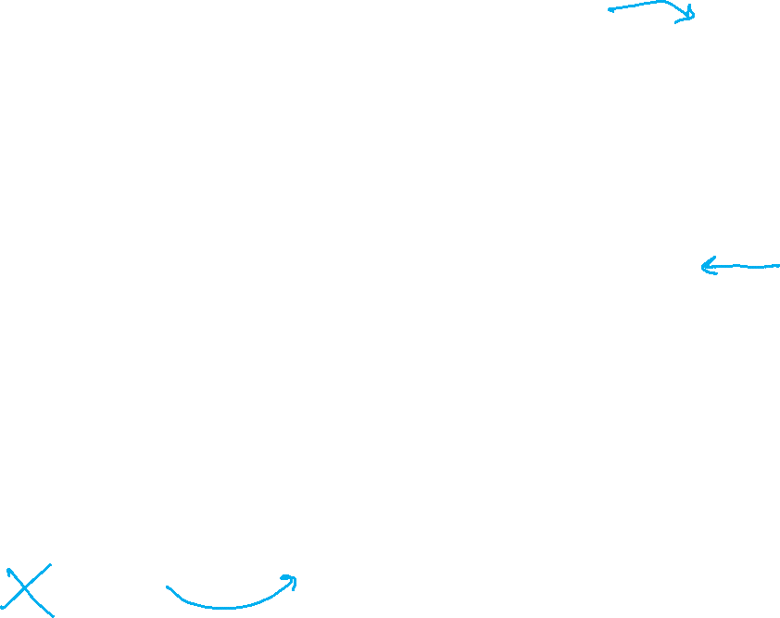
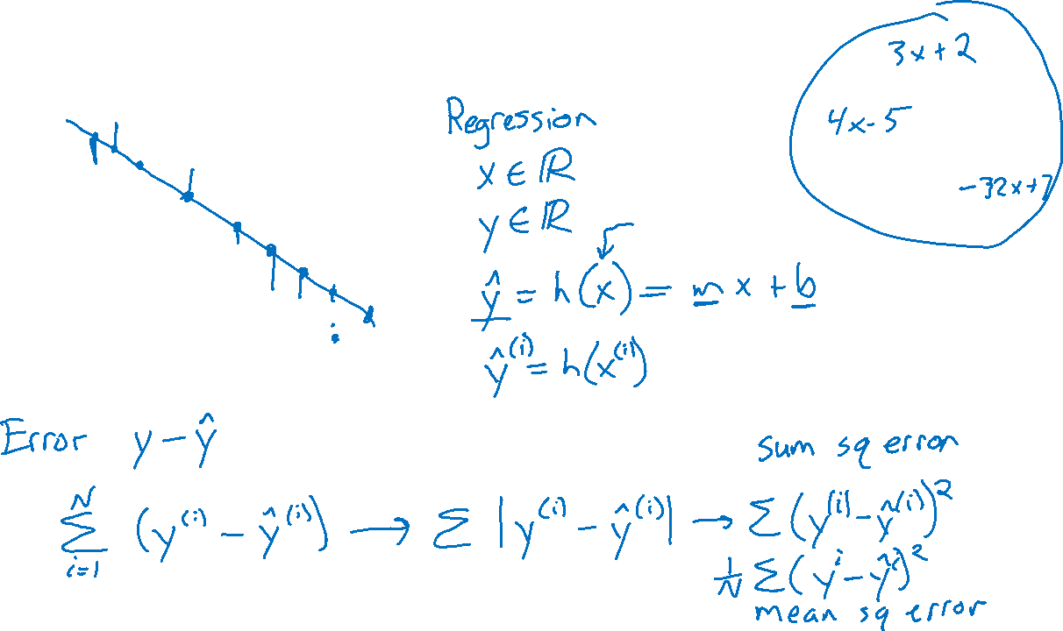
Lecture 2: Problem Formulation
Output y
Input x

Slide 26
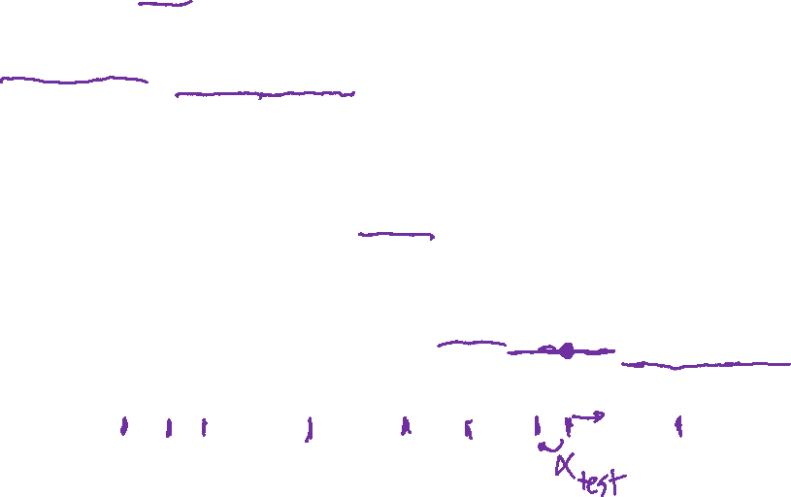
Regression: Nearest Neighbor
Output y
Input x

Slide 27
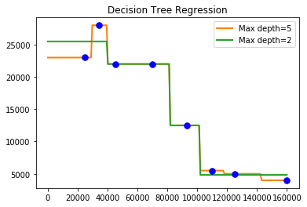
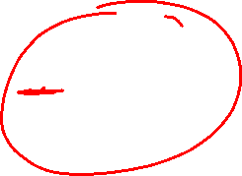
Regression
Decision Trees

Slide 28
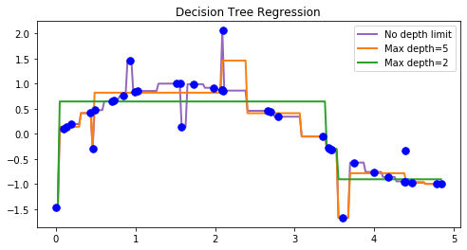
Nonparametric Regression
Decision Trees

Slide 29
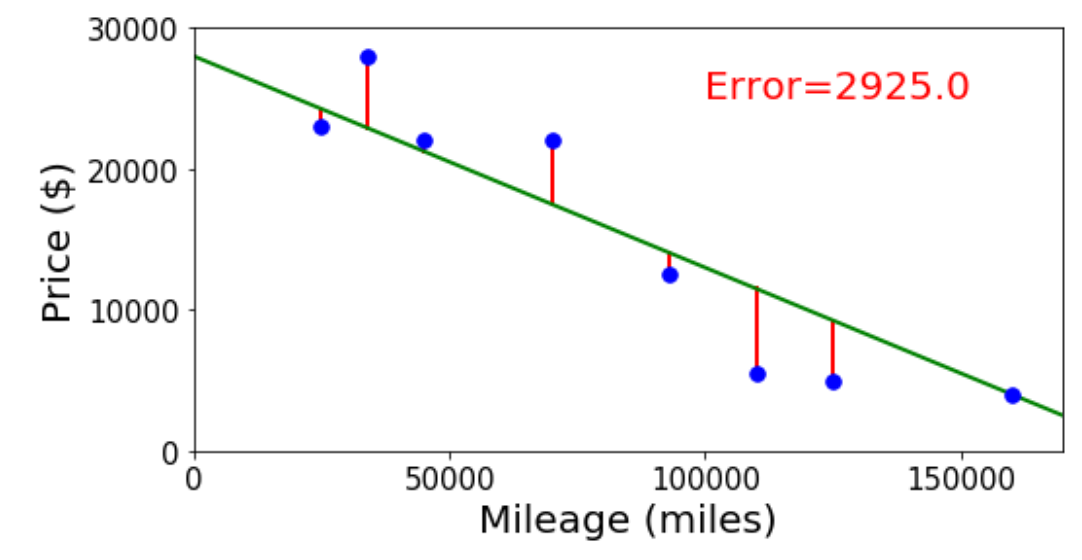
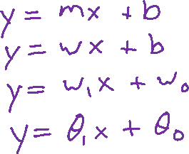
Linear Regression
Selling my car

Slide 30

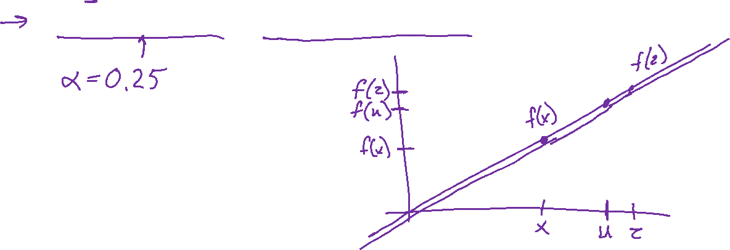
Linear Function
Linear function
If $f(x)$ is linear, then:
$f\left(x+z\right)=f\left(x\right)+f\left(z\right)$
$f\left(αx\right)=αf\left(x\right) ∀α$
$f\left(αx+\left(1−α\right)z\right)=αf\left(x\right)+\left(1−α\right)f\left(z\right) ∀α$

Slide 31
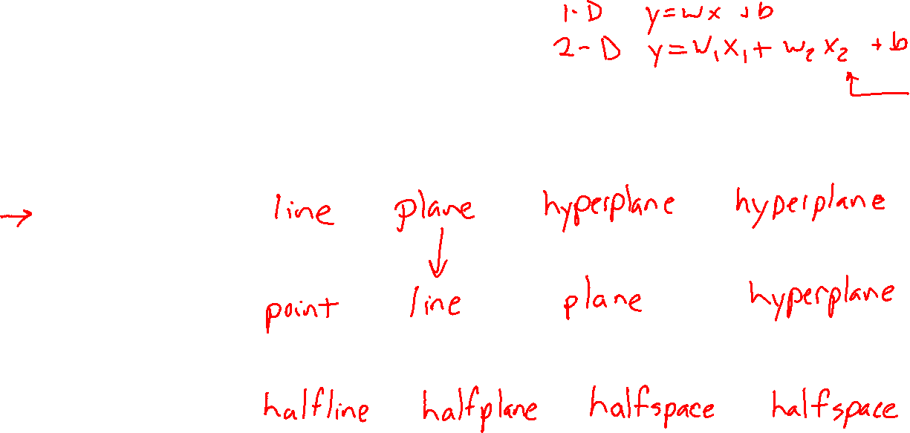
Linear in Higher Dimensions
What are these linear shapes called for 1-D, 2-D, 3-D, M-D input?
$$x∈ℝ$$
$$x∈ℝ^{2}$$
$$x∈ℝ^{3}$$
$$x∈ℝ^{M}$$
$y=w^{T}x+b$
$w^{T}x+b=0$
$w^{T}x+b≥0$

Slide 32
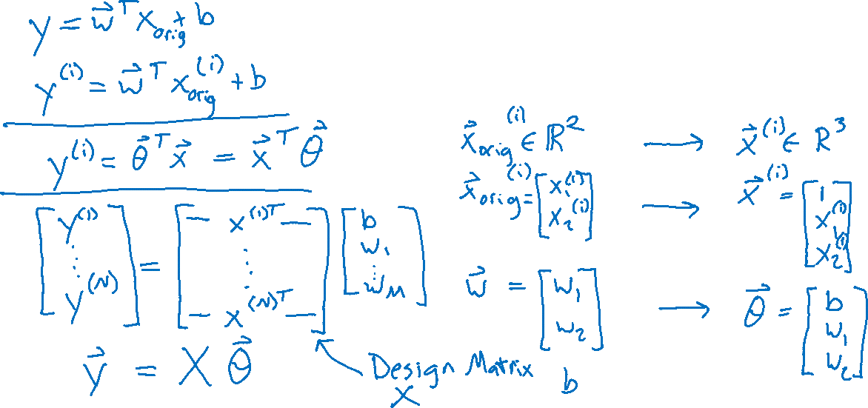
Linear Regression
Linear algebra formulation

Slide 33
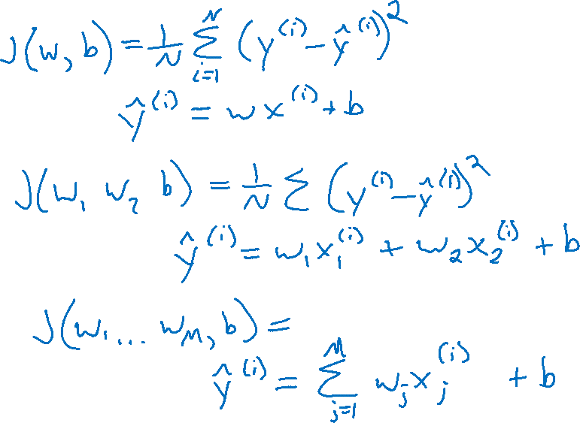
Linear Regression
Error and objectives

Slide 34
Linear Regression
Linear algebra formulation

Slide 35
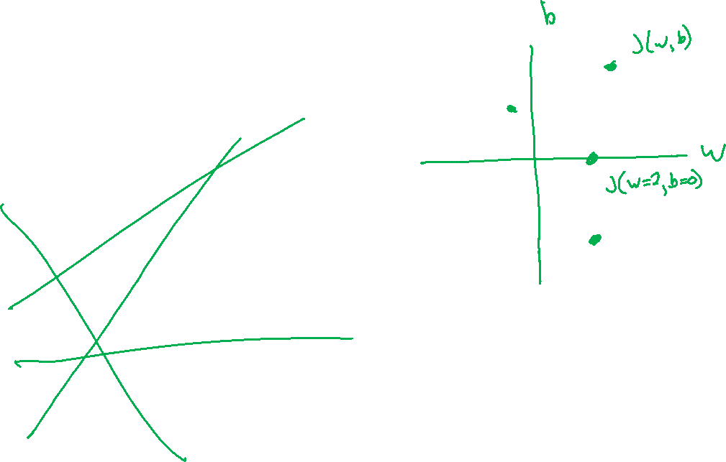
Linear Regression
Optimizing the objective
y
x

Slide 36
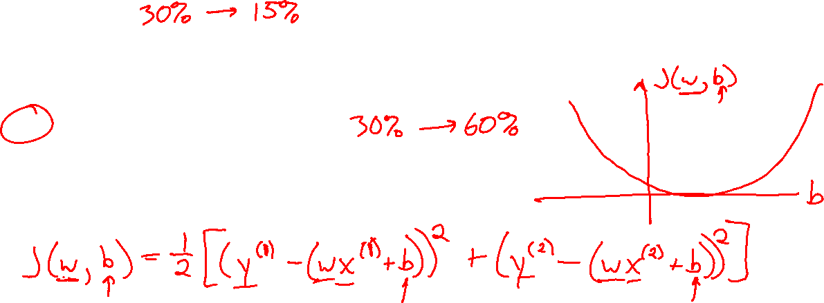
Piazza Poll 2
y
For fixed data and fixed slope, w, what shape do we get by plotting MSE objective vs intercept, b?
Line
Plane
Half-plane
Convex Parabola (U-shape)
Concave parabola (up-side-down U)
None of the above
x

