Slide 1

As you login
Rename yourself in Zoom to *pre*-pend your house number
e.g. “0 – Pat Virtue”
Open Piazza (getting ready for polls)
Download preview slides from course website
Grab something to write with/on ☺

Slide 2
Announcements
Assignments
HW1
Due Thu, 9/10, 11:59 pm (all times will be Pittsburgh time)
HW1 only – Extension request form – see Piazza
HW2
Out after HW1 due
Due Mon, 9/21, 11:59 pm

Slide 3
Announcements
Participation
Earn participation points for study group sessions
See Piazza for details
OH by appointment
Check OH Appointment Slots link on course webpage
Private post on Piazza with appointment request
Breakout rooms
Video on, unmute
Introduce yourself if you haven’t already met

Slide 4

Introduction to Machine Learning Decision Trees
Instructor: Pat Virtue

Slide 5
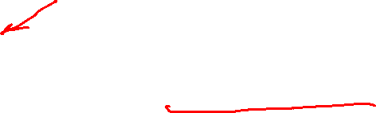
Plan
Last time
Problem formulation (notation)
Algorithm 0-2: Memorization, majority vote, decision stump
Today
Decision trees
Recursive algorithm
Better splitting criteria (entropy, mutual information)
Next time
Wrap up decision trees (overfitting, continuous features)
Nearest neighbor methods

Slide 6
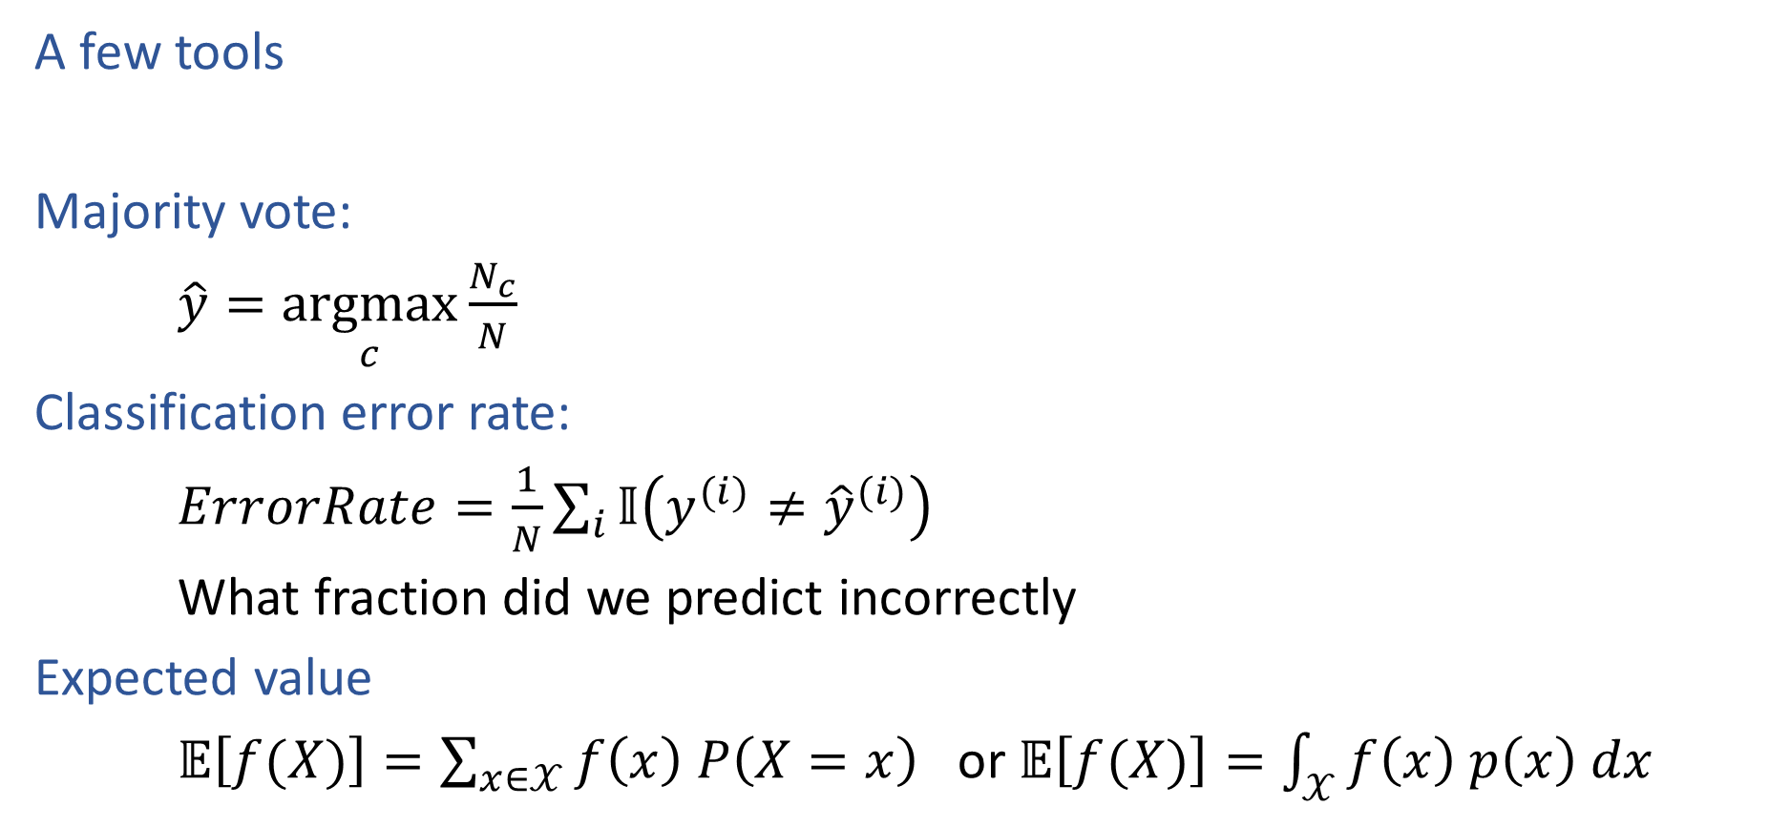
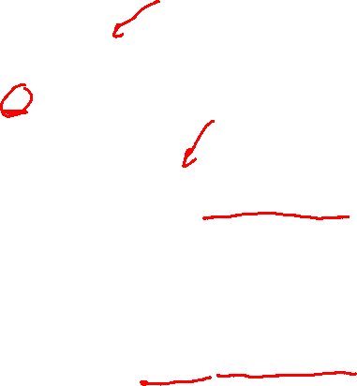
Decision Trees
A few tools
Majority vote:
$\hat{y}=\underset{c}{argmax}{\frac{N_{c}}{N}}$
Classification error rate:
$ErrorRate=\frac{1}{N}\sum_{i}{𝕀\left(y^{(i)}≠{\hat{y}}^{(i)}\right)}$
What fraction did we predict incorrectly
Expected value
$𝔼\left[f(X)\right]=\sum_{x∈𝒳}{f\left(x\right) P\left(X=x\right)}$ or $𝔼\left[f(X)\right]=\int_{𝒳}{f\left(x\right) p\left(x\right) dx}$

Slide 7
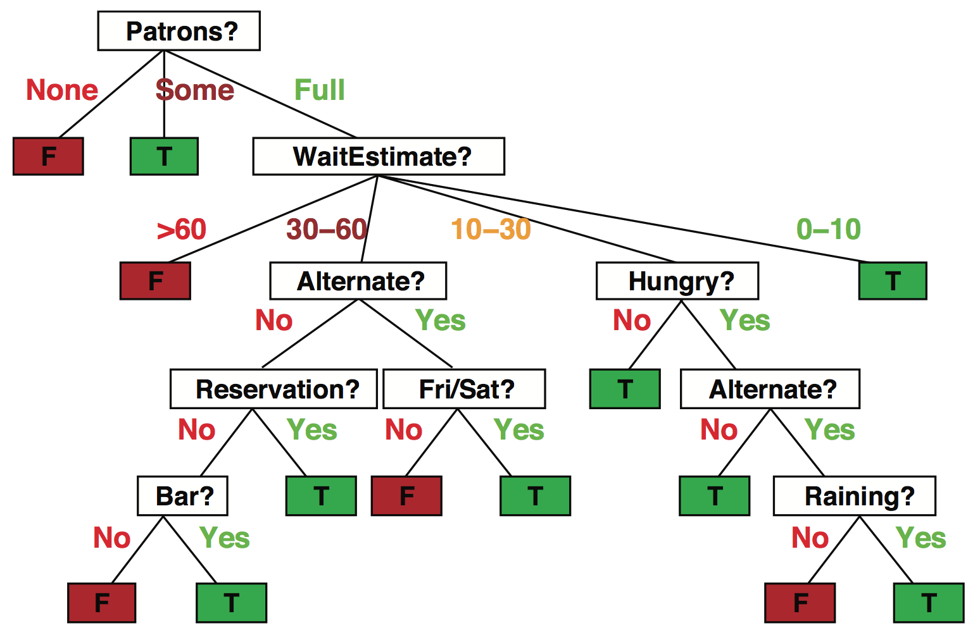
Decision trees
Popular representation for classifiers
Even among humans!
I’ve just arrived at a restaurant: should I stay (and wait for a table) or go elsewhere?
Slide credit: ai.berkeley.edu

Slide 8
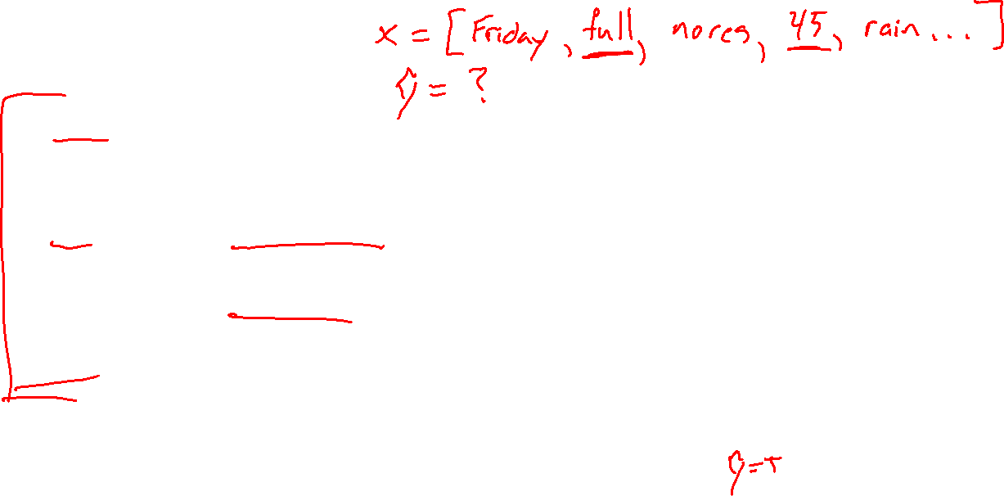
Decision trees
It’s Friday night and you’re hungry
You arrive at your favorite cheap but really cool happening burger place
It’s full and you have no reservation but there is a bar
The host estimates a 45 minute wait
There are alternatives nearby but it’s raining outside
Decision tree partitions the input space, assigns a label to each partition
Slide credit: ai.berkeley.edu

Slide 9

Problem Formulation
$x={\left[\begin{aligned}x_{1} \\ x_{2} \\ x_{3}\end{aligned}\right]=\left[x_{1},x_{2}, x_{3}\right]}^{T}$
$x_{1}∈\{Vertex, Breech, Abn\}$
$x_{2}∈\{Y,N\}$
$x_{3}∈\{Y,N\}$
$y∈\{Csection, Natural\}$
$\hat{y}=h(x)$
Medical Prediction
$Y$ $X_{1} X_{2}$ $X_{3}$
Outcome | Fetal Position | Fetal Distress | Previous C-sec
Natural | Vertex | N | N
C-section | Breech | N | N
Natural | Vertex | Y | Y
C-section | Vertex | N | Y
Natural | Abnormal | N | N

Slide 10

Decision Tree
Fetal
Position
Medical Prediction
(Oversimplified example)
Vertex
Abnormal
Breech
Fetal
Distress
C-section
C-section
No
Yes
Previous
C-section
C-section
No
Yes
Natural
C-section

Slide 11
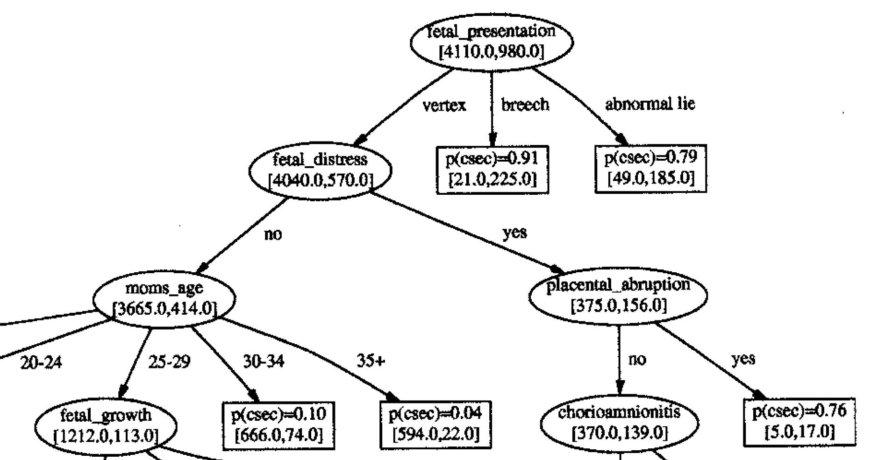
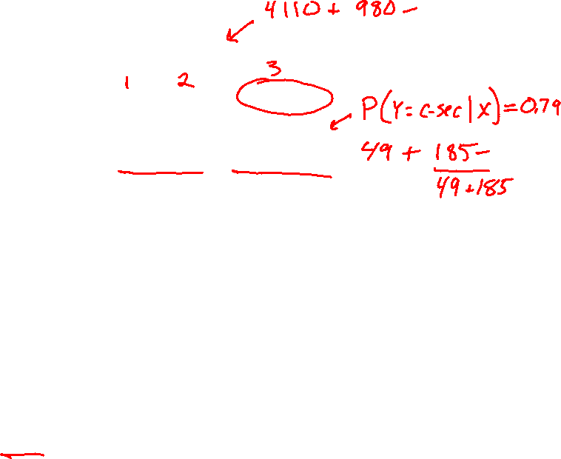
Tree to Predict C-Section Risk
Sims, C.J., Meyn, L., Caruana, R., Rao, R.B., Mitchell, T. and Krohn, M.
American journal of obstetrics and gynecology, 2000

Slide 12
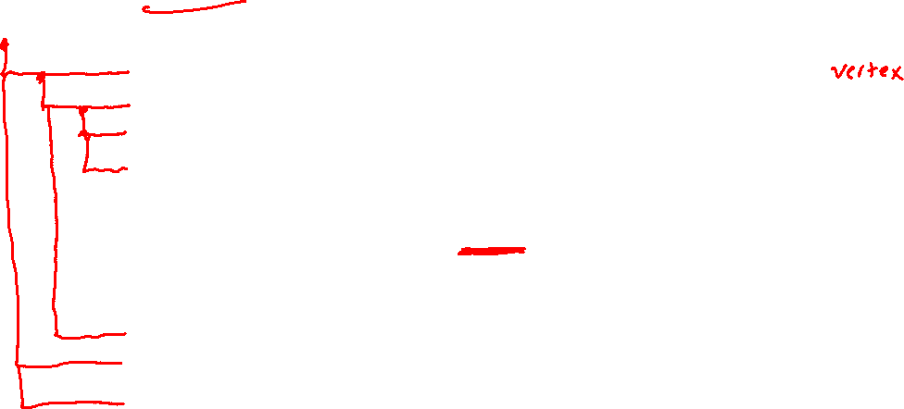
Tree to Predict C-Section Risk
Slide credit: CMU MLD Tom Mitchell

Slide 13
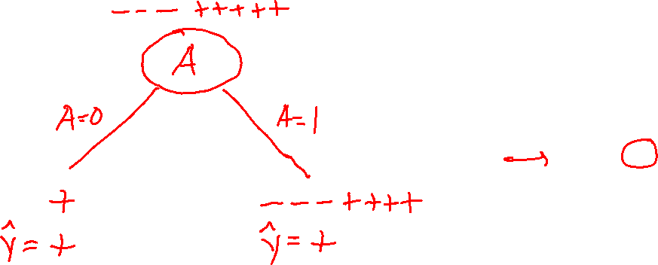
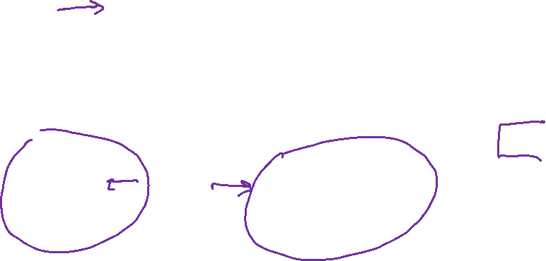
Decision Stumps
Split data based on a single attribute
Majority vote at leaves
Dataset: Output Y, Attributes A, B, C
Y | A | B | C
- | 1 | 0 | 0
- | 1 | 0 | 1
- | 1 | 0 | o
+ | 0 | 0 | 1
+ | 1 | 1 | 0
+ | 1 | 1 | 1
+ | 1 | 1 | 0
+ | 1 | 1 | 1
Slide credit: CMU MLD Matt Gormley

Slide 14
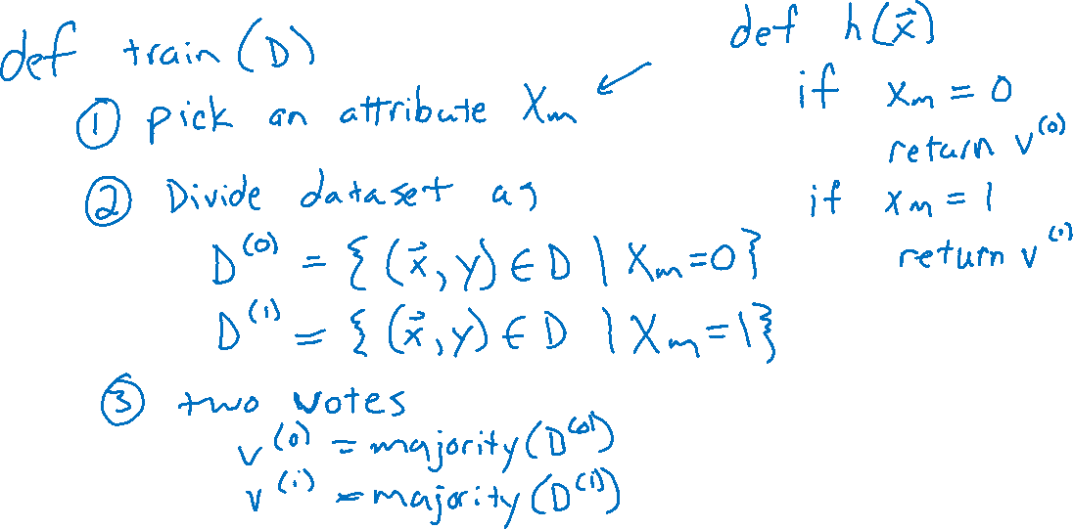
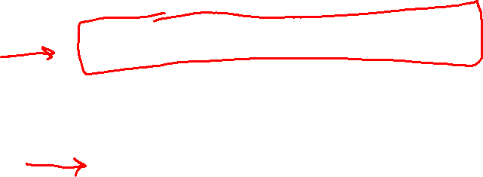
How could we implement training and prediction?
Algorithm 2: Decision stump algorithm
Slide credit: CMU MLD Matt Gormley

Slide 15
Decision Stumps
Splitting on which attribute {A, B, C} creates a decision stump with the lowest training error?
Dataset: Output Y, Attributes A, B, C
Y | A | B | C
- | 1 | 0 | 0
- | 1 | 0 | 1
- | 1 | 0 | o
+ | 0 | 0 | 1
+ | 1 | 1 | 0
+ | 1 | 1 | 1
+ | 1 | 1 | 0
+ | 1 | 1 | 1
Slide credit: CMU MLD Matt Gormley

Slide 16
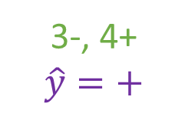
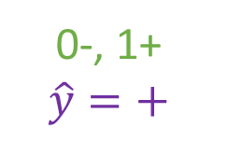
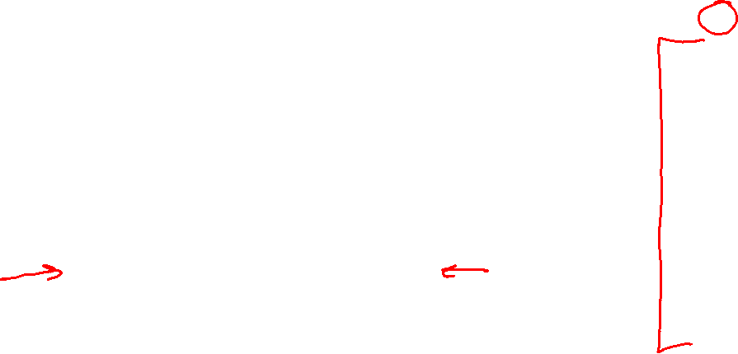
Decision Stumps
Splitting on which attribute {A, B, C} creates a decision stump with the lowest training error?
Answer: B
Dataset: Output Y, Attributes A, B, C
Y | A | B | C
- | 1 | 0 | 0
- | 1 | 0 | 1
- | 1 | 0 | o
+ | 0 | 0 | 1
+ | 1 | 1 | 0
+ | 1 | 1 | 1
+ | 1 | 1 | 0
+ | 1 | 1 | 1
3-, 5+
A
A=0
A=1
0-, 1+
$$\hat{y}=+$$
3-, 4+
$$\hat{y}=+$$
Error: ( 0 + 3 ) / 8
= 3/8
Slide credit: CMU MLD Matt Gormley

Slide 17
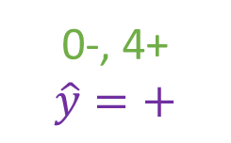
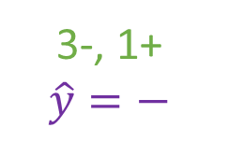
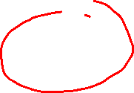
Decision Stumps
Splitting on which attribute {A, B, C} creates a decision stump with the lowest training error?
Answer: B
Dataset: Output Y, Attributes A, B, C
Y | A | B | C
- | 1 | 0 | 0
- | 1 | 0 | 1
- | 1 | 0 | o
+ | 0 | 0 | 1
+ | 1 | 1 | 0
+ | 1 | 1 | 1
+ | 1 | 1 | 0
+ | 1 | 1 | 1
3-, 5+
B
B=0
B=1
3-, 1+
$$\hat{y}=−$$
0-, 4+
$$\hat{y}=+$$
Error: ( 1 + 0 ) / 8
= 1/8
Slide credit: CMU MLD Matt Gormley

Slide 18
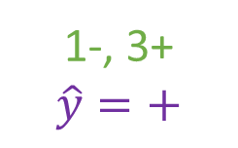
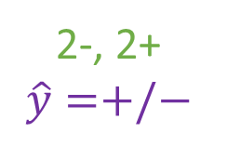
Decision Stumps
Splitting on which attribute {A, B, C} creates a decision stump with the lowest training error?
Answer: B
Dataset: Output Y, Attributes A, B, C
Y | A | B | C
- | 1 | 0 | 0
- | 1 | 0 | 1
- | 1 | 0 | o
+ | 0 | 0 | 1
+ | 1 | 1 | 0
+ | 1 | 1 | 1
+ | 1 | 1 | 0
+ | 1 | 1 | 1
3-, 5+
C
C=0
C=1
2-, 2+
$$\hat{y}=+/−$$
1-, 3+
$$\hat{y}=+$$
Error: ( 2 + 1 ) / 8
= 3/8
Slide credit: CMU MLD Matt Gormley

Slide 19
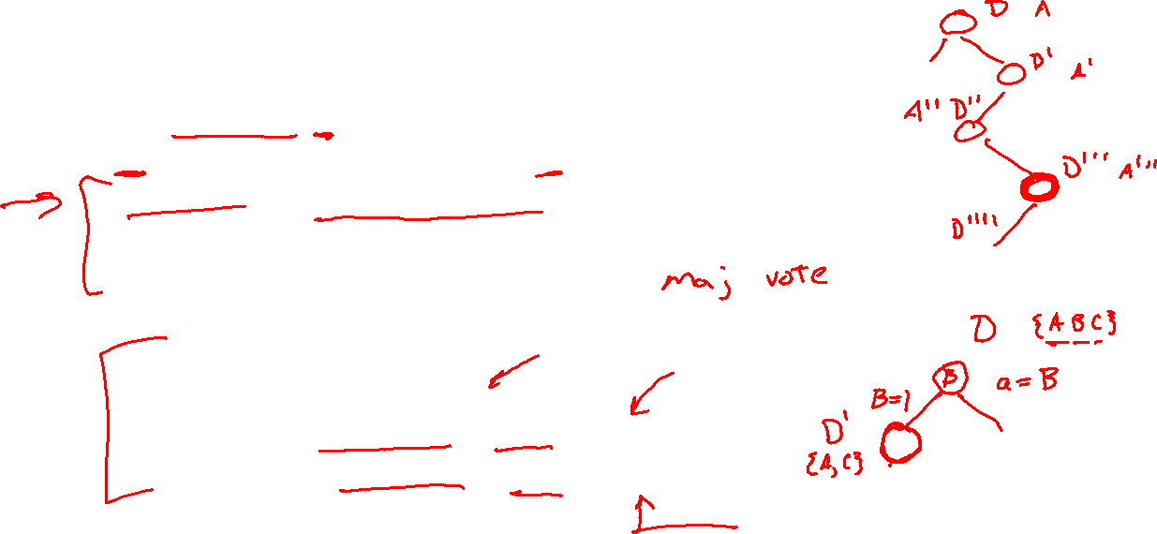
Building a Decision Tree
Function BuildTree(D,A)
# D: dataset at current node, A: current set of attributes
If empty(A) or all labels in D are the same
# Leaf node
class = most common class in D
else
# Internal node
a ⇐ bestAttribute(D,A)
LeftNode = BuildTree(D(a=1), A \ {a})
RightNode = BuildTree(D(a=0), A \ {a})
end
end

Slide 20
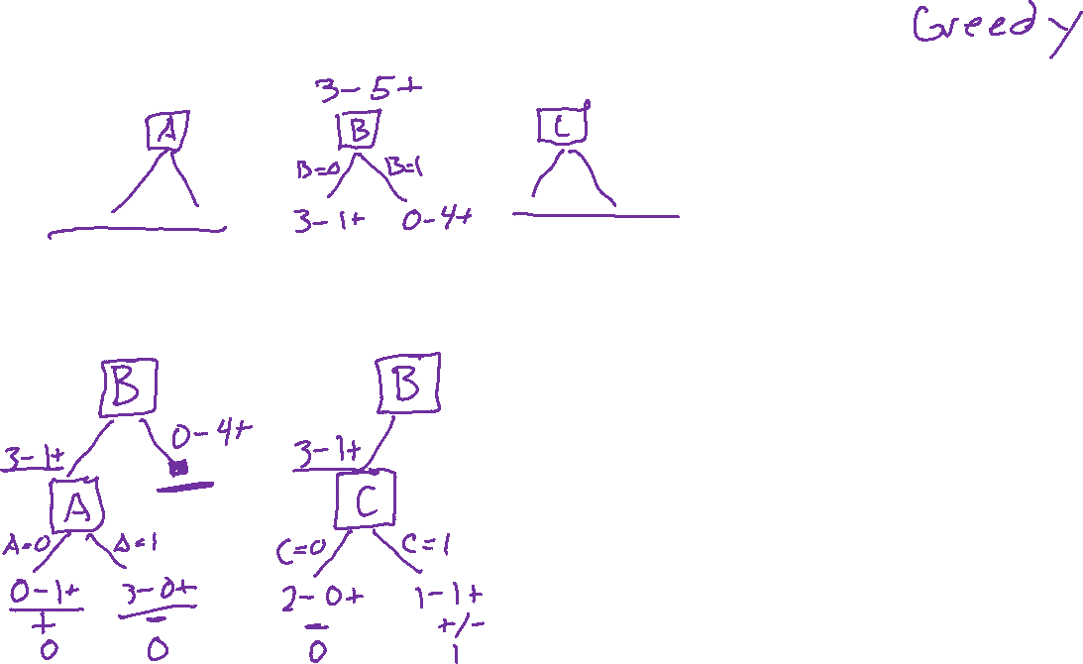
Building a Decision Tree
Dataset: Output Y, Attributes A, B, C
Y | A | B | C
- | 1 | 0 | 0
- | 1 | 0 | 1
- | 1 | 0 | o
+ | 0 | 0 | 1
+ | 1 | 1 | 0
+ | 1 | 1 | 1
+ | 1 | 1 | 0
+ | 1 | 1 | 1

Slide 21
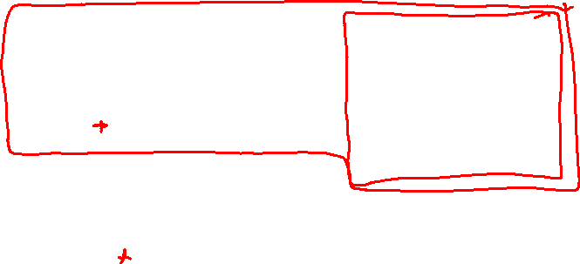
Piazza Poll 1
Dataset: Output Y, Attributes A, B, C
Which of the following trees would be learned by the decision tree learning algorithm using “error rate” as the splitting criterion?
(Assume ties are broken alphabetically.)
Y | A | B | C
+ | 0 | 0 | 0
+ | 0 | 0 | 1
- | 0 | 1 | 0
+ | 0 | 1 | 1
- | 1 | 0 | 0
- | 1 | 0 | 1
- | 1 | 1 | 0
+ | 1 | 1 | 1
1
A
2
A
3
A
0
1
0
1
0
1
C
C
B
C
B
B
0
1
0
1
0
1
0
1
0
1
0
1
+
-
-
+
+
-
-
+
+
C
-
C
0
1
0
1
4
C
5
B
-
+
-
+
0
1
0
1
6
B
B
A
A
C
0
1
0
1
0
1
0
1
0
1
A
A
+
-
-
+
+
-
-
+
0
1
0
1
+
-
C
C
0
1
0
1
+
-
-
+
Slide credit: CMU MLD Matt Gormley

Slide 22
Piazza Poll 1
Dataset: Output Y, Attributes A, B, C
Which of the following trees would be learned by the the decision tree learning algorithm using “error rate” as the splitting criterion?
(Assume ties are broken alphabetically.)
Y | A | B | C
+ | 0 | 0 | 0
+ | 0 | 0 | 1
- | 0 | 1 | 0
+ | 0 | 1 | 1
- | 1 | 0 | 0
- | 1 | 0 | 1
- | 1 | 1 | 0
+ | 1 | 1 | 1
1
A
2
A
3
A
0
1
0
1
0
1
C
C
B
C
B
B
0
1
0
1
0
1
0
1
0
1
0
1
+
-
-
+
+
-
-
+
+
C
-
C
0
1
0
1
4
C
5
B
-
+
-
+
0
1
0
1
6
B
B
A
A
C
0
1
0
1
0
1
0
1
0
1
A
A
+
-
-
+
+
-
-
+
0
1
0
1
+
-
C
C
0
1
0
1
+
-
-
+
Slide credit: CMU MLD Matt Gormley

Slide 23
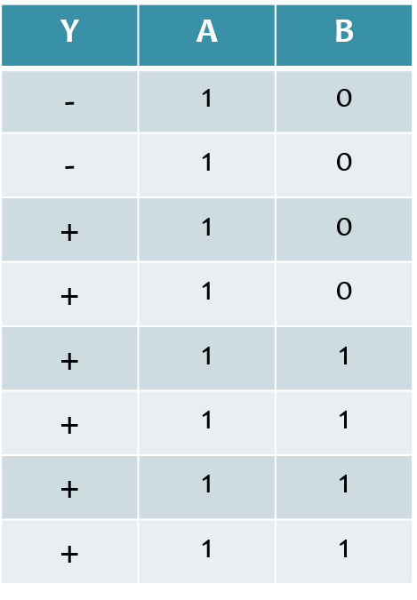
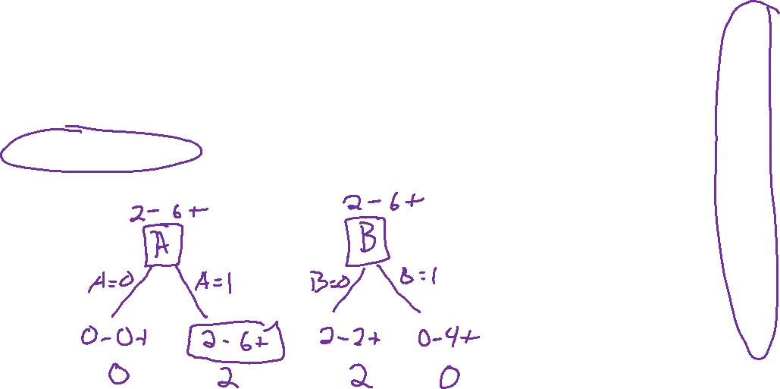
Piazza Poll 2
Dataset: Output Y, Attributes A and B
Which attribute {A, B} would error rate select for the next split?
A
B
A or B (tie)
I don’t know
Slide credit: CMU MLD Matt Gormley

Slide 24
Piazza Poll 2
Dataset: Output Y, Attributes A and B
Which attribute {A, B} would error rate select for the next split?
A
B
A or B (tie)
I don’t know
Slide credit: CMU MLD Matt Gormley

Slide 25
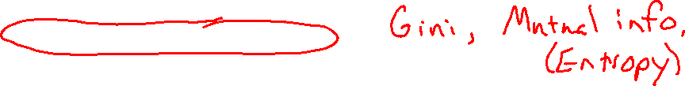
Building a Decision Tree
Function BuildTree(D,A)
# D: dataset at current node, A: current set of attributes
If empty(A) or all labels in D are the same
# Leaf node
class = most common class in D
else
# Internal node
a ⇐ bestAttribute(D,A)
LeftNode = BuildTree(D(a=1), A \ {a})
RightNode = BuildTree(D(a=0), A \ {a})
end
end

Slide 26
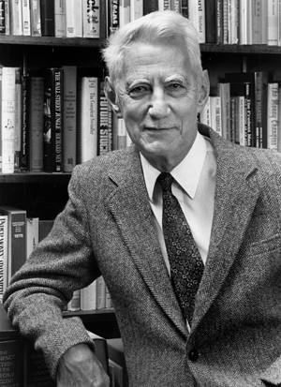
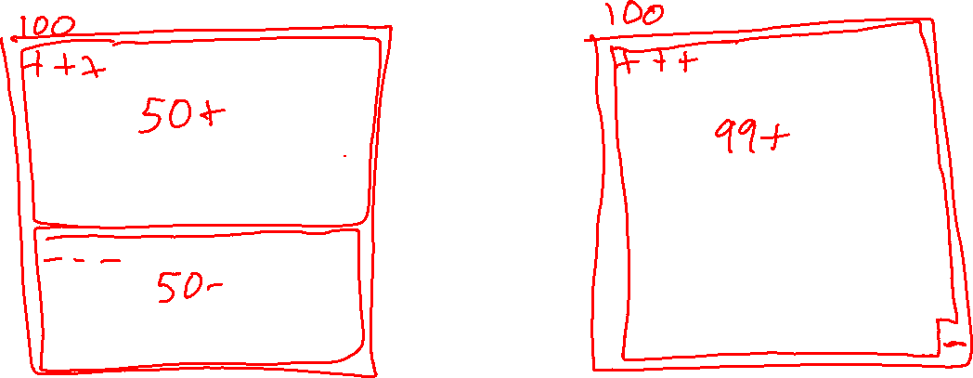
Entropy
Quantifies the amount of uncertainty associated with a specific probability distribution
The higher the entropy, the less confident we are in the outcome

Slide 27
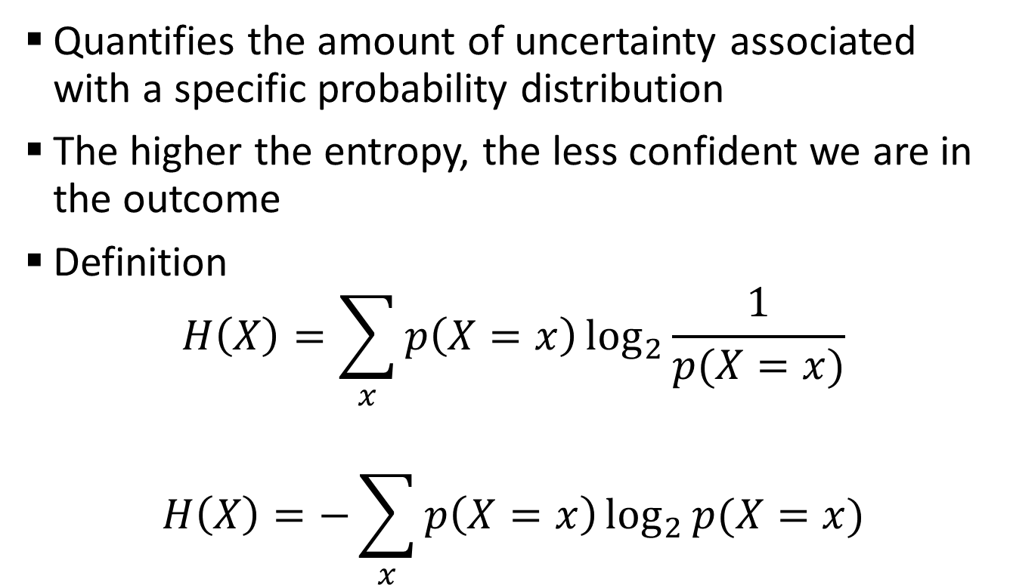
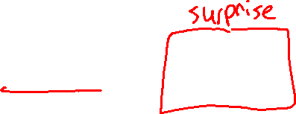
Entropy
Quantifies the amount of uncertainty associated with a specific probability distribution
The higher the entropy, the less confident we are in the outcome
Definition
$$H\left(X\right)=\sum_{x}{p\left(X=x\right)\log_{2}{\frac{1}{p(X=x)}}}$$
$$H\left(X\right)=−\sum_{x}{p\left(X=x\right)\log_{2}{p(X=x)}}$$
Claude Shannon (1916 – 2001), most of the work was done in Bell labs

Slide 28
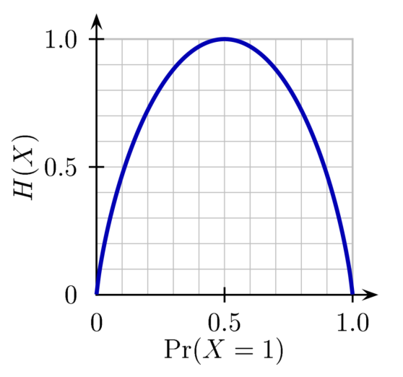
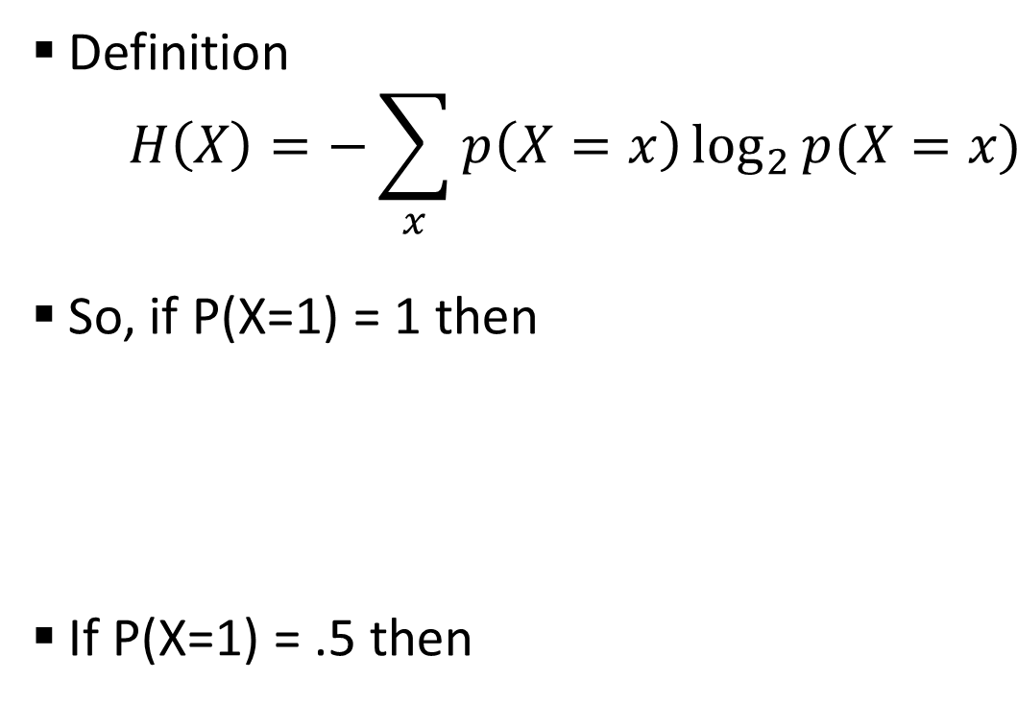

Entropy
H(X)
Definition
$$H\left(X\right)=−\sum_{x}{p\left(X=x\right)\log_{2}{p(X=x)}}$$
So, if P(X=1) = 1 then
If P(X=1) = .5 then
Notes:
Is the entropy between 0 and 1?

Slide 29
Entropy
H(X)
Definition
$$H\left(X\right)=−\sum_{x}{p\left(X=x\right)\log_{2}{p(X=x)}}$$
So, if P(X=1) = 1 then
If P(X=1) = .5 then
Notes:
Is the entropy between 0 and 1?

Slide 30
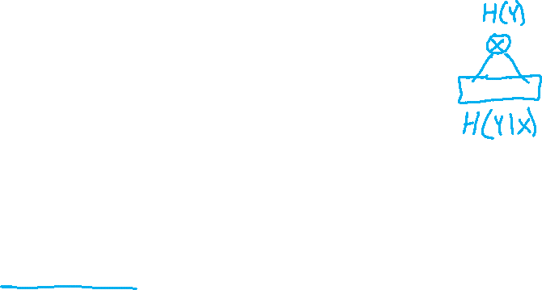
Mutual Information
Slide credit: CMU MLD Matt Gormley
For a decision tree, we can use mutual information of the output class Y and some attribute X on which to split as a splitting criterion
Given a dataset D of training examples, we can estimate the required probabilities as…
Notes:
In the preamble: \usepackage[fleqn]{amsmath}
Entropy:
\begin{align*} H(Y) = - \sum_{y \in \Yc} P(Y=y) \log_2 P(Y=y) \end{align*}
Specific Conditional Entropy:
\begin{align*} H(Y \mid X=x) = - \sum_{y \in \Yc} P(Y=y \mid X=x) \log_2 P(Y=y \mid X=x) \end{align*}
Conditional Entropy:
\begin{align*} H(Y \mid X) = \sum_{x \in \Xc} P(X=x) H(Y \mid X=x) \end{align*}
Mutual Information:
\begin{align*} I(Y; X) = H(Y) - H(Y|X) = H(X) - H(X|Y) \end{align*}

Slide 31
Mutual Information
Entropy measures the expected # of bits to code one random draw from X.
For a decision tree, we want to reduce the entropy of the random variable we are trying to predict!
Slide credit: CMU MLD Matt Gormley
For a decision tree, we can use mutual information of the output class Y and some attribute X on which to split as a splitting criterion
Given a dataset D of training examples, we can estimate the required probabilities as…
Conditional entropy is the expected value of specific conditional entropy E_{P(X=x)}[H(Y | X = x)]
Informally, we say that mutual information is a measure of the following: If we know X, how much does this reduce our uncertainty about Y?
Notes:
In the preamble: \usepackage[fleqn]{amsmath}
Entropy:
\begin{align*} H(Y) = - \sum_{y \in \Yc} P(Y=y) \log_2 P(Y=y) \end{align*}
Specific Conditional Entropy:
\begin{align*} H(Y \mid X=x) = - \sum_{y \in \Yc} P(Y=y \mid X=x) \log_2 P(Y=y \mid X=x) \end{align*}
Conditional Entropy:
\begin{align*} H(Y \mid X) = \sum_{x \in \Xc} P(X=x) H(Y \mid X=x) \end{align*}
Mutual Information:
\begin{align*} I(Y; X) = H(Y) - H(Y|X) = H(X) - H(X|Y) \end{align*}

Slide 32
Piazza Poll 3
Dataset: Output Y, Attributes A and B
Which attribute {A, B} would mutual information select for the next split?
A
B
A or B (tie)
I don’t know

Slide 33
Decision Tree Learning Example
Y | A | B
- | 1 | 0
- | 1 | 0
+ | 1 | 0
+ | 1 | 0
+ | 1 | 1
+ | 1 | 1
+ | 1 | 1
+ | 1 | 1
Slide credit: CMU MLD Matt Gormley

Slide 34
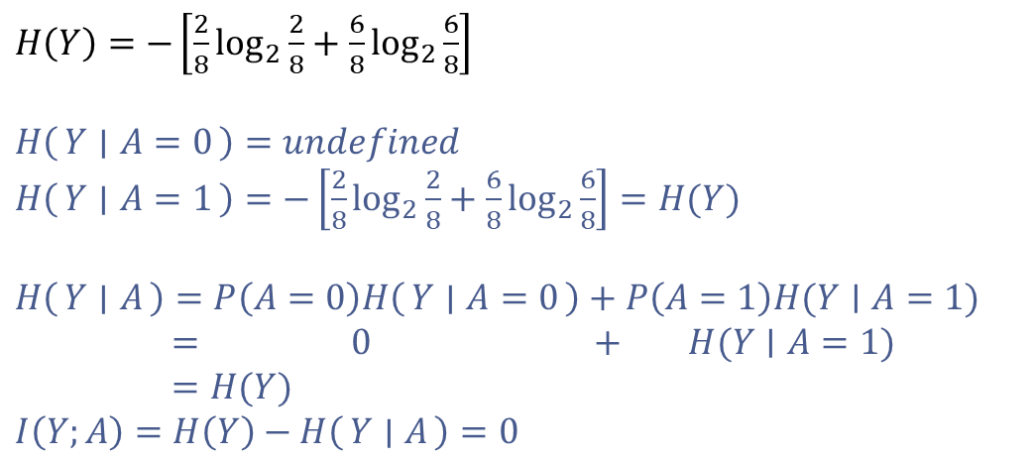
Decision Tree Learning Example
Y | A | B
- | 1 | 0
- | 1 | 0
+ | 1 | 0
+ | 1 | 0
+ | 1 | 1
+ | 1 | 1
+ | 1 | 1
+ | 1 | 1
$H\left(Y\right)=−\left[\frac{2}{8}\log_{2}{\frac{2}{8}}+\frac{6}{8}\log_{2}{\frac{6}{8}}\right]$
$H\left(Y ∣ A=0\right)=undefined$
$H\left(Y ∣ A=1\right)=−\left[\frac{2}{8}\log_{2}{\frac{2}{8}}+\frac{6}{8}\log_{2}{\frac{6}{8}}\right]=H(Y)$
$H\left(Y ∣ A\right)=P\left(A=0\right)H\left(Y ∣ A=0\right)+P\left(A=1\right)H(Y∣A=1)$
$= 0 + H(Y∣A=1)$
$=H(Y)$
$I\left(Y;A\right)=H\left(Y\right)−H\left(Y ∣ A\right)=0$
[2-, 6+]
A
A=0
A=1
[0-, 0+]
P(A=0) = 0
[2-, 6+]
P(A=1)=1
Slide credit: CMU MLD Matt Gormley

Slide 35
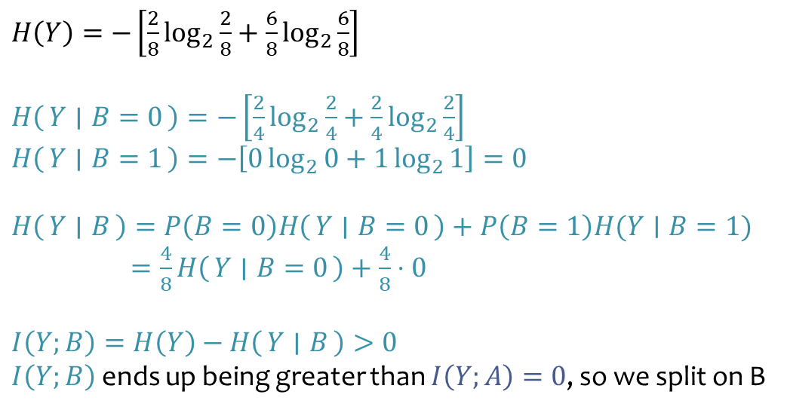
Decision Tree Learning Example
Y | A | B
- | 1 | 0
- | 1 | 0
+ | 1 | 0
+ | 1 | 0
+ | 1 | 1
+ | 1 | 1
+ | 1 | 1
+ | 1 | 1
$H\left(Y\right)=−\left[\frac{2}{8}\log_{2}{\frac{2}{8}}+\frac{6}{8}\log_{2}{\frac{6}{8}}\right]$
$H\left(Y ∣ B=0\right)=−\left[\frac{2}{4}\log_{2}{\frac{2}{4}}+\frac{2}{4}\log_{2}{\frac{2}{4}}\right]$
$H\left(Y ∣ B=1\right)=−\left[0\log_{2}{0}+1\log_{2}{1}\right]=0$
$H\left(Y ∣ B\right)=P\left(B=0\right)H\left(Y ∣ B=0\right)+P\left(B=1\right)H(Y∣B=1)$
$=\frac{4}{8}H\left(Y ∣ B=0\right)+\frac{4}{8}⋅0$
$I\left(Y;B\right)=H\left(Y\right)−H\left(Y ∣ B\right)>0$ $I\left(Y;B\right)$ ends up being greater than $I\left(Y;A\right)=0$, so we split on B
[2-, 6+]
B
B=0
B=1
[2-, 2+]
P(B=0)=4/8
[0-, 4+]
P(B=1)=4/8
Slide credit: CMU MLD Matt Gormley

Slide 36
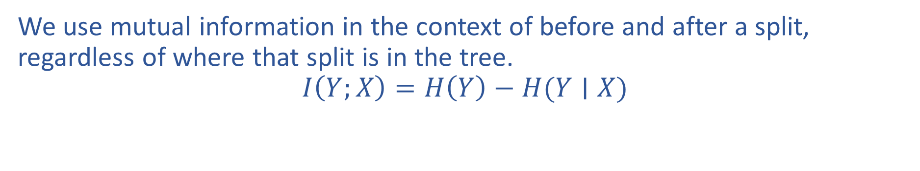
Mutual Information Notation
We use mutual information in the context of before and after a split, regardless of where that split is in the tree.
$$I\left(Y;X\right)=H\left(Y\right)−H(Y∣X)$$

