Slide 1
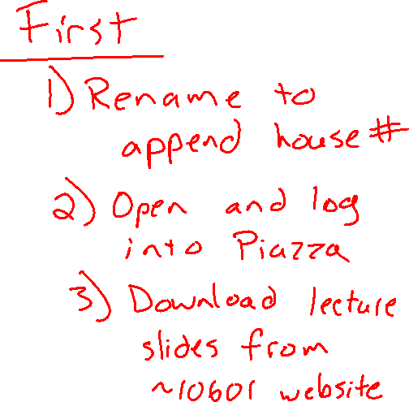
Warm-up as you login
Search internet to find:
Machine learning classification dataset
    Discrete/unordered output
Machine learning regression dataset
    Continuous output
Are the input values discrete/continuous?
Are the input values a single value or multiple values?
What assumptions might we make with these datasets?

Slide 2
Announcements
Help us help you
Student survey (see Piazza)
Name pronunciation (via Canvas)
Assignments:
HW1
    Out today
    Due Thu, 9/10, 11:59 pm (all times will be Pittsburgh time)
No class Monday: Labor Day

Slide 3
Q&A
Q:
In Lecture 1, why did we use the term experience instead of just data?
Because our concern isn’t just the data itself, but also where the data comes from (e.g. an agent interacting with the world vs. knowledge from a book).
As well, the word experience better aligns with the notion of what humans require in order to learn.
A:

Slide 4

Introduction to Machine Learning
Decision Trees
Instructor: Pat Virtue

Slide 5
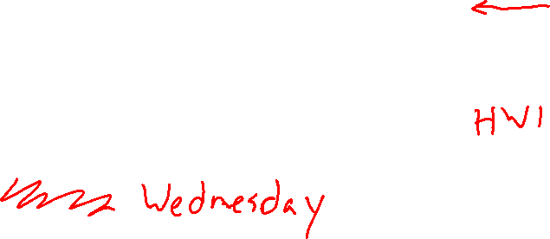
Plan
Today
Problem formulation (notation)
Algorithm 0: Memorization
Algorithm 1: Majority vote
Algorithm 2: Decision Stump
Monday
Decision trees

Slide 6
Well-Posed Learning Problems
Three components <T,P,E>:
  Task, T
  Performance measure, P
  Experience, E
Definition of learning:
A computer program learns if its performance at tasks in T, as measured by P, improves with experience E.
Definition from (Mitchell, 1997)

Slide 7
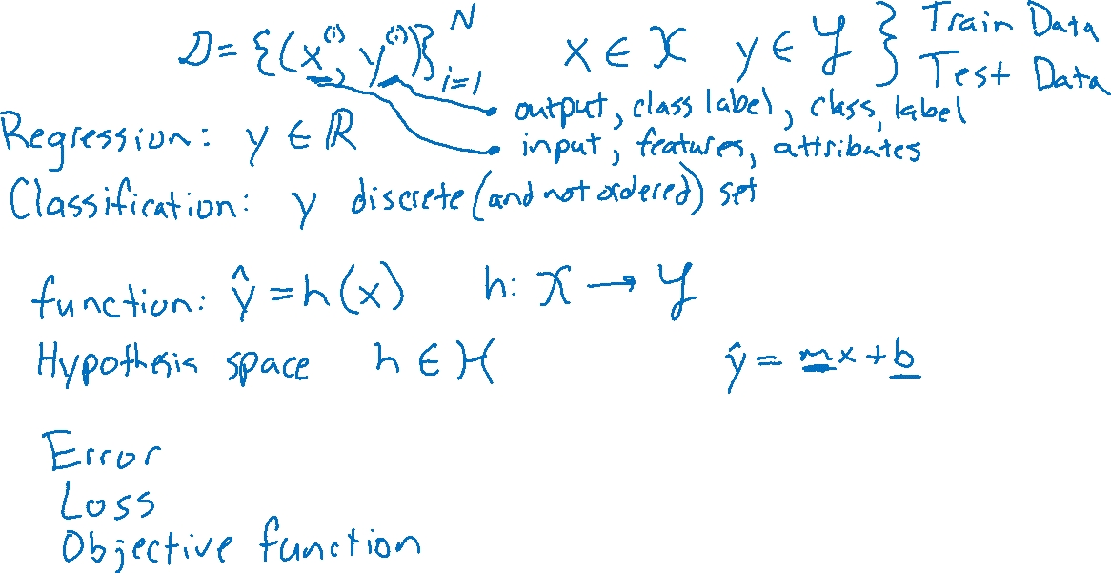
Problem Formulation
Experience
Hypothesis
Performance measure

Slide 8
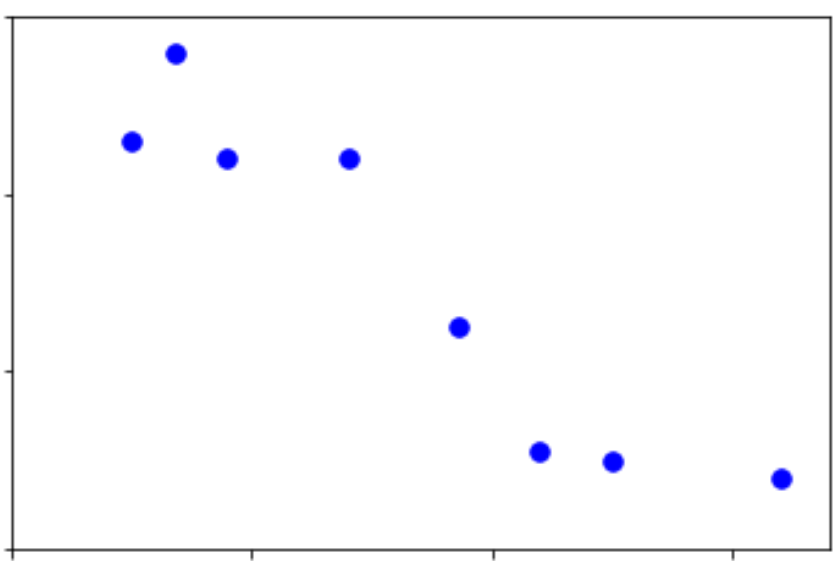
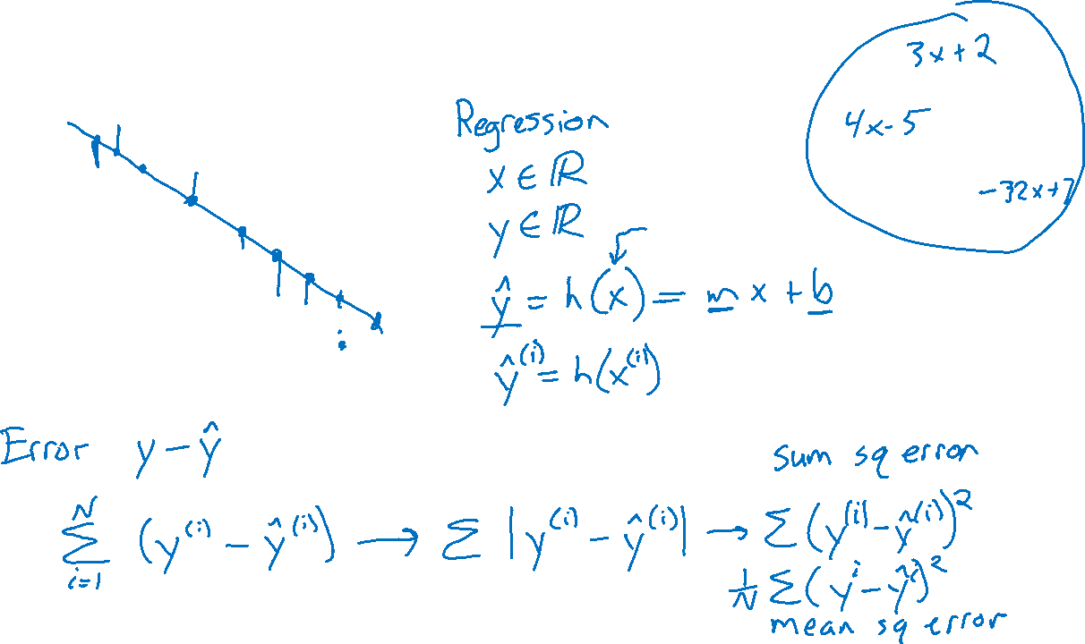
Problem Formulation
Output y
Input x

Slide 9
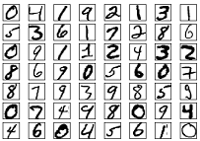
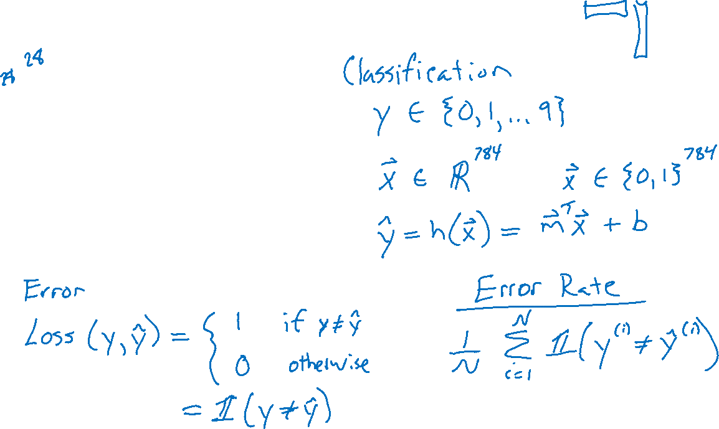
Problem Formulation

Slide 10
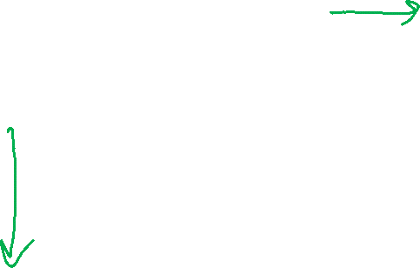
Problem Formulation
Medical Prediction
Outcome | Fetal Position | Fetal Distress | Previous C-sec
Natural | Vertex | N | N
C-section | Breech | N | N
Natural | Vertex | Y | Y
C-section | Vertex | N | Y
Natural | Abnormal | N | N

Slide 11

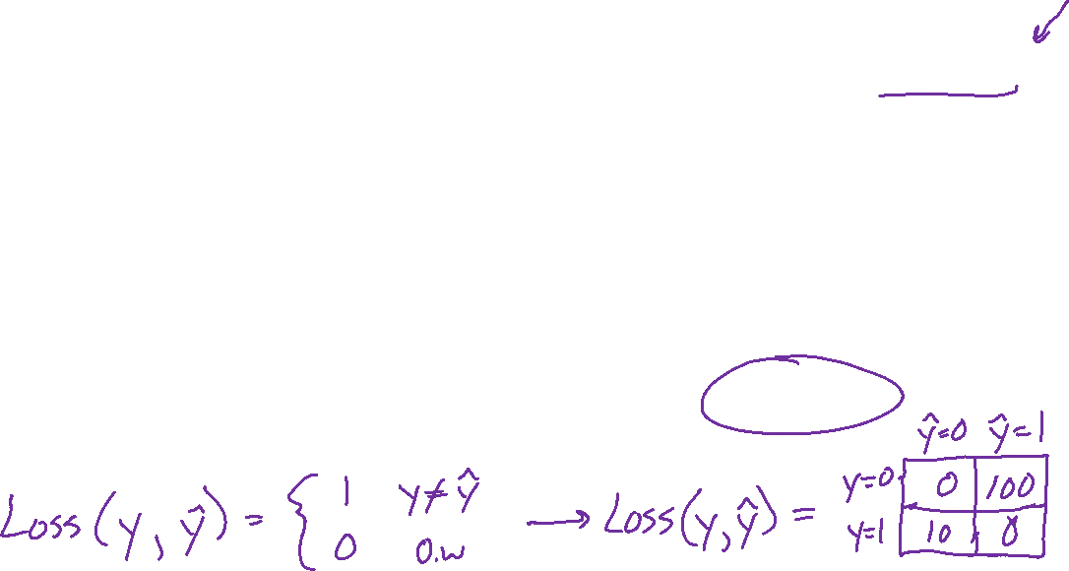
Problem Formulation
$x={\left[\begin{aligned}x_{1} \\ x_{2} \\ x_{3}\end{aligned}\right]=\left[x_{1},x_{2}, x_{3}\right]}^{T}$
$x_{1}∈\{Vertex, Breech, Abn\}$
$x_{2}∈\{Y,N\}$
$x_{3}∈\{Y,N\}$
$y∈\{Csection, Natural\}$
$\hat{y}=h(x)$
Medical Prediction
$Y$ $X_{1} X_{2}$ $X_{3}$
Outcome | Fetal Position | Fetal Distress | Previous C-sec
Natural | Vertex | N | N
C-section | Breech | N | N
Natural | Vertex | Y | Y
C-section | Vertex | N | Y
Natural | Abnormal | N | N

Slide 12
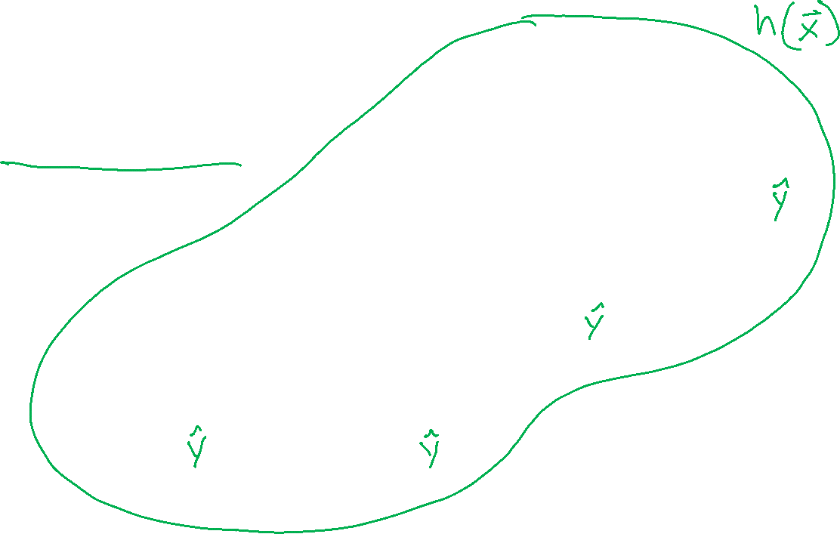
Decision Tree
Fetal
Position
Medical Prediction
(Oversimplified example)
Vertex
Abnormal
Breech
Fetal
Distress
C-section
C-section
No
Yes
Previous
C-section
C-section
No
Yes
Natural
C-section

Slide 13
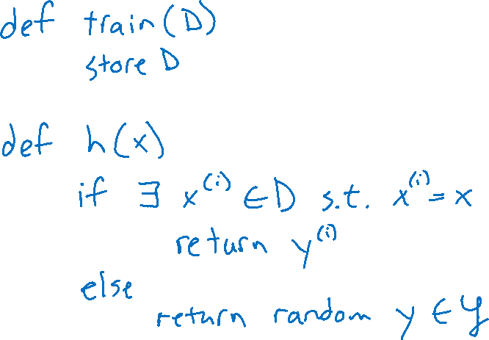
How could we implement training and prediction?
Algorithm 0: Memorization algorithm
Slide credit: CMU MLD Matt Gormley

Slide 14
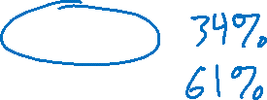
Piazza Poll 1
Does the memorization algorithm learn?
Yes
No
I have no clue
Slide credit: CMU MLD Matt Gormley

Slide 15
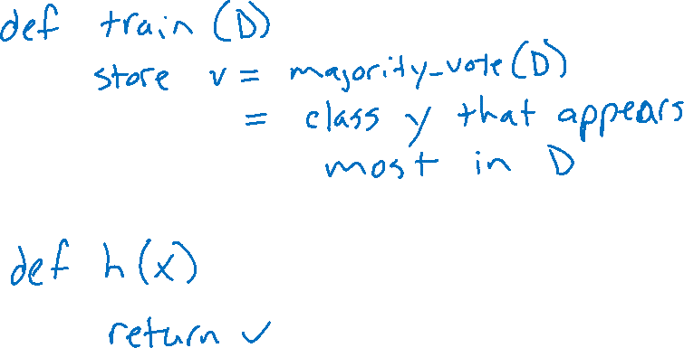
How could we implement training and prediction?
Algorithm 1: Majority vote algorithm
Slide credit: CMU MLD Matt Gormley

Slide 16
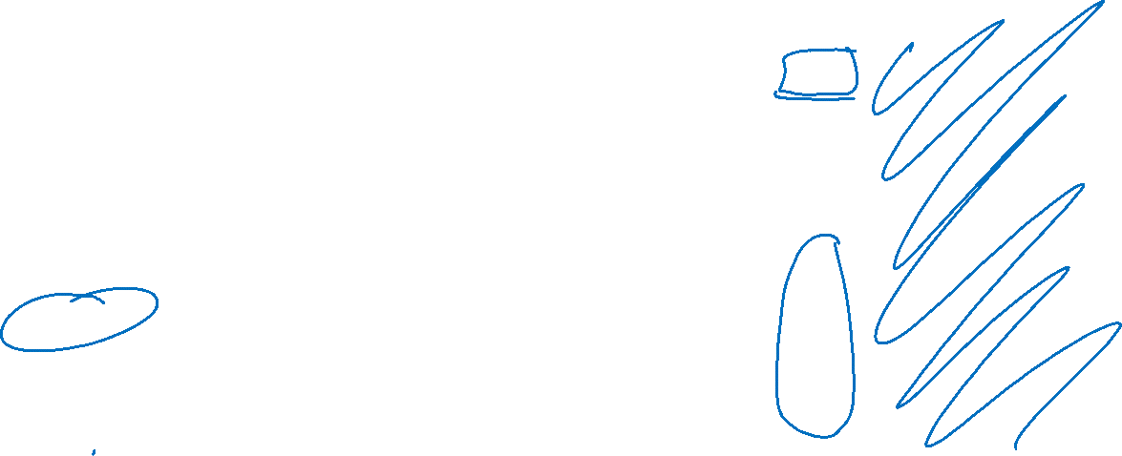
Piazza Poll 2
What does the majority vote algorithm return on this training data?
A
B
C
0
1
+
-
Dataset:
Output Y, Attributes A, B, C
Y | A | B | C
- | 1 | 0 | 0
- | 1 | 0 | 1
- | 1 | 0 | o
+ | 0 | 0 | 1
+ | 1 | 1 | 0
+ | 1 | 1 | 1
+ | 1 | 1 | 0
+ | 1 | 1 | 1
Slide credit: CMU MLD Matt Gormley

Slide 17
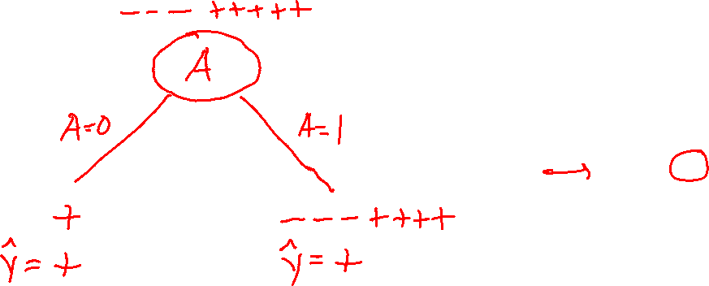
Decision Stumps
Split data based on a single attribute
Majority vote at leaves
Dataset:
Output Y, Attributes A, B, C
Y | A | B | C
- | 1 | 0 | 0
- | 1 | 0 | 1
- | 1 | 0 | o
+ | 0 | 0 | 1
+ | 1 | 1 | 0
+ | 1 | 1 | 1
+ | 1 | 1 | 0
+ | 1 | 1 | 1
Slide credit: CMU MLD Matt Gormley

Slide 18
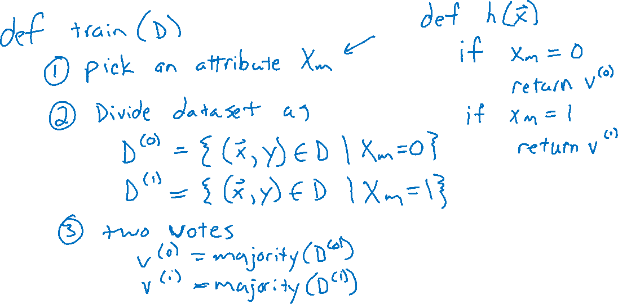
How could we implement training and prediction?
Algorithm 2: Decision stump algorithm
Slide credit: CMU MLD Matt Gormley

Slide 19
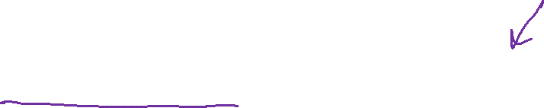
Piazza Poll 3
Splitting on which attribute {A, B, C} creates a decision stump with the lowest training error?
Dataset:
Output Y, Attributes A, B, C
Y | A | B | C
- | 1 | 0 | 0
- | 1 | 0 | 1
- | 1 | 0 | o
+ | 0 | 0 | 1
+ | 1 | 1 | 0
+ | 1 | 1 | 1
+ | 1 | 1 | 0
+ | 1 | 1 | 1
Slide credit: CMU MLD Matt Gormley

Slide 20
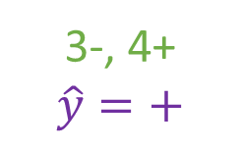
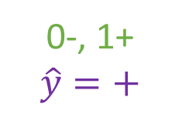
Piazza Poll 3
Splitting on which attribute {A, B, C} creates a decision stump with the lowest training error?
Answer: B
Dataset:
Output Y, Attributes A, B, C
Y | A | B | C
- | 1 | 0 | 0
- | 1 | 0 | 1
- | 1 | 0 | o
+ | 0 | 0 | 1
+ | 1 | 1 | 0
+ | 1 | 1 | 1
+ | 1 | 1 | 0
+ | 1 | 1 | 1
3-, 5+
A
A=0
A=1
0-, 1+
$$\hat{y}=+$$
3-, 4+
$$\hat{y}=+$$
Error rate: ( 0 + 3 ) / 8
= 3/8
Slide credit: CMU MLD Matt Gormley

Slide 21
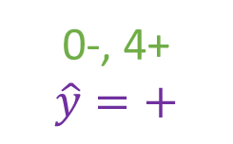
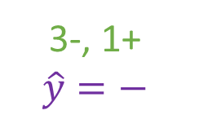
Piazza Poll 3
Splitting on which attribute {A, B, C} creates a decision stump with the lowest training error?
Answer: B
Dataset:
Output Y, Attributes A, B, C
Y | A | B | C
- | 1 | 0 | 0
- | 1 | 0 | 1
- | 1 | 0 | o
+ | 0 | 0 | 1
+ | 1 | 1 | 0
+ | 1 | 1 | 1
+ | 1 | 1 | 0
+ | 1 | 1 | 1
3-, 5+
B
B=0
B=1
3-, 1+
$$\hat{y}=−$$
0-, 4+
$$\hat{y}=+$$
Error rate: ( 1 + 0 ) / 8
= 1/8
Slide credit: CMU MLD Matt Gormley

Slide 22
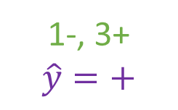
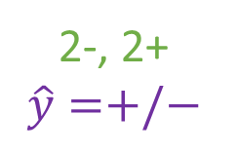
Piazza Poll 3
Splitting on which attribute {A, B, C} creates a decision stump with the lowest training error?
Answer: B
Dataset:
Output Y, Attributes A, B, C
Y | A | B | C
- | 1 | 0 | 0
- | 1 | 0 | 1
- | 1 | 0 | o
+ | 0 | 0 | 1
+ | 1 | 1 | 0
+ | 1 | 1 | 1
+ | 1 | 1 | 0
+ | 1 | 1 | 1
3-, 5+
C
C=0
C=1
2-, 2+
$$\hat{y}=+/−$$
1-, 3+
$$\hat{y}=+$$
Error rate: ( 2 + 1 ) / 8
= 3/8
Slide credit: CMU MLD Matt Gormley

