Slide 1

Announcements
Assignments
HW9
    Out Friday
    Due Wed, 12/9, 11:59 pm
    The two slip days are free (last possible submission Fri, 12/11, 11:59 pm)
Final Exam
Mon, 12/14
Stay tuned to Piazza for more details

Slide 2

Introduction to Machine Learning
Clustering
Instructor: Pat Virtue

Slide 3
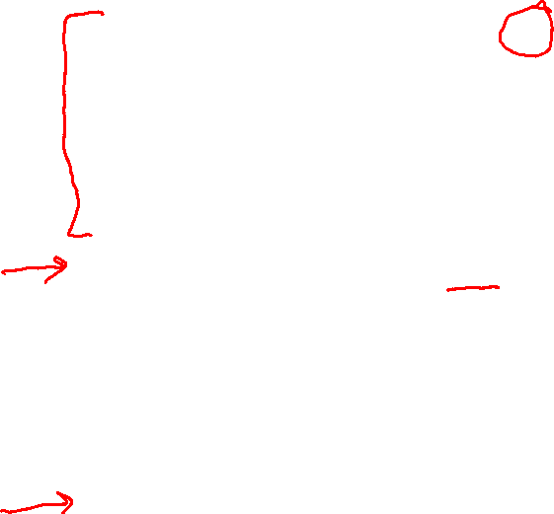
Learning Paradigms
Slide credit: CMU MLD, Matt Gormley

Slide 4
Clustering, Informal Goals
Goal: Automatically partition unlabeled data into groups of similar datapoints.
Question: When and why would we want to do this?
Useful for:
• Automatically organizing data.
• Understanding hidden structure in data.
• Preprocessing for further analysis.
• Representing high-dimensional data in a low-dimensional space (e.g., for visualization purposes).
Slide credit: CMU MLD Nina Balcan

Slide 5





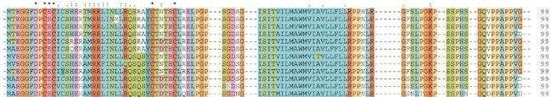
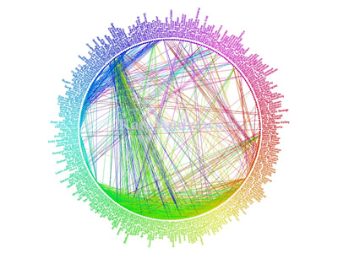
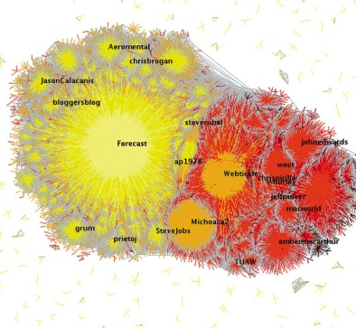
Applications (Clustering comes up everywhere…)
Cluster news articles or web pages or search results by topic.
Cluster protein sequences by function or genes according to expression profile.
Cluster users of social networks by interest (community detection).
Facebook network
Twitter Network
Slide credit: CMU MLD Nina Balcan

Slide 6

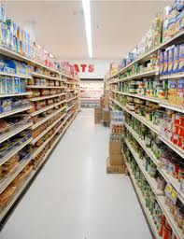
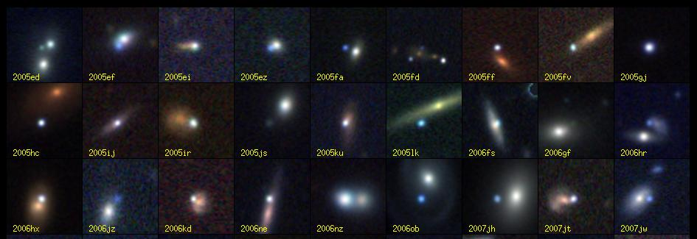
Applications (Clustering comes up everywhere…)
Cluster customers according to purchase history.
Cluster galaxies or nearby stars (e.g. Sloan Digital Sky Survey)
And many many more applications….
Slide credit: CMU MLD Nina Balcan

Slide 7
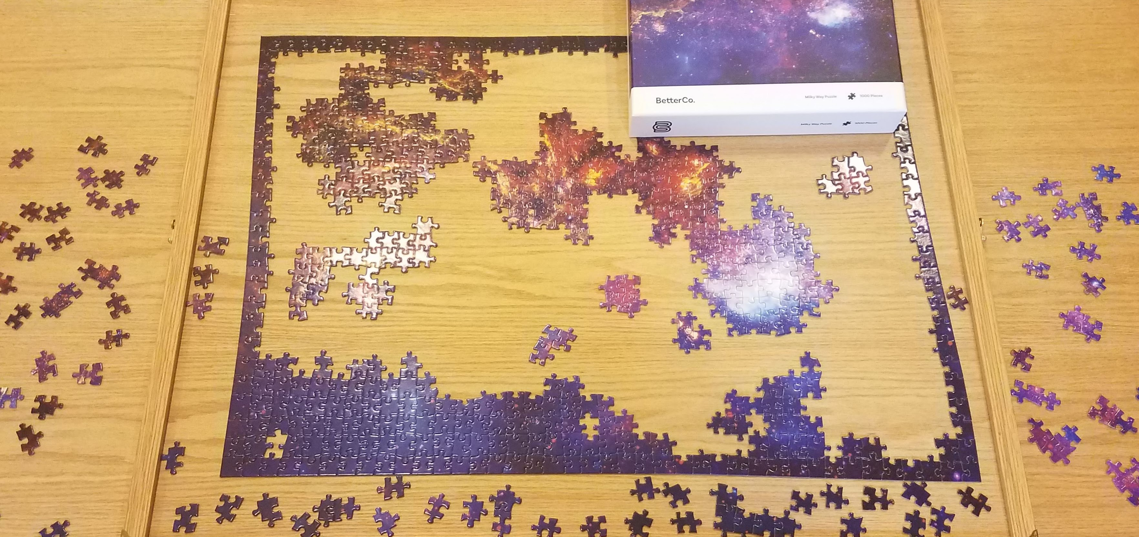
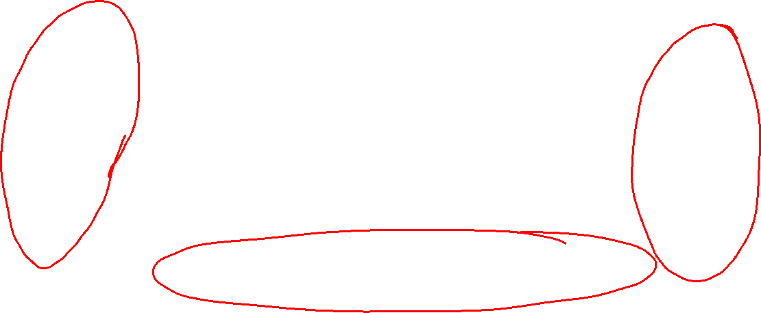
Clustering Applications
Jigsaw puzzles!

Slide 8
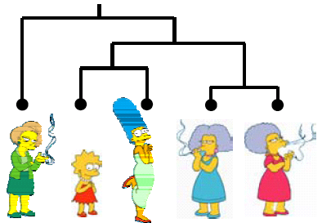
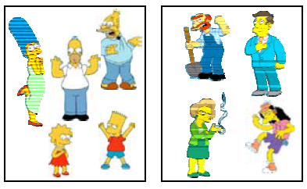
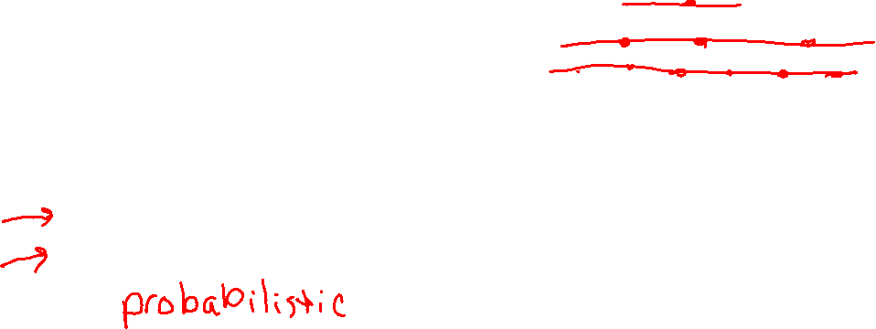
Clustering Algorithms
Hierarchical algorithms
    Bottom-up: Agglomerative Clustering
    Top-down: Divisive
Partition algorithms
    K means clustering
    Mixture-Model based clustering
Slide credit: CMU MLD Aarti Singh and Eric Xing

Slide 9
Hierarchical Clustering
Bottom-Up Agglomerative Clustering
  Starts with each object in a separate cluster, and repeat:
  Joins the most similar pair of clusters,
  Update the similarity of the new cluster to others
  until there is only one cluster.
  Greedy – less accurate but simple to implement
Top-Down divisive
  Starts with all the data in a single cluster, and repeat:
  Split each cluster into two using a partition algorithm
  Until each object is a separate cluster.
  More accurate but complex to implement
Slide credit: CMU MLD Aarti Singh and Eric Xing

Slide 10
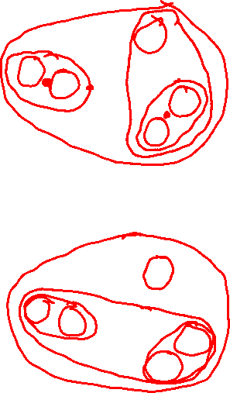
Hierarchical Clustering
Bottom-Up Agglomerative Clustering
  Starts with each object in a separate cluster, and repeat:
  Joins the most similar pair of clusters,
  Update the similarity of the new cluster to others
  until there is only one cluster.
  Greedy – less accurate but simple to implement
Top-Down divisive
  Starts with all the data in a single cluster, and repeat:
  Split each cluster into two using a partition algorithm
  Until each object is a separate cluster.
  More accurate but complex to implement
Slide credit: CMU MLD Aarti Singh and Eric Xing

Slide 11
Partitioning Algorithms
Partitioning method: Construct a partition of N objects into a set of K clusters
Given: a set of objects and the number K
Find: a partition of K clusters that optimizes the chosen partitioning criterion
  Globally optimal: exhaustively enumerate all partitions
  Effective heuristic method: K-means algorithm
Slide credit: CMU MLD Aarti Singh

Slide 12
Course Feedback
See Piazza for two surveys
FCE (Faculty Course Evaluation)
TA survey
    Fill out once for each TA that you can provide feedback for

Slide 13
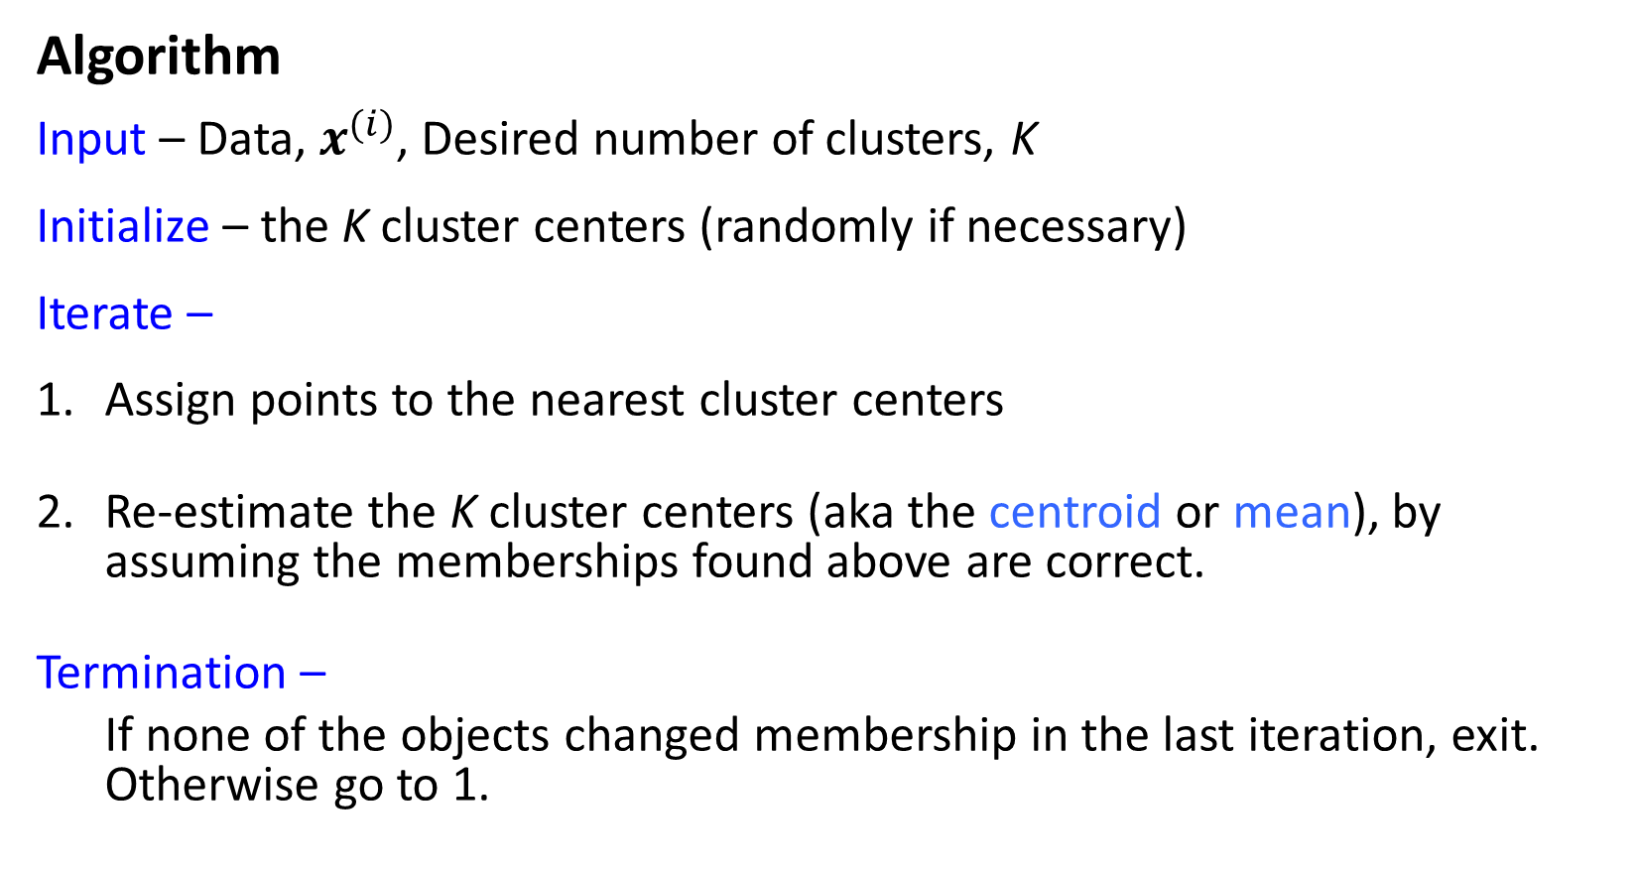
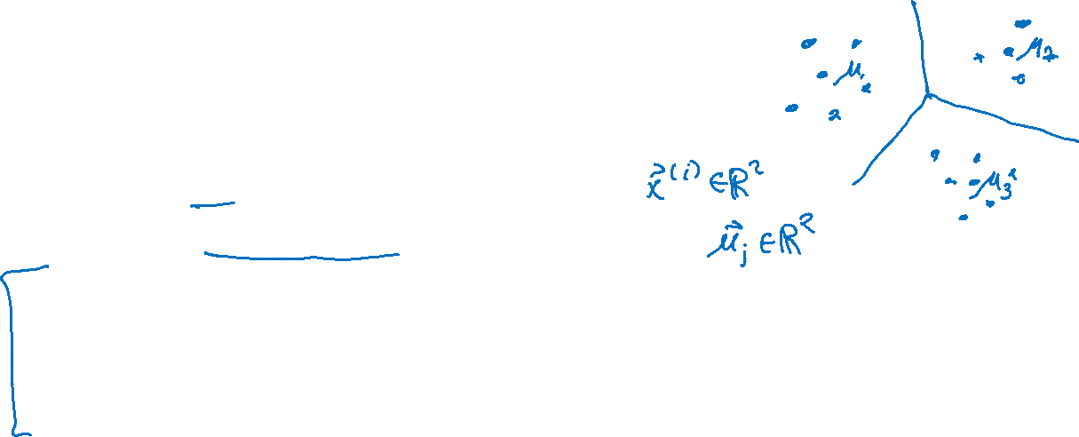
K-Means
Algorithm
Input – Data, $x^{(i)}$, Desired number of clusters, K
Initialize – the K cluster centers (randomly if necessary)
Iterate –
Assign points to the nearest cluster centers
Re-estimate the K cluster centers (aka the centroid or mean), by assuming the memberships found above are correct.
Termination –
If none of the objects changed membership in the last iteration, exit. Otherwise go to 1.
Slide credit: CMU MLD Aarti Singh

Slide 14
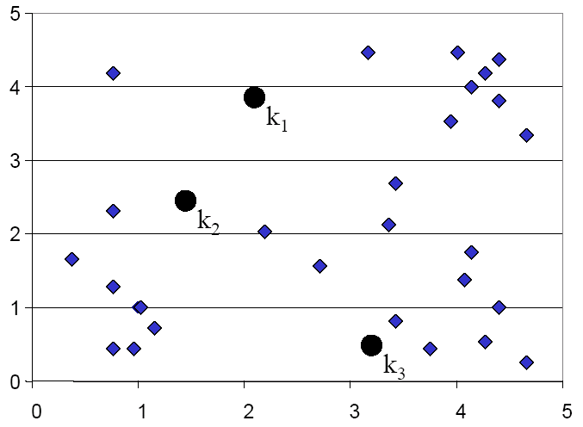
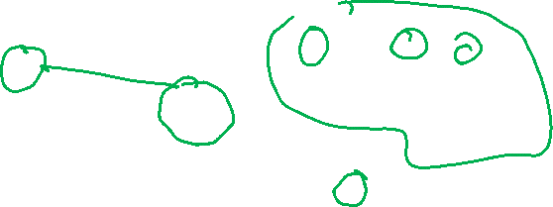
K-means Clustering: Assign points
Slide credit: CMU MLD Eric Xing

Slide 15
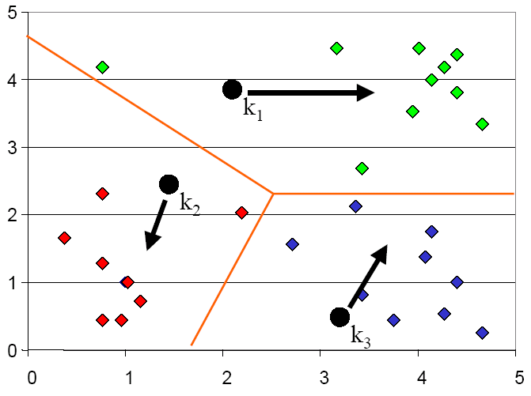
K-means Clustering: Update centers
Slide credit: CMU MLD Eric Xing

Slide 16
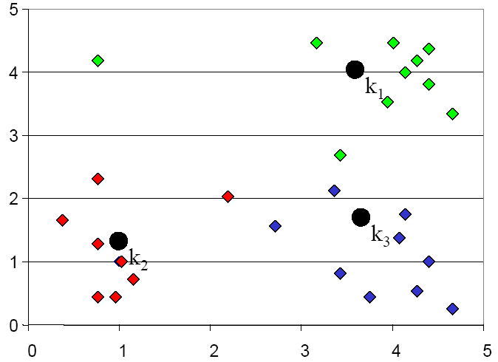
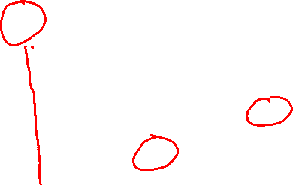
K-means Clustering: Assign points
Slide credit: CMU MLD Eric Xing

Slide 17
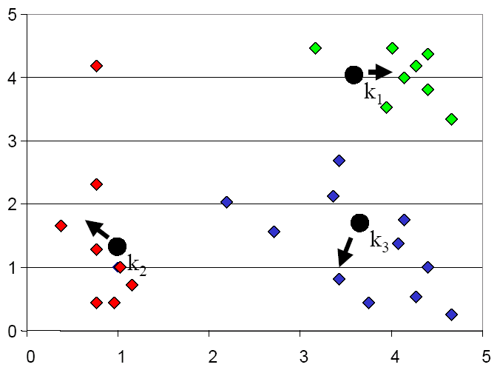
K-means Clustering: Update centers
Slide credit: CMU MLD Eric Xing

Slide 18
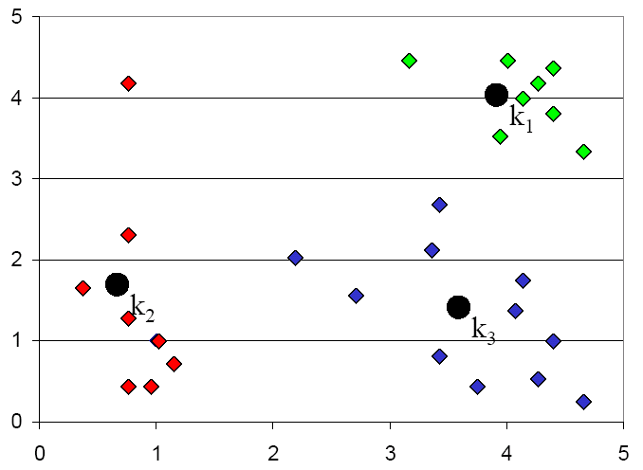
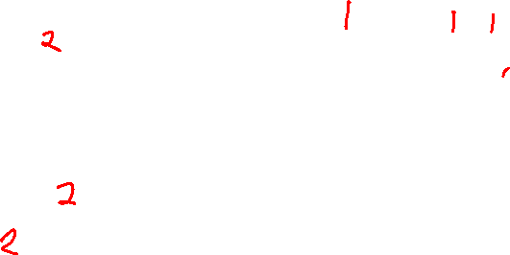
K-means Clustering: Assign points
Slide credit: CMU MLD Eric Xing

Slide 19
K-means Optimization
Optimization recipe
Formulate objective
Minimize objective
Slide credit: CMU MLD Matt Gormley

Slide 20
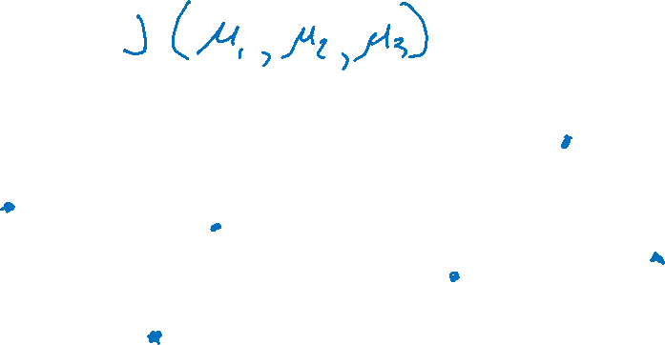
K-means Optimization
Question: Which of these partitions is “better”?
Slide credit: CMU MLD Matt Gormley

Slide 21
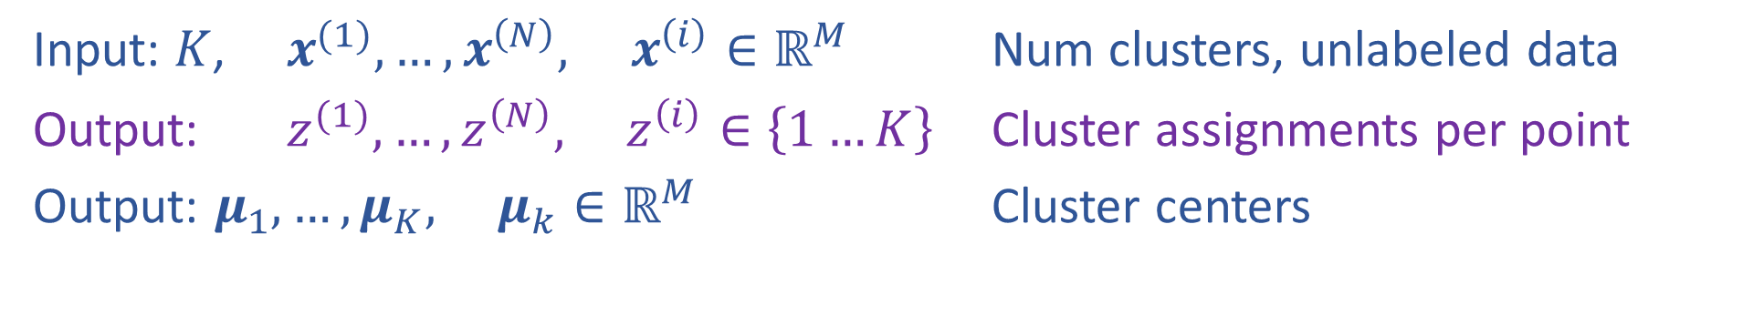
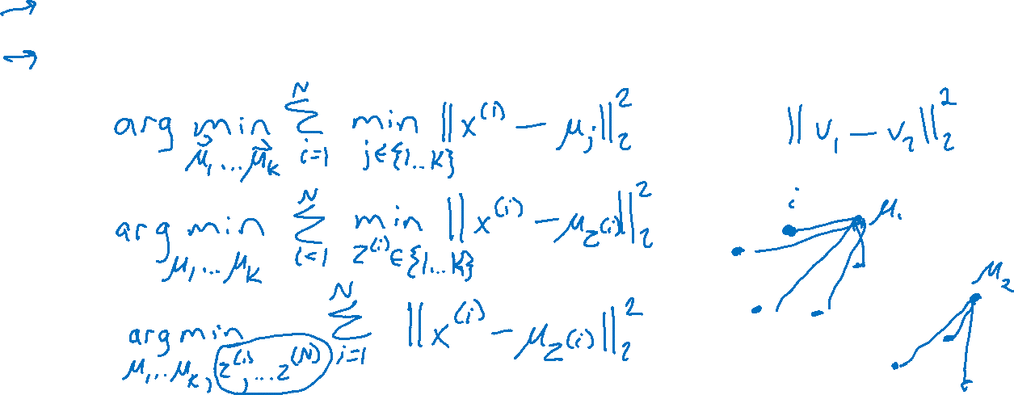
K-means Optimization
Input: $K$, $x^{(1)}, …, x^{\left(N\right)}, x^{\left(i\right)}∈ℝ^{M}$ Num clusters, unlabeled data
Output: $z^{(1)}, …,z^{\left(N\right)}, z^{\left(i\right)}∈\left\{1…K\right\}$ Cluster assignments per point
Output: $μ_{1}, …, μ_{K}, μ_{k}∈ℝ^{M}$ Cluster centers
Slide credit: CMU MLD Matt Gormley

Slide 22
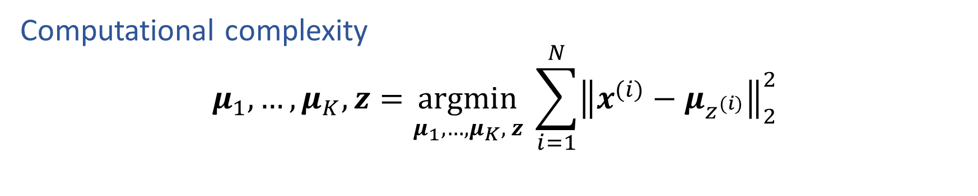
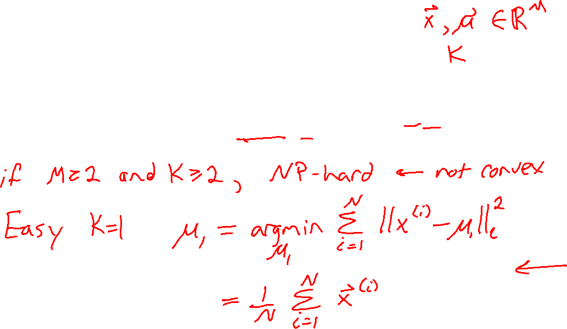
K-means Optimization
Computational complexity
$$μ_{1}, …, μ_{K},z=\underset{μ_{1}, …, μ_{K}, z}{argmin} \sum_{i=1}^{N}{{\left\|x^{(i)}−μ_{z^{(i)}}\right\|}_{2}^{2}}$$
Slide credit: CMU MLD Matt Gormley

Slide 23
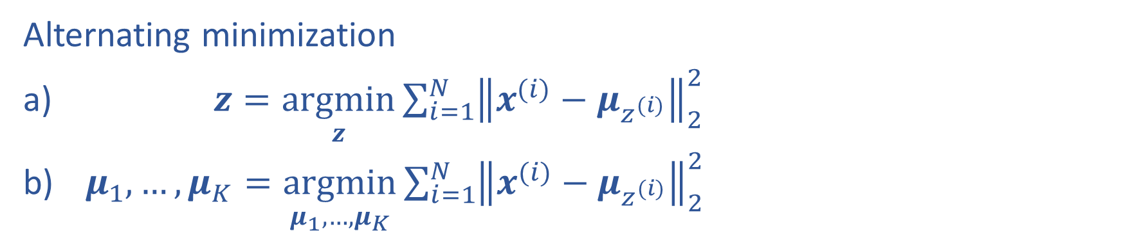
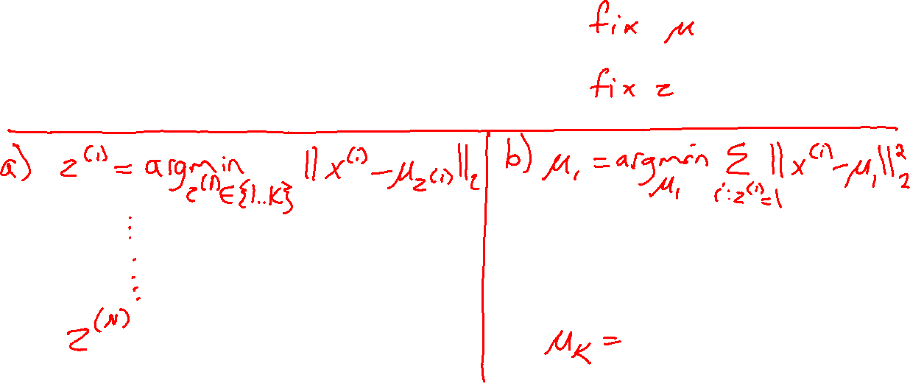
K-means Optimization
Alternating minimization
$z=\underset{z}{argmin}\sum_{i=1}^{N}{{\left\|x^{(i)}−μ_{z^{(i)}}\right\|}_{2}^{2}}$
$μ_{1}, …, μ_{K}=\underset{μ_{1}, …, μ_{K}}{argmin}\sum_{i=1}^{N}{{\left\|x^{(i)}−μ_{z^{(i)}}\right\|}_{2}^{2}}$

Slide 24

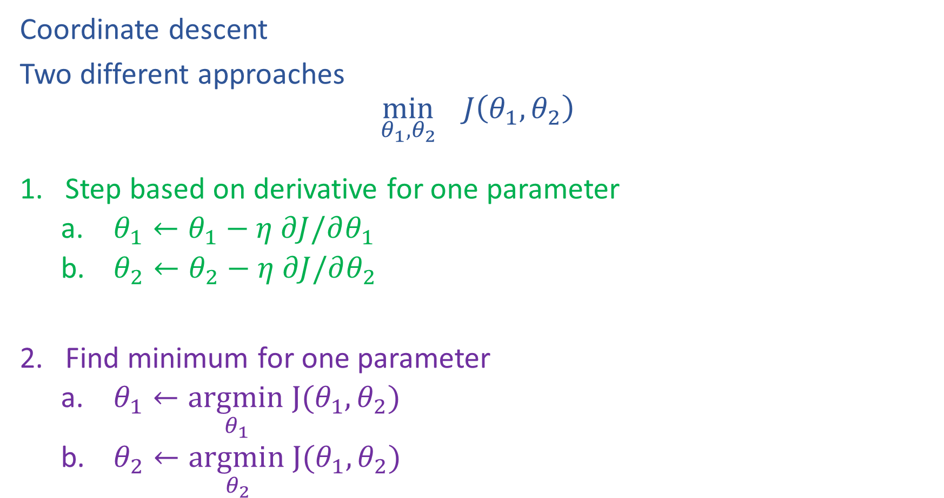

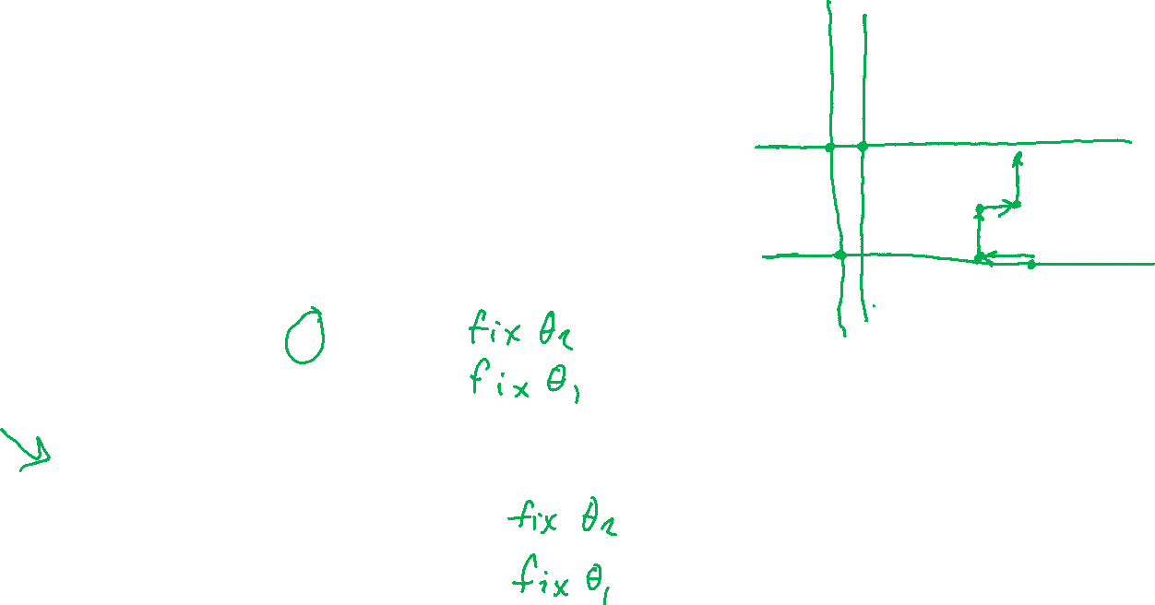
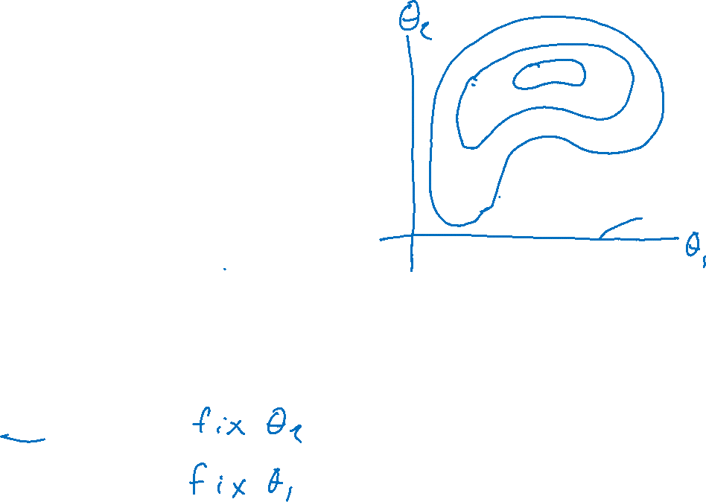
Alternating minimization
Coordinate descent
Two different approaches
$$\min_{θ_{1},θ_{2}}{ J\left(θ_{1},θ_{2}\right)}$$
Step based on derivative for one parameter
    $θ_{1}←θ_{1}−η ∂J/∂θ_{1}$
    $θ_{2}←θ_{2}−η ∂J/∂θ_{2}$
Find minimum for one parameter
    $θ_{1}←\underset{θ_{1} }{argmin}J(θ_{1},θ_{2})$
    $θ_{2}←\underset{θ_{2} }{argmin}J(θ_{1},θ_{2})$

Slide 25
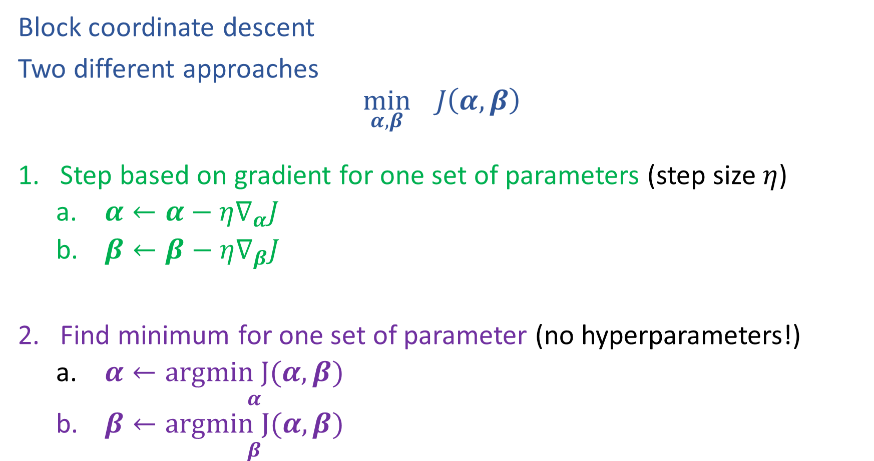
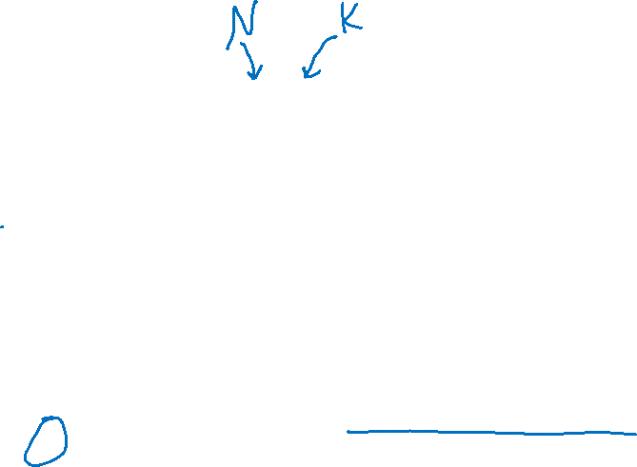
Alternating minimization
Block coordinate descent
Two different approaches
$$\min_{α,β}{ J\left(α,β\right)}$$
Step based on gradient for one set of parameters (step size $η$)
    $α←α−η∇_{α}J$
    $β←β−η∇_{β}J$
Find minimum for one set of parameter (no hyperparameters!)
    $α←\underset{α}{argmin J(α, β)}$
    $β←\underset{β}{argmin J(α, β)}$

Slide 26
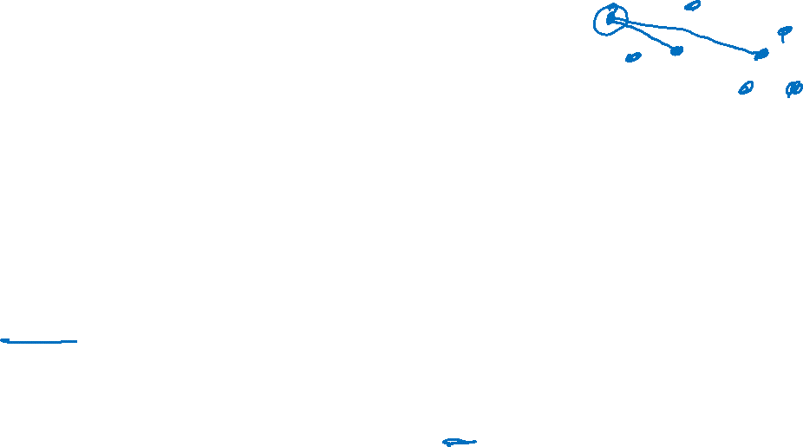
Computational Complexity
At each iteration,
  Computing cluster centers: Each object gets added once to some cluster: O(N)
  Computing distance between each of the N objects and the K cluster centers is O(KN)
Assume these two steps are each done once for l iterations: O(lKN)
Slide credit: CMU MLD Aarti Singh
Notes:
Why does k-means converge? How many steps?

Slide 27
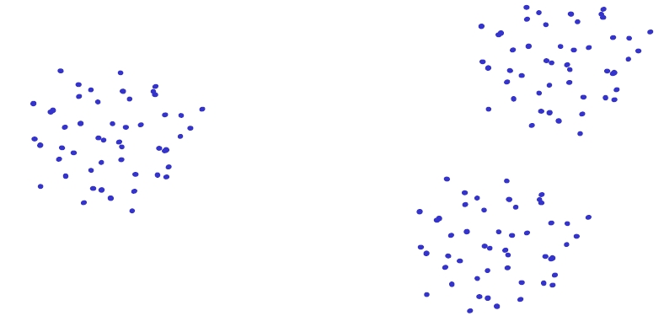
Issues: Seed Choice
Results are quite sensitive to seed selection.
Slide credit: CMU MLD Aarti Singh

Slide 28
Issues: Seed Choice
Results are quite sensitive to seed selection.
Slide credit: CMU MLD Aarti Singh

Slide 29
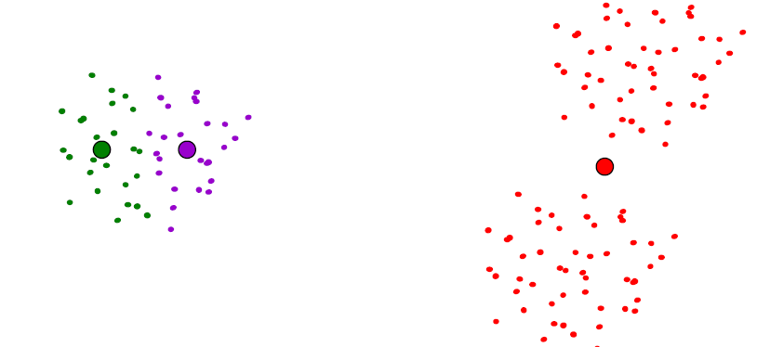
Issues: Seed Choice
Results are quite sensitive to seed selection.
Slide credit: CMU MLD Aarti Singh

Slide 30
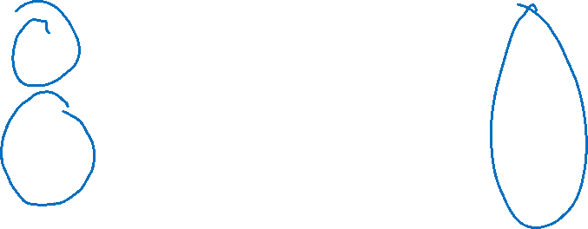
Issues: Seed Choice
K-means always converges, but it may converge at a local optimum that is different from the global optimum, and in fact could be arbitrarily worse in terms of its objective.
Slide credit: CMU MLD Nina Balcan

Slide 31
Issues: Seed Choice
Results can vary based on random seed selection.
Some seeds can result in poor convergence rate, or convergence to sub-optimal clustering.
  Try out multiple starting points (very important!!!)
  k-means ++ algorithm of Arthur and Vassilvitskii
  key idea: choose centers that are far apart
  (probability of picking a point as cluster center distance from nearest center picked so far)
Slide credit: CMU MLD Aarti Singh

Slide 32
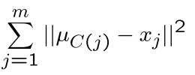
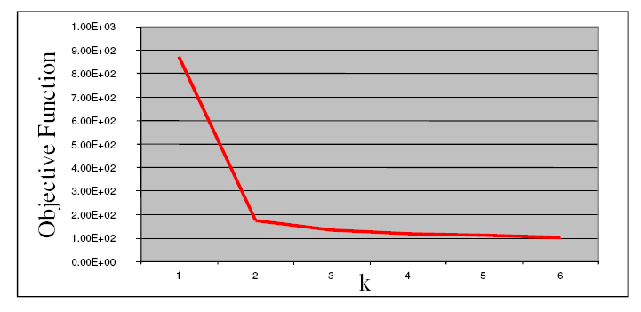

Other Issues
Number of clusters K
  Objective function
  Look for “Knee” in objective function
  Can you pick K by minimizing the objective over K?
Slide credit: CMU MLD Aarti Singh

Slide 33
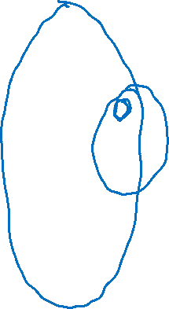
(One) bad case for K-means
Clusters may overlap
Some clusters may be “wider” than others
Clusters may not be linearly separable
Slide credit: CMU MLD Aarti Singh

