Slide 1

Announcements
Assignments
HW8: due Thu, 12/3, 11:59 pm
HW9
    Out Friday
    Due Wed, 12/9, 11:59 pm
    The two slip days are free (last possible submission Fri, 12/11, 11:59 pm)
Final Exam
Mon, 12/14
Stay tuned to Piazza for more details

Slide 2

Wrap-up MDP/RL
RL slides

Slide 3

Introduction to Machine Learning
Support Vector Machines
Instructor: Pat Virtue

Slide 4
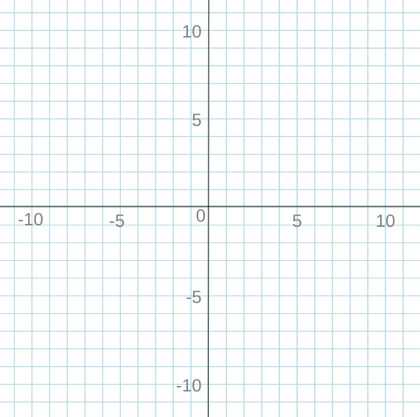
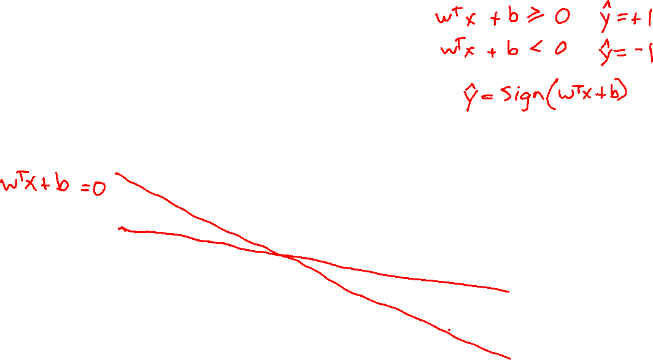
Support Vector Machines
Linear Classification
x₂
x₁

Slide 5
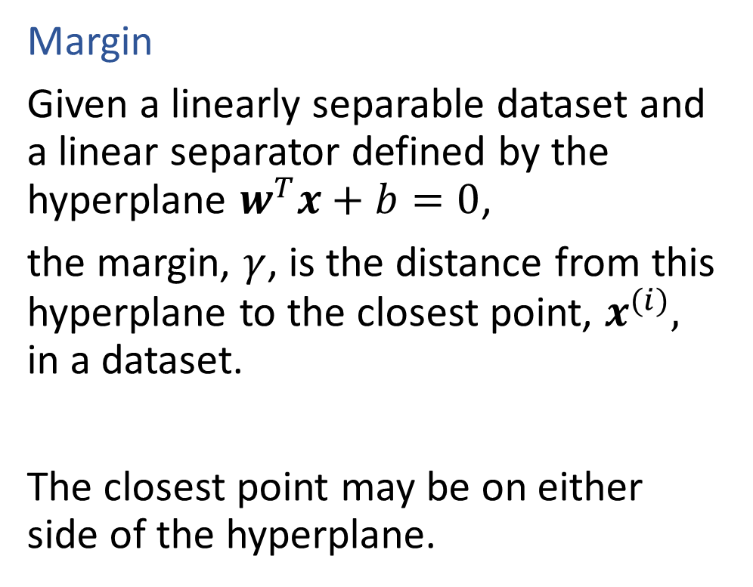
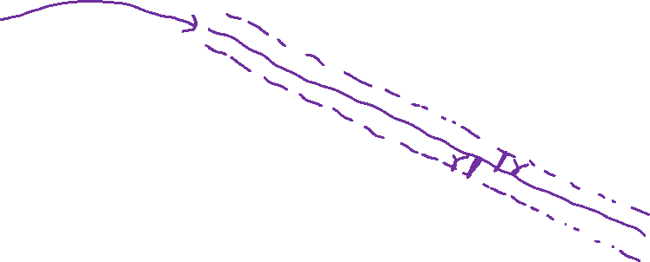
Support Vector Machines
x₂
Margin
Given a linearly separable dataset and a linear separator defined by the hyperplane $w^{T}x+b=0$,
the margin, $γ$, is the distance from this hyperplane to the closest point, $x^{(i)},$ in a dataset.
The closest point may be on either side of the hyperplane.
x₁

Slide 6
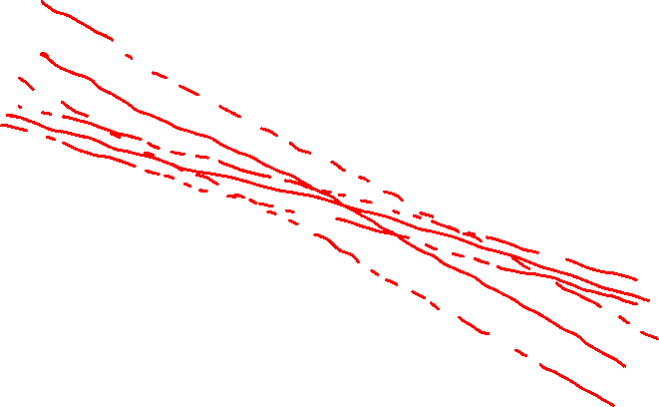
Support Vector Machines
Max Margin
x₂
x₁

Slide 7
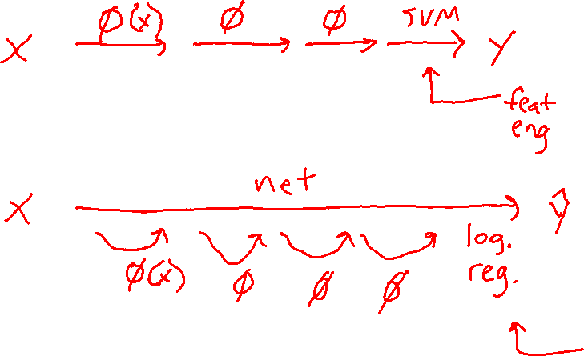
Support Vector Machines
SVM were super popular right before the current deep learning craze

Slide 8
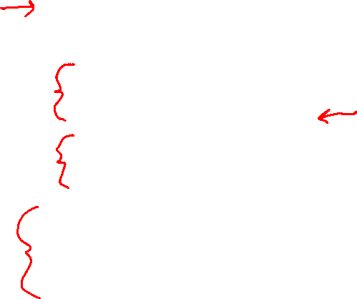
Support Vector Machines
Important concepts withing SVMs
Max-margin classification
Optimization
    Constrained optimization
    Quadratic program
    Primal → dual
    Lagrange Multipliers
Support non-linear classification
    Feature maps
    Kernel trick

Slide 9
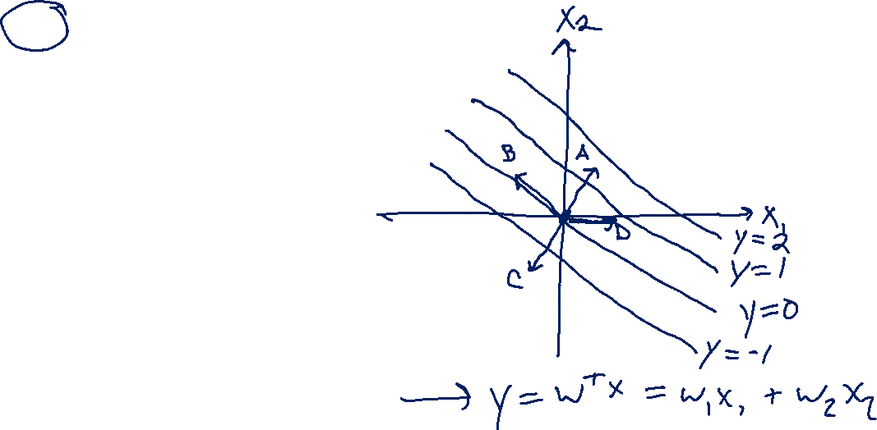
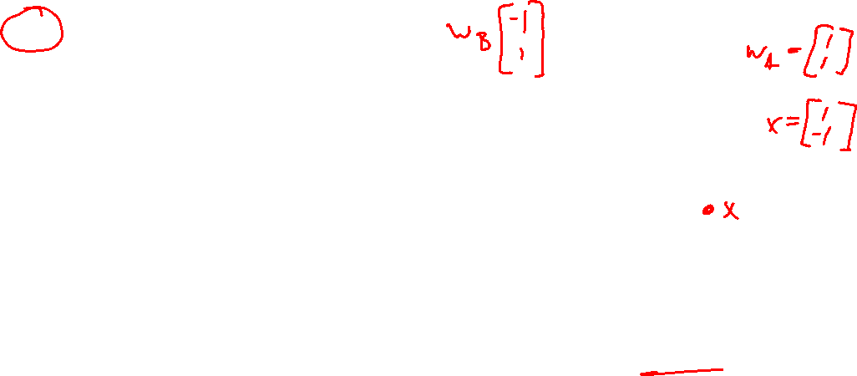

Piazza Poll 1
Which is the correct vector $w$?
  I don’t know

Slide 10

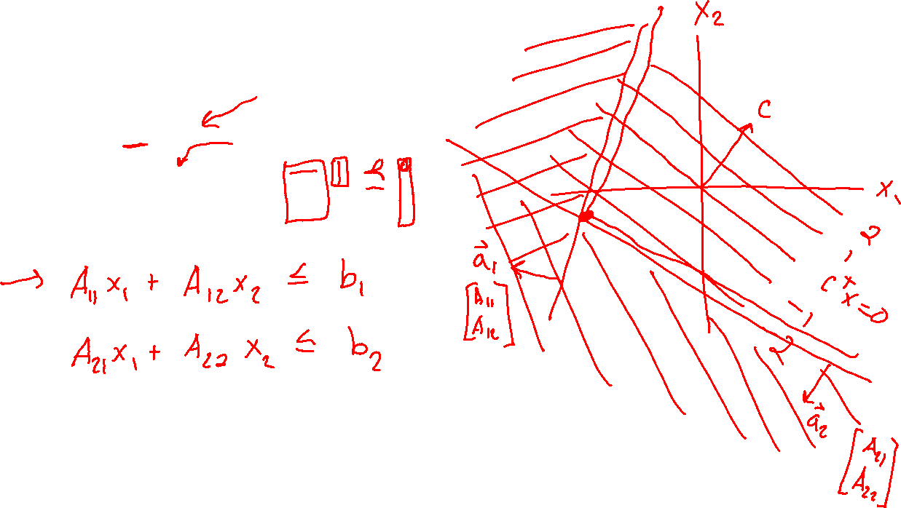
Constrained Optimization
Linear Program
$\min_{x}{ c^{T}x}$
s.t. $Ax⪯b$

Slide 11
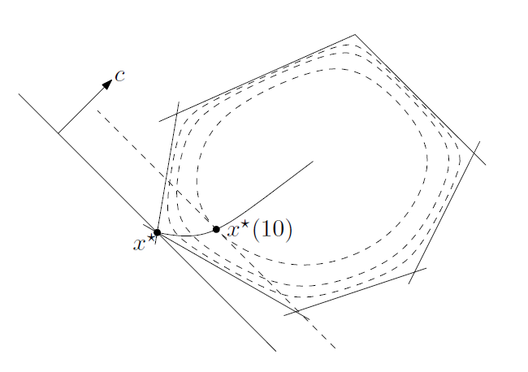


Constrained Optimization
Linear Program
$\min_{x}{ c^{T}x}$
s.t. $Ax⪯b$
Solvers
Simplex
Interior point methods
Figure: Fig 11.2 from Boyd and Vandenberghe, Convex Optimization

Slide 12

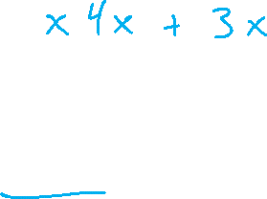
Constrained Optimization
Linear Program
$\min_{x}{ c^{T}x}$
s.t. $Ax⪯b$
Solvers
Simplex
Interior point methods
Quadratic Program
$\min_{x}{ x^{T}Qx+}$ $c^{T}x$
s.t. $Ax⪯b$

Slide 13
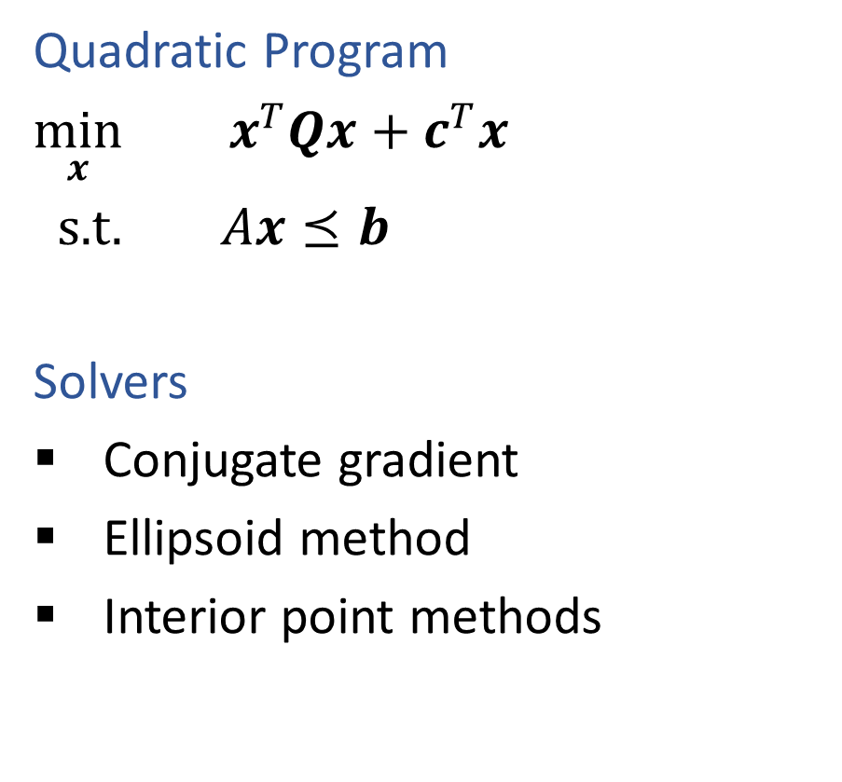
Constrained Optimization
Linear Program
$\min_{x}{ c^{T}x}$
s.t. $Ax⪯b$
Solvers
Simplex
Interior point methods
Quadratic Program
$\min_{x}{ x^{T}Qx+}$ $c^{T}x$
s.t. $Ax⪯b$
Solvers
Conjugate gradient
Ellipsoid method
Interior point methods

Slide 14
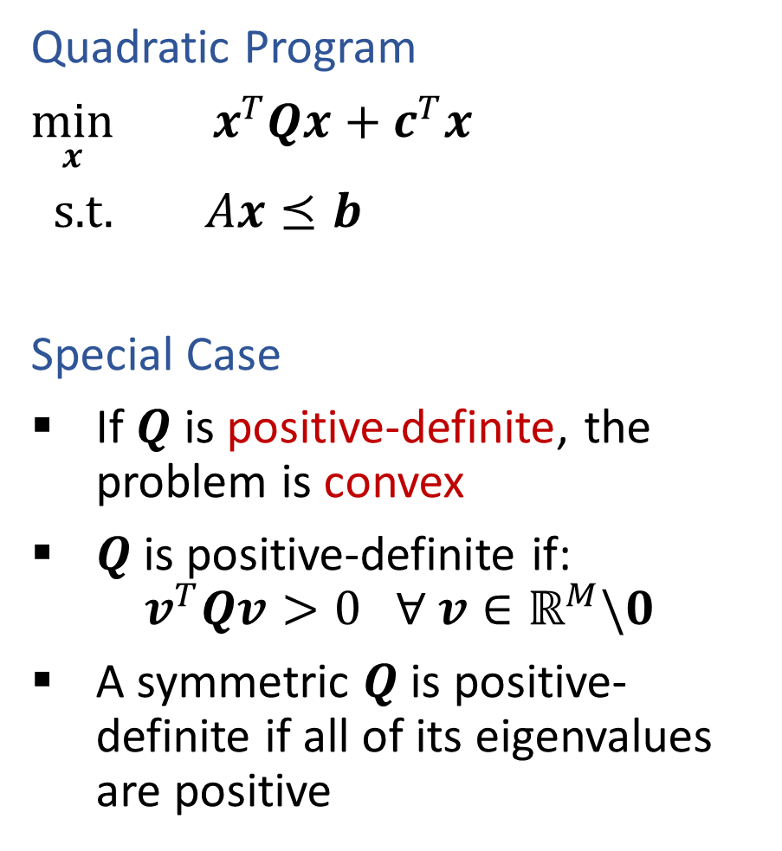

Constrained Optimization
Linear Program
$\min_{x}{ c^{T}x}$
s.t. $Ax⪯b$
Solvers
Simplex
Interior point methods
Quadratic Program
$\min_{x}{ x^{T}Qx+}$ $c^{T}x$
s.t. $Ax⪯b$
Special Case
If $Q$ is positive-definite, the problem is convex
$Q$is positive-definite if:
$$v^{T}Qv>0 ∀ v∈ℝ^{M}\backslash 0$$
A symmetric $Q$is positive-definite if all of its eigenvalues are positive

Slide 15

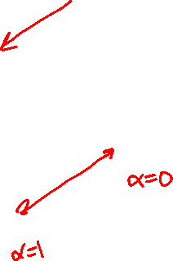
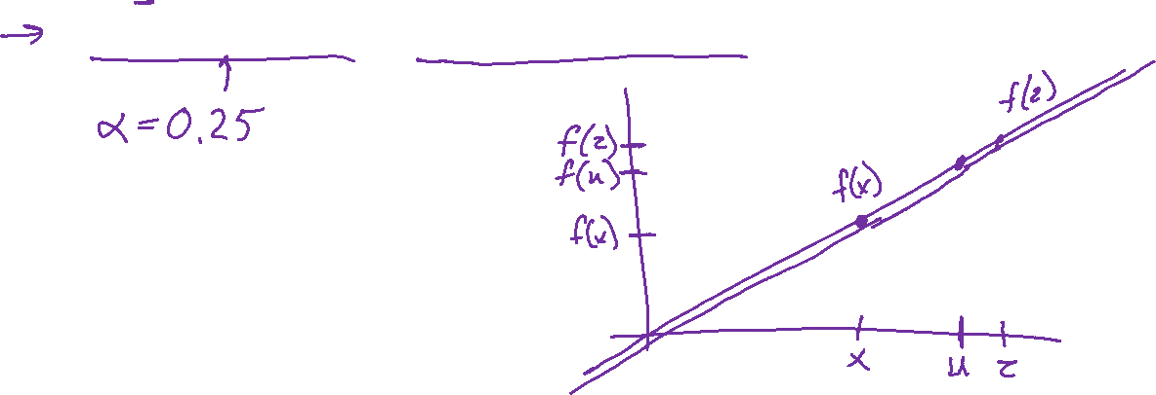
Optimization (from Lecture 7)
Linear function
If $f(x)$ is linear, then:
$f\left(x+z\right)=f\left(x\right)+f\left(z\right)$
$f\left(αx\right)=αf\left(x\right) ∀α$
$f\left(αx+\left(1−α\right)z\right)=αf\left(x\right)+\left(1−α\right)f\left(z\right) ∀α$

Slide 16


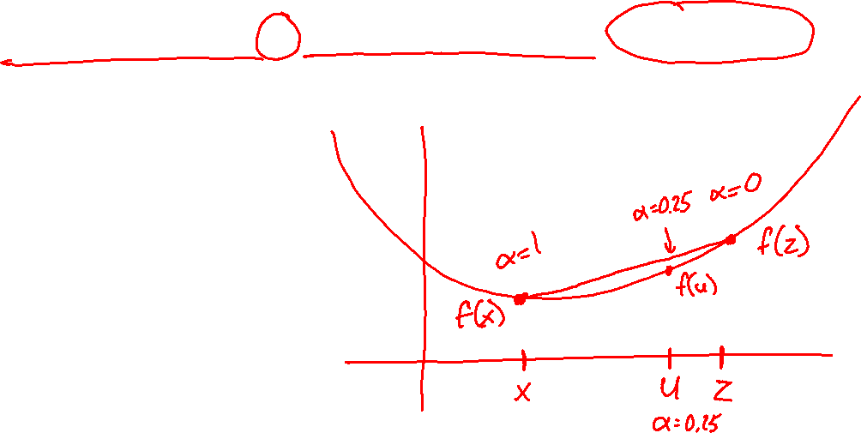
Optimization (from Lecture 7)
Convex function
If $f(x)$ is convex, then:
$f\left(αx+\left(1−α\right)z\right)≤αf\left(x\right)+\left(1−α\right)f\left(z\right) ∀ 0≤α≤1$
Convex optimization
If $f(x)$ is convex, then:
Every local minimum is also a global minimum ☺

Slide 17
Constrained Optimization
Linear Program
$\min_{x}{ c^{T}x}$
s.t. $Ax⪯b$
Solvers
Simplex
Interior point methods
Quadratic Program
$\min_{x}{ x^{T}Qx+}$ $c^{T}x$
s.t. $Ax⪯b$
Special Case
If $Q$ is positive-definite, the problem is convex
$Q$is positive-definite if:
$$v^{T}Qv>0 ∀ v∈ℝ^{M}\backslash 0$$
A symmetric $Q$is positive-definite if all of its eigenvalues are positive

Slide 18
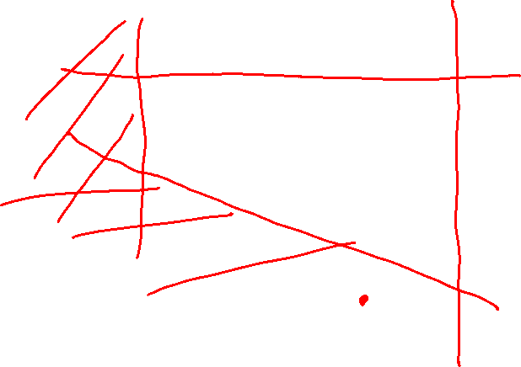
Quadratic Program
Slide credit: CMU MLD Matt Gormley

Slide 19
Quadratic Program
Slide credit: CMU MLD Matt Gormley

Slide 20
Quadratic Program
Slide credit: CMU MLD Matt Gormley

Slide 21
Quadratic Program
Slide credit: CMU MLD Matt Gormley

Slide 22
Quadratic Program
Slide credit: CMU MLD Matt Gormley

Slide 23
Support Vector Machines
Find linear separator with maximum margin

Slide 24
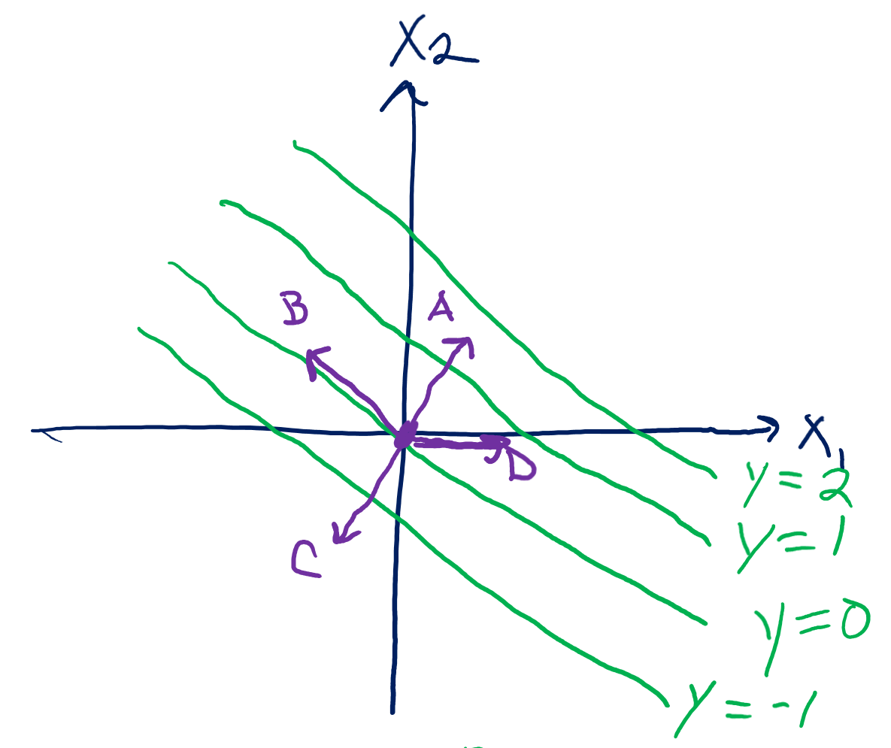
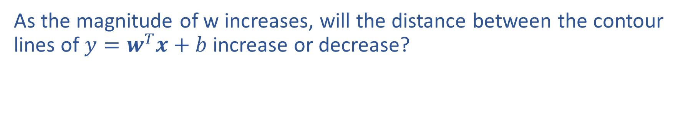

Piazza Poll 2
As the magnitude of w increases, will the distance between the contour lines of $y=w^{T}x+b$ increase or decrease?

Slide 25
Support Vector Machines
Find linear separator with maximum margin
x₂
x₂
x₂
x₁
x₁
x₁

Slide 26
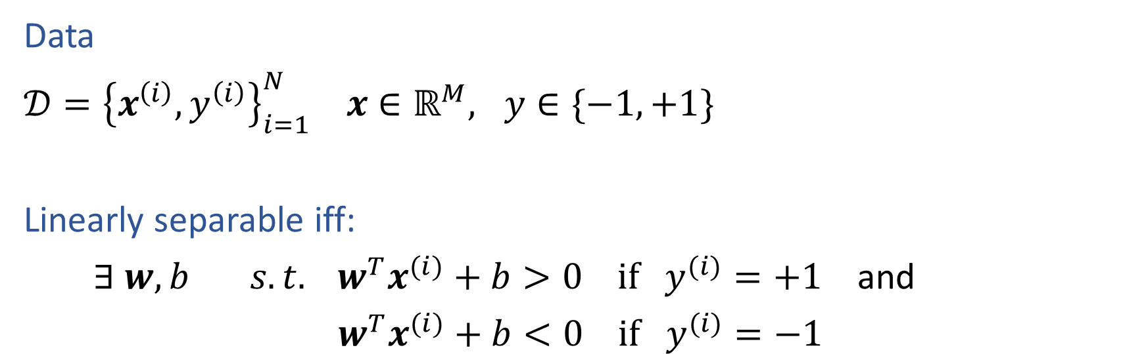
Linear Separability
Data
$𝒟={\left\{x^{\left(i\right)}, y^{\left(i\right)}\right\}}_{i=1}^{N} x∈ℝ^{M}, y∈\{−1, +1\}$
Linearly separable iff:
$∃ w, b s.t. w^{T}x^{(i)}+b>0 if y^{(i)}=+1$ and
$w^{T}x^{(i)}+b<0 if y^{(i)}=−1$
Slide credit: CMU MLD Matt Gormley

Slide 27
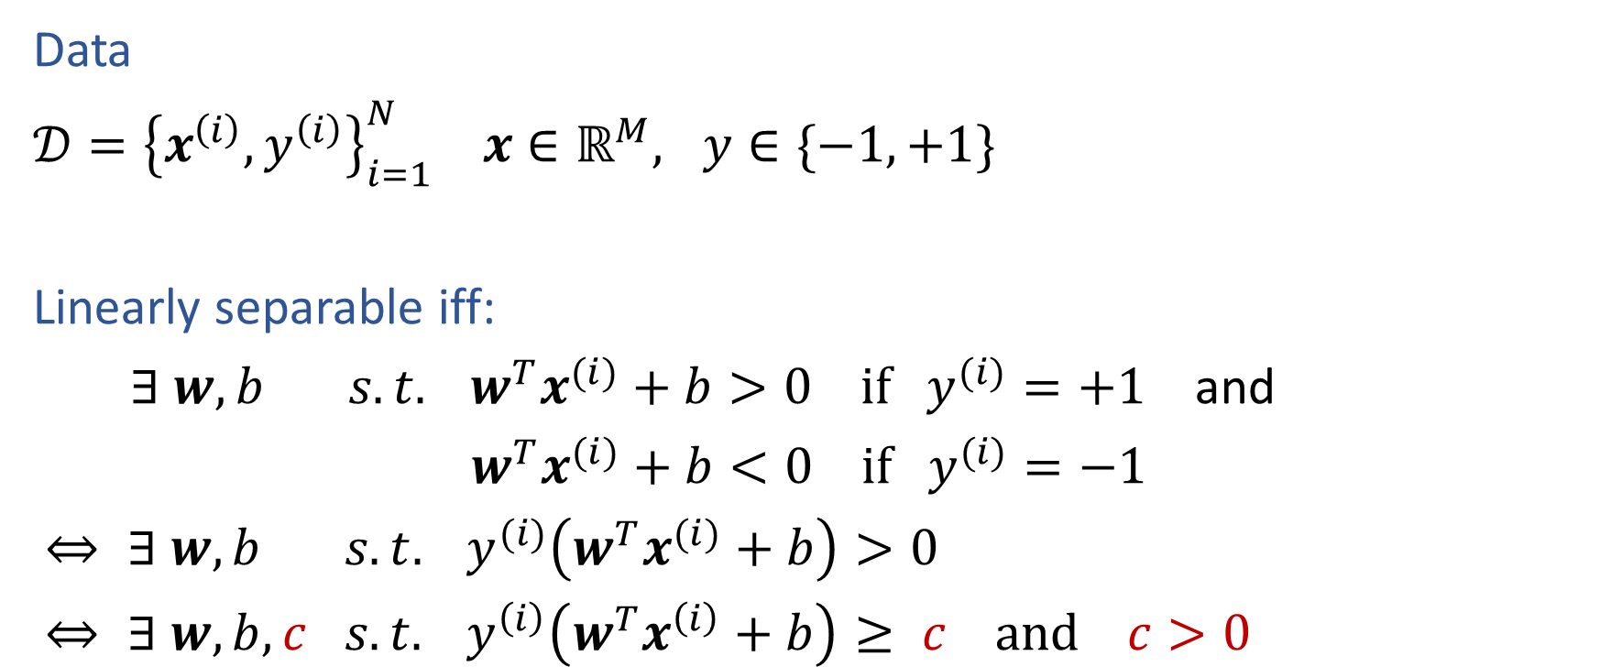
Linear Separability
Data
$𝒟={\left\{x^{\left(i\right)}, y^{\left(i\right)}\right\}}_{i=1}^{N} x∈ℝ^{M}, y∈\{−1, +1\}$
Linearly separable iff:
$∃ w, b s.t. w^{T}x^{(i)}+b>0 if y^{(i)}=+1$ and
$w^{T}x^{(i)}+b<0 if y^{(i)}=−1$
$⇔ ∃ w, b s.t. y^{(i)}\left(w^{T}x^{(i)}+b\right)>0$
$⇔ ∃ w, b,c s.t. y^{\left(i\right)}\left(w^{T}x^{\left(i\right)}+b\right)≥ c and c>0$
Slide credit: CMU MLD Matt Gormley

