Slide 1

Announcements
Assignments
HW8: Out today, due Thu, 12/3, 11:59 pm
Schedule next week
Monday: Recitation in both lecture slots
No lecture Wednesday
No recitation Friday
Final exam scheduled

Slide 2

Introduction to Machine Learning
Reinforcement Learning
Instructor: Pat Virtue

Slide 3
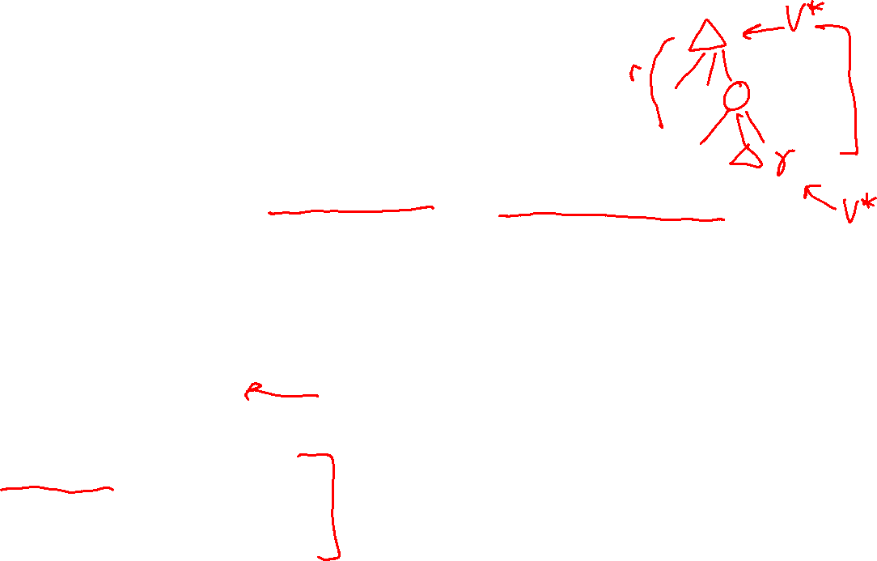
Plan
Last time
Rewards and Discounting
Finding optimal policies: Value iteration and Bellman equations
Today
MDP: How to use optimal values
Reinforcement learning
    Models are gone!
    Rebuilding models
    Sampling and TD learning
    Q-learning
    Approximate Q-learning

Slide 4
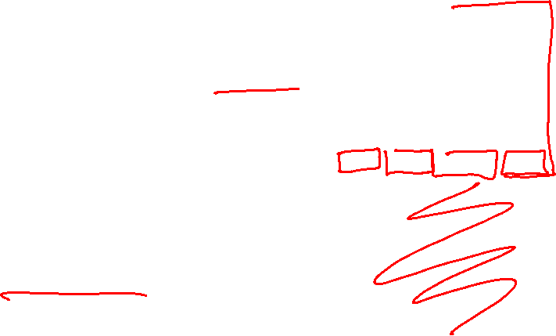
Value Iteration
Start with V₀(s) = 0: no time steps left means an expected reward sum of zero
Given vector of V_{k}(s) values, do one ply of expectimax from each state:
Repeat until convergence
Complexity of each iteration: O(S²A)
Theorem: will converge to unique optimal values
  Basic idea: approximations get refined towards optimal values
  Policy may converge long before values do
V_{k+1}(s)
a
s, a
s,a,s’
V_{k}(s’)
Slide: ai.berkeley.edu
Notes:
Discuss computational complexity: S * A * S times number of iterations
Note: updates not in place [if in place, it means something else and not even clear what it means]

Slide 5
Optimal Quantities
The value (utility) of a state s:
  V*(s) = expected utility starting in s and acting optimally
The value (utility) of a q-state (s,a):
  Q*(s,a) = expected utility starting out having taken action a from state s and (thereafter) acting optimally
The optimal policy:
  π*(s) = optimal action from state s
s
s is a state
a
(s, a) is a q-state
s, a
s,a,s’
(s,a,s’) is a
transition
s’
[Demo – gridworld values (L8D4)]
Notes:
[Note: this demo doesn’t show anything in action, just pops up V and Q values.]

Slide 6

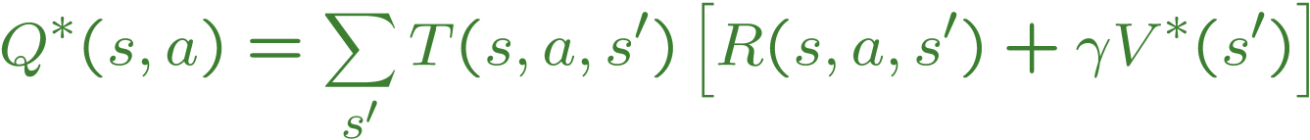
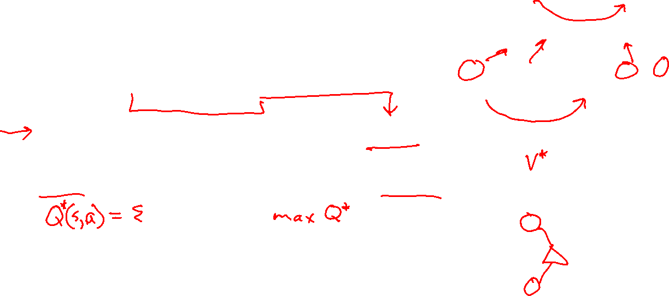
The Bellman Equations
s
Definition of “optimal utility” via expectimax recurrence gives a simple one-step lookahead relationship amongst optimal utility values
These are the Bellman equations, and they characterize optimal values in a way we’ll use over and over
a
s, a
s,a,s’
s’
Slide: ai.berkeley.edu
Notes:
Let’s start by equations that characterize these quantities through mutual recursions. [step through this by writing on slide, one step at a time]
Recursive characterization of V* in terms of V*; not necessarily helpful; but it is a characterization.
Note: this is a set of equations that needs to be satisfied; but it could have multiple solutions (it does not, but at this stage of our knowledge it could).

Slide 7
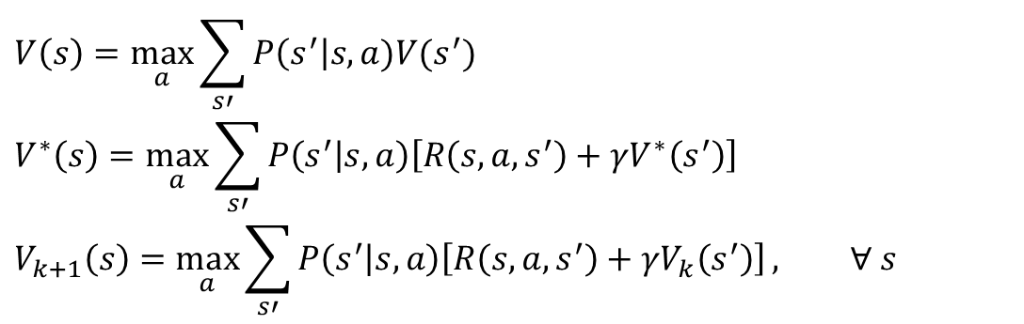
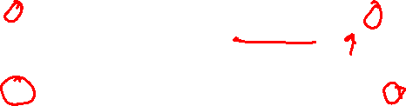
MDP Notation
$$V\left(s\right)=\max_{a}{\sum_{s′}{P\left(s^{′}\right|s,a)V(s^{′})}}$$
$$V^{∗}\left(s\right)=\max_{a}{\sum_{s′}{P\left(s^{′} | s,a\right)\left[R\left(s,a,s^{′}\right)+γV^{∗}\left(s^{′}\right)\right]}}$$
$$V_{k+1}\left(s\right)=\max_{a}{\sum_{s′}{P\left(s^{′} | s,a\right)\left[R\left(s,a,s^{′}\right)+γV_{k}\left(s^{′}\right)\right]}}, ∀ s$$
Standard expectimax:
Bellman equations:
Value iteration:

Slide 8
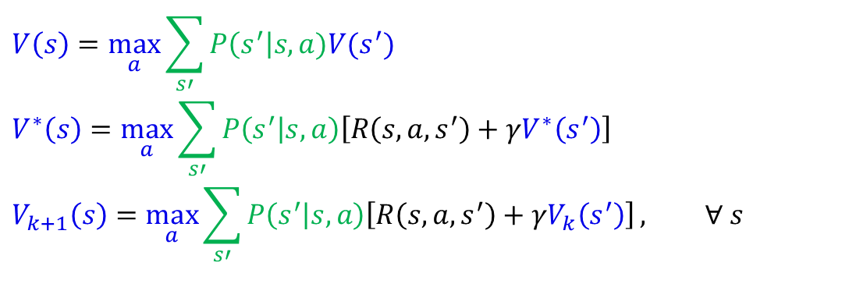
MDP Notation
$$V\left(s\right)=\max_{a}{\sum_{s′}{P\left(s^{′}\right|s,a)V(s^{′})}}$$
$$V^{∗}\left(s\right)=\max_{a}{\sum_{s′}{P\left(s^{′} | s,a\right)\left[R\left(s,a,s^{′}\right)+γV^{∗}\left(s^{′}\right)\right]}}$$
$$V_{k+1}\left(s\right)=\max_{a}{\sum_{s′}{P\left(s^{′} | s,a\right)\left[R\left(s,a,s^{′}\right)+γV_{k}\left(s^{′}\right)\right]}}, ∀ s$$
Standard expectimax:
Bellman equations:
Value iteration:

Slide 9
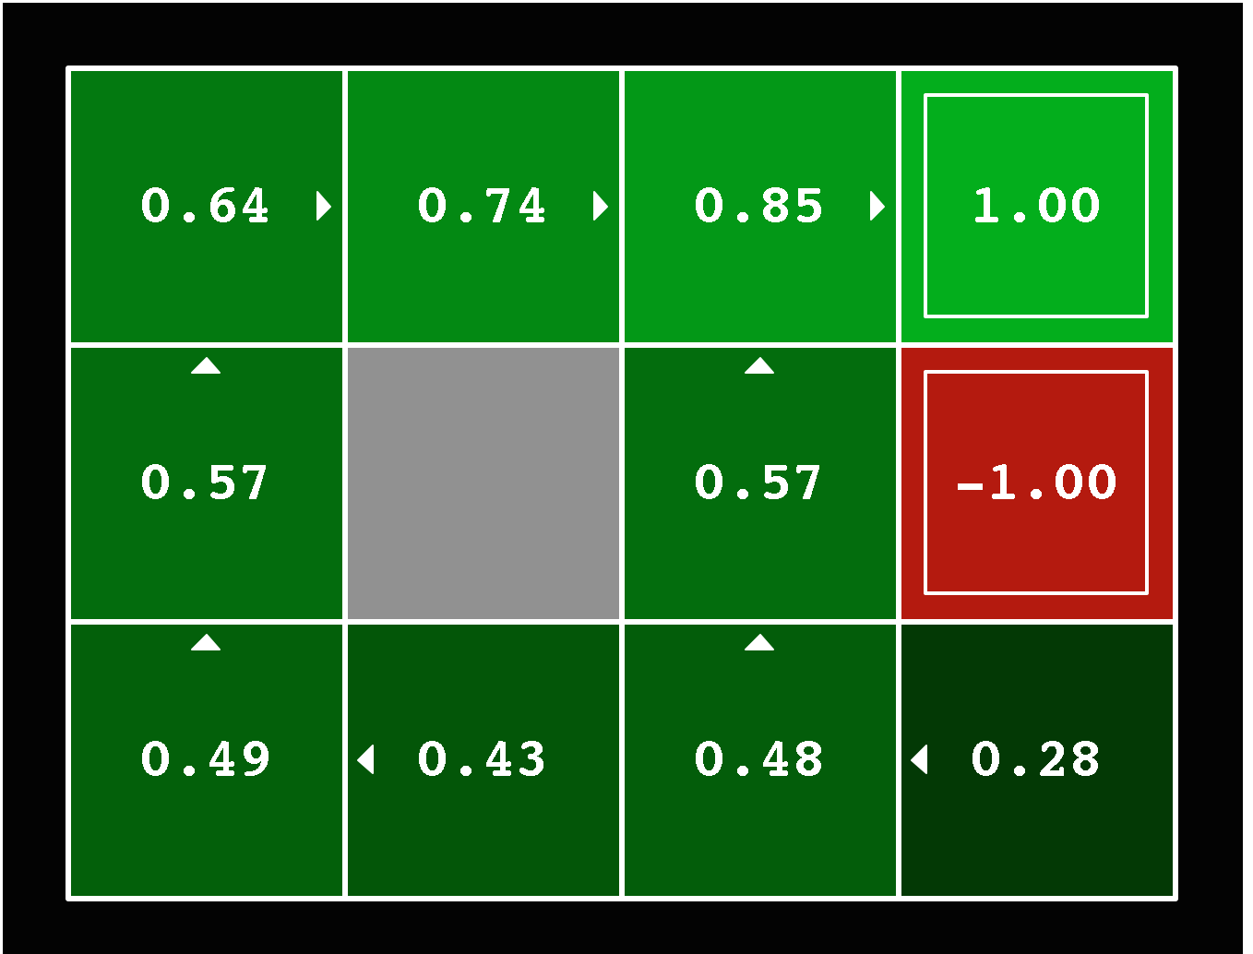
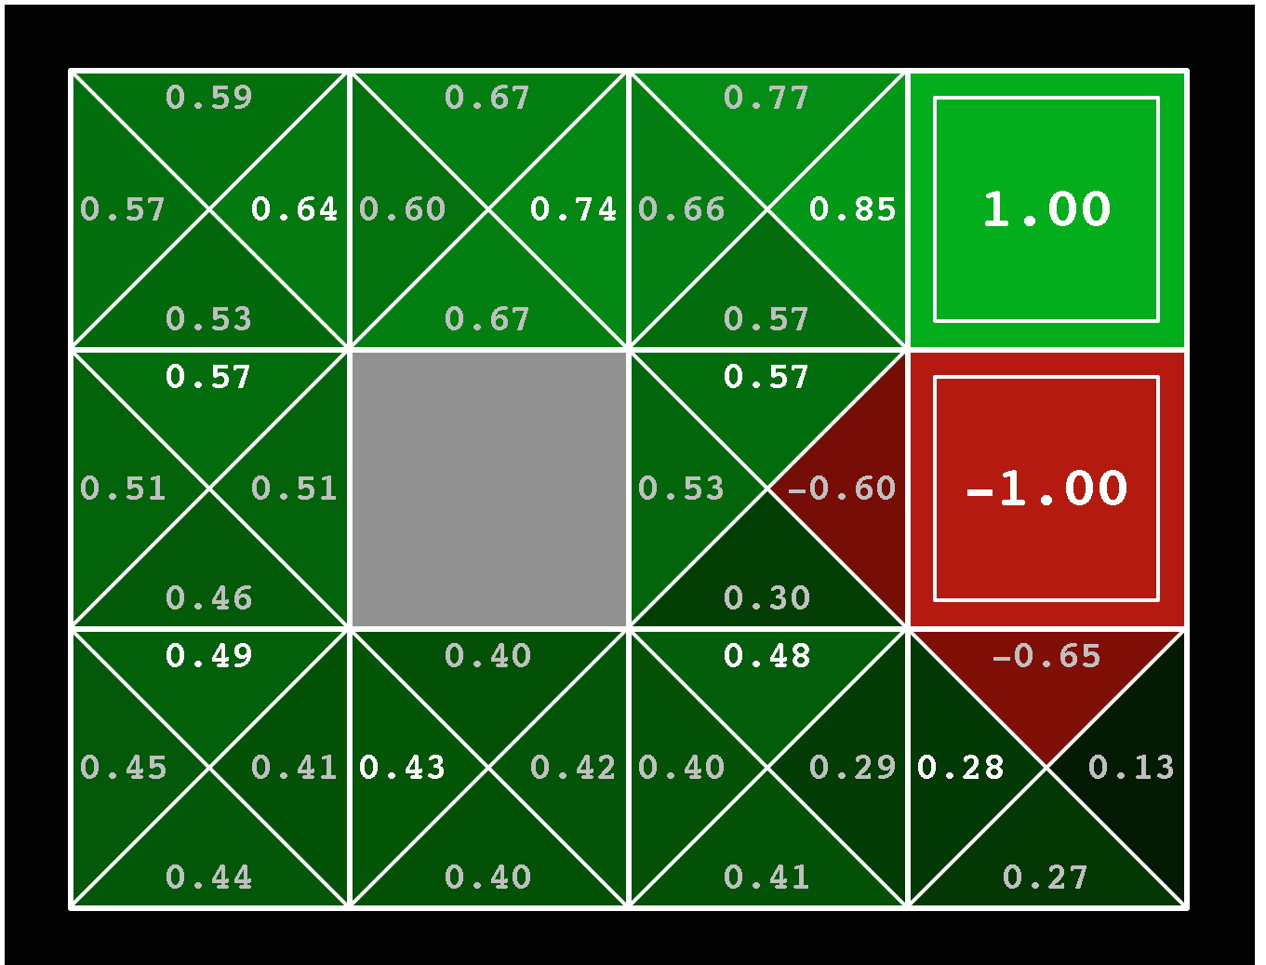
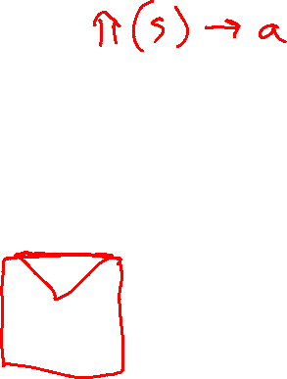


Solved MDP! Now what?
What are we going to do with these values??
$$V^{∗}\left(s\right)$$
$$Q^{∗}\left(s,a\right)$$

Slide 10
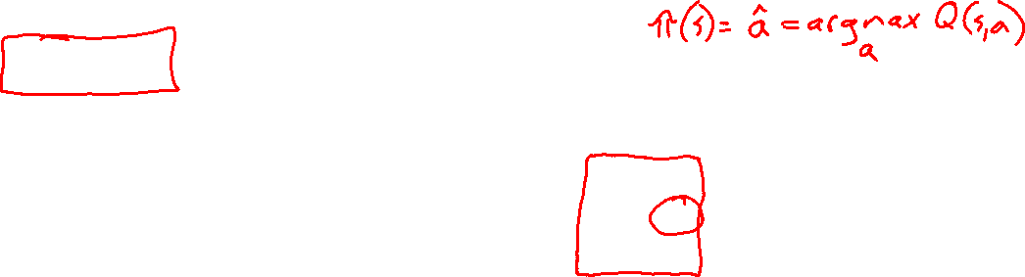
Piazza Poll 1
If you need to extract a policy, would you rather have
A) Values, B) Q-values or C) Z-values?

Slide 11
Piazza Poll 1
If you need to extract a policy, would you rather have
A) Values, B) Q-values or C) Z-values?

Slide 12
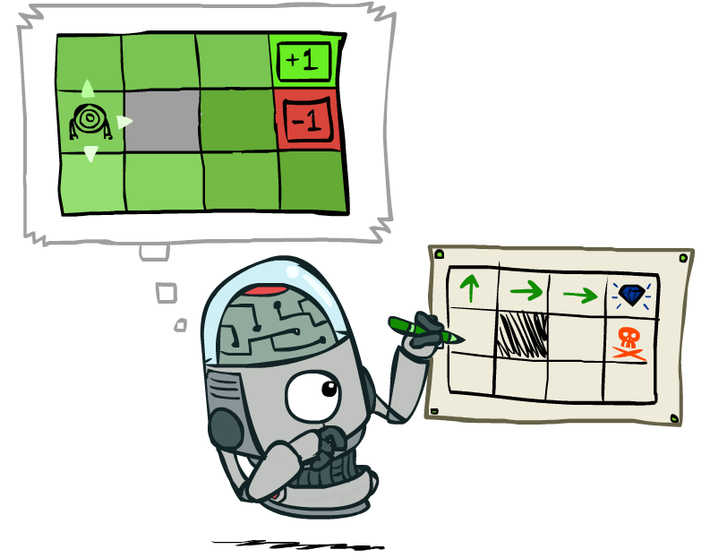
Policy Extraction
Slide: ai.berkeley.edu

Slide 13
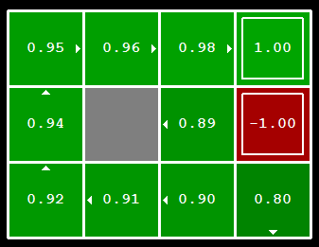

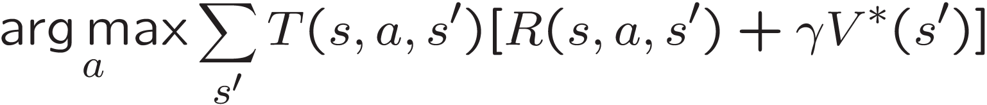
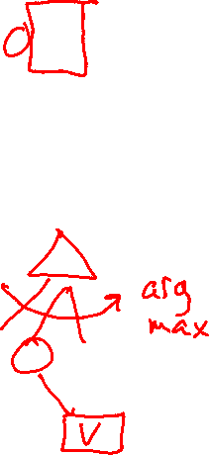
Computing Actions from Values
Let’s imagine we have the optimal values V*(s)
How should we act?
  It’s not obvious!
We need to do a mini-expectimax (one step)
This is called policy extraction, since it gets the policy implied by the values
Slide: ai.berkeley.edu

Slide 14
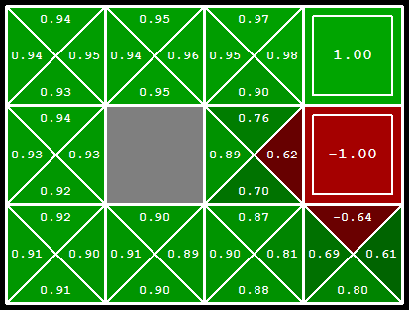
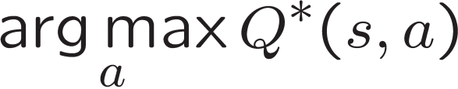

Computing Actions from Q-Values
Let’s imagine we have the optimal q-values:
How should we act?
  Completely trivial to decide!
Important lesson: actions are easier to select from q-values than values!
Slide: ai.berkeley.edu

Slide 15
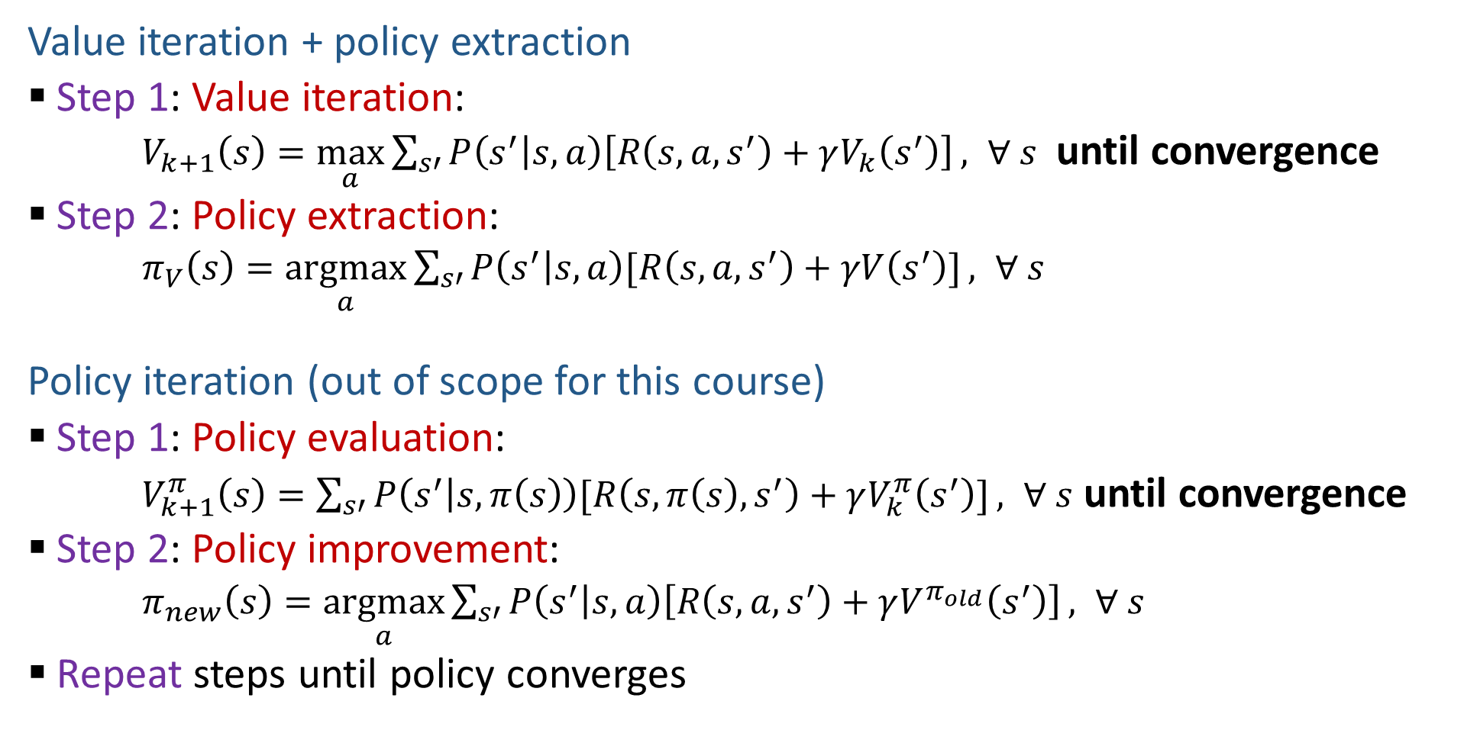
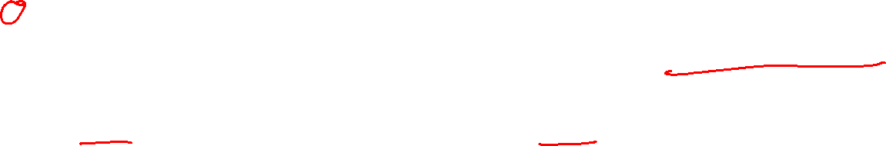
Two Methods for Solving MDPs
Value iteration + policy extraction
  Step 1: Value iteration:
  $V_{k+1}\left(s\right)=\max_{a}{\sum_{s′}{P\left(s^{′} | s,a\right)\left[R\left(s,a,s^{′}\right)+γV_{k}\left(s^{′}\right)\right]}}, ∀ s$ until convergence
  Step 2: Policy extraction:
  $π_{V}\left(s\right)=\underset{a}{argmax}{\sum_{s′}{P\left(s^{′} | s,a\right)[R\left(s,a,s^{′}\right)+γV\left(s^{′}\right)]}}, ∀ s$
Policy iteration (out of scope for this course)
  Step 1: Policy evaluation:
  $V_{k+1}^{π}\left(s\right)=\sum_{s′}{P\left(s^{′} | s,π\left(s\right)\right)[R\left(s,π\left(s\right),s^{′}\right)+γV_{k}^{π}\left(s^{′}\right)]}, ∀ s$ until convergence
  Step 2: Policy improvement:
  $π_{new}\left(s\right)=\underset{a}{argmax}{\sum_{s′}{P\left(s^{′} | s,a\right)\left[R\left(s,a,s^{′}\right)+γV^{π_{old}}\left(s^{′}\right)\right]}}, ∀ s$
  Repeat steps until policy converges

Slide 16
Summary: MDP Algorithms
So you want to….
  Compute optimal values: use value iteration or policy iteration
  Turn your values into a policy: use policy extraction (one-step lookahead)
All these equations look the same!
  They basically are – they are all variations of Bellman updates
  They all use one-step lookahead expectimax fragments
  They differ only in whether we plug in a fixed policy or max over actions

Slide 17
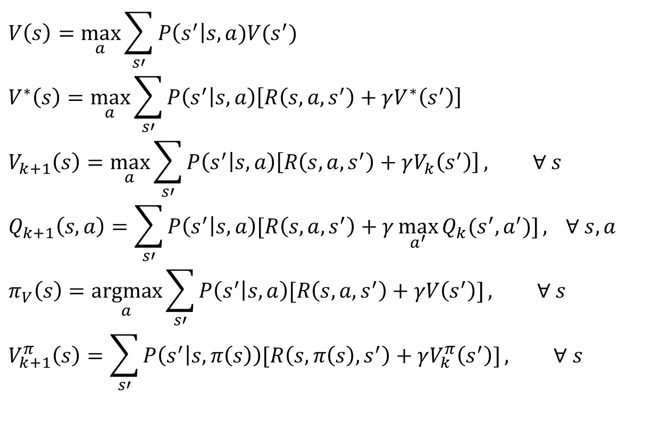
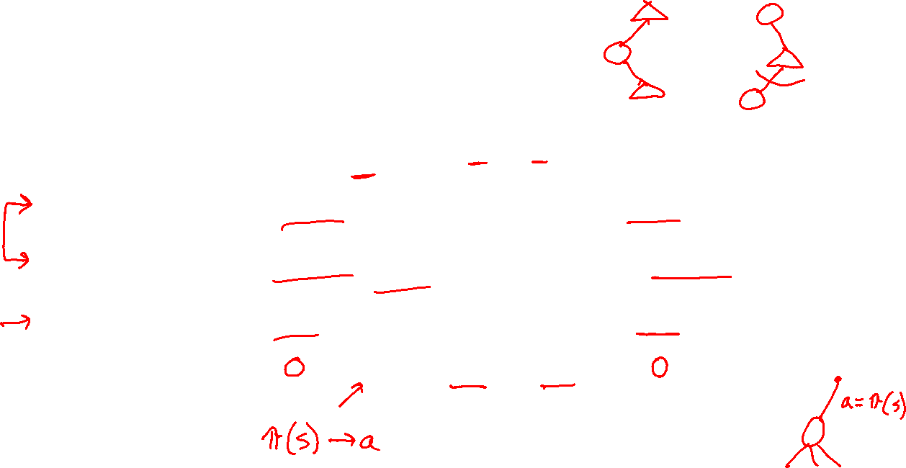
MDP Notation
$$V\left(s\right)=\max_{a}{\sum_{s′}{P\left(s^{′}\right|s,a)V(s^{′})}}$$
$$V^{∗}\left(s\right)=\max_{a}{\sum_{s′}{P\left(s^{′} | s,a\right)\left[R\left(s,a,s^{′}\right)+γV^{∗}\left(s^{′}\right)\right]}}$$
$$V_{k+1}\left(s\right)=\max_{a}{\sum_{s′}{P\left(s^{′} | s,a\right)\left[R\left(s,a,s^{′}\right)+γV_{k}\left(s^{′}\right)\right]}}, ∀ s$$
$$Q_{k+1}\left(s,a\right)=\sum_{s′}{P\left(s^{′} | s,a\right)[R\left(s,a,s^{′}\right)+γ\max_{a^{′}}{Q_{k}(s^{′},a^{′})]}, } ∀ s,a$$
$$π_{V}\left(s\right)=\underset{a}{argmax}{\sum_{s′}{P\left(s^{′} | s,a\right)[R\left(s,a,s^{′}\right)+γV\left(s^{′}\right)]}}, ∀ s$$
$$V_{k+1}^{π}\left(s\right)=\sum_{s′}{P\left(s^{′} | s,π\left(s\right)\right)[R\left(s,π\left(s\right),s^{′}\right)+γV_{k}^{π}\left(s^{′}\right)]}, ∀ s$$
Standard expectimax:
Bellman equations:
Value iteration:
Q-iteration:
Policy extraction:
Policy evaluation:

Slide 18
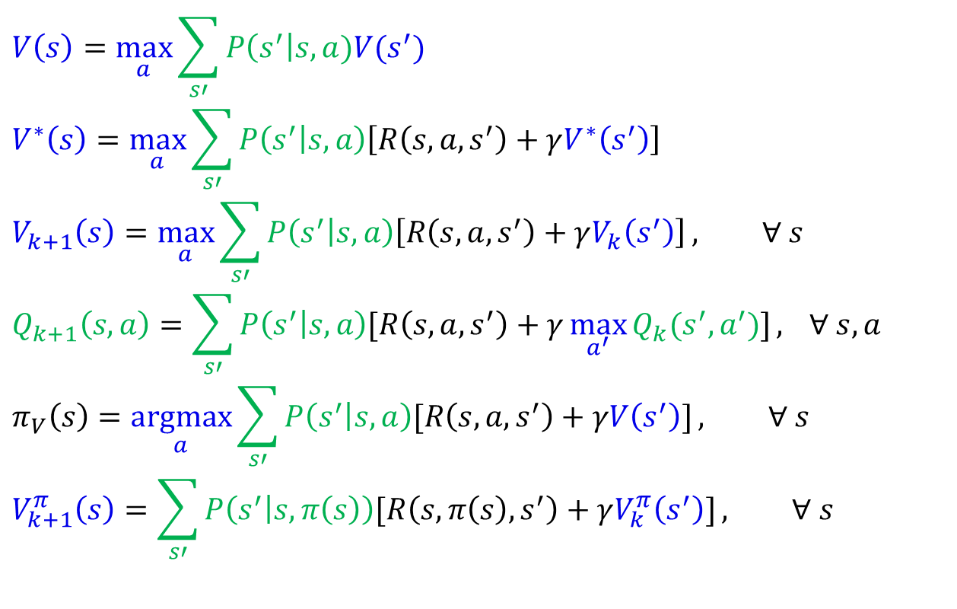
MDP Notation
$$V\left(s\right)=\max_{a}{\sum_{s′}{P\left(s^{′}\right|s,a)V(s^{′})}}$$
$$V^{∗}\left(s\right)=\max_{a}{\sum_{s′}{P\left(s^{′} | s,a\right)\left[R\left(s,a,s^{′}\right)+γV^{∗}\left(s^{′}\right)\right]}}$$
$$V_{k+1}\left(s\right)=\max_{a}{\sum_{s′}{P\left(s^{′} | s,a\right)\left[R\left(s,a,s^{′}\right)+γV_{k}\left(s^{′}\right)\right]}}, ∀ s$$
$$Q_{k+1}\left(s,a\right)=\sum_{s′}{P\left(s^{′} | s,a\right)[R\left(s,a,s^{′}\right)+γ\max_{a^{′}}{Q_{k}(s^{′},a^{′})]}, } ∀ s,a$$
$$π_{V}\left(s\right)=\underset{a}{argmax}{\sum_{s′}{P\left(s^{′} | s,a\right)[R\left(s,a,s^{′}\right)+γV\left(s^{′}\right)]}}, ∀ s$$
$$V_{k+1}^{π}\left(s\right)=\sum_{s′}{P\left(s^{′} | s,π\left(s\right)\right)[R\left(s,π\left(s\right),s^{′}\right)+γV_{k}^{π}\left(s^{′}\right)]}, ∀ s$$
Standard expectimax:
Bellman equations:
Value iteration:
Q-iteration:
Policy extraction:
Policy evaluation:

Slide 19
MDP Notation
$$V\left(s\right)=\max_{a}{\sum_{s′}{P\left(s^{′}\right|s,a)V(s^{′})}}$$
$$V^{∗}\left(s\right)=\max_{a}{\sum_{s′}{P\left(s^{′} | s,a\right)\left[R\left(s,a,s^{′}\right)+γV^{∗}\left(s^{′}\right)\right]}}$$
$$V_{k+1}\left(s\right)=\max_{a}{\sum_{s′}{P\left(s^{′} | s,a\right)\left[R\left(s,a,s^{′}\right)+γV_{k}\left(s^{′}\right)\right]}}, ∀ s$$
$$Q_{k+1}\left(s,a\right)=\sum_{s′}{P\left(s^{′} | s,a\right)[R\left(s,a,s^{′}\right)+γ\max_{a^{′}}{Q_{k}(s^{′},a^{′})]}, } ∀ s,a$$
$$π_{V}\left(s\right)=\underset{a}{argmax}{\sum_{s′}{P\left(s^{′} | s,a\right)[R\left(s,a,s^{′}\right)+γV\left(s^{′}\right)]}}, ∀ s$$
$$V_{k+1}^{π}\left(s\right)=\sum_{s′}{P\left(s^{′} | s,π\left(s\right)\right)[R\left(s,π\left(s\right),s^{′}\right)+γV_{k}^{π}\left(s^{′}\right)]}, ∀ s$$
Standard expectimax:
Bellman equations:
Value iteration:
Q-iteration:
Policy extraction:
Policy evaluation:

Slide 20
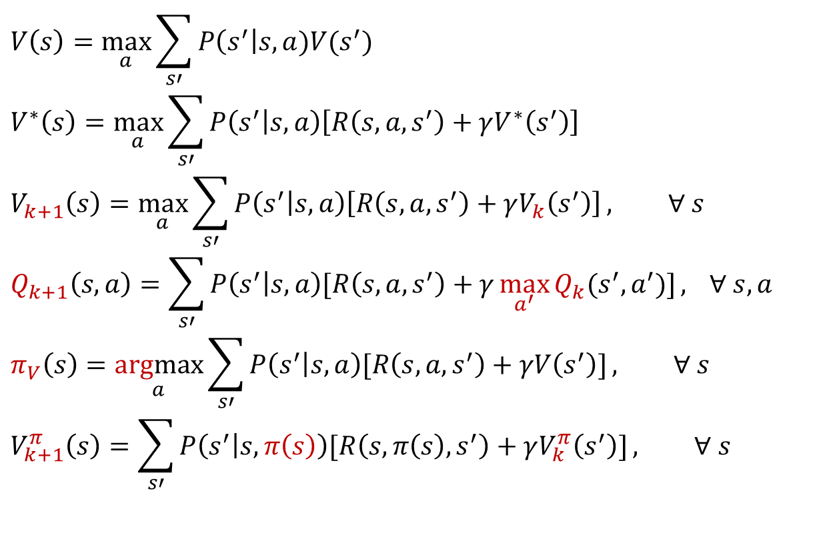
MDP Notation
$$V\left(s\right)=\max_{a}{\sum_{s′}{P\left(s^{′}\right|s,a)V(s^{′})}}$$
$$V^{∗}\left(s\right)=\max_{a}{\sum_{s′}{P\left(s^{′} | s,a\right)\left[R\left(s,a,s^{′}\right)+γV^{∗}\left(s^{′}\right)\right]}}$$
$$V_{k+1}\left(s\right)=\max_{a}{\sum_{s′}{P\left(s^{′} | s,a\right)\left[R\left(s,a,s^{′}\right)+γV_{k}\left(s^{′}\right)\right]}}, ∀ s$$
$$Q_{k+1}\left(s,a\right)=\sum_{s′}{P\left(s^{′} | s,a\right)[R\left(s,a,s^{′}\right)+γ\max_{a^{′}}{Q_{k}(s^{′},a^{′})]}, } ∀ s,a$$
$$π_{V}\left(s\right)=\underset{a}{argmax}{\sum_{s′}{P\left(s^{′} | s,a\right)[R\left(s,a,s^{′}\right)+γV\left(s^{′}\right)]}}, ∀ s$$
$$V_{k+1}^{π}\left(s\right)=\sum_{s′}{P\left(s^{′} | s,π\left(s\right)\right)[R\left(s,π\left(s\right),s^{′}\right)+γV_{k}^{π}\left(s^{′}\right)]}, ∀ s$$
Standard expectimax:
Bellman equations:
Value iteration:
Q-iteration:
Policy extraction:
Policy evaluation:

Slide 21
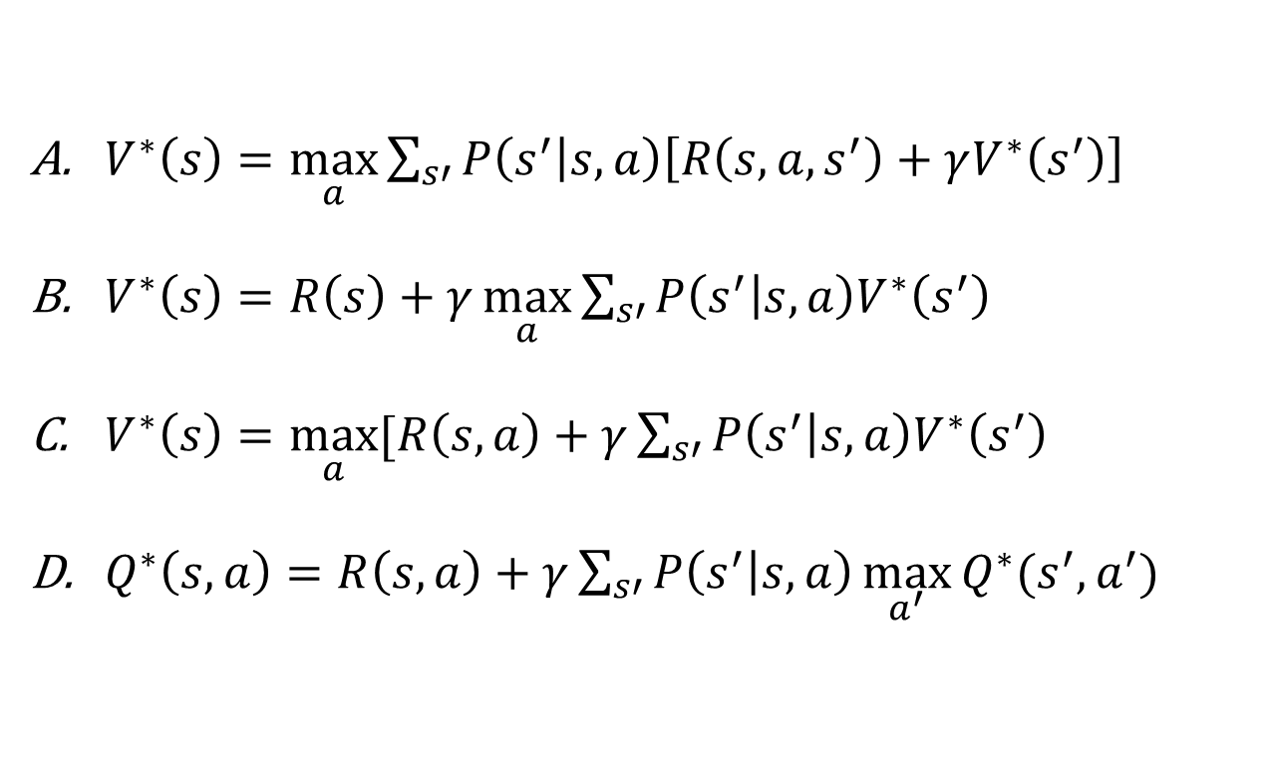
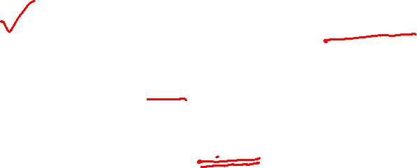
Piazza Poll 2
Rewards may depend on any combination of state, action, next state.
Which of the following are valid formulations of the Bellman equations?
Select ALL that apply.
$V^{∗}\left(s\right)=\max_{a}{\sum_{s′}{P\left(s^{′} | s,a\right)\left[R\left(s,a,s^{′}\right)+γV^{∗}\left(s^{′}\right)\right]}}$
$V^{∗}\left(s\right)=R\left(s\right)+γ\max_{a}{\sum_{s′}{P\left(s^{′} | s,a\right)V^{∗}\left(s^{′}\right)}}$
$V^{∗}\left(s\right)=\max_{a}{[R\left(s, a\right)+γ\sum_{s′}{P\left(s^{′} | s,a\right)V^{∗}\left(s^{′}\right)}}$
$Q^{∗}\left(s,a\right)=R\left(s, a\right)+γ\sum_{s′}{P\left(s^{′} | s,a\right)\max_{a^{′}}{Q^{∗}(s^{′},a^{′})} }$

Slide 22

Piazza Poll 2
Rewards may depend on any combination of state, action, next state.
Which of the following are valid formulations of the Bellman equations?
Select ALL that apply.
$V^{∗}\left(s\right)=\max_{a}{\sum_{s′}{P\left(s^{′} | s,a\right)\left[R\left(s,a,s^{′}\right)+γV^{∗}\left(s^{′}\right)\right]}}$
$V^{∗}\left(s\right)=R\left(s\right)+γ\max_{a}{\sum_{s′}{P\left(s^{′} | s,a\right)V^{∗}\left(s^{′}\right)}}$
$V^{∗}\left(s\right)=\max_{a}{[R\left(s, a\right)+γ\sum_{s′}{P\left(s^{′} | s,a\right)V^{∗}\left(s^{′}\right)}}$
$Q^{∗}\left(s,a\right)=R\left(s, a\right)+γ\sum_{s′}{P\left(s^{′} | s,a\right)\max_{a^{′}}{Q^{∗}(s^{′},a^{′})} }$

Slide 23

Reinforcement Learning
Image: ai.berkeley.edu

Slide 24



Double Bandits
Slide: ai.berkeley.edu

Slide 25
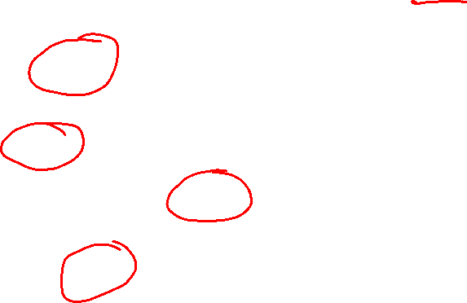
Double-Bandit MDP
No discount
100 time steps
Both states have the same value
Actions: Blue, Red
States: Win, Lose
0.25 $0
0.75
$2
W
L
0.25
$0
$1
1.0
$1
1.0
0.75 $2
Slide: ai.berkeley.edu

Slide 26
Offline Planning
No discount
100 time steps
Both states have the same value
Solving MDPs is offline planning
  You determine all quantities through computation
  You need to know the details of the MDP
  You do not actually play the game!
0.25 $0
Value
0.75
$2
0.25
$0
Play Red
150
W
L
$1
1.0
$1
1.0
0.75 $2
Play Blue
100
Slide: ai.berkeley.edu

Slide 27
Let’s Play!
$2
$2
$0
$2
$2
$2
$2
$0
$0
$0
Slide: ai.berkeley.edu

Slide 28
Online Planning
Rules changed! Red’s win chance is different.
?? $0
??
$2
W
L
??
$0
$1
1.0
$1
1.0
?? $2
Slide: ai.berkeley.edu

Slide 29
Let’s Play!
$0
$0
$0
$2
$0
$2
$0
$0
$0
$0
Slide: ai.berkeley.edu

Slide 30
What Just Happened?
That wasn’t planning, it was learning!
  Specifically, reinforcement learning
  There was an MDP, but you couldn’t solve it with just computation
  You needed to actually act to figure it out
Important ideas in reinforcement learning that came up
  Exploration: you have to try unknown actions to get information
  Exploitation: eventually, you have to use what you know
  Regret: even if you learn intelligently, you make mistakes
  Sampling: because of chance, you have to try things repeatedly
  Difficulty: learning can be much harder than solving a known MDP
Slide: ai.berkeley.edu

Slide 31



Reinforcement learning
What if we didn’t know $P(s’|s,a)$and $R(s,a,s’)$?
$$V_{k+1}\left(s\right)=\max_{a}{\sum_{s′}{P\left(s^{′} | s,a\right)\left[R\left(s,a,s^{′}\right)+γV_{k}\left(s^{′}\right)\right]}}, ∀ s$$
$$Q_{k+1}\left(s,a\right)=\sum_{s′}{P\left(s^{′} | s,a\right)[R\left(s,a,s^{′}\right)+γ\max_{a^{′}}{Q_{k}(s^{′},a^{′})]}, } ∀ s,a$$
$$π_{V}\left(s\right)=\underset{a}{argmax}{\sum_{s′}{P\left(s^{′} | s,a\right)[R\left(s,a,s^{′}\right)+γV\left(s^{′}\right)]}}, ∀ s$$
$$V_{k+1}^{π}\left(s\right)=\sum_{s′}{P\left(s^{′} | s,π\left(s\right)\right)[R\left(s,π\left(s\right),s^{′}\right)+γV_{k}^{π}\left(s^{′}\right)]}, ∀ s$$
Value iteration:
Q-iteration:
Policy extraction:
Policy evaluation:

Slide 32
Reinforcement Learning
Agent
State: s
Reward: r
Actions: a
Environment
Basic idea:
  Receive feedback in the form of rewards
  Agent’s utility is defined by the reward function
  Must (learn to) act so as to maximize expected rewards
  All learning is based on observed samples of outcomes!
Slide: ai.berkeley.edu
Notes:
Show robot-soccer learning to walk videos (UT Austin):
? Show snake robot:

Slide 33
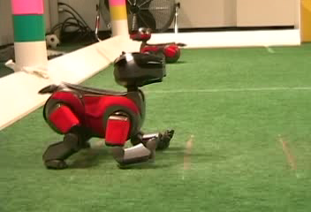
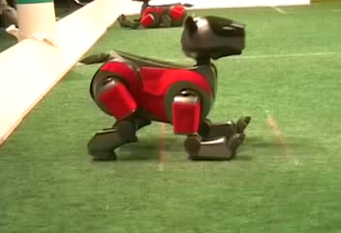
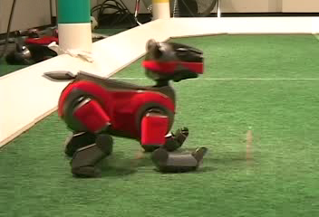
Example: Learning to Walk
Initial
A Learning Trial
After Learning [1K Trials]
[Kohl and Stone, ICRA 2004]
Notes:
Peter Stone, Austin

Slide 34

Example: Learning to Walk
Initial
[Kohl and Stone, ICRA 2004]
[Video: AIBO WALK – initial]

Slide 35

Example: Learning to Walk
Training
[Kohl and Stone, ICRA 2004]
[Video: AIBO WALK – training]

Slide 36

Example: Learning to Walk
Finished
[Kohl and Stone, ICRA 2004]
[Video: AIBO WALK – finished]

Slide 37
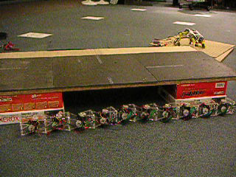
Example: Sidewinding
[Andrew Ng]
[Video: SNAKE – climbStep+sidewinding]

Slide 38

Example: Toddler Robot
[Tedrake, Zhang and Seung, 2005]
[Video: TODDLER – 40s]
Notes:
MIT

Slide 39
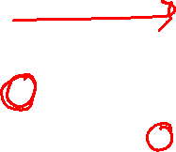
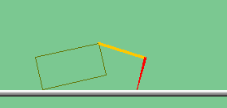
The Crawler!
Slide: ai.berkeley.edu
[Demo: Crawler Bot (L10D1)]
Notes:
At times no reward accumulated at all, just sitting still

Slide 40
Demo Crawler Bot

Slide 41
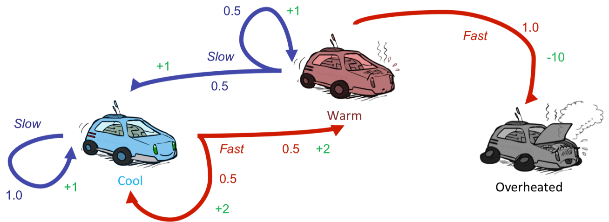
Reinforcement Learning
Still assume a Markov decision process (MDP):
  A set of states s ∈ S
  A set of actions (per state) A
  A model T(s,a,s’)
  A reward function R(s,a,s’)
Still looking for a policy π(s)
New twist: don’t know T or R
  I.e. we don’t know which states are good or what the actions do
  Must actually try actions and states out to learn
Slide: ai.berkeley.edu

Slide 42
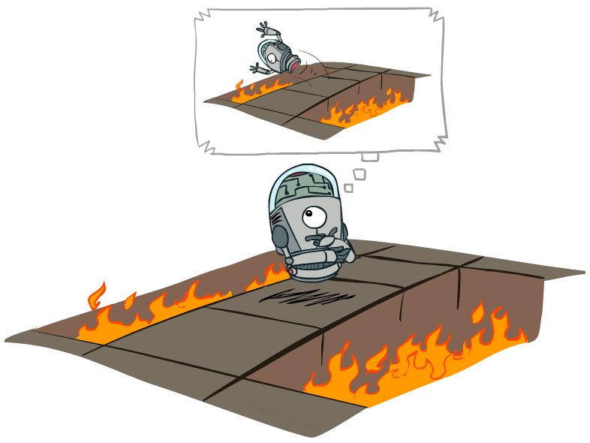
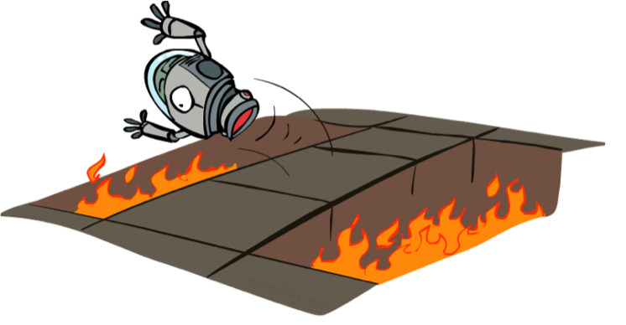
Offline (MDPs) vs. Online (RL)
Offline Solution
Online Learning
Slide: ai.berkeley.edu

Slide 43

Model-Based Learning
Slide: ai.berkeley.edu

Slide 44




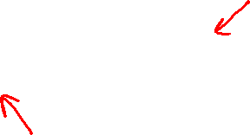
Model-Based Learning
Model-Based Idea:
  Learn an approximate model based on experiences
  Solve for values as if the learned model were correct
Step 1: Learn empirical MDP model
  Count outcomes s’ for each s, a
  Normalize to give an estimate of
  Discover each when we experience (s, a, s’)
Step 2: Solve the learned MDP
  For example, use value iteration, as before
Slide: ai.berkeley.edu

Slide 45
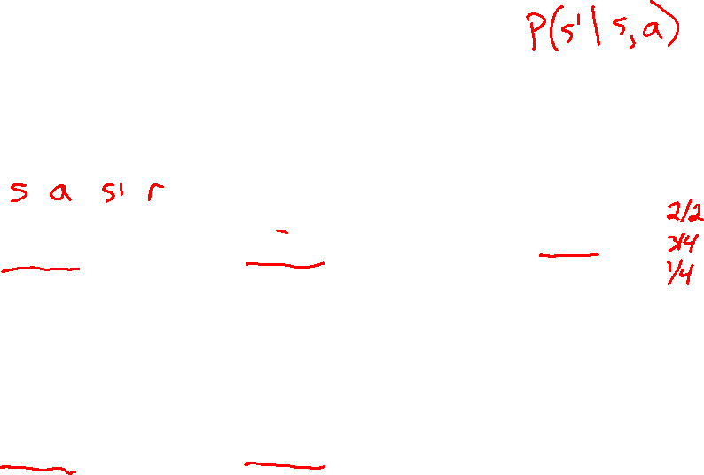
Example: Model-Based Learning
Input Policy π
Observed Episodes (Training)
Learned Model
Episode 1
Episode 2
T(s,a,s’).
T(B, east, C) =
T(C, east, D) =
T(C, east, A) =
…
R(s,a,s’).
R(B, east, C) =
R(C, east, D) =
R(D, exit, x) =
…
 | A
B | C | D
 | E
B, east, C, -1
C, east, D, -1
D, exit, x, +10
B, east, C, -1
C, east, D, -1
D, exit, x, +10
Episode 3
Episode 4
E, north, C, -1
C, east, D, -1
D, exit, x, +10
E, north, C, -1
C, east, A, -1
A, exit, x, -10
Assume: γ = 1
Slide: ai.berkeley.edu

Slide 46
Example: Model-Based Learning
Input Policy π
Observed Episodes (Training)
Learned Model
Episode 1
Episode 2
T(s,a,s’).
T(B, east, C) = 1.00
T(C, east, D) = 0.75
T(C, east, A) = 0.25
…
R(s,a,s’).
R(B, east, C) = -1
R(C, east, D) = -1
R(D, exit, x) = +10
…
 | A
B | C | D
 | E
B, east, C, -1
C, east, D, -1
D, exit, x, +10
B, east, C, -1
C, east, D, -1
D, exit, x, +10
Episode 3
Episode 4
E, north, C, -1
C, east, D, -1
D, exit, x, +10
E, north, C, -1
C, east, A, -1
A, exit, x, -10
Assume: γ = 1
Slide: ai.berkeley.edu

Slide 47
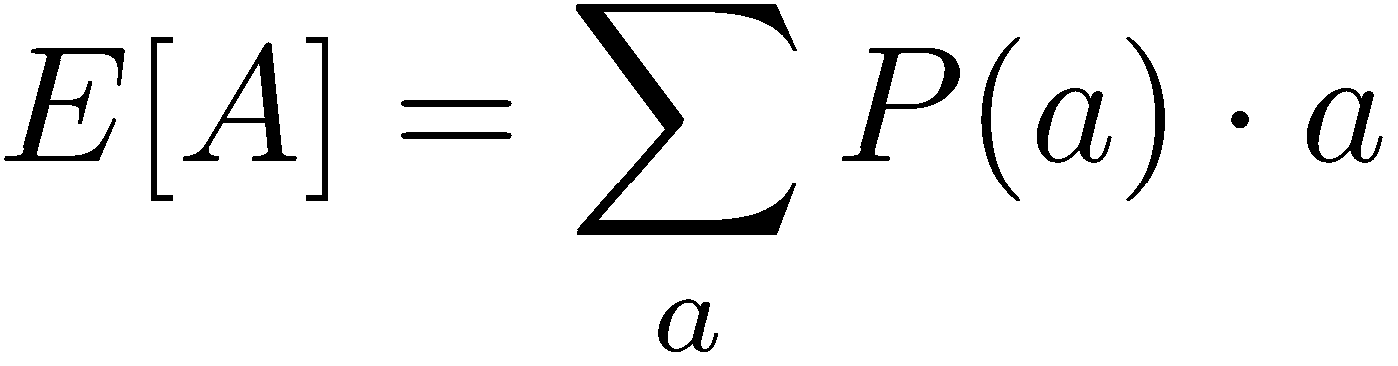
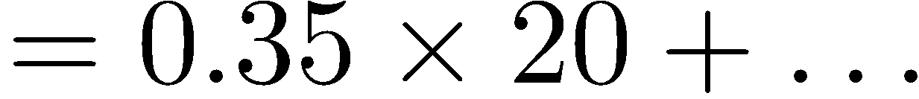
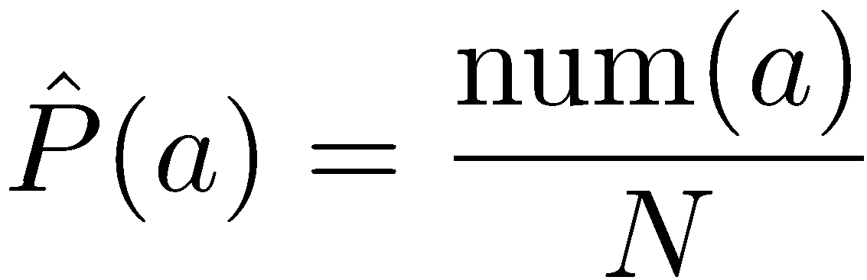
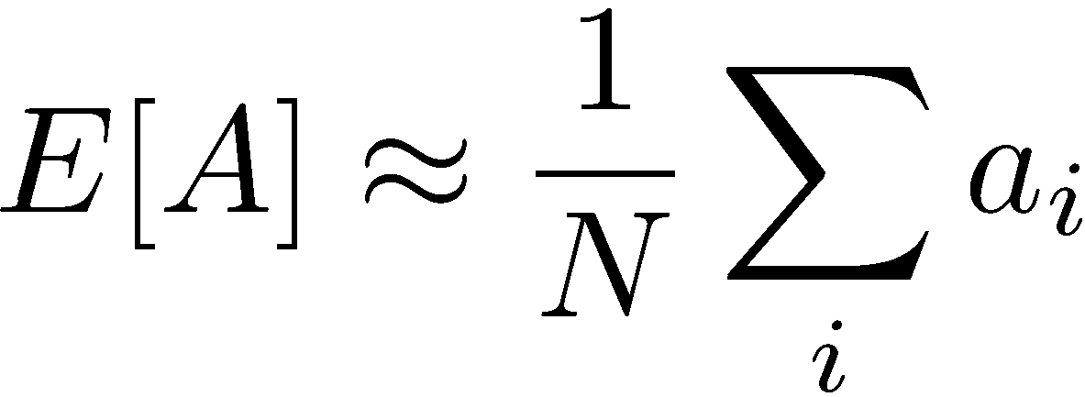
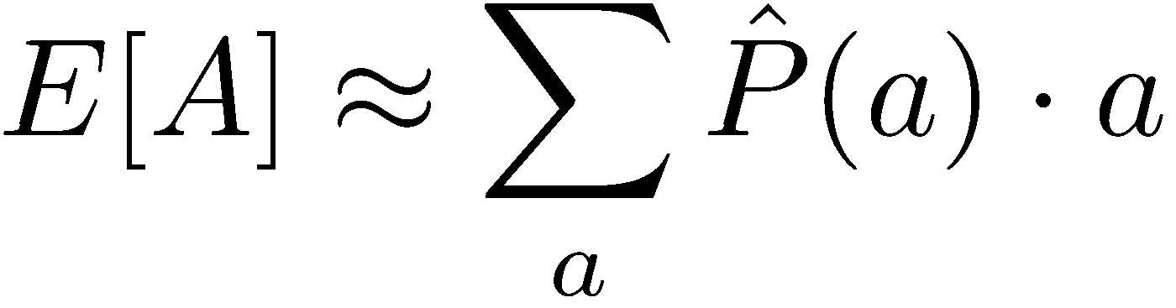
Example: Expected Age
Goal: Compute expected age of students
Known P(A)
Without P(A), instead collect samples [a₁, a₂, … a_{N}]
Unknown P(A): “Model Based”
Unknown P(A): “Model Free”
Why does this work? Because eventually you learn the right model.
Why does this work? Because samples appear with the right frequencies.
Slide: ai.berkeley.edu

Slide 48
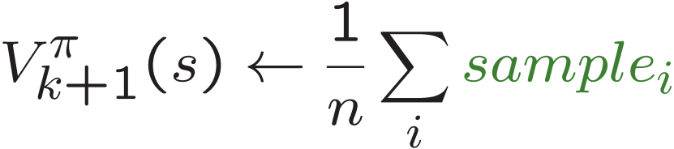
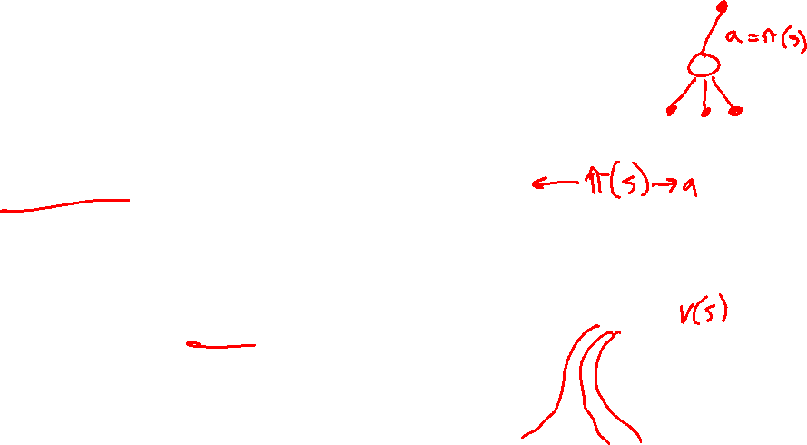
Sample-Based Policy Evaluation?
We want to improve our estimate of V by computing these averages:
Idea: Take samples of outcomes s’ (by doing the action!) and average
s
π(s)
s, π(s)
s, π(s),s’
s₁'
s₂'
s'
s₃'
Almost! But we can’t rewind time to get sample after sample from state s.
Slide: ai.berkeley.edu

Slide 49

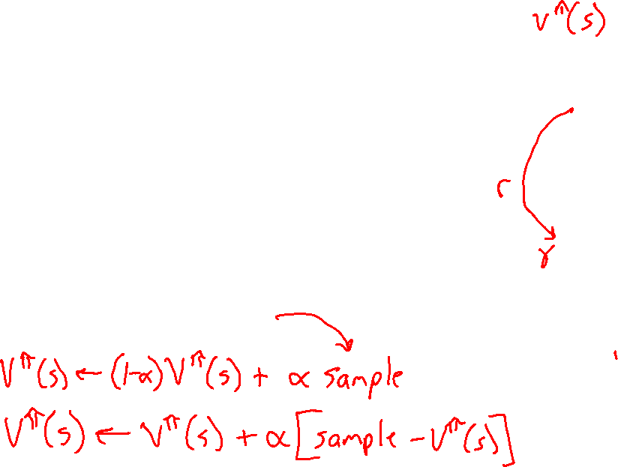
Temporal Difference Learning
Big idea: learn from every experience!
  Update V(s) each time we experience a transition (s, a, s’, r)
  Likely outcomes s’ will contribute updates more often
Temporal difference learning of values
  Policy is fixed, just doing evaluation!
  Move values toward value of whatever successor occurs: running average
s
π(s)
s, π(s)
s’
Sample of V(s):
$$sample= r+γ V^{π}\left(s^{′}\right)$$
Update to V(s):
Slide: ai.berkeley.edu

Slide 50

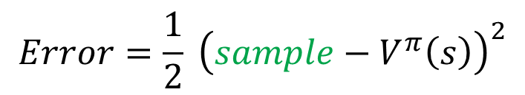


Temporal Difference Learning
Big idea: learn from every experience!
  Update V(s) each time we experience a transition (s, a, s’, r)
  Likely outcomes s’ will contribute updates more often
Temporal difference learning of values
  Policy is fixed, just doing evaluation!
  Move values toward value of whatever successor occurs: running average
s
π(s)
s, π(s)
s’
Sample of V(s):
$$sample= r+γ V^{π}\left(s^{′}\right)$$
Update to V(s):
$$V^{π}\left(s\right) ← {\left(1−α\right) V}^{π}\left(s\right)+(α) sample$$
Same update:
$$V^{π}\left(s\right) ← V^{π}(s) +α \left[sample− V^{π}\left(s\right)\right]$$
$$Error=\frac{1}{2} {\left(sample−V^{π}\left(s\right)\right)}^{2}$$
Same update:
$$V^{π}\left(s\right) ← V^{π}\left(s\right)−α∇Error$$

Slide 51
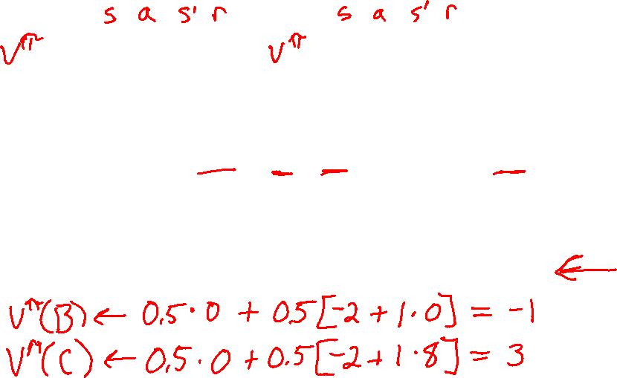
Example: Temporal Difference Learning
States
Observed Transitions
B, east, C, -2
C, east, D, -2
 | A
B | C | D
 | E
 | 0
0 | 0 | 8
 | 0
 | 0
-1 | 0 | 8
 | 0
 | 0
-1 | 3 | 8
 | 0
$$V^{π}\left(s\right) ← {\left(1−α\right) V}^{π}\left(s\right)+\left(α\right)\left[r+γ V^{π}\left(s^{′}\right)\right]$$
Assume: γ = 1, α = 1/2
Slide: ai.berkeley.edu

Slide 52

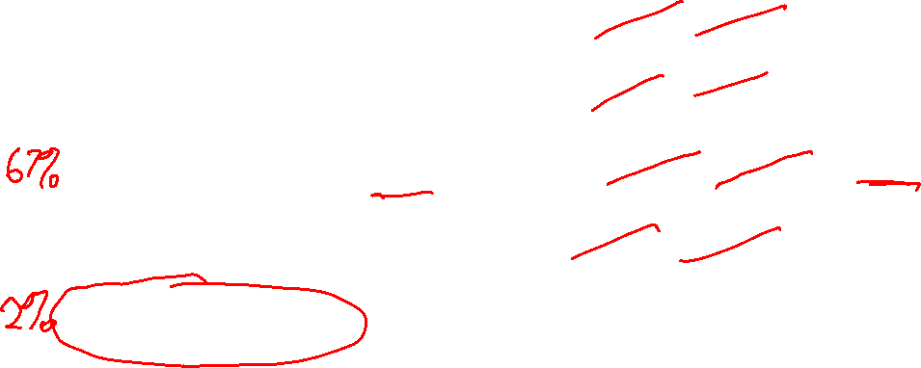
Piazza Poll 3
TD update:
$$V^{π}\left(s\right) = V^{π}(s) +α \left[r+γ V^{π}\left(s^{′}\right)− V^{π}\left(s\right)\right]$$
Which converts TD values into a policy?
$$V_{k+1}\left(s\right)=\max_{a}{\sum_{s′}{P\left(s^{′} | s,a\right)\left[R\left(s,a,s^{′}\right)+γV_{k}\left(s^{′}\right)\right]}}, ∀ s$$
$$Q_{k+1}\left(s,a\right)=\sum_{s′}{P\left(s^{′} | s,a\right)[R\left(s,a,s^{′}\right)+γ\max_{a^{′}}{Q_{k}(s^{′},a^{′})]}, } ∀ s,a$$
$$π_{V}\left(s\right)=\underset{a}{argmax}{\sum_{s′}{P\left(s^{′} | s,a\right)[R\left(s,a,s^{′}\right)+γV\left(s^{′}\right)]}}, ∀ s$$
$$V_{k+1}^{π}\left(s\right)=\sum_{s′}{P\left(s^{′} | s,π\left(s\right)\right)[R\left(s,π\left(s\right),s^{′}\right)+γV_{k}^{π}\left(s^{′}\right)]}, ∀ s$$
A) Value iteration:
B) Q-iteration:
C) Policy extraction:
D) Policy evaluation:
E) None of the above

Slide 53
Piazza Poll 3
TD update:
$$V^{π}\left(s\right) = V^{π}(s) +α \left[r+γ V^{π}\left(s^{′}\right)− V^{π}\left(s\right)\right]$$
Which converts TD values into a policy?
$$V_{k+1}\left(s\right)=\max_{a}{\sum_{s′}{P\left(s^{′} | s,a\right)\left[R\left(s,a,s^{′}\right)+γV_{k}\left(s^{′}\right)\right]}}, ∀ s$$
$$Q_{k+1}\left(s,a\right)=\sum_{s′}{P\left(s^{′} | s,a\right)[R\left(s,a,s^{′}\right)+γ\max_{a^{′}}{Q_{k}(s^{′},a^{′})]}, } ∀ s,a$$
$$π_{V}\left(s\right)=\underset{a}{argmax}{\sum_{s′}{P\left(s^{′} | s,a\right)[R\left(s,a,s^{′}\right)+γV\left(s^{′}\right)]}}, ∀ s$$
$$V_{k+1}^{π}\left(s\right)=\sum_{s′}{P\left(s^{′} | s,π\left(s\right)\right)[R\left(s,π\left(s\right),s^{′}\right)+γV_{k}^{π}\left(s^{′}\right)]}, ∀ s$$
A) Value iteration:
B) Q-iteration:
C) Policy extraction:
D) Policy evaluation:
E) None of the above

Slide 54



Problems with TD Value Learning
TD value leaning is a model-free way to do policy evaluation, mimicking Bellman updates with running sample averages
However, if we want to turn values into a (new) policy, we’re sunk:
Idea: learn Q-values, not values
Makes action selection model-free too!
s
a
s, a
s,a,s’
s’
Slide: ai.berkeley.edu

Slide 55

Detour: Q-Value Iteration
Value iteration:
  Start with V₀(s) = 0
  Given V_{k}, calculate the iteration k+1 values for all states:
But Q-values are more useful, so compute them instead
  Start with Q₀(s,a) = 0, which we know is right
  Given Q_{k}, calculate the iteration k+1 q-values for all q-states:

Slide 56


Q-Learning
We’d like to do Q-value updates to each Q-state:
  But can’t compute this update without knowing T, R
Instead, compute average as we go
  Receive a sample transition (s,a,r,s’)
  This sample suggests
  But we want to average over results from (s,a) (Why?)
  So keep a running average
Slide: ai.berkeley.edu

Slide 57

Q-Learning Properties
Amazing result: Q-learning converges to optimal policy -- even if you’re acting suboptimally!
This is called off-policy learning
Caveats:
  You have to explore enough
  You have to eventually make the learning rate
  small enough
  … but not decrease it too quickly
  Basically, in the limit, it doesn’t matter how you select actions (!)
Slide: ai.berkeley.edu

Slide 58

The Story So Far: MDPs and RL
Known MDP: Offline Solution
Goal Technique
Compute V*, Q*, π* Value / policy iteration
Evaluate a fixed policy π Policy evaluation
Unknown MDP: Model-Based
Unknown MDP: Model-Free
Goal Technique
Compute V*, Q*, π* VI/PI on approx. MDP
Evaluate a fixed policy π PE on approx. MDP
Goal Technique
Compute V*, Q*, π* Q-learning
Evaluate a fixed policy π TD/Value Learning
Slide: ai.berkeley.edu

Slide 59


MDP/RL Notation
Standard expectimax:
$$V\left(s\right)=\max_{a}{\sum_{s′}{P\left(s^{′}\right|s,a)V(s^{′})}}$$
$$V^{∗}\left(s\right)=\max_{a}{\sum_{s′}{P\left(s^{′} | s,a\right)\left[R\left(s,a,s^{′}\right)+γV^{∗}\left(s^{′}\right)\right]}}$$
$$V_{k+1}\left(s\right)=\max_{a}{\sum_{s′}{P\left(s^{′} | s,a\right)\left[R\left(s,a,s^{′}\right)+γV_{k}\left(s^{′}\right)\right]}}, ∀ s$$
$$Q_{k+1}\left(s,a\right)=\sum_{s′}{P\left(s^{′} | s,a\right)[R\left(s,a,s^{′}\right)+γ\max_{a^{′}}{Q_{k}(s^{′},a^{′})]}, } ∀ s,a$$
$$π_{V}\left(s\right)=\underset{a}{argmax}{\sum_{s′}{P\left(s^{′} | s,a\right)[R\left(s,a,s^{′}\right)+γV\left(s^{′}\right)]}}, ∀ s$$
$$V_{k+1}^{π}\left(s\right)=\sum_{s′}{P\left(s^{′} | s,π\left(s\right)\right)[R\left(s,π\left(s\right),s^{′}\right)+γV_{k}^{π}\left(s^{′}\right)]}, ∀ s$$
$$V^{π}\left(s\right) = V^{π}(s) +α \left[r+γ V^{π}\left(s^{′}\right)− V^{π}\left(s\right)\right]$$
$Q(s,a) = Q(s,a) +α[r+γ \max_{a^{′}} Q\left(s^{′},a^{′}\right)−Q\left(s, a\right)]$
Bellman equations:
Value iteration:
Q-iteration:
Policy extraction:
Policy evaluation:
Value (TD) learning:
Q-learning:

Slide 60
Demo Q-Learning Auto Cliff Grid
[Demo: Q-learning – auto – cliff grid (L11D1)]
[python gridworld.py -n 0.0 -a q -k 400 -g CliffGrid -d 1.0 -r -0.1 -e 1.0]
Slide: ai.berkeley.edu

Slide 61

Exploration vs. Exploitation
Slide: ai.berkeley.edu

Slide 62


How to Explore?
Several schemes for forcing exploration
  Simplest: random actions (ε-greedy)
    Every time step, flip a coin
    With (small) probability ε, act randomly
    With (large) probability 1-ε, act on current policy
  Problems with random actions?
    You do eventually explore the space, but keep thrashing around once learning is done
    One solution: lower ε over time
    Another solution: exploration functions
[Demo: Q-learning – manual exploration – bridge grid (L11D2)] [Demo: Q-learning – epsilon-greedy -- crawler (L11D3)]
Slide: ai.berkeley.edu

Slide 63
Demo Q-learning – Manual Exploration – Bridge Grid

Slide 64

Demo Q-learning – Epsilon-Greedy – Crawler

Slide 65

Regret
Even if you learn the optimal policy, you still make mistakes along the way!
Regret is a measure of your total mistake cost: the difference between your (expected) rewards, including youthful suboptimality, and optimal (expected) rewards
Minimizing regret goes beyond learning to be optimal – it requires optimally learning to be optimal
Example: random exploration and exploration functions both end up optimal, but random exploration has higher regret
Slide: ai.berkeley.edu

Slide 66


Approximate Q-Learning
Slide: ai.berkeley.edu
Notes:
:34 in, :40 to go

Slide 67





Example: Pacman
How many possible states?
55 (non-wall) positions
1 Pacman
2 Ghosts
Dots eaten or not
Image: ai.berkeley.edu

Slide 68


Generalizing Across States
Basic Q-Learning keeps a table of all q-values
In realistic situations, we cannot possibly learn about every single state!
  Too many states to visit them all in training
  Too many states to hold the q-tables in memory
Instead, we want to generalize:
  Learn about some small number of training states from experience
  Generalize that experience to new, similar situations
  This is a fundamental idea in machine learning, and we’ll see it over and over again
Slide: ai.berkeley.edu
[demo – RL pacman]

Slide 69


Example: Pacman
Let’s say we discover through experience that this state is bad:
In naïve q-learning, we know nothing about this state:
Or even this one!
[Demo: Q-learning – pacman – tiny – watch all (L11D5)]
[Demo: Q-learning – pacman – tiny – silent train (L11D6)]
[Demo: Q-learning – pacman – tricky – watch all (L11D7)]
Slide: ai.berkeley.edu

Slide 70

Feature-Based Representations
Solution: describe a state using a vector of features (properties)
  Features are functions from states to real numbers (often 0/1) that capture important properties of the state
  Example features:
    Distance to closest ghost
    Distance to closest dot
    Number of ghosts
    1 / (dist to dot)²
    Is Pacman in a tunnel? (0/1)
    …… etc.
    Is it the exact state on this slide?
  Can also describe a q-state (s, a) with features (e.g. action moves closer to food)
Slide: ai.berkeley.edu

Slide 71


Linear Value Functions
Using a feature representation, we can write a q function (or value function) for any state using a few weights:
  V_{w}(s) = w₁f₁(s) + w₂f₂(s) + … + w_{M}f_{M}(s)
  Q_{w}(s,a) = w₁f₁(s,a) + w₂f₂(s,a) + … + w_{M}f_{M}(s,a)
Advantage: our experience is summed up in a few powerful numbers
Disadvantage: states may share features but actually be very different in value!

Slide 72


Updating a linear value function
Q_{w}(s,a) = w₁f₁(s,a) + … + w_{M}f_{M}(s,a)
Original Q learning rule tries to reduce prediction error at s, a:
    Q(s,a) ← Q(s,a) + α ⋅ [R(s,a,s’) + γ max_{a’} Q (s’,a’) - Q(s,a) ]
Instead, we update the weights to try to reduce the error at s, a:
      w_{i} ← w_{i} + α ⋅ [R(s,a,s’) + γ max_{a’} Q_{w} (s’,a’) - Q_{w}(s,a) ] ∂Q_{w}(s,a)/∂w_{i}
  = w_{i} + α ⋅ [R(s,a,s’) + γ max_{a’} Q_{w} (s’,a’) - Q_{w}(s,a) ] f_{i}(s,a)

Slide 73




Updating a linear value function
Q_{w}(s,a) = w₁f₁(s,a) + … + w_{M}f_{M}(s,a)
Original Q learning rule tries to reduce prediction error at s, a:
    Q(s,a) ← Q(s,a) + α ⋅ [R(s,a,s’) + γ max_{a’} Q (s’,a’) - Q(s,a) ]
Instead, we update the weights to try to reduce the error at s, a:
      w_{i} ← w_{i} + α ⋅ [R(s,a,s’) + γ max_{a’} Q_{w} (s’,a’) - Q_{w}(s,a) ] ∂Q_{w}(s,a)/∂w_{i}
  = w_{i} + α ⋅ [R(s,a,s’) + γ max_{a’} Q_{w} (s’,a’) - Q_{w}(s,a) ] f_{i}(s,a)
$Q_{w}\left(s, a\right)=w_{1}f_{1}\left(s, a\right)+w_{2}f_{2}\left(s, a\right)$
$\frac{∂Q}{∂w_{2}}=$
$$Error\left(w\right)=\frac{1}{2}{\left(y−w^{T}f\left(x\right)\right)}^{2}$$
$$\frac{∂Error}{∂w}=−\left(y−w^{T}f\left(x\right)\right)f(x)$$

Slide 74

Updating a linear value function
Original Q learning rule tries to reduce prediction error at s, a:
    Q(s,a) ← Q(s,a) + α ⋅ [R(s,a,s’) + γ max_{a’} Q (s’,a’) - Q(s,a) ]
Instead, we update the weights to try to reduce the error at s, a:
      w_{i} ← w_{i} + α ⋅ [R(s,a,s’) + γ max_{a’} Q_{w} (s’,a’) - Q_{w}(s,a) ] ∂Q_{w}(s,a)/∂w_{i}
  = w_{i} + α ⋅ [R(s,a,s’) + γ max_{a’} Q_{w} (s’,a’) - Q_{w}(s,a) ] f_{i}(s,a)
Qualitative justification:
  Pleasant surprise: increase weights on +ve features, decrease on –ve ones
  Unpleasant surprise: decrease weights on +ve features, increase on –ve ones

Slide 75



Approximate Q-Learning
Q_{w}(s,a) = w₁f₁(s,a) + w₂f₂(s,a) + … + w_{M}f_{M}(s,a)
Q-learning with linear Q-functions:
Intuitive interpretation:
  Adjust weights of active features
  E.g., if something unexpectedly bad happens, blame the features that were on: disprefer all states with that state’s features
Formal justification: online least squares
Exact Q’s
Approximate Q’s
Slide: ai.berkeley.edu

Slide 76







Example: Q-Pacman
Slide: ai.berkeley.edu
[Demo: approximate Q-learning pacman (L11D10)]

Slide 77
Demo Approximate Q-Learning -- Pacman

Slide 78




Minimizing Error
Imagine we had only one point x, with features f(x), target value y, and weights w:
Approximate q update explained:
“target”
“prediction”
Slide: ai.berkeley.edu

Slide 79


Reinforcement Learning Milestones
Image: ai.berkeley.edu

Slide 80

TDGammon
1992 by Gerald Tesauro, IBM
4-ply lookahead using V(s) trained from 1,500,000 games of self-play
3 hidden layers, ~100 units each
Input: contents of each location plus several handcrafted features
Experimental results:
  Plays approximately at parity with world champion
  Led to radical changes in the way humans play backgammon

Slide 81


Deep Q-Networks
sample = r + γ max_{a’} Q_{w} (s’,a’)
Q_{w}(s,a): Neural network
Deep Mind, 2015
Used a deep learning network to represent Q:
  Input is last 4 images (84x84 pixel values) plus score
49 Atari games, incl. Breakout, Space Invaders, Seaquest, Enduro
Image: Deep Mind

Slide 82




Images: Open AI, Atari

Slide 83





OpenAI Gym
2016+
Benchmark problems for learning agents
https://gym.openai.com/envs
Images: Open AI

Slide 84


AlphaGo, AlphaZero
Deep Mind, 2016+

Slide 85
Autonomous Vehicles?

