Slide 1

Announcements
Canvas
Up-to-date with scores and slip days
Assignments
HW7: Thu, 11/19, 11:59 pm
Schedule change
Friday: Lecture in all three recitation slots
Monday: Recitation in both lecture slots
Final exam scheduled
Study groups

Slide 2
Wrap Up HMMs
HMM slides from last time

Slide 3

Introduction to Machine Learning Markov Decision Processes
Instructor: Pat Virtue

Slide 4

Learning Paradigms
Slide credit: CMU MLD, Matt Gormley

Slide 5
Learning Paradigms
Slide credit: CMU MLD, Matt Gormley

Slide 6
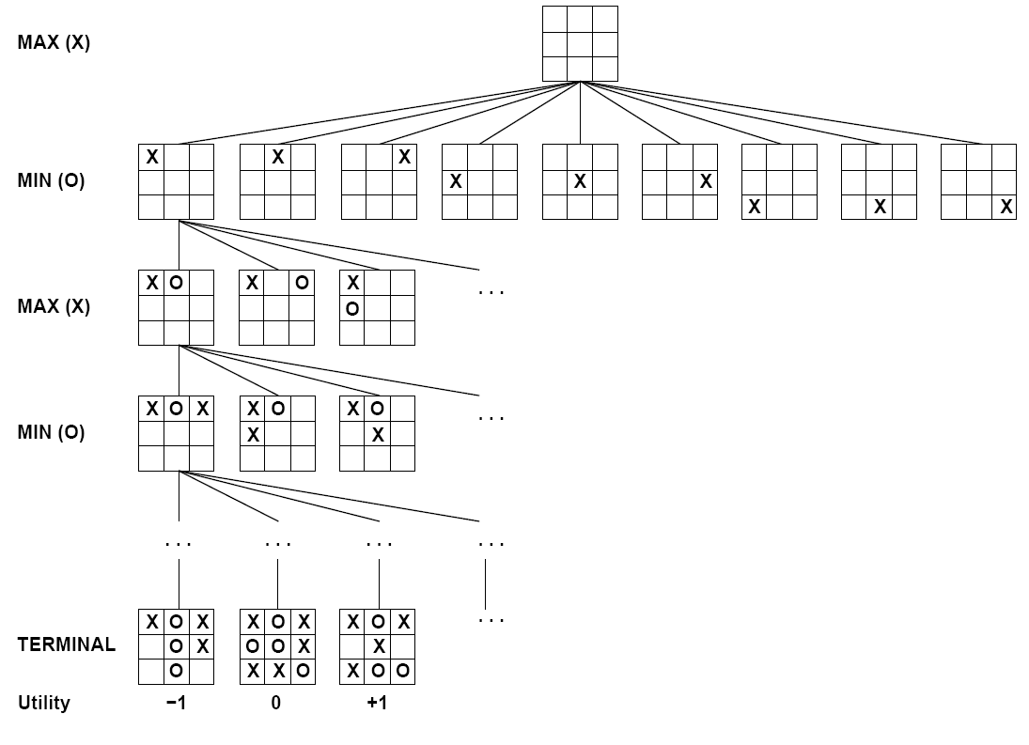
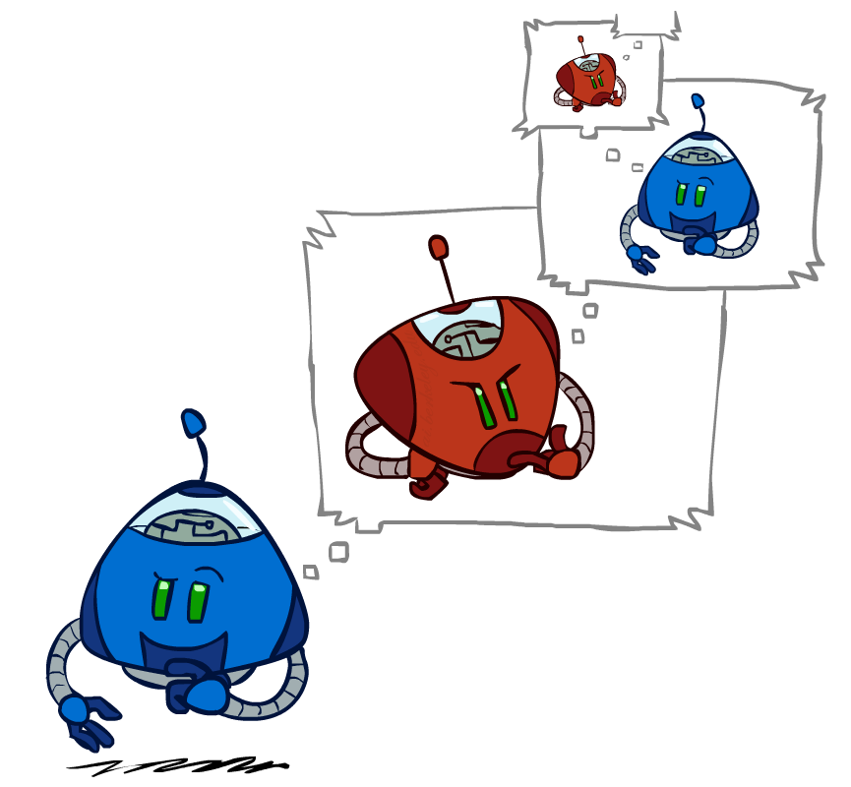
Interacting with the World
Sequential decision making
Games
Simple: Tic-tac-toe
Go
Arcade games
Worlds
Simple: Grid World
Open AI Gym https://gym.openai.com/
Autonomous Driving
Image: ai.berkeley.edu

Slide 7
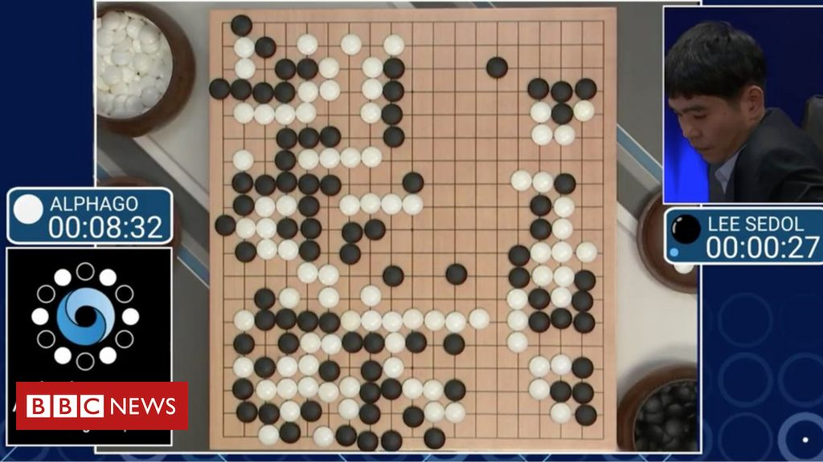
Interacting with the World
Sequential decision making
Games
Simple: Tic-tac-toe
Go
Arcade games
Worlds
Simple: Grid World
Open AI Gym https://gym.openai.com/
Autonomous Driving
Image: BBC News

Slide 8
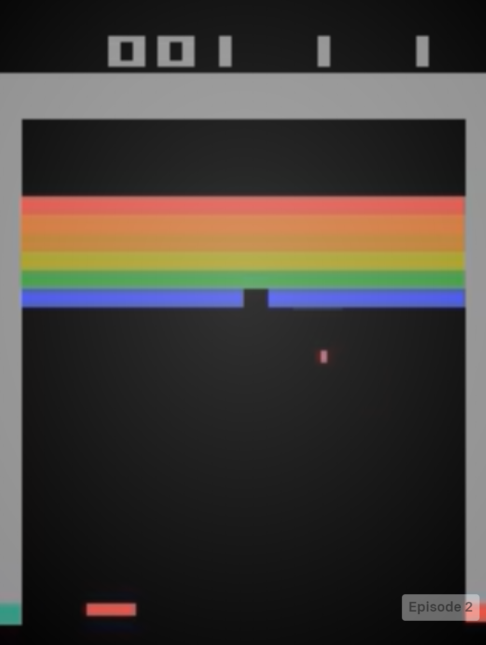
Interacting with the World
Sequential decision making
Games
Simple: Tic-tac-toe
Go
Arcade games
Worlds
Simple: Grid World
Open AI Gym https://gym.openai.com/
Autonomous Driving
Image: https://gym.openai.com/

Slide 9
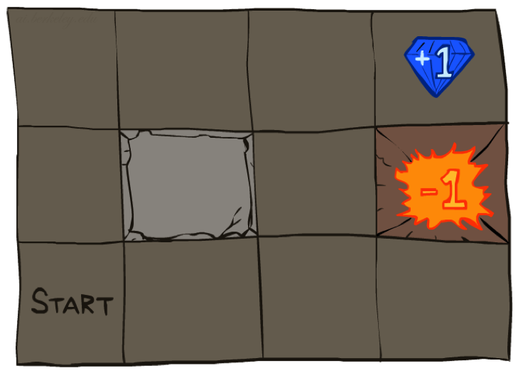




Interacting with the World
Sequential decision making
Games
Simple: Tic-tac-toe
Go
Arcade games
Worlds
Simple: Grid World
Open AI Gym https://gym.openai.com/
Autonomous Driving
Image: ai.berkeley.edu

Slide 10
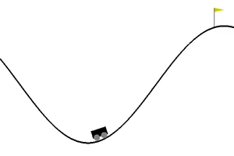
Interacting with the World
Sequential decision making
Games
Simple: Tic-tac-toe
Go
Arcade games
Worlds
Simple: Grid World
Open AI Gym https://gym.openai.com/
Autonomous Driving
Image: https://gym.openai.com/

Slide 11
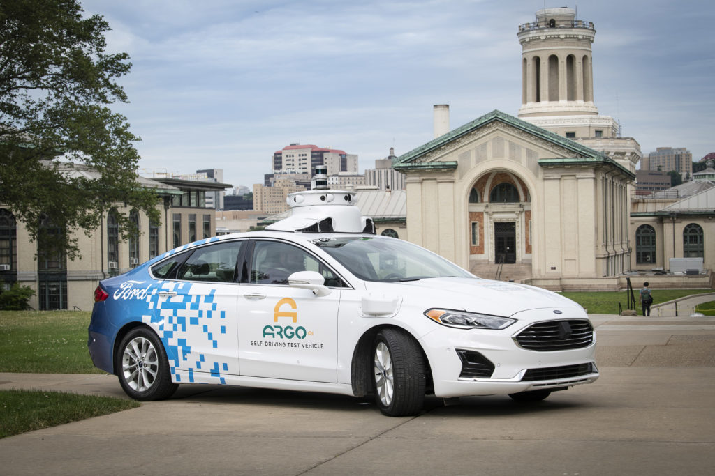
Interacting with the World
Sequential decision making
Games
Simple: Tic-tac-toe
Go
Arcade games
Worlds
Simple: Grid World
Open AI Gym https://gym.openai.com/
Autonomous Driving
Image: https://www.argo.ai/2019/06/pushing-the-self-driving-frontier-argo-ai-partners-with-carnegie-mellon-to-form-autonomous-vehicle-research-center/

Slide 12
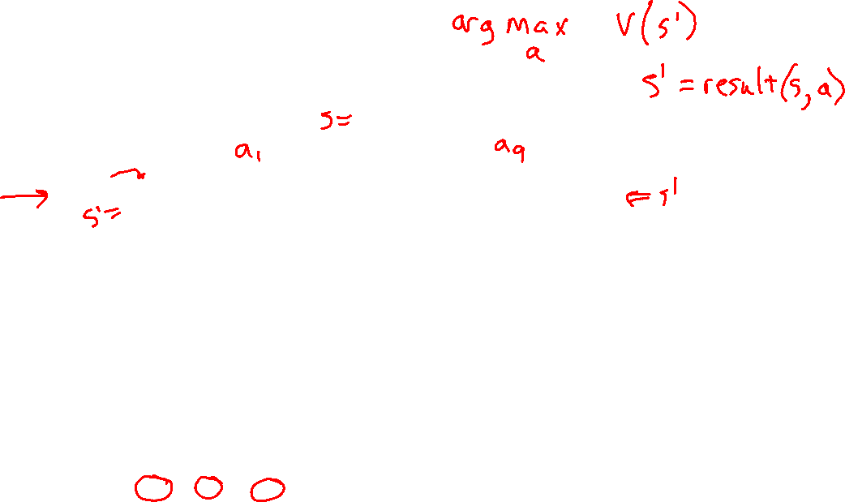
Games Trees
Minimax Search
Image: ai.berkeley.edu

Slide 13
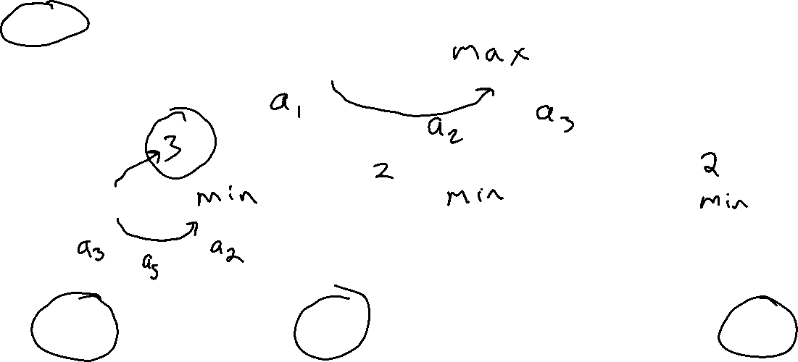
Piazza Poll 1
What is the minimax value at the root?
2
3
6
12
14
3
12
8
2
4
6
14
5
2
Notes:
Add values by hand if on tablet, or add by animation steps

Slide 14
Piazza Poll 1
What is the minimax value at the root?
2
3
6
12
14
3
3
2
2
3
12
8
2
4
6
14
5
2
Notes:
Add values by hand if on tablet, or add by animation steps

Slide 15

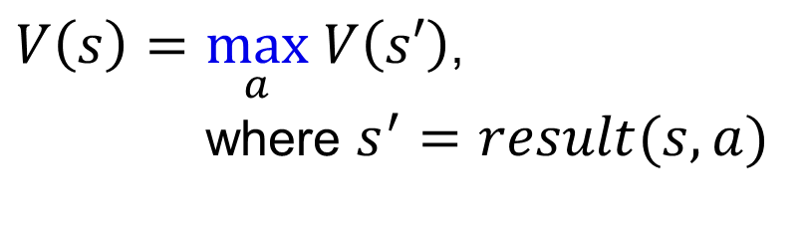

Minimax Notation
$V\left(s\right)=\max_{a} V\left(s′\right)$,
where $s^{′}=result(s, a)$
$a=\underset{a}{argmax} V\left(s′\right)$,
where $s^{′}=result(s, a)$
$\hat{a}=\underset{a}{argmax} V\left(s′\right)$,
where $s^{′}=result(s, a)$

Slide 16
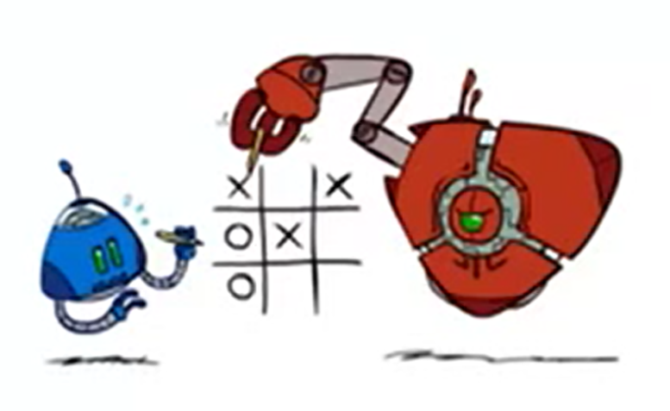
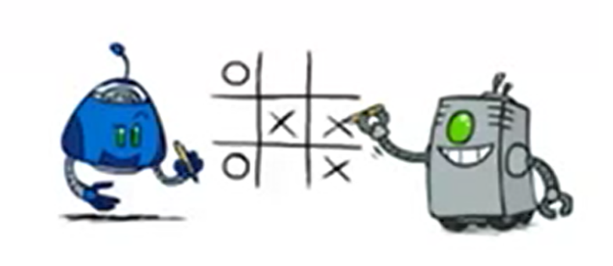
Modeling Assumptions
Know your opponent
10
10
9
100
Image: ai.berkeley.edu

Slide 17

Minimax Driver?
Clip: How I Met Your Mother, CBS

Slide 18
Modeling Assumptions
Know your opponent
10
10
9
100
Image: ai.berkeley.edu

Slide 19
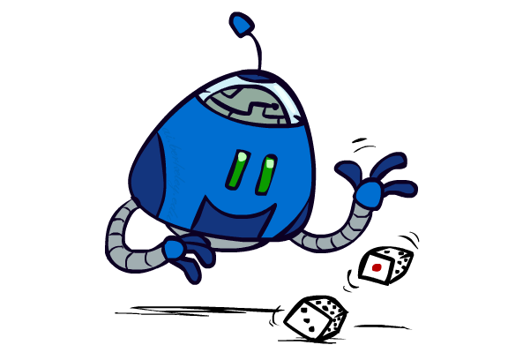
Modeling Assumptions
Chance nodes: Expectimax
10
10
9
100
Image: ai.berkeley.edu

Slide 20
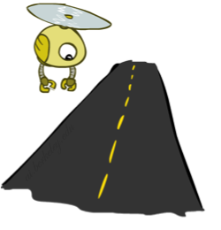
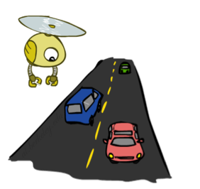
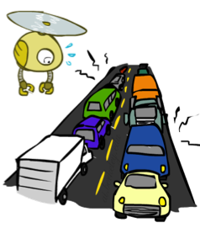
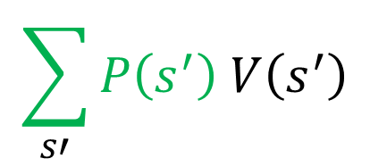


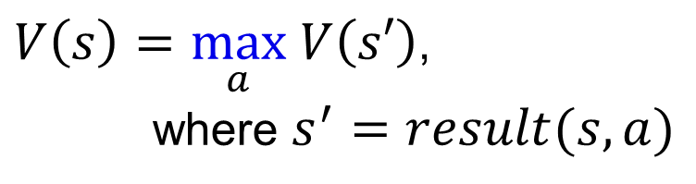
Expectations
Time:
20 min
30 min
60 min
+
+
x
x
x
Probability:
0.25
0.50
0.25
0.25
0.25
0.5
20
30
60
Max node notation
Chance node notation
$$\sum_{s′}{P\left(s^{′}\right) V\left(s^{′}\right)}$$
$V\left(s\right)=\max_{a} V\left(s′\right)$,
where $s^{′}=result(s, a)$
$$V\left(s\right)=$$
Image: ai.berkeley.edu

Slide 21
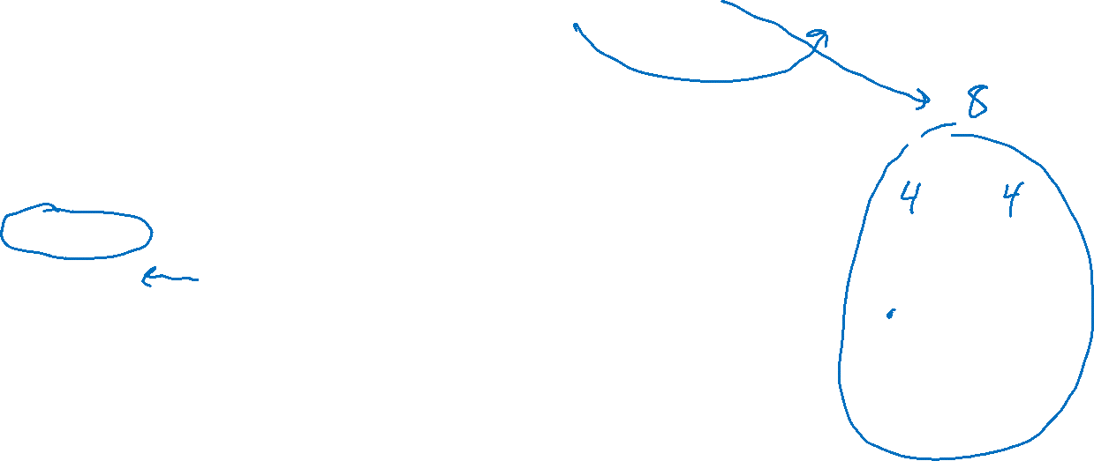
Piazza Poll 2
Expectimax tree search:
Which action do we choose?
A: Left
B: Center
C: Right
D: Eight
Left
Right
Center
1/4
1/2
1/2
1/2
1/3
2/3
1/4
12
8
4
8
6
12
6

Slide 22
Piazza Poll 2
Expectimax tree search:
Which action do we choose?
A: Left
B: Center
C: Right
D: Eight
8, Right
Left
Right
Center
3+2+2=7
4+3=7
4+4=8
1/4
1/2
1/2
1/2
1/3
2/3
1/4
12
8
4
8
6
12
6

Slide 23
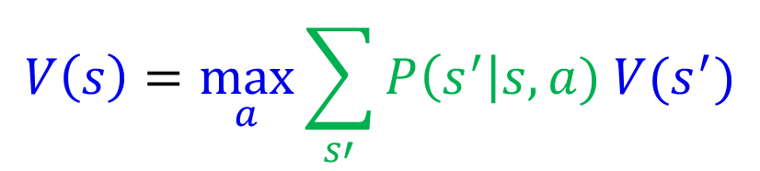
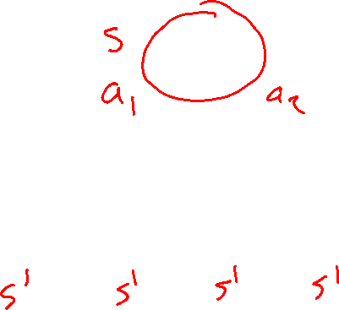
Expectimax Notation
$$V\left(s\right)=\max_{a}{\sum_{s′}{P\left(s^{′}\right|s,a) V(s^{′})}}$$

Slide 24
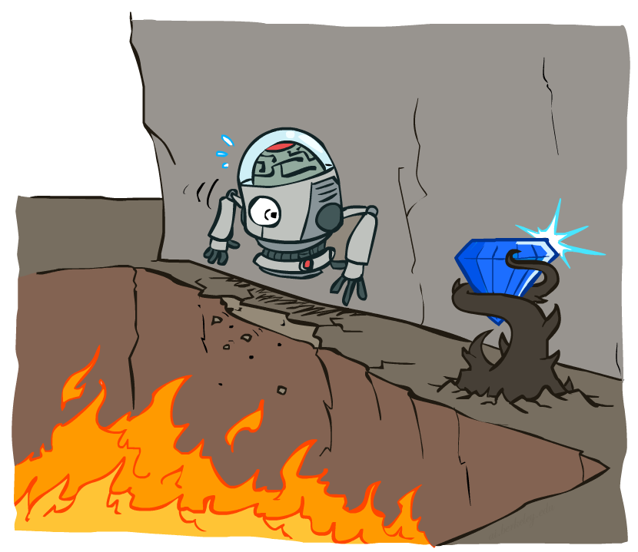
Non-Deterministic Search
Image: ai.berkeley.edu

Slide 25
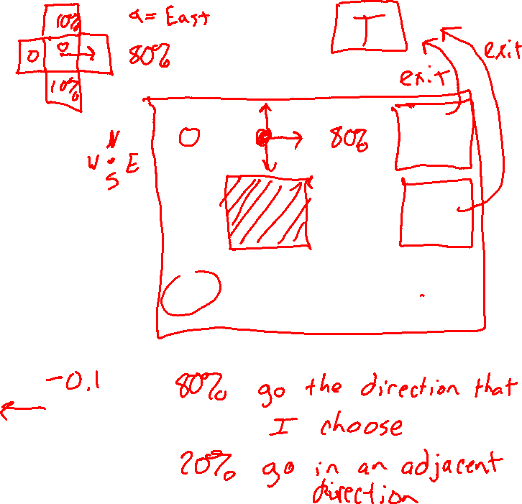
Example: Grid World
A maze-like problem
The agent lives in a grid
Walls block the agent’s path
Noisy movement: actions do not always go as planned
80% of the time, the action North takes the agent North (if there is no wall there)
10% of the time, North takes the agent West; 10% East
If there is a wall in the direction the agent would have been taken, the agent stays put
The agent receives rewards each time step
Small “living” reward each step (can be negative)
Big rewards come at the end (good or bad)
Goal: maximize sum of rewards
Slide: ai.berkeley.edu
Notes:
[cut demo of moving around in grid world program]

Slide 26
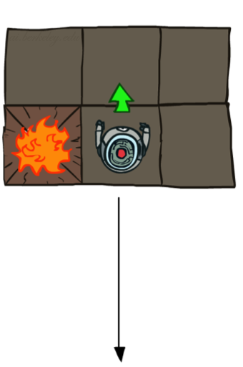
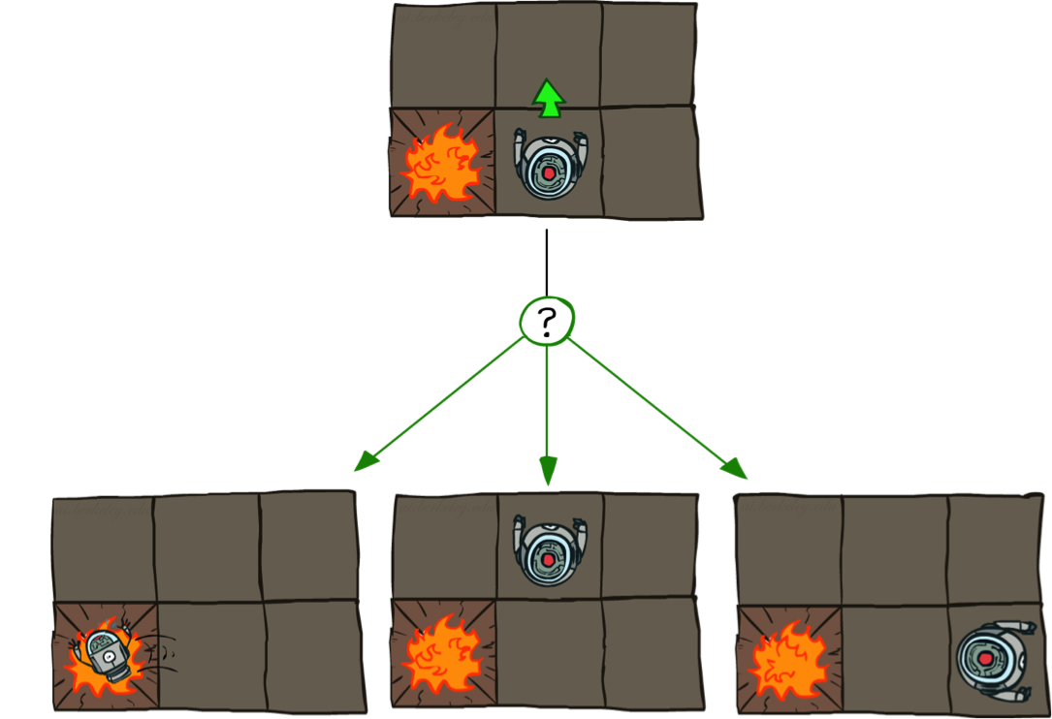
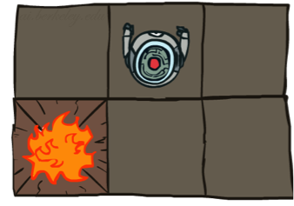
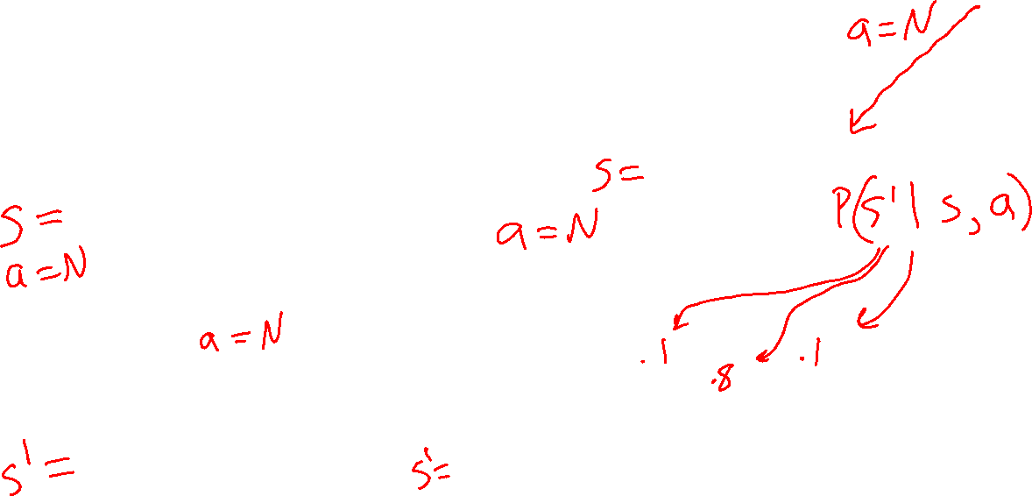
Grid World Actions
Deterministic Grid World
Stochastic Grid World
Slide: ai.berkeley.edu

Slide 27
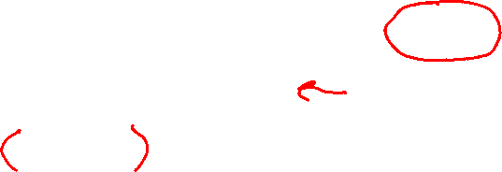
Markov Decision Processes
An MDP is defined by:
A set of states s ∈ S
A set of actions a ∈ A
A transition function T(s, a, s’)
Probability that a from s leads to s’, i.e., P(s’| s, a)
Also called the model or the dynamics
A reward function R(s, a, s’)
Sometimes just R(s) or R(s’)
A start state
Maybe a terminal state
MDPs are non-deterministic search problems
One way to solve them is with expectimax search
We’ll have a new tool soon
Slide: ai.berkeley.edu
[Demo – gridworld manual intro (L8D1)]
Notes:
In search problems: did not talk about actions, but about successor functions --- now the information inside the successor function is unpacked into actions, transitions and reward
Write out S, A, example entry in T, entry in R
Reward function different from the book : R(s,a,s’)
In book simpler for equations, but not useful for the projects.
Need to modify expectimax a tiny little bit to account for rewards along the way, but that’s something you should be able to do, and so you can already solve MDP’s (not in most efficient way)

Slide 28
Demo of Gridworld

Slide 29
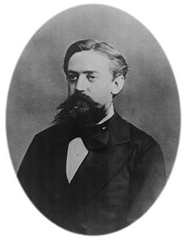

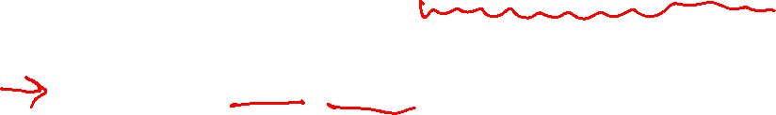
What is Markov about MDPs?
“Markov” generally means that given the present state, the future and the past are independent
For Markov decision processes, “Markov” means action outcomes depend only on the current state
Andrey Markov (1856-1922)
Slide: ai.berkeley.edu
Notes:
Like search: successor function only depended on current state
Can make this happen by stuffing more into the state;
Very similar to search problems: when solving a maze with food pellets, we stored which food pellets were eaten

Slide 30
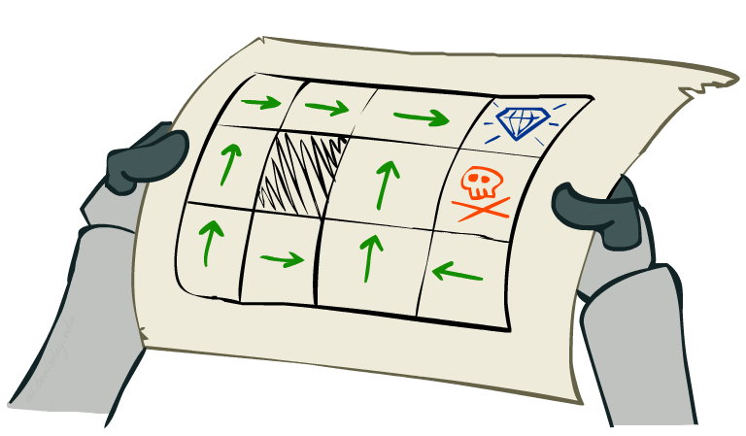
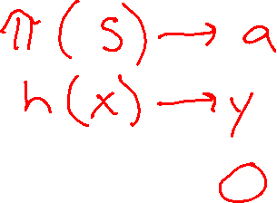
Policies
We don’t just want an optimal plan, or sequence of actions, from start to a goal
For MDPs, we want an optimal policy π*: S → A
A policy π gives an action for each state
An optimal policy is one that maximizes expected utility if followed
Expectimax didn’t compute entire policies
It computed the action for a single state only
Optimal policy when R(s, a, s’) = -0.03 for all non-terminals s
Slide: ai.berkeley.edu
Notes:
Dan has a DEMO for this.

