Slide 1

Announcements
Midterm
Grades out today or tomorrow
Assignments
HW7: Thu, 11/19, 11:59 pm

Slide 2

Introduction to Machine Learning Hidden Markov Models
Instructor: Pat Virtue

Slide 3
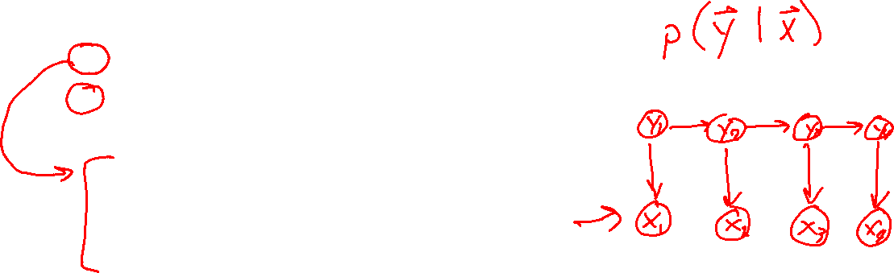
Outline
Probability primer
Generative stories and Bayes nets
Learning HMM parameters
MLE for categorical distribution
Inference in Bayes Nets and HMMs
Forward algorithm (Markov chains)
HMM Queries
Message passing algorithms
Forward algorithm
Forward-backward algorithm
Viterbi algorithm

Slide 4
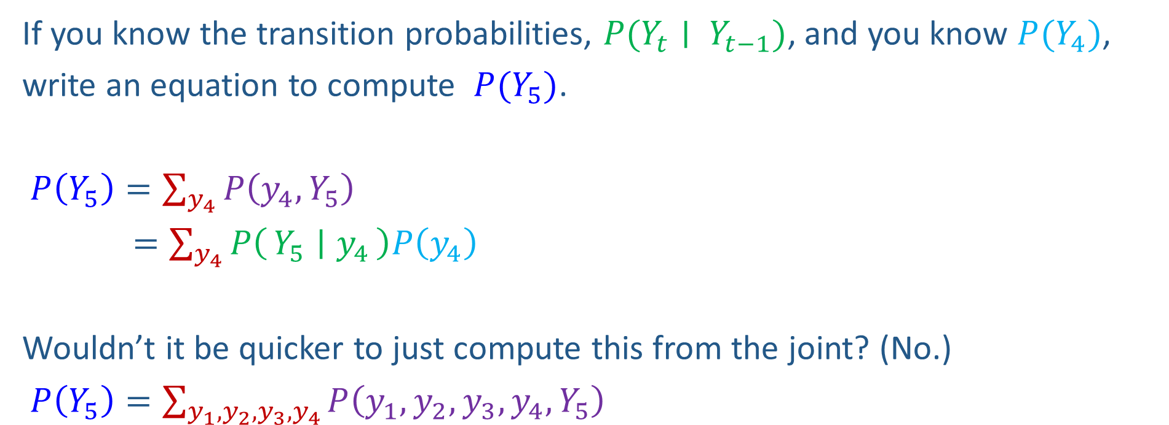
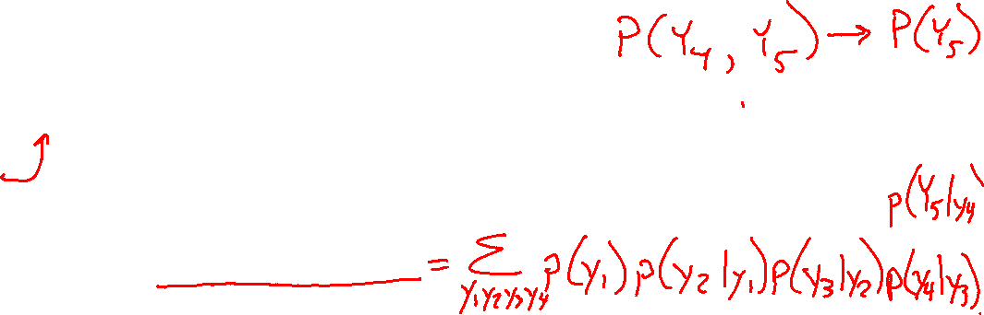
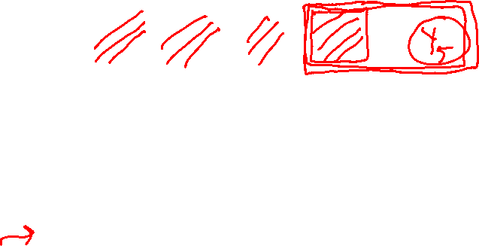
Markov Chain Inference
Y₁
Y₂
Y₃
Y₄
If you know the transition probabilities, $P(Y_{t}∣ Y_{t−1})$, and you know $P(Y_{4})$,
write an equation to compute $P(Y_{5})$.
$P\left(Y_{5}\right)=\sum_{y_{4}}{P\left(y_{4},Y_{5}\right)}$
$=\sum_{y_{4}}{P\left(Y_{5} ∣ y_{4}\right)P\left(y_{4}\right)}$
Wouldn’t it be quicker to just compute this from the joint? (No.)
$P\left(Y_{5}\right)=\sum_{y_{1},y_{2},y_{3},y_{4}}{P\left(y_{1},y_{2},y_{3},y_{4},Y_{5}\right)}$

Slide 5
Forward algorithm (simple form)
Probability from previous iteration
What is the state at time t?
P(Y_{t}) = ∑_{yt-1} P(Y_{t-1}=y_{t-1}, Y_{t})
= ∑_{yt-1} P(Y_{t}| Y_{t-1}=y_{t-1}) P(Y_{t-1}=y_{t-1})
Iterate this update starting at t=1
Transition model

Slide 6

Inference: Hidden Markov Models
Image: http://ai.berkeley.edu/

Slide 7

HMM as Probability Model
Joint distribution for Markov model:
P(Y₀,…, Y_{T}) = P(Y₀) ∏_{t=1:T} P(Y_{t} | Y_{t-1})
Joint distribution for hidden Markov model:
P(Y₀, Y₁,X₁, …, Y_{T},X_{T}) = P(Y₀) ∏_{t=1:T} P(Y_{t} | Y_{t-1}) P(X_{t} | Y_{t})
Future states are independent of the past given the present
Current evidence is independent of everything else given the current state
Are evidence variables independent of each other?
Y₀
Y₁
Y₂
Y₃
X₅
Notation alert!
Useful notation: X_{a:b} = X_{a} , X_{a+1}, …, X_{b}
For example: P(Y_{1:2} | x_{1:3}) = P(Y₁, Y₂ | x₁ , x₂, x₃)
X₁
X₂
X₃
E₅
Notes:
Add conditional independence consequences here

Slide 8
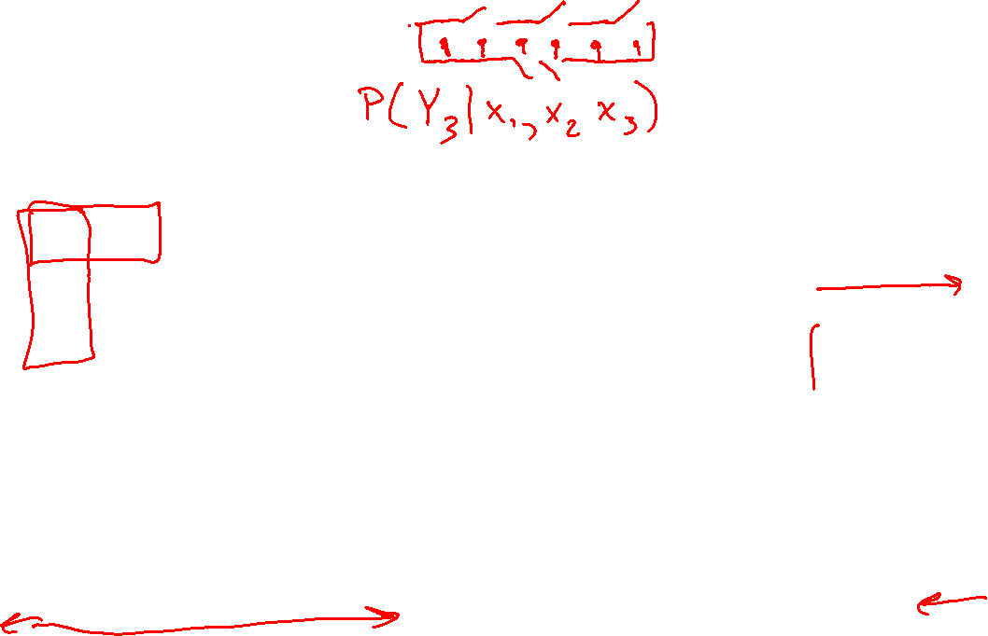
HMM Queries
Filtering: P(Y_{t}|x_{1:t})
Prediction: P(Y_{t+k}|x_{1:t})
Y₁
Y₂
Y₃
Y₄
Y₁
Y₂
Y₃
Y₄
Y₅
x₁
x₂
x₃
x₄
x₁
x₂
x₃
Smoothing: P(Y_{k}|x_{1:t}), k<t
Explanation: P(Y_{1:t}|x_{1:t})
Y₁
Y₂
Y₃
Y₄
Y₁
Y₂
Y₃
Y₄
x₁
x₂
x₃
x₄
x₁
x₂
x₃
x₄

Slide 9
Inference Tasks
Filtering: P(Y_{t} | x_{1:t})
Belief state—input to the decision process of an autonomous agent
Prediction: P(Y_{t+k} | x_{1:t}) for k > 0
Evaluation of possible action sequences; like filtering without the evidence
Smoothing: P(Y_{k} | x_{1:t}) for 0 ≤ k < t
Better estimate of past states, essential for learning
Most likely explanation: argmax_{y1:t} P(y_{1:t} | x_{1:t})
Speech recognition, decoding with a noisy channel

Slide 10

Real HMM Examples
Speech recognition HMMs:
Observations are acoustic signals (continuous valued)
States are specific positions in specific words (so, tens of thousands)
Machine translation HMMs:
Observations are words (tens of thousands)
States are translation options
Robot tracking:
Observations are range readings (continuous)
States are positions on a map (continuous)
Molecular biology:
Observations are nucleotides ACGT
States are coding/non-coding/start/stop/splice-site etc.

Slide 11


Danielle Belgrave, Microsoft Research
https://www.microsoft.com/en-us/research/people/dabelgra/
Developmental Profiles of Eczema, Wheeze, and Rhinitis:
Two Population-Based Birth Cohort Studies
Danielle Belgrave, et al. PLOS Medicine, 2014
https://journals.plos.org/plosmedicine/article?id=10.1371/journal.pmed.1001748

Slide 12

HMM Queries
Filtering: P(Y_{t}|x_{1:t})
Prediction: P(Y_{t+k}|x_{1:t})
Y₁
Y₂
Y₃
Y₄
Y₁
Y₂
Y₃
Y₄
Y₅
x₁
x₂
x₃
x₄
x₁
x₂
x₃
Smoothing: P(Y_{k}|x_{1:t}), k<t
Explanation: P(Y_{1:t}|x_{1:t})
Y₁
Y₂
Y₃
Y₄
Y₁
Y₂
Y₃
Y₄
x₁
x₂
x₃
x₄
x₁
x₂
x₃
x₄

Slide 13
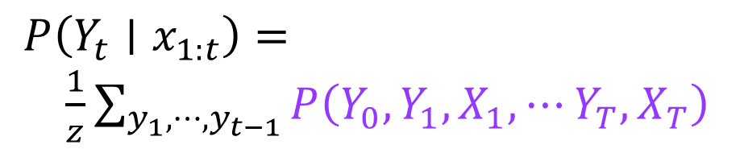
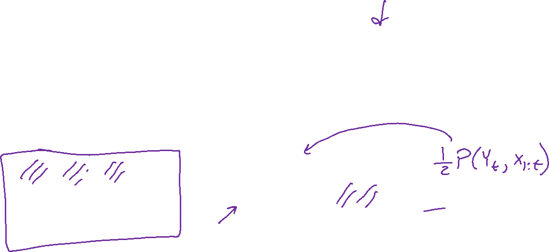
HMM Queries
Joint distribution: P(Y₀, Y₁,X₁, …, Y_{T},X_{T}) = P(Y₀) ∏_{t=1:T} P(Y_{t} | Y_{t-1}) P(X_{t} | Y_{t})
Filtering: P(Y_{t}|x_{1:t})
Y₁
Y₂
Y₃
Y₄
$P\left(Y_{t}∣x_{1:t}\right)=$
$\frac{1}{z}\sum_{y_{1},⋯,y_{t−1}}{P\left(Y_{0}, Y_{1}, X_{1},⋯Y_{T}, X_{T}\right)}$
x₁
x₂
x₃
x₄

Slide 14
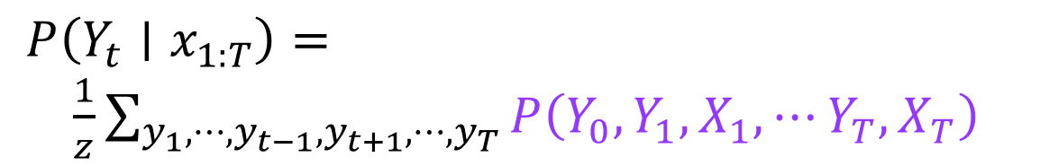

HMM Queries
Joint distribution: P(Y₀, Y₁,X₁, …, Y_{T},X_{T}) = P(Y₀) ∏_{t=1:T} P(Y_{t} | Y_{t-1}) P(X_{t} | Y_{t})
Smoothing: P(Y_{t}|x_{1:T})
Y₁
Y₂
Y₃
Y₄
$P\left(Y_{t}∣x_{1:T}\right)=$
$\frac{1}{z}\sum_{y_{1},⋯,y_{t−1},y_{t+1},⋯,y_{T}}{P\left(Y_{0}, Y_{1}, X_{1},⋯Y_{T}, X_{T}\right)}$
x₁
x₂
x₃
x₄

Slide 15
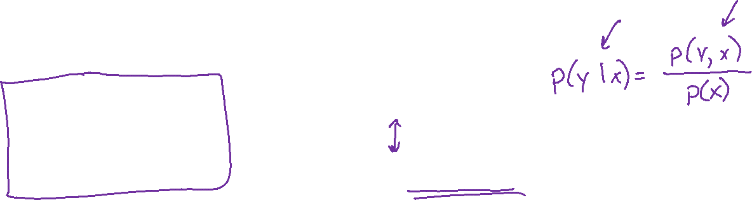
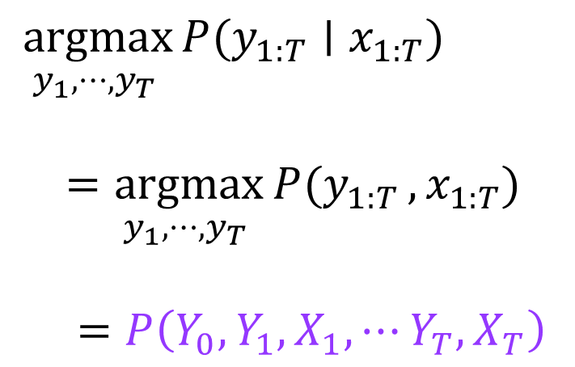
HMM Queries
Joint distribution: P(Y₀, Y₁,X₁, …, Y_{T},X_{T}) = P(Y₀) ∏_{t=1:T} P(Y_{t} | Y_{t-1}) P(X_{t} | Y_{t})
Explanation: $\underset{y_{1},⋯,y_{T} }{argmax}{P(y_{1:T}}∣x_{1:T})$
Y₁
Y₂
Y₃
Y₄
$\underset{y_{1},⋯,y_{T} }{argmax}{P(y_{1:T}}∣x_{1:T})$
$=\underset{y_{1},⋯,y_{T} }{argmax}{P(y_{1:T}},x_{1:T})$
$=P\left(Y_{0}, Y_{1}, X_{1},⋯Y_{T}, X_{T}\right)$
x₁
x₂
x₃
x₄

Slide 16
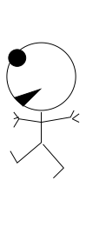
Great Ideas in ML: Message Passing
Count the soldiers
there's
1 of me
1 before you
2 before you
3 before you
4 before you
5 before you
5 behind you
4 behind you
3 behind you
2 behind you
1 behind you
Slide credit: CMU MLD, Matt Gormley
adapted from MacKay (2003) textbook
16

Slide 17
Great Ideas in ML: Message Passing
Count the soldiers
Belief: Must be
2 + 1 + 3 = 6 of us
there's
1 of me
2 before you
2
1
3
2 before you
only see
my incoming
messages
3 behind you
Slide credit: CMU MLD, Matt Gormley
adapted from MacKay (2003) textbook
17

Slide 18
Great Ideas in ML: Message Passing
Count the soldiers
Belief: Must be
1 + 1 + 4 = 6 of us
Belief: Must be
2 + 1 + 3 = 6 of us
there's
1 of me
1
1
4
2
1
3
1 before you
only see
my incoming
messages
4 behind you
Slide credit: CMU MLD, Matt Gormley
adapted from MacKay (2003) textbook
18

Slide 19
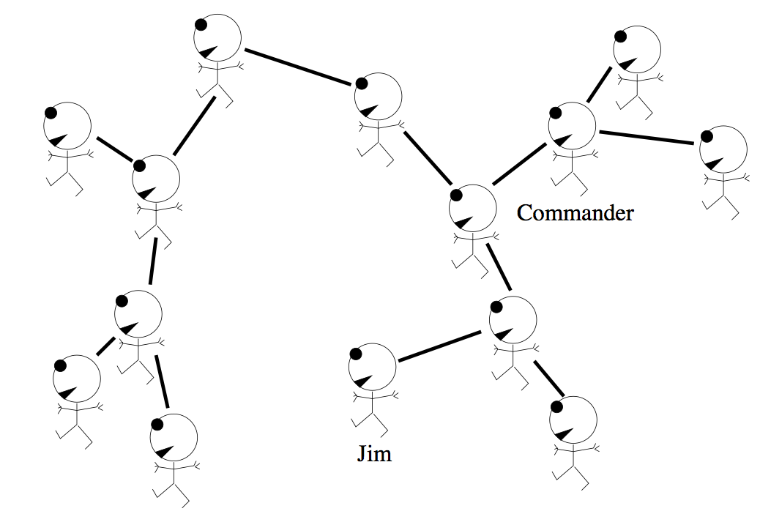

Great Ideas in ML: Message Passing
Each soldier receives reports from all branches of tree
3 here
7 here
1 of me
11 here
(= 7+3+1)
Slide credit: CMU MLD, Matt Gormley
adapted from MacKay (2003) textbook
19

Slide 20
Great Ideas in ML: Message Passing
Each soldier receives reports from all branches of tree
3 here
7 here
(= 3+3+1)
3 here
Slide credit: CMU MLD, Matt Gormley
adapted from MacKay (2003) textbook
20

Slide 21
Great Ideas in ML: Message Passing
Each soldier receives reports from all branches of tree
11 here
(= 7+3+1)
7 here
3 here
Slide credit: CMU MLD, Matt Gormley
adapted from MacKay (2003) textbook
21

Slide 22
Great Ideas in ML: Message Passing
Each soldier receives reports from all branches of tree
3 here
7 here
Belief:
Must be
14 of us
3 here
Slide credit: CMU MLD, Matt Gormley
adapted from MacKay (2003) textbook
22

Slide 23
Great Ideas in ML: Message Passing
Each soldier receives reports from all branches of tree
3 here
7 here
Belief: Must be
14 of us
3 here
Slide credit: CMU MLD, Matt Gormley
wouldn't work correctly with a 'loopy' (cyclic) graph
adapted from MacKay (2003) textbook
23

Slide 24
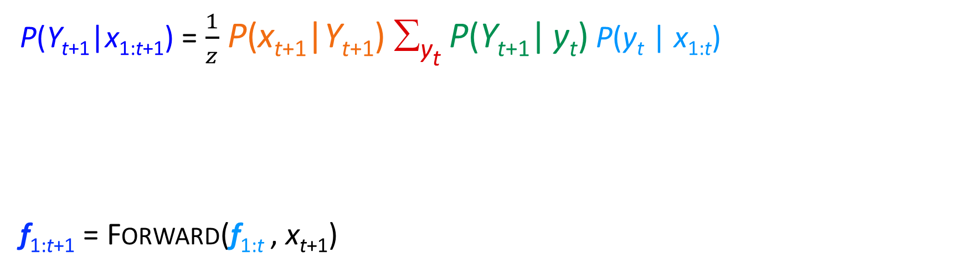
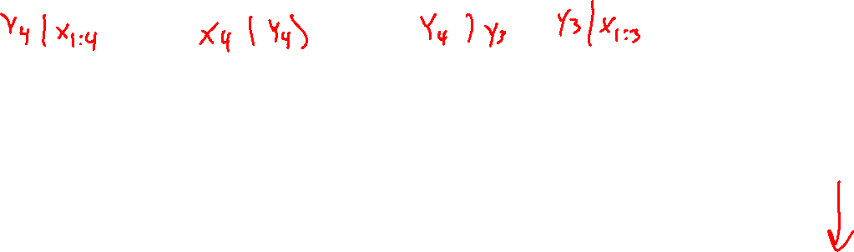
Filtering: Forward Algoritm
P(Y_{t+1}|x_{1:t+1}) = $\frac{1}{z}$ P(x_{t+1}|Y_{t+1}) ∑_{yt} P(Y_{t+1}| y_{t}) P(y_{t} | x_{1:t})
f_{1:t+1} = Forward(f_{1:t} , x_{t+1})
Normalize
Update
Predict
Y₁
Y₂
Y₃
Y₄
x₁
x₂
x₃
x₄

Slide 25
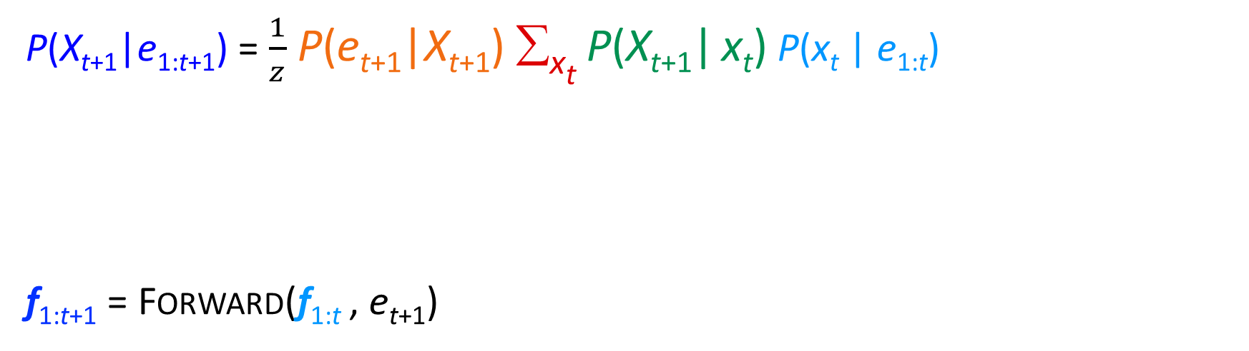
Filtering: Forward Algoritm
P(X_{t+1}|e_{1:t+1}) = $\frac{1}{z}$ P(e_{t+1}|X_{t+1}) ∑_{xt} P(X_{t+1}| x_{t}) P(x_{t} | e_{1:t})
f_{1:t+1} = Forward(f_{1:t} , e_{t+1})
Normalize
Update
Predict
X₁
X₂
X₃
X₄
e₁
e₂
e₃
e₄

Slide 26

Filtering Algorithm
Query: What is the current state, given all of the current and past evidence?
Marching forward through the HMM network
X₁
X₂
e₁
e₂

Slide 27

Filtering Algorithm
Query: What is the current state, given all of the current and past evidence?
Marching forward through the HMM network
X₁
X₂
X₃
e₁
e₂
e₃

Slide 28
Filtering Algorithm
Query: What is the current state, given all of the current and past evidence?
Marching forward through the HMM network
X₁
X₂
X₃
X₄
e₁
e₂
e₃
e₄

Slide 29
Filtering Algorithm
Query: What is the current state, given all of the current and past evidence?
Marching forward through the HMM network
X₁
X₂
X₃
X₄
e₁
e₂
e₃
e₄

Slide 30
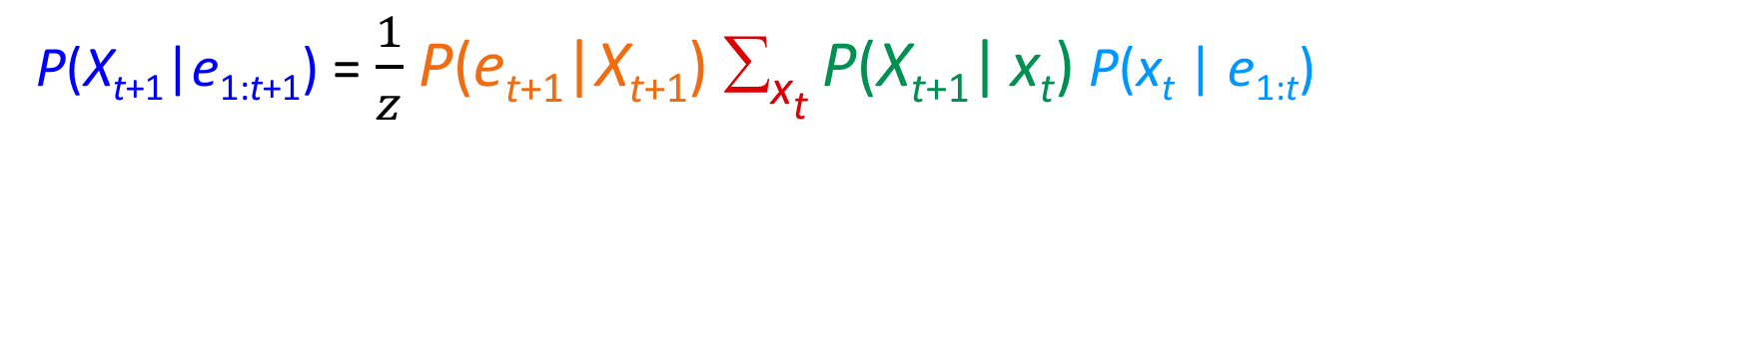
Filtering Algorithm
P(X_{t+1}|e_{1:t+1}) = $\frac{1}{z}$ P(e_{t+1}|X_{t+1}) ∑_{xt} P(X_{t+1}| x_{t}) P(x_{t} | e_{1:t})
Normalize
Update
Predict

Slide 31
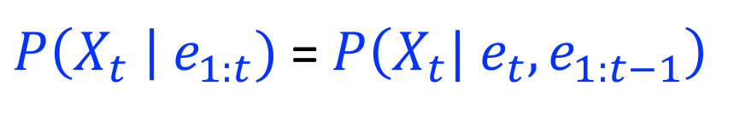
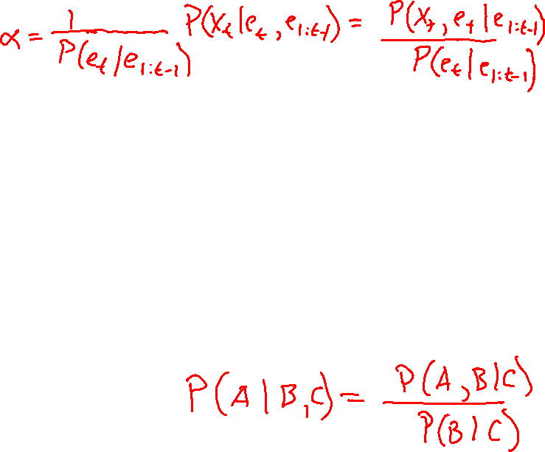


Filtering Algorithm
Query: What is the current state, given all of the current and past evidence?
Matching math with Bayes net
$P\left(X_{t} \right| e_{1:t})$ =$P\left(X_{t}{| e_{t}, e}_{1:t−1}\right)$
X₁
X₂
X₃
X₄
$$=α P\left(X_{t}, {e_{t}| e}_{1:t−1}\right)$$
e₁
e₂
e₃
e₄
Def. of cond. probability with $X_{t}$, $e_{t}$
Notes:
Explain propto

Slide 32
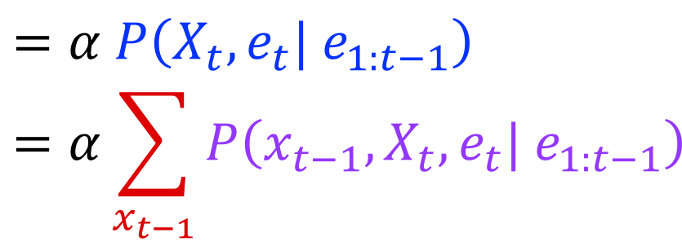


Filtering Algorithm
Query: What is the current state, given all of the current and past evidence?
Matching math with Bayes net
$P\left(X_{t} \right| e_{1:t})$ =$P\left(X_{t}{| e_{t}, e}_{1:t−1}\right)$
X₁
X₂
X₃
X₄
$$=α P\left(X_{t}, {e_{t}| e}_{1:t−1}\right)$$
$$=α\sum_{x_{t−1}}{P\left(x_{t−1},X_{t}, e_{t}| e_{1:t−1}\right)}$$
e₁
e₂
e₃
e₄
Summation over variable $X_{t−1}$

Slide 33
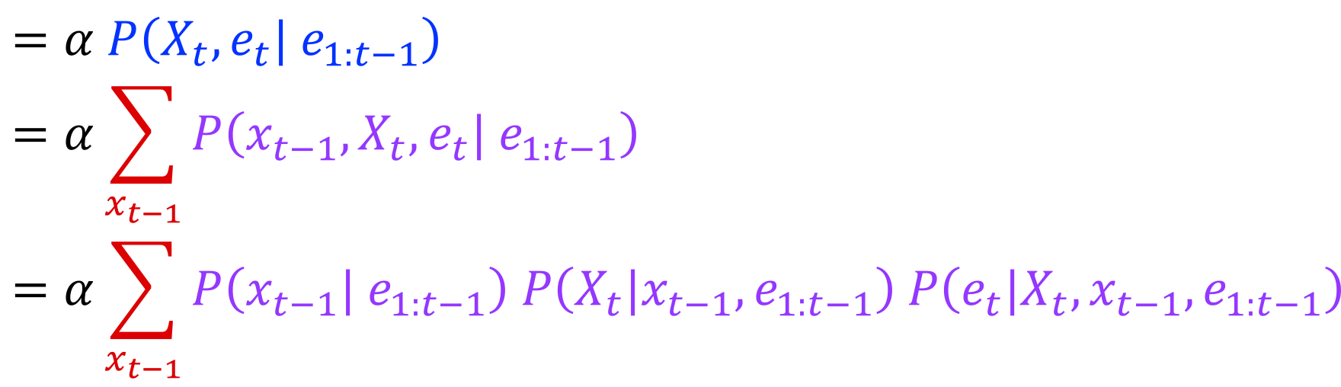


Filtering Algorithm
Query: What is the current state, given all of the current and past evidence?
Matching math with Bayes net
$P\left(X_{t} \right| e_{1:t})$ =$P\left(X_{t}{| e_{t}, e}_{1:t−1}\right)$
X₁
X₂
X₃
X₄
$$=α P\left(X_{t}, {e_{t}| e}_{1:t−1}\right)$$
$$=α\sum_{x_{t−1}}{P\left(x_{t−1},X_{t}, e_{t}| e_{1:t−1}\right)}$$
$$=α\sum_{x_{t−1}}{P\left(x_{t−1}| e_{1:t−1}\right) P\left(X_{t}|x_{t−1},e_{1:t−1}\right) P\left(e_{t}|X_{t},x_{t−1},e_{1:t−1}\right)}$$
e₁
e₂
e₃
e₄
Chain rule with $x_{t−1}$, $X_{t}$, and $e_{t}$

Slide 34
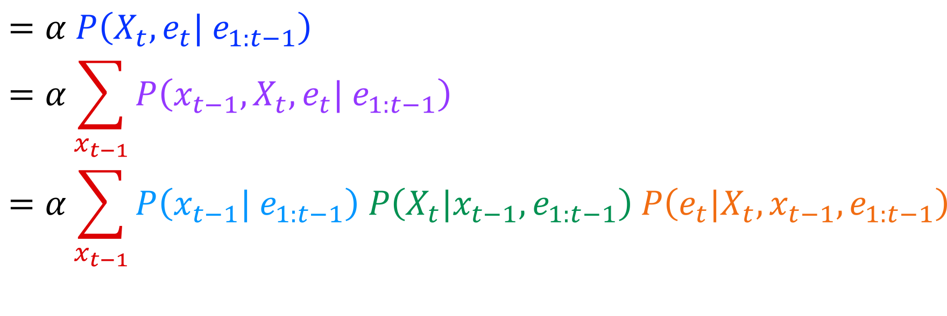
Filtering Algorithm
Query: What is the current state, given all of the current and past evidence?
Matching math with Bayes net
$P\left(X_{t} \right| e_{1:t})$ =$P\left(X_{t}{| e_{t}, e}_{1:t−1}\right)$
X₁
X₂
X₃
X₄
$$=α P\left(X_{t}, {e_{t}| e}_{1:t−1}\right)$$
$$=α\sum_{x_{t−1}}{P\left(x_{t−1},X_{t}, e_{t}| e_{1:t−1}\right)}$$
$$=α\sum_{x_{t−1}}{P\left(x_{t−1}| e_{1:t−1}\right) P\left(X_{t}|x_{t−1},e_{1:t−1}\right) P\left(e_{t}|X_{t},x_{t−1},e_{1:t−1}\right)}$$
e₁
e₂
e₃
e₄
Chain rule with $x_{t−1}$, $X_{t}$, and $e_{t}$

Slide 35
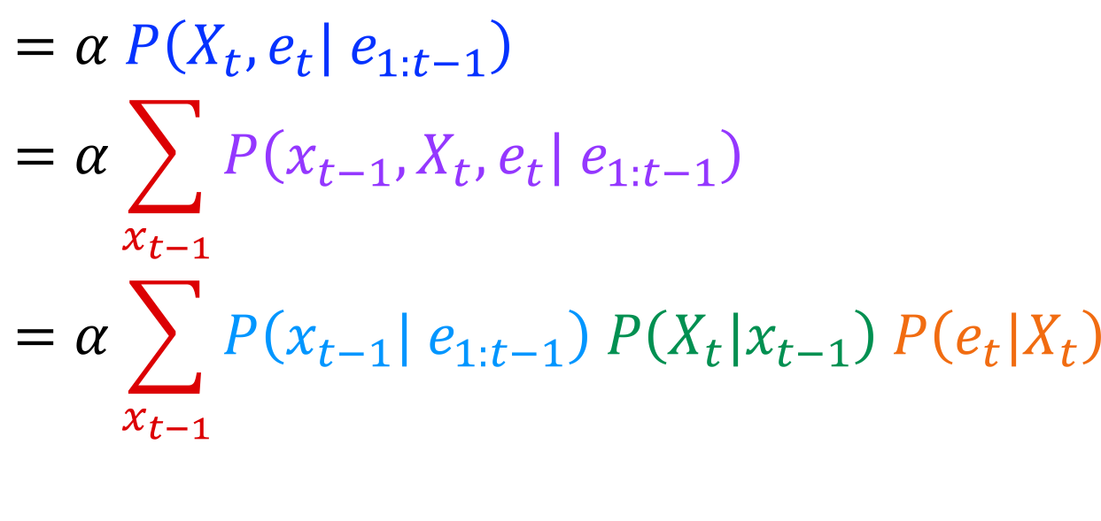

Filtering Algorithm
Query: What is the current state, given all of the current and past evidence?
Matching math with Bayes net
$P\left(X_{t} \right| e_{1:t})$ =$P\left(X_{t}{| e_{t}, e}_{1:t−1}\right)$
X₁
X₂
X₃
X₄
$$=α P\left(X_{t}, {e_{t}| e}_{1:t−1}\right)$$
$$=α\sum_{x_{t−1}}{P\left(x_{t−1},X_{t}, e_{t}| e_{1:t−1}\right)}$$
$$=α\sum_{x_{t−1}}{P\left(x_{t−1}| e_{1:t−1}\right) P\left(X_{t}|x_{t−1}\right) P\left(e_{t}|X_{t}\right)}$$
e₁
e₂
e₃
e₄
Bayes net conditional independence

Slide 36
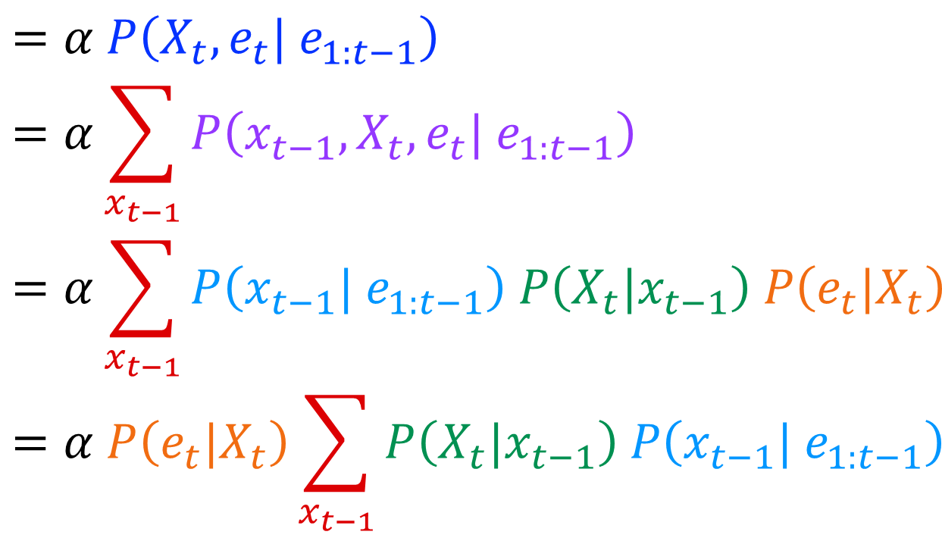

Filtering Algorithm
Query: What is the current state, given all of the current and past evidence?
Matching math with Bayes net
$P\left(X_{t} \right| e_{1:t})$ =$P\left(X_{t}{| e_{t}, e}_{1:t−1}\right)$
X₁
X₂
X₃
X₄
$$=α P\left(X_{t}, {e_{t}| e}_{1:t−1}\right)$$
$$=α\sum_{x_{t−1}}{P\left(x_{t−1},X_{t}, e_{t}| e_{1:t−1}\right)}$$
$$=α\sum_{x_{t−1}}{P\left(x_{t−1}| e_{1:t−1}\right) P\left(X_{t}|x_{t−1}\right) P\left(e_{t}|X_{t}\right)}$$
$$=α P\left(e_{t}|X_{t}\right)\sum_{x_{t−1}}{P\left(X_{t}|x_{t−1}\right) P\left(x_{t−1}| e_{1:t−1}\right) }$$
e₁
e₂
e₃
e₄
Pulling $P\left(e_{t}|X_{t}\right)$ out of the summation

Slide 37
Filtering Algorithm
Query: What is the current state, given all of the current and past evidence?
Matching math with Bayes net
$P\left(X_{t} \right| e_{1:t})$ =$P\left(X_{t}{| e_{t}, e}_{1:t−1}\right)$
X₁
X₂
X₃
X₄
$$=α P\left(X_{t}, {e_{t}| e}_{1:t−1}\right)$$
$$=α\sum_{x_{t−1}}{P\left(x_{t−1},X_{t}, e_{t}| e_{1:t−1}\right)}$$
$$=α\sum_{x_{t−1}}{P\left(x_{t−1}| e_{1:t−1}\right) P\left(X_{t}|x_{t−1}\right) P\left(e_{t}|X_{t}\right)}$$
$$=α P\left(e_{t}|X_{t}\right)\sum_{x_{t−1}}{P\left(X_{t}|x_{t−1}\right) P\left(x_{t−1}| e_{1:t−1}\right) }$$
e₁
e₂
e₃
e₄
Recursion!

Slide 38
Filtering Algorithm
Query: What is the current state, given all of the current and past evidence?
Matching math with Bayes net
$P\left(X_{t} \right| e_{1:t})$ =$P\left(X_{t}{| e_{t}, e}_{1:t−1}\right)$
X₁
X₂
X₃
X₄
$$=α P\left(X_{t}, {e_{t}| e}_{1:t−1}\right)$$
$$=α\sum_{x_{t−1}}{P\left(x_{t−1},X_{t}, e_{t}| e_{1:t−1}\right)}$$
$$=α\sum_{x_{t−1}}{P\left(x_{t−1}| e_{1:t−1}\right) P\left(X_{t}|x_{t−1}\right) P\left(e_{t}|X_{t}\right)}$$
$$=α P\left(e_{t}|X_{t}\right)\sum_{x_{t−1}}{P\left(X_{t}|x_{t−1}\right) P\left(x_{t−1}| e_{1:t−1}\right) }$$
e₁
e₂
e₃
e₄
Recursion!

Slide 39
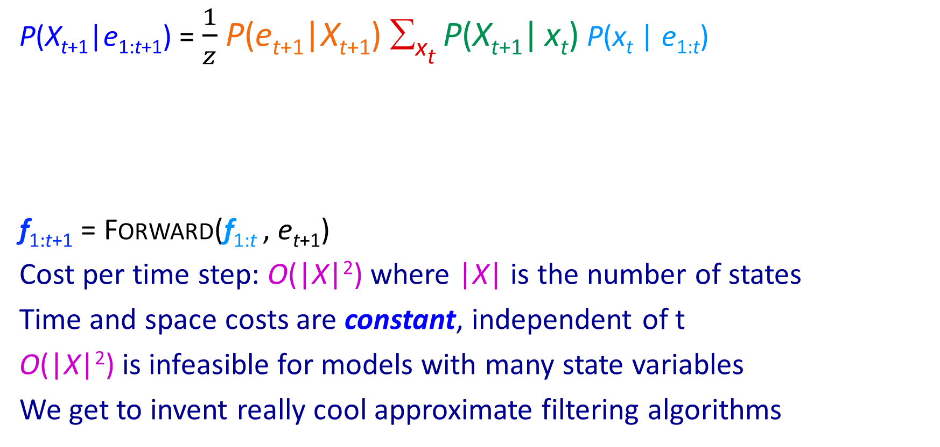

Filtering Algorithm
P(X_{t+1}|e_{1:t+1}) = $\frac{1}{z}$ P(e_{t+1}|X_{t+1}) ∑_{xt} P(X_{t+1}| x_{t}) P(x_{t} | e_{1:t})
f_{1:t+1} = Forward(f_{1:t} , e_{t+1})
Cost per time step: O(|X|²) where |X| is the number of states
Time and space costs are constant, independent of t
O(|X|²) is infeasible for models with many state variables
We get to invent really cool approximate filtering algorithms
Normalize
Update
Predict

Slide 40

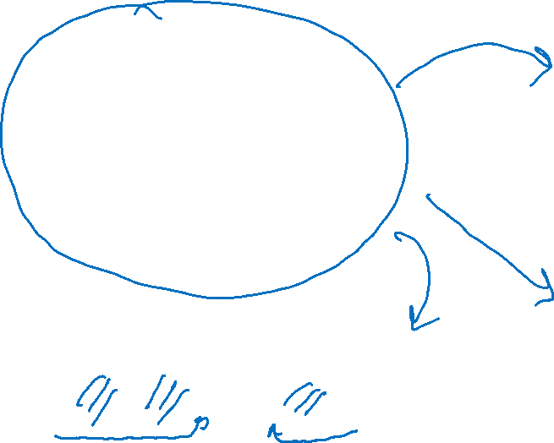
HMM Queries
Filtering: P(Y_{t}|x_{1:t})
Prediction: P(Y_{t+k}|x_{1:t})
Y₁
Y₂
Y₃
Y₄
Y₁
Y₂
Y₃
Y₄
Y₅
x₁
x₂
x₃
x₄
x₁
x₂
x₃
Smoothing: P(Y_{k}|x_{1:t}), k<t
Explanation: P(Y_{1:t}|x_{1:t})
Y₁
Y₂
Y₃
Y₄
Y₁
Y₂
Y₃
Y₄
x₁
x₂
x₃
x₄
x₁
x₂
x₃
x₄

Slide 41
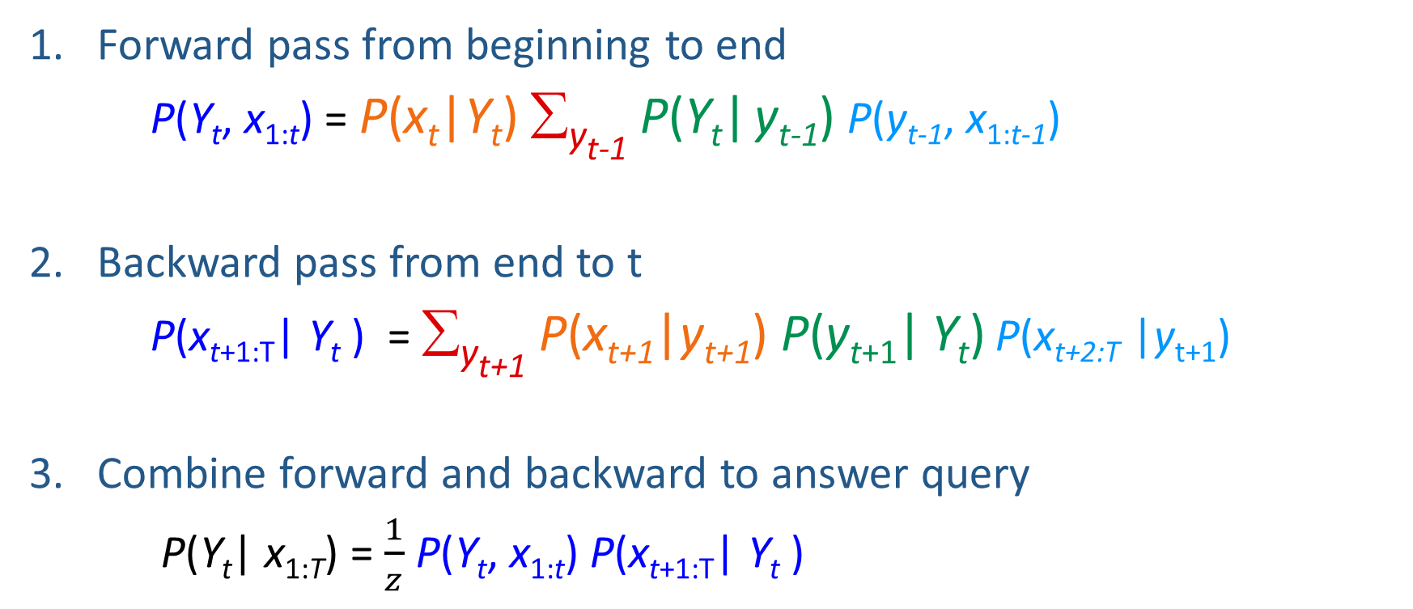

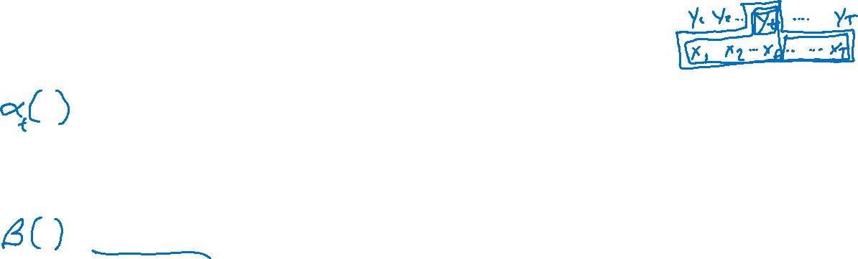
Smoothing: Forward-Backward Algorithm
Forward pass from beginning to end
P(Y_{t}, x_{1:t}) = P(x_{t}|Y_{t}) ∑_{yt-1} P(Y_{t}| y_{t-1}) P(y_{t-1}, x_{1:t-1})
Backward pass from end to t
P(x_{t+1:T}| Y_{t} ) = ∑_{yt+1} P(x_{t+1}|y_{t+1}) P(y_{t+1}| Y_{t}) P(x_{t+2:T} |y_{t+1})
Combine forward and backward to answer query
P(Y_{t}| x_{1:T}) = $\frac{1}{z}$ P(Y_{t}, x_{1:t}) P(x_{t+1:T}| Y_{t} )

Slide 42
Course Survey(s)
See Piazza for course survey
(Some of you: see e-mail for research feedback survey)

Slide 43
Dataset for Supervised Part-of-Speech (POS) Tagging
Data:
n
v
p
d
n
y⁽¹⁾
Sample 1:
time
flies
like
an
arrow
x⁽¹⁾
n
n
v
d
n
y⁽²⁾
Sample 2:
time
flies
like
an
arrow
x⁽²⁾
Slide credit: CMU MLD, Matt Gormley
n
v
p
n
n
y⁽³⁾
Sample 3:
flies
fly
with
their
wings
x⁽³⁾
p
n
n
v
v
y⁽⁴⁾
Sample 4:
time
you
x⁽⁴⁾
with
will
see
Notes:
Why would you want a model that’s not a linear chain?
Well, here’s an example.
Here I’ll generate tagged sentences.
When I pull a sample out of my pocket, sometimes it’s a tagging of “Time flies like an arrow” … but sometimes it’s a tagging of some other sentence.
Some sentences are more likely than others, and we are using POS tags to help model which sentences are likely.
The bigram “an arrow” is likely not because there’s a bigram parameter for it – there isn’t – but because the model captures something more general: determiners like to be followed by nouns.

Slide 44

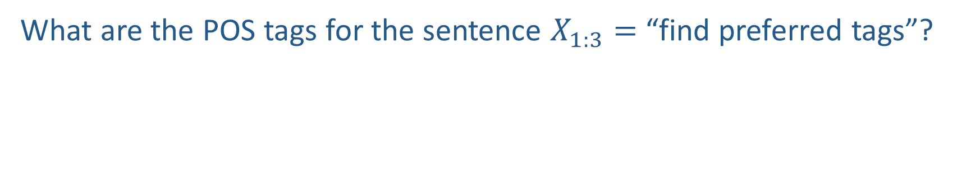


Queries for Part-of-Speech (POS) Tagging
What are the POS tags for the sentence $X_{1:3}=$ “find preferred tags”?
$$X_{1}=find$$
$$X_{2}=preferred$$
$$X_{3}=tags$$
Slide credit: CMU MLD, Matt Gormley
Could be verb or noun
Could be adjective or verb
Could be noun or verb

Slide 45
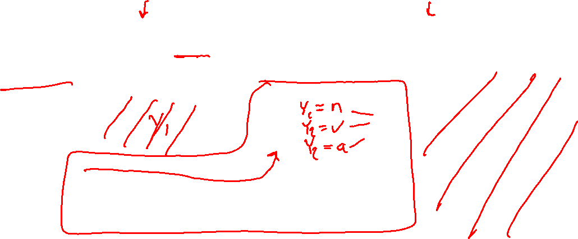
Filtering P(Y₂|x_{1:2}) vs Smoothing P(Y₂|x_{1:3})
Filtering (forward algorithm, then possibly argmax)
$$X_{1}=find$$
$$X_{2}=preferred$$
$$X_{3}=tags$$

Slide 46
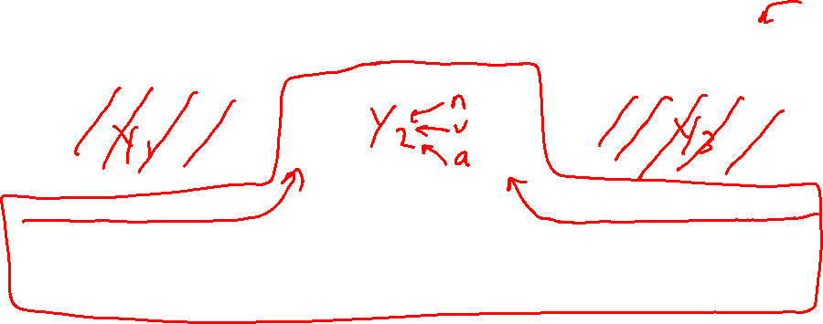
Filtering P(Y₂|x_{1:2}) vs Smoothing P(Y₂|x_{1:3})
Smoothing (forward-backward algorithm, then possibly argmax)
$$X_{1}=find$$
$$X_{2}=preferred$$
$$X_{3}=tags$$

Slide 47
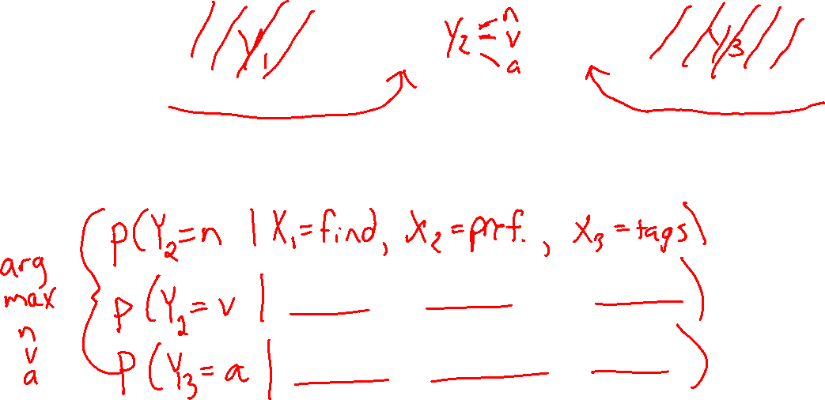
Smoothing P(Y₂|x_{1:3}) vs Explanation P(Y_{1:3}|x_{1:3})
Smoothing (forward-backward algorithm, then argmax)
$$X_{1}=find$$
$$X_{2}=preferred$$
$$X_{3}=tags$$

Slide 48

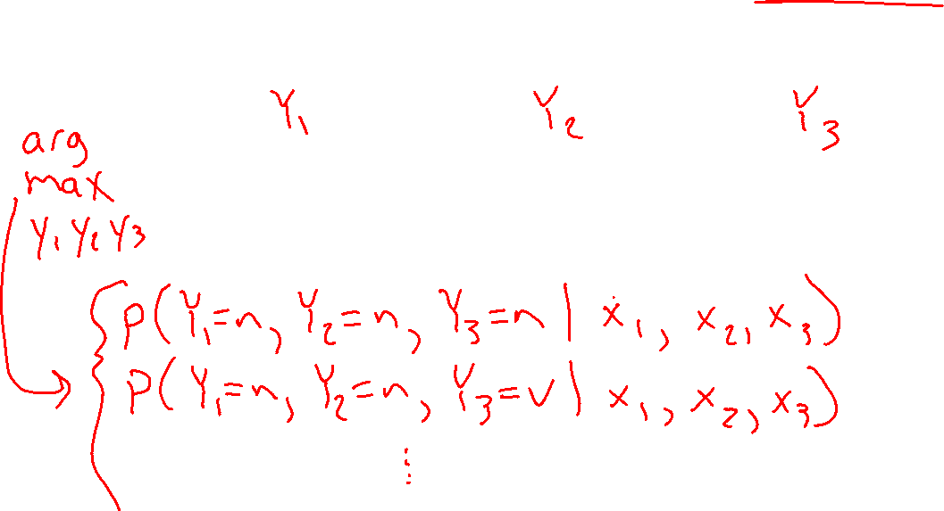
Smoothing P(Y₂|x_{1:3}) vs Explanation P(Y_{1:3}|x_{1:3})
Explanation (Viterbi algorithm)
$$X_{1}=find$$
$$X_{2}=preferred$$
$$X_{3}=tags$$

Slide 49
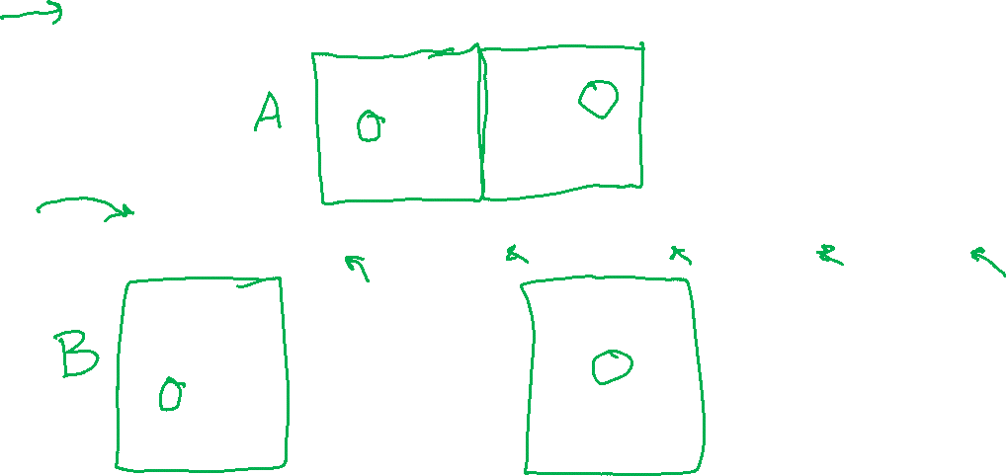
Hidden Markov Model
A Hidden Markov Model (HMM) provides a joint distribution over the the sentence/tags with an assumption of dependence between adjacent tags.
p(n, v, p, d, n, time, flies, like, an, arrow) = (.3 * .8 * .2 * .5 * …)
 | v | n | p | d
v | .1 | .4 | .2 | .3
n | .8 | .1 | .1 | 0
p | .2 | .3 | .2 | .3
d | .2 | .8 | 0 | 0
 | v | n | p | d
v | .1 | .4 | .2 | .3
n | .8 | .1 | .1 | 0
p | .2 | .3 | .2 | .3
d | .2 | .8 | 0 | 0
Slide credit: CMU MLD, Matt Gormley
<START>
n
v
p
d
n
 | time | flies | like | …
v | .2 | .5 | .2
n | .3 | .4 | .2
p | .1 | .1 | .3
d | .1 | .2 | .1
 | time | flies | like | …
v | .2 | .5 | .2
n | .3 | .4 | .2
p | .1 | .1 | .3
d | .1 | .2 | .1
time
flies
like
an
arrow

Slide 50
Viterbi Algorithm: Most Probable Assignment
Y₁
Y₂
Y₃
X₁
X₂
X₃
Slide credit: CMU MLD, Matt Gormley
find
preferred
tags
Could be verb or noun
Could be adjective or verb
Could be noun or verb
50

Slide 51
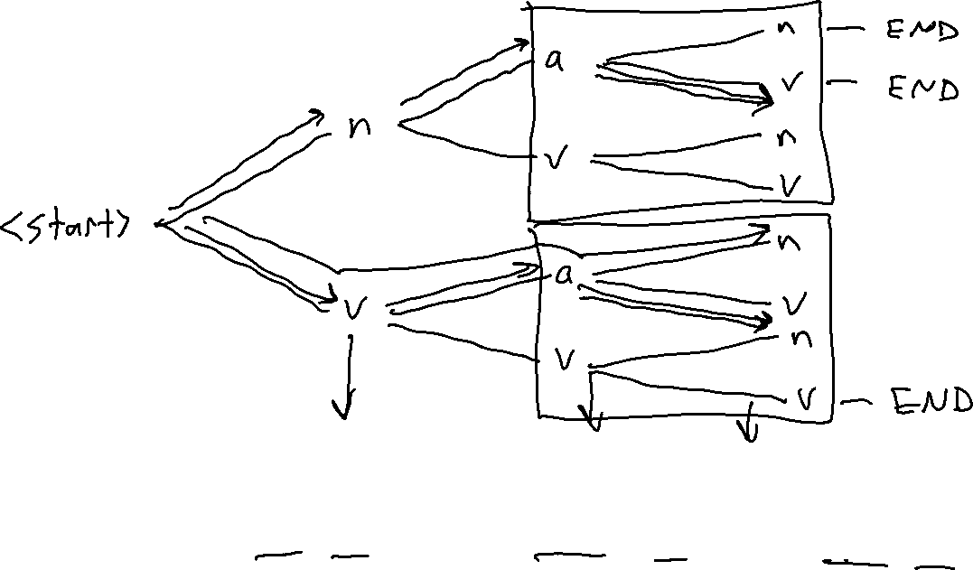
Viterbi Algorithm: Most Probable Assignment
Slide credit: CMU MLD, Matt Gormley
X₁
X₂
X₃
find
preferred
tags
Could be adjective or verb
Could be noun or verb
Could be verb or noun
51

Slide 52
Viterbi Algorithm: Most Probable Assignment
Y₁
Y₂
Y₃
Slide credit: CMU MLD, Matt Gormley
X₁
X₂
X₃
find
preferred
tags

Slide 53
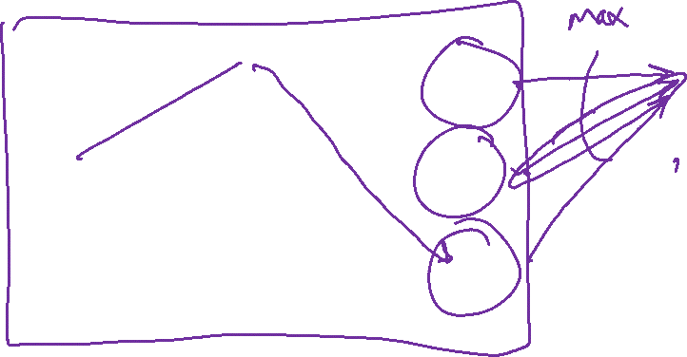
Viterbi Algorithm: Most Probable Assignment
Y₁
Y₂
Y₃
v
v
v
START
n
n
n
END
a
a
a
Slide credit: CMU MLD, Matt Gormley
X₁
X₂
X₃
find
preferred
tags
Let’s show the possible values for each variable
One possible assignment
And what the 7 factors think of it …

Slide 54
Viterbi Algorithm: Most Probable Assignment
Y₁
Y₂
Y₃
v
v
v
START
n
n
n
END
a
a
a
Slide credit: CMU MLD, Matt Gormley
X₁
X₂
X₃
find
preferred
tags
Let’s show the possible values for each variable
One possible assignment
And what the 7 factors think of it …

Slide 55
Viterbi Algorithm: Most Probable Assignment
Y₁
Y₂
Y₃
v
v
v
START
n
n
n
END
a
a
a
Slide credit: CMU MLD, Matt Gormley
X₁
X₂
X₃
find
preferred
tags
Let’s show the possible values for each variable
One possible assignment
And what the 7 factors think of it …

Slide 56
Viterbi Algorithm: Most Probable Assignment
Y₁
Y₂
Y₃
v
v
v
START
n
n
n
END
a
a
a
Slide credit: CMU MLD, Matt Gormley
X₁
X₂
X₃
find
preferred
tags
Let’s show the possible values for each variable
One possible assignment
And what the 7 transition / emission factors think of it …
56

Slide 57
Viterbi Algorithm: Most Probable Assignment
Y₁
 | v | n | a
v | 1 | 6 | 4
n | 8 | 4 | 0.1
a | 0.1 | 8 | 0
Y₂
Y₃
v
v
v
START
n
n
n
END
 | find | pref. | tags | …
v | 3 | 5 | 3
n | 4 | 5 | 2
a | 0.1 | 0.2 | 0.1
a
a
a
Slide credit: CMU MLD, Matt Gormley
X₁
X₂
X₃
find
preferred
tags
Let’s show the possible values for each variable
One possible assignment
And what the 7 transition / emission factors think of it …
57

Slide 58
Viterbi Algorithm: Most Probable Assignment
Y₁
Y₂
Y₃
v
v
v
B(START,v)
A(find,v)
START
n
B(v,a)
n
n
B(a,END)
END
B(a,n)
A(tags,n)
a
a
a
Slide credit: CMU MLD, Matt Gormley
A(pref., a)
X₁
X₂
X₃
find
preferred
tags
So p(v a n | x) = (1/Z) times product of 7 numbers
Numbers associated with edges and nodes of path
Most probable assignment = path with highest product
58

Slide 59
HMM Queries
Filtering: P(Y_{t}|x_{1:t})
Prediction: P(Y_{t+k}|x_{1:t})
Y₁
Y₂
Y₃
Y₄
Y₁
Y₂
Y₃
Y₄
Y₅
x₁
x₂
x₃
x₄
x₁
x₂
x₃
Smoothing: P(Y_{k}|x_{1:t}), k<t
Explanation: P(Y_{1:t}|x_{1:t})
Y₁
Y₂
Y₃
Y₄
Y₁
Y₂
Y₃
Y₄
x₁
x₂
x₃
x₄
x₁
x₂
x₃
x₄

Slide 60
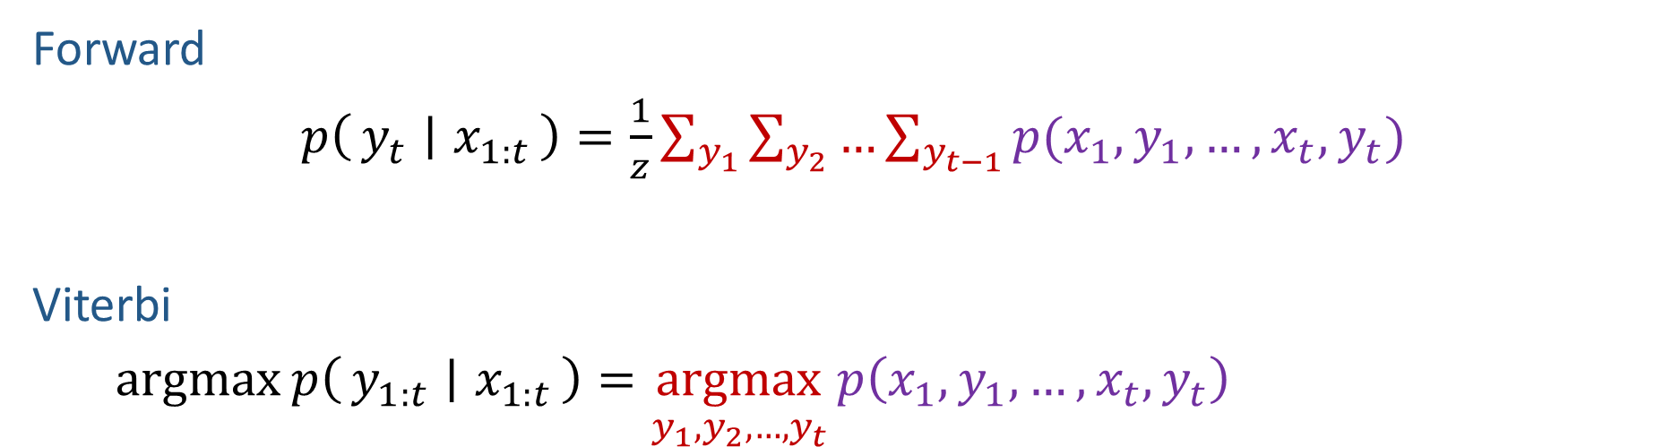

Forward vs Viterbi
Y₁
Y₂
Y₃
Y₄
Forward
$p\left(y_{t} ∣ x_{1:t}\right)=\frac{1}{z}\sum_{y_{1}}{\sum_{y_{2}}{…\sum_{y_{t−1}}{p(x_{1},y_{1}, …,x_{t}, y_{t}}})}$
Viterbi
$\operatorname{argmax}{p\left(y_{1:t} ∣ x_{1:t}\right)}=\underset{y_{1},y_{2},…,y_{t}}{argmax}{p\left(x_{1},y_{1}, …,x_{t}, y_{t}\right)}$
x₁
x₂
x₃
x₄
Y₁
Y₂
Y₃
Y₄
x₁
x₂
x₃
x₄

Slide 61
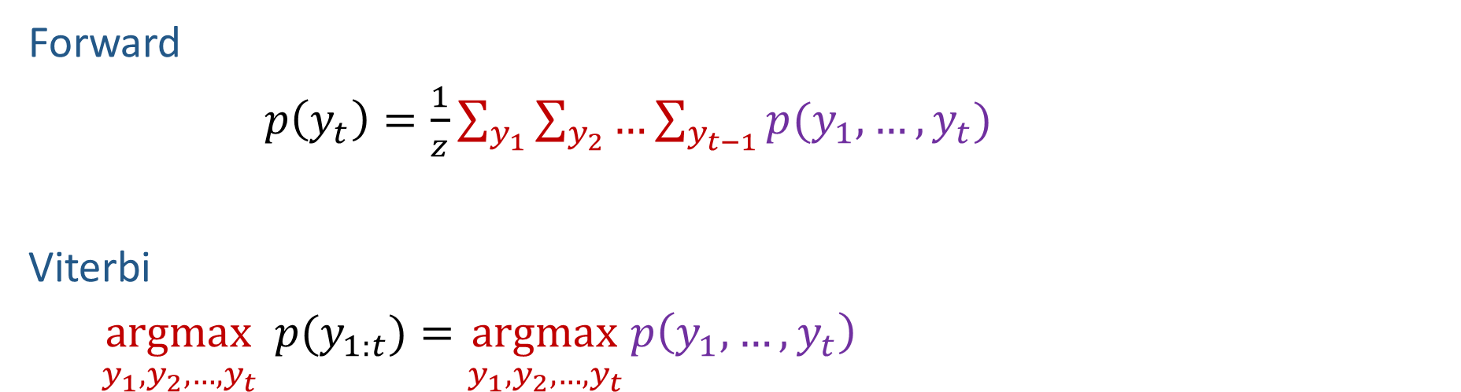
Forward vs Viterbi (Simple Markov Chain)
Y₁
Y₂
Y₃
Y₄
Forward
$p\left(y_{t}\right)=\frac{1}{z}\sum_{y_{1}}{\sum_{y_{2}}{…\sum_{y_{t−1}}{p(y_{1}, …, y_{t}}})}$
Viterbi
$\underset{y_{1},y_{2},…,y_{t}}{argmax}{p(y_{1:t})}=\underset{y_{1},y_{2},…,y_{t}}{argmax}{p\left(y_{1}, …, y_{t}\right)}$
Y₁
Y₂
Y₃
Y₄

Slide 62
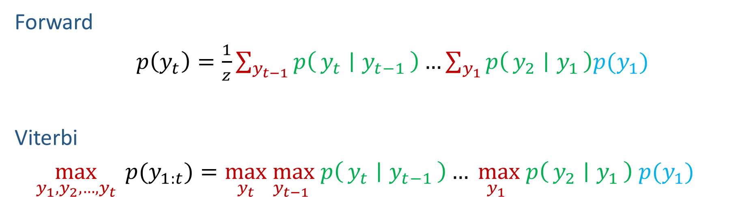

Forward vs Viterbi (Simple Markov Chain)
Y₁
Y₂
Y₃
Y₄
Forward
$p\left(y_{t}\right)=\frac{1}{z}\sum_{y_{t−1}}{p\left(y_{t} ∣ y_{t−1}\right)}…\sum_{y_{1}}{p\left(y_{2} ∣ y_{1}\right)p(y_{1})}$
Viterbi
$\max_{y_{1},y_{2},…,y_{t}}{p(y_{1:t})}=\max_{y_{t}}\max_{y_{t−1}} p\left(y_{t} ∣ y_{t−1}\right)…\max_{y_{1}} p\left(y_{2} ∣ y_{1}\right)$ $p(y_{1})$
Y₁
Y₂
Y₃
Y₄

Slide 63
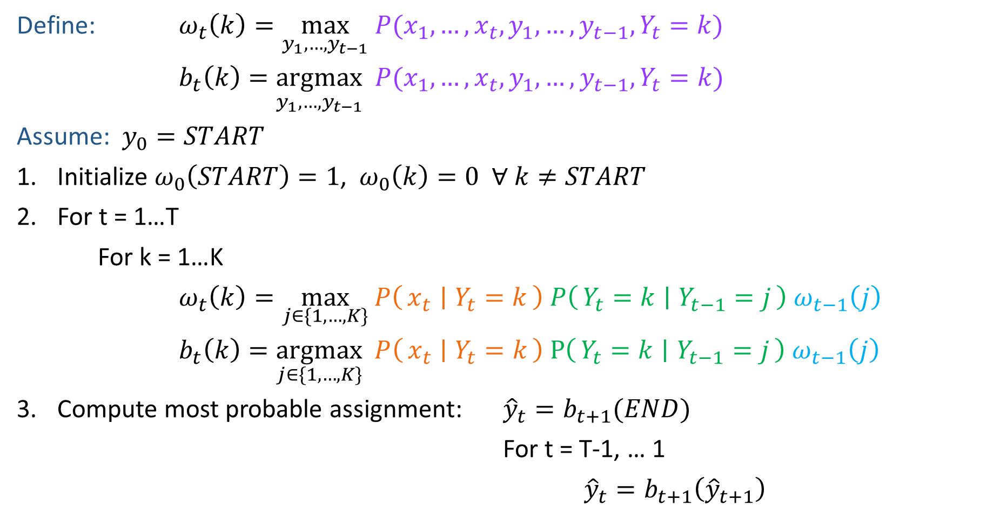
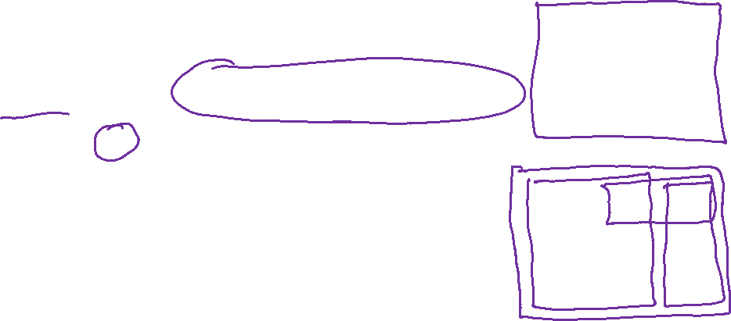
Viterbi Algorithm
Y₁
Y₂
Y₃
Y₄
Define: $ω_{t}\left(k\right)=\max_{y_{1}, …,y_{t−1}} P(x_{1}, …,x_{t},y_{1}, …,y_{t−1},Y_{t}=k)$
$b_{t}\left(k\right)=\underset{y_{1}, …,y_{t−1}}{argmax} P(x_{1}, …,x_{t},y_{1}, …,y_{t−1},Y_{t}=k)$
Assume: $y_{0}=START$
Initialize $ω_{0}\left(START\right)=1$, $ω_{0}\left(k\right)=0 ∀ k≠START$
For t = 1…T
For k = 1…K
$ω_{t}\left(k\right)=\max_{j∈\{1, …, K\}} P\left(x_{t} ∣ Y_{t}=k\right) P\left(Y_{t}=k ∣ Y_{t−1}=j\right) ω_{t−1}\left(j\right)$
$b_{t}\left(k\right)=\underset{j∈\{1, …, K\}}{argmax} P\left(x_{t} ∣ Y_{t}=k\right) P\left(Y_{t}=k ∣ Y_{t−1}=j\right) ω_{t−1}\left(j\right)$
Compute most probable assignment: ${\hat{y}}_{t}=b_{t+1}(END)$
For t = T-1, … 1
${\hat{y}}_{t}=b_{t+1}\left({\hat{y}}_{t+1}\right)$
x₁
x₂
x₃
x₄
Y₁
Y₂
Y₃
Y₄
x₁
x₂
x₃
x₄

Slide 64
Viterbi Algorithm: Most Probable Assignment
Y₁
Y₂
Y₃
v
v
v
B(START,v)
A(find,v)
START
n
B (v,a)
n
n
B(a,END)
END
B(a,n)
A(tags,n)
a
a
a
Slide credit: CMU MLD, Matt Gormley
A(pref., a)
X₁
X₂
X₃
find
preferred
tags
So p(v a n | x) = (1/Z) times product weight of one path
64

Slide 65

Forward-Backward Algorithm: p(y_{t} | x)
Y₁
Y₂
Y₃
v
v
v
START
n
n
n
END
a
a
a
Slide credit: CMU MLD, Matt Gormley
X₁
X₂
X₃
find
preferred
tags
So p(v a n | x) = (1/Z) times product weight of one path
Probability p(Y₂ = a | x) = (1/Z) times total weight of all paths through
a
65

Slide 66
Forward-Backward Algorithm: p(y_{t} | x)
Y₁
Y₂
Y₃
v
v
v
START
n
n
n
END
a
a
a
Slide credit: CMU MLD, Matt Gormley
X₁
X₂
X₃
find
preferred
tags
So p(v a n | x) = (1/Z) times product weight of one path
Probability p(Y₂ = n | x) = (1/Z) times total weight of all paths through
n

Slide 67
Forward-Backward Algorithm: p(y_{t} | x)
Y₁
Y₂
Y₃
v
v
v
START
n
n
n
END
a
a
a
Slide credit: CMU MLD, Matt Gormley
X₁
X₂
X₃
find
preferred
tags
So p(v a n | x) = (1/Z) times product weight of one path
Probability p(Y₂ = v | x) = (1/Z) times total weight of all paths through
v

Slide 68
Inference in HMMs
What is the computational complexity of inference for HMMs?
The naïve (brute force) computations for Filtering, Smoothing, and Explanation take exponential time, O(K^{T})
The forward-backward algorithm and Viterbi algorithm run in polynomial time, O(T*K²)
Thanks to dynamic programming!
Slide credit: CMU MLD, Matt Gormley

Slide 69
Learning Objectives
Hidden Markov Models
You should be able to…
Show that structured prediction problems yield high-computation inference problems
Define the first order Markov assumption
Draw a Finite State Machine depicting a first order Markov assumption
Derive the MLE parameters of an HMM
Define the key queries for an HMM: filtering, prediction, smoothing, explanation
Derive a dynamic programming algorithm for a key queries of an HMM
Interpret the forward-backward algorithm as a message passing algorithm
Implement supervised learning for an HMM
Implement the forward-backward algorithm for an HMM
Implement the Viterbi algorithm for an HMM
Slide credit: CMU MLD, Matt Gormley

